Slide 1

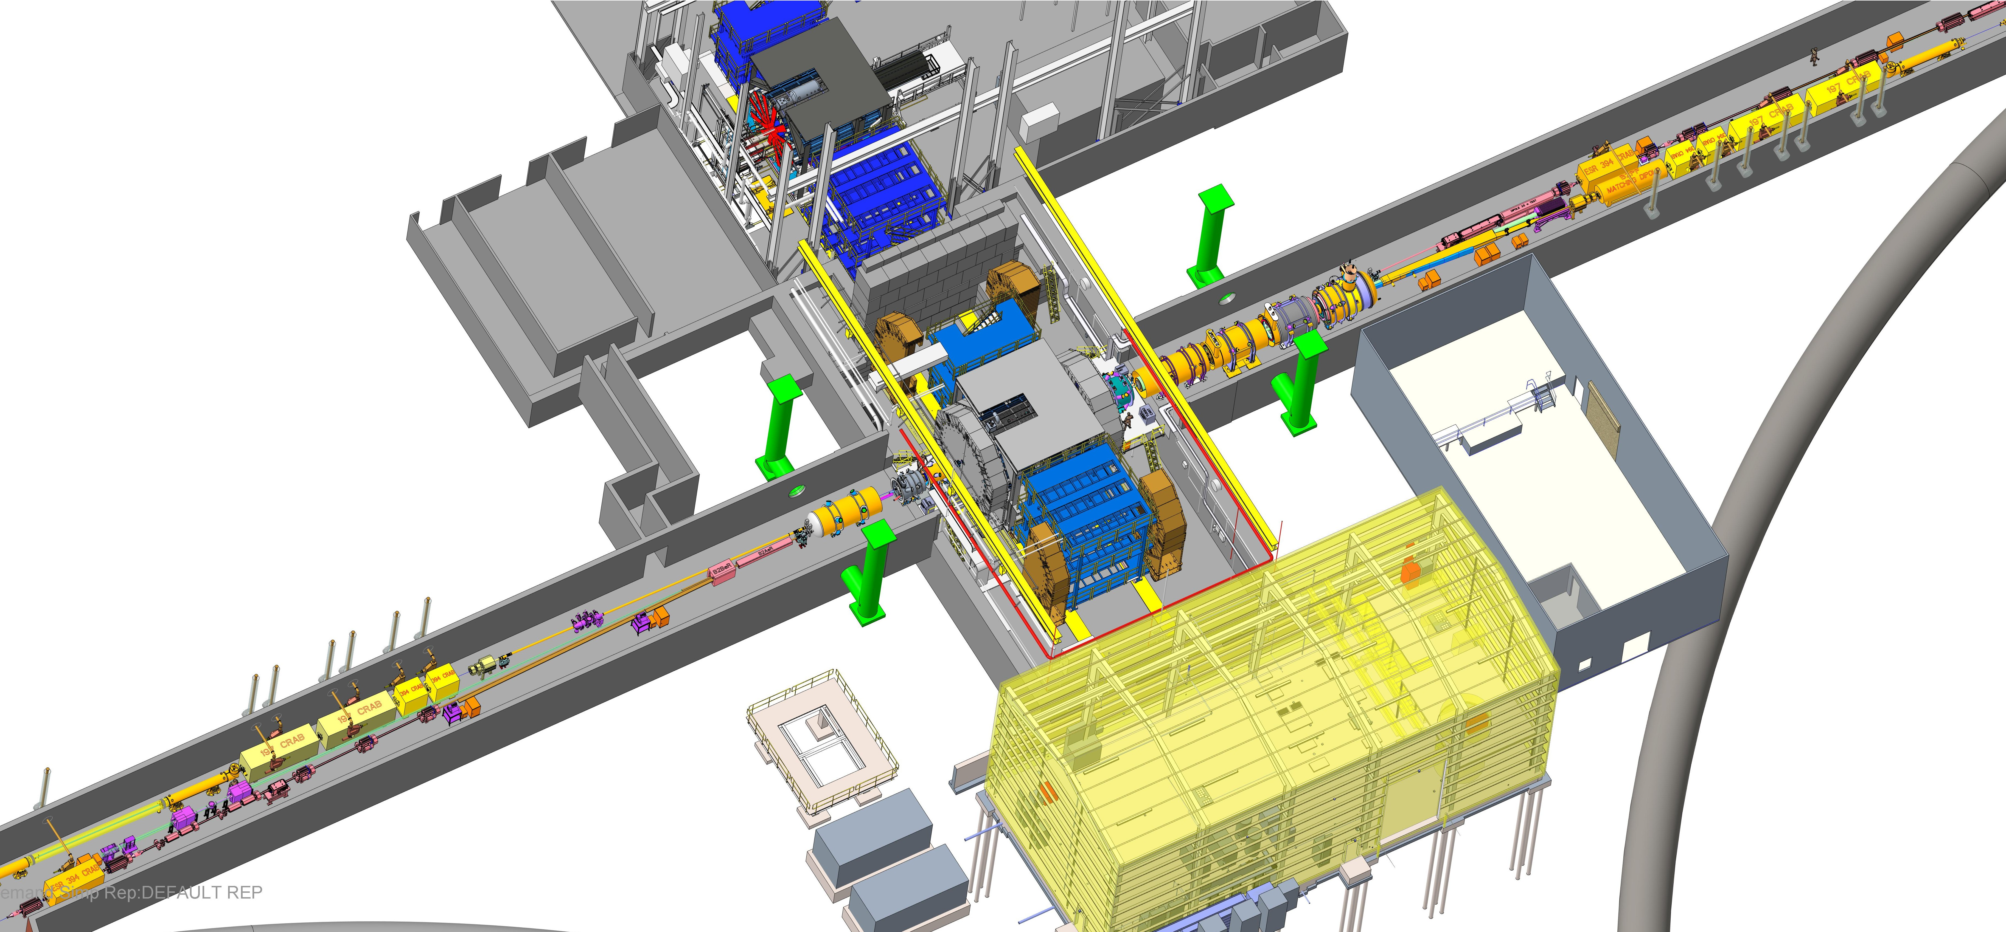
EIC Detector Scope Proposal Radiation & Oxygen Deficiency Hazard Safety PPS
Prepared for: EIC Detector Sub-Project Review
Prepared by: J. Reich
Date: 2025-11-10

Slide 2
Objectives & Scope
Objectives
Assure safe operation of Detector Hall with integrated personnel Radiation & Oxygen Deficiency Hazard protections.
Establish clean interfaces to Detector enclosure, Ventilation, and Ring Personnel Protection System.
Scope
Personnel Protection System — Radiation Safety for interlocked critical devices, access control, sweep, interlocked devices, and annunciation.
Personnel Protection System — Oxygen Deficiency Hazard Monitoring System for oxygen monitoring, voting, horns/strobes, and Fan and vent controls.
Functional: Safety(IEC 61508/61511 Safety Integrity Level‑targeted,), , Reliability, Maintainability, clear Human‑Machine Interface, testability.

Slide 3
Detector/6OC Interaction Region

Slide 4
Personnel Protection System — Radiation Overview
Functions
Controlled entry/exit, sweep & reset sequences, Area Radiation Monitor / Radiation Trip, emergency stops.
Permits to interlocked subsystems (RF systems, Dipole Magnet systems, beam stops).
Interfaces
Door hardware, BNL ID RFID readers, Trapped Keys for CA Access, Emergency Stop buttons, Beacons/strobes, sirens, Human‑Machine Interface, event logging.
Logic
State machine with safe defaults; loss of communications/Uninterruptible Power Supply → fail‑safe inhibits.

Slide 5
Personnel Protection System — Oxygen Deficiency Hazard Monitoring System Overview
Sensors & Voting
ADIV/BDIV sensor packages with local warning and global evacuation.
Actions
Warning: sectional beacons + ventilation boost.
Evacuation: global horns/strobes/voice; permits drop; notify central HMI.
Reliability
Periodic functional proof‑tests, channel diagnostics, tag health monitoring, Uninterruptible Power Supply and Emergency Generator-backed.

Slide 6
Architecture & Interfaces
Topology
ODHMS: A‑Division PLC and Safety Hub PLC (10‑o’clock) and B‑Division PLC and Safety Hub (12‑o’clock), fiber‑isolated safety Input/Output.
GuardLogix + 5094 platform Safety Input/Output modules; produced/consumed safety tags across sites.
External Interfaces
Detector area- Radiation- Beam and RF critical devices, ODHMS- Fans and Vents, Power Monitoring and Control System.
Cyber/Networks
Non‑routable safety Virtual Local Area Networks; gatewayed read‑only mirrors for supervision & history.

Slide 7
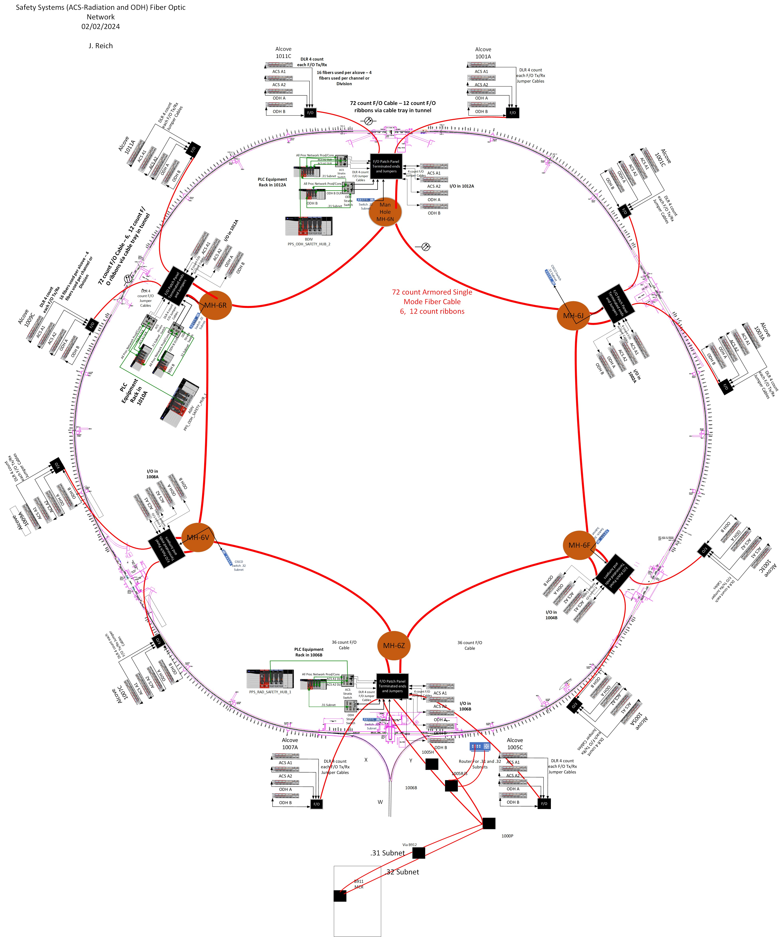
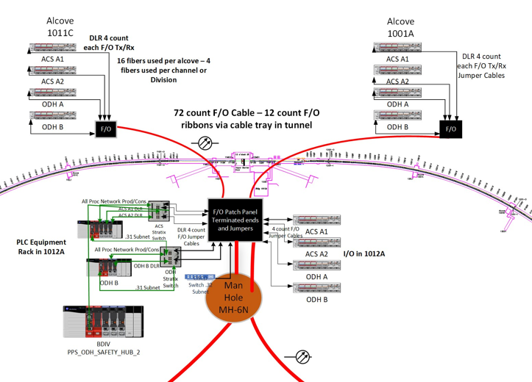
Personnel Protection System — Radiation Personnel Protection System — Oxygen Deficiency Hazard Monitoring System System Layout

Slide 8
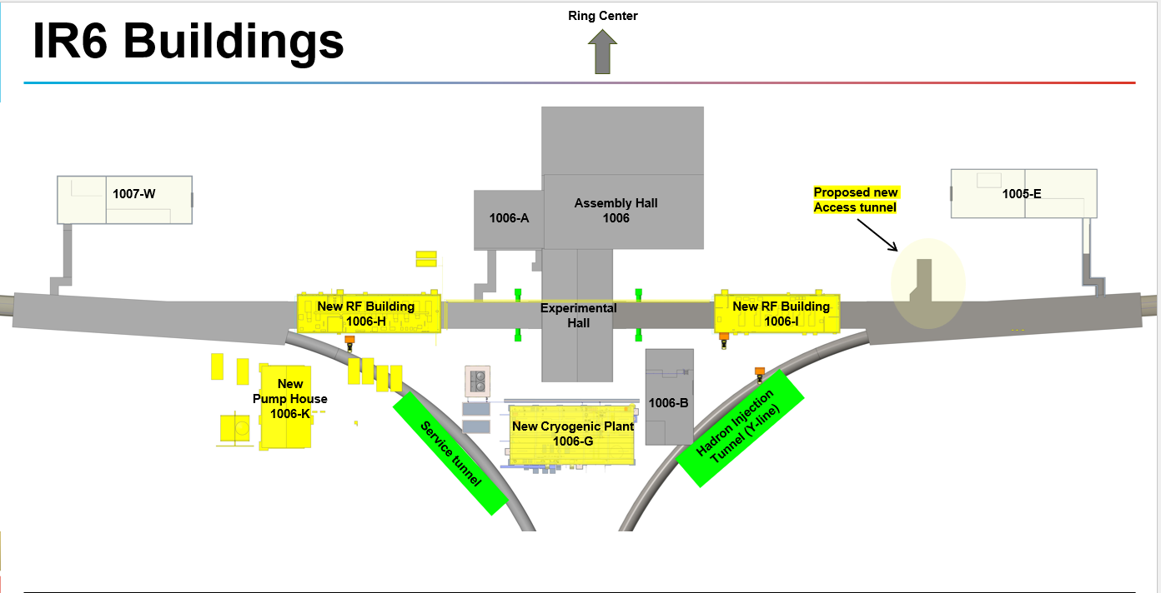
6OC Interaction Region Overview

Slide 9
Dependencies on Accelerator Storage Ring Scope
Accelerator Storage Ring Completion Is a Hard Pre‑Requisite
Detector Scope commissioning depends on the Accelerator Safety Ring backbone being installed, validated, and under change control.
Core Accelerator Storage Ring Deliverables Required
A/B Division PLCs, Safety hubs, fiber plant, and non‑routable safety Virtual Local Area Networks in service.
GuardLogix L9 series processor(or latest version) + 5094 platform Safety Input/Output racks for Accelerator Storage Ring nodes powered, addressed, and verified.
Produced/Consumed Safety Tag registry and governance established across sites.
Time sync for timestamp fidelity in events/alarms.
Uninterruptible Power Supply-backed power, fail‑safe defaults, and network isolation proven under loss scenarios.
Interfaces the Accelerator Storage Ring Must Expose
Read/Write points for Detector Scope permits, alarms, and evacuation/warnings.
Read‑only mirrors for Human‑Machine Interface/historian; and fire alarm interface points.
Ventilation/Standard Fan and Vent controls, Variable Frequency Drive command paths and feedback for ventilation boost functions.
Sequencing & Verification
Acceptance Tests: Accelerator Storage Ring safety Input/Output and system wide VnV tests, and tag‑health checks.
Site Acceptance Test: end‑to‑end timing—sensor → vote (Accelerator Storage Ring)→annunciation/ventilation (Detector Scope).
Detector Scope Site Acceptance Test cannot start until Accelerator Storage Ring Site Acceptance Test criteria are met.

Slide 10
Commissioning, Testing & Deliverables
Verification and Validation Tests
Input/Output continuity, simulated device matrices, safety logic benches, network failover.
End‑to‑end timing: sensor → vote → annunciation → ventilation/control.
Procedures & Docs
Functional Design Specification/System Design Description, State Tables(defined logic) Interface document, Performance Document, cause‑&‑effect, Reliability Block Diagram & Average Probability of Failure on Demand, proof‑test plan, Operations and Maintenance manuals, training.
Delivery Milestones
Design freeze → Verification and Validation Acceptance Tests → Review results, correct as required, Re-test corrections → handover with documentation, as‑builts, & spares. Review signatures → Ready for operations

