Slide 1
MARCO Magnet Instrumentation
Slow Control Workshop
November 13, 2025

Slide 2
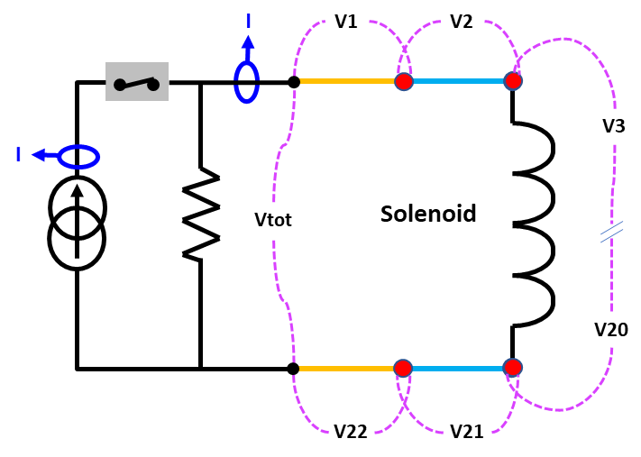
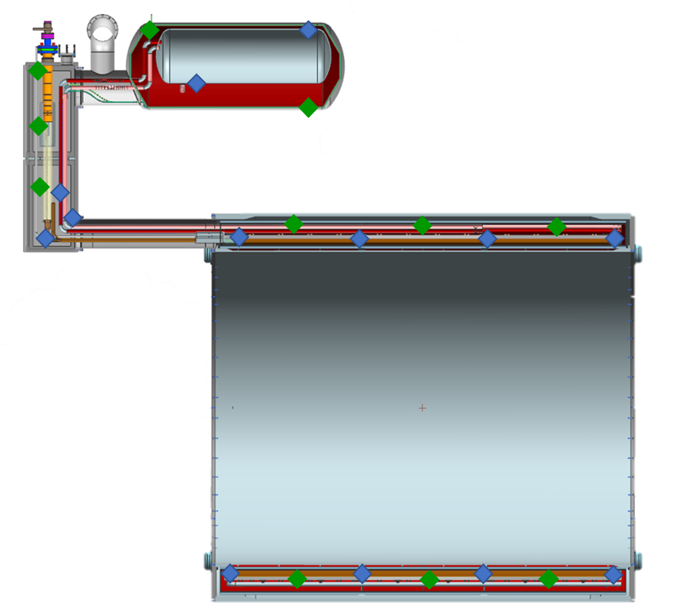
Magnet Instrumentation
Voltage taps
Temperature sensors (4 K and 100K)
Strain gages ad load sensors
Quench detectors
DCCTs
Heaters
Vacuum gages
Flow meters
He level gages
Pressure gages
Pressure Valves
Water pressure and temperature

Slide 3
Deliverable from the Magnet Vendor
D3: Construction of the magnet and its ancillaries.
This includes activities and the materials for delivering the following components:
Fully functional magnet, meeting all the requirements given in the table 1, in the vacuum vessel (cryostat), including supporting system, thermal shield and transportation tool. Vacuum vessels should be ASME stamped or all the calculations and design work needs approval from the JLab design authority.
Fully functional phase separator
Magnet chimney with vapor cooled installed
Vacuum system for cryostat insulation including pumps, valves and gauges
All the required instrumentation
Instrumentation racks

Slide 4













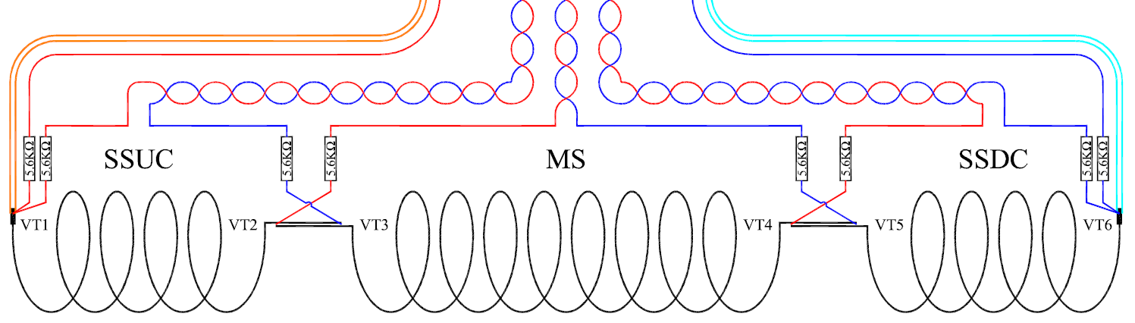
Voltage Instrumentation and protection
Voltage taps (eventually double for redundancy)
42 for the solenoids (21 DP)
4 for the busbars (2 DP)
4 for the current leads (2 DP)
2 for Vtot (1 DP)
1
44
2 3 5
1’ 2’
40 42 43
4 7 6 9 8 11 10 13 12 15 14 17 16 19 18 21 20 23 22 25 24 27 26 29 28 31 30 33 32 35 34 37 36 39 38 41
45 47 46 49 48 50

Slide 5
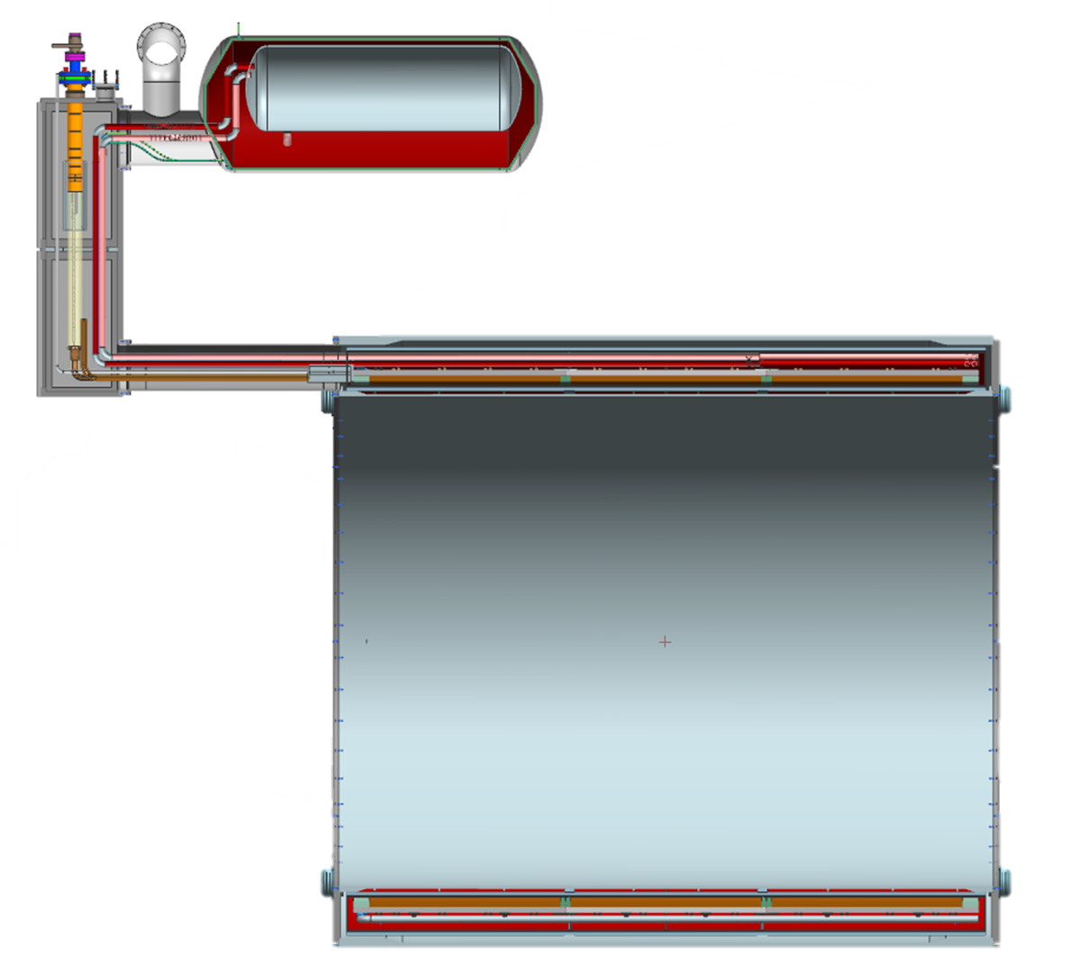
Temperature Instrumentation
PT 100 thermal sensors:
10 on the thermal shield
6 on the current leads
CERNOX thermal sensors:
12 distributed on the magnet and the shell
6 on the phase separator and thermosiphon inlet and outlet
Cernox
PT100

Slide 6
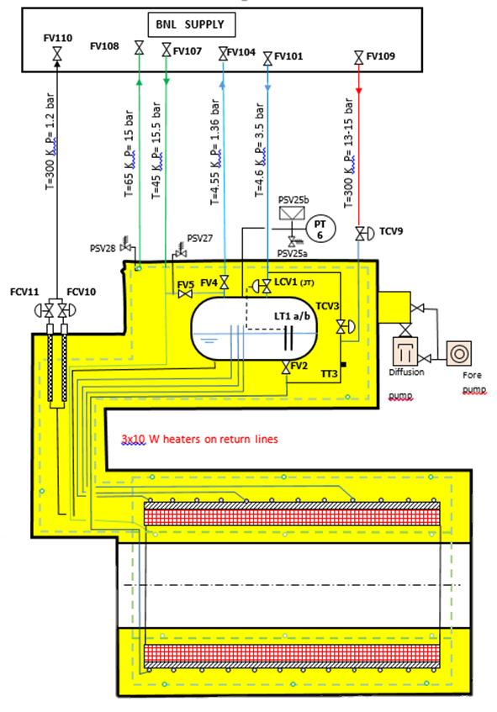
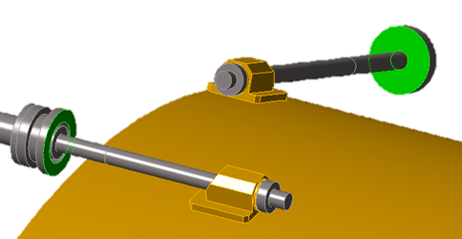
Cryogenic and Mechanical Instrumentation
Flow meter:
2 for the current leads
2 to 4 for the thermosiphons inlet and outlet
2 for the 50 K shield inlet and outlet
1 or 2 He level gages
2 Pressure gages
3 Heaters
2 Vacuum gages
Load sensors
He level gages
Phase separator tank
+ cold valves
Current leads
Vacuum
gages
Thermosiphon
Heat exchanger tubes
Vacuum
gages

Slide 7
Data sampling speed
Voltage taps:
5 kHz to 10 KHz Fast DAQ
5Hz for slow data
Temperature monitoring/control (4.2K, 80K, and 300K) - 4.2 K: Temperature monitoring/control (4.2K at 100 Hz; 80/77-300 K: PT-100 temp sensors at 100 Hz

Slide 8
Monitoring Systems-EPICS from Hall B Solenoid
EPICS is used as follows:
Graphical User Interface (GUI)
Operator interfaces with screens.
Displays actual value of configured EPICS PVs(process variables).
Provides ability to send values to PLC (i.e. valve position).
Archiver
Utilizing Accelerator Mya archiver and Mya Viewer.
Most tags visible on GUI screens will be archived.
Absolute (specific amount)
Relative (specific percentage)
Alarm Handler
Global alarm handler runs 24/7, monitoring alarm-configured PVs.
Alarm handler can be configured to alert operators by:
Local enunciator, pager, email, text message.
Alarm status logged.

Slide 9
Monitoring Systems-EPICS from Hall B Solenoid
No | Screen Name | Description
1 | Cryo DBX | DBX cryogenics He and N2 circuits
2 | Quench Detection | Solenoid voltage taps in coils 1–4 and splices, total of 21 VT displayed on screen
3 | Fast DAQ | Records data and saves Root files from fast DAQ during energization of Solenoid
4 | Voltage Tap Statistics | Max, Min and average of 21 VT
5 | Voltage Tap Calculations | Voltages definition used to calculate software comparators to quench detection
6 | Fast DAQ Live | Displays voltage taps data readouts of cRIO systems in real time
7 | Helium SST | He cryogenics circuit with main values for instrumentation in Solenoid Service Tower
8 | Cooldown Parameters | Main temperature differentials in Solenoid during cooldown operation
9 | Cooldown Interlocks | Status and thresholds of cooldown interlocks
10 | Cryocon Status | Connection Status of Cryocon temperature monitors 1 and 2; reset option
11 | Helium - Solenoid Temps | Temperatures detail in Solenoid. Temperatures in coils, splices, LHe channels, shields, and suspension
12 | Magnet Power Supply | Controls MPS, set and read status of MPS during ramp up/down of Solenoid
13 | Interlock Status | Solenoid MPS interlock status – fast dump and controlled ramp down status
14 | Vacuum System | Displays vacuum readouts for gauges, status of turbo pump and main gate vacuum valve
15 | Load Cells | Radial and axial load cells forces in lb are displayed
16 | EM Forces | Shows limits of for Load Cells and Imbalance forces in the Axial and Radial supports.

Slide 10
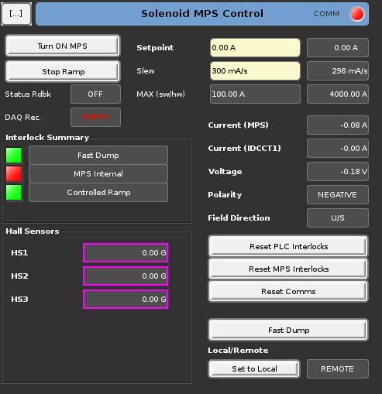
Monitoring systems – EPICS (Continued)
Solenoid MPS Control screen

Slide 11
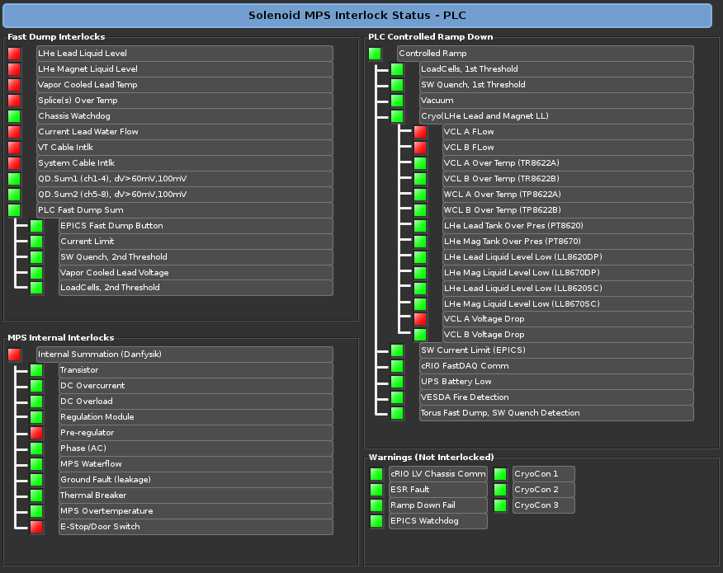
Monitoring systems – EPICS (Continued)
Interlocks Status screen

