Slide 1
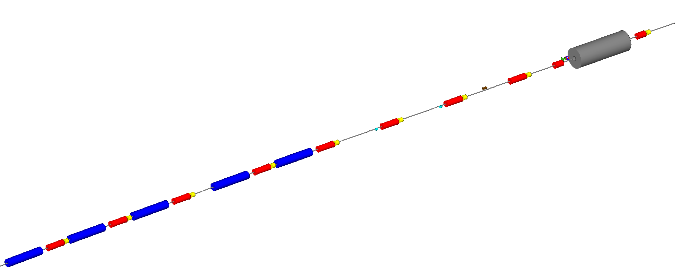
Electron Storage Ring Polarimeter
Polarization components at Laser IP
Photon Detector
(30 m from Laser IP)
Crab cavity
Beam energy | P_{L} | P_{T}
5 GeV | 99.1% | 13.2%
10 GeV | 96.5% | 26.2%
18 GeV | 89.0% | 45.6%
Electron Detector
D2EF
Q3EF
Q4EF
D3EF
θ_{B}=13 mr
Q5EF
D4EF
θ_{B}=1.5 mr
Q6EF
D5EF
θ_{B}=1.5 mr
Q7EF
*
Q8EF
D6EF
θ_{B}=12 mr
Q9EF
Polarimeter Components:
RF-pulsed laser system (under development)
Position sensitive detectors (diamond strips) for scattered electrons and backscattered photons
Calorimeter for backscattered photons
Q10EF
Laser IP​
74 m upstream of IP-6

Slide 2
ESR Information Needed for Compton Polarimeter
Beam position at laser IP and just before electron detector
Position “lock” at laser IP possible? Maybe AI based incorporating detector rates?
Beam current/charge information
Track correlation of polarization with bunch charge
Magnet currents/BdL between laser IP and electron detector
Needed to map asymmetry vs. position at detector
Spin rotator settings upstream of laser IP, magnet currents/BdL
Monitor spin direction
Bunch identifier, polarization state

Slide 3
Other Controls
Controls that don’t interface with the beam
Laser system
Seed laser, amplifier
Remote stages (rotation, mirrors)
Readback of power meters, photodiodes and quad-photodiodes
Photon detector → remote motion control to center detector on backscattered photon cone
Electron detector → remote motion control

Slide 4
RCS Compton Polarimeter
Compton polarimeter will also be used in RCS
Will use commercial, low-duty laser, operate in multi-photon mode
Photon detector only – no electron detector
Similar beam information needed:
Beam position information at laser (and position lock?)
Bunch intensity
Due to vertical polarization, don’t need as much information about magnet currents, fields

