Slide 1
Slow control
EIC Hadron Polarimetry
Frank Rathmann
EIC, Slow Controls workshop
November 13, 2025

Slide 2
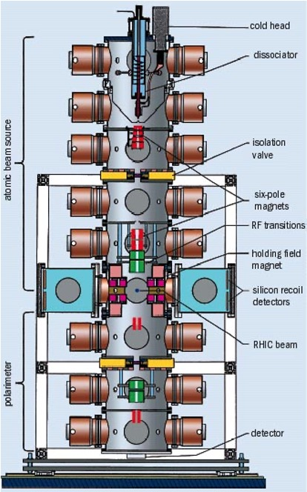
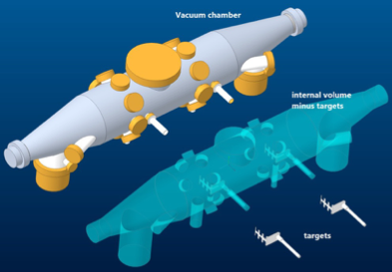
Two primary polarimeter systems
pC
HJET

Slide 3
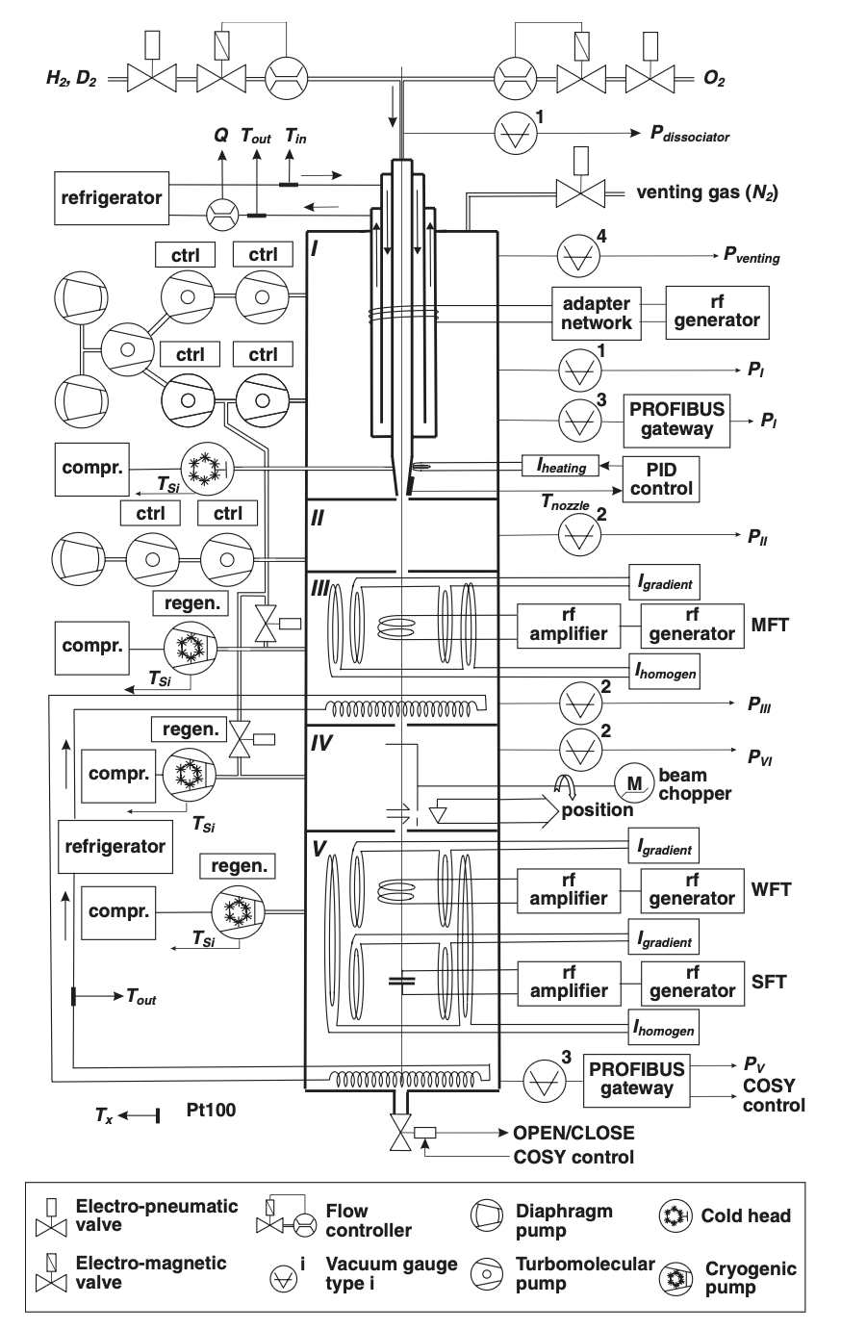
HJET subsystems
H. Kleines et al. , NIM A 560 (2006) 503
ABS (Atomic Beam Source)
  Vacuum and interlock
  Gas supply system H₂, O₂, N₂
  RF dissociator
  PID loops for temperature and chopper control
  RF Transition units
    WFT and SFT
  Holding field magnet control
BRP (Breit-Rabi Polarimeter)
  Vacuum and interlock
  QMA (Quadrupole mass analyzer)
    H₁ and H₂ transverse beam profiles (xy)
    Rest gas analysis at target
    Stepper motor control
  RF Transition units
    WFT and SFT
  Chopper control
  Ion gauge signal detector

Slide 4
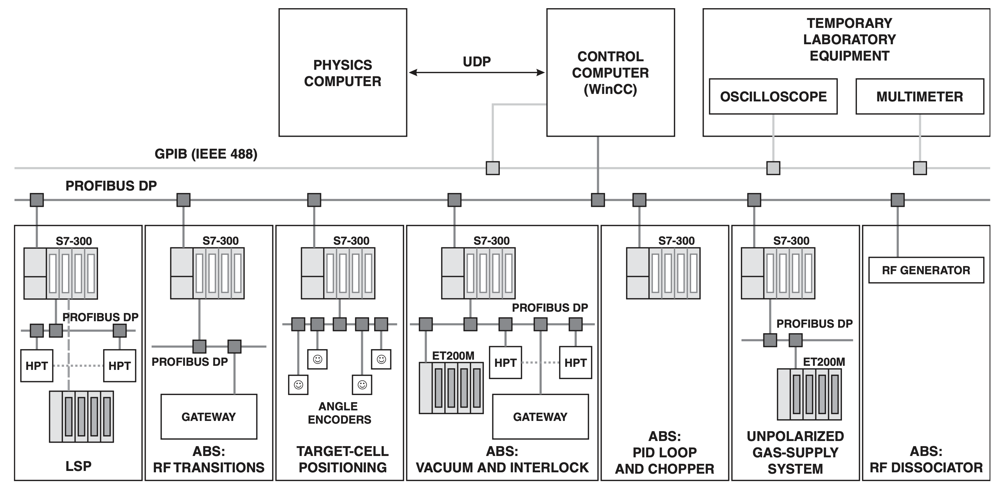
Structure HJET control system
H. Kleines et al. , NIM A 560 (2006) 503

Slide 5
pC subsystems
pC polarimeter
  Positioning of C targets in beam
    Stepper motor control
  QMA (future)
    Rest gas analysis of chamber vacuum
  Temperature readout
    C targets (in progress, difficult)
    Holders (future, easy)
Vacuum transfer chamber
  Vacuum and interlock
  QMA (Quadrupole mass analyzer)
    Rest gas analysis to ensure C targets are clean
  Stepper motor control linear drive

Slide 6
Comments
HJET
  Total number of HJET process variables (PV) logged in EPICS ~ 500
  Most of these PVs are slow -> 0.1s update
  All PVs go to EPICS database
  CS Studio application for HJET
  Some subsystems require fast feedback loops (e.g., SFTs)
  Valve control to ring interlocked with ring vacuum
  Polarization + detector system info -> EPICS
    Info time stamped
pC
  Control system will get a similar architecture as HJET
  Focus on stepper motor control for C target movement
    Valve control for target transfer interlocked with ring vacuum
  Total number of PVs around 200
  CS Studio application for pC
  Polarization + detector system info -> EPICS
    Info time stamped
EIC control room talks to polarimetry equipment
Convenient to communicate directly via PVs through EPICS
  need to provide specific timing sequences for certain tasks

