Slide 1
FEMC, SiPM performance under irradiation. O.Tsai 06/04/2025
ePIC conditions.
Neutron fluence for 100 fb⁻¹ ~ 10¹¹ n/cm²
Leakage Current per tower ~ 1.6 mA ( 400 uA/SiPM @ 2V overvoltage)
Light Yield ~ 1580 pixels/GeV
Threshold – 15 MeV (to be revisited) – 23 pixels
Eq. Noise ~ 85 MeV (scaled from STAR FCS)
Rates above threshold - TBD
Integrated neutron fluxes ePIC 10x275 top luminosity, 6 month running at 100 % efficiency,
SiPM located at Z =3408 from IP

Slide 2
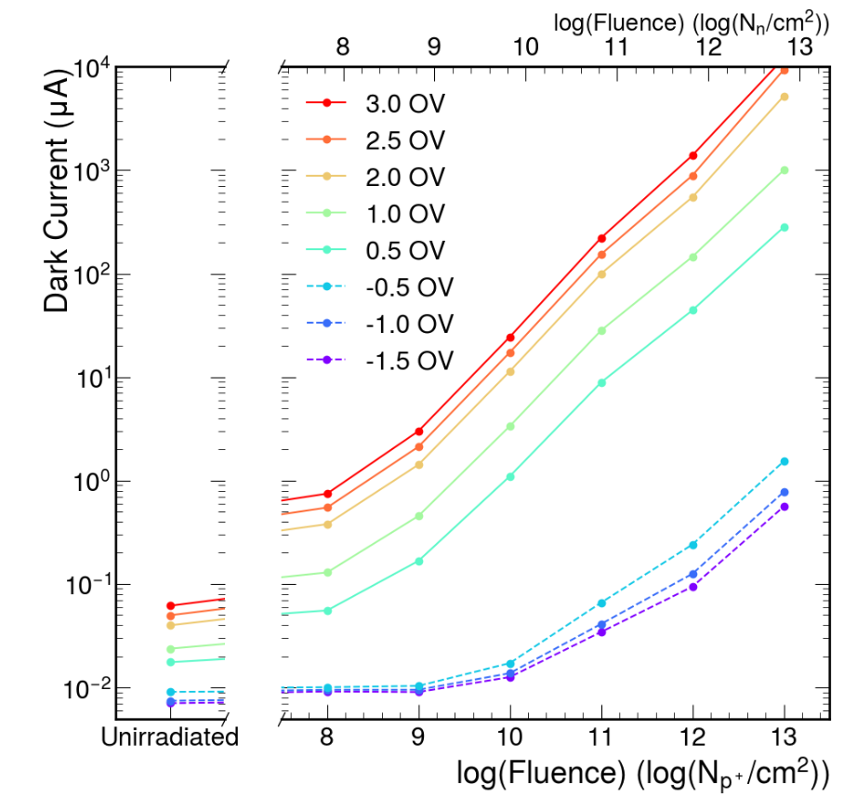
What was scaled from STAR FCS?
According to RHIC official numbers delivered luminosity for Run 22 is 807 pb⁻¹
at R=20 cm, rate is 5*10⁻³ n/cm²/event
Integrated flux for Run 22 is 5*10⁻³ x 807 pb⁻¹ x 50 *10⁹ pb = 2*10¹¹ n/cm2. <- similar to what expected at ePIC
STAR FCS
STAR FCS consistent with Davice measuremnst
(Current for 4 3x3 mm2 SiPMs at STAR, annealed
for three years at room T)
UCR measurements at Davice

Slide 3
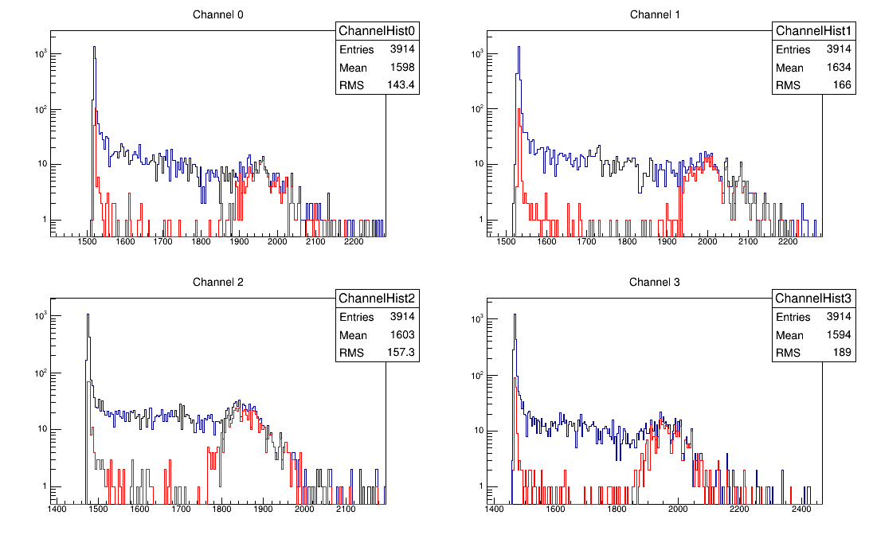
What was scaled from STAR FCS?
Cosmic Muons with un-exposed SiPMs ENF ~ 1.7 MeV
SiPMs Degrade with exposure (details later in talk).
500 GeV pp (Run 17) was the worst case in terms of exposure.
Cosmic Muons with exposed (Run17, same neutron fluxes as Run 22) SiPMs, ENF – 10 MeV/tower

Slide 4
What was scaled from STAR FCS?
Mean Eq noise of STAR FCS SiPMs is ~ 27 MeV after Run 22. Run 23 and Run 24 (pp 100 GeV, AuAu) did not changed this. Worst cases noise is ~ 42 MeV a bit more than expected before Run22.
Projection to ePIC.
STAR FCS EMcal LY ~ 1500 pixels/GeV – measured with cosmics
ePIC fEMCal LY ~2470 pixels/GeV – measured at FNAL test Run 2024, SiPMs – 50 um pixels.
Accounting to PDE difference between 50 um pixel SiPMs used at FNAL with 15 um pixel SiPM which will be used for ePIC LY for fEMCal is 1580 pixels/GeV
For ePIC fEMCal we will use 4 times more SiPMs compare to STAR FCS, which means that EQ. noise for FEMCla will be ~ 85 MeV after exposure to 2 x 10¹¹ n/cm²

Slide 5
To do list:
Minimal threshold for FEMC – currently 15 MeV – no real justification for that.
Sasha reached out to exclusive WG.
2. Lab tests with STAR FCS SiPMs (UCLA/Indiana) and ePIC SiPM boards at Indiana:
Rates vs threshold
Resoultions for small signals vs overvoltage
For ePIC boards , constant illumination with LED will be used to mimic exposure with neutrons. Noise spectar was checked with STAR FCS boards looks the same for exposed SiPM boards and un-exposed boards at constant illuminations (at the same leakage current)
By the end of summer we should have results from these measurements.
STAR Vop
STAR FCS boards after 10¹¹ n/cm²

