Slide 1
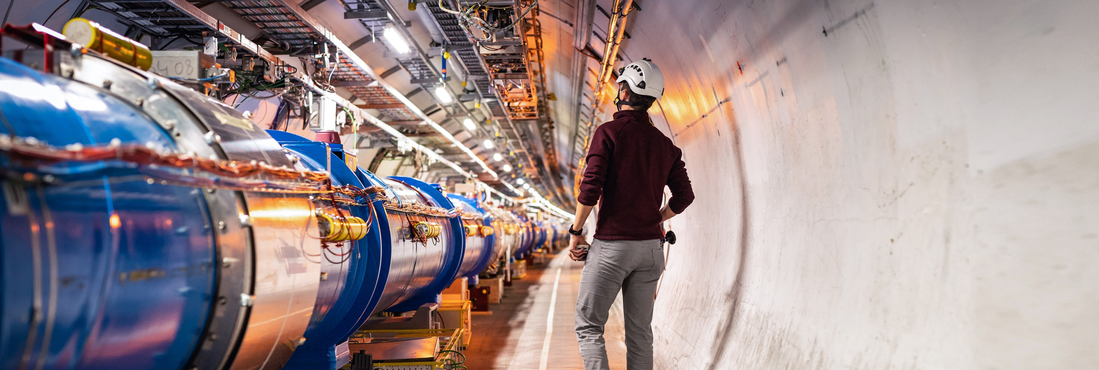
Particle Physics:
Today and Tomorrow
Mark Thomson
CERN
University of Cambridge

Slide 2
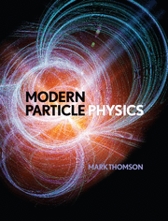
A few words about me
2000 – … : Professor of Experimental Particle Physics at the University of Cambridge in the UK
  Research in collider physics, with a strong focus on electron-positron physics at CERN in Switzerland and, more recently neutrino physics in the US, first spokesperson of the Deep Underground Neutrino Experiment
2013: published Modern Particle Physics
2018 – 2024: Executive Chair of the UK Science and Technology Facilities Council (STFC)
  Funder of UK particle physics, nuclear physics and astronomy
  Operated national infrastructure such as light and neutron sources
  Ran two Research and Innovation Campuses (Harwell and Daresbury)
2024: Selected as next Director General of CERN, starting Jan 2026
  based at CERN since January

Slide 3
Today’s Presentation
Some personal perspectives on
where we are today with particle physics
what the next ten years might bring
and then what?
Looking back 30 years
The very massive top quark had just been discovered (1995)
Neutrinos were usually considered massless (although there was some evidence to the contrary) until 1998
Dark energy (1998 – 2013 – )
The Brout–Englert–Higgs mechanism was a beautiful theoretical idea (until the Higgs boson was discovered in 2012)
Gravitational waves had yet to be observed (until 2016)
A profound discovery every 5–10 years… not bad!

Slide 4
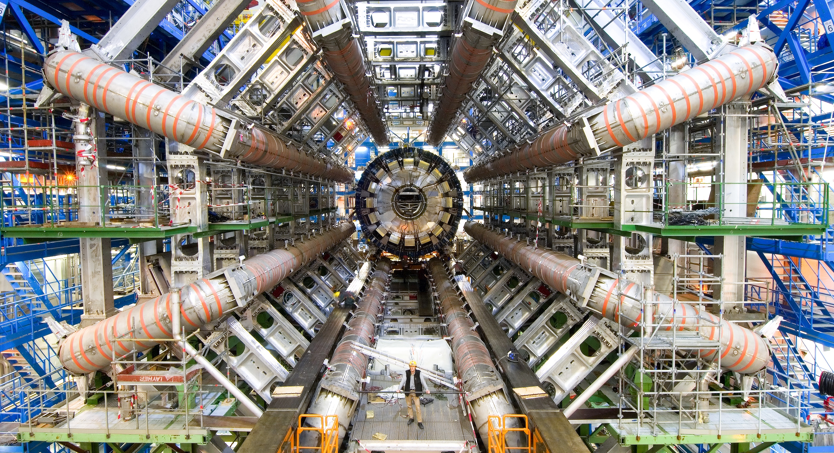
Exploring the universe
Today

Slide 5
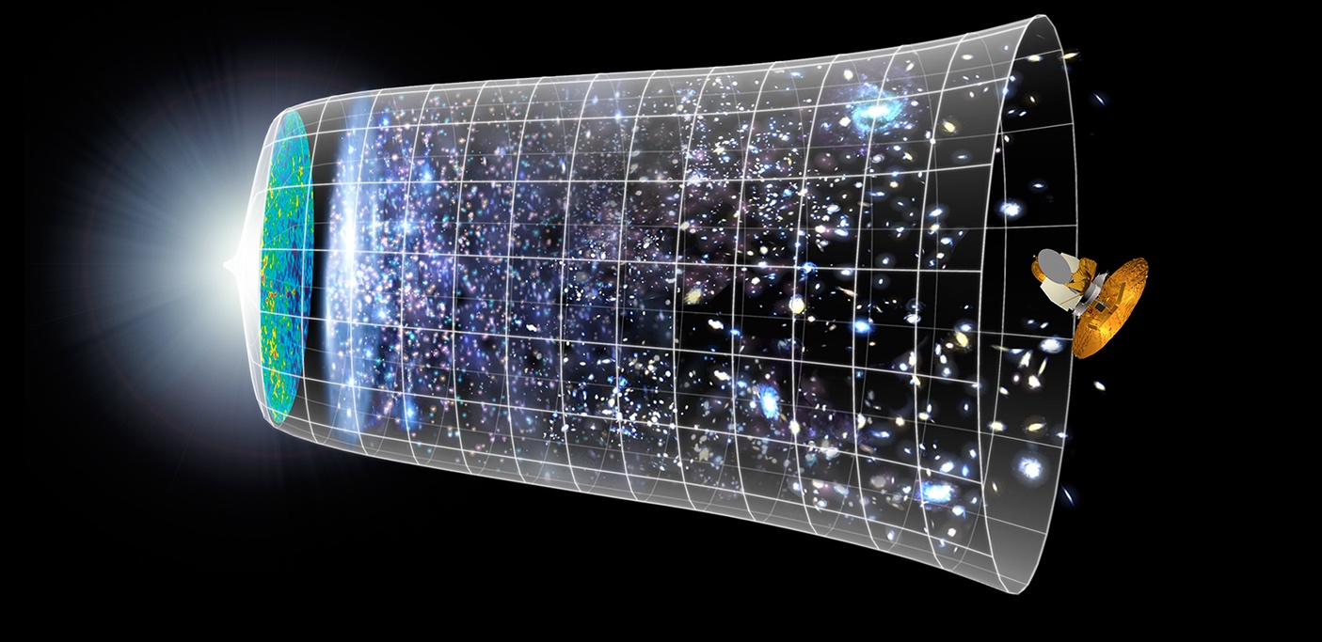

Uncovering the Secrets of the Universe
Fundamental physics: aim to understand the Universe from the Big Bang to the stars and galaxies we see today
Big Bang
We reproduce the conditions a fraction of
a second after the Big Bang, to gain insight into the structure and evolution
of the universe.
Telescopes
Accelerators
380 000 years
13.8 Billion Years
Today
10²⁸ cm

Slide 6
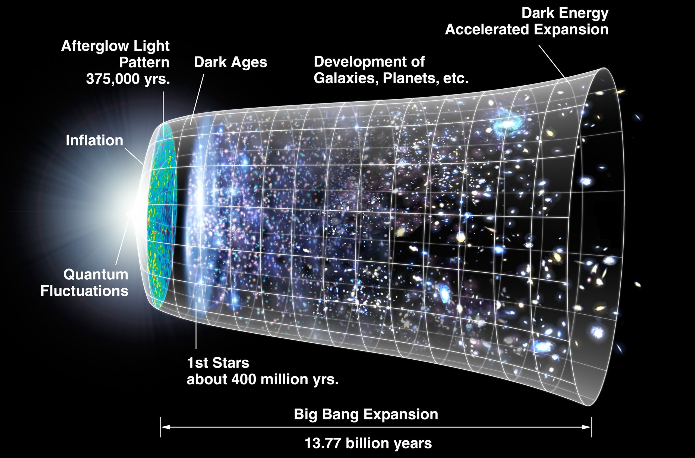
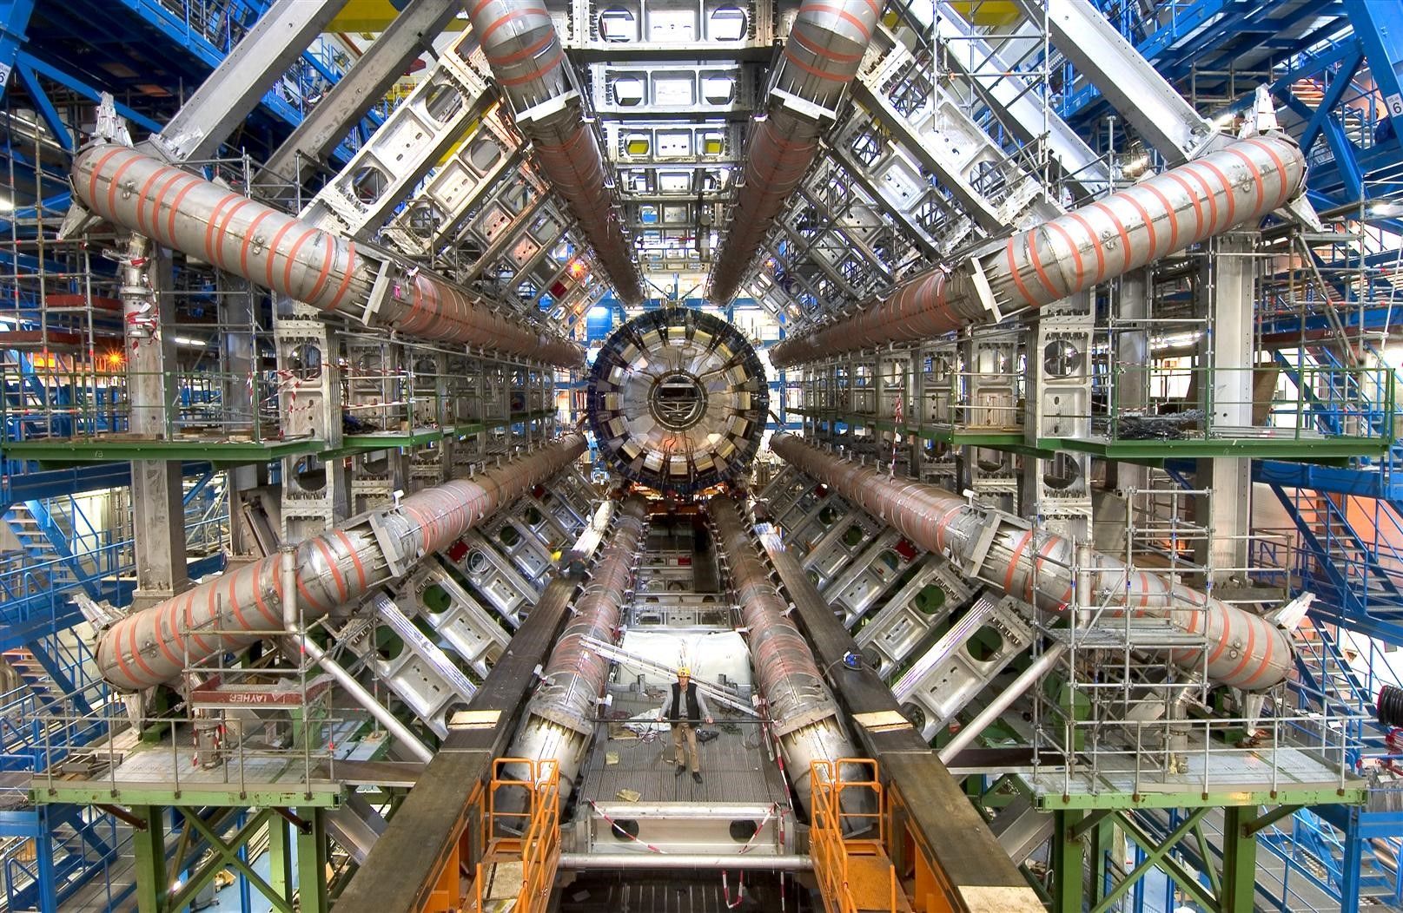
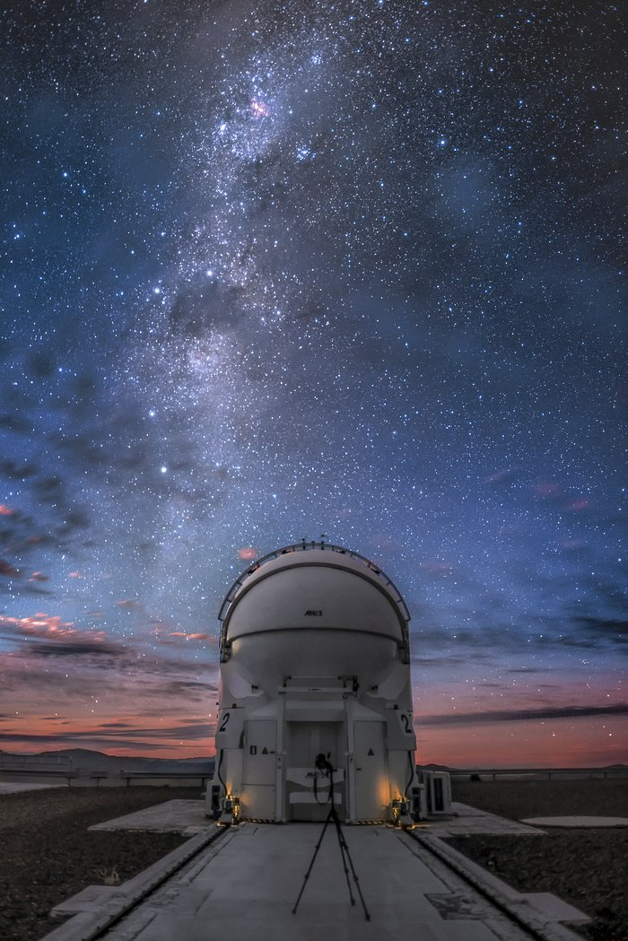
Uncovering the Secrets of the Universe
Fundamental physics: aim to understand the Universe from the Big Bang to the stars and galaxies we see today. Answer questions such as:
What are the building blocks of the Universe: the particles
How does the Universe “work”: the forces, ultimately including gravity
How did the Universe evolve: black holes, stars, galaxies, and role of Dark Matter

Slide 7
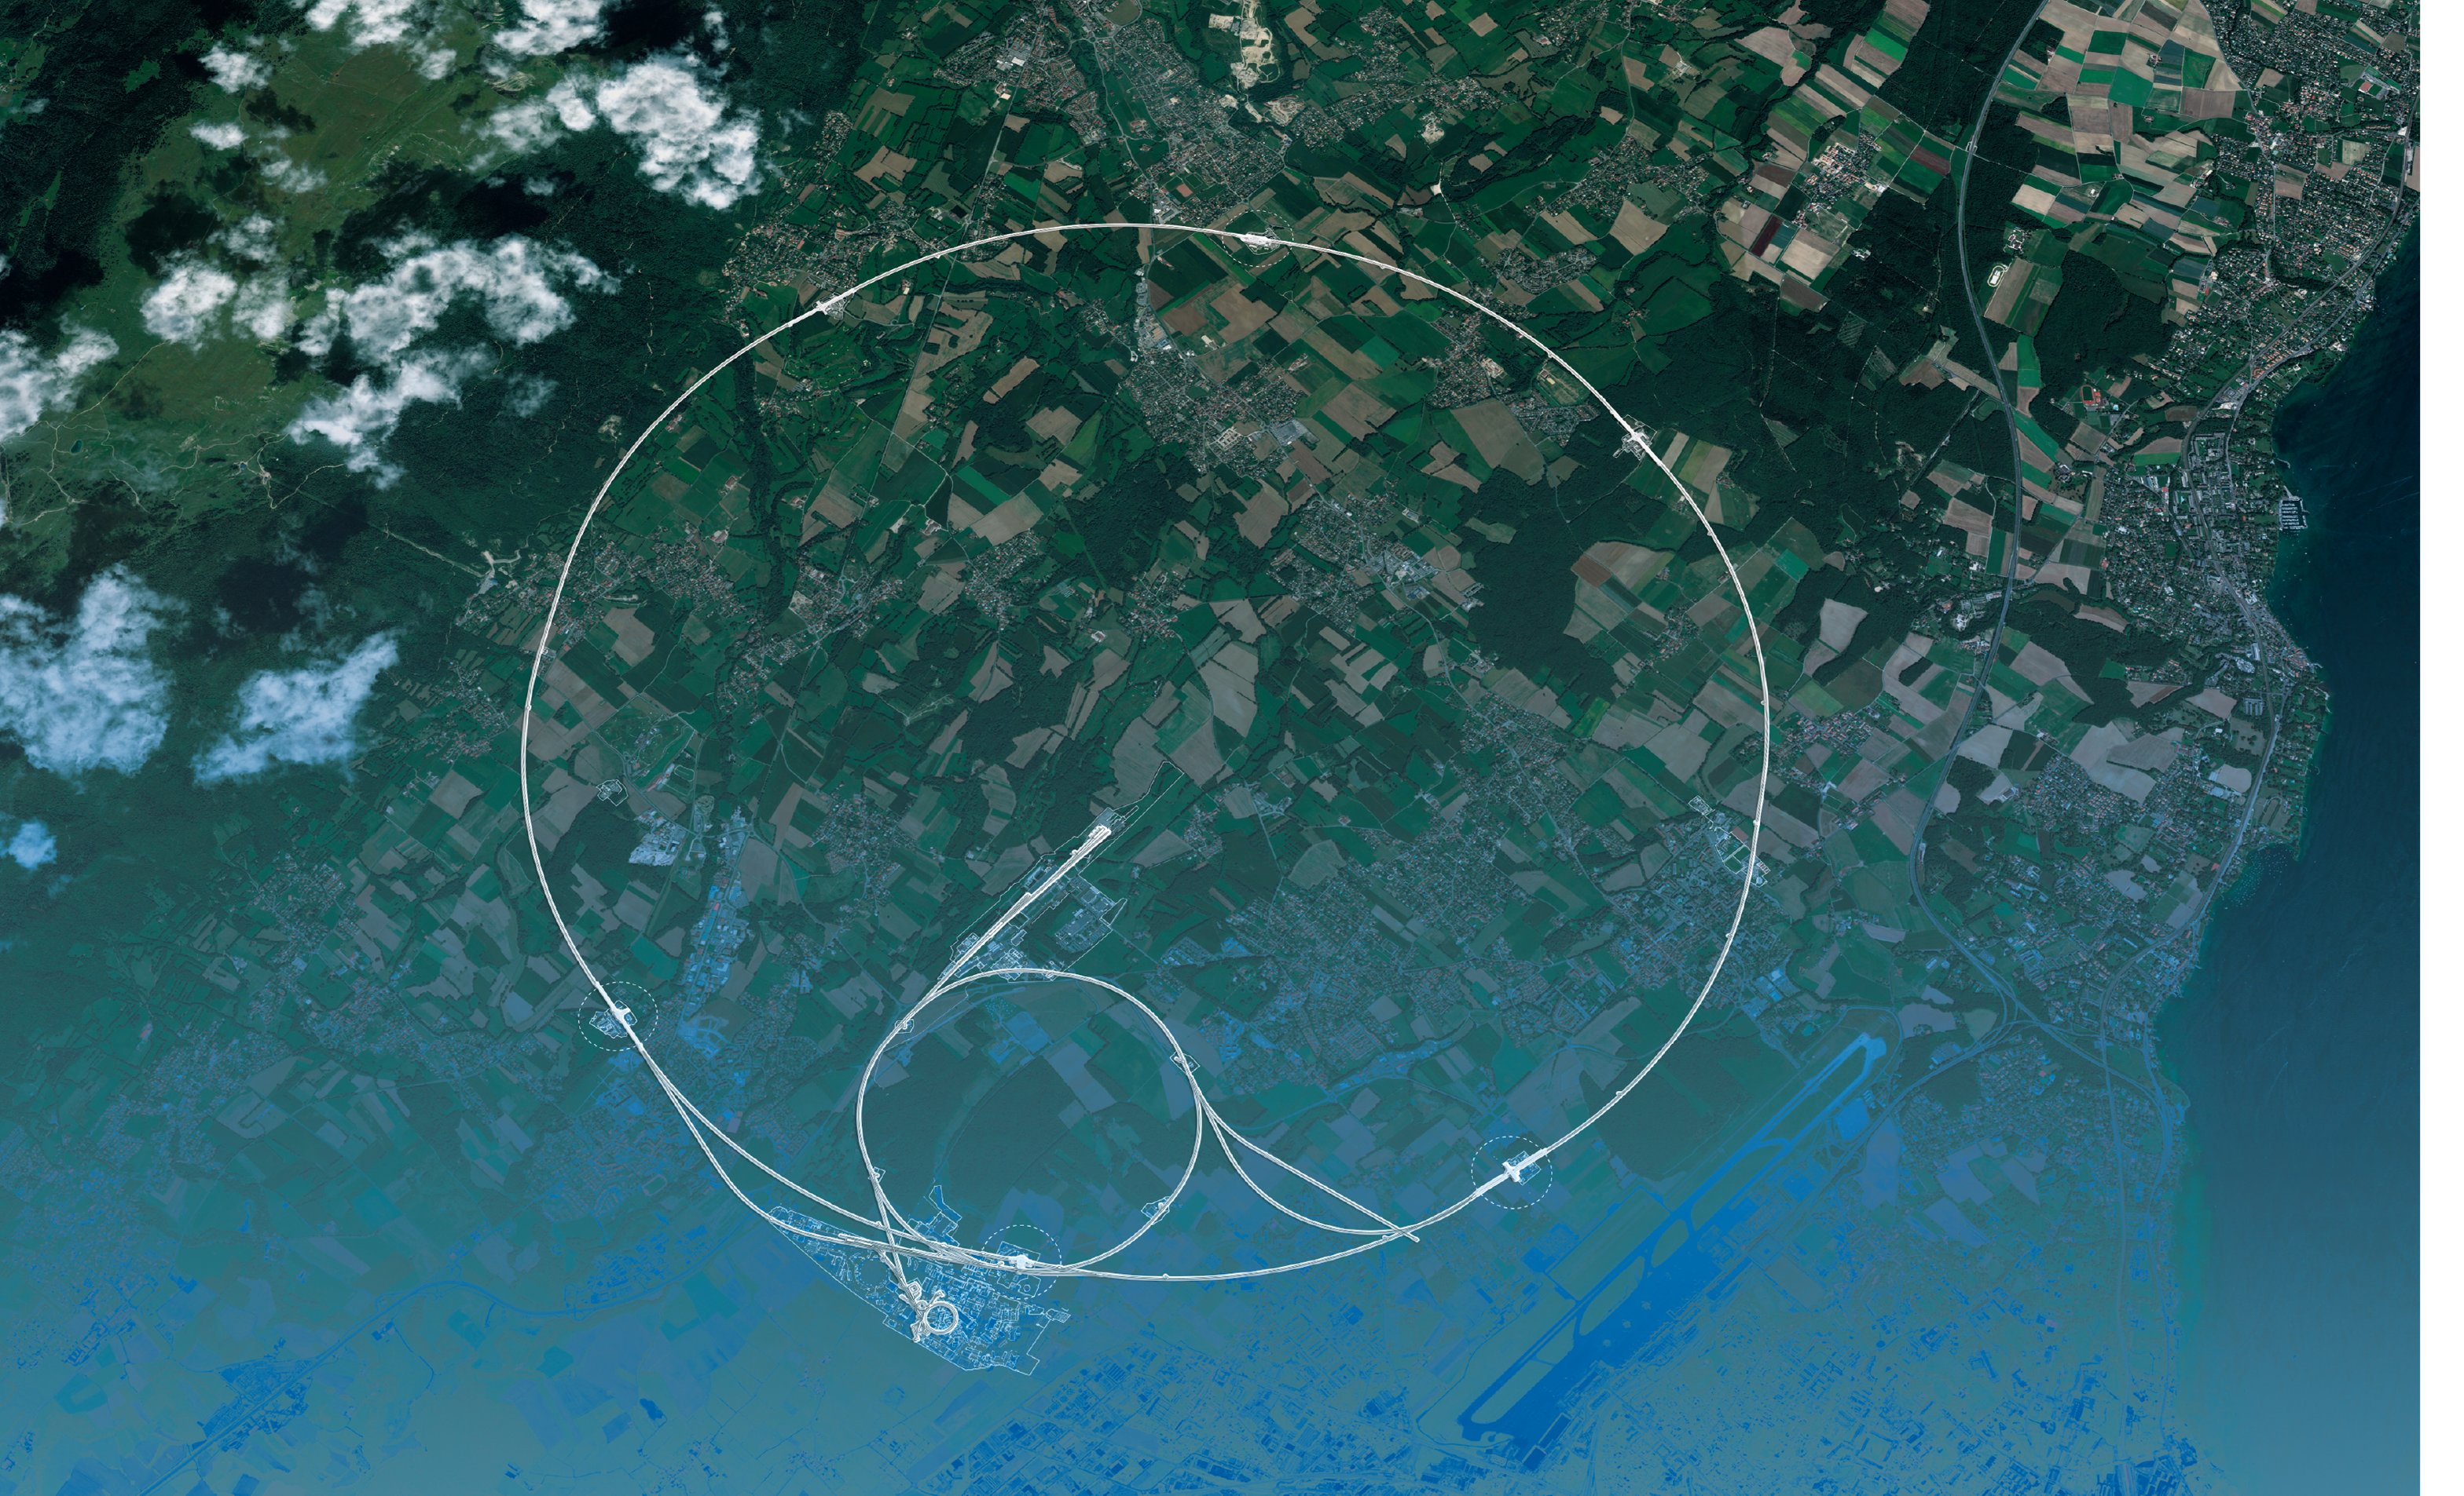
CERN

Slide 8
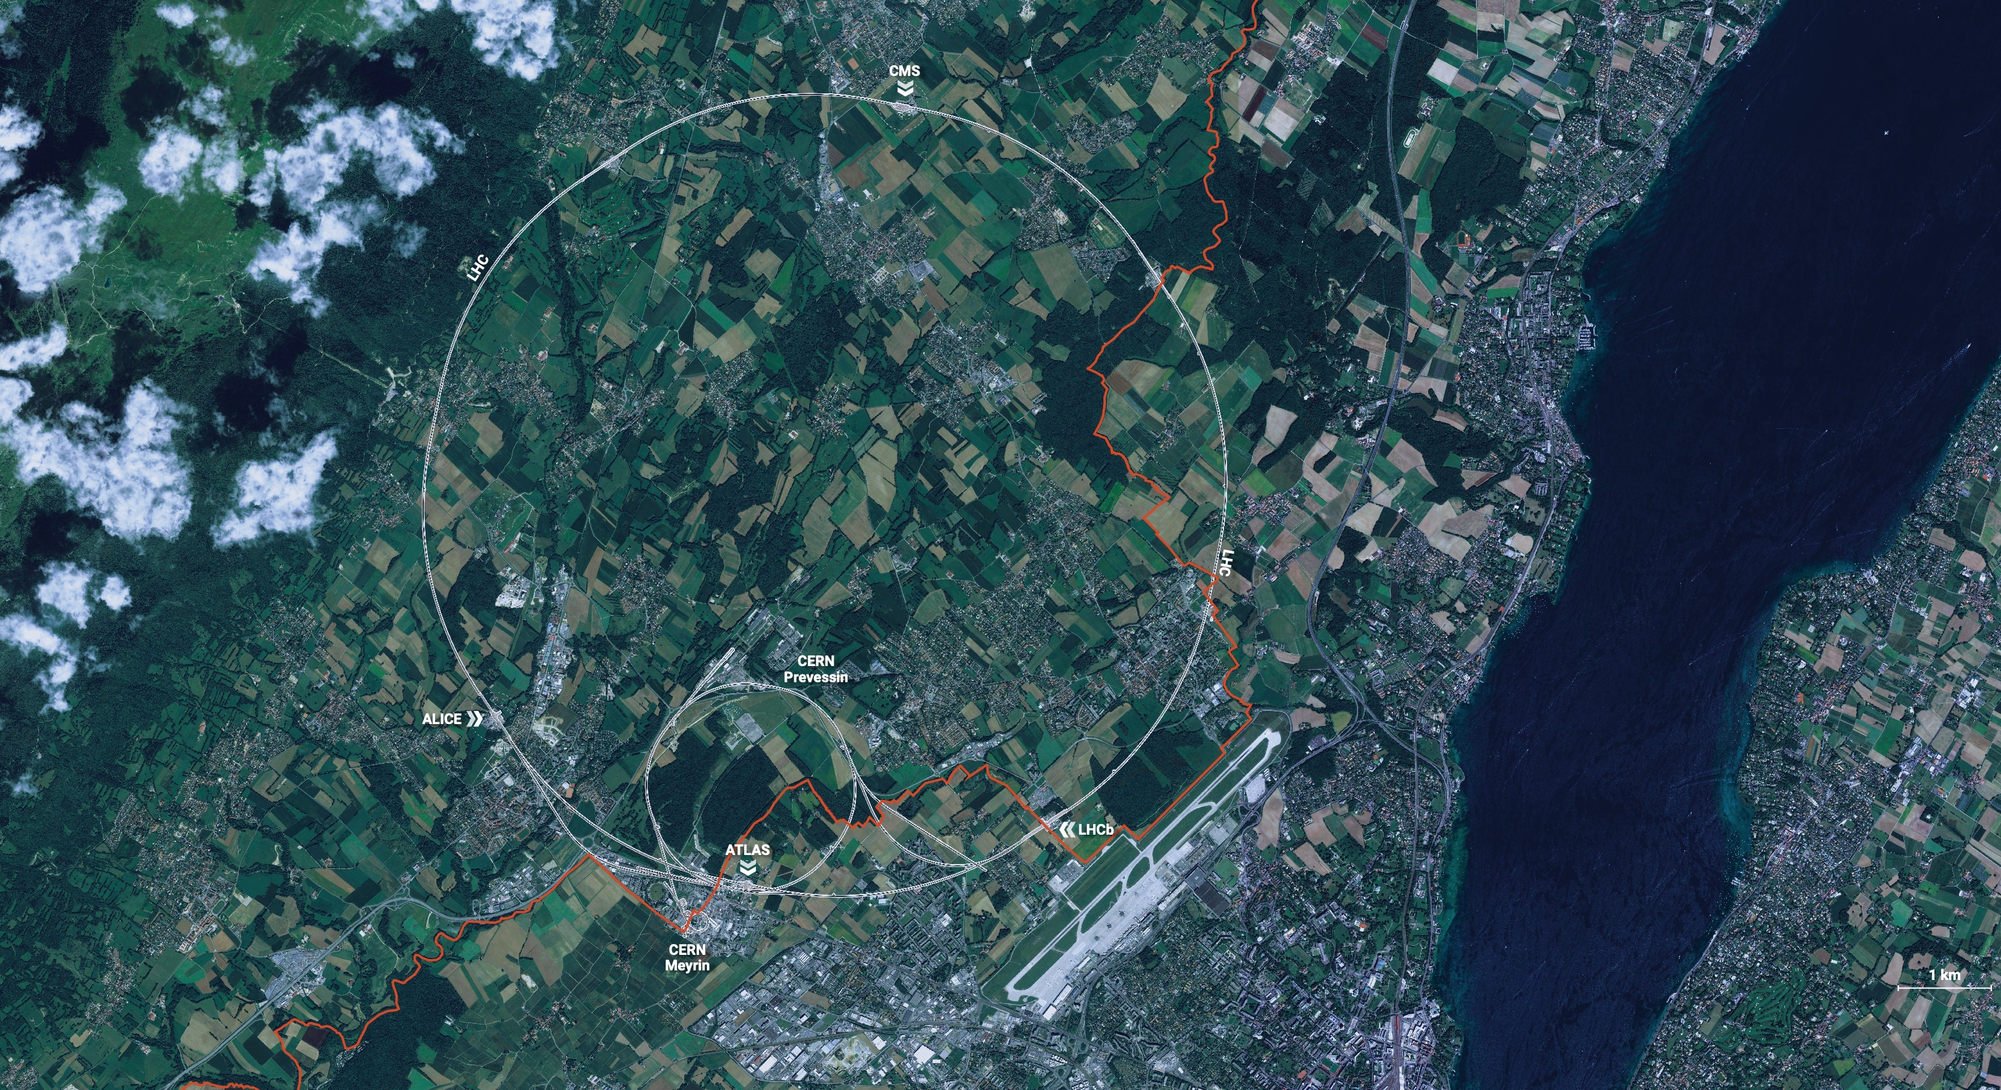

CERN
CERN is the world’s biggest laboratory
for particle physics.
Straddles the French – Swiss border near Geneva
Our mission is to understand the most fundamental particles and laws
of the universe.
Built on over 70 years of deep international collaboration

Slide 9

Science for peace
CERN was founded in 1954 with 12 European Member States
Success built on long-term international collaboration in science
25 Member States
Austria – Belgium – Bulgaria – Czech Republic
Denmark – Estonia – Finland – France – Germany
Greece – Hungary – Israel – Italy – Netherlands
Norway – Poland – Portugal – Romania – Serbia
Slovakia – Slovenia – Spain – Sweden – Switzerland – United Kingdom
CERN’s annual budget
is 1200 MCHF (1.5 B$) – equivalent to a medium-sized European university
Employees:
~2700 staff, ~1200 graduates
Associates:
12 000+ users
11 Associate Member States
Brazil – Croatia – Cyprus – India – Ireland – Latvia – Lithuania Pakistan – Türkiye – Ukraine
4 Observers
Japan – USA – European Union – UNESCO

Slide 10
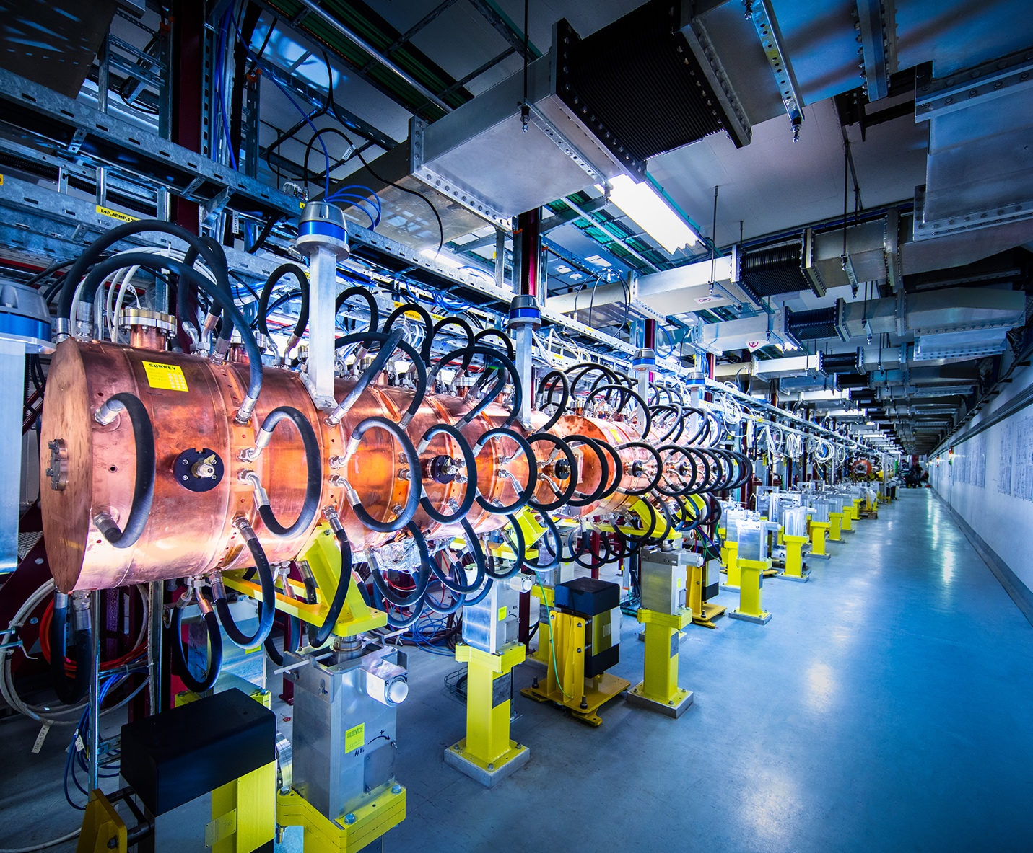
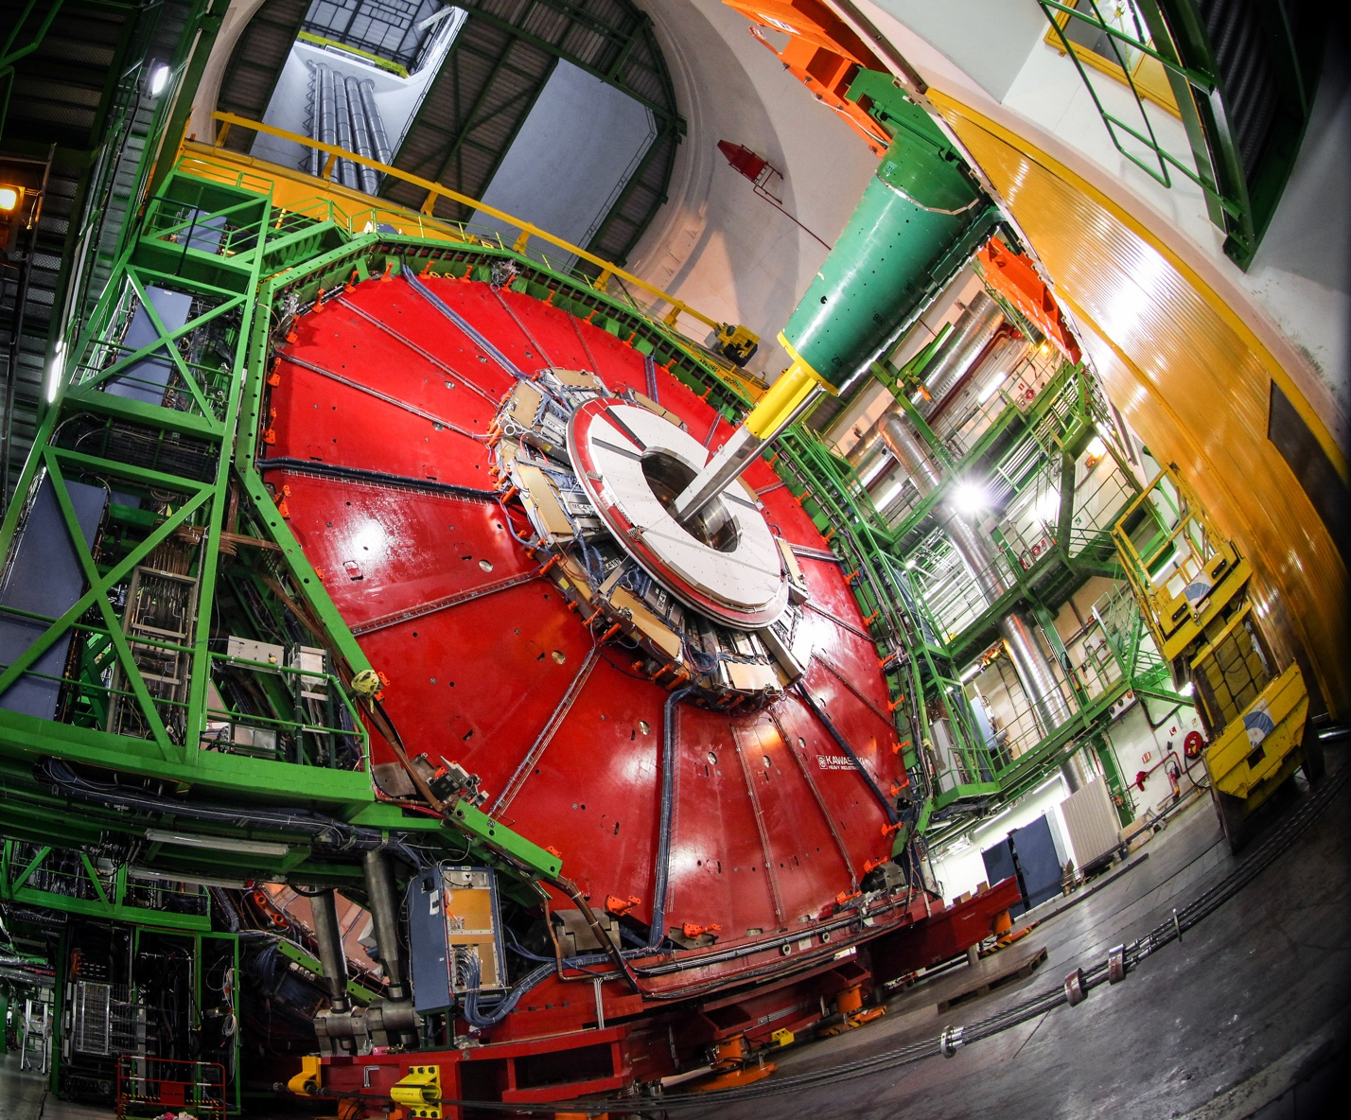
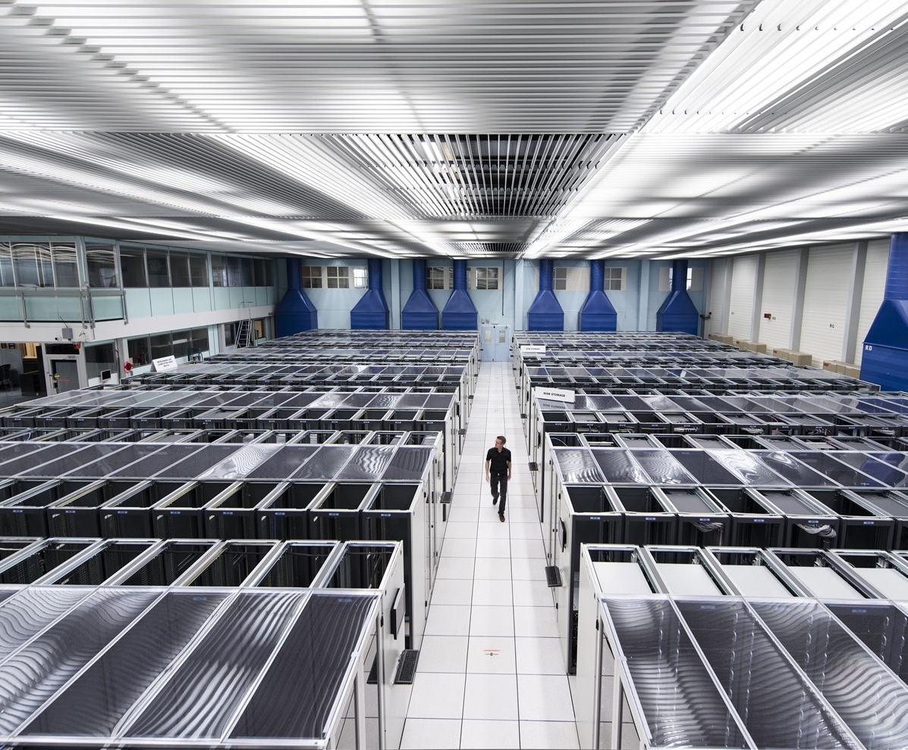
At CERN we use very advanced technology
Technology and engineering is the driver for discovery in fundamental science
we are constantly pushing the boundaries beyond what exists today…
At CERN there are three central technology areas
ACCELERATORS
DETECTORS
COMPUTING

Slide 11
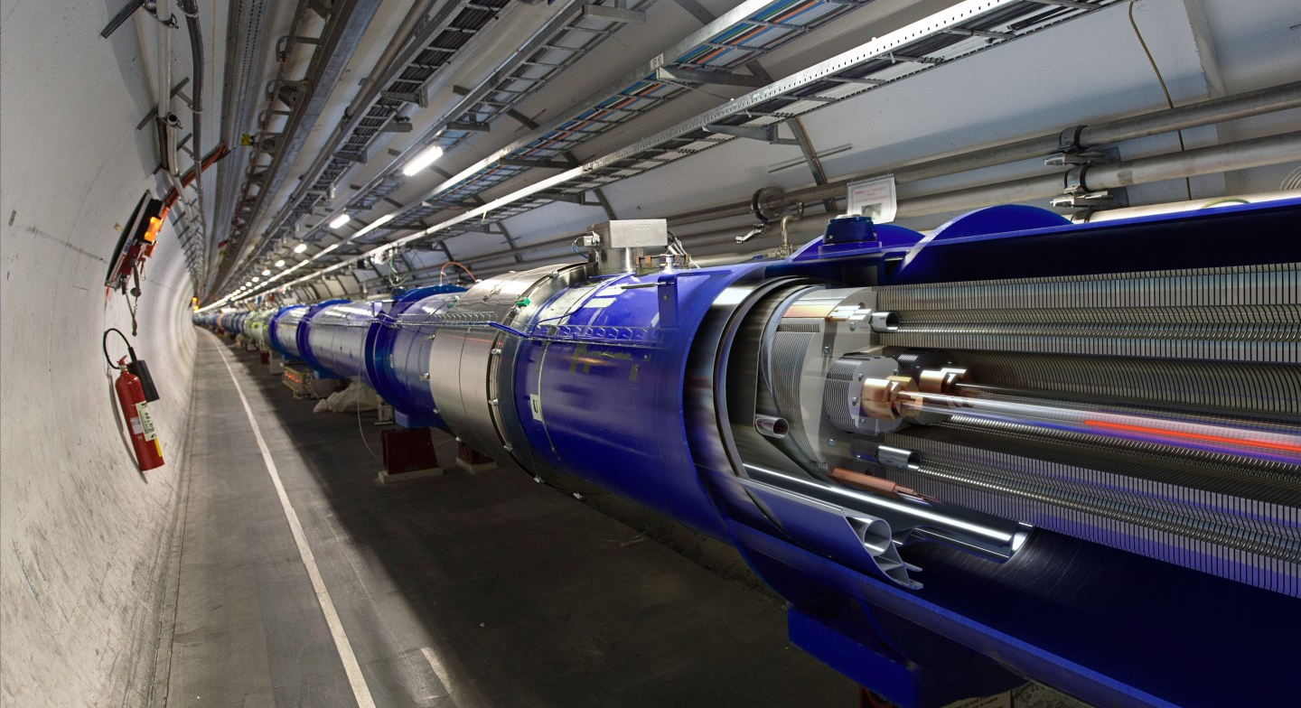
The Large Hadron Collider at CERN

Slide 12
The Large Hadron Collider
Our most powerful “tool” to understand the “particle-verse”
Large: 27 km circumference ring of superconducting magnets
Hadron: accelerates protons (hadrons) to almost the speed of light… 99.9999991%
Collider: two proton beams collide 40 million times a second at four points around the ring where the fragments are “photographed” with massive imaging detectors

Slide 13
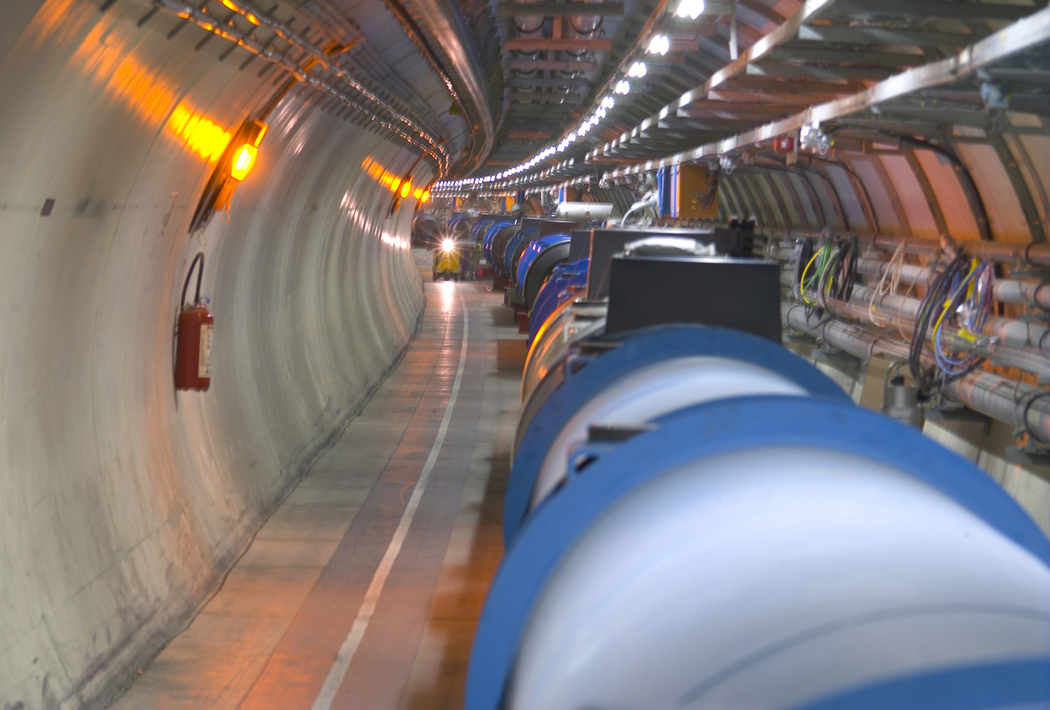

The LHC is Incredible
The LHC is the most powerful collider ever built
A truly remarkable feat of engineering
Accelerating protons to close to the speed of light and steer them around the 17 mile ring
The proton beams brought into collision in four detectors areas 40 million times a second
  Equivalent to the kinetic energy of 1000 stampeding African elephants
  Or equivalently, the kinetic energy of a Boeing 777 aircraft as it lands
  Or equivalently, more than enough energy to melt tonnes of Copper…
The energy stored is huge: ~350 MJ

Slide 14
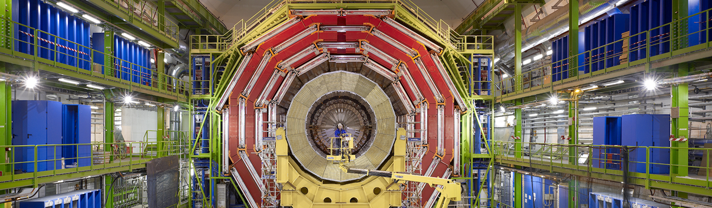
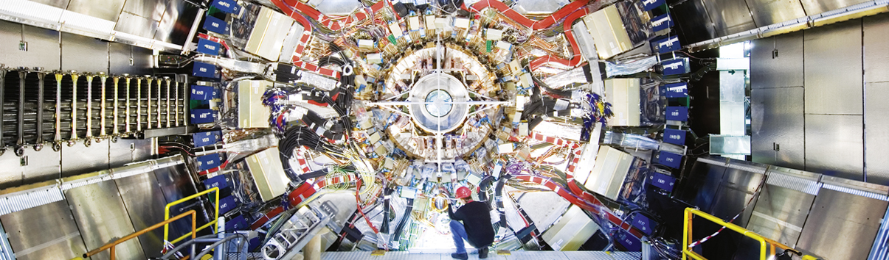
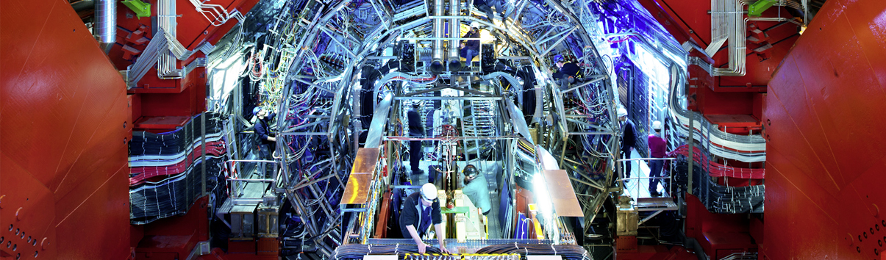
Giant detectors record the particles formed at the four collision points
CMS
CMS
CMS
ATLAS
ALICE
ALICE
ALICE
ATLAS
LHCb
ATLAS
LHCb
LHCb

Slide 15
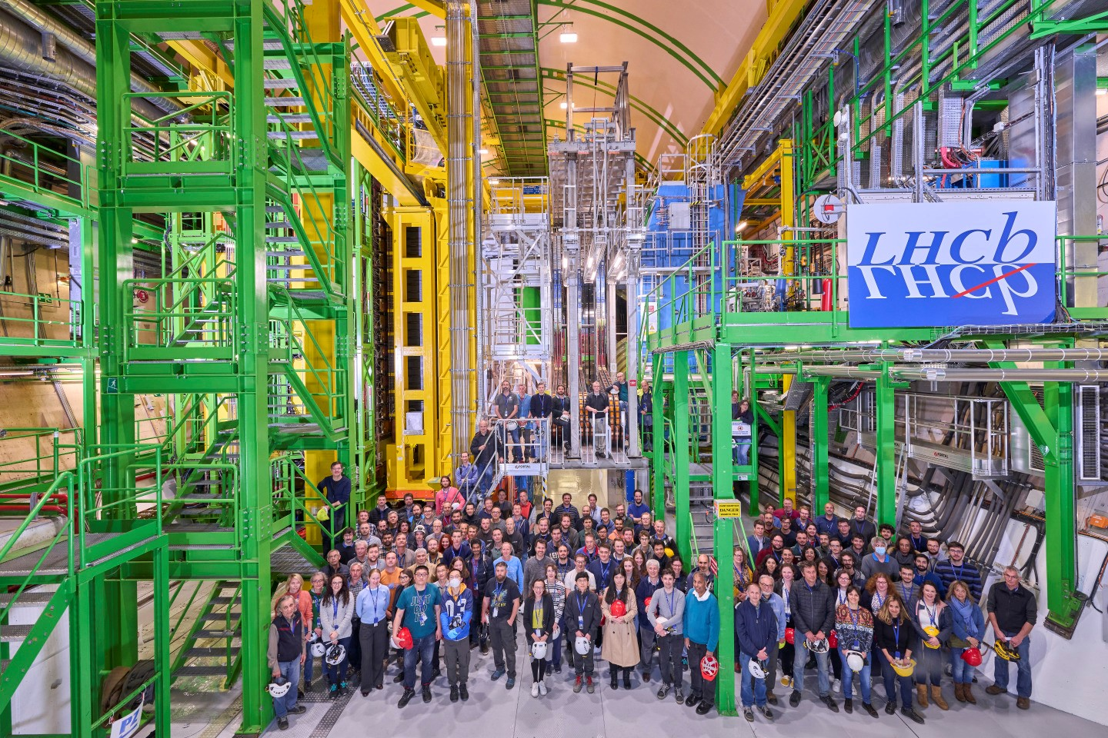
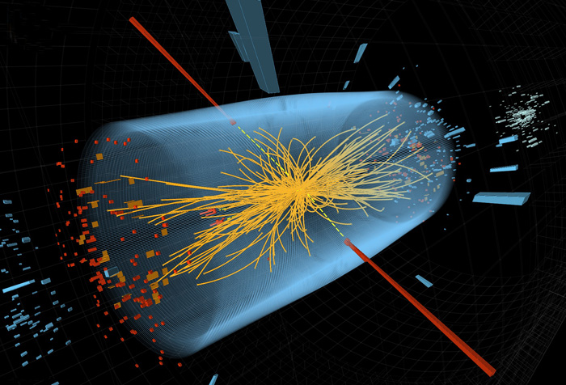
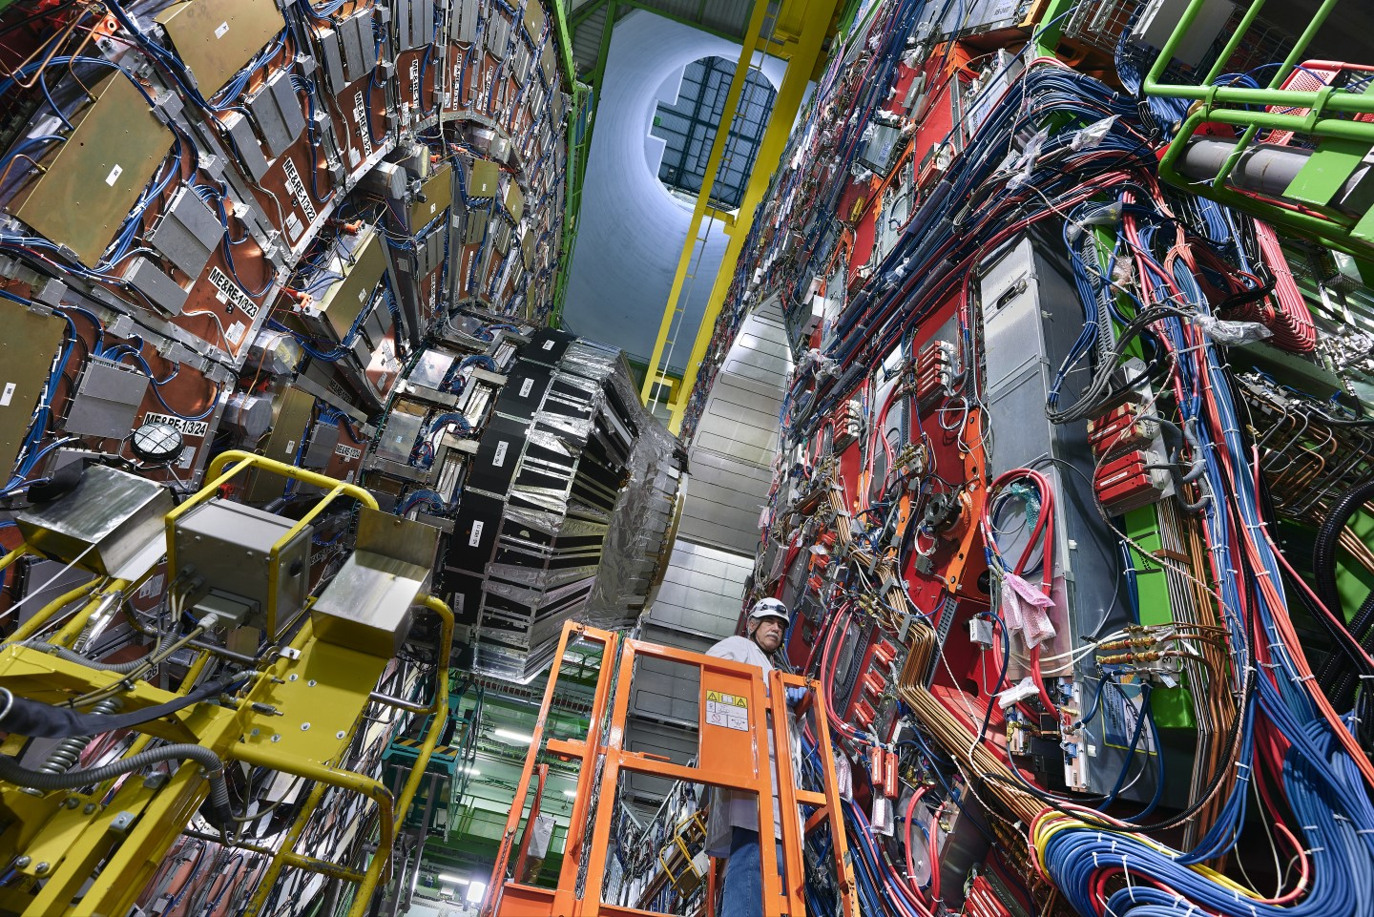
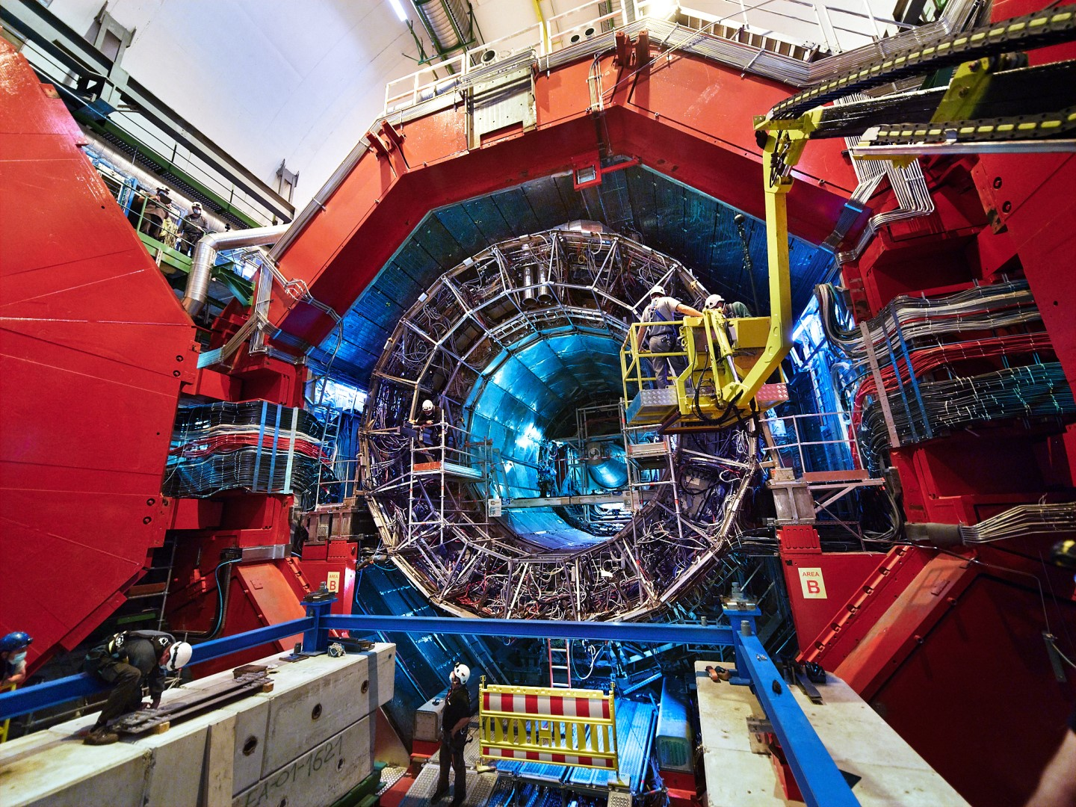
The LHC Detectors
Giant cameras operating at 40,000,000 frames per second

Slide 16
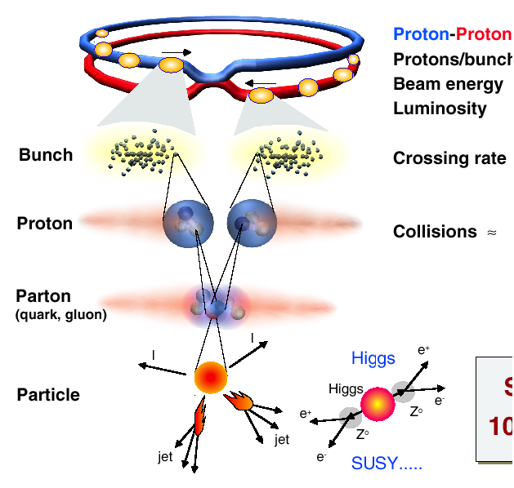
The LHC Detectors are also incredible
The most complex detector systems ever built - a remarkable achievement
The challenges (are many)…
Proton/Proton collisions, with 10¹¹ protons per bunch every, 25 ns
25 ns
Very high event rate 1,000,000,000+ pp interactions per second
“the most interesting events” are very rare: 1 in 10,000,000,000,000 interactions
Detectors designed to image these “events” in great detail and identify the “rare ones”

Slide 17
The Higgs Boson
is Special

Slide 18
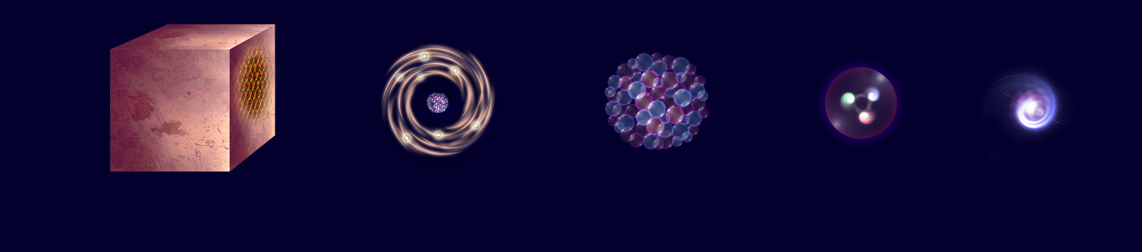
What is the universe made of?
The basic building blocks of most of the “low-energy” universe
The electrons: that orbit the nucleus in atoms : determines chemical properties
The “up-quarks” and “down-quarks”: the building blocks of protons and neutrons
The neutrino: very weakly interacting almost massless particles
The reality is somewhat (but not very much) more complex, e.g. 3 generations
we also want to know “why the universe is as it is?” – here there are many questions
Electron
Matter
0.1 m
Atom
~10⁻¹⁰ m
Nucleus
~10⁻¹⁴ m
Proton
~10⁻¹⁵ m
Quark
<10⁻¹⁸ m

Slide 19


Cooking the Standard Model
Deep Theoretical Concepts
Einstein: Special Relativity
Schrödinger +… : Quantum Mechanics
Dirac: a relativistic theory of QM
  Spin and anti-matter
Feynman + … : Quantum Field Theory
  Particles are excitations of fields
Local Gauge symmetry principle
  the forces: QED, …
Brout–Englert–Higgs mechanism
The Standard Model
Experimental Observations
Observed particles and types of force
Observed parameters, e.g. masses

Slide 20
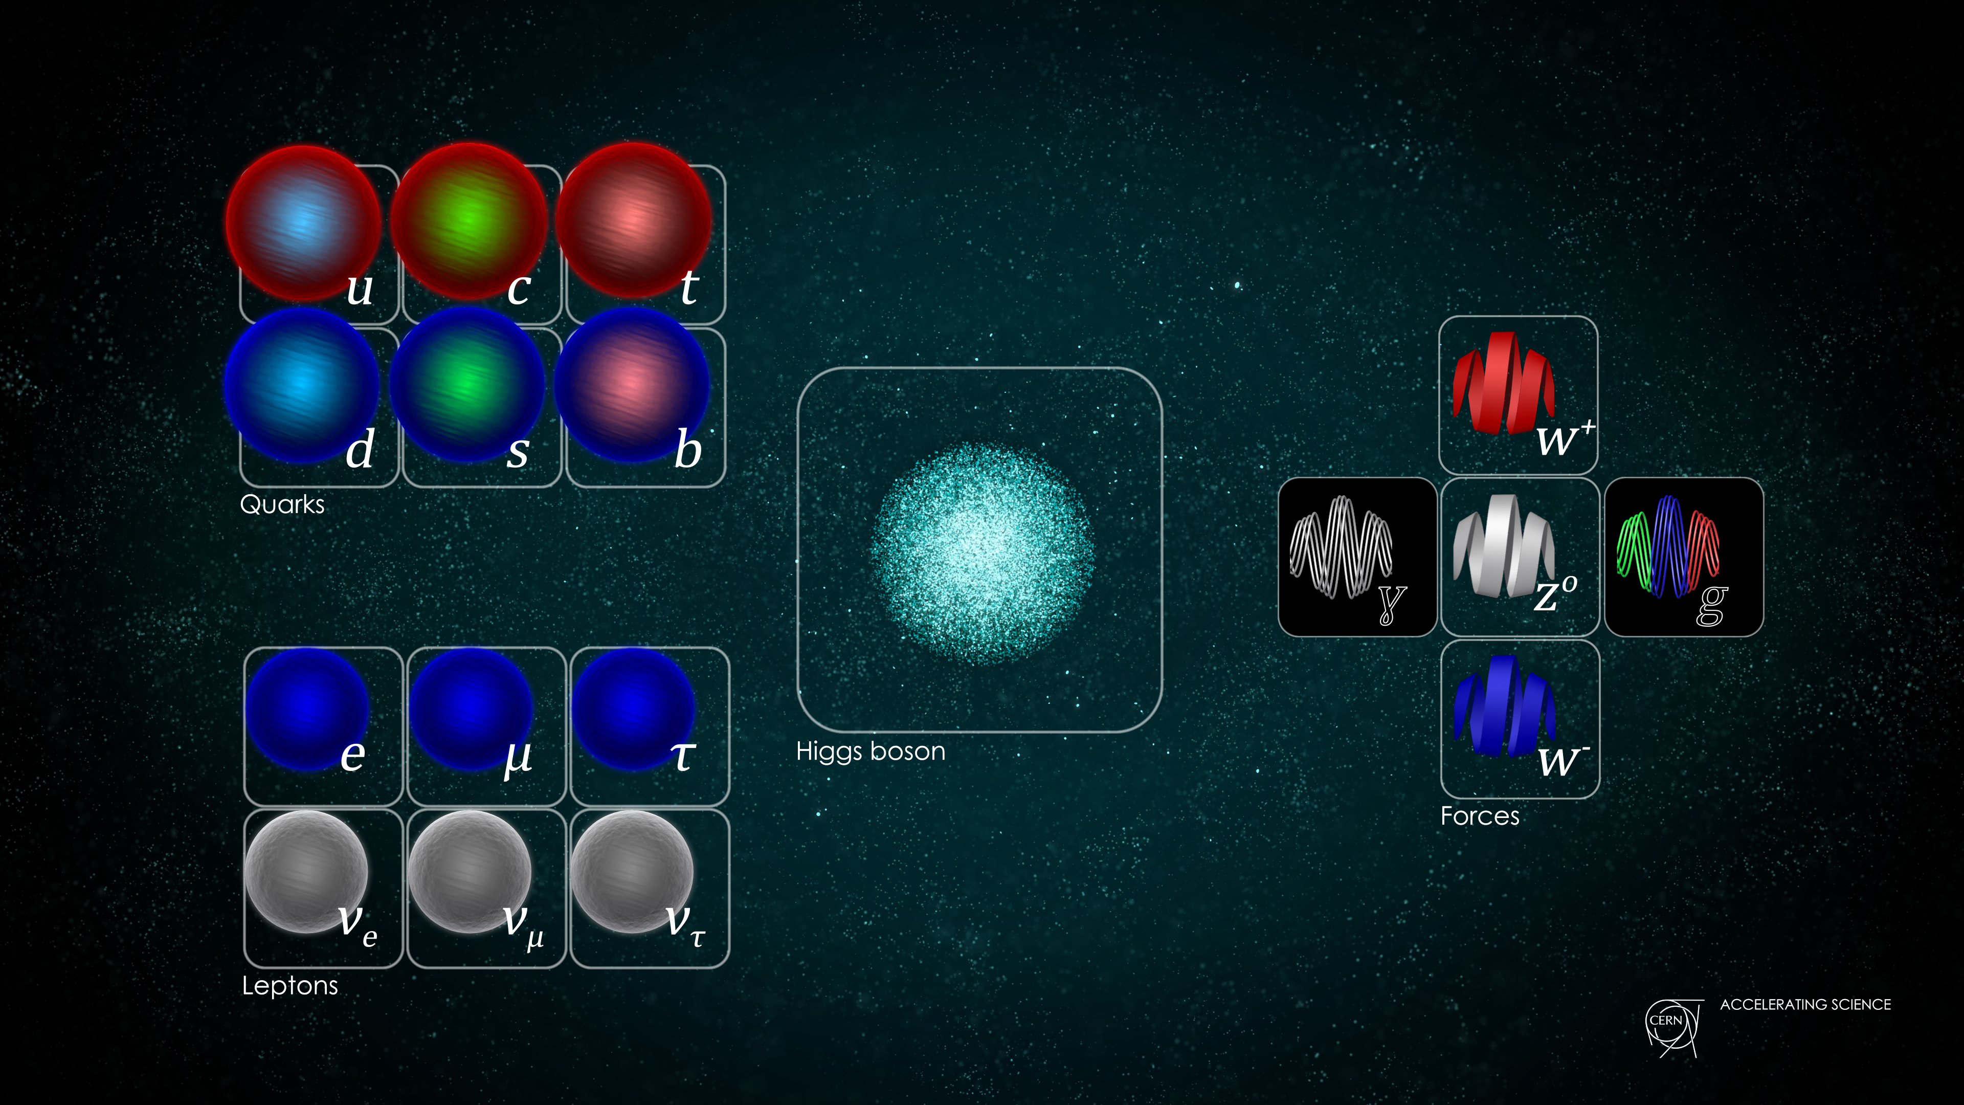
The Higgs Boson is Special
The Higgs Boson was and is a key component of the LHC science case
Not just “another” particle
Standard Model (SM) building blocks
12 matter particles (fermions)
5 force particles (bosons)
The Universe is a strange place…
As far as we know, fundamental particles have no size – pin pricks in space-time
Without some “magic”, the SM would only work for massless particles – but we know they are not massless…

Slide 21
The Higgs Boson is Special
The Higgs Boson was and is a key component of the LHC science case
Not just “another” particle
Standard Model (SM) building blocks
12 matter particles (fermions)
5 force particles (bosons)
1 Higgs boson (a scalar field!)
The Universe is a strange place indeed!
As far as we know, fundamental particles have no size – pin pricks in space-time
Particles, in some sense, are massless, but the Higgs field gives all particles their (apparent) masses

Slide 22


The Higgs Boson – a dubious analogy
Can think of the Higgs “field” as a property of the vacuum
All other particles have a zero “vacuum expectation value”
  makes sense – it is the vacuum, there is nothing there
But this is not the case for the Higgs “field”…
  in some sense it is always there – a non-zero vacuum expectation value
The Higgs field makes the vacuum “sticky”
Other particles feel the presence of Higgs field as they wander through space: this gives them inertia, a.k.a. mass
  generates a “Lagrangian” term that looks like mass
If you collide particles hard enough, they can cause ripples in the Higgs Field
  the Higgs Bosons that we can detect at the LHC

Slide 23
LHC Physics Today

Slide 24
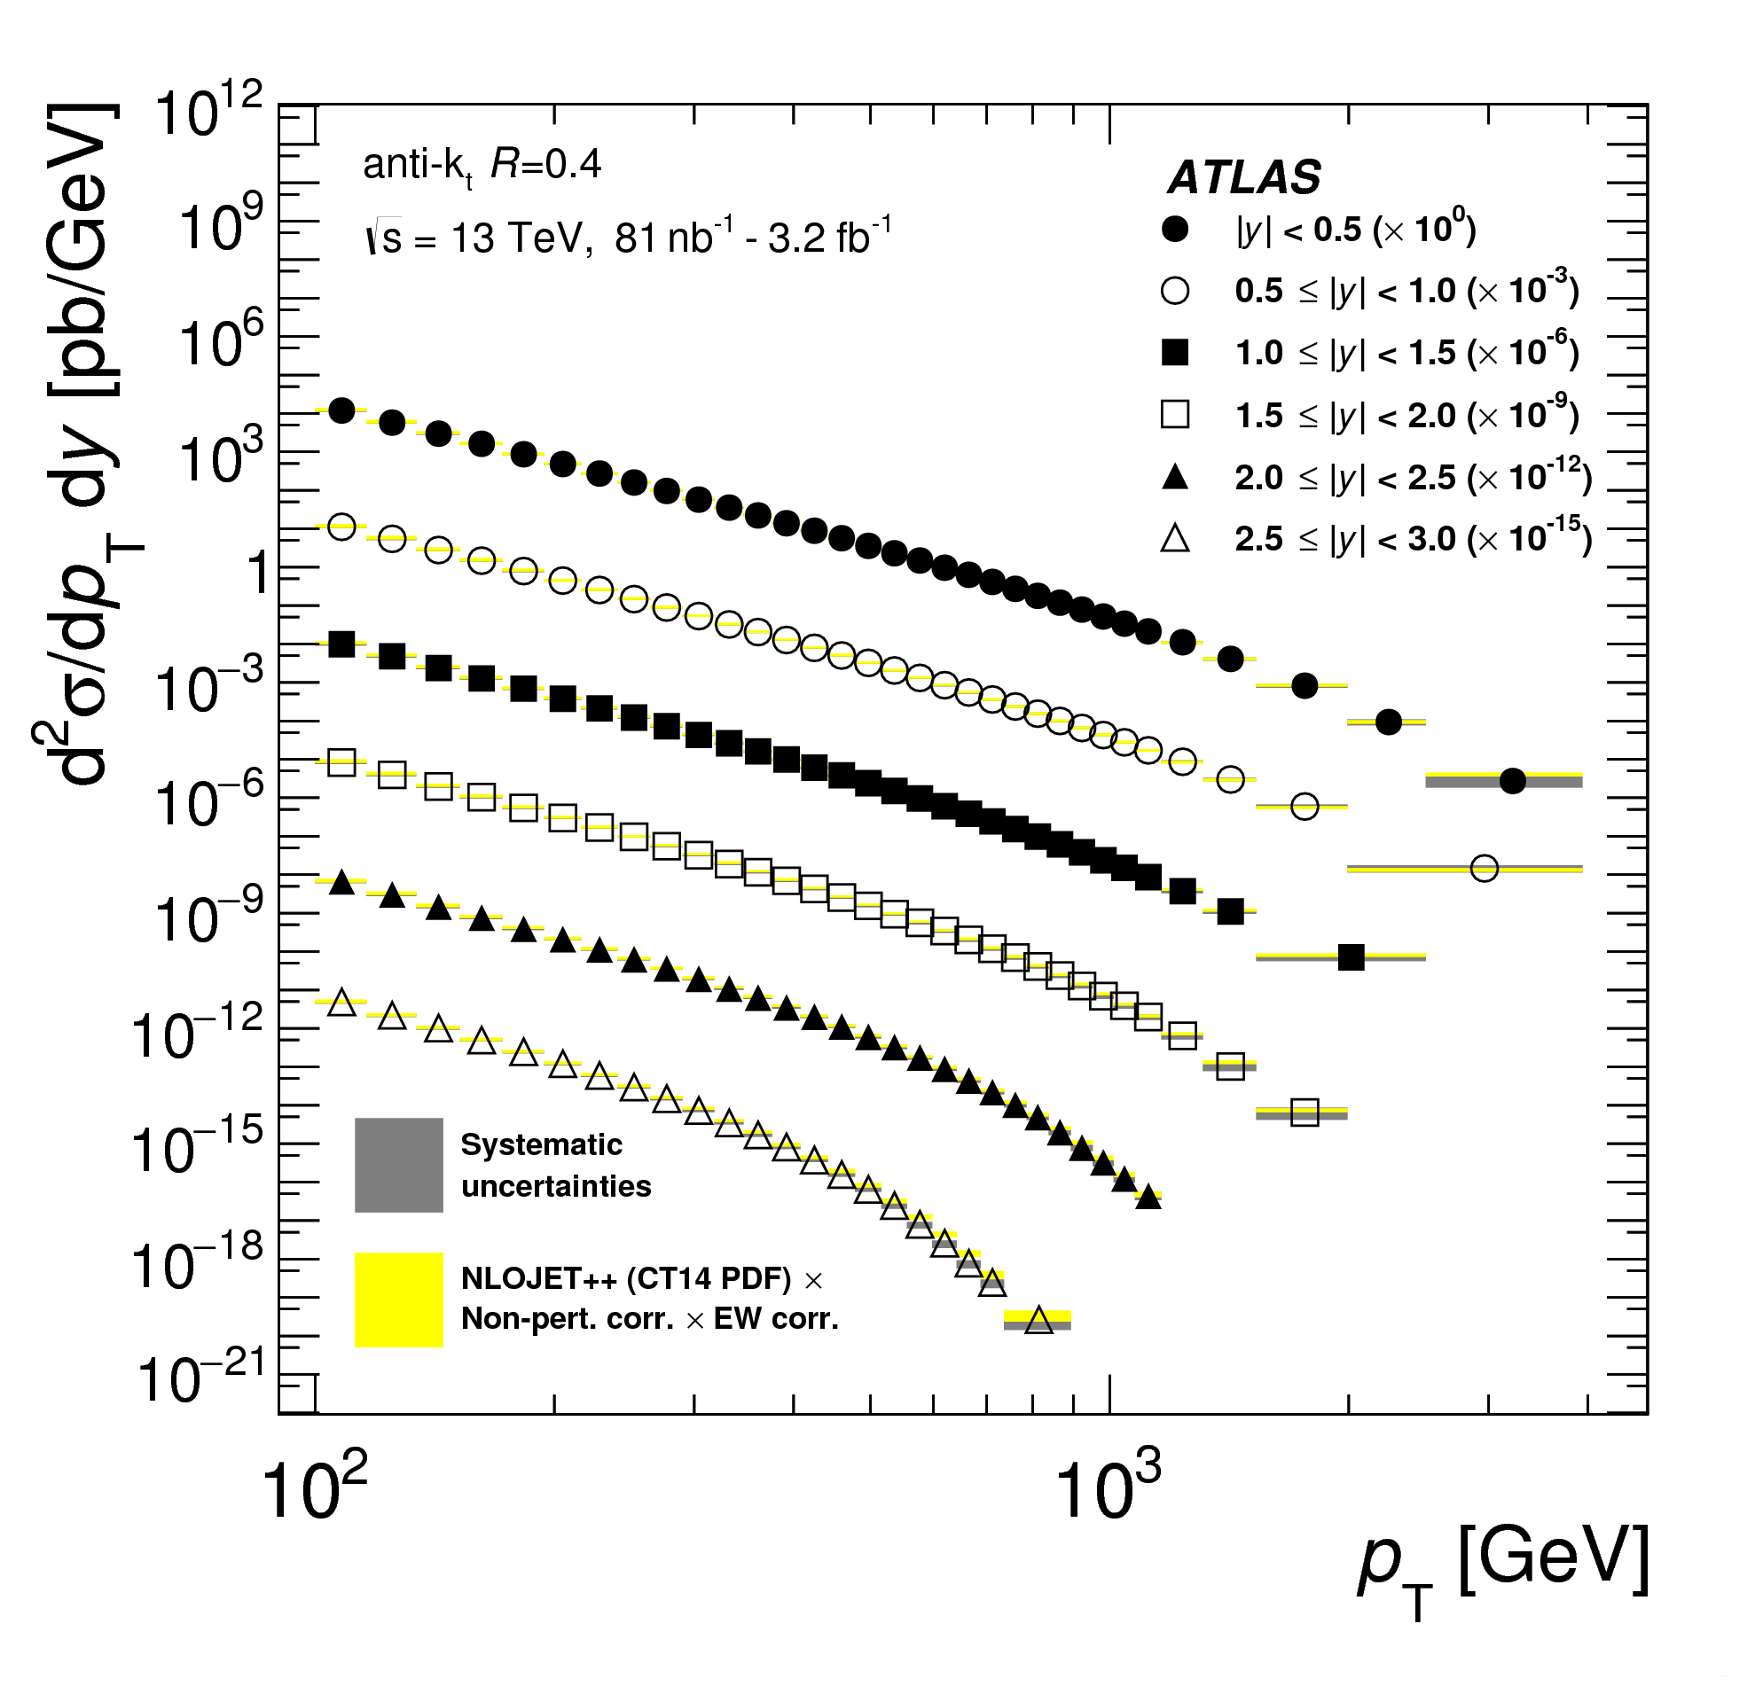

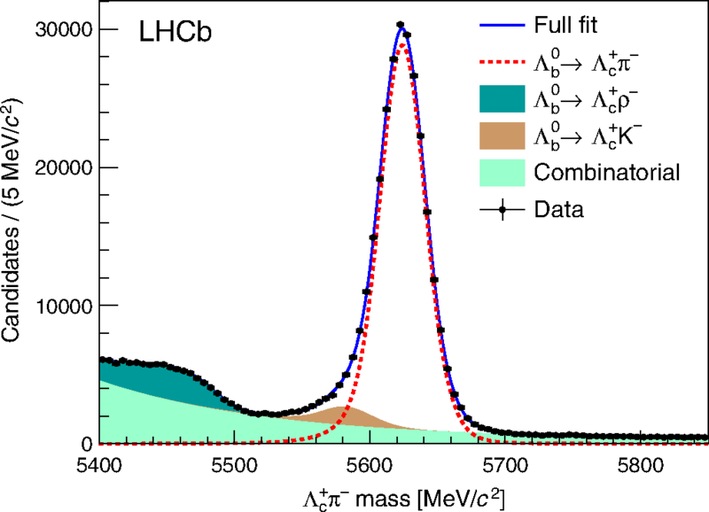
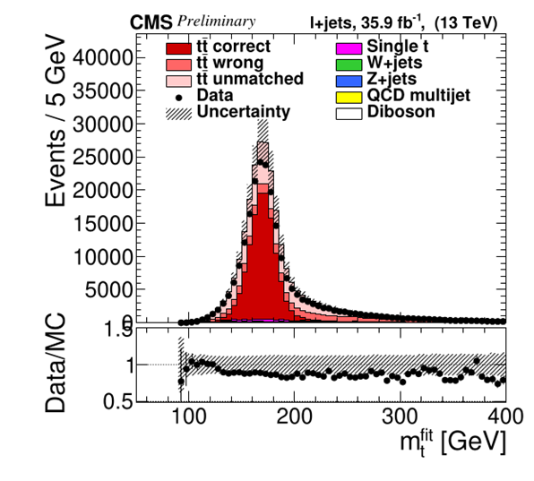
Many discoveries and new measurements
Covering a vast range of topics
Higgs boson discovery in 2012
Higgs boson properties
Over fifty new hadronic states
Rare decays like Z→eeμμ and B_{s}→ μμ
CP violation in the charm sector
Jet quenching in heavy ions
VVHH Higgs four-boson coupling
Publications galore:
  LHC experiments ~4000 publications !

Slide 25
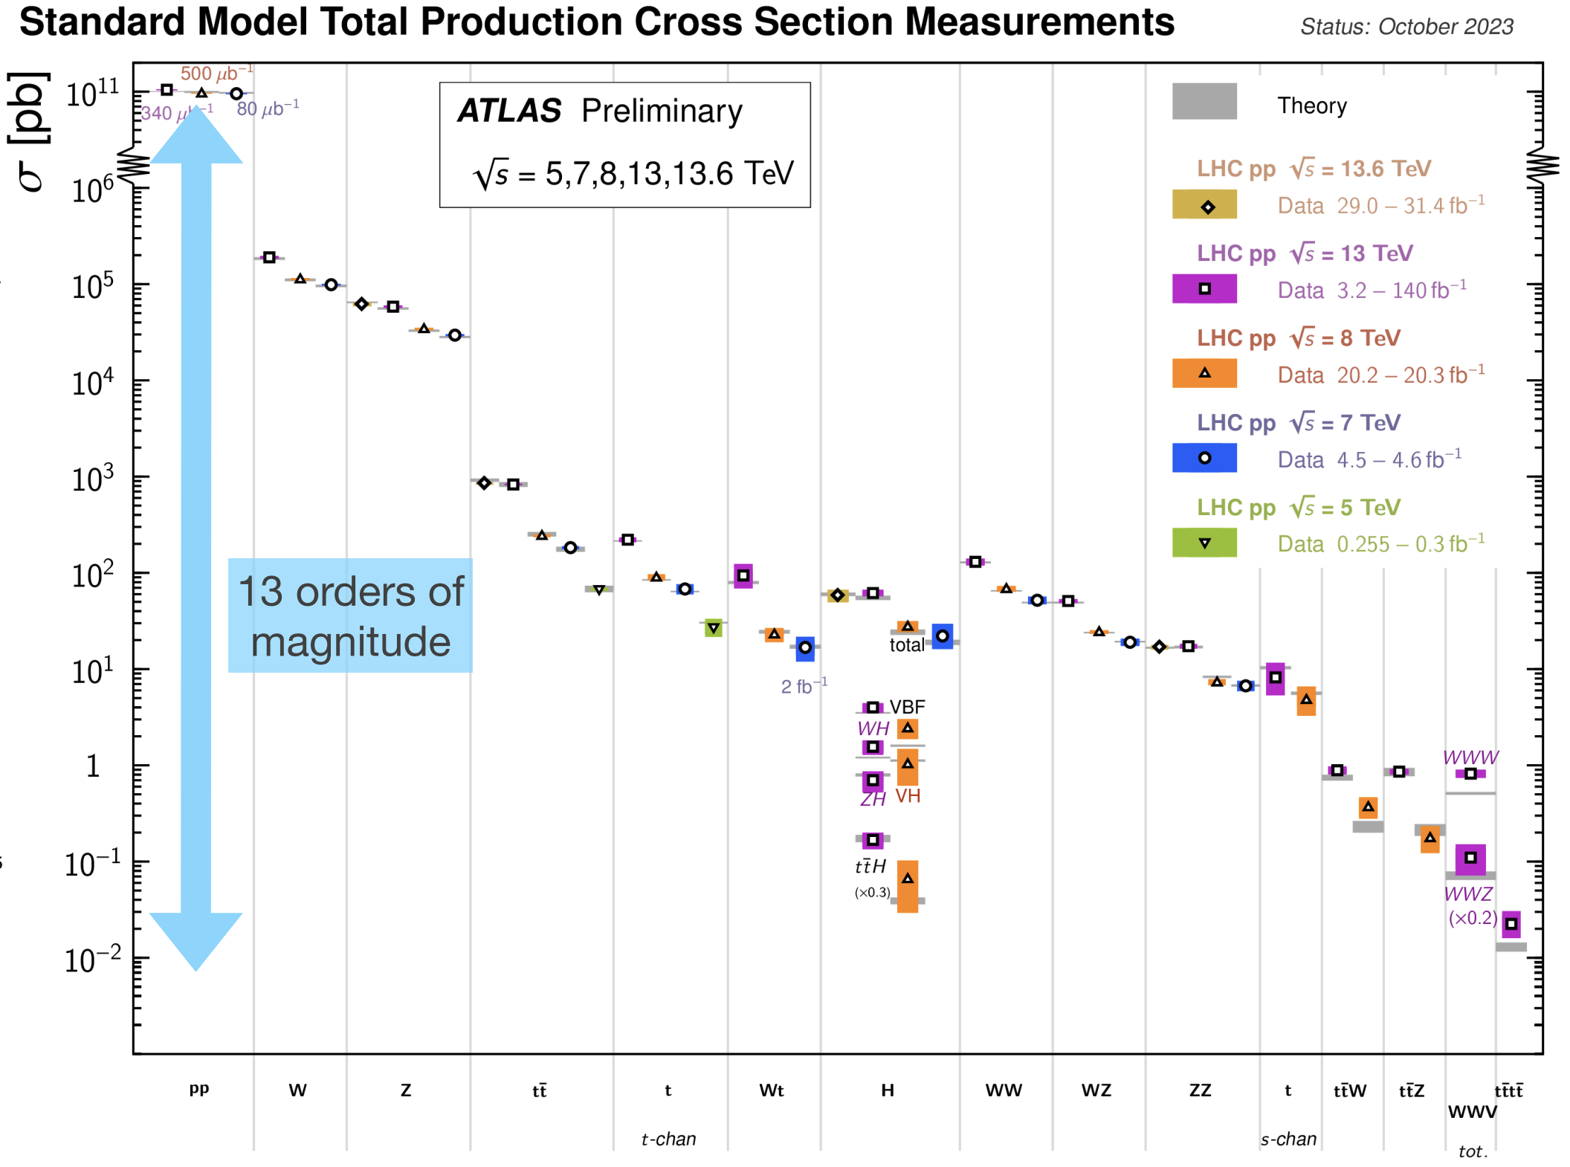
The Standard Model remains in good shape
The precision achieved is an incredible achievement many scientists
Often (usually) surpassing the original design goals
Despite occasional anomalies, the Standard Model of particle physics remains in very good health

Slide 26
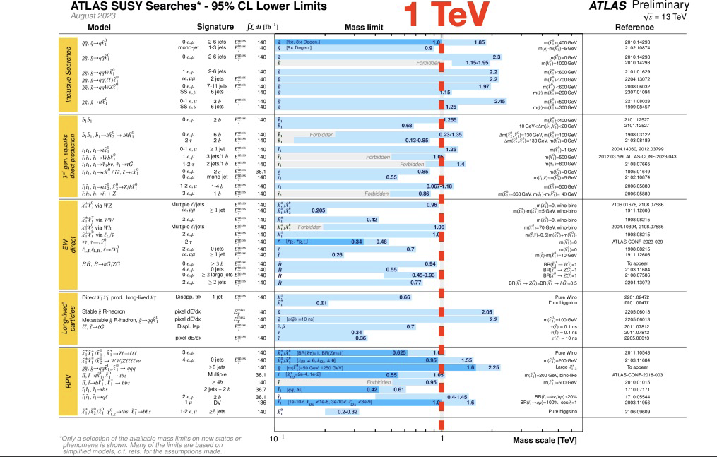
We continue to search far and wide
Precision measurements complemented by searches for a wide range of BSM phenomena
Despite occasional hints, no strong signals for the manifestation of BSM physics (yet)
Probing scales in the range of 1 – 10 TeV
  e.g. SUSY to ~1 TeV
  with a few blind spots

Slide 27
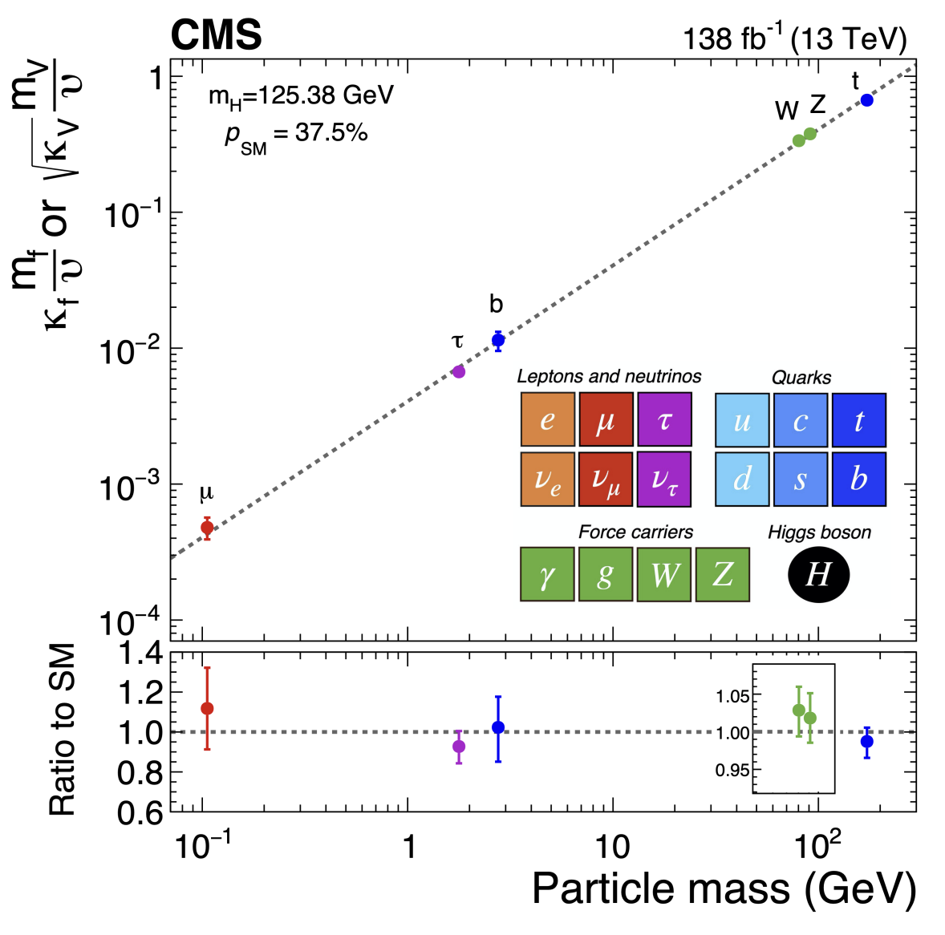
The Higgs Boson as a probe of BSM
Probing couplings over a mass-range of ~3 orders of magnitude
So far, couplings look as expected, but we have just started to scratch the surface
  typically, measurements at the 5% – 10% level
Far from the end of the story…
  for the Higgs mechanism to “do its job” there are strong constraints on the size and nature of possible BSM deviations
  need to be aiming for 1% level precision or better

Slide 28
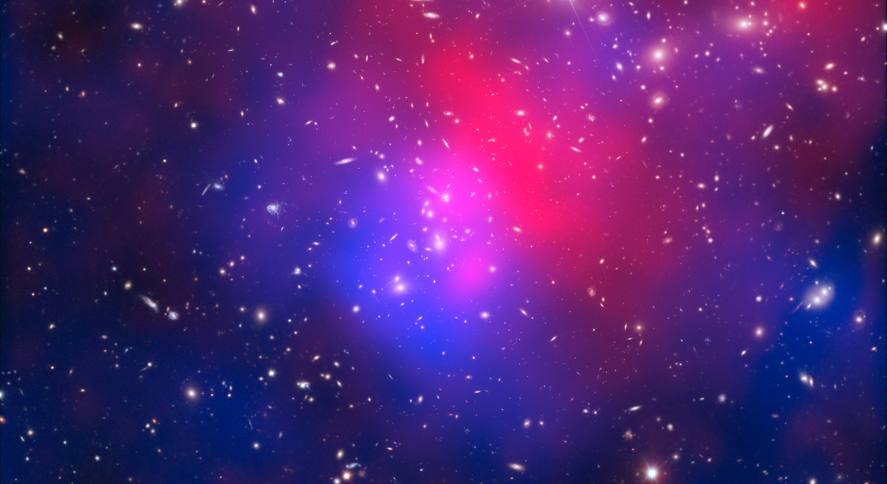
What next?
We know a vast amount about the nature of the universe, but…
…there are many deep mysteries, including
Why is the universe made only of matter, with hardly any antimatter?
What is the unknown 95% of the mass
and energy
of the universe?
Does the Higgs boson interact with dark matter?
Is the Higgs Boson a fundamental particle?
H
H
Unification and why is gravity so weak compared to the other forces?
Why three generations and are there more?
What determines the hierarchy of masses of the particles?
What is the nature and stability of the Higgs potential
H
H

Slide 29
What Next?

Slide 30
The next major discoveries?
Where will the next breakthroughs/discoveries come from?
Obviously, we don’t know – and that’s OK, if we knew they wouldn’t be discoveries
But in the next ~10 years we are looking in the right places
HL-LHC: Higgs and more
Searches for Dark Matter – we know it is out there…
Next generation neutrino experiments
Flavor sector (LHCb, Belle-II, mu2e, …)
Cosmology/astrophysics
….
And we are necessarily planning for the very long term
Higgs factory – e.g. FCC-ee
Pushing the energy frontier for discovery – e.g. FCC-hh and/or a muon collider
….

Slide 31
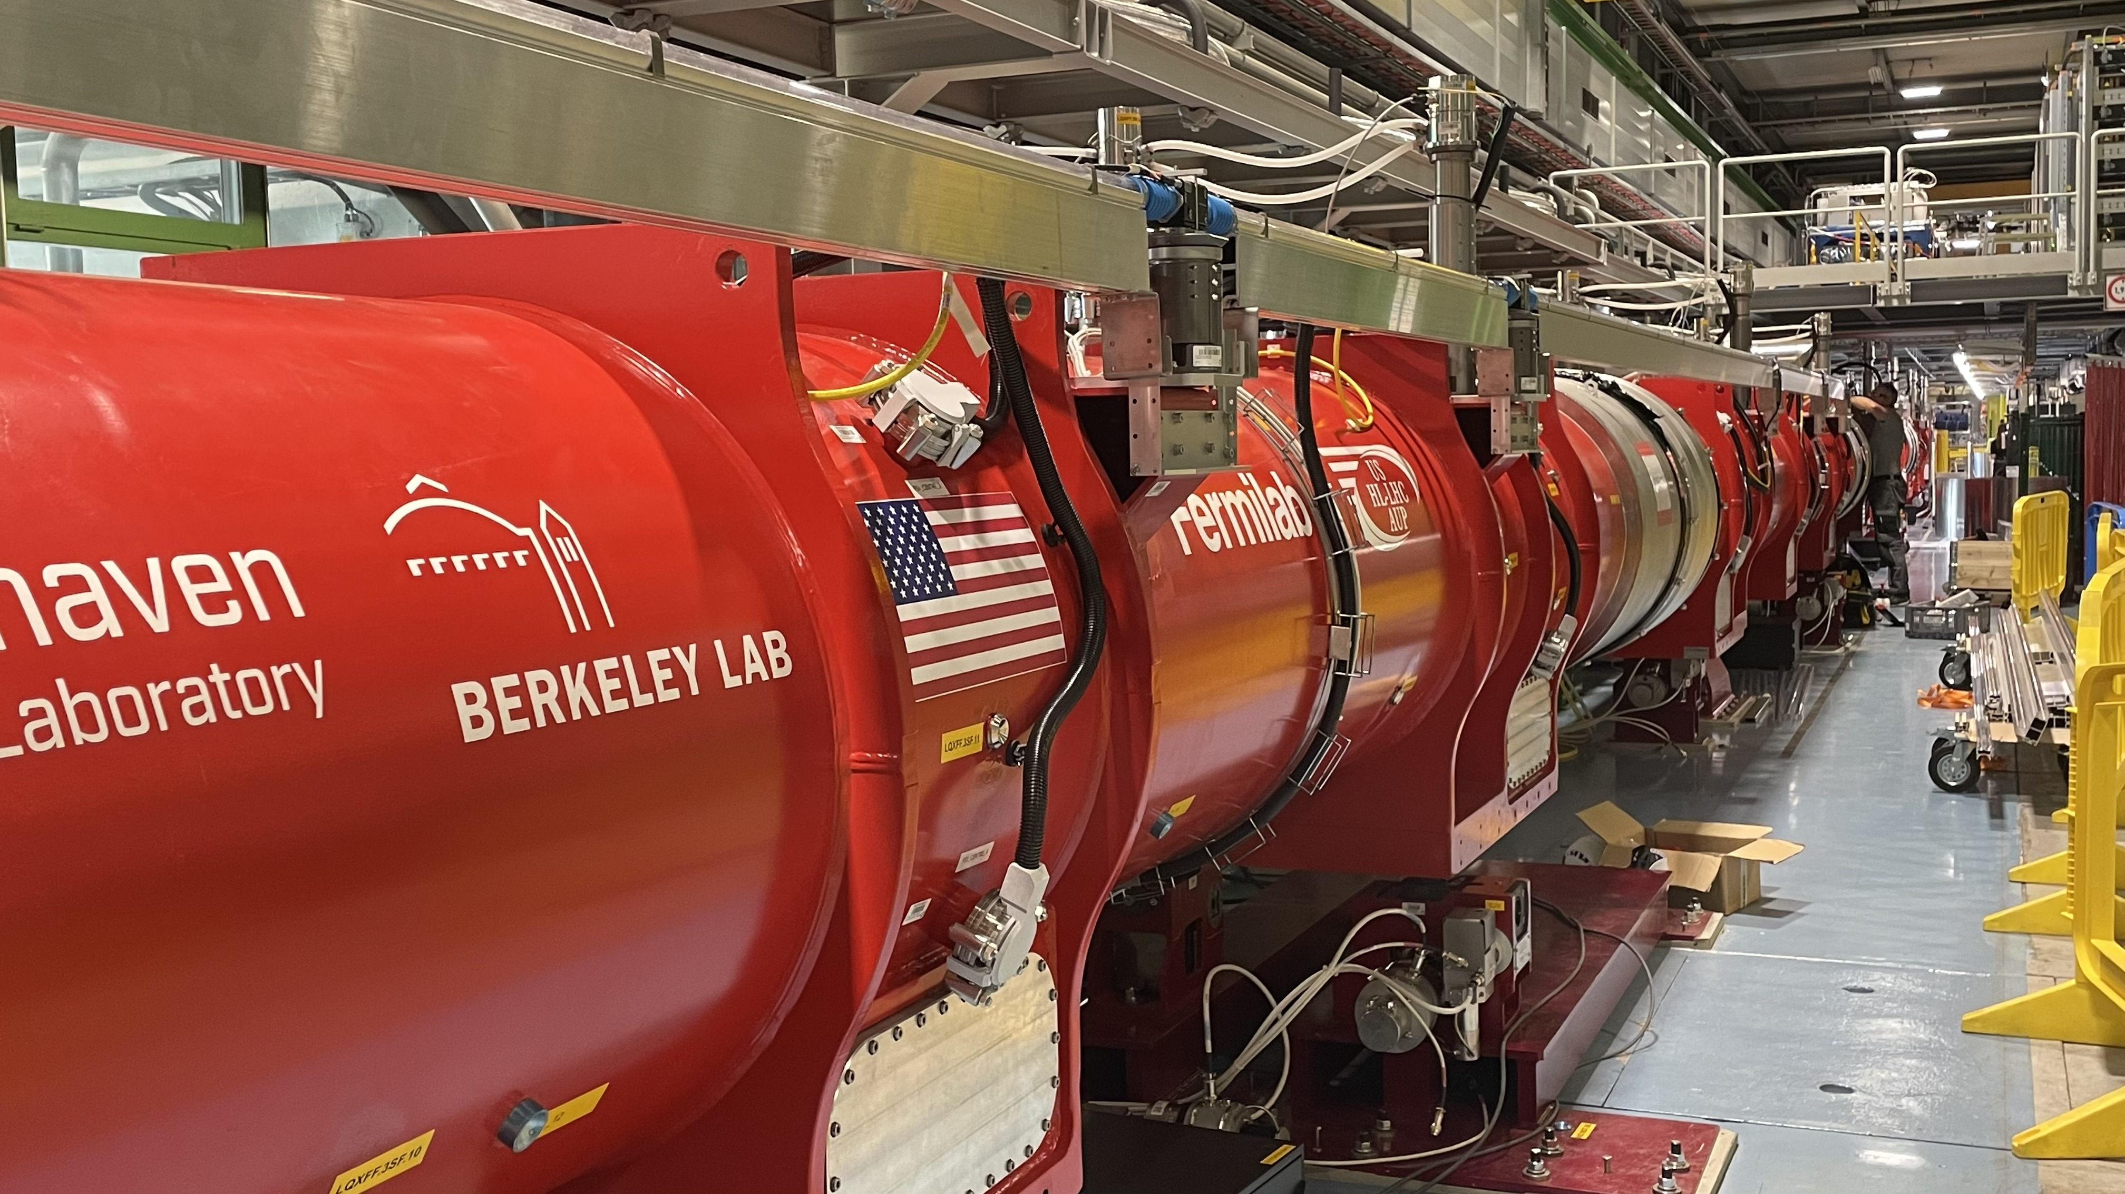
What Next for CERN? HL-LHC
The High-Luminosity LHC
major “upgrade” of the LHC, starting operations ~2030 and running until 2041
based on new cutting-edge technology that didn’t exist when the LHC was built
With 10 times increased “brightness” compared to the LHC
so we are just at the start of the LHC/HL-LHC journey
Meanwhile the detectors and triggers become ever more capable
wider range of processes targeted more precisely
And never forget the people
Brilliant young researchers, aided by AI tools, will give ever greater power
The HL-LHC is an incredible scientific opportunity
- a lot more data, even better detectors, new techniques
- real discovery potential!

Slide 32
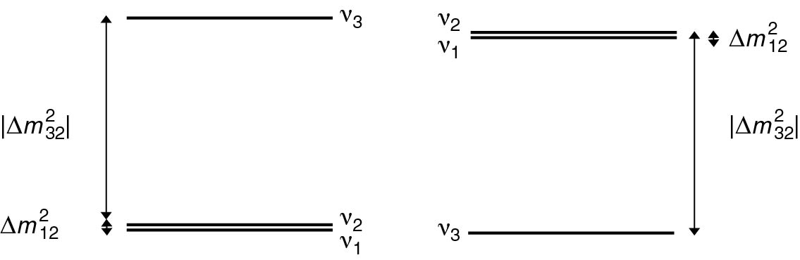
2) Neutrinos
Three big questions
Neutrino masses (mass ordering and absolute scale)
CP violation in the neutrino sector?
Are neutrinos Majorana particles?
?
NO
IO

Slide 33
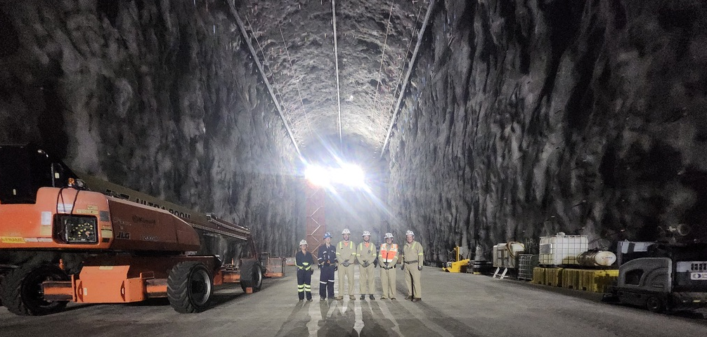
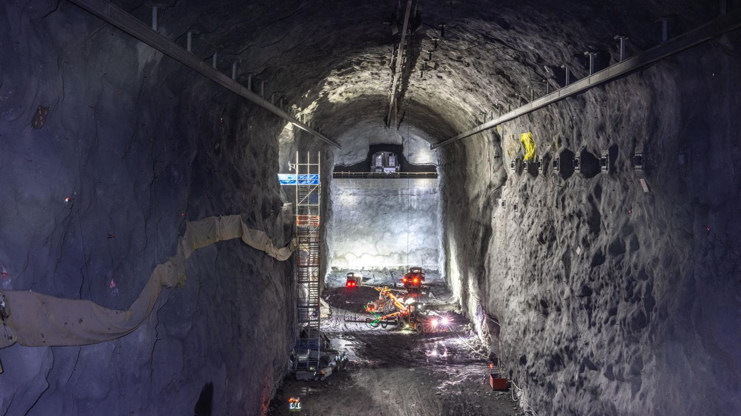
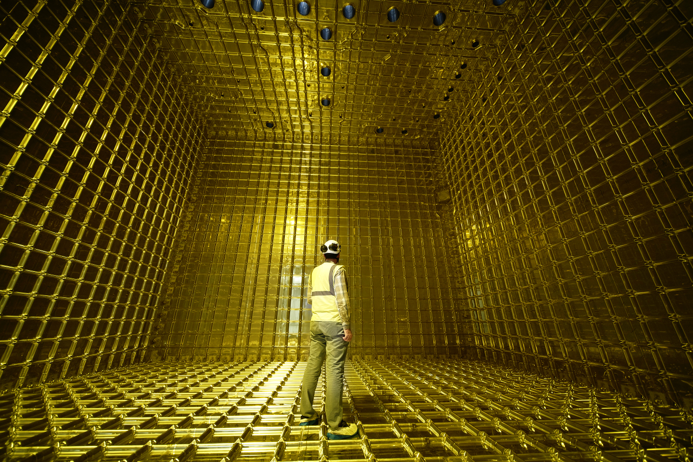
2) Neutrinos
Can be confident that we will have some answers in the next 10 years
We are building the right experiments
  e.g. DUNE in the US and Hyper-Kamiokande in Japan
By 2035, we will know the mass ordering and a lot more about CP violation
  … and there could be surprises

Slide 34
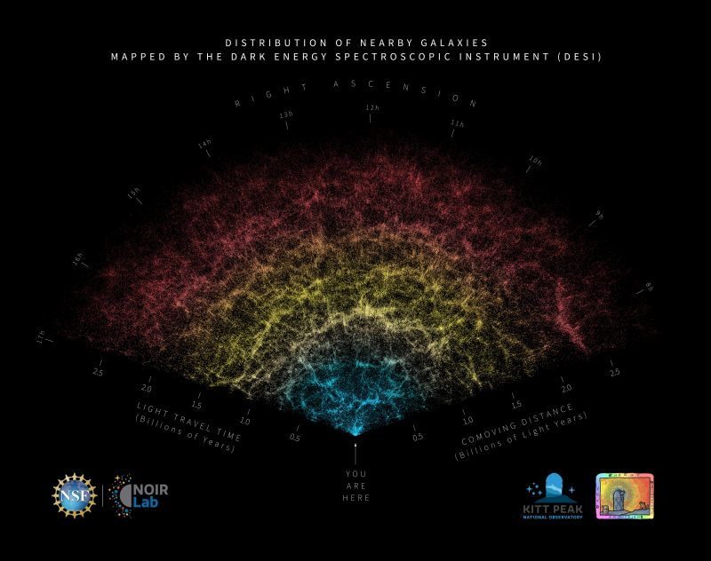
3) Cosmology: DESI, EUCLID, …
Current and next generation ground-based and space-based galaxy surveys looking at large-scale structure will increase knowledge of (for example)
Dark energy
…and particle physics
For example: Dark Energy Spectroscopic Instrument (DESI) Year 1 results
600,000 “local” galaxies
Indirect measurement of neutrino masses
Compared to what we know from oscillations
Taken at face value…
  But in the future, could see tensions

Slide 35

FCC and the European Strategy

Slide 36
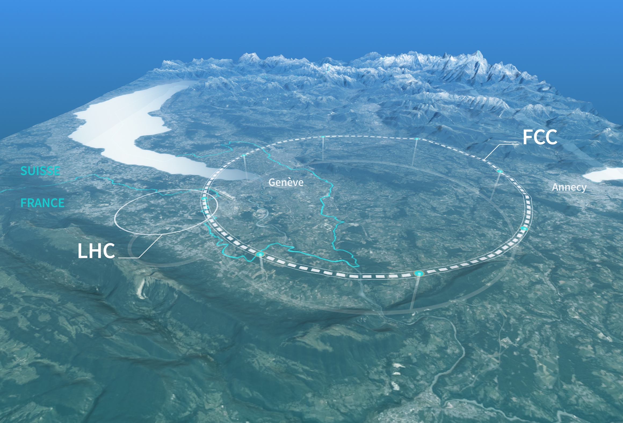
CERN’s long-term vision
The Higgs Boson is a genuinely new and unique type of matter
It is also very strange – and may well provide a new window for discovery
A strong scientific case for a new “Higgs Factory” machine to study it in fine detail
The “Future Circular Collider” (FCC)
A new 91km ring
First stage collides electrons & positrons: FCC-ee
An ambitious and exciting scientific programme
  Higgs and much more (Z, flavour, …)
Targeting start of operations in ~2045-2048
Total cost over ~15 years of about 15 BCHF…
It is incredibly exciting and is a suitably ambitious next project for CERN
Not yet approved, but we are hoping for a positive decision in ~2028

Slide 37
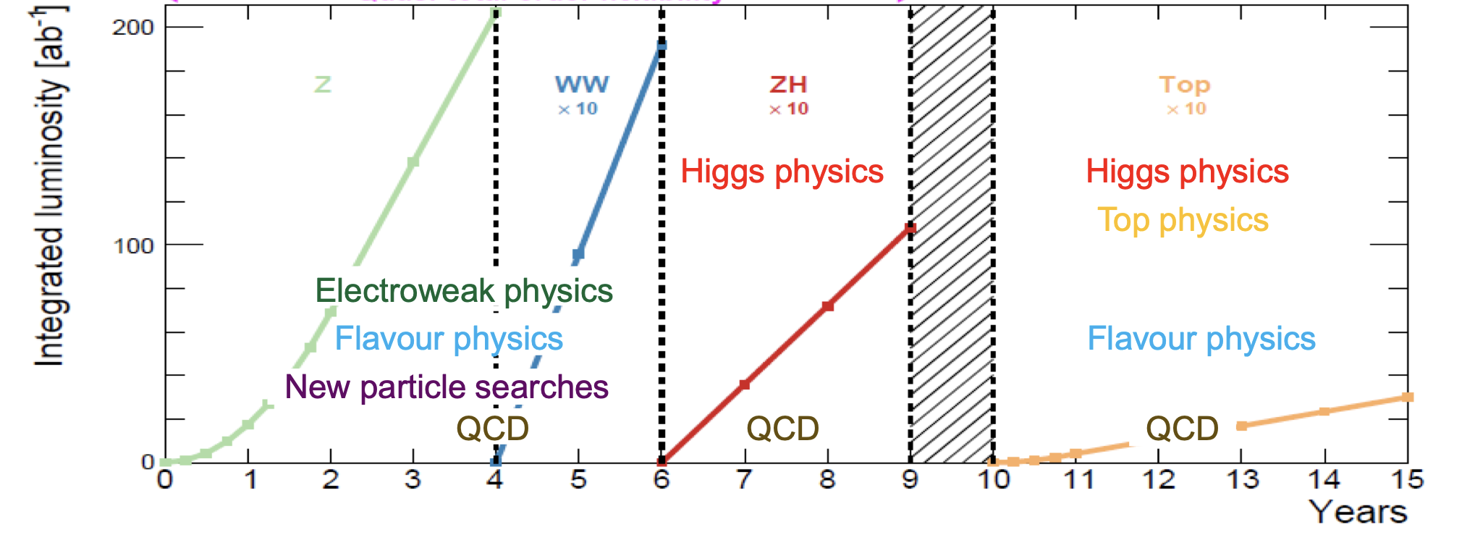
FCC-ee Physics
Flexible exploration of the Higgs and the wider electro-weak sector
Flexibility to run at Z, WW and ZH and subsequently top-pair production
Huge event samples for incredible precision – e.g. 10¹² Z bosons = 1,000,000 x LEP

Slide 38
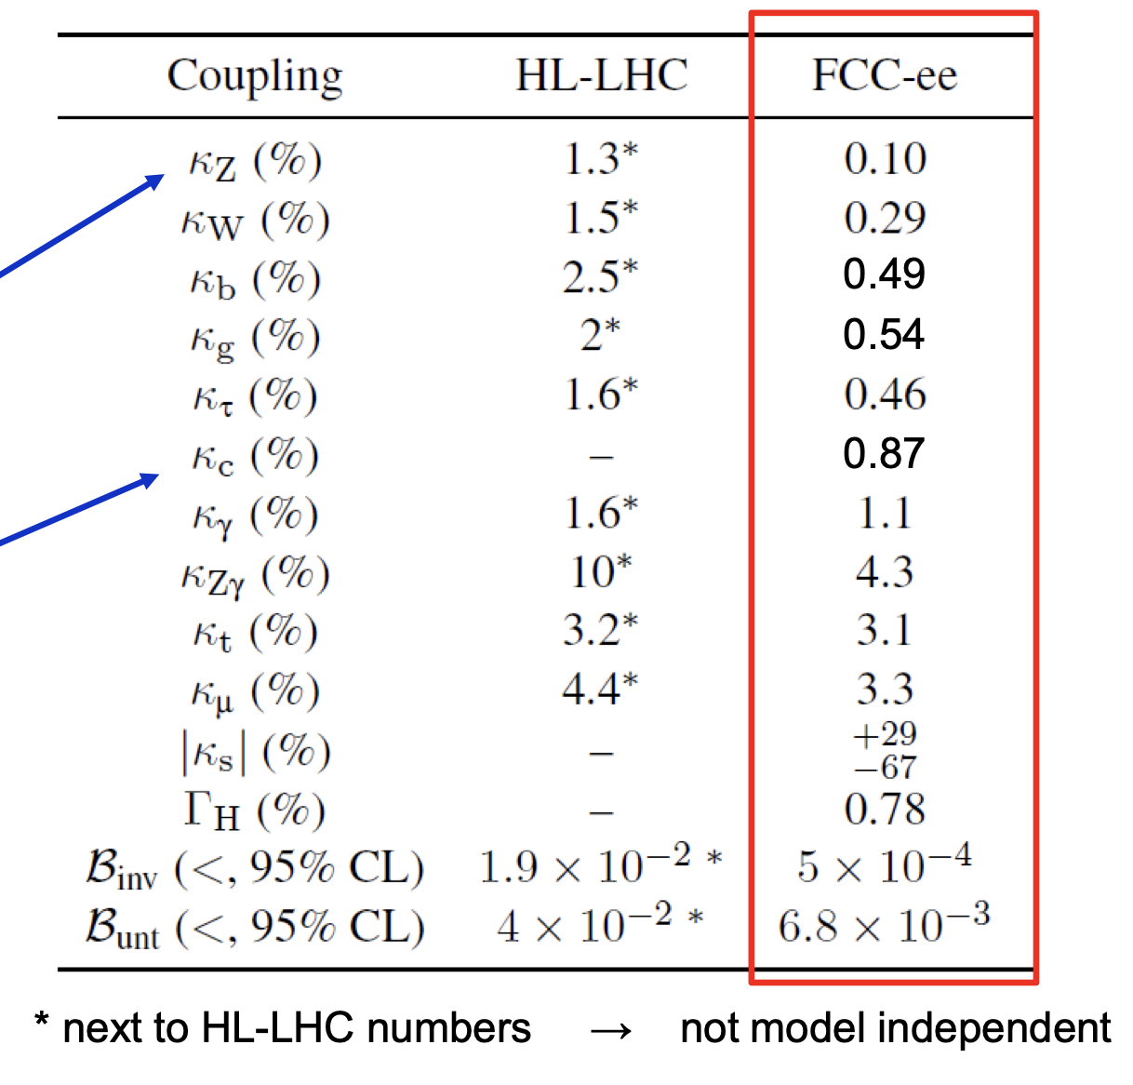
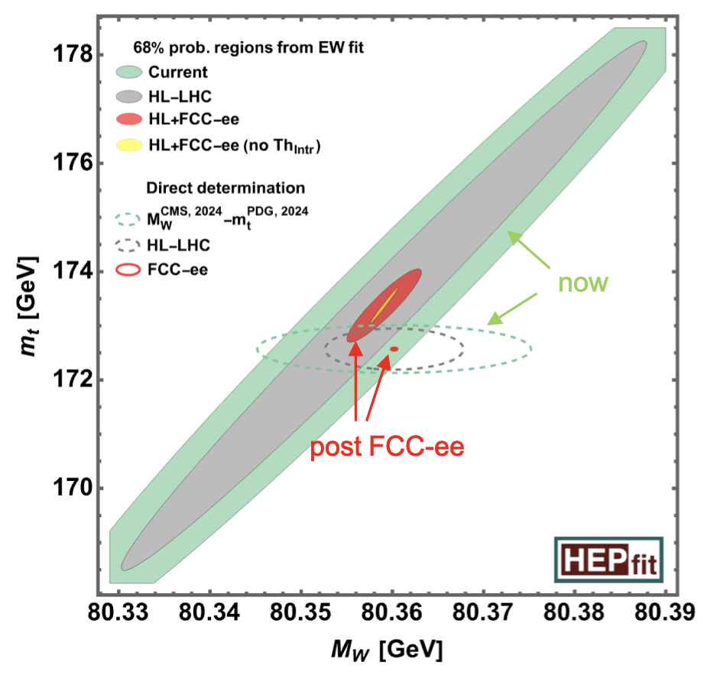
FCC-ee Physics
A large step-change in precision!
e.g. Model-independent Higgs couplings at the sub-1% level
e.g. Three-orders of magnitude improvement w.r.t. LEP – this is a paradigm change

Slide 39
CERN’s long-term vision
FCC and the “FCC Feasibility Study”:
Provides an exciting scientific vision for CERN’s future…
First stage: a luminosity-frontier electron-positron collider (FCC-ee)
Possible second stage: an energy-frontier hadron collider (FCC-hh)
FCC-ee: a precision instrument to study the Z, W, Higgs and top particles, direct and indirect sensitivity to new physics
  A precision Higgs factory and much more
FCC-hh: at some stage (I believe) we are going to want/need a very high energy hadron collider to explore new mass scales…
  Much of the FCC-ee infrastructure could be reused (2060+) to provide p-p collisions at a centre-of-mass energy of ~100 TeV
  Is FCC the right option for the next collider at CERN?
    One of the main topics for the ESPPU
    – in my view YES

Slide 40
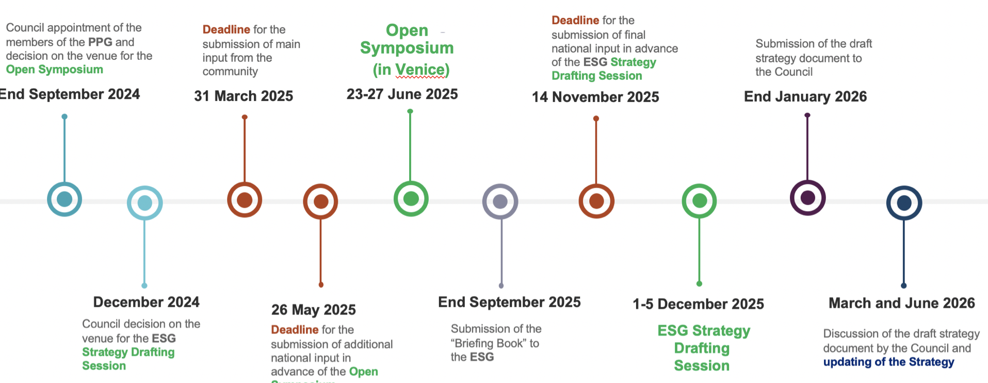
ESPP Update – European Strategy
We are part way through the ~18-month process:
Scientific input
“Open Meeting”
Draft Strategy
Approval
National input

Slide 41
Update on the ESPP Update
So where are we today ?
The Venice Open Symposium meeting in June was an important step
  Excellent presentations and wide-ranging discussion
However, it was just a step, so it is currently premature to pre-judge the outcome of the ESPPU
Nevertheless, at that stage there were already a few clear themes:
  Scientifically, the Future Circular Collider (FCC) is widely viewed as the preferred option for the next collider at CERN. The question is mostly cost / affordability
    the case for TeraZ (electroweak + flavour), WW, Higgs & top is seen as compelling
    also provides a possible path (tunnel) to a 100 TeV-scale hadron-hadron collider
  If FCC-ee is not feasible either technically or financially (or from an environmental perspective), the path forward is less clear – no strong consensus yet

Slide 42
Final Words

Slide 43
Final Words
The future of particle physics is incredibly exciting – we should not forget this
We are going to address some profound fundamental questions
  the next breakthrough could come from many places, so it is essential that we keep asking the right questions and pursuing multiple approaches
HL-LHC will be amazing
HL-LHC will be a giant leap forward in capability
  ~10x the current LHC integrated luminosity, upgraded detectors, AI, …
  Precision measurements (Higgs and more)
  Higgs self-coupling + genuine opportunity for BSM discovery
Planning for next major collider facility is moving at pace
The ESPPU is well underway
I believe the FCC is a truly outstanding scientific opportunity
  we need make the strongest possible case (science + …) – it will be well worth it!

Slide 44
Thank You!

