Slide 1
OB update
With input from Marcello Borri, Ken Davies, James Glover, Adam Huddart

Slide 2
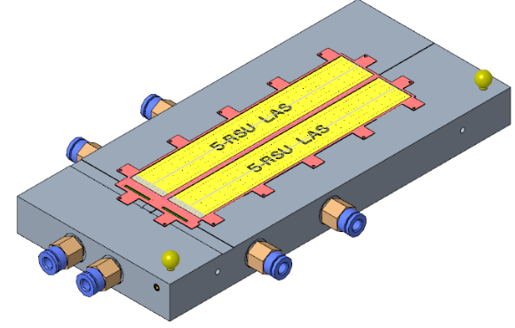
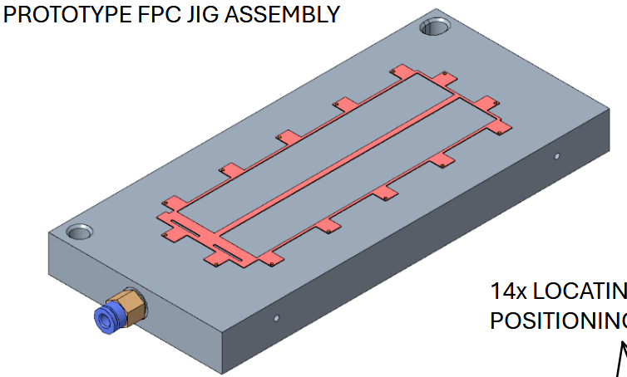
Modules
Current work on module tooling is for flat modules
  For a curved stave module would need to be built curved and jigs would need to be modified accordingly
  Prototype module assembly jig has been designed
  Currently scraping together funds for procuring parts & bondable dummy sensors and AncASICs
Prototype LAS jig
Prototype FPC jig

Slide 3
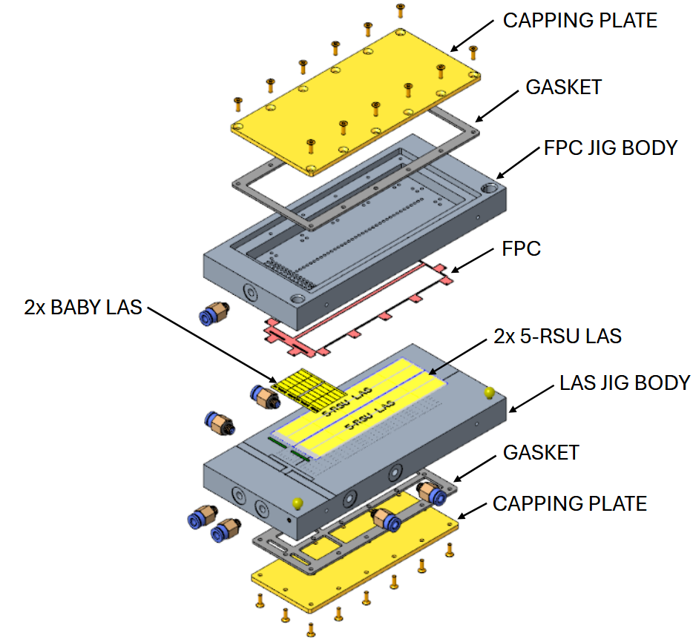
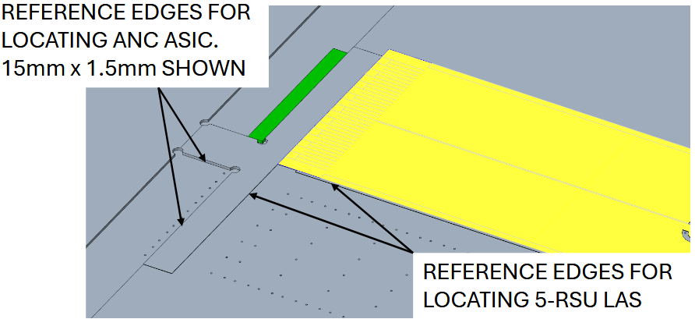
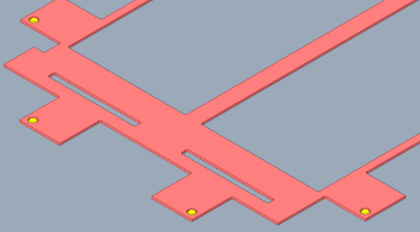
Module assembly jig details
14x locating pins for
module FPC
FPC sucked down by vacuum

Slide 4
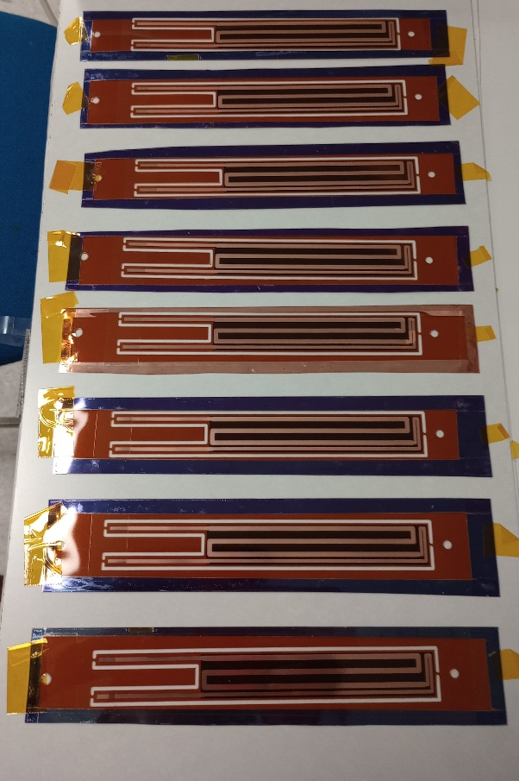
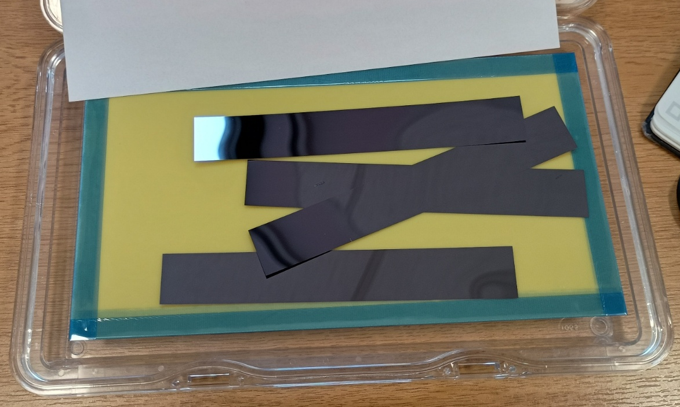
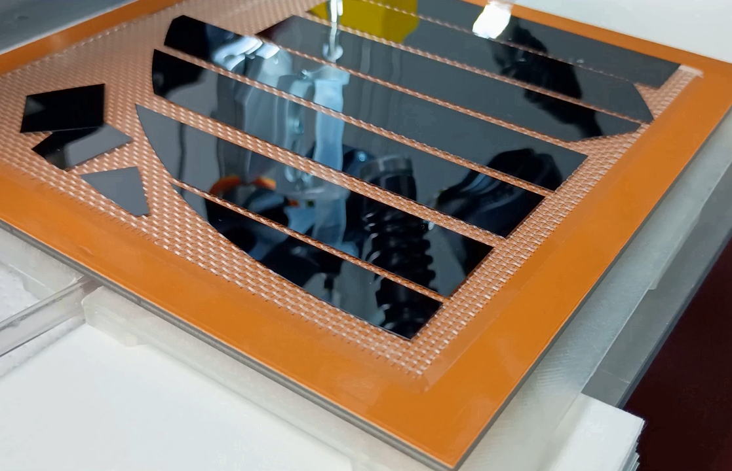
Dummy sensors
Pure silicon dummy sensors
  Removed from backing foil at CERN, then shipped to UK
    Use membrane boxes and gelpaks
    No breakages
      Modules have moved in membrane boxes
      Removal from gelpaks in vacuum jig, using suction cups worked (more than one suction cup is better)
Encapsulated silicon dummies have arrived in UK
Encapsulated dummies

Slide 5
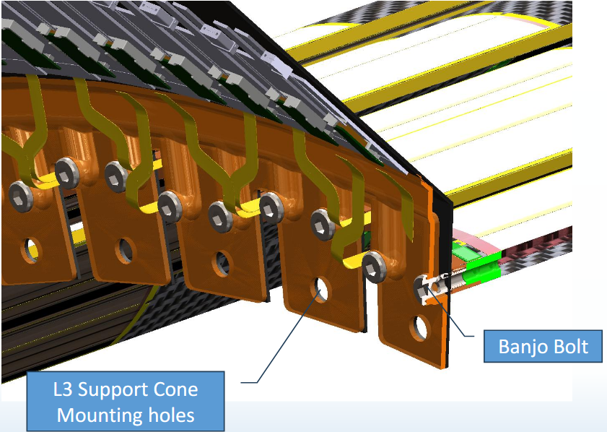
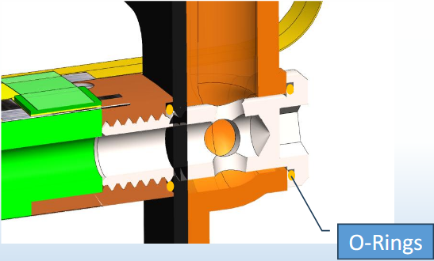
Stave & FIB support
Design stave support with minimal z-extension
Investigating banjo bolts
  Hollow bolts for air flow
  Still investigating how to supply counter-flow

Slide 6
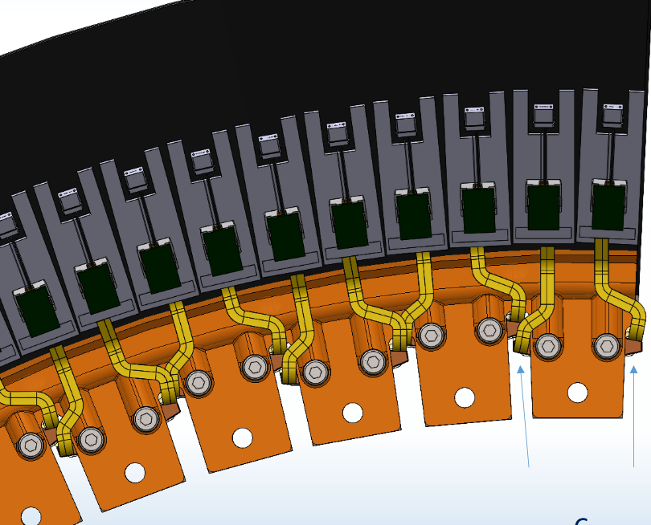
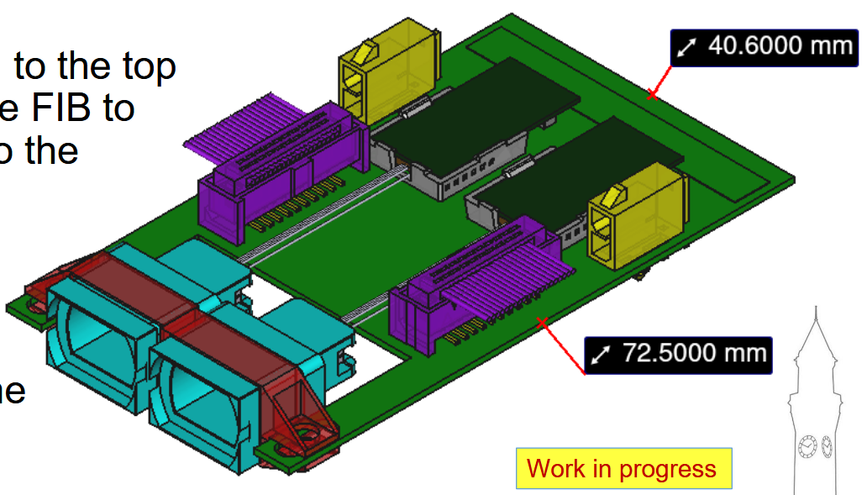
FIB placement
FIB design ongoing, but currently single FIBs too wide
  Mostly driven by MTP connectors
Investigating double-FIB
Previous iteration of FIB: too small

Slide 7
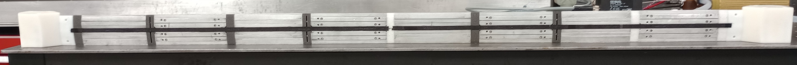
Stave prototyping
We are now working on completing a full length L4 stave
  Materials (CF prepreg, K9 foam) are scraps/rejects/expired from ATLAS
    In this stave some substitute foam pieces (actually will allow us to look at effects
3D-printed end pieces with optimised air flow
K9 cross-ribs
Non-conductive cross-ribs

Slide 8
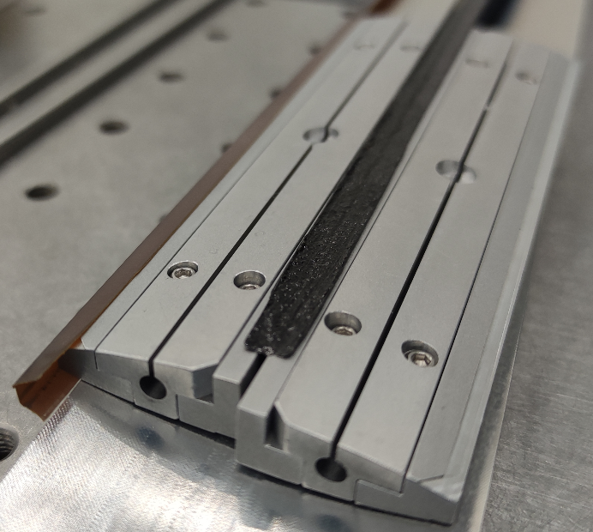
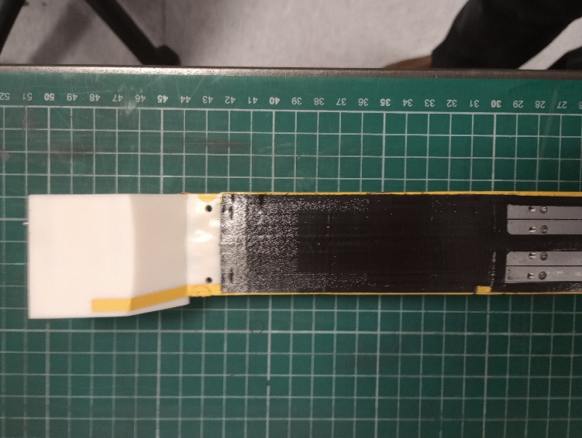
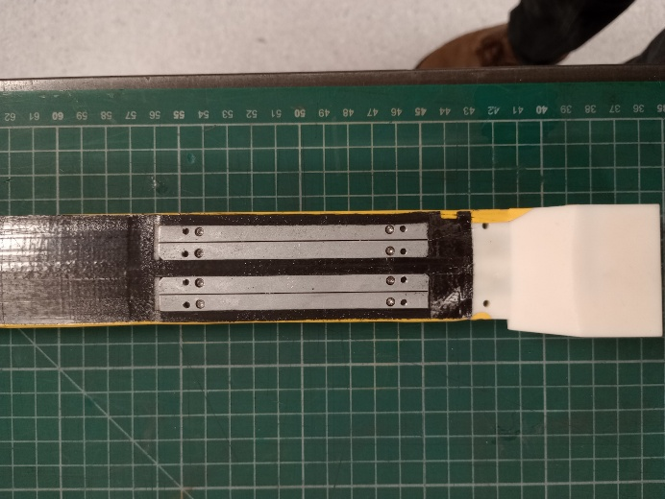
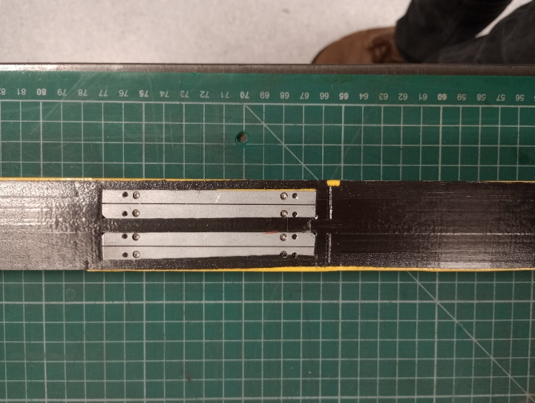
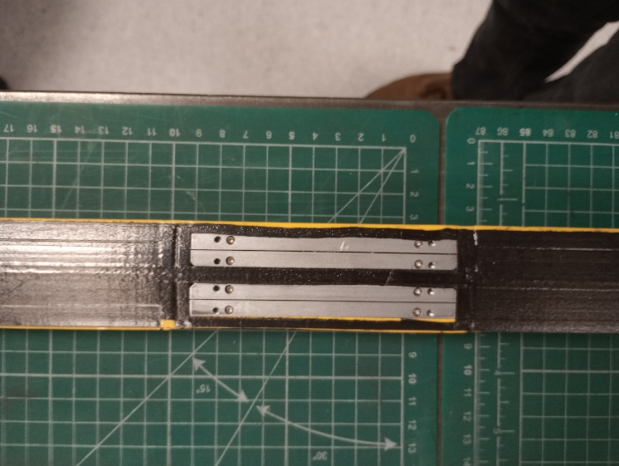
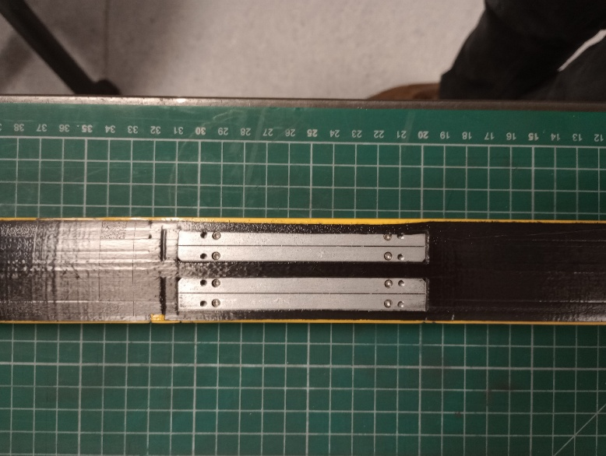

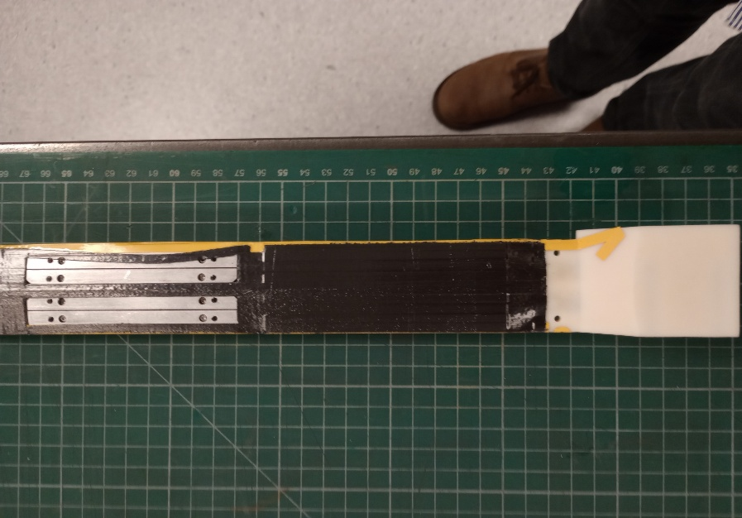
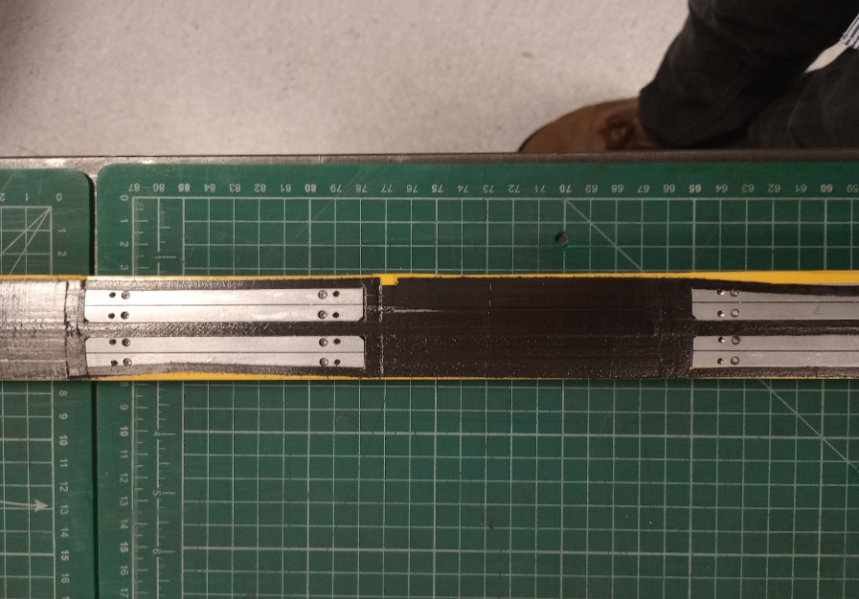
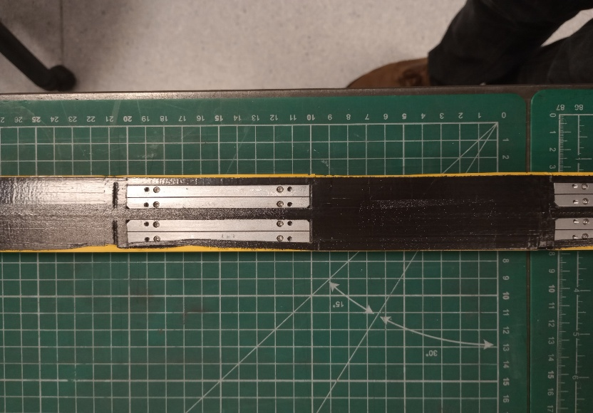
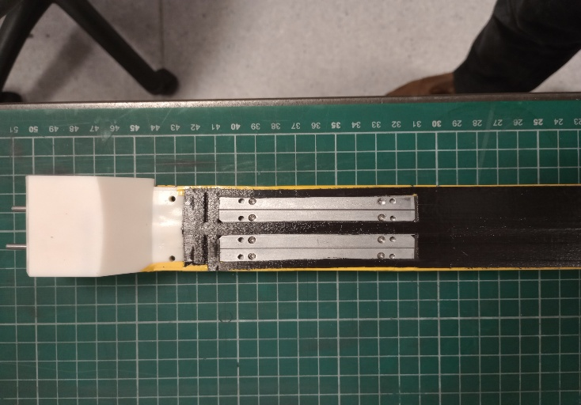
Stave prototyping II
Several issues during cure:
  Material not tacky: thin parts at the edge of cut-outs have moved
    Could be caused by humidity – will try to keep material drier in the future, but the material is expired…
    Alternative is that we keep the thin parts in place using flashbreaker tape
  Inner and outer mould parts stuck in stave
    Baked into surface and also glue seeping between the mould parts – cannot be removed without damaging stave…
    We have used mould release agent
    Need to find another solution (e.g. use flashbreaker tape, alternative material like PTFE…)

Slide 9
Further material

Slide 10
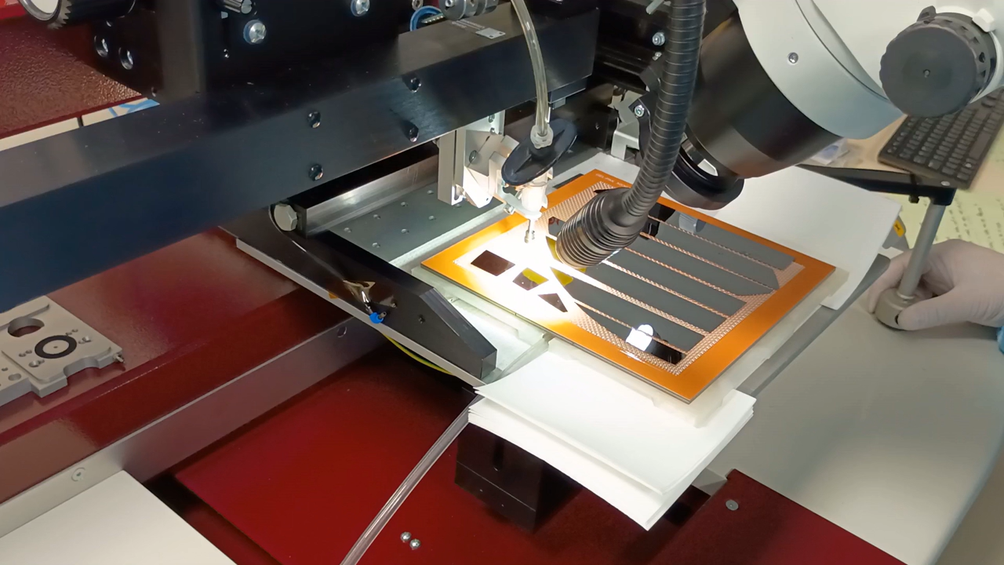
GelPak removal

Slide 11
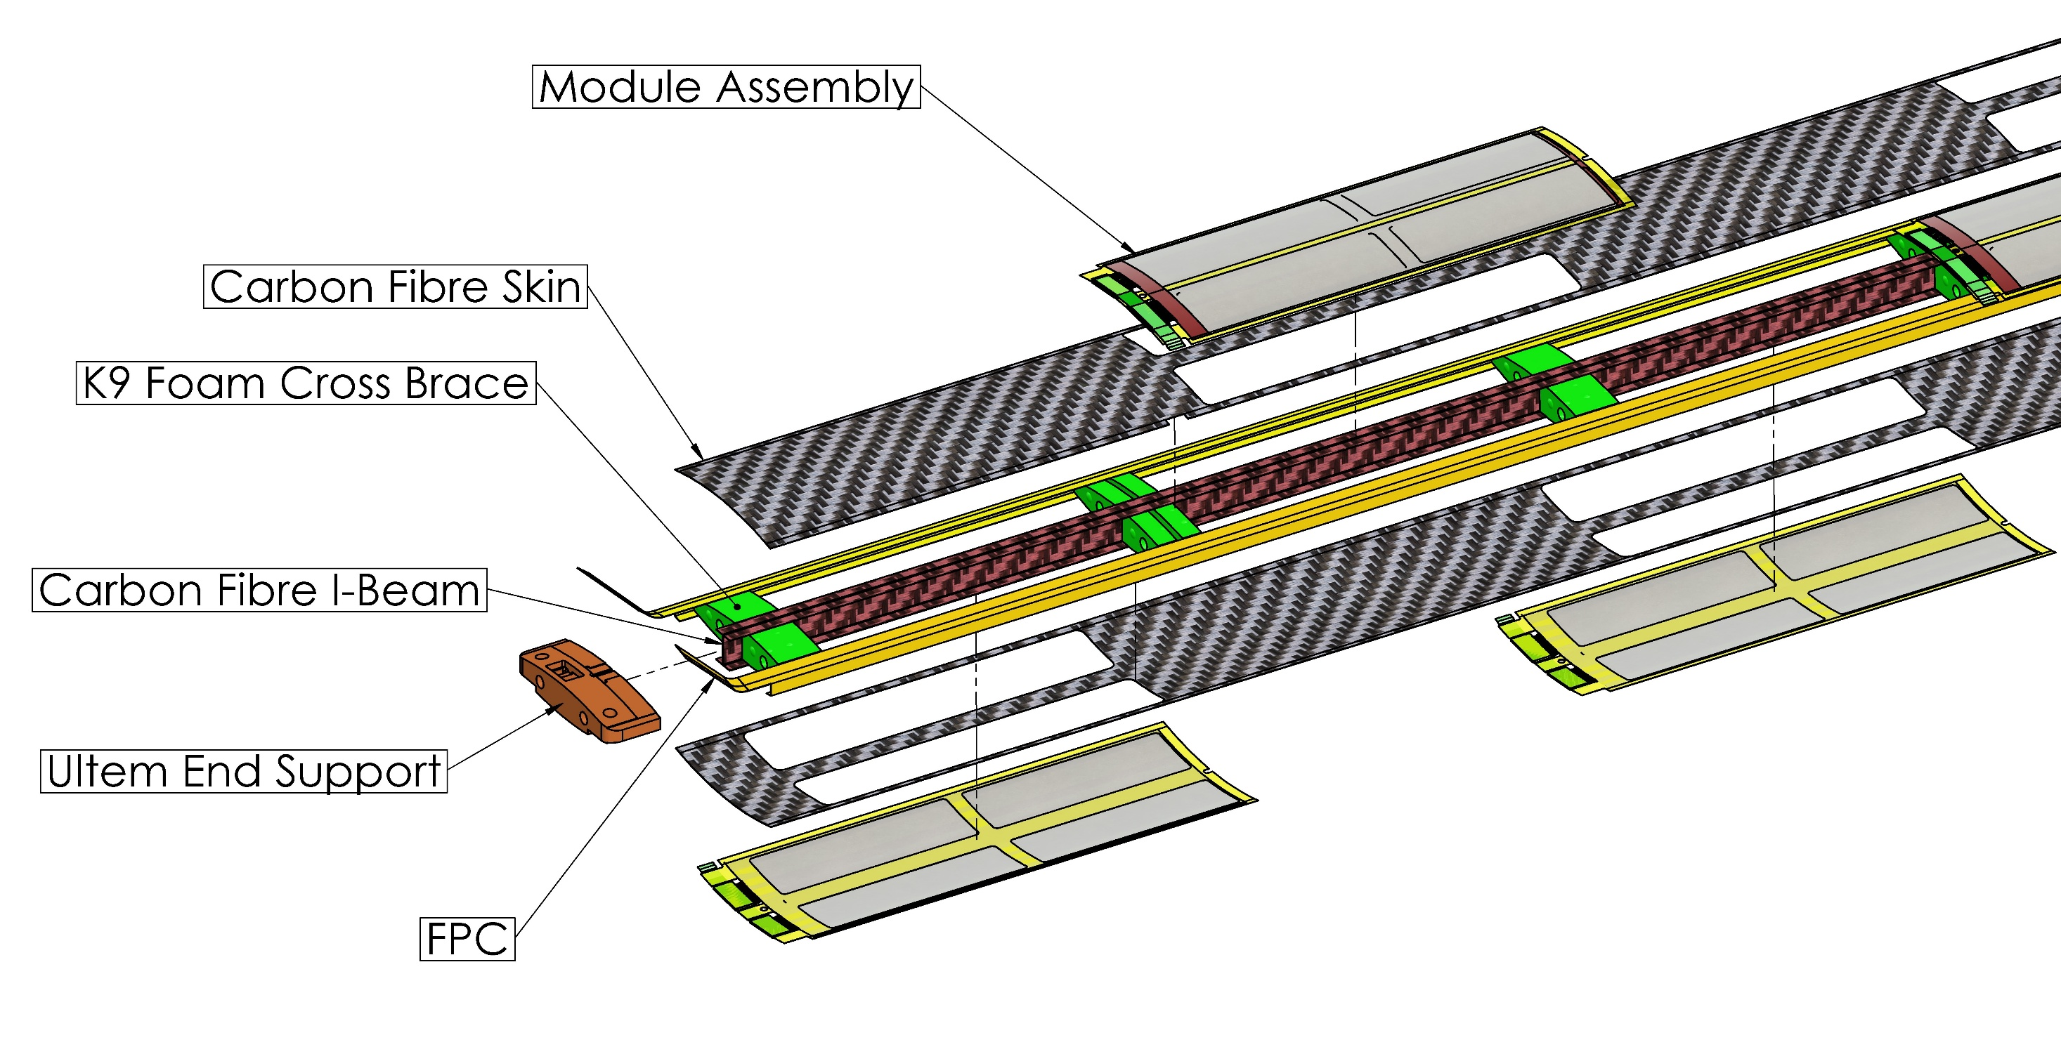
Stave design

