Slide 1
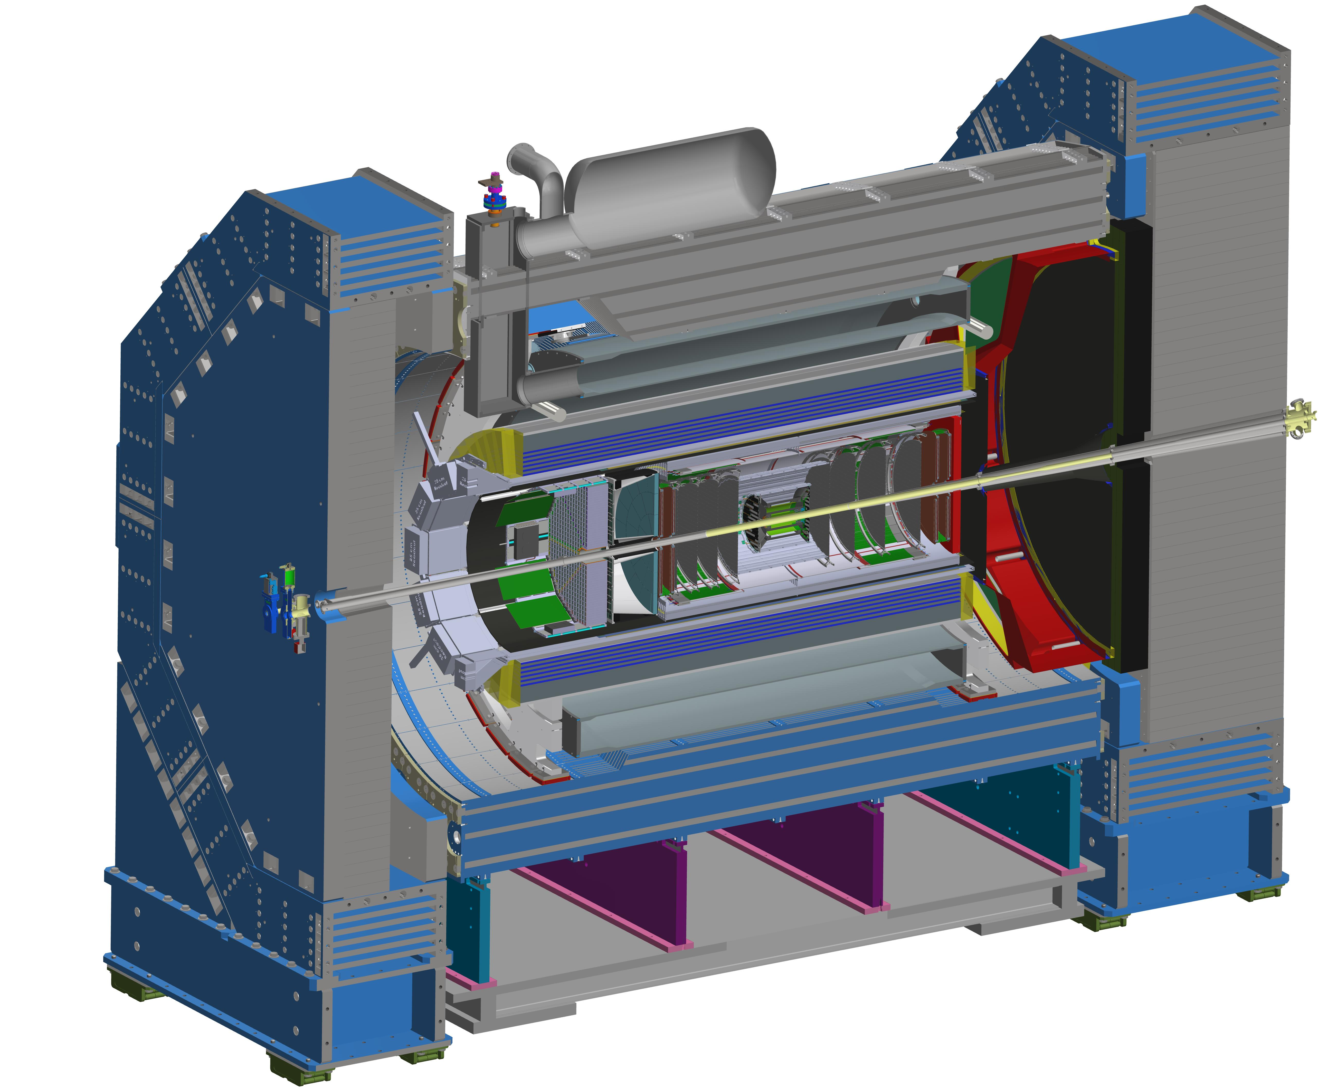

Status of the
Collaboration
John Lajoie
Silvia Dalla Torre
January 20, 2026

Slide 2

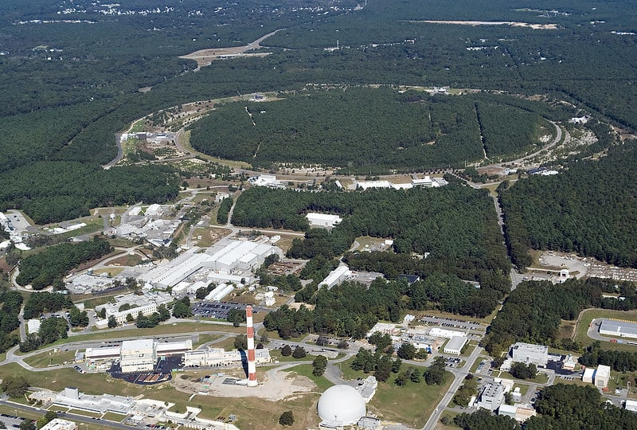

Welcome to
Future home of the Electron-Ion Collider!
…and the Jan 2026 ePIC collaboration meeting!
143+ in-person
200+ online
A huge THANK YOU to the local organizers for pulling everything together on short notice!

Slide 3


Slide 4


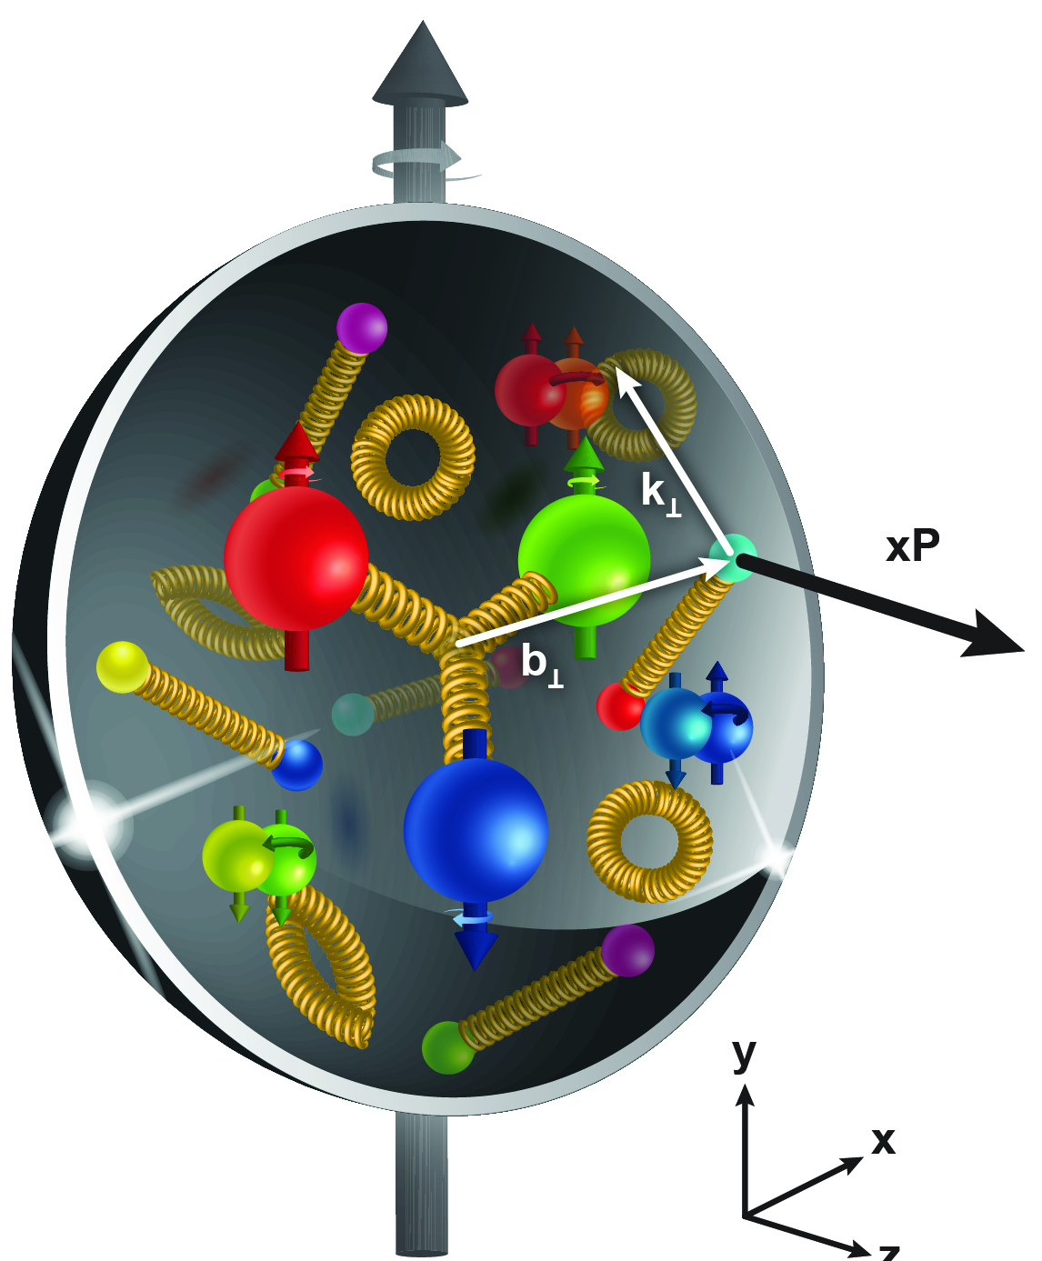
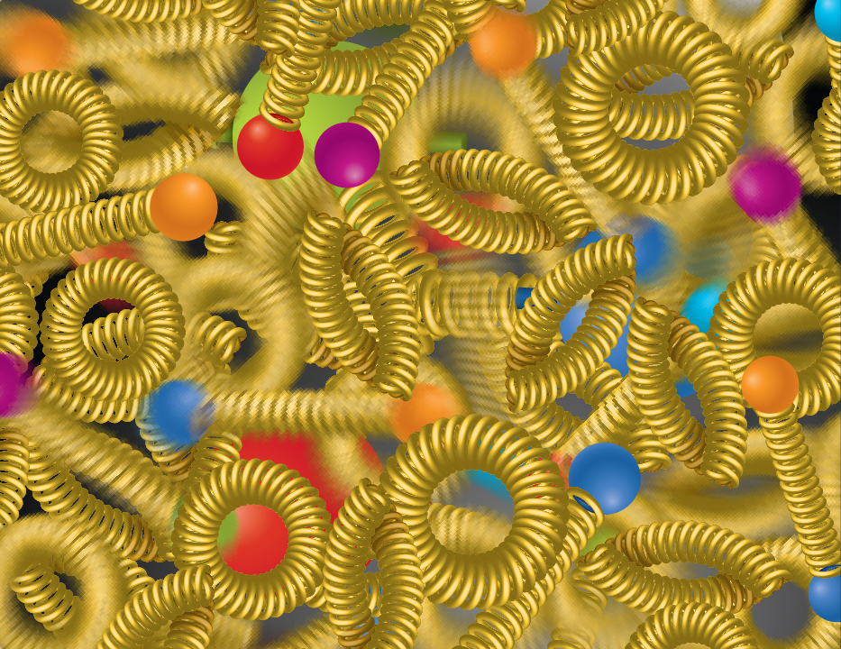
EIC NAS Science Pillars
The EIC will unravel the different contribution from the quarks, gluons and orbital angular momentum
SPIN is one of the fundamental properties of matter.
All elementary particles, but the Higgs carry spin.
Spin cannot be explained by a static picture of the proton
It is the interplay between the intrinsic properties and interactions of quarks and gluons
Does the mass of visible matter emerge from quark-gluon interactions?
Atom: Binding/Mass =
0.00000001
Nucleus: Binding/Mass =
0.01
Proton: Binding/Mass =
100
For the proton the EIC will determine an important term contributing to the proton mass, the so-called “QCD trace anomaly
How can we understand their dynamical origin in QCD?
What is the relation to Confinement
How are the quarks and gluon distributed in space and momentum inside the nucleon & nuclei?
How do the nucleon properties emerge from them and their interactions?
How do the confined hadronic states emerge from quarks and gluons?
Is the structure of a free and bound nucleon the same?
How do quarks and gluons, interact with a nuclear medium?
How do the quark-gluon interactions create nuclear binding?
What happens to the gluon density in nuclei? Does it saturate at high energy?
How many gluons can fit in a proton?
How does a dense nuclear environment affect the quarks and gluons, their correlations, and their interactions?
?
gluon
splitting
=
gluon
recombination

Slide 5

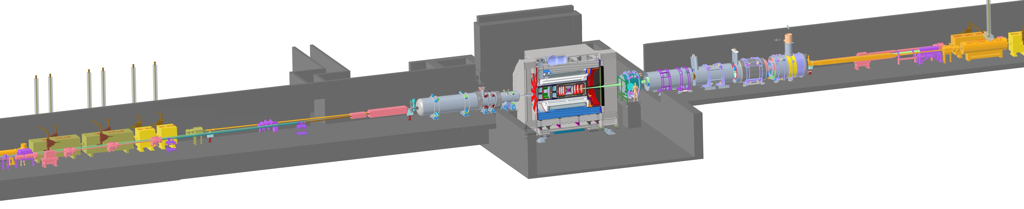
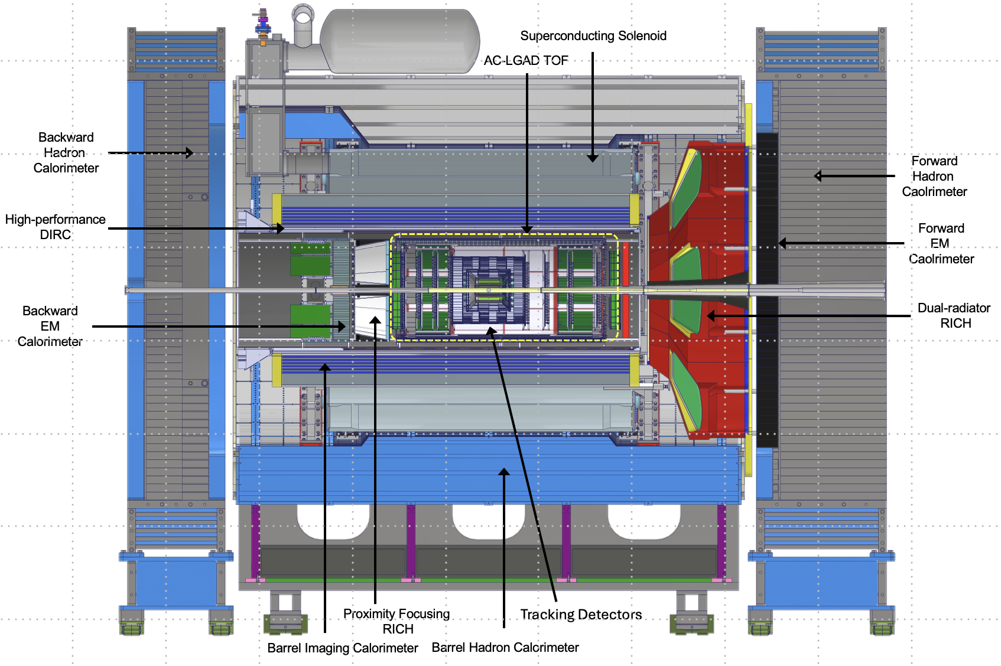
ePIC – The EIC State-of-the-Art General-Purpose Detector
electron beam
Zero Degree Calorimeter
p/A beam
Luminosity
System
Low-Q2 Taggers
B0 Magnet
Spectrometer
Roman Pots (RPs) and
Off-Momentum Detectors (OMDs)
26 subsystems over ± 40 m
to measure particle momenta, energy and particle type
3 electromagnetic calorimeters
3 hadronic calorimeters
Silicon and Multi-pattern gas detectors
3 RICH detector + time-of-flight
7 Auxiliary detectors (Si + HCal + ECals)
electron and hadron polarimetry
Integration, Installation and Infrastructure
Non-Beam Commissioning
Highest scientific flexibility
→ fully streaming readout electronics and data acquisition
→ integration AI/ML capabilities from the start
5

Slide 6
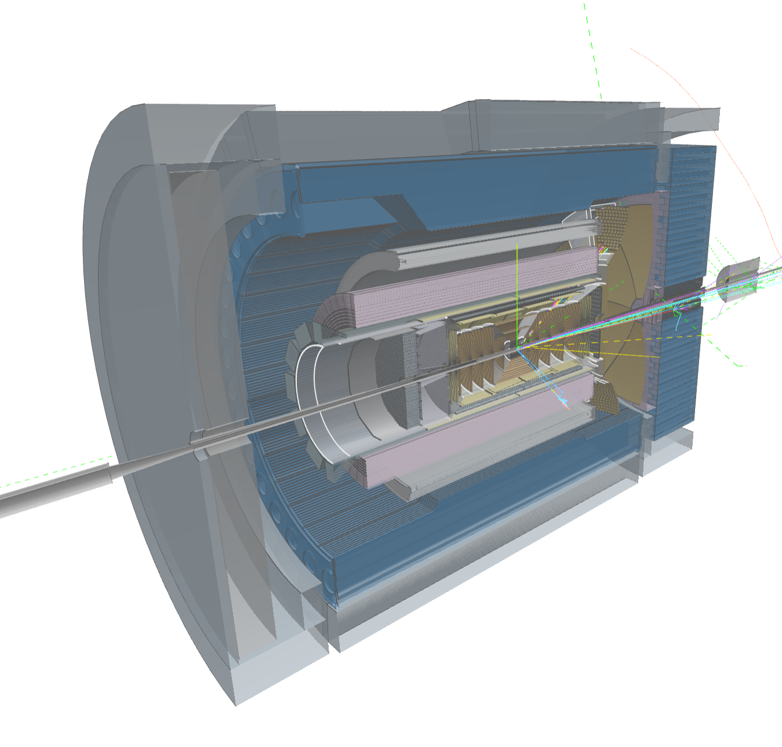
Compute-Detector Integration
Streaming Readout and DAQ:
High-speed data flow: The front-end electronics are designed to support a total bandwidth of up to 50 Tbps, with over 3,000 fiber streams feeding data from the detector to the computing system.
Zero dead time: By avoiding a traditional hardware trigger, the system eliminates dead time and allows for unbiased data collection.
AI and ML in the Data Pipeline:
Intelligent data filtering: AI/ML algorithms can select the most relevant collision events to study.
Real-time feedback: AI can enable rapid detector diagnostics and optimization, with systems capable of automatically calibrating detectors and validating data.
Streaming Computing Model:
Continuous calibration and alignment: Enables rapid delivery of scientific results.
Echelon Model: Organizes resources across the computing hierarchy and enables international contributions.
ePIC event display by Dmitry Romanov

Slide 7
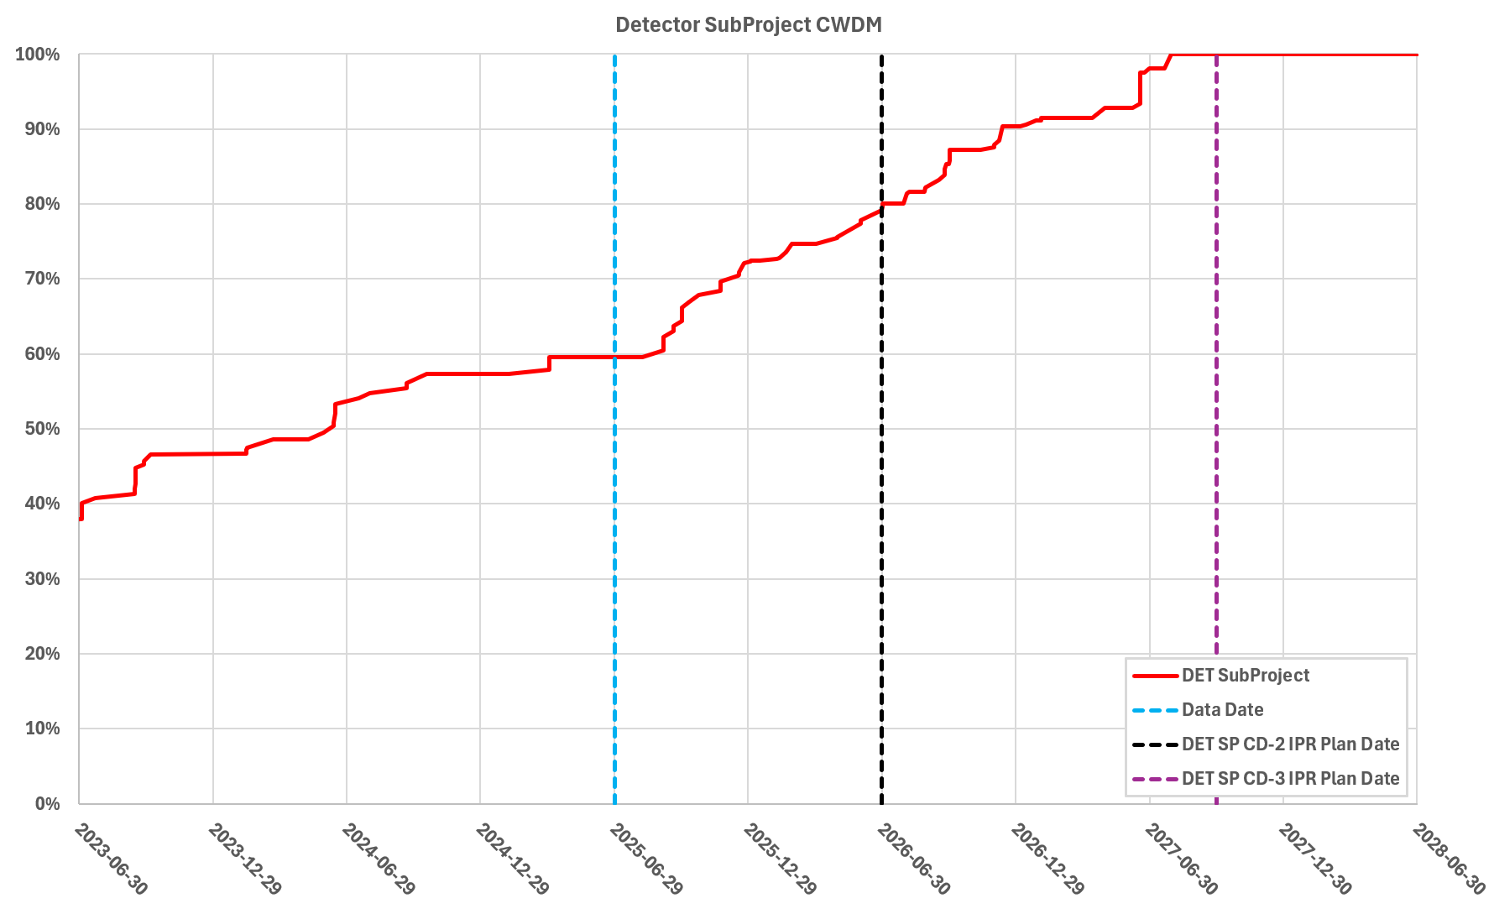
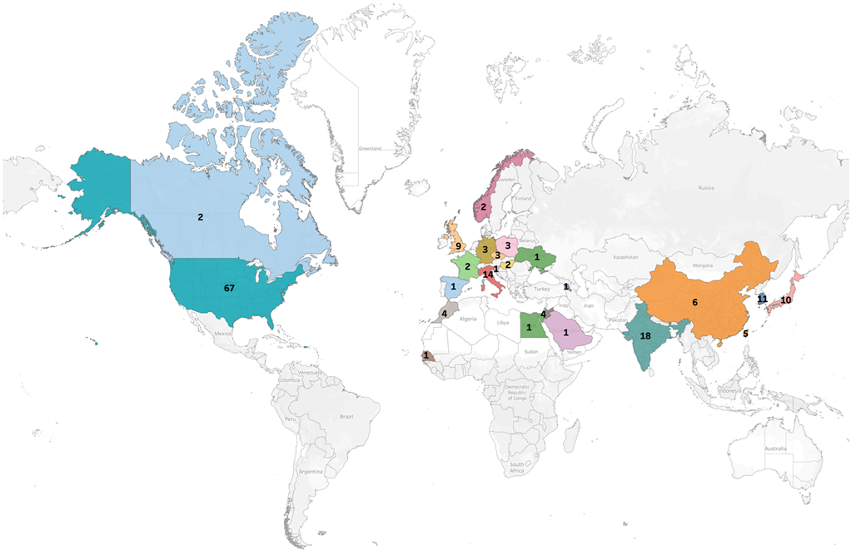
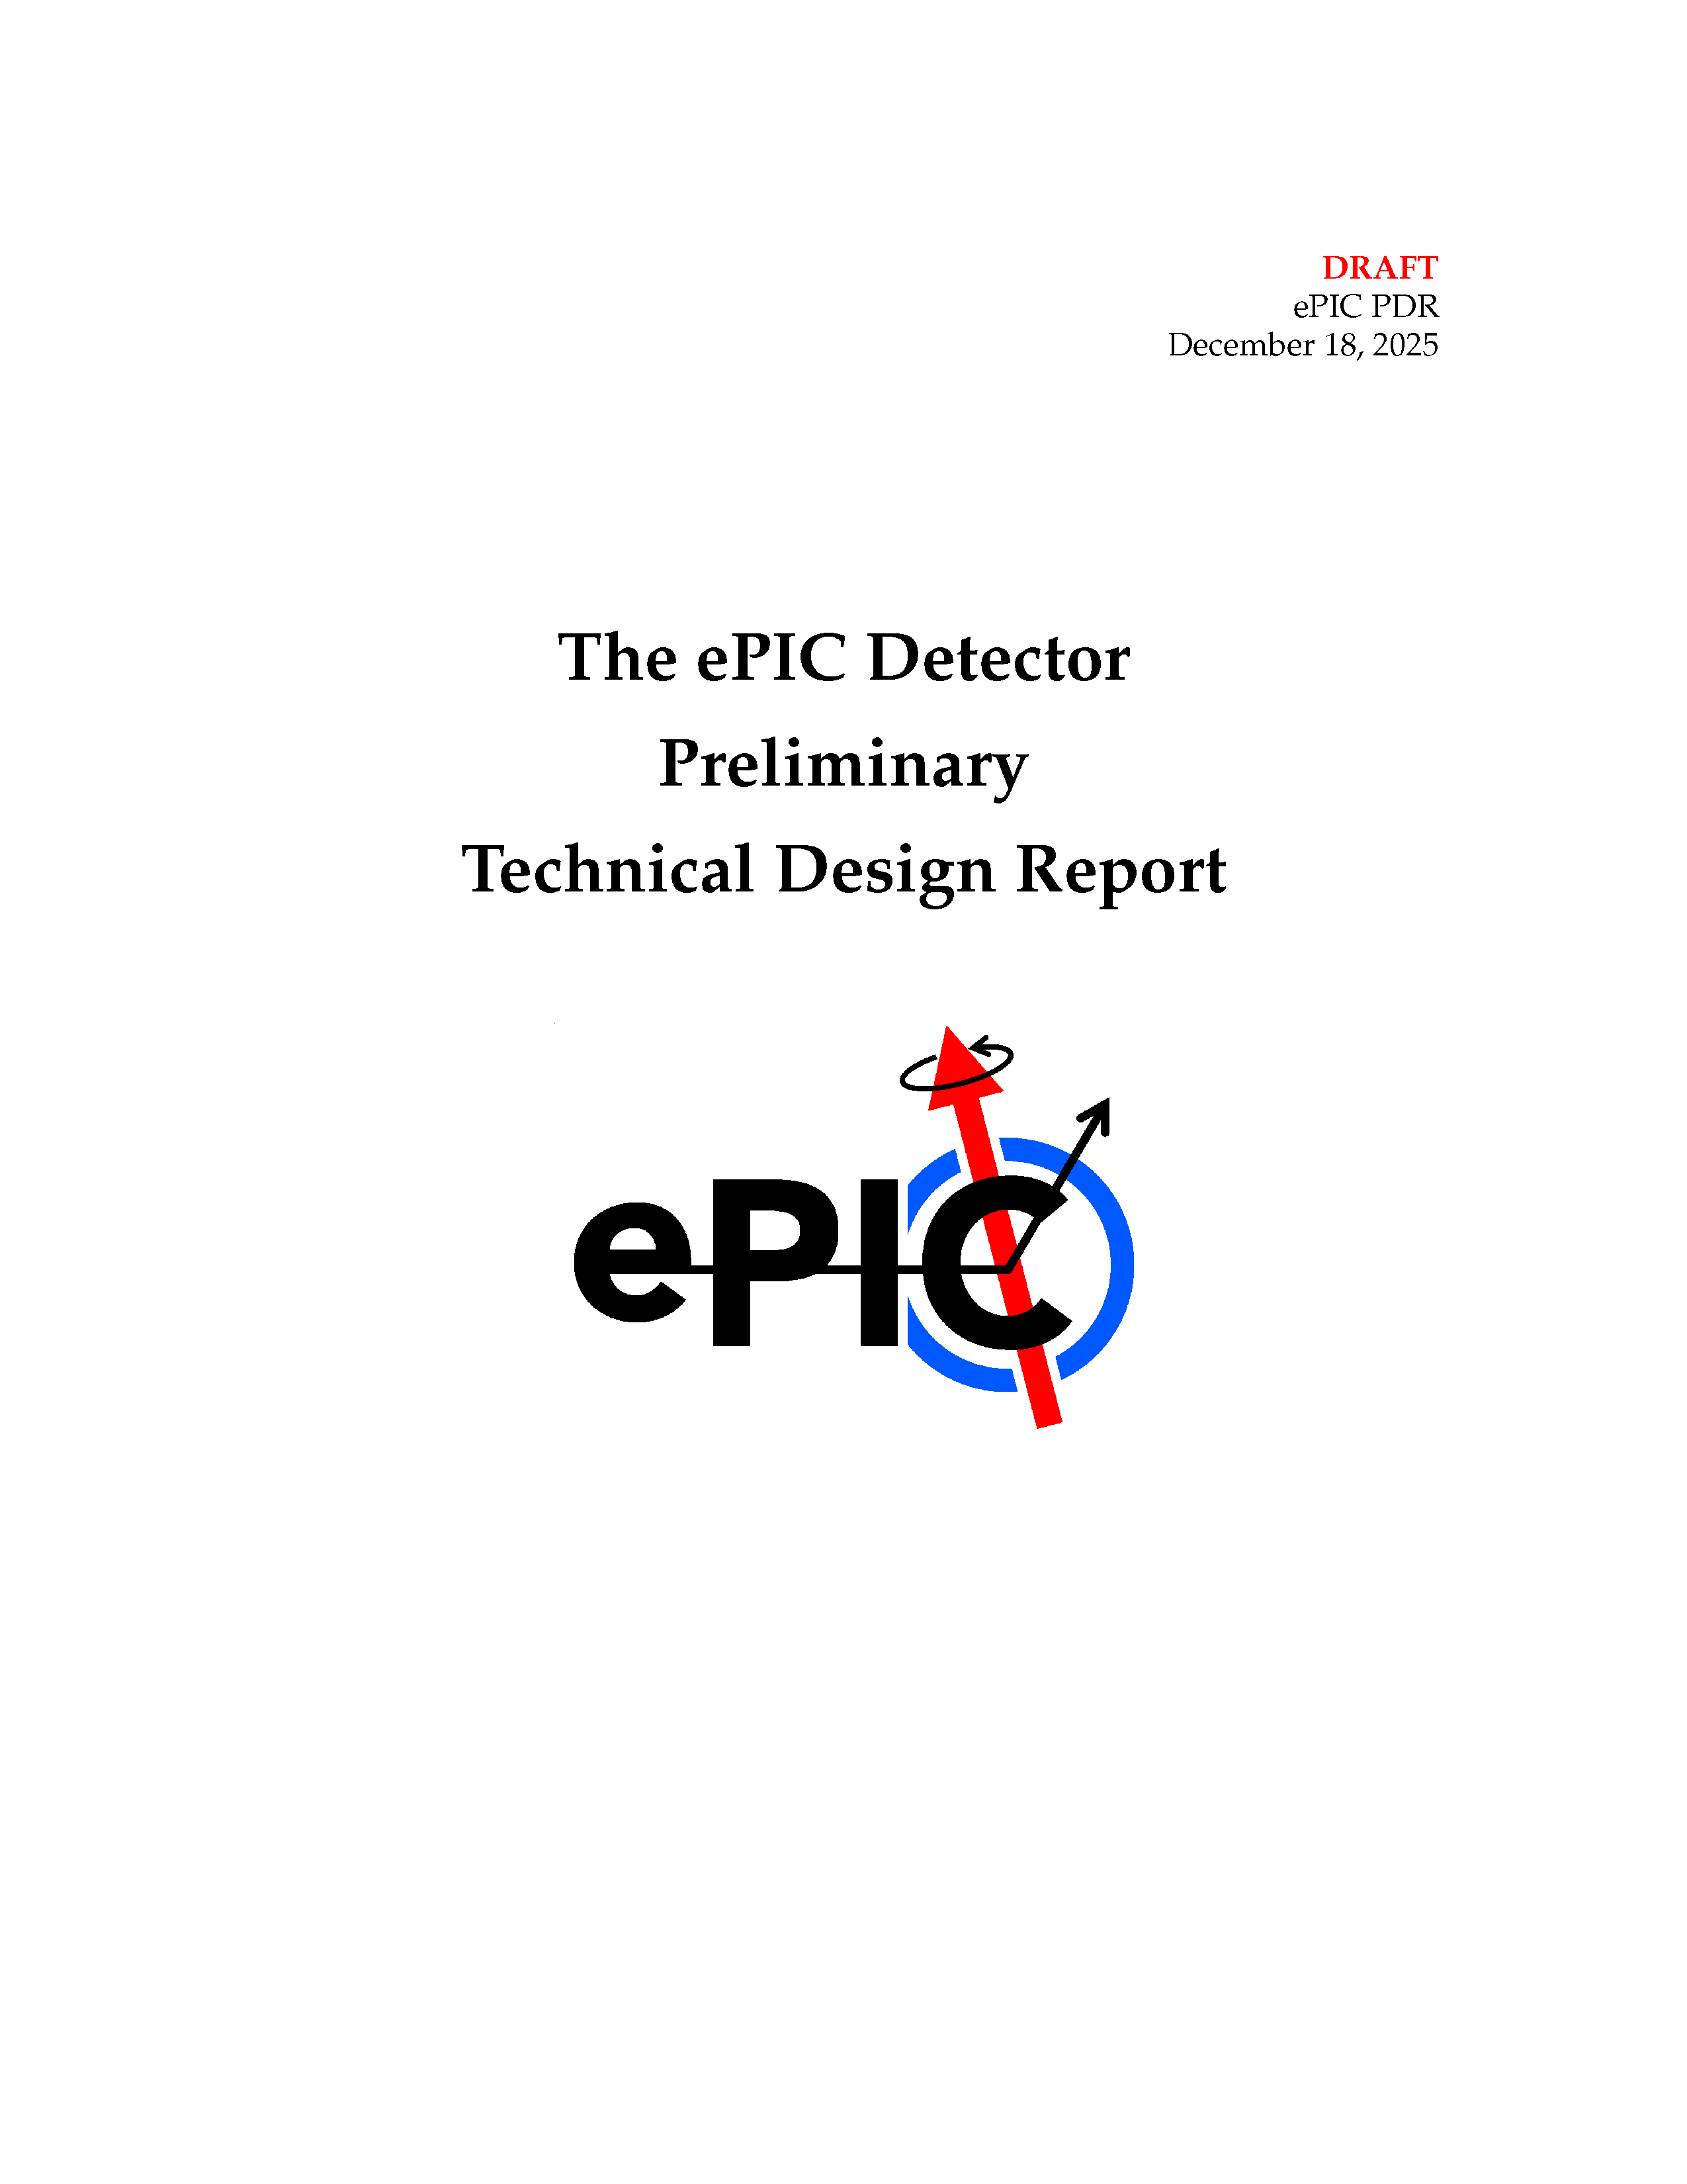
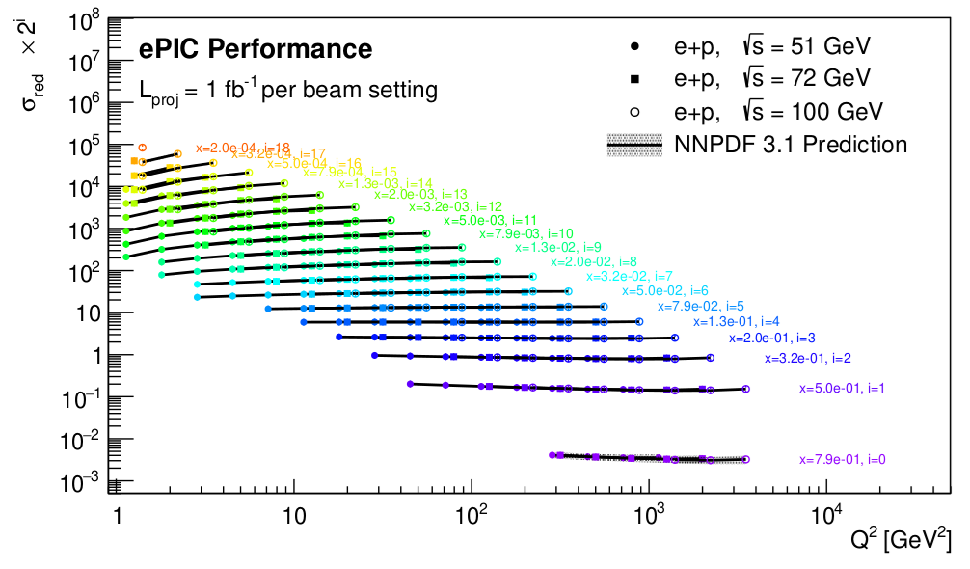
Success in 2025
Cost Weighted
Design Maturity
>1100 collaborators
181 institutions, 25 countries
ePIC is a CERN recognized experiment
Long list of completed PDR/FDR’s
Achieved design maturity required for CD-2
$29.1M in CD-3A/3B Long-Lead Procurements
First ePIC Physics Forum –
Dec. 16, 2025:
Standalone
ePIC pTDR draft:
553+ pages

Slide 8
Challenges
In the General Meeting on Jan. 9th we outlined several challenges facing the collaboration:
Unfortunate news from UKRI
  This results in delaying some ePIC detector systems
The EIC project must develop a baseline that:
  Address the EIC CD-0 Mission Need Statement
  Start early science within 10 years
  Costs less than ~$2.8B
These challenges are changing the roadmap to our goal of realizing EIC science – but they do not change the destination!
We will hear more on this directly from the EIC project at this meeting.

Slide 9
Collaboration Input
The outcome of the project baselining exercise can affect the EIC science program in multiple ways:
  Changes to the scope of the DET subproject
  Changes to the ASR, EIN and ISR subprojects (EIC performance)
The collaboration must have an opportunity to respond to changes in the baseline that affect EIC science
We have discussed with Jim Yeck, David Dean, and Abhay a process by which the collaboration is charged to provide a formal, written response on the impact to EIC science before the baseline is finalized
We hope to have a better understanding of the implications of the baselining exercise for EIC science at this collaboration meeting.

Slide 10
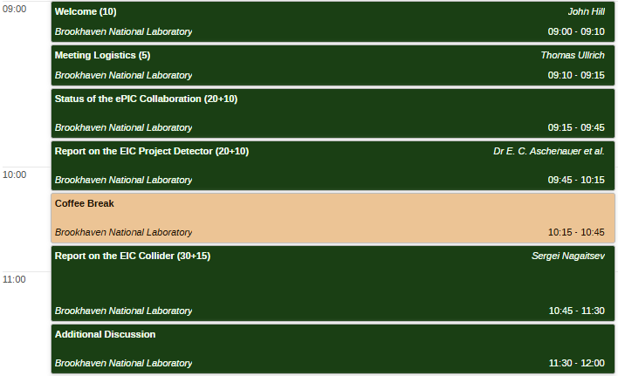
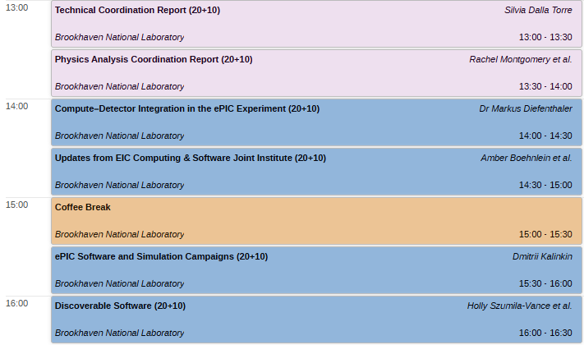
Tuesday: Plenary I and II
Morning: Plenary I
Afternoon: Plenary II
Status Reports from the ePIC Collaboration and EIC Project
Special S&C Plenary Session

Slide 11
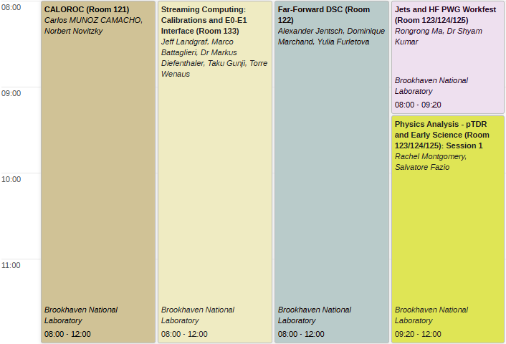
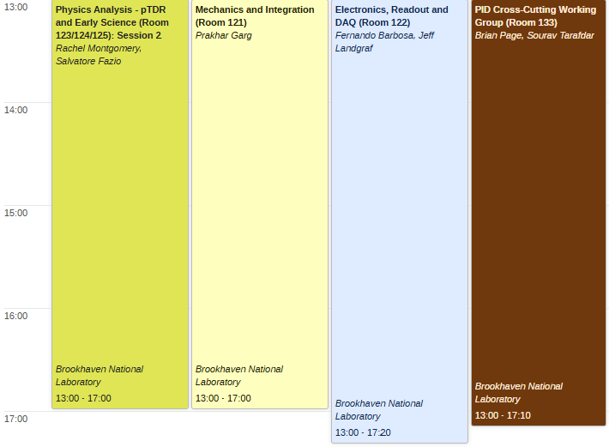
Wednesday: Workfests I & II
Morning: Workfest I
Afternoon: Workfest II

Slide 12
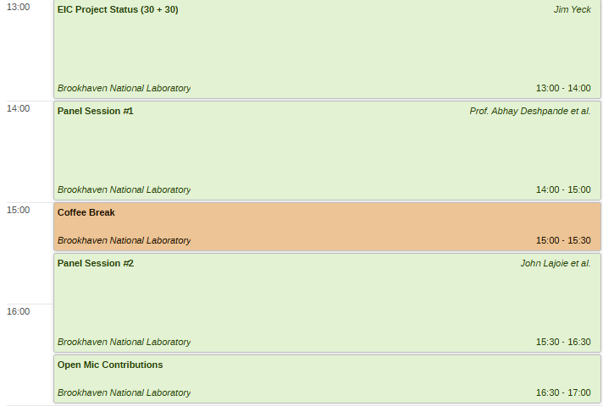
Thursday: CC Meeting and Plenary III
Collaboration Council meeting Thursday AM:
https://indico.bnl.gov/event/31005/
The afternoon plenary will consist a presentation from Jim Yeck followed by two panel discussions:
Panel #1: EIC Project
Moderator: Thomas Ullrich
Panel Members: Jim Yeck, Kevin Smith, Elke Aschenauer, Rolf Ent, Abhay Deshpande
Panel #2: ePIC Leadership
Moderator: Rolf Ent
Panel Members: John Lajoie, Silvia Dalla Torre, Markus Diefenthaler, Salvatore Fazio, Rachel Montgomery
Afternoon: Plenary III
A small amount of time is available for contributions – email lajoiejg@ornl.gov to be added to the agenda.

Slide 13
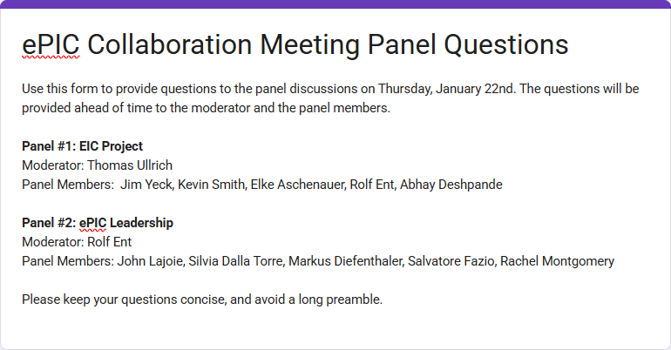
Questions for the Panels
https://forms.gle/PmA5enfvNKNqunJi7
Please submit your questions by Thursday morning, January 22nd.

Slide 14
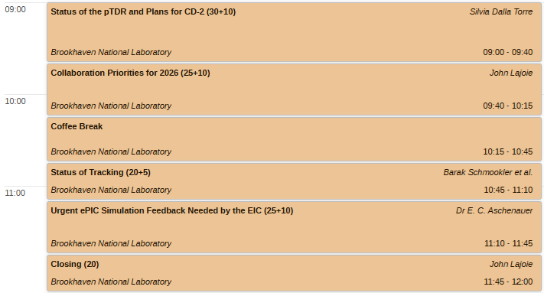
Friday Morning: Plenary IV
The individual coordination offices will discuss their priorities in the talks today. This is to allow discussion and feedback throughout the week.
In the Friday plenary session we will pull this all together and discuss collaboration priorities for the coming year.

Slide 15
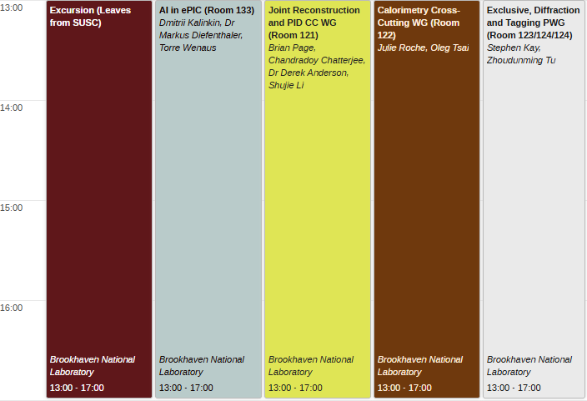
Friday Afternoon: Workfests and Excursion
I hope everyone will take advantage of the Friday workfests and/or the tour!

Slide 16
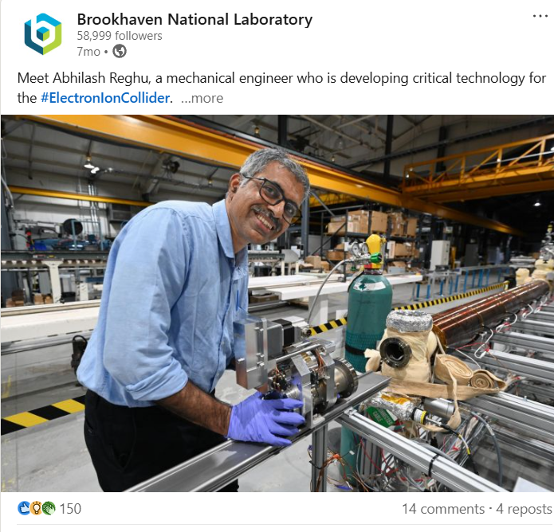
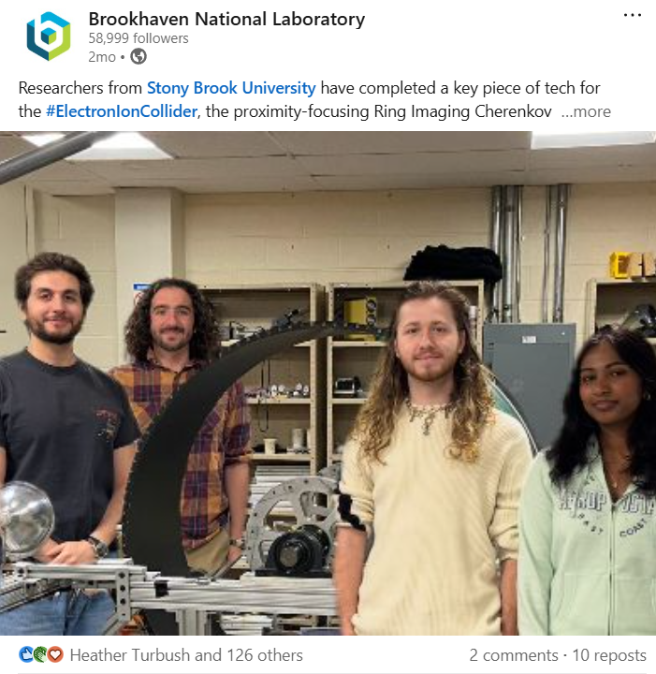
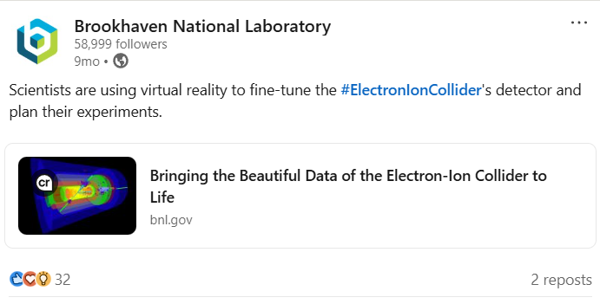
EIC Social Media
Amber Aponte
BNL Media & Communications Office
We want to shine a light on you! Stop by registration in the lobby on Thursday, Jan. 22 during the AM and PM coffee breaks.
We will conduct “pop-up” interviews with collaborators for social media.
Reminders:
  When posting about EIC on your own socials, remember to use #ElectronIonCollider
  Help us stay informed! Fill out the EIC Profile Form online or contact ePIC Outreach or aaponte@bnl.gov.
ePIC Collaboration Meeting
January 2026

Slide 17
Parting Thoughts
It is critically important that we work as a collaboration along with the EIC project to establish the project baseline.
  The EIC project must transition to a construction project this year
  A well advanced pTDR is an important contribution
It is critically important that we work as a collaboration to communicate the importance of EIC science.
  The Early Science whitepaper will be even more important in
  light of the new baseline
We have to stay the course on what has been a successful path and continue to work united to maximize EIC science. This will take time, patience, and fortitude.
  Stay committed to the full EIC science program

Slide 18

Looking forward to an exciting meeting!
Thanks again to Oskar Hartbrich for the sticker design!

Slide 19


Slide 20
NIMA Special Issue
This Special Issue will be an important tool to communicate to the NP community the depth, breadth and excitement for EIC science.
NIMA Special will open March 2026
  Open through October 2026
  Coordinators to act as Guest Editors
  Goal of the issue is a comprehensive overview of ePIC
Plan to publish a super-set of the material prepared for the pTDR
  Subsystem technical papers derived from pTDR
  Physics performance paper spin-off from pTDR*
  Early Science whitepaper*
  Exclusive, Diffraction and Tagging paper
  Streaming Computing Model*
  Planning for publications to be Open Access
* Full collaboration author list

Slide 21
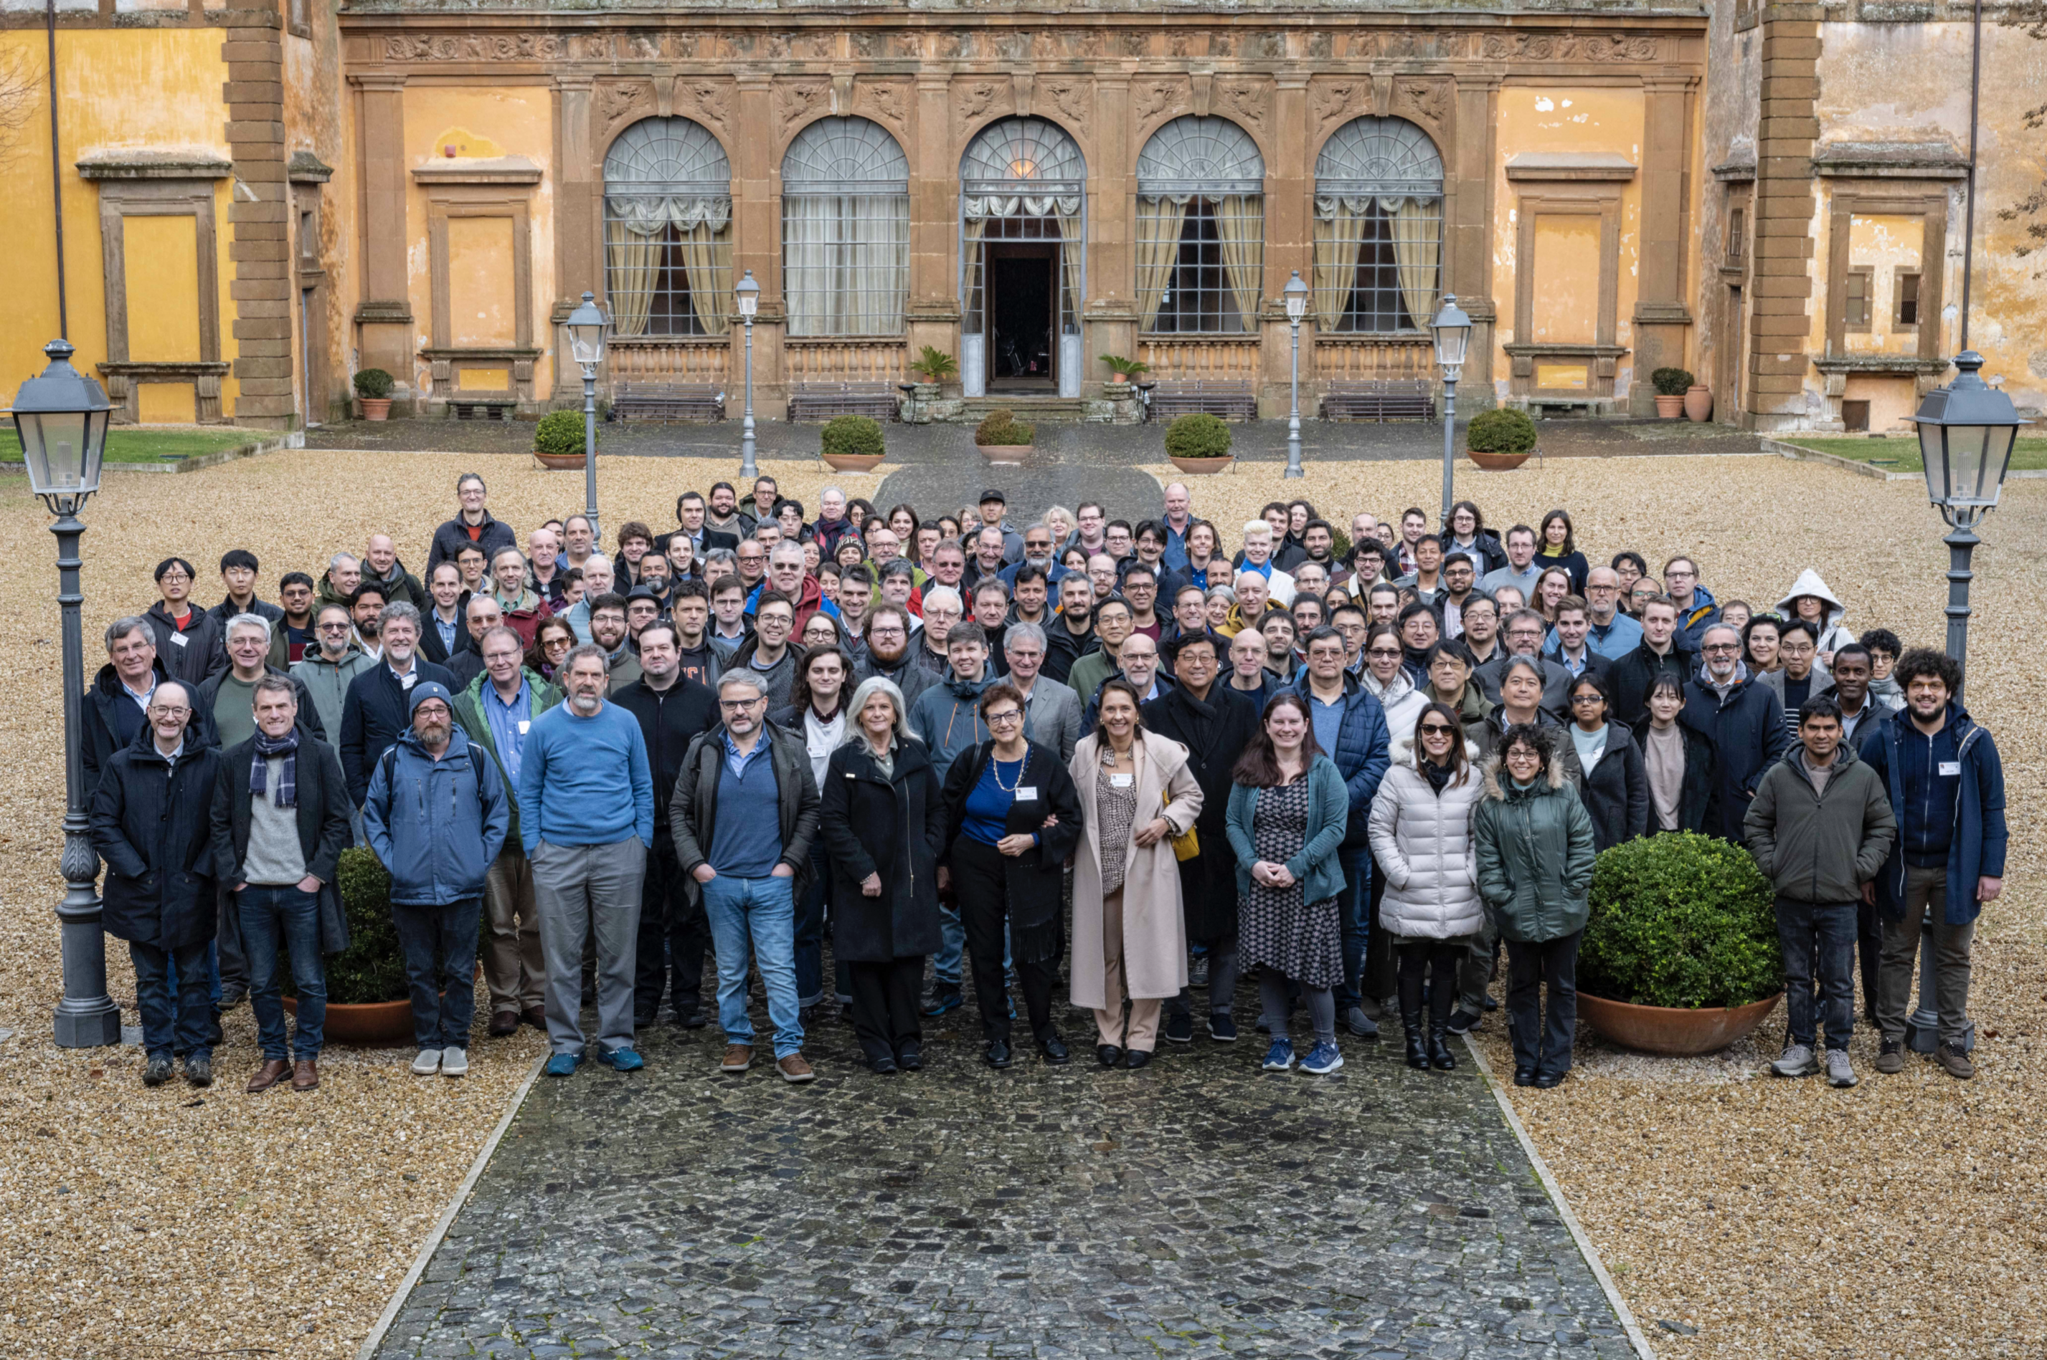
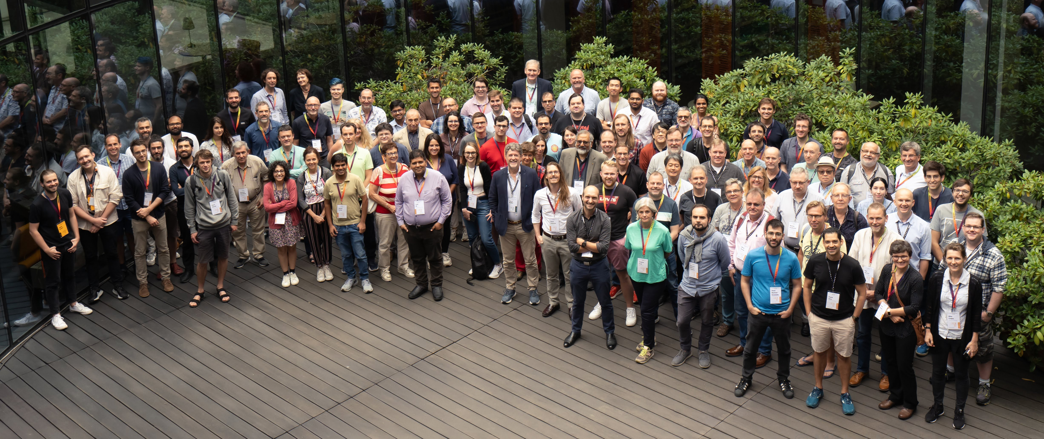
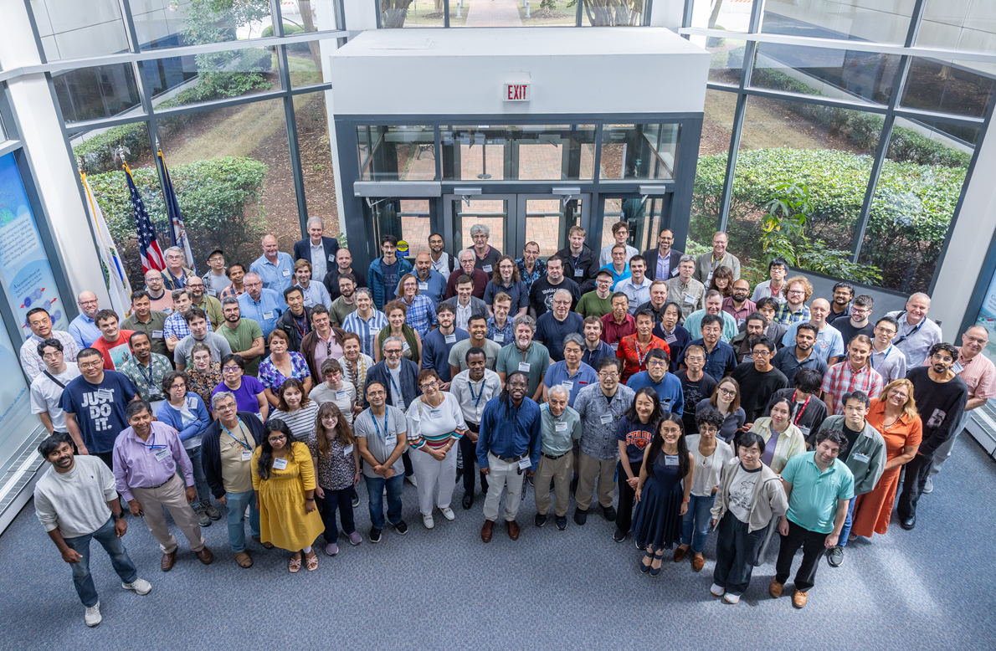
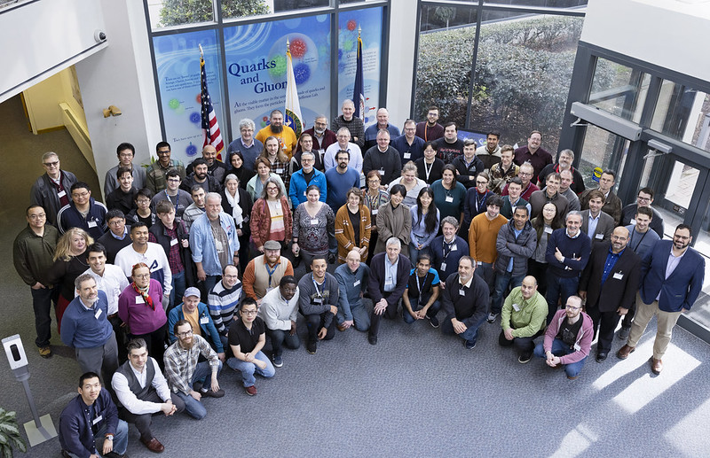
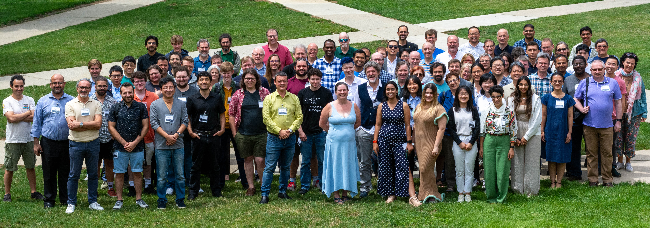
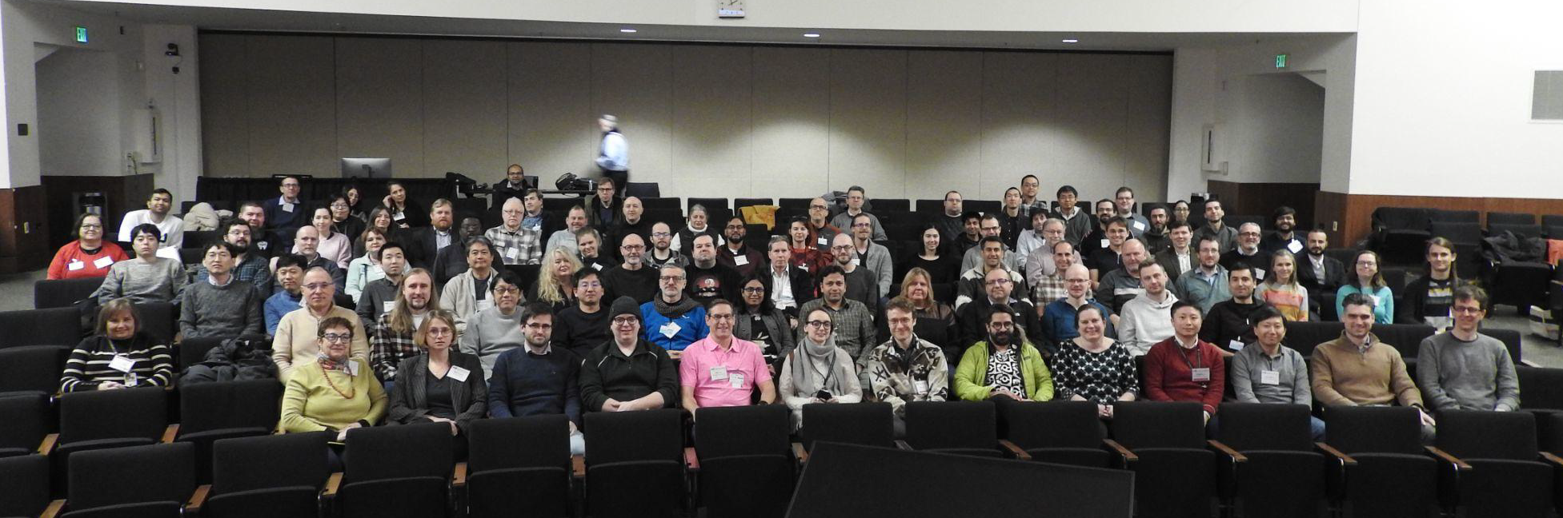
The Collaboration
JLab, Jan. 2023
Warsaw, July 2023
ePIC is a community of scientists dedicated to realizing the EIC science mission.
The ePIC Collaboration is as unique as the ePIC detector.
Frascati, January 2025
EICUG/ePIC Meeting – Lehigh, July 2024
Jefferson Lab, July 2025
ANL, Jan 2024

Slide 22
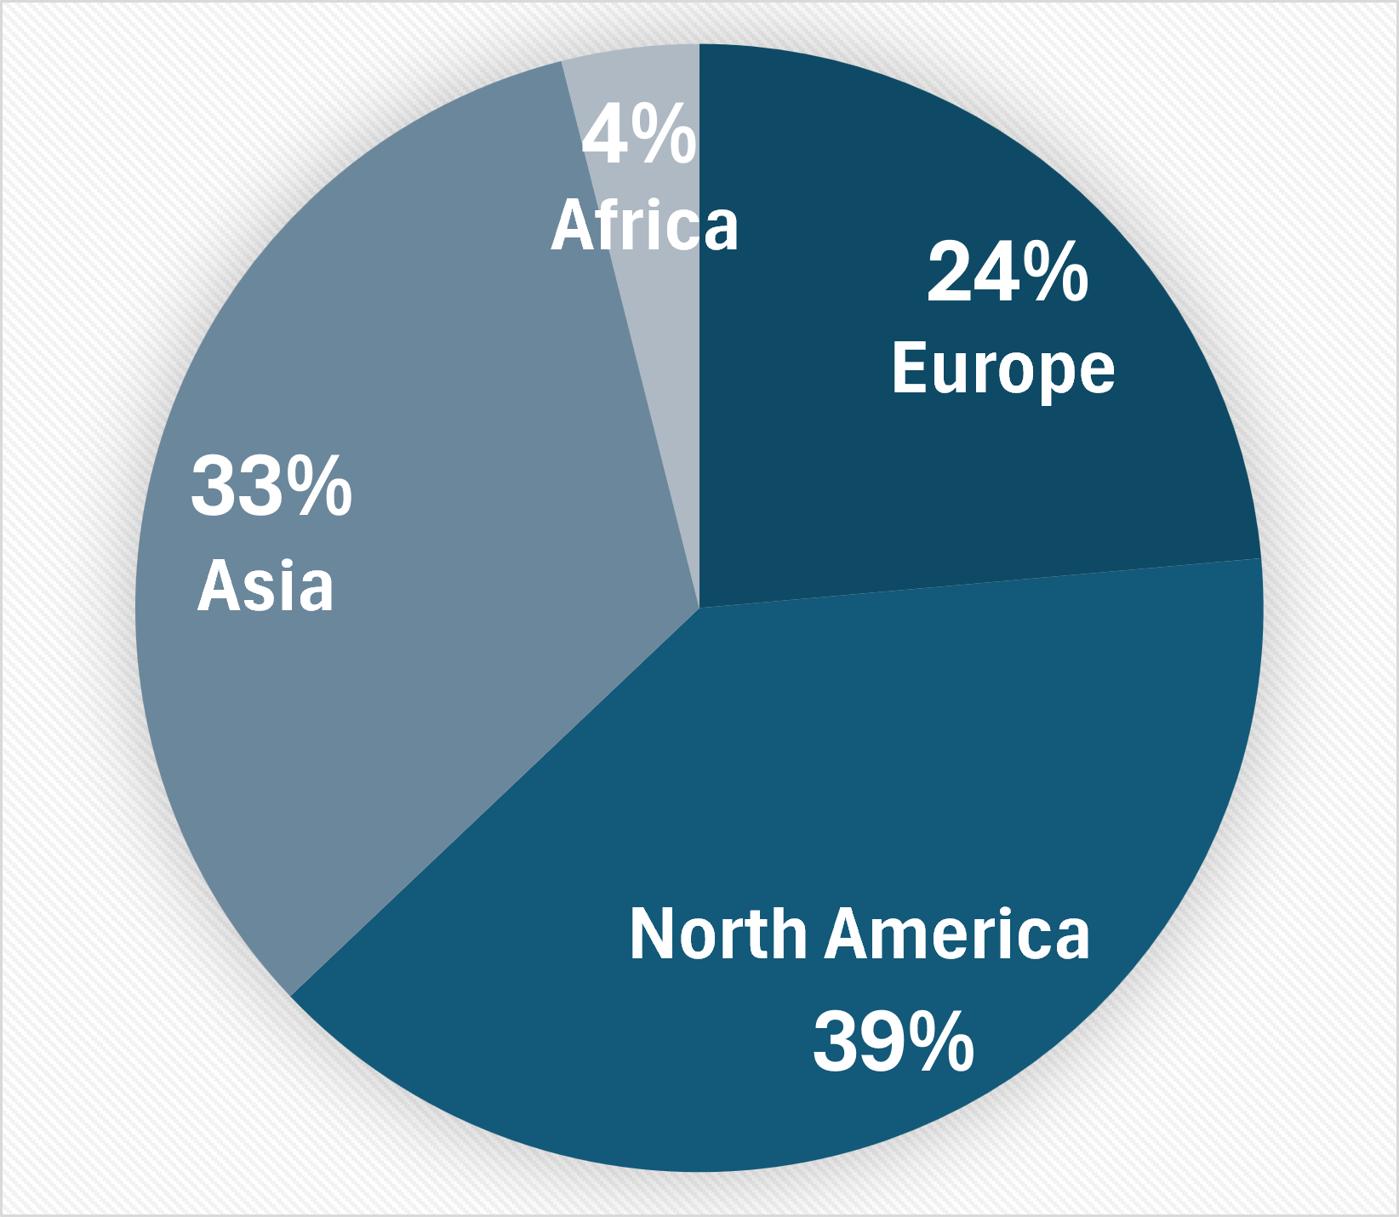
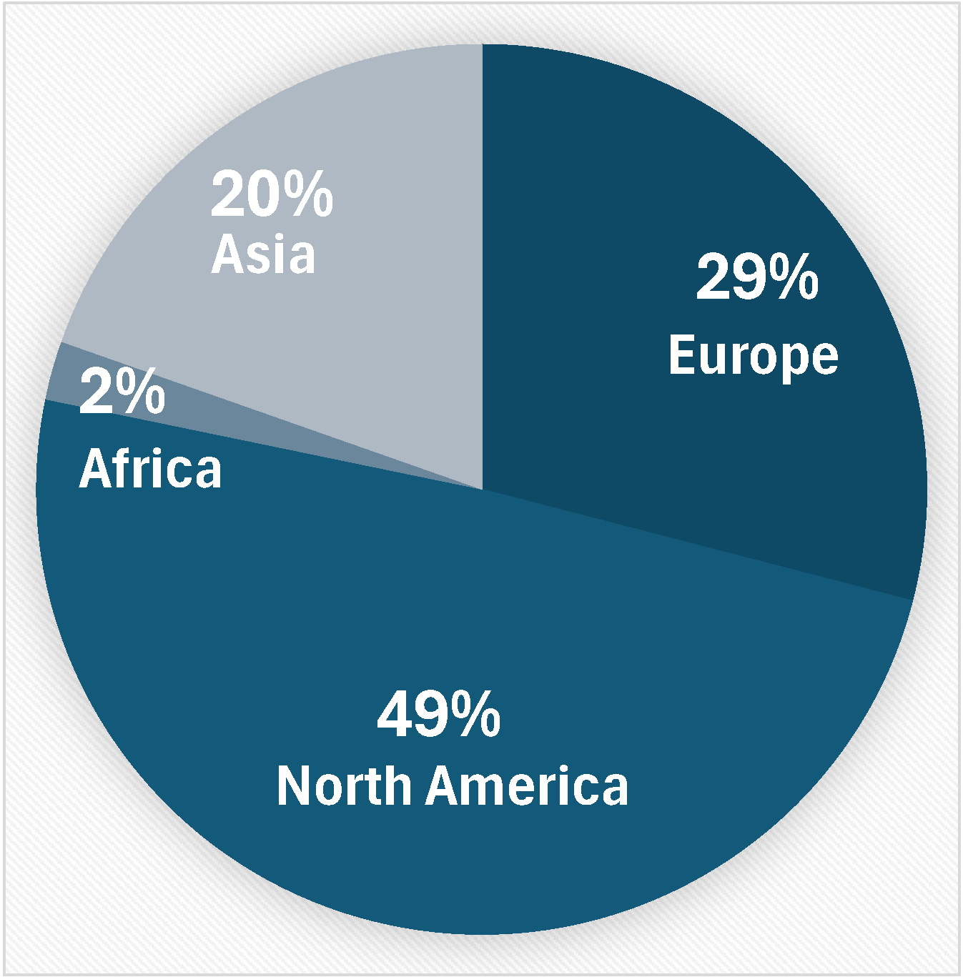
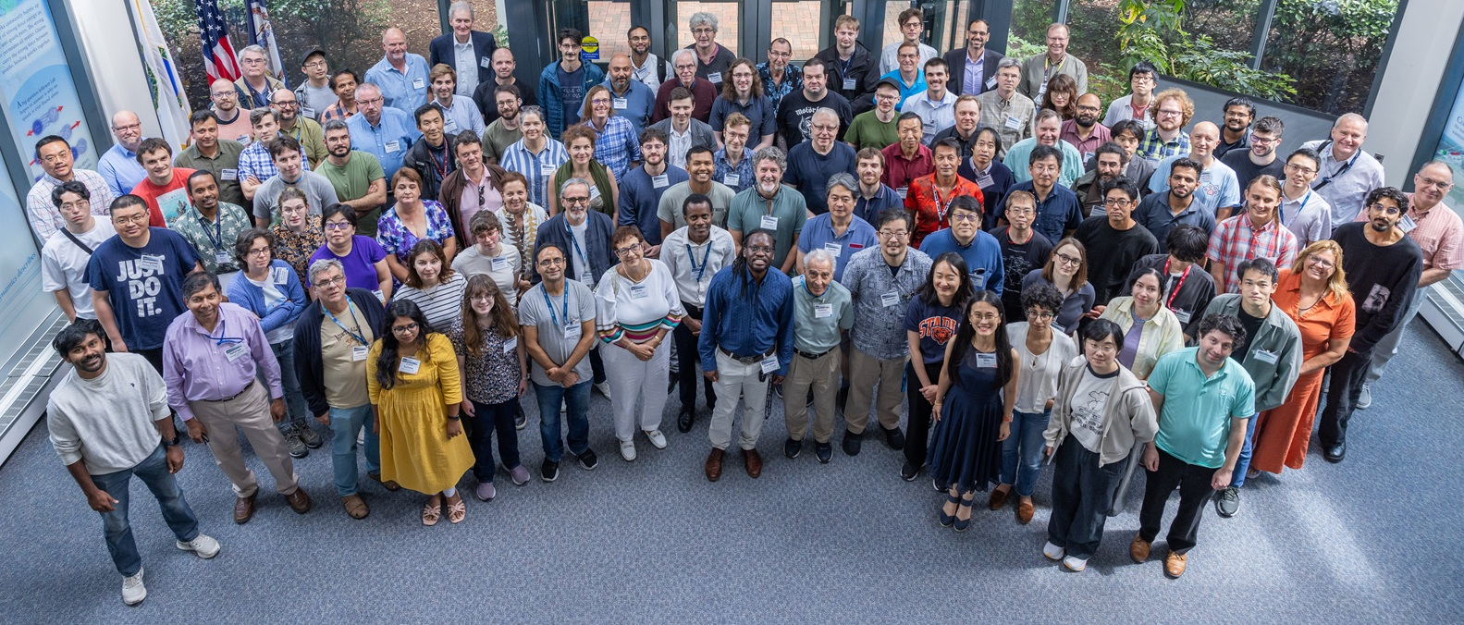
Institutions:
Collaborators:
>1100 collaborators
181 institutions, 25 countries
The ePIC Collaboration is strong, active and growing:
CERN Recognized Experiment
Adding new collaborating institutions
Ongoing subdetector design reviews
2025 Collaboration Priorities:
Writing ePIC pTDR
Developing the EIC Early Science plan
Supporting baselining for the ePIC detector in 2026
ePIC Collaboration - July 2025

Slide 23
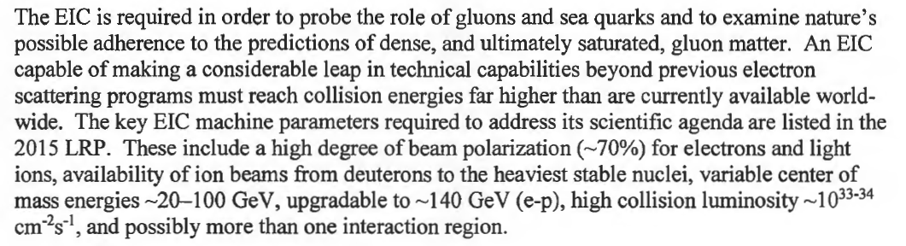

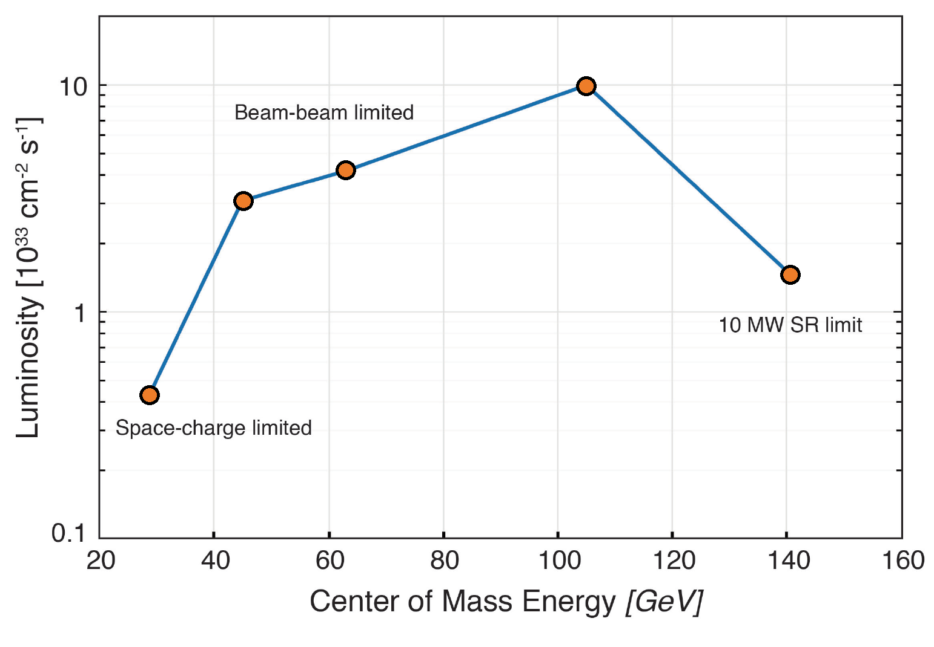
The DOE CD-0 Mission-Need Statement (MNS) 2019
10x275
Bunch charges: 28 nC (10 GeV, e) and 11 nC (275 GeV, p)
5x100
10x100
18x275
5x41
The EIC CDR design parameters are all traceable to the MNS and the
EIC Global Requirements Document.
EIC peak luminosities (CDR)

Slide 24
ePIC Resources
Public Website - https://www.bnl.gov/eic/epic.php
Mailing Lists – https://lists.bnl.gov/mailman/listinfo
Indico Agenda - https://indico.bnl.gov/category/402/
  ePIC Software and Computing: https://indico.bnl.gov/category/435/
Wiki - https://wiki.bnl.gov/EPIC
ePIC Software Training:
  Landing Page: https://eic.github.io/documentation/landingpage.html
  Tutorials: https://eic.github.io/documentation/tutorials.html
Mattermost: https://chat.epic-eic.org
ePIC Zenodo Community: https://zenodo.org/communities/epic

Slide 25
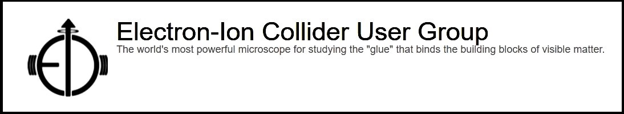

EICUG Membership
The EICUG is a vital organization to promote the interests of the EIC community!
  Without the EICUG we would never have gotten far enough to form ePIC!
Please register your institution!
Check with your EICUG IB representative to get registered as a member
https://www.eicug.org/content/join.html

Slide 26
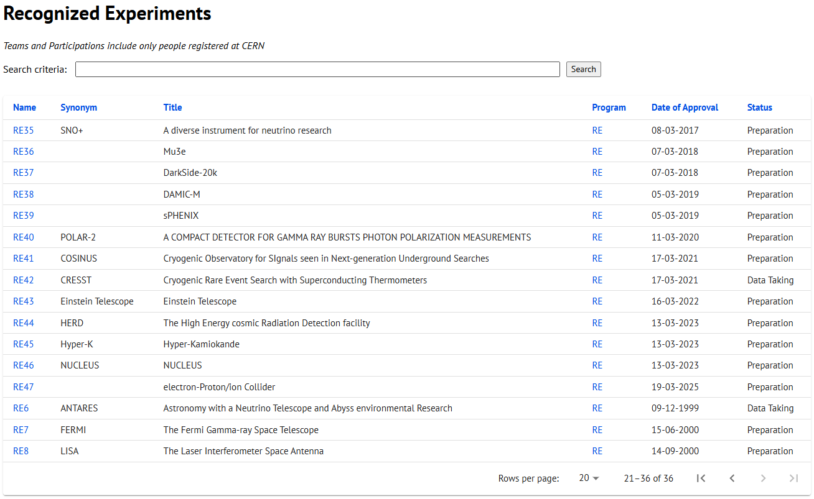
CERN Recognized Experiment Status: RE47
ePIC now appears in the CERN Grey Book database as RE47:
https://greybook.cern.ch/experiment/recognized
Two steps to get ePIC Collaborators registered at CERN:
CC Representative needs to register as team leader with
CERN Users Office:
  https://usersoffice.web.cern.ch/
  https://usersoffice.web.cern.ch/team-leaders-corner
  Users.Office@cern.ch
CC member can then certify registrations of team members
Contact us if you run into problems!

