Slide 1
Report on the EIC Project Detector
E.C. Aschenauer (BNL), R. Ent (JLab)
Co-Associate Directors for the EIC Experimental Program
ePIC Collaboration Meeting
BNL, January 20th, 2026

Slide 2
Outline
EIC Status-At-A-Glance
Overall Project and Detector Update
Preparations for Detector Baseline Readiness Assessment Review
EIC Project Developments in December
Further Developments over the Holidays

Slide 3
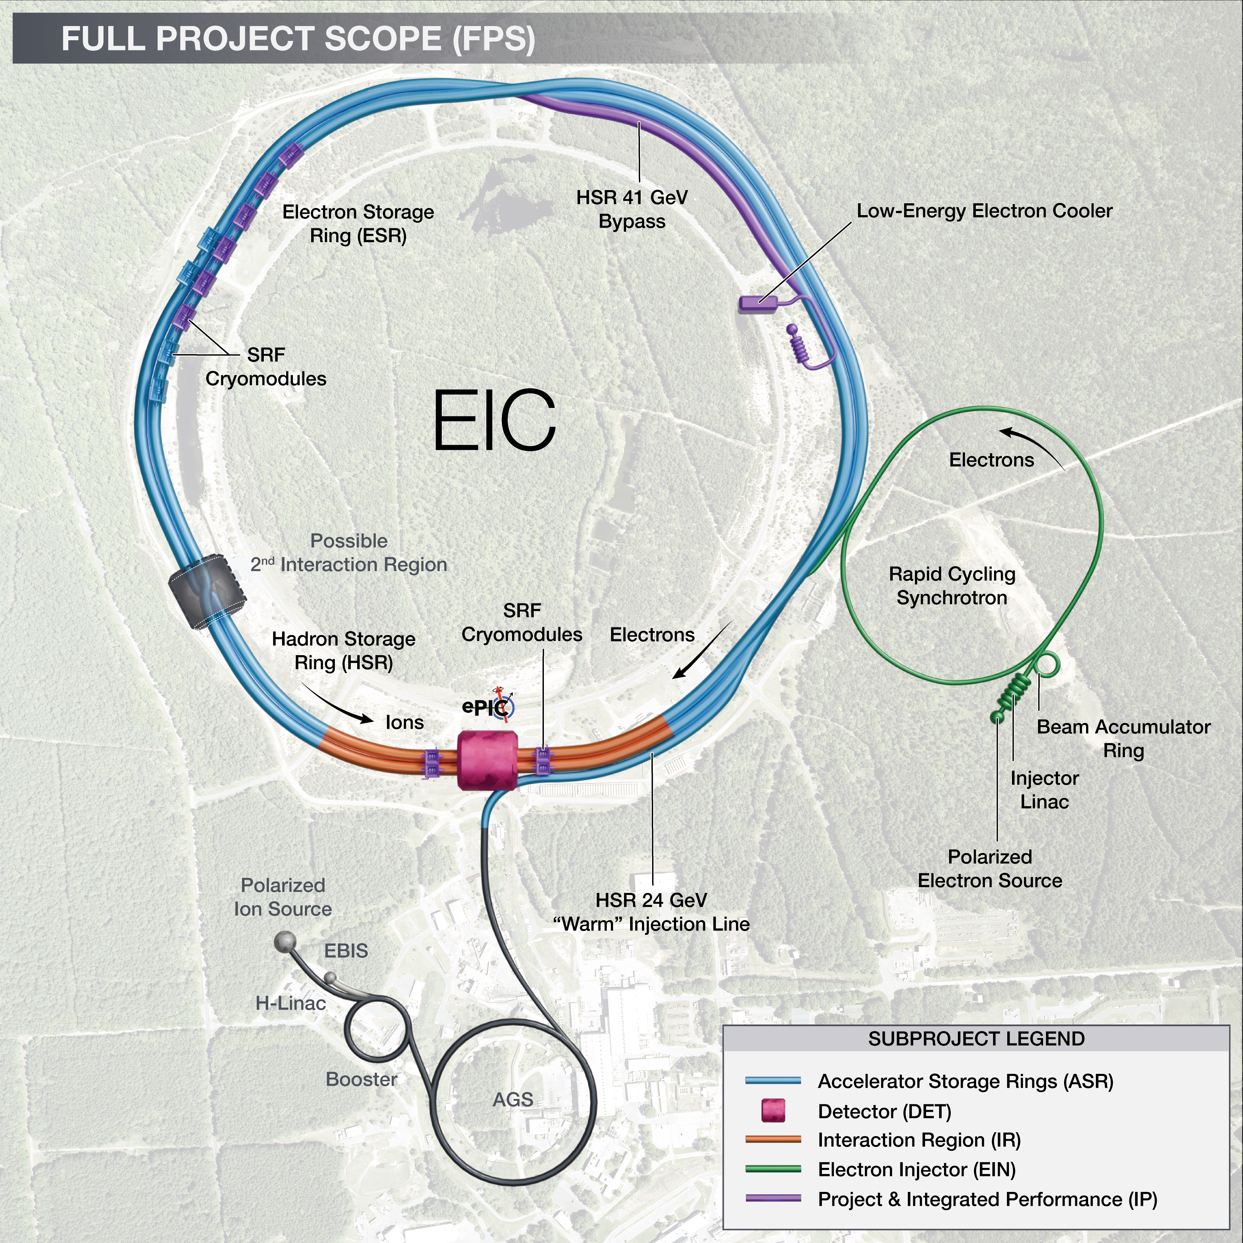
EIC Status At A Glance
EIC facility scope provides the capability to achieve the performance required by the Mission Need.
  CD-0 – December 2019
  CD-1 – June 2021
  CD-3A – March 2024
  CD-3B – pending, ESAAB approval expected soon
EIC cost is <$3B, continuing to absorb cost of delays
  To end-of-FY25: $0.5B funded by DOE, including $138M IRA funds
  FY26: House Water and Energy Appropriations: $158M for EIC
  $100M of additional NYS funding is in the bank.
A single integrated line-item construction project executed as subprojects with well-defined deliverables, interfaces, and Key Performance Parameters.
  Accelerator Storage Rings (ASR)
  Detector (DET)
  Interaction Region (IR)
  Electron Injector (EIN)
  Project and Integrated Performance (IP)
  (includes Energy & Luminosity Ramp-up (ELR))
EIC is ready to start construction after RHIC concludes late January 2026.
Anticipate CD-2/3 for ASR and CD-2 for DET in 2026.
EIC initial science begins in 2035

Slide 4
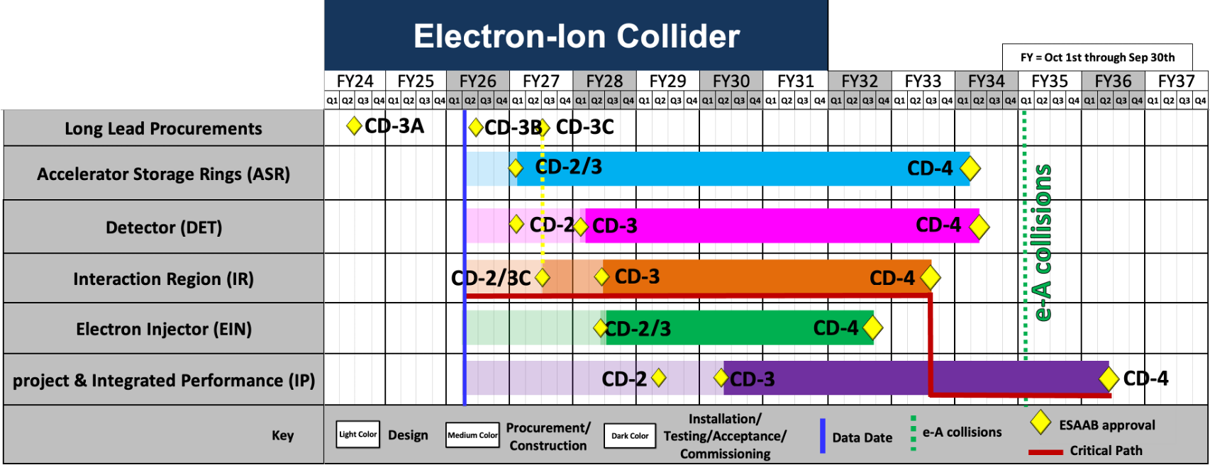
Summary Project Schedule
This is a high-level technically driven schedule – funding constraints and profiles need to be folded in once known
4

Slide 5
CD-3A Status and CD-3B Scope
CD | Scope | Status
CD-3A | Lead Tungstate Crystals for the Detector Backward Electro-Magnetic (EM) Calorimeter (1069 of 2899 crystals) | Contract awarded 3/5/2025 (CRYTUR) – 1069 (!) crystals delivered – quality tests completed on 930 crystals, all passed specifications
 | Scintillating Fibers for the Detector Barrel (1125 km of 4900 km) and Forward EM Calorimeters (750 km of 3000 km) | Barrel SciFi: Contract awarded 12/19/2025 (Kuraray) → first delivery soon Forward SciFi: Contract awarded 3/12/2025 (Luxium) → iterated with Luxium to fulfill requirements, 81.5 km received to date
 | Silicon Photomultipliers for the Detector Forward Hadronic Calorimeter (321k of 540k) | Contract awarded 11/25/2024 (Hamamatsu) → 231840 SiPMs delivered to BNL → testing continuously ongoing at Yale → no quality issues.
 | Steel towers for the Detector Forward Hadronic Calorimeter (650 towers of 1500) | RFP for steel modules is at BHSO for approval
 | Detector Solenoid Magnet Design and Fabrication and Conductor | Solenoid: becomes in-kind. Tender process starting in Spring 2026 led by Italy Conductor: contract awarded 09/23/2025 (Luvata)
CD-3B | Lead Tungstate Crystals for the Detector Backward Electro-Magnetic (EM) Calorimeter (1000 pieces cont. CD-3A) | Waiting for CD-3B approval Implemented as options in CD-3A contracts
 | Scintillating Fibers for the Detector Barrel (1264 km cont. CD-3A ) and Forward EM Calorimeters (1065 km cont. CD-3A )
 | Steel towers for the Detector Forward Hadronic Calorimeter (200 towers cont. CD-3A )
 | Detector Solenoid Magnet Power Supply | SOW is signed and approved; the specification document is approved. TPRR completed in August 2025, PRR completed October 2025.
 | Flux Return Steel for the Electron and Hadron Endcap Structures (50% of needed steel → first phase hadron endcap) | procurement package nearly finalized, PRR planned for February 2026.
 | VTRx+: Versatile Link Plus Transceivers (5500 pieces ) and lpGBT: Low Power GigaBit Transceivers (1500 pieces) | Planning with CERN, procurement pending DOE-CERN agreement and CD-3B authorization → assembly will happen after HI-LHC components are done.
 | DIRC Bar Refurbishment – work-to-go related to reuse of components | 2 (of 8) ex-BABAR DIRC bar boxes opened and disassembled in short bars, last 6 DIRC bar boxes on hold waiting for CD-3B authorization.
DET: $30M DOE scope (38%)
DET: $12M DOE scope (25%)
5

Slide 6
Detector is Ready to be Baselined
Subsystem | PDR Completed | PDR Scheduled | FDR Completed
Tracking | 40% Si, 40% & 60% MPGD | 60% Si PDR: January 27-28, 2026
PID | 40% & 60% hpDIRC, pfRICH, dRICH ToF 40%, TOF Peer review | 60% TOF PDR: aim for April 2026 | DIRC Bar refurbishment
ECals | 60% bECal, BECal, fECal |  | SiPM & SciFi fECal, BEcal SiPM & PbW04 bECal
HCals | 40% & 60% BHCal & fHCal 40% & 50% bHCal |  | SiPM bHcal & fHcal Absorber blocks fHCal
Solenoid | 60% PDR Cryogenics |  | Magnet, Conductor and Power Supply
Electronics | 40%, 50% & 60% |  | VTRX+ & lpGBT
DAQ | 40%, 50% & 60%
Integration- Installation - infrastructure | 60% Inner and outer Barrel support-structures |  | electron and hadron endcap support structures
Auxiliary Detectors | 30% & 40% RP, B0, ZDC, Low Q2-Tagger, Lumi. | 60% RP, B0, ZDC, Low Q2-Tagger, Lumi: aim for late March/early April 2026
Polarimetry | 40% RCS & ESR Compton Polarimeter & HSR Polarimeters | 60% RCS & ESR Compton Polarimeter & HSR Polarimeters PDR: February 18, 2026.
June 11-13, 2025: Comprehensive Design Review by DAC
Feb 3-5, 2026: Baseline Readiness Assessment review scheduled

Slide 7
Recent Updates – AC-LGAD/TOF Peer Review
On December 3 we had a peer review for the AC-LGAD/TOF detectors with three reviewers. See https://indico.bnl.gov/event/30519/ (Passwd: ToF122025).
  Review Committee: Koji Nakamura (KEK), Stefania Bufalino (Torino) and Giovanni Pinaroli (BNL)
The main questions and discussions related to the overall time-of-flight requirements and what this entails for the sensor timing requirements, the need for electrical tests of the assembled modules to validate sensor yield, and the power budget estimation and cooling design strategy.
The closeout was a week later on December 10. The reviewers concluded that the status of the different activities presented shows a sufficient level of maturity for the current phase of the project. They had four recommendations for further project planning towards a 60% Preliminary Design Review in a few months, related to:
  further work on PCB design for transmission lines and to define the technical performance;
  clearer power budget estimation and cooling design strategy;
  labor estimates as available and for the future phases of the project; and
  need for an interface document with details about the interfaces of the single parts of the project (for instance the geometry envelope). This recommendation has been addressed with that ICD now posted.

Slide 8
Recent Updates – PDR of the ePIC Outer and Inner Support Structures
The 60% preliminary design review of the Support Structures in the Central Detector (under the Integration, Infrastructure and Installation scope) was held on December 8 and 9.
  Review Committee: Michael Gaffney (BNL), Jim Mills (BNL), Timothy Whitlatch (JLab), Kyle Zeug (UW-Madison Physical Sciences Laboratory)
The review committee answered yes to four charge questions and mostly yes to the other three. The mostly yes relates to their three recommendations:
  The status of the Cradle, Moving Mechanism and Barrel Access Platforms subsystem is still in a very preliminary state. It is important that the project address this issue by providing additional staff to the engineering lead.
    Assign additional help to complete the design and analysis of the cradle system
    Moving the detector assembly from the IR to the assembly hall after initial magnet testing will have a time critical element to keep the MARCO magnet cool. Consider adding redundancy in the air castor system.
  Mock up a portion of the services runs to ensure there is enough space to install all services as soon as reasonably possible.
  Expedite the analysis and modifications to the floor structure. Ensure a POC is identified to coordinate and lead this deliverable.
The report is posted on https://indico.bnl.gov/event/30101/ (Passwd: I3PDR2025).

Slide 9
Recent Updates – PDR of the MPGD Trackers
The preliminary (60%) design review for the gaseous-based tracking detectors was on December 15.
  Review Committee: Maxim Titov (CEA), Florian Brunbauer (CERN), Marco Cortesi (FRIB/MSU)
The reviewers answered yes or partially yes to the six charge questions, with the partial yes correlated with four recommendations related to completion of tracking simulations with backgrounds included, improved documentation, and completion of the final gas mixture choice and the powering scheme.
  The ongoing performance analyses and activities related to the selected gas mixtures, readout geometries, drift gaps, and mechanical support structures would benefit from being completed and more fully documented to provide a clear and well-justified technical basis for baselining. Clear demonstration of consistency between the design choices and the required detector performance would further support the maturity and readiness of the baseline design.
  Comprehensive simulations, including realistic background conditions and beam-energy dependence, are needed prior to baselining to validate the technical approach. Completing this work at an early stage reflects systems-engineering practice and effective risk management, as it helps reduce the likelihood of post-baseline design changes that could introduce complications across mechanical, electrical, and integration interfaces.
  It is recommended that the plan for full testing of the first articles for the various tracker systems be completed and clearly documented prior to baselining. Well-defined fabrication, testing, and qualification procedures, informed by the first-article experience, would help identify and address unforeseen technical issues and thereby further mitigate technical, cost, and schedule risks before proceeding to full-scale production. Develop a fabrication and assembly plan for the MPGD’s with emphasis on institutional commitments.
  Possible optimization of the sectorization and powering scheme of the GEM in the muRWELL- ECT should be considered in view of the expected currents on each sector and the expected current per sector should be quantified. A different orientation of the sectors (radially) may result in a better distribution of background current rate. The powering scheme should account for possible resistive voltage drops due to expected background currents.
The review committee congratulates the ePIC MPGD’s tracking system teams on its significant progress since the previous review in 2024. The technologies for each component of the tracker are being advanced and development paths are now better defined from final prototypes to preproduction and final production.
The report has been posted. See https://indico.bnl.gov/event/30521/ (Passwd: MPGD122025PDR).

Slide 10
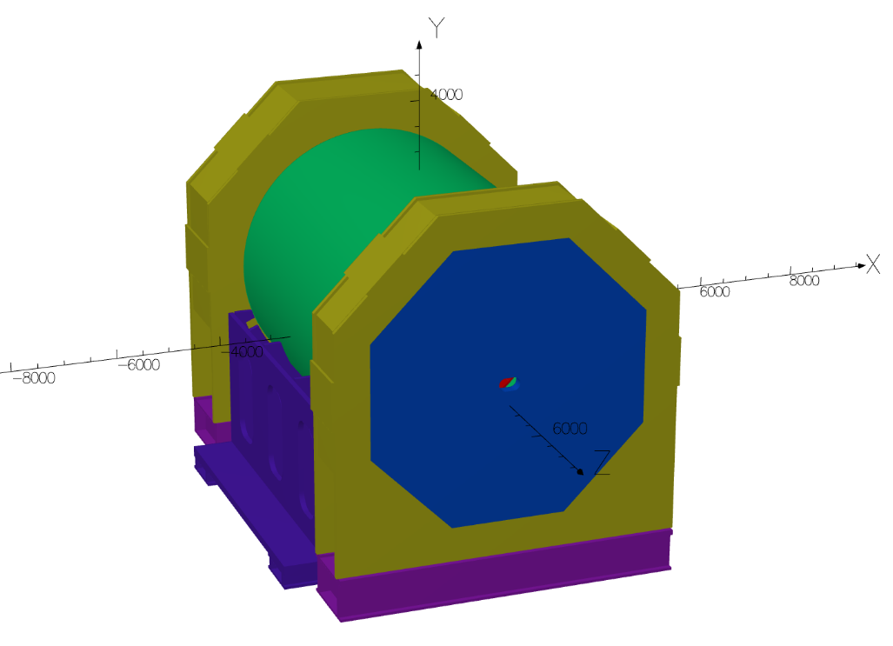
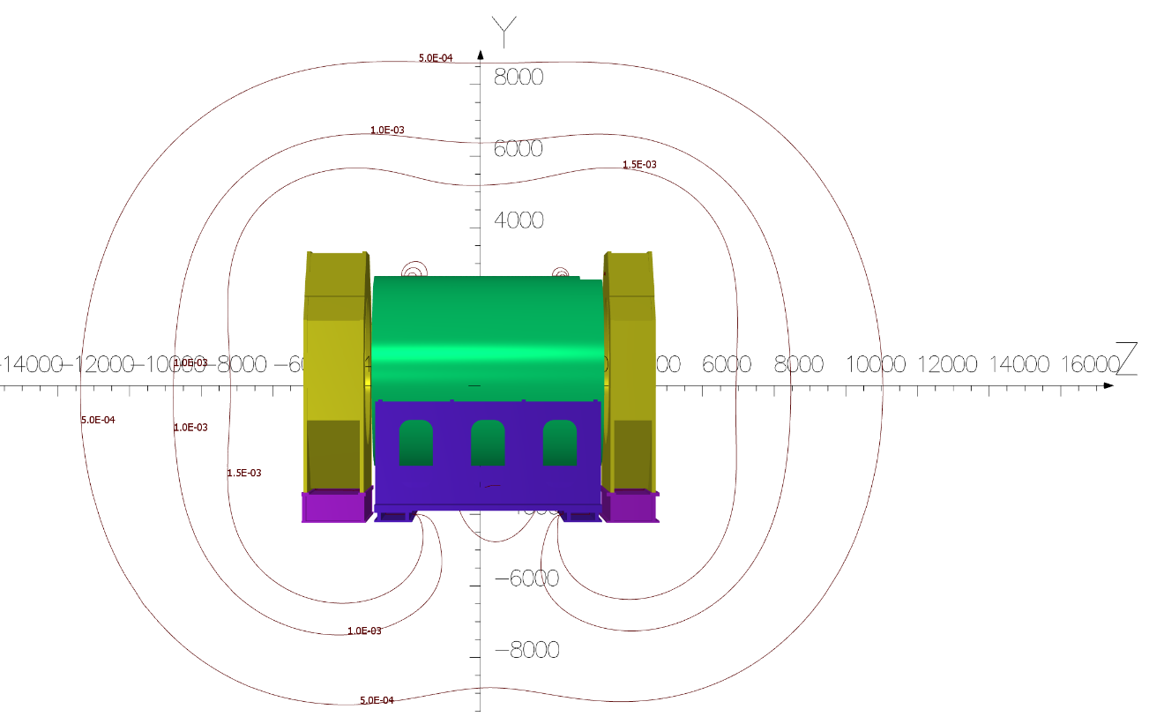
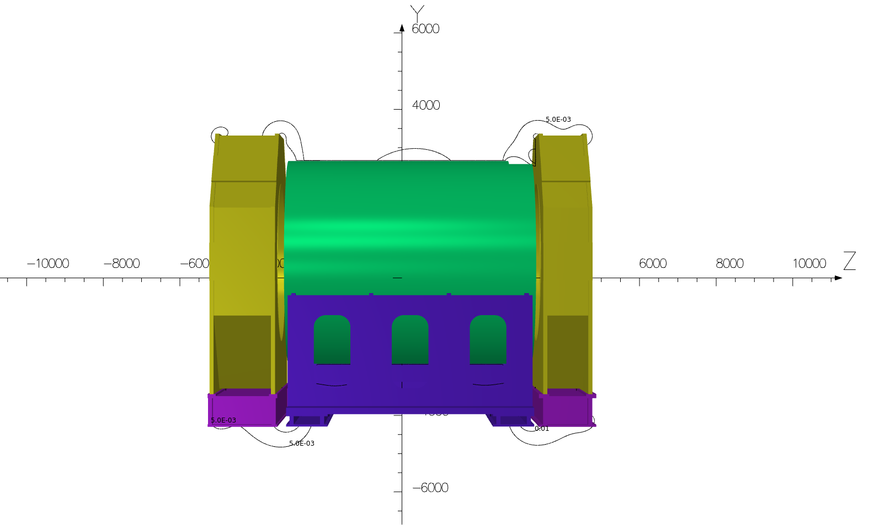
Recent Updates – Magnet Fringe Field Lines
Valerio Calvelli (CEA)
5 G, 10 G and 15 G lines in YZ plane
50 G and 100 G lines in YZ plane. The 100 G lines follow the edges of the yoke’s components.
Updated magnet geometry:
(updated after RCS was removed from the collider tunnels and IR magnet fringe field requirements were relaxed – this allowed us to reduce weight)
barrel steel is removed from the geometry,
EndCaps and Endcap cradles are new geometry
New Barrel cradle is used
New endcap oculi is used and
There are no links in geometry

Slide 11
More Recent Updates - Miscellaneous
The procurement for the scintillation fibers for the Barrel Electromagnetic Calorimeter (CD-3A scope) was awarded to Kuraray.
A Record of Decision was signed by both ePIC and EIC detector project leadership to constrain the number of readout channels of the CALOROC ASIC (Application Specific Integrated Circuit) for readout of calorimeters with Silicon Photomultiplier sensors to 36 channels and evade an extra engineering run.
The individual quality control plan for the data acquisition/computing subsystem was posted, see https://eic.jlab.org/Detector.
The inspection and test plan for the wafer probing of the Silicon Vertex Tracker was posted.
The inspection and test plan for the scintillating fibers of the barrel imaging electromagnetic calorimeter was posted.
Interfaces were updated. The Interface Control Documents related to Hadron Polarimetry and to the Detector Envelope governing the various allotted sub-detector spaces were completed and posted (see https://eic.jlab.org/Detector).
Work is ongoing to document the detector pre-ops phase, one era with cosmics and a later era with beam.

Slide 12
Update on Reviews – Planned for 2026
Preliminary Design Reviews (60% design maturity equivalent, called PDR, PDR2 or PDR3, pending the subsystem)
  PDR2: Silicon Tracking Detectors (6.10.03.01) – Jan. 27-28, 2026
  PDR2: Polarimetry (6.10.14) – February 18, 2026
  PDR: DAQ-Slow Controls (6.10.09.02) – Spring 2026 – Separated from electronics/DAQ to ensure integration in the collider common platform
  PDR3: IR Integration and Auxiliary Detectors (6.10.11) – March/April 2026 – includes 6.10.14 lumi detector
  PDR2: AC-LGAD-based Particle Identification Detectors (6.10.04; BTOF, FTOF, common systems) – April 2026
Final Design Reviews (FDR):
  FDR: Backward EM Calorimetry – Mid February 2026?
Project Reviews:
  Detector Baseline Readiness Review Feb 3 – 5, 2026
  BNL Director’s Review – Comprehensive, Mar. 9-12, 2026
  DOE OPA Status Review April 28-May 1, 2026
  CD2 IPR & ICR Fall 2026?
Other Meetings:
  7th RRB Meeting: June 9-10, 2026 – MEXT, Tokyo

Slide 13
Preparation for
Detector Baseline Readiness Assessment

Slide 14
Detector Baseline Readiness Assessment – Charge Questions
Is the design of the EIC Detector (ePIC) Subproject technically sound, sufficiently mature and on a trajectory to support a CD-2 baseline in FY2026? Will the DET subproject be ready for a DOE CD-2 review in the 4Q FY26?
Is the Detector scope well defined, with clear responsibilities? Does the baseline, including U.S. and international contributions, reflect full scope and requirements? Is the scope integrated into the EIC subproject structure such that future design evolution of complementary scope in other subprojects will not cause excessive rework or costly redesigns? Are interfaces clearly defined and controlled?
Are the DET cost and schedule estimates sufficiently complete and reliable and on a trajectory to establish baseline on the projected timeline? Do the estimates include adequate cost, schedule, and scope contingency to address the risks inherent in the remaining work and are the risks being properly managed?
Is the DET subproject being properly managed (e.g., properly organized, adequately staffed) for its successful execution? Does the baseline include the full scope, with mechanisms to manage international contributions?
Are ES&H, Procurement, and Quality being properly addressed? Is performance on CD-3A items related to DET scope satisfactory?
Has the project responded appropriately to recommendations from prior DOE/SC reviews?
14

Slide 15
Detector Baseline Readiness Assessment – Prep in good shape
To be ready: Must have:
Draft Preliminary Design Report == Draft Pre-TDR Version as is
WBS dictionary updates with scope descriptions and deliverables – done
P6 updates done (as applicable) - great progress made in various detector systems. Often just reshuffles without cost additions. Have now approved cost additions for electronics, a second engineering test article run for HRPPDs, an air bearing system for detector installation driven by (accelerator) alignment needs, rigging labor, and a more complex global support tube allowing for detector serviceability. Tracking (MPGD + SVT) updates were completed in P6 last week.
Basis Of Estimates in good order such that they are traceable – ongoing, thanks for providing input to CAMs!
Remaining review (PDR, FDR) dates finalized – have almost all weeks defined, exact dates pend on reviewers
Some Interface Control Documents – Interfaces cleaned up and made consistent with Subprojects, many draft ICDs updated, final ICDs of Magnet, Hadron Polarimeter and Infrastructure/detector envelope. See https://eic.jlab.org/Detector
Some Subsystem Individual Quality Control Plans – Have Magnet and DAQ, and can complete EEEMCAL
Some Inspection and Test Plans (component and unit tests, transportation) – see below
Multi-Party ICRADAs started and Draft (In-Kind) Project Planning Document – ICRADA for magnet was sent to INFN few months back, BNL & JLab have prepared synchronized submission to DOE. Once INFN approval in can start final process.
Should have:
Many Inspection and Test Plans – posted on eic.jlab.org/Detector (see also backup slide), more in progress – THANKS!!!
(In-Kind) Project Planning Documents – postpone, started work on the first one for the detector solenoid
Updated Budget Estimate Quotes (many in, need them early 2026)

Slide 16
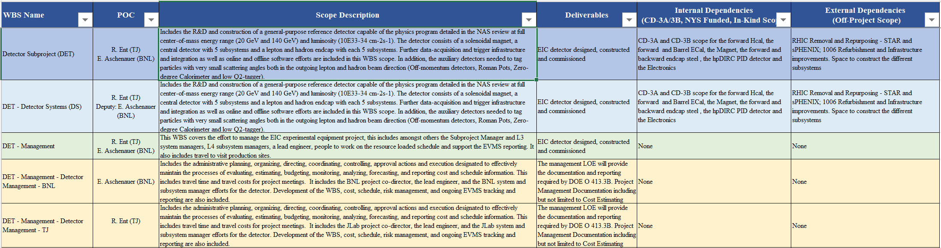
WBS Dictionary Ready
Internal Dependencies
External Dependencies
Scope Description
Deliverables
Each WBS Sub-System talk in the Detector Baseline Readiness Assessment review parallel sessions will include slides on their respective dependencies
16

Slide 17
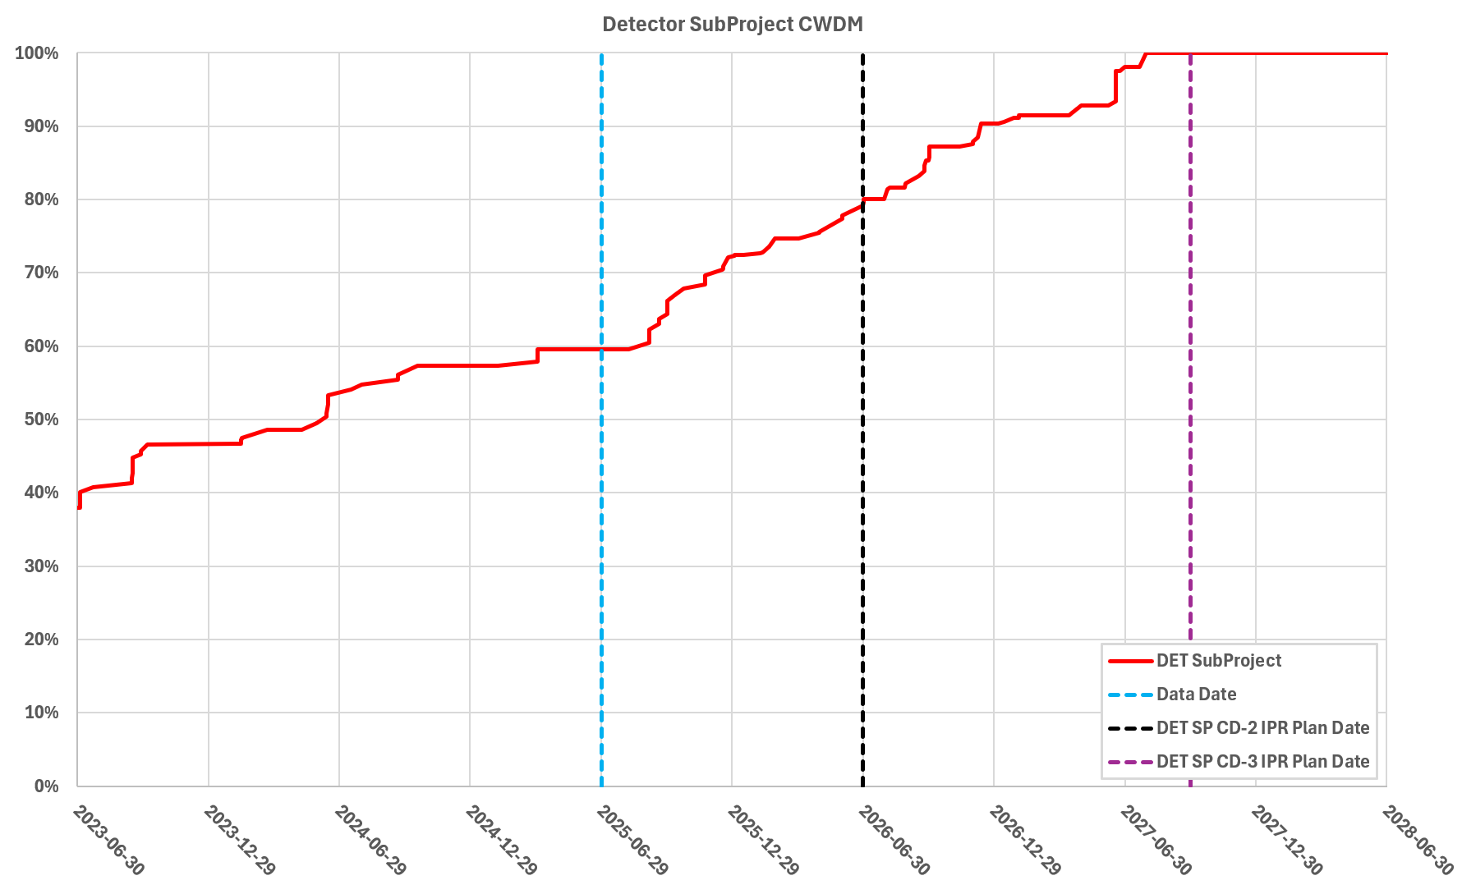
Detector Design Maturity - Summary
Cost Weighted
Design Maturity
Cost-weighted design maturity:
Present design maturity above 70%
Projected ~80% in June, 2026
All 26 subsystems have already received at least one PDR
End-of-January 2026 projection: only need to complete the final (60%) PDR for 3 subsystems
17

Slide 18
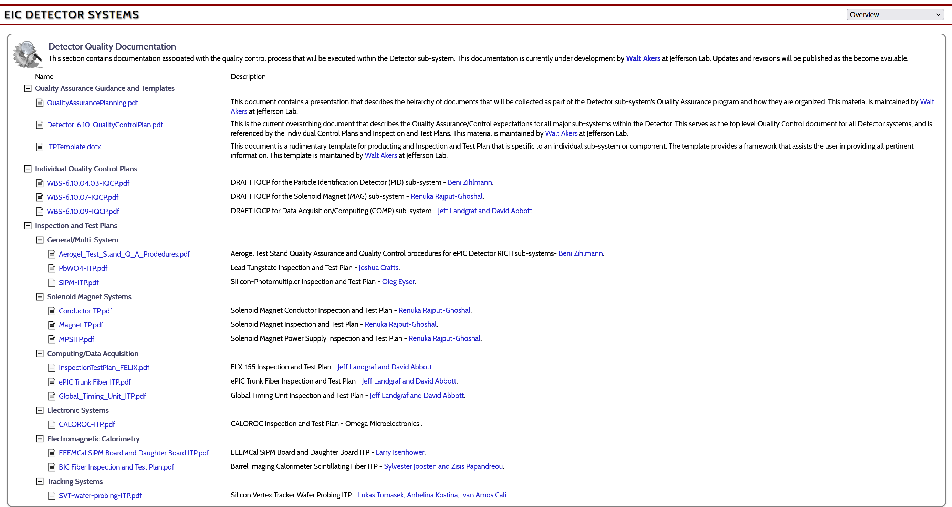
Documenting the Information
Requirements, Interfaces, Quality Assurance
Excellent start on Inspection and Test Plans! This week: also received SVT Modules ITP.
Need to complete ITPs in next few months.
18

Slide 19

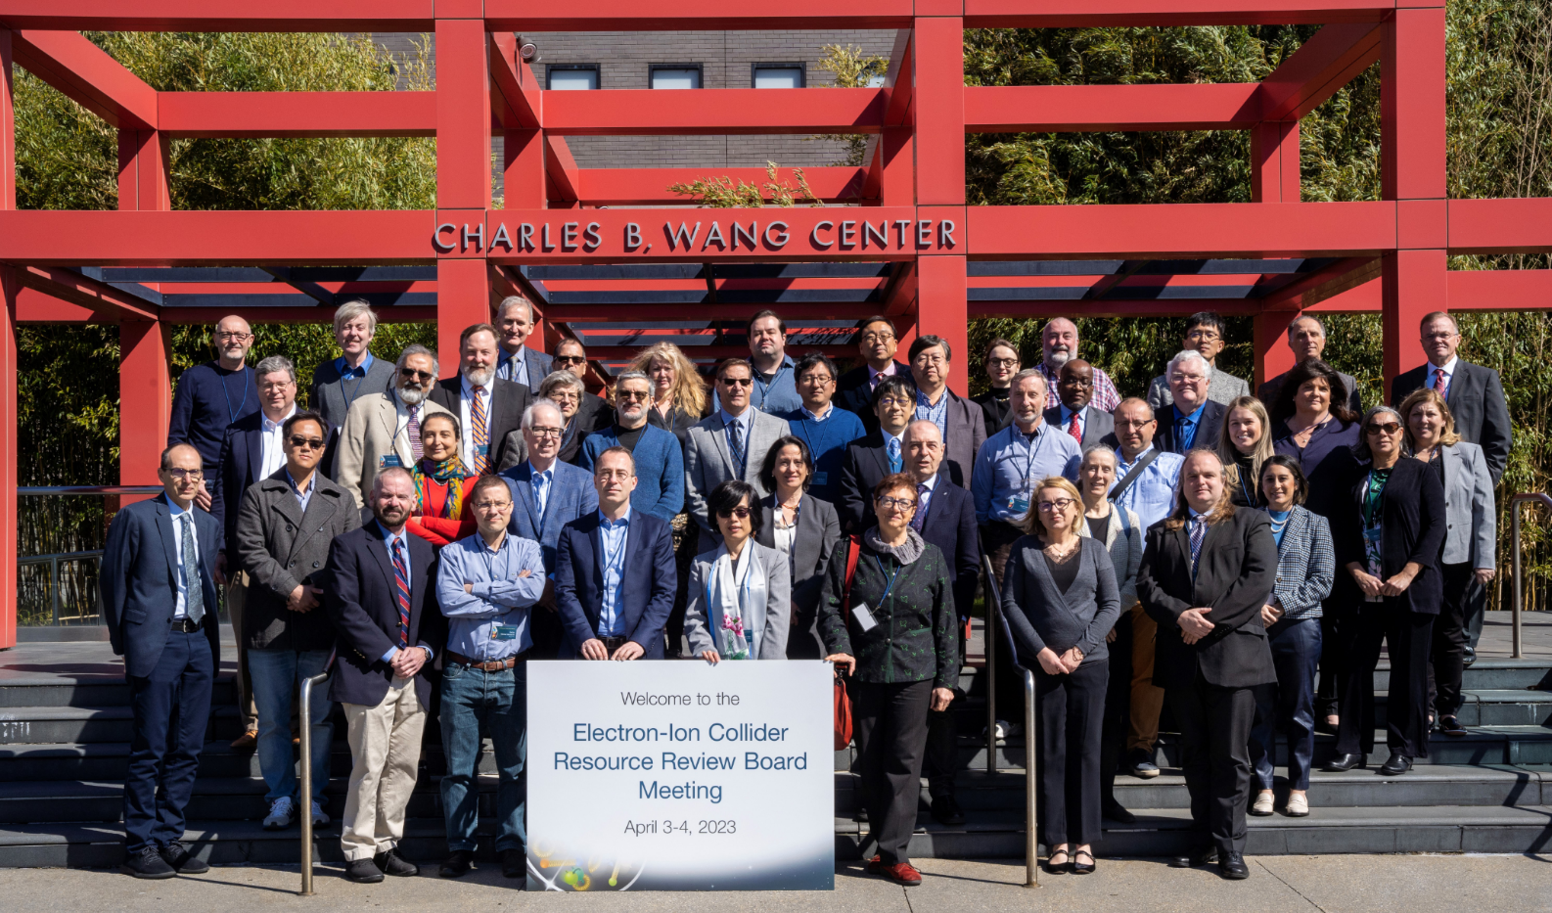
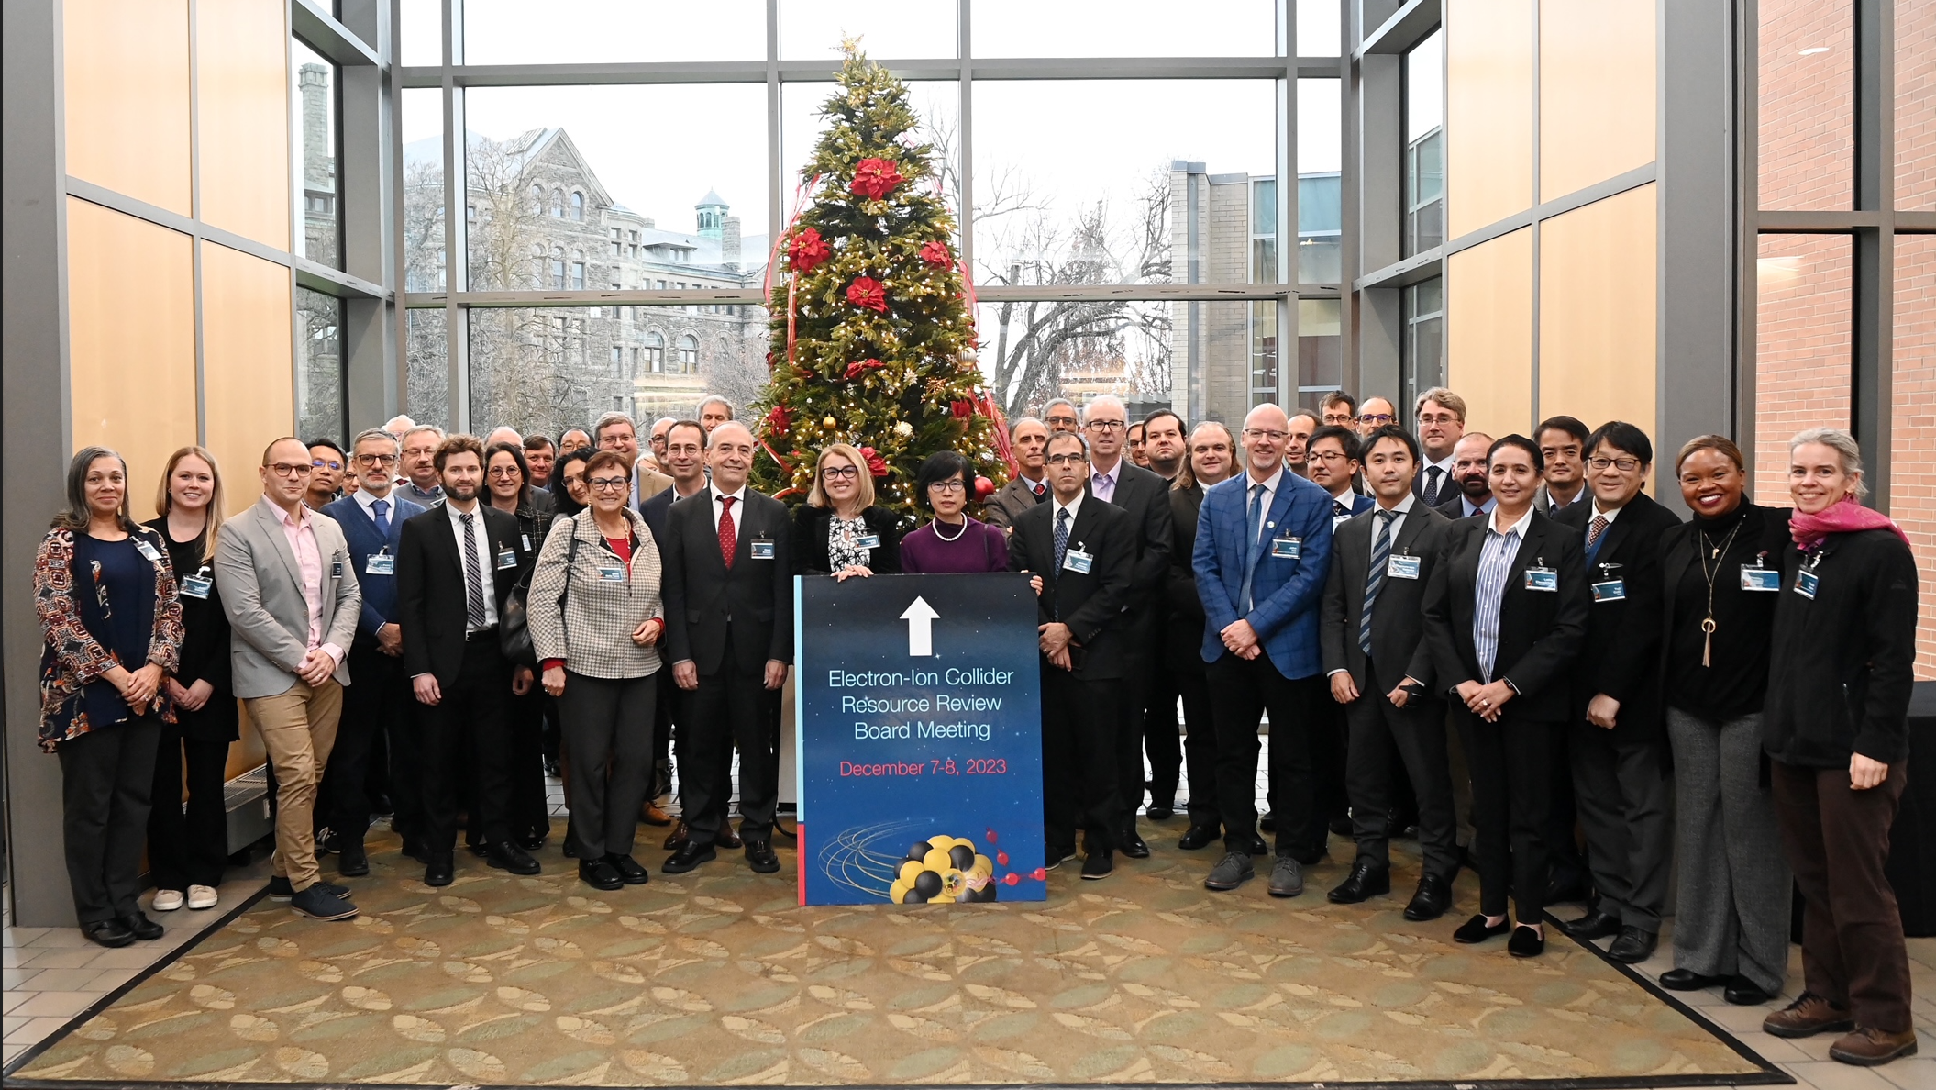
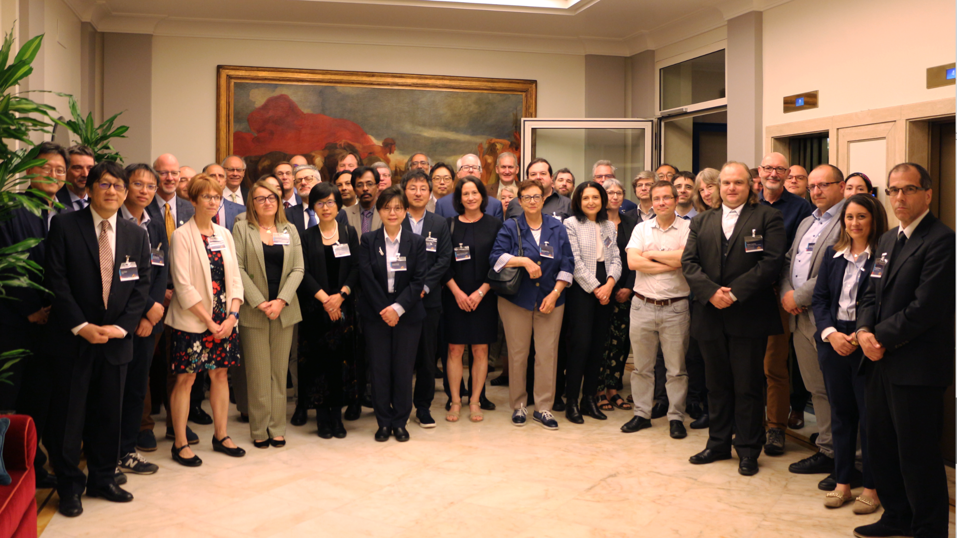
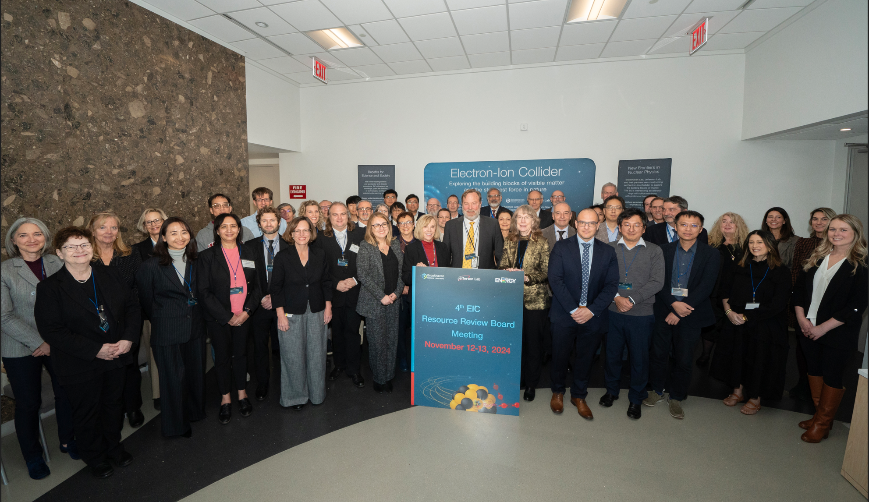
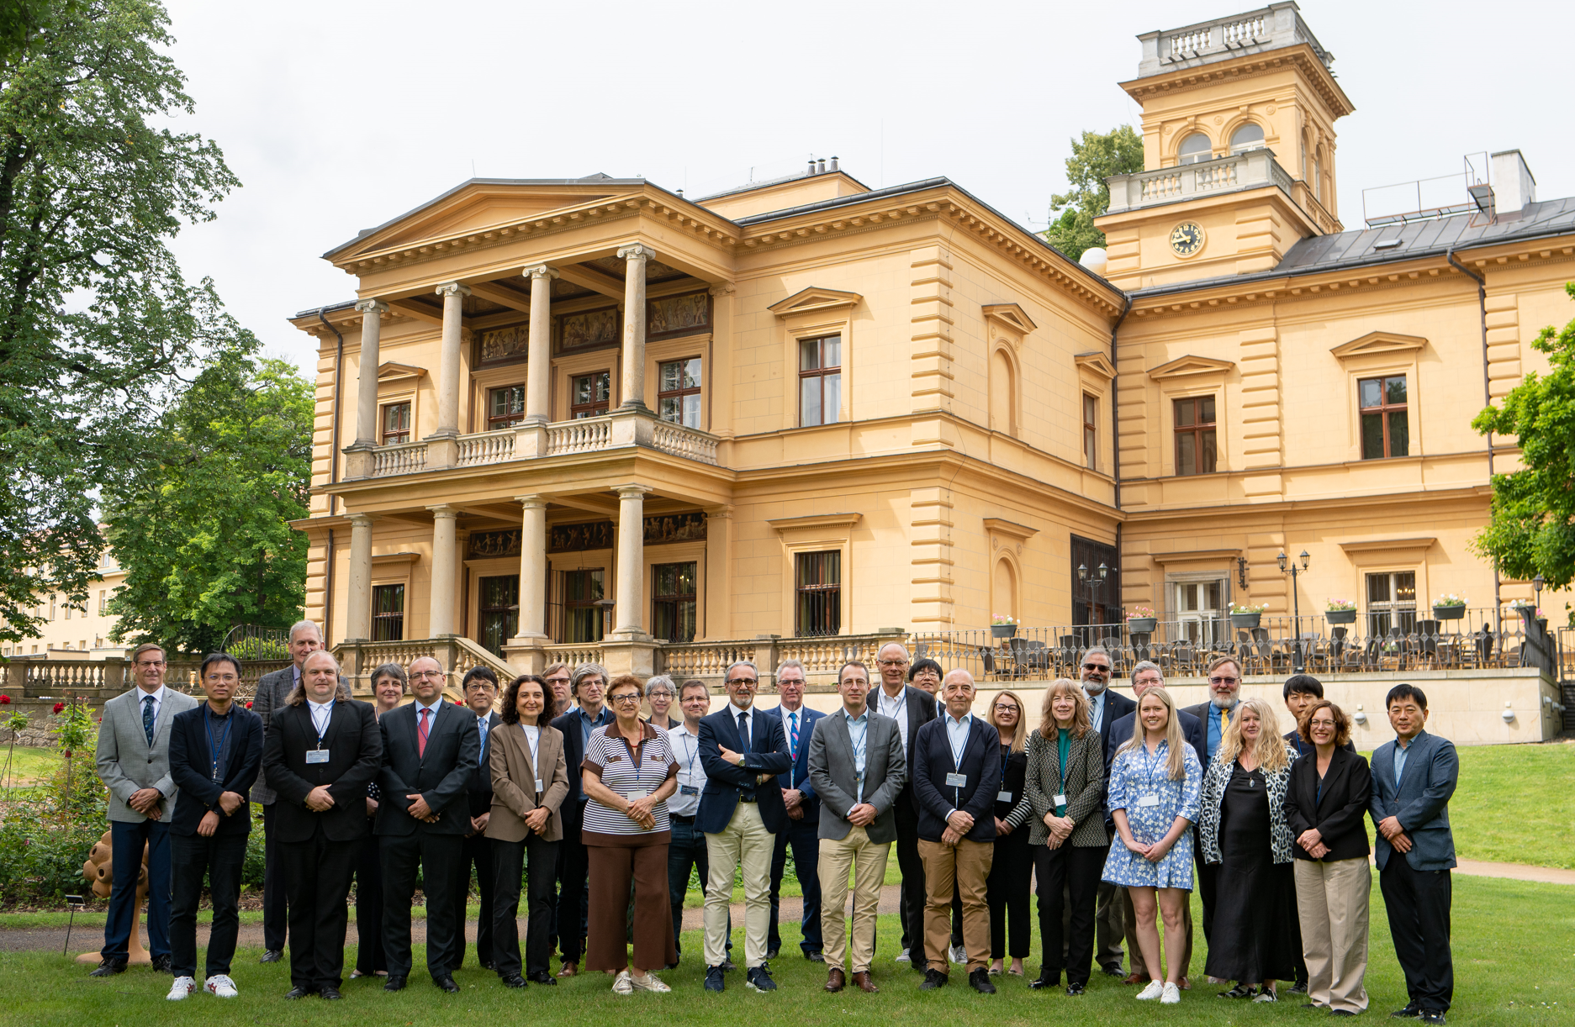
Resource Review Board (RRB) Meetings
DOE and the host labs promote the EIC as a facility “fully international in character.”
Strong international participation included: Armenia, Brazil, Canada, CERN, Czech Rep., France, India, Israel, Italy, Morocco, Japan, Poland, South Korea, Senegal, South Africa, Taiwan, UK
April 3rd-4th, 2023 - Stony Brook University, New York, U.S.A
December 7th- 8th,2023 - Catholic University of America, Washington, D.C, U.S.A.
May 6th-7th, 2024 – INFN, Rome, Italy
November 12th-13th,2024 – BNL, New York, U.S.A
June 5th-6th,2025 – Czech Ministry, Prague, Czech
November 4th-5th, 2025 – BNL Science & User Support Center, New York, U.S.A.
Future:
June 9th-10th 2026 – MEXT, Tokyo, Japan
November 2026 – U.S.A.
June 2027 - Interest from Taiwan & France

Slide 20
EIC Project Developments

Slide 21
EIC Planning Dates - I
Milestone |  | Milestone
DOE Independent Project Review (IPR) | Jan. 7-9, 2025 | Assessments of Baseline Readiness for SPs | Nov’ 25 – Apr’ 26
Start Developing Scope of Subprojects | January 10, 2025 | Interaction Region | Nov. 18-20, 2025
IR SC Magnet Steering Group Meetings - Monthly | January 17, 2025 | Accelerator Storage Rings | Jan. 14-16, 2026
Project Advisory Committee Meeting | February 11, 2025 | Detector (Rescheduled from November 12-14) | Feb. 3-5, 2026
Detector Advisory Committee Meeting | June 11-13, 2025 | Global, Energy and Luminosity Ramp-Up (Full Project) | Feb. 9-13, 2026
EIC Advisory Board Meeting | June 17, 2025 | Electron Injector (follow-up to Apr ‘25 Review) | April 2026
DOE CD-3B ESAAB Approval | Pending | EIC Project Advisory Committee (2-3 hrs, virtual) | Dec. 2, 2025
DOE IPR Focused Status Review | August 5-7, 2025 | EIC Project Strategy Workshop - Stakeholders | Dec. 4, 2025
DOE RHIC R&R/Injector Operations Review | Sept. 8-10, 2025 | EIC Management Team Retreat – Action Plans | Dec. 5, 2025
Machine Advisory Committee Meeting | Sept. 16-18, 2025 | RHIC Operations Concludes and R&R Starts | January 2026
Infrastructure Construction Advisory Committee | October 1-2, 2025 | BNL Director’s Review – Comprehensive | Mar. 9-13, 2026
EIC Advisory Board Meeting | October 10, 2025 | DOE IPR Comprehensive Review | Apr. 28-May 1, 2026
Resource Review Board Meeting (BNL) | Nov. 4-5, 2025 | DOE CD-2/3 Approval for Accelerator Rings | ~End 2026
 |  | DOE CD-2 Approval for Detector | ~End 2026

Slide 22
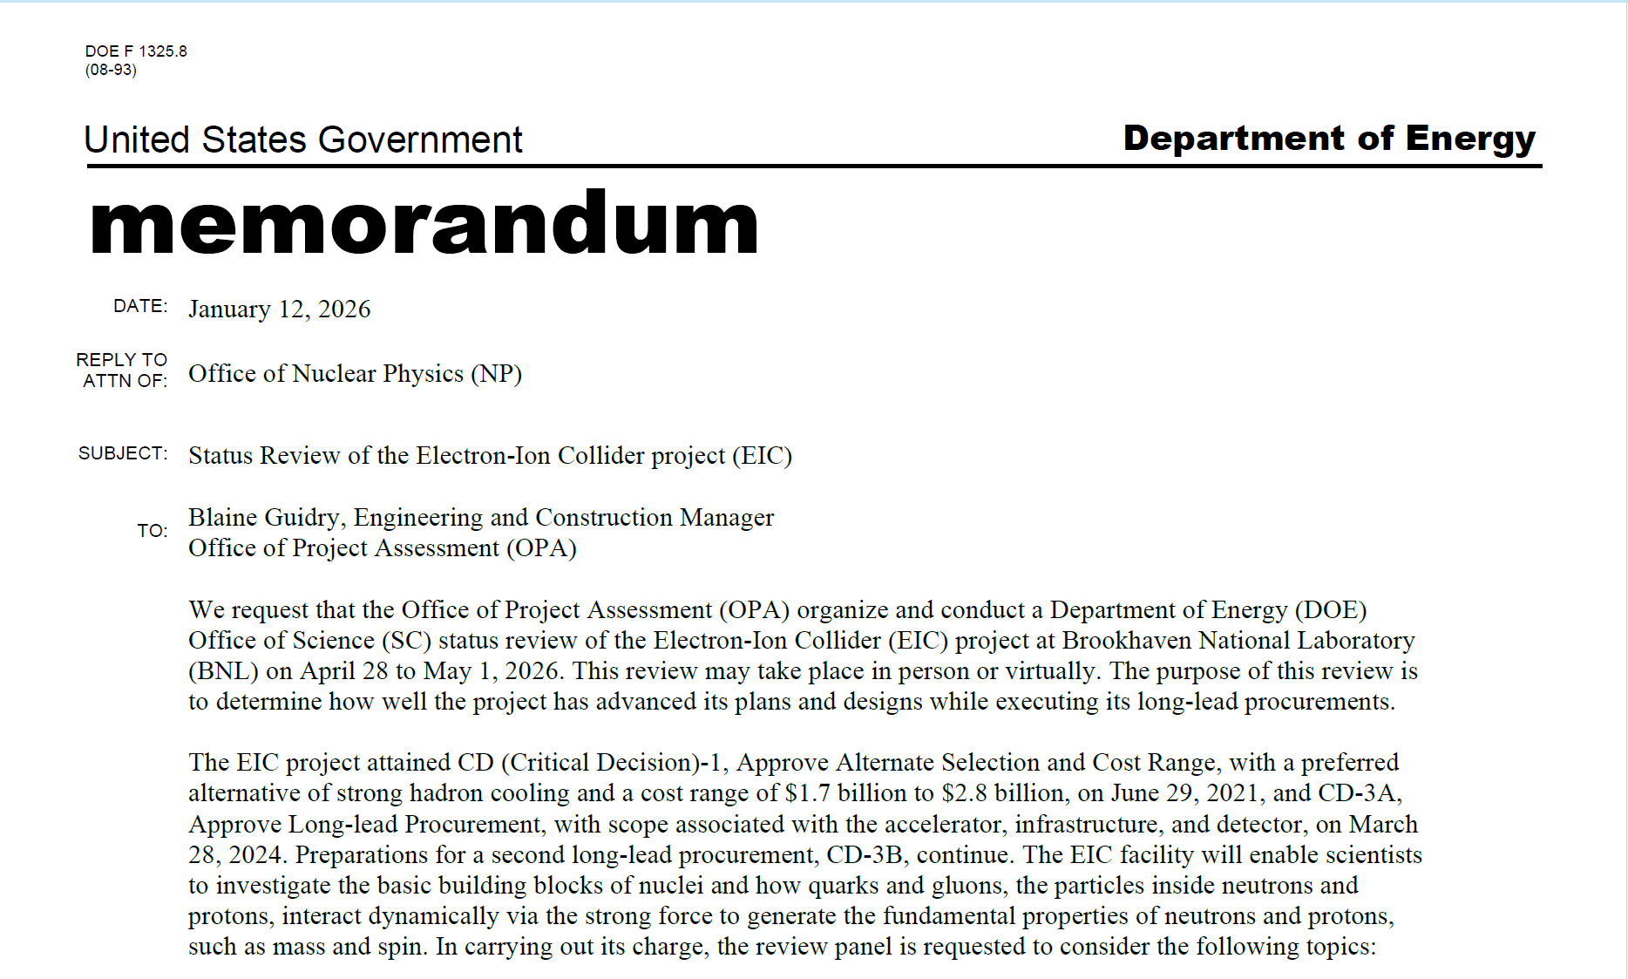
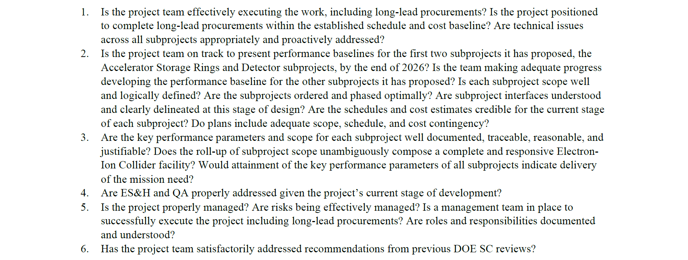
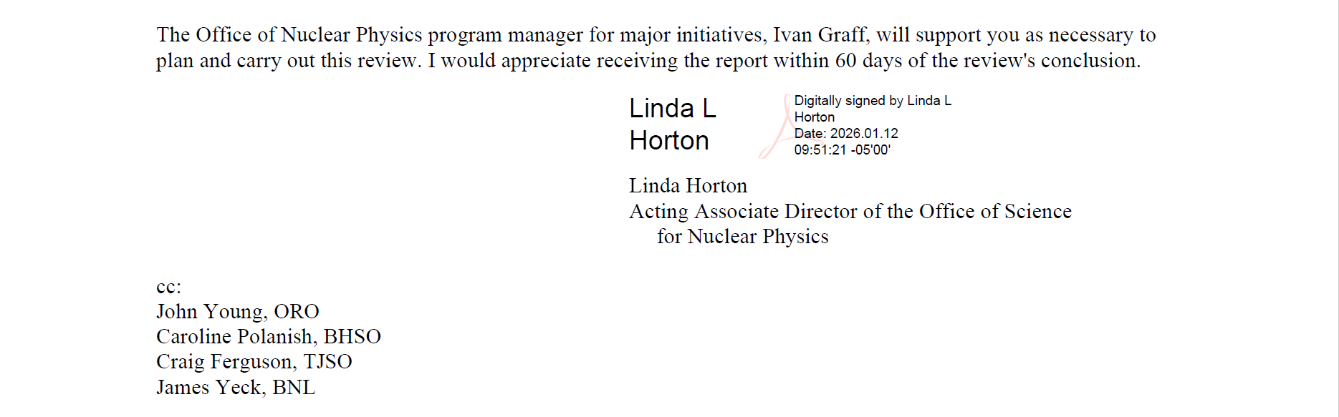
Recent Update – Charge for OPA Review

Slide 23
EIC Key Challenge
The lab directors (BNL, JLab) and the EIC Project are working with DOE to find a path forward that provides the funding needed for the EIC project
→ Deliver scope necessary for Mission Need for a Total Project Cost (TPC) and
at a funding profile that is realistic.
    Funding plans consider both the EIC line-item project and the portfolio of scope outside of the project that is essential for the EIC facility.
Guidance given to us (EIC project) by lab directors: Remain at a TPC below 3B$
→ Project Strategy Workshop December 2025
Participants included EIC primary points of contact and DOE observers
Chairs of Advisory Committees, Steering Group, and EIC Governance Boards
EIC Users Group and ePIC Collaboration Leadership
Members of the EIC Project Advisory Committee
Engaged stakeholders in the development of plans for delivering the EIC facility and efforts to align with DOE funding guidance and the mission need.
Assessed progress on revising plans based on new funding guidance
Discussed plans and results of the Assessments of Baseline Readiness
Discussed plans for establishing subproject baselines and starting construction in 2026

Slide 24
Project Update December 23, 2025
Dear EIC Project Team,
Attached is a revised note summarizing the current preliminary cost baseline for the EIC line-item project. This document is intended primarily to support internal alignment as we prepare for upcoming subproject readiness assessments and continue our engagement with DOE.
A few points of context as you review the note:
DOE guidance is to target a $2.8B Total Project Cost for the preliminary baseline, corresponding to the upper bound of the approved CD-1 range. This note reflects that guidance and signals our intent to take it seriously.
The baseline is preliminary by design. Further refinement of subproject scope, design maturity, and cost estimates is expected prior to CD-2. Any future cost growth would be addressed through approved preliminary baseline changes.
The purpose of this note is to clarify our current position and to outline how we are organizing the path toward CD-2/CD-3.
The next steps will be to:
Establish a timeline leading up to CD-2;
Identify areas requiring further consideration of scope, value engineering, and cost and requirements scrubbing;
Update the preliminary baseline monthly; and,
Establish a funding profile that supports the preliminary baseline and evaluate the implications of current guidance.
Please treat this as a working document intended to support internal coordination and disciplined planning. Feedback is welcome, particularly where additional clarity would be helpful as we move toward upcoming assessments.
Thank you.
Jim

Slide 25
Detector Cost Status
(High-Level Targets given to us by Project Director, without contingency)
Present Cost Summary:
LLP Actuals thru Nov. 2025: $4.4 M
LLP (CD-3A/CD-3B): $ 29.2 M
Actuals thru Nov 2025: $ 38.2 M
Cost to DOE to go in present P6: $ 198.2 M (without contingency)
Includes Polarimetry, PreOps, Management (not listed in the table in next slide)
This is for a technically driven schedule → will increase with a more realistic budget profile
Base Total: $236.4 M (Base Total Addressing Recent UKRI Challenge: $242.4 M)
In-Kind Goal Met:
Re-Use: $ 22 M
In-Kind: $ 96 M (but a recent wrinkle for UK In-Kind assumptions)

Slide 26
Detector Cost Status
Detector | Total Cost excl. LLP | DOE Cost to go | Cost in LLP | In-Kind | Re-Use
Si Tracker | $ 41.8M | $ 24.5M |  | $ 17.8M
MPGD Tracker | $ 11.8M | $ 4.94M |  | $ 6.1M
dRICH | $ 10.9M | $ 2.5M |  | $ 7.9M
DIRC | $ 14.7M | $ 9.1M | $ 0.8M |  | $ 5.4 M
pfRICH | $ 7.9M | $ 6.1M
Barrel ToF | $ 16.4M | $ 2.9M |  | $ 13.5 M
Forward ToF | $ 6.1M | $ 3.1M |  | $ 2.2M
forward ECal | $ 9.1M | $ 9.1M | $ 1.1M
Barrel ECal | $ 24.4 M | $ 12.3M | $ 3.4M | $ 9.2 M
backward ECal | $ 5.4M | $ 3.7M | $ 5.7M | $ 1.6M
forward HCal | $ 11.5M | $ 10.8M | $ 6.9M
Barrel HCal | $12.9M | $ 2.2M |  |  | $10.7M
Backward HCal | $ 7.3M | $ 5.3M
Magnet | $ 17.3M | $ 3.1M | $ 6.0M | $ 11.8M
Electronics | $ 46.7M | $ 28.6M | $ 1.8M | $ 15.7M
DAQ | $ 13.4M | $ 12.7M
Installation & …. | $ 39.2M | $ 30.9M | $ 3.5M | $ 0.3M | $ 5.5M
Auxiliary Det. | $ 14.8M | $1.9 M |  | $ 10.5M
Cost Summary:
Re-Use: $ 21.5 M
In-Kind: $ 96.7 M
Actuals thru Nov 2025: $42.6M
LLP Actuals: $4.4M
Non-LLP Actuals: $38.2M
LLP (CD-3A/CD-3B): $ 29.2 M
Cost to DOE to go: $ 198.4 M
Includes Polarimetry ($9.4M),
PreOps ($8.1M), Management ($6.2M)
(not listed in the table)
This cost-to-go is for a technically driven schedule, it will go up with a more realistic funding profile once given.
Cost-to-go Target given to us:
$212M … but a recent wrinkle for In-Kind assumptions ☹

Slide 27
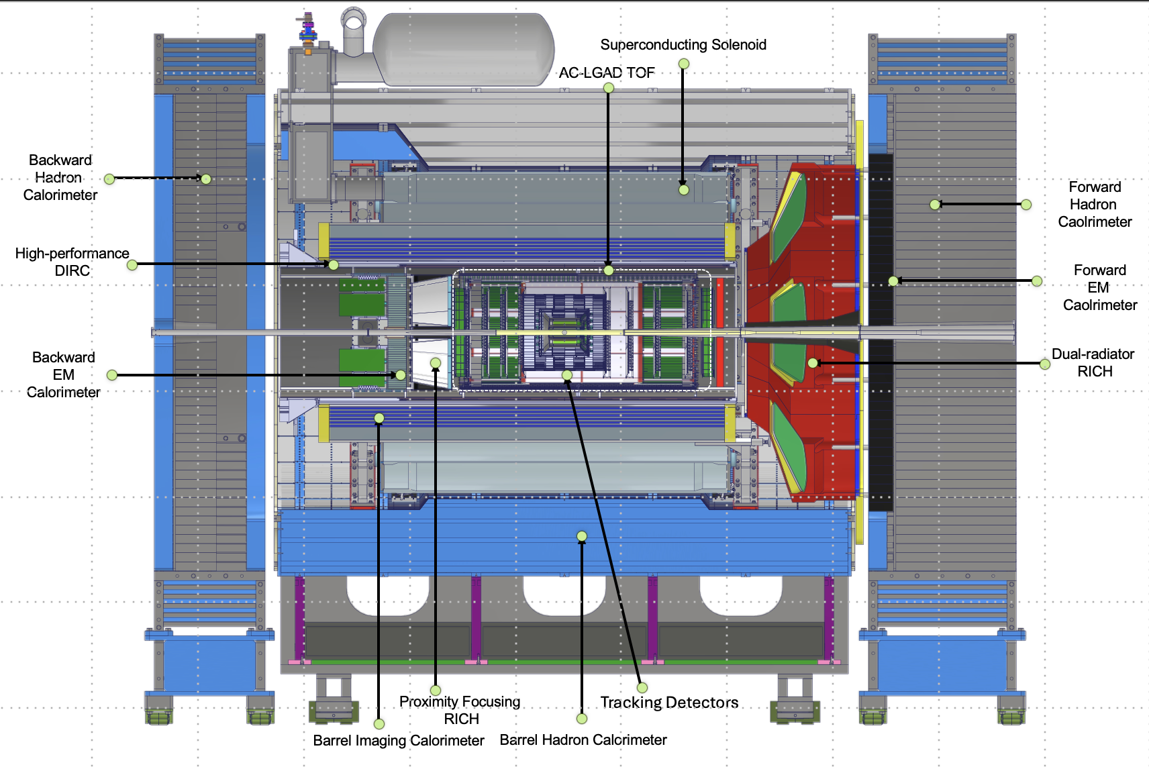








In-Kind Contributions – Updated to P6 Status As Is Now (January 2026)
Luminosity
Monitor
pC Hadron
Polarimeter
Zero Degree
Calorimeter
B0 Detectors
Hadron Storage Ring
Electron Storage Ring
Low Q² Taggers
Off Momentum
Detectors
Roman
Pots
In-kind contribution goal: 30% of Detector TPC → ~100M
Reused equipment is not listed (~$21.5M); R&D and PED in-kind is not listed (~$10M)
Up-To Cost are DOE construction costs; they will differ greatly from the country proposals that include engineering and design and research activities → current $96.7M
 | Up-To Cost | Proposal Status | Tracking | ECal | HCal | PID | Solenoid | Auxiliary Det. | Luminosity | Electronics
Canada | $1 M | approved |  | Barrel ECal Readout
France IN2P3 | $7.6 M | in final stages of ministry approval |  | Rear Ecal: Cooling, Readout, Mechanics |  |  |  | RP & Off-momentum Det.: Cooling, Readout |  | CaloRoc & EICROC ASICs
France IRFU | $9.5 M | in final stages of ministry approval | Barrel MicroMegas |  |  |  | Construction Oversight |  |  | Salsa ASIC
Italy | $28 M | approved | MAPS L0-L2 μRWell Disks |  |  | dRICH (but not mirrors) | Construction |  |  | Alcor ASIC
Israel | $1.9 M | Proposal submitted |  |  |  |  |  | B0 Tracker & ECal
Japan | $14.6 M | In final stages of MEXT approval |  |  |  | Barrel Tof |  | ZDC - HCal
Korea | $8.5 M | in final stages of approval | Barrel μRWell | Half of Barrel ECal |  | Barrel & Forward ToF |  | Contribution to ZDC
Taiwan | $5 M | Authorized to be done from grants |  |  |  | Barrel & Forward ToF |  | ZDC - ECal
UK | $20 M | administrative process passed | MAPS L3 - L4 |  |  |  |  | Construction of Low-Q² Tagger | Construction of Lumi-Detector
27

Slide 28
December 19th
Santa brought ePIC bad news

Slide 29
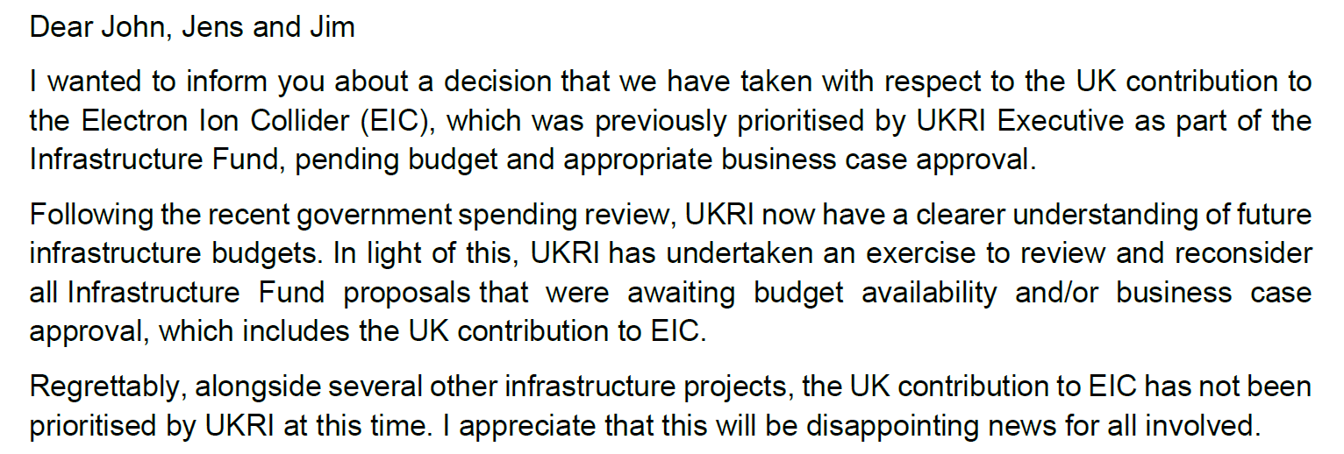
Letter of UKRI to Lab Directors of December 19, 2025

Slide 30
UKRI E-Mail of 12/19/25 – Impact Assumptions
UK contribution to EIC science development and the ePIC detector & collaboration has been and is important → It is crucial to allow UK scientists to be able to maintain their roles and leadership positions within EIC/ePIC… but situation is not clear.
UK Assumed In-Kind:
Lumi detector ~1M$
  Is required for any EIC science → Absorb as DOE Cost
Low-Q2 Detector ~3.5M$
  Almost no DOE Cost as this was assumed as UK in-kind → Delay
SVT L3/L4 ~ 15M$
  Critical towards LAS and L3/L4 of SVT barrel (and disks)
  → Keep moving as we can…
  Requires UK critical specialized labor !!!

Slide 31
Further Campaign following up on the UKRI news
Several letters were sent to UKRI this week to point to the impact of their decision on UK scientists and their long-standing legacy and impact on EIC science and detector, to the impact on the DOE/EIC project, and on the long-term engagement in international scientific collaboration
  A letter from DOE to UKRI
  A letter from the Lab Directors (BNL & JLab) and the EIC Project Director
  A letter from the ePIC spokespersons
  A letter from the EIC-UK Collaboration

Slide 32
Guiding Principles for Scope Delay
Remember:
The ePIC Detector is designed to fulfill the EIC mission need science → NAS Science Report
Detector DOE scope is < 10% of the Project TPC augmented by large in-kind contributions
Guiding Principles:
Detector components can not directly impact start of the community-vetted NSAC/NAS science
Detectors with large in-kind contributions represent crucial engagement by the international community and must be maintained
Hadron, electron polarimetry and luminosity monitor cannot be touched as they are needed for collider commissioning
Detectors crucial to detect the scattered electron (or DIS kinematics) cannot be touched as they are needed for the entire science program
Detector elements that function as magnet flux return cannot be touched
We exclude options that substantially increase risk or have large coupling to CD-3A & CD-3B scope
Changes need to be recoverable on reasonable time scale without requiring a year+ shutdown

Slide 33
Mitigations After New Guidance and UKRI Info - Updated
Given the <3B$ TPC, accelerator scope will also be limited → we will not have 18 GeV electrons at the start
We have to assume the detector DOE costs-to-go are $212M at best (for a technically driven schedule and without contingency)
  It is not clear if this will not change, the EIC project as a whole is not yet at the <3B$ goal with sufficient contingency
  We do benefit from a) $38M actuals costs to date, b) $29M in LLP scope, and c) large projected in-kind contributions
We were at a projected costs-to-go that seemed within Target (with lean labor assumptions and with an optimistic budget profile)
  The UKRI letter implies a potential large increase of the DOE cost-to-go
  We need to pick up the essential Lumi Detector as DOE scope, with an estimated cost-to-go of ~$1M
  We need to keep the critical ITS3/LAS efforts moving → This would increase DOE costs-to-go by ~$15M
    Note that this DOES rely on being able to keep the UK critical skill labor; since some of those are at UK national labs this may also be an issue…
We consider it critical that all ePIC Detector Sub-Systems can continue beyond PDR-level (almost there) to full E&D completion (90% design-maturity FDR-level) to allow the UK situation to evolve and seek further in-kind.
Mitigation to ensure we can baseline the detector given while keep working on ITS3/LAS:
  Delay forward TOF construction
  Delay backward HCal construction
  Delay Low-Q2 Detector
  Delay Astropix layers construction (DOE scope only)
  Delay electronics (HV, LV, FEB) that accompanies these systems
The goal of the above was to have a backup solution might the UK situation not be resolved as ePIC must have a means to measure luminosity and continue the Silicon/ITS3 work. The Project Control Analysts and the CAMs have added this with filters in P6 to verify we can remain within the $212M DOE cost-to-go Target.

Slide 34
Summary
ePIC is technically baselined since Spring 2024
Draft Preliminary Design Report (== pre-TDR) complete.
Cost-weighted design maturity is >70% now and is projected to be > 80% by CD-2 review.
~$40M actuals to date, $29M in CD-3A/CD-3B scope, $212M DOE Cost-To-Go
CD-3A scope is making good progress!
Preparing for CD-3B authorization
  several procurements are ready to go, as they are folded in as options in CD-3A contracts.
Goal of $100 M in-kind is achieved, but need to formalize agreements
  Backup solution in place to address UK funding wrinkle
CD-2 required documentation is in good shape, see https://eic.jlab.org/Detector/
34

Slide 35


Slide 36
Update on Reviews – Completed in 2025
Preliminary Design Reviews (60% design maturity equivalent, called PDR, PDR2 or PDR3, pending the subsystem)
  PDR2: Cherenkov-based Particle Identification Detectors (6.10.04; pfRICH, hpDIRC, dRICH) – April 1-2, 2025
  PDR3: Electronics/DAQ-computing (6.10.08. 6.10.09.01) – September 3-4, 2025 (this does not include slow controls)
  PDR3: Barrel EM Cal (6.10.05.02) – September 17-18, 2025
  PDR (60%) Barrel & Forward & Backward HCAL (6.10.05.01; 6.10.06.02; 6.10.06.03) and forward ECAL – October 30-31, 2025
  PDR: Magnet Cryogenics and infrastructure (6.10.07) – November 4-5, 2025 (integrated in overall EIC Project Cryogenics PDR)
  Peer Review: AC-LGAD-based Particle Identification Detectors (focus on sensors) – December 3rd 2025
  PDR: Integration, Infrastructure and Installation (6.10.10) – everything inside & outside GST, includes cradle, HCAL, etc. – Dec. 8-9, 2025
  PDR: MPGD Tracking Detectors (6.10.03.02) – Dec. 15, 2025
Final Design Reviews (FDR):
  FDR: Final Design Review of the BABAR DIRC Bar Refurbishment for the High Performance DIRC Particle Identification Detector – April 1, 2025
Project Reviews:
  DOE OPA CD-3B Review – January 7-9, 2025
  “Red Team” Review (acts as Director’s Review for DOE OPA Focused Status Review) – May 20-21, 2025
  Comprehensive ePIC/EIC Detector Review by Detector Advisory Committee – June 11-13, 2025
  DOE OPA Focused Status Review – August 5-7, 2025
Other Meetings:
  EIC International Computing Organization (EICO) – April 2–4, 2025 @BNL
  Detector R&D Day hosted by ePIC and EIC Project – April 16-17, 2025
  Technical interchange meeting with EIC Computing and Software Advisory Committee (ECSAC) – May 12, 2025
  5th RRB Meeting: June 5-6, 2025 – Prague, Czech
  10th DAC Meeting – Comprehensive look to design status and readiness for CD-2. June 11-13, 2025.
  EIC Software & Computing annual review – October 6-7 @ JLab (and Echelon 0–1 mini-workshop on October 8)
  6th RRB Meeting: November 4-5, 2025 - BNL

Slide 37
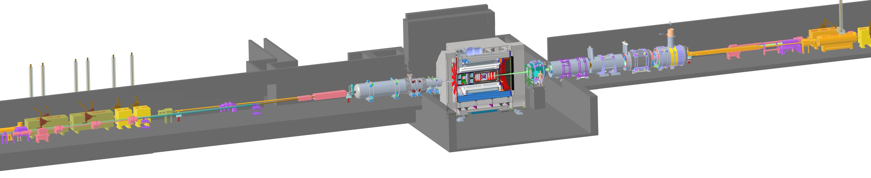

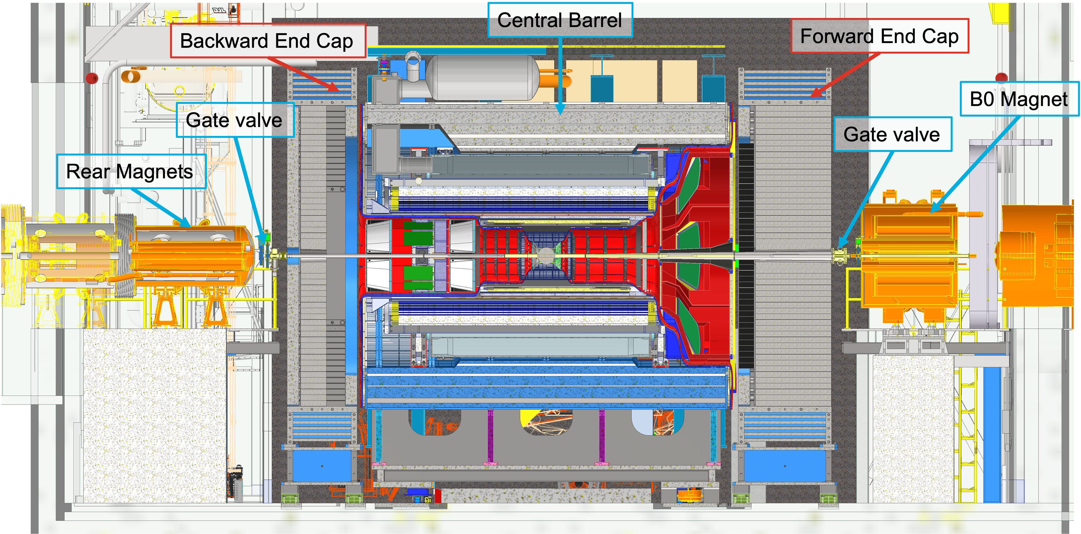
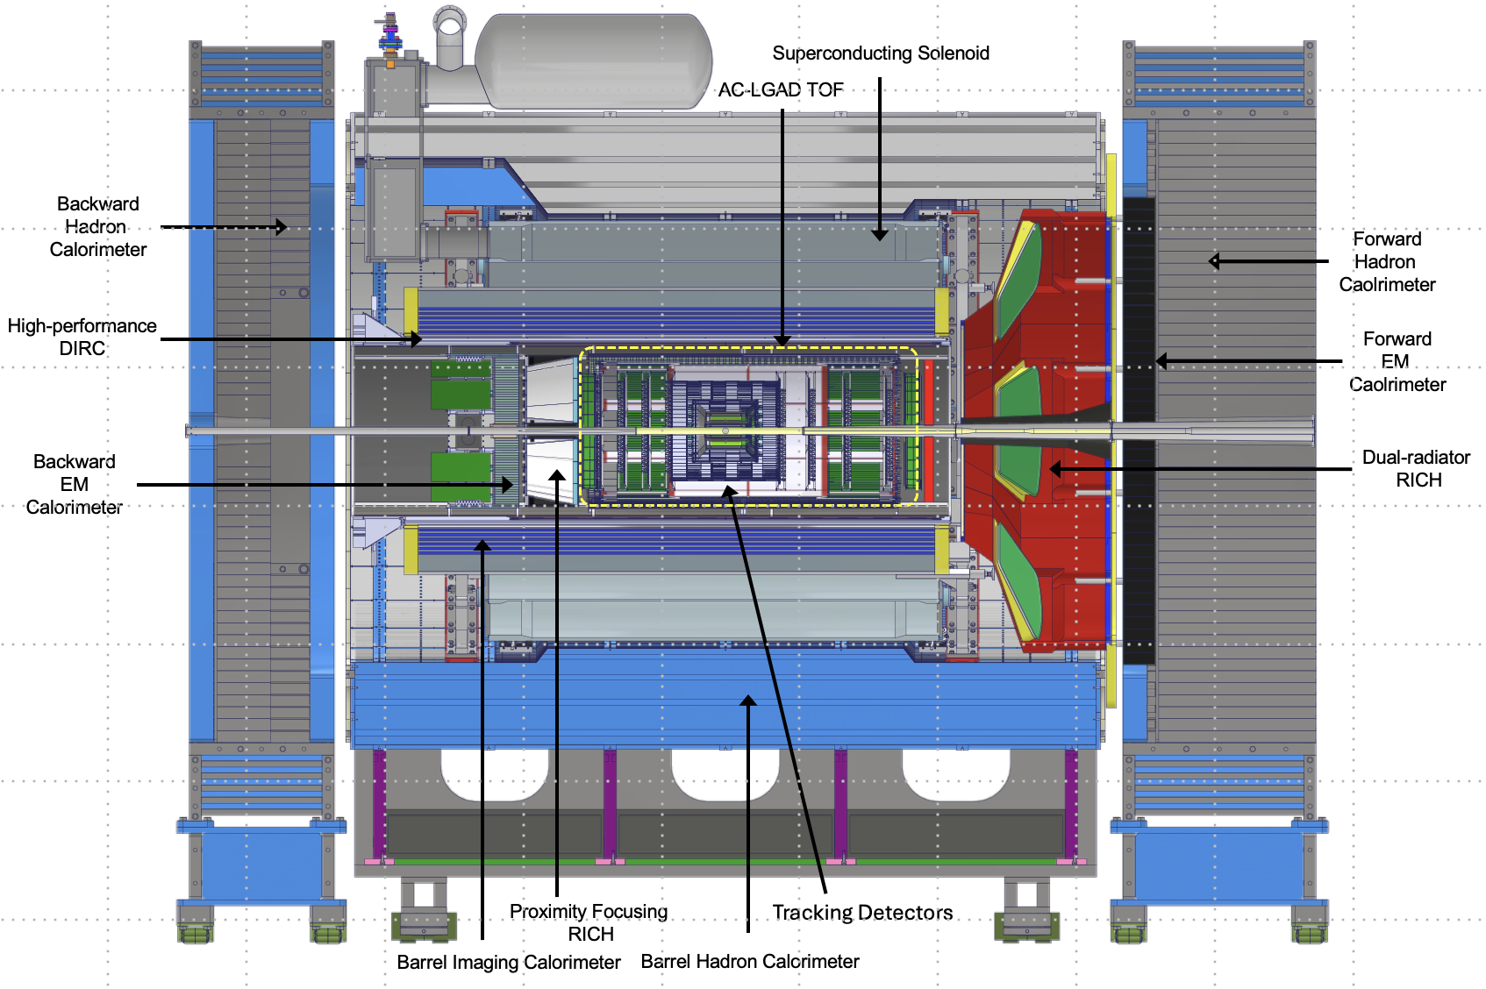
Subproject 6.03 (ePIC Detector) Scope Overview
Zero Degree Calorimeter
electron beam
Luminosity
System
p/A beam
Low-Q2 Taggers
Roman Pots (RPs) and
Off-Momentum Detectors (OMDs)
B0 Magnet
Spectrometer
ePIC detector:
26 subsystems over ± 40 m
to measure particle momenta, energy and particle type
3 electromagnetic calorimeters
3 hadronic calorimeters
Silicon and Micro-pattern gas tracking detectors
3 RICH detectors + 2 time-of-flight detectors
7 Auxiliary detectors (Si + HCal + ECals)
fully streaming readout electronics and DAQ
electron and hadron polarimetry
Integration, Installation and Infrastructure
Non-Beam Commissioning

Slide 38
What is required of an EIC Detector
Asymmetric beam energies
  41GeV 100 to 275 GeV p/A electron: 5 GeV, 10 GeV, 18 GeV
requires an asymmetric detector with an electron and a hadron endcap
Dedicated detector to measure very low Q² at 35 m
Detectors integrated along the beam line up to 40 m
SPIN
QCD in
Nuclei
Dense Gluon
Systems
MASS
3D-Imaging
require detection of scattered electron and produced hadrons
require detection detection of all produced particles, especially the ones scattered under very small angles into the detectors along the beam line
38

Slide 39
EIC Detector Subsystems versus Science Pillars
 | Spin | Mass | 3D-Imaging | QCD in Nuclei | Dense Gluon Systems
Tracking (SVT + MPGD) | X X | X X | X X | X X | X X
forward ECal |  | X | X
Barrel ECal | X | X X | X X | X | X
Backward ECal | X | X X | X X | X | X
Forward HCal | X | X | X | X | X
Barrel HCal (reuse, also required as magnet flux return) | x | x | x | x | x
Backward HCal (becomes important at s ~140 GeV → low x) |  |  |  | o | o
dRICH | X | X | X | X | X
DIRC | X |  | X | X | X
pfRICH | X |  | X | X | X
Magnet + Flux Return (incl. BHcal & fHCal) | X X | X X | X X | X X | X X
ToF (required SIDIS PID for low z hadrons) | o |  | o | o
B0 & RP & OMD |  | X | X | X
ZDC |  | X |  | X | X
Map of science pillars to main mission need detector components
for starting NAS science
X indicate needed subsystems to measure scattered electron
and DIS kinematics
X,X,X,X,X indicate needed subsystems to measure the hadronic final state, for Spin, Mass, 3D-Imaging, QCD in Nuclei, and Dense Gluon Systems, respectively.
o indicate subsystems needed for the full NSAC/NAS EIC science but not needed to start

Slide 40
A very busy Pre-Christmas Time
December 2025
Project Update
Dec. 9th
Project Update
Dec. 23rd
Project Update
Dec. 23rd
“…long-term success depends on aligning scope, cost, and schedule with a reasonable funding profile while meeting performance expectations. We can achieve this by working in close partnership with DOE, the EIC user community, and all our stakeholders.
Across all three activities, we made substantial progress toward defining an EIC project that will meet DOE’s approved mission need within an affordable Total Project Cost (TPC). We plan to continue along this path, while continuing the dialogue with our partners. Important work remains, particularly in aligning with anticipated annual funding profiles, but the direction is positive and the engagement from the team has been excellent.”
“…
DOE guidance is to target a $2.8B Total Project Cost for the preliminary baseline, corresponding to the upper bound of the approved CD-1 range. This note reflects that guidance and signals our intent to take it seriously.
The baseline is preliminary by design. Further refinement of subproject scope, design maturity, and cost estimates is expected prior to CD-2. Any future cost growth would be addressed through approved preliminary baseline changes.
The purpose of this note is to clarify our current position and to outline how we are organizing the path toward CD-2/CD-3.”
From the note, Preliminary Cost Baseline:
“…
DOE Critical Decision 1 (CD-1), approval of the preliminary cost range, was granted in 2021. Since that time, the EIC Total Project Cost (TPC) point estimate has increased and now approaches the upper bound of the approved CD-1 range ($2.8B). There are many reasons for the increase in the cost estimate including funding delays, inflation, and the scope changes. DOE guidance is to target the $2.8B for the preliminary cost baseline, recognizing that further refinement of subproject baselines prior to CD-2 may result in additional cost growth that would need to be addressed as the project moves fully into construction.
The table below summarizes the current preliminary cost baseline, expressed in millions of year-of-expenditure dollars. The estimates reflect differing levels of design maturity and risk across the subprojects and incorporate explicit contingency at the total project level.

Slide 41
Project Update December 9 2025
Dear EIC Project Team,
I would like to provide a brief update following last week’s key engagements: the EIC Project Advisory Committee (PAC) meeting on Tuesday, the Project Strategy Workshop on Thursday, and the Executive Management Team retreat on Friday, December 5. Each of these project focused deliberations reinforced an essential truth for complex projects like ours: long-term success depends on aligning scope, cost, and schedule with a reasonable funding profile while meeting performance expectations. We can achieve this by working in close partnership with DOE, the EIC user community, and all our stakeholders.
Across all three activities, we made substantial progress toward defining an EIC project that will meet DOE’s approved mission need within an affordable Total Project Cost (TPC). We plan to continue along this path, while continuing the dialogue with our partners. Important work remains, particularly in aligning with anticipated annual funding profiles, but the direction is positive and the engagement from the team has been excellent.
A second update concerns the DOE Independent Project Review (IPR). We are proposing to shift the IPR dates from early March to April 27–30, 2026. This adjustment reflects the reality that too many essential reviews were previously concentrated in early 2026. The updated sequence of major reviews would be:
Interaction Region (IR) Assessment of Baseline Readiness (complete) November 18-20
Accelerator Storage Rings (ASR) Assessment of Baseline Readiness January 14-16
Detector (DET) Assessment of Baseline Readiness February 3-5
Director’s Review of the EIC Project March 9-12
DOE IPR April 27-30
All reviews will be conducted in person, except for the DOE IPR which will be fully remote if federal travel restrictions remain in place. Preparing for these reviews—while simultaneously advancing our technical deliverables within available funding—places a significant demand on the project team. I continue to appreciate your professionalism and perseverance.
Finally, I want to return to our shared responsibility to reduce total project cost. Each of us plays a role in challenging assumptions, refining requirements, clarifying essential project scope, and aligning schedules with available resources to ensure we pursue the most cost-effective path forward. As you evaluate your areas, please continue asking the difficult but essential questions: Is there a better or simpler approach? Could a partner or vendor perform this work at lower cost? Can we reduce technical risk without compromising performance? Is the scope more appropriately addressed in operations? These conversations are already yielding positive results, and your continued diligence is critical. We will capture the results in detailed guidance to the subproject leads.
Thank you for your sustained effort and dedication. I will provide another update in two weeks.
Sincerely,
Jim Yeck
EIC Project Director
→ April 28-May 1

Slide 42
EIC Subprojects Target Costs ($M)
 | Subproject Title | DOE Actuals End Nov 25 | DOE Cost-to-go | DOE Cost Target incl. actuals, w/o IKC | Point Estimates Up-to-date | IKC Target | NYS
 | Long Lead Procurements & NYS | $11M (CD-3A) | $62M | $73M | $73M | $11M | $100M
 |  | $6M (CD-3B) | $45M | $51M | $51M | -
e-A collisions | Accelerator Storage Rings (ASR) | $101M | $674M | $775M | Higher | - | -
x | Detector (DET) | $38M | $212M | $250M | $250M | $100M | -
 | Interaction Region (IR) | $51M | $359M | $410M | Significant higher | $50M | -
x | Electron Injectors (EIN) | $28M | $382M | $410M | Higher | $50M | -
Full Project | Integrated Performance (IP) | $144M | $356M | $500M | (Slightly) Higher | $50M | -
Total |  | $379M | $2,090M | $2,469M |  | $261M
DOE contingency |  |  | $431M
Total Project Cost (TPC) |  |  |  | $2,900M
42

Slide 43
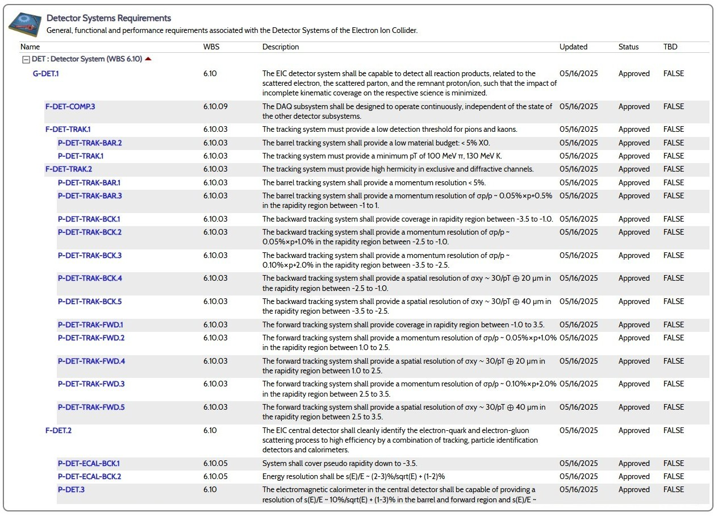
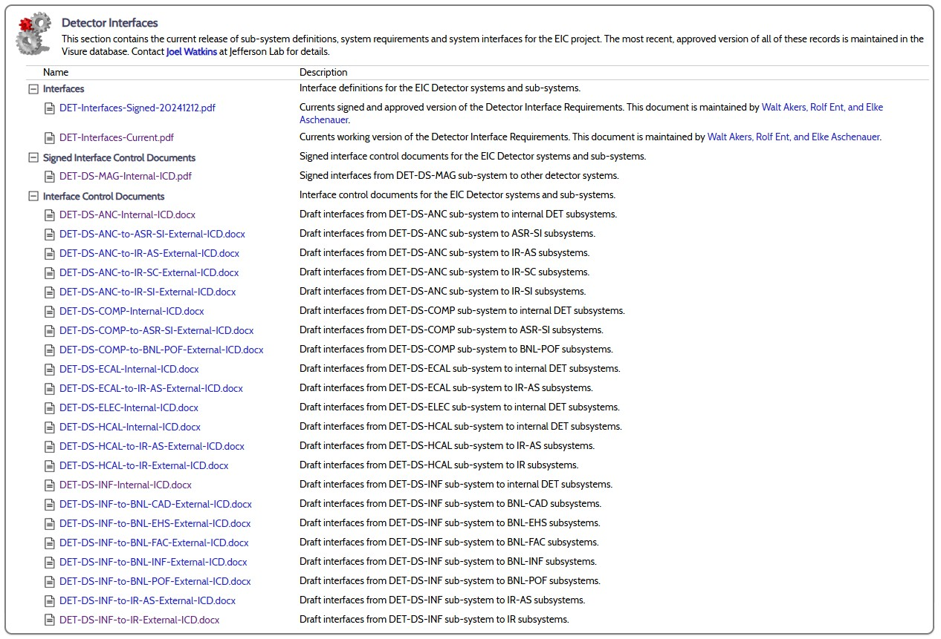
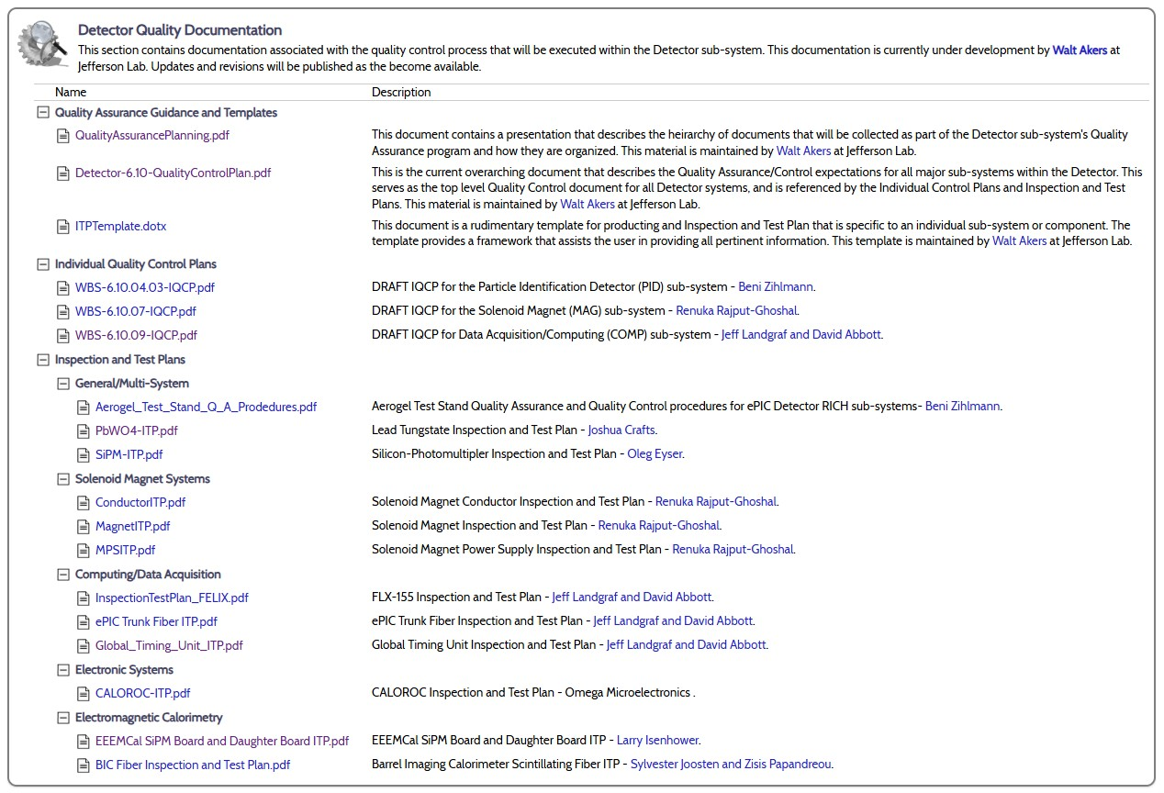
Systems Engineering – Requirements, Interfaces, and Quality Assurance
Where are we now?
  Requirements
    General, functional, and performance requirements have been completed for all systems and subsystems within the Detector.
  Interfaces
    Interfaces between Detector sub-systems have been identified and documented.
    Preliminary interfaces between Detector sub-systems and external systems have been identified and are being coordinated.
    Draft interface requirements documents and interface control documents have been published.
  Quality Assurance
    The Detector Systems Product Quality Control Plan is complete.
    Individual Quality Control Plans are in development – 3 are complete.
    Inspection and Test Plans are in active development – 13 are complete.
See https://eic.jlab.org/Detector for copies of all documents
43

Slide 44
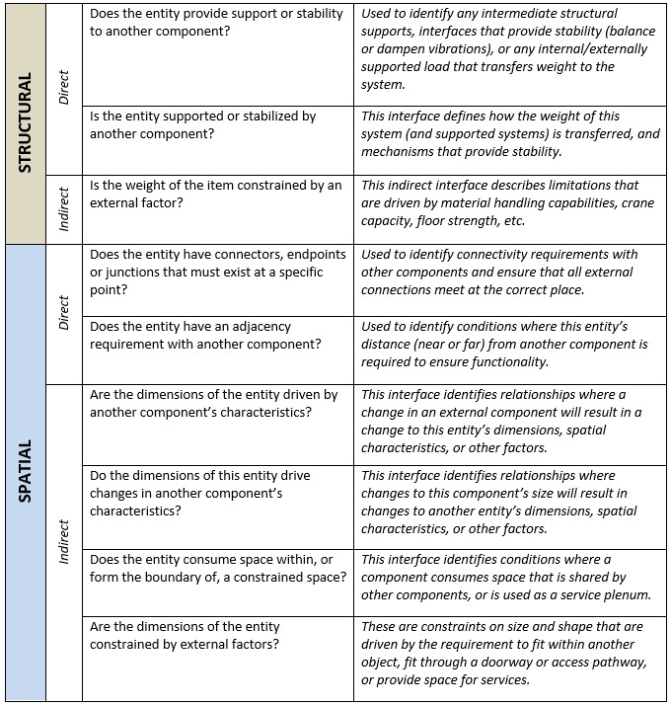
Deriving Interfaces
Interface Development
Interfaces have been derived using an interrogative process that examines the stated requirements and identified dependencies. It is a three-part process that includes:
  Interrogating Requirements
    Identify relationships or dependencies that are represented by each requirement. For each relationship, identify and document the type of interface that will be required to accommodate it.
  Interrogating Known Interfaces
    Using a list of expected system interfaces (provided by an SME), confirm that each one is represented by an interface identified in the prior step. If it is missing, then the reviewer should determine if the requirements need to be revised.
  Inter-System Interrogation
    For each interface that extends outside of the local system, ensure that there is a corresponding interface on the external system.
The current Interface Requirements Document is available from: https://eic.jlab.org/Documents/DET/Interfaces/DET-Interfaces-Current.pdf
Current and draft Interface Control Documents are available from: https://eic.jlab.org/Detector/#INTSet (recently added comprehensive ICDs for hadron polarimetry and related to the infrastructure/detector envelope)
Visit https://eic.jlab.org/Documents/InterfaceInterrogation.pdf
for more details.
44

