Slide 1





Physics Analysis Coordinators’ Report
Rachel Montgomery (Glasgow) & Salvatore Fazio (Calabria)
Rosi Reed (Lehigh)
ePIC Collaboration Meeting
BNL - Jan 20-23, 2026

Slide 2

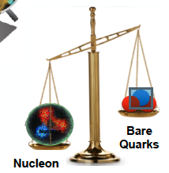
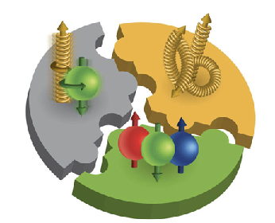
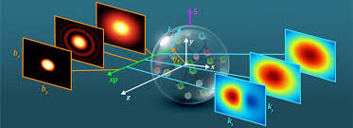
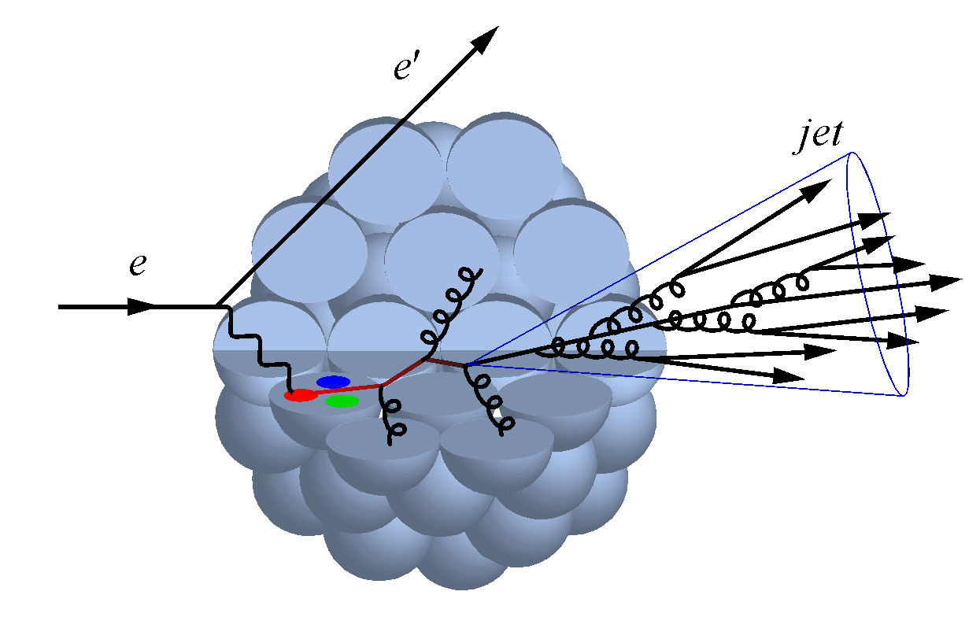


ePIC: a Collaboration driven by science!
Origin of hadron mass
“An electron–ion collider allows us to probe of the substructure of protons and neutrons via a high energy electron”… “Some of the remaining mysteries associated with atomic nuclei include how nuclear properties such as spin and mass emerge from the lower-level constituent dynamics of quarks and gluons. Formulations of these mysteries, encompassing research projects, include the proton spin crisis and the proton radius puzzle”
Wikipedia
Origin of proton spin
3D structure of hadrons (tomography)
Gluon saturation
Nuclear effects
gluon
emission
gluon recombination
?
=

Slide 3

Structure of the Physics Working Groups
PHYSICS ANALYSIS COORDINATORS
Salvatore Fazio (Calabria) - Rachel Montgomery (Glasgow)
Rosi Reed (Lehigh) - deputy
PWGs typically meet by-weekly
SINCLUSIVE PHYSICS
Win Lin (Stony Brook)
Stephen Maple (Birmingham)
  Mailing list: eic-projdet-Inclusive-l@lists.bnl.gov
  Indico: https://indico.bnl.gov/category/417/
SSEMI-INCLUSIVE PHYSICS
Anselm Vossen (Duke)
Ralf Seidl (RIKEN)
  Mailing list: eic-projdet-semiincl-l@lists.bnl.gov
  Indico: https://indico.bnl.gov/category/418/
SJETS AND HEAVY FLAVOR
Shyam Kumar (Bari)
Rongrong Ma (BNL)
  Mailing list: eic-projdet-jethf-l@lists.bnl.gov
  Indico: https://indico.bnl.gov/category/420/
SEXCLUSIVE, DIFFRACTION TAGGING
Stephen Kay (York)
Zhoudunming Tu (BNL)
  Mailing list: eic-projdet-excldiff-l@lists.bnl.gov
  Indico: https://indico.bnl.gov/category/419/
SBSM AND PRECISION EW
Zuhal Seyma Demiroglu (Stony Brook)
Juliette Mammei (Manitoba)
  Mailing list: eic-projdet-semiincl-l@lists.bnl.gov
  Indico: https://indico.bnl.gov/category/421/

Slide 4


Other relevant meetings
Physics Analysis Coordination meeting (open to all)
Typically biweekly on Tuesdays at either 8:30am or 11:00am ET
Indico page: https://indico.bnl.gov/event/30471/
Goal: cross-cutting discussions on analyses progress and priorities
Joint S&C and Physics Working Groups meeting
Typically, several per year
Last meeting on September 3, 2025: https://indico.bnl.gov/event/28125/
Goal: an opportunity to coordinate efforts between the two endeavors
  Discuss: generators, simulation campaigns, status of reconstruction, specific TDR needs and mutual feedback
  Incredibly important for a successful TDR!
Joint SCCs and PACs meeting ( ): biweekly on Wednesday at 9:30am
Physics Forums (open to all): when results are released to the whole ePIC Collaboration!

Slide 5

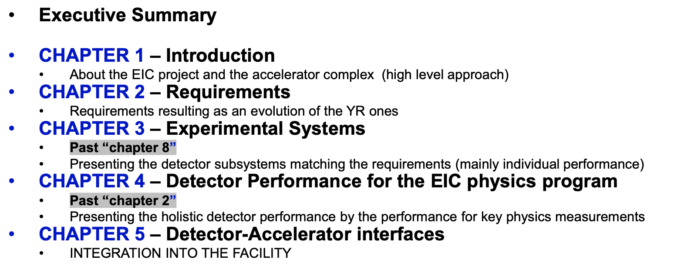
Technical Design Report
preTDR ⟹ 19 December 2025 -> preTDR v3.1
TDR (90% design completion) ⟹ ~ late 2026
(pre)TDR are deliverables of the EIC/ePIC Project
An ePIC Coll. physics paper, spin-off from Ch.4, will be part of a NIM Special Issue

Slide 6
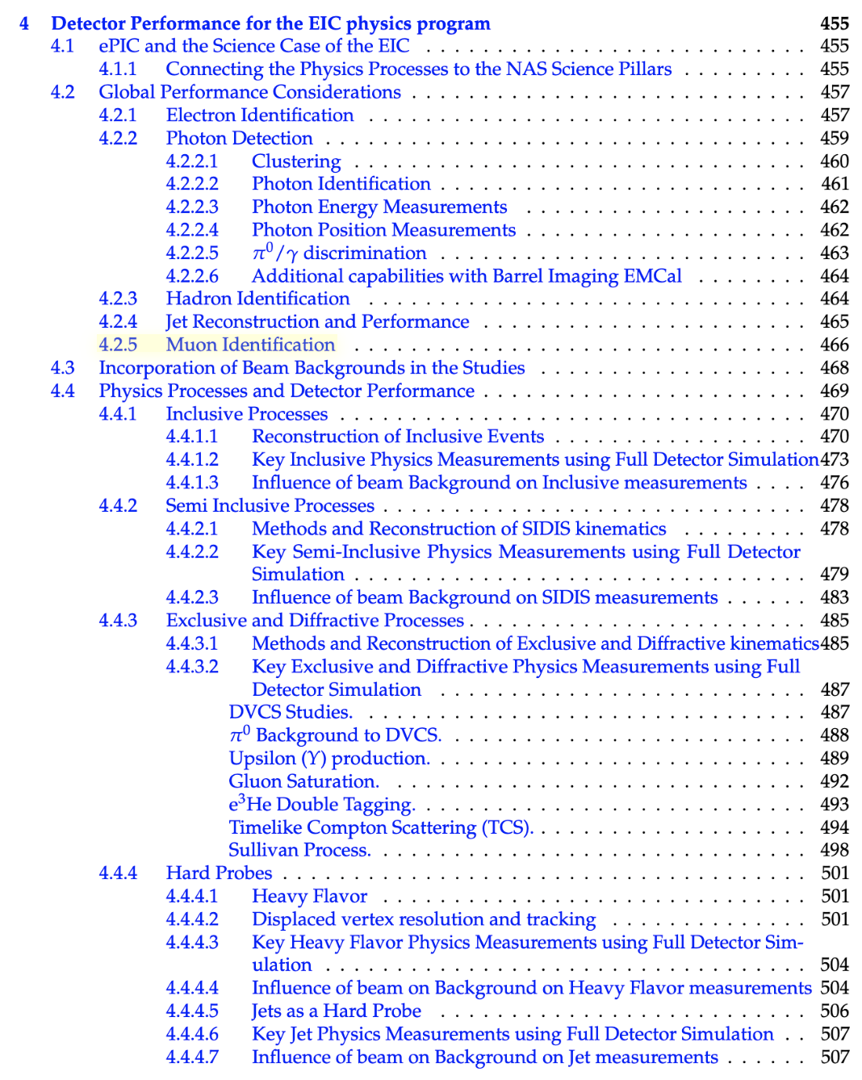
TDR - Structure of Ch.4
Connects processes with the NAS pillars (provides a table)
Presents global performance and tools:
Electron identification
Photon measurement
Hadron identification
Jets reconstruction
Muon identification
Discuss the detector performance in measuring physics processes:
Inclusive
Semi-inclusive
Exclusive and diffractive
Hard probes (heavy flavor and jets)
For each process the influence of beam background is assessed as well as kinematics reconstruction
We will continue polishing the document under the guidance of the Editorial Board, the Project, and we will welcome feedback by the Collaboration! (link here)

Slide 7
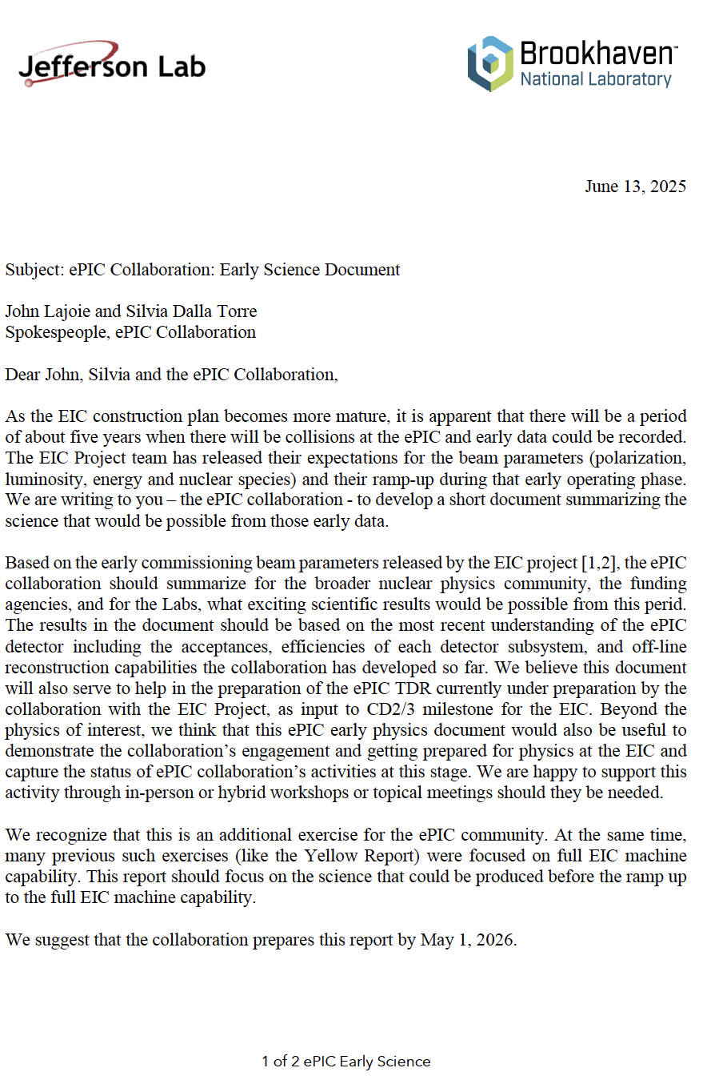
EIC/ePIC Early Science Report
Charge by BNL/JLAB Associate Lab Directors [by May 1st]
Goal of this exercise:
  Highlight meaningful and impactful science within early years of running without undermining the importance of achieving full EIC capabilities
  Meaningful: The EIC early science program must engage the collaboration; it must get the collaboration excited about working hard for the future. It must have a balance of breadth and depth
  Impactful: The EIC early science program must take the first steps down the path to realizing the EIC science goals
Dedicated “physics readiness” workshops:
  Sep. 13, 2024 – online [link]
  Jan. 2025, plenary at Coll. Meeting [link]
  Apr. 2025, CFNS @ Stony Brook [link]
  Sep. 2025, IoP in London [link]
  NEXT: Mar. 2026, Calabria U. and INFN Cosenza [link]

Slide 8
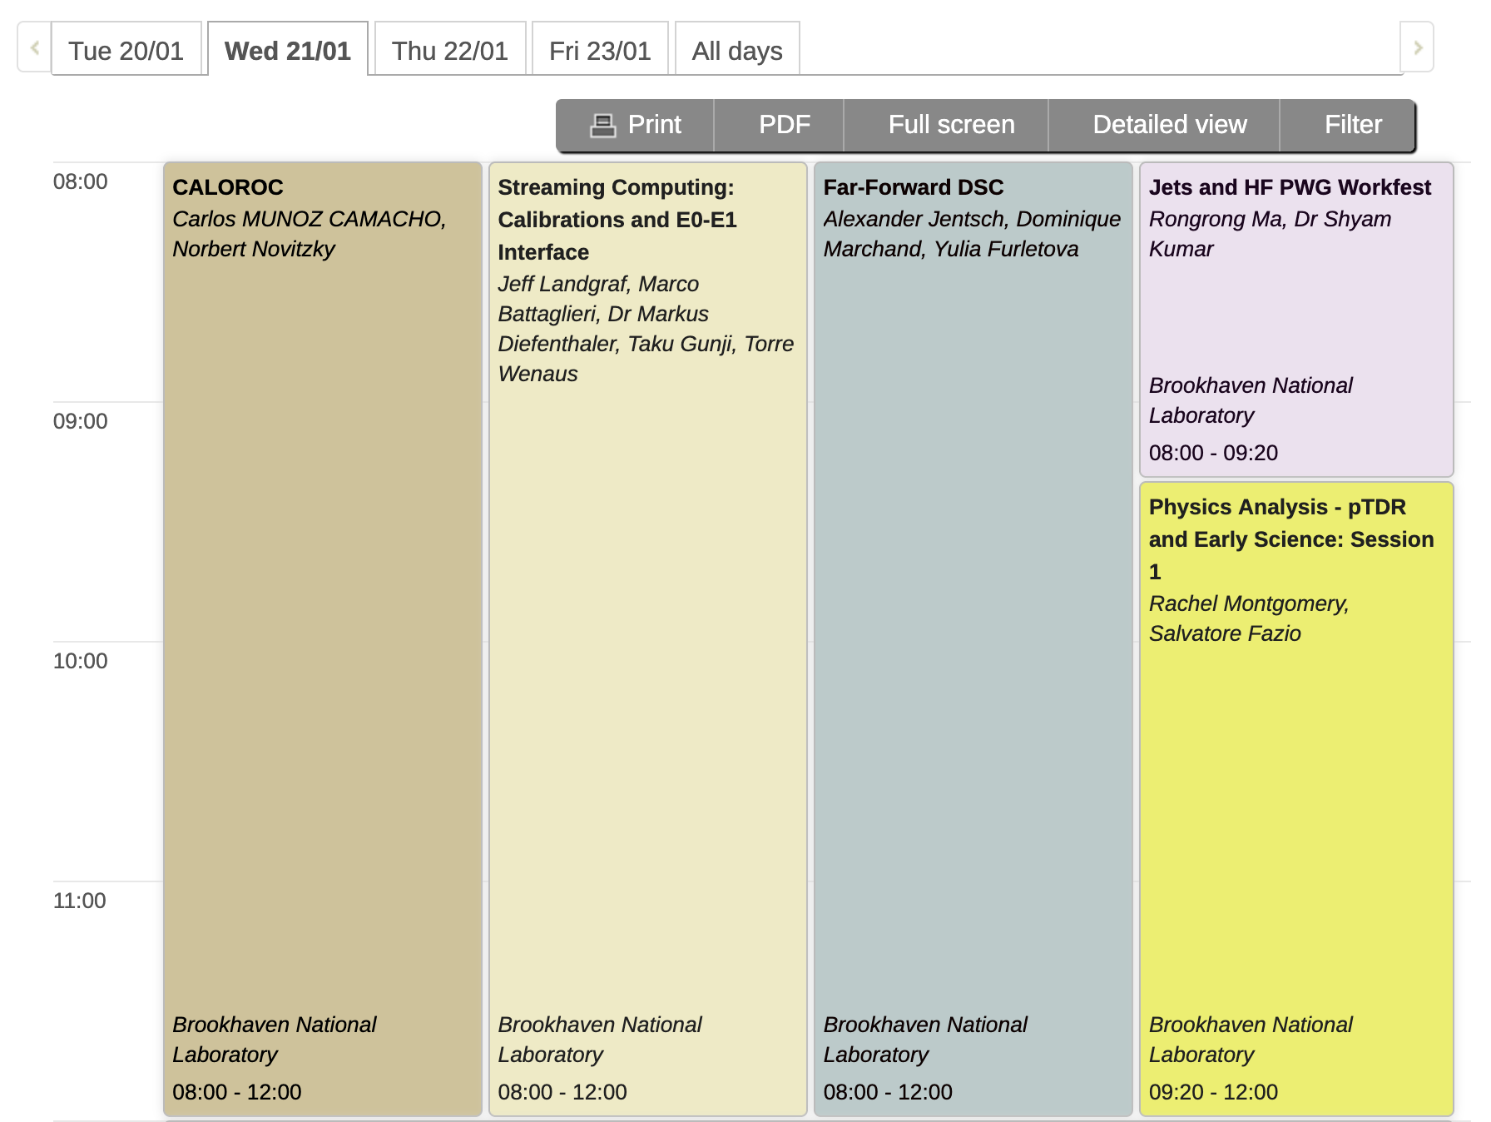
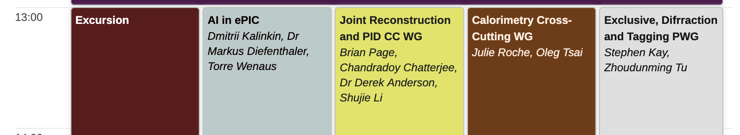
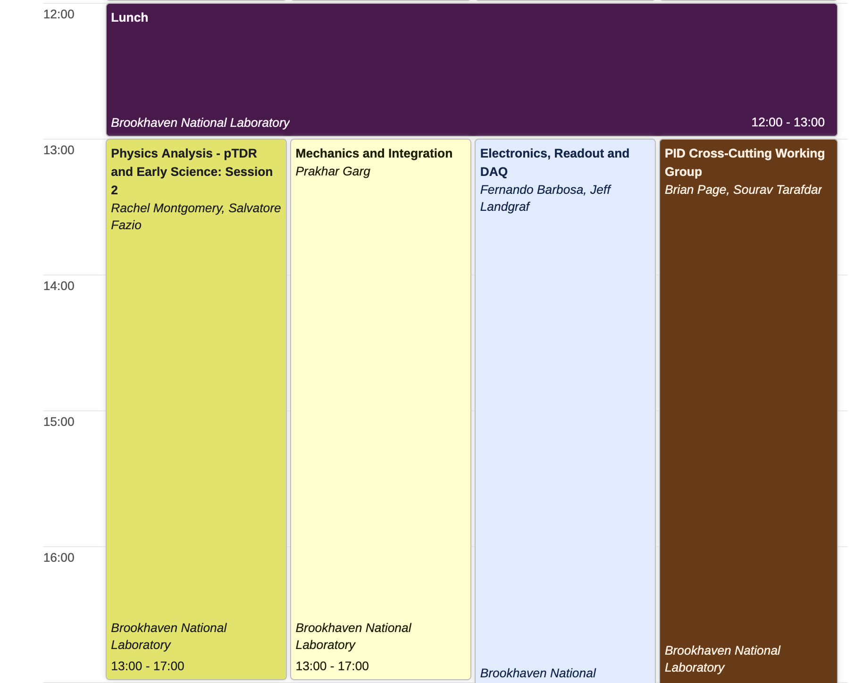
Sessions and discussions relevant to Physics Analysis
Wednesday 21
Friday 23
Jets+HF PWG parallel (Wed 21 - morning)
Exclusive+Diffractive+Tagging parallel (Fri 23 - afternoon)
Focused on ongoing efforts within the PWGs
Physics Analysis workfest (Wed 21 - morning)
Status reports: Particle flow, Electron finder, Radiative corr.
Discussion: machine bkd. studies across PWGs
Physics Analysis workfest (Wed 21 - afternoon)
Discussion: systematics across PWGs
Novel efforts in France
Reports by PWG conveners
Discussion: plans for the Early Science document

Slide 9
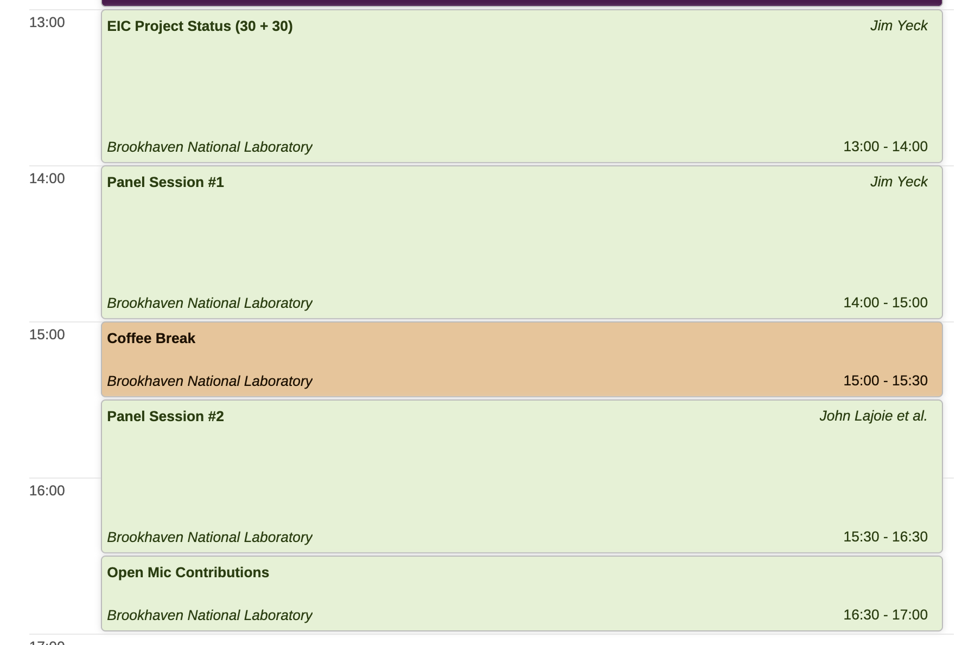
Panel Sessions - Thu 22 afternoon
Two important panel sessions scheduled immediately after the Project status report:
Project panel Session (Jim Yeck, Kevin Smith, Elke, Rolf, and Abhay) moderated by Thomas Ullrich
Collaboration panel session (SP Office + top-level coord.s) moderated by Rolf Ent
Both panel sessions are very relevant to coordinate current and future physics analysis activities!
Forms to collect questions is provided to the Collaboration and the questions will be passed to the panel members and moderators by Thursday morning

Slide 10
Our path to results release and papers
Lots of activities and progress in PWGs - many analyses looking to release ePIC Public (Performance) Results based on simulation studies
  Released Performance Results can be used for publications, conference talks and showcasing our physics to wider community
  Release procedure in accordance with ePIC Results Release Policy: https://zenodo.org/records/15390156
  In addition, we are establishing a custom of holding a Physics Forum linked to each release of Performance Results
Physics Forums aim to:
  Encourage dialogue between analysers, PWGs, and ePIC Collaboration
  Generate awareness on the physics linked to the results and collect feedback from the Collaboration on Performance Results being released
  Highlight work and efforts of the analysers

Slide 11
Our path to results release and papers
Principle Analysers (PAs) present analysis in PWG meetings and write Analysis Note (AN)
  For Performance Results - AN can be brief and should include descriptions of e.g.:
    Production campaign; how analysis was performed; cuts, how plots were made
    Link to code for reproducing plots and metadata for collaboration
  PWG Convenors approve the AN
  PACs review and confirm approval of the AN, and assign an official AN tag
  AN and plots uploaded to Zenedo and circulated to the Collaboration
  PAs give presentation at a Physics Forum open to the whole ePIC Collaboration for discussion and feedback → release results to the public
Performance Results are released for Collaboration use (talks, papers, documents … etc)
Released Performance Results can be shared with phenomenologists for impact studies
Plots of performance results have a tag (simulation campaign) and can evolve over time
  New versions will not require the full approval chain, just the conveners approval

Slide 12
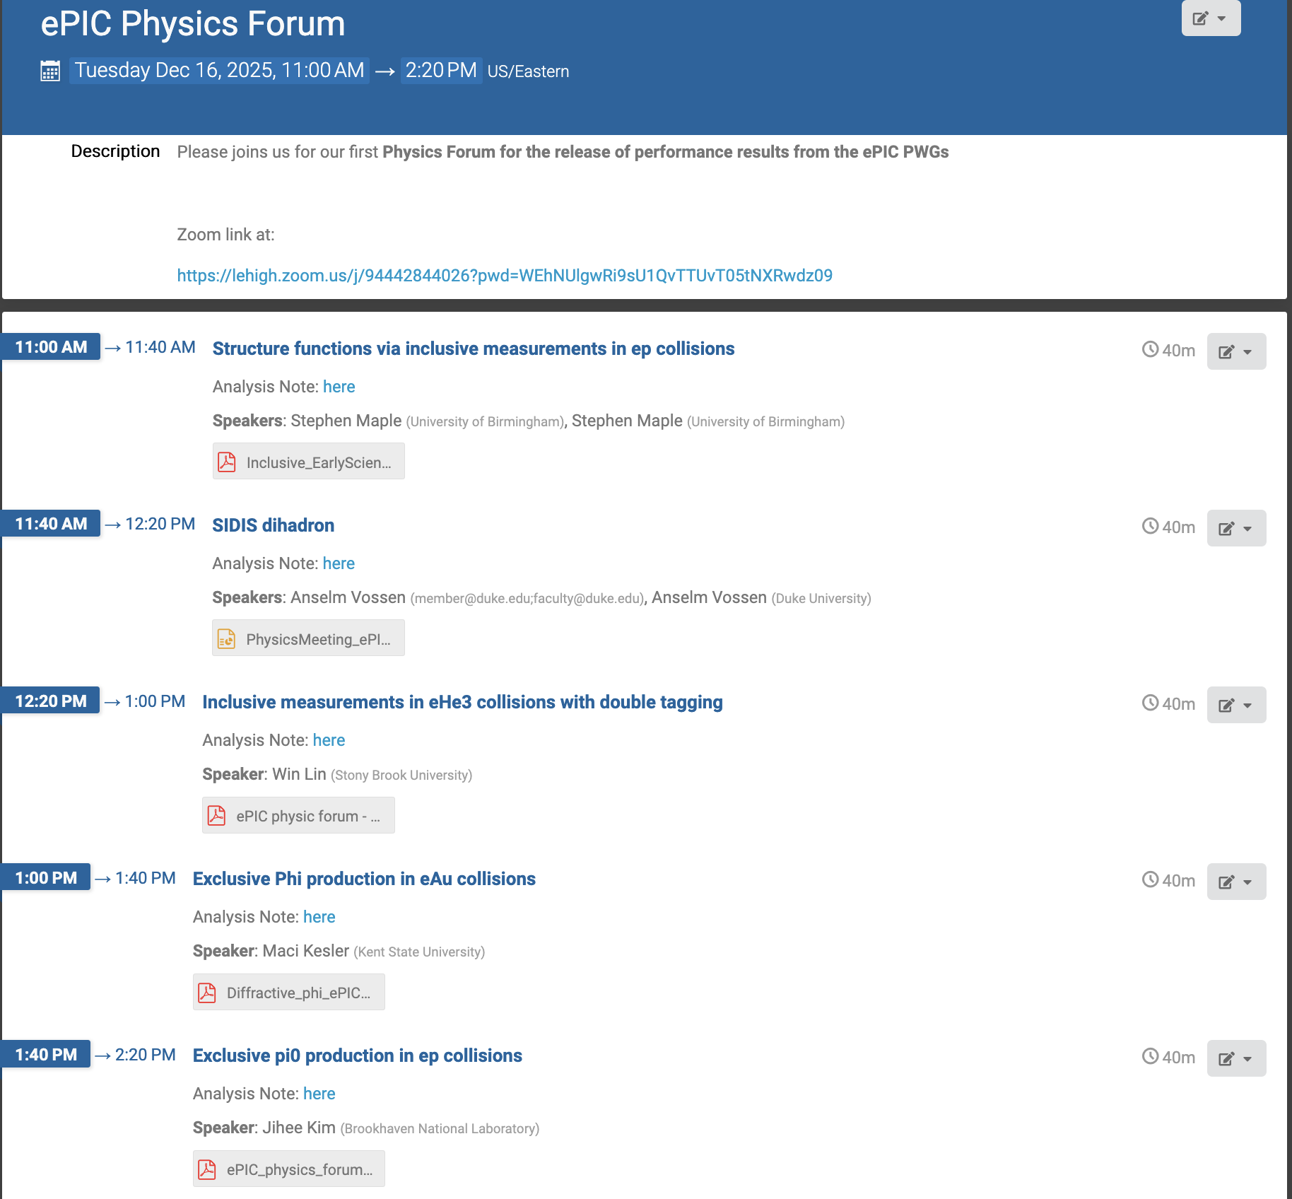
First ePIC Physics Forum
We have been excited to host our first Physics forum on Dec 16th: https://indico.bnl.gov/event/30818/
Agenda included analyses from Inclusive, SIDIS, and EDT PWGs
The releases of these results are linked to forthcoming papers
A small author list paper on SFs phenom.
An ePIC coll. paper on Exclusive and Diffractive case for the early science
Two ePIC coll. papers part of the NIM special edition:
  ePIC Science → spin-off of TDR ch. 4
  ePIC Early Science Report
More Physics Forums to be announced in 2026

Slide 13
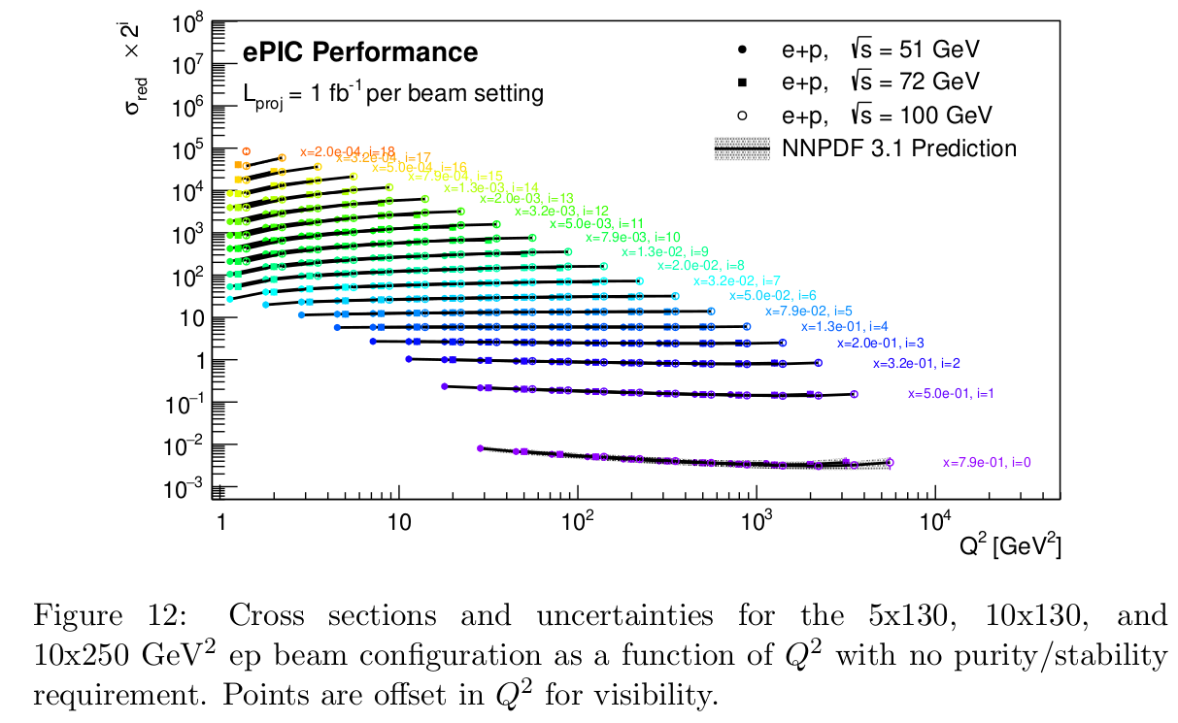
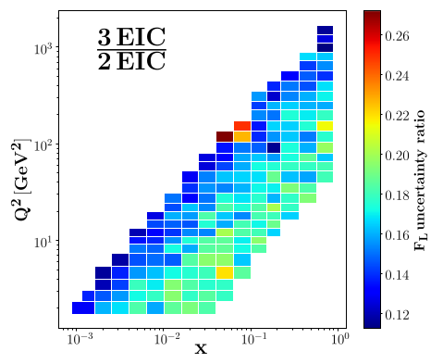
Structure Func.s via inclusive measurements
Stephen Maple (Birmingham); Analysis Note: here
After adding 3rd energy: Factor of ~5 improvement in FL uncertainties!
Impact study shows significant improvement on u_v and gluon uncertainties in HERAPDF2.0 vs HERA alone, as well as constraining the strong coupling αs
Phase space with 3 potential early science ep configurations (5x130 GeV configuration added)
Conservative (pessimistic) total uncertainty on plot﻿﻿

Slide 14
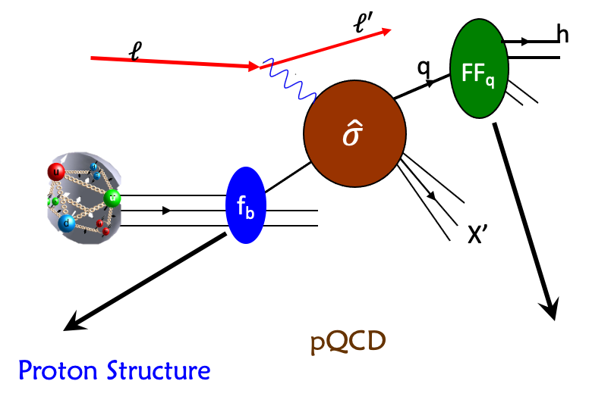
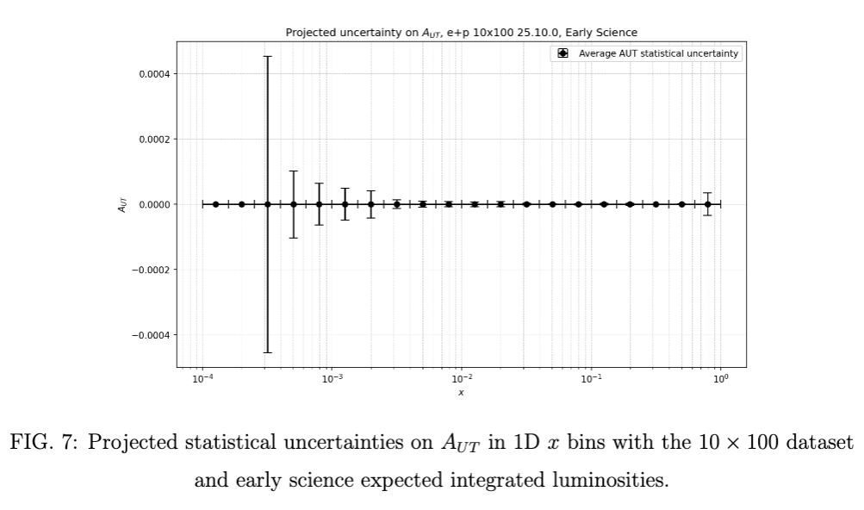
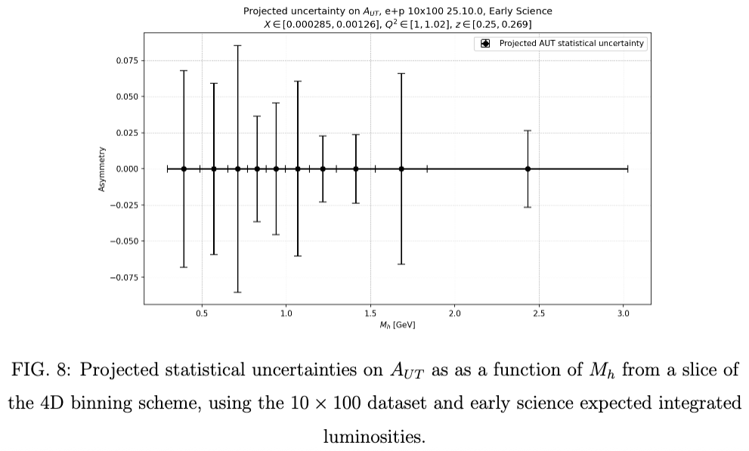
Dihadron in SIDIS
Anselm Vossen (Duke); Analysis Note: here
Proton Structure extracted using QCD factorization theorem
FFs contribute to virtually all processes
Particular important for transverse spin structure
Polarization of e+p: 70%
Polarization of e+n= 60.2% (=86% × 70%)
Statistical Uncertainties
  Extracted from unbinned likelihood fits, weighted event-by-event by luminosity scaling factor
Systematic Uncertainties
  Polarization 1.5%
  Luminosity 1.5%
  Electron Purity 1%
  Kinematic smearing 3% (prev. experiments)
  Radiative Corrections: 1%. (YR)
  scale of 2.3 %
  Point-to-point: 3.2 % (5% for early science)

Slide 15
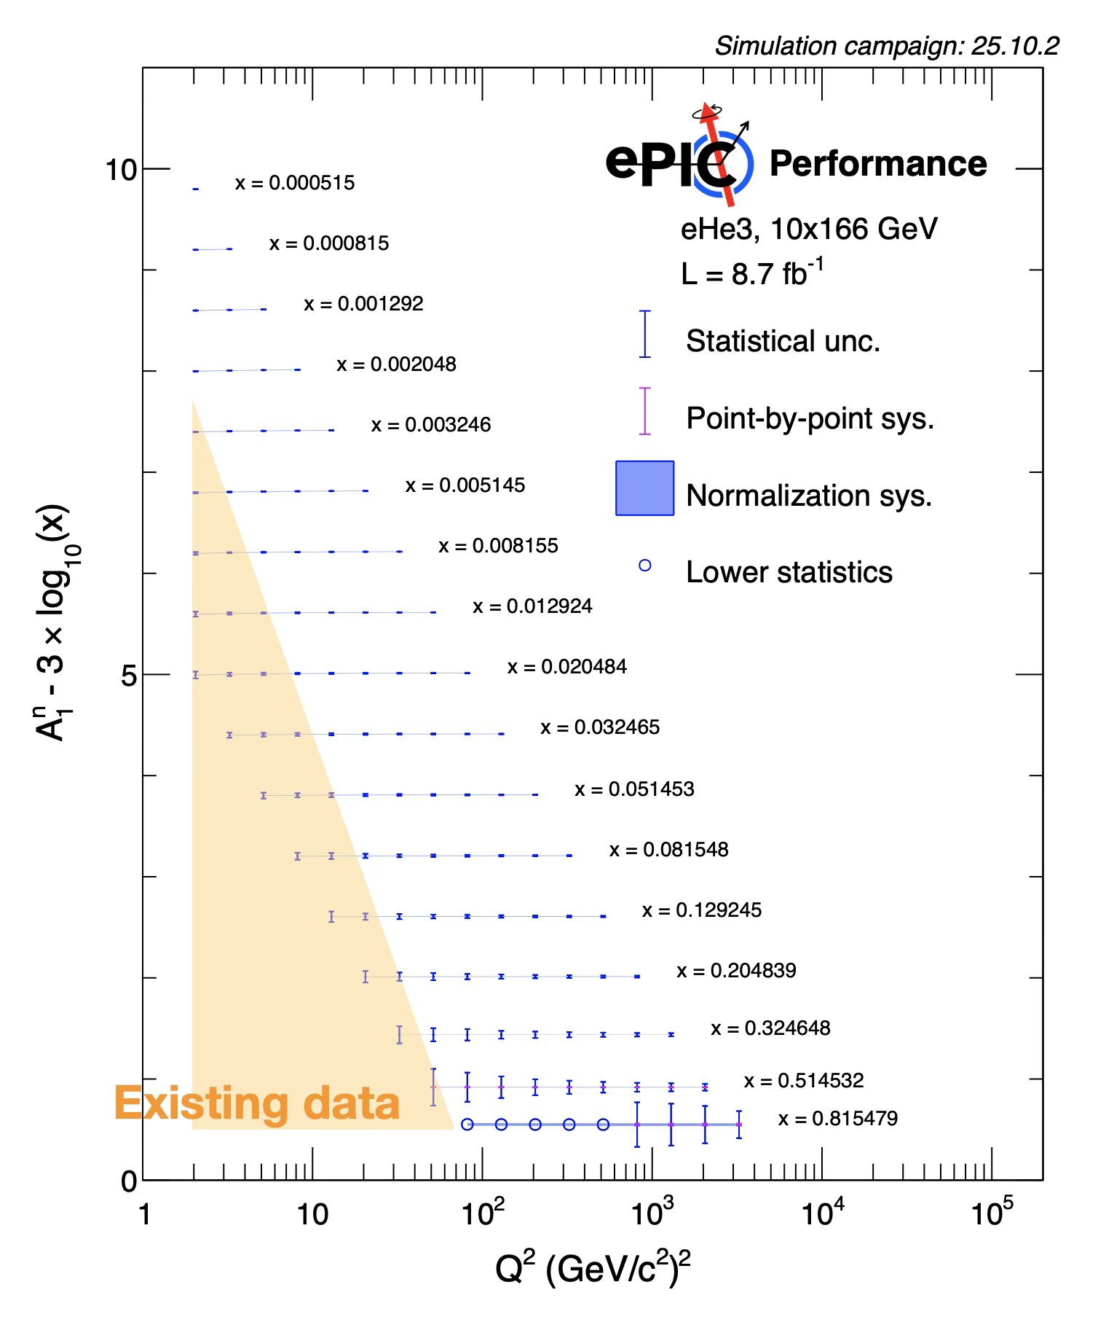
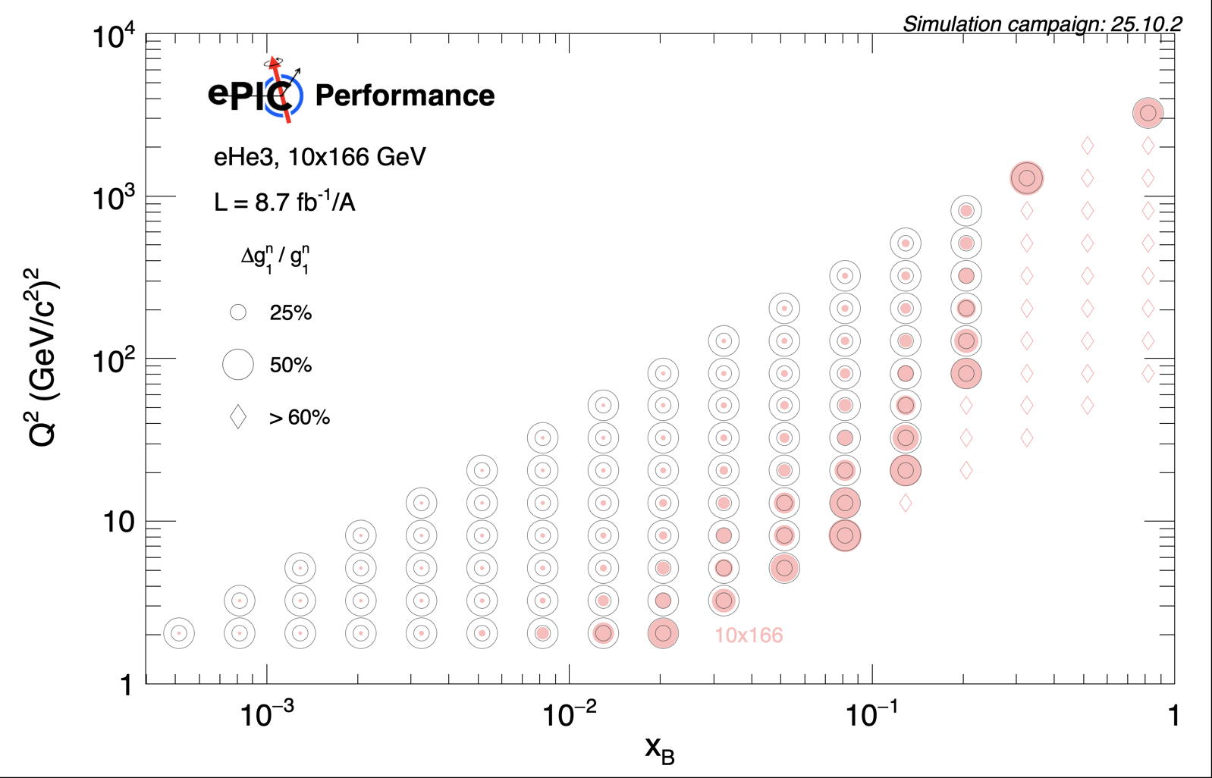
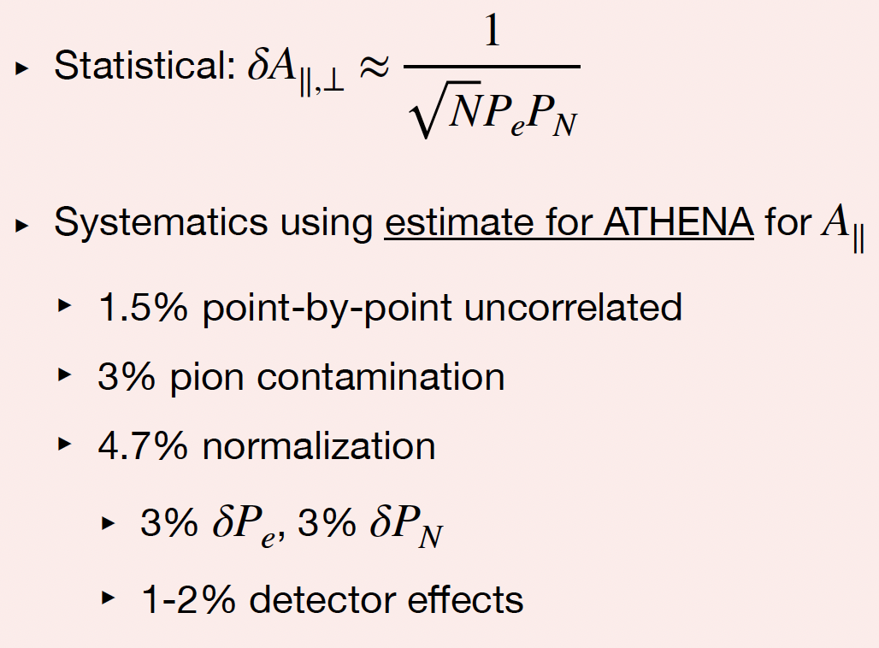
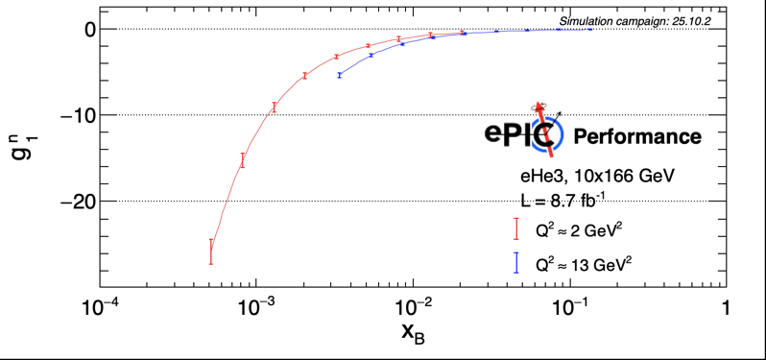
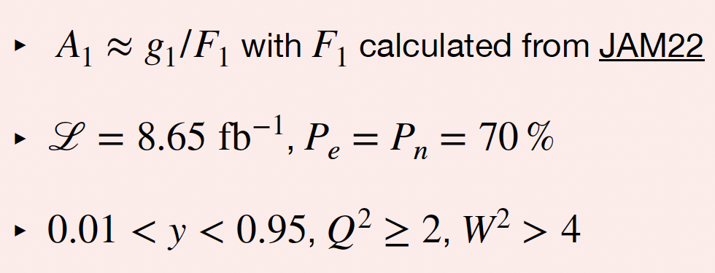
Inclusive e+He3 with double tagging
Win Lin (Stony Brook); Analysis Note: here
High statistics, large & new kinematic coverage A1n and g1n in year 5 of early EIC running!
Projected A1n
Projected g1n

Slide 16
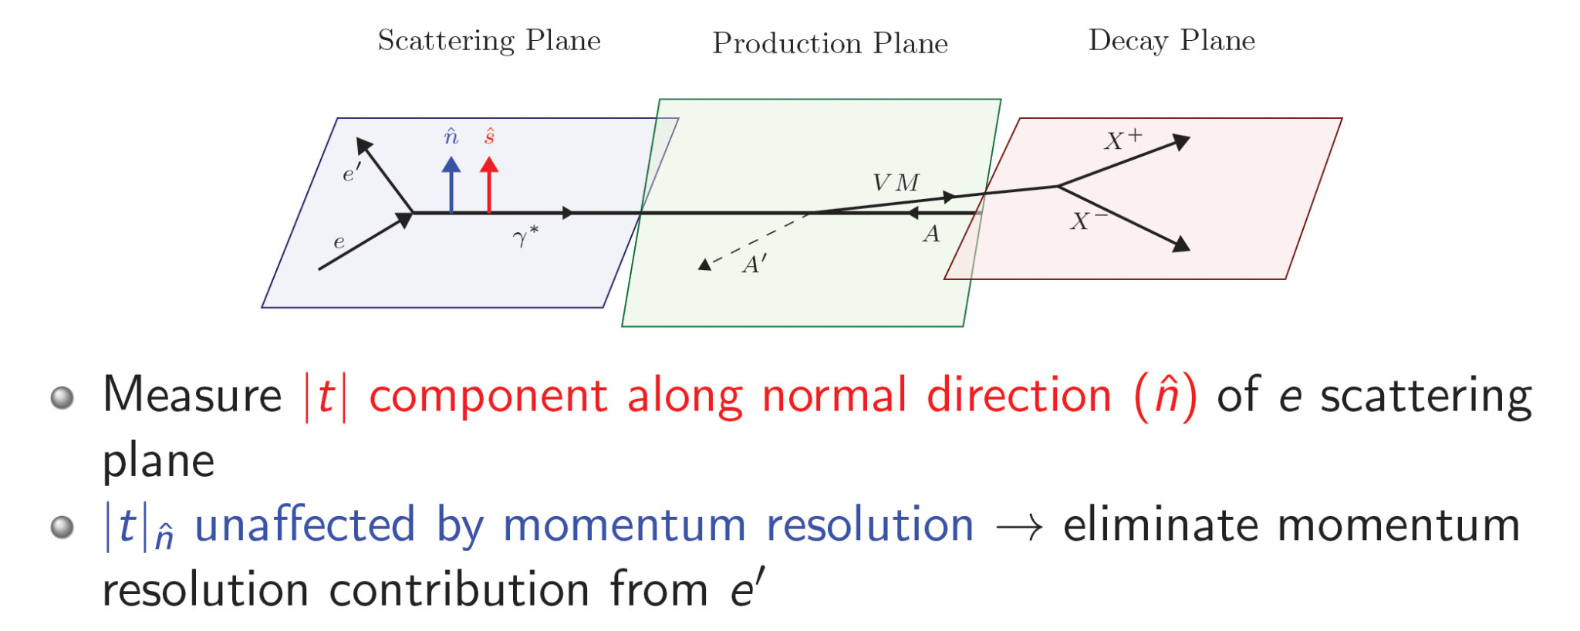
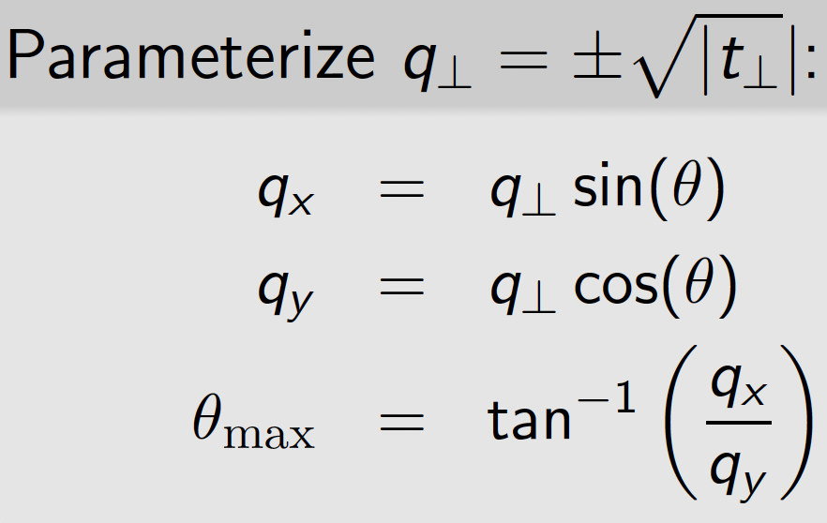
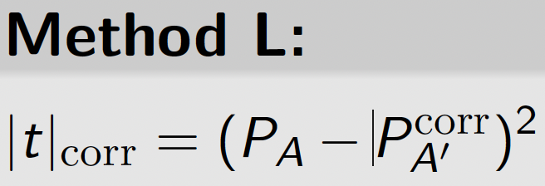
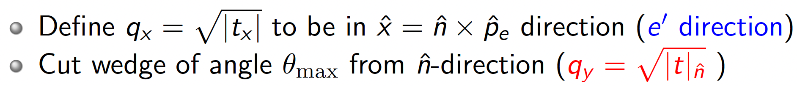
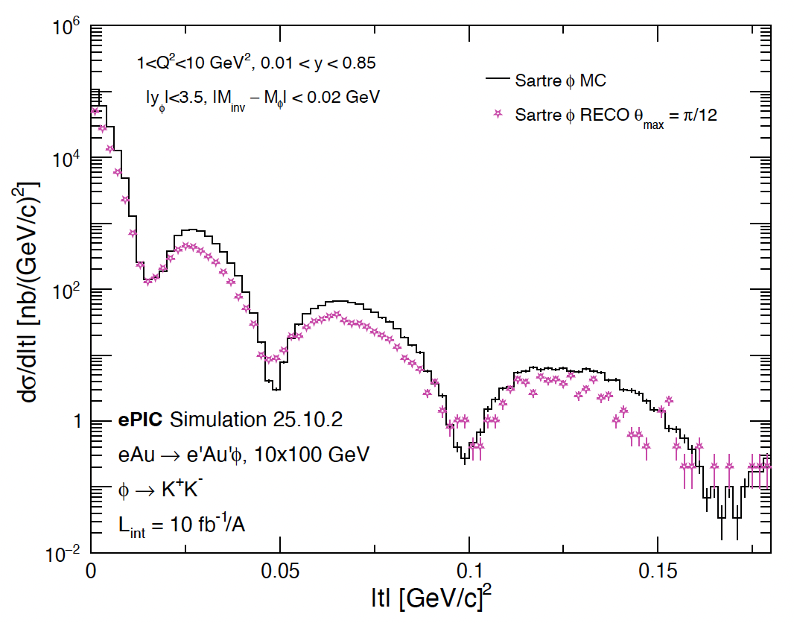
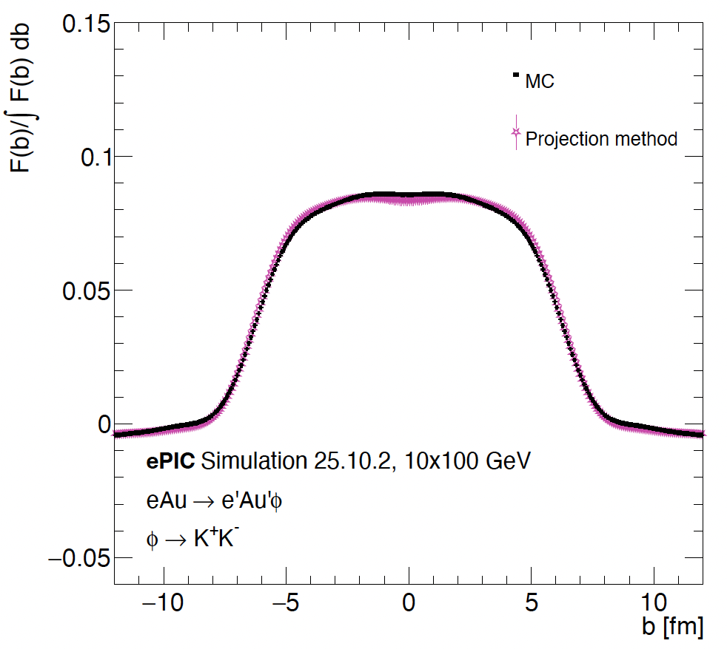
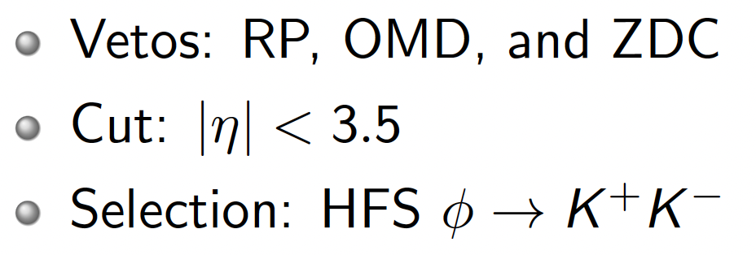
Exclusive phi in e+Au
Maci Kesler (Kent); Analysis Note: here
New Technique:
Cut on 𝜃max eliminates most of the qx component (e’ direction)
Fourier transform
t-differential xSec
Critical measurement:
Probe to gluon density
→ saturation

Slide 17
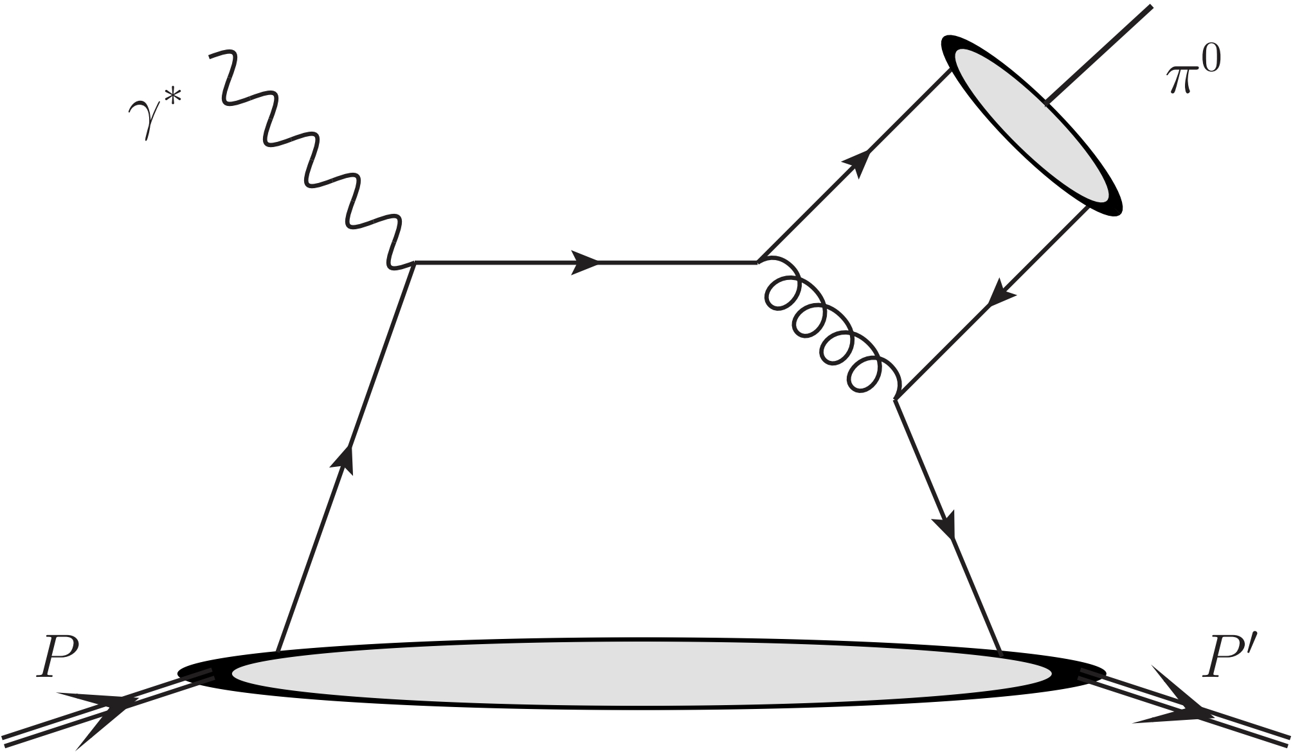
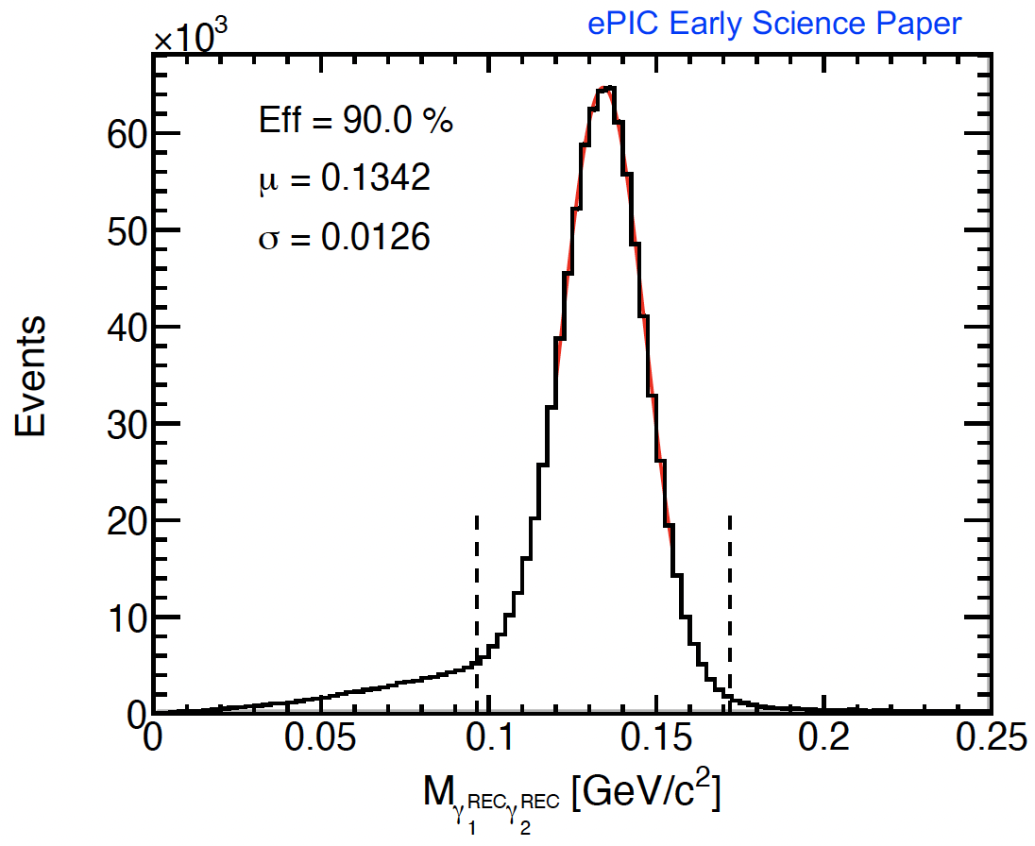
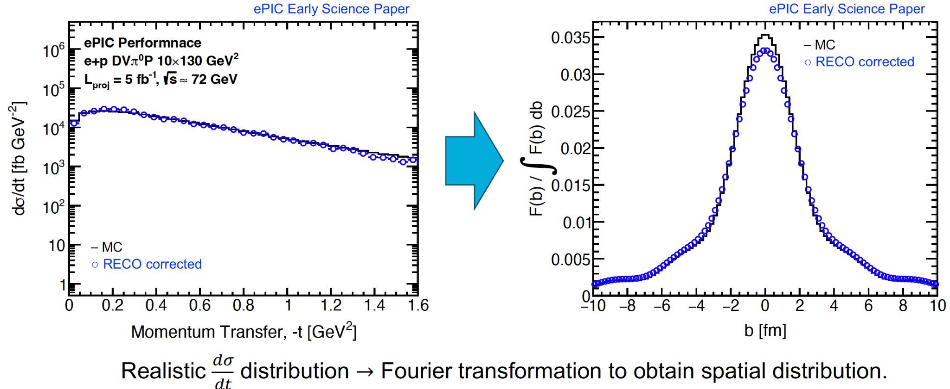
Exclusive pi0 in e+p
Jihee Kim (BNL); Analysis Note: here
Previously studied in fixed-target (JLab, and COMPASS), never at a collider (wide kinem. range)
Generalized Parton Distributions (GPDs)
  Extract the t-distribution to obtain the quark spatial distribution
Quark Orbital Angular Momentum (OAM)
  Conduct a feasibility study of the longitudinal single-target spin asymmetry
  Theory [arXiv:2312.01309]: A_UT sensitive to quark OAM, yet no experimental measurement exists to date
Background to DVCS: estimate rate of single-photon mis-identification, which can mimic a DVCS signal

Slide 18
2025 Priorities - Where do we stand?
2025 priorities had been presented by the PACs at the Frascati meeting
Accelerate website and wiki integration: started and keeping up the effort
Validation and release of the results: developed a standard which led to the physics forum and the release of our first performance results
Onboarding of new groups: we created new tutorials and have been outreaching to existing collaborators and new communities. We will keep up the momentum
TDR - provide clear link between science and processes (requirements): we initiated an effort which culminated in the current Ch.4, which starts by linking the Science pillars to the processes and the observables. We’ll welcome suggestions
TDR - assign internal reviewers to guide us through the process: task now taken up by the Editorial Board
ESR - define a clear and achievable roadmap to the final product: we received a charge by the ALDs that set the process in motion. We have assigned reviewers and initiated a series of dedicated workshops which mark a clear roadmap

Slide 19
2026 Reconstruction Priorities
Will keep pursuing 2025 priorities for 2026 as well!
Holistic reconstruction
  There has been a tremendous progress with our reconstruction software, which has enabled many physics performance studies over the past year!
  Nevertheless, further development of a more realistic holistic treatment of information from different components is crucial
  Starting with 2026: working together with S&C, we prioritize:
    Development of our electron finder into a more complex tool, capable of identifying all electrons candidates and assigning to them a probability, via combining informations from calorimeters, trackers and PID systems
    Complete the development of a particle flow algorithm
    Development of a true PID reconstruction, using the information from all PID subsystems (we are currently using look-up tables)
    Development of a muon finder, using tracker and veto from HCAL

Slide 20
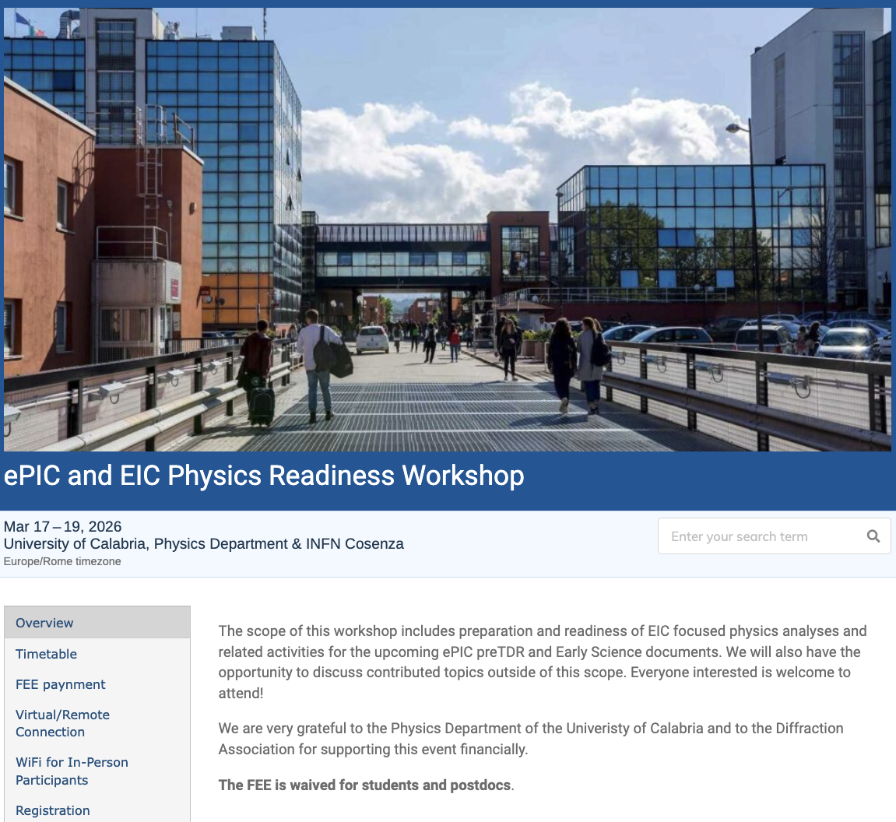
Next Physics Readiness Workshop
Next Physics Readiness Workshop scheduled for March 17-19
  Hosted by the U. of Calabria & INFN Cosenza
  Indico: https://indico.bnl.gov/event/30283/
  Hybrid format - Please register even if attending online (select proper option)
  €150 FEE waived for students/postdocs
  Possibility for (very limited) support for ECRs support
The workshop will focus on the finalization of studies and text for the TDR and early science documents

Slide 21
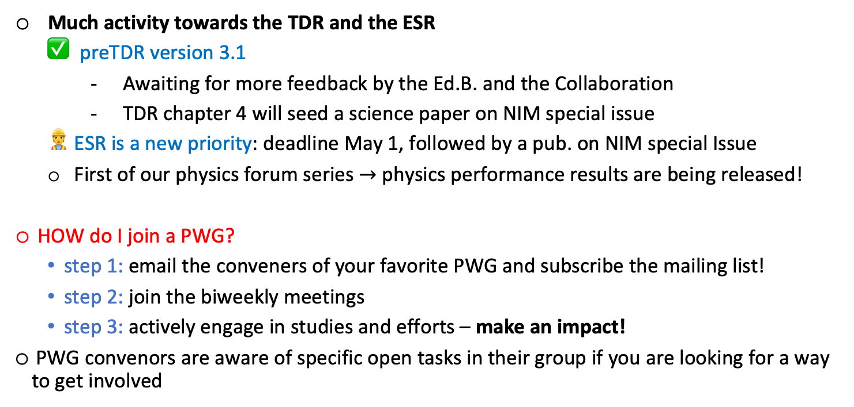
Summary
Much activity towards the TDR and the ESR
  preTDR version 3.1
    Awaiting for more feedback by the Ed.B. and the Collaboration
    TDR chapter 4 will seed a science paper on NIM special issue
  ESR is a new priority: deadline May 1, followed by a pub. on NIM special Issue
  First of our physics forum series $→$ physics performance results are being released!
HOW do I join a PWG?
  step 1: email the conveners of your favorite PWG and subscribe the mailing list!
  step 2: join the biweekly meetings
  step 3: actively engage in studies and efforts – make an impact!
PWG convenors are aware of specific open tasks in their group if you are looking for a way to get involved

