Slide 1
Overview of the ePIC Installation, Integration and Infrastructure and Alignment
Rahul Sharma
Chief Mechanical Engineer & L3 CAM
I^3 Group
ePIC Collaboration Meeting
Jan 20 to 23, 2026

Slide 2
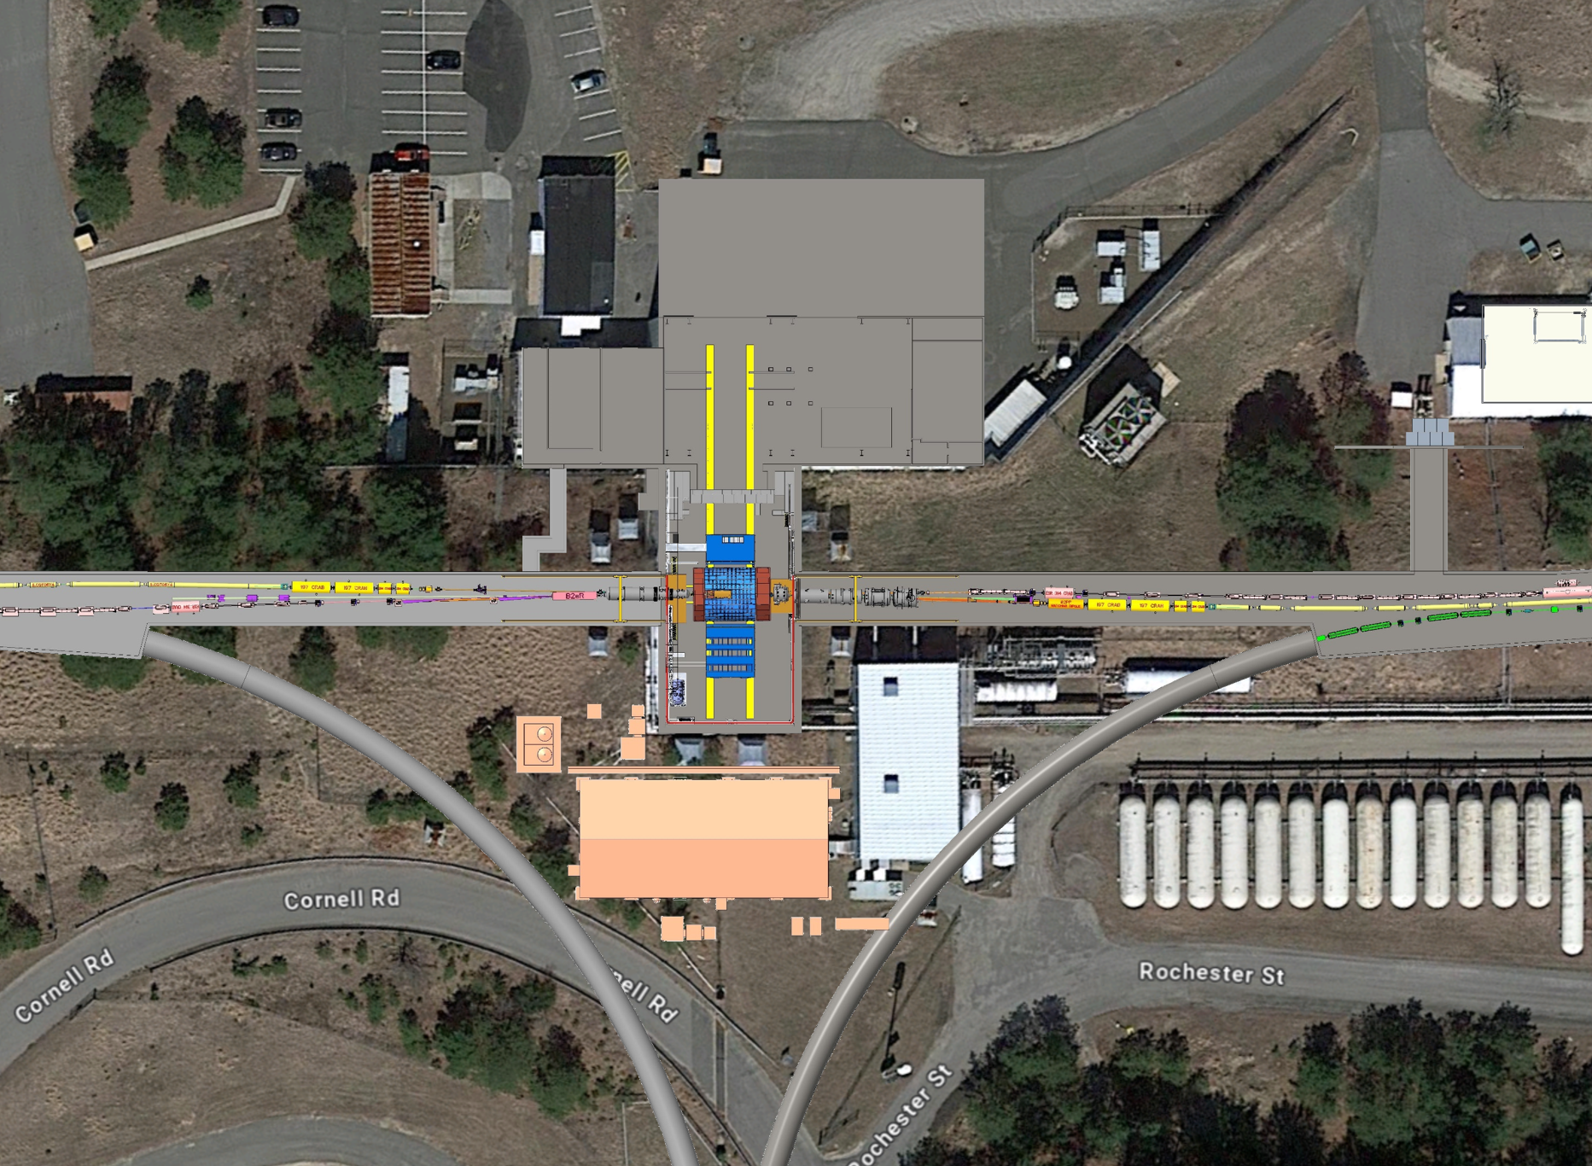
Outline
Introduction & I³ Group Role
Scope Definition
Scope of work: supports, platforms, tooling, detector integration, and utilities coordination
Requirements & Mechanical Design Guidance
Key detector and facility requirements
Mechanical design standards, safety factors, materials, alignment and documentation practices
Building 1006 & ePIC Detector Overview
Assembly/Experimental Hall layout and detector motion
Endcaps, central barrel, flux-return structures and support hierarchy
Integration, Envelopes & Alignment Strategy
Envelope model and drawing package
Mechanical interfaces and load paths
Interaction region alignment requirements, challenges, and proposed solutions
Installation & Assembly Sequences
External Interfaces & Facility / ePIC Infrastructure Requirements (Off Project Dependencies)
Quality Assurance, Schedule & Path to Final Design
Technical Summary
Parking Lot
DAQ and Control Room
Assembly Hall
1006
Elec and Pump Room
ePIC
WAH

Slide 3

About Me-First Name, Last Name
Rahul Sharma
Current Project Role
L3 Manager, Chief Mechanical Engineer, WBS 6.10.10 (Integration, Installation and Infrastructure)
Relevant Experience
Over 18 years of Engineering Experience
16+ Years at BNL
Design, analysis and construction of Daya Bay, DUNE, STAR
Highest Degree
Masters of Science (Mechanical Engineering) from Stony Brook University
Multiple Spotlight Awards
Brookhaven Engineering Award 2021

Slide 4
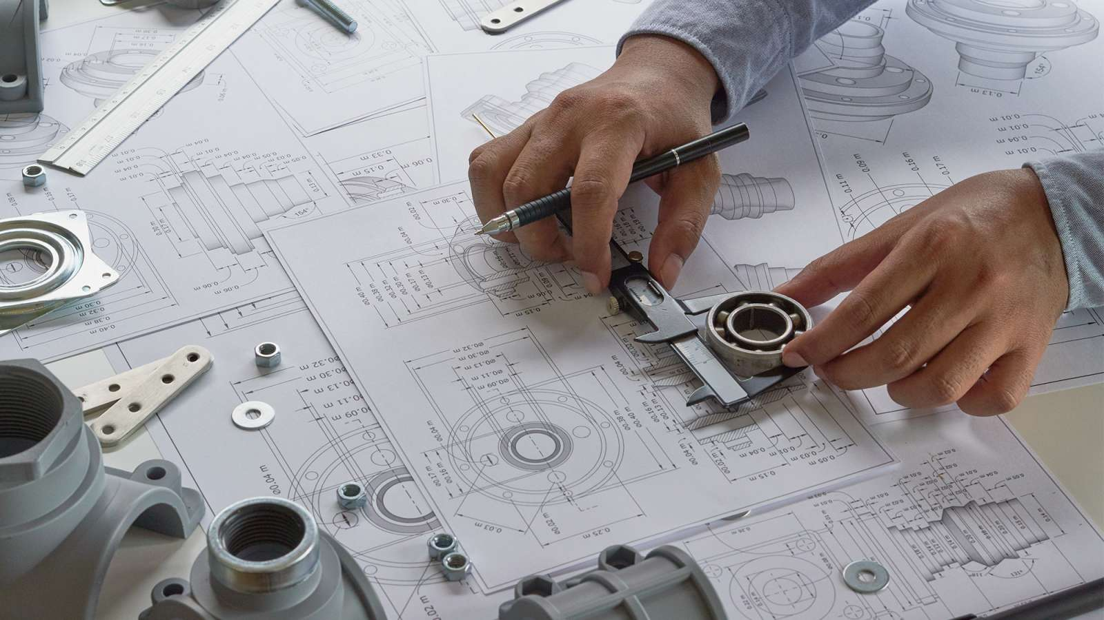
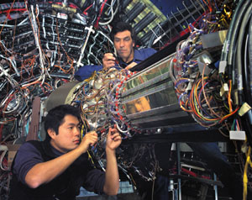
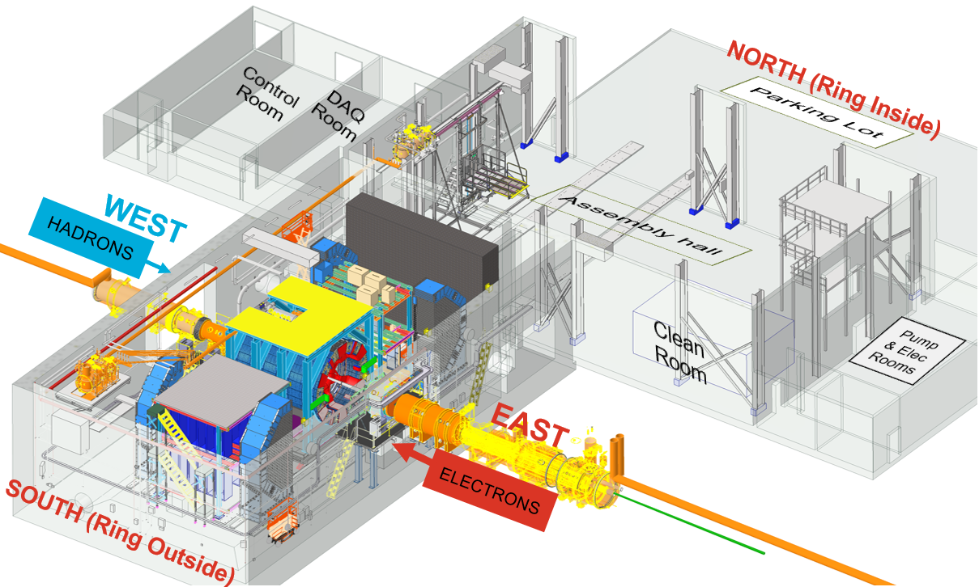
EPIC Triple I Team:
Charge #1
Rahul Sharma (BNL) – Chief Mechanical Engineer
Walt Akers (JLAB) – Systems Integration
Roland Wimmer (BNL) – Mechanical Engineer
Dan Cacace (BNL) – Mechanical Engineer – Endcap Structures and Flux Return Steel
Alex Eslinger (JLAB) – Mechanical Engineer – pfRICH Design
Alessandro Saputi (INFN/CERN) – dRICH Design and Installation
Ron Lassiter (JLAB) – Forward Detectors – Mechanical Engineer
Johnathan Smith (JLAB) – Mechanical Engineer
Andreas Jung (Purdue University) – Detector Scientist – AC LGAD and GST
Sushrut Karmarkar (Purdue University) – Mechanical Engineer – AC LGAD and GST
Ben Denos (Purdue University) – Mechanical Engineer – SVT and PST
Karim Hamdi (BNL) – Mechanical Designer
John Tuozzolo (BNL) – Mechanical Designer
Nathaniel Speece-Moyer (BNL) – Mechanical Engineer
Seung Joon Lee (JLAB) – Detector Scientist
Julien Bettane ( IJC Lab – Orsay) – Mechanical Engineer – EEEMCAL
Joshua Crafts (CUA) – Postdoc – EEEMCAL
Tom O’Connor(ANL) – Barrel EMCAL Design
Kevin Bailey (ANL) – Barrel EMCAL Design
Girish Gowda (BNL) – CFD and Thermal Analysis Engineer

Slide 5
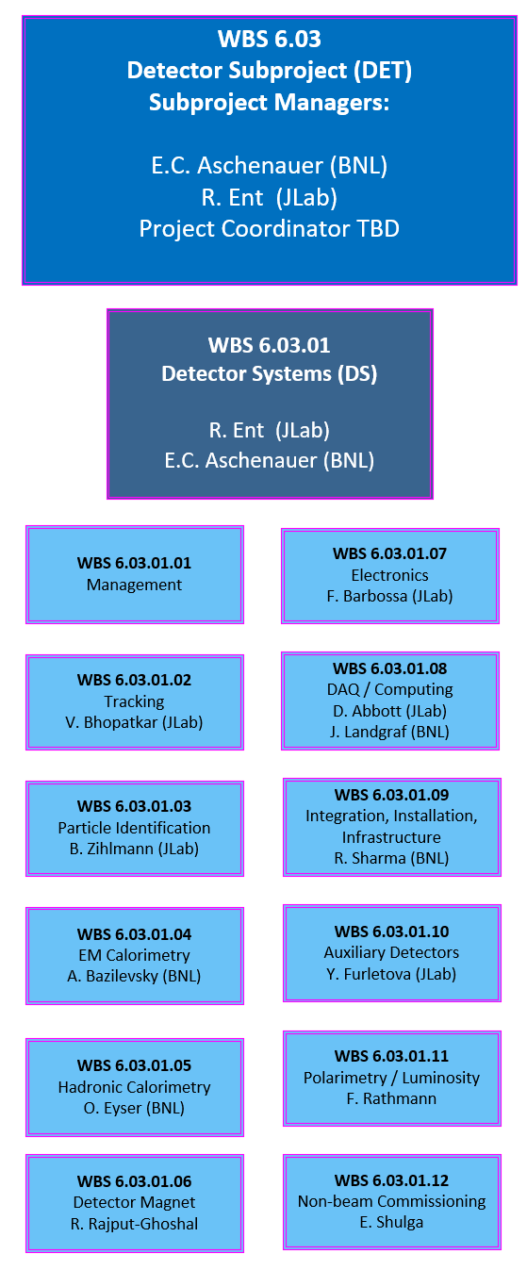
Scope Summary
WBS | WBS Name | WBS Manager | Scope Description
6.03.01.09 | Integration, Installation and Infrastructure | R. Sharma | Includes the following: Effort needed to design and build new infrastructure, modify/repurpose existing infrastructure and Integration of various subdetectors for construction of ePIC detector in Bldg 1006 Assembly Hall and Experimental Hall.
Effort needed to design and build new infrastructure, modify/repurpose existing infrastructure and Integration of various subdetectors for construction of ePIC detector in Bldg 1006 Assembly Hall and Experimental Hall.

Slide 6
Scope Definition
Design, Fabrication, Assembly, and Installation: Lead the design, manufacturing, assembly, and installation of support structures, installation tooling/access equipment and platforms for all sub-detectors, ensuring readiness for full installation prior to detector commissioning.
Detector Integration: Integration of sub-detectors and associated components into the ePIC detector, maintaining alignment, functionality, and overall system compatibility.
Manages Interfaces within Detector: Define and manage mechanical and services interfaces between experimental equipment, the central magnet, sub-detectors, other detector components, and the collider. Provide technical guidance to detector subgroups to ensure their designs are consistent with integration requirements.
Utilities Coordination: Coordinate and manage with EIC infrastructure subgroups to ensure provision and distribution of utilities—including power, water cooling (using existing MCW), air cooling, and HVAC—for both the ePIC detector and Building 1006. Please note that any special cooling units will be responsibility of subgroups.

Slide 7
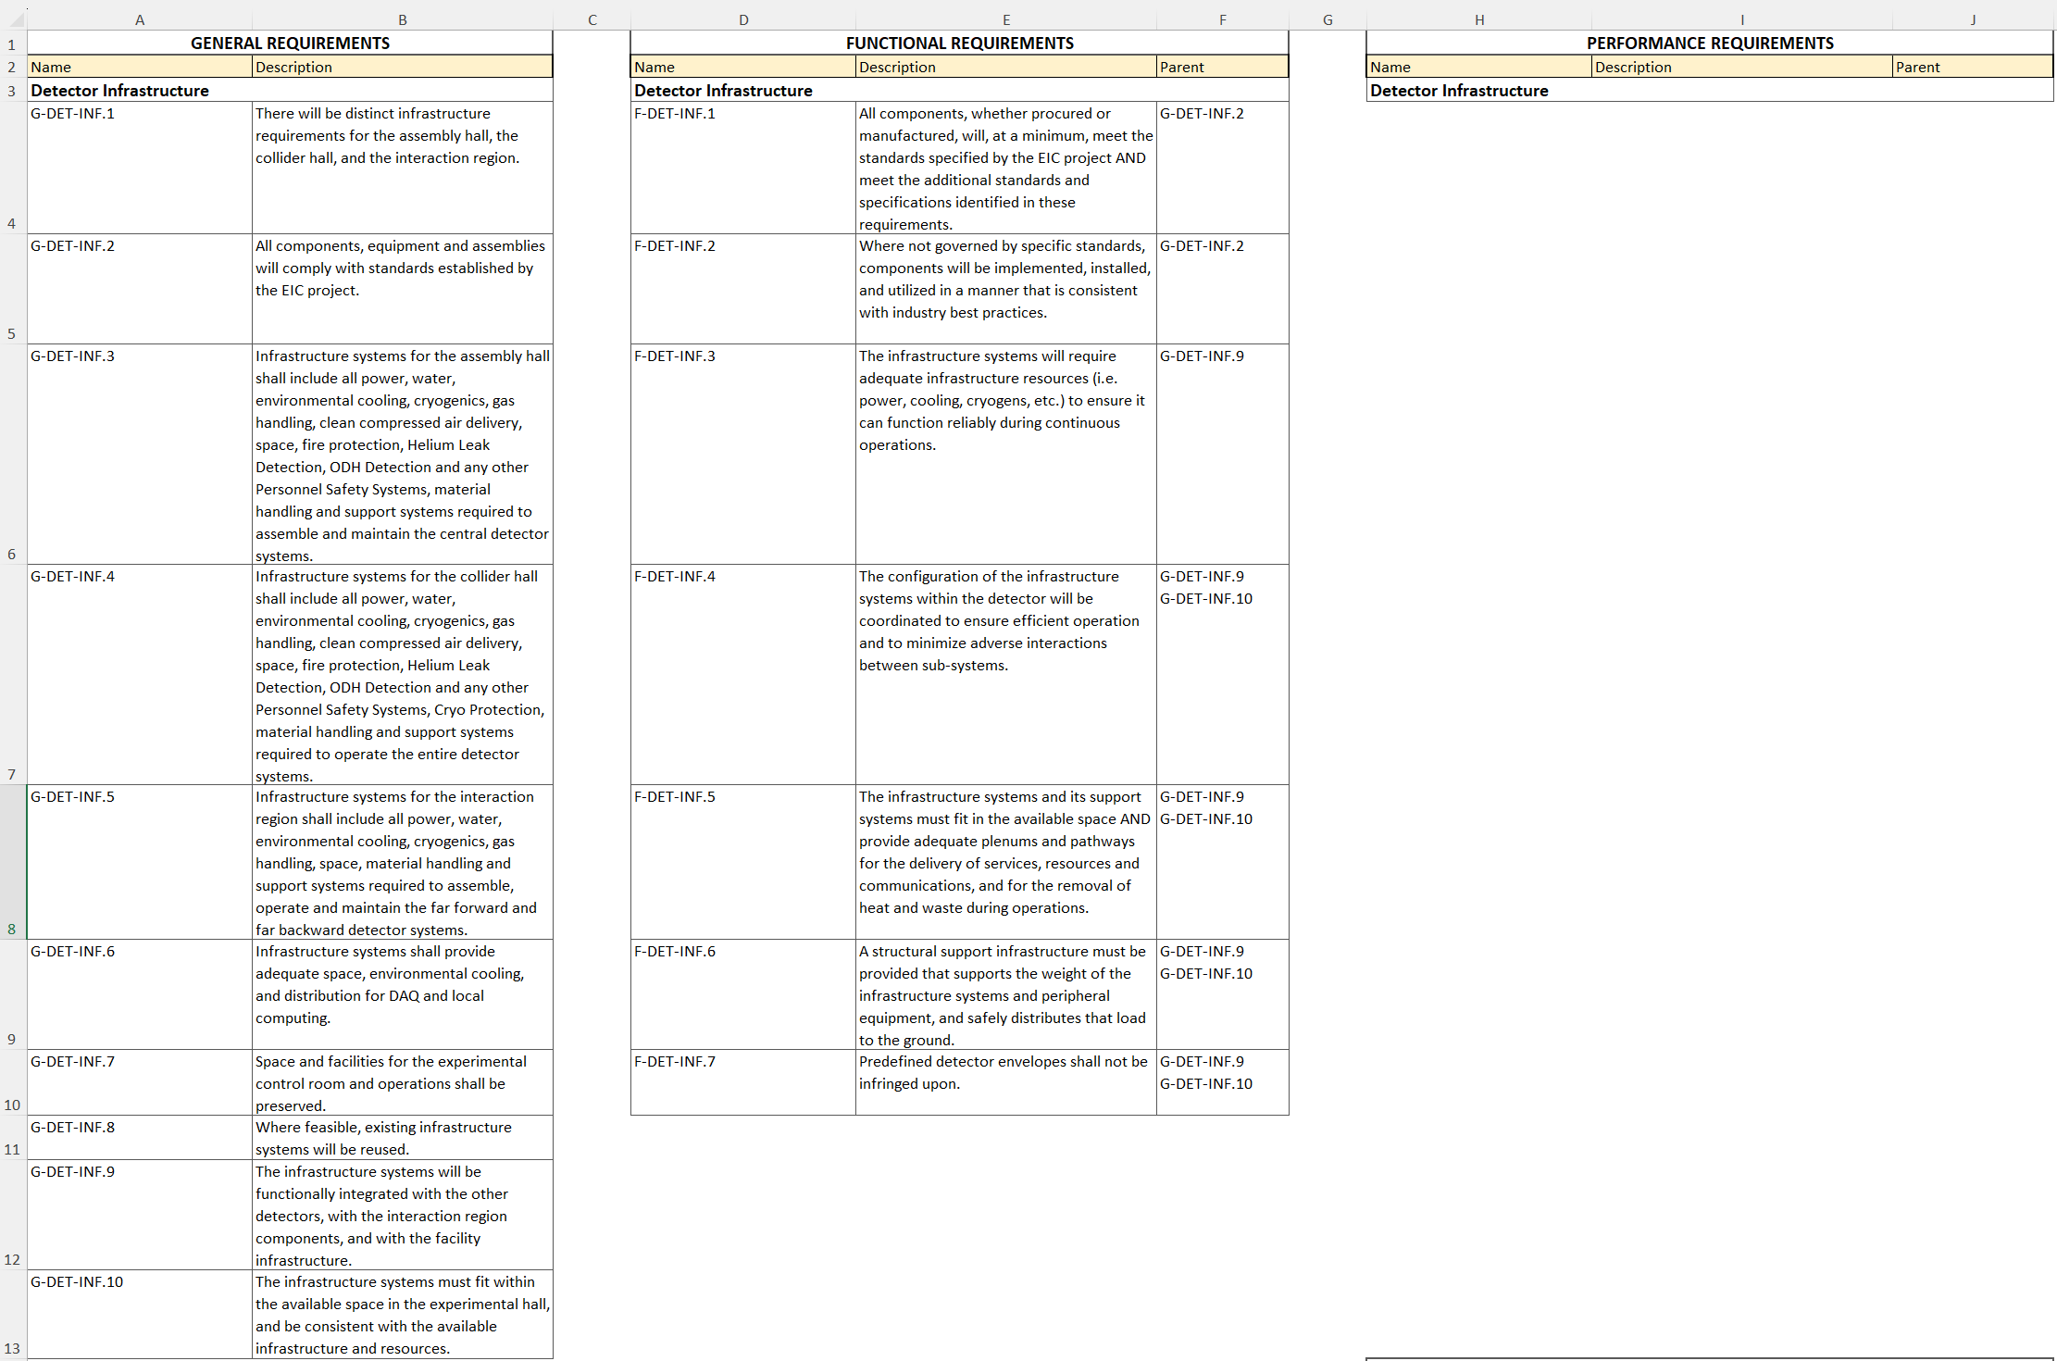
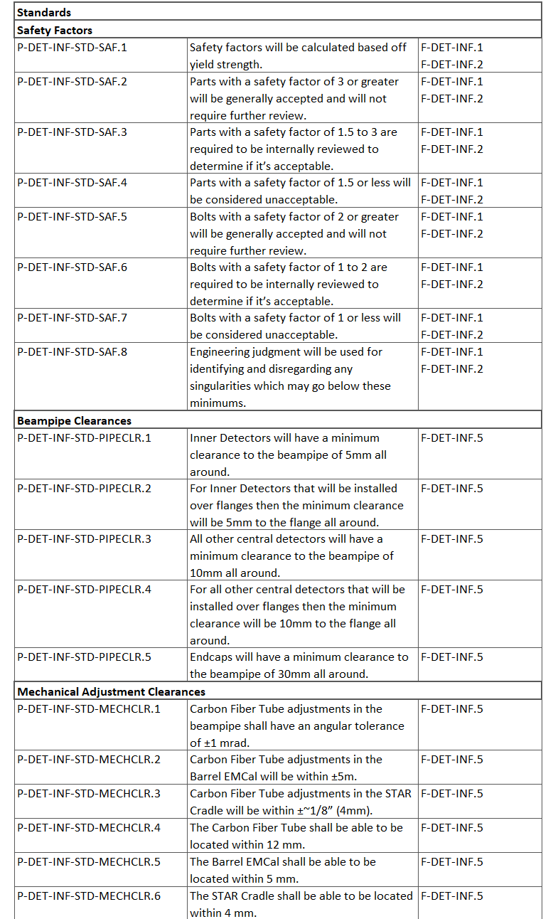
Requirements
Charge #4
See pre-brief: Requirements.20241205.xlsx

Slide 8
ePIC Mechanical Design Guidance
Charge #3
Scope
ePIC-owned detector supports, platforms, rails, structures etc.
BNL SBMS/ ES&H standards apply; most conservative approach taken.
Steel Design & Safety Factors (yield-based)
Codes: AISC/ASCE, AWS, ASTM, RCSC + BNL ES&H;
Loads: Dead, Live, Transport/Motion, Thermal, Seismic etc.
Structural Members: SF ≥ 3 OK · 1.5–3 review · ≤ 1.5 redesign. Bolts: SF ≥ 2 OK · 1–2 review · ≤ 1 redesign.
FEA singularities: use engineering judgment; justify and document.
Materials (Magnet, Radiation, Fire)
Any magnetic detector/support steel → project approval; prefer non-magnetic near magnet.
Services in radiation areas (hoses, flex, jackets, seals) must be radiation-qualified & project-approved.
Use flame-retardant materials wherever possible; flammable use needs project review/approval.
Geometry, Alignment, Survey
Single global coordinate system + elevation datum; each major structure has a mapped local CS.
Controlled envelopes & stay-clear volumes; IR alignment (e.g., ±1 mm X/Y, ±5 mm Z) drives deflection/tolerance budgets.
Provide survey monuments, shims, and adjustment features; survey informs as-built model.
Documentation, CAD, Configuration Control
Released drawings with clear datums, GD&T as needed, BOM with material + ratings (non-magnetic, rad-qualified, flame-retardant).
Master integration CAD = single source of truth; subsystem models must align.
Interfaces in ICDs; all changes via ECR/ECO, with revisions and as-built updates under config control.

Slide 9
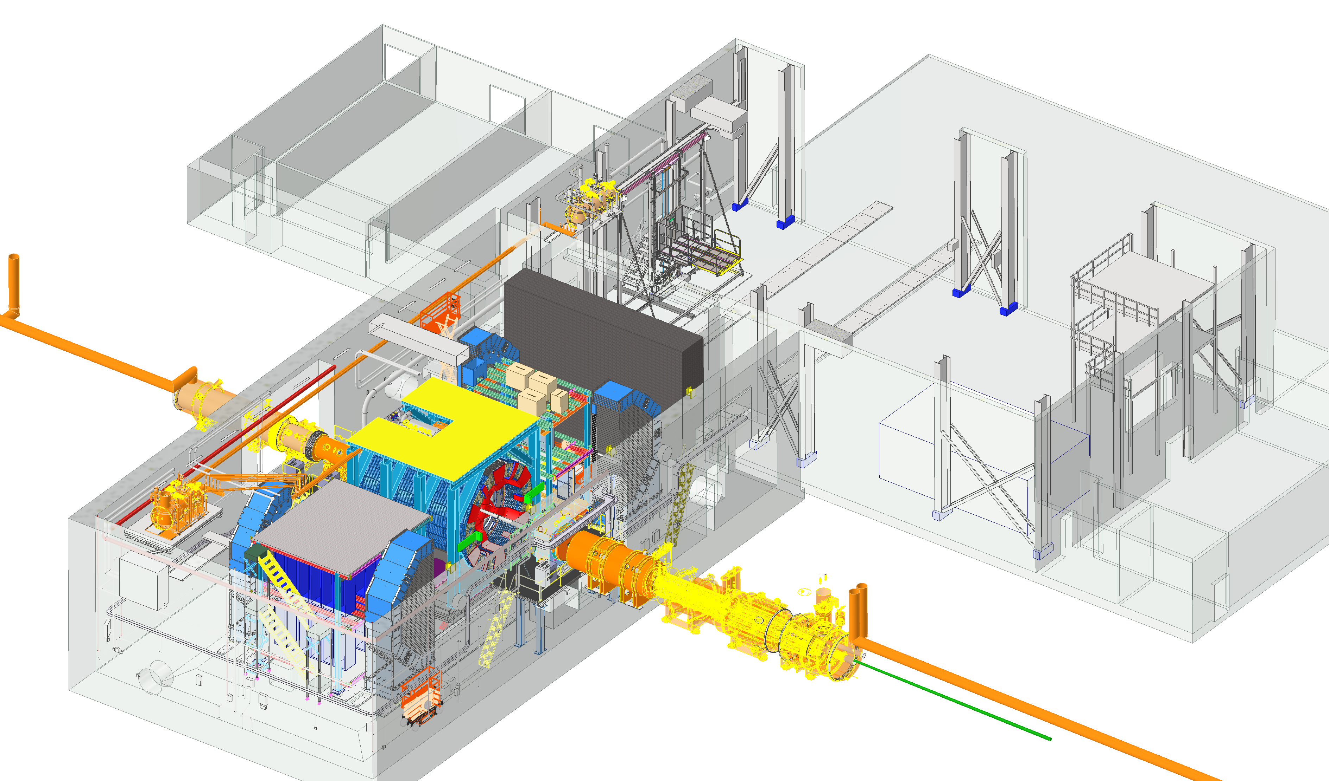
Bldg 1006 and ePIC Detector Overview
Charge #2
Control Room
NORTH (Ring Inside)
DAQ Room
Parking Lot
WEST
Assembly hall
HADRONS
Y
X
Clean Room
Pump & Elec Rooms
Z
EAST
ELECTRONS
SOUTH (Ring Outside)
EPIC Detector Barrel will be assembled in the Assembly Hall and End Caps will be assembled in the Experimental Hall
During maintenance shutdowns, detector barrel (central detector) can be rolled out from Experimental Hall to the Assembly Hall. Endcaps will always stay in the Experimental Hall.

Slide 10
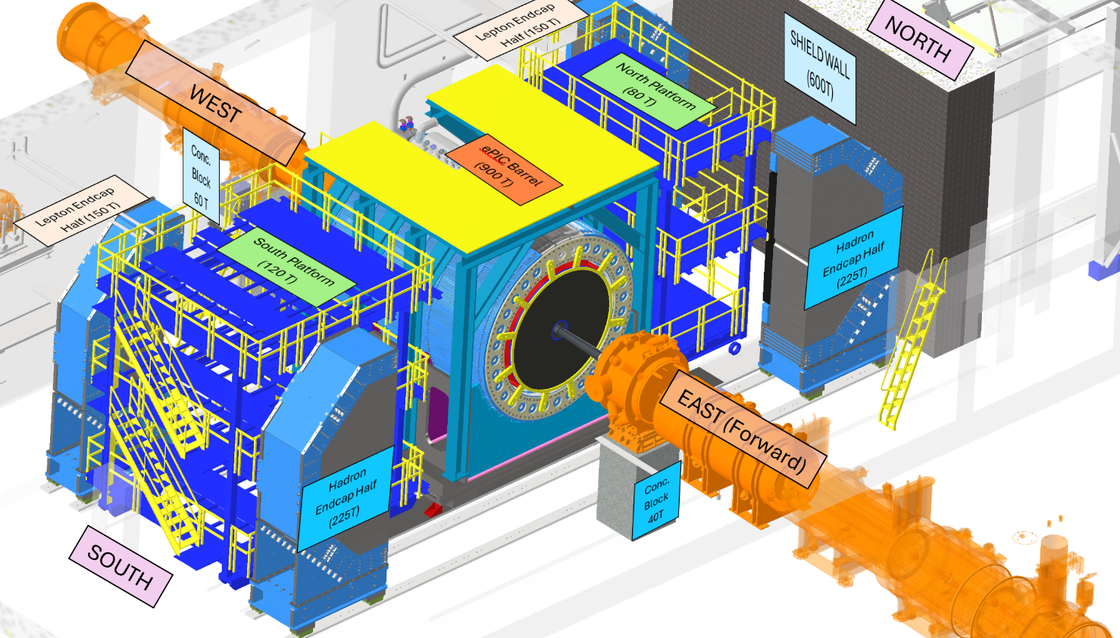
Endcaps in Experimental Hall
Charge #2
Endcap Structures and Flux-Return Steel, which support the Fwd & Backward HCAL and Fwd EMCAL detectors, successfully completed FDR in Dec 2024.
The Barrel HCAL and supporting cradle plates are being reused from the sPHENIX detector and will follow the same proven installation procedures.
The Fwd HCAL steel forms part of the magnetic flux-return system, whereas the Bwd HCAL uses stainless steel and does not contribute to the flux return.

Slide 11
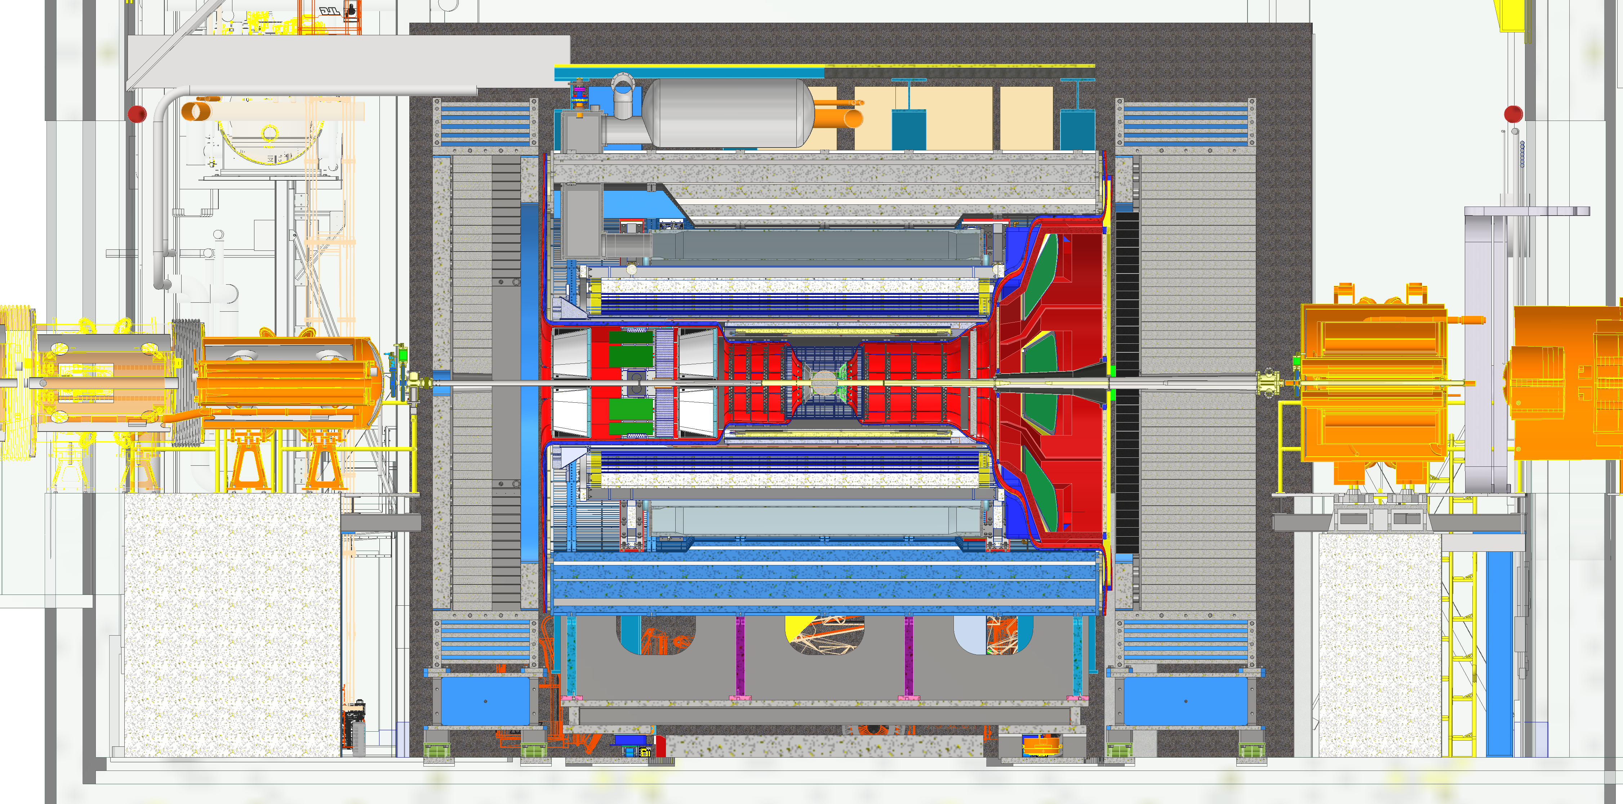
Overall Integration of EPIC in Experimental Hall
Charge #2,4
SIDE VIEW
Central Barrel
Backward End Cap
Forward End Cap
B0 Magnet
Gate valve
Gate valve
Rear Magnets

Slide 12
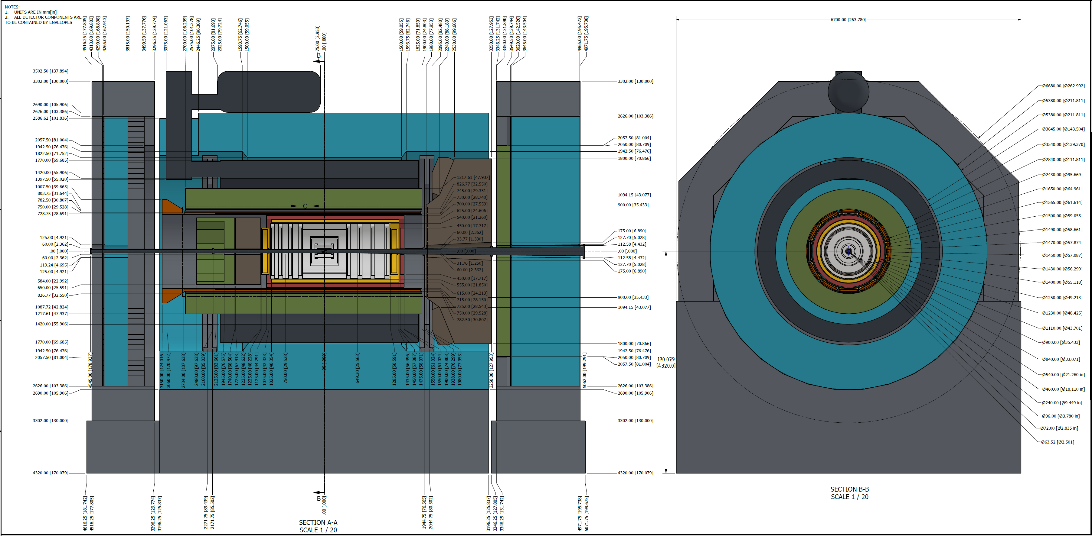
Envelopes Model and Drawing Package
Charge #4
All detectors, their respective electronics and any support structures needed for the detectors must fit within their defined geometric envelopes as specified in the official envelope drawings.
Detector subgroups should review and follow the service routing schemes proposed by the Integration Group to ensure compatibility and clearance with surrounding systems.
Any deviation from the defined envelope or routing paths must be communicated to the Integration Group for review and approval prior to implementation.
Adherence to envelope and routing constraints ensures proper detector motion, maintainability, and overall mechanical integration within the ePIC system.

Slide 13
ePIC Central Detector Weight Summary
Charge #4
The total weight of the cradle, cradle platform, and air bearing assembly is under the target of 900 tons, including margin.
The detector weight, which needs to be supported by the barrel HCAL and pedestals, is increasing by 3.4% compared to the sPHENIX detector.
Detector weights are being tracked here: Total Weights 2025-06-13.xlsx

Slide 14
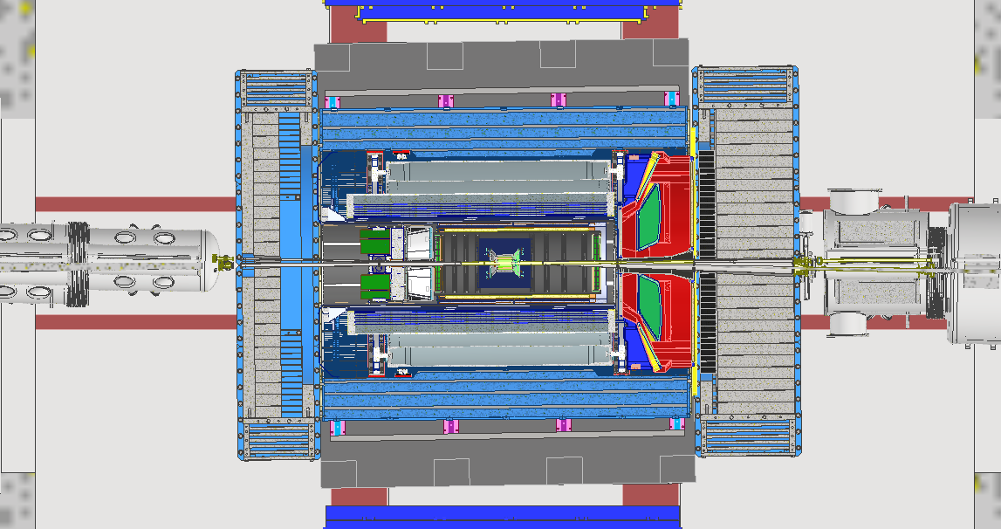
8mrad Rotation
Charge #2
TOP VIEW
9.518m
5.018m
Lepton Endcap 300 Tons
Hadron Endcap 450 Tons
Central Barrel 900 Tons
IP 6
0.39m
0.45m
8mrad
1.671m
1.204m
ePIC Detector is aligned with the Electron beam which is at 8 mrad angle through the Hall. It creates some design complications for various detector components.

Slide 15
Interaction Region and Alignment Requirement
Charge #4
Requirement from ePIC Detector Group:
Primary constraint is the central beryllium section of the beam pipe at the IP.
Required to stay within:
±1 mm in X (horizontal, transverse to beam)
±1 mm in Y (vertical)
±5 mm in Z (along the beam axis)
Applies to the fully assembled detector at its final operating position.
Other sub-detectors and supports may have looser tolerances as long as they assemble cleanly, maintain clearances, and can be accurately surveyed and reconstructed.
Why this alignment is critical:
Provides sufficient clearance for the beam envelope.
Supports safe and stable accelerator operation
Reducing the risk of beam particles striking the beam pipe and generating background in the detector.

Slide 16
Alignment Challenges
Charge #4
Tight requirement focused on the Be section
Central beryllium section at the IP must stay within ±1 mm (X/Y) and ±5 mm (Z).
Surrounding detectors and supports can be looser as long as they can be surveyed.
Shared, tightly packed alignment budget
Manufacturing tolerances, structural deflections, survey / transfer errors, and adjustment mechanism tolerances all draw from the same small budget.
Any single contributor getting “too large” reduces margin for the others and risks exceeding the overall ±1 mm(X/Y) / ±5 mm (Z) limits.
High support sensitivity of the thin Be pipe
Thin, flexible Be pipe will react strongly to small motions or rotations at its supports.
Heavy detector installations such as EEMCAL can move/deflect GST/PST structure and in turn move the beam pipe. Kniematic mounts and pre adjustments to allow for deflection are being planned at the moment.
Interface constraints at ends and short bellows
Beam-pipe ends and flanges must stay compatible with the rest of the beam line; short bellows can only accept a few mm of X/Y misalignment and limited angle.
Maintaining the IP position while also keeping end offsets and angles within bellow capacity is a coupled, multi-point constraint.
Thermal cycling and operational handling
Pump-down / bake out to >100 °C introduces thermal expansion and contraction; the system must return to the same aligned state after cooling.
Repeated thermal and operational cycles (bake outs, interventions, motion of surrounding detectors) must not accumulate into permanent Be-pipe misalignment.
Vacuum Group evaluating titanium end sections (central section remains beryllium) in place of aluminum to improve behavior under bakeout thermal cycling; bellows at both ends will accommodate thermal expansion/contraction, and a mock-up with testing is being considered to validate the approach.

Slide 17
Proposed Solutions and Implementation
Charge #4
Baseline
Hierarchical adjustment chain (Baseline)
Cradle: Coarse positioning with ±2 mm in X, Y, Z using precision blocks, shims, and adjustment mechanisms.
GST: Intermediate adjustment with ±3 mm relative to cradle to center the PST/central region.
PST (fine alignment host): ±3 mm travel, used to set the central Be beam pipe to ±1 mm (X/Y) and ±5 mm (Z) at the IP. This is not part of the design yet, but under investigation.
Survey-driven implementation
Central detectors and beam pipe precisely surveyed with respect to PST during assembly.
PST/GST remain surveyable after installation, while the central Be section is not directly visible.
Final shim and adjustment settings (cradle, GST, PST, and possibly beam pipe supports) are tuned from survey data so the Be section meets ±1 mm / ±5 mm while keeping ends/flanges compatible with short bellows and the rest of the beam line.
Verification, Acceptance & Reuse
Verification: Post-adjustment survey of PST/GST and beam line; confirm computed Be position at IP and bellow offsets are within allowable range.
Acceptance: Alignment accepted when Be section satisfies ±1 mm (X/Y), ±5 mm (Z) and interface misalignments stay within bellow capacity; as-built survey and shim settings are documented.
Reuse: Same survey references and recorded shim/adjustment “recipe” are used to re-establish alignment after opening/closing cycles or major interventions.
Possible Backup
Potential direct beam pipe adjustability
Exploring additional X/Y adjustment on the beam pipe supports if beampipe radius can be decreased. clearances to SVT and other central detectors can be increased.

Slide 18
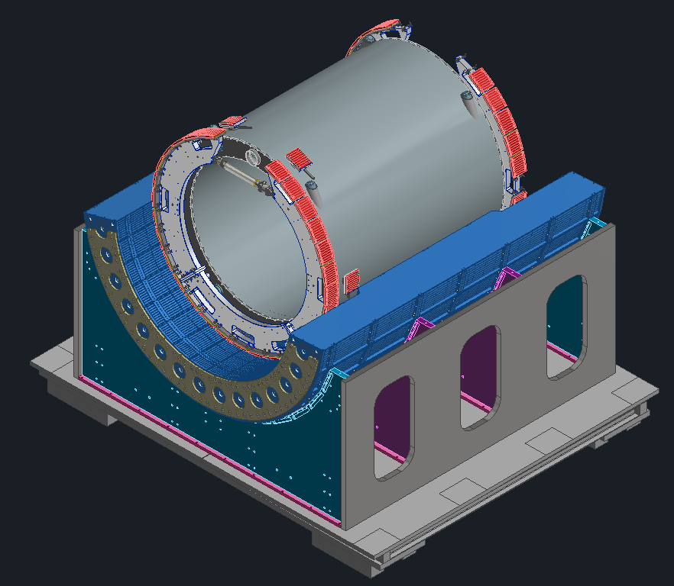
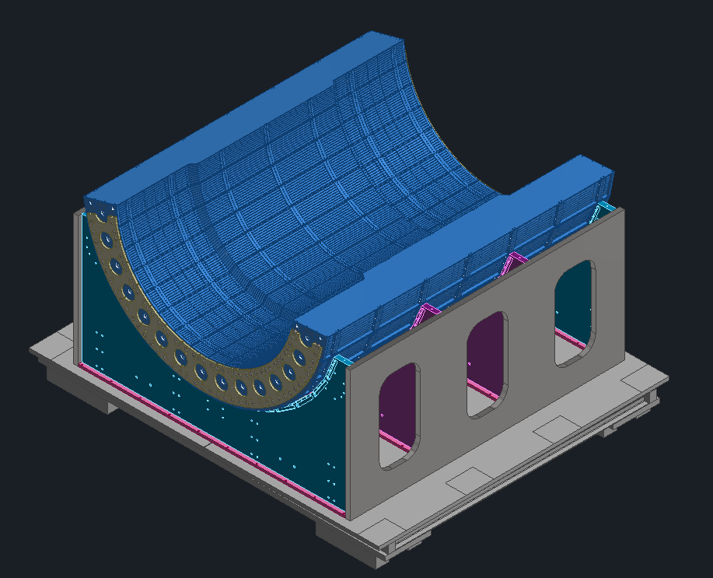
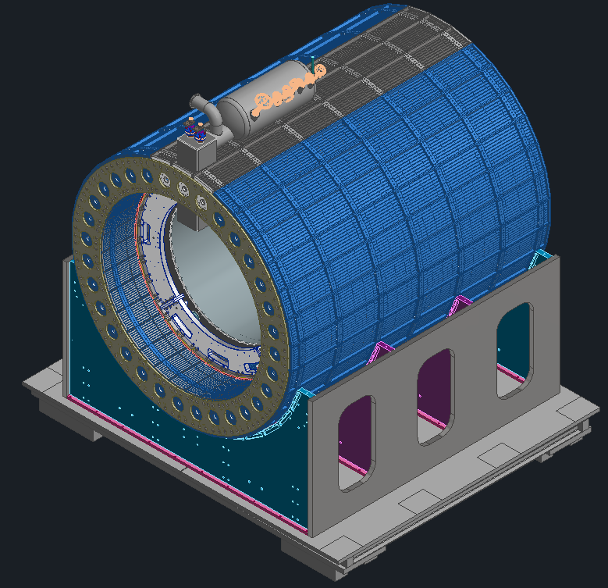
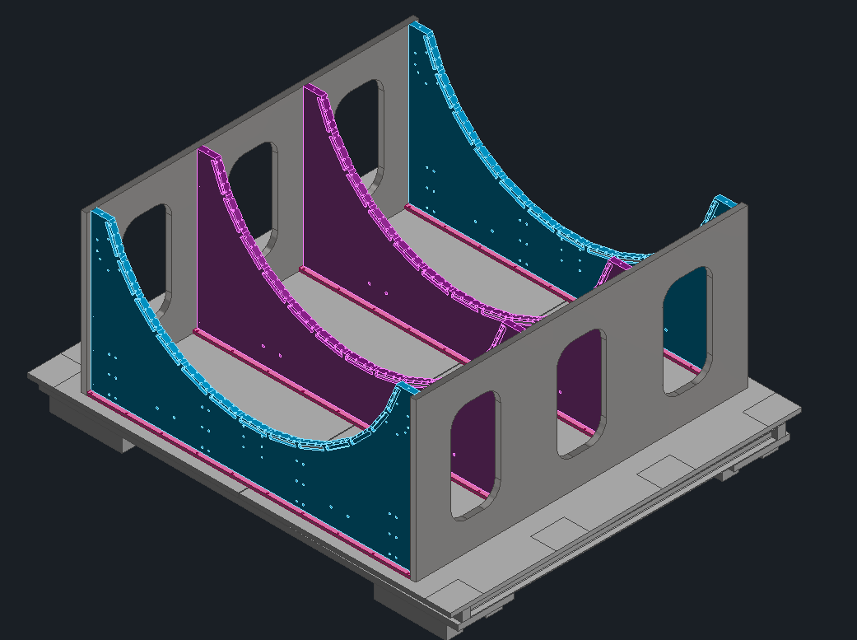
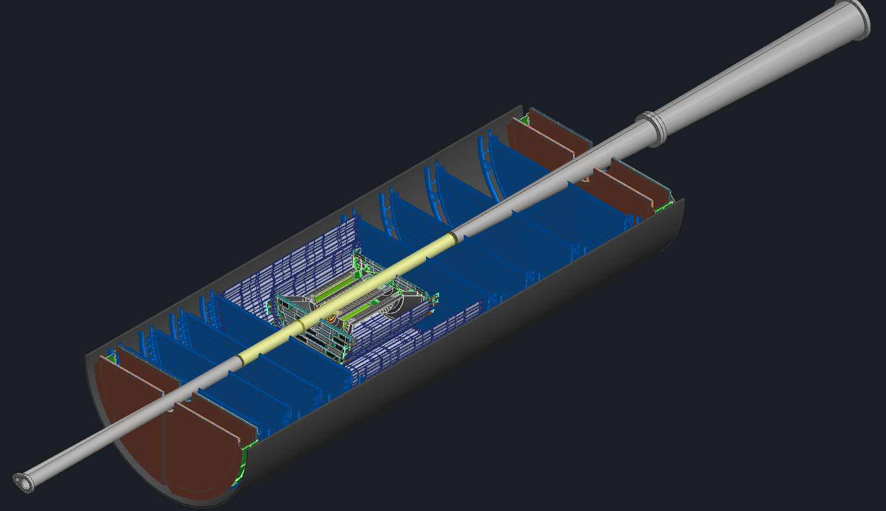
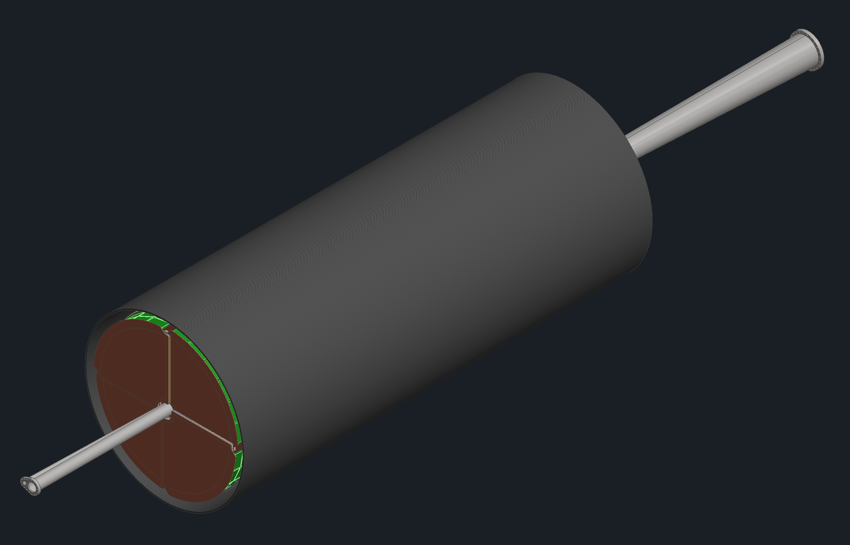
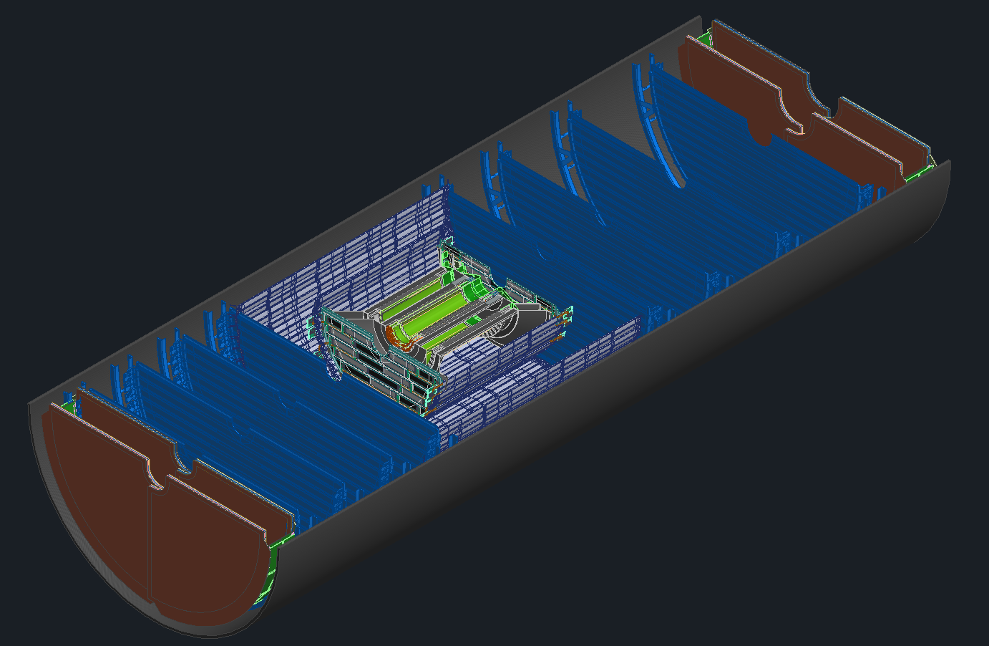
ePIC Barrel Assembly/Installation
Charge #4
Step 1:
Detector Cradle
Step 2:
HCAL Bottom Half Installation
Step 3:
Magnet & Support Rings Installation
Step 4:
HCAL Top Half and Magnet Chimney Installation
Step 5: Magnet Mapping
(2 Months)
60 d
42 d
8 d
42 d
While Magnet Mapping Takes place, We can Assemble PST with Silicon Detectors, MPGD Disks and TOF Disks (60days total)
Step 6: PST Bottom half assembly
Step 7: Beampipe Installation
Step 8: PST Top half Installation
SVT Disks
SVT Tracker
MPGD Disks

Slide 19
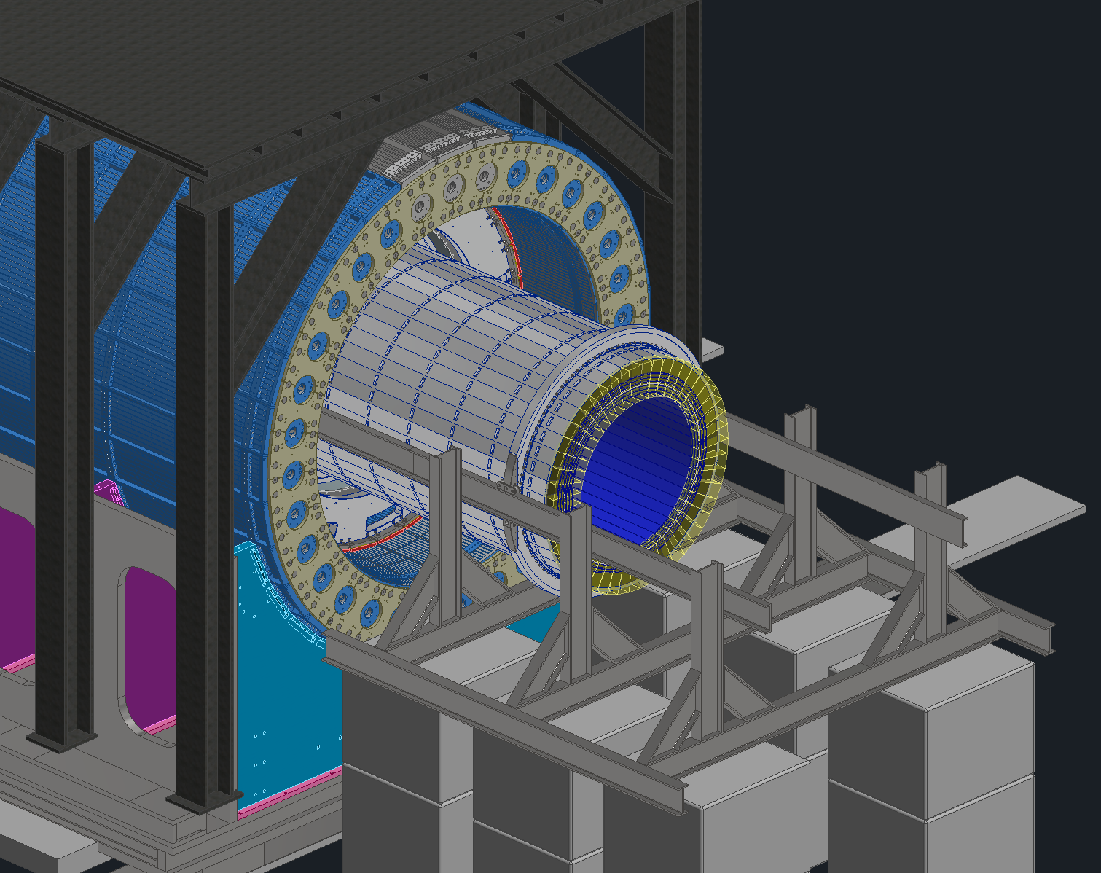
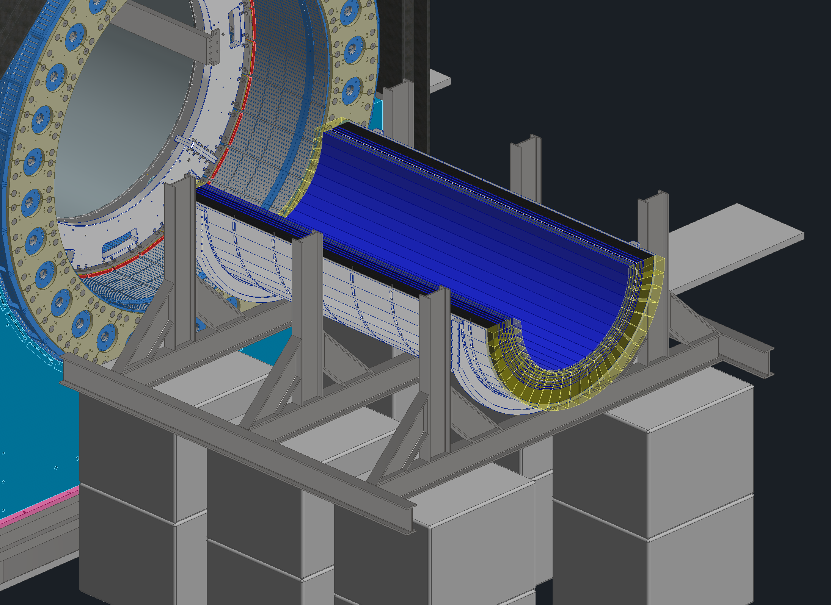
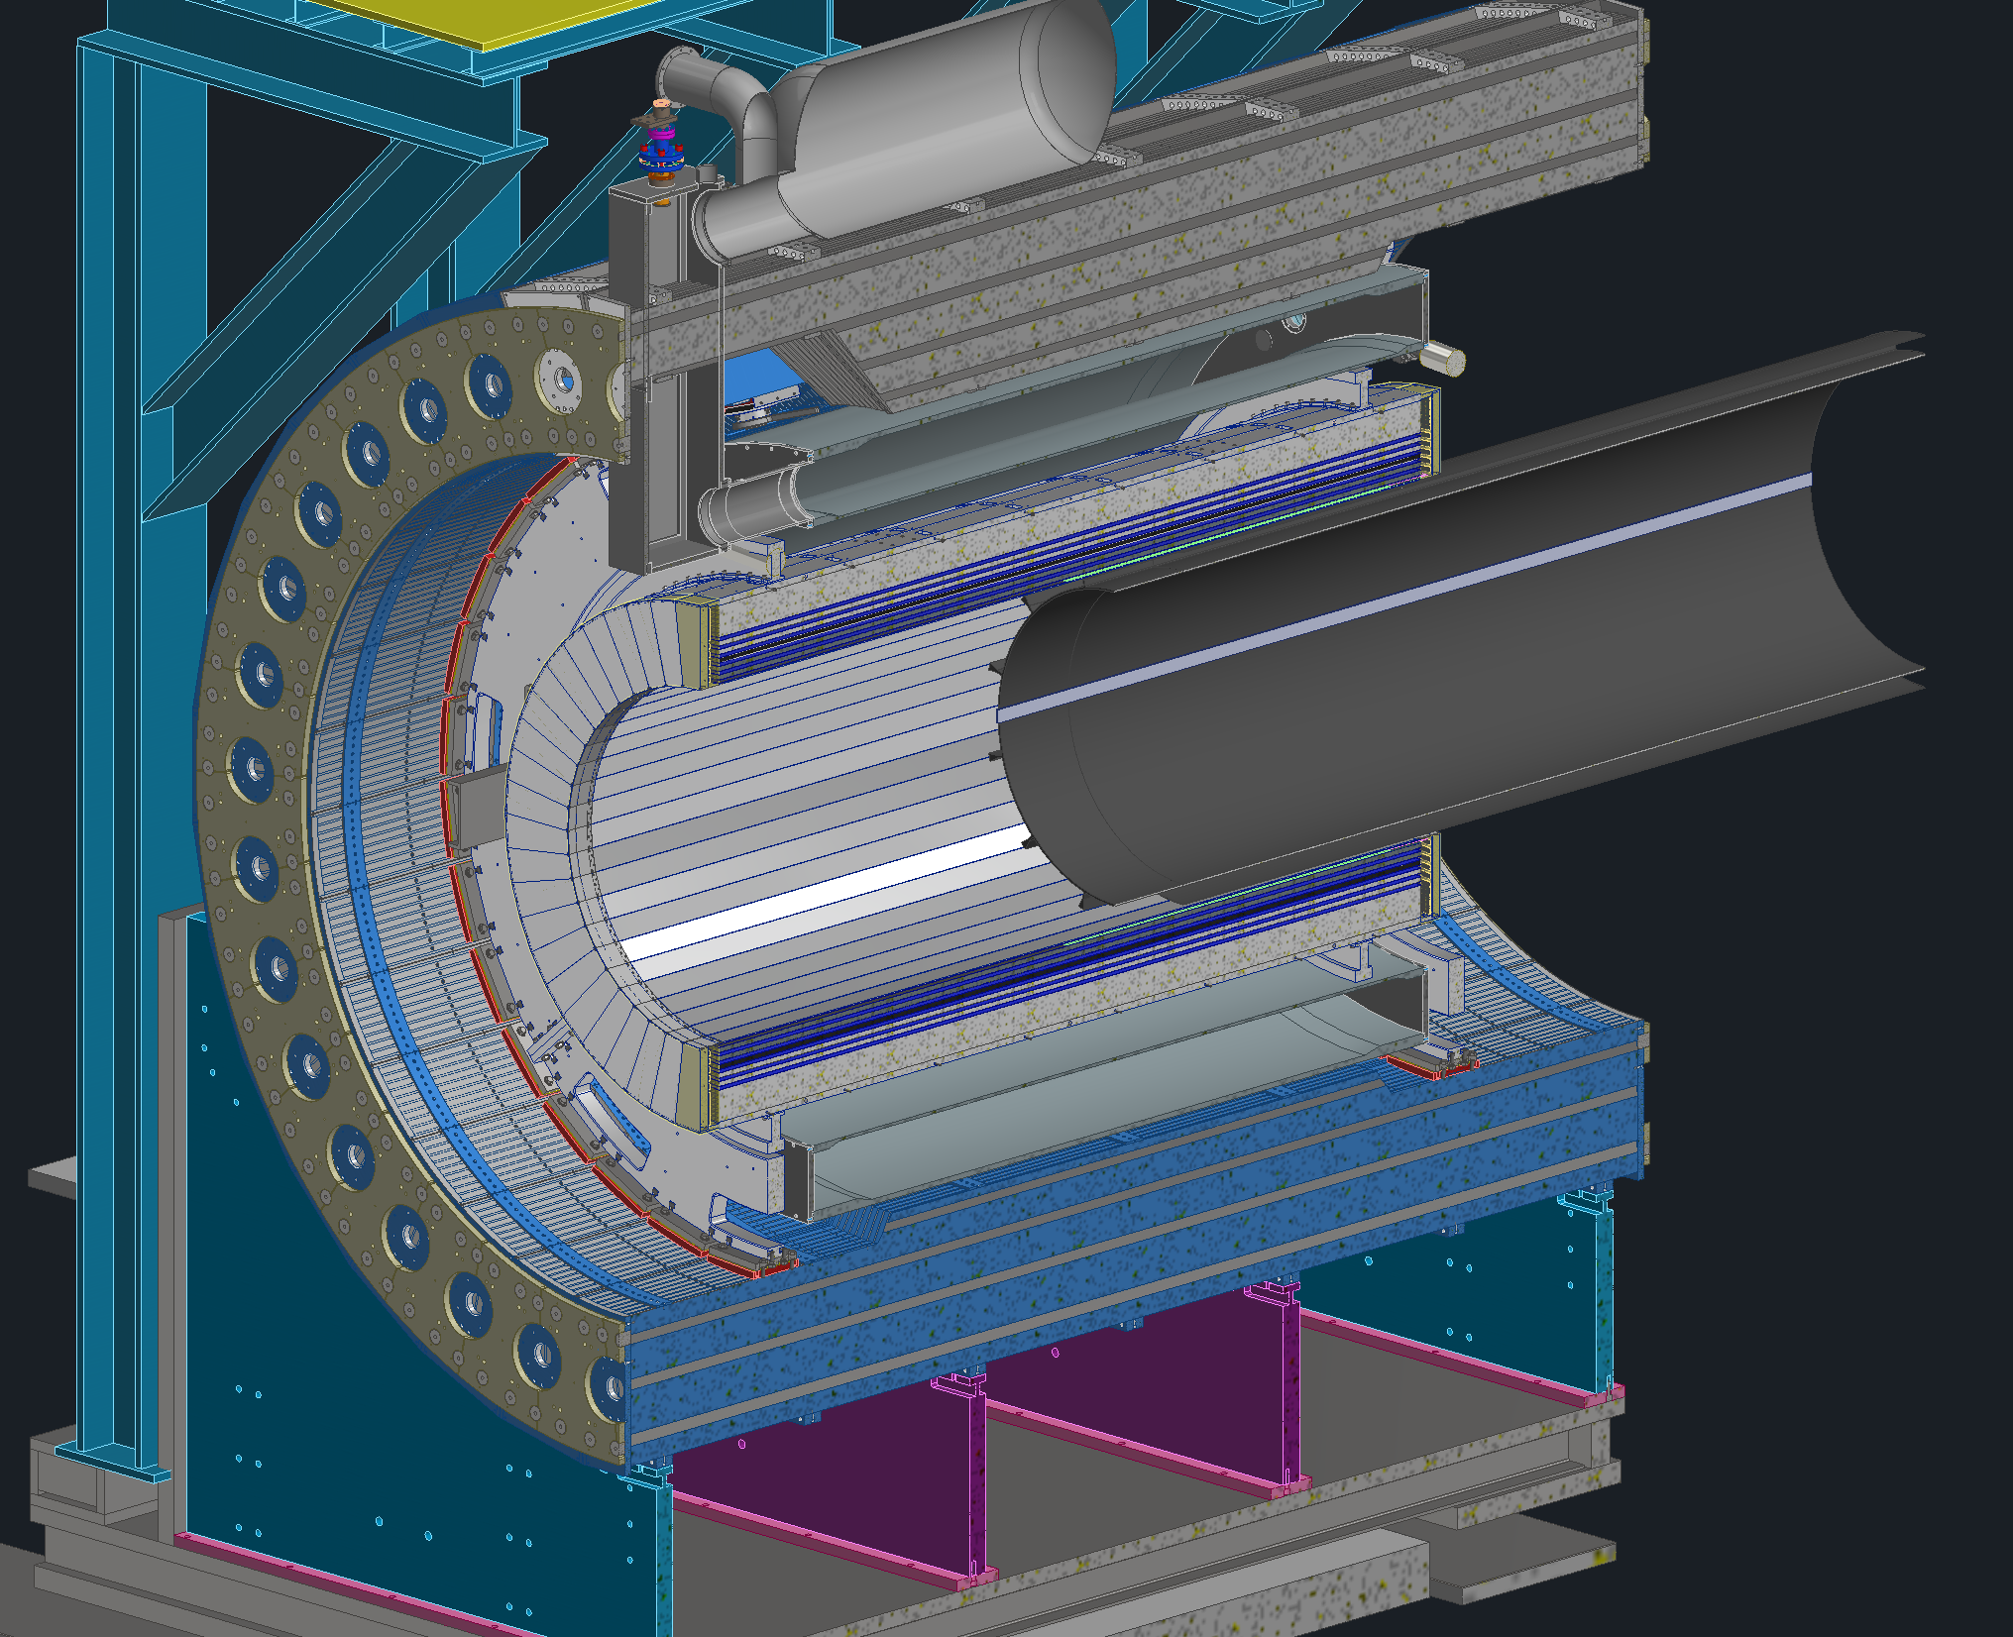
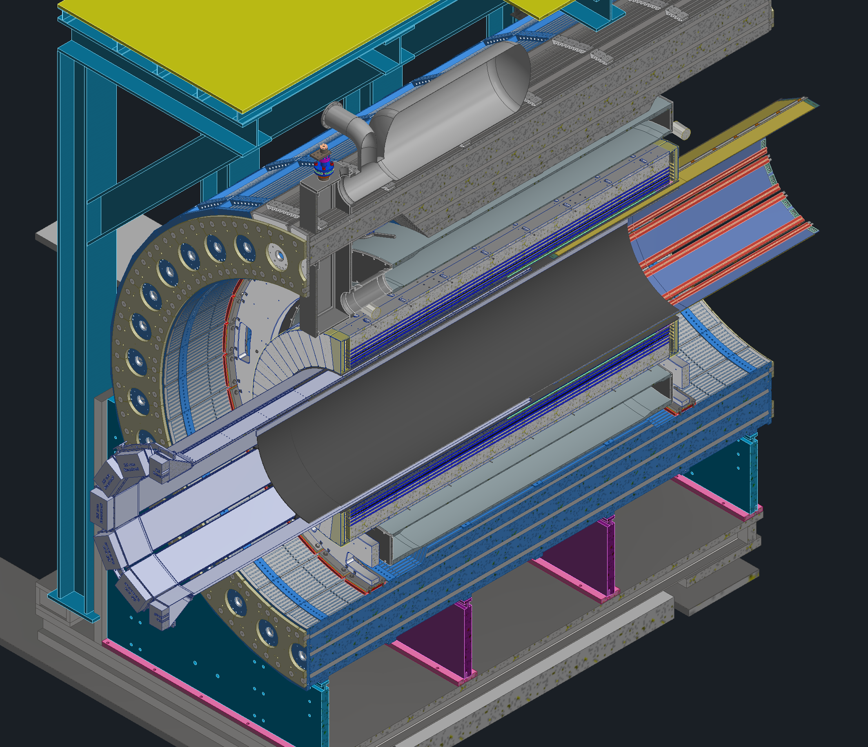
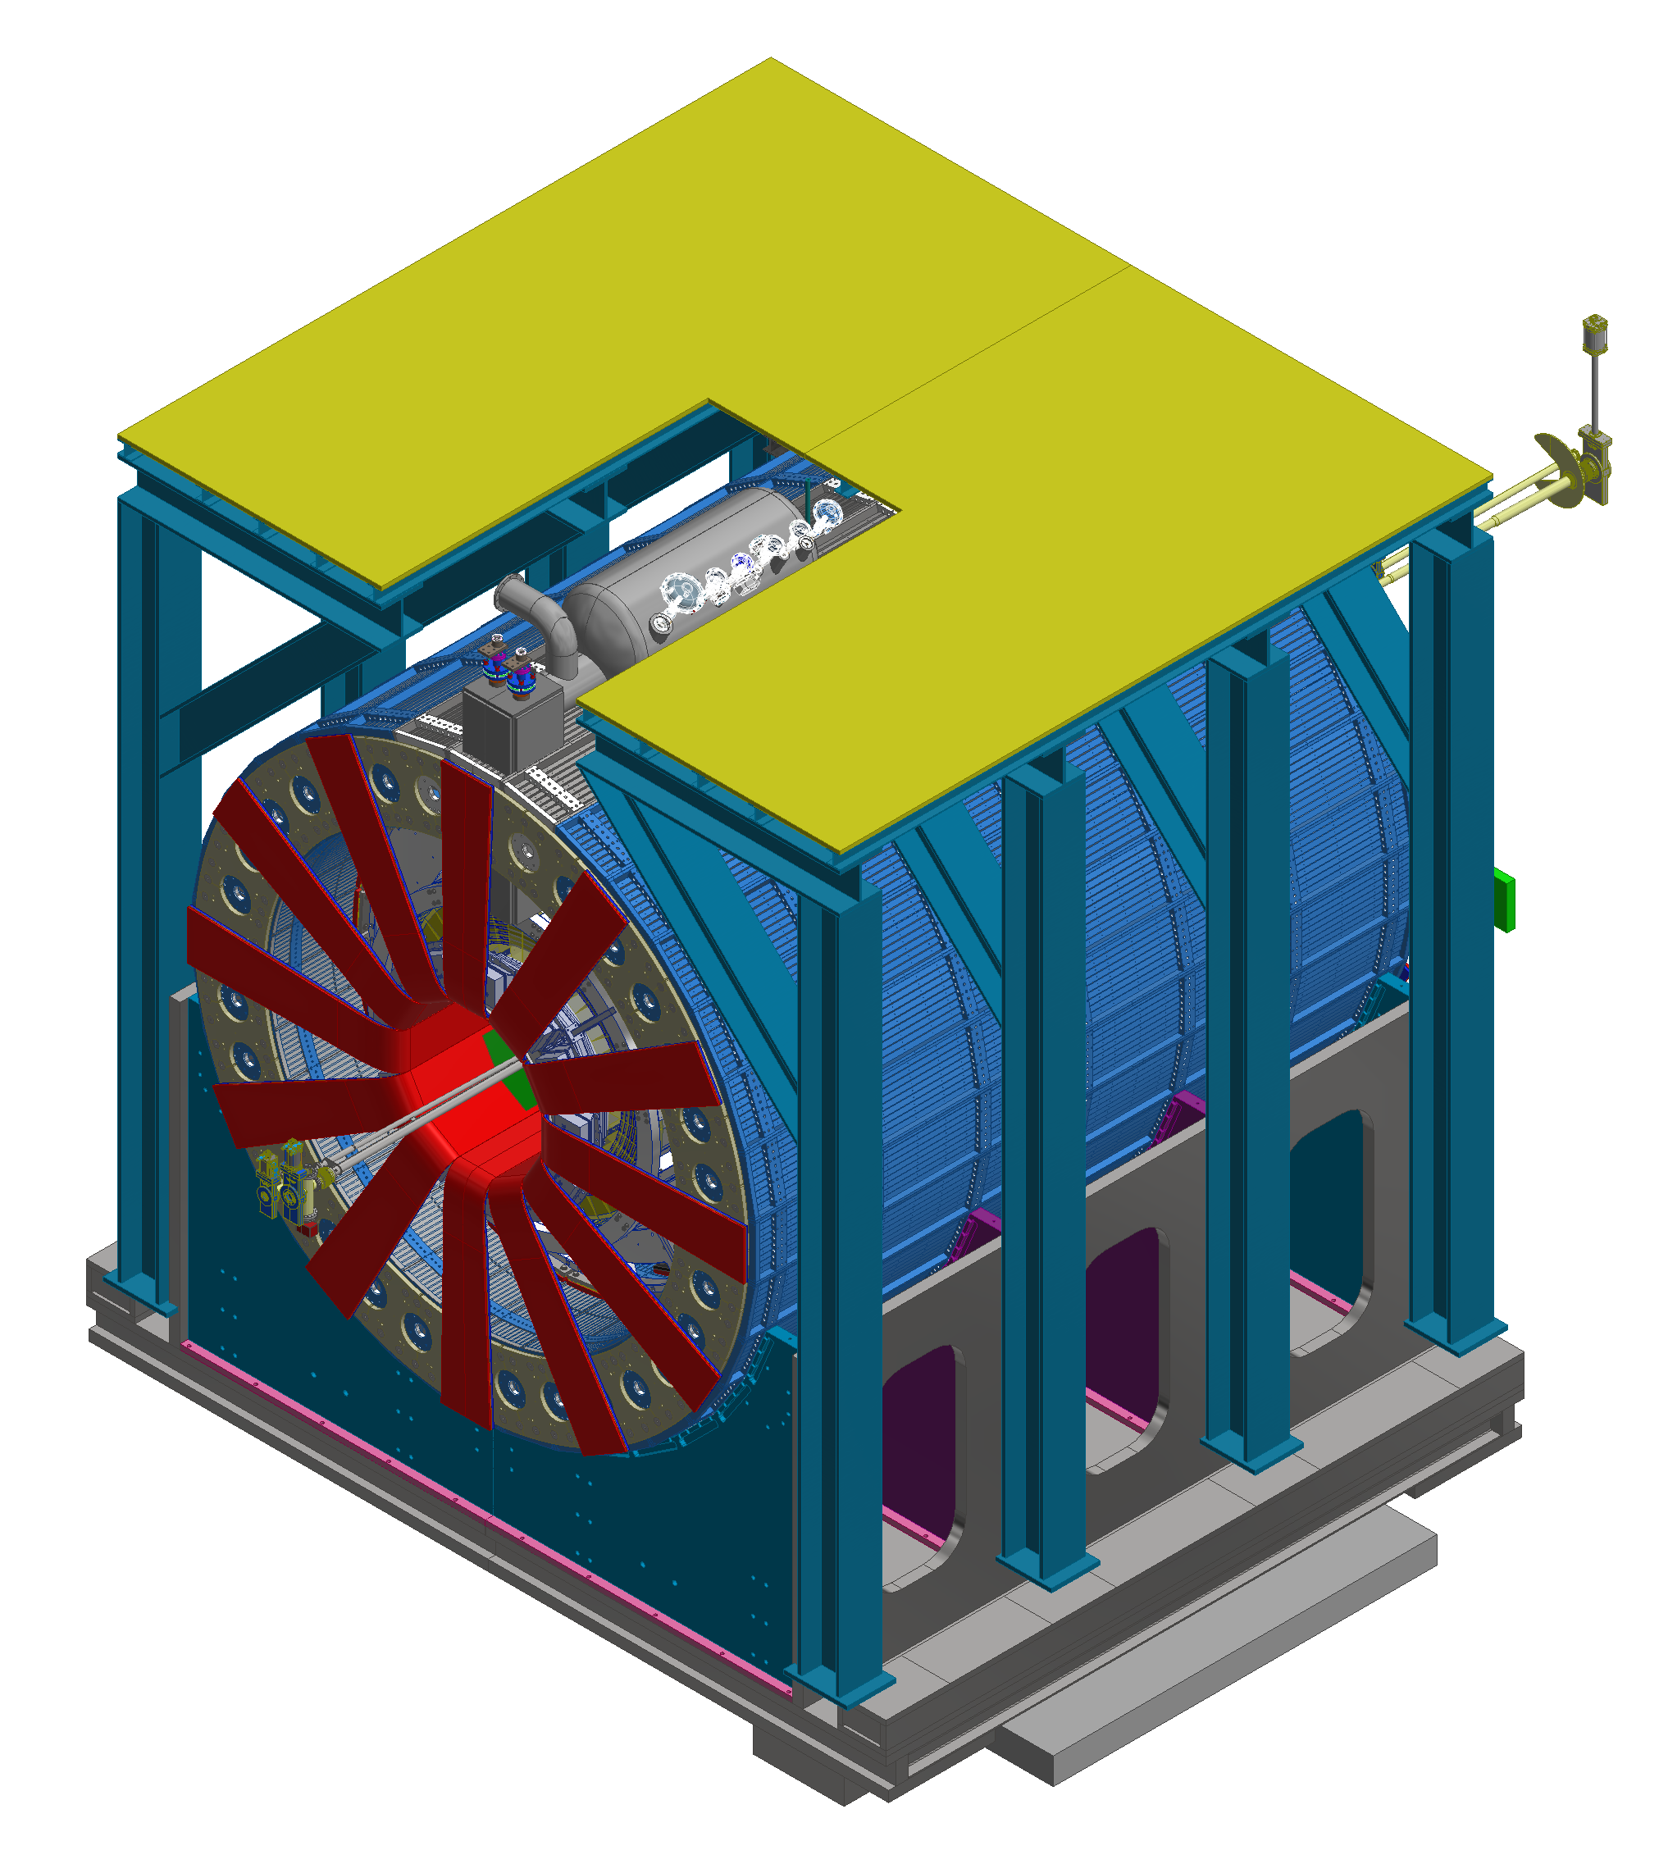
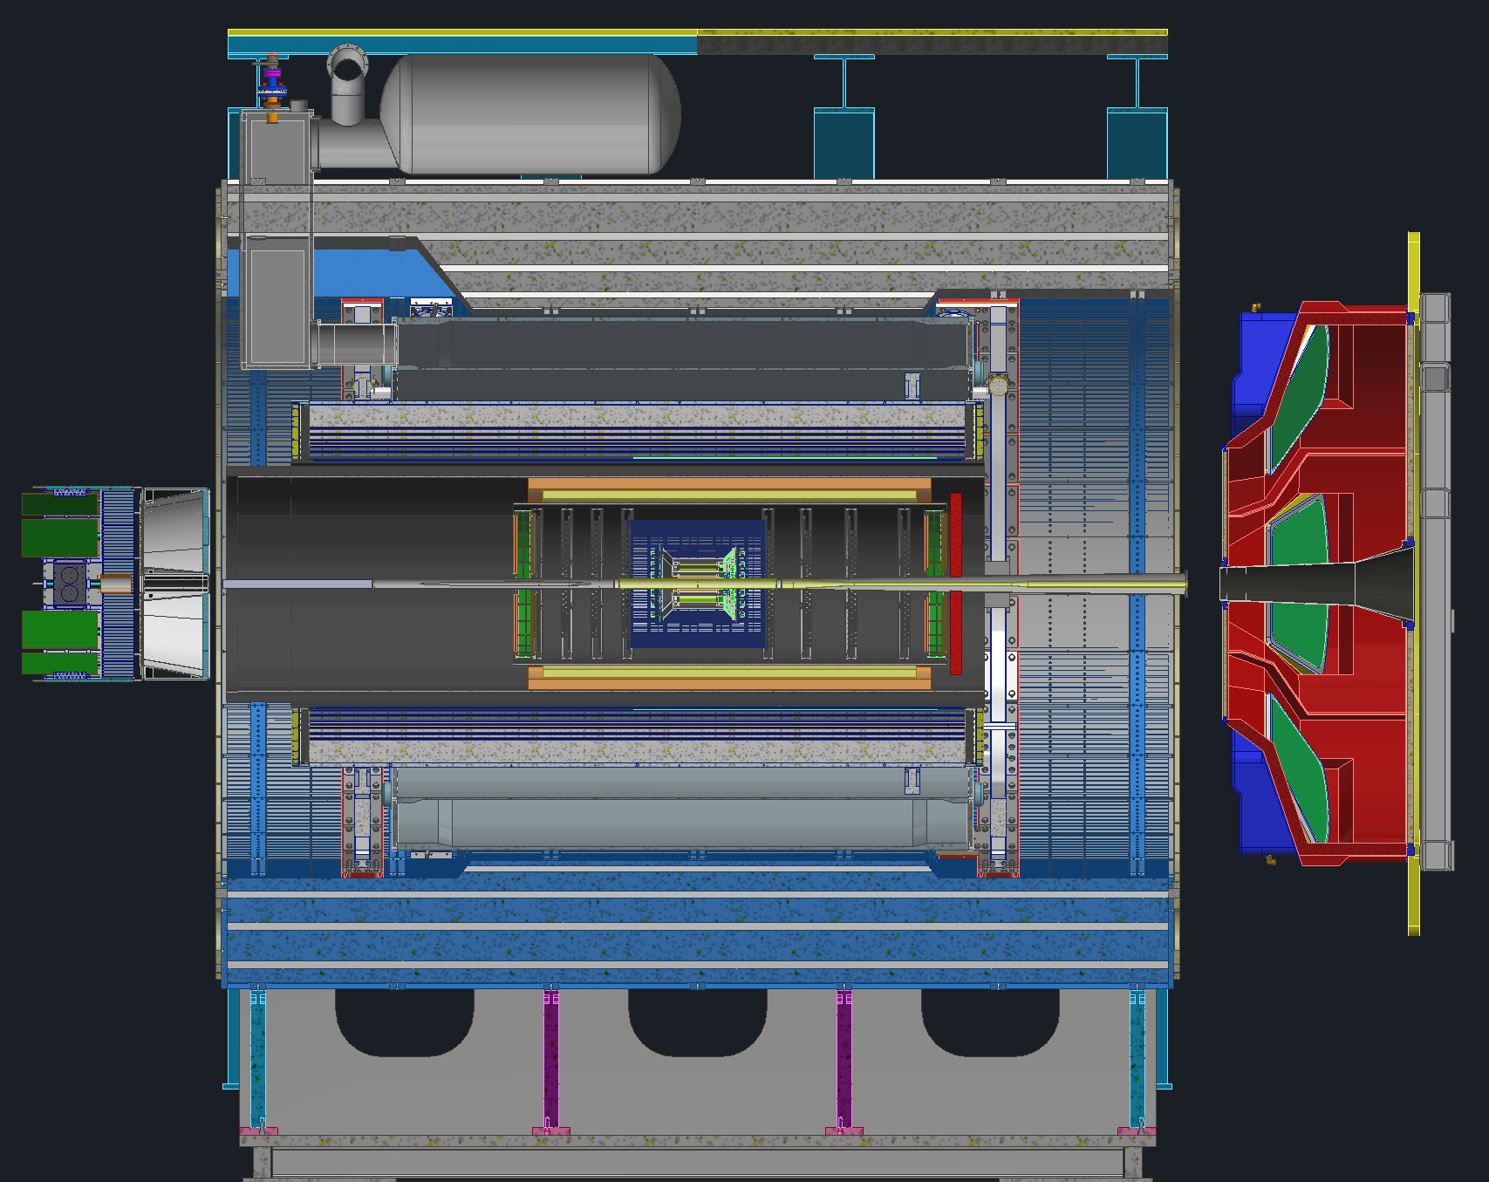
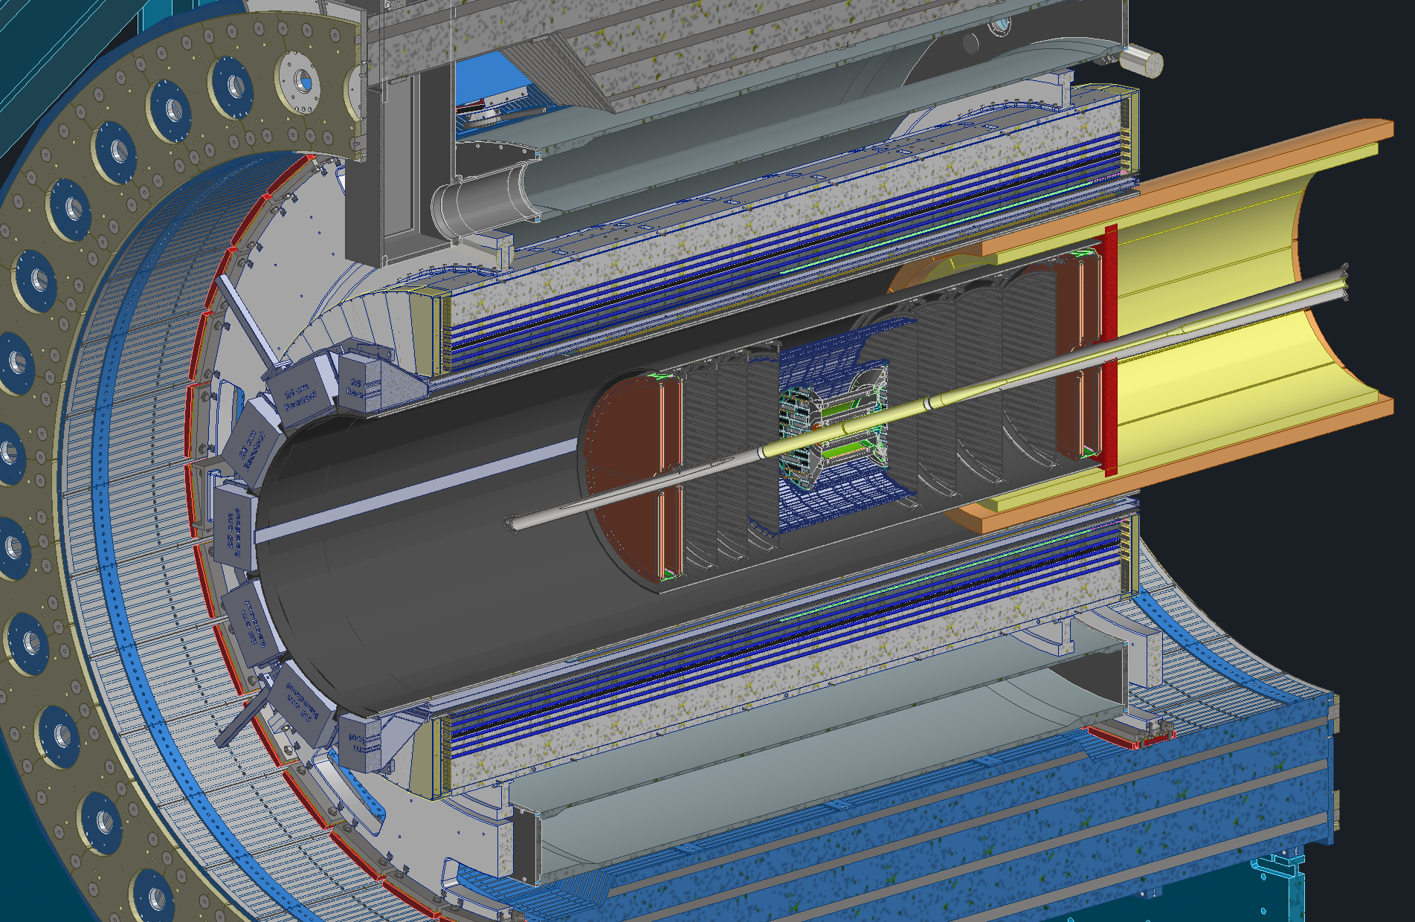
ePIC Barrel Assembly/Installation
Charge #4
Step 9:BEMCAL Assembly and Installation (60days)
Step 10: GST Installation (5 days)
Step 11: MPGD and DIRC Installation (50 days)
GST
Outer MPGDs
DIRC Bar Boxes
Step 13: EEEMCAL, pfRICH and dRICH (50days)
Step 12: PST, TOF and Cymbal Installation (50days)
ePIC Barrel Detector Ready

Slide 20
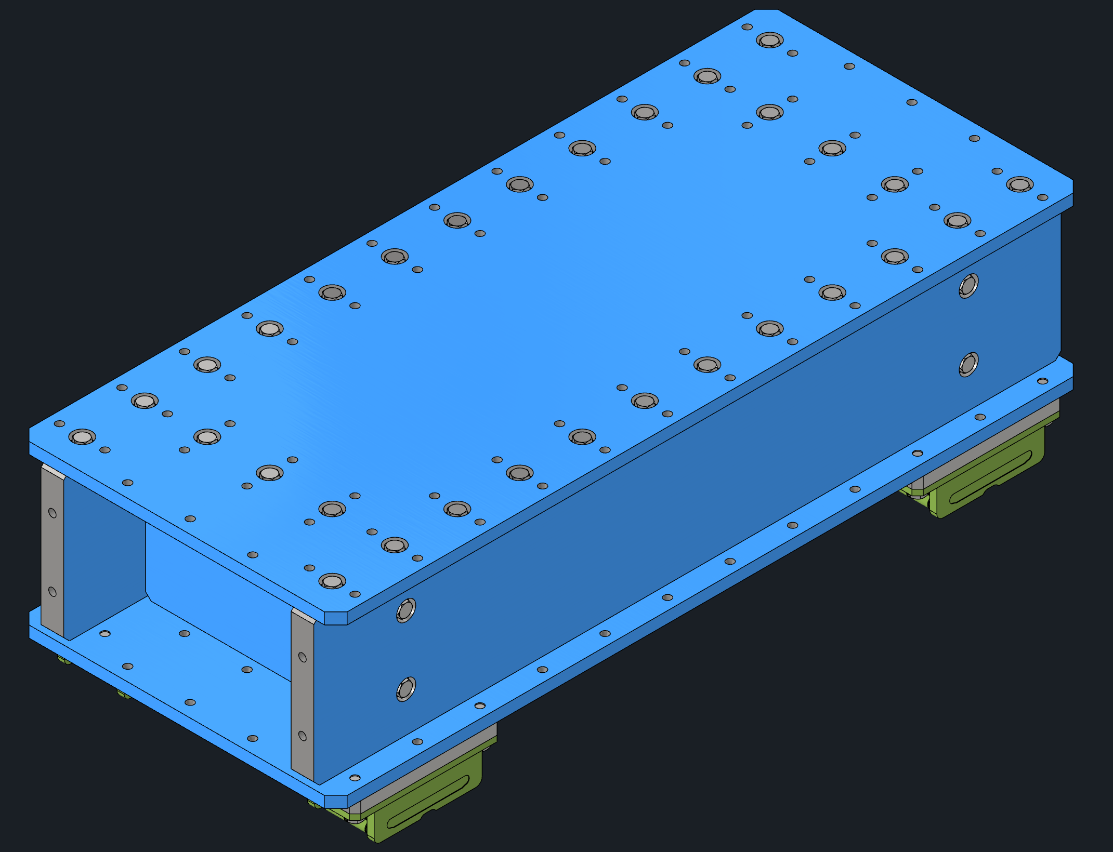
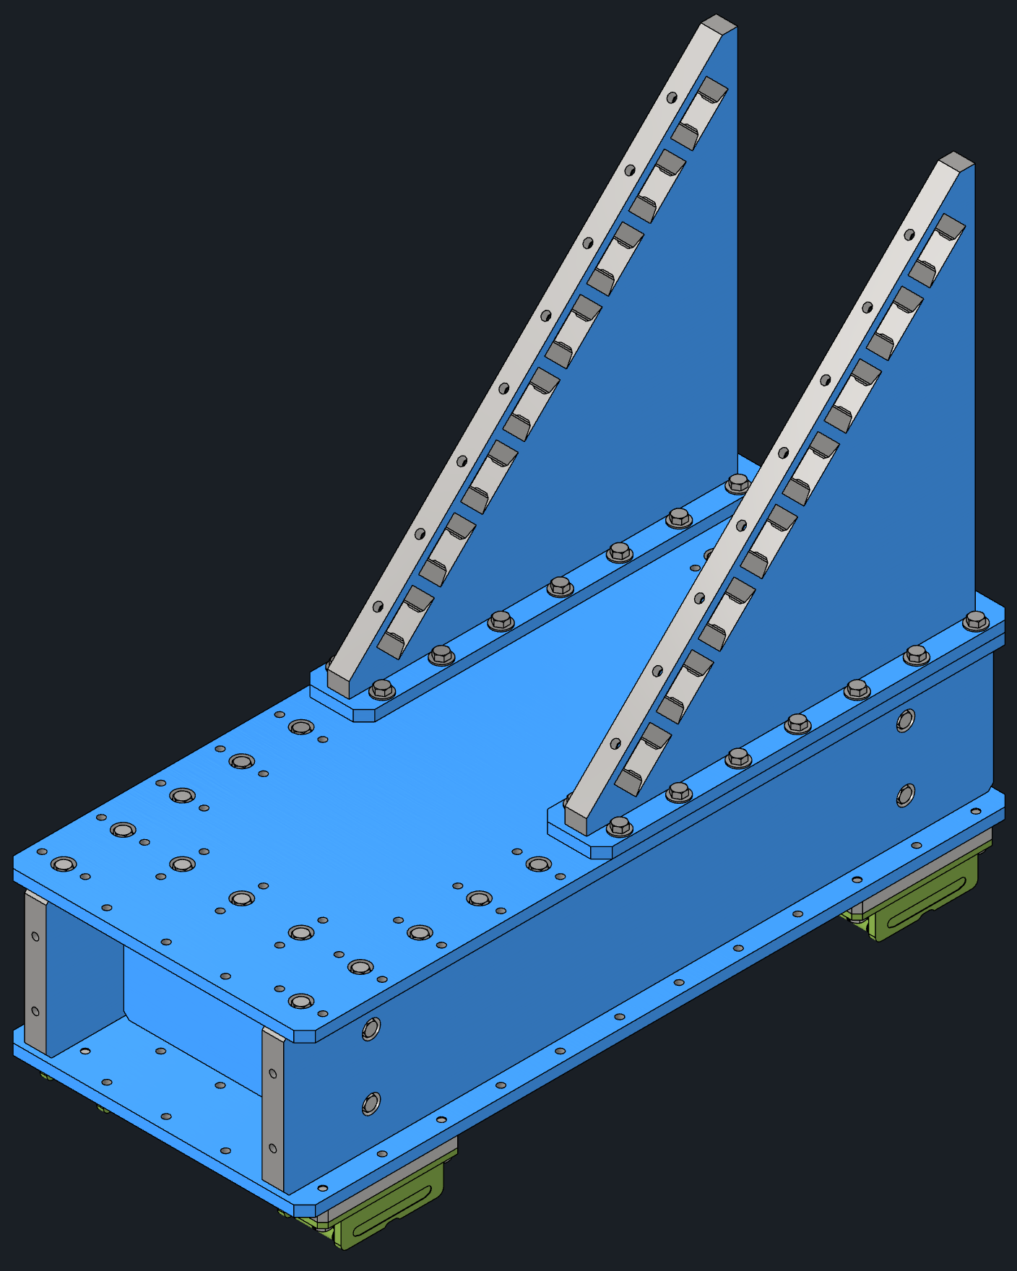
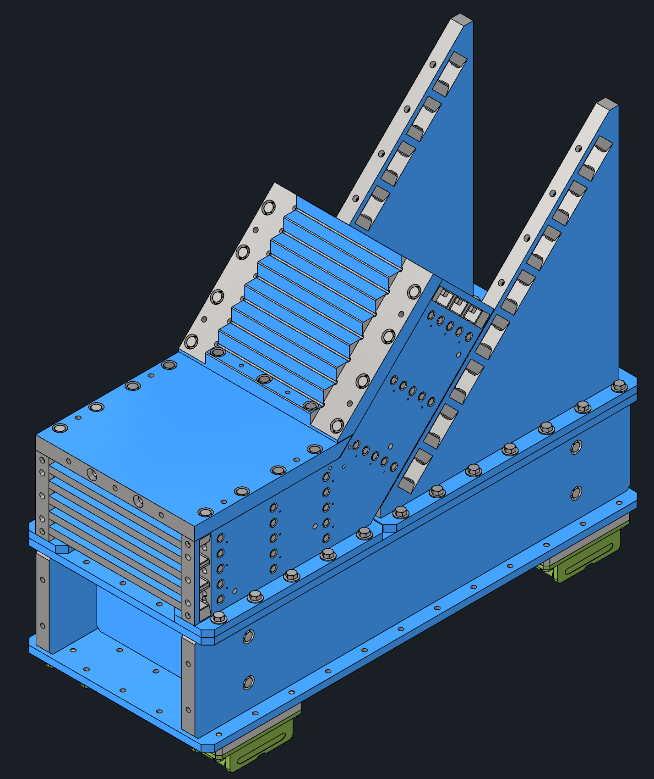
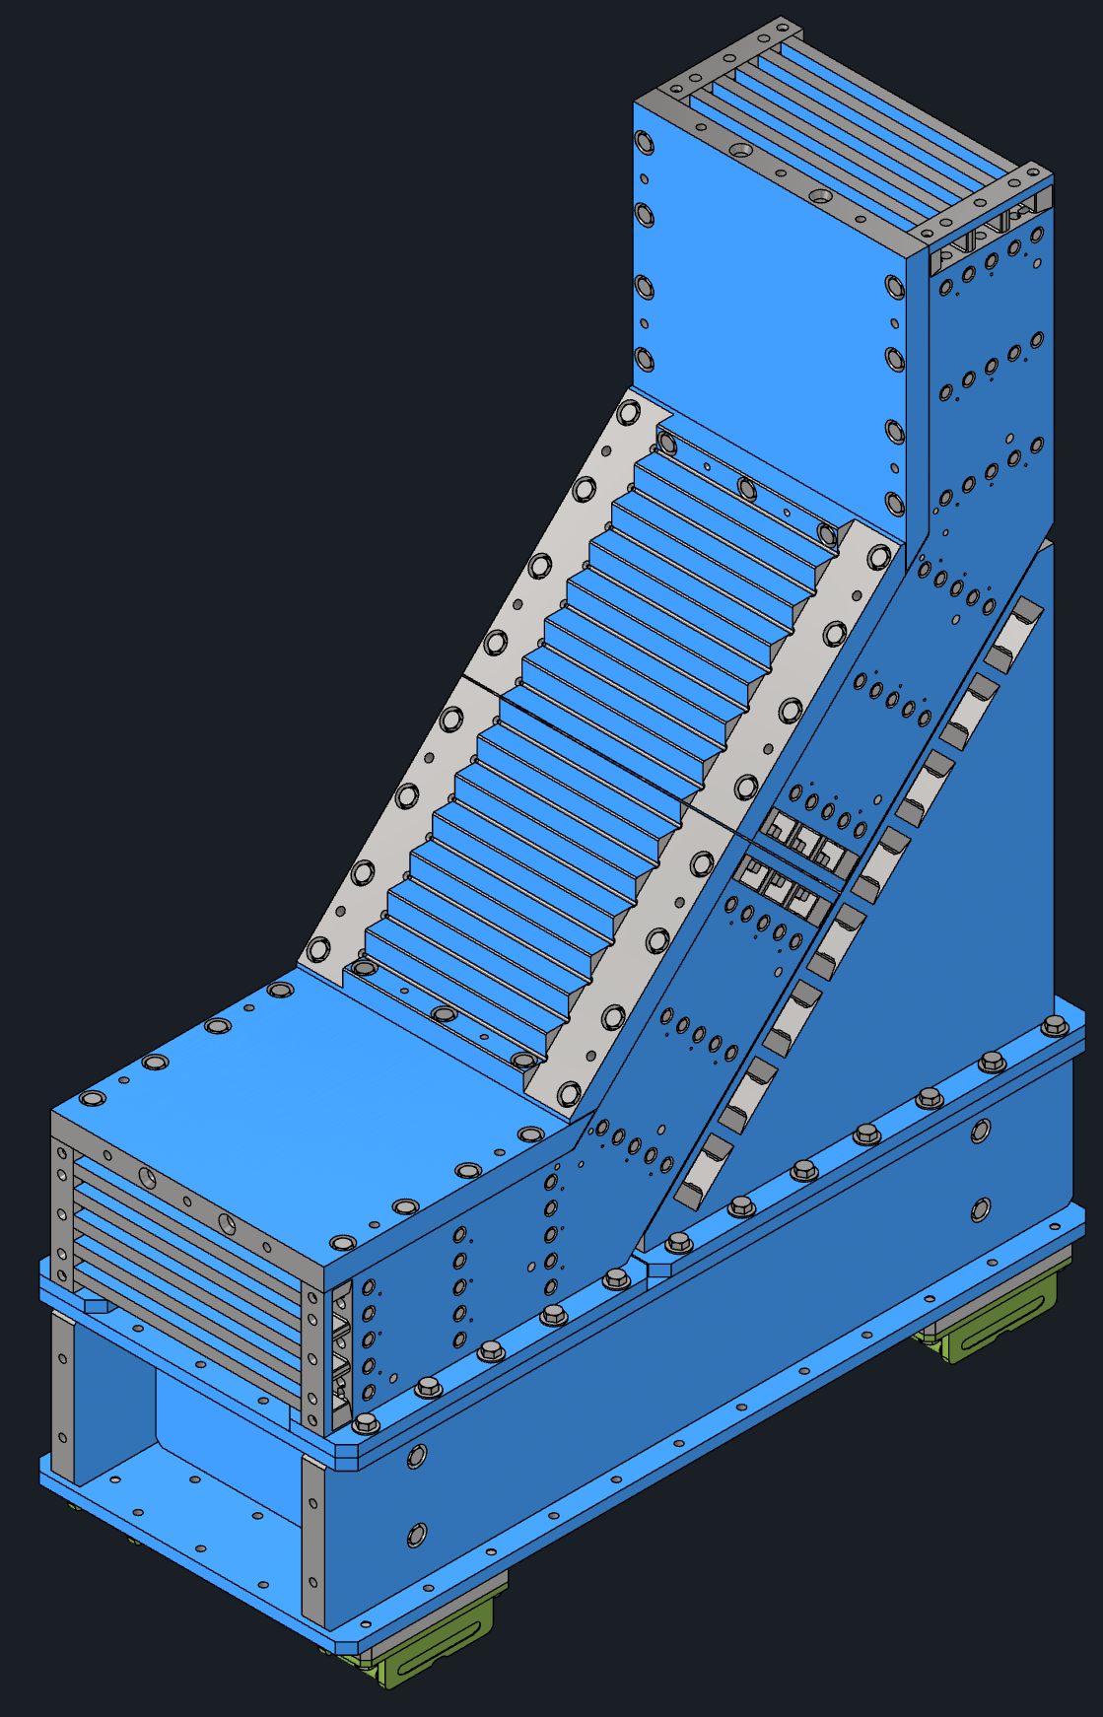
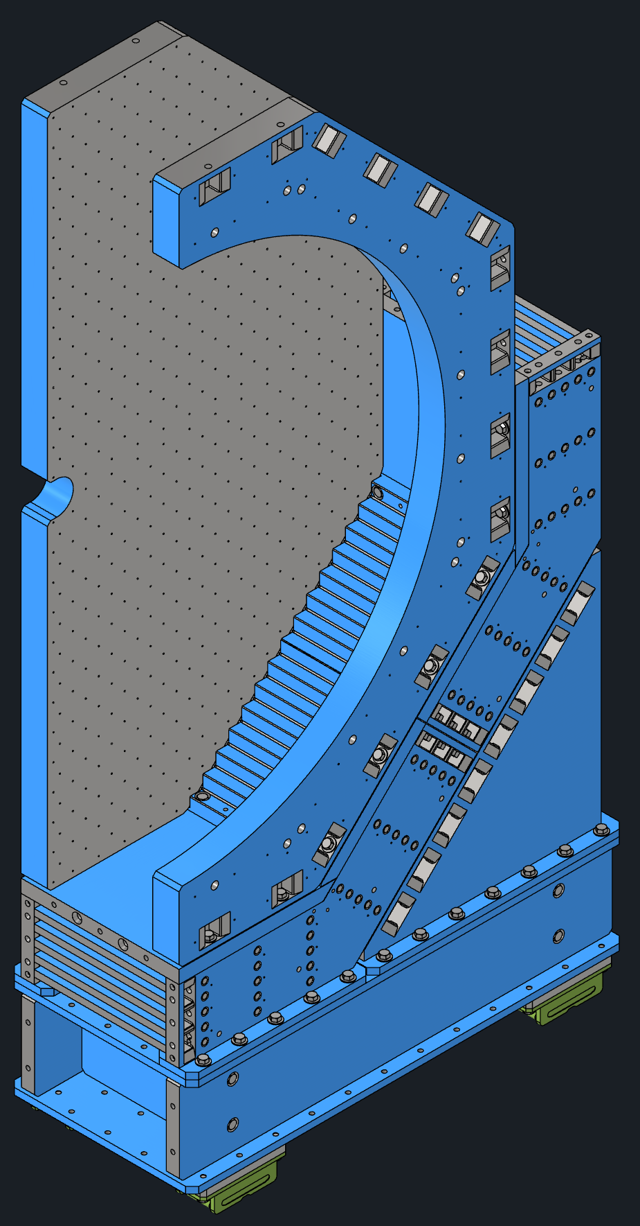
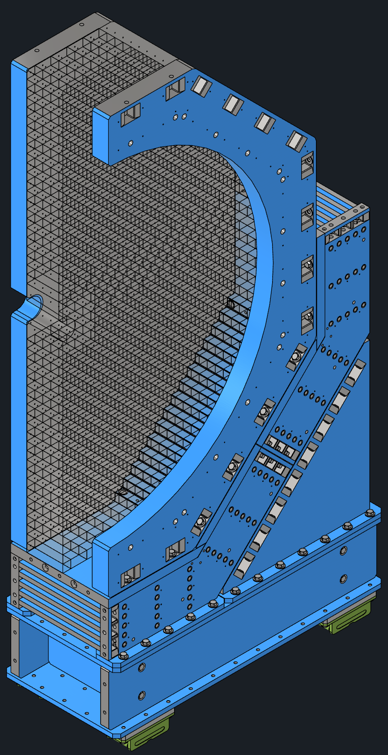
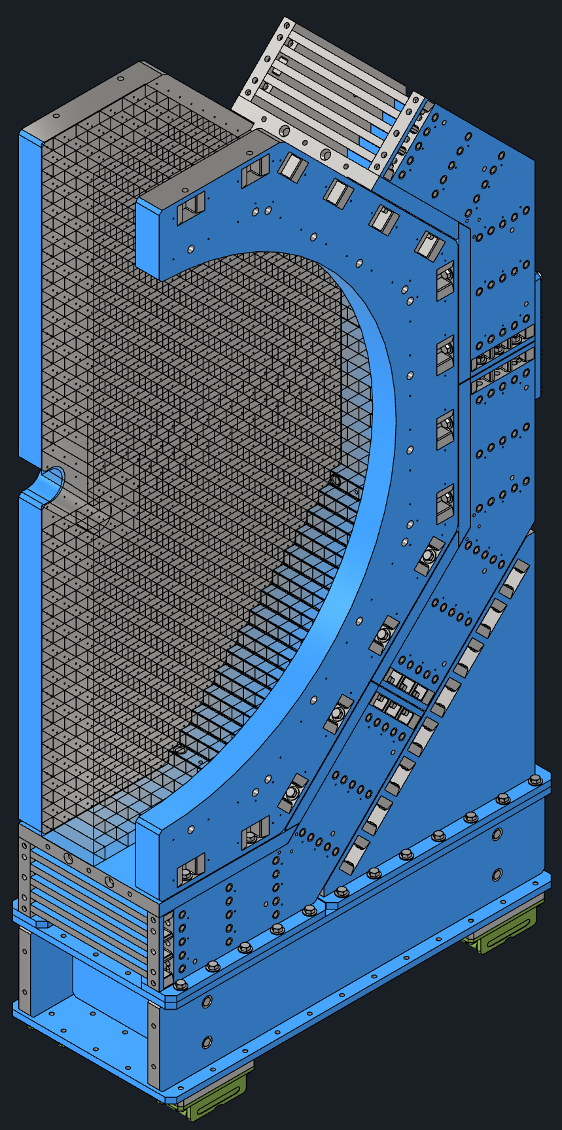
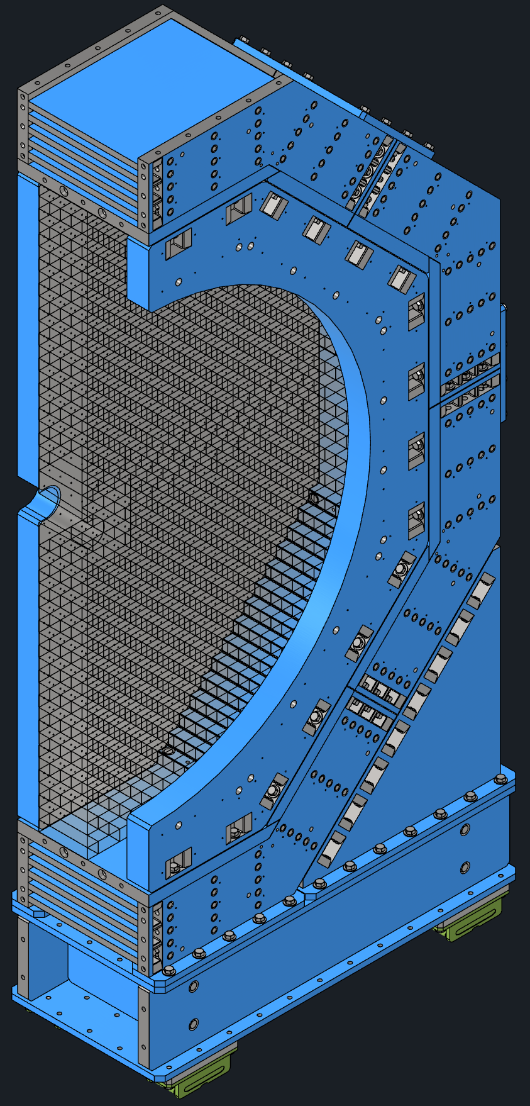
Endcap Assembly Steps
Charge #4
1. Base shimmed to height and anchored FE: 11.25ton BE: 9.5ton
2. Flux return support attached FE: 15ton BE: 13.25ton
3. First flux return module attached
FE: 28.25ton BE: 23.5ton
4. Second flux return module attached
FE: 41.5ton BE: 33.75ton
HCAL Detector Installation (100d)
5. Pole tip and half annulus attached
FE: 51.5ton BE: 60.5ton
6. Detector installed
FE: 51.5ton (+100ton) BE: 60.5ton (+30ton)
7. Third flux return module attached
FE: 65.5ton (+100ton) BE: 71.25ton (+30ton)
8. Forth flux return module attached
FE: 79.5ton (+100ton) BE: 82ton (+30ton)

Slide 21
ePIC Detector Support Hierarchy Y-Z View
Charge #4
Mechanical Interfaces and Load Paths Description:
Inner Tracking (Beam Pipe, SVT Barrel, SVT Disks, MPGD Disks) is supported by PST.
PST rides on two precision rails inside GST.
GST also supports: Cymbal (Inner MPGD Barrel), TOF Barrel, Outer MPGDs, DIRC Bar Boxes, EEEMCAL, pfRICH
GST transfers all loads only to HCAL Support Rings through Barrel EMCAL Support Beams.
Barrel EMCAL resides inside MARCO magnet, but does not transfer the load to the magnet.
Entire Barrel EMCAL weight goes to HCAL Support Rings → Barrel HCAL → Cradle.
Magnet (MARCO) supported vertically by jacks mounted on the inner surface of HCAL, horizontally by HCAL Support Rings.
Barrel HCAL carries all HCAL Ring loads + supports dRICH.
Cradle supports the full barrel assembly.
Endcaps (Independent Structures):
Forward Endcap: FEMCAL + LFHCAL, ≥15 cm clearance to barrel.
Backward Endcap: BHCAL, ≥10 cm clearance to barrel.
In nominal position, Endcaps are tied to the Barrel using links for Seismic constraint.
Lepton Endcap
Barrel HCAL and Support Rings
Hadron Endcap
Backward
HCAL
MARCO (Super Conducting Magnet)
dRICH
Fwd EMCAL
Fwd HCAL
Barrel EMCAL
GST
HP DIRC
OMPGD
E
E
E
M
C
A
L
p
f
R
I
C
H
LGAD - TOF
MPGD
MPGD
PST
L4
L3 L2
L1, L0
M
P
G
D
M
P
G
D
Si Disks
Si Disks
M
P
G
D
M
P
G
D
TO
F
ED4 ED3 ED2 ED1 ED0
Y
HD0 HD1 HD2 HD3 HD4
Z
X o
Beam Pipe
PST with Inner Detectors and Beam Pipe
Barrel Si Trackers
PST
MPGD
MPGD
LGAD - TOF
GST
OMPGD
HP DIRC
Barrel EMCAL
Barrel EMCAL
MARCO (Super Conducting Magnet)
Barrel HCAL and Support Rings
Steel Structure
Steel Structure
ePIC Barrel Cradle
Bldg 1006 Floor
Supports that act as load transfer paths

Slide 22
Maintenance Plan for ePIC
Charge #1,4
Detailed ePIC installation and maintenance schedules were developed. They show that, during a typical six-month maintenance shutdown, more than four months are consumed by rolling the ePIC detector out and back in and erecting temporary scaffolds and platforms. This leaves very limited time to work on the inner detectors if servicing can only occur in the Assembly Hall. As a result, our strategy is to service as many detectors as possible in the Experimental Hall. Following maintenance plan will be followed for detectors:
Barrel HCAL: HCAL Sectors are not removable. All the electronics will be on the exterior and is accessible for maintenance.
Magnet: Cryostat is not removable. Chimney and Phase separator are on top of HCAL and are accessible for maintenance.
Barrel EMCAL: Not to be removed. Is removable only in case of full upgrade of the detector. All electronics are accessible on both ends.
DIRC : Bar Boxes not needed to be removed for maintenance. Electronics are accessible from the backward end.
Outer MPGD: Modules can be removed inside the experimental hall for full maintenance.
Cymbal & Barrel TOF: Modules can be removed inside the experimental hall for full maintenance.
EEEMCAL and pfRICH: Detectors can be removed inside the experimental hall for full maintenance.
dRICH: Detector can be removed inside the experimental hall for full maintenance.
Inner Detectors (Si Disks, Si Tracker, MPGD Disks): PST can be removed in the assembly hall for full maintenance. ePIC Roll Out needed for full maintenance. Can’t be done during regular 6 months maintenance shutdown. Needs extended shutdown.
TOF Disk: Detector can be removed inside the experimental hall for full maintenance.
Forward HCAL: Towers/Modules not removable. Electronics accessible from the back end.
Forward EMCAL: Modules removable. Electronics accessible from the back end.
Backward HCAL: Towers/Modules not removable. Electronics accessible from the front end.
Electronics racks/chillers/cooling systems/gas systems are accessible from north and south platforms.
Blue – Detector modules don’t have to be removed in Assembly or Experimental Hall for full Maintenance.
Green – Detector modules can be removed in Exp. Hall for Full Servicing
Red – ePIC needs to Roll out for sub detector Maintenance.

Slide 23
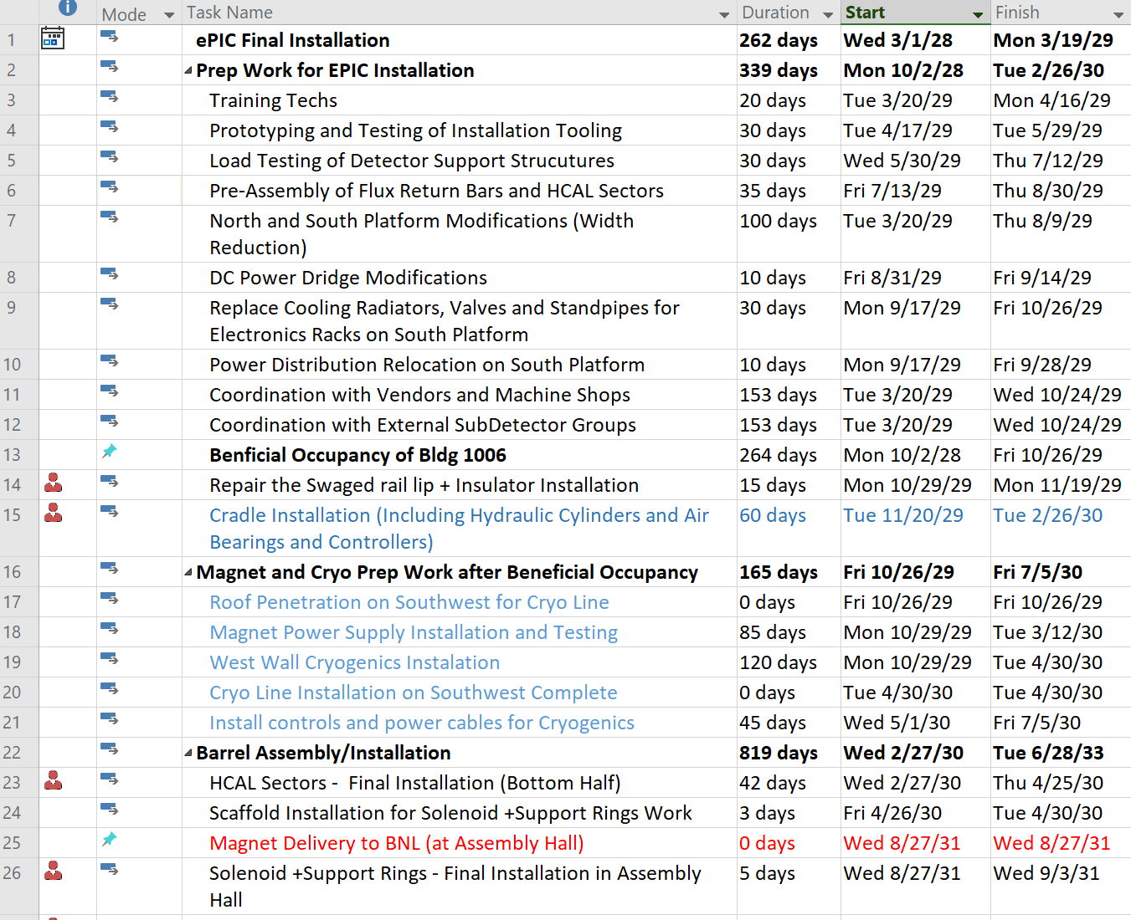
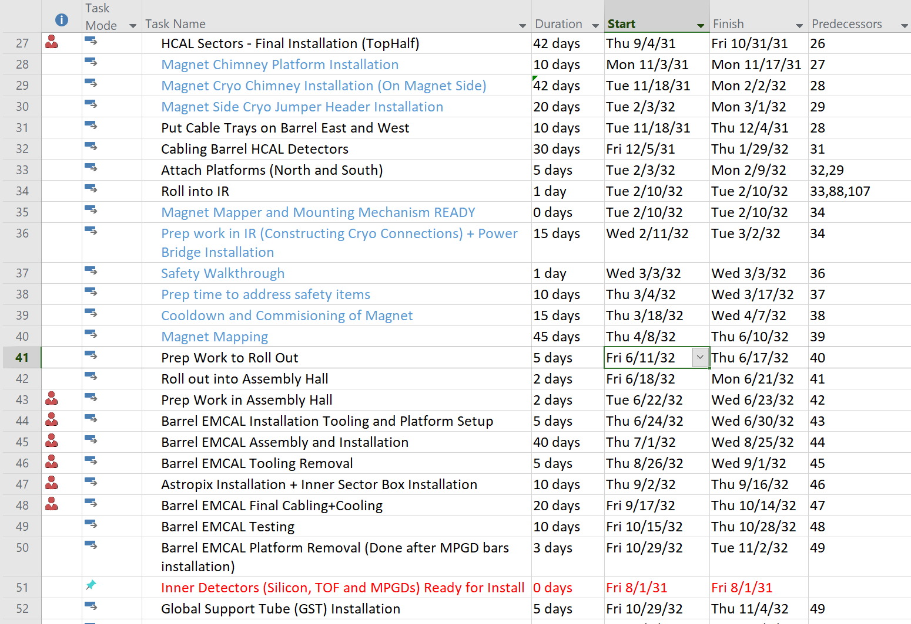
Installation Schedule
Charge #2&4
Key Schedule Drivers/Assumptions: The support structure and installation tooling design schedule is contingent on timely completion of subdetector designs to Final Design Review (FDR) level. Any delay in achieving detector design maturity will directly impact our design schedule, as support structures, installation tooling, and interface definitions cannot be finalized until each subdetector design is complete. This will in delay the production schedule for above items as well for that particular subdetector.
Beneficial Occupancy and Magnet Delivery are also schedule drivers.

Slide 24
Major External Interfaces
Charge #2
Detector ↔ Building 1006
Assembly Plan for Barrel and Endcaps.
Motion System: Barrel rides its cradle with air casters (lift) + push/pull pistons (translation) on the existing rail route (parking lot → AH → EH); N/S platforms attach and roll on Hillman rollers + guide cams.
Rails & Floor Readiness:
Fix hadron-side rail lip; restore gauge, level, straightness.
Build up floor ~1.5″ to rail-top elevation to create a flush plane for air-caster pallet; provide smooth, durable wear surface.
Acceptance: post-refurb survey (gauge/elevation/straightness/planarity) and functional dry-run with representative pallet + roller train.
Verify floor capacity at all intended positions (Remember: Barrel 900 t, Fwd EC 450 t, Rear EC 300 t).
Power Interfaces
Magnet Power-Supply Feed
PS Output & Distribution Detailed Specs
Detector/Platform Power distribution
Grounding
Safety & Interlocks

Slide 25
Major External Interfaces
Charge #2
Vacuum Group
Beam-pipe path: Forward magnet → Forward Endcap → Barrel + detectors → Rear Endcap → Rear magnet; preserve B0 access for pump-down/button-up.
Clearances (hard limits): ≥12 mm at both endcaps; ≥5 mm to all barrel detectors (Silicon, MPGD, EEEMCAL, pfRICH).
Equipment: Pumps on separate metal platforms (not on magnet concrete blocks); vibration isolation.
Magnet Group (Forward & Rear)
Supports: Magnets on solid concrete blocks only — no other equipment on blocks (vibration/alignment).
Platforms/Materials: Independent metal platforms for vacuum pumps/tooling.
Water Interface
Reuse: MCW + ACW (Aluminum Compatible Water) formerly STAR “TPC Water”; inspect, refurbish, requalify post-STAR.
Safety
Safety/Fire: Maintain 36″ egress; critical lift plans; rail/floor acceptance before moves; evaluate/reuse HSSD & sprinklers after testing/refurbishment; ODH assessment for helium (likely ODH-0, final by Safety)

Slide 26
Infrastructure & Facility Requirements
Charge #2
Item No. | Description | Responsibility
1 | Office Space Requirements (Trailers at 1006) | Off Project
2 | Air Conditioning for DAQ Room and Control Room | Off Project
3 | Continuous Maintenance of Assembly Hall and Experimental Hall at 1006 | Off Project
4 | Air Conditioning for Gas Room | Off Project
5 | Clean Room Refurbishment | Off Project
6 | Chilled Water Systems | Off Project
7 | Removal of obsolete Infrastructure | Off Project
8 | Platform Modifications (Mechanical) | Project
9 | Platform Modifications (Electrical) | Project
10 | Safety and Monitoring Systems | Off Project
11 | Floor Modifications (In Experimental Hall and Assembly hall) | Off Project
12 | Access Tunnels on Sector 5 and 6 | Off Project
13 | Workshop in Assembly Building | Off Project
14 | Sump Pump System in Parking Lot Area | Off Project
Document included in Pre-brief defines infrastructure and facility upgrade requirements (office space, HVAC, power, cooling, safety, etc.) to support construction, installation, and long-term operation of the ePIC detector.
Identifies Off-Project Dependency items and assigns clear ownership via a responsibility matrix, ensuring all systems meet applicable codes, safety standards, and best practices by beneficial occupancy.

Slide 27
Technical Summary
Subsystem / Area | Status | Key Notes
Barrel Systems (Cradle, Platforms, Support Rings, All subdetector Support structures and Installation Tooling) | PDR Completed | Integrated model under refinement. Subdetector installation tooling design and procedures also under refinement.
Endcap Structures (Flux Return Steel, Support Frames) | FDR Complete | Fabrication packages and drawings approved
Endcap and Barrel Motion & Control Systems | PDR Completed | Mechanisms and control integration validated in model
Services Integration (Cooling, Power, Signal Routing) | PDR Completed | Service envelopes defined; routing documented and verified
Cooling Systems | In Progress | Design maturing with detector designs; Facilities 18 °C water baseline. Air Cooling or Convection Cooling as a second preference. Special cooling like Glycol cooling system is only used for dRICH detector.
Building 1006 Modifications (Experimental & Assembly Halls) | PDR Completed | Reuse of existing STAR infrastructure provides major schedule and cost advantage

Slide 28

Questions?

Slide 29
Acronyms
Acronym | Full Form / Meaning
DAQ | Data Acquisition
DIRC | Detector of Internally Reflected Cherenkov light
dRICH | Dual-Radiator Ring Imaging Cherenkov detector
EIC | Electron–Ion Collider
ePIC | Electron–Proton/Ion Collider Detector
EMCAL | Electromagnetic Calorimeter
FEA | Finite Element Analysis
GD&T | Geometric Dimensioning and Tolerancing
GST | Global Support Tube
HCAL | Hadronic Calorimeter
HEPA | High-Efficiency Particulate Air (filter)
HSSD | High Sensitivity Smoke Detection
HVAC | Heating, Ventilation and Air Conditioning
ICD | Interface Control Document
I³ | Integration, Installation & Infrastructure
MCW / ACW | Modified Chilled Water / Aluminum Compatible Water
MPGD | Micro-Pattern Gas Detector
ODH | Oxygen Deficiency Hazard
PDR / FDR | Preliminary Design Review / Final Design Review
pfRICH | Proximity-Focusing Ring Imaging Cherenkov detector
PST | Pixel Support Tube
QA / QC | Quality Assurance / Quality Control
SVT | Silicon Vertex Tracker
TOF | Time-of-Flight
WBS | Work Breakdown Structure

Slide 30
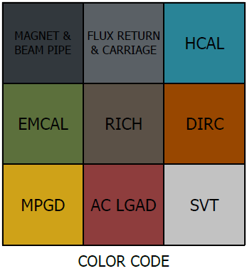
Envelopes Model and Drawing Package

Slide 31
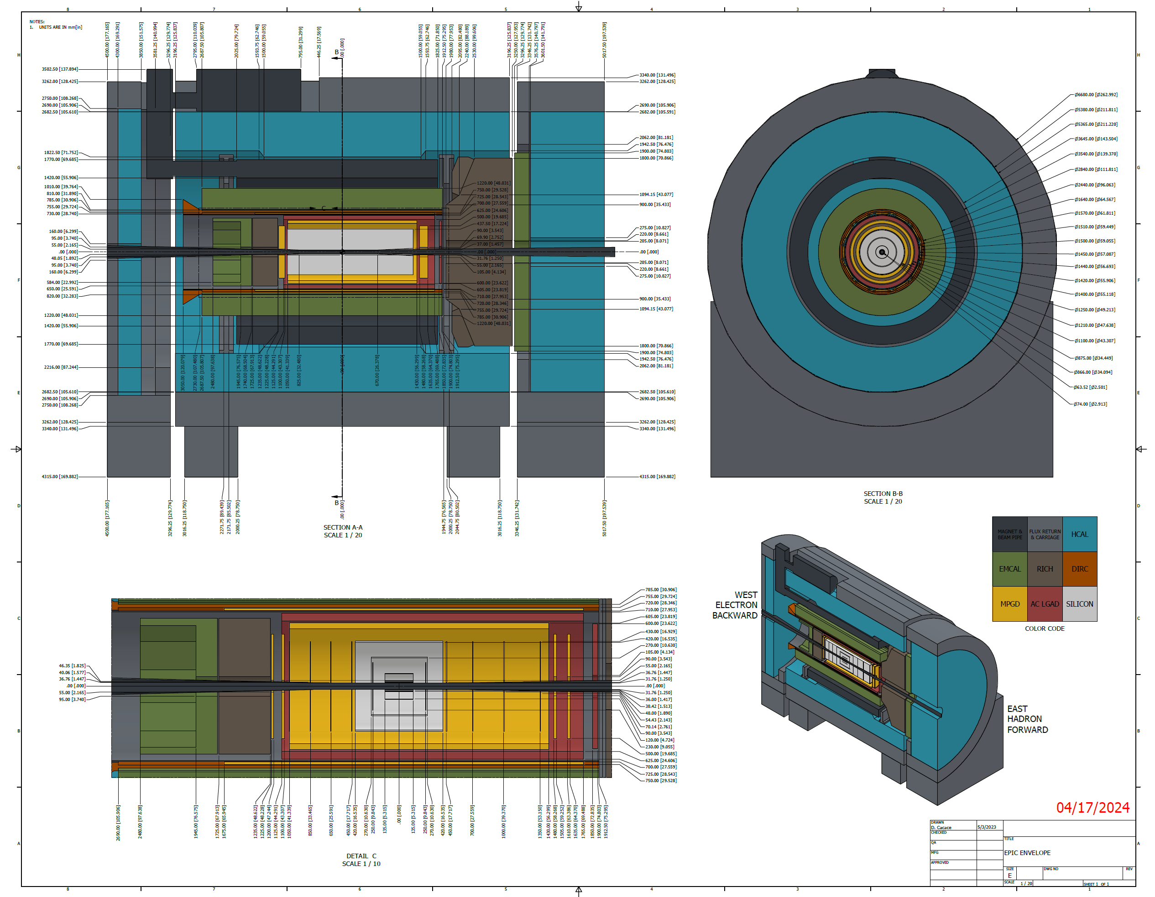
Envelopes Model and Drawing Package
1

