Slide 1
Status of developing a global thermal model and cooling of ePIC
Girish Gowda
Mechanical Engineer
Integration, Installation and Infrastructure
ePIC Collaboration Meeting
January 20th – 23rd, 2026

Slide 2
Outline
Detector Cooling Scope of Work
Detector Cooling Overview
Detector Cooling Water Treatment
Detector Cooling Plan and Guidelines
Detector Heat Load
Cooling Circulator – Negative Pressure Water
Detector Global Thermal Model
Detector Cooling Systems
Summary / Next Steps

Slide 3
ePIC Detector – Cooling Scope of Work
Global Cooling – BNL Scope
Define Facility primary loop, Technology Secondary loop and heat transfer interface for cooling between them
Identify Leak risk Mitigation Cooling Approach
Selection of Water Treatment
Selection of Cooling Type – Liquid, Air, Special Cooling
Identify Climate control requirements – Building 1006
Global Thermal Model Development
Finalize Manifold Sizing locations
Consider cooling interface details
CFD Thermal Analysis for detectors - Forward Emcal, Forward Hcal
Detector Groups Cooling – External Collaborators Scope
Confirm power estimates
Confirm temperature, flow, tubing requirements
CFD Thermal Analysis for their respective detectors

Slide 4
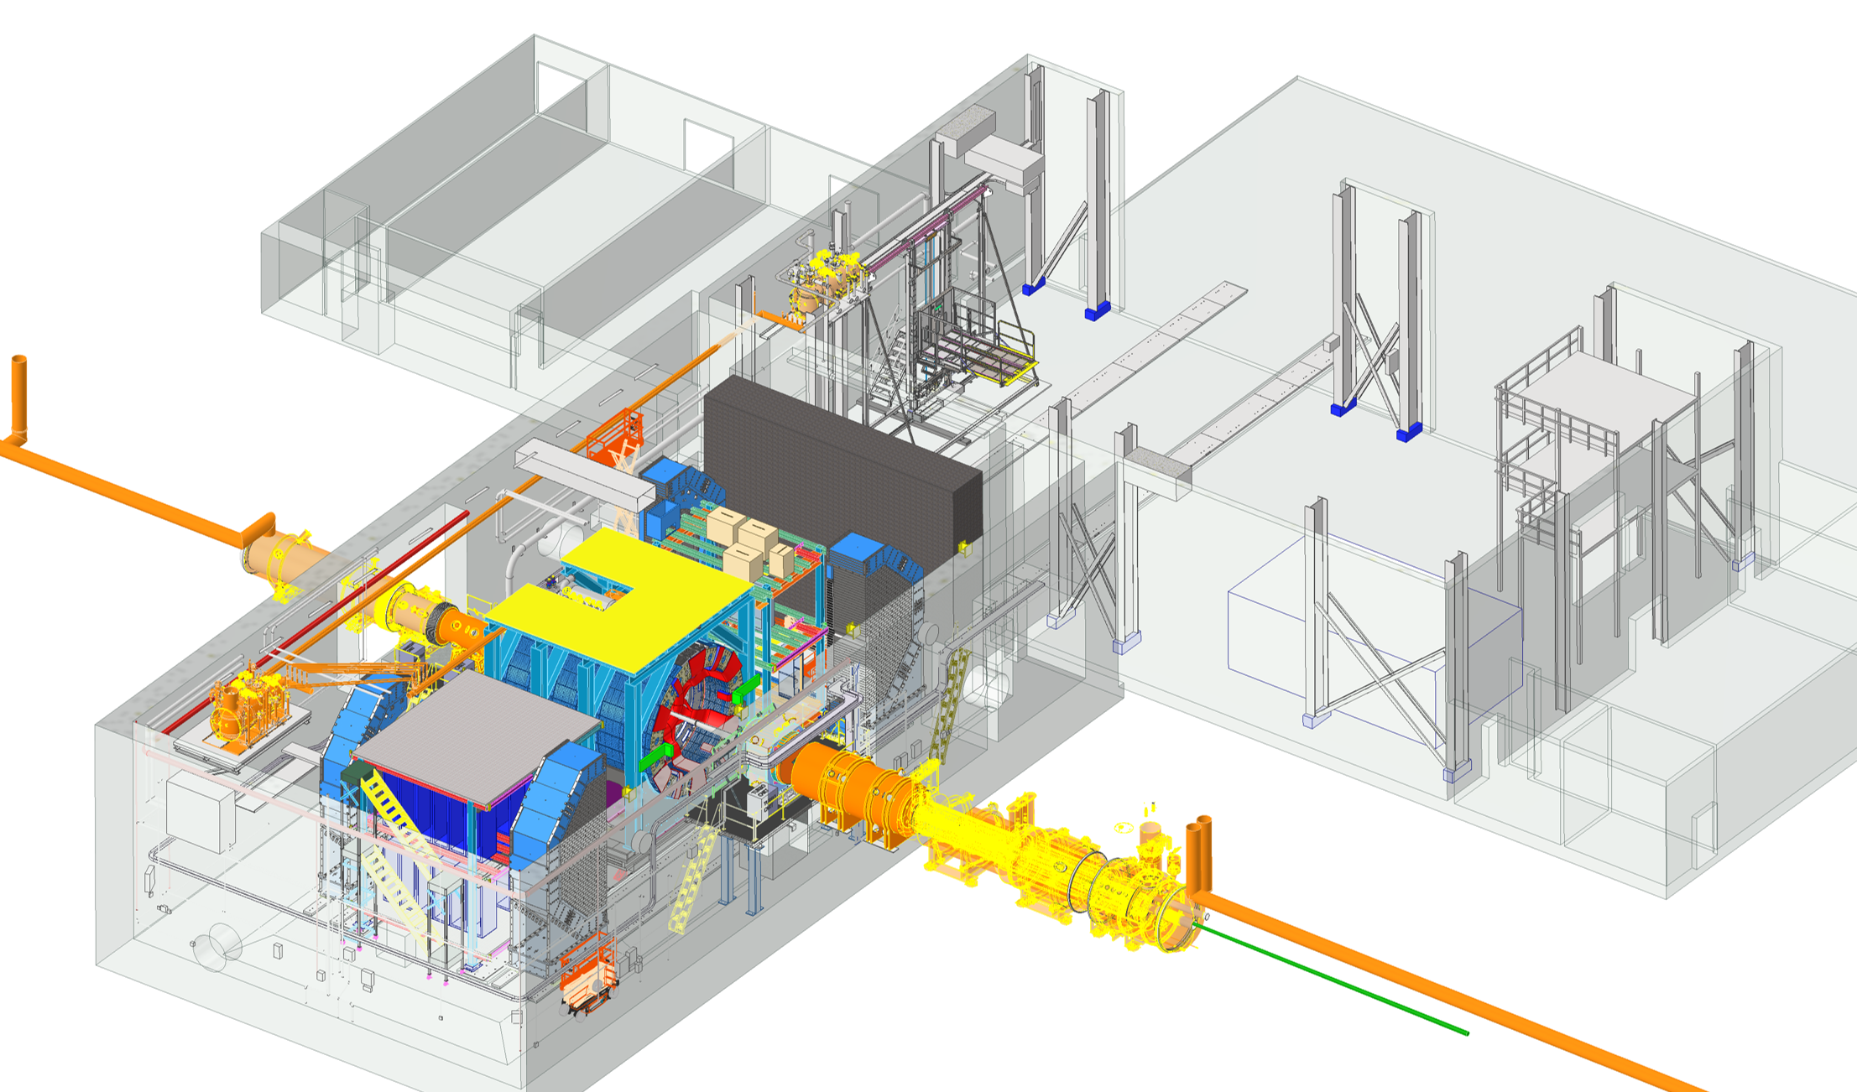
Detector Cooling Overview
Air Conditioning for Wide Angle Hall (WAH) – Building 1006
Existing HVAC upgrading for environmental control demands of the detector
System must maintain ambient temperature between 70F to 74F
RH should be below 65 %
Air Conditioning for Assembly Hall – Building 1006
Climate control requirements of ambient temperature between 65F to 75F
RH should be below 75 %
Control Room
Ring Inside
DAQ Room
Assembly Hall
Facility Water System
Main loop that takes in cool water from cooling towers, circulates through chillers, heat exchangers and then sends it back out.
Generate and manage bulk of facility's chilled water supply efficiently.
Operates with constant-speed pumps and maintains a consistent temperature
Rear
Wide Angle Hall
Clean Room
Pump & Elec Rooms
Technology Cooling System
Secondary Loop is directly connected to equipment. Heat from the detector components is transferred to the primary loop via an intermediary device Cooling Distribution Unit (CDU).
To provide precise cooling for equipment.
Variable speed pumps used to precisely match the cooling demand and heat is ultimately rejected to the primary loop.
Cooling Distribution Unit (CDU)
Ring Outside
Forward
Cooling Distribution Unit (CDU)
Using negative pressure water circulators to mitigate leak concerns (draws air into lines instead of leaking water out)
This two-loop design allows primary loop to remain more stable while secondary loop can be dynamically adjusted to meet the varying cooling needs.

Slide 5
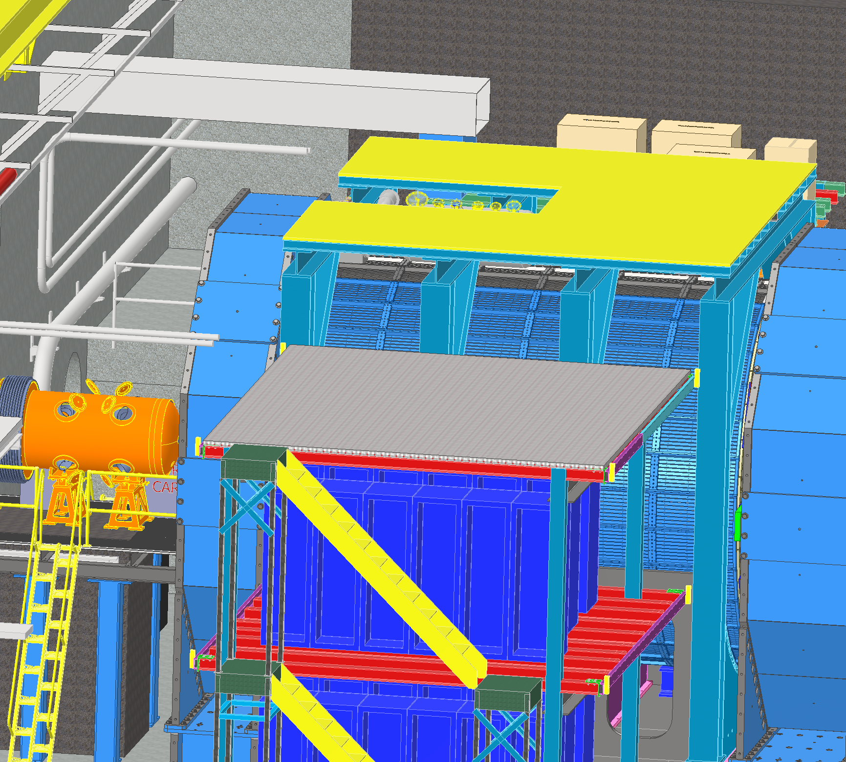
Detector Cooling – Water Treatment
Modified Chilled Water
Cooling Lines on Ring Inside
Modified Chilled Water - 400 gpm (MCW)
Delivers water at temperature of 64 F (18 C)
RH considered is 65 %
Used for sub detector cooling, electronic rack cooling and manifolds made of material other than Aluminum
Cool the Cooling Distribution Unit (CDU)
Primary Facility Cooling loop for Support Infrastructure
Aluminum Compatible Water (ACW)
Chemically treated water system to prevent corrosion
Used for sub detector cooling of Aluminum manifolds and tubing
Modified Chilled Water
Cooling Lines on Ring Outside

Slide 6
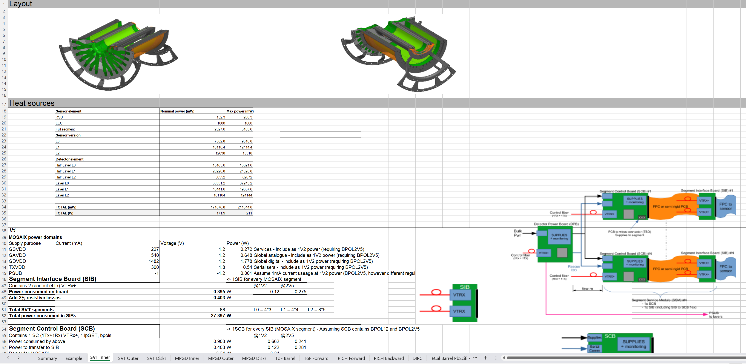
ePIC Detector – Cooling Requirements
Cooling spreadsheet of detectors updated

Slide 7
ePIC Detector – Cooling Plan
Detector | Cooling Method | Design Tasks | Description | Status
 |  | Cooling system | Cooling requirements, Calculation of heat load, flow rate, pressure drop, | In Progress
Forward Emcal | Water Cooling |  | dew point temperature for condensation, Tubing diameter, Insulation requirement.
 |  | Modeling of Cooling system | CAD Model of the 1/4 inch copper tubing with heat sink integrated with board assembly | Completed
 |  | Cooling of FEB | Thermal simulation of FEB's | Completed
 |  | Active cooling of the SiPM's to be assesed | Design change with and without thermal pad downstream of SiPM board | Completed
 |  | Optimisation of cooling system design | Reduce FEB temperatures to 3C above dew point | In Progress
Barrel Emcal | Water Cooling | Cooling system for Barrel Pb/Scifi | Cooling requirements, Calculation of heat load, flow rate, pressure drop | In Progress
 |  | ESB Cooling of Astropix heat removal | Thermal simulation of Astropix through PbScifi to assese need for active cooling | Completed
 |  | ESB Cooling for SiPM stability | Thermal simulation of cold plate design optimisation as per temperature specification | Completed
Forward Hcal | Convective Cooling | Cooling system | Cooling requirements, Calculation of heat load, flow rate, pressure drop | In Progress
 |  | Cooling of PCB | Thermal Simulation of Insert Assembly | In Progress
Barrel Hcal | Convective Cooling | Assese the need for Active Cooling | Cooling requirements, Calculation of heat load, flow rate, pressure drop | In Progress
EEEMCAL | Water Cooling | Cooling system | Cooling requirements, Calculation of heat load, flow rate, pressure drop | In Progress
 |  | Cooling of SiPM | Thermal Simulation of of SiPM in contact with crystals | Completed
 |  | Cooling of FEB | Thermal Simulation of FEB | In Progress

Slide 8
ePIC Detector – Cooling Guidelines
Guiding Principles
Sub detectors should maintain minimum water temperature at 64 F (≥18 C) to avoid insulation
Insulation on respective sub detectors impacts services on ePIC
Operating temperatures of the sub detectors should be above dew point temperature to prevent condensation
Cooling Design Considerations
Minimize potential damage from cooling system (since inner detectors are difficult to service)
Using negative pressure water circulators to mitigate leak concerns (draws air into lines instead of leaking water out)
Make manifolds and cooling services disconnects as accessible and serviceable as possible.
Stringent separation between Modified Chilled Water and Aluminum Compatible Water circuits must be maintained to prevent cross-contamination or chemical incompatibility.

Slide 9
ePIC Detector – Heat Load
Liquid Cooling System
Air Cooling System
 |  | Units
Cooling media | Water
Forward EMCAL | 3,428 | W
Barrel EMCAL | 3,101 | W
Cymbal | 1,944 | W
Outer MPGD | 2,856 | W
pfRICH | 294 | W
DIRC | 310 | W
EEMCAL | 1,010 | W
TOF | 30,000 | W
SVT Outer | 301 | W
SVT Disks | 655 | W
SVT Inner | 412 | W
MPGD Endcap Disks | 1,296 | W
Total Heat Load | 45,564 | W
, |  | Units
Cooling media | Air
Barrel HCAL | 1,280 | W
Forward HCAL | 1,656 | W
SVT Inner | 211 | W
SVT Disks | 5,819 | W
SVT Outer | 3,218 | W
Total Heat Load | 12,184 | W
Special Cooling System
 |  | Units
Cooling media | Glycol
dRICH | 19,968 | W
Platform Electronics & Racks
 |  | Units
Cooling media | Water
Platform | 80,000 | W
DAQ Room | 250,000 | W
Total Heat Load | 330,000 | W
Barrel TOF and Forward TOF heat load needs update

Slide 10
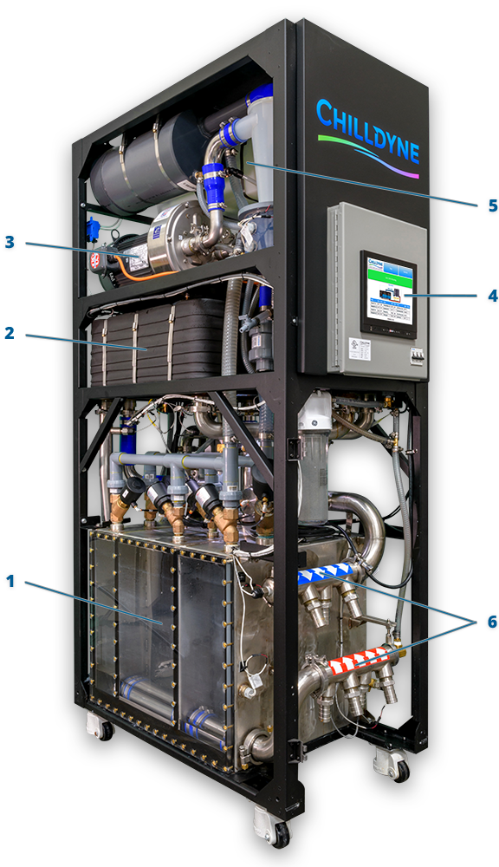
Negative Pressure Water – Cooling Circulator
Chilldyne CDU 300 Components
1. Pump Chambers The pump chambers control the flow of fluid into and out of the CDU. The proprietary three-chamber arrangement allows the CDU to pull fluid through the loop while maintaining a steady flow.
2. Heat Exchangers The heat exchangers move heat from the technology cooling system to the facility water system. The two series heat exchangers allow the CDU to move up to 300 kW of heat even on hot and humid days.
3. Liquid Ring Pump Liquid ring pumps use water as a seal that never needs to be replaced. The CDU’s liquid ring pump provides the vacuum used to pull the coolant through the load.
4. Microprocessor Control The intelligent, network-enabled core of the CDU automatically manages coolant temperatures, flow rates, water quality, and more. The Cool-Flo Software allows the CDU to be easily integrated into popular DCIM and BMS systems.
5. Water Quality Control The CDU automatically monitors and controls the quality of the water in the technology cooling system. The water quality system dispenses coolant additives as-needed to prevent corrosion and biological growth.
6. Coolant Handling Manifolds Up to 4 cooling loops exit either the top or bottom of the CDU to support both raised floor and overhead configurations.
Product Line: CF-CDU300
Cooling Capacity: Up to 300kW with 15 °C rise.
Flow Rate: Up to 300 LPM at 0.5 bar differential
sPHENIX Detector is using Chilldyne Cooling Circulator

Slide 11
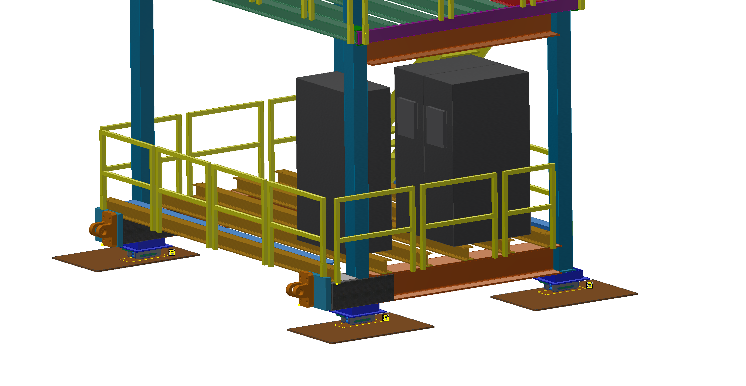
ePIC Detector – Cooling Distribution Unit - CDU
Chilldyne Option 1
 |  | Units
Cooling media | Water/Glycol
Total Heat Load of Electronics | 46 | kW
CDU Cooling Capacity | 40 | kW
Number of CDUs required | 1.15 | 2
Single CDU | 57.50 | %
Margin CDU | 3 | CDUs
density | 1000 | kg/m^3
Specific Heat | 4186 | J/kg C
Temperature rise, ΔT | 2 | C
Pressure available | 0.5 | bar
Pressure available | 50000 | Pa
Mass flow rate | 5.49 | kg/s
Volumetric flow rate | 0.00549 | m^3/s
Volumetric flow rate per unit | 0.00275 | m^3/s
Volumetric flow rate per unit | 164.84 | lpm
Volumetric flow rate per unit | 43.52 | gpm
CDUs
Cooling Distribution Units on Ring Inside
Each CDU will operate at 23 kW – 57.5 percent of it’s rated capacity
Active CDUs – 2, Standby CDU – 1 for backup
Dimensions (L*W*H) inches : 45’’ * 24’’ * 80’’
Decrease in temperature rise decreases CDU cooling capacity
Decrease in temperature rise increases flow rate at given pressure

Slide 12
ePIC Detector – Cooling Calculations
Technical Specification
Relative Humidity | Ambient Temperature | Ambient Temperature | Dew Point Temperature | Dew Point Temperature | Inlet Temperature | Inlet Temperature | Chiller Flow Rate | Chiller Flow Rate
% | F | C | F | C | F | C | gpm | lpm
65 | 74 | 23.3 | 61.5 | 16.4 | 64.4 | 18 | 400 | 1,514
Cooling Calculation
Detector | Total Heat Load | Temperature change | Flow Rate
Units | W | C | lpm
Forward EMCAL | 3,428 | 2 | 25
Barrel EMCAL | 3,101 | 2 | 22
Cymbal | 1,944 | 2 | 14
Outer MPGD | 2,856 | 2 | 20
pfRICH | 294 | 2 | 2
DIRC | 310 | 2 | 2
EEMCAL | 1,010 | 2 | 7
TOF | 30,000 | 3 | 143
SVT Outer | 301 | 5 | 1
SVT Disks | 655 | 5 | 2
SVT Inner | 412 | 5 | 1
MPGD Endcap Disks | 1,296 | 2 | 9
Total | 45,607 |  | 248
TOF temperature change input needs update

Slide 13
ePIC Detector – Global Thermal Model
Forward Emcal Detailed Calculation
 |  | Units
Cooling media | Water
Chiller flow rate | 400 | gpm
Chiller flow rate | 1514 | lpm
Chiller flow rate | 0.02523 | m^3/s
Chiller flow rate | 25.23 | kg/s
density | 1000 | kg/m^3
Specific Heat | 4186 | J/kg C
RH | 65 | %
Ambient Temp | 74 | F
Ambient Temp | 23.3 | C
Dew Point Temp | 61.5 | F
Dew Point Temp | 16.4 | C
Inlet Temp | 64.4 | F
Inlet Temp | 18.0 | C
FEB Full Board Heat | 4.5 | W
FEB Half Board Heat | 2.25 | W
Number of FEB Full Board North half | 277
Number of FEB Half Board North half | 44
Total Heat Generation FEB Full Board North half | 1246.5 | W
Total Heat Generation FEB Half Board North half | 99 | W
Number of FEB Full Board South half | 274
Number of FEB Half Board South half | 24
Total Heat Generation FEB Full Board South half | 1233 | W
Total Heat Generation FEB Half Board South half | 54 | W
SiPM Board Heat | 0.17 | W
Number of SiPM Board North half | 2392
Number of SiPM Board South half | 2288
Total Heat Generation SiPM Board North half | 406.64 | W
Total Heat Generation SiPM Board South half | 388.96 | W
Total Heat Load | 3428.1 | W
Temperature rise ΔT | 2 | C
Required flow rate | 0.409 | kg/s
Required flow rate | 0.000409 | m^3/s
Required flow rate | 25 | lpm
Dynamic Viscosity | 0.001 | Ns/m^2
Copper Tube length | 6 | m
Maximum number of FEB per detector row | 10
Maximum number of SiPM per detector row | 76
Maximum total power per cooling loop | 58 | W
Maximum total power per cooling loop NS half | 116 | W
Number of cooling loops | 18
Cooling loops | Parallel
Required flow rate per loop | 1.38366E-05 | m^3/s
Required flow rate per loop | 0.83 | lpm
Required total flow rate | 15 | lpm
Velocity | 0.757 | m/s
Copper tube outer diameter | 0.25 | inch
Copper tube outer diameter | 0.00635 | m
Copper tube inner diameter | 0.19 | inch
Copper tube inner diameter | 0.004826 | m
Area | 0.0000183 | m^2
Reynolds Number | 3652
Pipe Absolute Roughness | 0.0000015 | m
Pipe Relative Roughness | 0.0003 | m
Pressure drop per loop | 0.3 | bar
Pressure drop per loop | 4.35 | psi
Friction factor | 0.08
Ambient temperature | 22 | C
RH | 65 | %
Dew point temperature | 15.5 | C
Minimum water temperature | 18 | C

Slide 14
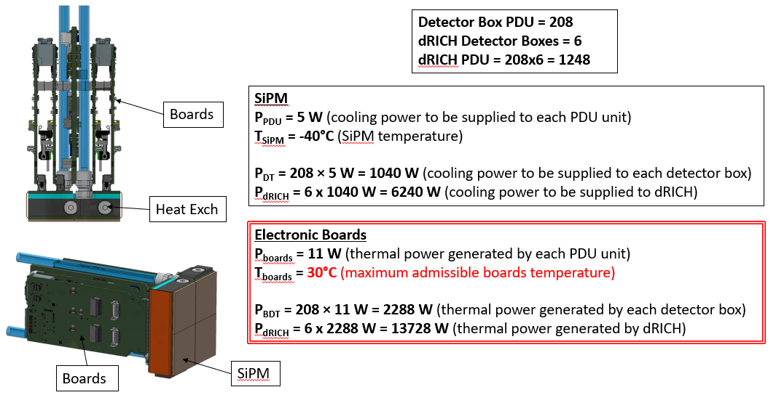
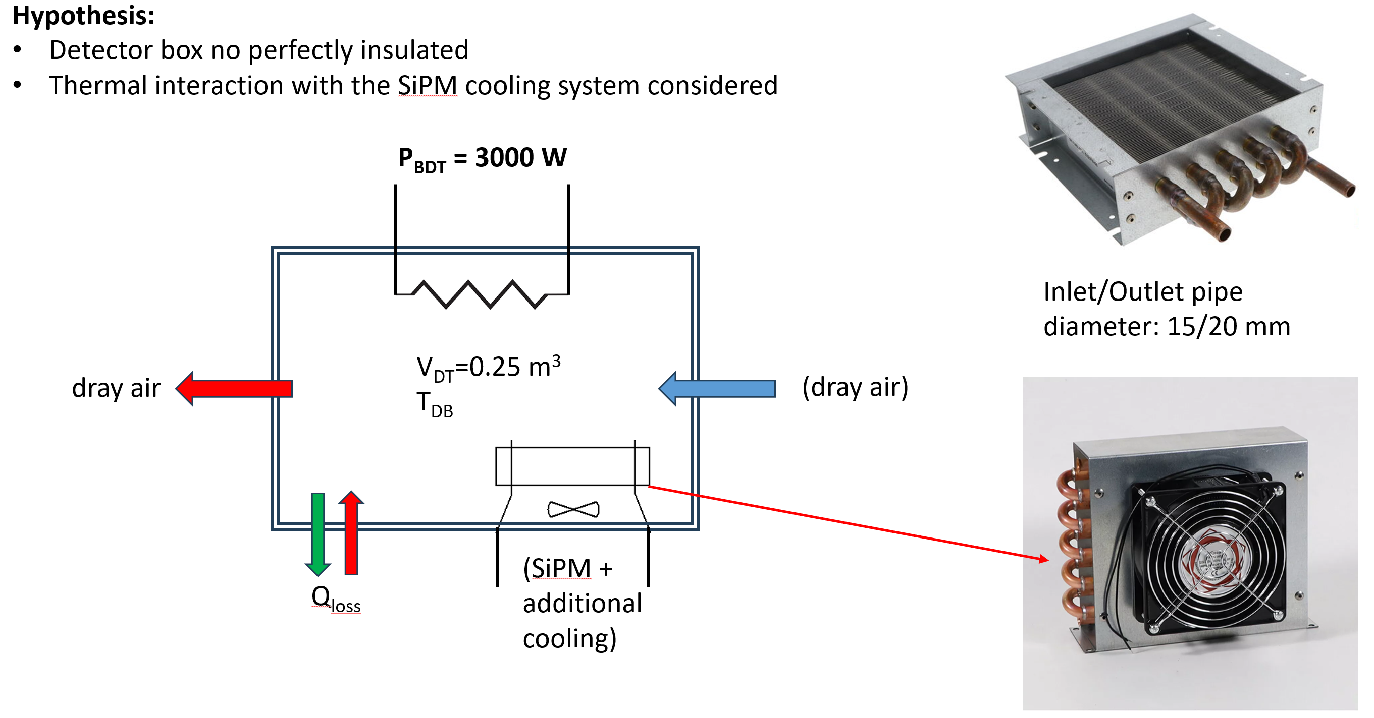
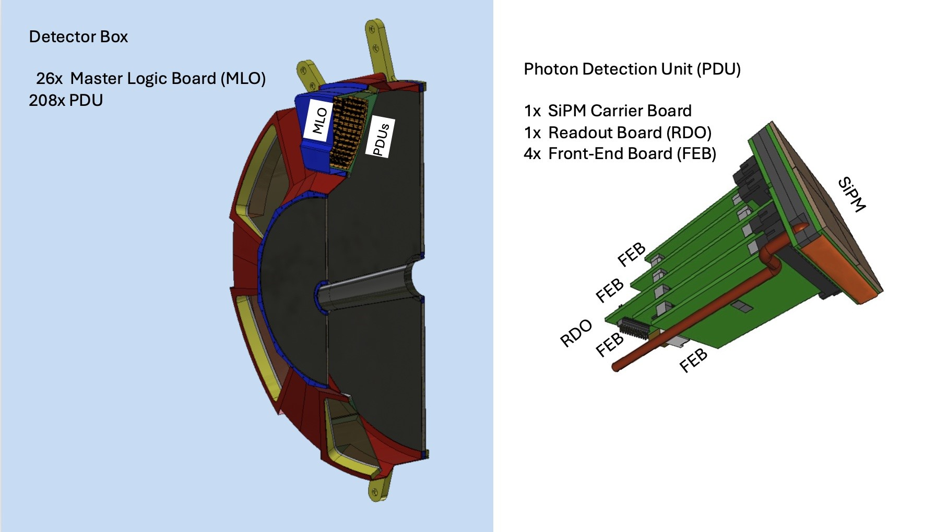
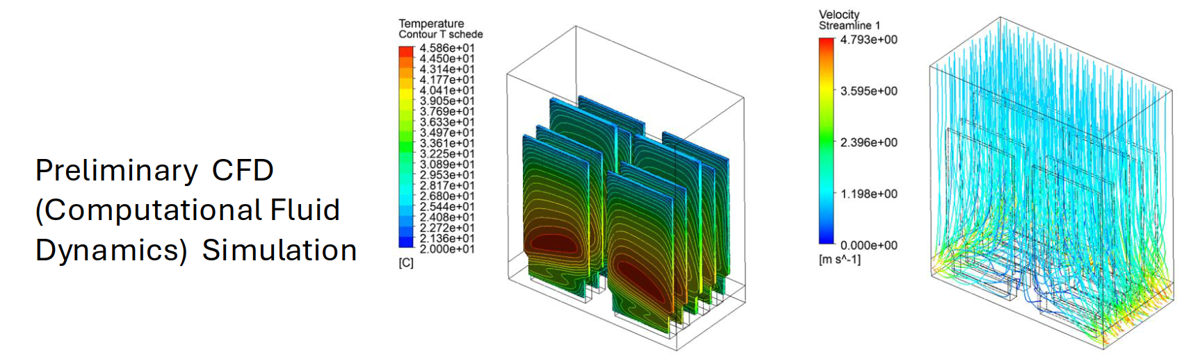
Special Cooling System – Detector
dRICH
Heat Sources – Primarily located in Photon Detector Box
Uniform distribution - Physics operation mode
Non-Uniform distribution - Annealing operation mode
Cooling/Heating System – Main Requirements
Heating mode (annealing): Maximum temperature 100 °C
Cooling mode: Minimum temperature –40 °C
Coolant options: Glycol, Silicone oil, or HFE 7100
Cooling system type: Closed-loop system with freeze protection, ideal for both cooling and heating operations, and designed to prevent leakage.
Detector box air cooling

Slide 15
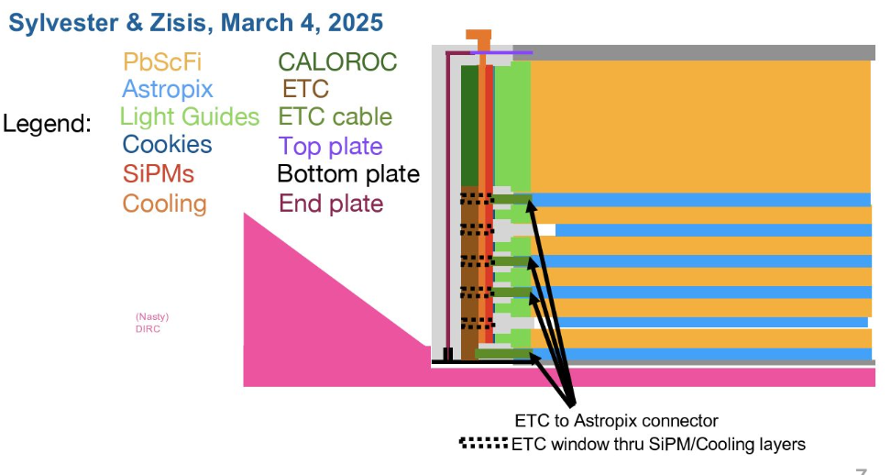
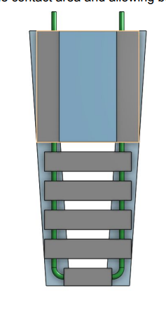
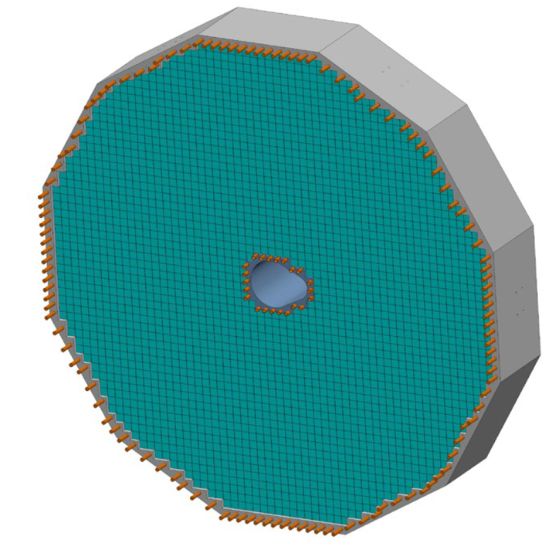
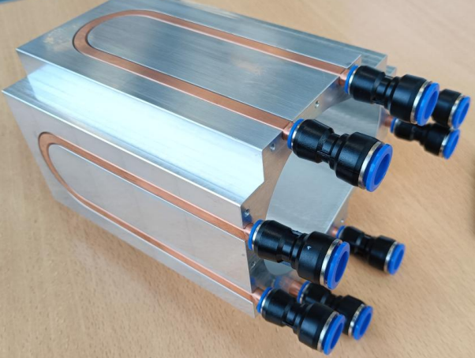
Liquid Cooling – Detectors
Forward EMCAL
Electronics : FEB, SiPM
Temperature : 2 to 3C above dew point
Barrel EMCAL
Electronics : SiPM, Astropix, ETC, Caloroc, Astrolinx
Temperature : SiPM : +/- 2 C (7C on SiPM’s)
Astropix, Astrolinx : 20 +/- 3 C, ETC, Caloroc: below 40 C
DIRC
Electronics : ASIC
Temperature : ASIC: +/- 2 C
Outer MPGD
Electronics : FEB
Temperature : ASIC : 30 +/-3C, Operation : 22 to 25C
Cymbal
Electronics : FEB, DC-DC Converters
Temperature : FEB : +/- 2C, Detector Operation : 15 to 25 C
pfRICH
Electronics : ASIC
Temperature : ASIC : +/- 2 C
EEMCAL
Electronics : FEB, SiPM
Temperature : +/- 0.1 C on crystals, Crystal temperature : 15 to 25 C
Cold plate, double-sided cooling:
- Side 1: ESB PCB with SiPMs
- Side 2: CALOROC and AstroPix ETC
Barrel Emcal
EEmcal
Internal Structure - Copper Tubes

Slide 16
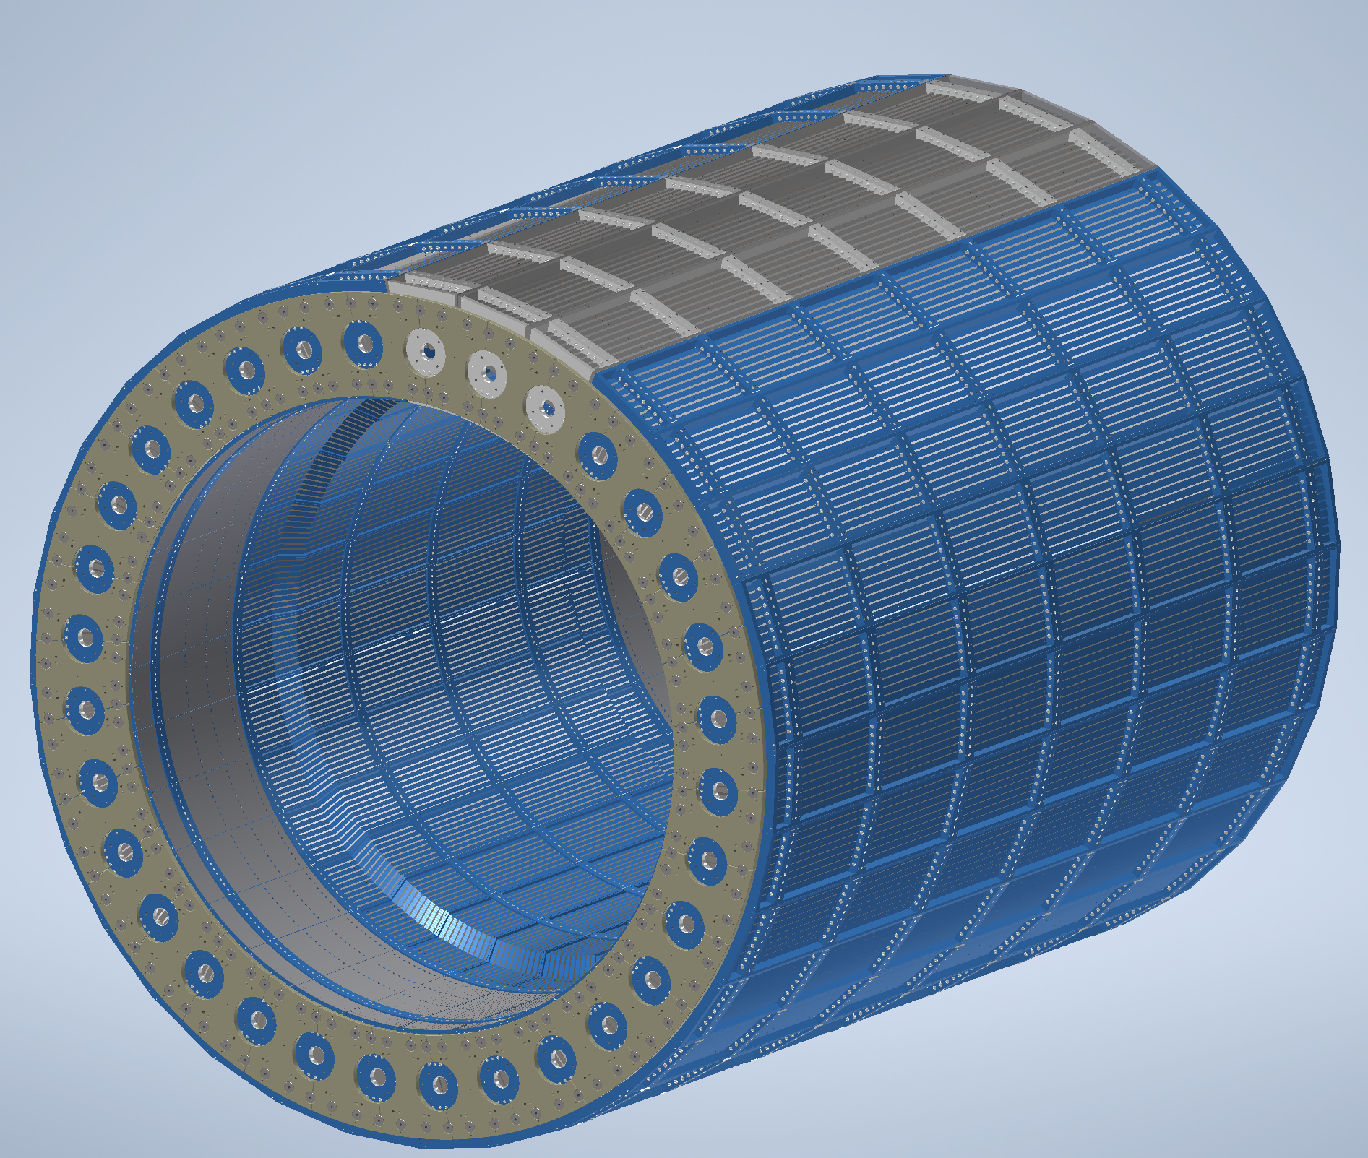
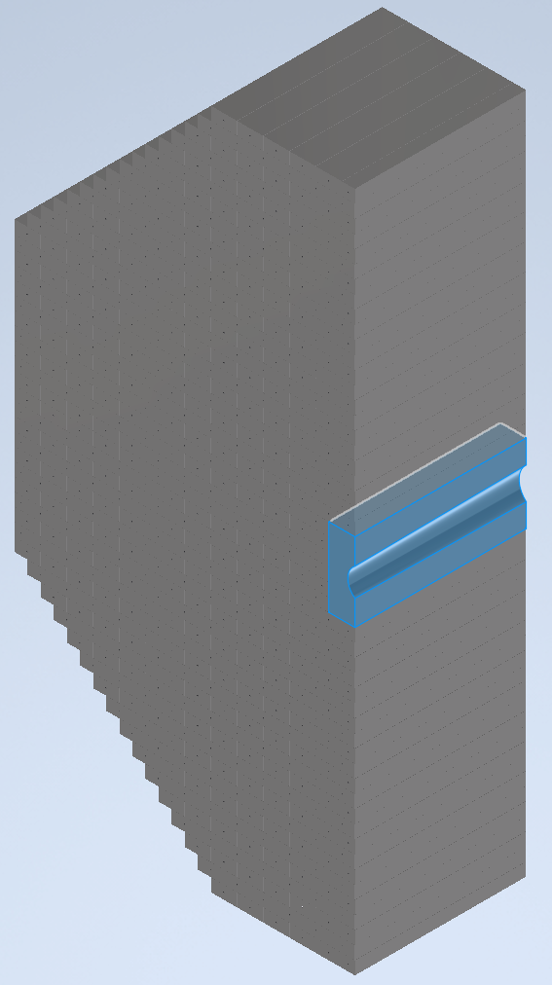
Air Cooling – Detectors
Barrel HCAL
Convective Cooling : Electronics : SiPM
Operating Temperature : 25C
Forward HCAL
Convective Cooling : PCB
Operating Temperature : <40C
SVT Outer
Air Cooling : L4 and L3 staves
Temperature : +/- 1 C for stability
SVT Inner
Air Cooling : L0, L1 and L2 staves
Temperature : <5C for stability, Detector Operation : Sensors <30C
SVT Disks
Air Cooling : ED and HD
Temperature : <5C for stability, Detector Operation : Sensors <30C
Electronics is placed on outside surface in the middle of each sector at z=0
Barrel Hcal
Insert Layers of PCB Carbon Steel thermal analysis under progress to predict air temperature on cone shaped beam pipe
Forward Hcal

Slide 17
Summary & Next Steps
Summary
Existing MCW, ACW and Cooling circulator with number of CDUs is sufficient to cool the heat load of the various detector components which are liquid cooled.
Convective Cooling is used to cool other detector components which are air cooled.
Special Cooling systems such as Glycol is used to cool the dRICH detector.
Global Thermal model development is in progress for various detectors.
Next Steps
Refine cooling calculations
Decide manifolding sizes and locations
Work with detector groups to determine temperatures, tube sizes, flow rates
Consider cooling interface details

Slide 18
QUESTIONS?

Slide 19
Backup Slides

Slide 20
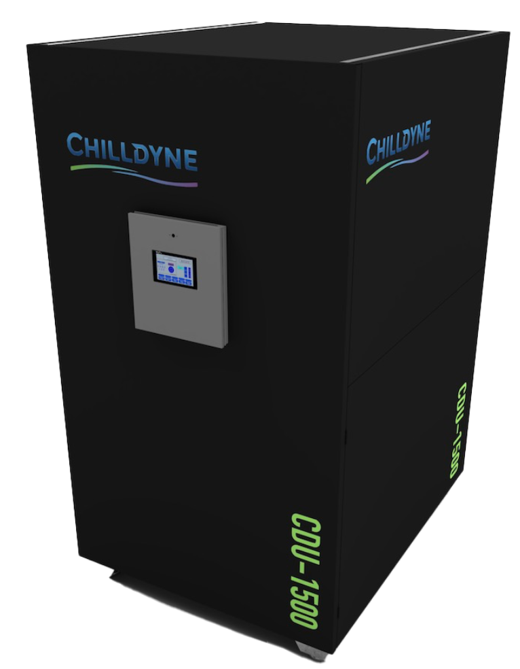
ePIC Detector – Cooling Distribution Unit - CDU
Chilldyne Option 2
Chilldyne CDU 1500
Cooling media | Water/Glycol
Total Heat Load of Electronics | 46
CDU Cooling Capacity | 200
Number of CDUs required | 0.23
Single CDU | 23.00
Margin CDU | 2
density | 1000
Specific Heat | 4186
Temperature rise, ΔT | 2
Pressure available | 0.5
Pressure available | 50000
Mass flow rate | 5.49
Volumetric flow rate | 0.00549
Volumetric flow rate per unit | 329.67
Volumetric flow rate per unit | 87.03
Rated Cooling Capacity (kW) : 1500 kW (1,500 lpm) @ 15°C ΔT
Primary (FWS) Loop: 400 GPM (1,500 lpm) or 25% more than TCS loop max 8 psi (55 kPa) ΔP
Secondary (TCS) Loop: 400 GPM (1,500 lpm) @ 10-29 psi (69-269 kPa) ΔP
Each CDU will operate at 46 kW - 23 percent of it’s rated capacity
Active CDUs – 1, Standby CDU – 1 for backup
Dimensions (L*W*H) inches : 60’’ * 48’’ * 74’’

Slide 21
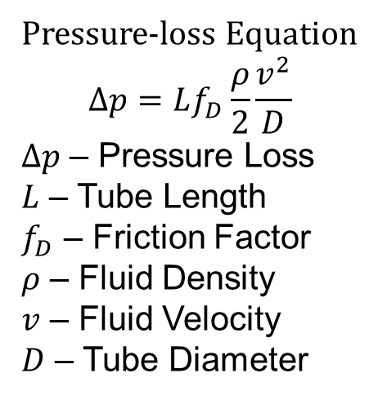
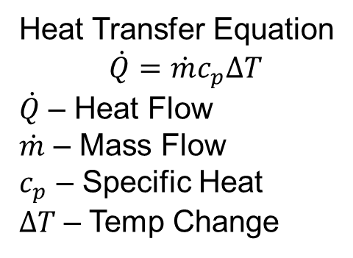
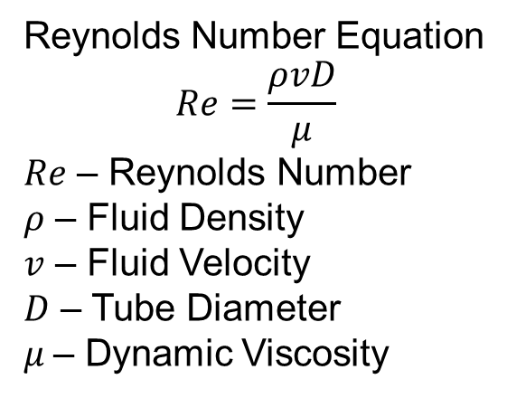
ePIC Detector – Cooling Calculation
Heat Transfer Equation
$$\dot{Q}=\dot{m}c_{p}∆T$$
$\dot{Q}$ – Heat Flow
$\dot{m}$ – Mass Flow
$c_{p}$ – Specific Heat
$∆T$ – Temp Change
Pressure-loss Equation
$$∆p=Lf_{D}\frac{ρ}{2}\frac{v^{2}}{D}$$
$∆p$ – Pressure Loss
$L$ – Tube Length
$f_{D}$ – Friction Factor
$ρ$ – Fluid Density
$v$ – Fluid Velocity
$D$ – Tube Diameter
Reynolds Number Equation
$$Re=\frac{ρvD}{μ}$$
$Re$ – Reynolds Number
$ρ$ – Fluid Density
$v$ – Fluid Velocity
$D$ – Tube Diameter
$μ$– Dynamic Viscosity

Slide 22
ePIC Detector – Detailed Calculation
Barrel EMCAL
Barrel HCAL
 |  | Units
Cooling media | Natural Convection
Caloroc Board Heat Load | 5 | W
Number of Caloroc boards in each sector | 8
Sector Heat Load | 40 | W
Total Number of Sectors | 32
Total Heat Load | 1280 | W
Density | 1.2 | kg/m^3
Specific Heat | 1005 | J/kg C
Temperature rise | 22 | C
Flow Rate | 0.0482 | m^3/s
Flow Rate | 102.22 | cfm
Heat transfer coefficient required | 5.87 | W/m^2- C
Read out box width | 0.2 | m
Read out box length | 0.4 | m
Read out box area | 0.08 | m^2
Number of electornics read out boxes | 8
Total Surface Area | 9.92 | m^2
Total Length | 6.2 | m
Total Width | 1.6 | m
 |  | Units
Cooling media | Water
Chiller flow rate | 400 | gpm
Chiller flow rate | 1514 | lpm
Chiller flow rate | 0.02523 | m^3/s
Chiller flow rate | 25.23 | kg/s
density | 1000 | kg/m^3
Specific Heat | 4186 | J/kg C
RH | 65 | %
Ambient Temp | 72 | F
Ambient Temp | 22.2 | C
Dew Point Temp | 60 | F
Dew Point Temp | 15.3 | C
Inlet Temp | 64.4 | F
Inlet Temp | 18.0 | C
Temperature rise ΔT | 0.029 | C
Outlet Temp | 18.029 | C
Astropix Chip | 43.5 | W
End of Tray Card | 7.2 | W
Astropix Module PCB | 10.9 | W
FEB | 3 | W
ESB Sector Heat load | 64.6 | W
Number of sectors | 48 | W
Total Heat Load | 3100.8 | W
Temperature rise ΔT | 2 | C
Required flow rate | 0.370 | kg/s
Required flow rate | 0.000370 | m^3/s
Required flow rate | 22 | lpm
Dynamic Viscosity | 0.001 | Ns/m^2
Length | 5 | m

Slide 23
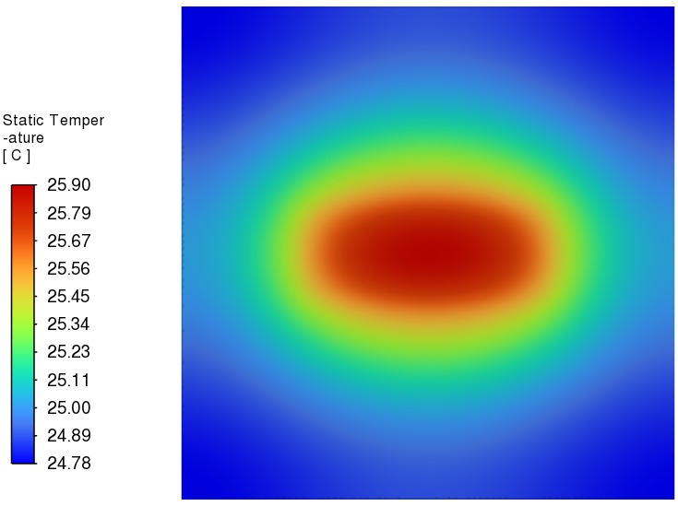
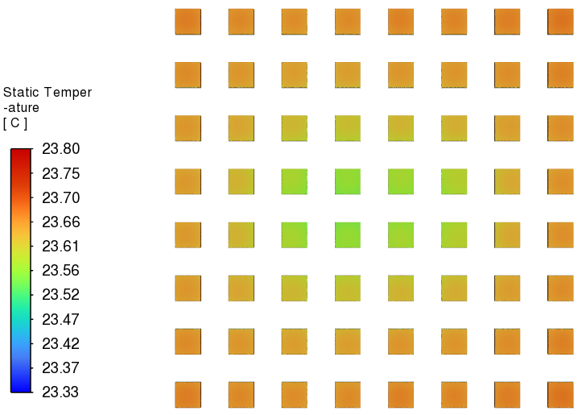
ePIC Detector – Global Thermal Model
Forward Emcal CFD Simulation
FEB Temperature
SiPM Temperature
Ambient Temperature (C) | Flow velocity (m/s) | Half FEB Heat load (W) | SiPM Heat load (W)
20 | 0.76 | 2.25 | 0.17
Heat Transfer Coefficient (W/m^2 C) | Water Inlet Temperature (C) | FEB Temperature (C) | SiPM Temperature (C)
5 | 22 | 25.9 | 23.8

Slide 24
Liquid Cooling – Detectors
TOF
Electronics :
SVT Outer
Electronics : FIB, FIB-CB, FPC-CB
Temperature : +/- 5 C, Detector Operation : 18 C
SVT Inner
Electronics : SIB, SCB, DPB
Temperature : +/- 5 C, Detector Operation : 18 C
SVT Disks
Electronics : FIB, FIB-CB, FPC-CB
Temperature : +/- 5 C, Detector Operation : 18 C
MPGD Endcap Disks
Electronics : FEB
Temperature : FEB: +/- 2C, Detector Operation : 15 to 25 C

