Slide 1
Far-Forward Cooling needs
Alex Jentsch (BNL)
ePIC Collaboration Meeting
Jan 20th to 24th, 2026

Slide 2
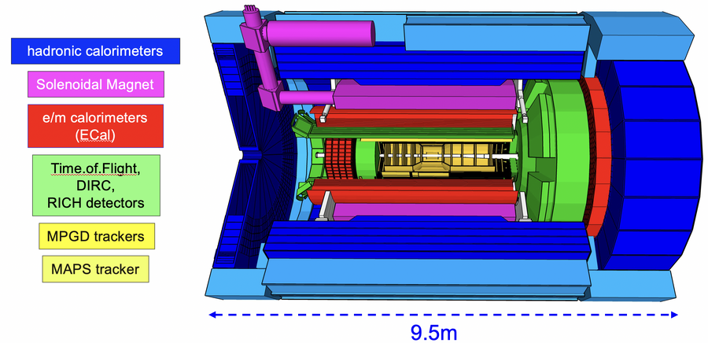
ePIC Far-Forward Detectors
B0 tracking spectrometer (inside accelerator magnet)
Luminosity
Monitor
Photon
Beam
pC Hadron
Polarimeter
Rear
SC Magnets
Forward
SC Magnets
Dipoles
Ring Inside
Hadron Storage Ring
Electron Storage Ring
electrons
Hadrons
*Not to scale
Ring Outside
Low Q²
Taggers
Off Momentum Detectors
Roman
Pots
Zero Degree
Calorimeter
TOF Peer Review, Dec. 3rd, 2025
Alex Jentsch (BNL)

Slide 3
ePIC Far-Forward Detectors
B0 tracking spectrometer (inside accelerator magnet)
Luminosity
Monitor
Photon
Beam
pC Hadron
Polarimeter
Rear
SC Magnets
Forward
SC Magnets
Dipoles
Ring Inside
Hadron Storage Ring
Electron Storage Ring
electrons
Hadrons
*Not to scale
Ring Outside
Low Q²
Taggers
Off Momentum Detectors
Roman
Pots
Zero Degree
Calorimeter
2 AC-LGAD tracking detectors in vacuum (Roman pots & off-momentum).
1 AC-LGAD tracking detector in air (embedded in B0 accelerator magnet).
Zero-degree calorimeter in air (on a table between the beam pipes).
Alex Jentsch (BNL)

Slide 4
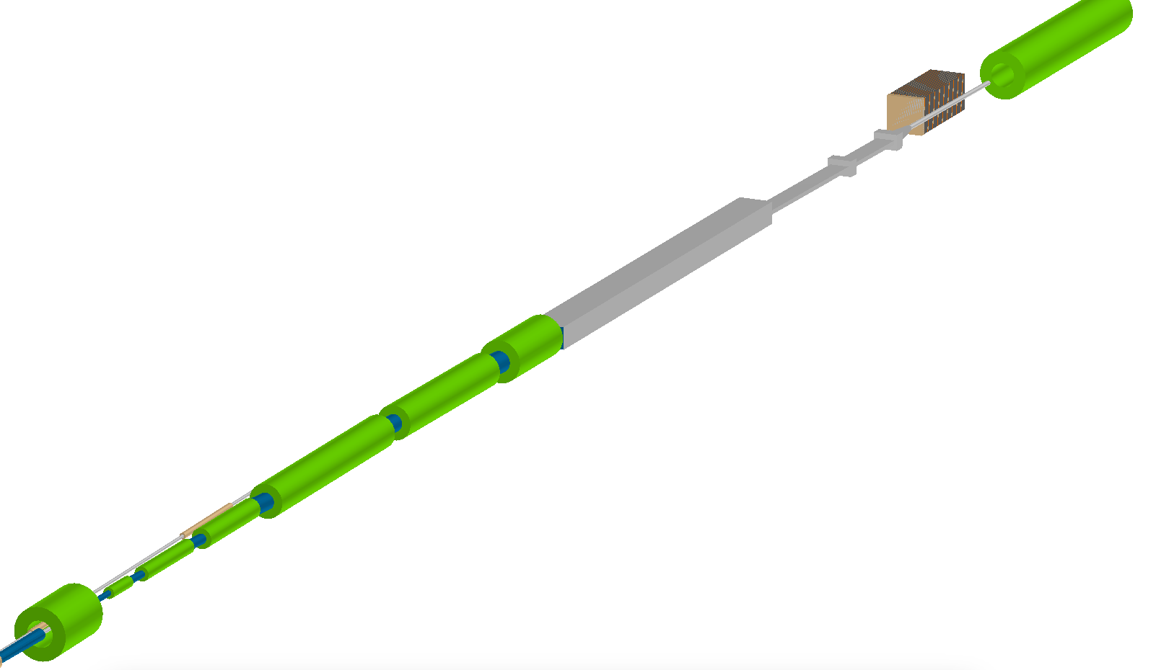
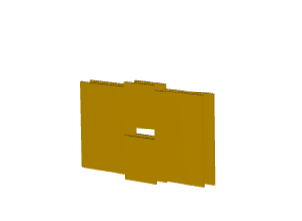

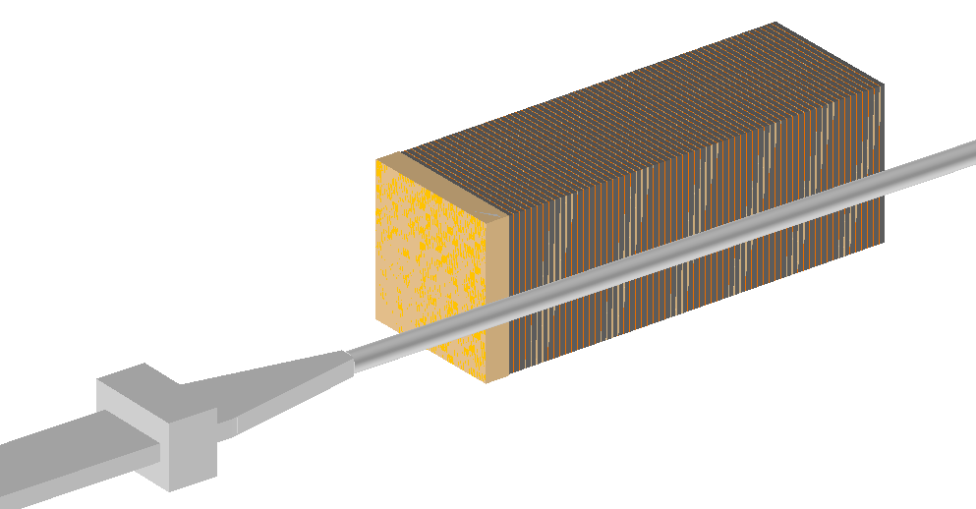
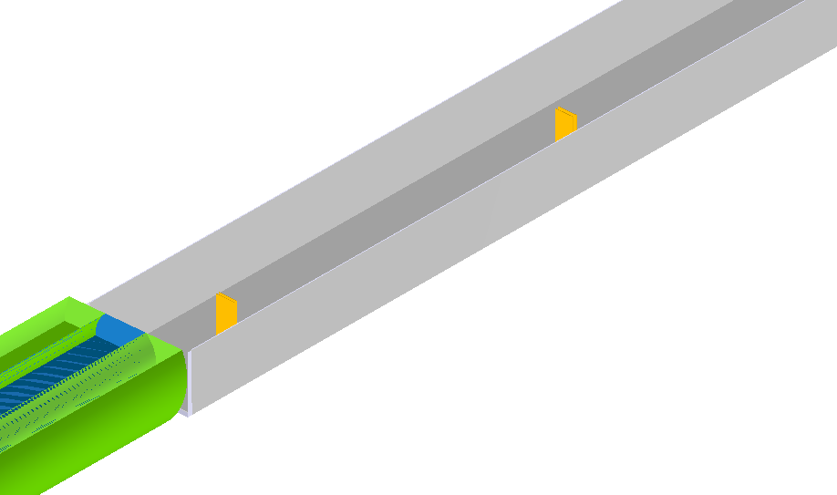
ePIC Far-Forward Detectors
Roman Pots
B2pf
B0 detector
ZDC
Crystal EMCAL
B1apf
SiPM-on-tile HCAL
Off-Momentum Detectors
Focusing quadrupoles
B0pf combined function magnet

Slide 5
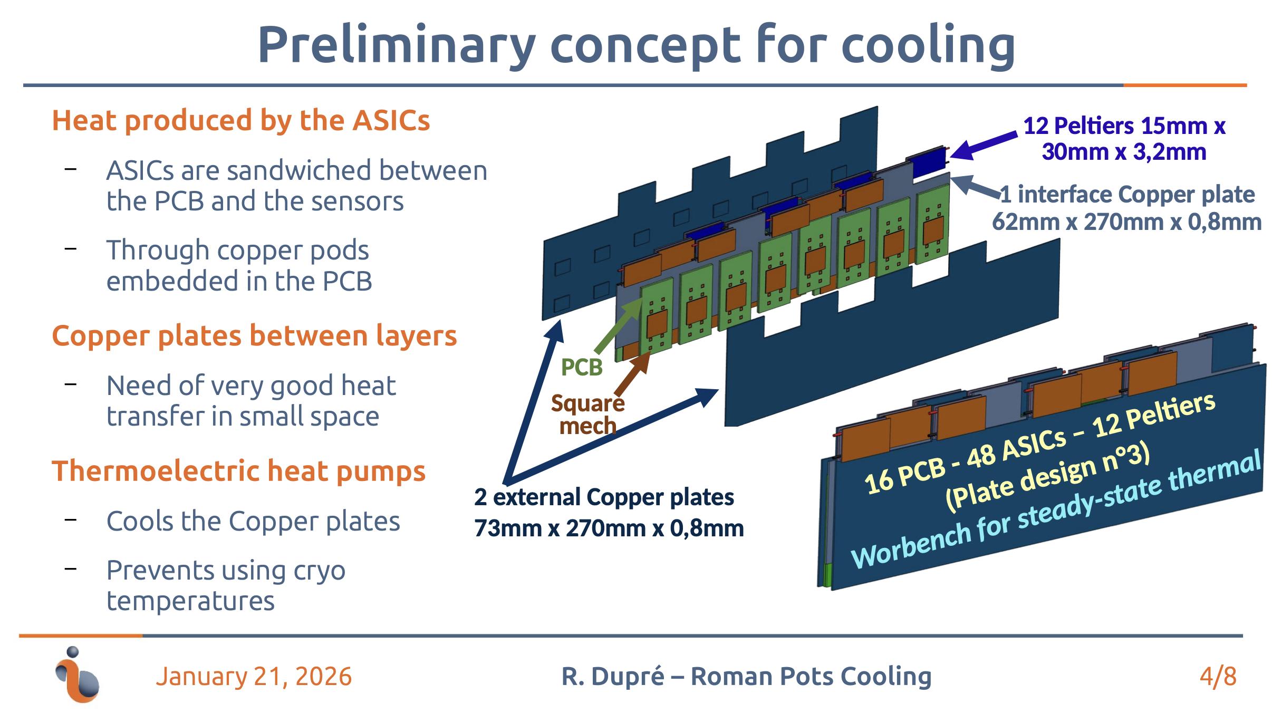
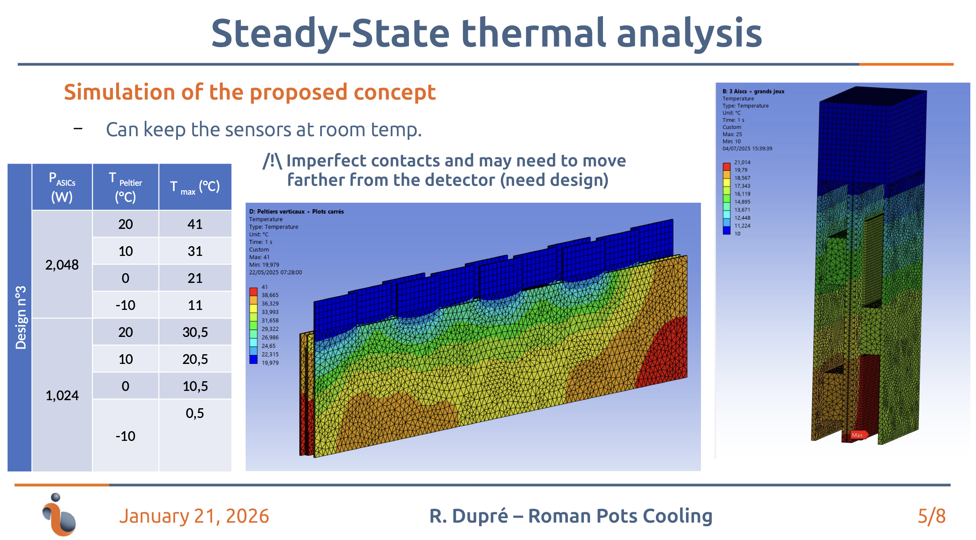
Vacuum AC-LGAD detector (RP, OMD)
Working under the assumption that we cannot use liquid or air cooling in vacuum (this is not fully true, but there are very strict requirements).
Currently using a Peltier based approach.
Cooling aimed at conservative 2mW/channel power consumption for the ASIC (aim is to achieve 1mW/channel).
Cooling design underway by IJCLab.

Slide 6
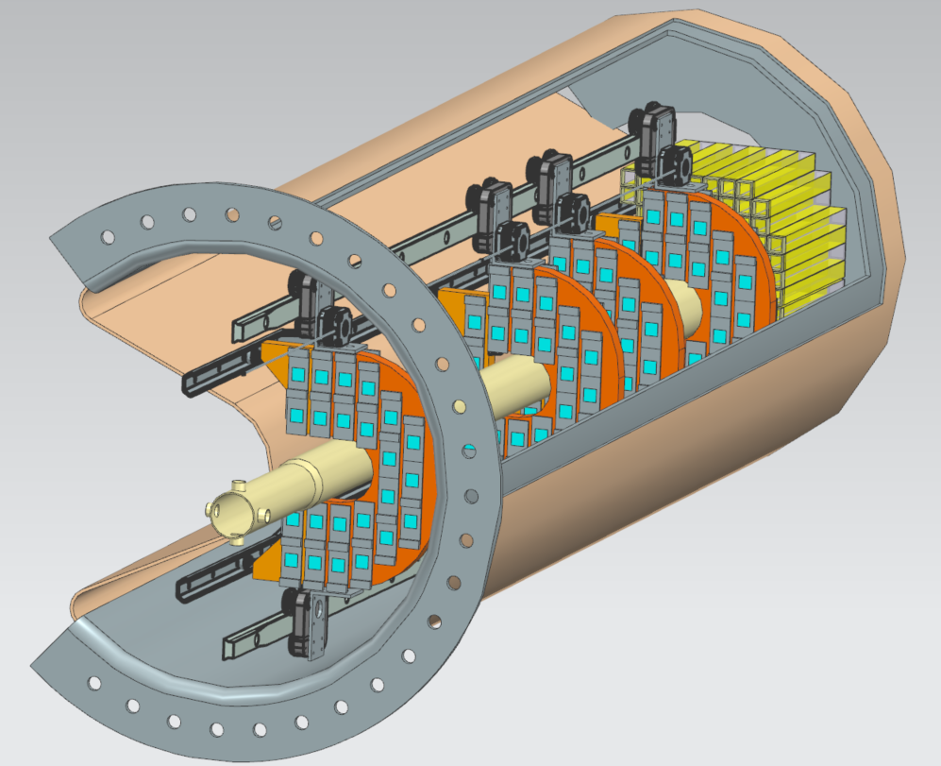
Air AC-LGAD detector (B0 tracking)
More-conventional tracking approach, but embedded in an accelerator magnet (access is challenging).
Same power consumption expectations as for the RP/OMD.
Will use understanding of cooling needs from RP/OMD studies to drive design of air or liquid (need to understand the cooling requirement, overall, and part of the issue is the conservative understanding of power consumption).
Will also have cooling needs nearest to the crystal EMCAL – work underway to determine temperature near the crystals → require stable temperature for resolution.
Jonathan Smith (JLAB)

Slide 7
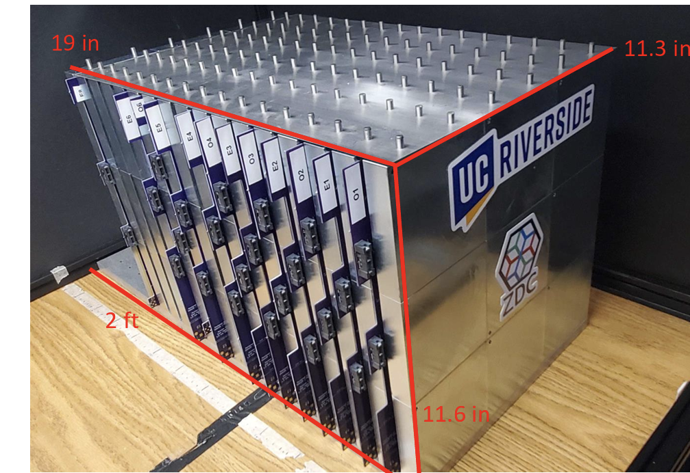
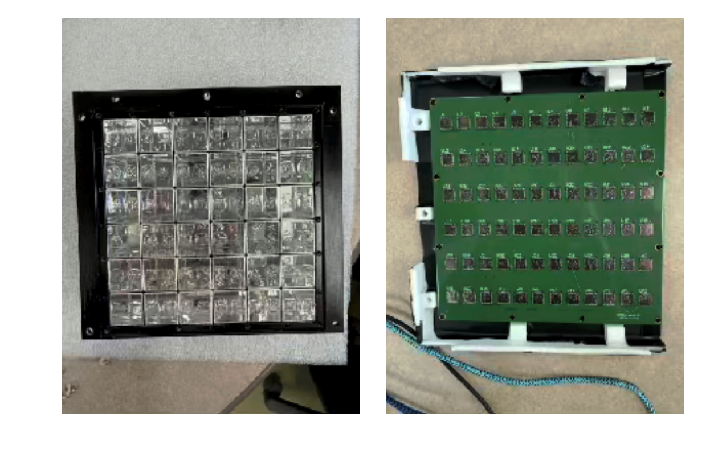
Zero-Degree Calorimeter
No strict requirements given → SiPM is primary technology, but ZDC is sitting on a table in the hall.

Slide 8
Summary
Roman pots and OMD cooling design is well-underway – simulations already performed.
Need to understand Peltier long-term functionality (e.g. radiation hardness).
Need to asses full power consumption of modules as new ASICs become available.
B0 tracking and EMCAL at very preliminary stage of cooling design.
Less restrictive than RP/OMD (which are in-vacuum), but Peltier concept may not work at all here due to high dose/neutron fluence.
ZDC does not have strict requirements defined, but cooling will be easy given the location of the ZDC.

Slide 9
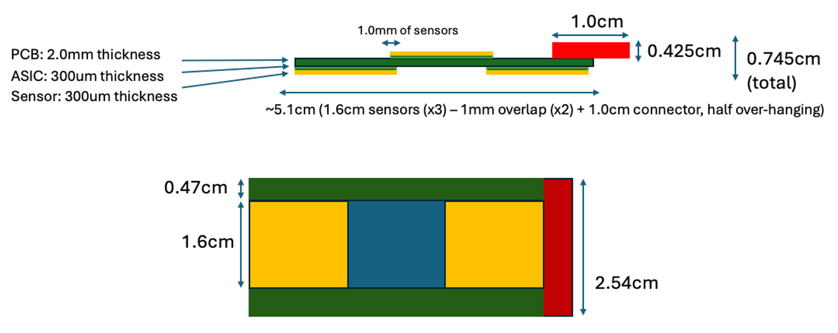
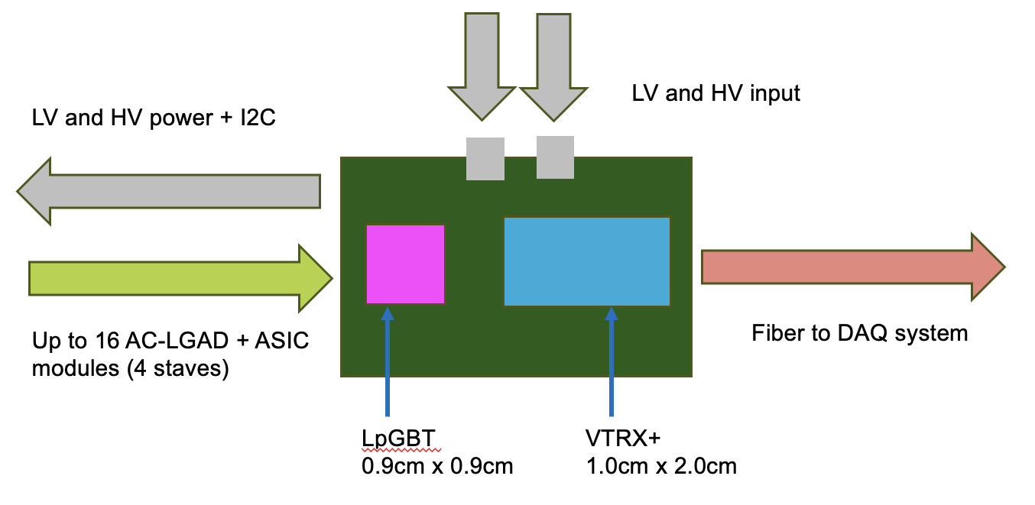
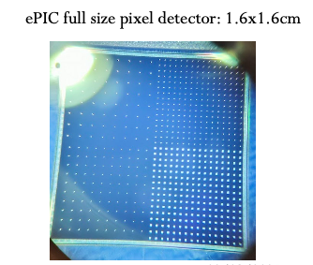
Implementation of AC-LGADs for FF Tracking
Readout needs to be separated from sensor/ASIC board to obey physical constraints for far-forward subsystems.
*Stave dimensions will be updated once EICROC1 schematic is in-hand.
Far-forward sensor “staves”
(3) 1.6cm x 1.6cm AC-LGADs with 500um pixel pitch
bump-bonded to EICROC1/2 ASICs
staggered on a two-sided PCB to provide full active-area coverage.
These sensors have 32x32 channels, matching the EICROC1/2.
Currently have 32x32 channel sensors from HPK which are under test.

Slide 10
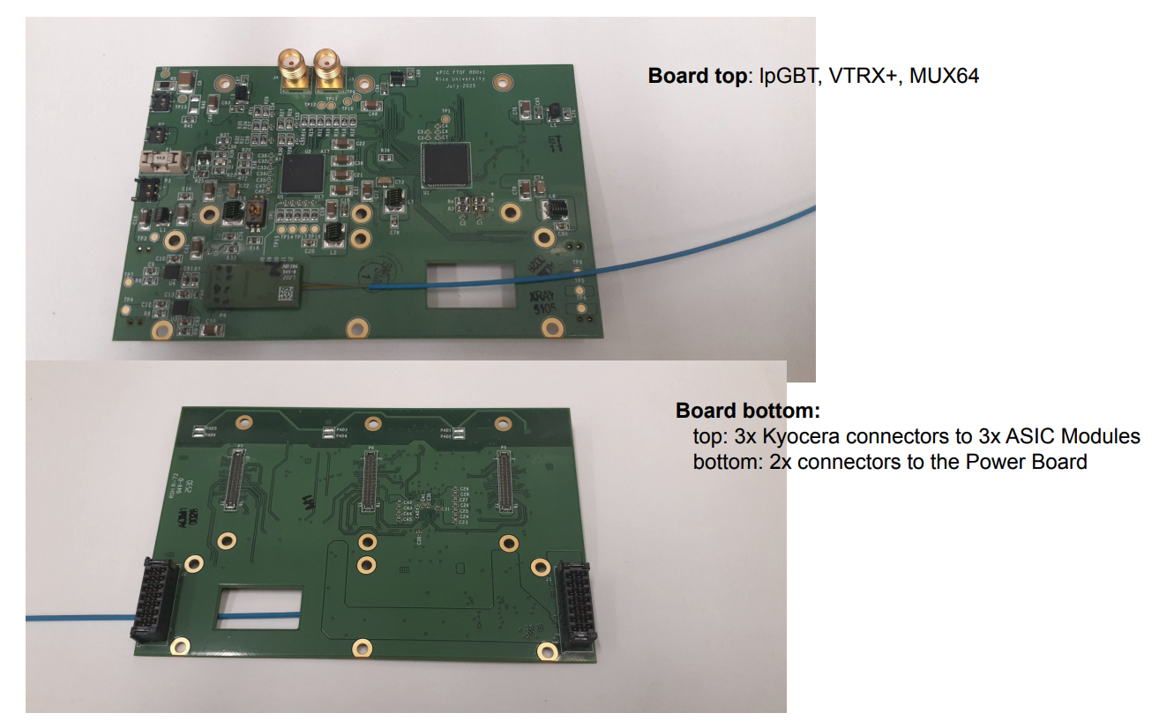
Implementation of AC-LGADs for FF Tracking
Tonko Ljubicic (Rice Univ.)
*Stave dimensions will be updated once EICROC1 schematic is in-hand.
Far-forward sensor “staves”
(3) 1.6cm x 1.6cm AC-LGADs with 500um pixel pitch
bump-bonded to EICROC1/2 ASICs
staggered on a two-sided PCB to provide full active-area coverage.
These sensors have 32x32 channels, matching the EICROC1/2.
Currently have 32x32 channel sensors from HPK which are under test.
Strong synergy with TOF: front-end + power board will be the same as FTOF.
Only difference is sensor stave/module, and the separation of the FEB for flexibility for FF detector needs.
Presently optimizing choice of readout board “flavor” which works best for auxiliary detector needs.

Slide 11
Broad timeline of AC-LGAD activities (non-exhaustive)
Action Item | Current Status | Dates (expected completion) | Notes
4x4 BNL and HPK sensors tested at Fermilab | Complete | 2020 to Summer 2022 | Established timing resolution ~ 20ps and spatial resolution ~ 20um (7x better than normal for pixel pitch due to charge sharing)
EICROC0 testing with charge injection | Mostly complete (jitter still under study) | Summer 2023 to now (Feb. 2026) | Tested analog and digital output, measured jitter, tested linearity of ADC Firmware does not support external trigger; will be updated to enable this with EICROC1
4x4 sensor testing with EICROC0 | Mostly complete (jitter still under study) | Summer 2023 to now (Feb. 2026) | Testing has been done with AC-LGADs wirebonded to EICROC0 – noise unacceptably high. Now using bump-bonded assemblies. Tested with TCT and Sr-90 source. Jitter from individual components small (10-15ps) – total jitter from analog output of EICROC0 testboard with AC-LGADs bump-bonded high – under study now.
Testing of full-size 32x32 channel HPK sensors | In-progress | Summer 2025 to now (Summer 2026) | IV curves measured and breakdown voltages identified; production yield > 90%; first test beam @ DESY in December 2025; hope for test beam @ SPS in Summer 2026; Lab testing underway (laser, source)
RBv1 setup and initial tests | In-progress | Summer 2025 to now (Spring 2026) | Work done to validate setup at Rice; setup being established at BNL to test EICROC1 with two different readouts after receipt of ASIC
Testing of EICROC1 | Not started | March 2026 to Fall 2026 | Will test with FPGA setup as done with EICROC0; aim is to test with RBv1 (lpGBT-based readout) as soon as EICROC1 is received.
Full-chain tests (32x32 sensor with EICROC1 and RBv1) | Not started | Late Spring 2026 – TBD (end of 2026) | Goal is to have initial full chain testing done by Summer if EICROC1 testing + RBv1 setup is successful.

