Slide 1
Auxiliary Detector Systems
Yulia Furletova
JLAB
L3-Manager 6.10.11
ePIC Collaboration meeting

Slide 2







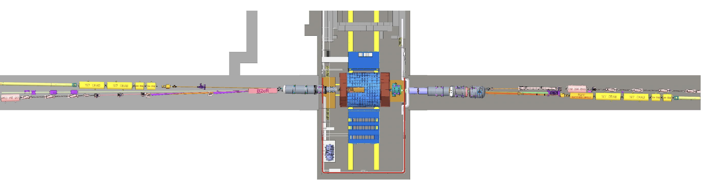


Participating Institutions
Riken, Japan
Kobe, Japan
Many international groups
weekly meetings to coordinate between project and participating institutions
Ben Gurion University of the Negev, Israel
Taiwan
South Korea
Hebrew University of Jerusalem, Israel
Kansas university, USA
PNNL, USA
UCR, USA
Tel Aviv University, Israel
York, UK
Prague, CZ
BNL, USA
Kraków, Poland
B0 detectors
Luminosity system
JLAB/BNL
Zero-Degree Calorimeter
p/A
e
Low-Q2
taggers
Off-momentum detectors
Roman Pots
AC-LGAD consortium :
BNL, USA
IJCLab - Orsay, France
OMEGA , France
IRFU/CEA-Saclay, France
Glasgow, UK
W&M, USA
York, UK
Prague, CZ

Slide 3
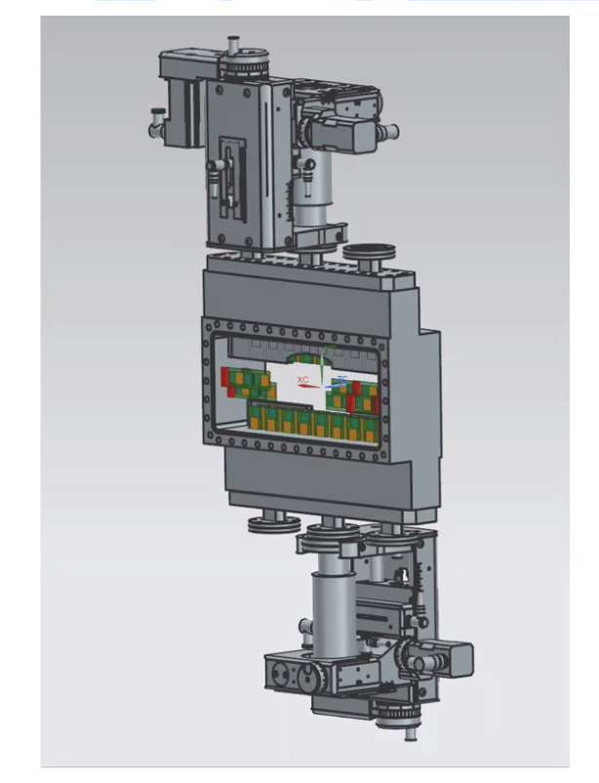
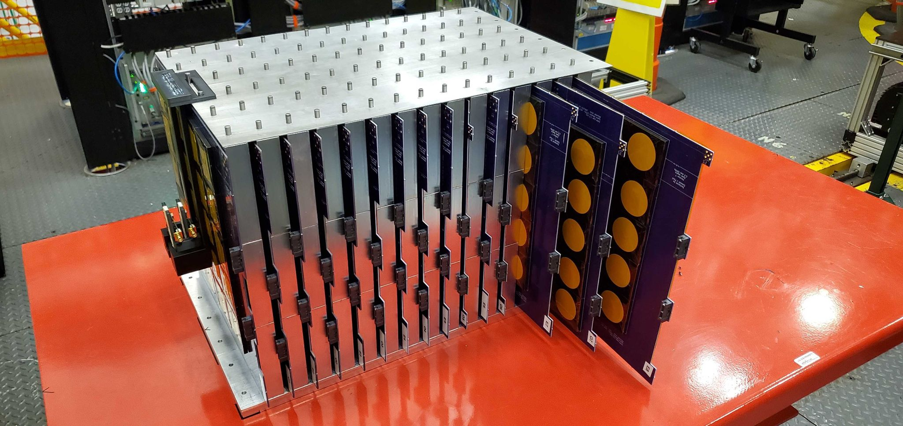
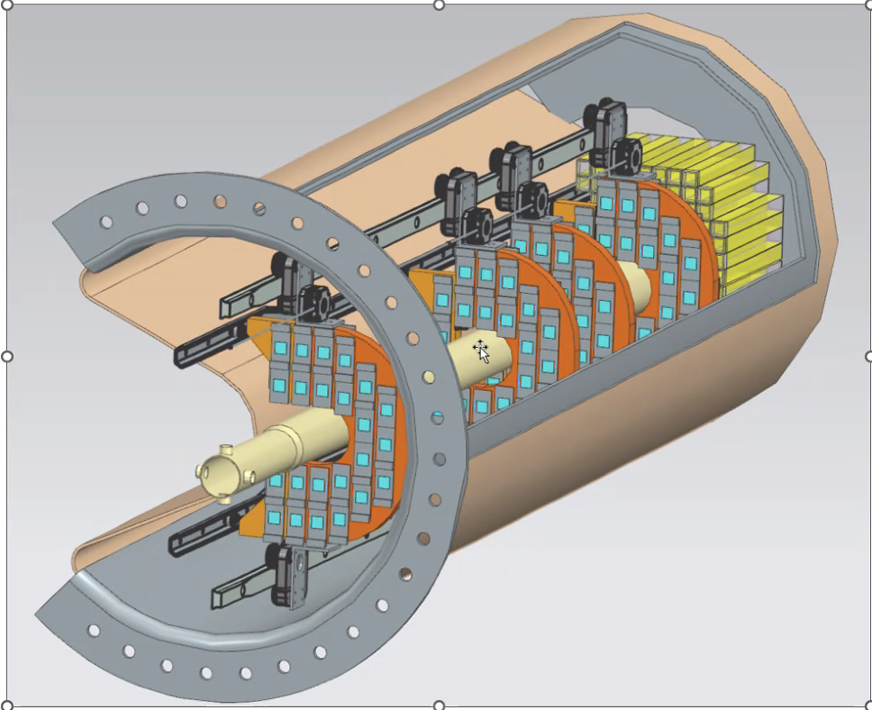
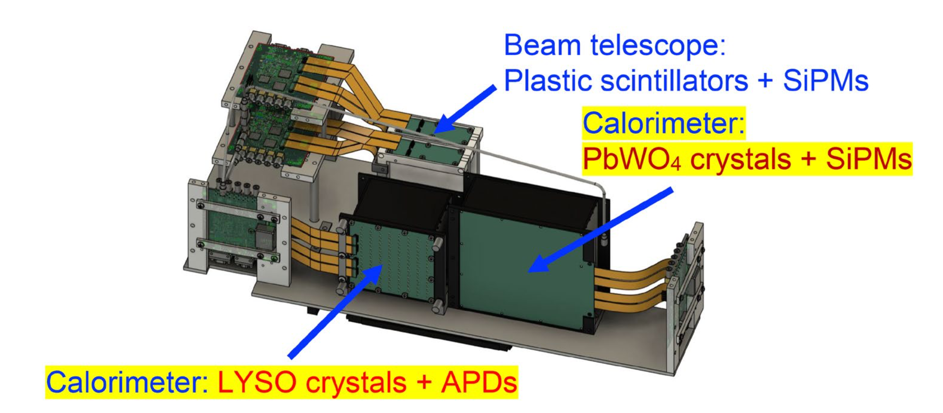
Thank you for all your efforts !!!

Slide 4
Reviews
PDR1 (40%) Feb 2022 , PDR2(50%) April 2024 are completed.
Preliminary Design Reviews (60% design maturity)
PDR3: Auxiliary Detectors + lumi detector - End March/ Early April 2026
PDR2: AC-LGAD-based Particle Identification Detectors (6.10.04; BTOF, FTOF, common systems) – April 2026
Project Reviews:
Detector Baseline Readiness Review Feb 3 – 5, 2026
BNL Director’s Review – Comprehensive, Mar. 9-12, 2026
DOE OPA Status Review April 28-May 1, 2026
CD2 IPR & ICR Fall 2026?
Final Design Reviews (FDR ) - path towards CD3
FDR: Auxiliary Detectors + lumi detector : spring/summer 2027

Slide 5
Preliminary Design PDR 60% review preparation
Thank you!
Baseline of technology , scope definition ( preTDR ) =>
Requirements and interfaces
Technical progress/IR integration
(services, cables, cooling)
Recommendations from previous reviews
Cost for materials
Labor cost
QA / ES&H / Fabrication and assembly plan
Schedule

Slide 6
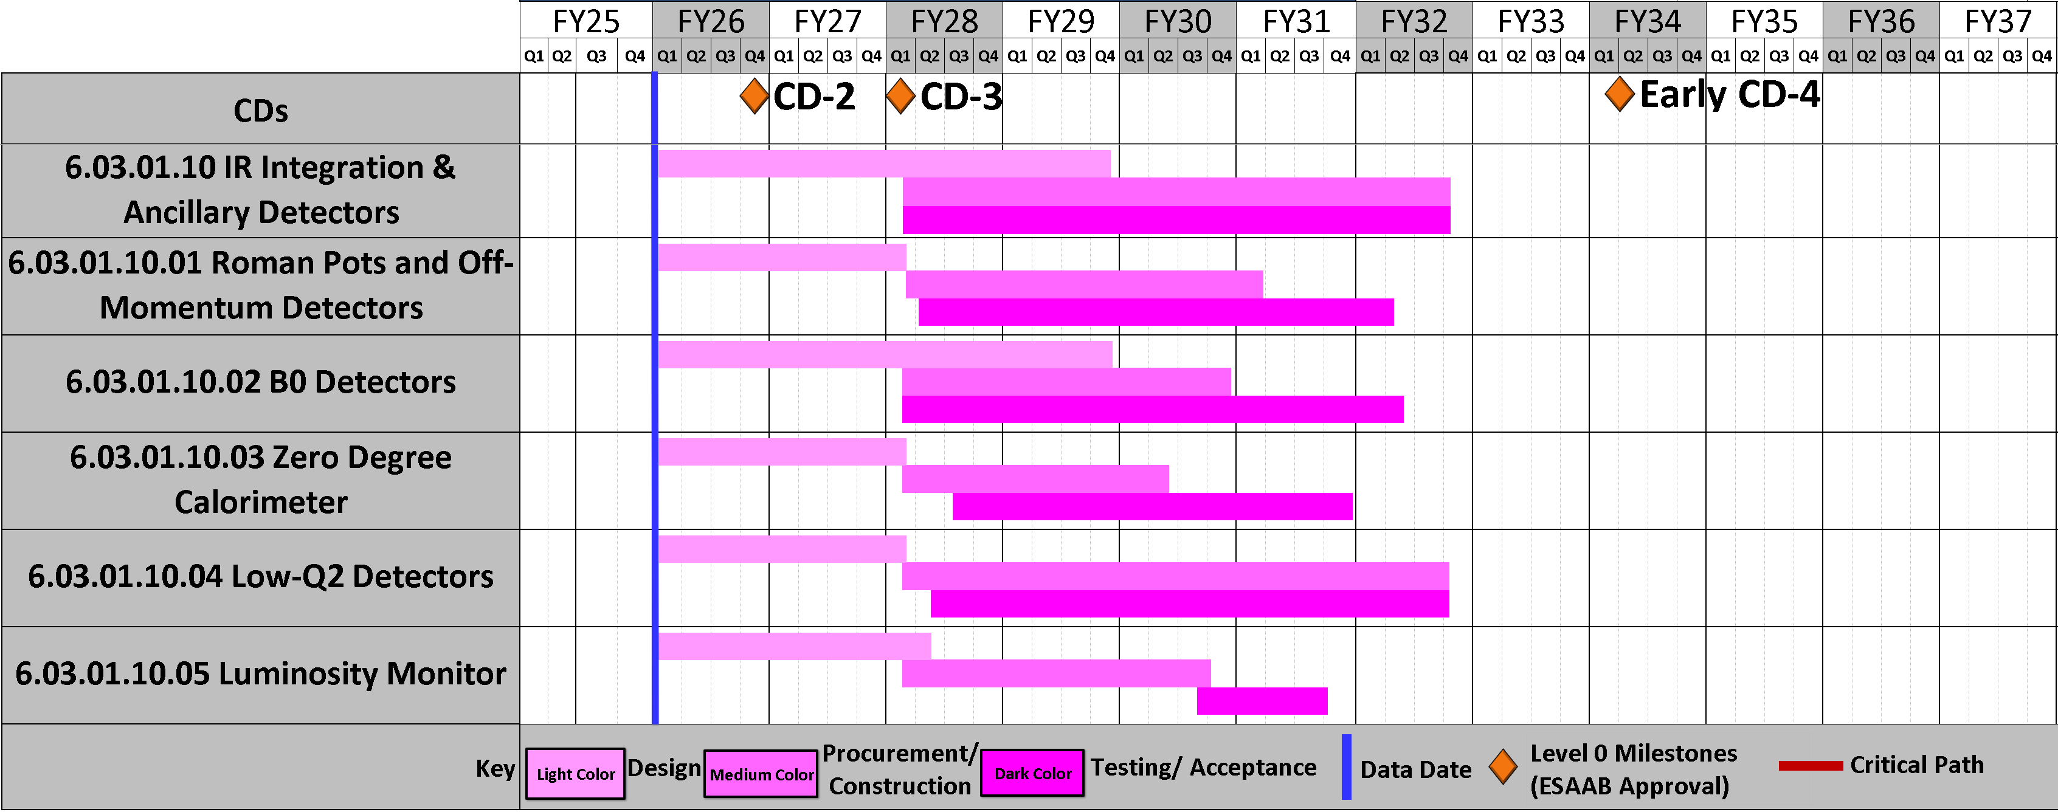
Schedule
PDR1 (40%) on 27 April 2022, PDR2 (50%) on 12 Feb 2024 , PDR3 (60%) is planning for March/April 2026
Key Schedule Drivers/Assumptions:
Production of AC-LGAD -based tracking detectors depends on the availability of EICROC chips ( RPOTs/OMDs/B0/Lumi-tracker)
RPOTs/OMDs will be installed once the accelerator will achieve a stable beam operation (potentially 1 year later from start of physics).
Installation of individual sub-components needs to merge with IR subproject installation schedule

Slide 7
Recommendations tracker
No dedicated recommendations from DOE reviews
Here are recommendations from PDR1(40%) and PDR2(50%):
Develop and review the readout strategy.
-> ( completed) Regular meetings with DAQ team to discuss number of channels, detector occupancy, background and synchronization. As the technologies are identical as the ones in main detector systems, no new readout needs to be developed.
Provide as soon as possible milestones towards technology choices for the detectors.
-> ( completed) The default configuration is chosen. Value engineering on the technology choices are ongoing ( synergies with other sub-detectors)
Continue making system accessibility a priority in system and sub-system design.
-> ( completed) The engineering design to improve integration and accessibility is ongoing. All the detectors but the EmCal in the BO can be regularly maintained during operations. A 3D printed mockup was build to check integrations and installations of sub-systems
Make sure that all collaborating institutes are familiar and on-board with the integration strategy and systems.
-> ( completed) Weekly meetings.
Consider the adoption of formal engineering and system management system such as PLM (Product Lifetime Management) and AM (Asset Management) early in the life of the EIC facility.
-> ( completed) The project elected "Visure" to provide management and system tracking . Also using excel tables.
For future review, include an ESH&Q slide in every presentation.
->(completed) ES&H slides included in the Feb 2024 review
Develop and review an overall project plan for Quality Assurance and Control.
-> ( completed) The project is developing in In collaboration with participating institutions the required QA and controls documents, for details see https://eic.jlab.org/Detector/
Make sure you work with the Project to plan your Accelerator Readiness Reviews (ARR) well in advance.
->( completed) the dated for ARRs and ERR are integrated in P6
Ensure that WBS 6.06 continues to develop comprehensive dynamic aperture evaluations including effect of crab cavities, auxiliary components and imperfections to demonstrate the requirements technical feasibility before CD‐2
->( completed) All beam effects are included into the simulation of FF/FB detectors. The dynamic aperture evaluation is ongoing by the accelerator team and iterations between the physics team and the accelerator team are constantly ongoing.Each time a new lattice is released the golden science channels are run to monitor any changes in acceptance, till now none have been seen. All auxiliary detectors sit between the incoming and outgoing beam crab cavities so no additional effects are seen.

Slide 8
Recommendations tracker
No dedicated recommendations from DOE reviews
Here are recommendations from PDR1(40%) and PDR2(50%):
Ensure that WBS 6.06 continues to develop comprehensive dynamic aperture evaluations including effect of crab cavities, auxiliary components and imperfections to demonstrate the requirements technical feasibility before CD‐2
-> (in progress ) All beam effects are included into the simulation of FF/FB detectors. The dynamic aperture evaluation is ongoing by the accelerator team The dynamic aperture evaluation is done continuously as soon as there are any lattice changes in the inner IR.
Fast track the engineering design of B0 and Roman Pots, before CD2.Fast track the engineering design of B0 and Roman Pots, before CD2.
-> ( in progress) The engineering design of B0 and RPOTs are ongoing . Waiting for feedback on the RPOT design from the vacuum team. RF calculations needs to be performed. Impedance calculations are ongoing right now by the accelerator team. Interfaces and requirements of B0 system, B0 magnet and a vacuum team has been reviewed.
Develop plans for insertion of tracker and calorimeter readout into B0 magnet, including decision whether the device should be serviceable as soon as possible but not later than the next review
->( in-process ) A focused engineering effort is underway to improve the design. Including discussions with the magnet Designers of the B0.Integration of detectors as part of engineering CAD design is on-going to ensure that detectors will be serviceable A mockup of the system was build to check the integration aspects. We plan to present this at the 60% preliminary design review for the auxiliary detectors
Prepare and present a comprehensive risk analysis for the next FF‐FB system review
-> ( in progress) Agreed and will be incorporated into future review We have presented an update at the most recent (June 2025) Detector Advisory Committee comprehensive design review.
Present fabrication and assembly plans at the next review
-> ( in progress) Agreed and will be incorporated into future reviews. We will present an update on this at the next PDR. We have presented an update at the most recent Detector Advisory review.

Slide 9
List of detector parts and components subject to QA/acceptance tests
RPOTs/OMDs:
B0 detectors :
Sensors (AC-LGAD)
ASICs (EICROC) Limited (under Electronics )
Stave integration
PbWO4 crystals (*)
Photosensors (SiPMs) (*)
Mechanical integration
Cooling
ZDC:
▪ PbWO4 crystals (*)
▪ Photosensors (SiPMs) (*)
▪ Cooling system for EMCAL
▪ HCAL SiPM-onTile readout boards
▪ HCAL Photosensors (SiPMs)
▪ Mechanical support structure
▪ Sensors (AC-LGAD)
▪ ASICs (EICROC) Limited (under Electronics )
▪ Staves integration
▪ Vacuum system and integration
▪ Cooling system and integration
▪ Mechanical integration/Moving stages
QA/QC plans has been developed and documented:
(*) - Backward EMCAL
Synergy with FTOF
Synergy with Electronics
Synergy with forward HCAL/Insert
QualityControlPlan.pdf document

Slide 10
Environment, Safety, and Health (ES&H)
We will be using the appropriate ES&H and Radiation Safety measures as dictated by the participating universities and labs(BNL/JLAB). All personnel working within the labs have to have the appropriate training to ensure adherence to these safety protocols.
Flammable materials: fibers
Use of proper storage, extinguishing system, keep away from the open fire or hot temperature.
Electrical/ Cooling/Trip safety:
For operation with HV and Cooling: we will ensure that these are mechanically secure and not a trip hazard. HV lines/connectors will be isolated and will have proper warning signs and follow the lab procedures for electrical safety. Proper grounding scheme will be implemented.
Operation nearby magnets/magnetic fields:
Use of non-magnetic materials. In coordination with accelerator team: flashing signs or lights indicate magnet is on and magnetic fields may be present. Posting signs.
Operation near the beam-pipe and vacuum:
Including vacuum valves near RomanPots. Interlock systems to avoid movements of RomanPots without permission from accelerator team. Include extraction mechanism for RomanPots. We will require that anyone working near the far-forward/backward detectors to wears ear protection, and will post signage to that effect.

Slide 11
Today
Detector Integration and services ( Jonathan & India on behalf of all designers working on this topic)
Cooling ( Roman Pots/OMD) (Raphael)
Reconstruction ( RPOTs, B0 ) ( Alex, Baptiste)
AC-LGAD /EICROC testing at BNL (Alex)
AC-LGAD /EICROC testing at IJCLab ( Dominique)
EICROC1 (Christophe)
RBv1 (Tonko)

