Slide 1
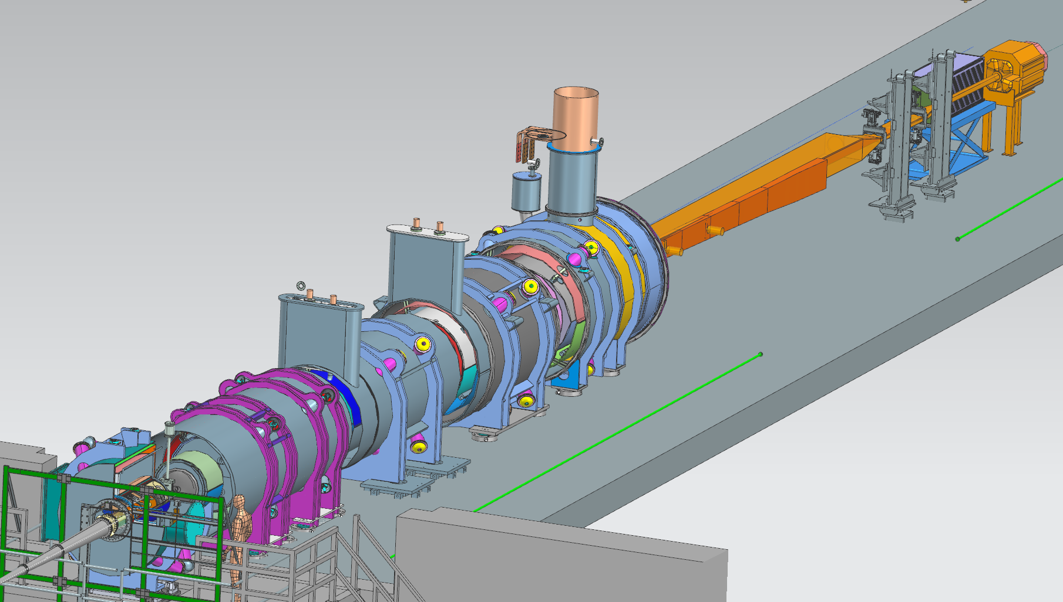
Far-Forward Integration
Zero-Degree
Calorimeter
B0 Detectors
Roman Pot Detectors
Off-Momentum Detectors
ePIC Collaboration Meeting, January 21, 2026

Slide 2
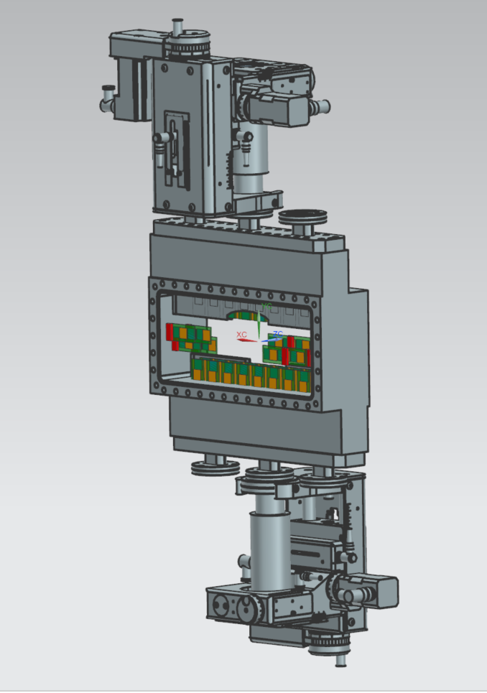
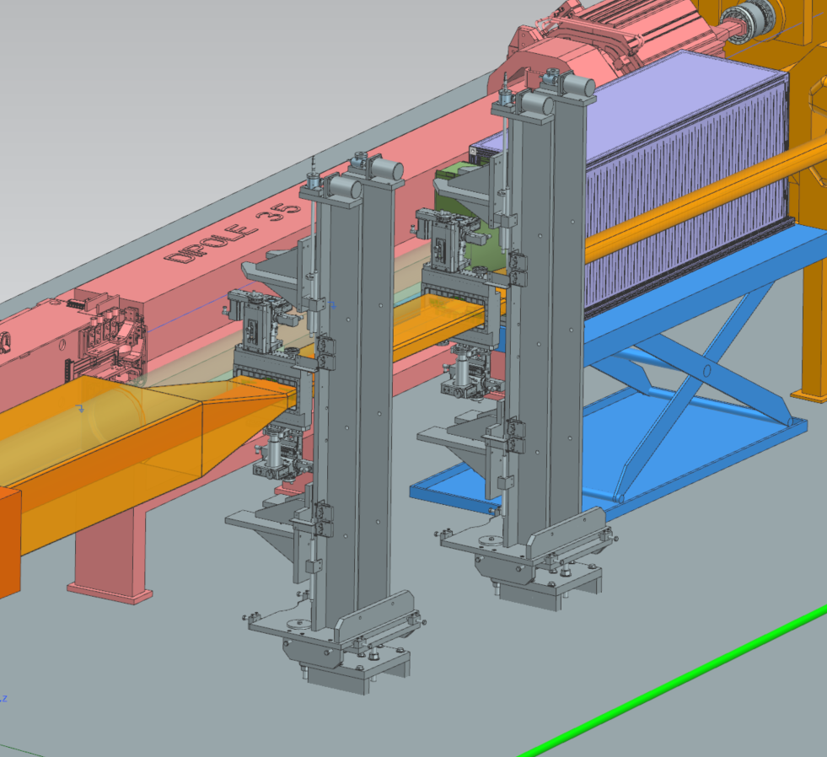
Roman Pots

Slide 3
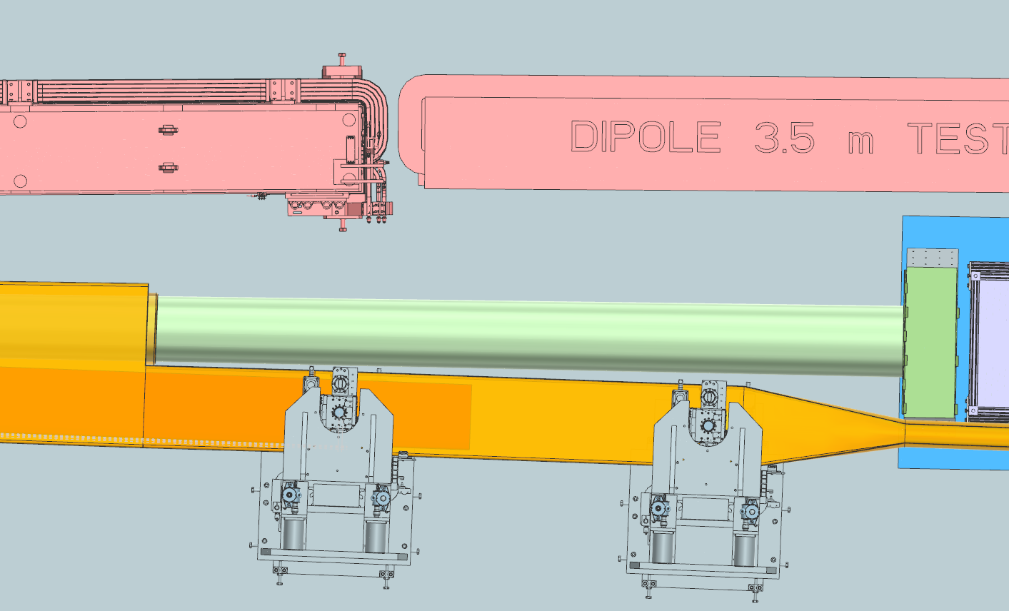
Roman Pot Arrangement
Integration for the Roman Pots must be clear from the Neutron Cone exit window directed towards the Zero-Degree Calorimeter
Roman Pot Stands within the model are repurposed from STAR. JLab will update the stands to suit final Roman Pot Design
ePIC Collaboration Meeting, January 21, 2026

Slide 4
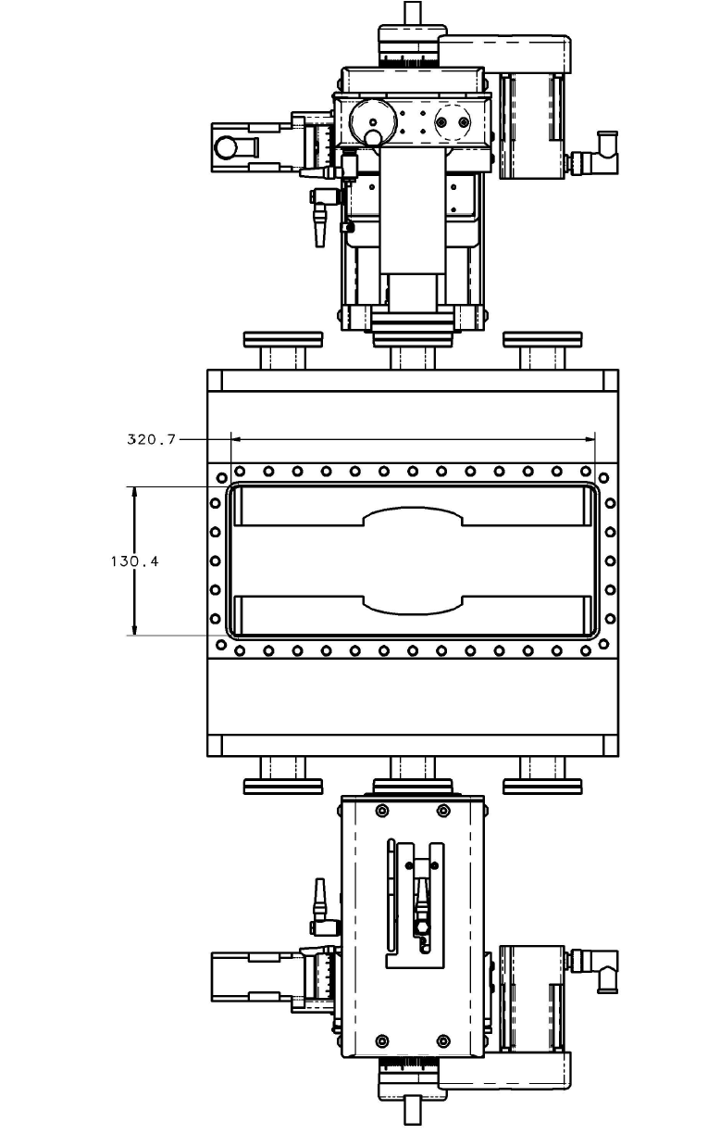
Roman Pot Design Criteria
Current overall Scattering Chamber size opening is 320.7mm x 130.4mm
(4) ports used for outside services (cooling/electronics) – Circled
Moving Stage motors from UHV Designs (http://www.uhvdesign.com)
Currently utilizing the existing STAR Roman Pots stands as a ‘stand-in’ and anticipate modeling the final stand once Roman Pot design is complete.
Sensors used are the preliminary ACLGAD (EICROC) modules
Detector Coverage Arrangements for (2) Beam Energies: 100 GEV and 275 GEV
  Anticipate running 100 GEV for the first three years of operation
ePIC Collaboration Meeting, January 21, 2026

Slide 5
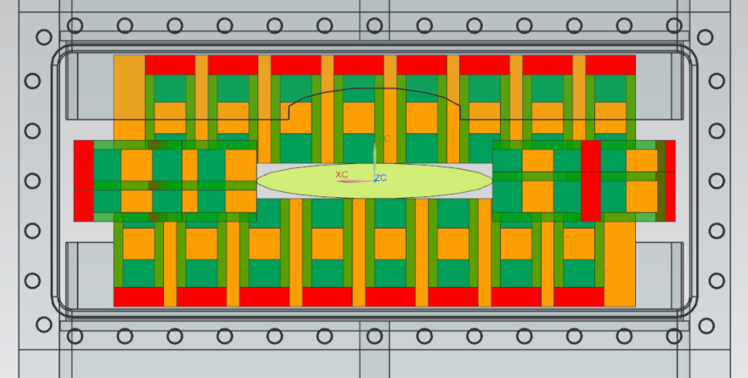
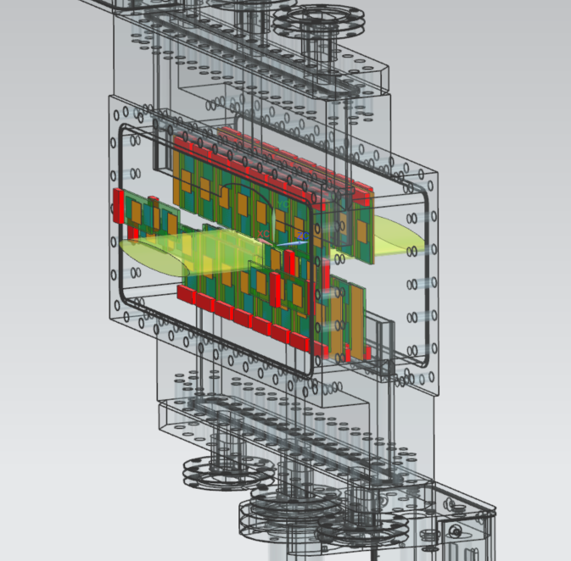
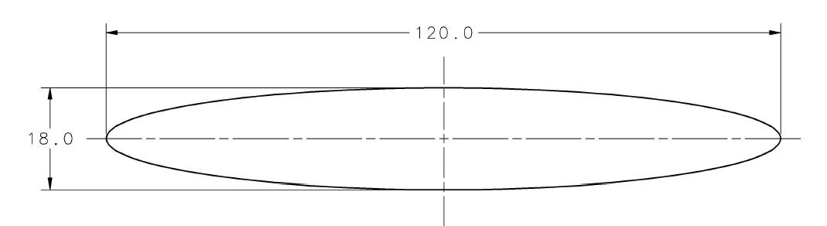
Roman Pot Detector Arrangement, Six Sigma - 100 GEV Beam Energy
Measurements are in MM
ePIC Collaboration Meeting, January 21, 2026
Notes:
Slicer: Orienting the print on the bed, Adjusting supports, Layer height/thickness, Infill pattern and density, Bed adhesion settings, Printing speed, Extrusion amount
.gcode: legible to the printer

Slide 6
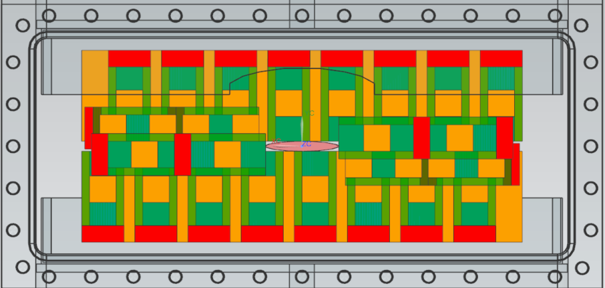
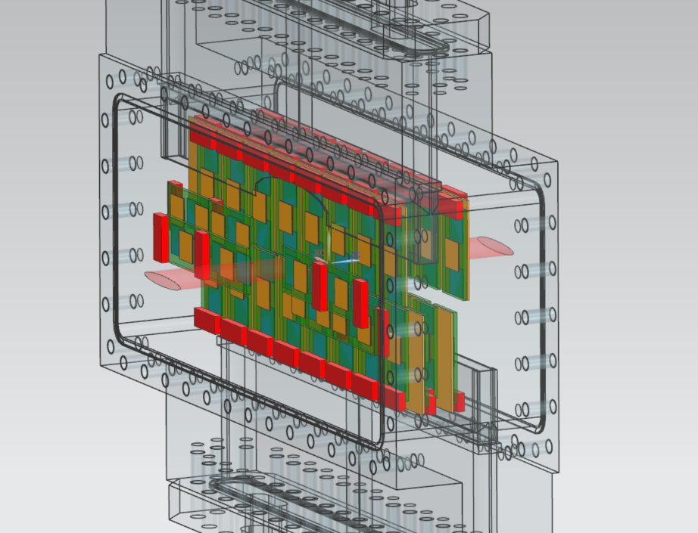
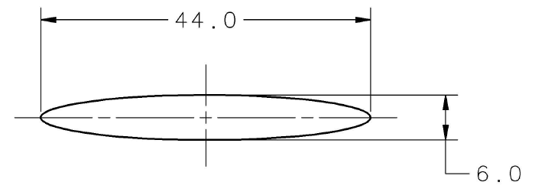
Roman Pot Detector Arrangement, Six Sigma - 275 GEV Beam Energy
Measurements are in MM
ePIC Collaboration Meeting, January 21, 2026
Notes:
Slicer: Orienting the print on the bed, Adjusting supports, Layer height/thickness, Infill pattern and density, Bed adhesion settings, Printing speed, Extrusion amount
.gcode: legible to the printer

Slide 7
Roman Pot Detector Arrangements
The current design utilizes (2) Top Rows and (2) bottom rows of detectors on independent stage motors. In addition, (2) staging motors will be required to support the horizontal detectors for full coverage.
ePIC Collaboration Meeting, January 21, 2026

Slide 8
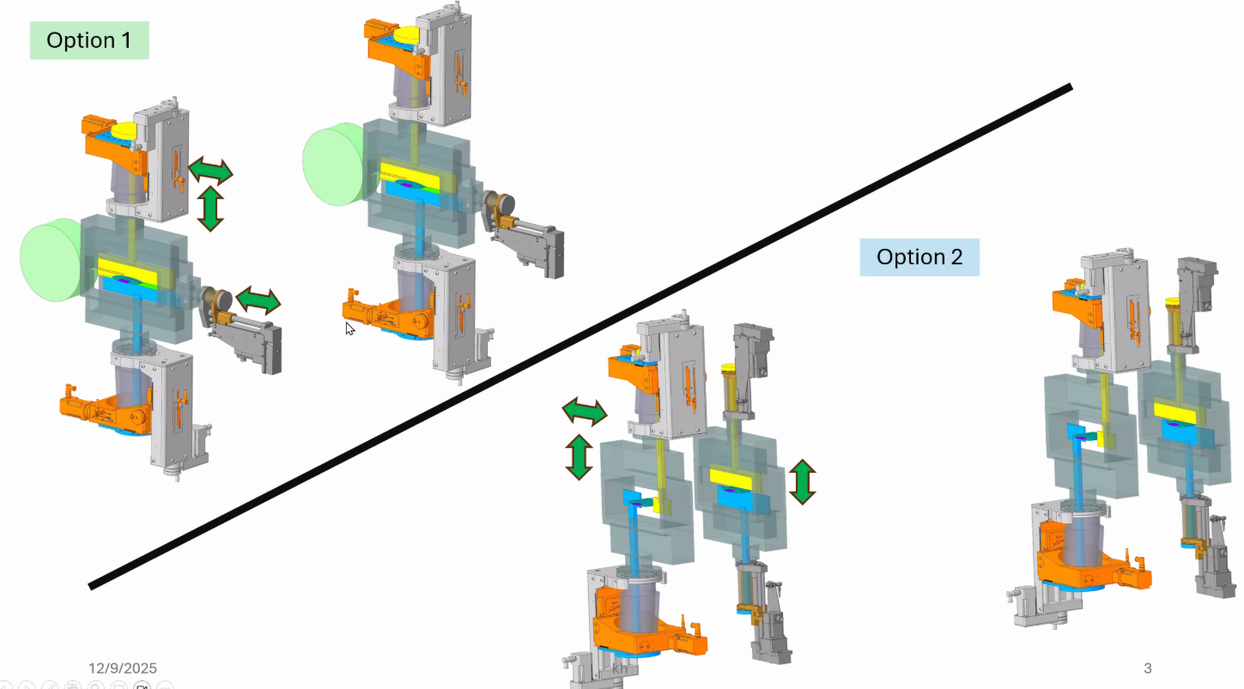
Current Roman Pot Coverage Discussions
Slide courtesy of Karim Hamdi and Alexander Jentsch
ePIC Collaboration Meeting, January 21, 2026

Slide 9
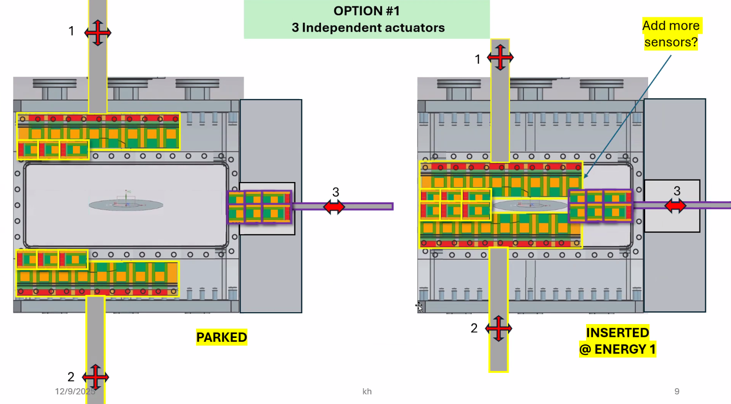
Option 1
Neutron cone
Slide courtesy of Karim Hamdi and Alexander Jentsch
ePIC Collaboration Meeting, January 21, 2026

Slide 10
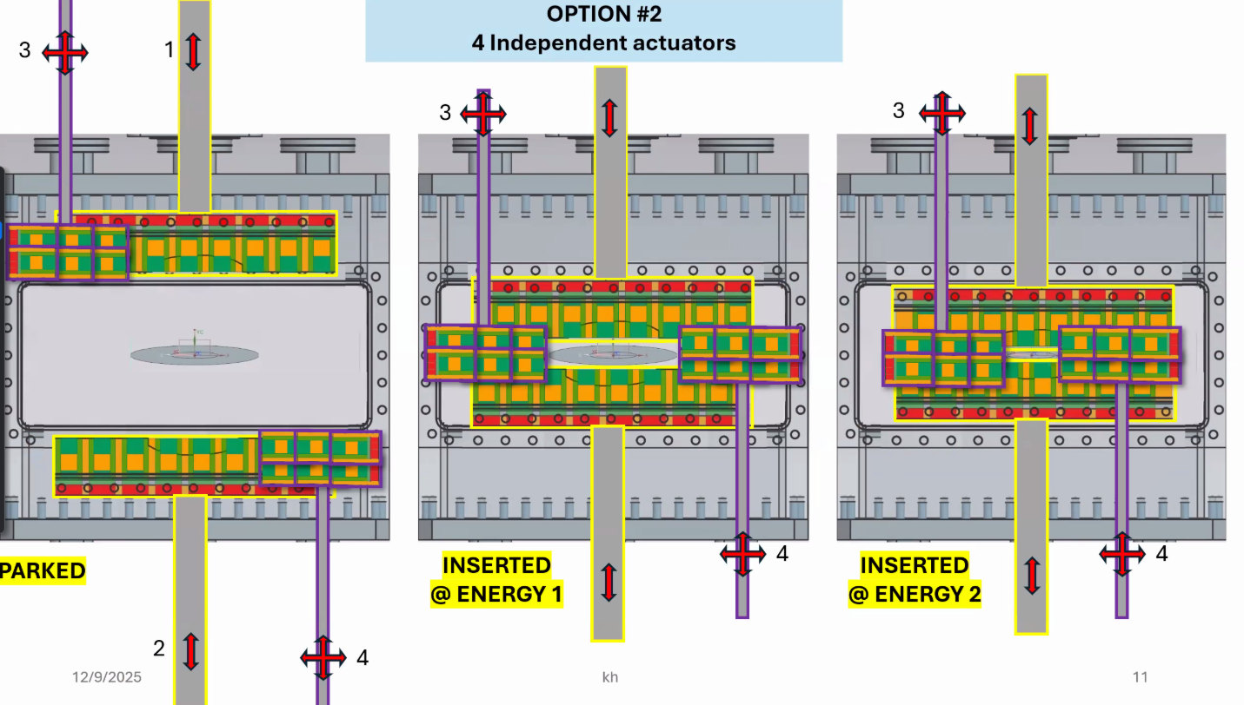
Option 2
Neutron cone
Slide courtesy of Karim Hamdi and Alexander Jentsch
ePIC Collaboration Meeting, January 21, 2026

Slide 11
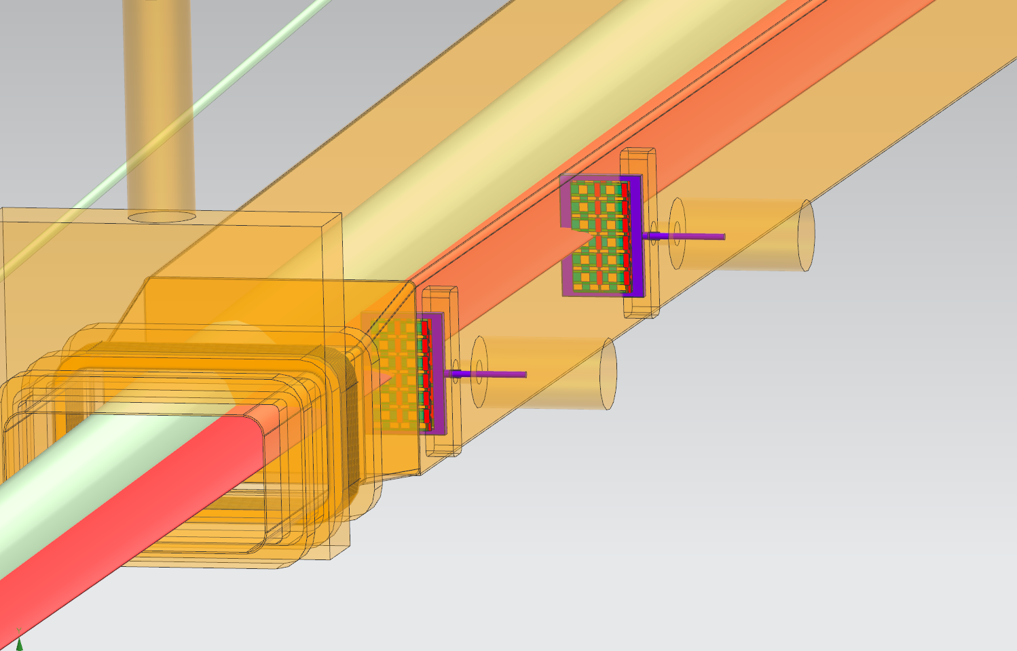
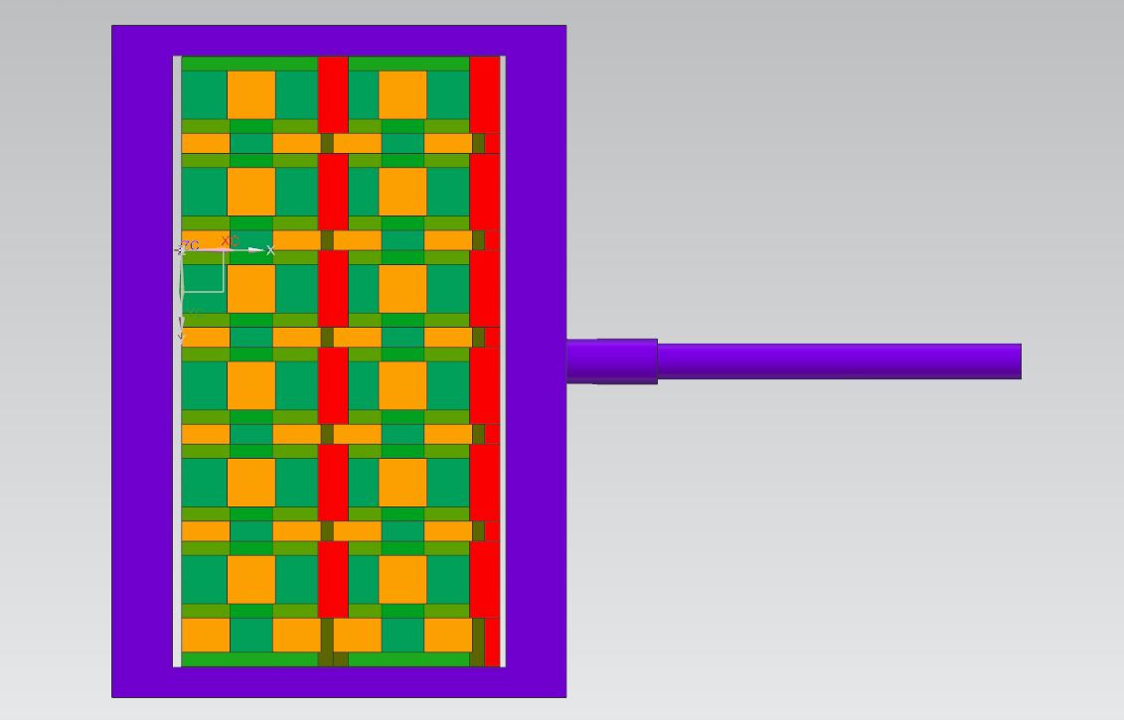
Off-Momentum Detectors
(2) Off-Momentum Stations
(2) Layers of detector staves (EICROCs) per station
  24 Staves per Layer, 48 per Station, 96 Total
(1) Independent actuator per station
ePIC Collaboration Meeting, January 21, 2026

Slide 12
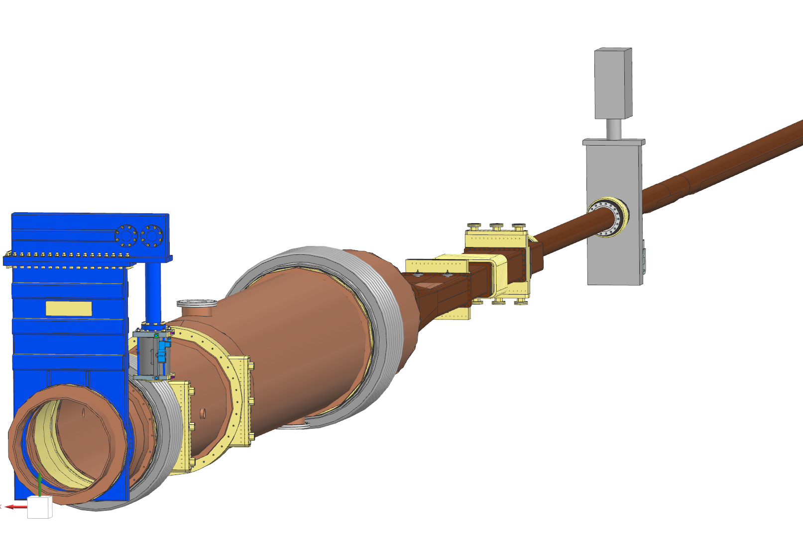
Roman Pots / OMD Conclusions
Update the detector coverage to suit final ACLGAD/EICROC Module design
Using the existing STAR Roman Pot Support design as a template to design the EIC Integration.
Work with other labs to provide appropriate detector coverage that supports cooling efforts.
Update models with latest Integration files are imported via Project Link/Data Sharing
  Team:
  Chang Jun & Charlie Hetzel (BNL) – Vacuum System / Scattering Chamber
  Karim Hamdi (BNL) – Integration
  IJC Lab / Orsay, France – Cooling
  Alexander Jentsch (BNL) – ACLGAD/EICROC
  Ron Lassiter, India Krehbiel, Jonathan Smith – Mechanical Integration
ePIC Collaboration Meeting, January 21, 2026

Slide 13
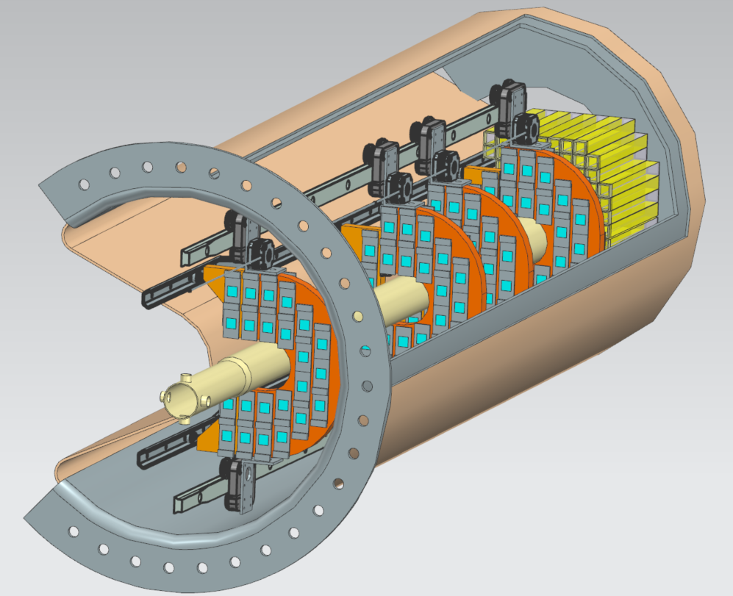
B0PF Detector Concept
ePIC Collaboration Meeting, January 21, 2026

Slide 14
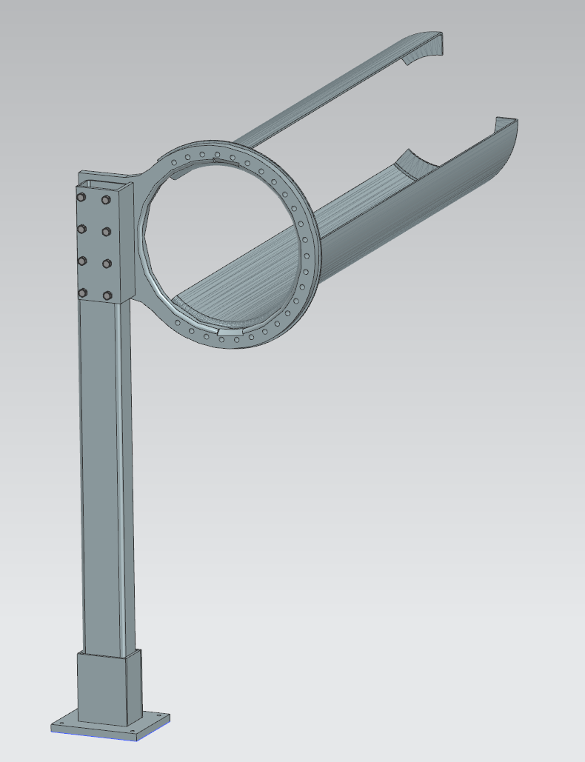
B0PF Support Structure
Counter-levered support from the front and Stand-off fasteners in the back
“Ship in a bottle” design
ePIC Collaboration Meeting, January 21, 2026

Slide 15
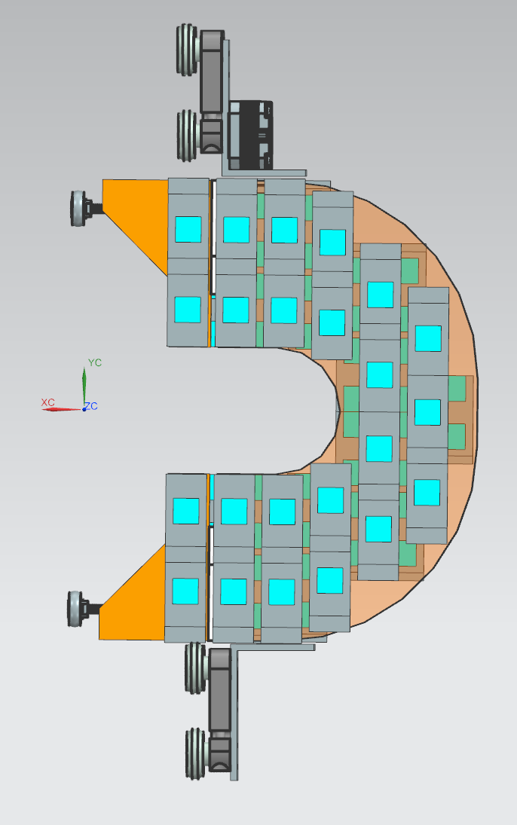
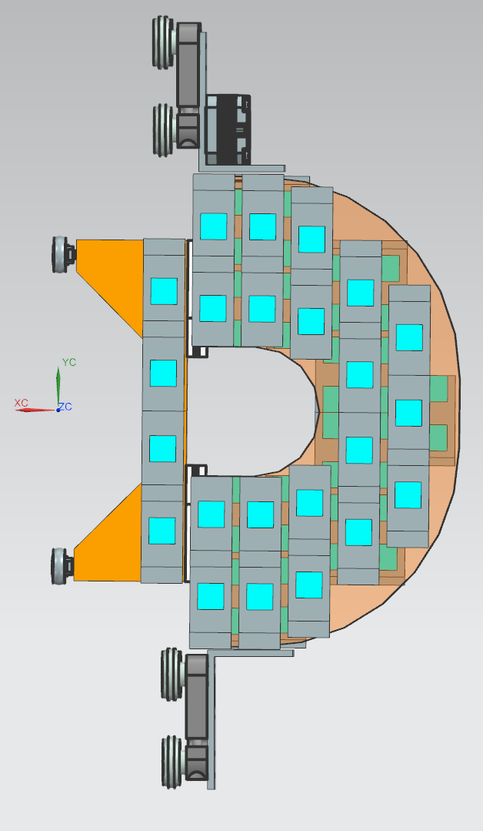
B0 Detector Layers
(4) Detector Planes inside the B0
Individually controlled via NEMA 17 Stepper Motor
“Horseshoe” Design with inner-most detectors on a slide to wrap around beampipe
Utilizing the same ACLGAD EICROC detectors as Roman Pots and Off-Momentum Detectors
OPEN
CLOSED
ePIC Collaboration Meeting, January 21, 2026

Slide 16
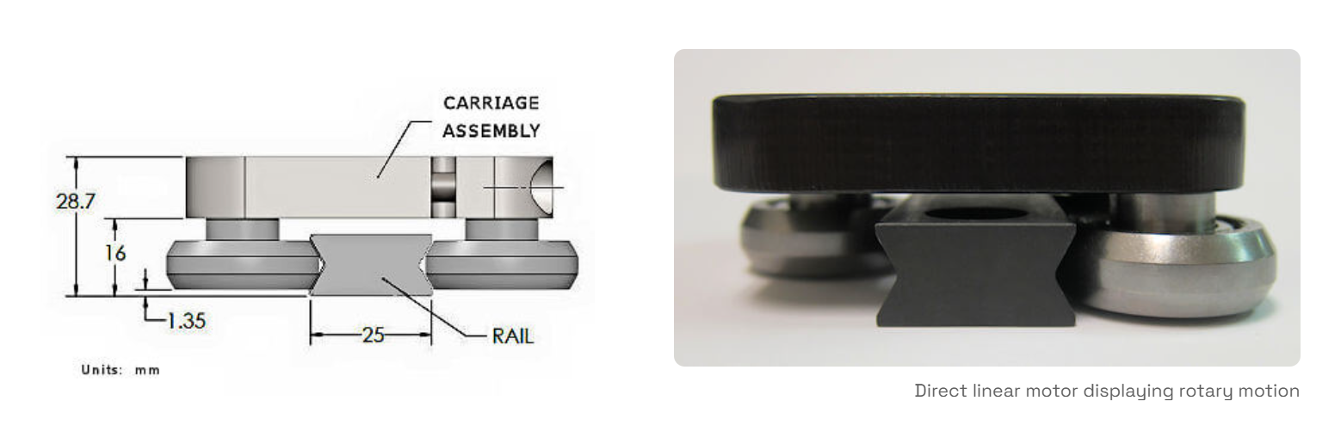
B0 Detector Carriage
Courtesy: Acuvi Group (Formerly TPA Motion)
ePIC Collaboration Meeting, January 21, 2026

Slide 17
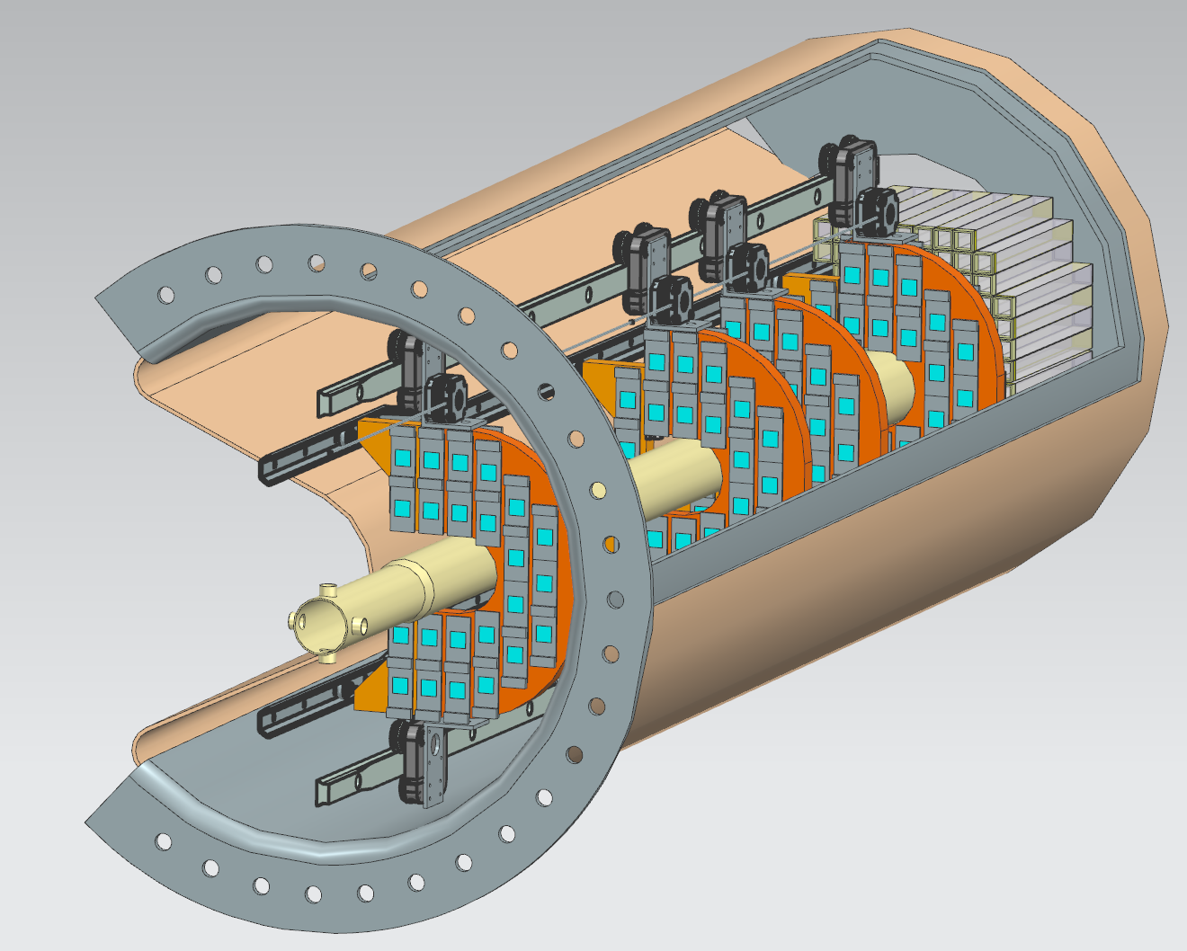
B0 Inner Mechanics
Previous design used (2) mechanized axis of motion to place two halves of a detector around the beampipe.
Current concept is using a single motor per layer with an additional guide rail to close inner-detector around beampipe
ePIC Collaboration Meeting, January 21, 2026

Slide 18
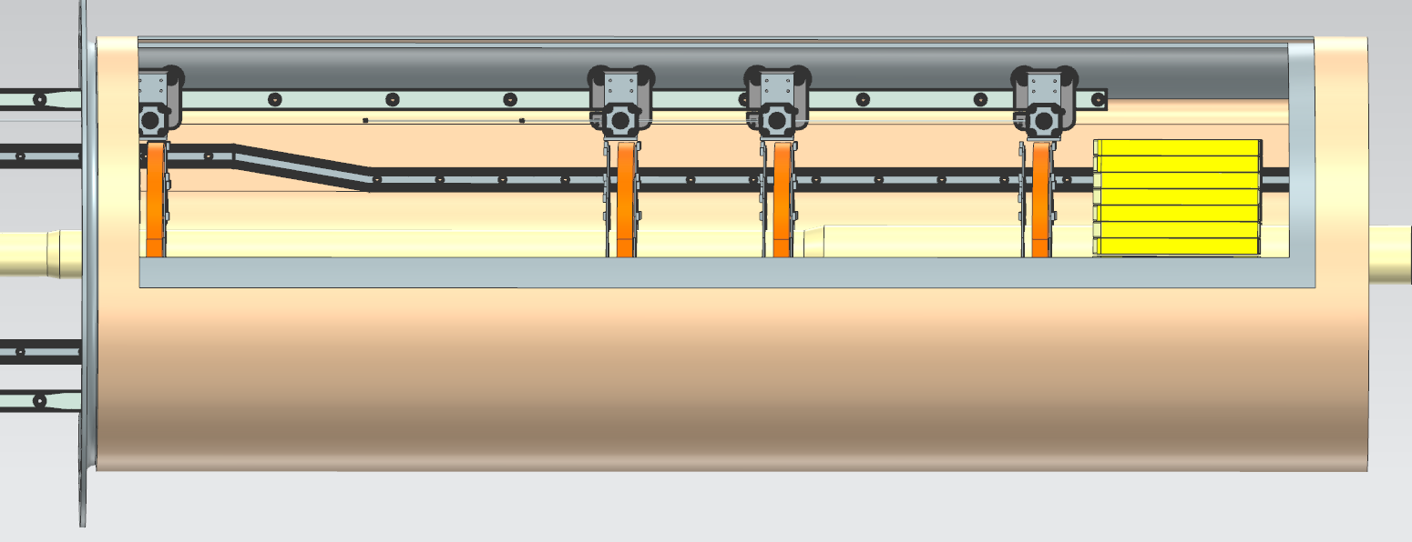
B0 Inner Mechanics
Linear Rail →
Guide Rail
ePIC Collaboration Meeting, January 21, 2026

Slide 19
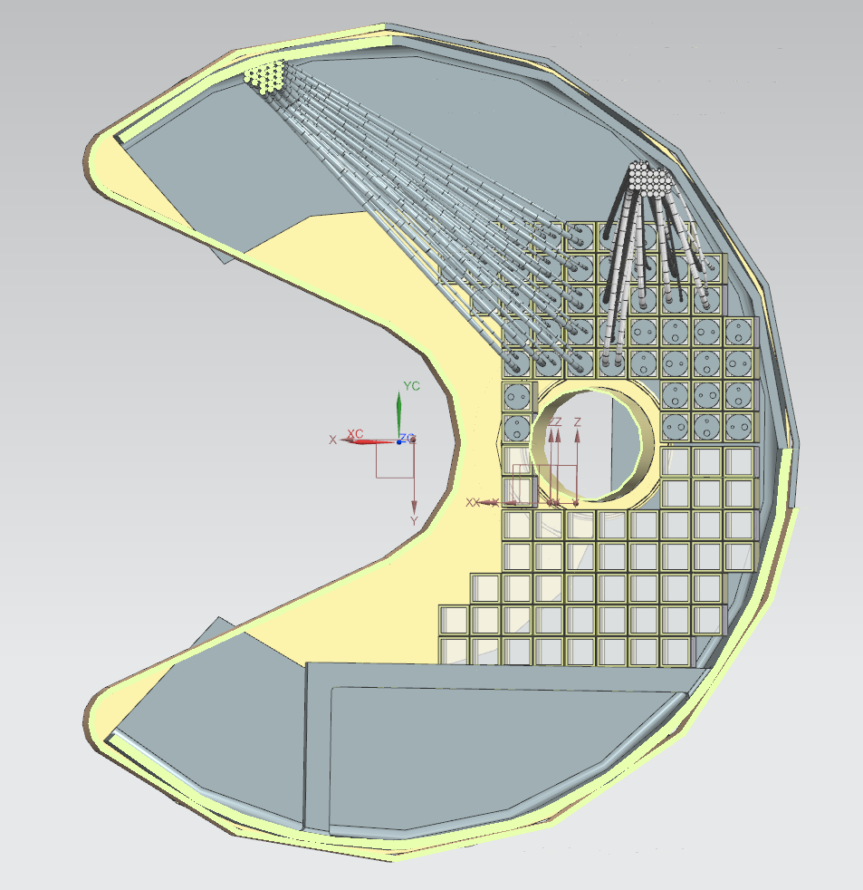
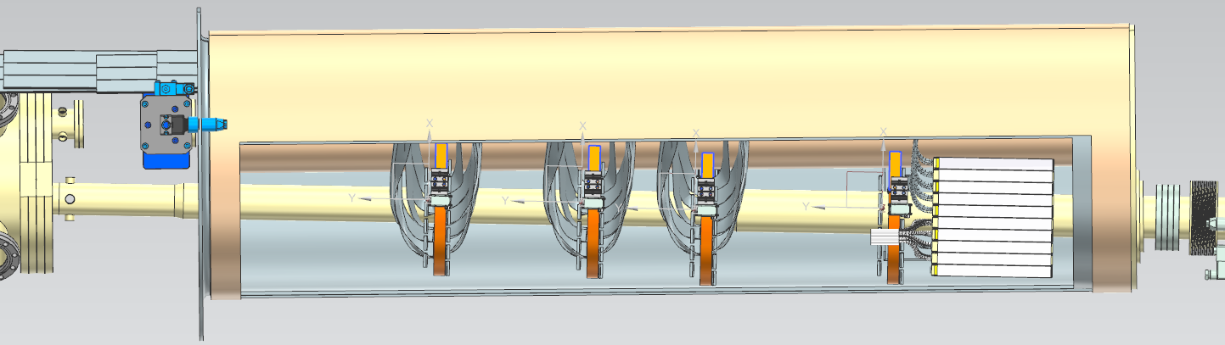
Calorimeter
Calorimeter is proving to be too large to remove the crystals from inside the B0 “Barrel”
  Backside of B0 is inaccessible
  Removing crystals via front-side risks damaging the inner cryostat
Investigating a method to remove electronics inlieu of crystals for maintenance
Creating a permanent mounting method for calorimeter crystals (creating a ‘shelf’ from inner barrel support structure)
Size of Calorimeter had to be reduced along X-Axis to accommodate B0 Magnet inner-barrel size (previously 5 crystals, reduced to 3)
ePIC Collaboration Meeting, January 21, 2026

Slide 20
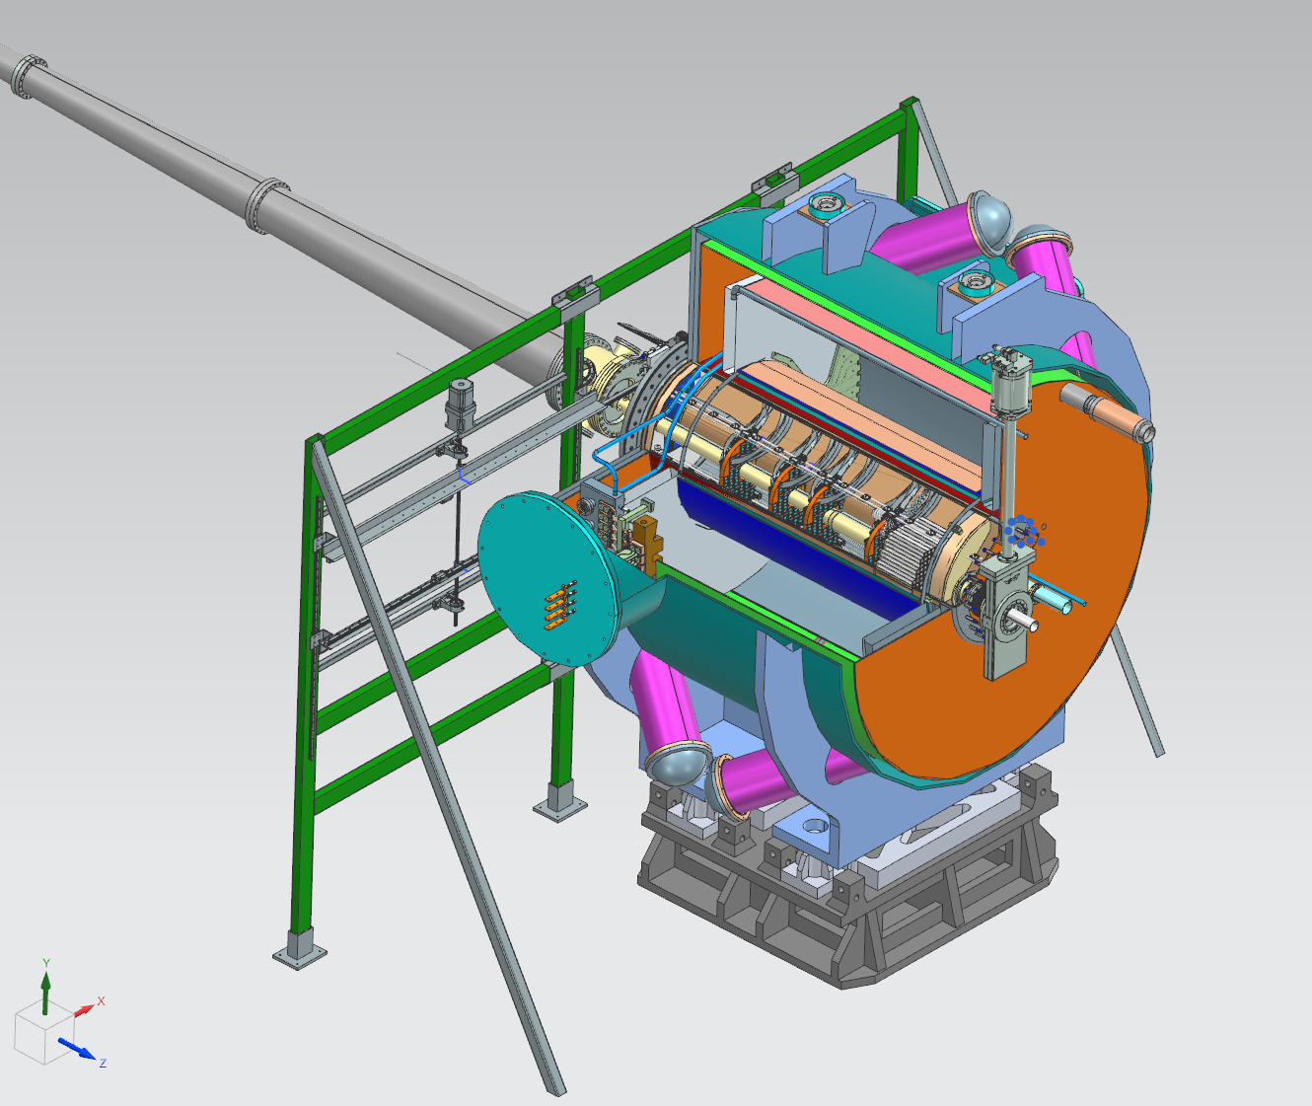
B0 Outer Mechanics
Outer support frame consists of a series of channel supports and linear rails
Currently shown is outdated as new concept no longer requires the vertical movement
ePIC Collaboration Meeting, January 21, 2026

Slide 21
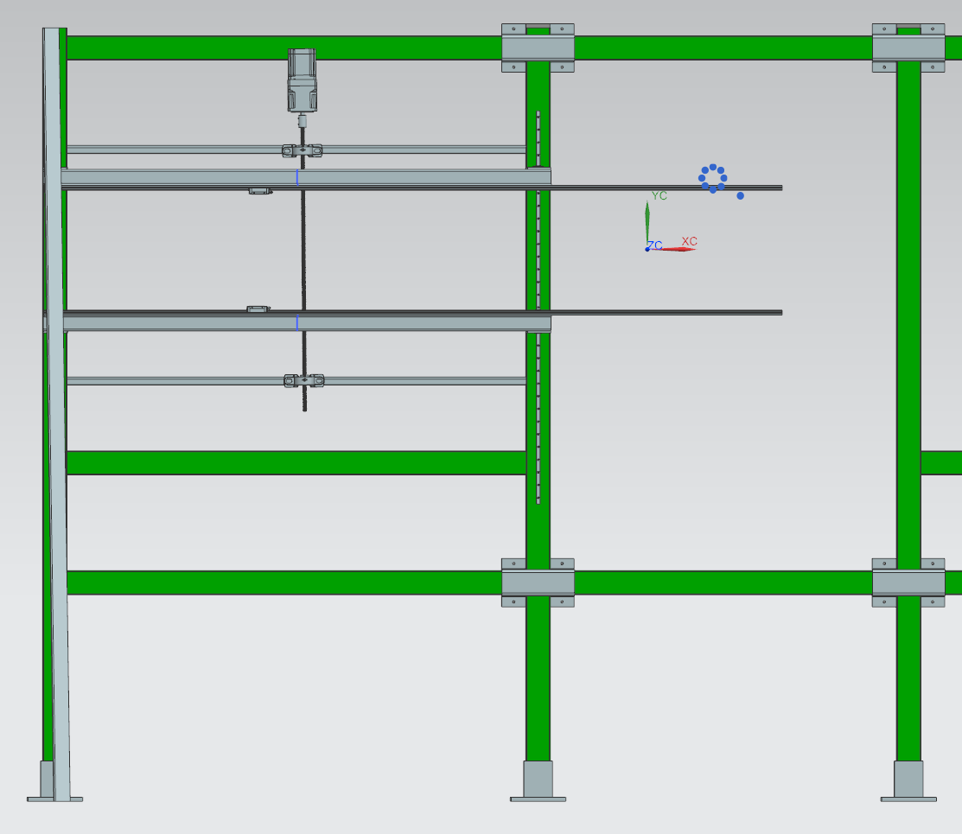
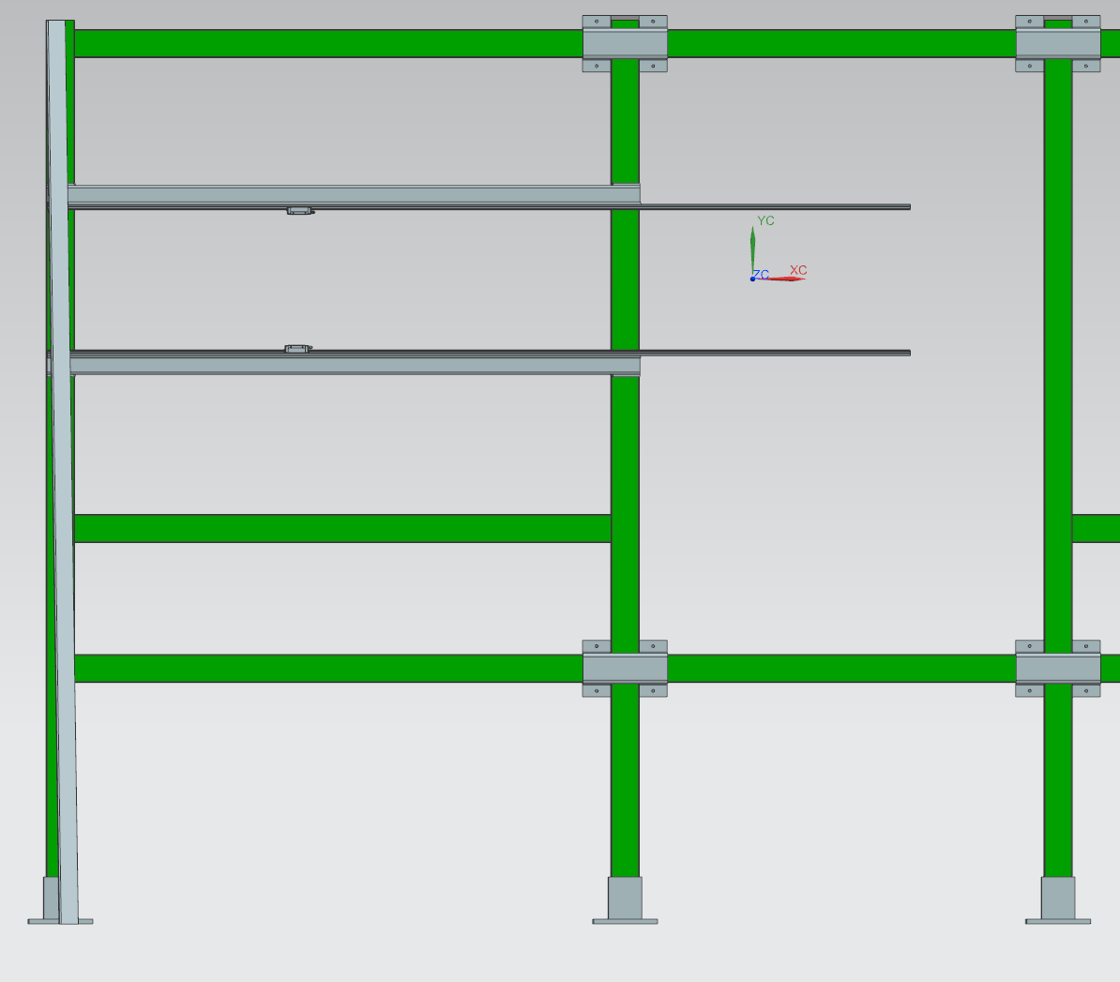
B0 Outer Mechanics
Current Layout (+/- Y-Axis and X-Axis Motion)
Upcoming Concept (Simpler, Only X-Axis Motion)
ePIC Collaboration Meeting, January 21, 2026

Slide 22
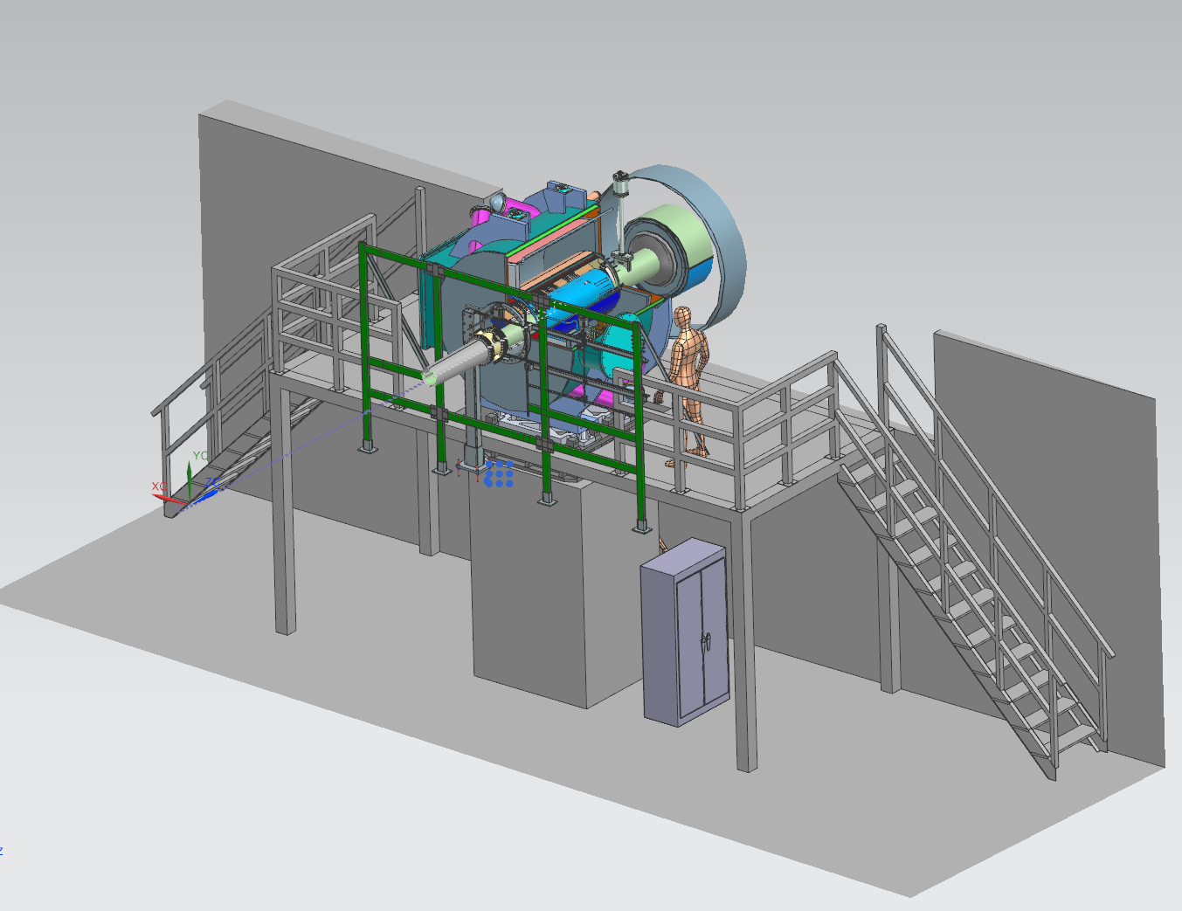
B0 Platform
NOTE – Jlab is actively updating our model to suit latest Platform Design. Ongoing discussions with Karim about expanding the platform towards IP to accommodate Outer B0 Supports
B0 Services located below platform
A portable work platform may be used for B0 Maintenance outside of beam operation
ePIC Collaboration Meeting, January 21, 2026

Slide 23
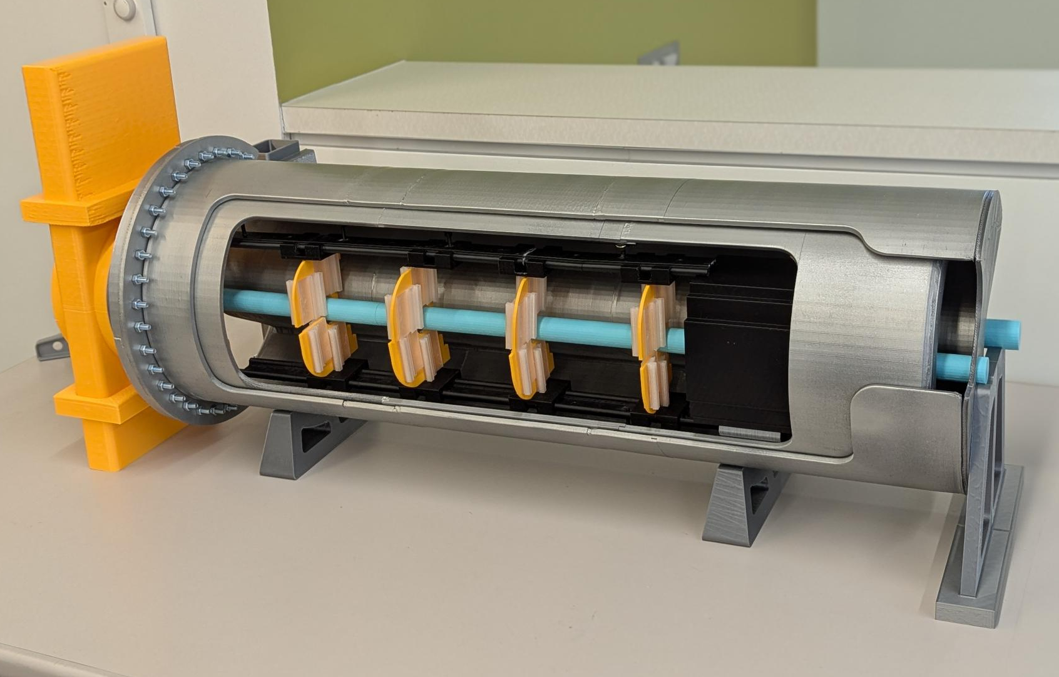
B0 Conclusion / Future Planning
Update the outer mechanical supports to suit latest inner detector install/removal system.
Develop a procedure to remove Calorimeter electronics for maintenance.
Continued updates for the inner-mechanical system.
Update existing B0 3D Mock-up for detector removal/installs.
Thanks to the Team:
  B0 Magnet Team (BNL)
  Vacuum beampipe (Chang Jun & Charlie Hetzel / BNL)
  Overall Integration with IR (Karim Hamdi / BNL)
  Detectors (Zvi, Igor, Avishay / Israel Group)
  ACLGAD (Alexander Jentsch / BNL)
  Mechanical Supports (Ron Lassiter, Jonathan Smith, India Krehbiel / Jlab)
ePIC Collaboration Meeting, January 21, 2026

