Slide 1
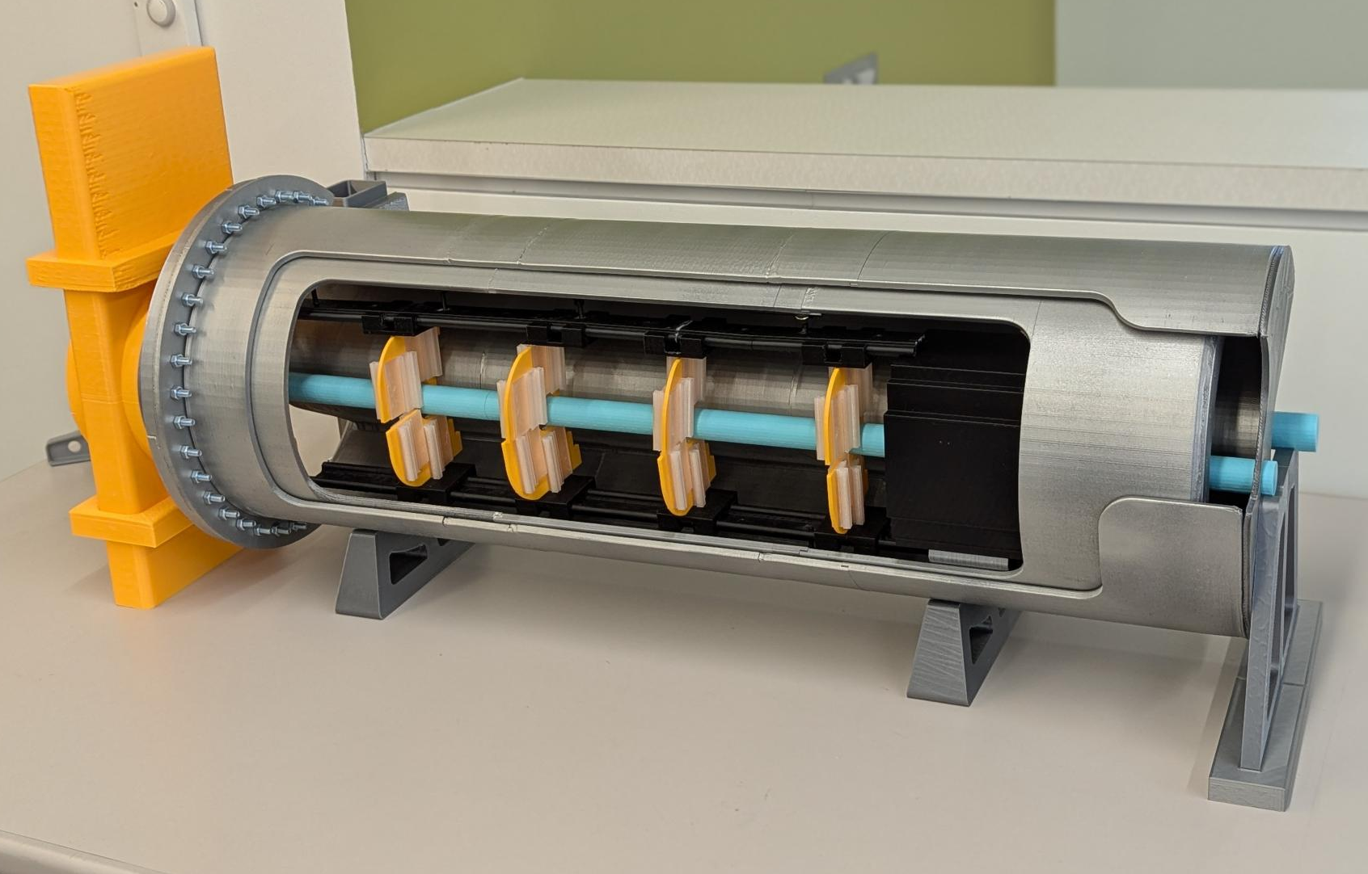
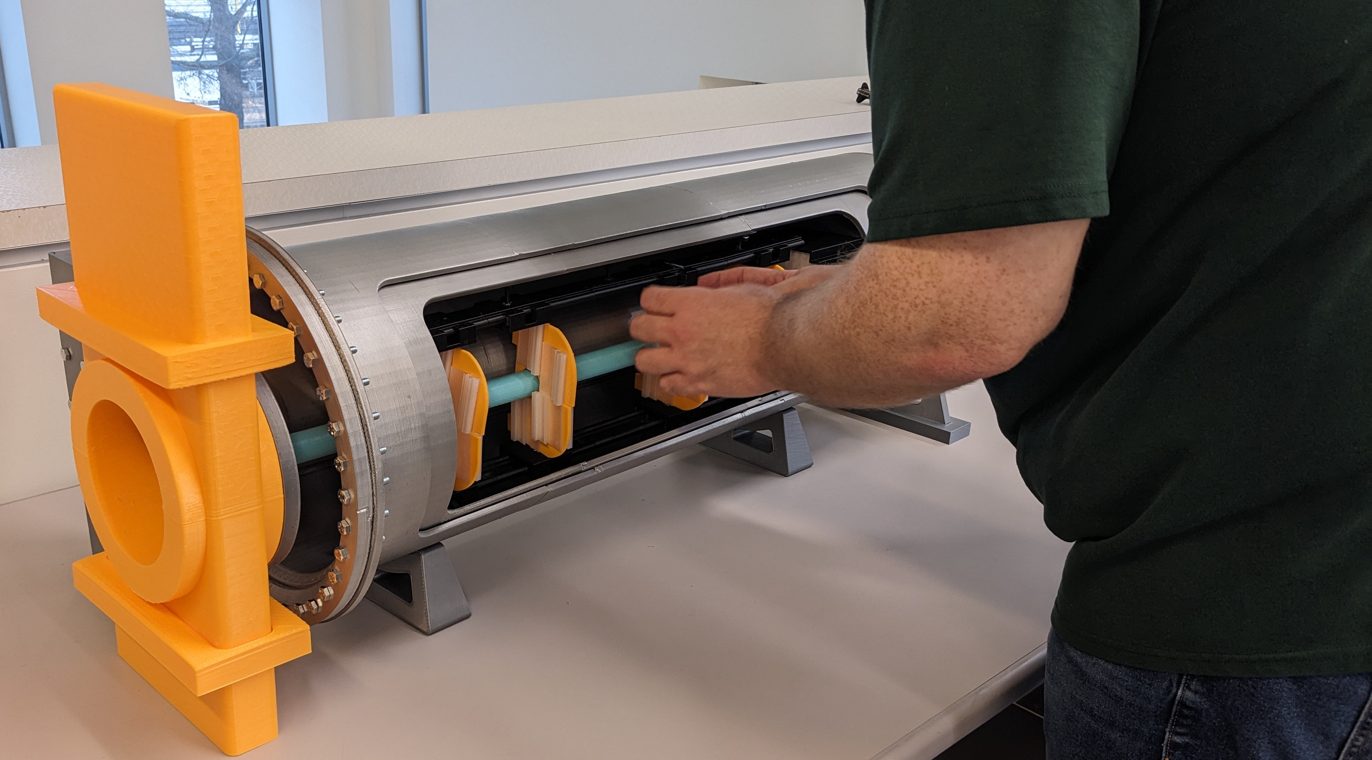
B0 Mock up – Additive Manufacturing
B0 detector installation in state of development. ½ scale
Visual understanding of installation tooling.
Hands on demonstration.

Slide 2
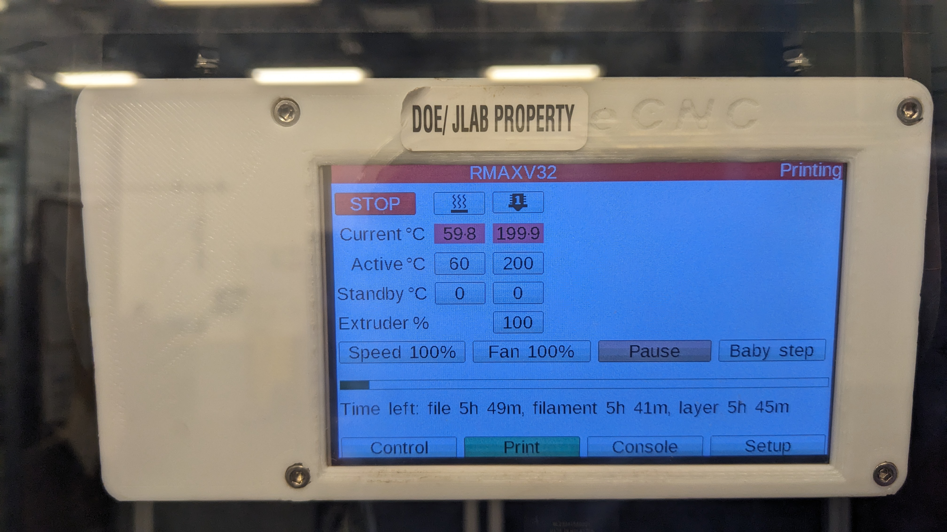
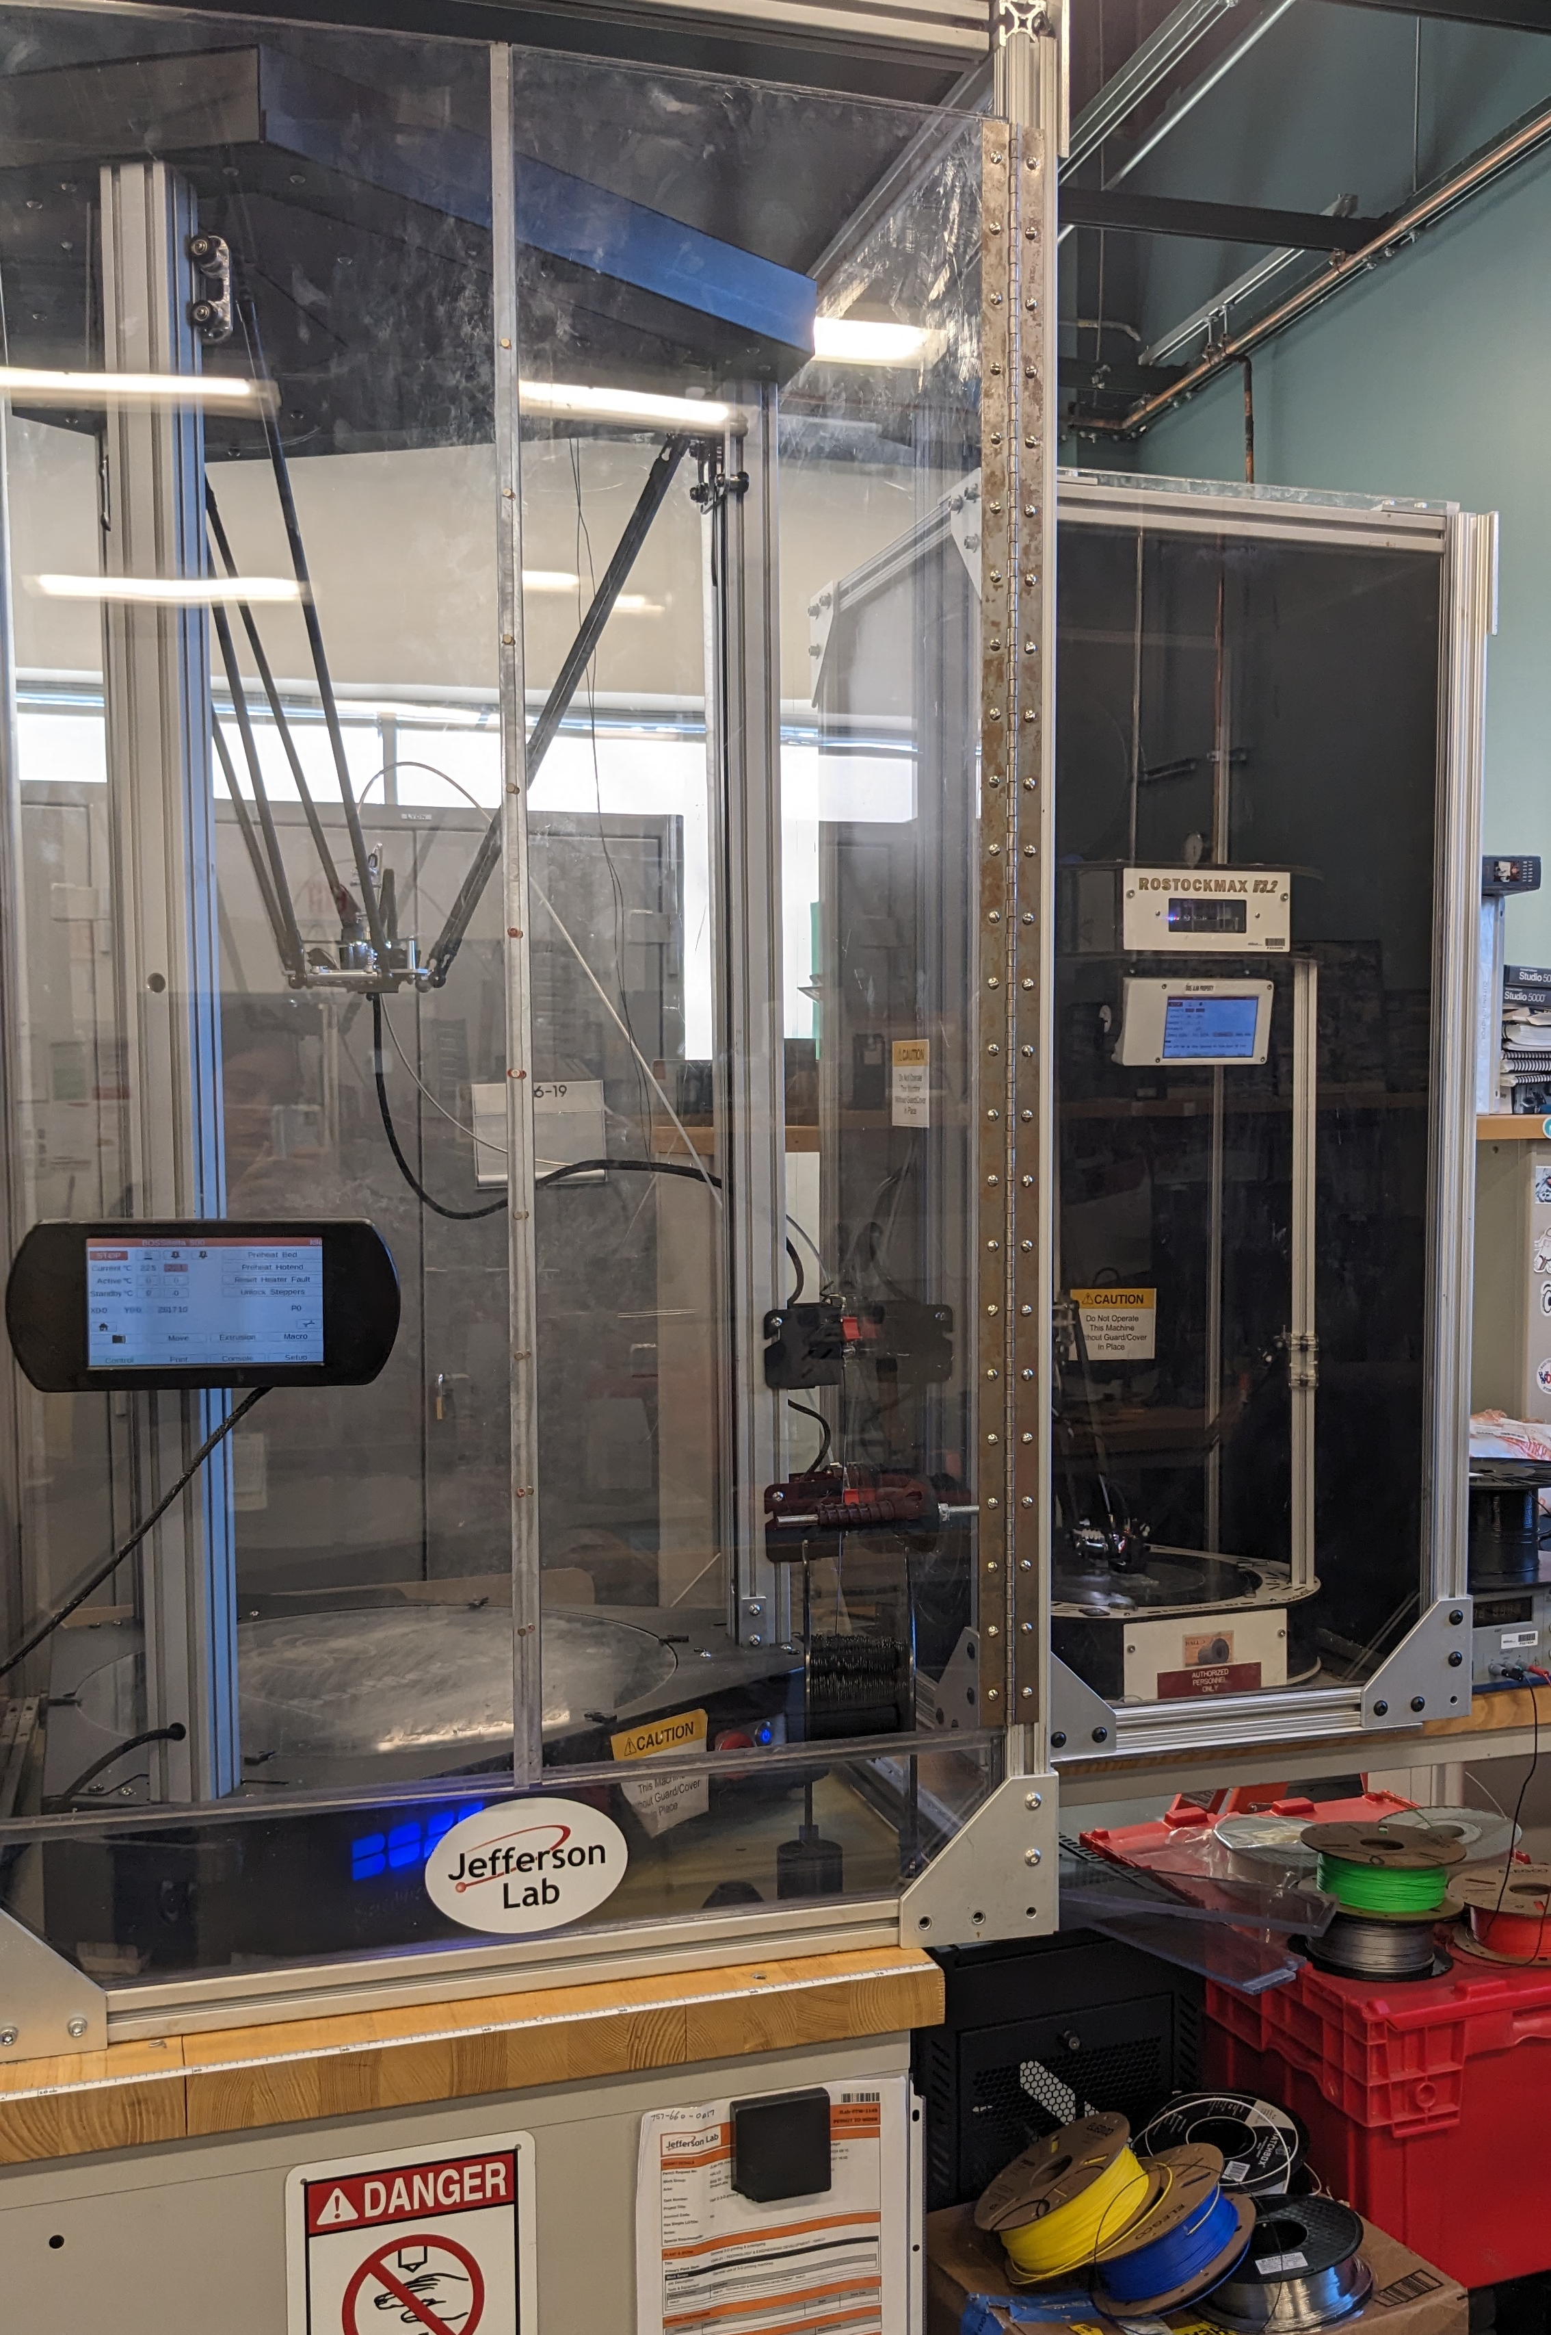
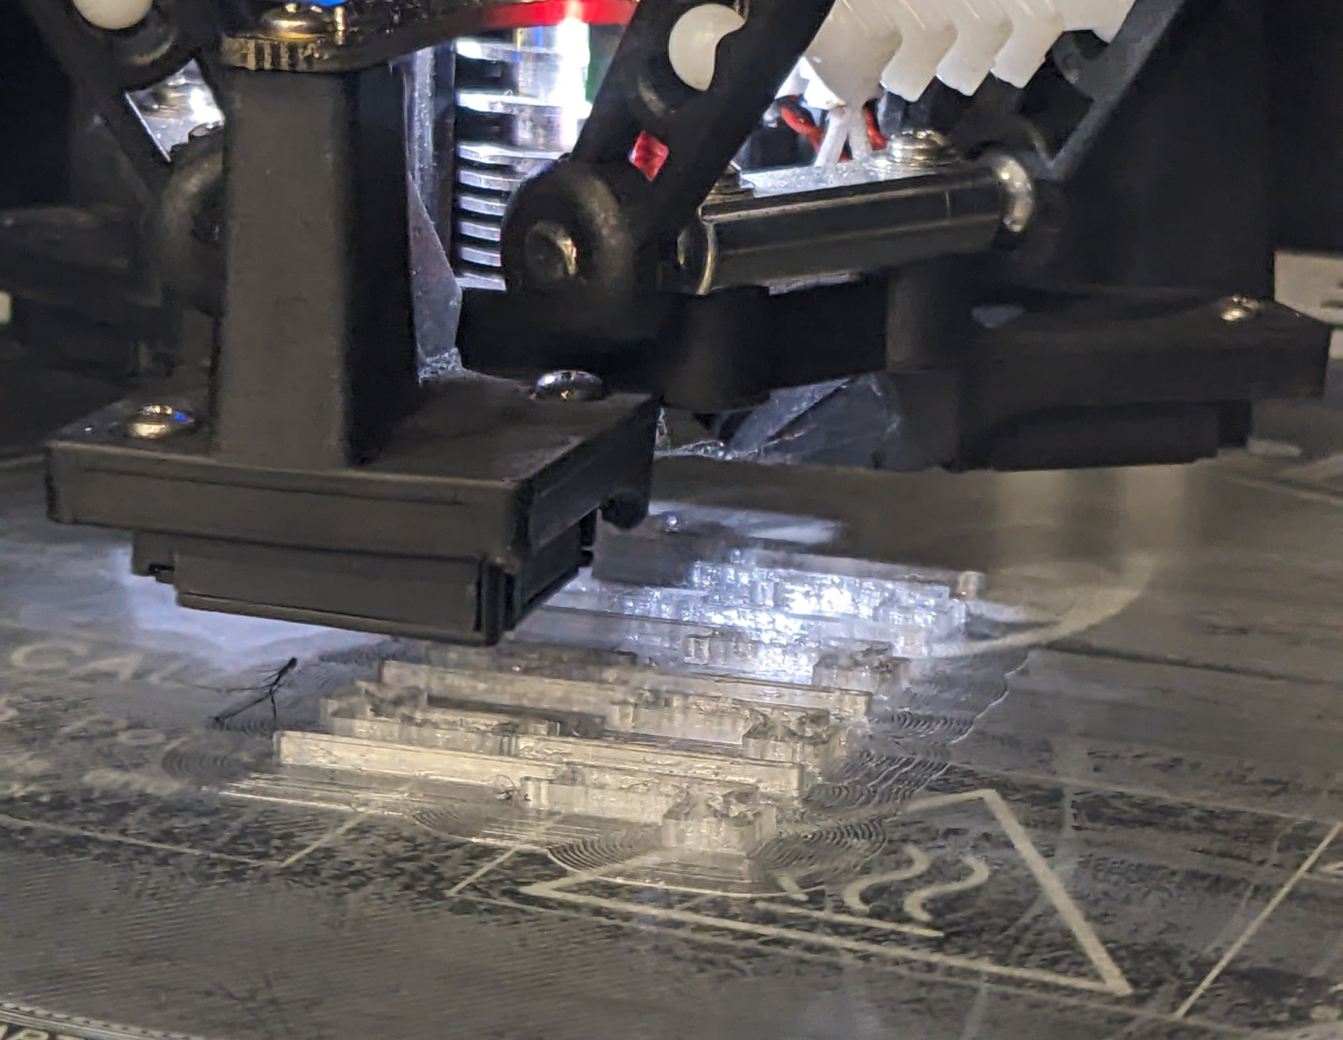
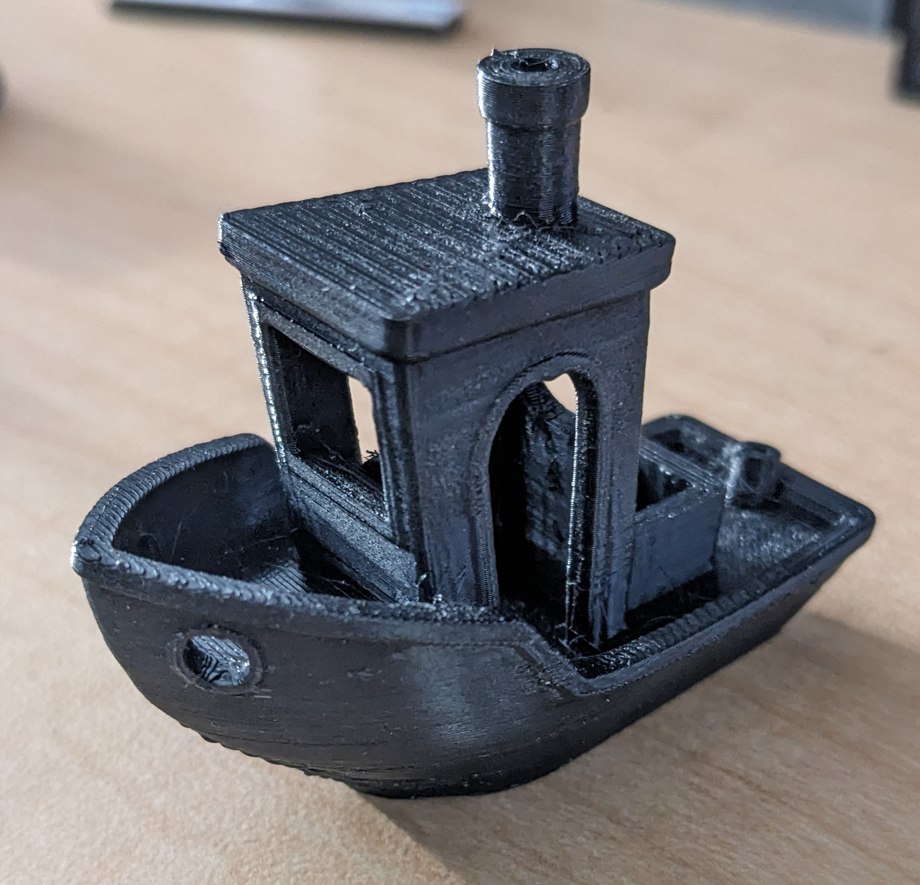
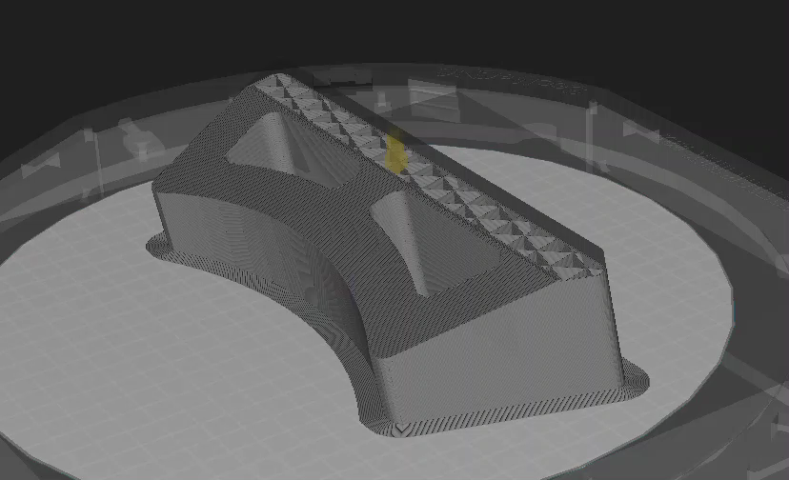
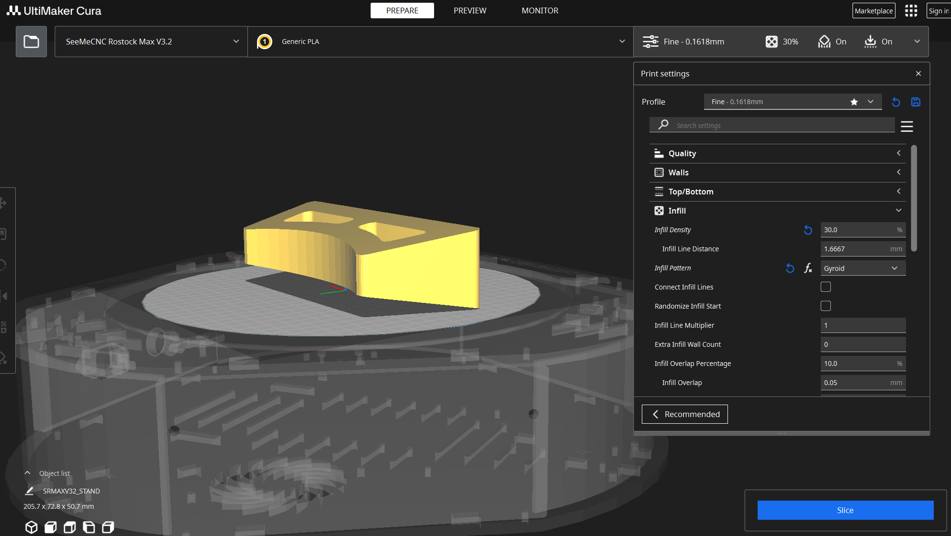
Process for AM (Additive Manufacturing)
FDM (fused deposition modeling)
Material is deposited layer by layer.
Prepare model in slicer
Adjusting model in CAD (NX)
Scaling
Exporting/importing into slicer –Ultimaker Cura
Adjusting settings for a successful print
Export .gcode
Adjusting settings on printers, add filament, prepare the bed
Monitor first layer and diagnose early failures.
Test printing
Notes:
Slicer: Orienting the print on the bed, Adjusting supports, Layer height/thickness, Infill pattern and density, Bed adhesion settings, Printing speed, Extrusion amount
.gcode: legible to the printer

Slide 3
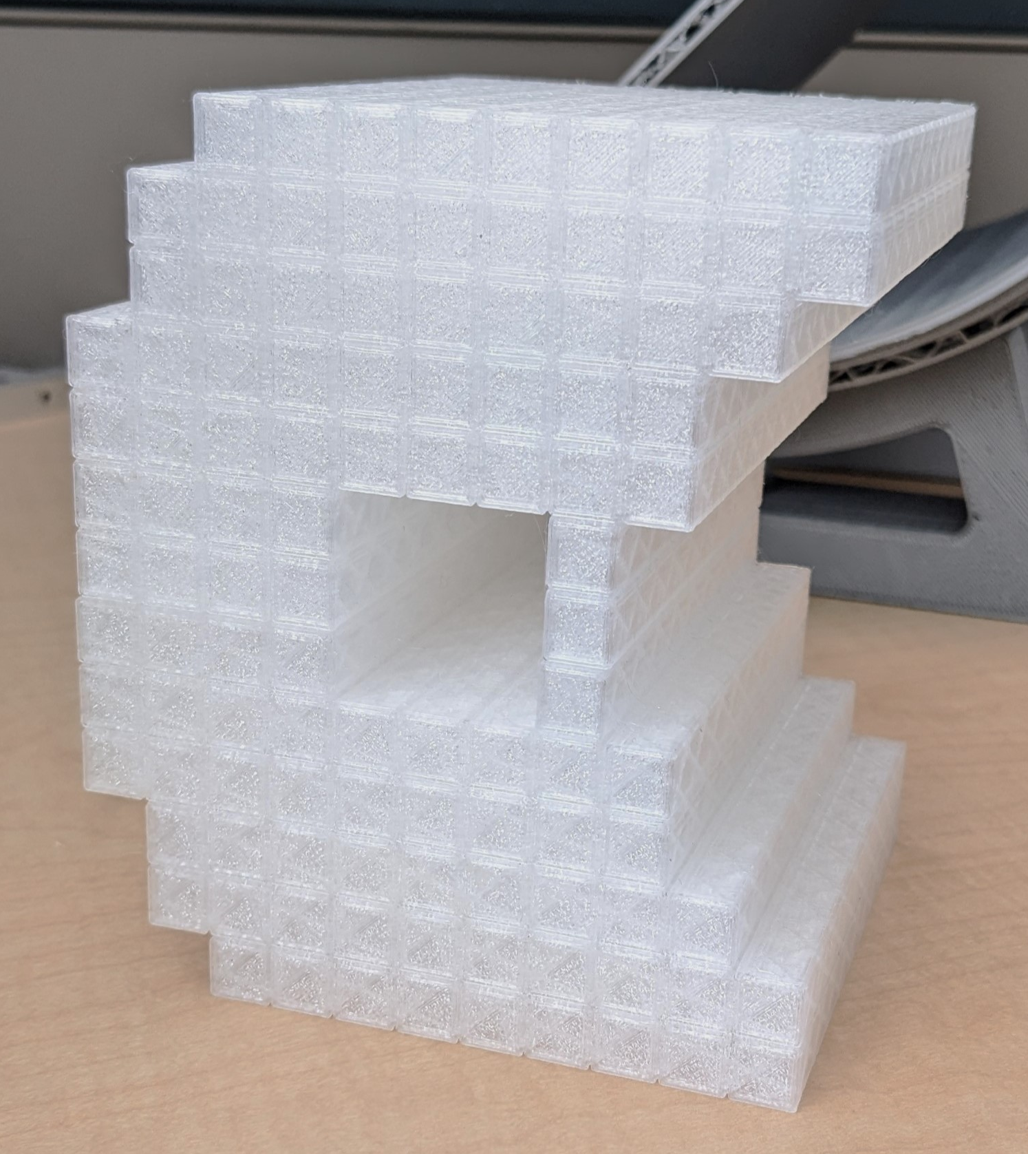
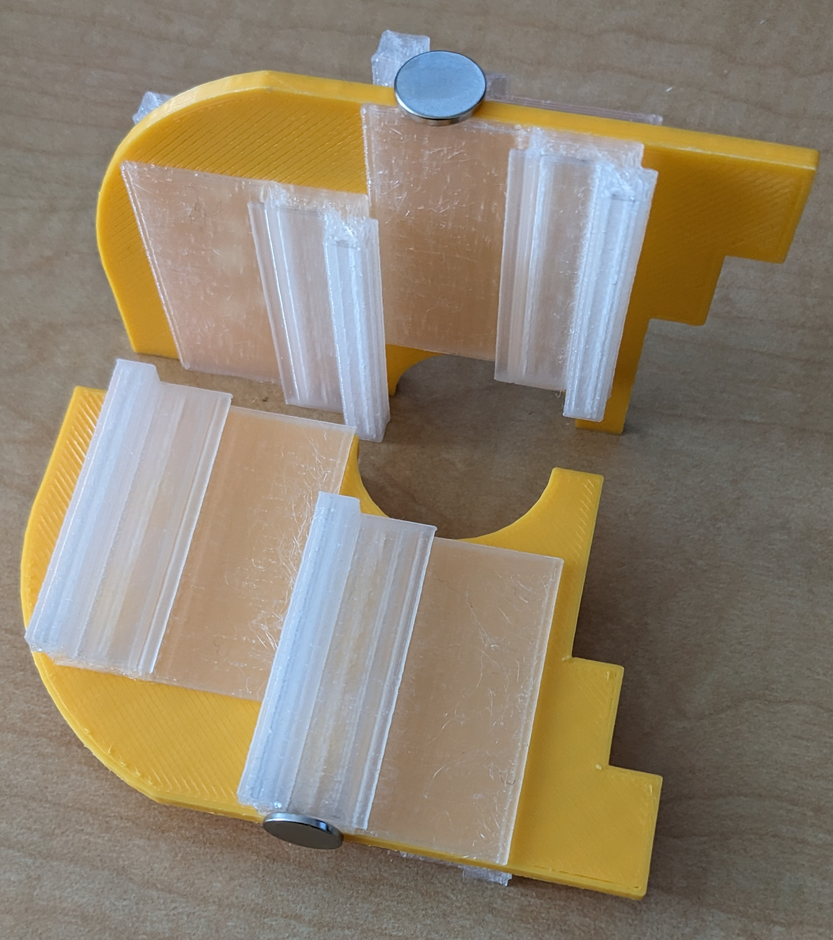
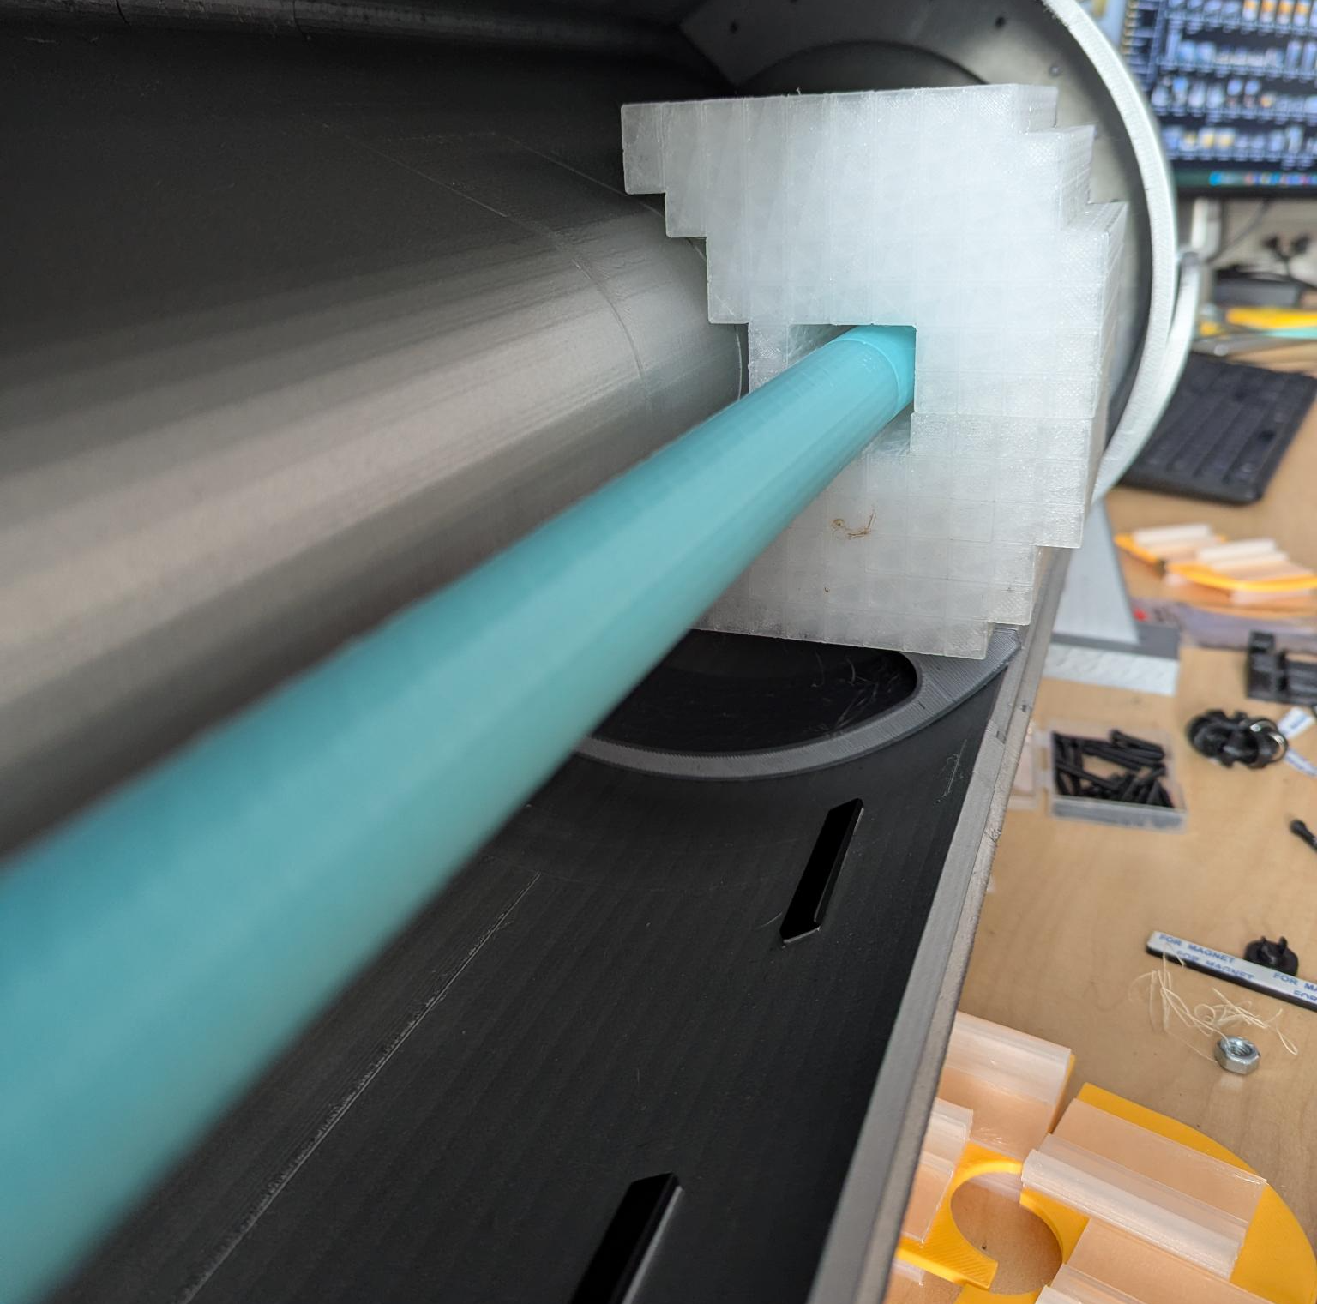
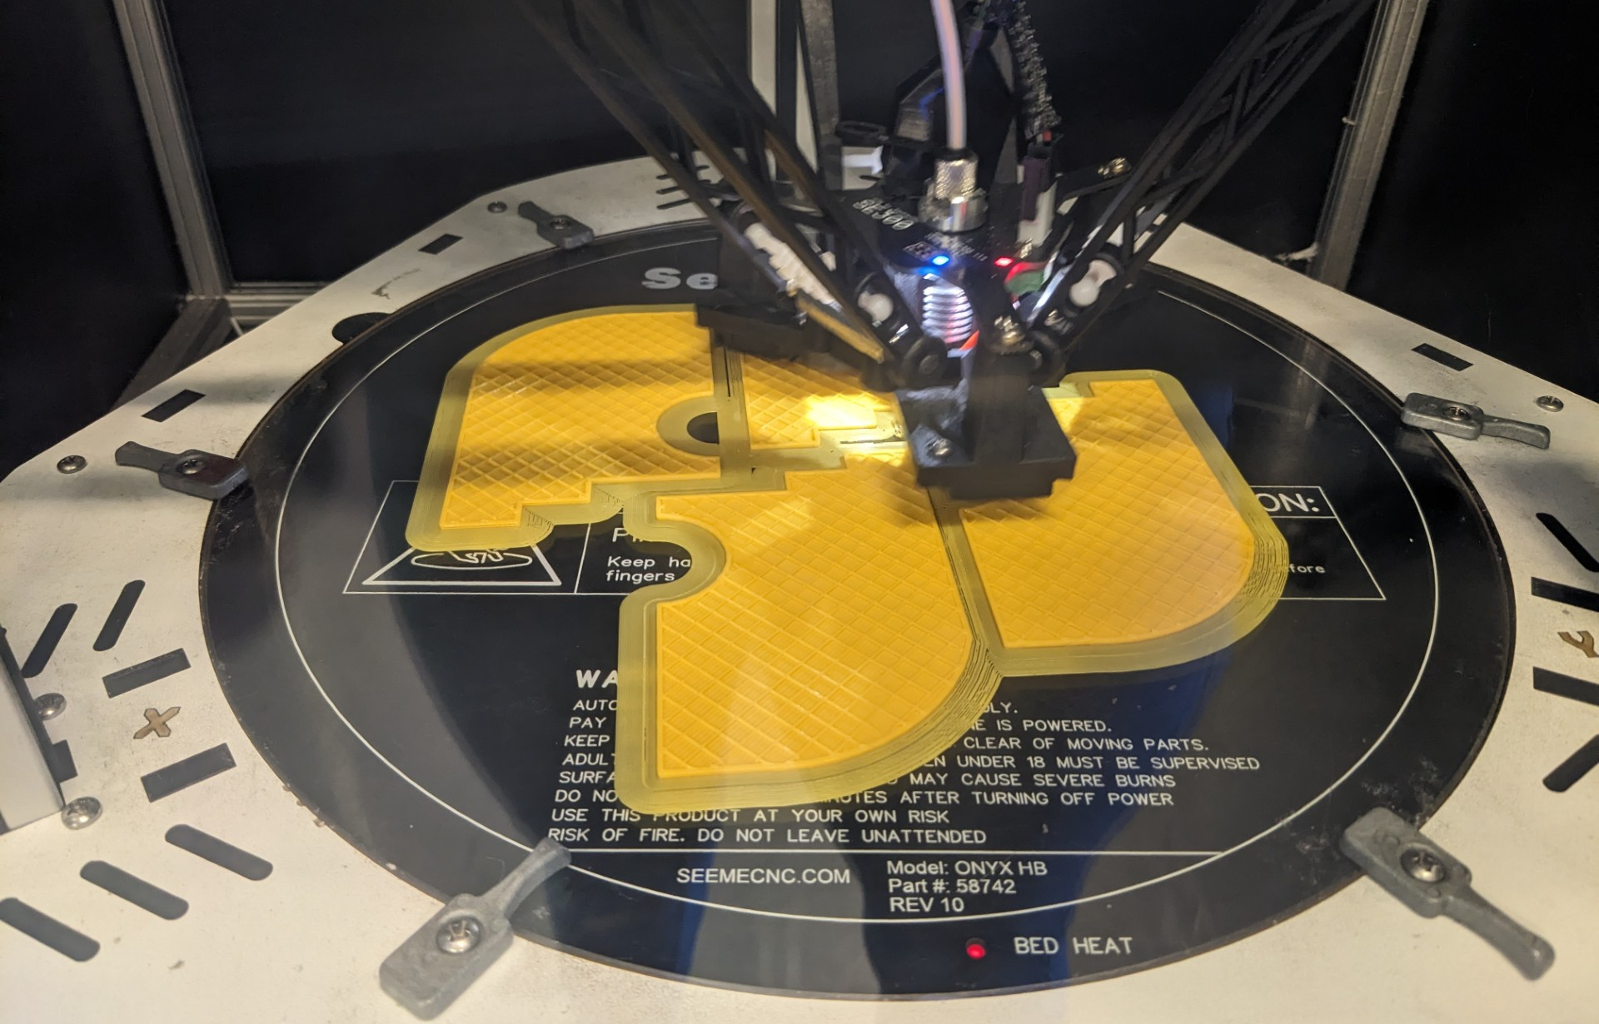
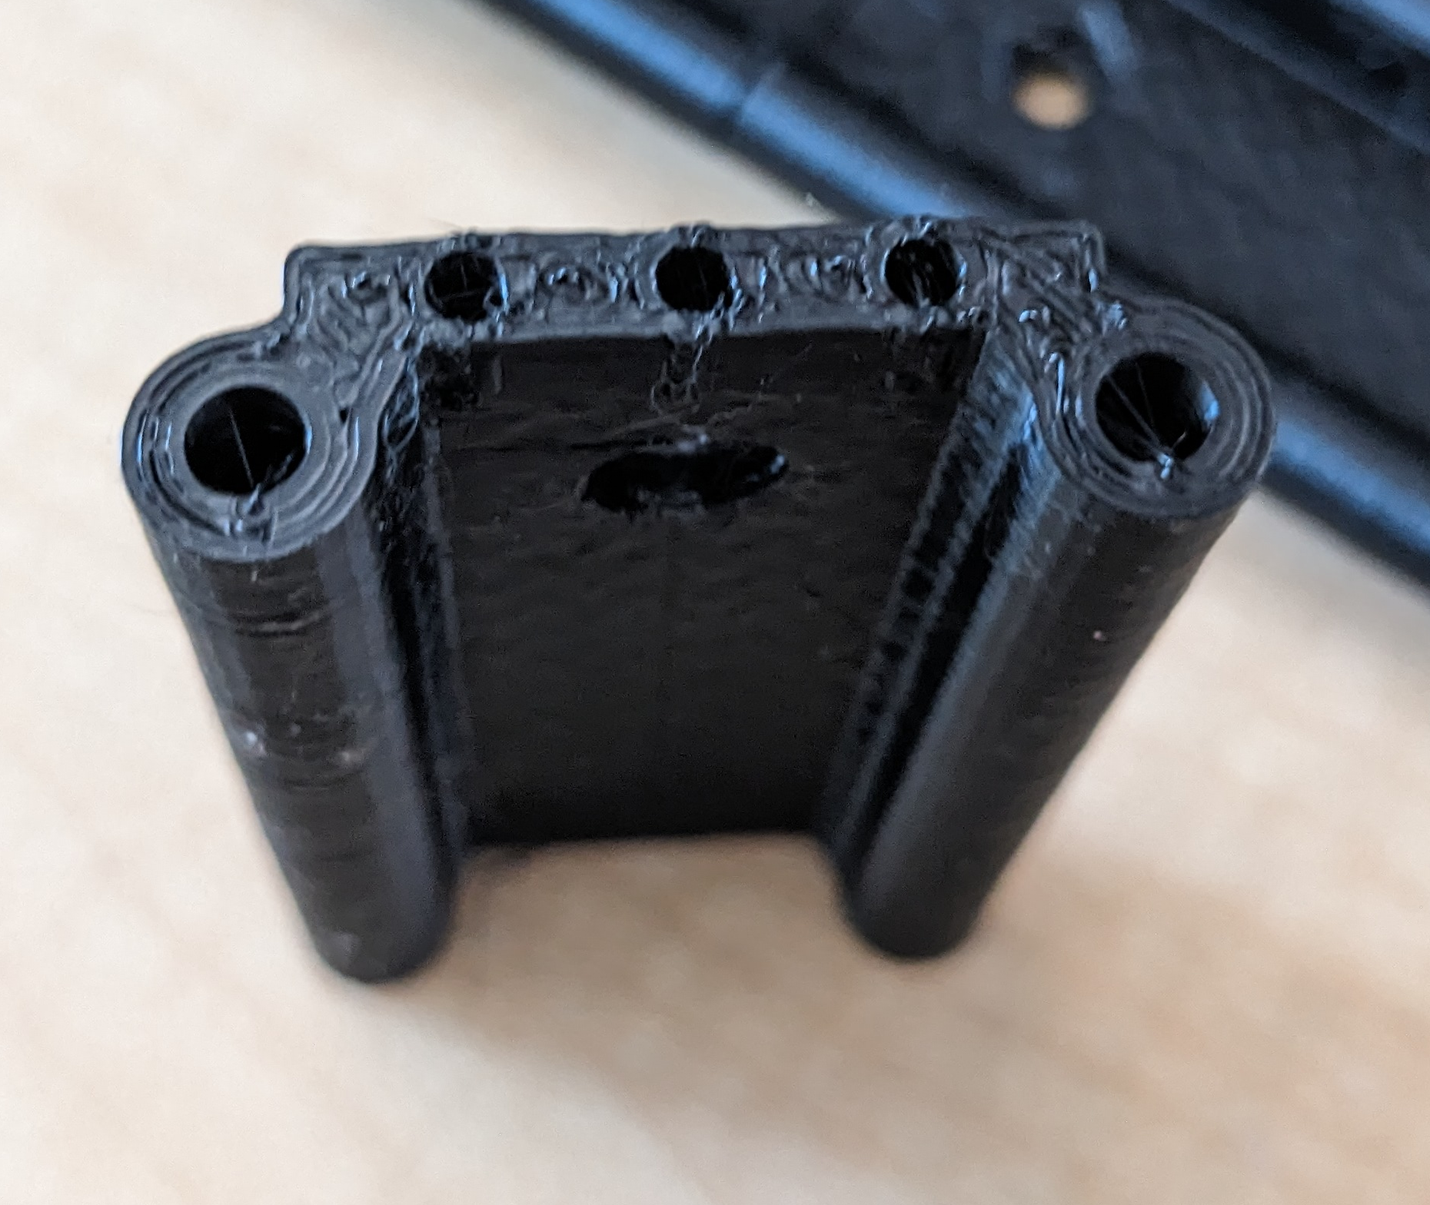
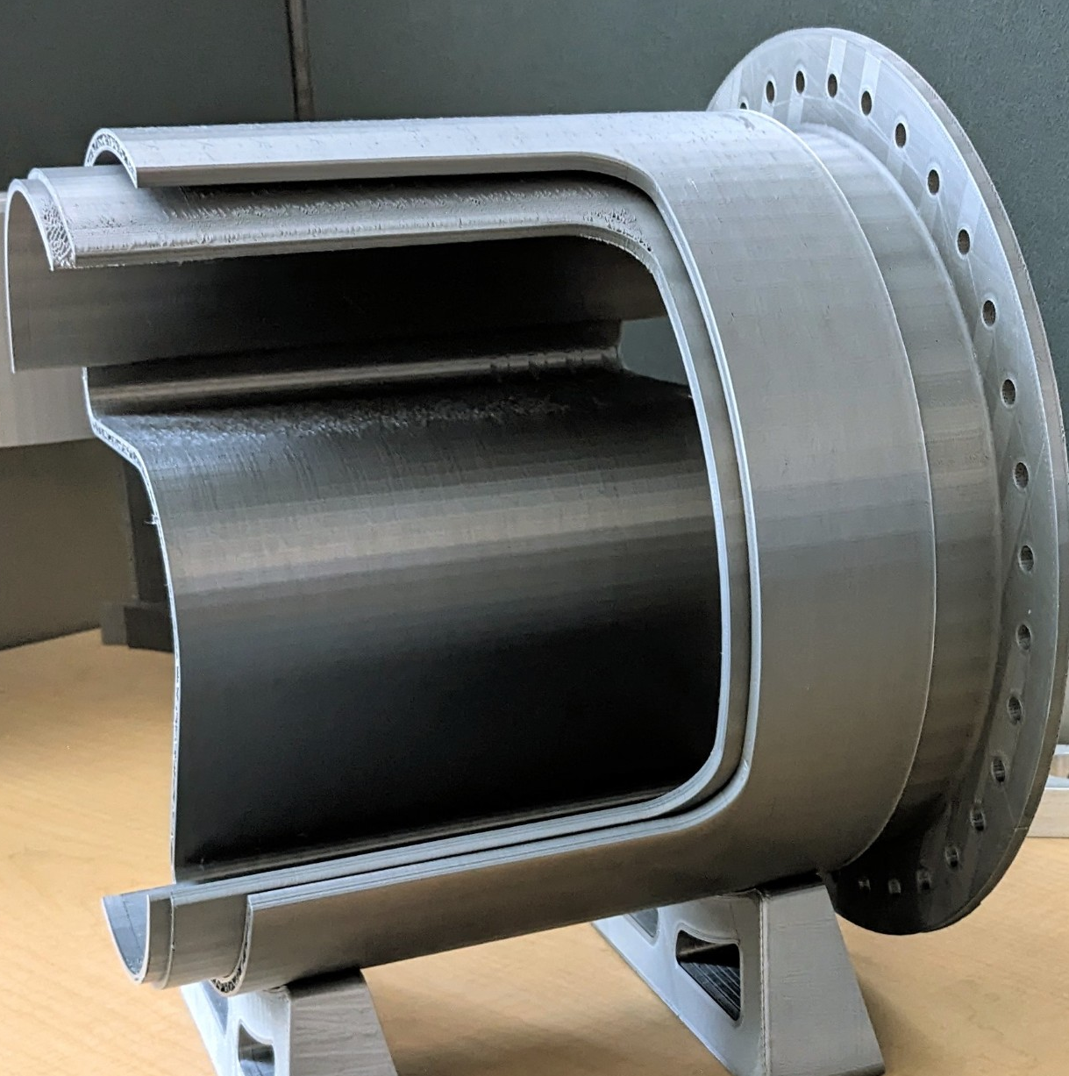
Material/Filament
Materials
Clear for crystals of the calorimeter and forward TOF detectors.
Yellow detector layers
Black for the tooling
Silver for the support and outer structures
Blue for the beam line

Slide 4
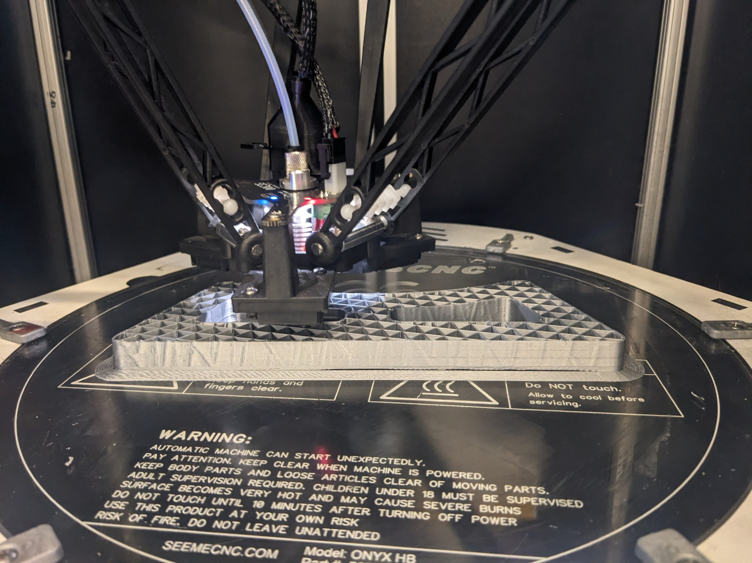
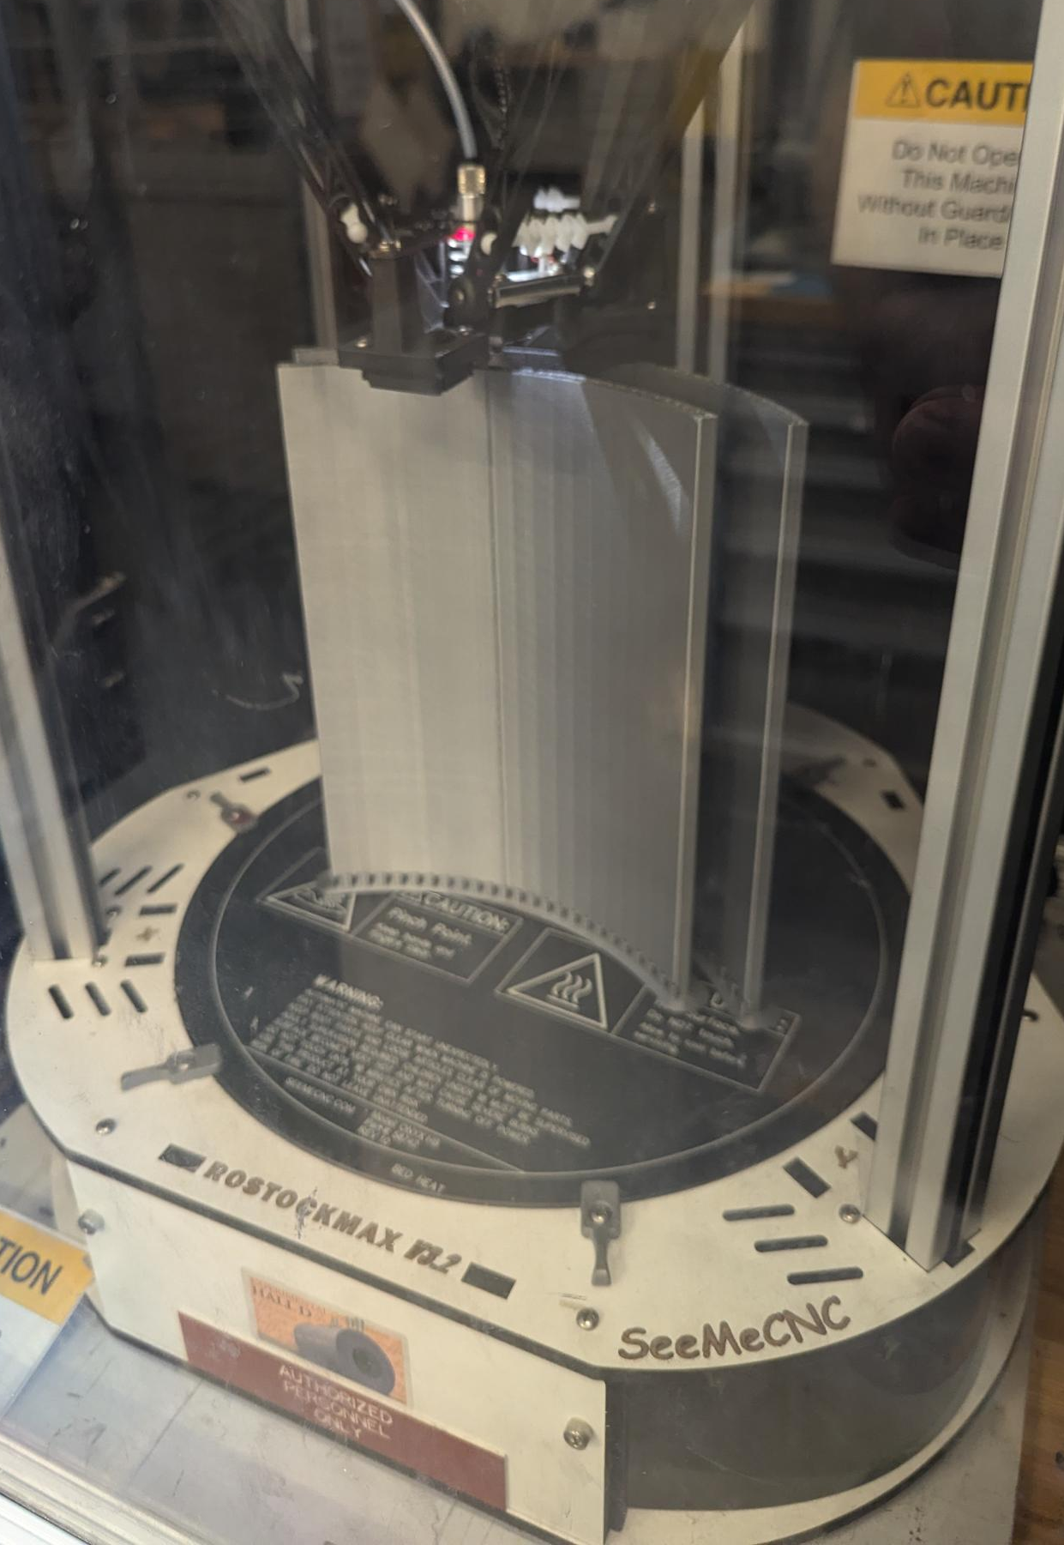
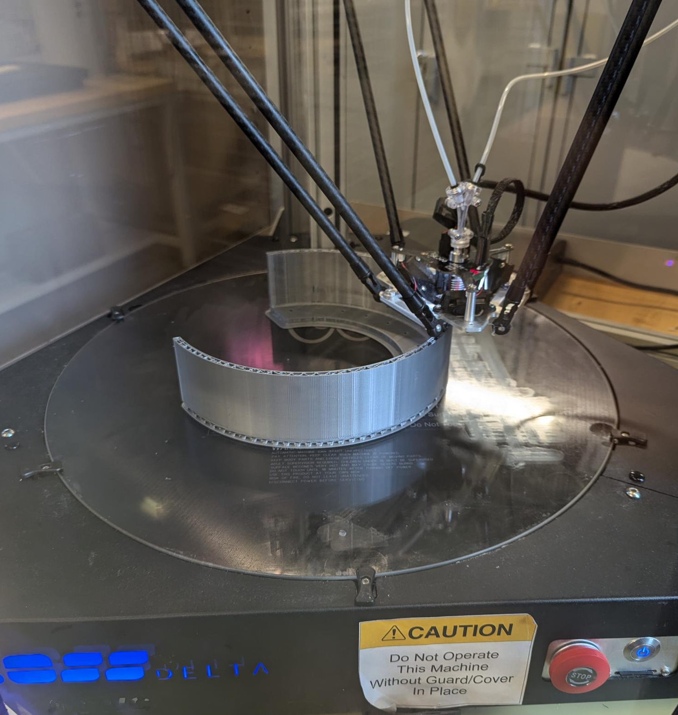
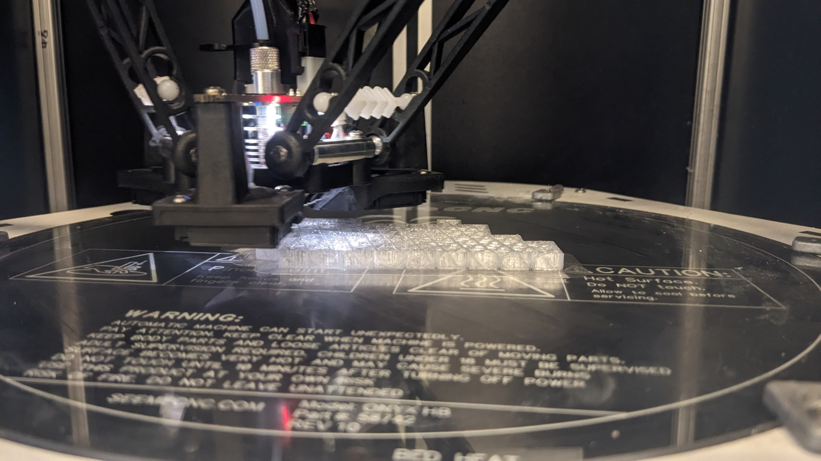
Printing Con’t
Printing

Slide 5
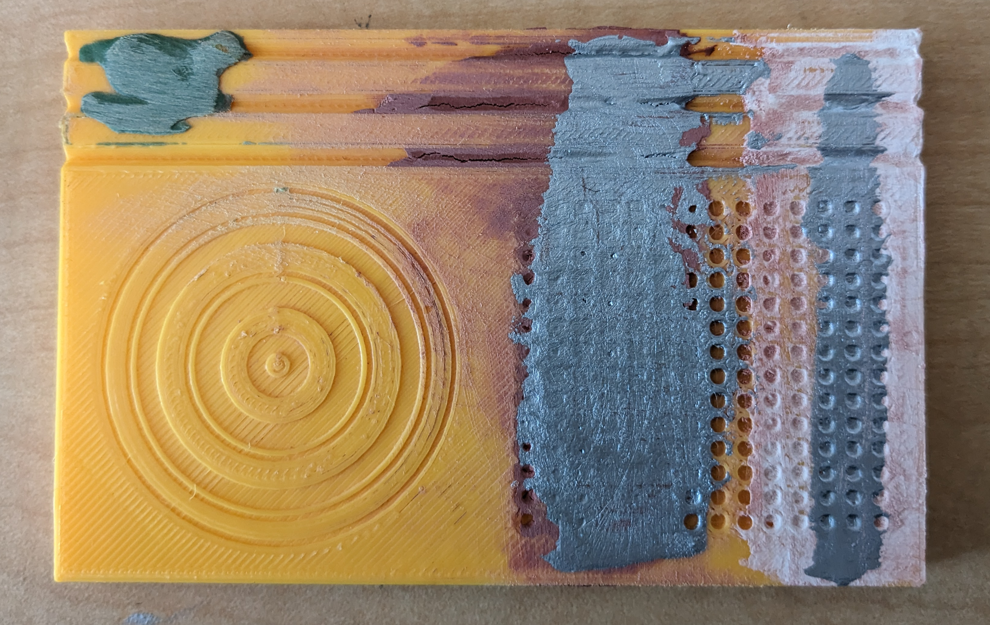
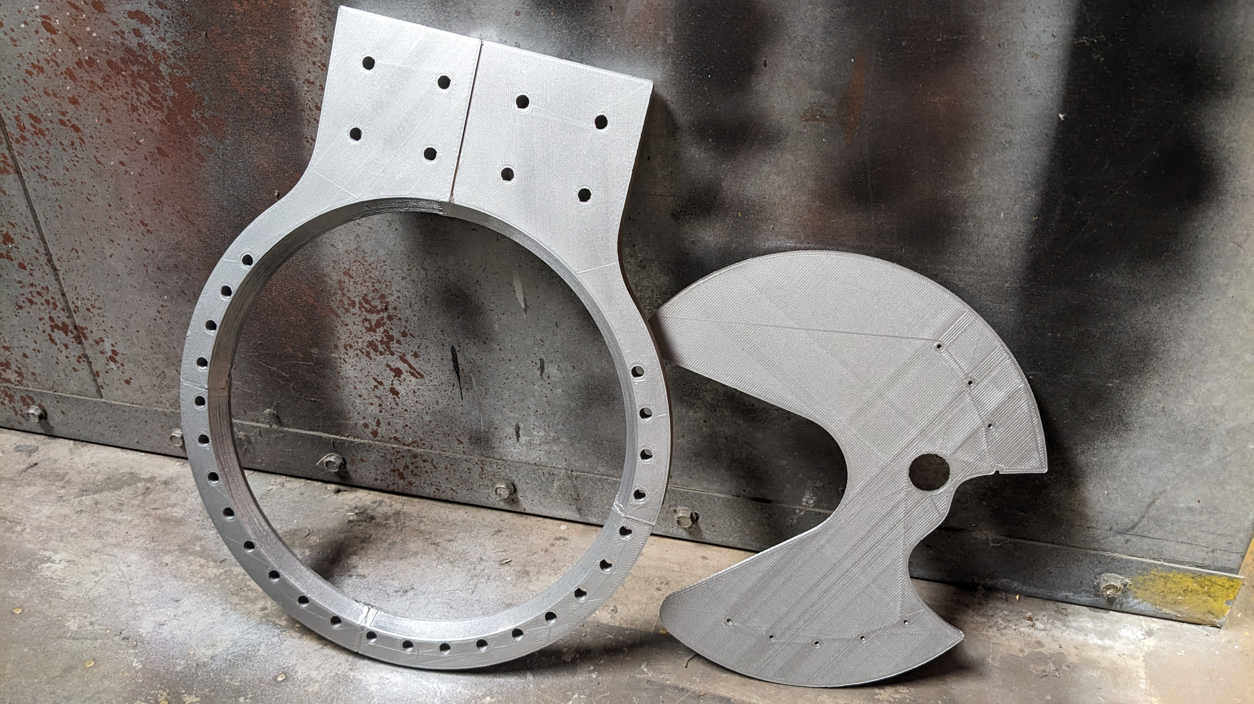
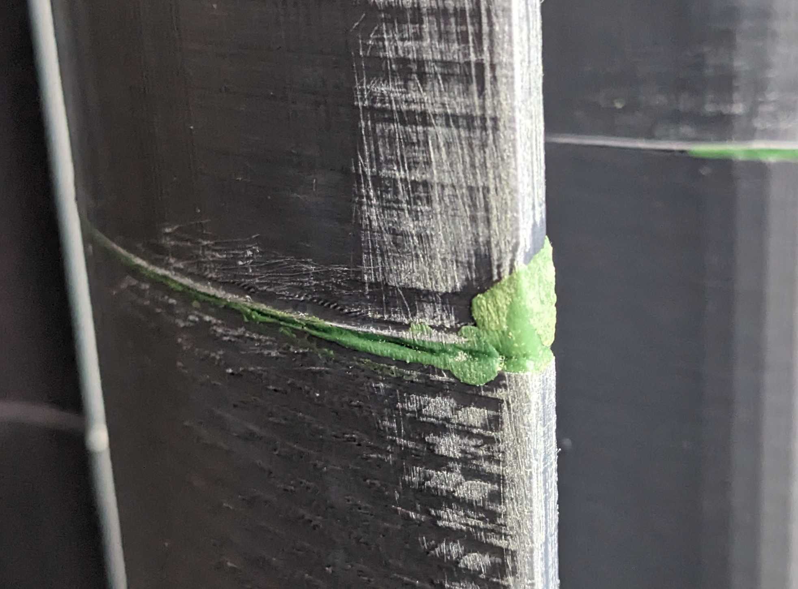
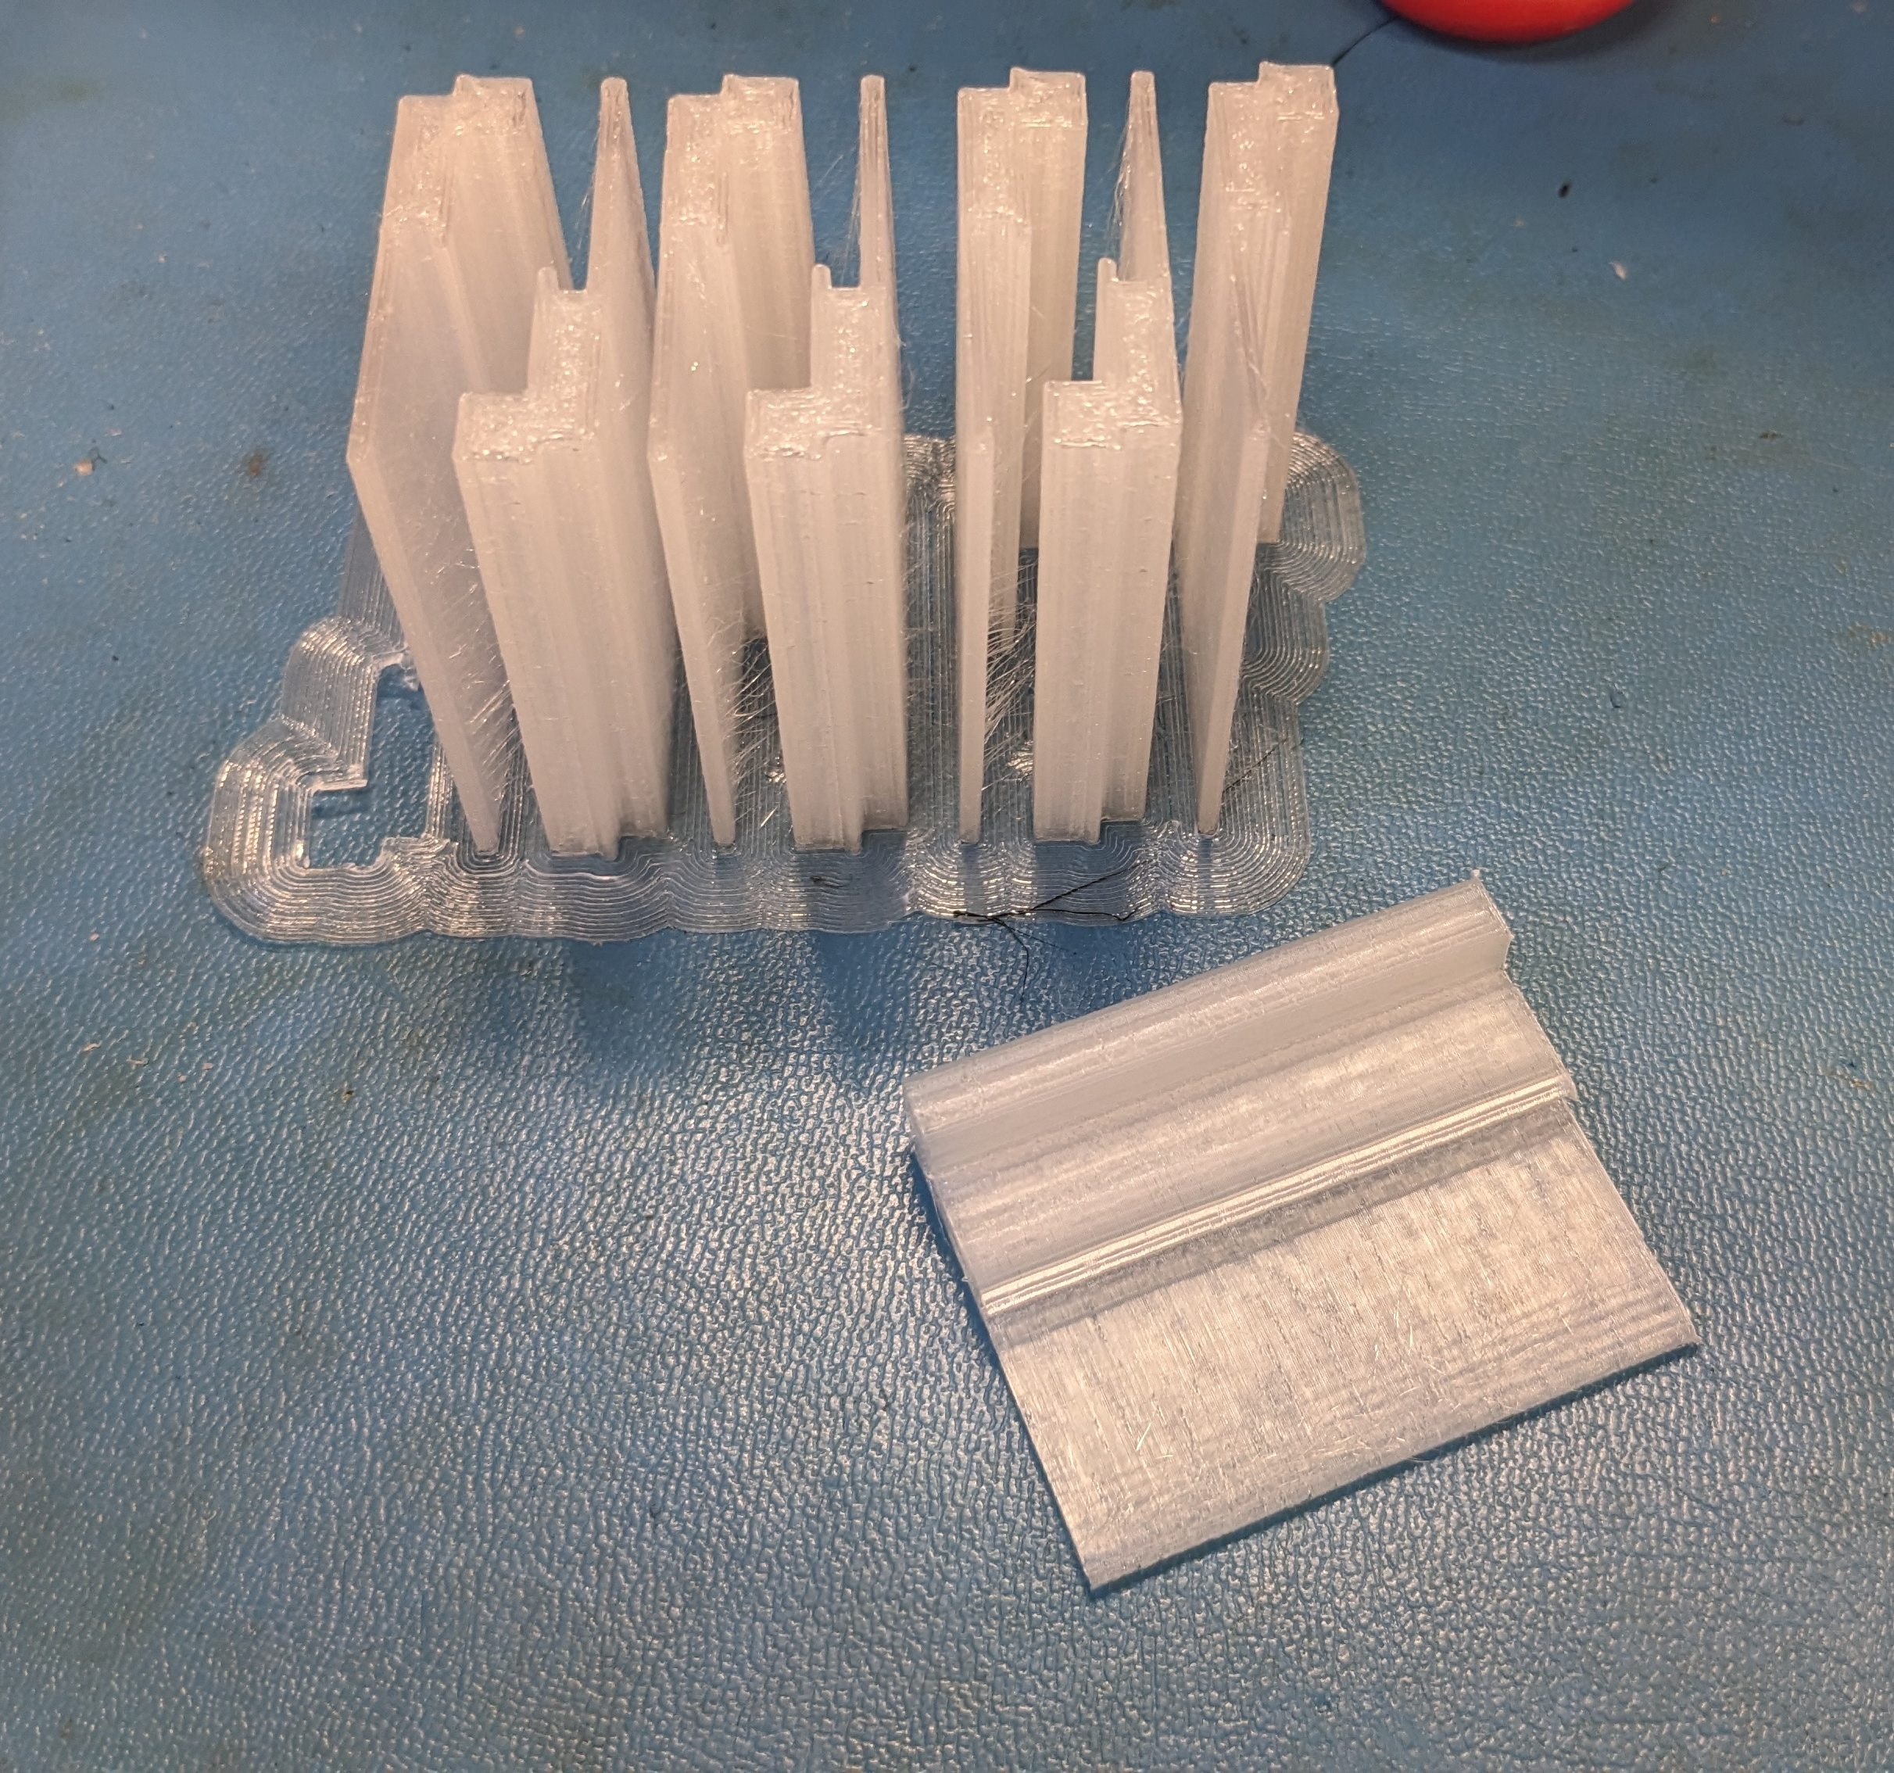
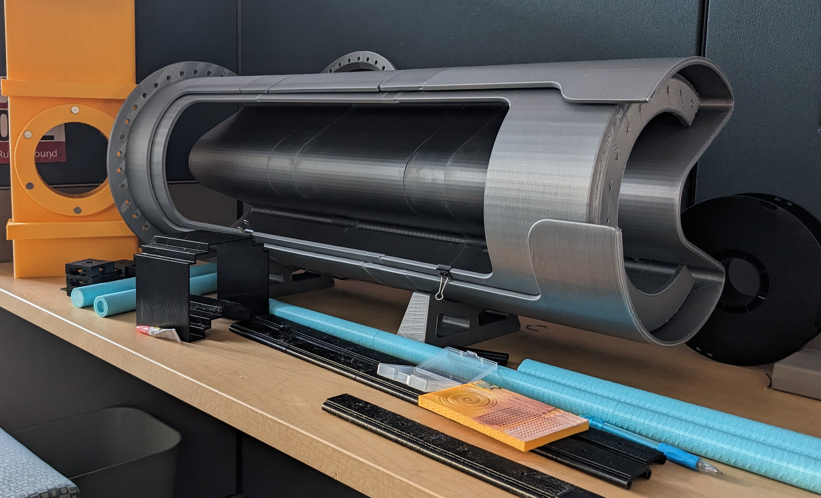
Post Processing
Cleaning printed parts
Painting
Filling voids
Gluing and assembling
Notes:
-removing support material
-filling in voids, tested several methods, each had their own strengths and weaknesses
-painting over the parts hat had patches o give an even appearance.
-gluing parts together

Slide 6
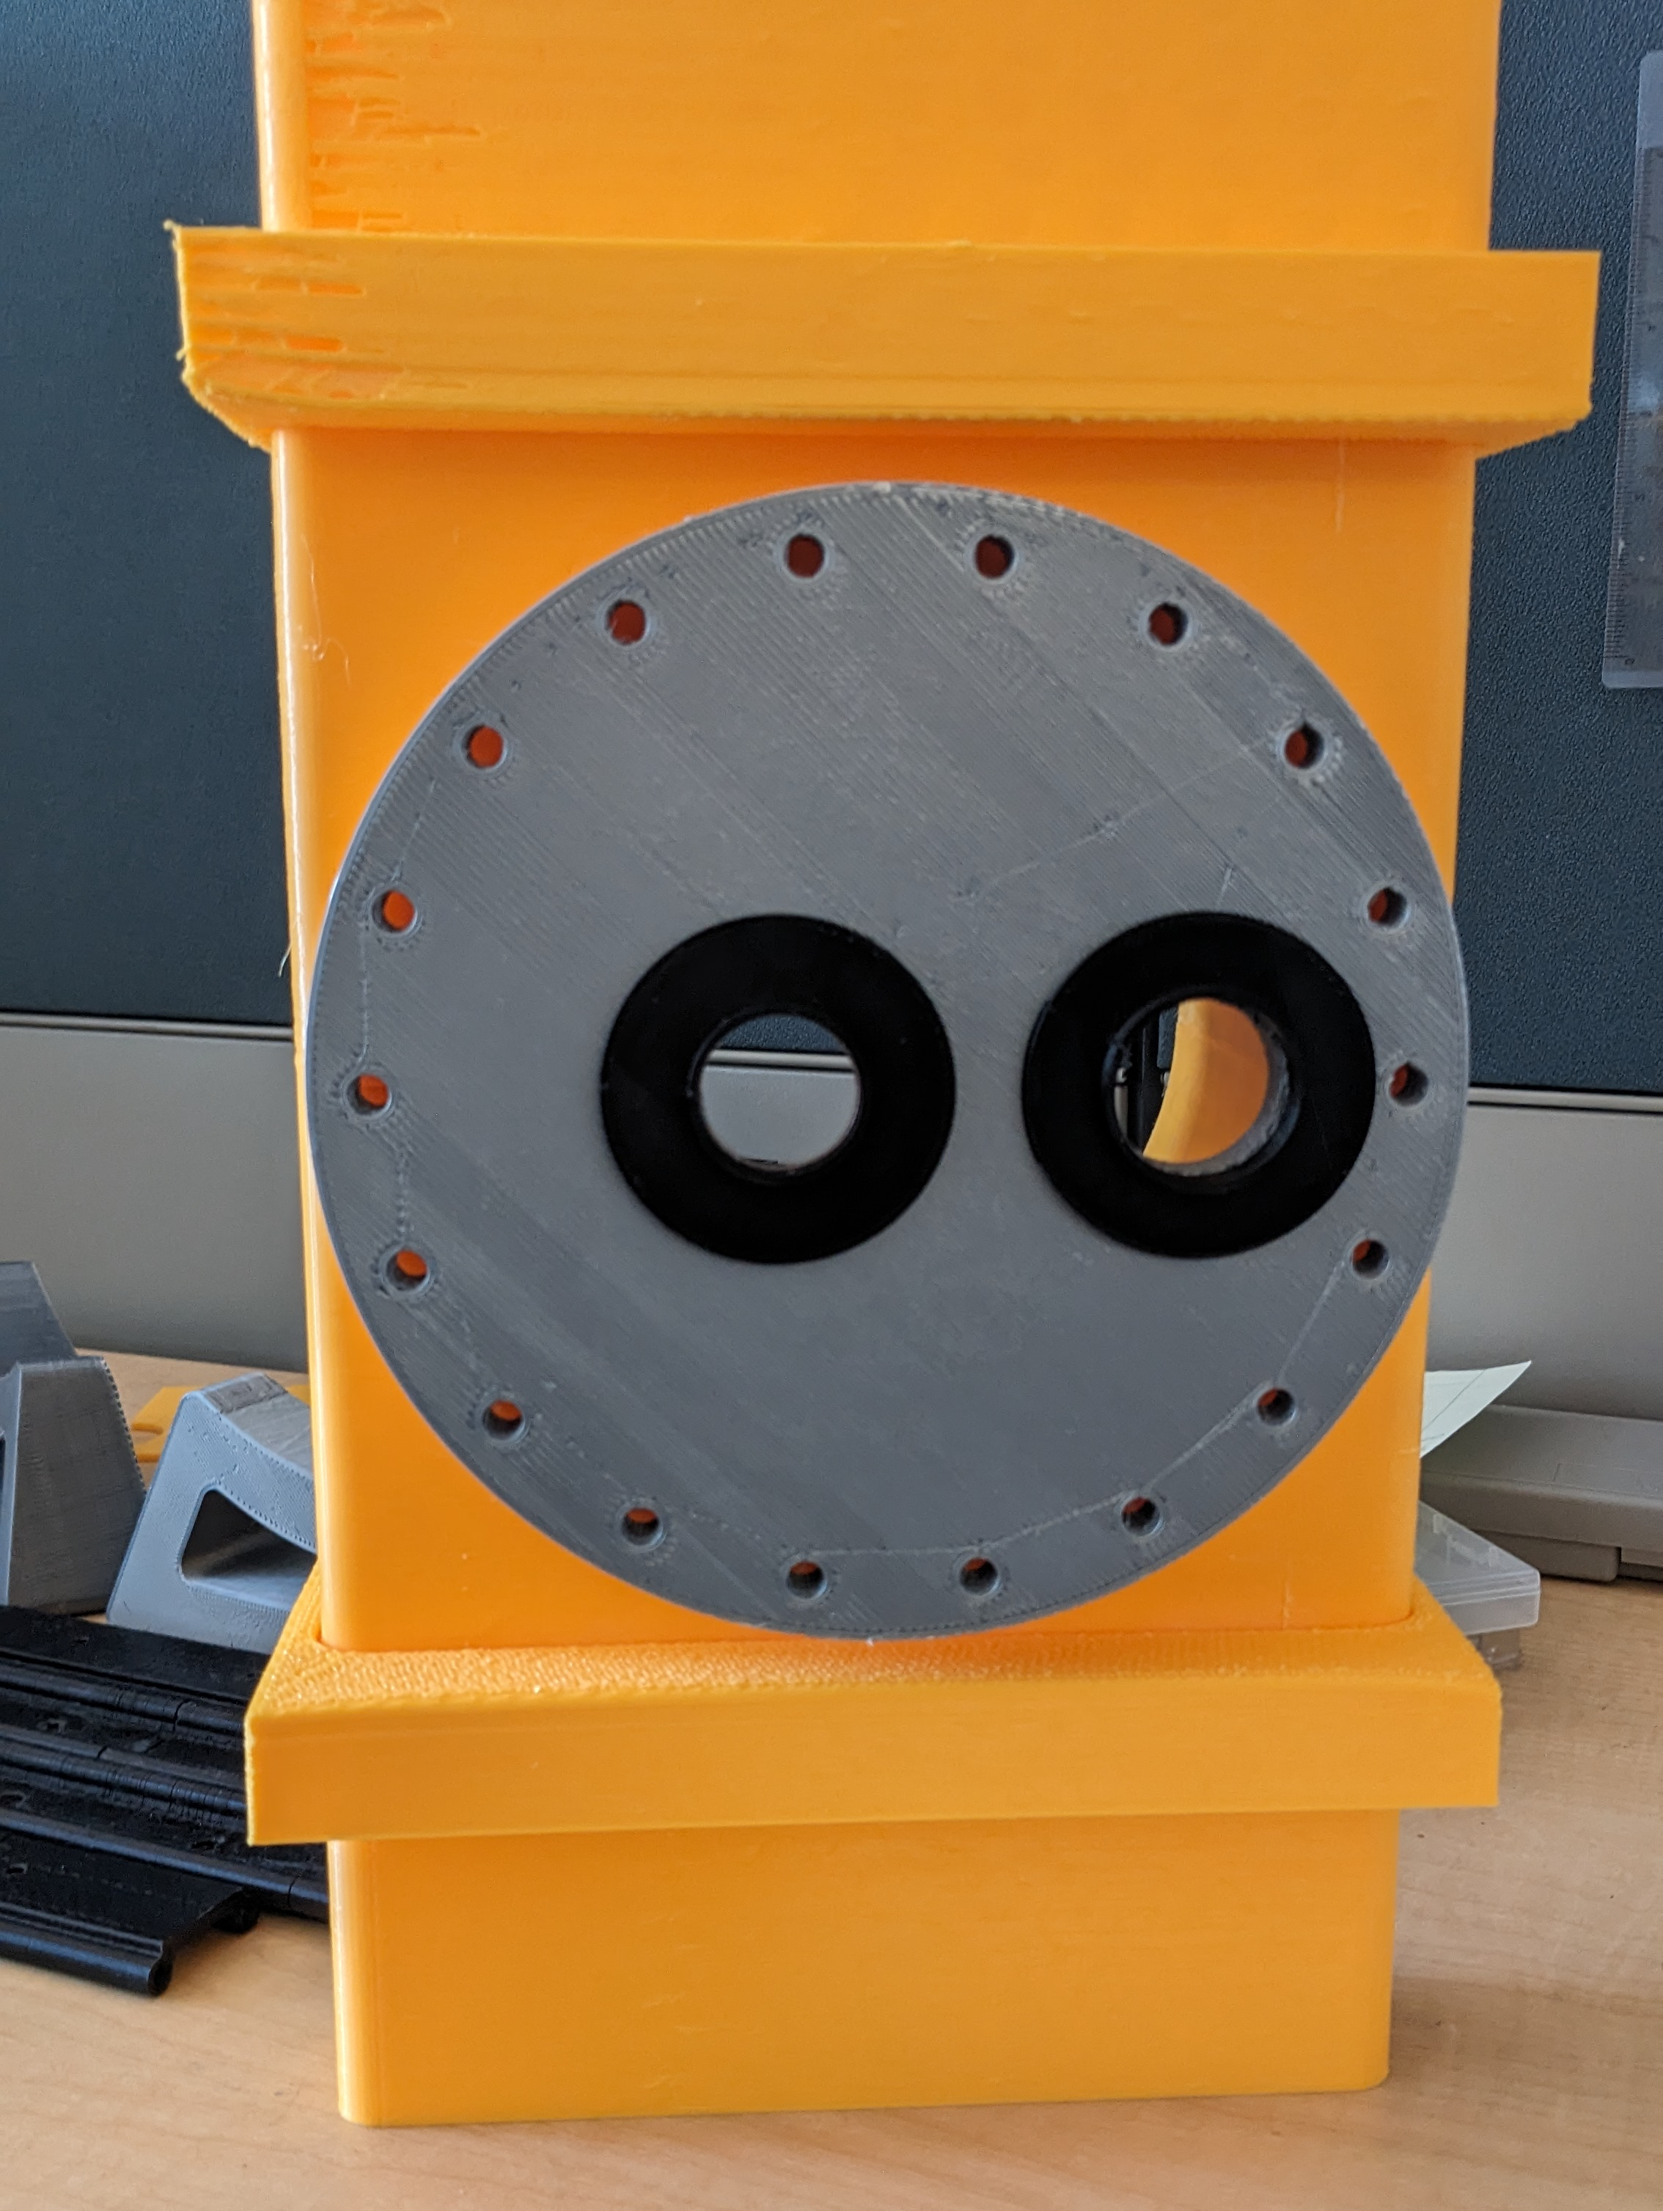
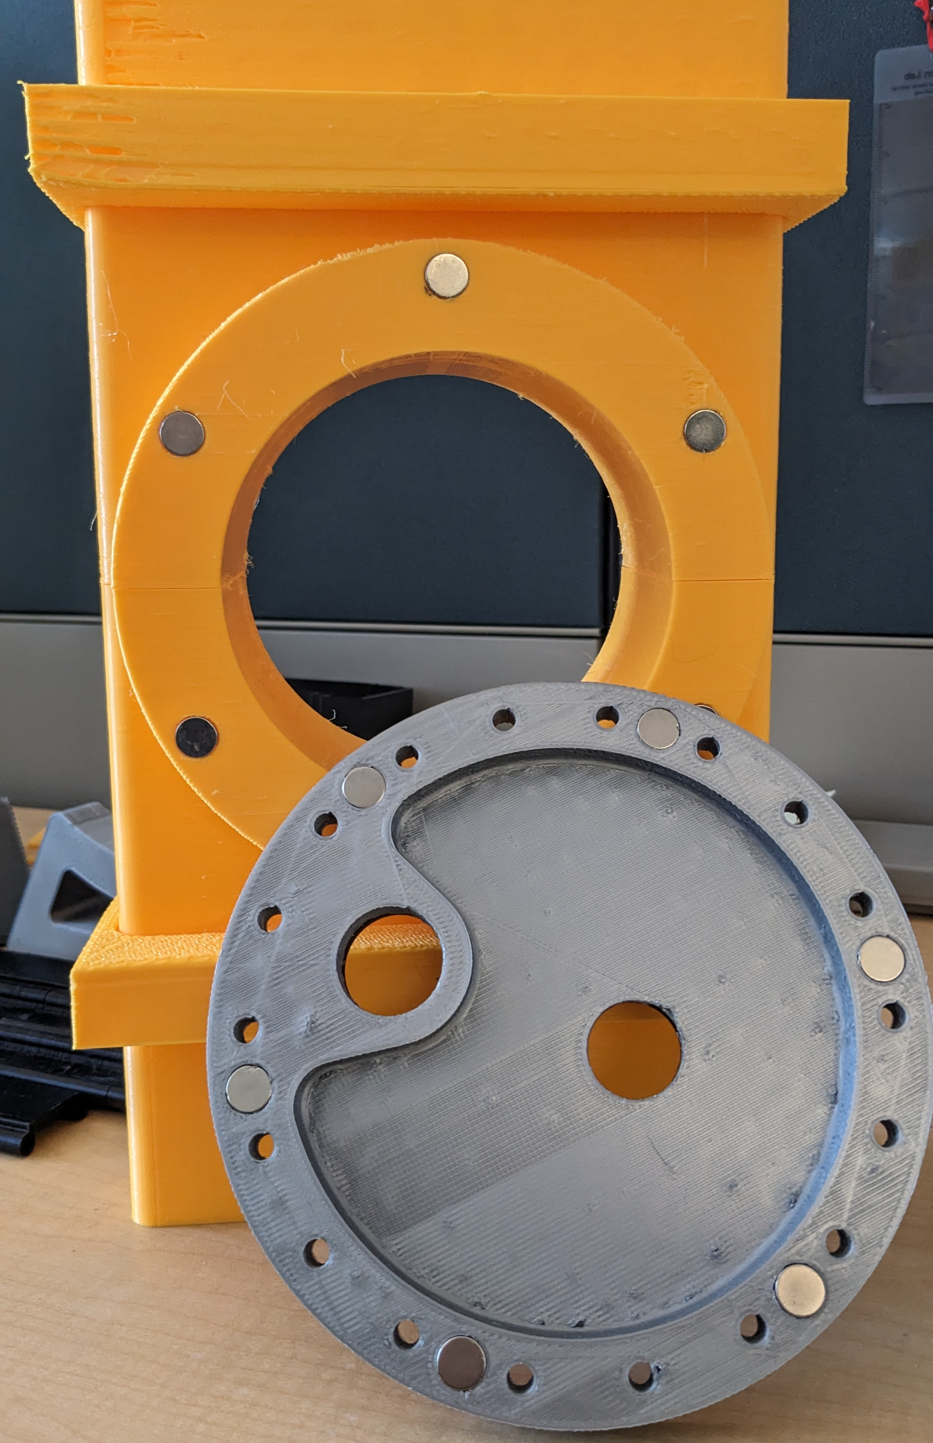
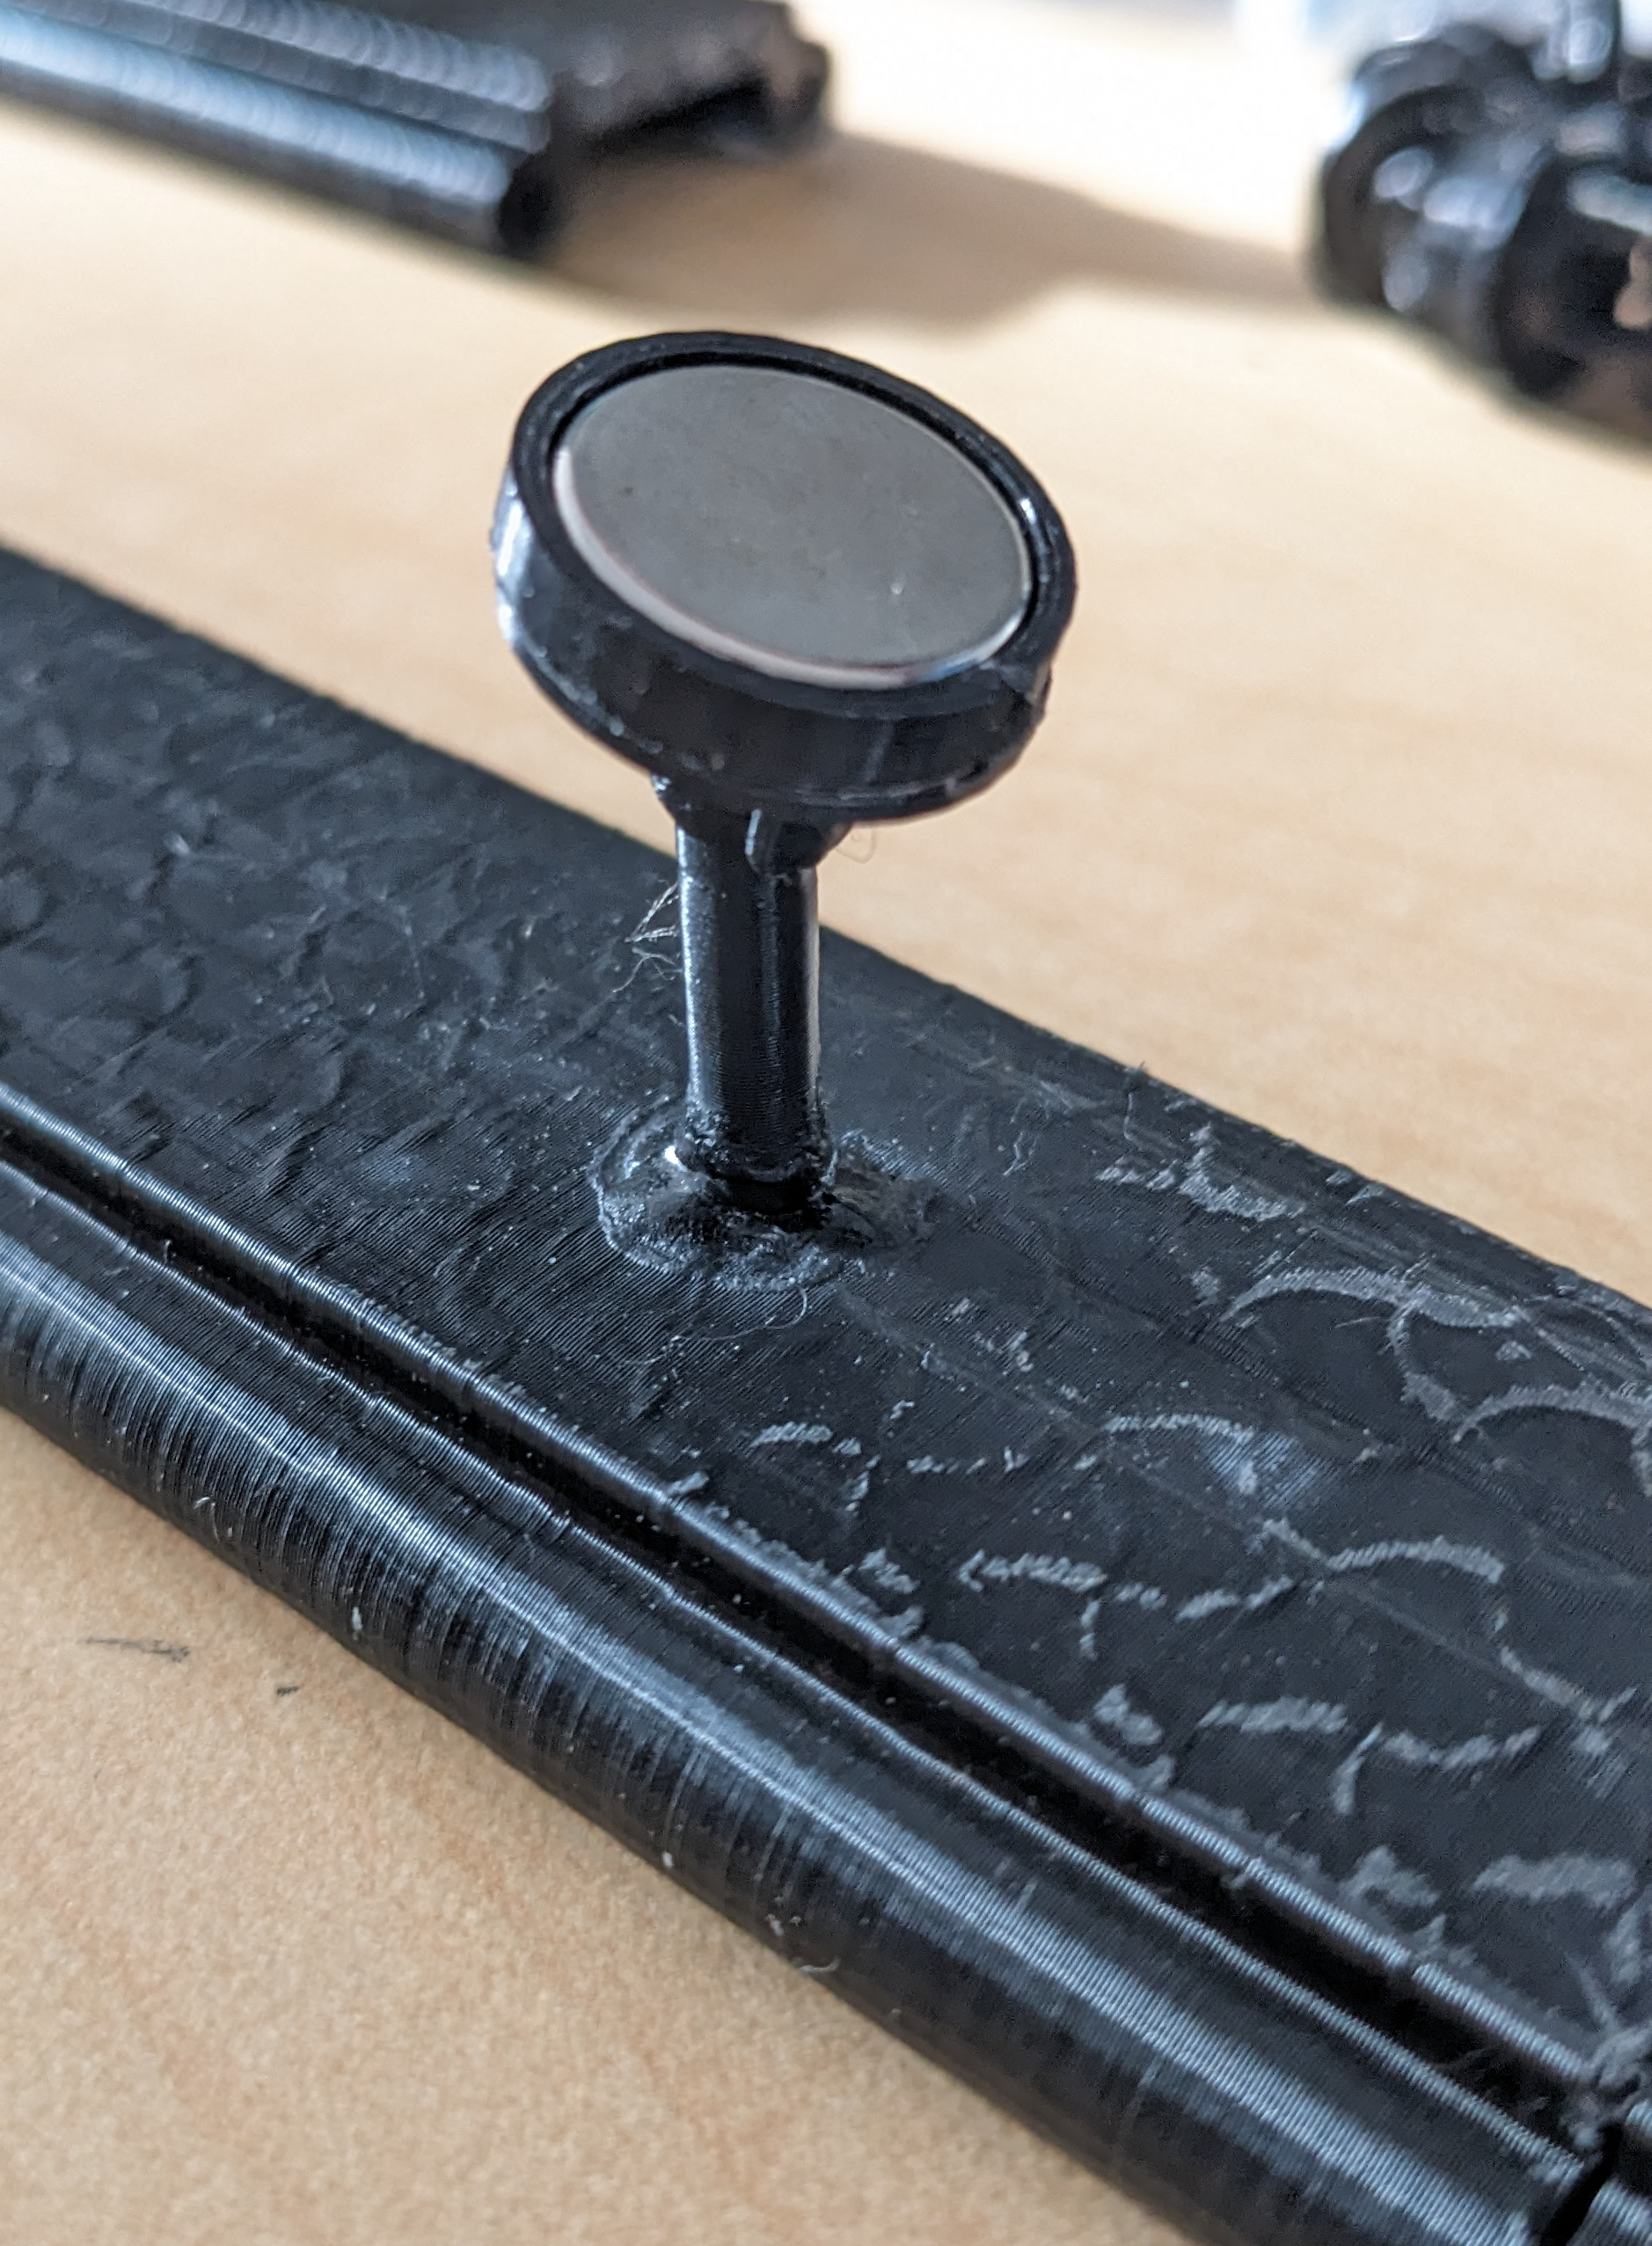
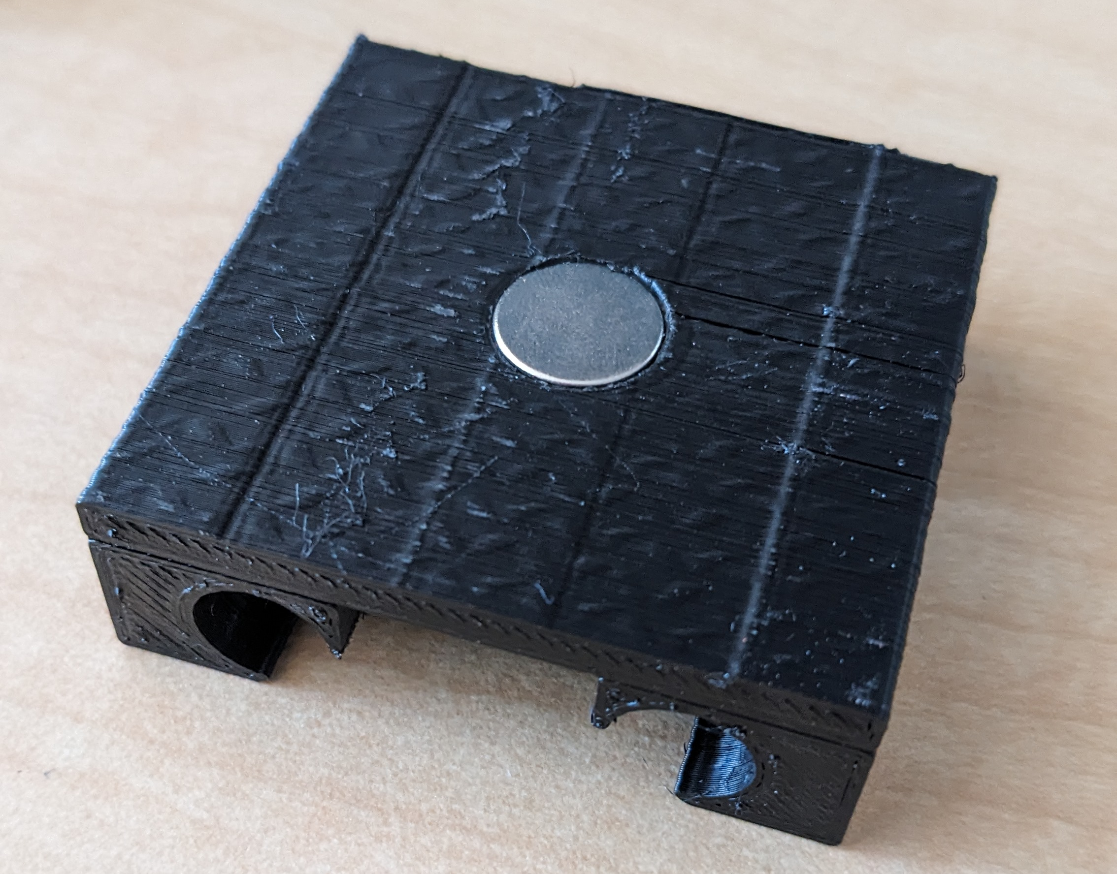
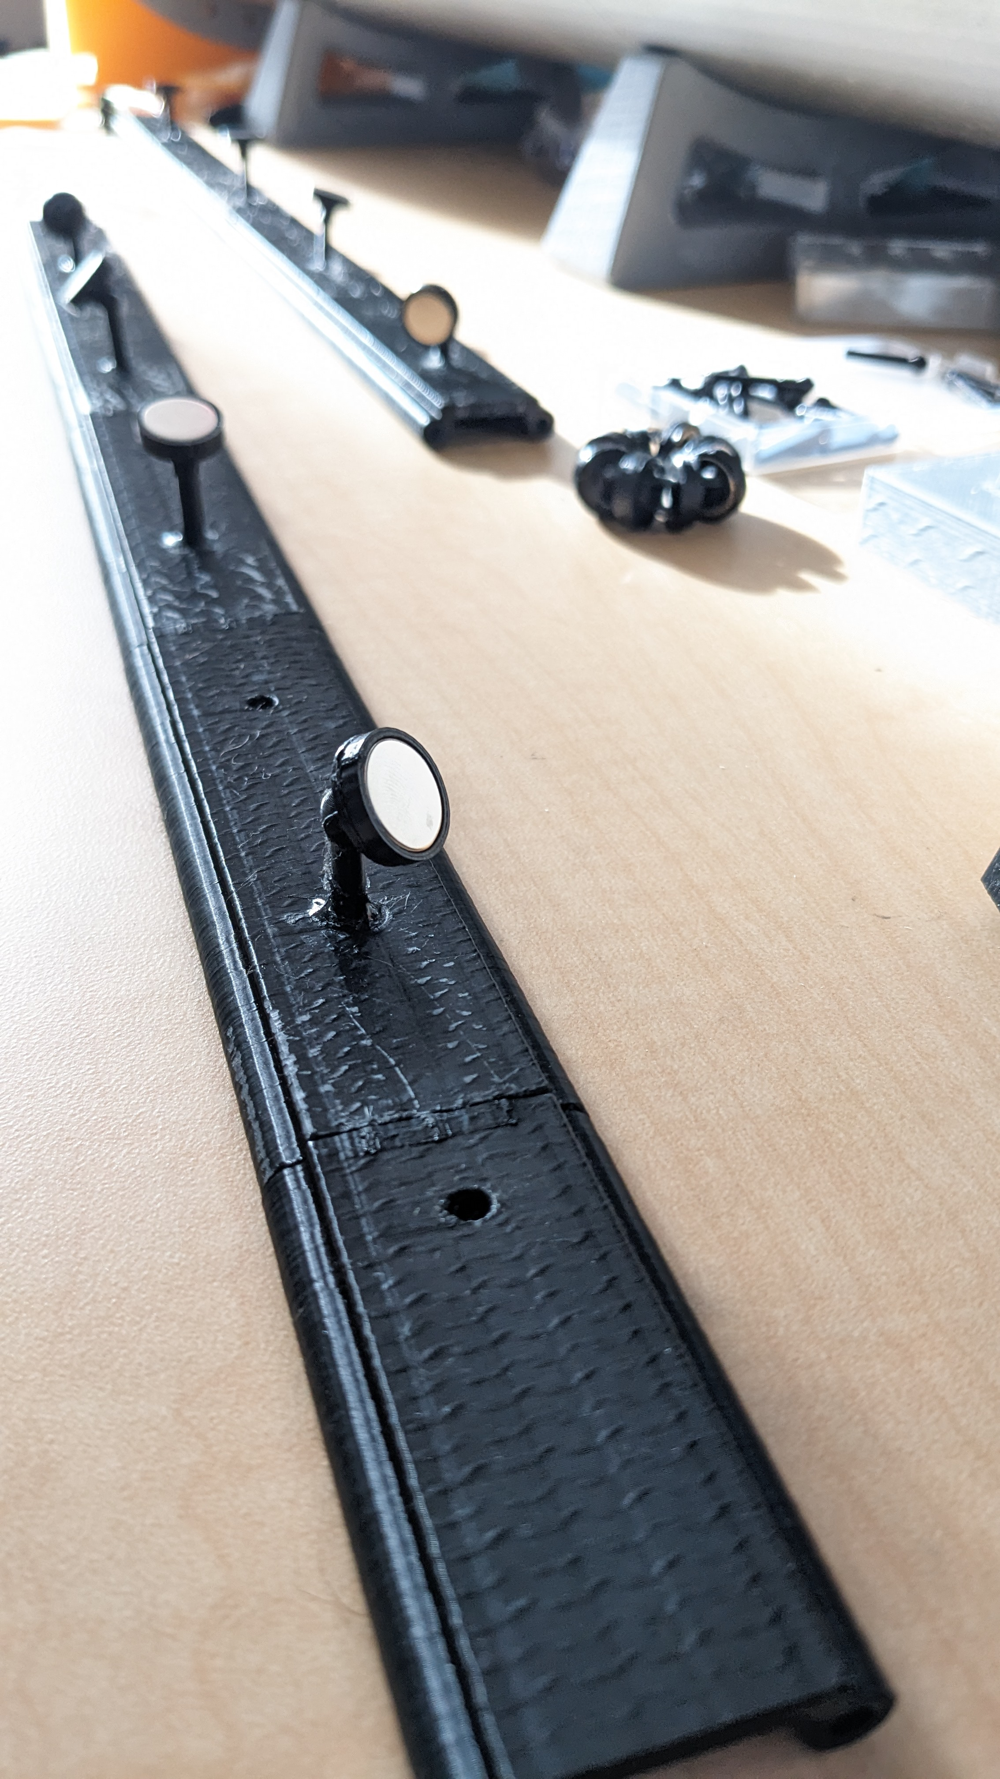
Assembly: Magnets
Use of magnets allow assembly to be broken down, replace parts. Can quickly print new parts to try out new arrangements.

Slide 7
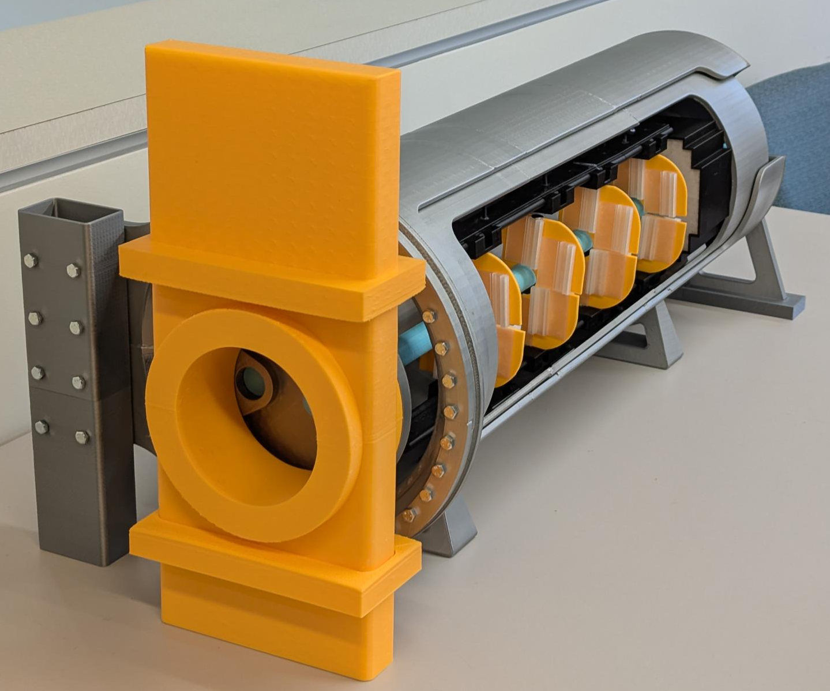
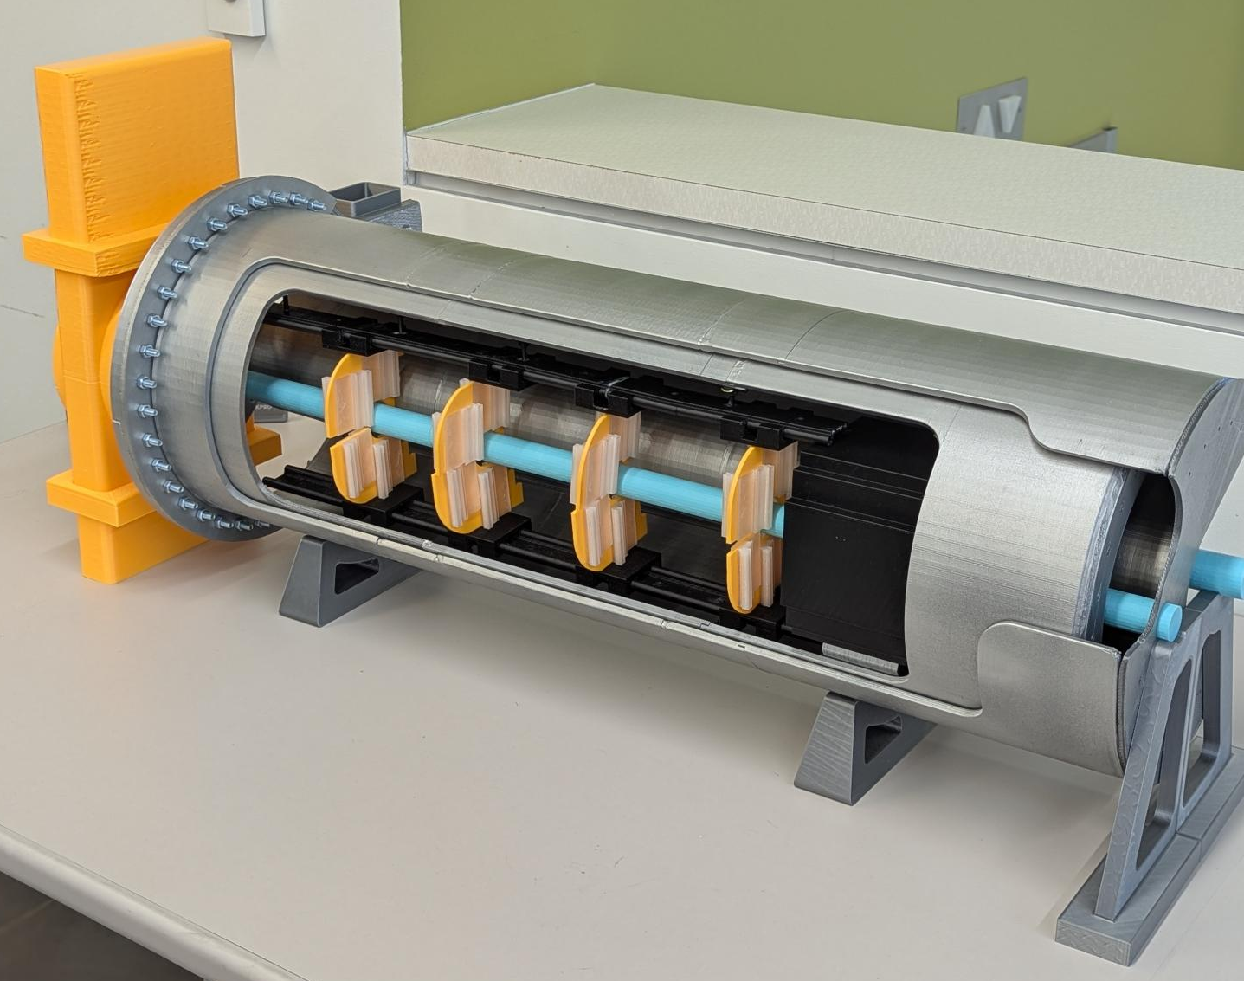
Assembly: Components

Slide 8
B0 Mock Up Path Forward
Update with new internal design.
Magnets will allow for simple exchange of parts.
New beampipe and B0 Calorimeter have been printed, ready to be added.
New split detector layers and rail system models will be printed next.

Slide 9
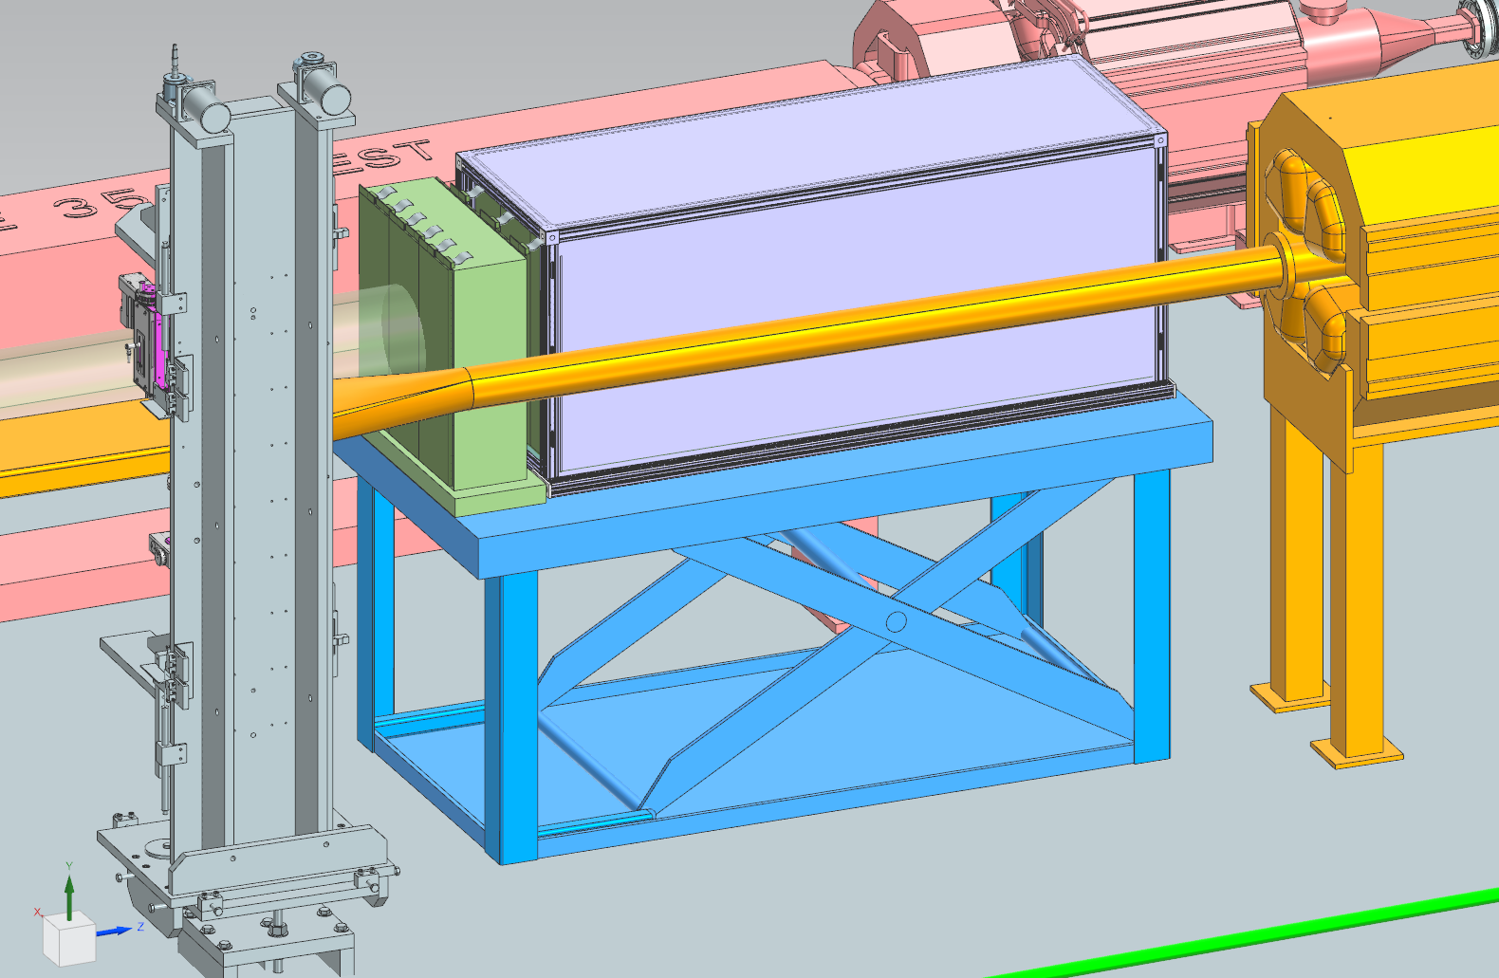
ZERO DEGREE CALORIMETER
EIC Collaboration Meeting January 21st, 2026

Slide 10
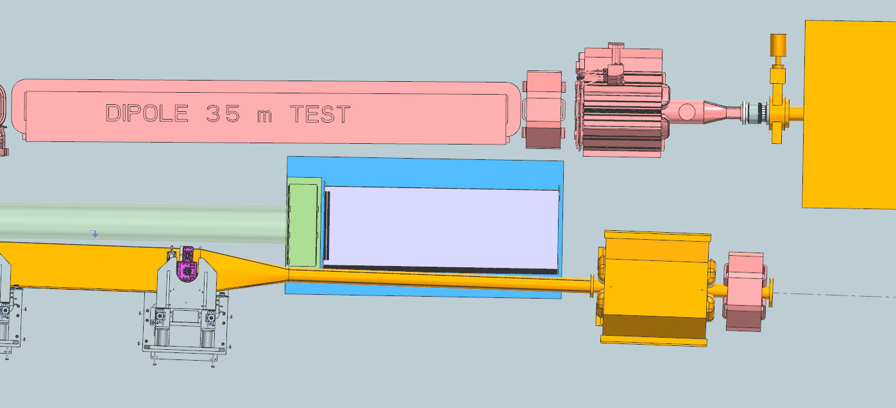
Zero Degree Calorimeter
EIC Collaboration Meeting January 21st, 2026

Slide 11
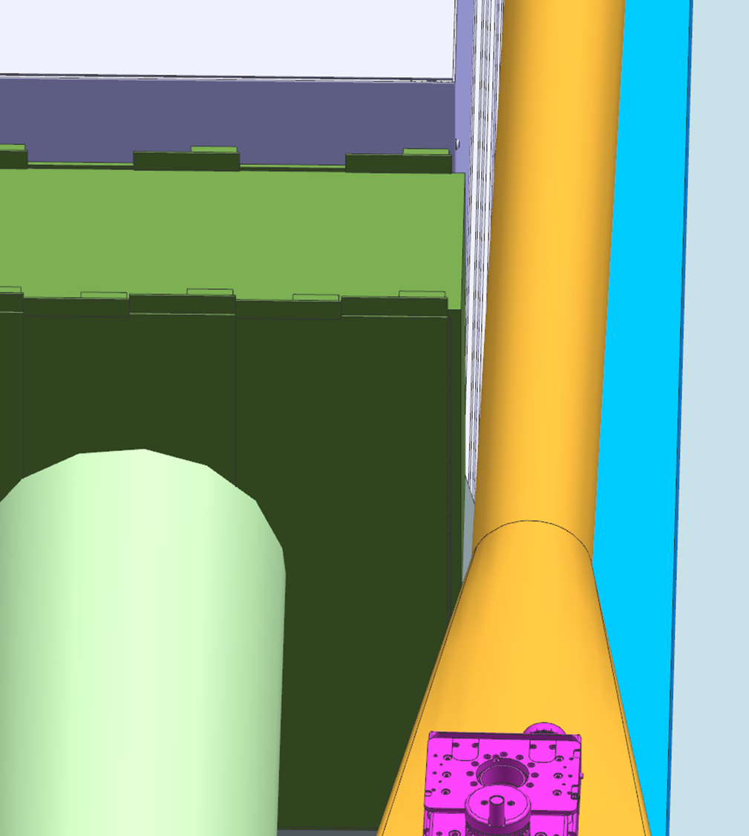
Zero Degree Calorimeter
The ZDC’s proximity to the beampipe presents issues with accessibility for servicing.
We have been able to maintain a gap of ~.25” with our design.
To service and perform maintenance the ZDC, a lift table system will support and lower the calorimeters. Allowing them to clear of the beampipe and become accessible.
EIC Collaboration Meeting January 21st, 2026

Slide 12
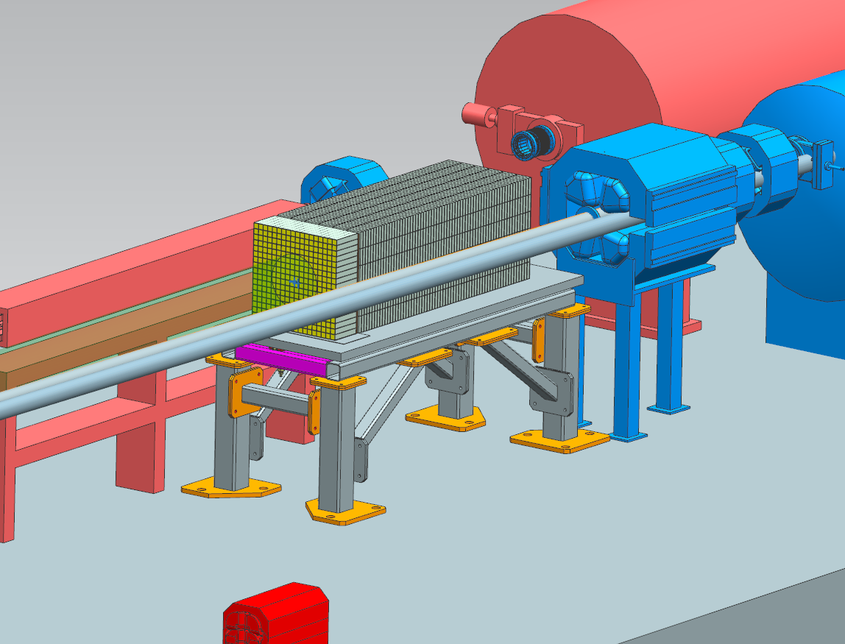
Previous Zero Degree Calorimeter Design
Previous design, fixed table
Servicing and maintenance around beampipe is problematic
During a previous review, we were directed to have maintainability of the ZDC
The detector needs to have the ability to be removed from the integration.
Moved to a lift table design
EIC Collaboration Meeting January 21st, 2026

Slide 13
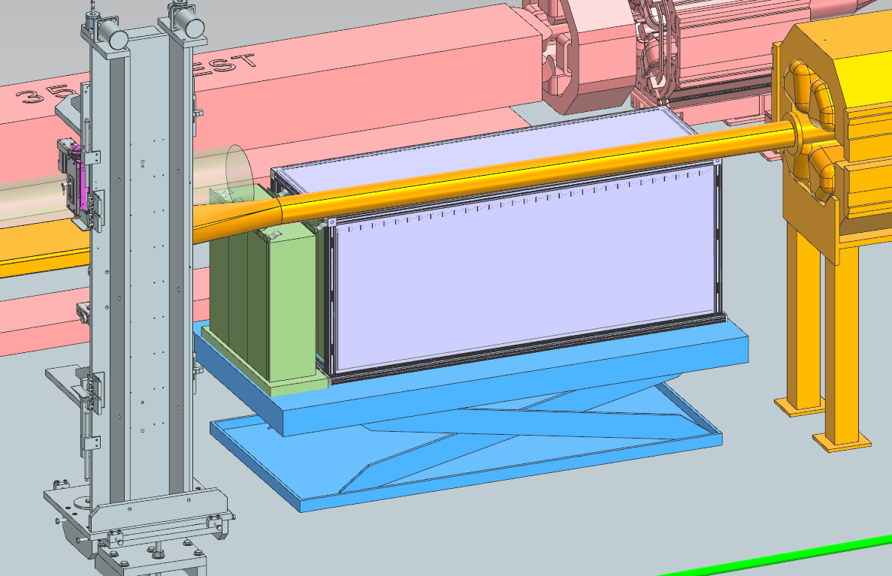
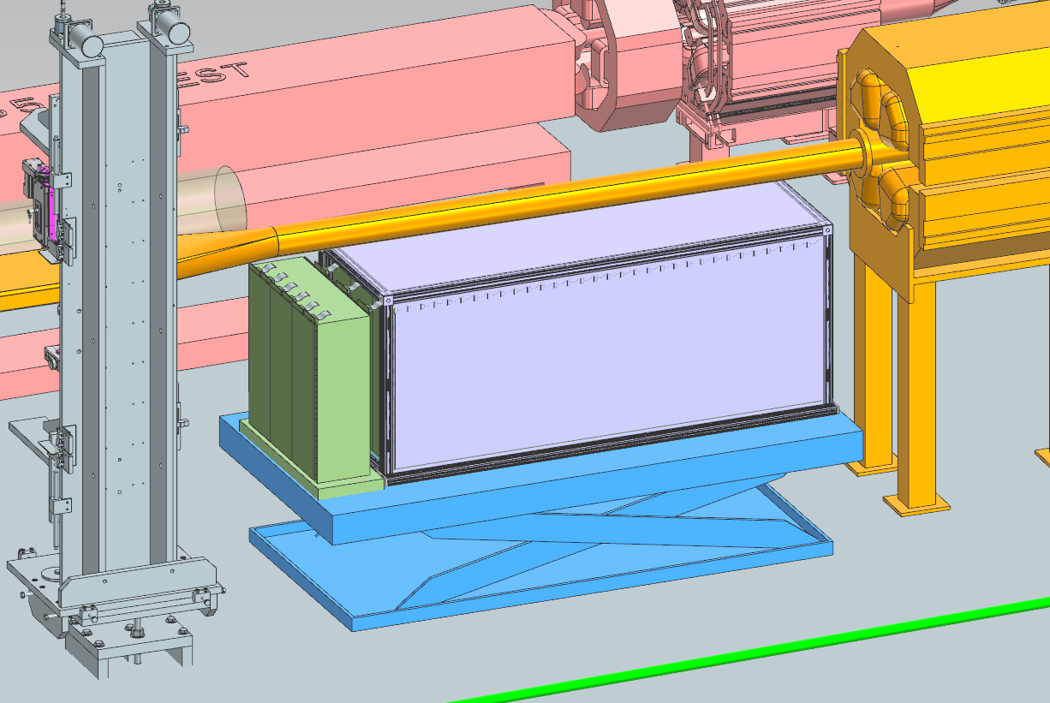
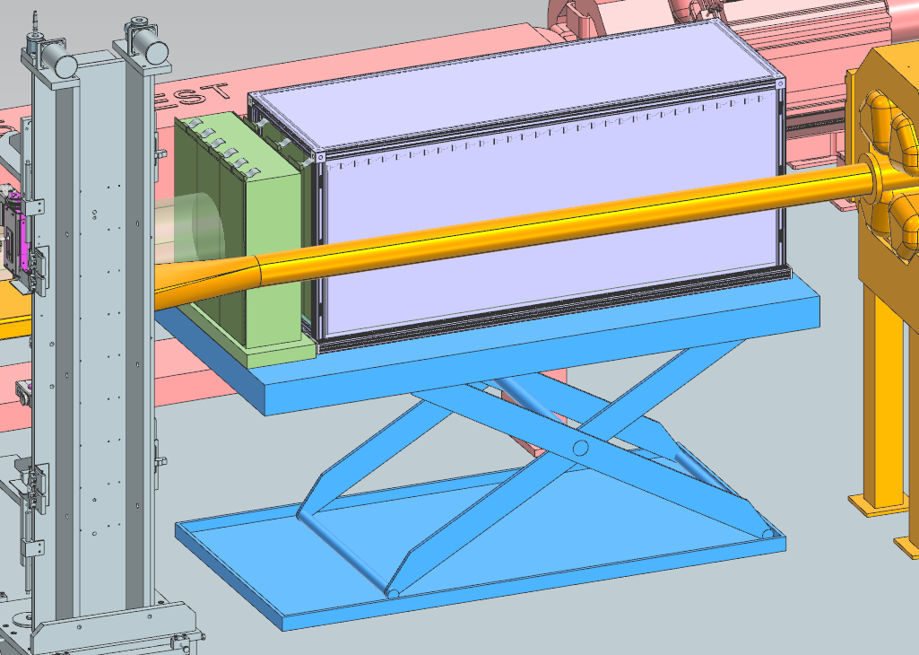
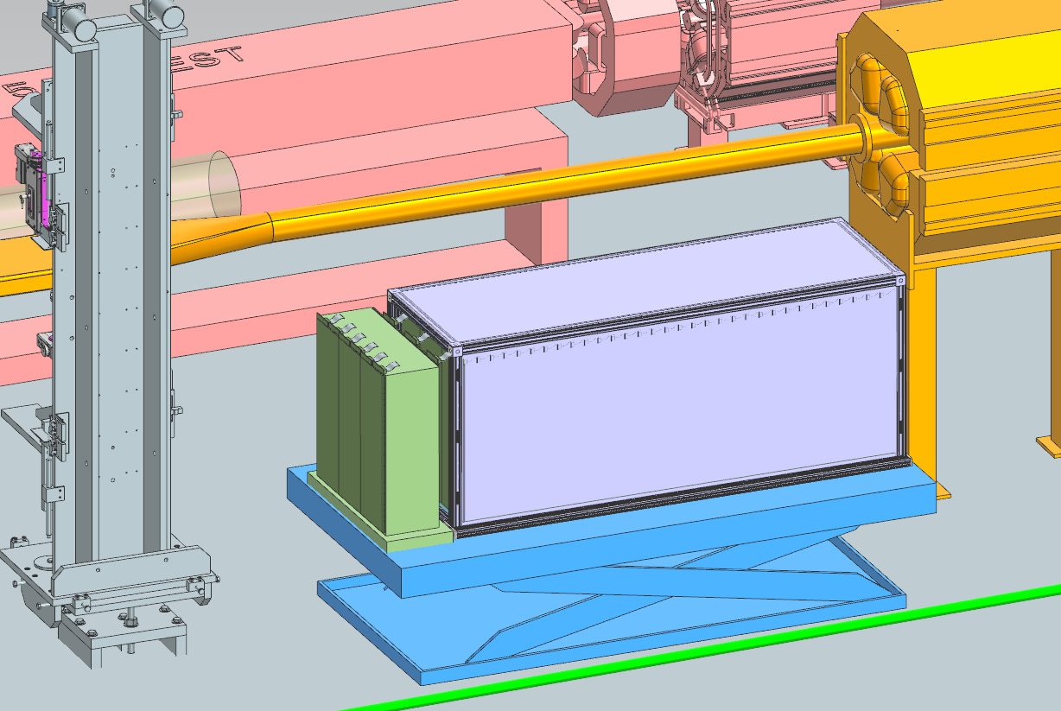
Lift table demo
For the new design we’re employing a hydraulic lift table for raising and lowering the calorimeter in position.
Custom table from vendor, Southworth
The table then would slide under the beampipe via track or casters.
EIC Collaboration Meeting January 21st, 2026

Slide 14
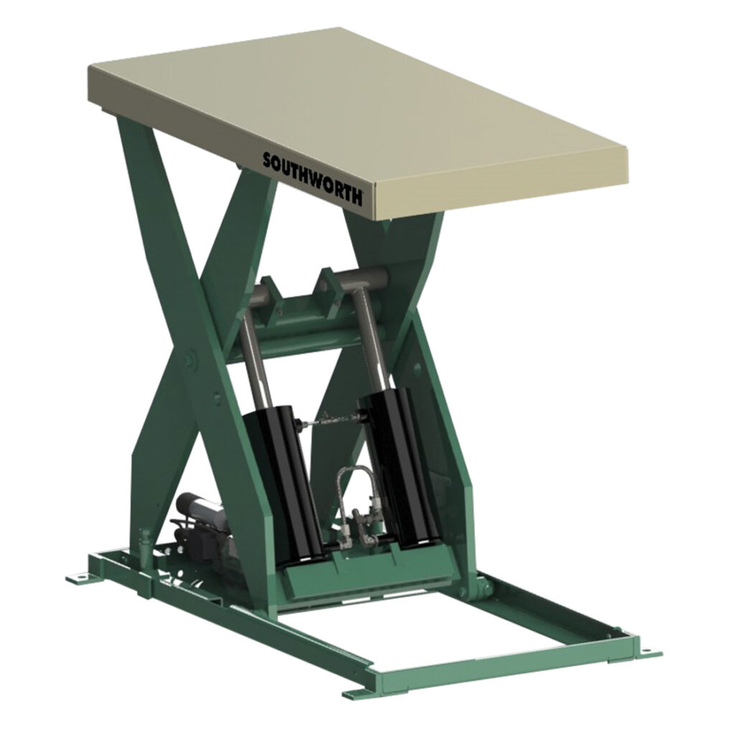
ZDC Vendor Custom Lift table
• Southworth
• Custom lift table
• Up to 12,000 lb capacity
• Lowered height 20”, raised height 38”
• 115 AC voltage
• 8” phenolic casters, side mounted (lengthwise traverse), Two rigid, two swivel
• Local controller
Adding custom chock while in raised position.
EIC Collaboration Meeting January 21st, 2026

Slide 15
ZDC Custom Lift table Chocks
• Four removable legs are added to each corner of the lift table and two rectangle tubes placed behind the lift mechanism will act as a chock while the table is in the fixed position.
The ZDC weighs ~3.5 tons (~7,000 lbs).
EIC Collaboration Meeting January 21st, 2026

Slide 16
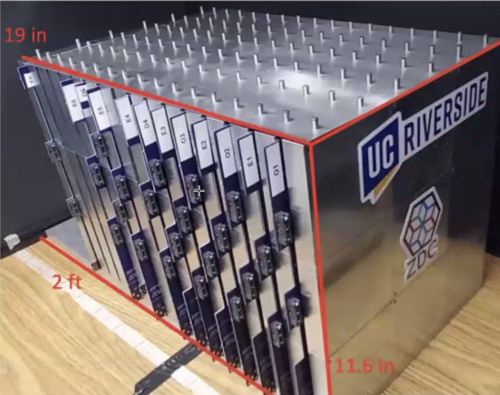
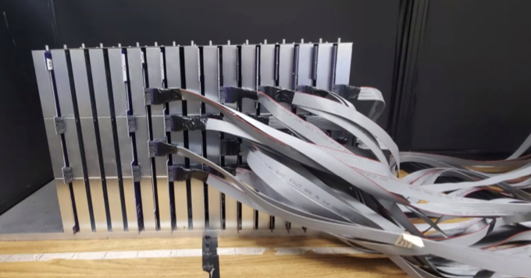
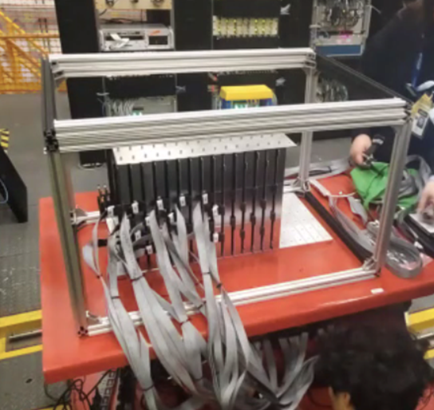
Zero Degree Calorimeter Cabling
Several mock ups initially assumed cabling would be mounted to the side.
The alternating pattern has been maintained to the new top mounted design.
EIC Collaboration Meeting January 21st, 2026

Slide 17
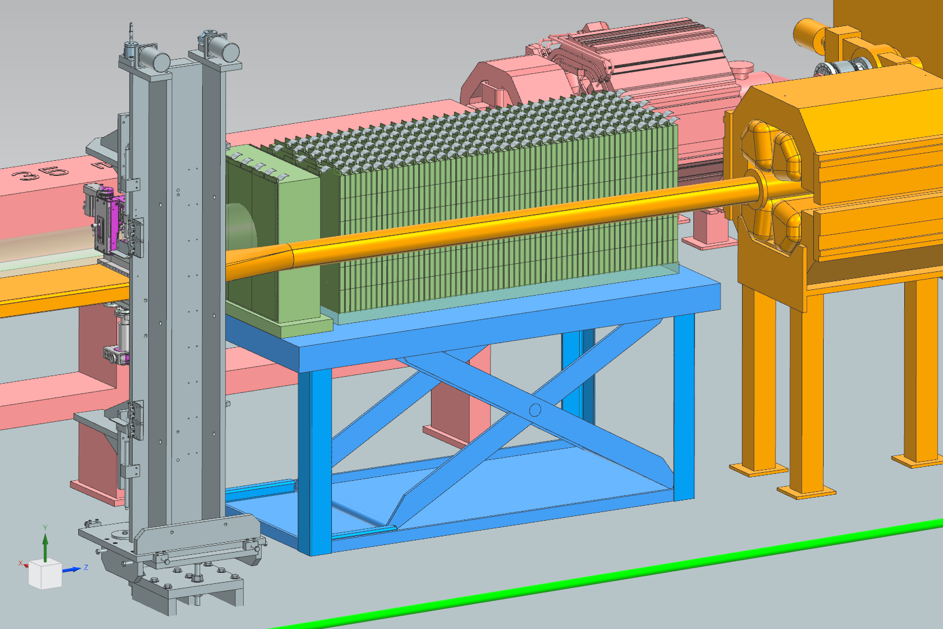
Zero Degree Calorimeter Cabling
Cables will route from the top of the calorimeter.
Side routing methods risked damage to the beampipe and inaccessibility.
EIC Collaboration Meeting January 21st, 2026

Slide 18
Zero Degree Calorimeter Dark Box
Dark box support frame
The box is constructed with 1.5” 80/20 and is shown here with sheets affixed to the outside, Though a black cloth will also work in this application.
The 80/20 frame also serves as additional support for the absorber block stacks.
EIC Collaboration Meeting January 21st, 2026

Slide 19
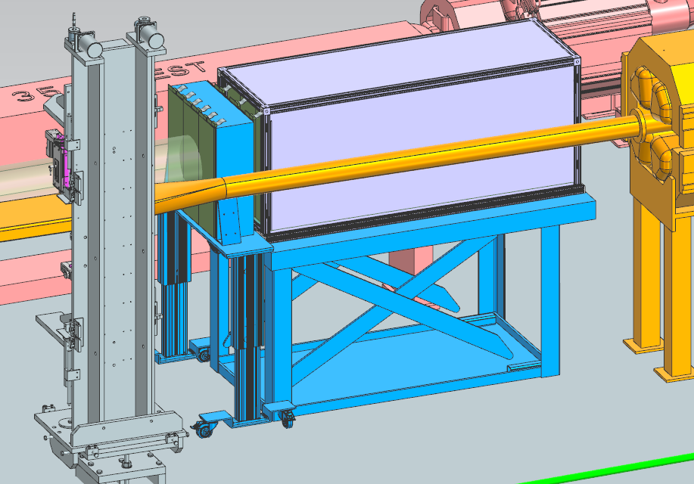
ZDC Additional Dual Lift Table Option
Single Lift Table
Dual Lift Tables
EIC Collaboration Meeting January 21st, 2026

Slide 20
ZDC Dual Lift tables
• Southworth – Model LS8-36, similar to the custom table used in the previous design.
It will also include the four additional leg supports and two rectangle tubes.
In combination with a custom lift column system utilizing 80/20 50021
The emcal will be mounted to a top supported by two lift column legs.
Max load: 660 lbs (300 kg) per leg
Retracted height of legs: 24.803”
Extended height of legs: 40.551”
EIC Collaboration Meeting January 21st, 2026

Slide 21
ZDC Path Forward
The ZDC is reaching final design maturity.
Choosing between the dual and single lift table design.
Procedure for maintenance, pulling it under the beampipe.
Team
Integration – Karim Hamdi (BNL)
Mechanical Supports – Ron Lassiter, Jonathan Smith, India Krehbiel, (Jlab)
Beampipe – Charlie Hetzle, Chang Jun (BNL)
Detectors – Sean Preins (UCR), Miguel Arratia (UCR), Yuji Goto (BNL)
EIC Collaboration Meeting January 21st, 2026
Notes:
Possibly permanent wench,
Update model file system for drawing deliverables

Slide 22
Questions?
EIC Collaboration Meeting January 21st, 2026

