Slide 1





Combined PWG pTDR and ES Workfest
Rachel Montgomery (Glasgow) & Salvatore Fazio (Calabria)
Rosi Reed (Lehigh)
ePIC Collaboration Meeting
BNL - Jan 20-23, 2026

Slide 2
Some shared notes for today’s workfest
Link to shared notes
Can use for taking notes, comments, extra questions, or to-dos during discussion session
Have put the link also on indico session page for workfest
https://indico.bnl.gov/event/30532/sessions/8770/#20260121
And will put in zoom chat too

Slide 3
Reviewers
Reviewers are ready to receive a draft to provide initial feedback:
  General Overview: Thomas Ulrich; Taju Gunki; John Lajoie; Wim Cosyn
  Inclusive: Katarzyna Witchman; Pia Zurita; Paul Newman; Enrico Tassi; Andy Buckley
  Exclusive, Diffractive, Tagging: Kresimir Kumericki; Nicole D’Hose; Alex Jentsch
  SIDIS: Marco Mirazita; Marco RAdici; Marco Contalbrigo; Charlotte Van Hulse
  Jets/HF: Olga Evdokimov; Deepa thomas; Brian Page; Rithya Kunnawalkam Elayavalli; Cameron Dean
Thanks to these colleagues who have offered their time to help during the drafting stage
Of course we will also be requesting feedback from the wider collaboration during this process as we develop the document

Slide 4
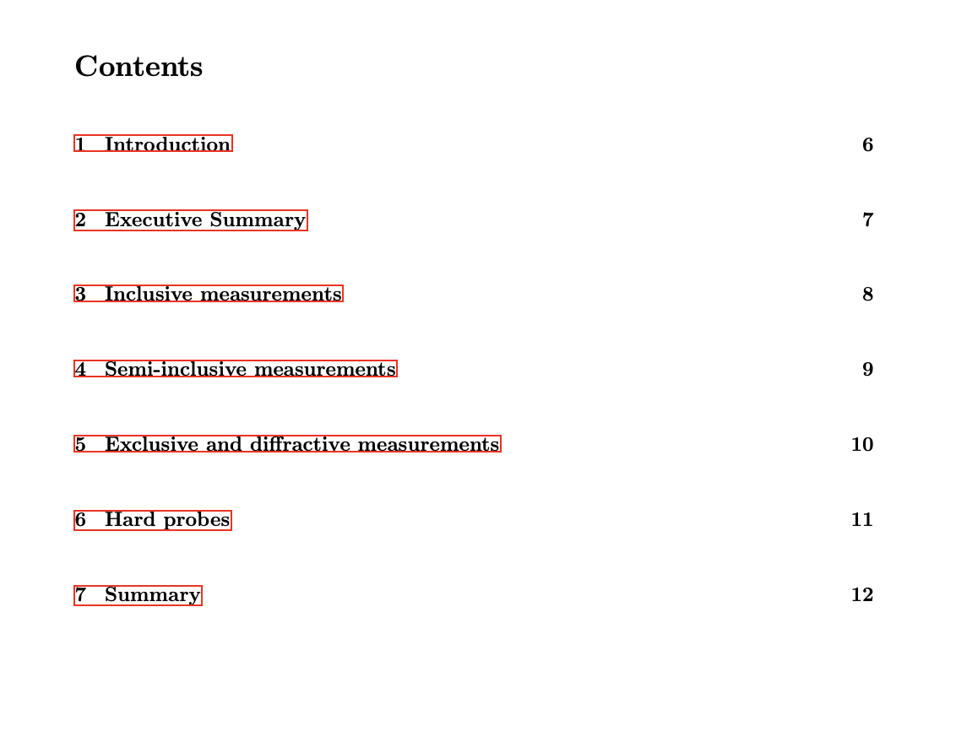
Structure of the Report
Template
Conveners: got the link?
Currently separate sections for PWG
Today we can discuss further the structure (eg do we put executive summary and refer to PWG sections or re-organise around physics and have PWG appendices or …)
PWGs are requested to fill what they have so far by Feb 16
We will polish and send to reviewers to provide initial feedback at March Workshop

Slide 5
Roadmap
Template
Jan 21 - today!
…. Work work work
Feb 16 - inputs by each PWG on overleaf and first draft
… intense polishing
Feb 19 ?? - hand it over to the referees
….. Keep working
March 17-19 - Readiness Workshop in Italy - first feedback from the referees
….. Work work work
?? - Secon draft to the Referees? And collab?
….
May 1 - final deadline for ESR to ALDs
…. Work on a publication version
….
Late in the year ? - Publish on the NIM Special Edition

