Slide 1

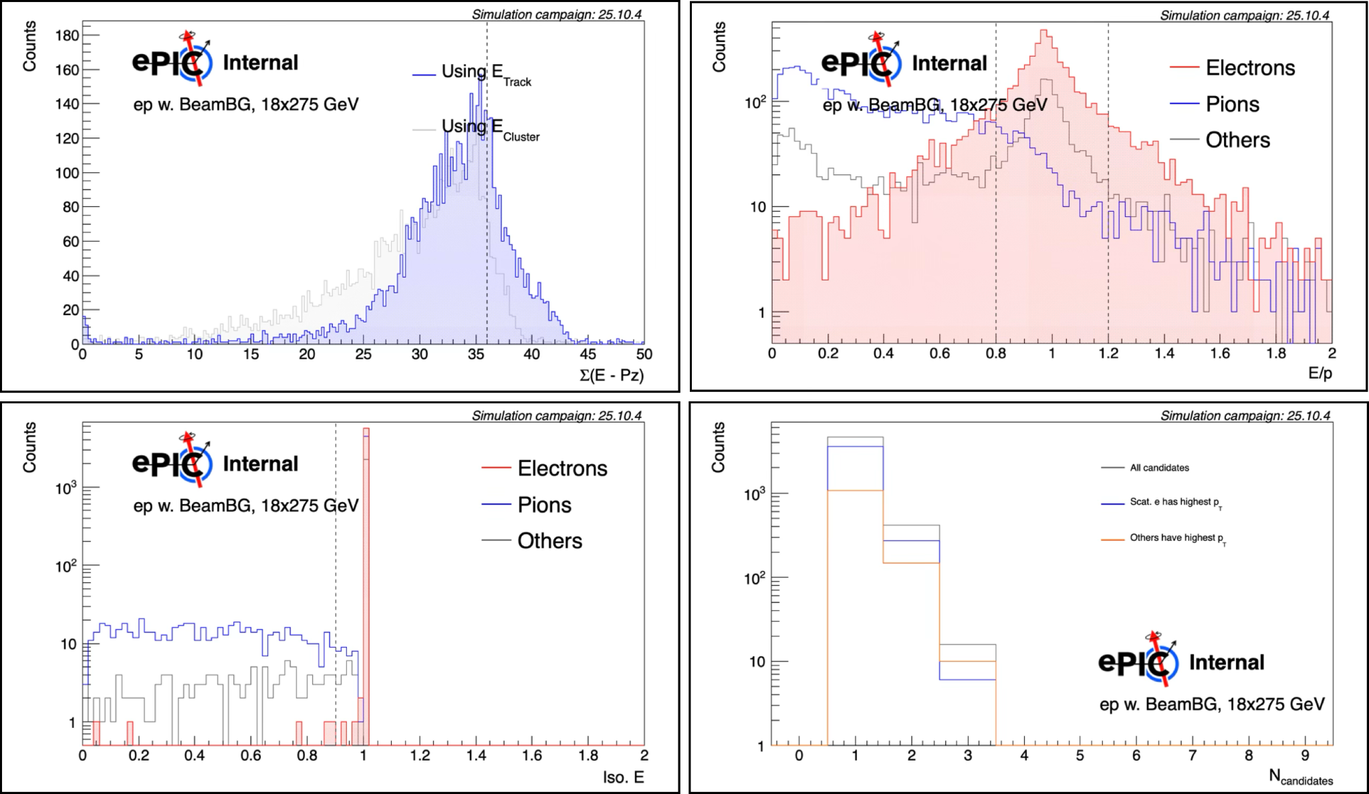
Machine Background Discussion (Inclusive PWG)
Study ongoing to check its effect on scattered electron finding
While tracking resolution is reduced, we don’t expect a big effect on the eID at E_{e} = 18 GeV. Effect is likely larger at lower beam energy.
Larger impact on kinematic reconstruction. To be studied.
More details in talk this morning

