Slide 1

ePIC Collaboration Meeting 2026
Exclusive, Diffraction and Tagging
Systematic Uncertainties
Stephen and Kong
21st January 2026

Slide 2
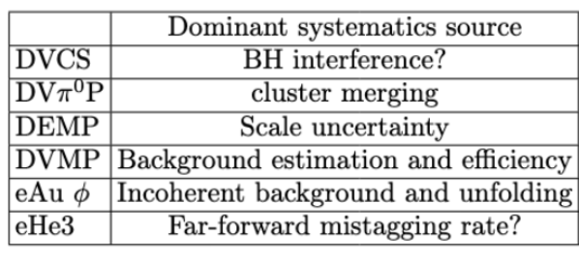

EDT Systematic Uncertainties
As part of EDT early science paper, analysers were tasked with identifying and flagging dominant source of systematic uncertainty for their measurement
Sources identified, but not necessarily quantified for following channels
For channels with analysis notes, more details in note
Expect full quantification of all systematics for the channels above soon

