Slide 1
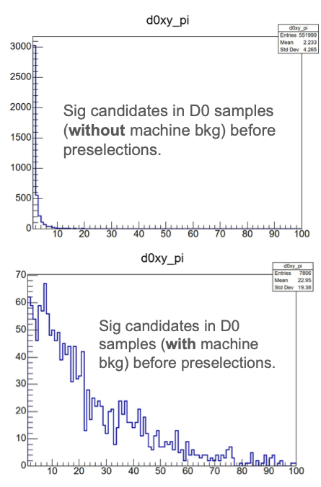
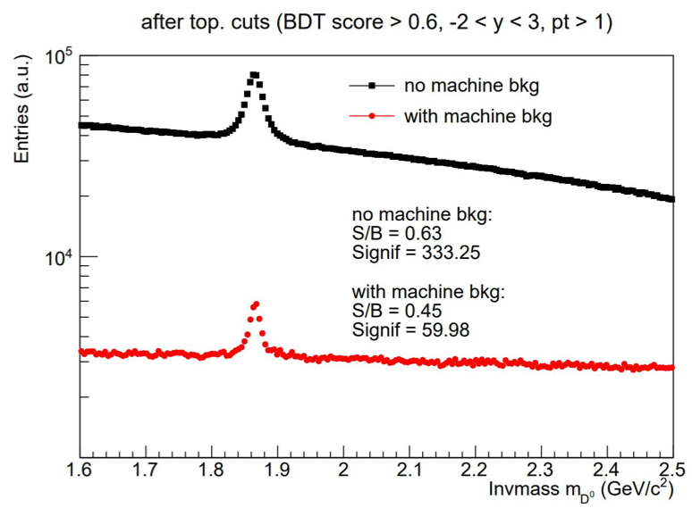
Machine background impact on HF
C. Yang (UT Austin)
SLIDES
25.10 campaign
Much wider DCA_{xy} distribution for pions from D⁰ decay, likely caused by worse primary vertex resolution (need to apply nhits>3 cut on tracks used to find vertex)

Slide 2
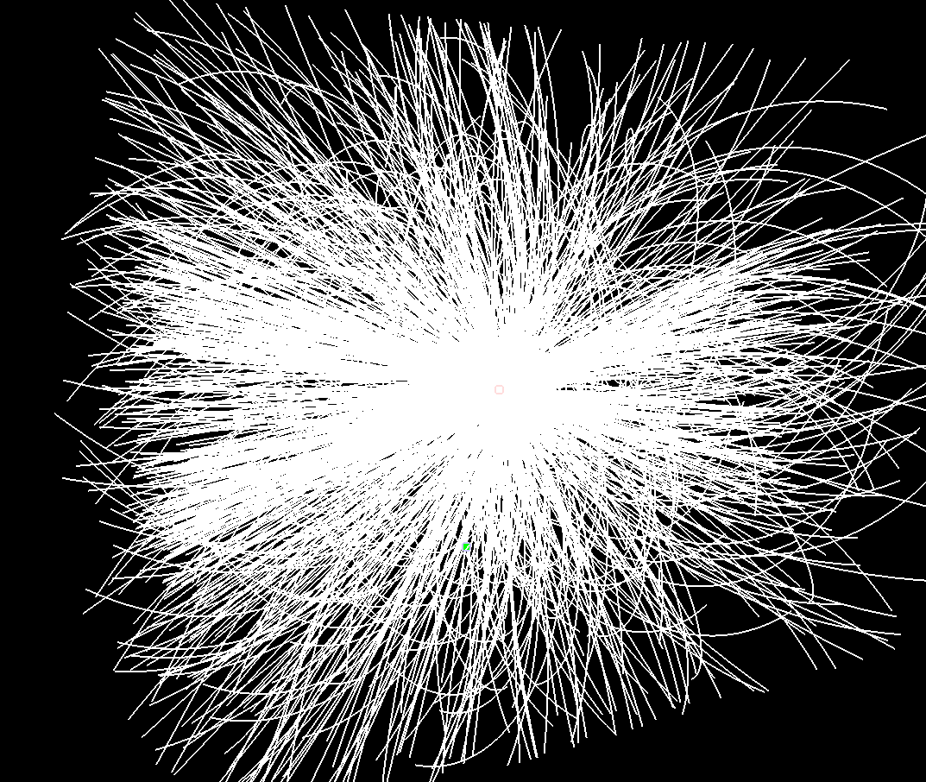
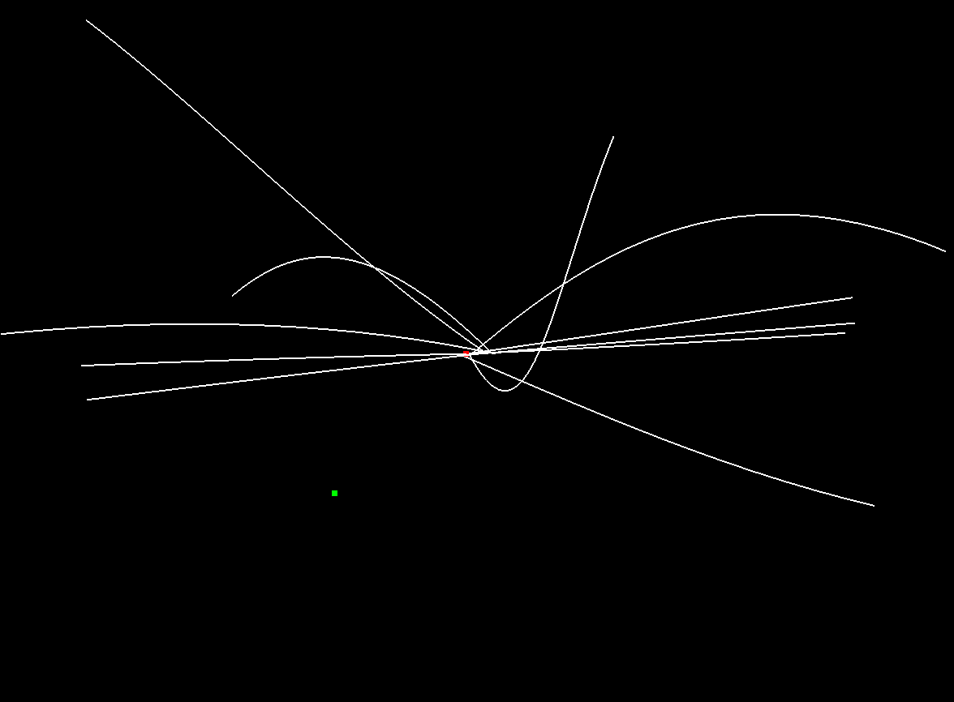
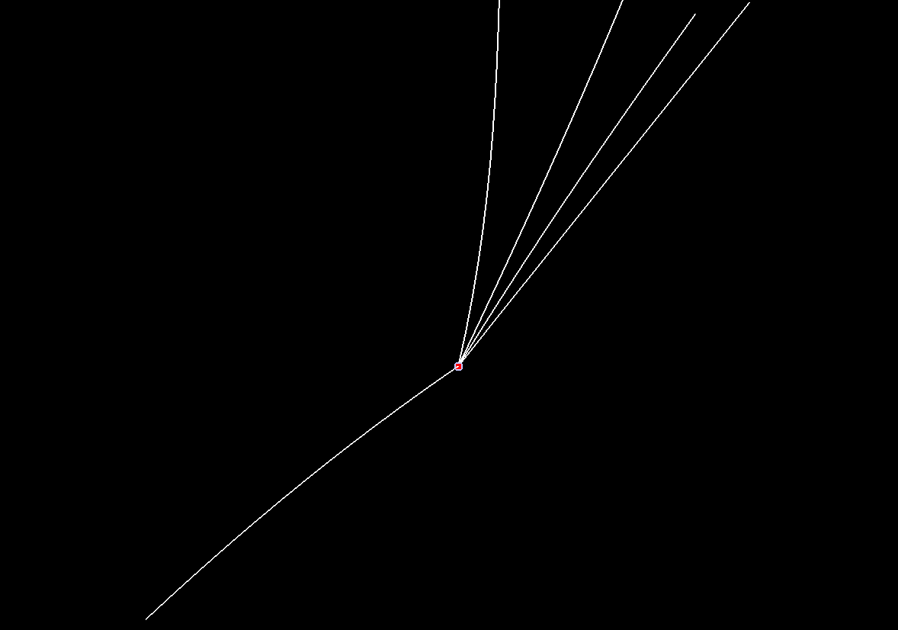
Machine background: event visualization
S. Kumar (INFN)
ep (10x100, Q²> 1 GeV² ) (Oct Campaign with machine background)
ep (10x100, Q²> 1 GeV²) DIS event w/o bkg
No nhits cut
nhits>3
Average multiplicity ~4
MC Vertex, Reco vertex failed

Slide 3
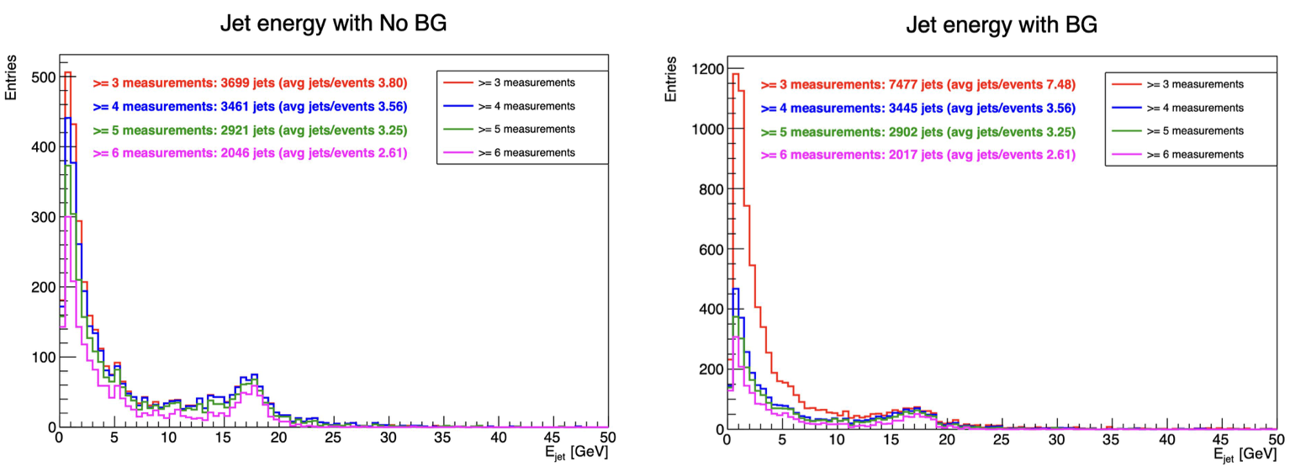
Machine background impact on Jets
J. Gupta
B. Schmookler (UH)
SLIDES
Using tracks with at least 4 hits, charged jet energy distribution is unaffected

Slide 4
Systematic uncertainties
Major uncertainty sources
  Luminosity (1.5%)
  Tracking efficiency (need input)
  PID efficiency (need input)

