Slide 1
EIC Project Status
Jim Yeck
EIC Project Director
Brookhaven National Laboratory
ePIC Collaboration Meeting – January 2026
January 22, 2026

Slide 2
Outline
EIC
Organization
Project Plans
DOE Review of August 2025
Progress on Annual Funding and TPC Point Estimate
ASR, DET, and Comprehensive Project Reviews
Summary

Slide 3
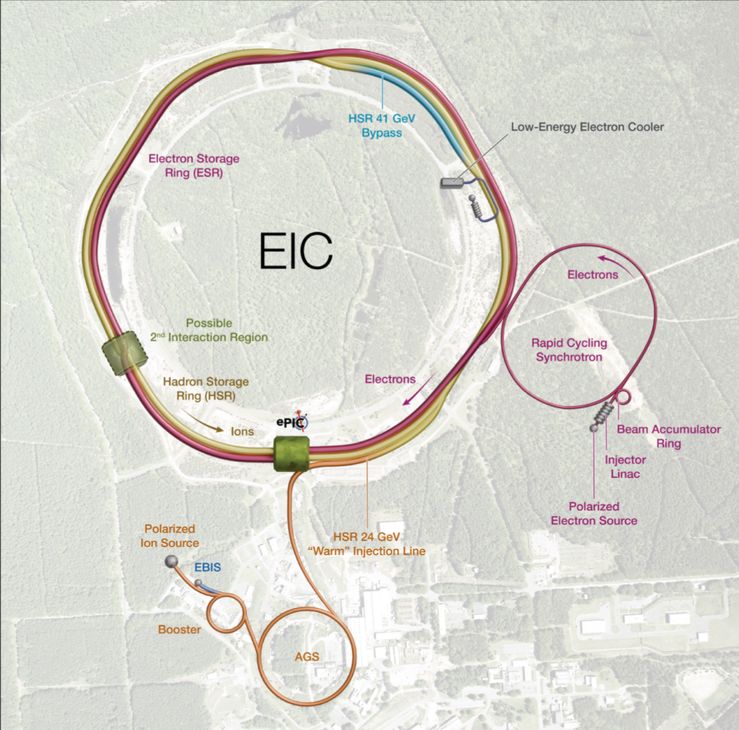
EIC Facility Requirements
Ultimate Performance Parameters
High Luminosity: L= 10³³ – 10³⁴cm⁻²sec⁻¹
Highly Polarized Beams (electrons, protons, ions): 70%
Large Center of Mass Energy Range: E_{cm} = 20 – 140 GeV
Large Ion Species Range: protons – Uranium
Large Detector Acceptance and Good Background Conditions
Possibility to implement a Second Interaction Region (IR)
The EIC design and performance parameters address the requirements established by the U.S. Nuclear Science Advisory Committee (NSAC) Long Range Plans (2015 & 2023) and endorsed by the U.S. National Academy of Sciences (2018). EIC will be a unique collider facility in the world, strengthen U.S. leadership in nuclear physics, and advance accelerator and detector technologies for future facilities.

Slide 4


EIC Facility Scope
Existing Accelerator Scope
Ion injection and acceleration systems (Linac, Booster, AGS)
Polarized ion/proton sources
New Scope
Hadron Storage Ring (40, 100 – 275 GeV)
Electron Pre-Injector (750 MeV Linac)
Electron Rapid Cycling Synchrotron (0.75 GeV – Top Energy)
Electron Storage Ring (5 GeV – 18 GeV)
Interaction Region (IR) and Provision for a 2nd IR
Hadron Injection Cooling System
General Purpose Collider Detector
RHIC Scope Reused Valued at ~$2B
Performance and technical risks addressed in a new design of the electron injector complex, removal of SHC and a simplification of long straight section at IR2, and removal of the blue hadron ring from the RHIC tunnel
4

Slide 5
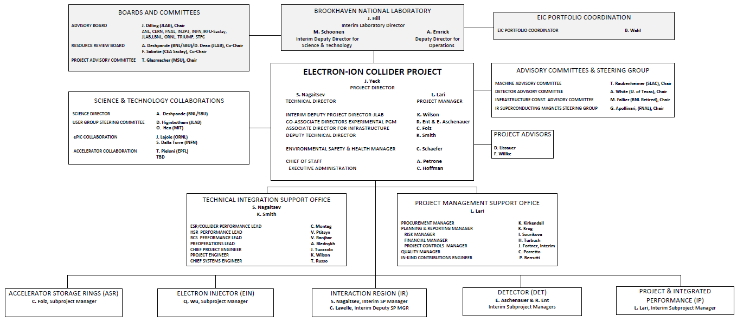
Project Organization Overview

Slide 6








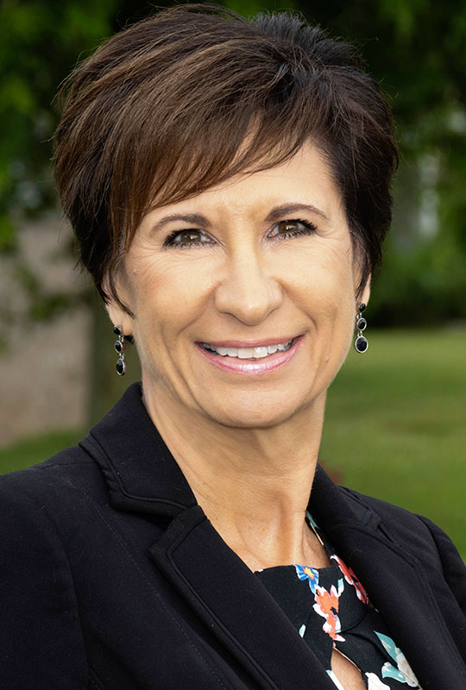


Defined Roles and Accountability for Project Execution
Jim Yeck
Project Director
Sergei Nagaitsev
Technical Director/ Interim IR SP Mgr.
Luisella Lari
Project Manager/ Interim IP SP Mgr.
Katherine Wilson
Interim Deputy Project Director JLAB
Charles Schaefer
Safety Manager
Rolf Ent & Elke Aschenauer
Co-Associate Directors for Exp. Program
Interim DET SP Manager,
Kevin Smith
Deputy Technical Director
Kelly Krug
Planning & Performance Mgr.
Charlie Folz
Assoc. Director Infra. ASR SP Manager
Qiong Wu
EIN SP Manager

Slide 7
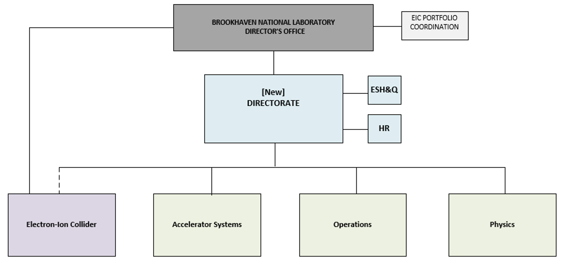
BNL is Organizing to Delivery the EIC Project
Initial concept for EIC and NPP Directorates after conclusion of RHIC collider operations.
RHIC will conclude collider operations on February 6.
The transition from RHIC operations to EIC construction will require an efficient organizational framework to ensure optimum use of available resources and
BNL leadership is developing plans to organize the workforce to support this transition.

Slide 8
EIC Portfolio (EIC and Off-Project Scope)
EIC Portfolio Managed by the BNL Director’s Office
Bill Wahl, Portfolio Manager
Major Categories of Work:
EIC Construction (Line-Item Project) – J. Yeck
SC Programmatic Engagements (primarily ONP) – A. Deshpande
Host Lab Engagements (traditional host lab responsibilities) – J. Hill
Excellent Progress (Scope, Cost, Funding, Schedule)
BNL Institutional MOUs established in 2020
Peer reviews of major scope items in 2024, e.g., R&R, Injection Complex
Portfolio WBS prepared in 2025
8

Slide 9
Portfolio Example – Scope, Cost, Priority, POC

Slide 10
EIC Scope per Subproject
 | WBS | Subproject Name | Subproject high level scope description
e-A collisions | 6.02 | Accelerator Storage Rings (ASR) | Hadron Storage Ring (HSR) modifications up to 250 GeV for protons, Electron Storage Ring (ESR) up to 10 GeV and infrastructures to accommodate EIC needed services.
x | 6.03 | Detector (DET) | ePIC Detector including Detector Solenoid Magnet and return Flux & installation. Auxiliary detector systems are included.
 | 6.04 | Interaction Region (IR) | Interaction Region including the SC magnets, the 197 MHz crab cavities and the machine protection systems.
x | 6.05 | Electron Injectors (EIN) | Electron Injectors incl. the LINAC, the Beam Accumulator Ring (BAR), the Rapid Cycling Synchrotron (RCS) up to 10 GeV and related infrastructure.
Full Scope | 6.01 | Project & Integrated Performance (IP) | Project and Technical integration Offices to support all the subprojects. Accelerator scope required to increase collider performance (incl. 394 MHz crab cavities, 41 GeV by-pass, Low Energy e⁻ Cooler, ESR RF). Final integration and global commissioning.
In-Kind Contribution Plan: 5% or more of the accelerator scope and 30% of the detector scope.
Additional IKC accelerator opportunities are under investigation.
10

Slide 11
EIC Line-Item Project Requirements
Project Requirements:
A single integrated line-item construction project.
Subprojects with well-defined deliverables, interfaces, and KPPs.
Plans consistent with DOE annual funding guidance and Total Project Cost (TPC) objectives.
EIC initial science program begins following the start of beam collisions.
Project scope provides the capability to achieve the performance required by the Mission Need.
EIC Line-Item Project Scope:
Accelerator Storage Rings (ASR)
Detector (DET)
Interaction Region (IR)
Electron Injector (EIN)
Project and Integrated Performance (IP)
Project scope required to start global commissioning and the EIC initial science program.

Slide 12
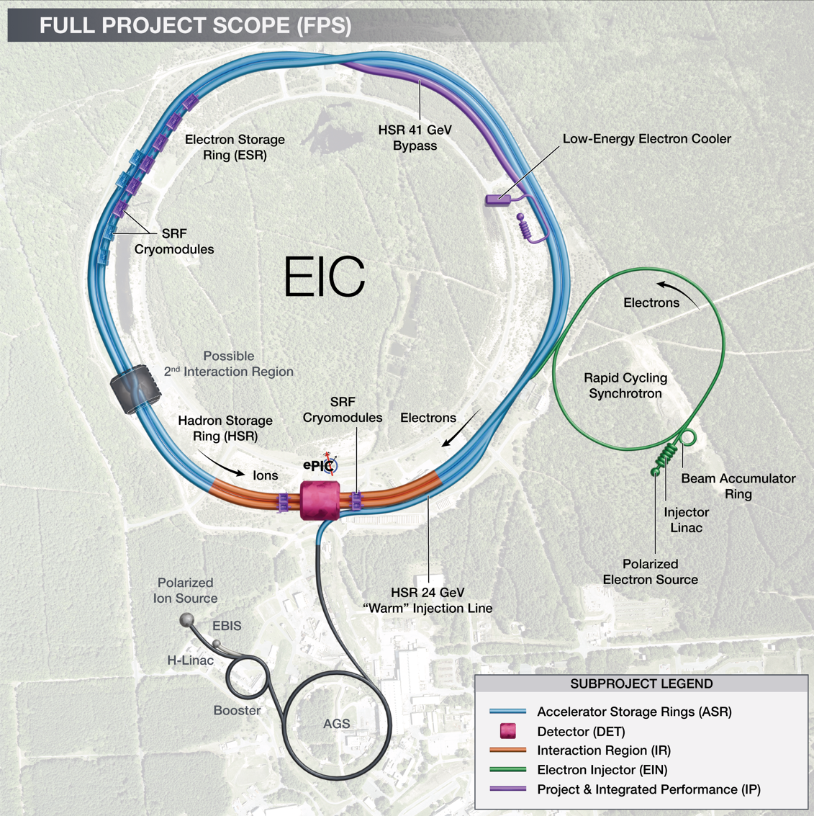
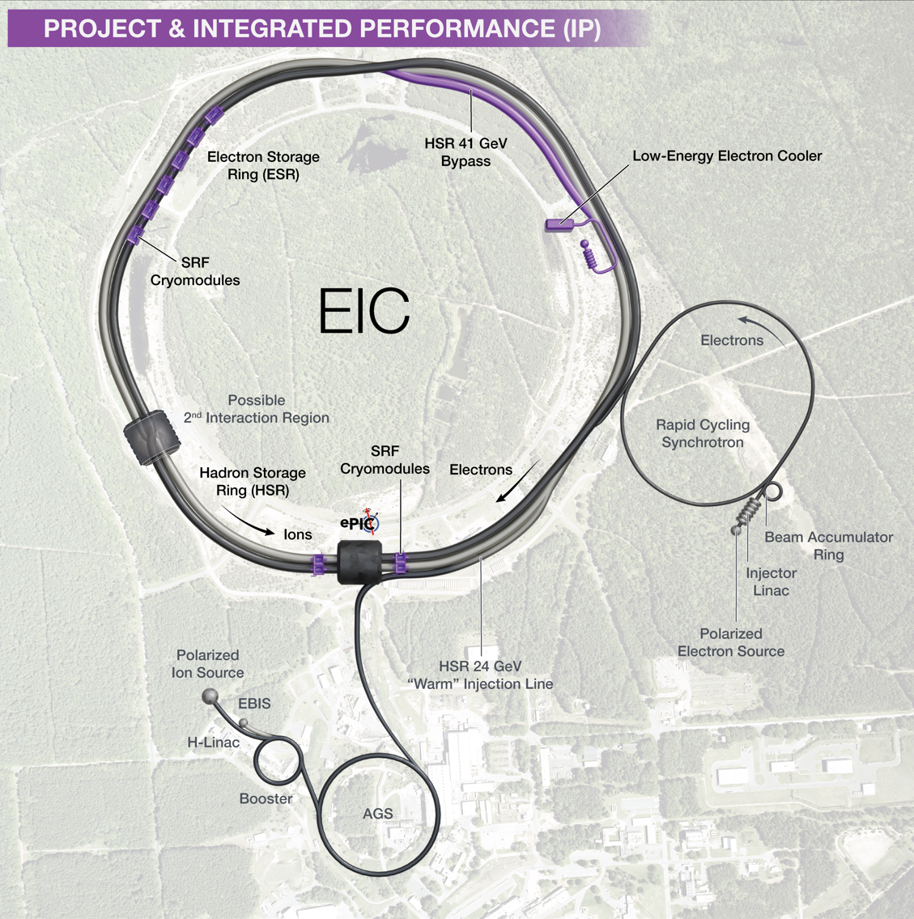
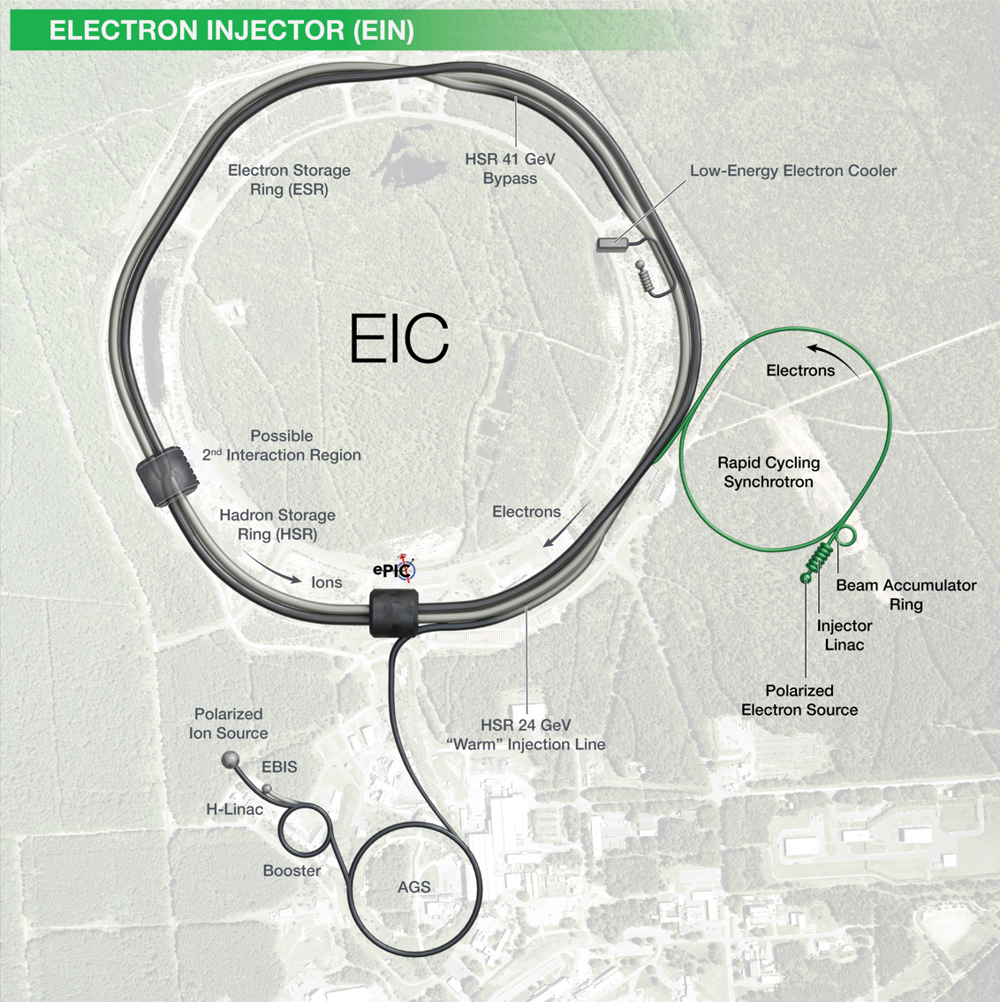
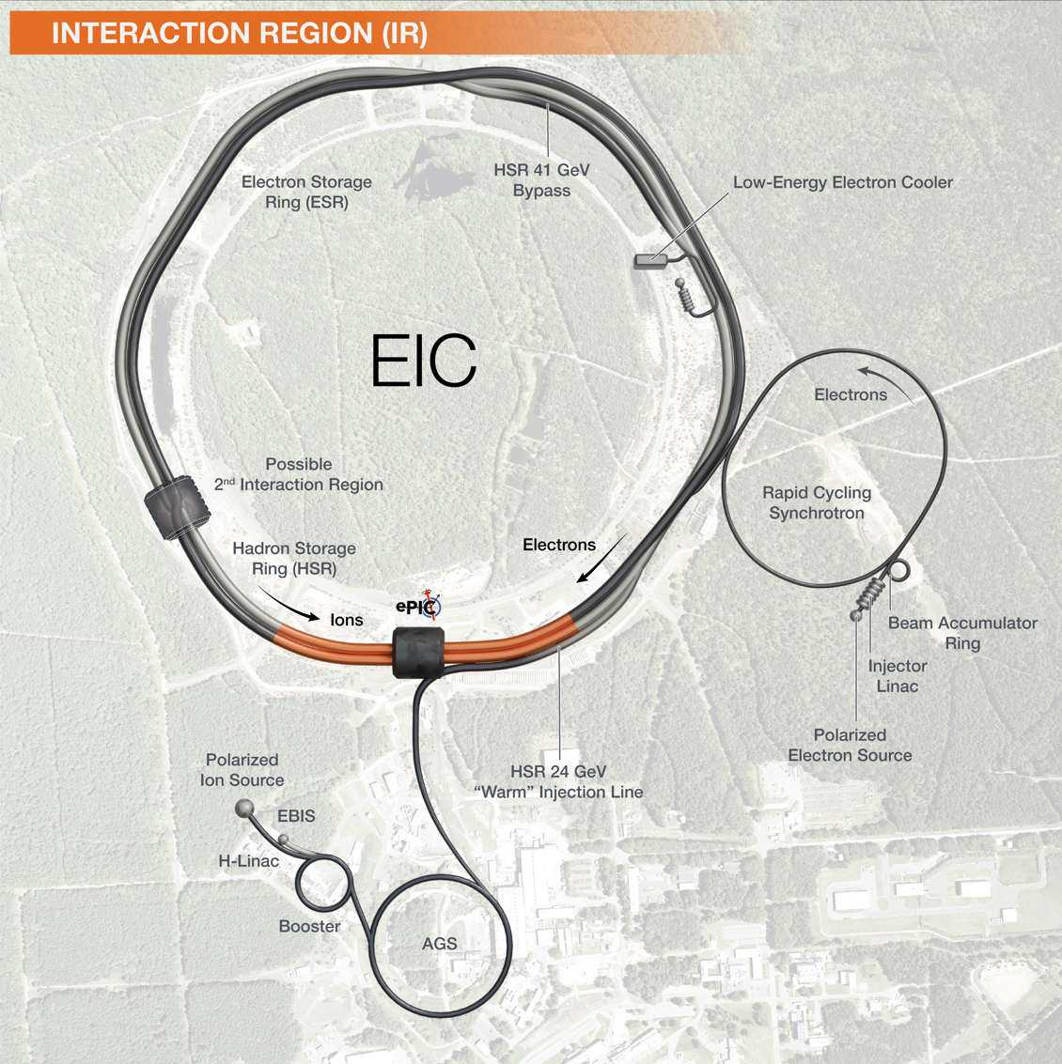

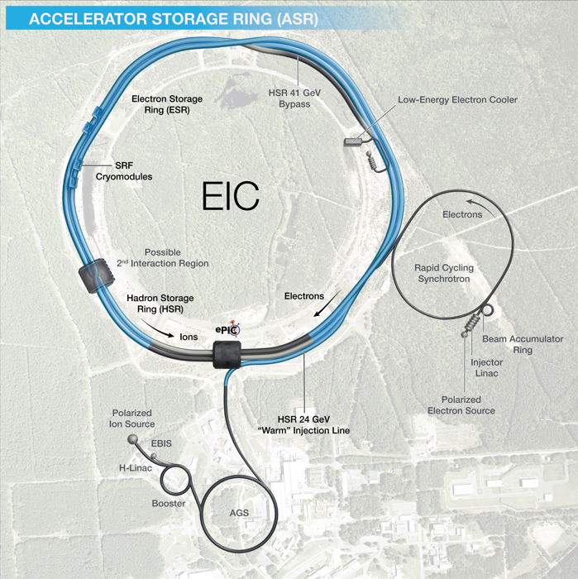
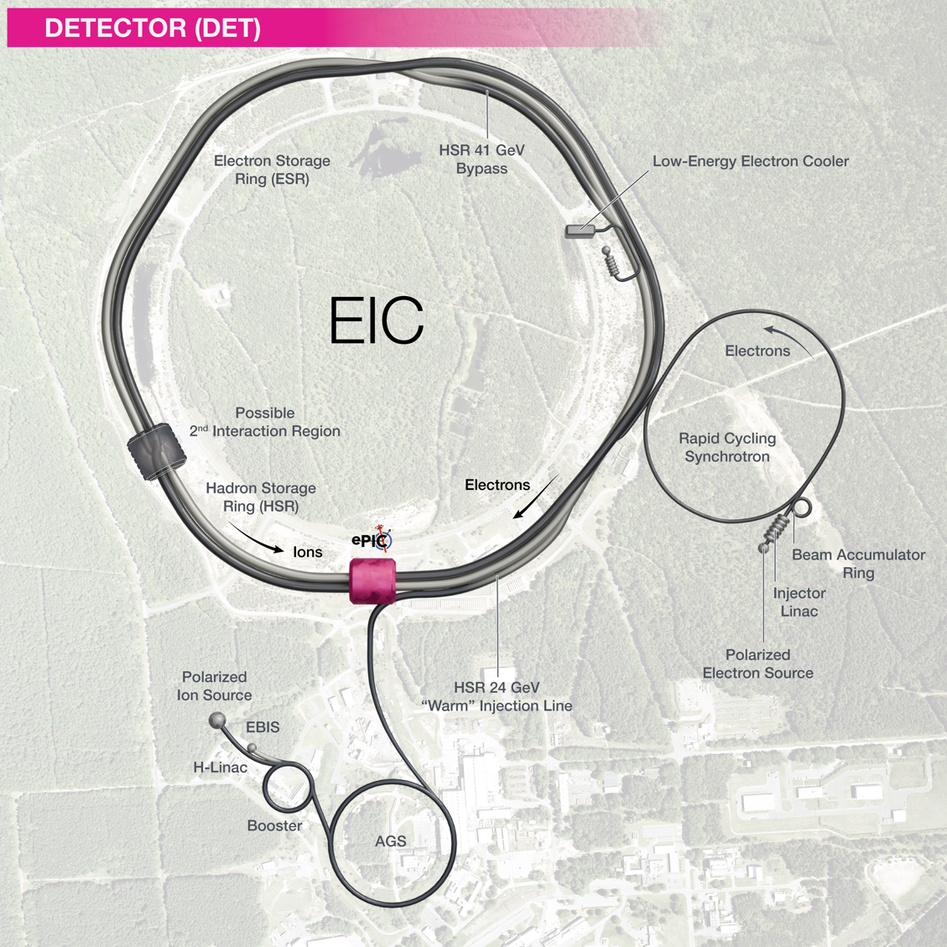

Slide 13
EIC Planning Dates
Plan to start EIC construction end of 2026.
Milestone |  | Milestone
DOE Independent Project Review (IPR) | Jan 7-9, 2025 | Assessments of Baseline Readiness for SPs | Nov ‘25 – May ‘26
Start Developing Scope of Subprojects | January 10, 2025 | Interaction Region | Nov. 18-20, 2025
IR SC Magnet Steering Group Meetings - Monthly | January 17, 2025 | Accelerator Storage Rings | Jan. 14-16, 2026
Project Advisory Committee Meeting | February 11, 2025 | Detector (Rescheduled from November 12-14) | Feb. 3-5, 2026
Detector Advisory Committee Meeting | June 11-13, 2025 | Electron Injector (follow-up to Apr ‘25 Review) | May 2026
EIC Advisory Board Meeting | June 17, 2025 | EIC Project Advisory Committee | Dec 2, 2025
DOE CD-3B ESAAB Approval | Pending | EIC Project Strategy Workshop - Stakeholders | Dec 4, 2025
DOE IPR Focused Status Review | August 5-7, 2025 | Mini-Workshop on IR Cost Reduction | Jan. 13, 2026
DOE RHIC R&R/Injector Operations Review | Sept 8-10, 2025 | RHIC Operations Concludes, R&R Starts | February 2026
Machine Advisory Committee Meeting | Sept. 16-18, 2025 | BNL Director’s Review – Comprehensive | Mar 9-13, 2026
Infrastructure Construction Advisory Committee | October 1-2, 2025 | DOE IPR Comprehensive Review | Apr 28 – May 1
EIC Advisory Board Meeting | October 10, 2025 | DOE Review of the ASR CD-2/3, DET CD-2 | October 2026
Resource Review Board Meeting (BNL) | Nov 4-5, 2025 | DOE CD-2/3 Approval for Accelerator Rings | ~End 2026

Slide 14
Assessments of Baseline Readiness
Assessments of baseline readiness measure status and evaluate future work needed to be ready for a future DOE CD-2 IPR. The charge for these reviews includes technical scope, cost, schedule, and management and plans for achieving established cost targets.
Electron Injector Complex (EIN) – complete……………………… April 8-10, 2025 (again in May ‘26)
Co-Chairs: T. Raubenheimer, SLAC, MAC Chair & E. Peoples-Evans, LBNL, ALS-U PM.
Detector (DET) (rescheduled from Nov 12-14, 2025, due to gov shutdown)………February 3-5, 2026
Co-Chairs: S. Nahn, FNAL, U.S. CMS PM & A. White, UTA, DAC Chair
Interaction Region (IR) – complete………………………………………………….November 18-20, 2025
Co-Chairs: O. Bruning, CERN, HL LHC PM, & R. Carcagno, FNAL HL LHC US Deputy, retired.
Accelerator Storage Rings (ASR) – last week……………………………………….January 14-16, 2026
Co-Chairs: J. Kerby, LBNF/DUNE Director, FNAL & T. Raubenheimer, SLAC, MAC Chair
Comprehensive Director’s Review……………………………………………………….March 9-13, 2026
Co-Chairs: T. Glasmacher, PAC Chair & TBD
DOE Independent Project Review……………………………… ………………... April 28 – May 1, 2026

Slide 15
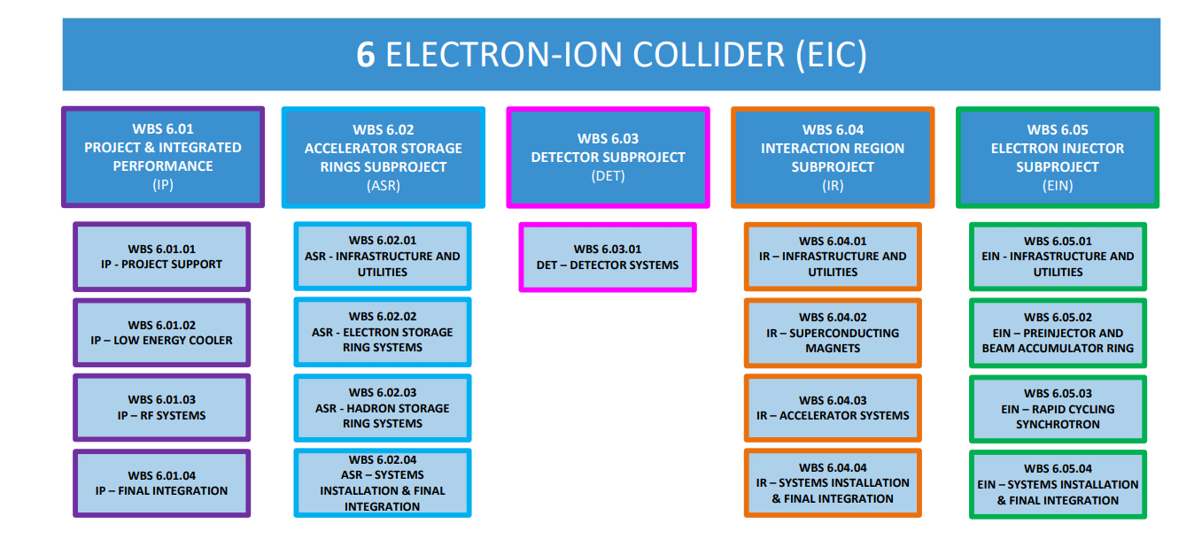
EIC Scope – Expanded WBS @ L3
Subprojects
*
The ASR and DET WBS dictionaries are fully developed.
15

Slide 16
DOE/SC Focused Review – August 2025
Select DOE Independent Project Review Committee Comments:
The EIC project team should be commended on the large amount of effort to stand-up a new subproject plan and subproject organization in the short time since the last OPA review.​
Great progress has been made in identifying and allocating the full scope of work within the EIC Portfolio. This work and the tools created therein are vital to ensure successful delivery of a facility that meets the mission needs.​
We support the plan to baseline the ASR and Detector subprojects first. Baselining the ASR is critical to retaining the RHIC expert workforce and preserving institutional knowledge following the scheduled RHIC shutdown at the end of 2025. Similarly, baselining the Detector is essential to uphold commitments related to in-kind contributions.
Recommendations for EIC Project:
Conduct a comprehensive IPR Status Review of the EIC Project in 2QFY26 (scheduled for Apr 28-May 1).
By the next review, work closely with the program to develop well documented and traceable KPPs that meet EIC mission need in a coherent manner across the subprojects (complete, draft KPPs prepared​).
By the next review, consider splitting the Integrated Project Office and Beam Commissioning (IPO) subproject to provide maximum optimization and flexibility for beam commissioning. ​(new plan combines IPO and ELR into IP).
By the next review, demonstrate that the full subproject strategy can be clearly mapped to the overall project mission need (work in progress, alongside a major effort to reduce costs to below $3B).

Slide 17
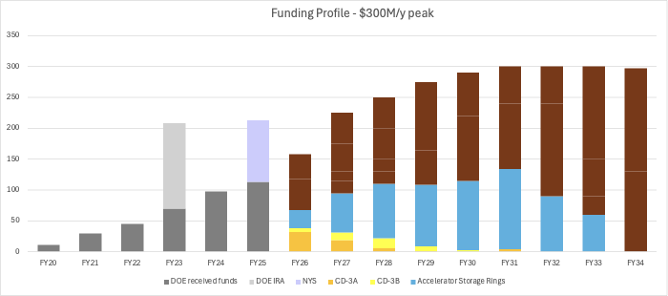
EIC Funding Profile V.5.x - DOE Review Aug. ’25
Total Per FY | 11 | 30 | 45 | 208 | 98 | 113 | 158 | 225 | 250 | 275 | 290 | 300 | 300 | 300 | 297 | TOT 2,900
New Annual Funding Targets
Assumptions:
RHIC concludes operations on February 6, 2026.
EIC project transitions into construction in 2026 with EIC site clearing and buildings supported by New York State and EIC storage rings.
Operations funding supports the hadron injector complex, removal and repurposing of RHIC equipment, and maintenance upgrades.

Slide 18
Draft Funding Profile – $300M annual peak
Total Per FY | 11 | 30 | 45 | 208 | 98 | 113 | 158 | 225 | 250 | 275 | 290 | 300 | 300 | 300 | 297 | TOT $2,900M
The ASR Subproject’s proposed funding profile can keep the funding-constrained ASR schedule closer to the technically driven schedule.

Slide 19
Project Strategy Workshop (Dec 4, 2025)
Goal: Engage stakeholders in the development of plans for delivering the EIC facility and efforts to align with DOE funding guidance and the mission need.
Assess progress on revising plans based on funding guidance
Discuss plans and results of the Assessments of Baseline Readiness
Discuss plans for establishing subproject baselines and starting construction in 2026
Participants: EIC stakeholder primary points of contact, DOE FPD and NP
Chairs of Advisory Committees, Steering Group, and EIC Governance Boards
EIC Users Group, ePIC Collaboration Spokesperson, EIC Accelerator Collaboration Co-chair
EIC Project Advisory Committee Members
Format: Similar to Aug 2024 Project Strategy Workshop (Focused on Subprojects)
Brief presentations to promote participation and discussion.
Results: Identified opportunities for significant cost reductions. EIC Project Manager tracking actions against the cost targets.

Slide 20
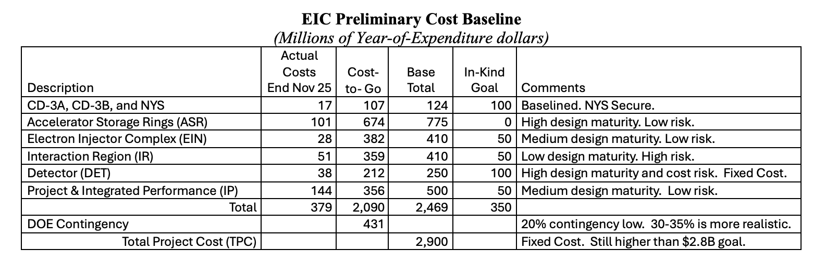
Subproject Cost Targets – J. Yeck
Subproject cost targets are required to support TPC point estimate guidance, i.e., < $3B.
Subproject cost estimates exceed their targets to varying degrees, e.g., ASR ~$200M.
A transparent process is used to track changes in project requirements and scope reductions.

Slide 21
ASR Review Draft Results – (1)
Accelerator Storage Rings (ASR) held January 14-16, 2026.
Co-Chairs: J. Kerby, LBNF/DUNE Director, FNAL & T. Raubenheimer, SLAC, MAC Chair
ASR is technically sound, well advanced, and the most mature EIC subproject.
Experienced teams, strong review culture, and steady design progress support CD-2/3 from a technical standpoint.
Designs across ESR, HSR, RF, Infrastructure, and Integration are credible; risks are understood with mitigation strategies in place.
ASR cost goal: $775M vs. current estimate of ~$1.0B; recent scrubbing reduced cost by ~$259M.
DOE IPR scheduled for April 2026, with potential CD-2/3 review for ASR in Fall 2026.
ASR organized into four major WBS elements (ESR, HSR, INF, SIFI) with roughly equal scope.
34 PDR/FDRs completed since 2023; ~30 additional reviews required before CD-2/3.
ASR hardware KPPs identified but not yet agreed to by DOE; beam storage not achievable at CD-2 due to IR vacuum readiness.

Slide 22
ASR Review Draft Results – (2)
Accelerator Storage Rings (ASR) held January 14-16, 2026.
Co-Chairs: J. Kerby, LBNF/DUNE Director, FNAL & T. Raubenheimer, SLAC, MAC Chair
Primary challenges are project-level, not technical: cost alignment, KPP convergence, scope definition, and schedule maturity.
Current TPC exceeds DOE guidance; uncertainty remains due to incomplete estimates across other EIC subprojects.
Integrated, resource-loaded P6 schedule is incomplete and must be finalized to support baselining.
Installation and integration are critical cross-cutting scopes requiring stronger coordination, interface control, and configuration management.
Several subsystems (HSR, RF, Infrastructure, civil construction) are technically ready to advance procurement.
Committee recommends continuing progress while converging with DOE on scope, cost, and KPPs by April 2026April IPR should present a clear path to October 2026: either a full CD-2/3 review or a phased approach advancing ready scopes.
With timely leadership decisions and improved integration, ASR can transition successfully from design to construction.

Slide 23
ASR Review Draft Recommendations
Many constructive recommendations, summarizing here:
Work with the DOE program on project implementation plans.
At the April Status IPR, the project should present a proposal for the path forward to the October IPR, whether it be a full CD-2/3 IPR or a IPR including mechanism for advancement of those components technically ready for procurement, such as the civil construction and other technical systems mentioned above.
J. Yeck Notes:
CD-2, Performance Baseline Approval, for a subproject requires a DOE approved funding profile.
CD-3, Construction Start Approval, requires completion of final design.
CD-3a,b,c, etc., Long Lead Procurement, requires a CD-2/3, for limited scope.

Slide 24
Detector Review
Detector (DET) assessment of baseline readiness is scheduled for Feb. 3-5, 2026.​
Co-Chairs: S. Nahn, FNAL, U.S. CMS PM & A. White, UTA, DAC Chair ​
Subcommittees
Electronics and DAQ, PID, Tracking (6 committee members)
Magnet, Calorimetry, Mechanical, Auxiliary, Polarimetry (5 committee members)
Management, Cost and Schedule (6 committee members)
A successful review will result in constructive recommendations aligned with the work needed to establish the ePIC detector baseline.
Collaboration support for the review is essential – thank you!
Collaboration support support is need following the review to address the recommendations from the review including the implications on the DET cost target.

Slide 25
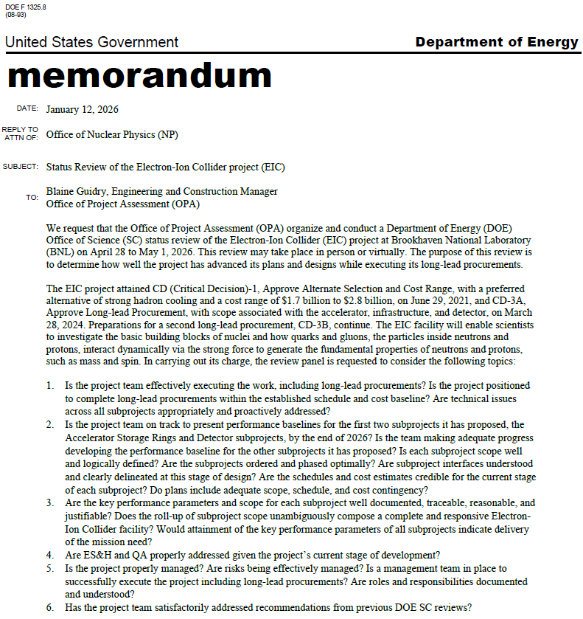
Comprehensive Director’s Review Charge
DOE IPR Charge, plus a few key meta challenges suggested by the Co-chairs.
Assess EIC’s readiness, at a strategic level:
Progress on cost expectations – Target cost, point estimate, potential for further cost reductions to hit targets?
Project Execution Plan – scope, sequencing of the subprojects, collisions.
Portfolio (off-project) Execution Plans –organization, scope, schedules including alignment with EIC project dates
Messaging – Alignment, quality, and impact.
Next 2 slides!

Slide 26
DOE IPR Charge (1)
Charge items 1-3, out of 6:
Is the project team effectively executing the work, including long-lead procurements? Is the project positioned to complete long-lead procurements within the established schedule and cost baseline? Are technical issues across all subprojects appropriately and proactively addressed?
Is the project team on track to present performance baselines for the first two subprojects it has proposed, the Accelerator Storage Rings and Detector subprojects, by the end of 2026? Is the team making adequate progress developing the performance baseline for the other subprojects it has proposed? Is each subproject scope well and logically defined? Are the subprojects ordered and phased optimally? Are the schedules and cost estimates credible for the current stage of each subproject? Do plans include adequate scope, schedule, and cost contingency?
Are the key performance parameters and scope for each subproject well documented, traceable, reasonable, and justifiable? Does the roll-up of subproject scope unambiguously and progressively elaborate a complete and responsive Electron-Ion Collider facility in an asset-oriented hierarchy? Are subproject interfaces understood and clearly delineated at this stage of design? Would attainment of the key performance parameters of all subprojects indicate delivery of the mission need?

Slide 27
DOE IPR Charge (2)
Charge items 4-6:
Are ES&H and QA properly addressed given the project’s current stage of development?
Is the project properly managed? Are risks being effectively managed? Is a management team in place to successfully execute the project including long-lead procurements? Are roles and responsibilities documented and understood?
Has the project team satisfactorily addressed recommendations from previous DOE SC reviews?

Slide 28
Summary – Starting EIC Construction in 2026
EIC will be a unique collider facility in the world and the only collider in the U.S.
There is a good understanding of the current EIC scope, cost, schedule, and funding requirements and the interfaces and design maturity of the subprojects.
The EIC subproject delivery strategy provides the possibility to start construction of the accelerator storage rings immediately following the conclusion of RHIC operations.
Project delivery plans are currently not consistent with the annual funding projections under discussion. The project is working to align requirements, scope, and cost with the revised funding projections. We are engaging EIC users and stakeholders.
There is excellent progress defining and managing the EIC Portfolio scope, e.g., the DOE ONP supported ops scope. The $100M of NYS funding is in the bank!
DOE will conduct a comprehensive IPR in April 2026. This review will set the stage for the DOE approval reviews in October: 1) Accelerator Storage Rings (CD-2/3) and 2) Detector (CD-2).

Slide 29
Backup Slides

Slide 30
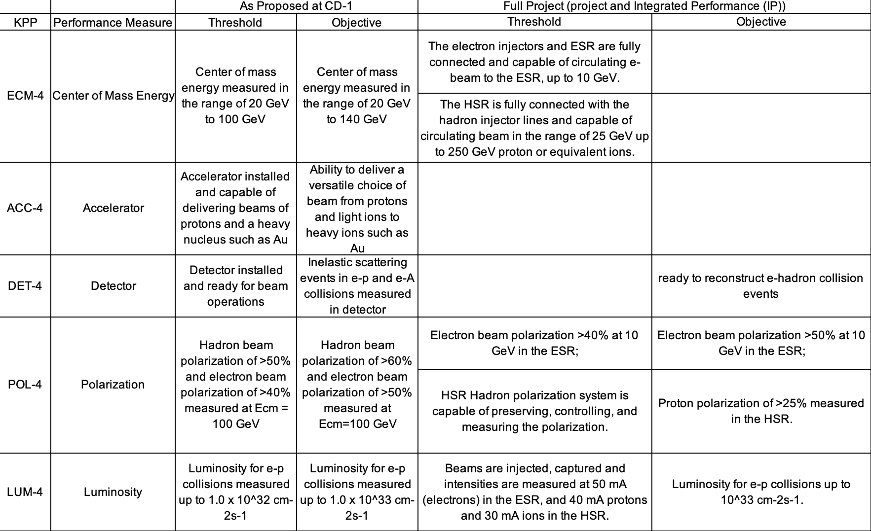
Draft KPPs (1/2)
The subproject delivery strategy required to revise the CD-1 proposed KPPs is set at the full project level.
Since last summer, we have worked in collaboration with DOE/NP to develop subproject KPPs in line with the EIC CD-0 Mission Need.

Slide 31
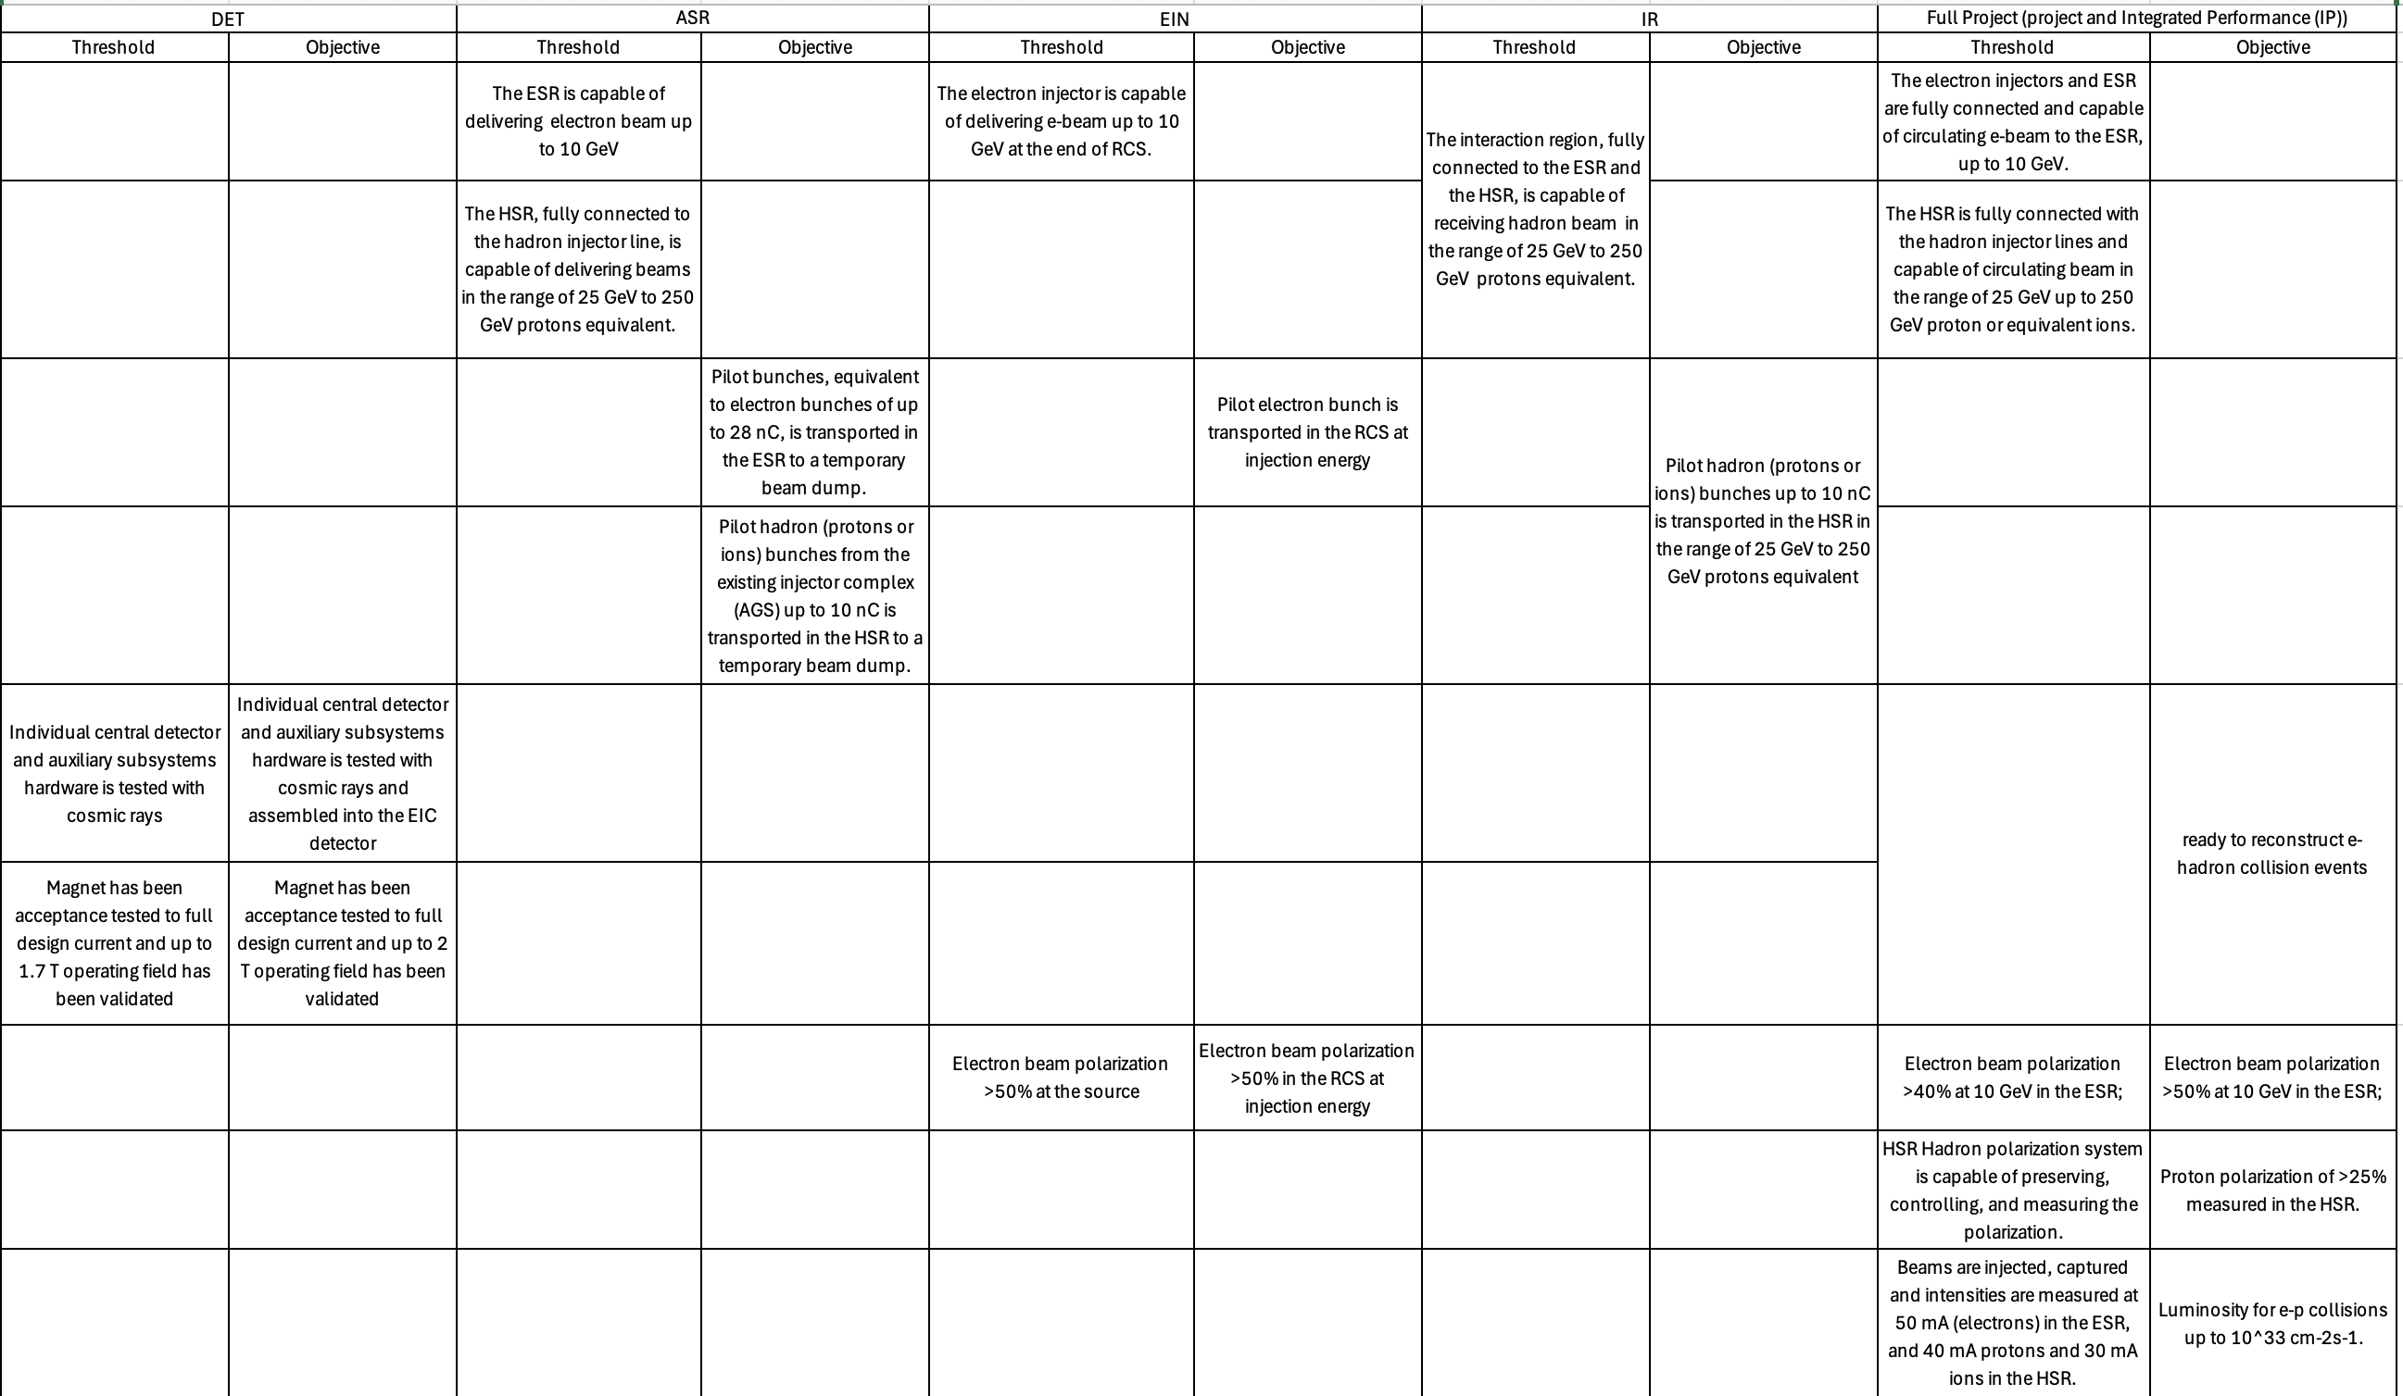
Draft KPPs (2/2)
e- line integrated
Hadron line integrated
e- beam circulating
Hadron beam circul.
Detector
e- polarization
Hadron polarization
Collisions
The subproject delivery strategy requires mapping the draft subproject KPPs to the final full Project goal.

Slide 32
Draft ASR KPPs
Subproject | Performance Measure | Threshold KPPs | Objective KPPs
ASR | e- beam | The ESR is capable of delivering electron beam up to 10 GeV | Pilot bunches, equivalent to electron bunches of up to 28 nC, is transported in the ESR to a temporary beam dump.
 | Hadron beam | The HSR, fully connected to the hadron injector line, is capable of delivering beams in the range of 25 GeV to 250 GeV protons equivalent. | Pilot hadron (protons or ions) bunches from the existing injector complex (AGS) up to 10 nC is transported in the HSR to a temporary beam dump.
Verification methodology
Threshold:
ESR: Magnets powered to the designed operating level, corresponding to 10 GeV/c momentum;
HSR: SC Magnets powered to the designed operating level, corresponding to 130 GeV/c (on-center orbit);
Four 591 MHz RF cryomodules in the ESR (2) and HSR (2) are conditioned in the tunnel.
Objective:
For HSR, proton beams from the existing hadron injector complex (AGS) at its standard injection energy (~25 GeV) and transported to a temporary beam dump.
For ESR injection, the current assumption is that the e- injector will be available to deliver beam. However, in absence of the completion of the e- injectors, proton pilot bunches will be transported in reverse direction to a temporary beam dump at 10 GeV/c proton momentum.

