Slide 1

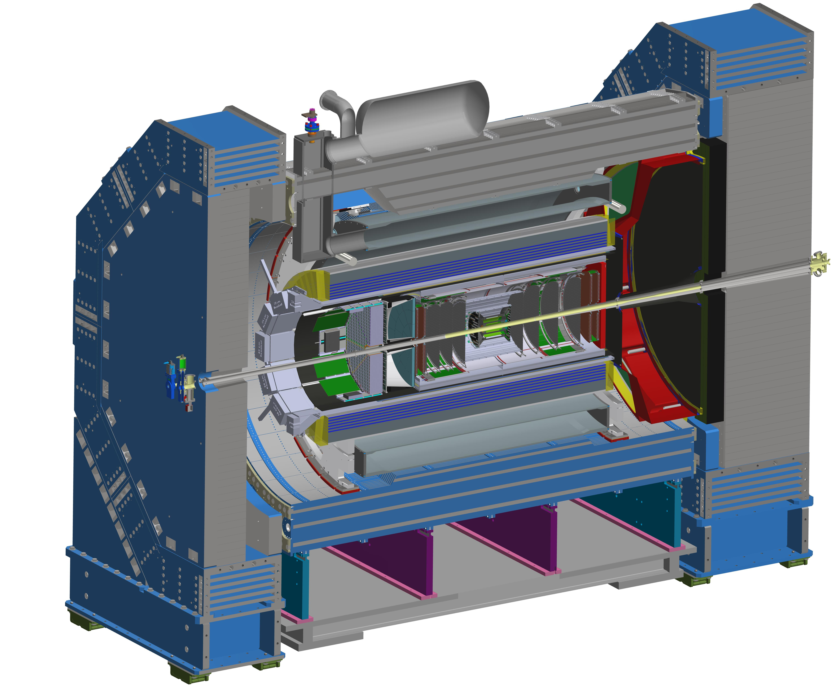
Closing and Farewell
John Lajoie
Silvia Dalla Torre
January 23, 2026

Slide 2

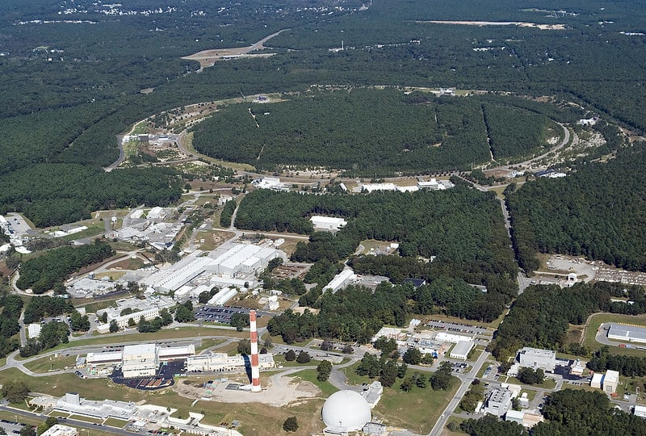

THANK YOU
Future home of the Electron-Ion Collider!
A huge THANK YOU to the local organizers for pulling everything together on short notice!

Slide 3
Thanks to those who made it happen!
Rachel Inguanta (Rachel)
Olabisi Ogunleye (Bisi)
Christine Immel (Christine)

Slide 4
What’s coming in 2026 …

Slide 5
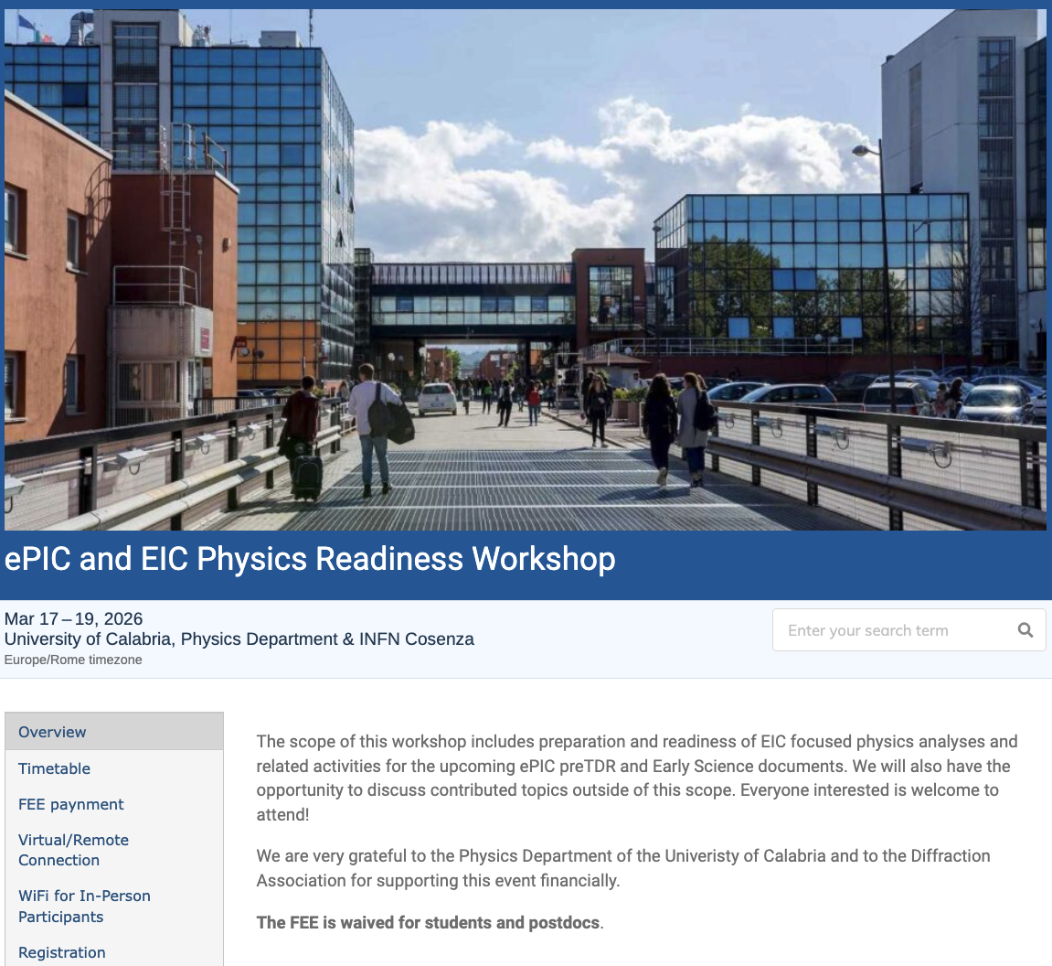
The discussion on performance continues!
Next Physics Readiness Workshop scheduled for March 17-19
Hosted by the University of Calabria & INFN Cosenza
Indico: https://indico.bnl.gov/event/30283/
Hybrid format - Please register even if attending online (select proper option)
€150 FEE waived for students/postdocs
Possibility (limited) for ECRs support
The workshop will focus on the finalization of studies and text for the TDR and early science documents

Slide 6
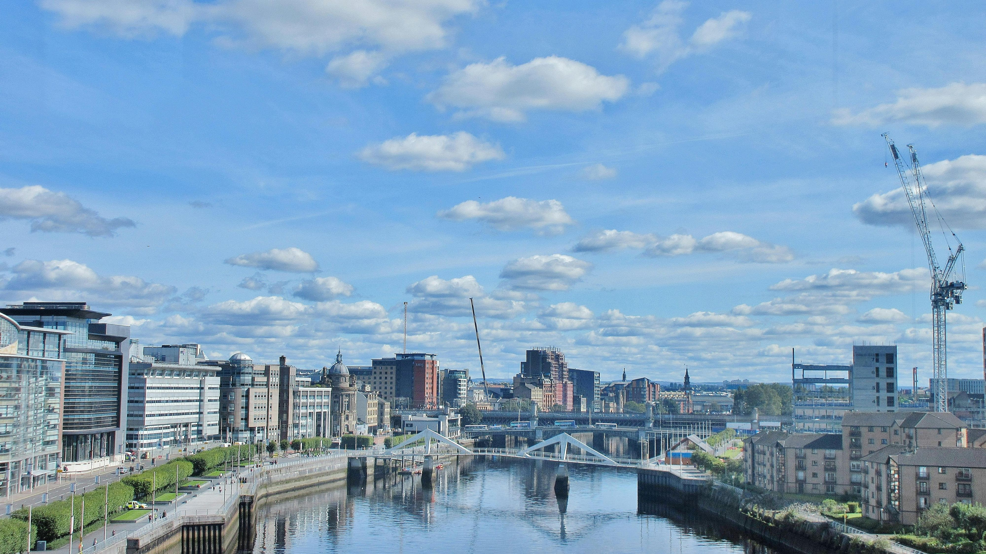
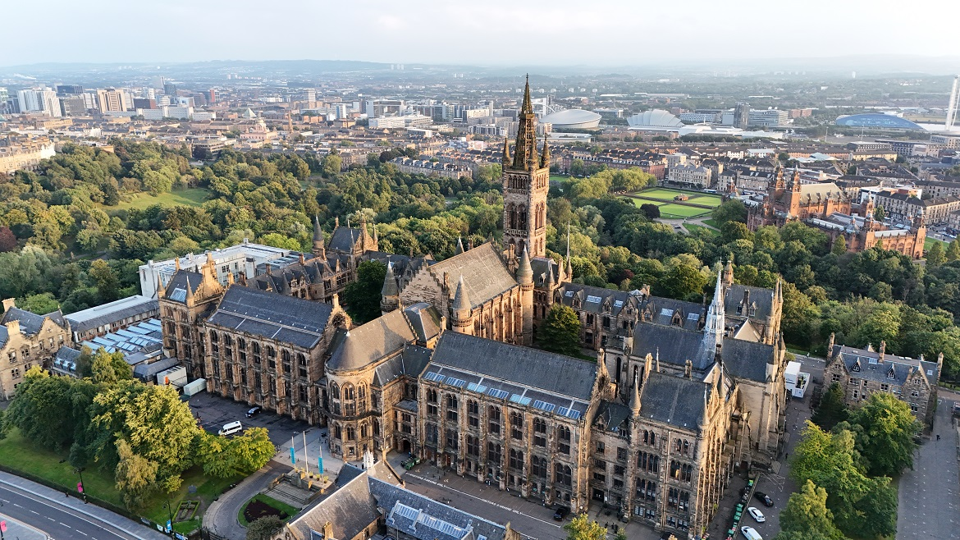
Summer 2026 Joint EICUG/ePIC Meeting
After discussions with the EICUG SC, the ePIC CC Chair/Vice-Chair, and the ePIC Spokespersons and coordinators, we have accepted a bid by the UK to host the Summer 2026 joint EICUG/ePIC meeting at the University of Glasgow July 13-17th , 2026.
More information coming soon!

Slide 7
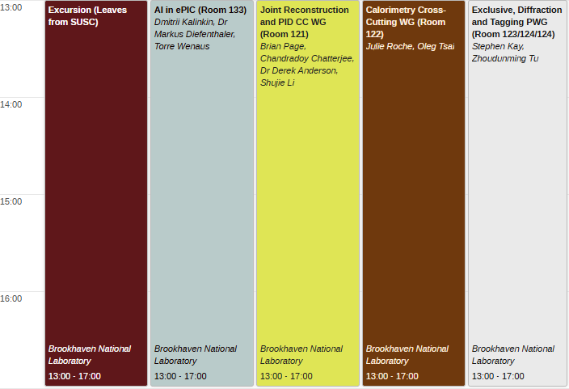
Friday Afternoon: Workfests and Excursion
I hope everyone will take advantage of the Friday workfests and/or the tour!

Slide 8
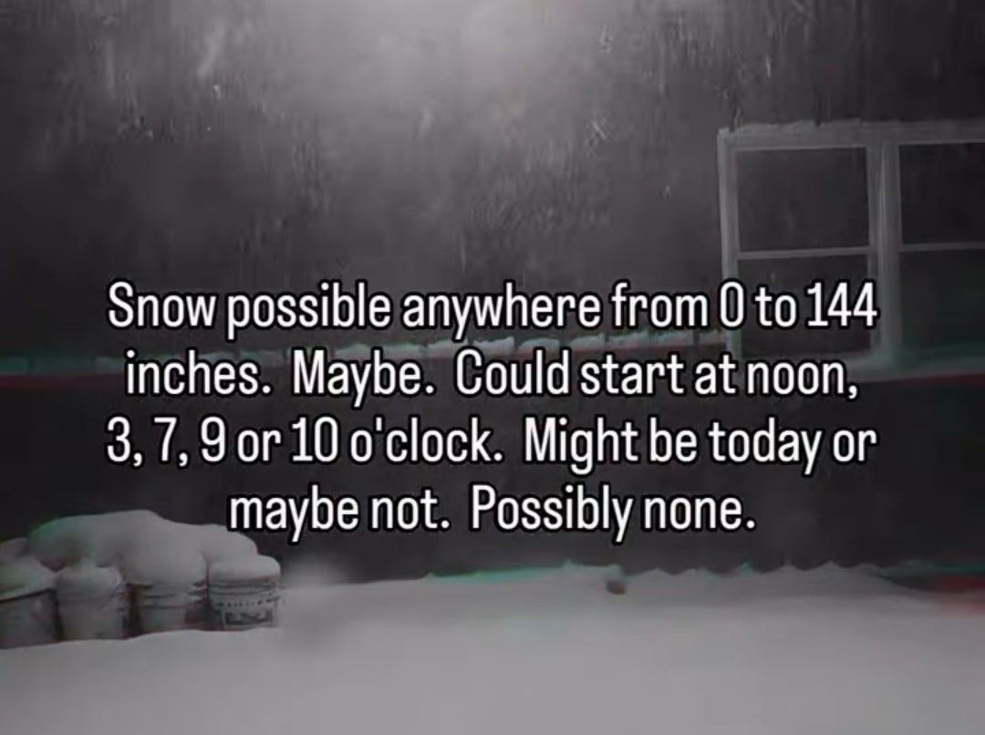
Weather Forecast

Slide 9

THANK YOU for a productive meeting!
Thanks again to Oskar Hartbrich for the sticker design!

Slide 10


Slide 11
ePIC Resources
Public Website - https://www.bnl.gov/eic/epic.php
Mailing Lists – https://lists.bnl.gov/mailman/listinfo
Indico Agenda - https://indico.bnl.gov/category/402/
ePIC Software and Computing: https://indico.bnl.gov/category/435/
Wiki - https://wiki.bnl.gov/EPIC
ePIC Software Training:
Landing Page: https://eic.github.io/documentation/landingpage.html
Tutorials: https://eic.github.io/documentation/tutorials.html
Mattermost: https://chat.epic-eic.org
ePIC Zenodo Community: https://zenodo.org/communities/epic

Slide 12


EICUG Membership
The EICUG is a vital organization to promote the interests of the EIC community!
Without the EICUG we would never have gotten far enough to form ePIC!
Please register your institution!
Check with your EICUG IB representative to get registered as a member
https://www.eicug.org/content/join.html

Slide 13
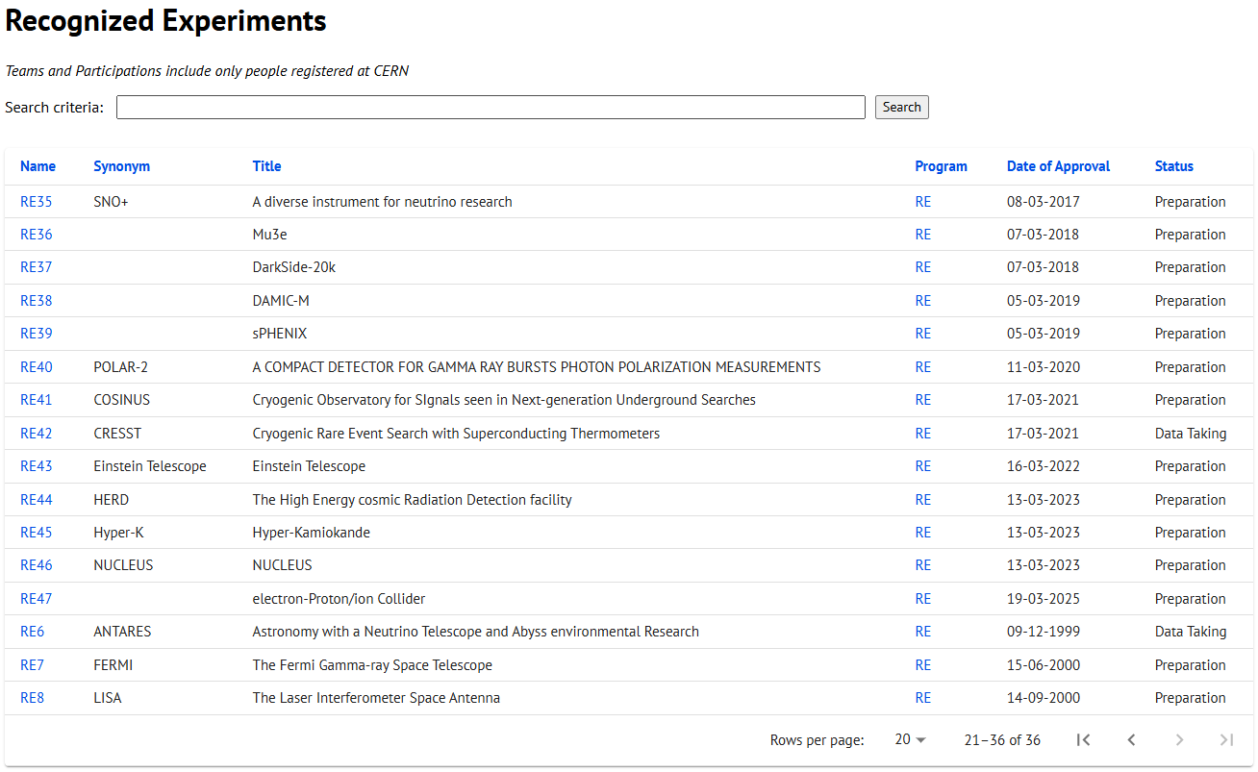
CERN Recognized Experiment Status: RE47
ePIC now appears in the CERN Grey Book database as RE47: https://greybook.cern.ch/experiment/recognized
Two steps to get ePIC Collaborators registered at CERN:
CC Representative needs to register as team leader with CERN Users Office:
https://usersoffice.web.cern.ch/
https://usersoffice.web.cern.ch/team-leaders-corner
Users.Office@cern.ch
CC member can then certify registrations of team members
Contact us if you run into problems!

