Slide 1
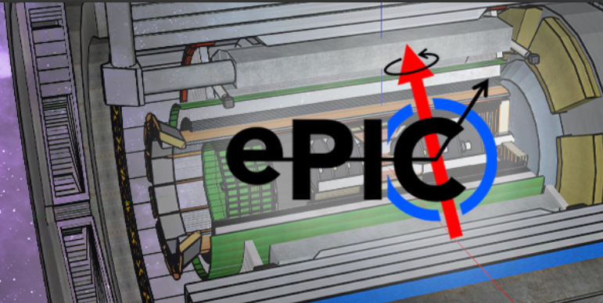


SRO Guided AI for Meson Structure Extraction and Background Distinction in EIC Reconstructions for SRO Frames
Multi-Method Ensemble for Anomaly Detection in EIC Reconstructions for SRO Frames with Background
Collaborators – Sandeep Shiraskar, Dominick Rizk, Tanja Horn, Dmitry Romanov, Baptiste Fraïsse, Avnish Singh.

Slide 2
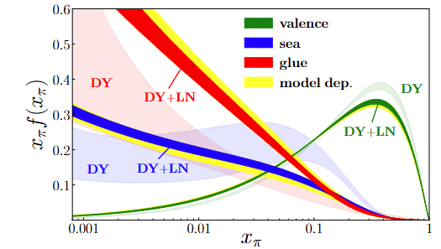
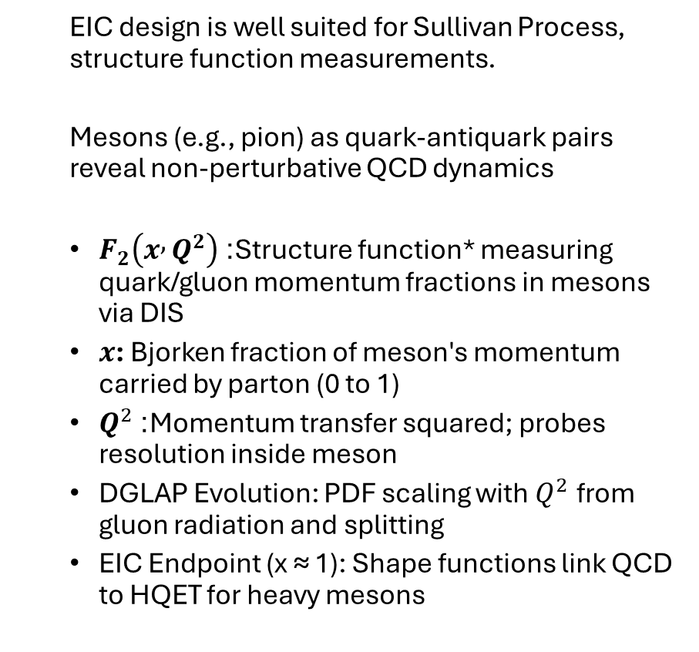
Meson Structure Functions in QCD
  EIC design is well suited for Sullivan Process, structure function measurements.
  Mesons (e.g., pion) as quark-antiquark pairs reveal non-perturbative QCD dynamics
  $F_{2}\left(x , Q^{2}\right)$: Structure function* measuring quark/gluon momentum fractions in mesons via DIS
  $x$: Bjorken fraction of meson's momentum carried by parton (0 to 1)
  $Q^{2}$: Momentum transfer squared; probes resolution inside meson
  DGLAP Evolution: PDF scaling with $Q^{2}$ from gluon radiation and splitting
  EIC Endpoint (x ≈ 1): Shape functions link QCD to HQET for heavy mesons
Pion PDFs xfx at Q² = 10 GeV² from global QCD fit (DY + LN data), decomposing valence, sea, and gluon contributions analogous to F₂^π(x, Q²) in meson DIS.
Reference : Barry, Sato, WM, C.-R. JiPRL 121, 152001 (2018)
*For further details or questions regarding Meson Structure Functions, please refer to the upcoming presentation by Baptiste Fraïsse.

Slide 3
Overall Goals
Leverage artificial intelligence to advance data quality nuclear physics experiments.
If, AI models can capture complex, non-linear noise signatures that exceed analytical approaches ?
Improve hit-level signal–noise separation for EIC Streaming Read Out (SRO) datasets.
Preserve physics efficiency while removing anomalous/background detector activity.

Slide 4
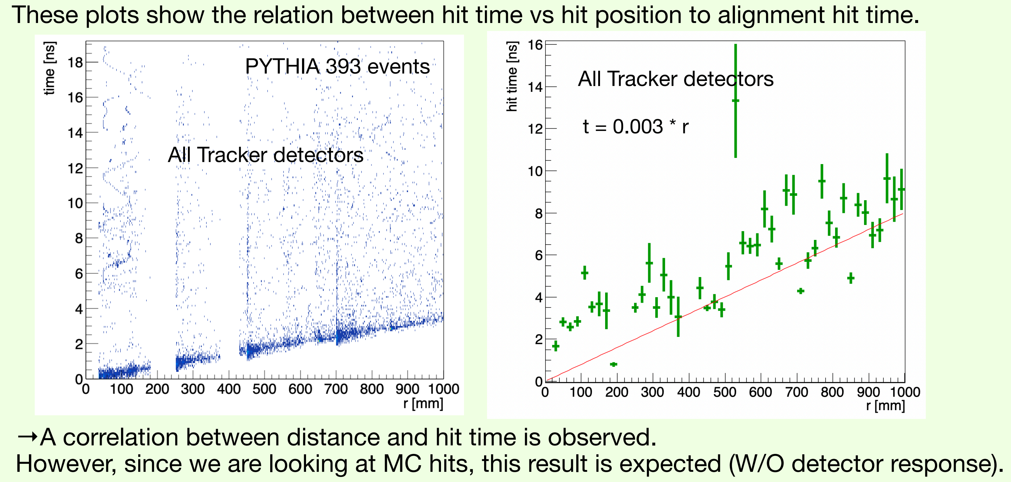
Without Using Machine Learning
One of the preTDR goals is software able to work with data frames
Reference : Takuya Kumaoka and Taku Gunji

Slide 5
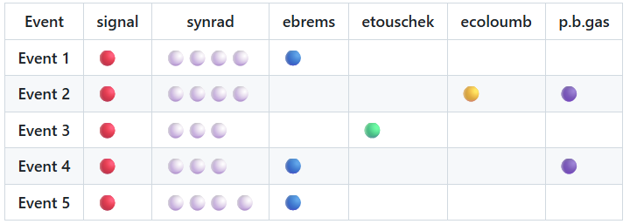
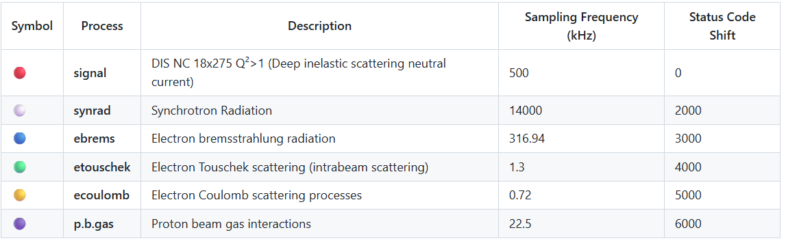
Dataset
Reconstructed Output data 25.10.4 simulation campaign, as documented in Background Mixed Samples
More Information: Background wiki
Each event contains at least 1 signal contribution
The background contributions get allocated per event based on their sampling frequency.
Processes with lesser sampling frequency are not guaranteed a contribution in every event.

Slide 6
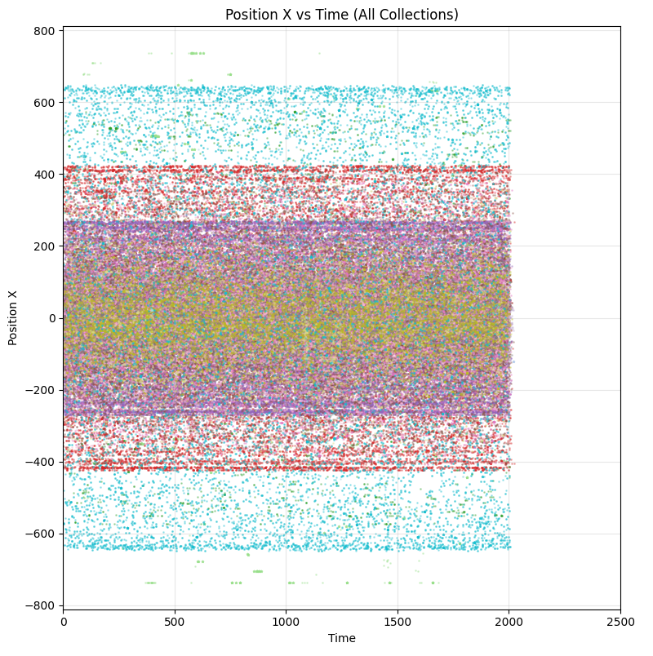
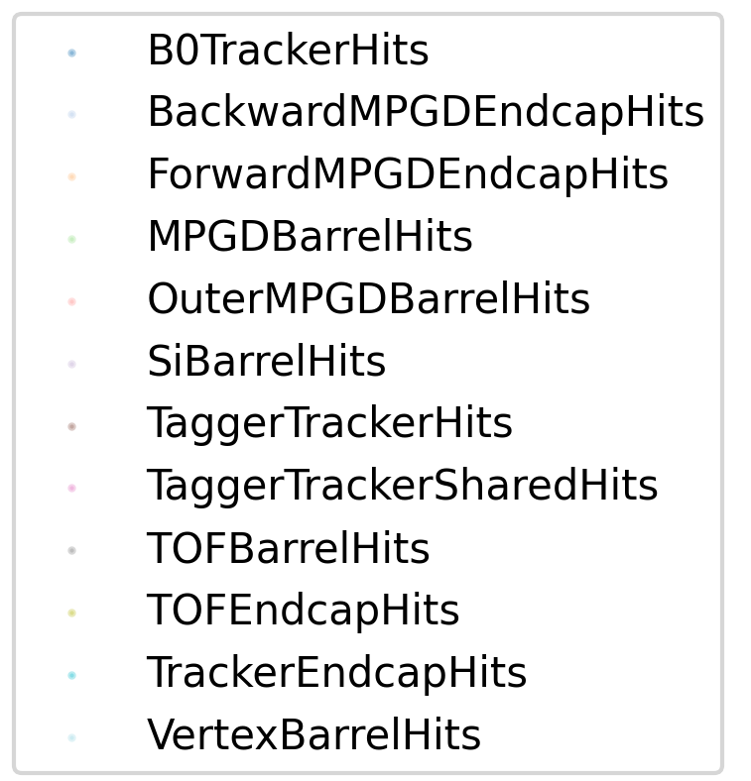
Background Enriched Data in EIC
Triggerless Design: Captures all events continuously within timestap intervals of 2000ns.
Hit Data: EDM4hep format with position, eDep, path length, time
Key Features: Compute dE/dx ratios, pseudorapidity η = -ln(tan(θ/2))
Output: Dense collections for ML filtering
Notes:
Describe the data, instead of SRO in EIC. After, the data slide.

Slide 7
Approach
A hybrid noise-detection ML pipeline consisting of (Isolation Forest, VAE, DBSCAN) and a Random Forest classifier.
Ensemble Approach - A stacked (meta-learning) ensemble in which multiple base detection (Isolation Forest, VAE, DBSCAN) produce scores that are combined via a meta-model (e.g.,Random Forest).
MC Truth based validation.

Slide 8
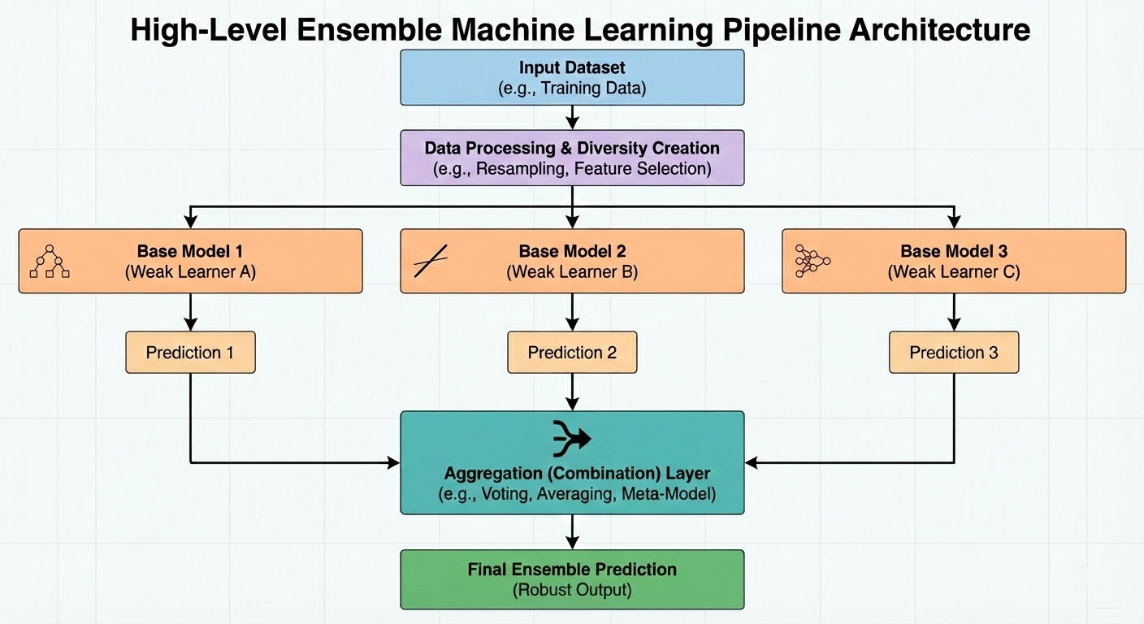

Slide 9
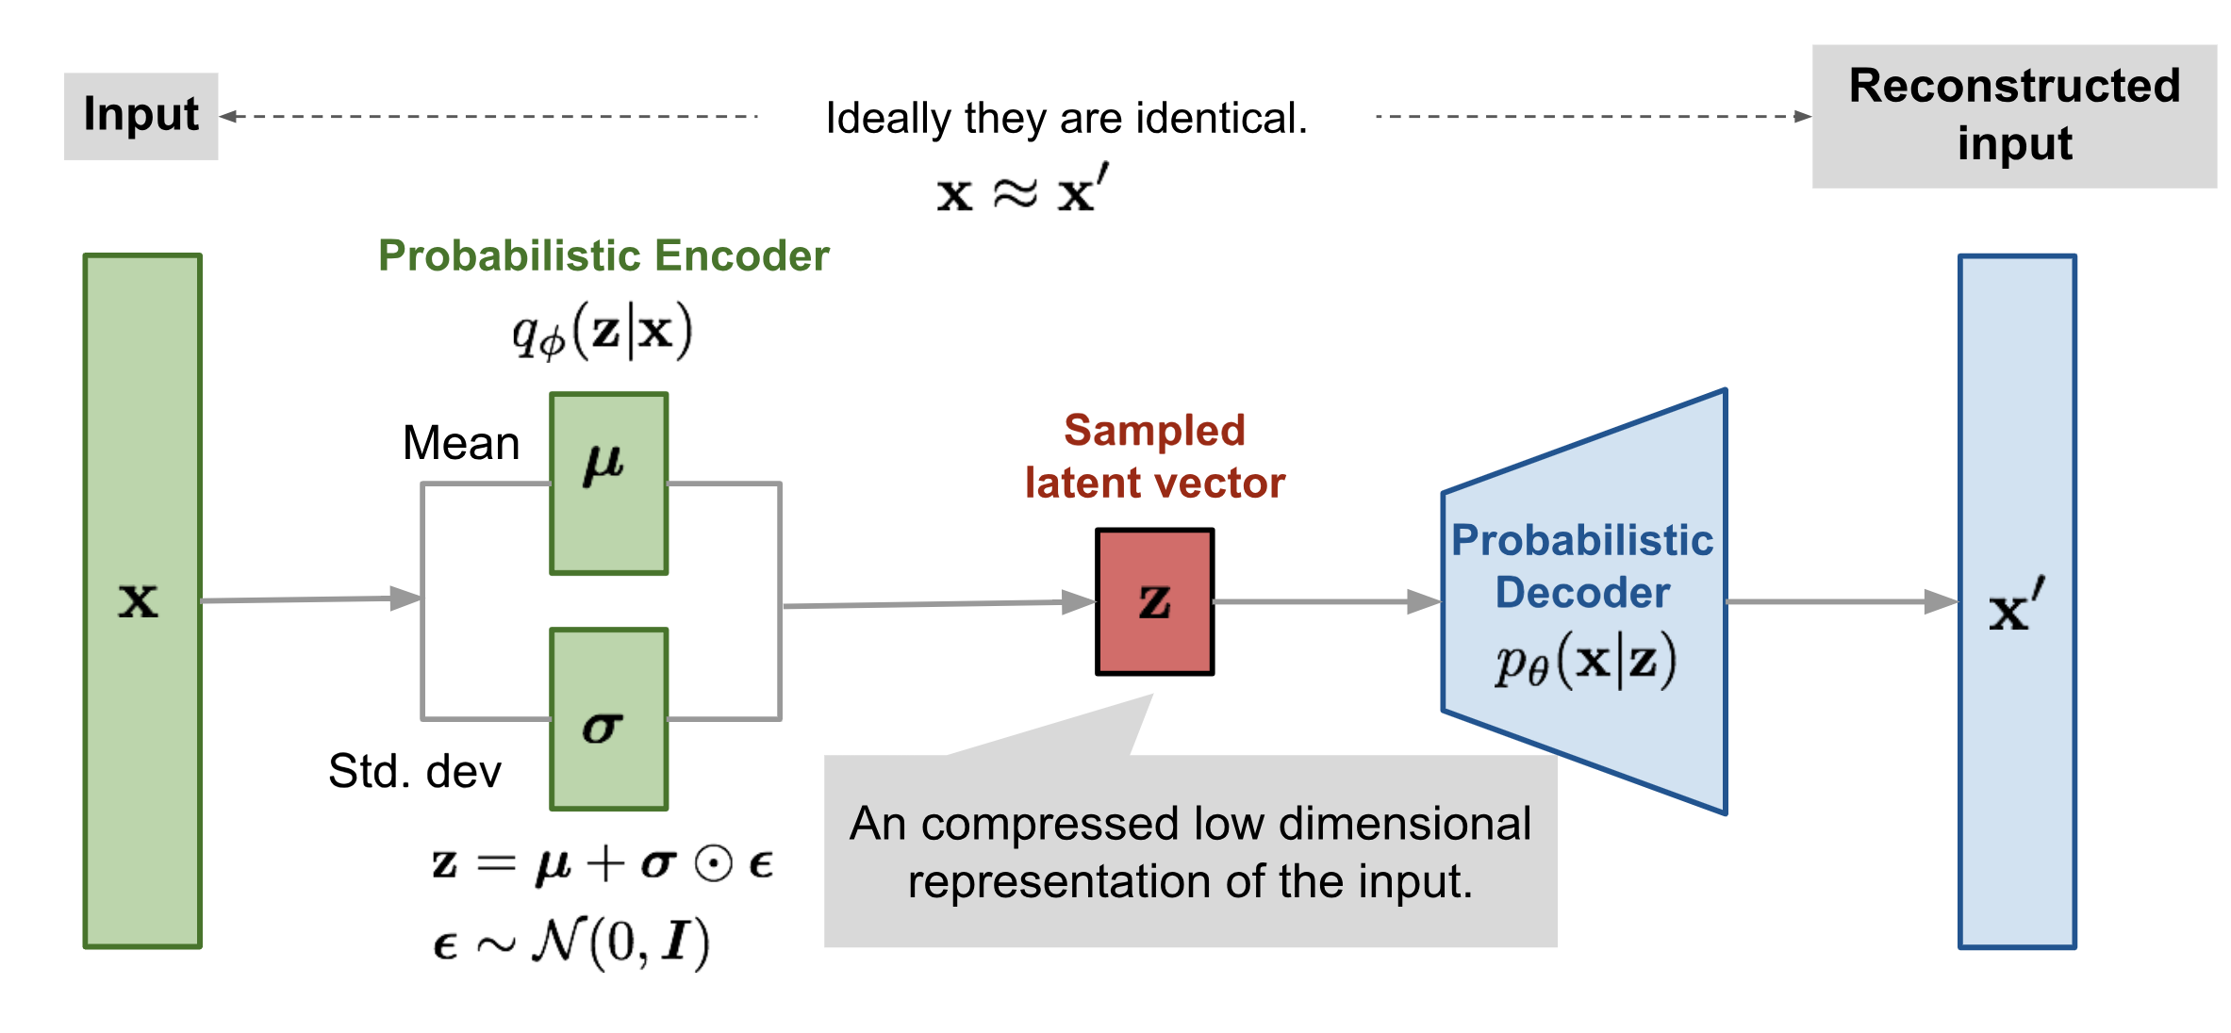
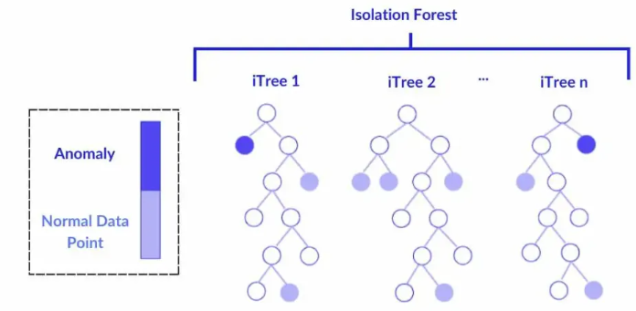
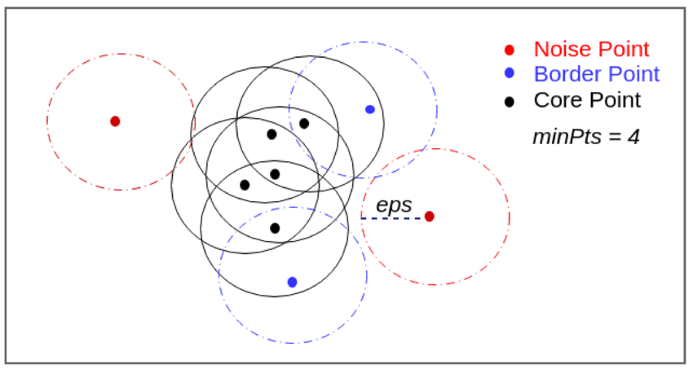
AI/ML for Anomaly Detection
Isolation Forest: Scores outliers by random feature splits
VAEs: Reconstruct hits, flag high MSE deviations
DBSCAN: Clusters dense signals vs. isolated noise
Notes:
Say what is ensemble method – definition.

Slide 10
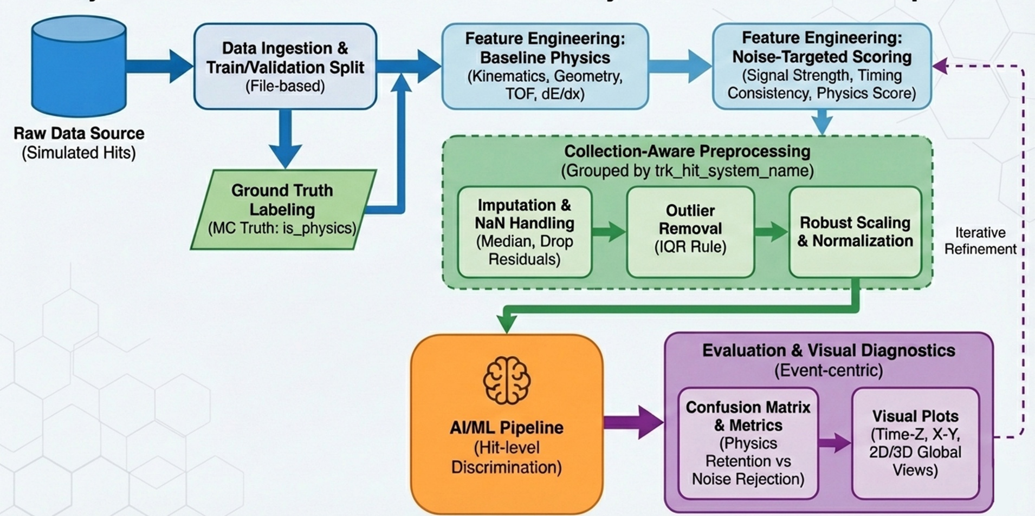
ML Pipeline for Anomalous Noise Detection

Slide 11
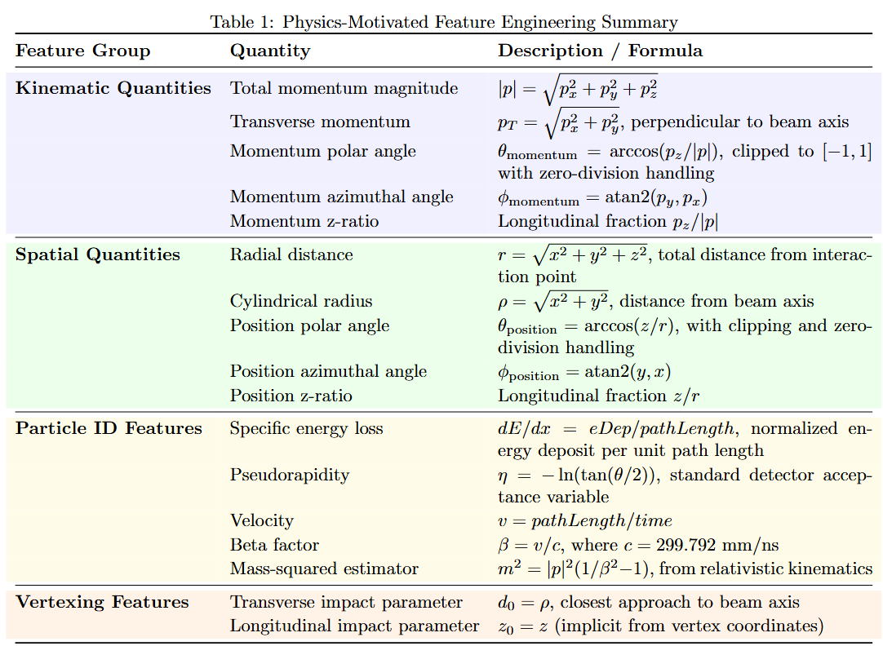
Feature Engineering
Calculate physics quantities (total momentum, energy loss rate, angles, etc.) instead of using raw numbers
Hits are processed separately for each detector collection (grouped by trk_hit_system_name),

Slide 12
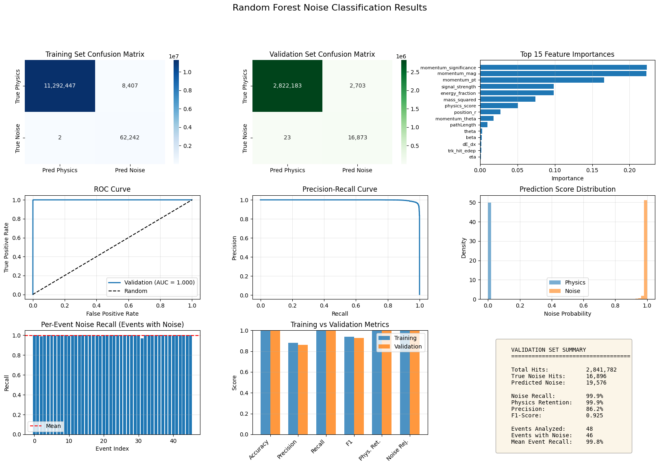
Feature Engineering
The feature set was explicitly designed to encode the physics differences between real charged-particle hits and electronic/background noise (e.g., correlations between momentum, geometry, energy deposit, and timing)

Slide 13
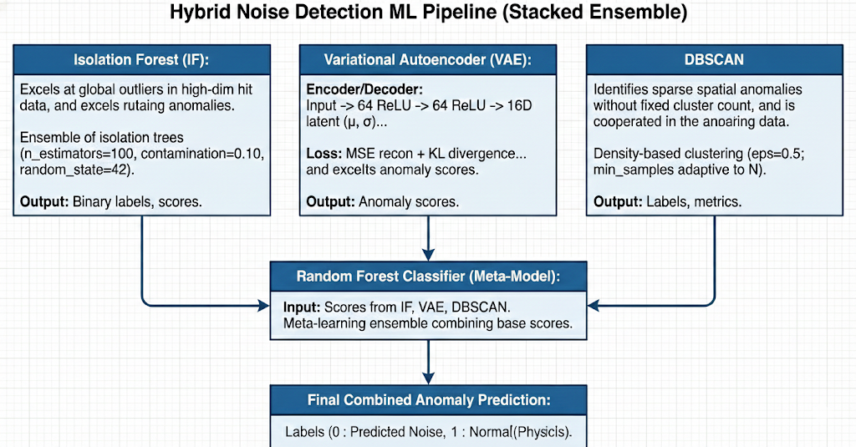
Training the Models : Transitioning to Anomalous Noise Detection

Slide 14
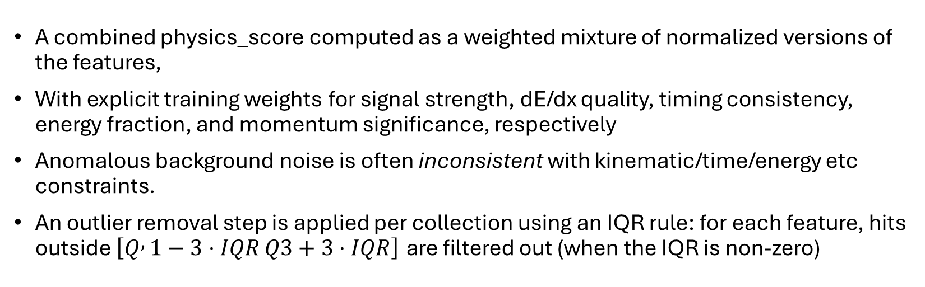
Noise-Targeted Feature Training
A combined physics_score computed as a weighted mixture of normalized versions of the features,
With explicit training weights for signal strength, dE/dx quality, timing consistency, energy fraction, and momentum significance, respectively
Anomalous background noise is often inconsistent with kinematic/time/energy etc constraints.
An outlier removal step is applied per collection using an IQR rule: for each feature, hits outside $\left[Q , 1−3⋅IQR Q3+3⋅IQR\right]$ are filtered out (when the IQR is non-zero)

Slide 15
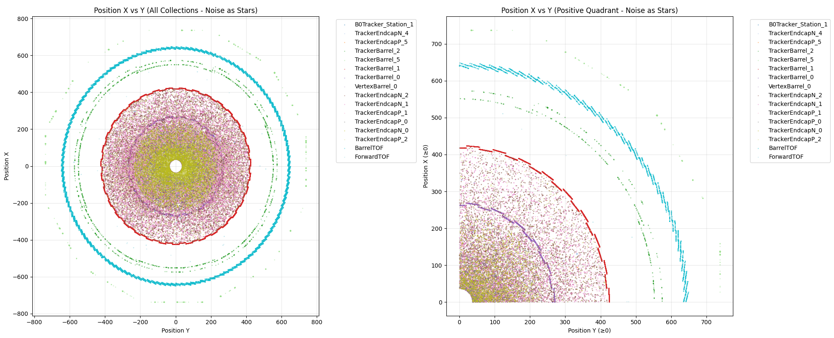
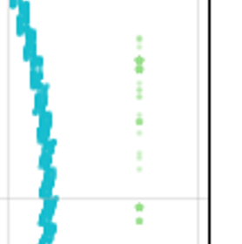
Results

Slide 16
Validation
“physics” label was defined from MC truth using prt_status: is_physics = 1 when prt_status ∈ {1, 2001}, otherwise is_physics = 0 (noise/background)
The event-level diagnostic plots that contrast predicted anomalies vs MC truth - e.g., Time vs Z and X vs Y views
Confusion-matrix reporting at the event level (TP/FP/TN/FN) provides a physics-friendly interpretation: e.g., “physics retention” vs “noise rejection,” not just generic accuracy

Slide 17
Results (all events)
99.90 %
99.86 %

Slide 18
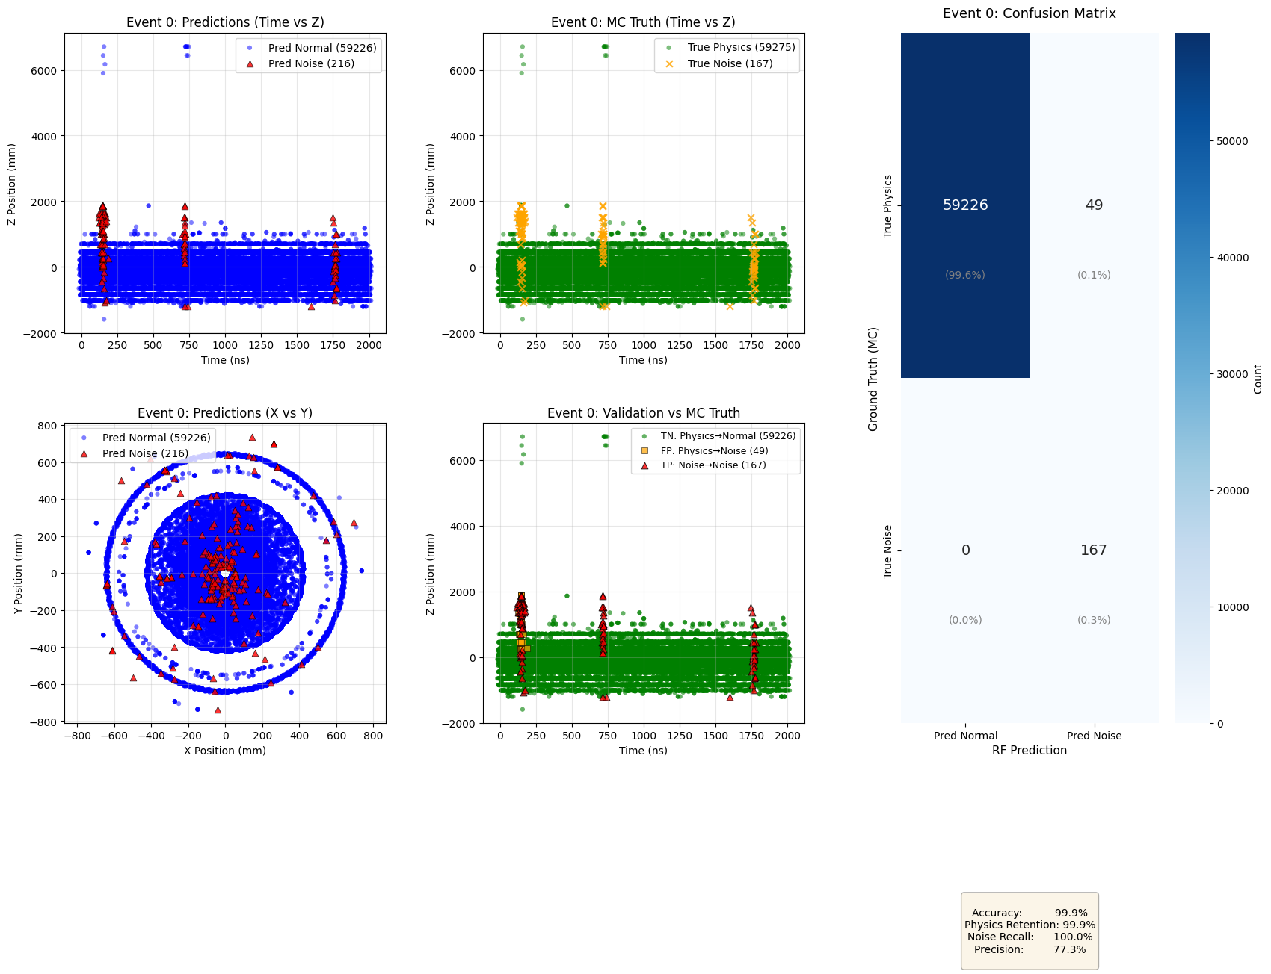
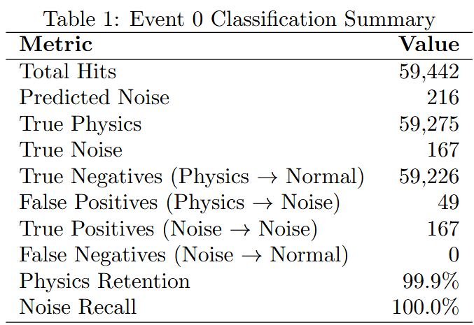
99.92%
0.08%
100%
Notes:
Represent conf. mat. In terms of percentages.
Explain conf matrices in other slide.

Slide 19
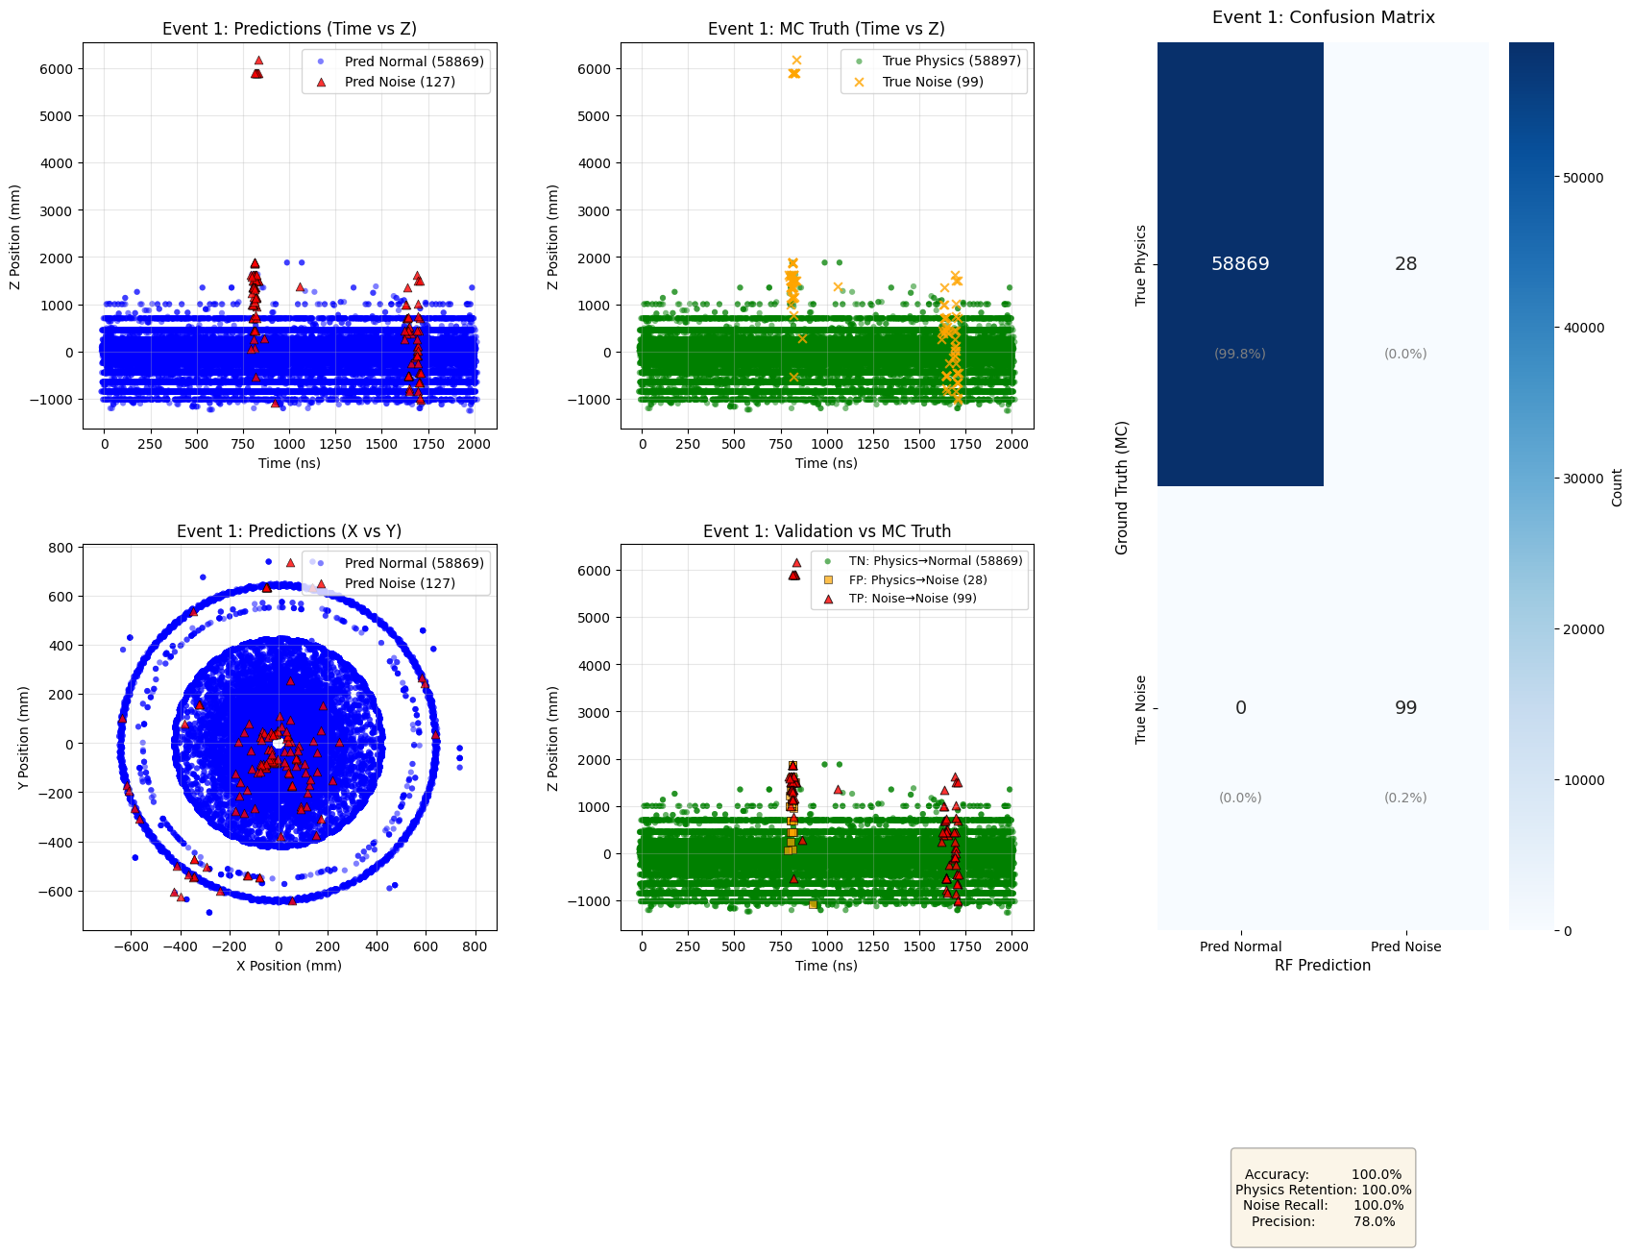
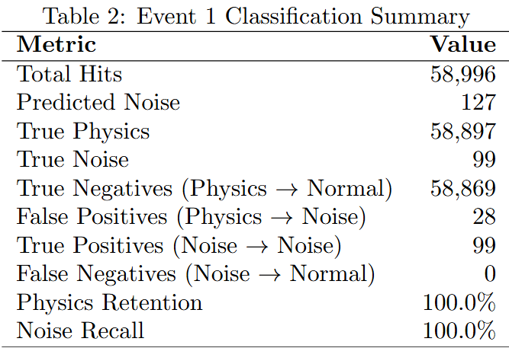
99.95%
0.05%
100%

Slide 21
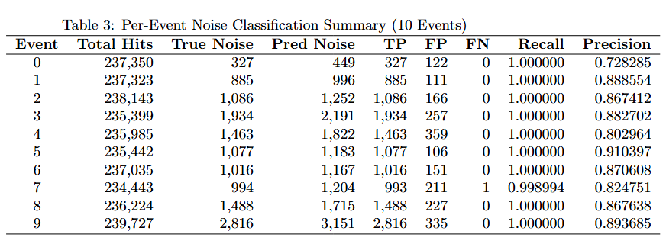

Slide 22
Conclusions
Project Overview
AIM : showcase how AI-driven analysis of streaming readout, frame-based data can enhance physics event detection in noisy environments.
To achieve this, we are:
Developing a robust ML pipeline tailored for efficient processing and analysis
This approach has the potential to allow for scalable AI workflows, paving the way for faster, more accurate insights in high-background experimental settings.
ML based ensemble pipelines can effectively filter out anomalies in SRO hits
Validation Success: Consistent signal (noise detection) rates across collections
Physics Impact: Clean data enables precise extraction for EIC meson studies
Ongoing: Integrate multi-task NN training with labeled data for supervised enhancement.
Promise: Robust anomaly detection supports streaming data EIC reconstruction, advancing QCD insights
Strengths of ML In Physics: Interpretable scores, spatial correlations.

Slide 23
Thank you for your time and attention !

