Slide 1
Electronics and DAQ Workfest Welcome
ePIC Electronics and DAQ WG Conveners
Fernando Barbosa (JLab), Jeff Landgraf (BNL)
WBS 6.10.08 Electronics
Fernando Barbosa (JLab)
WBS 6.10.09 DAQ
David Abbott (JLab), Jeff Landgraf (BNL)

Slide 2
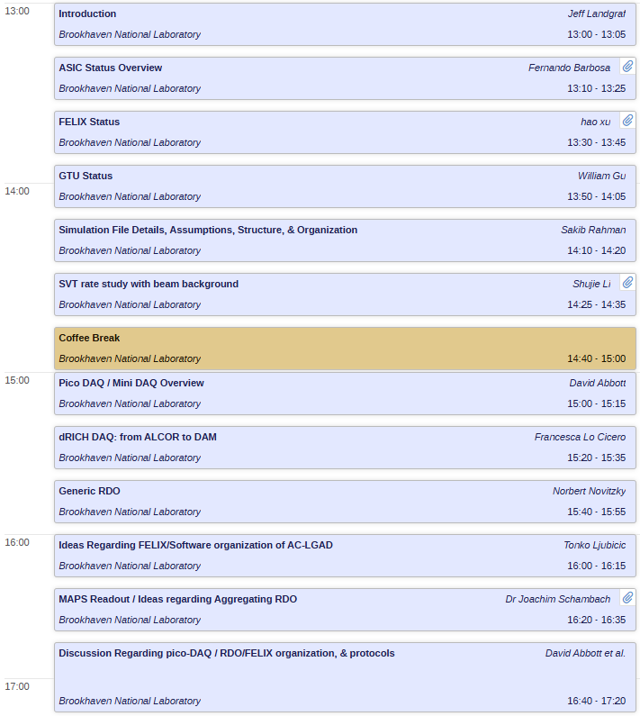
Welcome

