Slide 1
ePIC Collaboration Meeting ASIC Status Overview
Fernando Barbosa
Chief Electrical Engineer, L3 Manager
Control Account Manger WBS 6.03.01.07
January 20 – 23, 2026

Slide 2
Outline
ePIC Channels, Scale & Technology
Technical Progress
Path Forward
Summary

Slide 3
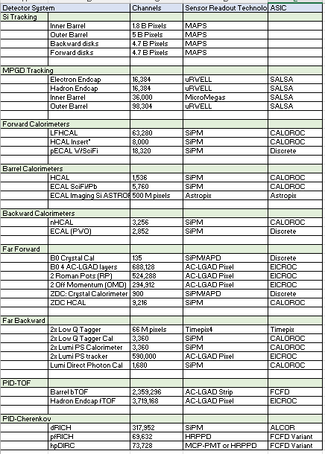
ePIC Channels, Scale & Techology
CERN
eRD109/PED Initiatives:
Discrete COTS – SiPM, 14-bit
CALOROC – SiPM, 10-bit
ALCOR – SiPM, 1 pe
EICROC – AC-LGAD, pixel
FCFD – AC-LGAD, strip
FCFD Variant – HRPPD/MCP-PMT
SALSA - MPGD
eRD109/PED
KIT, NASA (GSFC), ANL
eRD109/PED
Electronics Readout:
One (1) Discrete COTS
Six (6) ASICs
U. Glasgow
eRD109/PED

Slide 4




Technical Progress
Approximate quantities and costs shown with overages of 10% Discrete and 30% ASICs for production yields.
Costs include mask sets, fabrication, packaging & test NRE.
 | #Ch | #Ch/Unit | #ASICs/Wafer | #Wafers | Node (nm) | Packaging | Cost/ch (US$) | Institution
Discrete/COTS | 27.6k | 32 | NA | 863 Digitizers | COTS | NA | 66 (Includes FE Interface PCB) | Indiana University
CALOROC | 144 k | 36* | 800 | 5 | 130 | BGA | 2.2 | OMEGA/IN2P3/IJCL, ORNL
EICROC | 7.5 M | 1,024 | 160 | 46 | 130 | Wafer Bump | 0.1 | OMEGA/IN2P3/IJCL/CEA-Saclay, AGH
FCFD strip FCFD Variant | 3.1 M 207 k | 128 64 | 180 | 133 18 | 65 | Bump/Wire BGA | 0.4 4.1 | FNAL
ALCOR | 461 k | 64 | 800 | 9 | 110 | BGA | 0.7 | INFN
SALSA | 256 k | 64 | 500 | 8 | 65 | BGA | 3.2 | CEA-Saclay, U Sao Paulo
DOE
In-Kind
In-Kind
DOE
In-Kind
In-Kind
Production
65 nm: $750 k masks + $3.5 k per wafer
110 nm: $190 k masks + $4 k per wafer
130 nm: $250 k masks + $4 k per wafer
Packaging BGA: $3-$7.5 per chip; Wafer Bump: ~$25 k
ASIC Costs Total: ~$4 M
Masks: ~$3 M; Chips: ~$1 M
*Approved for 36 ch CALOROC, documented in record of decision EIC-ROD-051 (21 November 2025)

Slide 5
Path Forward – Discrete & ASICs
 | Status & Development Summary | Next Steps | Production Ready | Institution
Discrete/COTS | Devices selected, PCB design practically completed. Beam tests FY24-FY25 | Engineering article FY26 | FY27 | Indiana University
CALOROC (36) | Interface design FY23- FY24, CALOROC1A/B designed FY24-FY25 CALOROC1A: ADC/TOT + TOA, full SRO interface CALOROC1B: Switched gain (4) + ADC + TDC, full SRO interface | CALOROC2 (36 ch) – FY25-FY26 Select version 1A/1B. Tests - FY26-FY27 | FY28 | OMEGA/IN2P3/IJCL/CEA-Saclay, AGH, ORNL
EICROC (32x32) | EICROC0A (4x4) designed FY24-FY25, EICROC1 (32x32) FY25 EICROC0A: ADC + TOA, improved testability EICROC0B: Replaced ADC with peak sensing, Wilkinson ADC, lower power. EICROC1: added full SRO interface | EICROC2 (32x32) FY26 Add Derandomizer and ZS. Digital on Top design for lower power (~1 mW/ch). Tests. | FY27 – FY28 | OMEGA/IN2P3/IJCL/CEA-Saclay, AGH
FCFD (128) | Front end characterized, FCFDv1 (6 ch) FY23-FY24 characterized, FCFDv1.1 FY25; FCFDv1.2 and FCFDv2 FY26; FCFDv3 FY26-FY27 | FCFDv2 (32 ch) FY25-FY26 Add ADC, TDC, interfaces from ETROC, ECON CERN. FCFDv3 (128 ch) FY26 | FY28 | FNAL
FCFD Variant (64) | FCFDv1.1 FY25 Preliminary tests with sensors; FCFD Variant v1 FY26; FCFD Variant v2 FY26-FY27; FCFD Variant v3 FY27 | Harmonize sensor/ASIC specifications, adapt FCFD for 64 ch. | FY28 | FNAL
ALCOR (64) | ALCORv2.1 (32 ch) beam tests FY24, ALCOR v3 (64 ch) FY24-FY26 Full specification, SRO interface, BGA | ALCOR-64 – FY26 Final iteration for production | FY26 – FY27 | INFN
SALSA (64) | SALSA0/1 FY24, SALSA2 (32 ch) designed FY23-FY25 Full SRO interface, most DSP features, Submission October 2025 | SALSA3 (64 ch) FY25-FY27 full DSP, 64 ch | FY28 | CEA-Saclay, U Sao Paulo
ASIC production is ~1 Year: Fab, Packaging, Test. Additional information in the following slides. CD-3 in FY28.
- Complete
- Feb 2026 delivery
- Next Steps

Slide 6
Summary
Considerable progress:
Development of ASICs nearing final designs
Internal design reviews for each ASIC starting Q1 2026
Readiness reviews for each ASIC prior to start of production.
Outlook
Finalize Project Engineering and Design (PED) phase
Developments are within the R&D, PED, construction and installation schedules. Costs are well understood.
Production of ASICs and FEBs, including QA/QC, expected to be ready for installation within FY30 – FY32.

