Slide 1
ePIC Global Timing Unit (GTU) Update
Overview of the GTU
GTU Internal Review/Changes
The Current Status

Slide 2
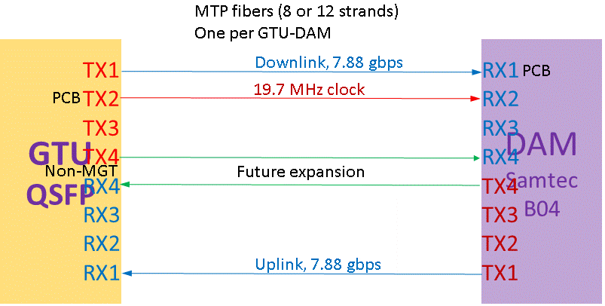
1. Overview of the GTU
1.1 The functional requirements
GTU required:
EIC common platform interface;
Run Control;
~150 DAM interface
Risk mitigation:
Beam vs clock phase monitoring;
Dedicated clock fanout
Dest#1
Dest#2
Dest#600
Between GTU and DAM (Quad LTI)
Same-length Multimode fibers: 4 Tx/4 Rx (inexpensive, standard, commercially available)

Slide 3
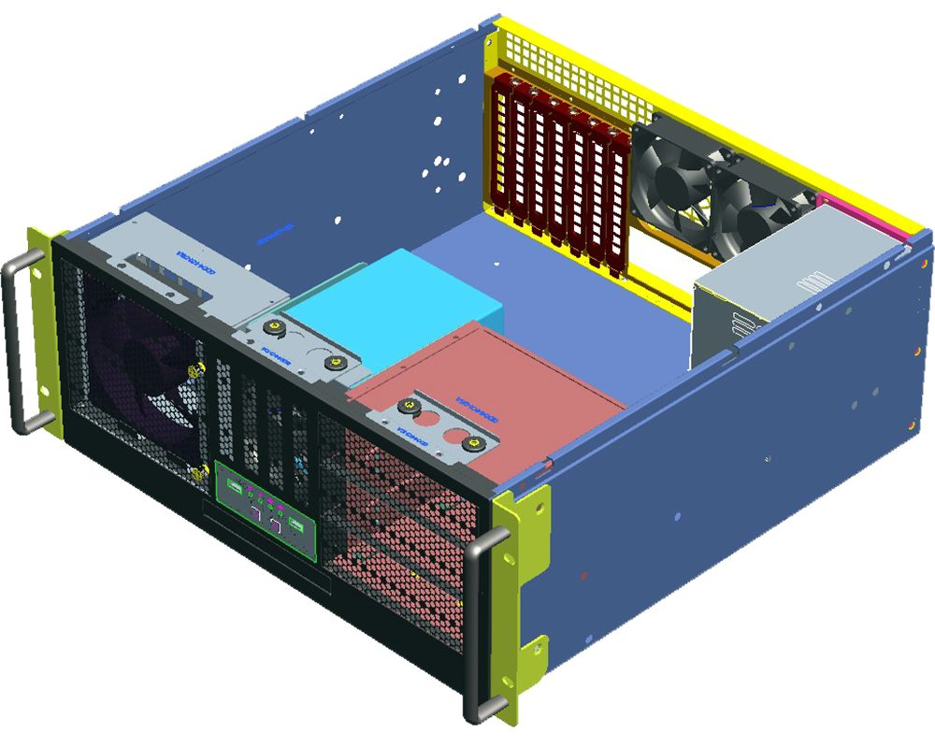

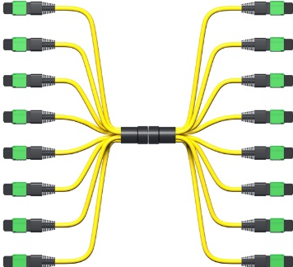
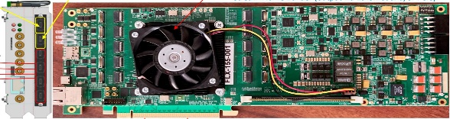
1. Overview of the GTU
1.2 The GTU hardware design
GTU
Up to 144
4U tall, 19” rack mounted
DAQ Room-air cooling
GTU base board
Optic transceiver adaptor boards
Clock monitor board
DAM

Slide 4
2. The internal review, Nov. 5, 2025
Thank you, reviewers.
Fernando Barbosa,
Tonko Ljubicic,
Norbert Novitzky,
Benjamin Raydo,
Joachim Schambach,
Gerard Visser
Dave Abbott,
Jeff Landgraf
Many good recommendations

Slide 5
2. The internal review, Nov. 5, 2025
(1) The possibility that future upgrades of ePIC require supporting more than 120 DAM must be kept in mind. It is desirable if there is a path for expansion inherent in the design, this should be clarified. | The current GTU design supports 148 DAM With the spare FPGA generic IO on the link, the number of supported DAM can be doubled by sacrificing the independence (two DAM will receive the same downlink from the GTU)
(2.2) External inputs should be buffered to decouple from PCB active circuitry. (5) External copper interfaces, especially DC coupled ones, wherever possible, should not connect directly to FPGA pins. There are several motivations for the ‘rule’: Surges may latch up and destroy an expensive FPGA. FPGA differential receivers usually have poor and poorly specified CMR. All I/O analog specifications may not be as completely specified, leading to interface malfunctions later if something changes in system. | Buffers are added, so that the 2x10-pin generic IO connectors are divided into 8 LVTTL inputs, 1 differential input and 8 LVTTL outputs, 1 LVDS output.
(3) We agree copper clock / revtick input is a reasonable plan. | The SFP interface is kept as the SFP removal will not benefit the GTU design.

Slide 6
2. The internal review, Nov. 5, 2025
(2.1) The clock input receive circuit does not present a good termination to the input line. The clock input receive circuit does not present a good termination to the input line. This is undesirable and can lead to unstable phase or jitter issues from reflections on the line affecting the waveform at threshold crossing. We advise changing the circuit design to have a good wideband termination (better than 10 dB to 500 MHz is suggested). (4) We recommend placing the clock / revtick input circuit on a small daughterboard rather than the main motherboard in order to eliminate the risk of revising the expensive main PCB if this interface changes in future, or if the circuitry has to be improved. (The present design with ‘flaw’ in input termination could be acceptable if it really is proven to work in practice, for instance, and this would be much less risky on a small inexpensive daughterboard.) | There will be a GTU_clockMonitor_plugin card with PCIex4 connector for the EIC common platform interface (and GTU clock monitoring). The ‘daughter card’ logic remains on the GTU engineering article.

Slide 7
2. The internal review, Nov. 5, 2025
(6) A jitter cleaner downstream of the master clock mux would provide a smooth transition from one clock to the next. This could be beneficial. | The SI5395A (faster clocks recovery) should be able to serve this purpose
(7) It is important - certainly GTU designers already have this in mind we know - that downstream electronics not crash after a GTU clock switch operation. It is OK / probably expected that some downstream electronics needs to be configured/reset after a small delay after a clock switch operation. | The SI5395A will continuously run after the inputs are lost with minimum frequency drift. When the inputs are recovered or switched, there will be no clock glitches, or interruptions for the downstream electronics (DAM). On Si5395 RESET, the outputs may be interrupted. In this case, the downstream needs be reset after SI5395 reset.
(8) A precise frequency monitor of the ePIC clock is necessary. This can be a commercial frequency counter, probably it does not make sense to build this function into GTU, but a diagnostic output should exist to use for this. However, this precise clock value needs to be available to general Run Control as well as entered in the database at Run Start time, so a device with e.g. ethernet readout is necessary. | A oven-controlled crystal oscillator (OCXO, $150) (accuracy < 1ppm) will be implemented on the GTU_clockMonitor_plugin card to measure the clock frequency to 10⁻⁶ If this is not accurate enough, an atomic (Rubidium) oscillator ($2K) can be implemented (<3 ppb). The clock frequency measurement can reach 10⁻⁸ The measurement results can be passed to the GTU_FPGA, and readout to the run-control user interface.

Slide 8
2. The internal review, Nov. 5, 2025
(9) A small/simple ASCII text display unit on the front panel connected to the main FPGA would be useful. | An I²C character display interface is implemented on the GTU. Additionally, the GTU_zynq can support a regular monitor with the builtin quad GTR (upto PCIe2x4)
(10) There are a number of LDOs on the main board – is cooling design sufficient? It’s suggested to make power dissipation estimates for LDO’s (and any other high power components), and consequent temperature estimates. The total power consumption for the chassis was stated to be around of 500 W: the power supply and cooling of the chassis must be well specified with the appropriate EMI rating (FCC Class B). | There are ~70 current measuring resistors (50 mΩ) on GTU. All the supply rails will be monitored and measured. The proper cooling will be implemented based on the measurements on the engineering article. The GTU is treated like a rack-mounted computer with front panel mounted cooling fans and (maybe) FPGA mounted cooling fans. The computer ATX power supply is adopted.
(11) Add LDOs to provide power to sensitive circuits (low jitter/jitter cleaning clock ICs) instead of using ATX power directly. This benefits signal integrity by filtering and decoupling. | The GTU clock distribution logic are all on LDOs. The FPGAs are on DC-DC converters with +12 inputs. The Optic transceivers (plugin card) are on DC-DC converters and LDOs. (+12V ➔ +4 V, ➔ +3.3V)

Slide 9
2. The internal review, Nov. 5, 2025
(12) Check that power sequencing (between the external supplies) is compatible with the design. The FPGA daughtercards take care of most sequencing issues, but their I/O may still have some sequencing issues in the overall design. None identified. | The regulators for FPGA V_{CCIO} (user controlled banks) can be enabled/disabled via the Zynq FPGA.
(13) Opto daughtercards may need some mechanical support. For the SFP versions they will be supported by the box panel, however that may not be in place for prototyping & development. Suggest adding some mounting hole or other feature on the opto daughtercard that could optionally be used for a support. | The ‘PCIe’ bracket can be mounted on the Opto Daughter card, and fixed to a GTU base board mounted bar and/or the GTU case mounted bar. (next section for details).

Slide 10
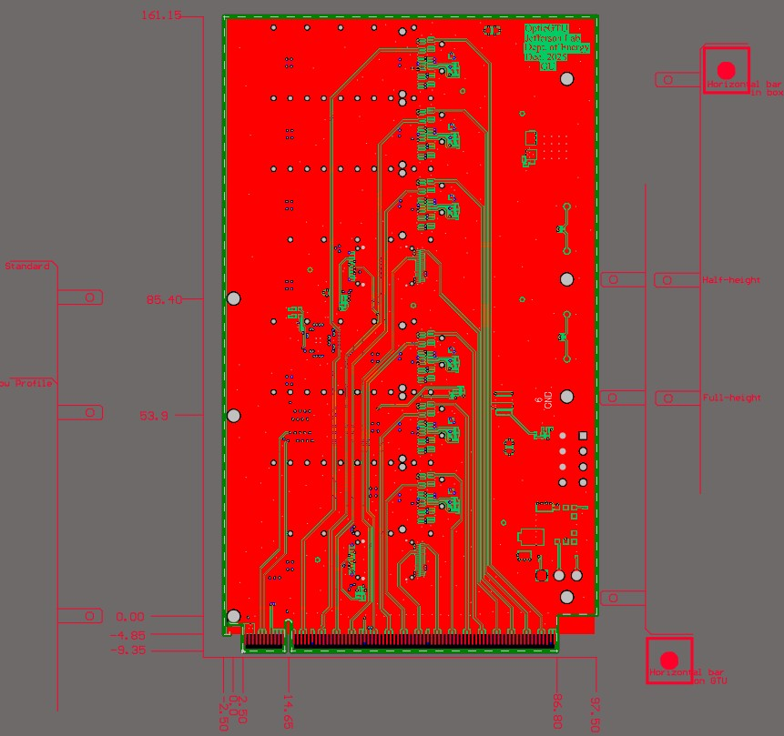
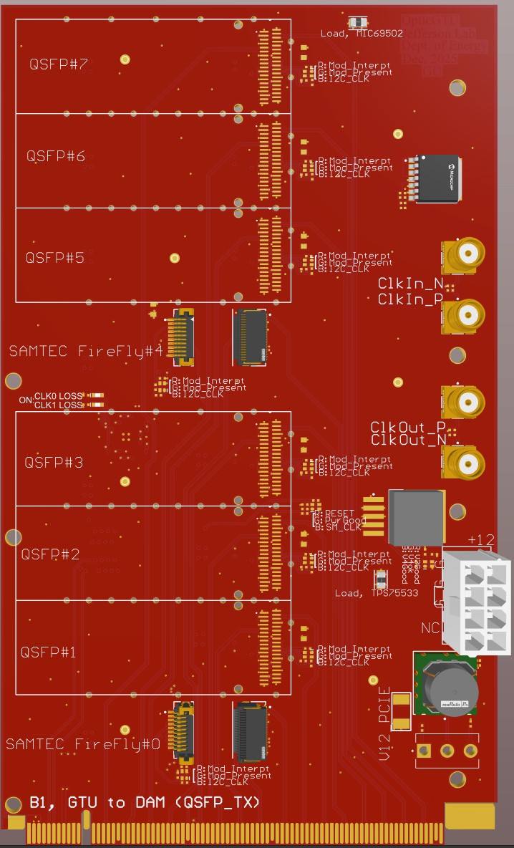
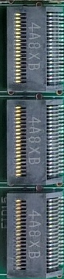

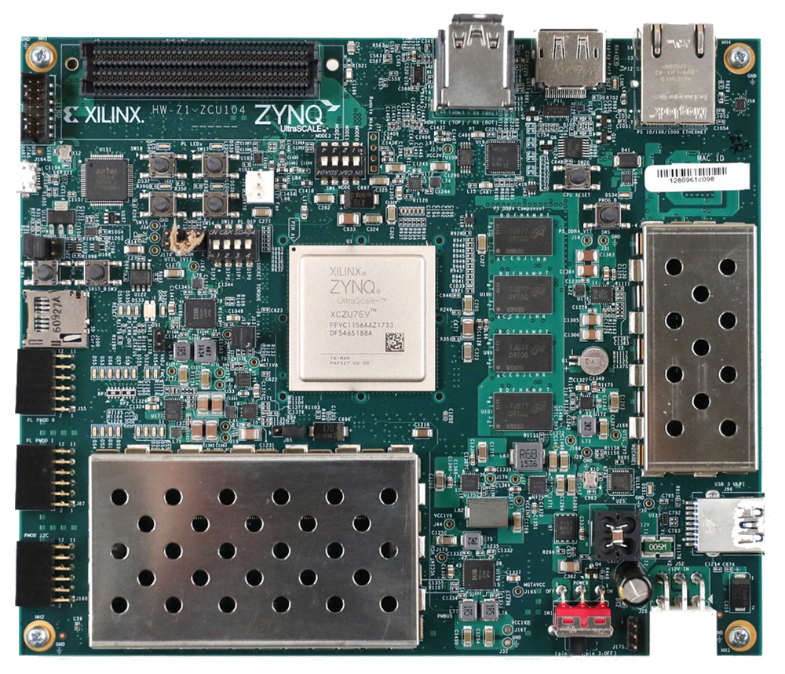
3. The Current Status
3.1 Optic Plugin card
Size: 100 mm x 170 mm
Four pieces are expected early next month (Feb. 2026)
The QSFP shells and the Optic transceivers will be added after powering up.

Slide 11
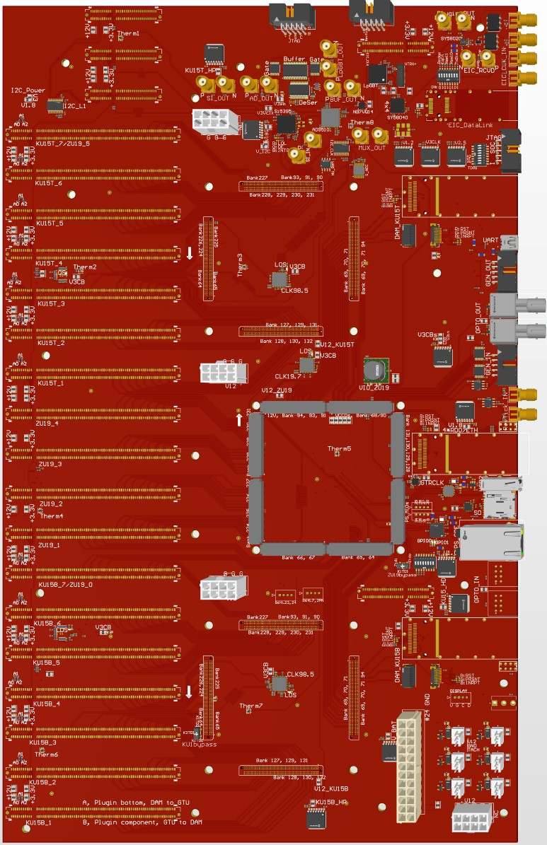
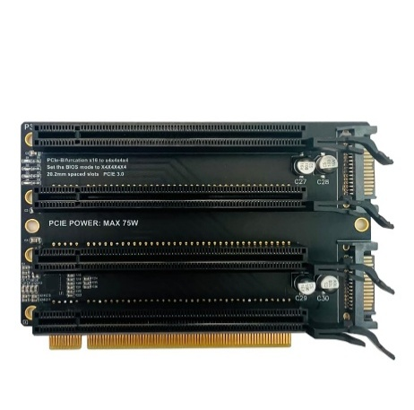



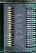
3. The Current Status
3.2 GTU base board
Size: 262 mm X 426 mm
AMD
KU15P
SOM#1
Two pieces are expected in late Feb. 2026
AMD
ZU19EG
MPSOC
In hands:
One 19” box
One ATX power supply
Two KU15P FPGA modules
Two ZU19EG MPSoC modules
AMD
KU15P
SOM#2
A BAR with many properly positioned threaded holes for the OpticGTU (to be designed and manufactured)

Slide 12
Thank you
The firmware and software are starting

Slide 13
not planned for the GTU engineering article
PCIe x4 for the phase measurement of the distributed clocks and EIC interface daughter card
PCIe x4 for the dedicated clock distribution (1:~200)
Standalone card for the (electron) beam pick up

Slide 14
GTU power
GTU cooling
ATX power modules, +12V, +5V, +3.3V, requires a 110V AC outlet
GTU base board (24-pin ATX power connector and PCIe 8-pin power connectors):
SOM: +12V
FPGA HP_IO: LDO mic69502 +3.3V in, +1.8V/+1.5V… out
FPGA HD_IO: LDO mic69502 +5V in, +3.3V/2.5V/1.8V… out
Zynq IO: DC-DC OKL-T/6-W5P, +5V in,
Optic Plugin card:
+3.3V from GTU base board, or
+12 V from GTU base board or connector, DC-DC ➔ 4V, LDO → 3.3V
Front panel room air in (three 12V 120mm fans, plus the ATX power built in fan)
Optional active SOM cooling (heat sink, optional 12V fan)
Back air outlet (back part of the top cover and the back panel, optic plugin cards area)

Slide 15
The ePIC clocks:
Single clock source, distributed to the whole system
* * * * * * * *
* * * * * * * *
* * * * * * * *
1 1 1 1
1 1 1 1 1 1 1 1 1 1 1 1
1 1 1 1
2 2 2 2
1 1 1 1 1 1 1 1 1 1 1 1
2 2 2 2
EIC_beam_orbit
5 5 5 6
5 5 5 5 5 5 5 6 6 6 6 6
5 5 5 6
7 8 9 0
1 2 3 4 5 6 7 8
3 4 5 6 7 8 9 0 1 2 3 4
7 8 9 0
1 2 3 4
1160 (all or 1/4 with beam)
100 (no-beam /gap)
EIC_BX_Clock, 98.5 MHz
GTU→DAM, 19.7 MHz
(Frequency divided by 5)
ePIC system clock
Fixed delay (divider, cable, PCB delays)
The phase (divider) is determined by the orbit information
39.4 MHz
DAM rec. Clock
98.5 MHz
others

Slide 16
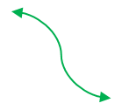
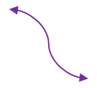
The ePIC downlink (fast controls)
ePIC system clock
(19.7 MHz)
GP_{N-1}
GP_{N}¹
GP_{N}²
GP_{N}³
GP_{N}⁴
GP_{N}⁵
GP_{N+1}
GP_{N}, Five 64-bit words, 8b/10b encoding, ➔ 7.88 Gbps, 320-bit per ePIC system clock cycle
The DownLink, DAM → LpGBT (39.4 MHz)
DgP_{N-1}
DgP_{N}¹
DgP_{N}²
DgP_{N+1}
DgP_{N}
LpGBT and VTRx+ dictated package format, extracted (repackaged) from GP_{N}
The DownLink, DAM → RDO (non-LpGBT) (98.5 MHz for example)
DrP_{N-1}
DrP_{N}¹
DrP_{N}²
DrP_{N}³
DrP_{N}⁴
DrP_{N}⁵
DrP_{N+1}
DrP_{N}
RDO dictated package format, extracted (repackaged) from GP_{N}

Slide 17
DAM control link (downlink/uplink)
XCKU15P
2 x DAM
2 x MGT
4 x d_IO
Plugin Cards for 144 DAM
XCZU19EG
1 x MGT
40 x IO
52 x MGT
104 x d_IO
Supports:
148 DAM
4 RDO
40 x MGT
80 x d_IO
40 GBE
Or 4 x RDO
4 x MGT
XCKU15P
52 x MGT
104 x d_IO
1 x MGT
40 x IO
2 x MGT
4 x d_IO
2 x DAM

Slide 18
Clock monitoring (another GTU plugin module)
Clock
Fanout
(4)
QSFP opticTRx
(2)
Clock_A
(1)
(2)
Clock_B
(12)
FPGA (SOM)
Clock phase measurement
Clocks’ phases
Clock
Fanout
(10)
FireFly opticTRx
(1)
Clock_C
Fiber loopback, either the spares between GTU and DAM, or the spares between DAM and RDO
Clocks from the GTU base board, and the phase measurement results to the GTU base board

Slide 19
Beam pickup signal: stand alone PCB design
GTU: Phase Correction
PhaseOrbit (average)
RF-SoC (?)
Phase adjustment:
Si5395 (I2C) : ~70 ps steps
AD9510 (SPI) : ~25 ps steps
Phase#1
Phase#2
Phase#1160
Phase#1
RDO(area) Clock
e⁻ Beam pickup

Slide 20
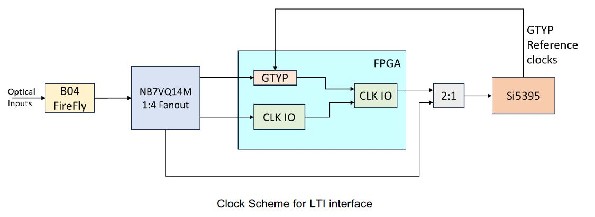
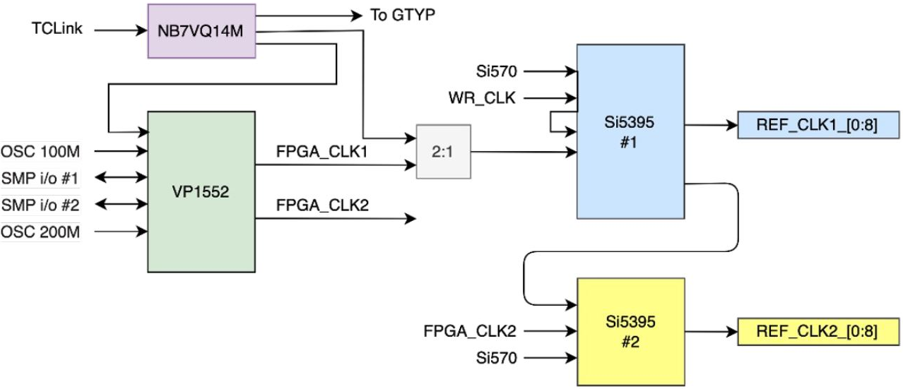
DAM (FLX155) clock interface
Dedicated Clock input,
up to three MGT lanes (Tx/Rx)
MTP multimode 850µm optical
* These two diagrams are from FLX155 presentations

