Slide 1
SIDIS WG update
Ralf Seidl (QNSI)
Anselm Vossen (Duke)

Slide 2
General information
Bi-weekly meetings Tuesday 8:30 EST/EDT
Mailing list eic-projdet-semiincl-l.lists.bnl.gov
Indico: https://indico.bnl.gov/category/418/

Slide 3
preTDR activities
Focus
on impact on TMD determination
Impact of PID
…

Slide 4
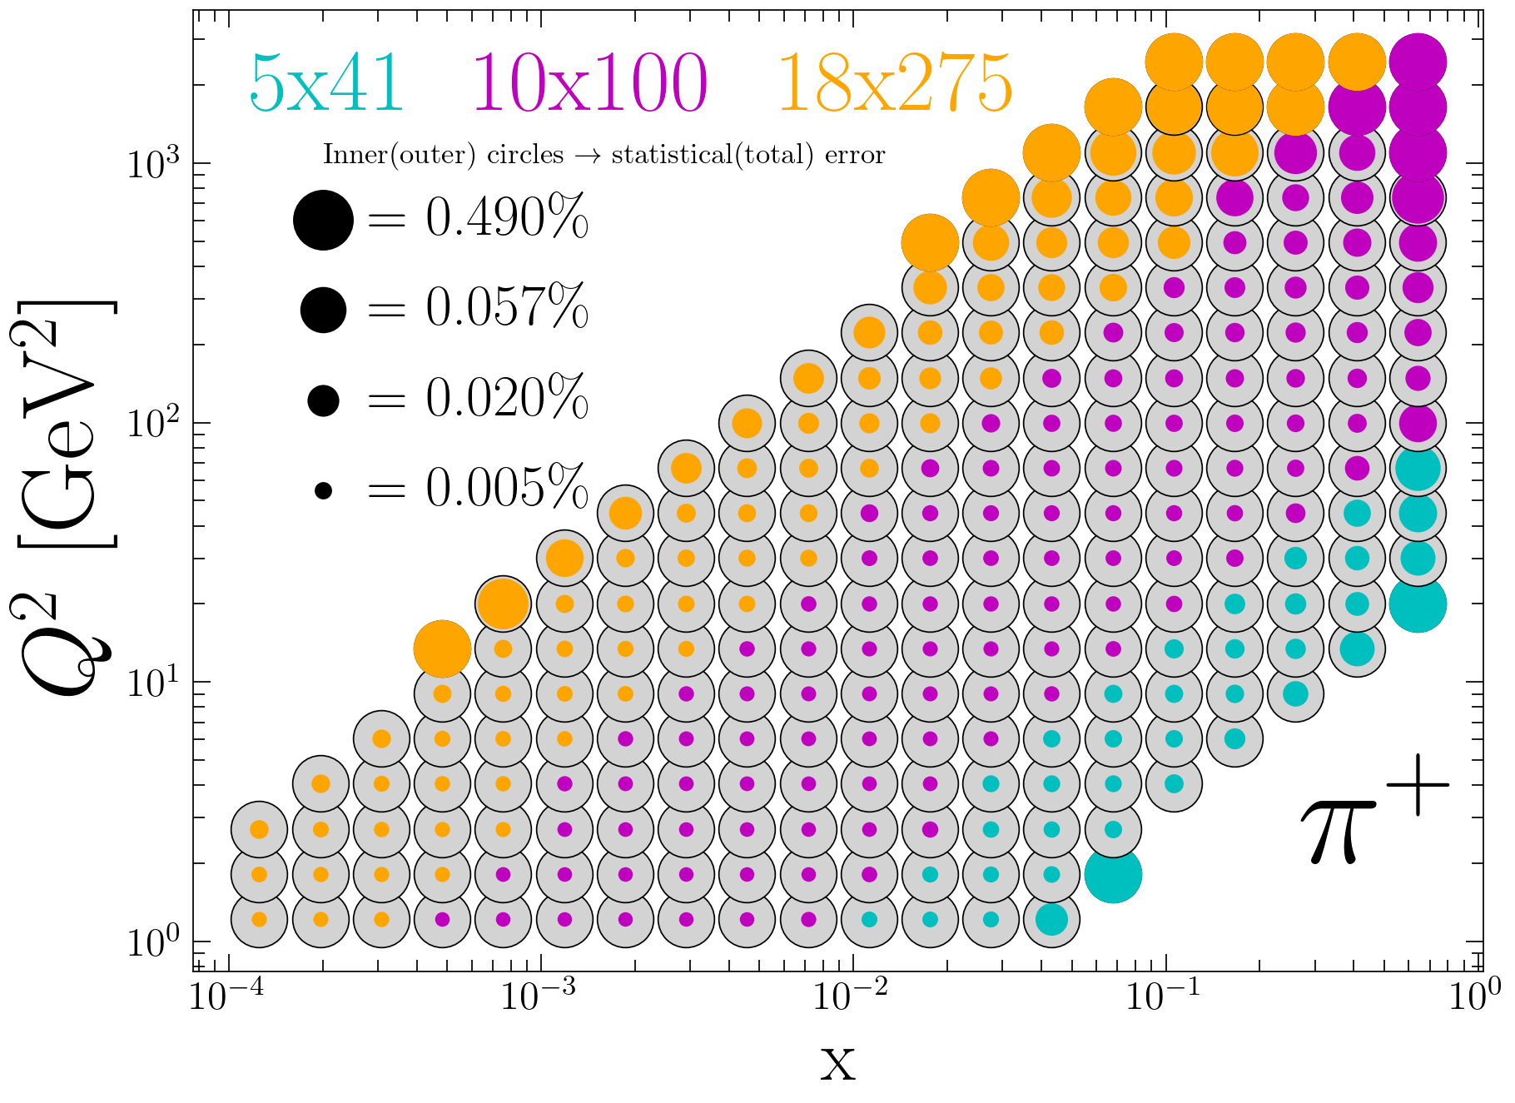
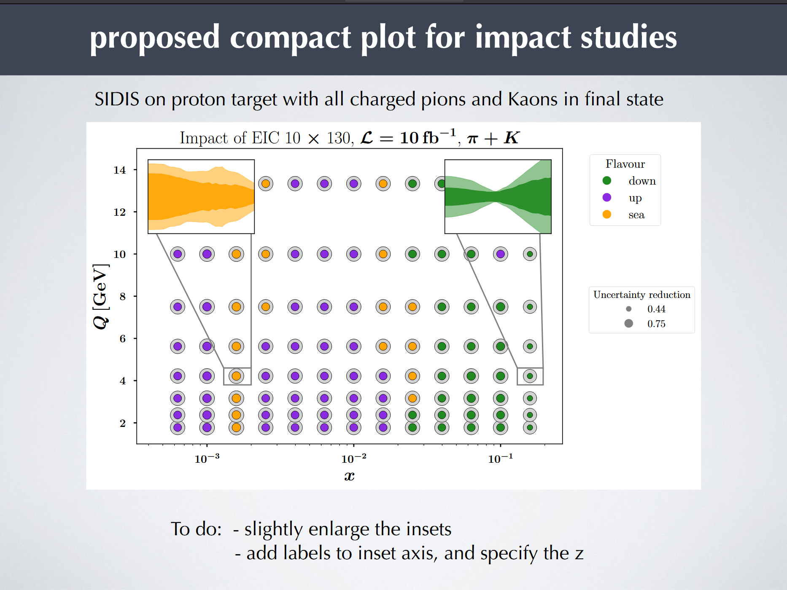
Discussion on presentation of TMD sensitivities
Gregory Matousek
Lorenzo Rossi, Marco Radidi
What are the best ways to display unpol TMD sensitivities
Can one display directly the impact on the Collins-Soper kernel?
Impact on TMD PDFs can be directly highlighted only for limited set
How to highlight model uncertainties? (difference between groups/fits)

Slide 5
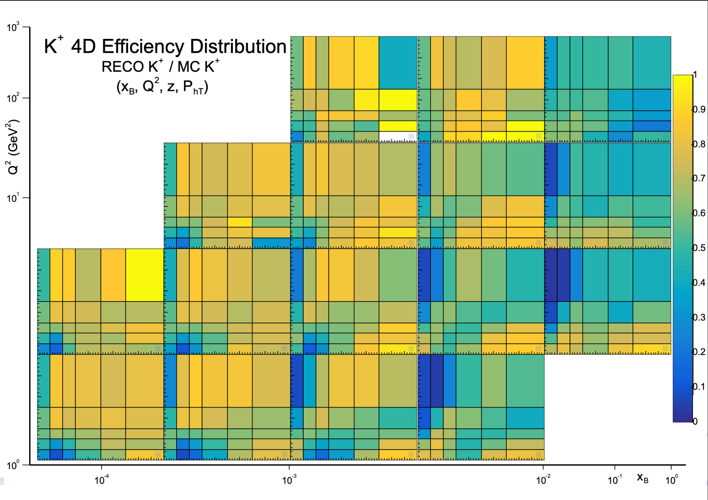
4D efficiencies for kaons
Still need to determine optimal working point/systematics with PID groups
Lorenzo Polizzi (Ferrara)

Slide 6
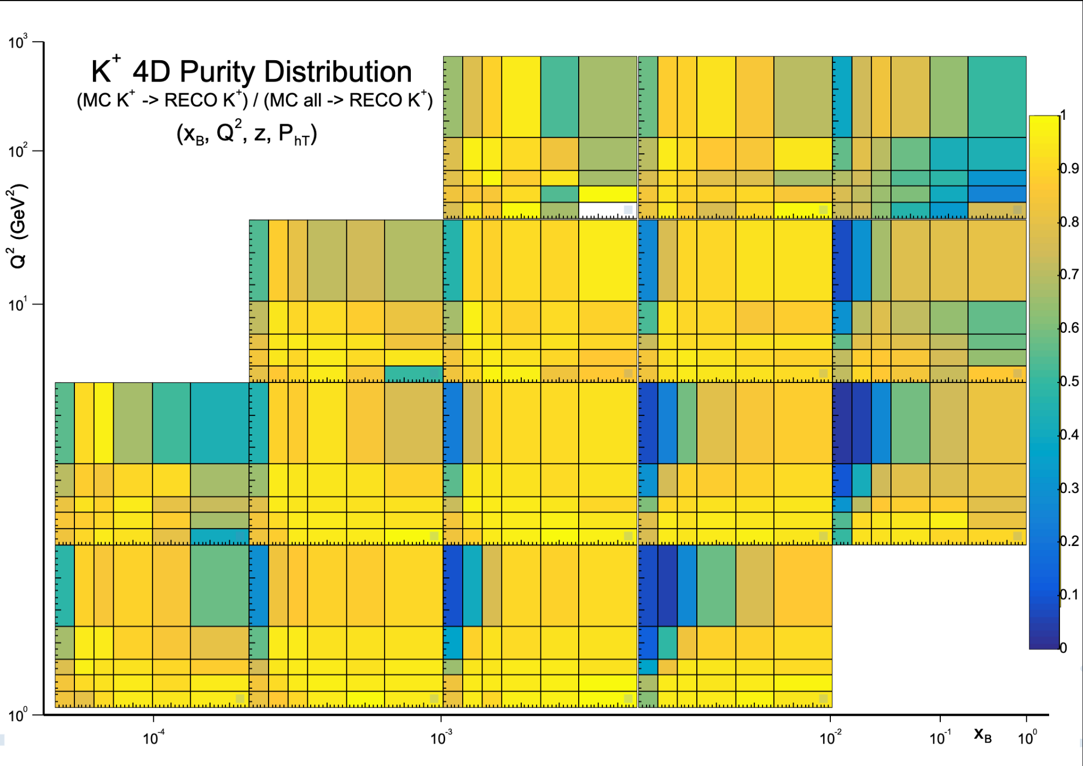
4D purities for kaons
Lorenzo Polizzi (Ferrara)

Slide 7
Backward Kaons $A_{LL}$
Highlight measurement to access sea quark helicity distributions and TMDs
Tests tracking and PID in backward region
Charlotte Van Hulse

Slide 8
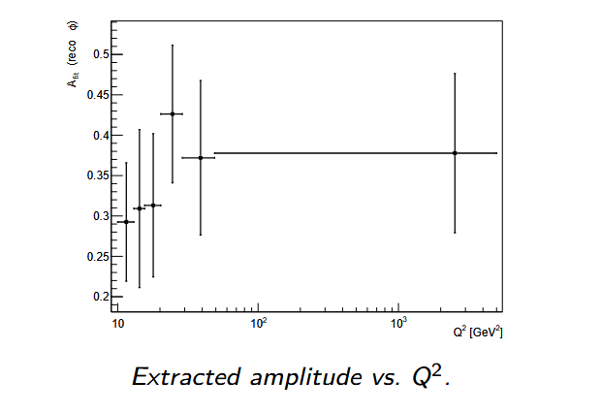
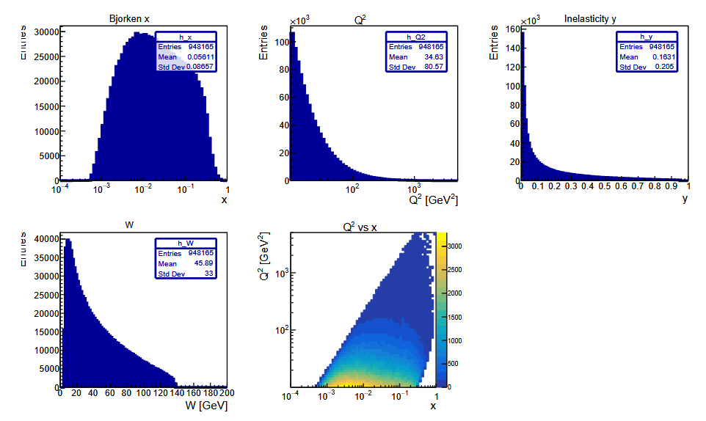
D0 reconstruction
Physics Goal and Strategy:
Extract Gluon Sivers Asymmetry via charm production in DIS
Use D0 → K −π+ as a clean probe of charm dynamics
Access gluon transverse momentum distributions
Artificially introduced azimuthal asymmetry of 0.3
Artur Hoghmrtsyan

Slide 9
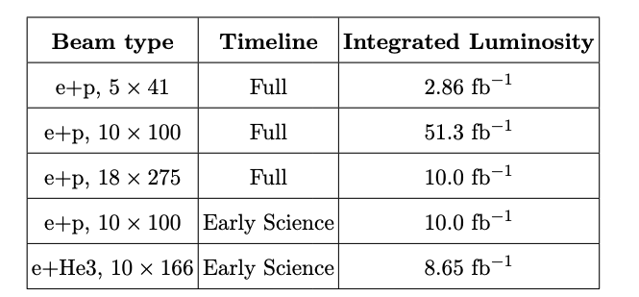
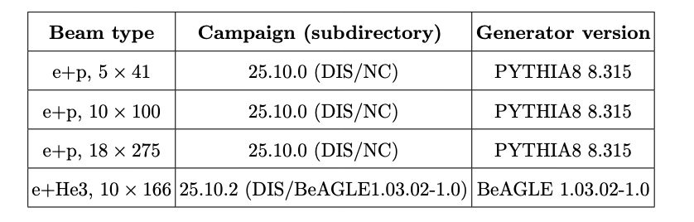
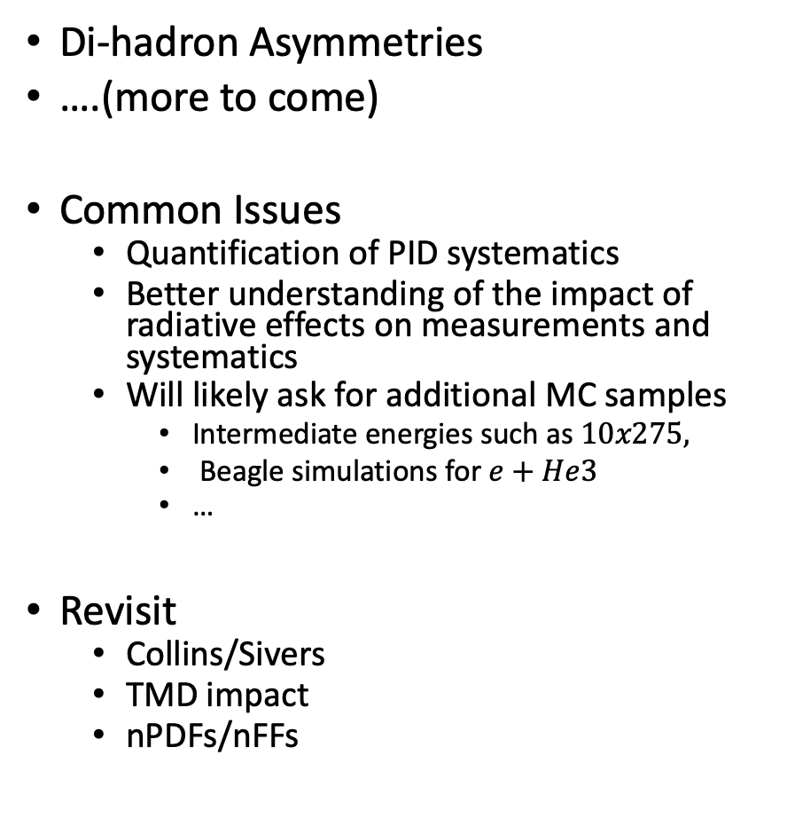
Physics impact studies
Di-hadron Asymmetries
….(more to come)
Common Issues
Quantification of PID systematics
Better understanding of the impact of radiative effects on measurements and systematics
Will likely ask for additional MC samples
Intermediate energies such as $10x275,$
Beagle simulations for $e+He3$
…
Revisit
Collins/Sivers
TMD impact
nPDFs/nFFs

