Slide 1
Echelon 0 Status and Plan for 2026
ePIC Electronics and DAQ WG Conveners
Fernando Barbosa (JLab), Jeff Landgraf (BNL)
WBS 6.10.08 Electronics
Fernando Barbosa (JLab)
WBS 6.10.09 DAQ
David Abbott (JLab), Jeff Landgraf (BNL)

Slide 2
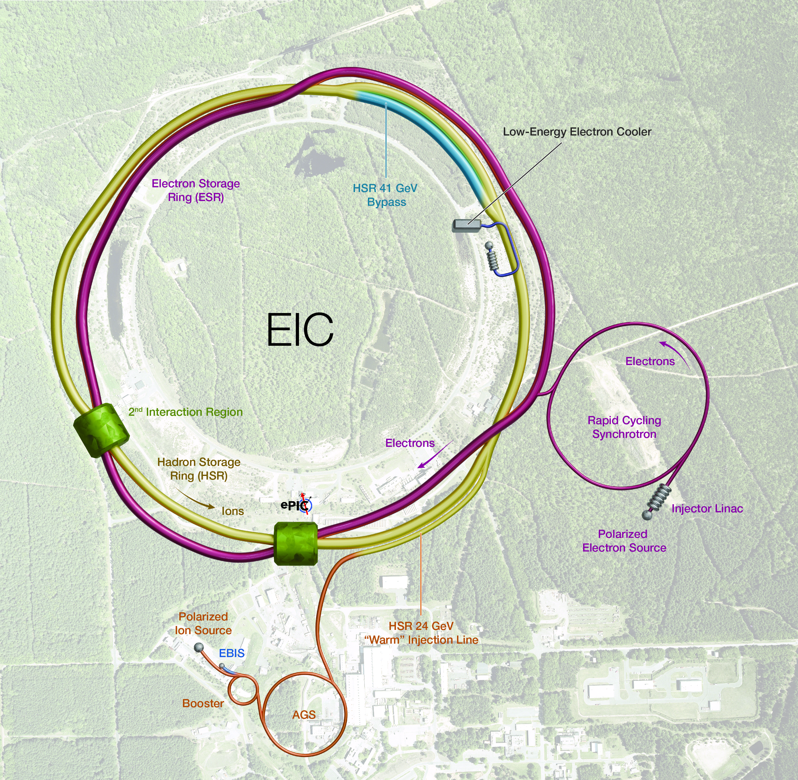
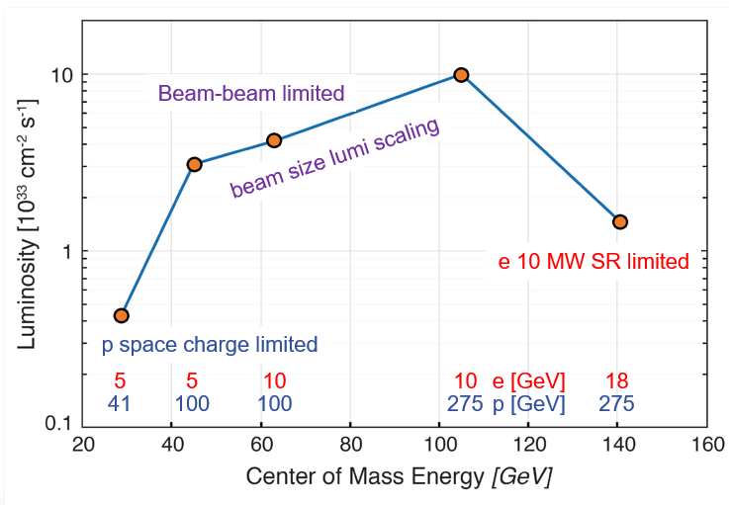
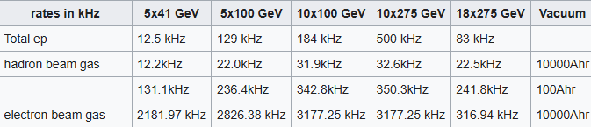
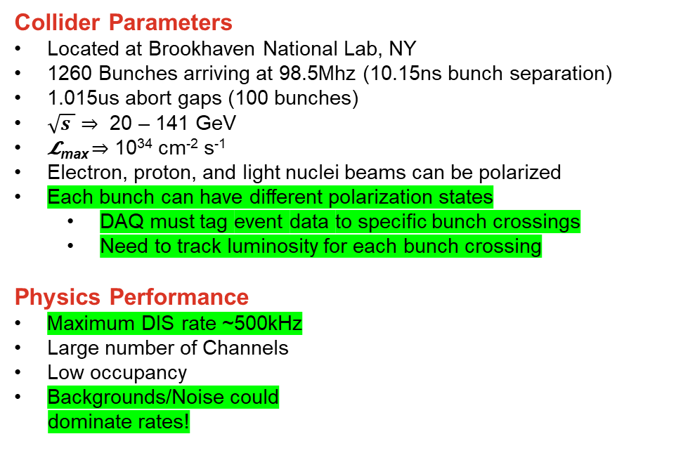
EIC Collider & DAQ Environment
Collider Parameters
Located at Brookhaven National Lab, NY
1260 Bunches arriving at 98.5Mhz (10.15ns bunch separation)
1.015us abort gaps (100 bunches)
$\sqrt{s }$ ⇒ 20 – 141 GeV
𝓛_{max} ⇒ 10³⁴ cm⁻² s⁻¹
Electron, proton, and light nuclei beams can be polarized
Each bunch can have different polarization states
  DAQ must tag event data to specific bunch crossings
  Need to track luminosity for each bunch crossing
Physics Performance
Maximum DIS rate ~500kHz
Large number of Channels
Low occupancy
Backgrounds/Noise could
dominate rates!

Slide 3
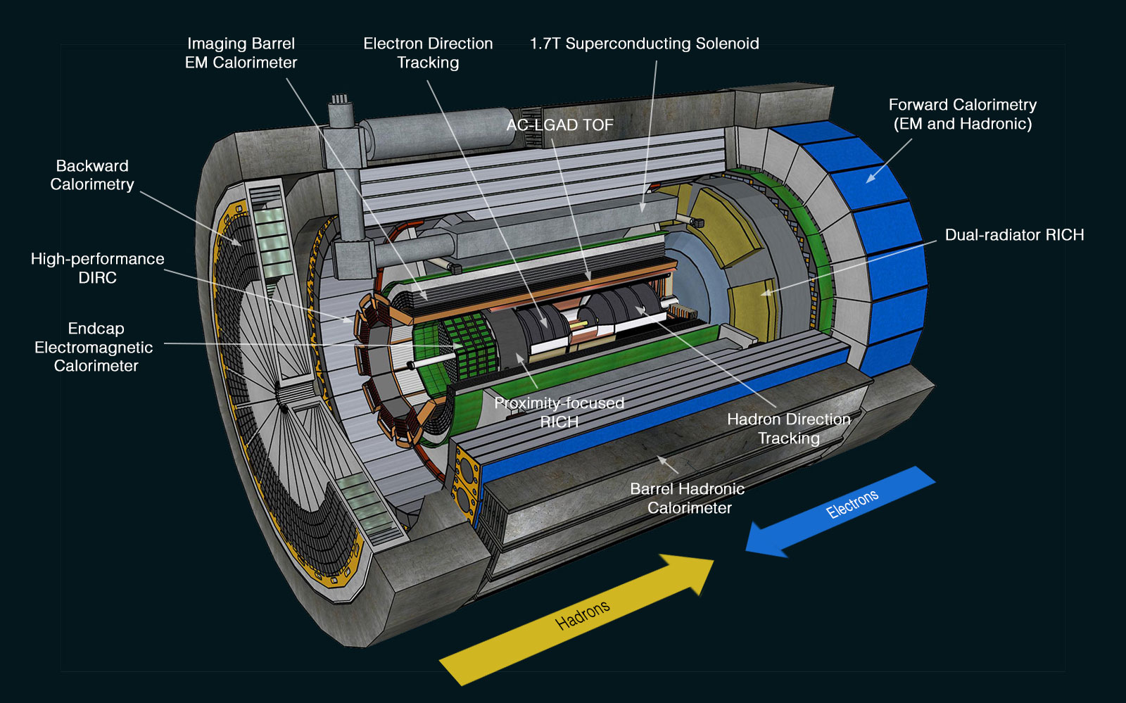
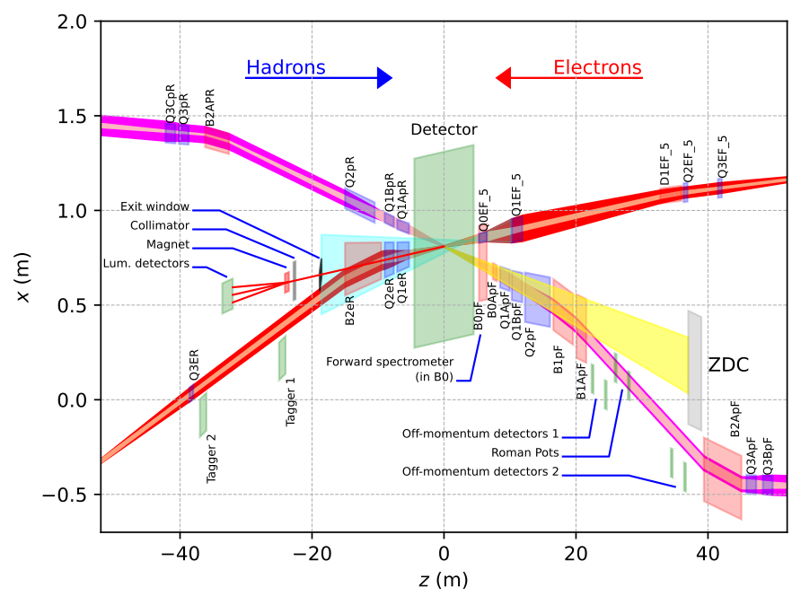
ePIC Detector Readout Technologies
~30 Detectors
Spread over +/- 40 meters
(13 bunch crossings @ c)
5 main digitization ASICs, 3 digitizing sensors, and discrete readouts
Many technologies, but effort has been made to make use of possible synergy…

Slide 4
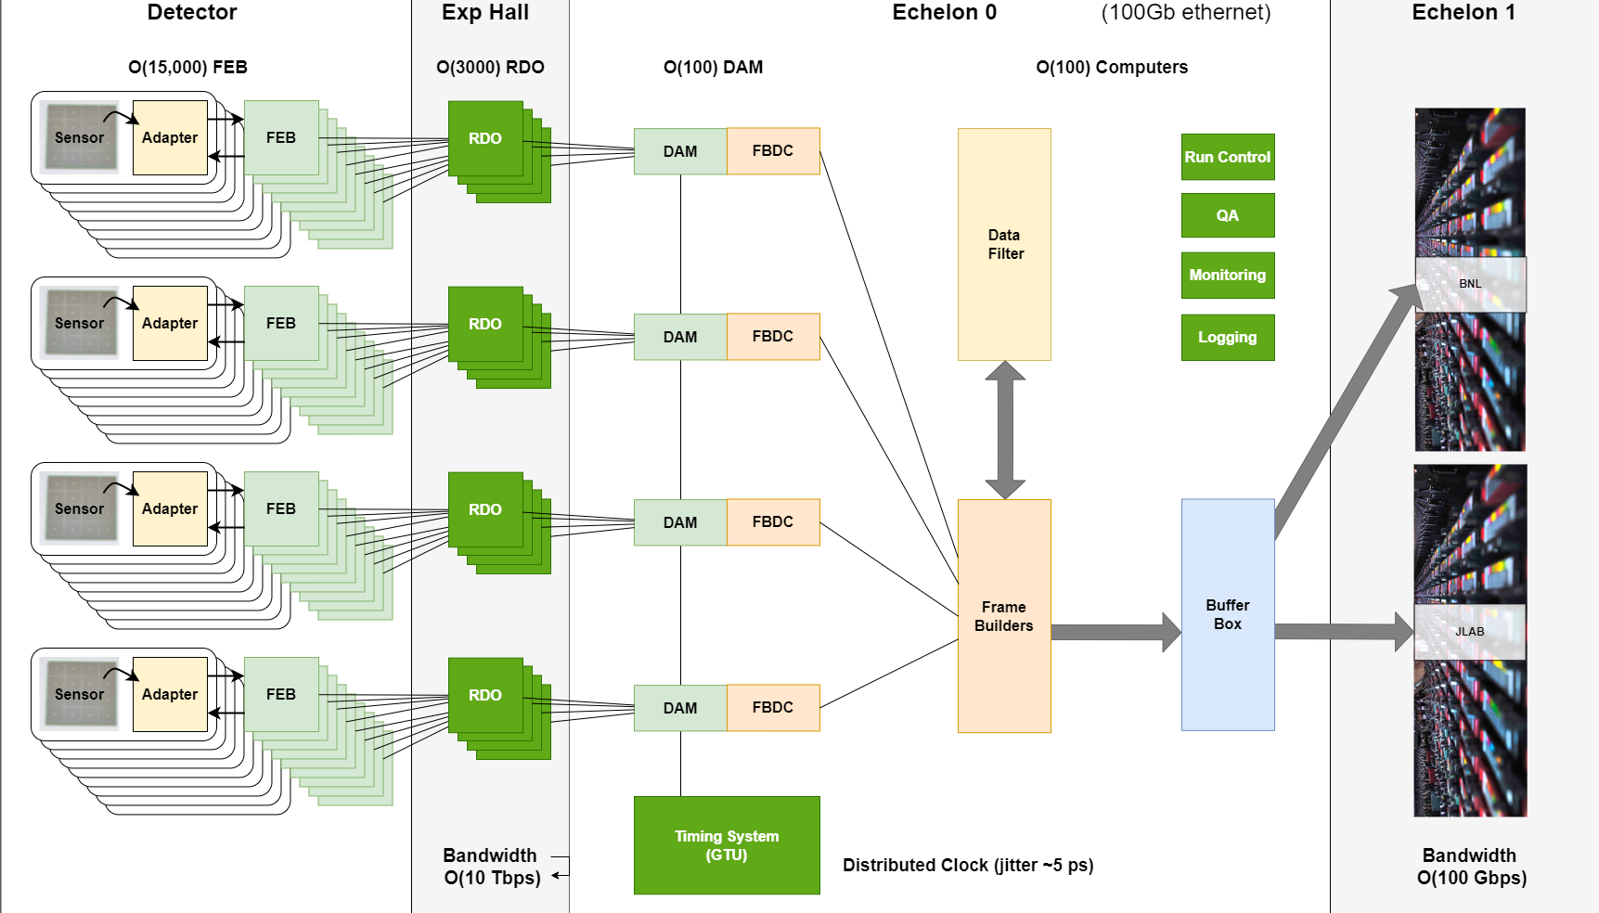
ePIC Streaming DAQ/Computing Architecture
(Online Computing)
EIC Specs
Bunch Crossing
~10.2 ns (98.5 MHz)
Interaction Rate
~ 2 us (500 kHz)
(one interaction per ~200
bunch crossings)
High Luminosity
-- up to 10³⁴ cm⁻²s⁻¹
-- Low occupancy
physics signal
-- Background and noise
significant for some
sub-systems
Frame Builder
Data Concentrator
(FBDC Server)
Controls

Slide 5
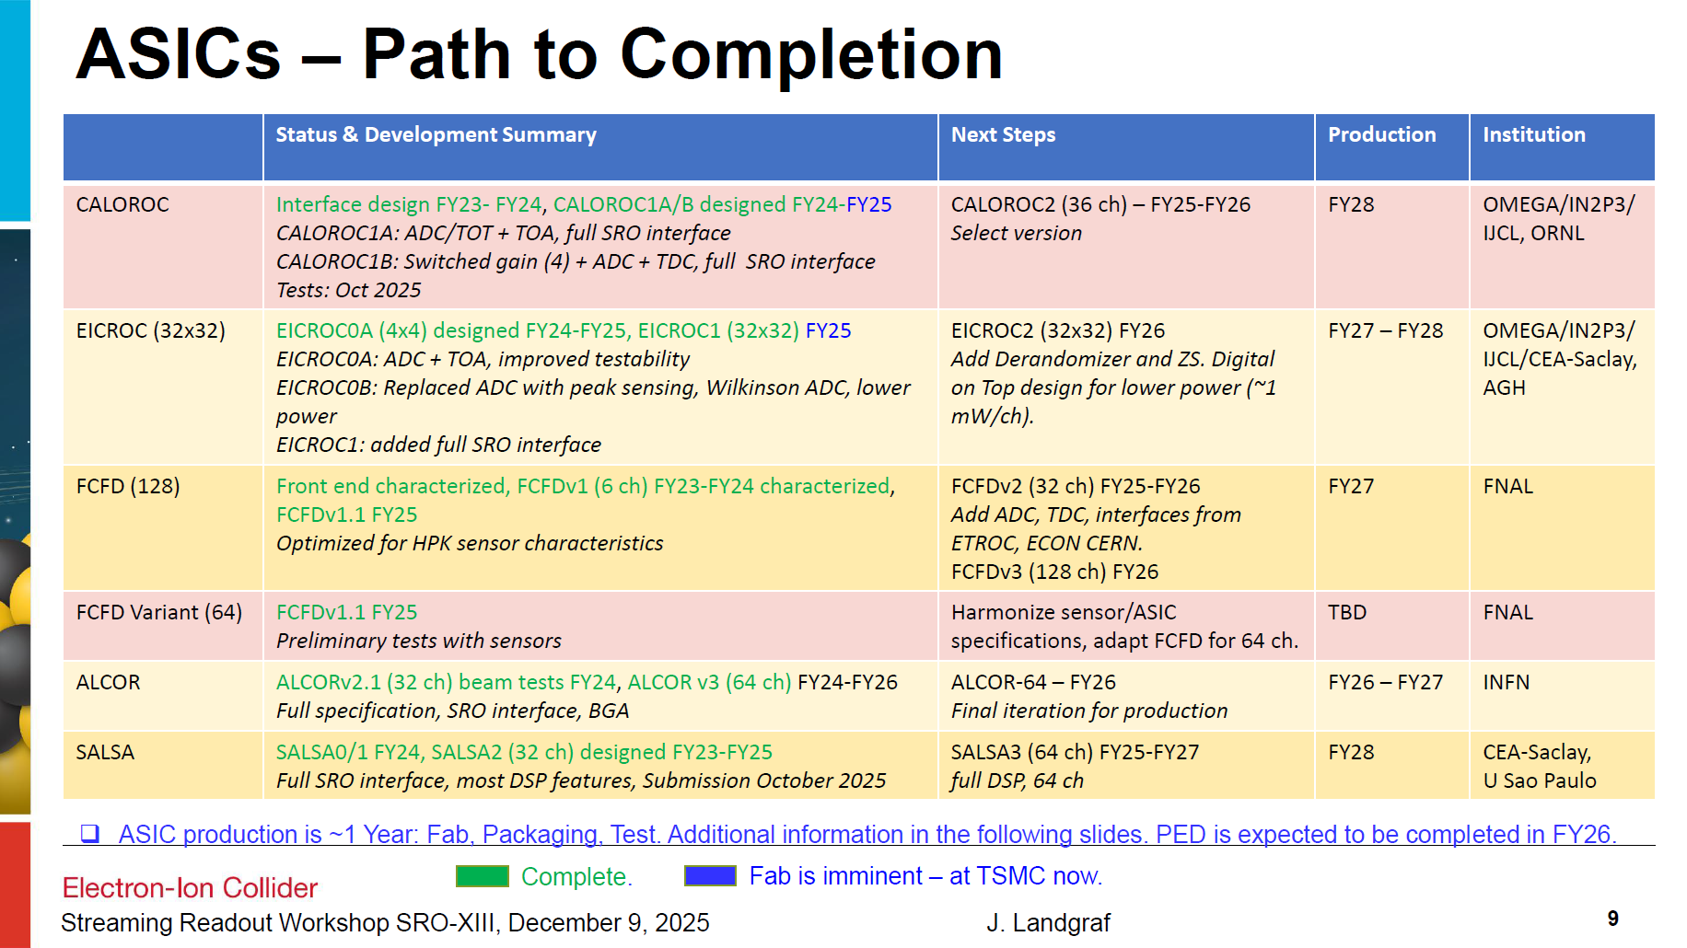
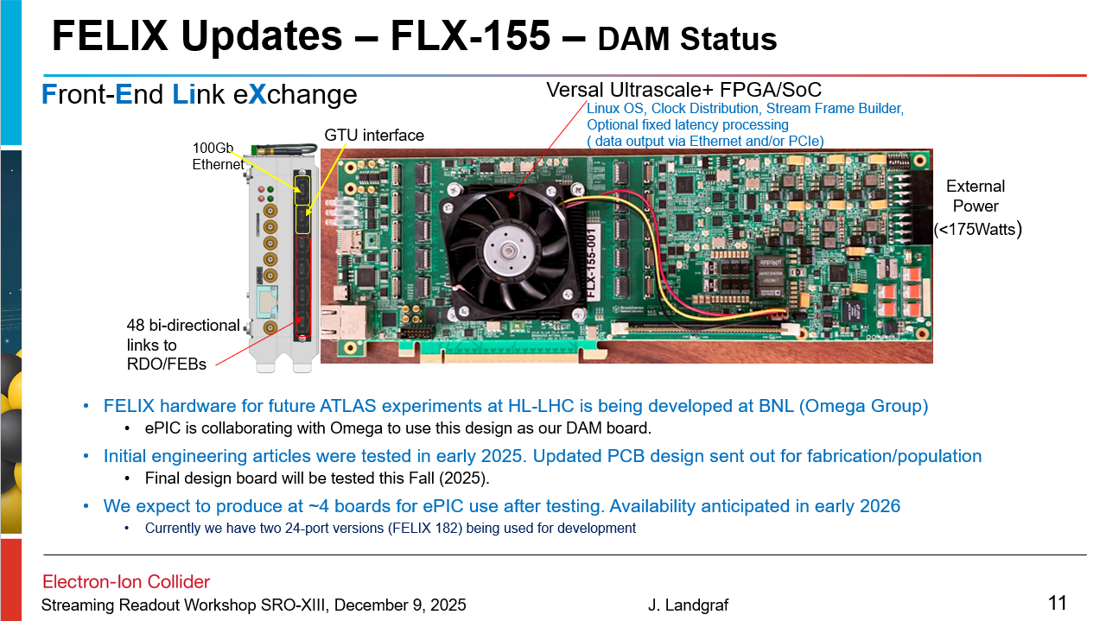
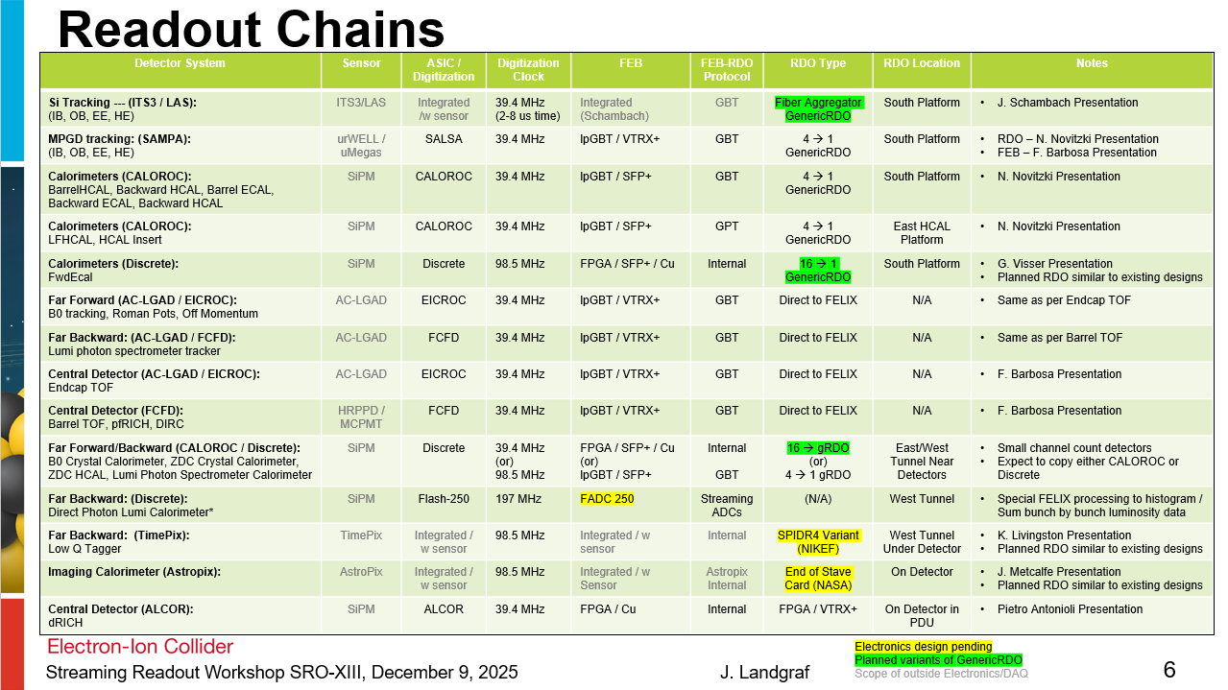
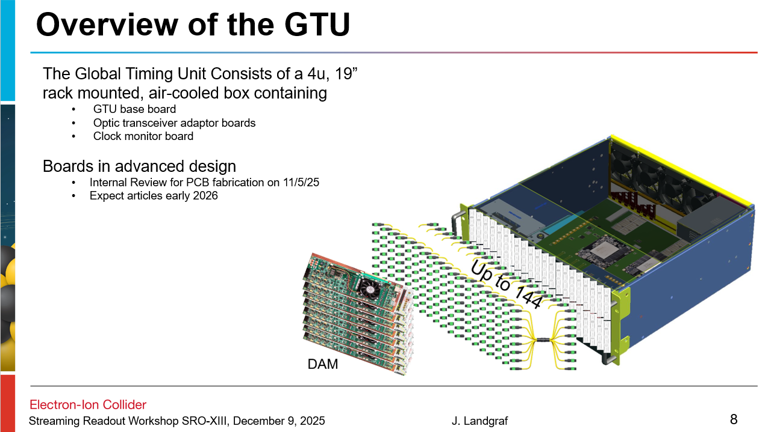
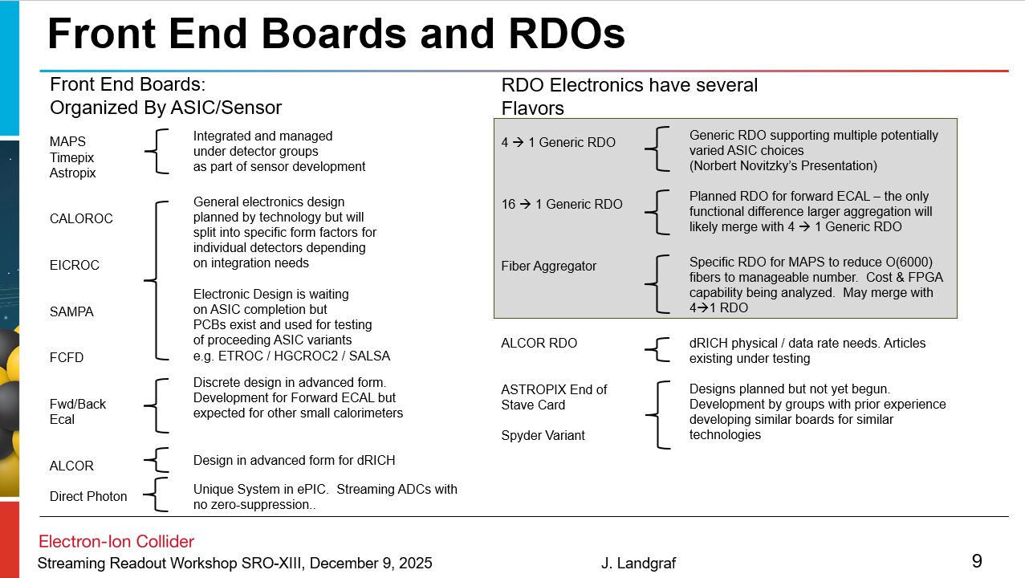
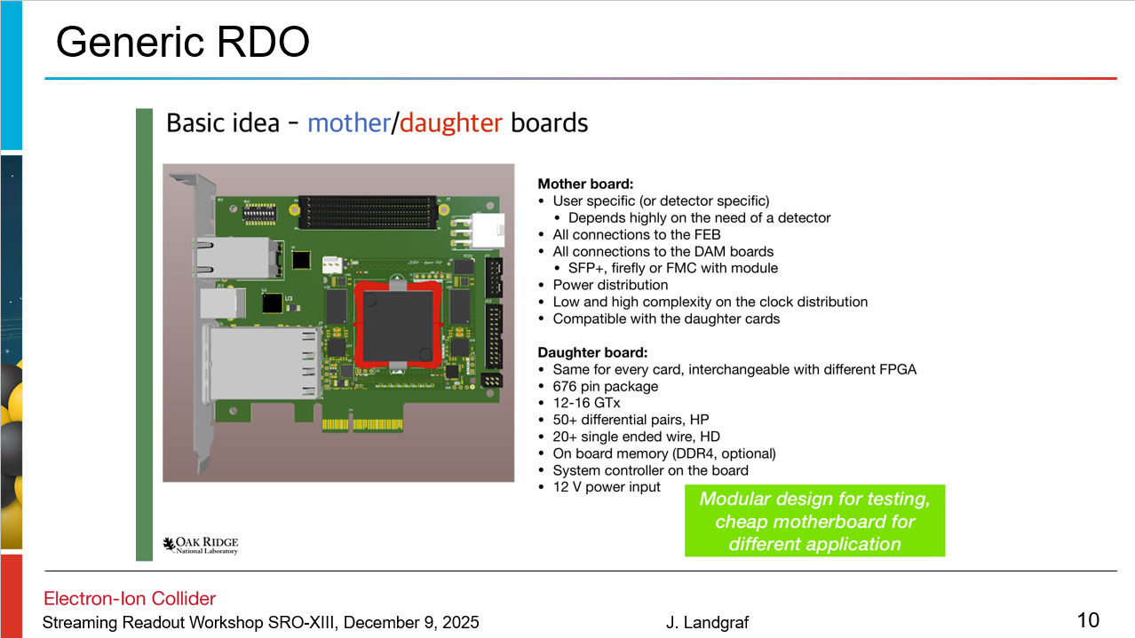
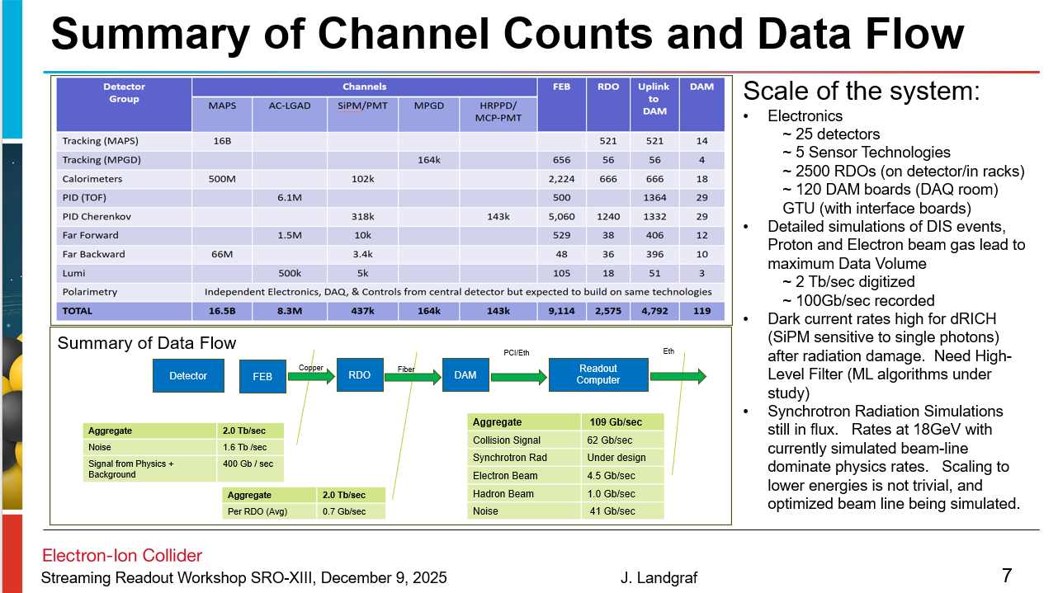
Electronics Status
Electronics and DAQ WG is primarily focusing on the Baseline for Electronics and Components… including design and “prototyping”
60% Design Review - 9/3/2025
Lots of progress (slides in Backup…)

Slide 6
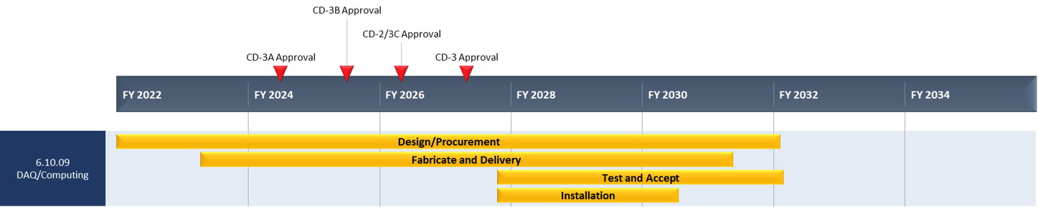
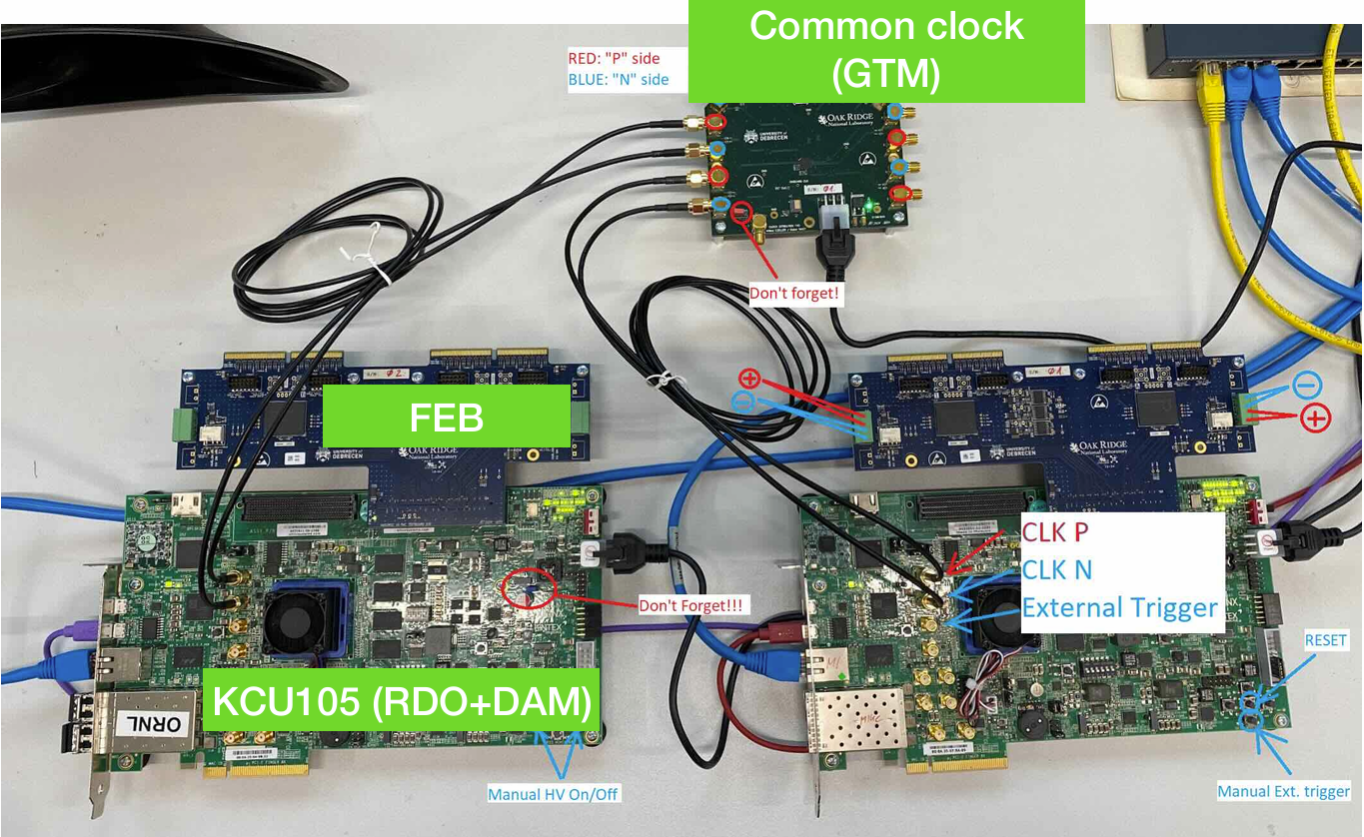
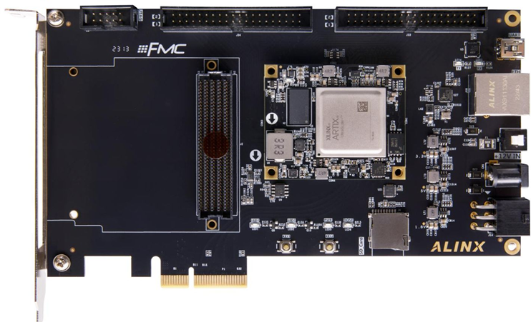
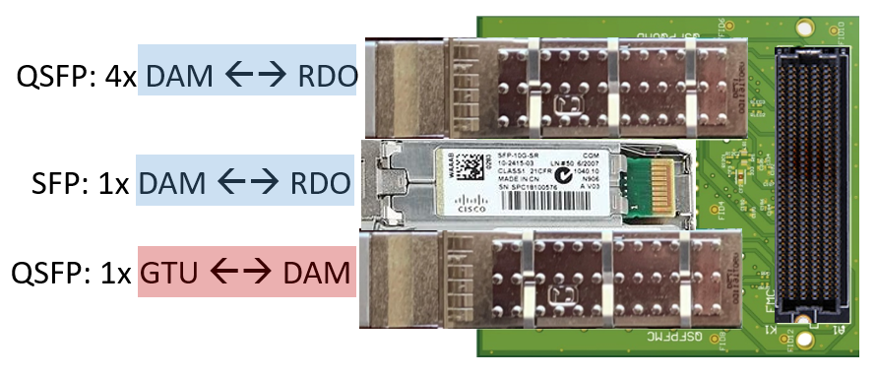
PicoDAQ / MicroDAQ
A functional DAQ will be necessary for small scale detector testing as well as commissioning and pre-ops.
Computing resources are staged to make purchases when the hardware is needed, taking advantage of price savings and performance improvements in time.
Hardware and software development early in the construction phase will involve a series of releases with increasing functionality
Detector Install: FY29Q2 - FY31Q2
Cosmics: FY31Q3
Early CD-4: FY32Q4
DAQ Releases:
PicoDAQ FY26Q2
  Basic readout test setups
MicroDAQ: FY27Q1
  Readout detector data in test stand using engineering articles
MiniDAQ: FY28Q1
  Readout detector data using full hardware and timing chain
Full DAQ-v1: FY29Q2
  Full functionality DAQ ready for full system integration & testing
Production DAQ: FY31Q3
Ready for cosmics
Pico DAQ Hardware Developments:
The focus during 2026 will continue to be on the electronics and those software/firmware aspects required for developing final design.
We expect to implement test stands of echelon0 computing in the labs, and at the SDCC computing facility during 2026, as part of MicroDAQ
Neither PicoDAQ nor MicroDAQ are expected to have direct interface between the detector components and echelon1
This does not prevent DAQ participation in echelon0-echelon1 interface test stands – for example implementing the DAQ side of transfer interfaces for the orchestration test setup
BHCAL --- (H2GCROC)
KCU105 (RDO+DAM) (kintex)
Python Config/Control
rcdaq integration
Norbert Novitzky, Miklos Czeller, Gabor Nagy, Shihai Jia, Martin Purschke
TOF DAM-Lite: (ETROC)
Alinx AXAU15 (Artix)
Reads from lpGBT FEB
Follows FELIX development scheme
(RICE)
WBS 6.03.01.08
DAQ/Computing
FMC - Q(SFP) Adapter
Allows use of prototype GTU/DAM with dev boards (such as AXAU15)
20 boards available now
Firmware under development
PDR1
PicoDAQ
MiniDAQ
Production
DAQ
PDR2
Expectation of uniform system hasn’t been realized!
MicroDAQ
Full DAQ-V1
PDR3

Slide 7
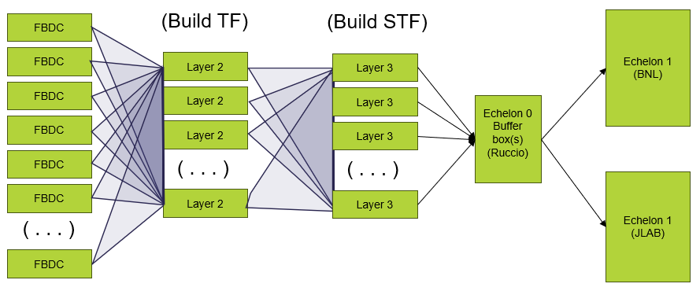
TF / STF and interface to Orchestration
Time Frames (TF) are buffers containing the multiplexed data from the entire detector corresponding to 0.6 ms time periods
Super Time Frames (STF) are ordered, contiguous sets of O(1000) time frames corresponding to roughly 0.6 seconds of detector data
Likely to have independent DAQ Systems
  Polarimetry
  Luminosity Detectors
  Independent STFs for each
On Start/Stop Run
  Notifies Orchestration of detector/collider status via message
On production of STF DAQ:
  Writes file to Buffer Box
  Notifies Orchestration of data availability via message

Slide 8
Thoughts on Artificial Intelligence Support
Focus on AI is intensifying
There are a number of potential applications within Echelon 0/Echelon 1 under discussion use specific sources of information (dRICH SiPM dark current filters, state monitoring to connect slow controls/collider status to operation of detector, autonomous calibration).
A general theme though, for future AI applications is the problem of gathering data from disparate interfaces. Model Context Protocol is a potential solution for this, which may deserve test stands:
Opt-in model:
(Provide easy to use “log” like functions to send data to MCP server)
(E0)
MCP Server
Smart Server Model:
Slow Controls
DAQ TF Building
DAM / Readout CPUs
MCP Servers
Data file Scraper
Slow Controls Database interpreter
Run Log DB interpreter
Log File scraper
E0/E1 Monitors
Run Control
Other

Slide 9
Summary
Description of the streaming ePIC DAQ
Brief status update
Brief description of plans for 2026
Questions?

Slide 10
Backup

Slide 11
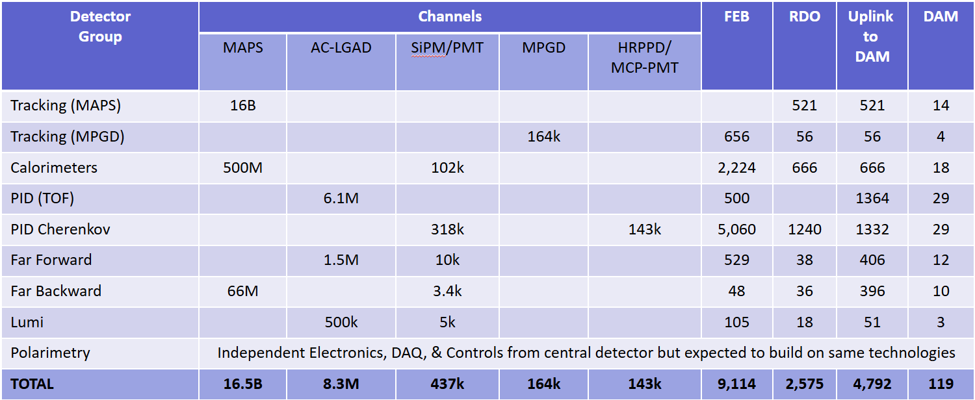
Summary of Channel Counts and Data Flow
Scale of the system:
Electronics
  ~ 25 detectors
  ~ 5 Sensor Technologies
  ~ 2500 RDOs (on detector/in racks)
  ~ 120 DAM boards (DAQ room)
  GTU (with interface boards)
Detailed simulations of DIS events, Proton and Electron beam gas lead to maximum Data Volume
  ~ 2 Tb/sec digitized
  ~ 100Gb/sec recorded
Dark current rates high for dRICH (SiPM sensitive to single photons) after radiation damage. Need High-Level Filter (ML algorithms under study)
Synchrotron Radiation Simulations still in flux. Rates at 18GeV with currently simulated beam-line dominate physics rates. Scaling to lower energies is not trivial, and optimized beam line being simulated.
Summary of Data Flow
PCI/Eth
Eth
Detector
FEB
Copper
RDO
Fiber
DAM
Readout Computer
Aggregate | 2.0 Tb/sec
Noise | 1.6 Tb /sec
Signal from Physics + Background | 400 Gb / sec
Aggregate | 109 Gb/sec
Collision Signal | 62 Gb/sec
Synchrotron Rad | Under design
Electron Beam | 4.5 Gb/sec
Hadron Beam | 1.0 Gb/sec
Noise | 41 Gb/sec
Aggregate | 2.0 Tb/sec
Per RDO (Avg) | 0.7 Gb/sec

Slide 12
Readout Chains
Detector System | Sensor | ASIC / Digitization | Digitization Clock | FEB | FEB-RDO Protocol | RDO Type | RDO Location | Notes
Si Tracking --- (ITS3 / LAS): (IB, OB, EE, HE) | ITS3/LAS | Integrated /w sensor | 39.4 MHz (2-8 us time) | Integrated (Schambach) | GBT | Fiber Aggregator GenericRDO | South Platform | J. Schambach Presentation
MPGD tracking: (SAMPA): (IB, OB, EE, HE) | urWELL / uMegas | SALSA | 39.4 MHz | lpGBT / VTRX+ | GBT | 4 → 1 GenericRDO | South Platform | RDO – N. Novitzki Presentation FEB – F. Barbosa Presentation
Calorimeters (CALOROC): BarrelHCAL, Backward HCAL, Barrel ECAL, Backward ECAL, Backward HCAL | SiPM | CALOROC | 39.4 MHz | lpGBT / SFP+ | GBT | 4 → 1 GenericRDO | South Platform | N. Novitzki Presentation
Calorimeters (CALOROC): LFHCAL, HCAL Insert | SiPM | CALOROC | 39.4 MHz | lpGBT / SFP+ | GPT | 4 → 1 GenericRDO | East HCAL Platform | N. Novitzki Presentation
Calorimeters (Discrete): FwdEcal | SiPM | Discrete | 98.5 MHz | FPGA / SFP+ / Cu | Internal | 16 → 1 GenericRDO | South Platform | G. Visser Presentation Planned RDO similar to existing designs
Far Forward (AC-LGAD / EICROC): B0 tracking, Roman Pots, Off Momentum | AC-LGAD | EICROC | 39.4 MHz | lpGBT / VTRX+ | GBT | Direct to FELIX | N/A | Same as per Endcap TOF
Far Backward: (AC-LGAD / FCFD): Lumi photon spectrometer tracker | AC-LGAD | FCFD | 39.4 MHz | lpGBT / VTRX+ | GBT | Direct to FELIX | N/A | Same as per Barrel TOF
Central Detector (AC-LGAD / EICROC): Endcap TOF | AC-LGAD | EICROC | 39.4 MHz | lpGBT / VTRX+ | GBT | Direct to FELIX | N/A | F. Barbosa Presentation
Central Detector (FCFD): Barrel TOF, pfRICH, DIRC | HRPPD / MCPMT | FCFD | 39.4 MHz | lpGBT / VTRX+ | GBT | Direct to FELIX | N/A | F. Barbosa Presentation
Far Forward/Backward (CALOROC / Discrete): B0 Crystal Calorimeter, ZDC Crystal Calorimeter, ZDC HCAL, Lumi Photon Spectrometer Calorimeter | SiPM | Discrete | 39.4 MHz (or) 98.5 MHz | FPGA / SFP+ / Cu (or) lpGBT / SFP+ | Internal GBT | 16 → gRDO (or) 4 → 1 gRDO | East/West Tunnel Near Detectors | Small channel count detectors Expect to copy either CALOROC or Discrete
Far Backward: (Discrete): Direct Photon Lumi Calorimeter* | SiPM | Flash-250 | 197 MHz | FADC 250 | Streaming ADCs | (N/A) | West Tunnel | Special FELIX processing to histogram / Sum bunch by bunch luminosity data
Far Backward: (TimePix): Low Q Tagger | TimePix | Integrated / w sensor | 98.5 MHz | Integrated / w sensor | Internal | SPIDR4 Variant (NIKEF) | West Tunnel Under Detector | K. Livingston Presentation Planned RDO similar to existing designs
Imaging Calorimeter (Astropix): | AstroPix | Integrated / w sensor | 98.5 MHz | Integrated / w Sensor | Astropix Internal | End of Stave Card (NASA) | On Detector | J. Metcalfe Presentation Planned RDO similar to existing designs
Central Detector (ALCOR): dRICH | SiPM | ALCOR | 39.4 MHz | FPGA / Cu | Internal | FPGA / VTRX+ | On Detector in PDU | Pietro Antonioli Presentation
Electronics design pending
Planned variants of GenericRDO
Scope of outside Electronics/DAQ

Slide 13
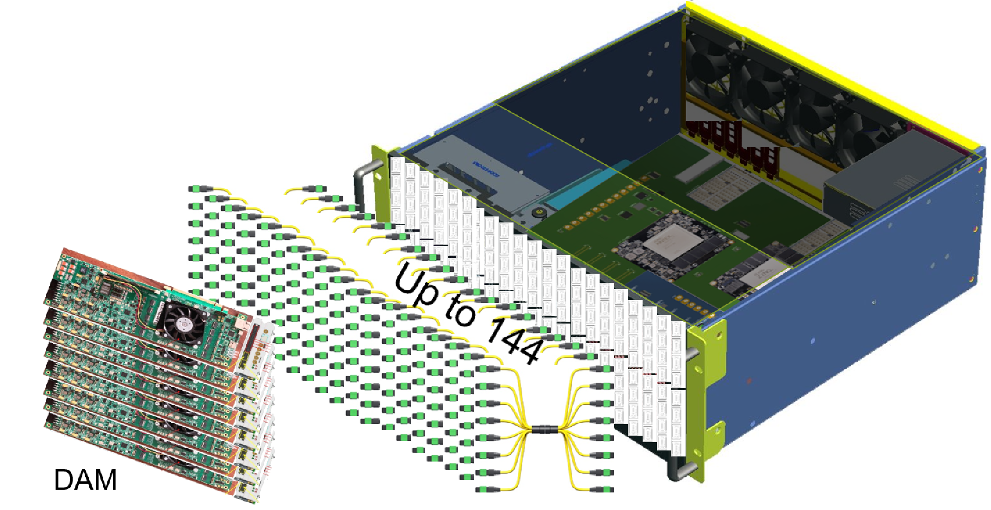
Overview of the GTU
The Global Timing Unit Consists of a 4u, 19” rack mounted, air-cooled box containing
  GTU base board
  Optic transceiver adaptor boards
  Clock monitor board
Boards in advanced design
  Internal Review for PCB fabrication on 11/5/25
  Expect articles early 2026

Slide 14
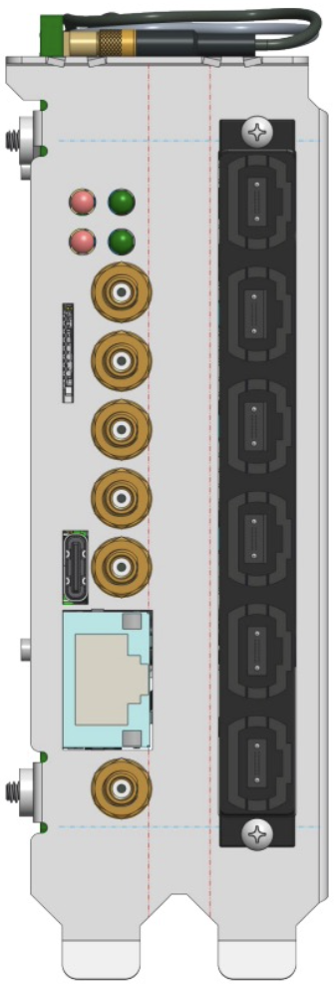
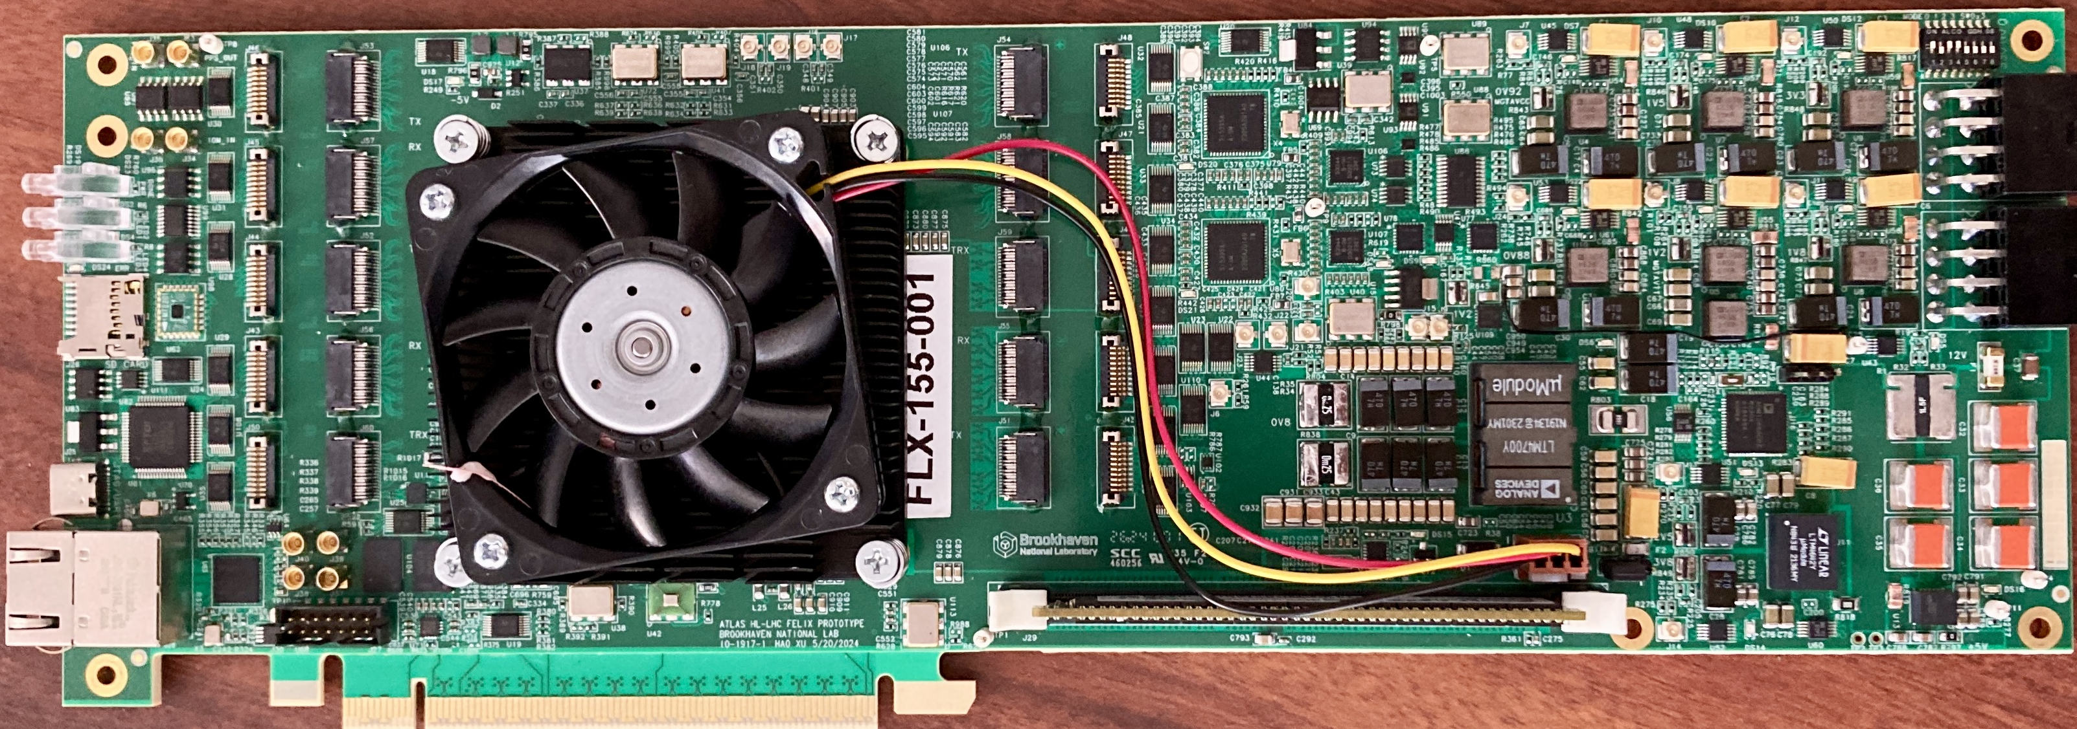
FELIX Updates – FLX-155 – DAM Status
Front-End Link eXchange
Versal Ultrascale+ FPGA/SoC
Linux OS, Clock Distribution, Stream Frame Builder, Optional fixed latency processing
( data output via Ethernet and/or PCIe)
GTU interface
100Gb
Ethernet
External
Power
(<175Watts)
48 bi-directional links to RDO/FEBs
FELIX hardware for future ATLAS experiments at HL-LHC is being developed at BNL (Omega Group)
  ePIC is collaborating with Omega to use this design as our DAM board.
Initial engineering articles were tested in early 2025. Updated PCB design sent out for fabrication/population
  Final design board will be tested this Fall (2025).
We expect to produce at ~4 boards for ePIC use after testing. Availability anticipated in early 2026
  Currently we have two 24-port versions (FELIX 182) being used for development

Slide 15
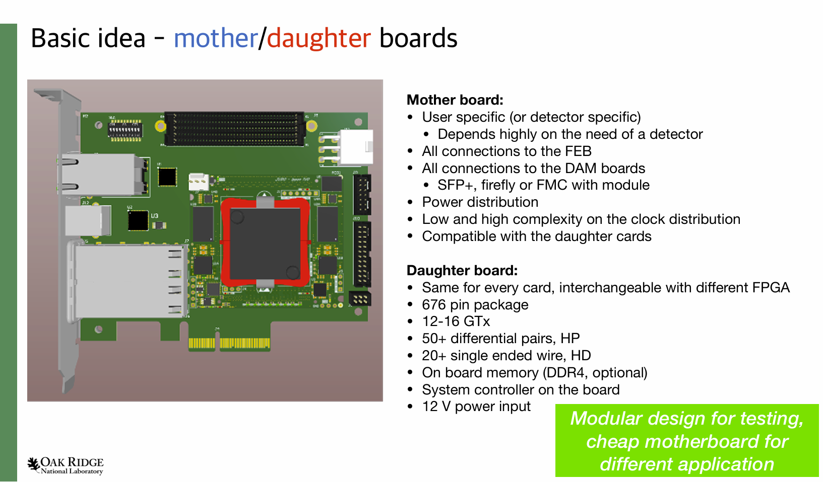
Generic RDO

Slide 16
Front End Boards and RDOs
Front End Boards:
Organized By ASIC/Sensor
MAPS
Timepix
Astropix
CALOROC
EICROC
SAMPA
FCFD
Fwd/Back
Ecal
ALCOR
Direct Photon
RDO Electronics have several
Flavors
4 → 1 Generic RDO
16 → 1 Generic RDO
Fiber Aggregator
ALCOR RDO
ASTROPIX End of
Stave Card
Spyder Variant
Integrated and managed
under detector groups
as part of sensor development
Generic RDO supporting multiple potentially varied ASIC choices
(Norbert Novitzky’s Presentation)
General electronics design
planned by technology but will
split into specific form factors for
individual detectors depending
on integration needs
Electronic Design is waiting
on ASIC completion but
PCBs exist and used for testing
of proceeding ASIC variants
e.g. ETROC / HGCROC2 / SALSA
Planned RDO for forward ECAL – the only functional difference larger aggregation will likely merge with 4 → 1 Generic RDO
Specific RDO for MAPS to reduce O(6000) fibers to manageable number. Cost & FPGA capability being analyzed. May merge with 4→1 RDO
dRICH physical / data rate needs. Articles existing under testing
Discrete design in advanced form. Development for Forward ECAL but expected for other small calorimeters
Designs planned but not yet begun. Development by groups with prior experience developing similar boards for similar technologies
Design in advanced form for dRICH
Unique System in ePIC. Streaming ADCs with no zero-suppression..

Slide 17
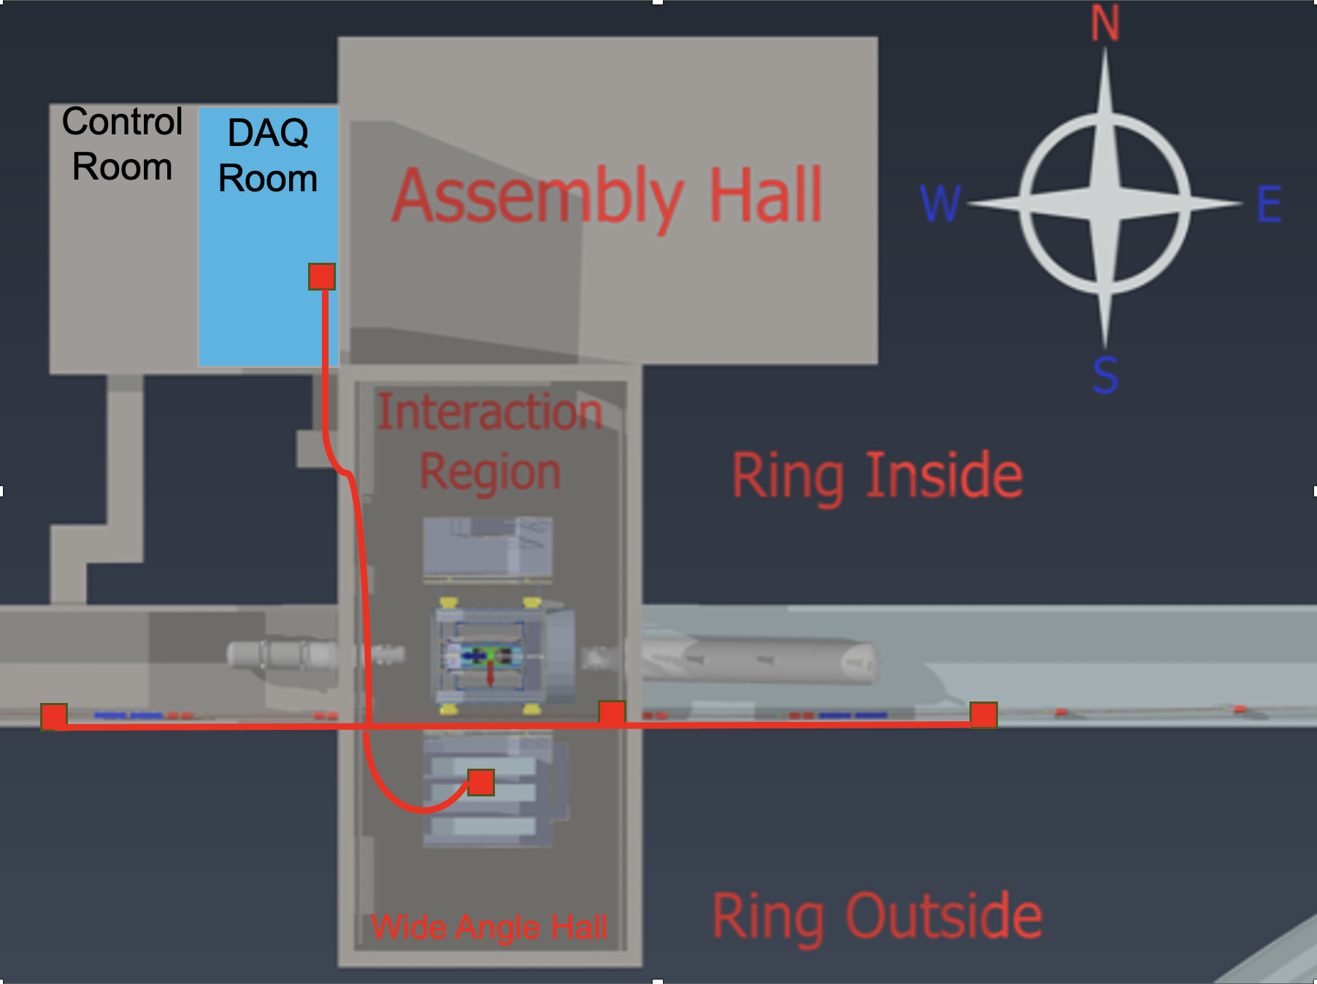
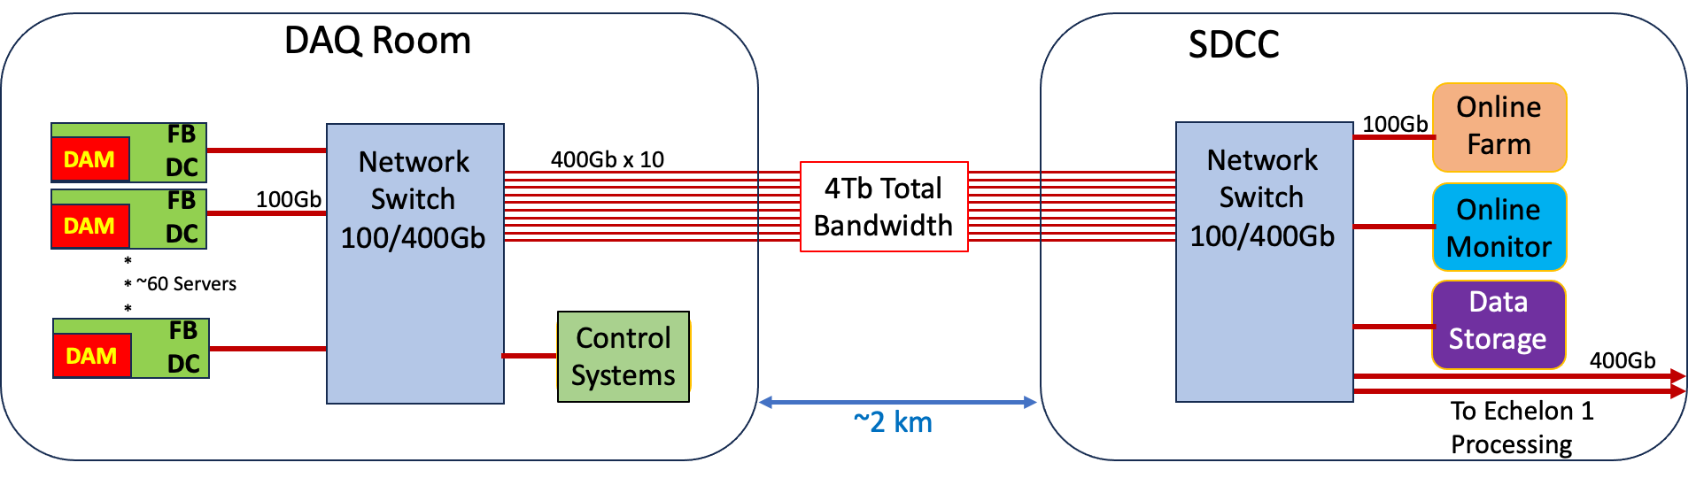
Echelon 0 computing
Echelon 0 consists of O(100) readout computers in DAQ Room
O(100) computers at SDCC data center for Time Frame Building, High Level Filters, archiving, monitoring, logging, QA and other DAQ related tasks.
Echelon 0
Software
Design
Run Control Model:
State model incorporates continuously running components (i.e.. scalers)
“Run” structure to configure / select enabled detectors
Slow Control status part of state model
EIC / LHC clock:
DAM selects 39.4 MHz or 98.5 MHz
GTU distributes 19.7 MHz to avoid phase problems when dividing clock
Fast commands restricted to EIC bunches at multiple of 5 (2 cycles of 39.4 MHz or 5 cycles of 98.5 MHz)
Time Frames:
$2^{16}$ Bunch Crossings ~ 667 µs
Not synchronized to Bunch 0 (Minimize correlation between edge effects and spin states)
Build all detector to each time frame
Group O(1000) TF into Super Time Frames
Data Banks:
RDO / lpGBT produced data formatted but not processed produce raw data banks
Processing (data reduction / or additional information) produces new data banks (no modification)
Fraction of raw banks always retained

Slide 18
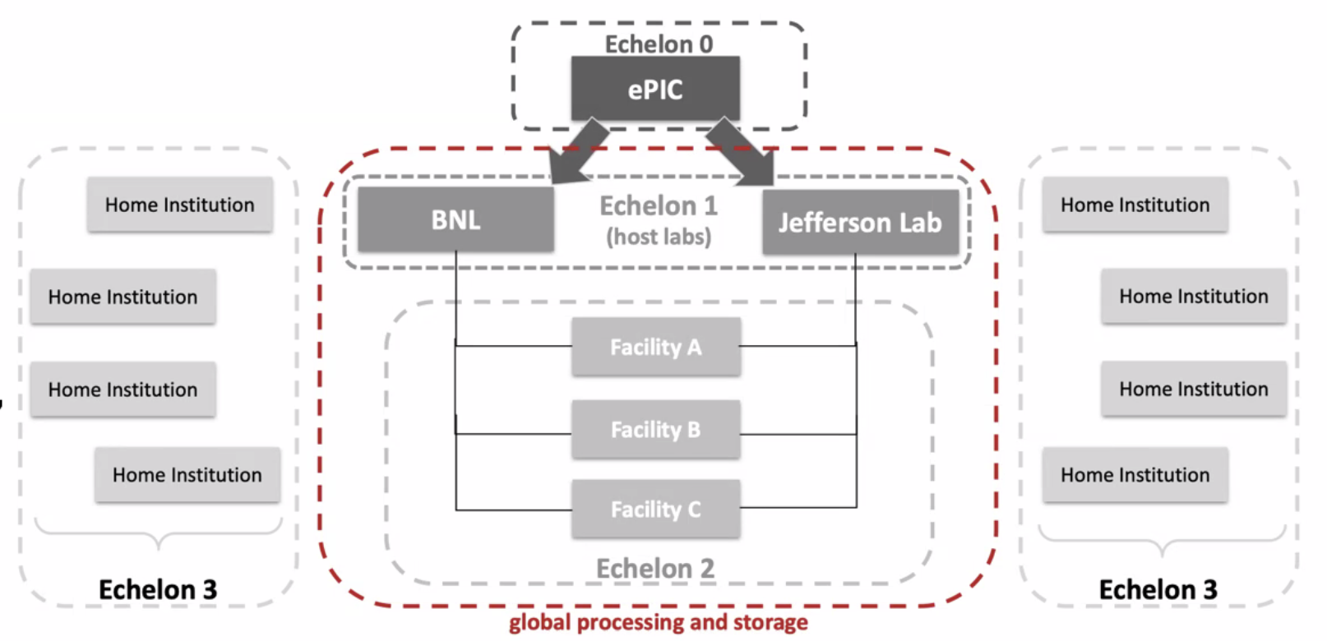
Boundary between Echelon 0 and Echelon 1
The streaming architecture allows for some blurring of the offline and online processing with respect to calibrations, QA monitoring, and potential seed analysis to improve reconstruction turn around.
Require an interface to allow sharing of code between offline / online processing
Local buffering (Echelon 0) provides elasticity in the transfer of data to computing facilities, but low latency transfers (< 10 seconds) are the goal
Echelon 1 will perform calibration and reconstruction from disk buffer over a period of 3 weeks avoiding tape readback
ePIC Scientific Computing
Is a dependency for the project handled in conjunction with host labs.
The Resource Review Board (RRB) looks at the international detector and computing resources.
The ePIC computing groups are actively implementing scientific software as well as working with the DAQ to define the interface with the streaming DAQ system.

Slide 19
Time Frames and Super-Time Frames
FBDC
(Build TF)
(Build STF)
Echelon 1
(BNL)
FBDC
Layer 2
Layer 3
Name
FBDC
Layer 2
Layer 3
Echelon 0
Buffer box(s)
(Ruccio)
FBDC
Layer 2
Layer 3
FBDC
( . . . )
( . . . )
Echelon 1
(JLAB)
FBDC
Layer 2
Layer 3
( . . . )
FBDC

