Slide 1
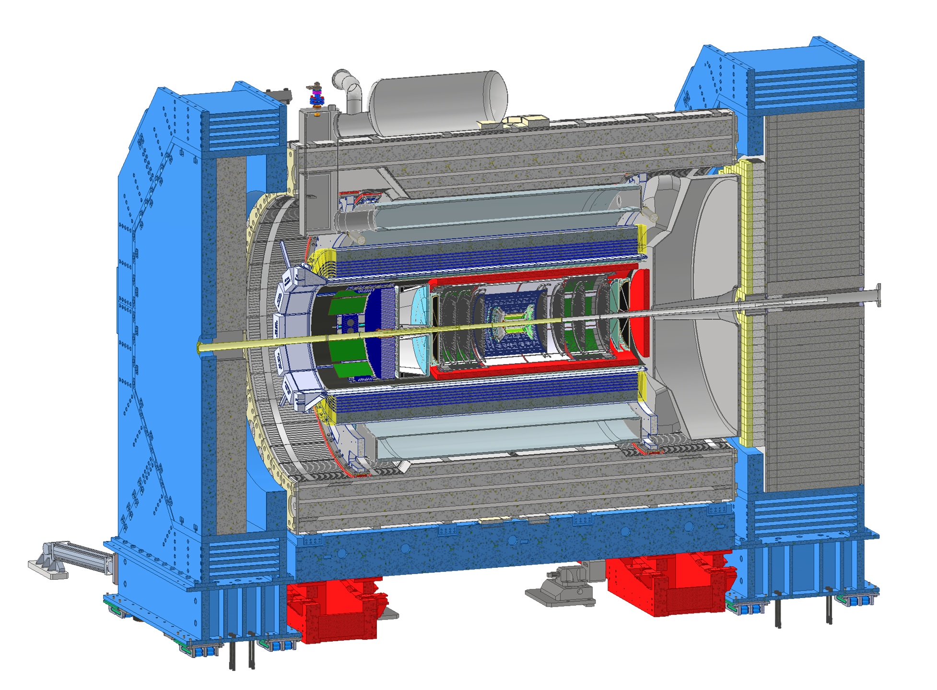
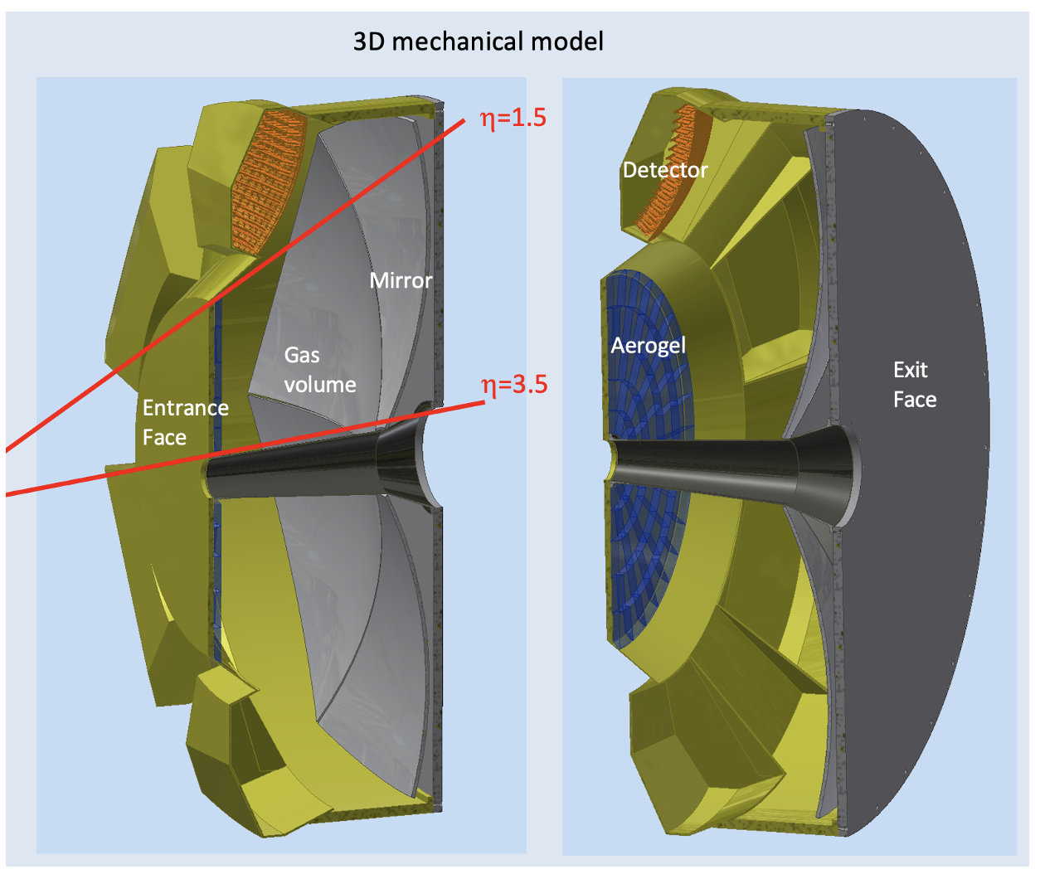
ePIC dRICH
Dual-radiator Ring-imaging Cherenkov Detector (dRICH)
Essential to access flavor information
Goals:
Hadron 3σ−separation between 3 - 50 GeV/c
Complement electron ID below 15 GeV/c
Cover forward pseudorapidity 1.5 (barrel) - 3.5 (b. pipe)
dRICH Features:
Extended 3-50 GeV/c momentum range --> Dual radiator
Single-photon detection in high Bfield --> SiPM
Limited space --> Compact optics with curved detector
4m
M. Contalbrigo
ePIC Collaboration Meeting, BNL , January 21st, 2026
1

Slide 2
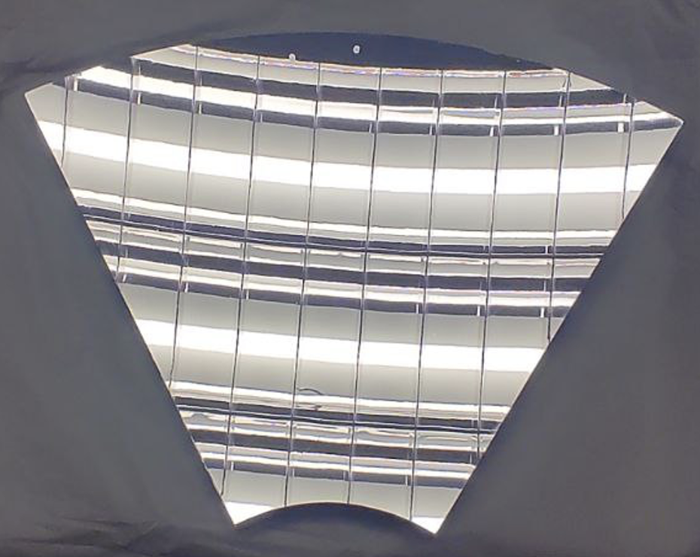
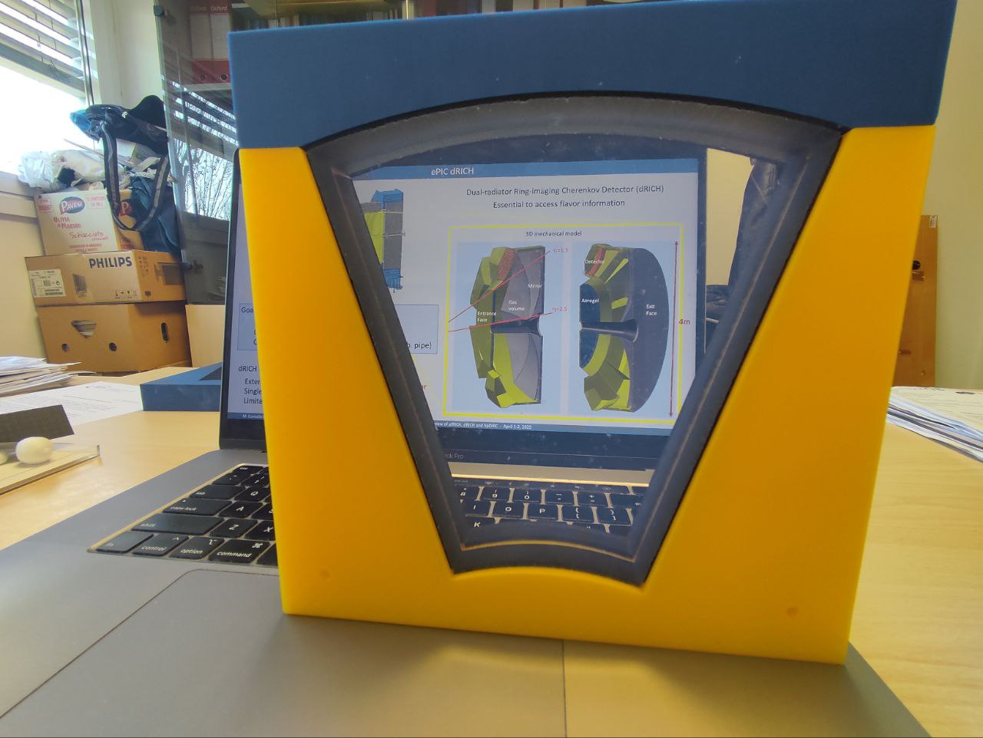
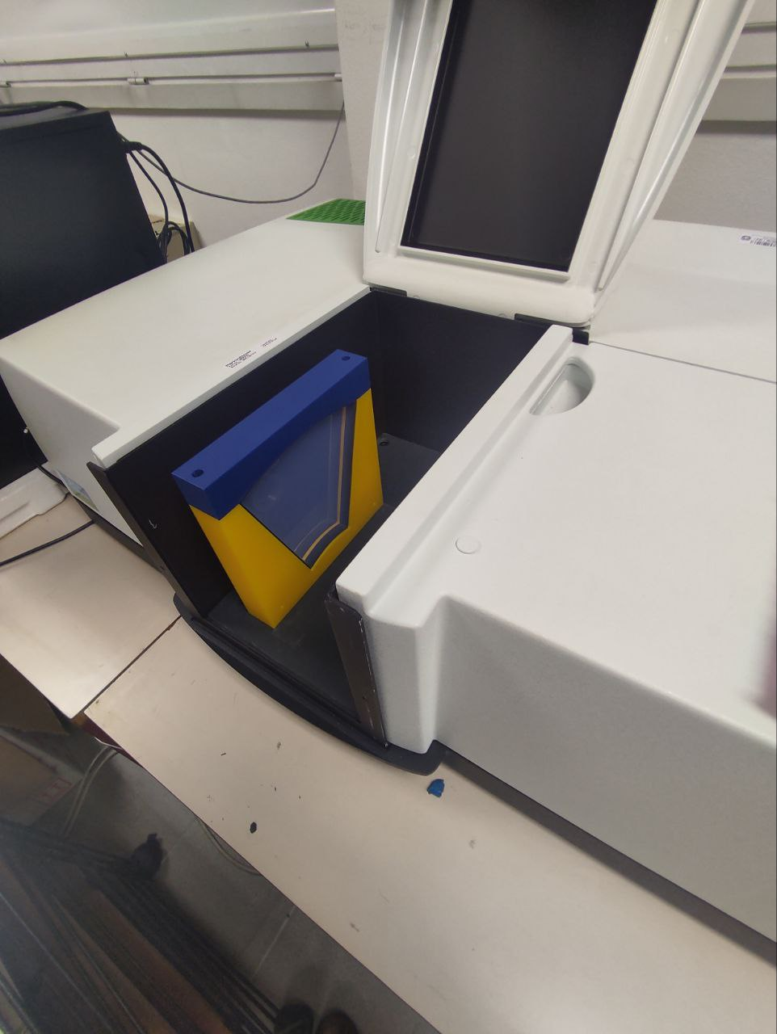
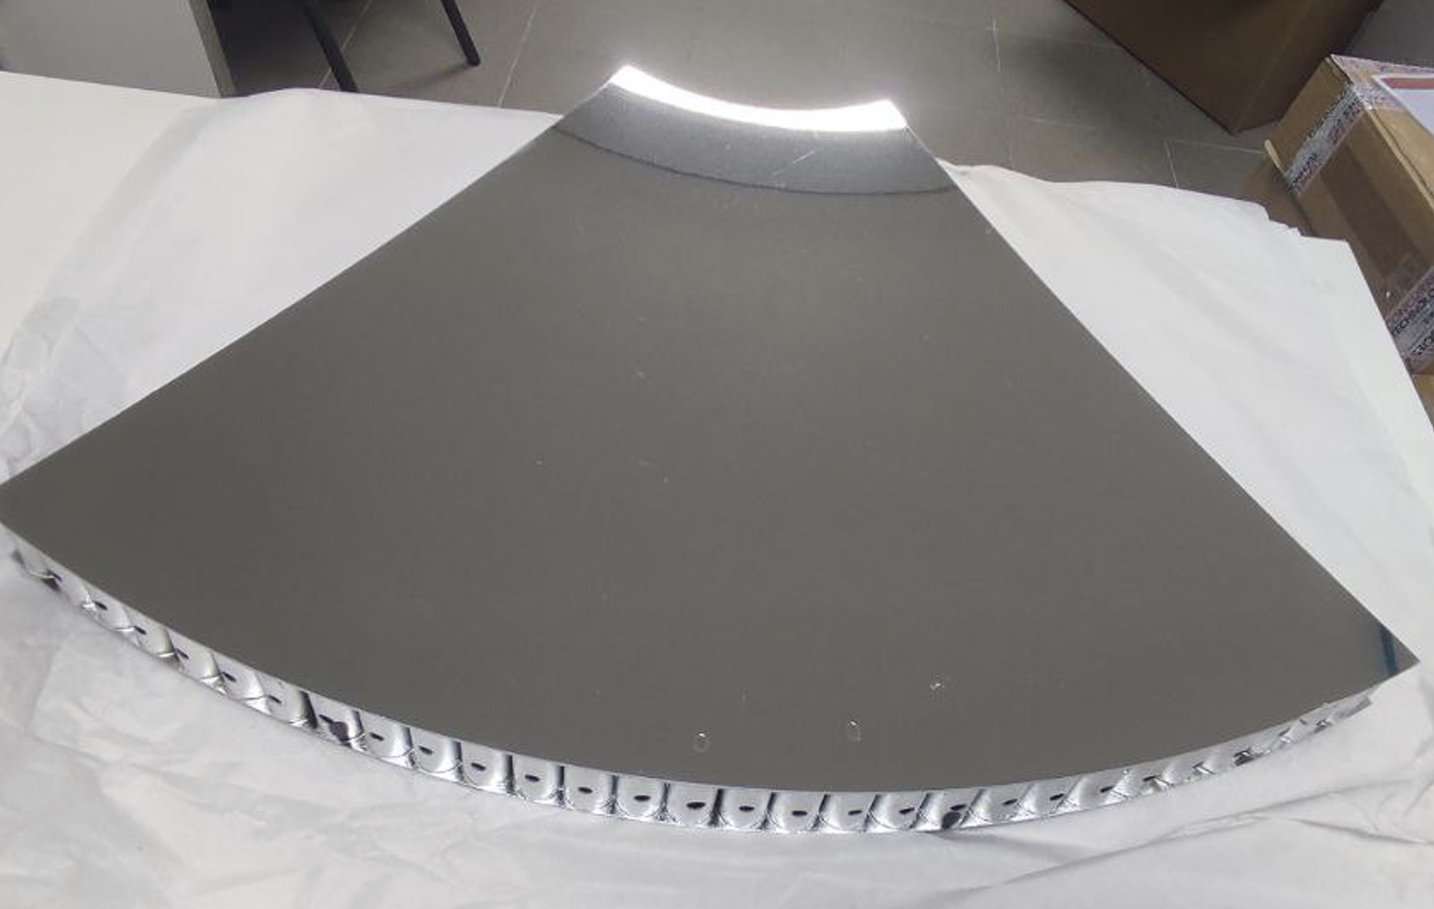
Latest Arrivals
Mid-size demonstrators successfully produced
Mid-size mirror coating successfully done at ECI
Mirror has arrived in EU (FE)
Refrence samples being characterized at DUKE
2025 production of mid-size aerogel (15-18 cm)
successfully completed, characterization ongoing
Production of large-size aerogel (> 20 cm) initiated
18 cm
52 cm
M. Contalbrigo
ePIC Collaboration Meeting, BNL , January 21st, 2026
2
Notes:
Aggiungere distribuzioni in numero fotoni ?

Slide 3
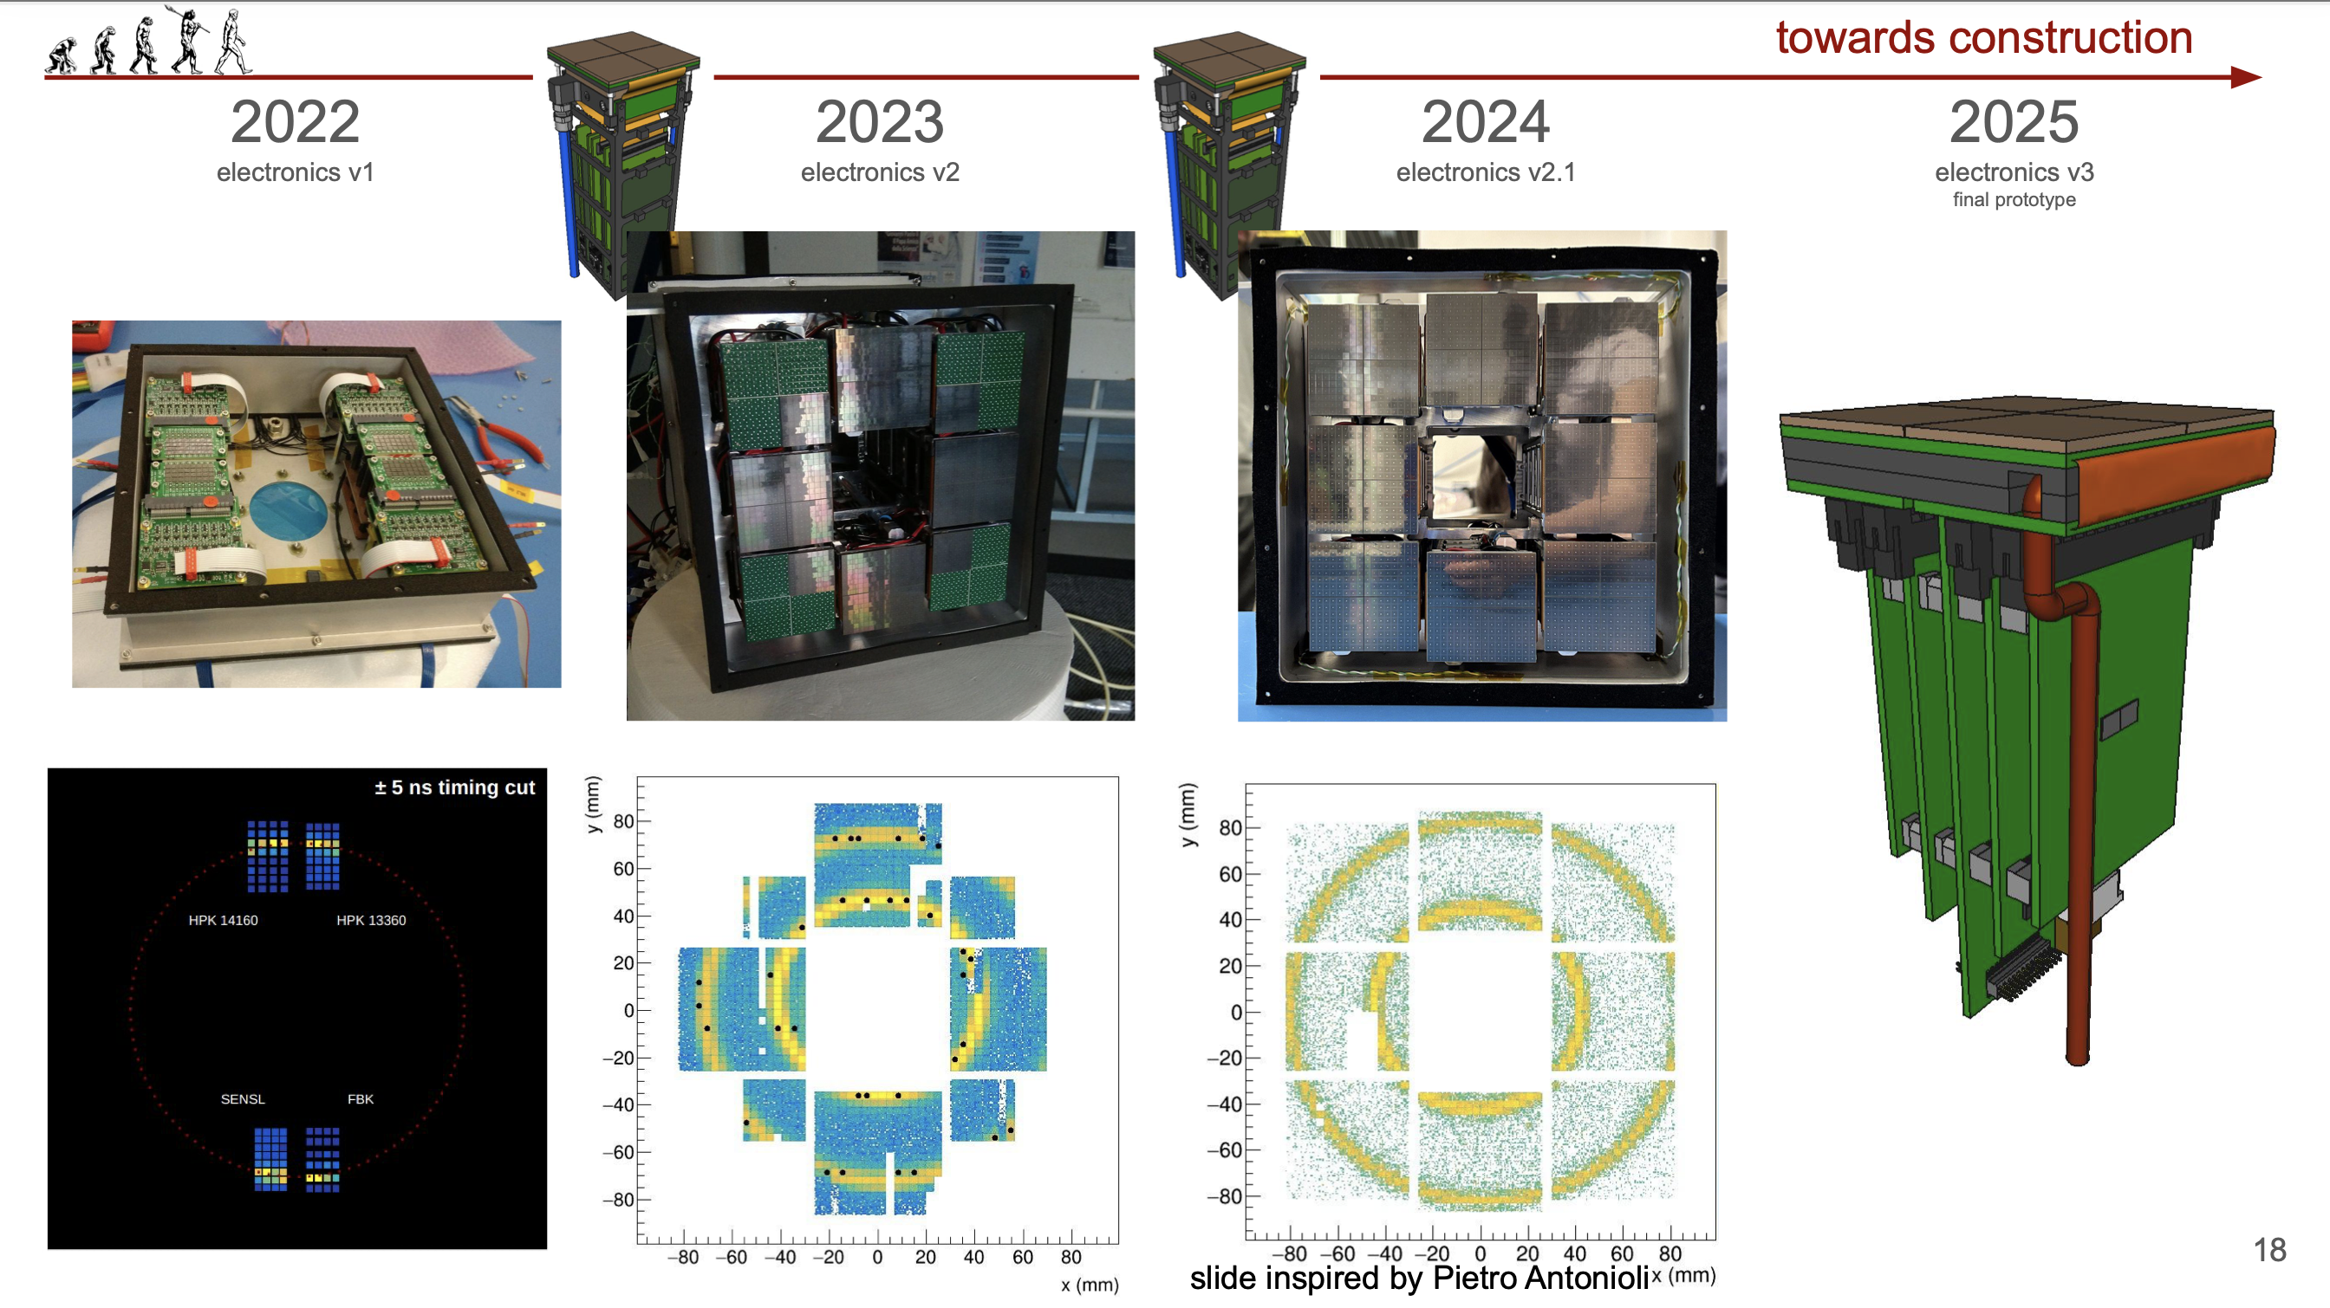
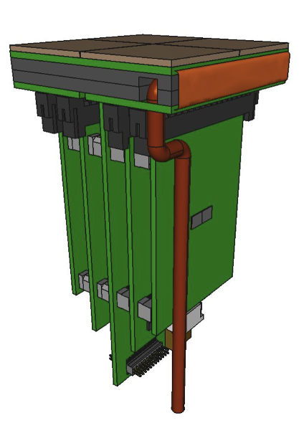
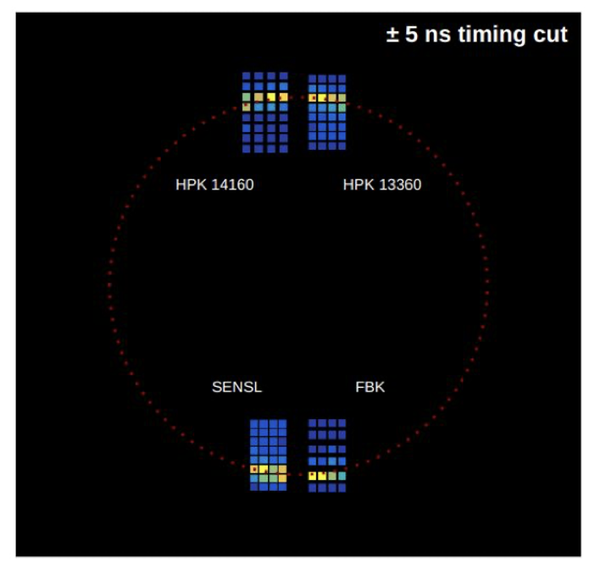
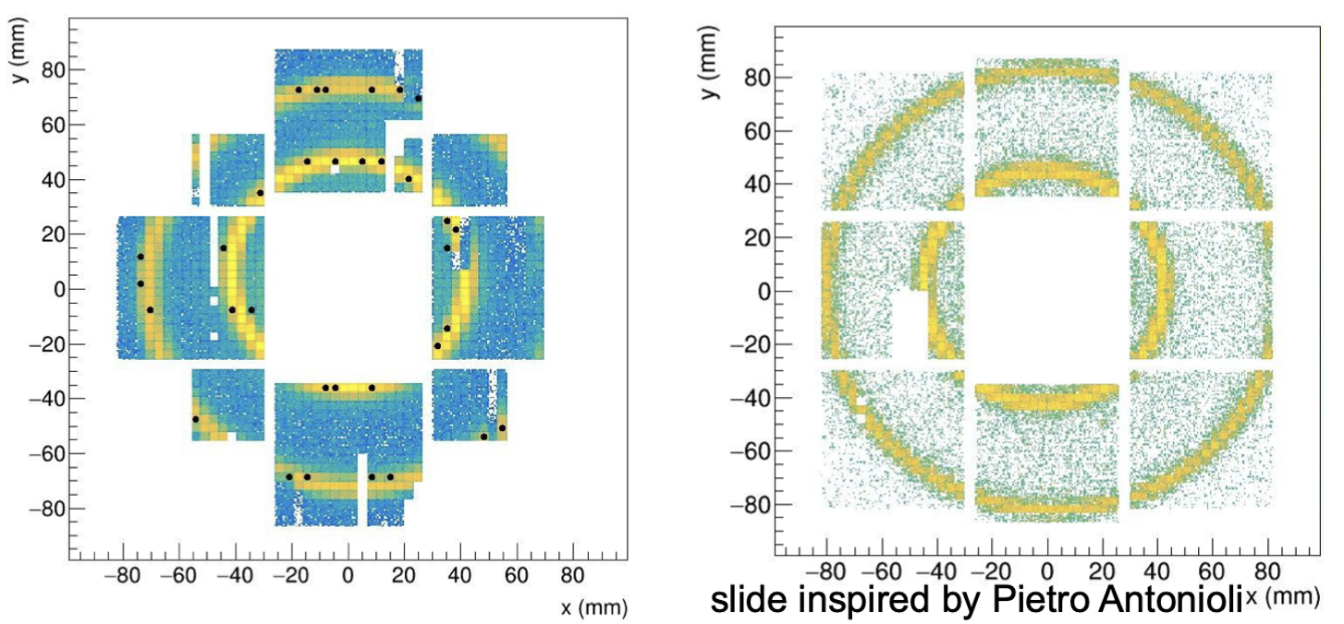
Photon Detector
Steadly progress of photodetector towards integrated design completion in 2026
/26
50 μm
75 μm
ALCOR 32 ch
Full size engineering
test article
2025
+ SiPM carrierv3
+ RDO
2026
+ ALCOR 64ch
+ FEB 64
M. Contalbrigo
ePIC Collaboration Meeting, BNL , January 21st, 2026
3
Notes:
Come si arriva ai 1.8 Tbps ? 3 KHz / 3(shutter) * 3e5 (canali) *64

Slide 4
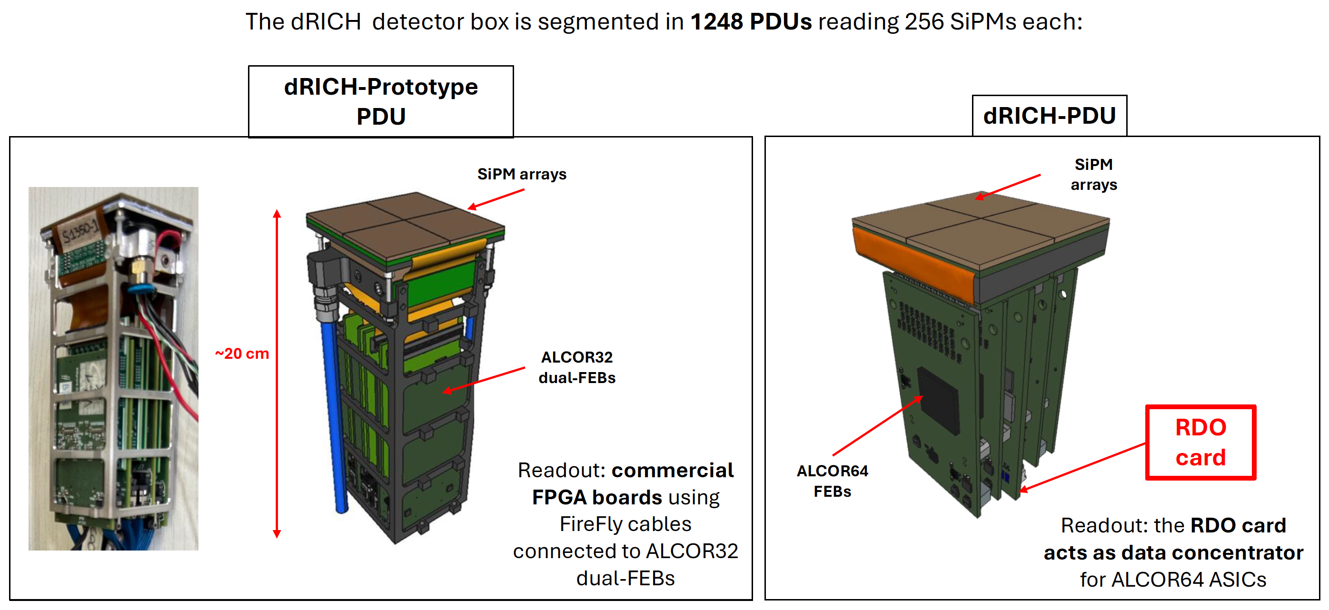
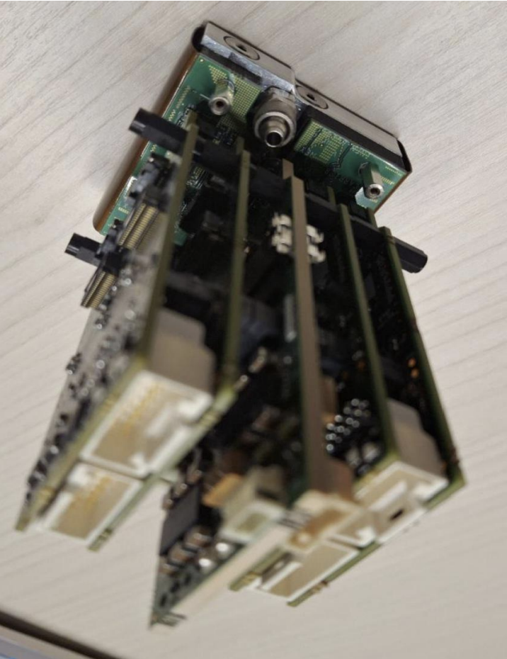
Photon Detection Unit
RDO
M. Contalbrigo
ePIC Collaboration Meeting, BNL , January 21st, 2026
4

Slide 5
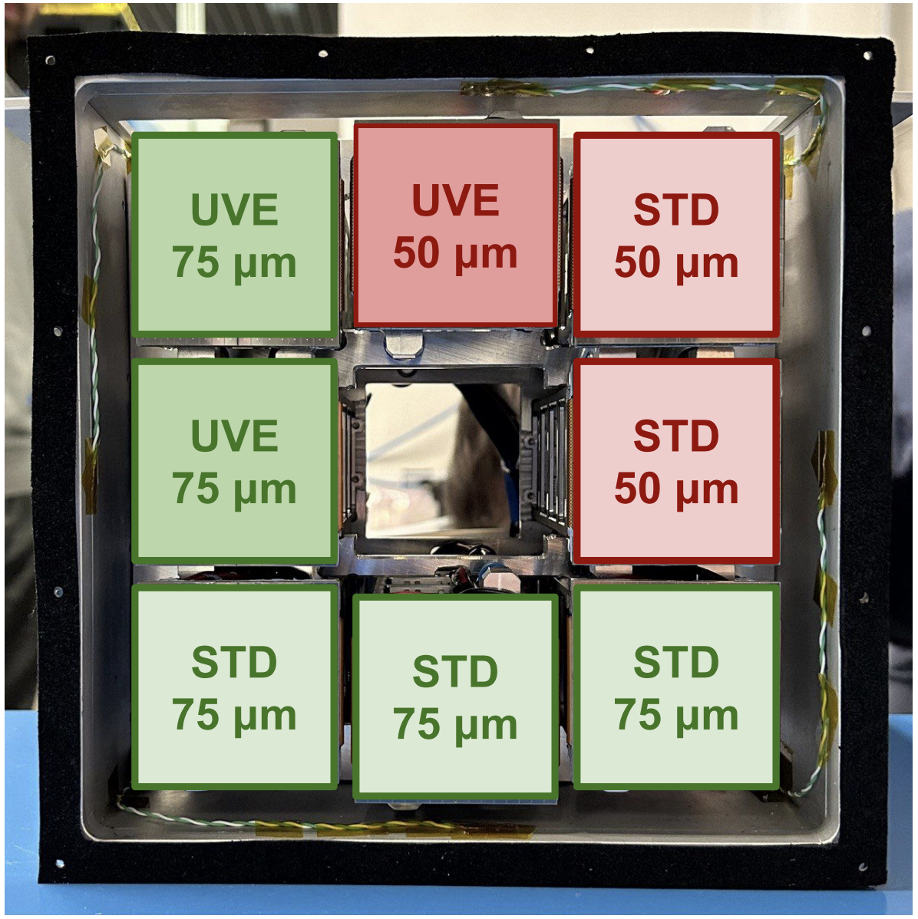
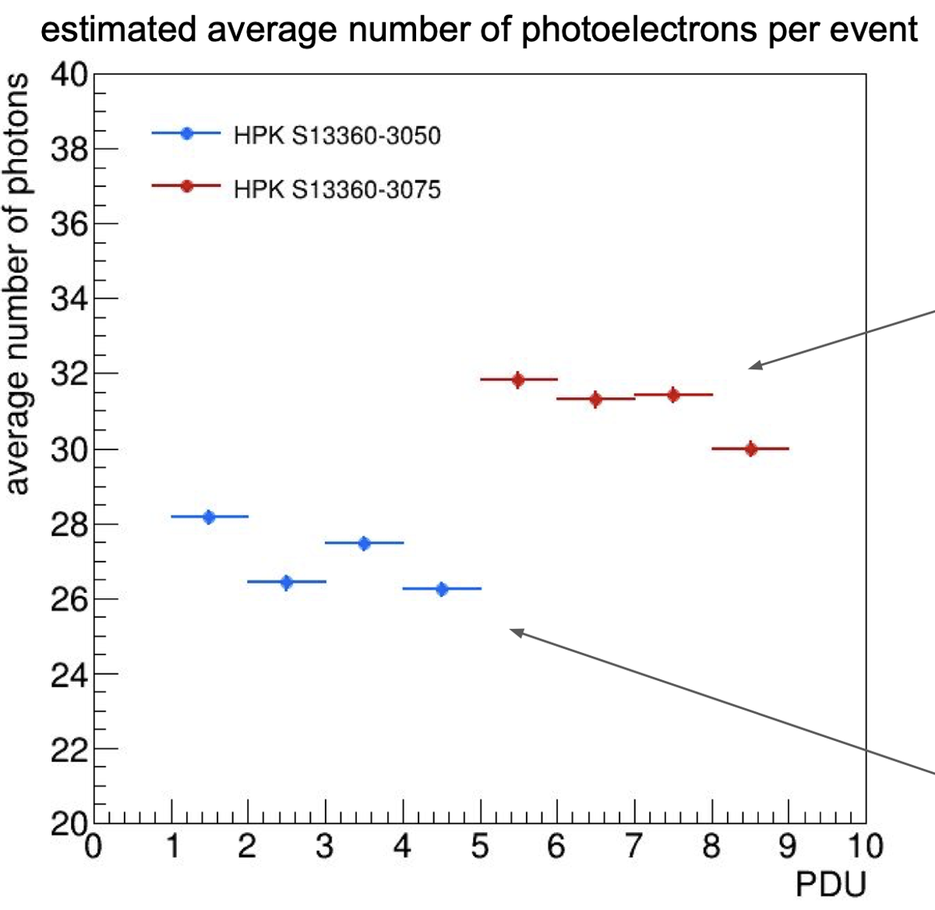
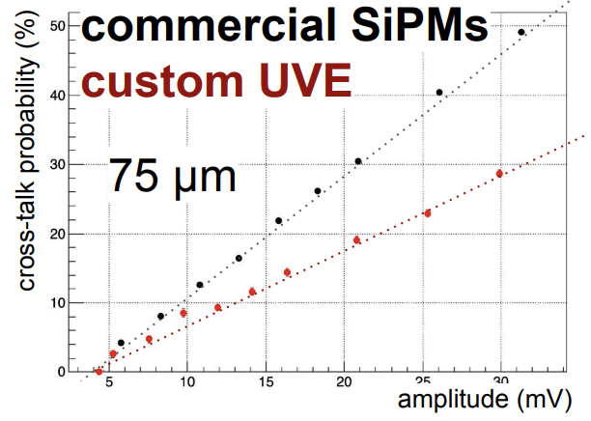
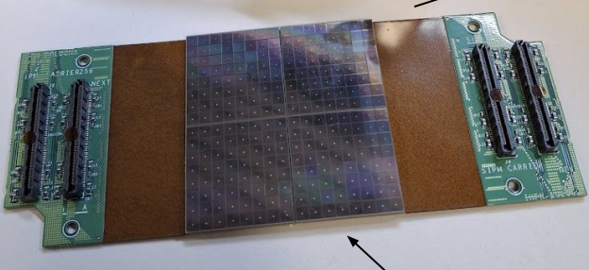
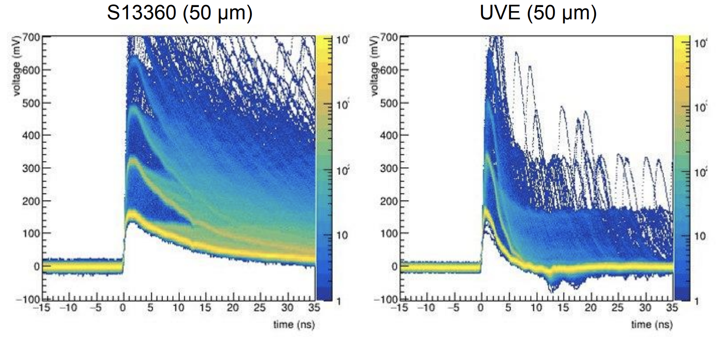
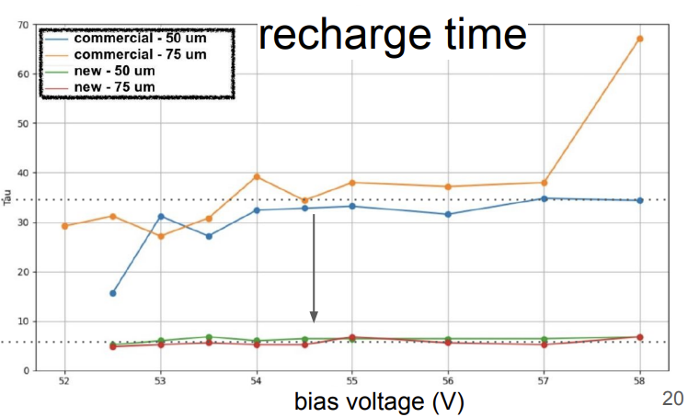
dRICH Sensors
FInalization of the engineering of the SiPM optimized layout
Spad size vs photon yield
Custom: lower
cross-talk probability
75 μm
50 μm
A manufacturer error prevented
the use at the 2025 test-beam
Custom: lower
pile-up probability
UV enhanced with fast signal
Custom
- UVE
M. Contalbrigo
ePIC Collaboration Meeting, BNL , January 21st, 2026
5
Notes:
Come si arriva ai 1.8 Tbps ? 3 KHz / 3(shutter) * 3e5 (canali) *64

Slide 6
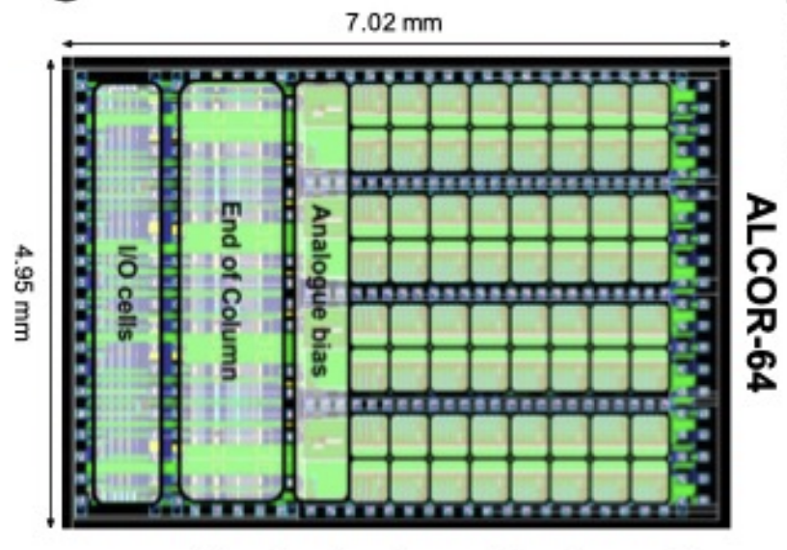
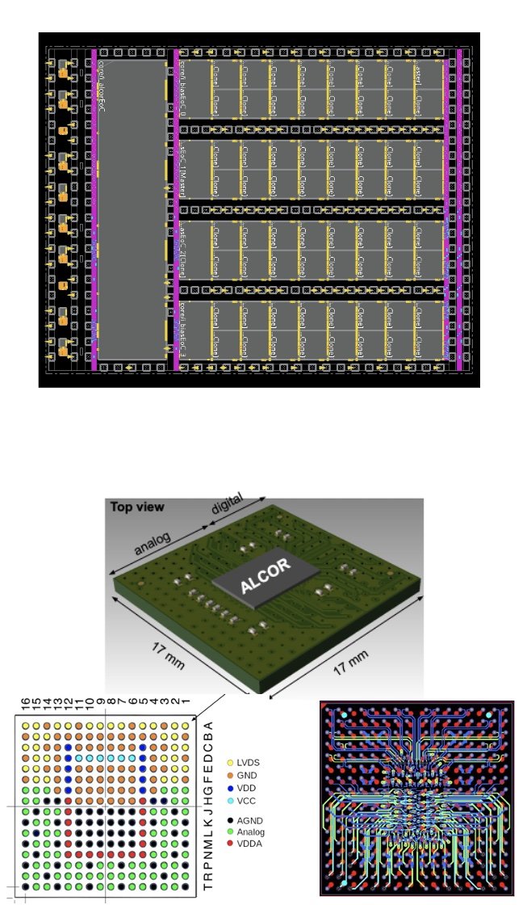
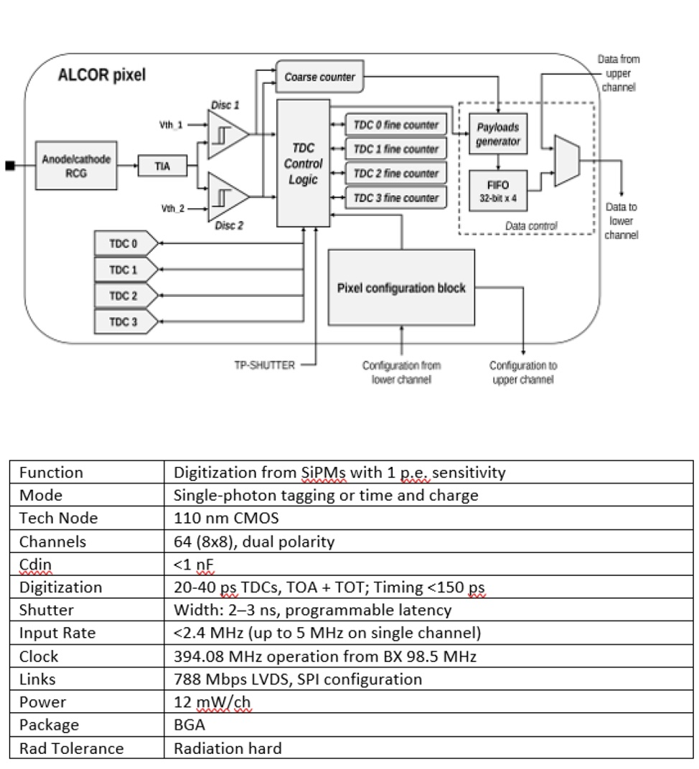
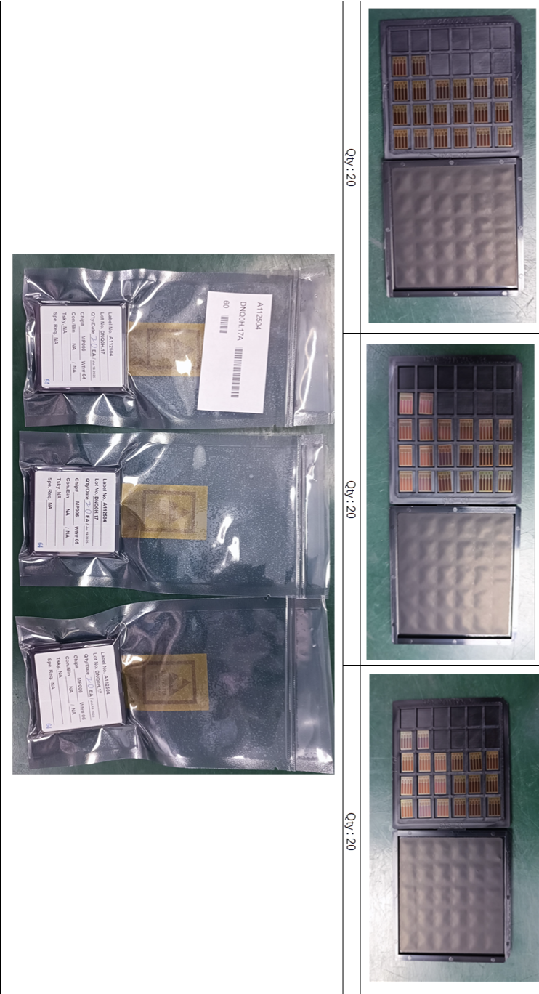
ALCOR v64
First ALCORv64 test article produced in a MPW run, chip packaging is ongoing with interesting lesson learned
Chip delivery expected soon
Silicon die layout
ALCOR block diagram
Compact ball-grid array (BGA)
package with interposer
ALCOR key specifications
M. Contalbrigo
6
Notes:
Vedere stage in ingresso, c’e’ gain programmabile ?

Slide 7
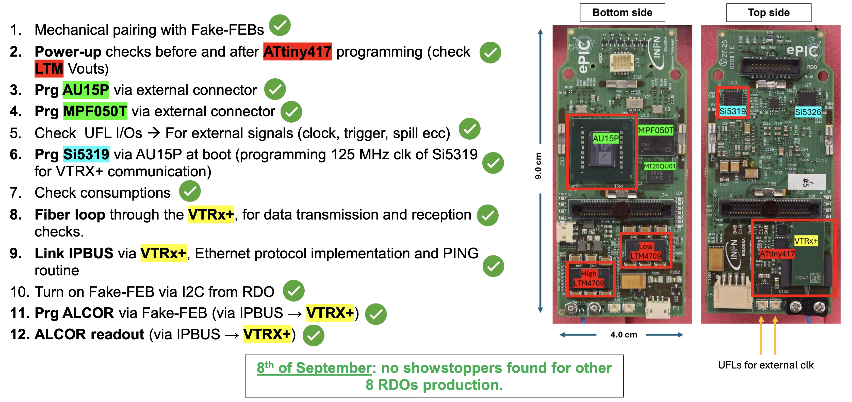
RDO Validation
Concentrate the ePIC RDO functionalities inside the space of a credit card
M. Contalbrigo
ePIC Collaboration Meeting, BNL , January 21st, 2026
7

Slide 8
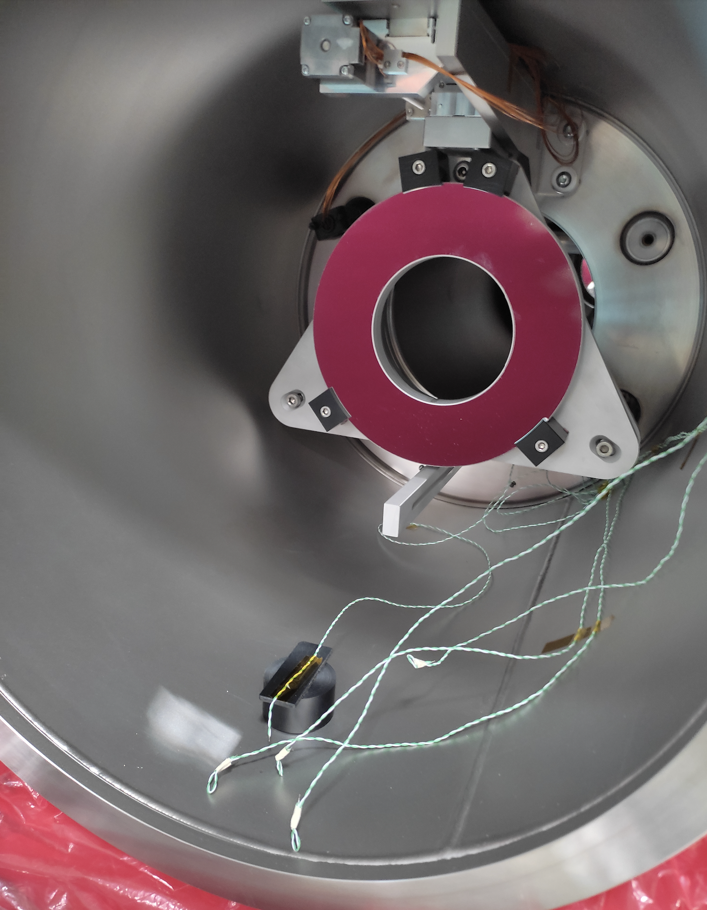
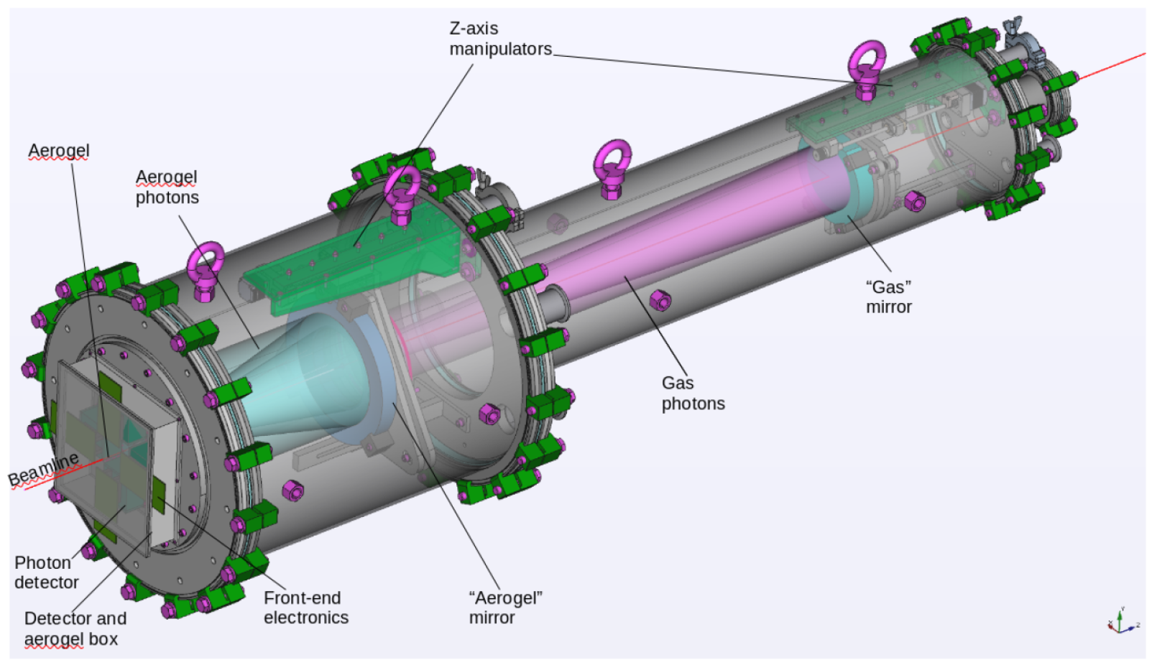
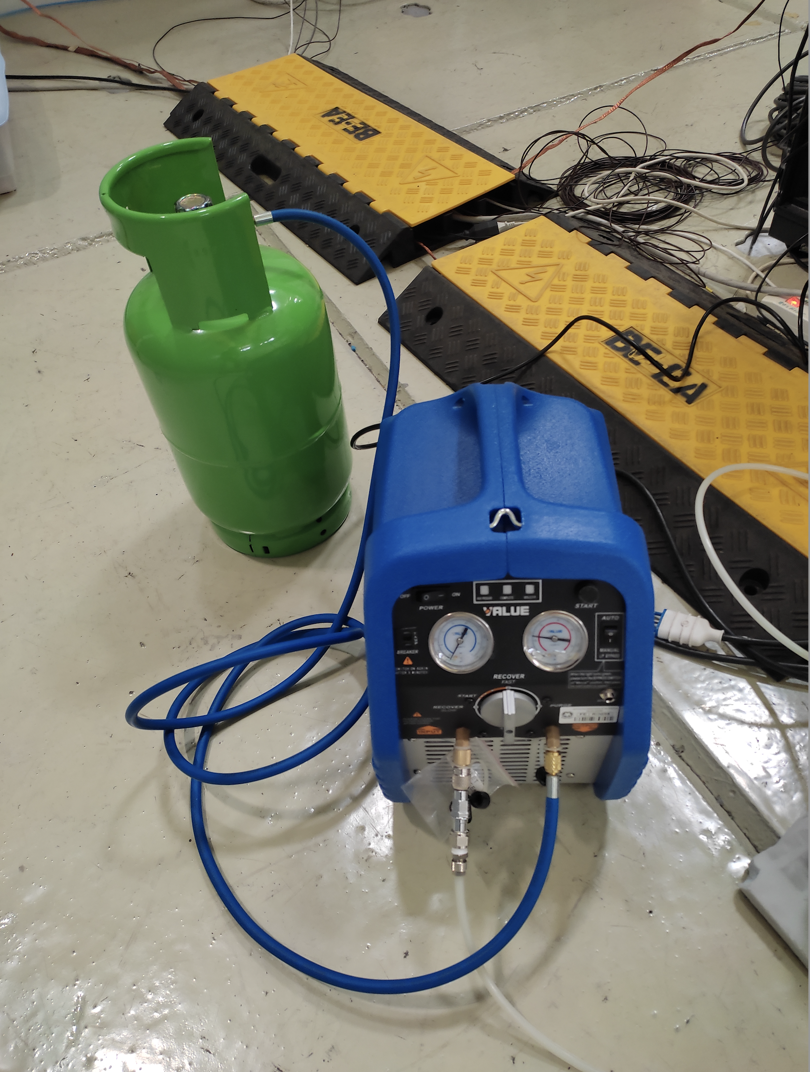
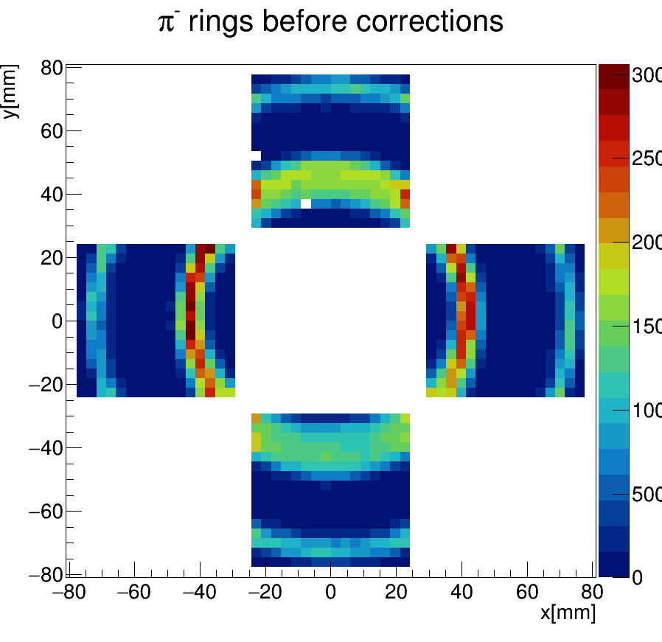
dRICH Prototype
1st chamber
On axis optics to minimize the active area, single or double radiator imaging
Vacuum technology & recovery system for efficient gas exchange
Gas recovery system
Reference
H12700
MAPMTs
M. Contalbrigo
ePIC Collaboration Meeting, BNL , January 21st, 2026
8

Slide 9
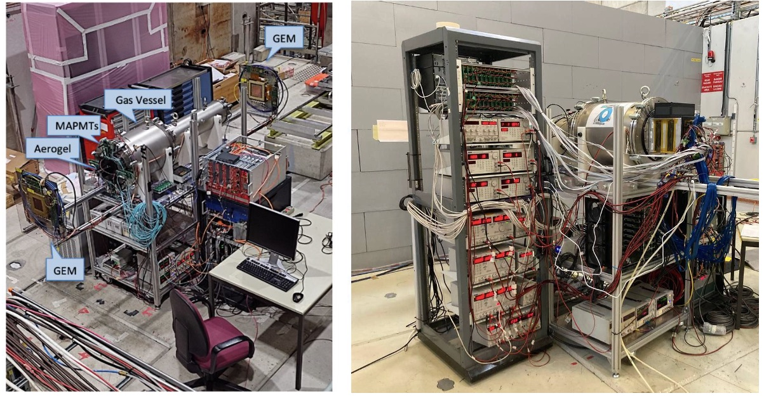
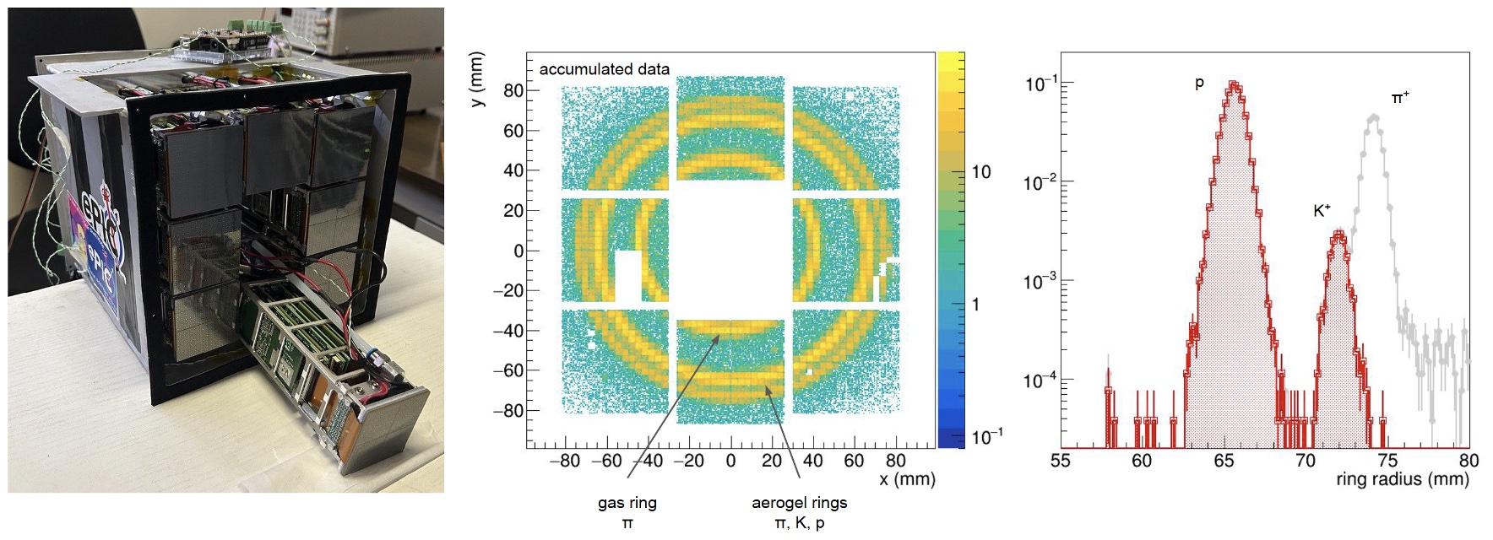
Performance with Basic Prototype
Previous validations w Basic Prototype:
Dual-radiator concept
C₂F₆ radiator gas performance
Aerogel rafractive index
SiPM-ALCOR readout chain
EIC-driven readout plane
Temperature gradients
RDO data acquisition
Alternate gases
M. Contalbrigo
ePIC Collaboration Meeting, BNL , January 21st, 2026
9

Slide 10
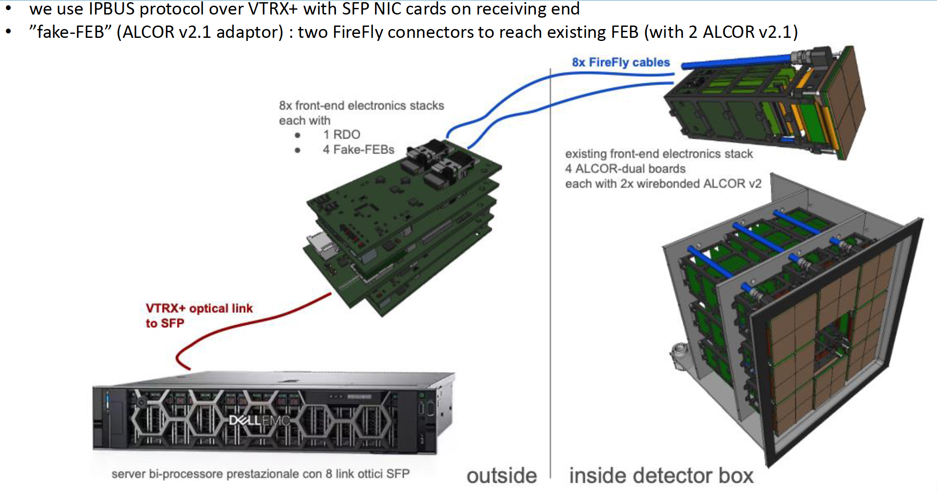
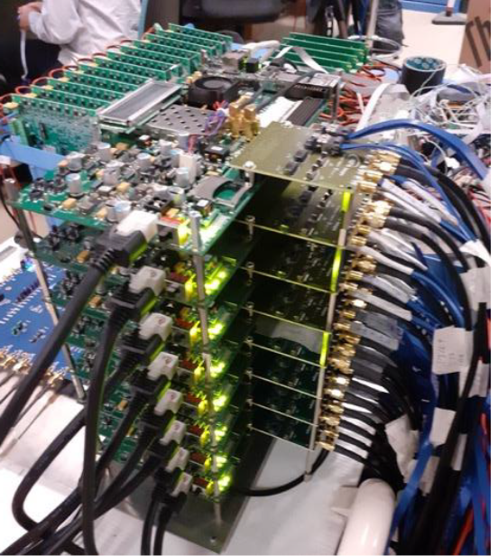
dRICH Readout
Insert the RDO into the readout chain (replacing a stack of 11 KC705 commercial FPGAs)
M. Contalbrigo
ePIC Collaboration Meeting, BNL , January 21st, 2026
10

Slide 11
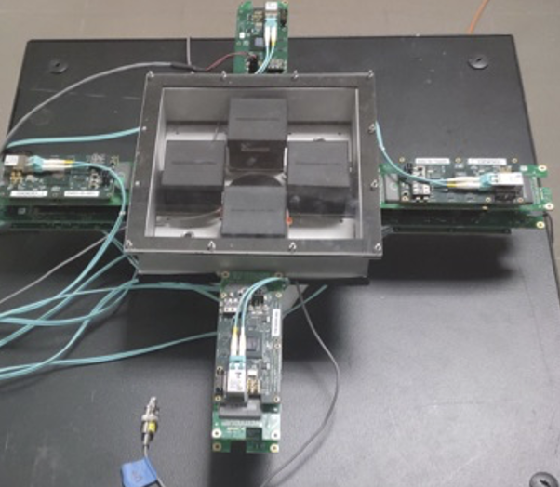
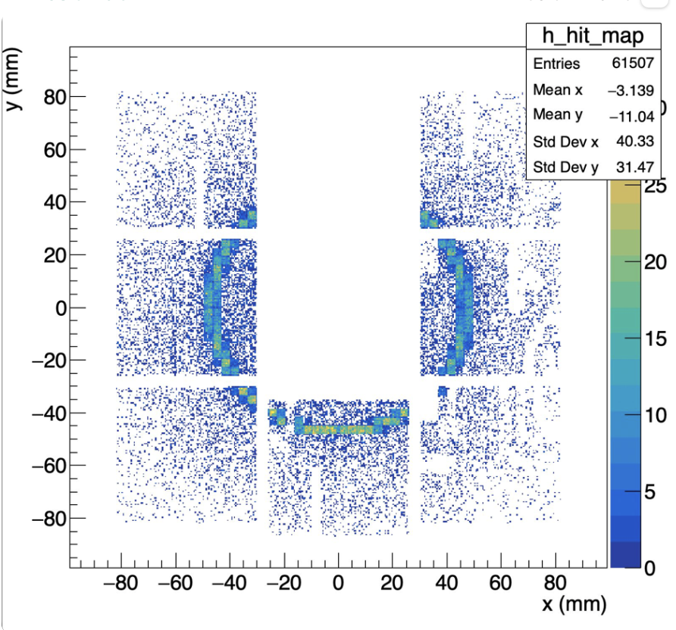
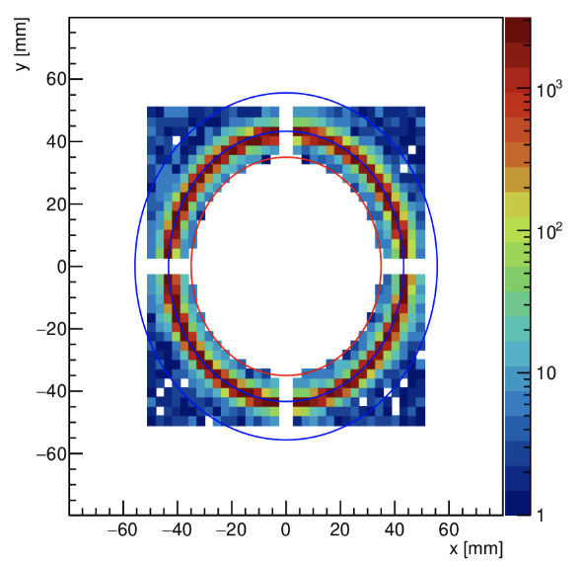
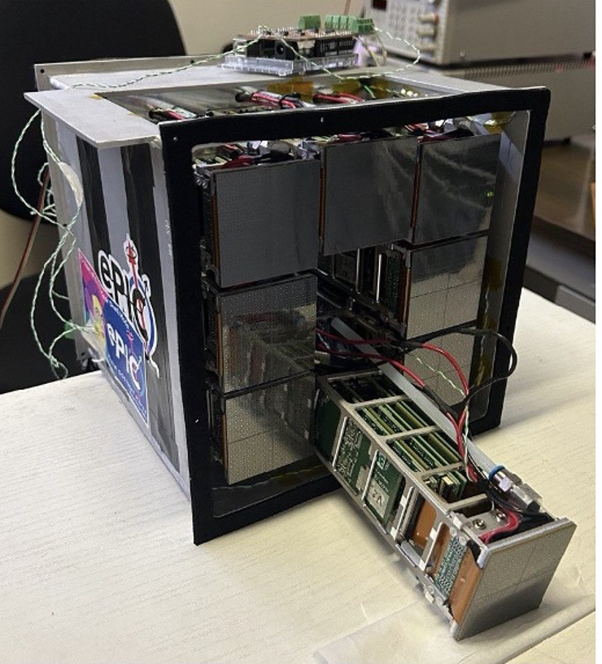
ePIC Readout Validation
First successful test of SiPM+ALCOR+RDO readout chain and direct comparison with reference MAPMT system
Argon at 2.5 bar
MAPMT + ALCOR readout
C₂F₆ at 1 bar
SiPM + ALCOR + RDO readout
M. Contalbrigo
ePIC Collaboration Meeting, BNL , January 21st, 2026
11

Slide 12
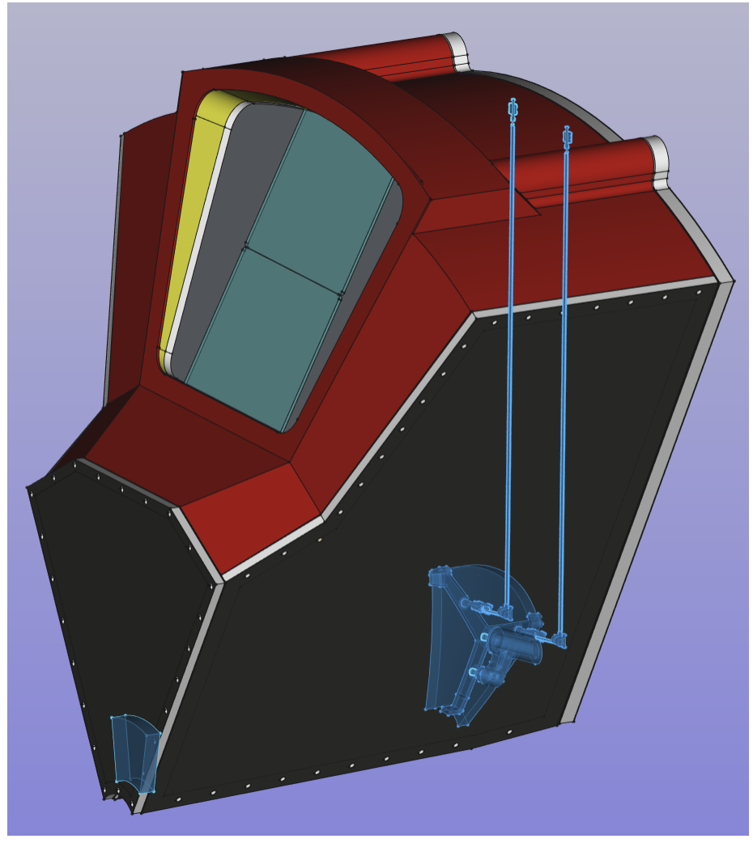
Real Scale Prototype
Previous validations w Basic Prototype:
Dual-radiator concept
C₂F₆ radiator gas performance
Aerogel rafractive index
SiPM-ALCOR readout chain
EIC-driven readout plane
Temperature gradients
RDO data acquisition
Alternate gases
2025++
Real-Scale Prototype:
Mechanical stability
Gas & light thightness
Temperature gradients
Assembling scheme
Inner components supports
Optical septa
……..
M. Contalbrigo
ePIC Collaboration Meeting, BNL , January 21st, 2026
12

Slide 13
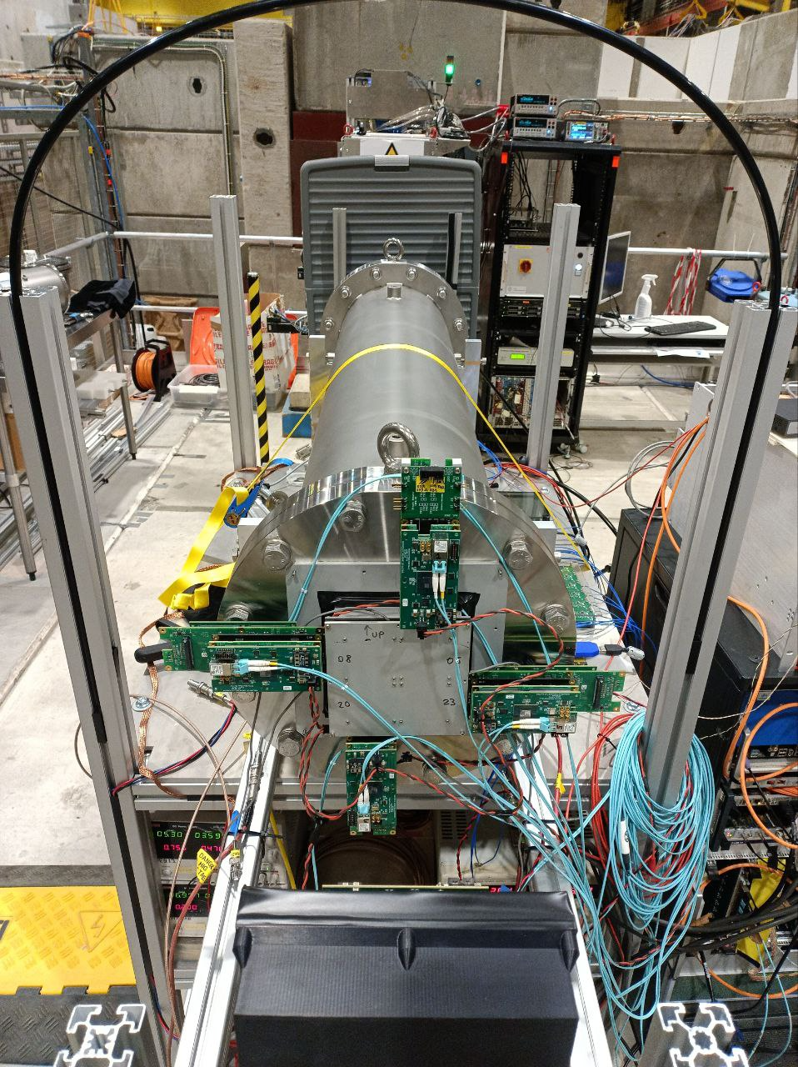
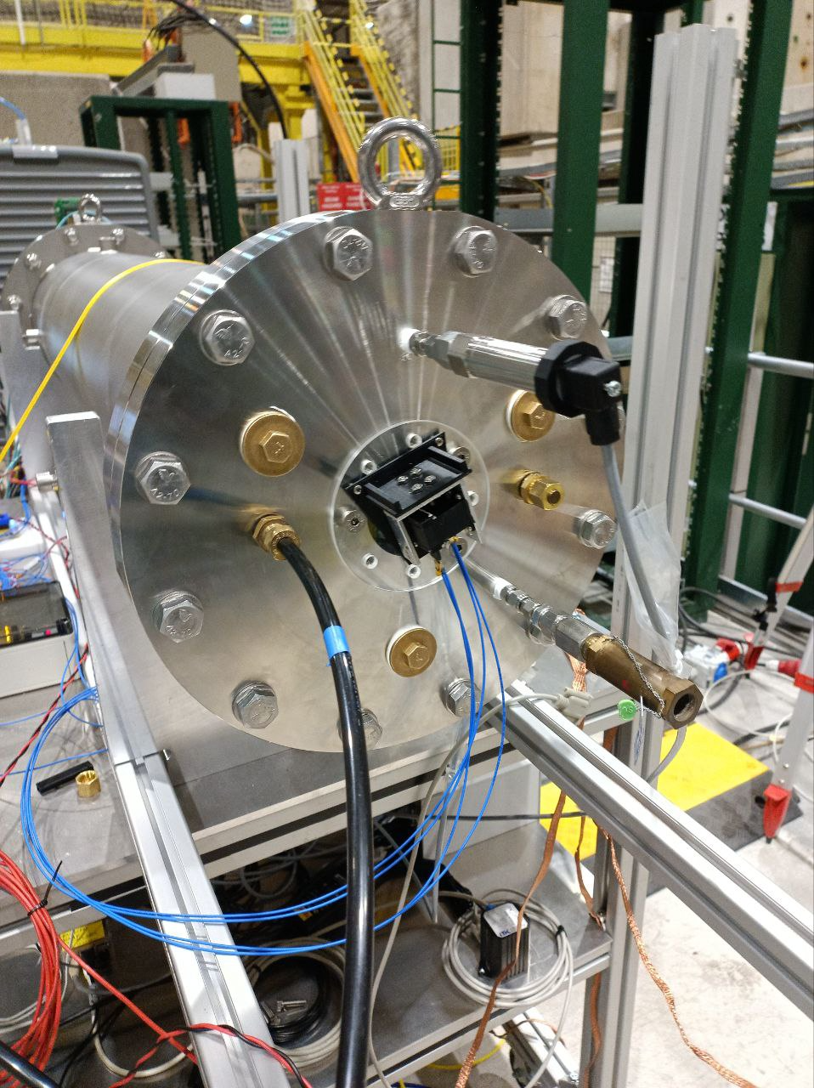
Pressurized RICH
Flanges re-worked to mount a suitable quartz window and get the CE safety certification for vacuum up to 3.3 bar
Compare C₂F₆ with
other radiators,
e.g. Argon
in a close gas circuit
(minimum leaks)
M. Contalbrigo
ePIC Collaboration Meeting, BNL , January 21st, 2026
13

Slide 14
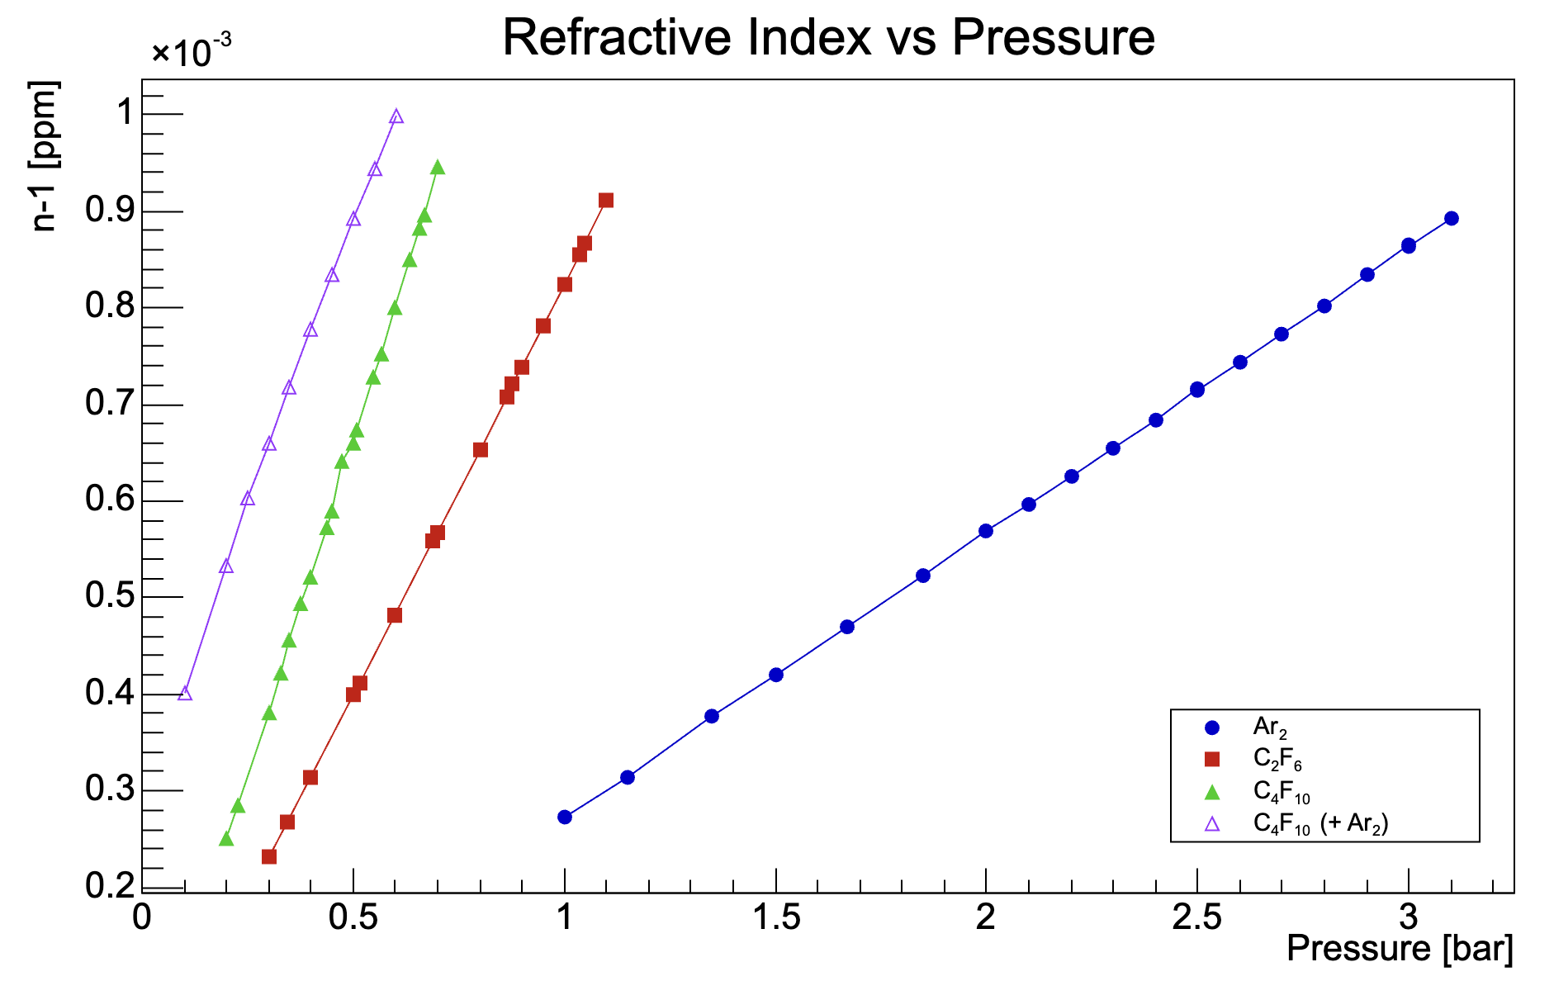
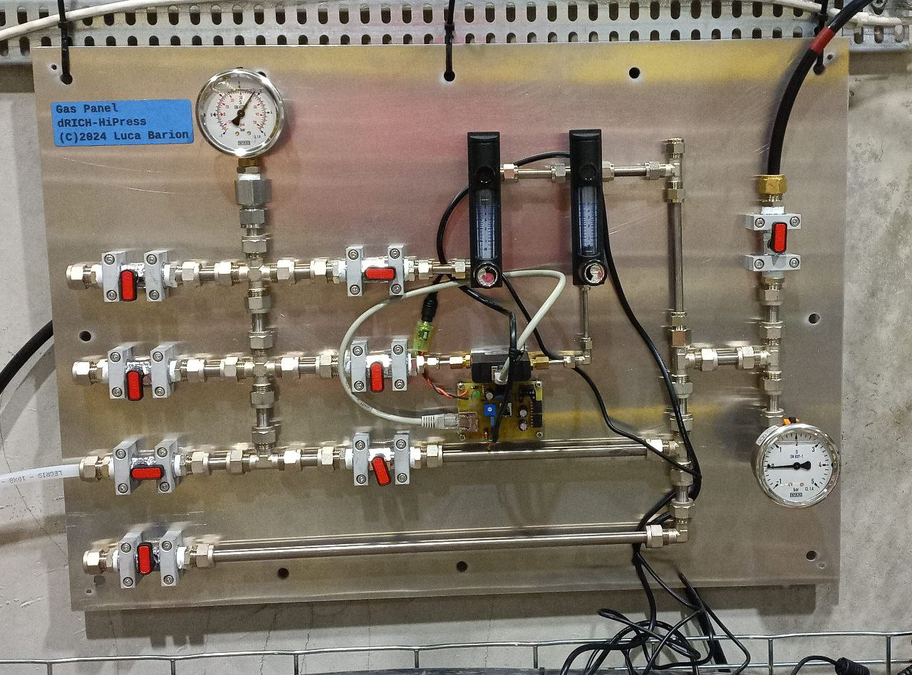
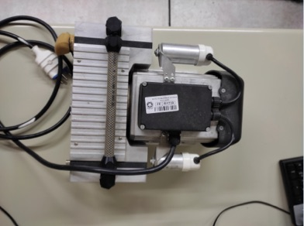
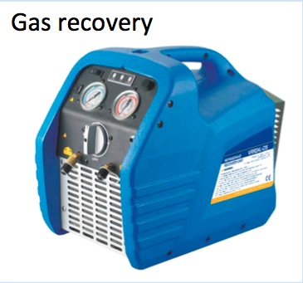
Alternate Gases
Tested gas:
C₂F₆
Ar
C₄F₁₀
C₄F₁₀ – Ar mixture
First successful comparison among alternate gas mixtures
ePIC target value
inlet
3x inputs
exhauts
+Ar
Vacuum pump
M. Contalbrigo
ePIC Collaboration Meeting, BNL , January 21st, 2026
14

Slide 15
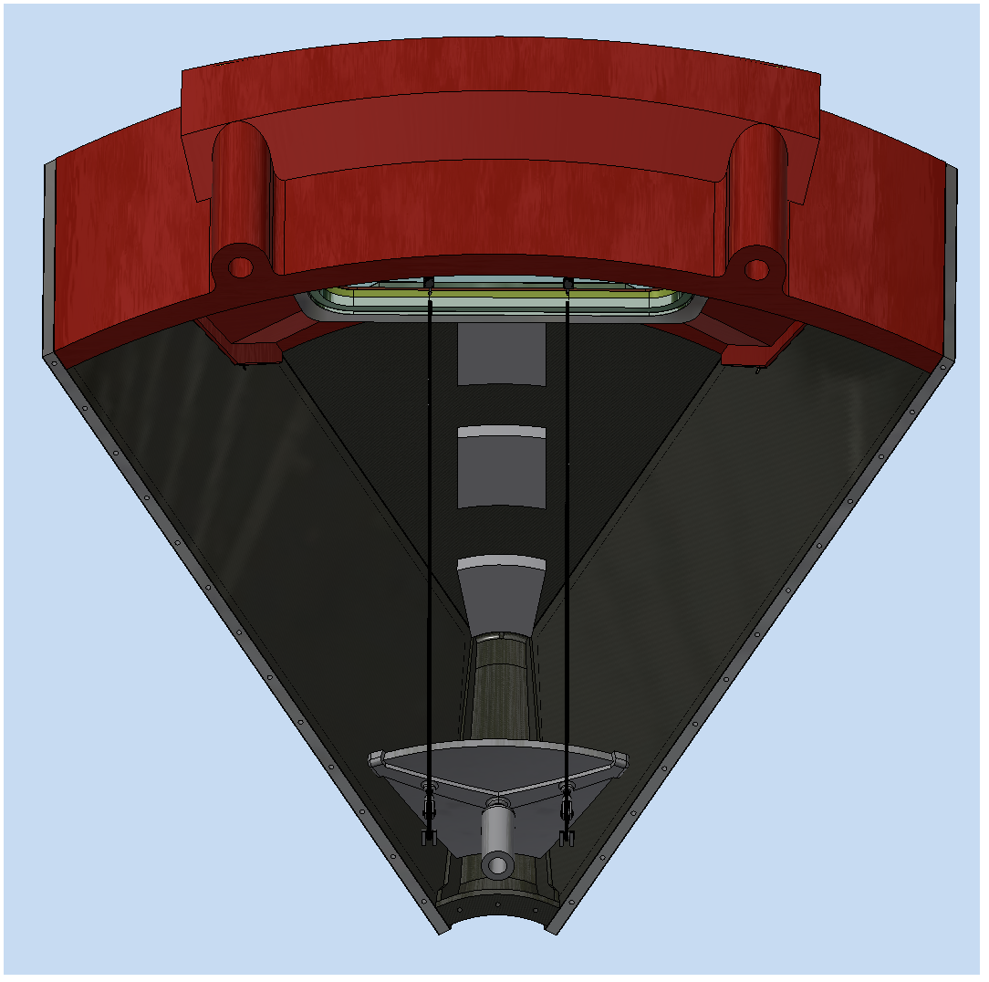
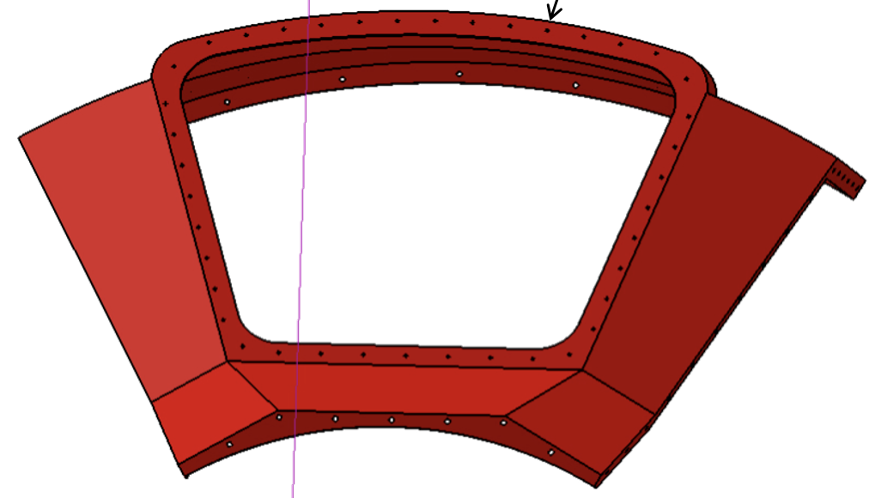
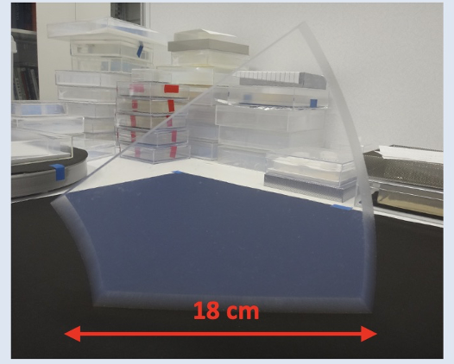
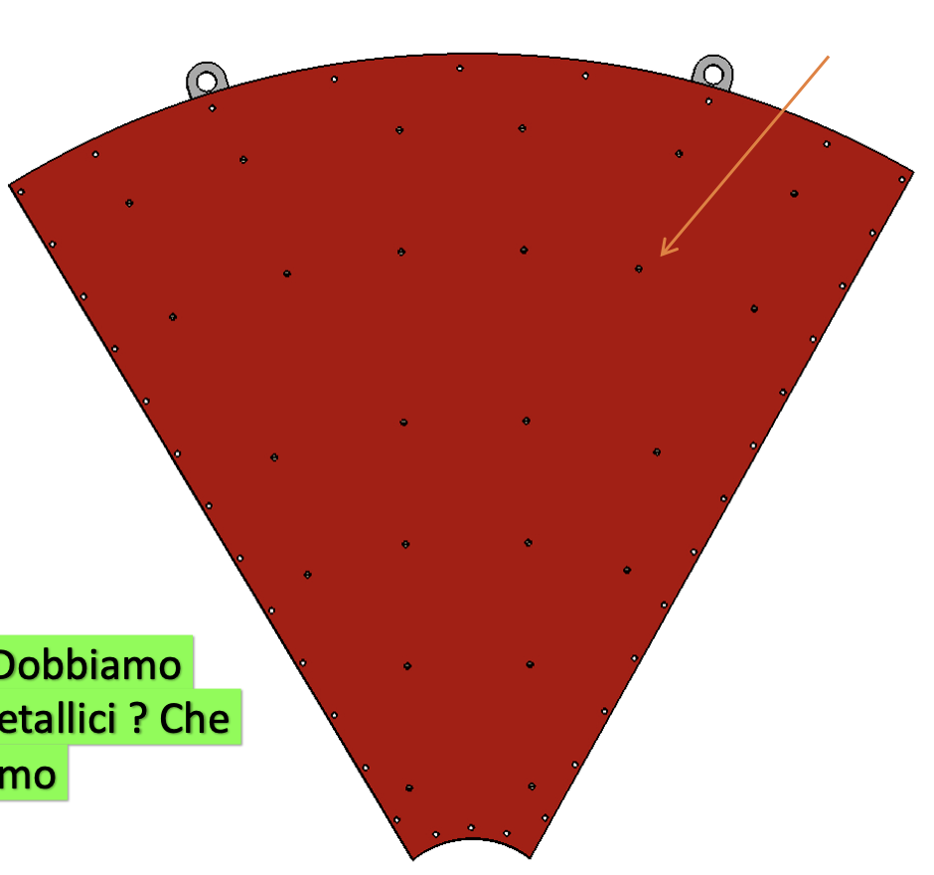
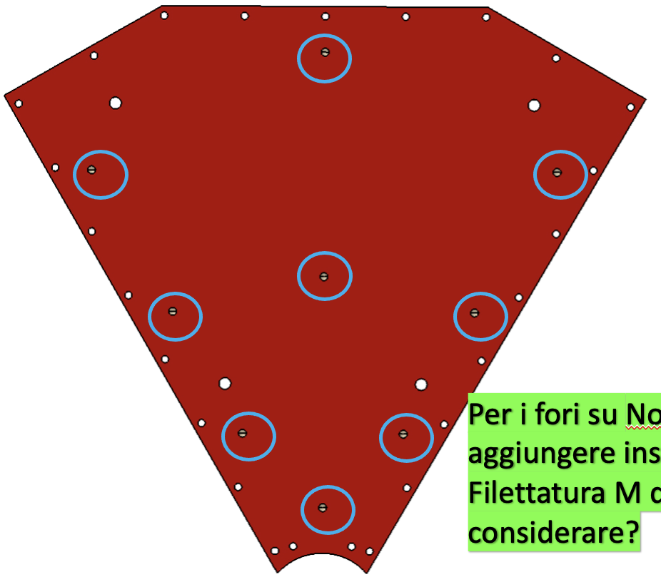
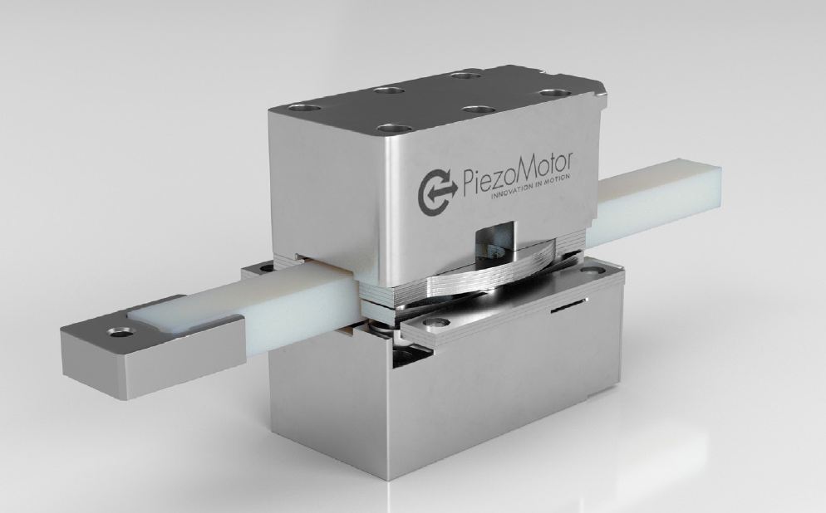
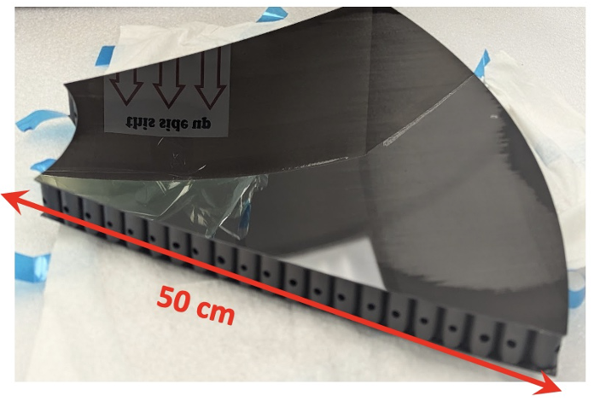
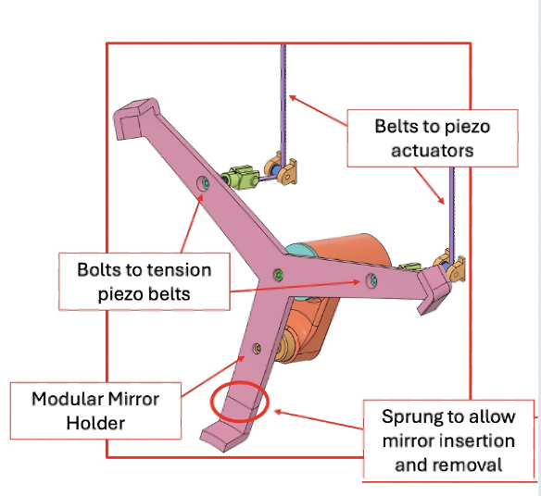




Real Scale Prototype
Engineering of all the mechanical details pursued with the real-scale prototype (eRD102 milestone)
Aerogel demonstrator
Under
Construction
Mirror mounting and holder
JLab
CFRP layer samples
CFRP Layer
composition
M. Contalbrigo
ePIC Collaboration Meeting, BNL , January 21st, 2026
15

Slide 16




Detector Box
Gas volume sealed by a large-area quartz window
Several inlets/outlets for gas dynamics study
Compatible with the existing detector boxes
Different mounting point mimicking the curved surface at ePIC
Baseline for future detector box upgrades
M. Contalbrigo
ePIC Collaboration Meeting, BNL , January 21st, 2026
16

Slide 17



Real Scale Prototype
Saddle + Platform for safe operations (pseudorapidity scan with beam and cosmic tests)
Being prepared for safety handling, gas operation validation and a cosmic campaign prior of 2026 test-beam
dRICH submitted two joined requests for beam time at CERN in May-July:
- 2 weeks at PS (mixed hadron beams < 12 GeV/c) with pfRICH 10-24 June 2026
- 1 week ar SPS (mixed hadron beams > 20 GeV/c) with pfRICH + LFHCAL
M. Contalbrigo
ePIC Collaboration Meeting, BNL , January 21st, 2026
17

Slide 18

Real Scale Prototype
ePIC IP
M. Contalbrigo
ePIC Collaboration Meeting, BNL , January 21st, 2026
18

Slide 19
Conclusions
Work ongoing to complete dRICH test articles
Test-beam campaign in 2025:
Implementation of RDO in the dRICH readout chain
successful commissioning in different experimental conditions
Deploiment of a eco-friendly station for gas performance validation
successful test of alternate gases at various pressure
Test-beam campaign in 2026:
Realization of PDU in the final layout
ALCOR 64
UVE SiPM
FEB+RDO stack
Real-scale prototype
off-axis optics
layout conformed to ePIC
M. Contalbrigo
ePIC Collaboration Meeting, BNL , January 21st, 2026
19

