Slide 1

TOF Test Beam Campaign 2026
Satoshi YANO
Hiroshima University

Slide 2
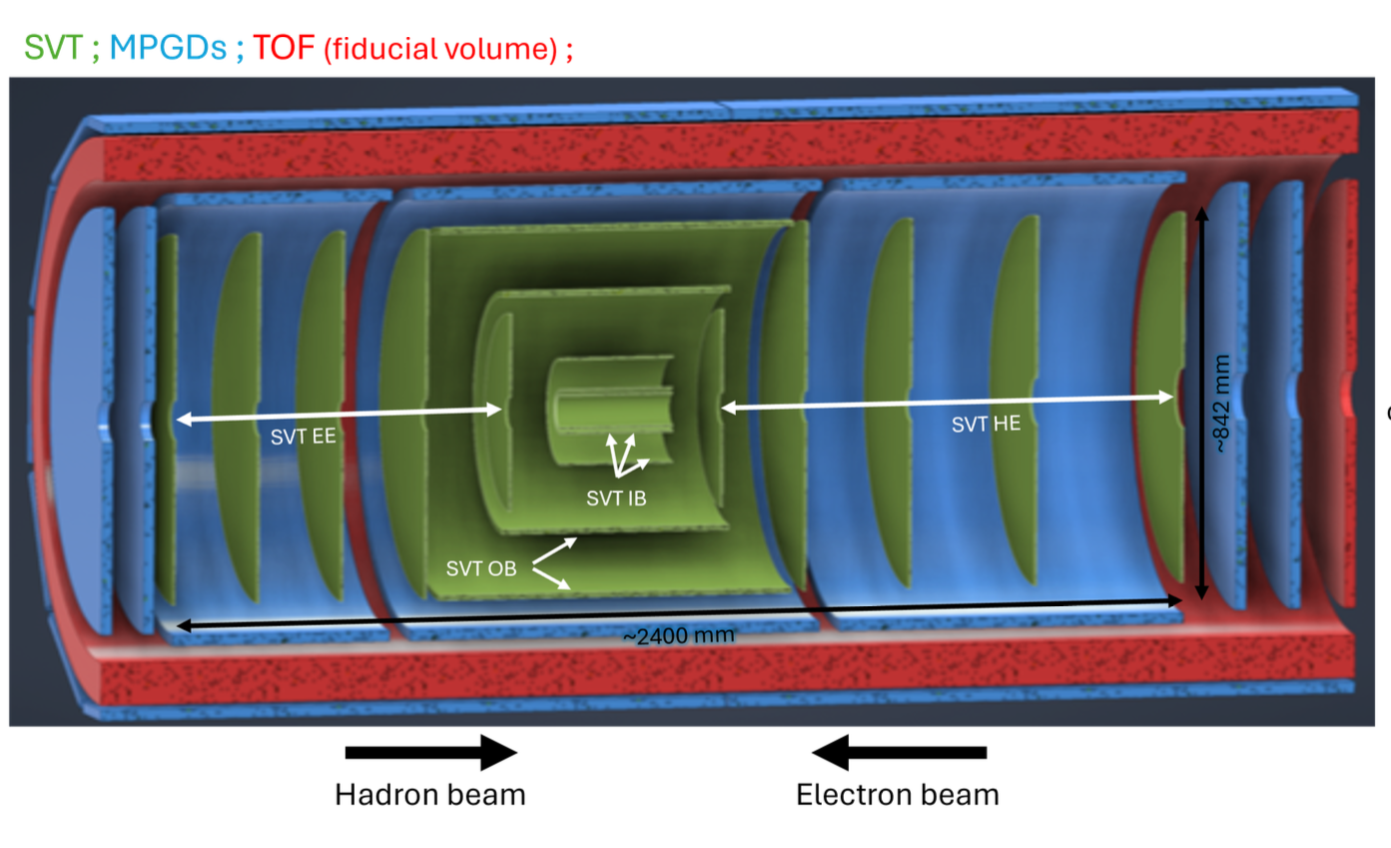
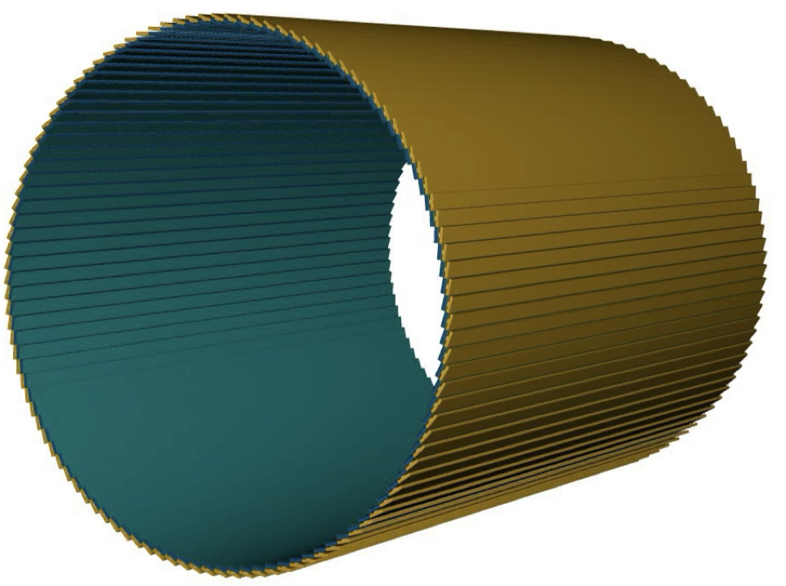

AC-LGAD Time-of-Flight at ePIC
Barrel-TOF (BTOF)
Forward-TOF (FTOF)
ePIC Tracking System
-1.33<η<1.74
1.84<η<3.61
0.64 m
10.5 cm
60 cm
~1.4 x 2 m = ~2.8 m
AC-LGAD TOF is used for PID, Tracking and background rejection at mid-rapidity and forward-rapidity
Timing resolution of 35ps and 25ps, positioning resolution of 30um and 30um for BTOF and FTOF, respectively, with installing in <8 cm thickness space are required

Slide 3
Challenge of AC-LGAD Test Beam
AC-LGAD requires high-precision waveform measurement
Rise time for timing
Height for hit position reconstruction
High performance digitizer or oscilloscope must be used
High band-width, high sampling rate, data-taking rate: ~1GHz, 10 GS/s, O(100) Hz data taking
CAEN DT5742: 500 MHz, 5GS/s, 16ch
LeCroy WaveRunner8204HD: 2 GHz, 10GS/s, 8ch
LeCroy WavePro804HD: 8 GHz, 20GS/s, 4ch
Three sensors or fast device are used for the timing measurement
E.g. Photek PMT240 (MCP-PMT): σ_{T} ~ 10ps

Slide 4
Challenge of AC-LGAD Test Beam
AC-LGAD requires high-precision waveform measurement
Rise time for timing
Height for hit position reconstruction
High performance digitizer or oscilloscope must be used
High band-width, high sampling rate, data-taking rate: ~1GHz, 10 GS/s, O(100) Hz data taking
CAEN DT5742: 500 MHz, 5GS/s, 16ch
LeCroy WaveRunner8204HD: 2 GHz, 10GS/s, 8ch
LeCroy WavePro804HD: 8 GHz, 20GS/s, 4ch
Three sensors or fast device are used for the timing measurement
E.g. Photek PMT240 (MCP-PMT): σ_{T} ~ 10ps

Slide 5
Challenge of AC-LGAD Test Beam
AC-LGAD requires high-precision waveform measurement
Rise time for timing
Height for hit position reconstruction
High performance digitizer or oscilloscope must be used
High band-width, high sampling rate, data-taking rate: ~1GHz, 10 GS/s, O(100) Hz data taking
CAEN DT5742: 500 MHz, 5GS/s, 16ch
LeCroy WaveRunner8204HD: 2 GHz, 10GS/s, 8ch
LeCroy WavePro804HD: 8 GHz, 20GS/s, 4ch
Three sensors or fast device are used for the timing reference
E.g. Photek PMT240 (MCP-PMT): σ_{T} ~ 10ps

Slide 6
Test Beam Campaign in 2025
Strip-type sensor has been tested at JLab in July
First full-size sensor test (variable pitch sensor)
Unfortunately, only 30um strip-type sensor has been tested
CAEN DT5742: 500 MHz, 5GS/s, 16ch
Full-size strip-type and pixel-type sensor have been tested at DESY in December
First real full-size strip-type sensor (BTOF sensor) has been tested
Full-size pixel-type sensor (variable pitch) has been also tested
Data was taken with several HV configuration (HV-scan)
CAEN DT5742: 500 MHz, 5GS/s, 16ch
FCFDv1.1 test at DESY in August
First FCFDv1.1 with strip-type AC-LGAD test
Small prototype sensor (50um) with FCFDv1.1 (6ch analog block)
LeCroy WaveRunner8204HD: 2 GHz, 10GS/s, 8ch

Slide 7
Test Beam Campaign in 2025
Strip-type sensor has been tested at JLab in July
First full-size sensor test (variable pitch sensor)
Unfortunately, only 30um strip-type sensor has been tested
CAEN DT5742: 500 MHz, 5GS/s, 16ch
Full-size strip-type and pixel-type sensor have been tested at DESY in December
First real full-size strip-type sensor (BTOF sensor) has been tested
Full-size pixel-type sensor (variable pitch) has been also tested
Data was taken with several HV configuration (HV-scan)
CAEN DT5742: 500 MHz, 5GS/s, 16ch
FCFDv1.1 test at DESY in August
First FCFDv1.1 with strip-type AC-LGAD test
Small prototype sensor (50um) with FCFDv1.1 (6ch analog block)
LeCroy WaveRunner8204HD: 2 GHz, 10GS/s, 8ch

Slide 8
Test Beam Campaign in 2025
Strip-type sensor has been tested at JLab in July
First full-size sensor test (variable pitch sensor)
Unfortunately, only 30um strip-type sensor has been tested
CAEN DT5742: 500 MHz, 5GS/s, 16ch
Full-size strip-type and pixel-type sensor have been tested at DESY in December
First real full-size strip-type sensor (BTOF sensor) has been tested
Full-size pixel-type sensor (variable pitch) has been also tested
Data was taken with several HV configuration (HV-scan)
CAEN DT5742: 500 MHz, 5GS/s, 16ch
FCFDv1.1 test at DESY in August
First FCFDv1.1 with strip-type AC-LGAD test
Small prototype sensor (50um) with FCFDv1.1 (6ch analog block)
LeCroy WaveRunner8204HD: 2 GHz, 10GS/s, 8ch

Slide 10
Results From 2025
Strip-type sensor has been tested at JLab in July
30um thickness result has been presented
σ_{t}~63 ps and σ_{x}~32 um
Full-size strip-type and pixel-type sensor have been tested at DESY in December
Analysis is on going
FCFDv1.1 has been tested with small-size strip-type sensor (eRD112 FY23 sensor) at DESY in August
σ_{t}~40 ps and σ_{x}~15 um
Sensor + PCB board was ~35 ps

Slide 11
Results From 2025
Strip-type sensor has been tested at JLab in July
30um thickness result has been presented
σ_{t}~63 ps and σ_{x}~32 um
Full-size strip-type and pixel-type sensor have been tested at DESY in December
Analysis is on going
FCFDv1.1 has been tested with small-size strip-type sensor (eRD112 FY23 sensor) at DESY in August
σ_{t}~40 ps and σ_{x}~15 um
Sensor + PCB board was ~35 ps

Slide 12
Results From 2025
Strip-type sensor has been tested at JLab in July
30um thickness result has been presented
σ_{t}~63 ps and σ_{x}~32 um
Full-size strip-type and pixel-type sensor have been tested at DESY in December
Analysis is on going
FCFDv1.1 has been tested with small-size strip-type sensor (eRD112 FY23 sensor) at DESY in August
σ_{t}~40 ps and σ_{x}~15 um
Sensor + PCB board was ~35 ps

Slide 13
Test Beam Campaign in 2026
KEK-PS, electron @ ~6.5 GeV (Fortunately obtained by chance, parasite)
Fixed: Feb. 19th ~ 25th
Primary Goal
20um and 30um pixel-type sensor test
20um, 30um, 50um strip-type sensor test
Tohoku-RARiS, electron @ 800 MeV (main)
Fixed: Mar. 3rd ~ 6th
Primary Goal
New geometry strip-type sensor (20um, 30um, 50um) test
Homework of previous beam tests
CERN-SPS, proton @ 120 GeV (main)
May/Eary June (Requested)
Primary Goal: Test of EICROC1 with full-size pixel sensor (under discussion)
KEK-PS, electron @ ~6.5 GeV (main)
Oct. to Dec (We will request the beam-time)
Primary Goal: BTOF sensor + FCFDv1.2 and the first full-chain test
Using oscilloscope (8 GHz, 20GS/s)
Using oscilloscope (8 GHz, 20GS/s)

Slide 14
Backup

Slide 15
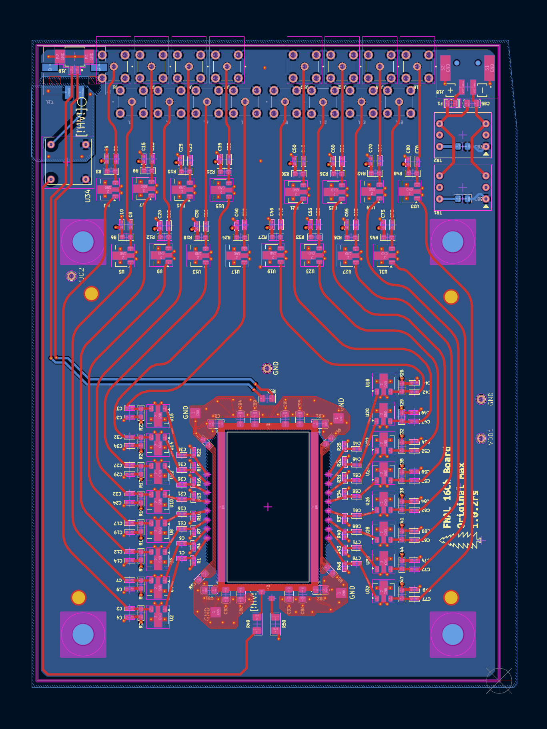
Multiple Scattering Effect @ RARiS
The new board with a hole under sensor has been developed
Δθ ~ 0.94 mrad @ 800 MeV

Slide 16
Plan-B Sensors
Larger-Gap and Shorten Strip Sensor
Geometry: 2x64=128ch → 4x32=128ch
Strip length: 10mm x 50um → 5mm x 50um
Strip Pitch: 500um → 1000um
Double-Layer Strip Sensor
Second metal layer is implemented to readout perpendicular direction

Slide 17
Multiple Scattering Effect @ RARiS

Slide 18
Control Room
Switch
Control
PC
Scintillator#0
Discriminator
3
Coincidence
FAN I/O
Scintillator#1
Scintillator#2
Trigger Enable Signal
EXT TRIG
Network
Switch
WaveRunner#0
2
8
AUX OUT
HV
Board#0
Ref-In
EXT TRIG
WaveRunner#1
2
8
AUX OUT
Board#1
Ref-In
MPC-PMT
EXT TRIG
Storage
PC
Beam
Hall
WavePro#0
2
AUX OUT
Board#2
DUT
3
Ref-In
3
EXT TRIG
HV
DT1471ET
WavePro#1
2
AUX OUT
Ref-In
EXT TRIG
WaveRunner#2
8
AUX OUT
Board#3
Ref-In
EXT TRIG
WaveRunner#3
2
AUX OUT
Board#4
8
Ref-In
External Clock
FAN I/O

Slide 19
EUDRBs
Telescope DAQ PC
DUT DAQ PC
DIGITIZER
DIGITIZER
BUSY
AC-LGAD
TRIGGER
Scintillator
AC-LGAD
Scintillator
AC-LGAD
Scintillator
COINCIDENCE
TLU
TRIGGER

Slide 20
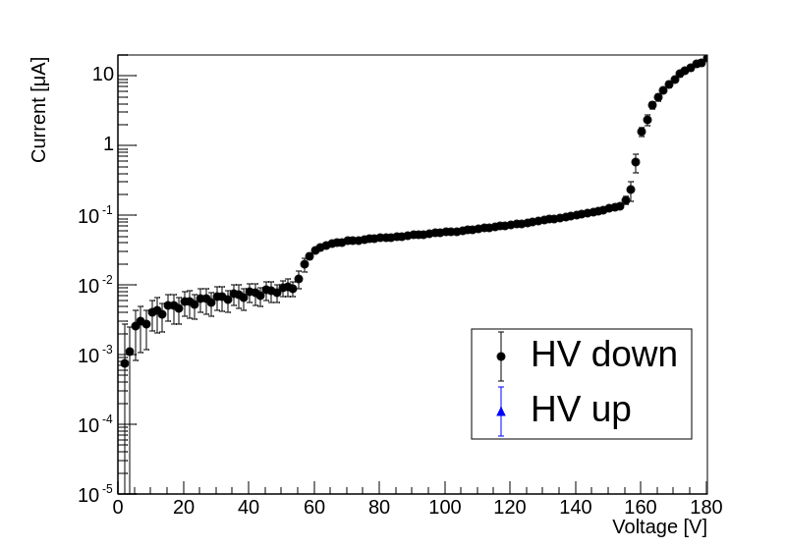
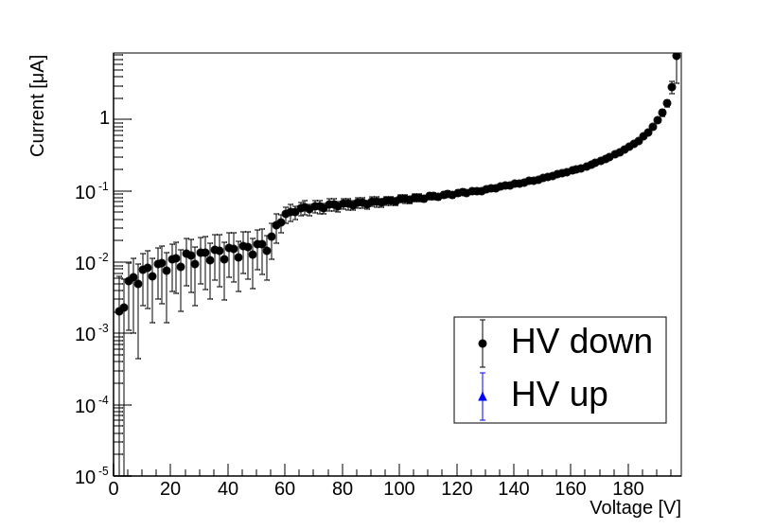
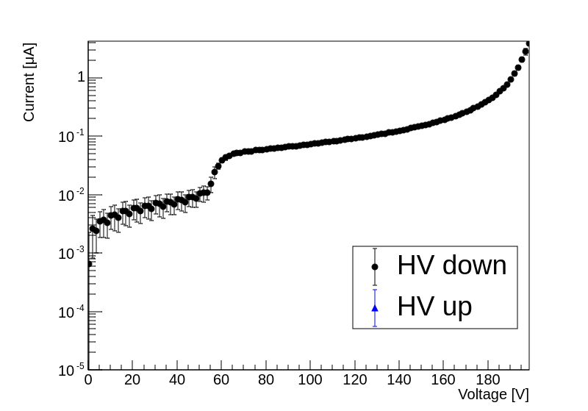
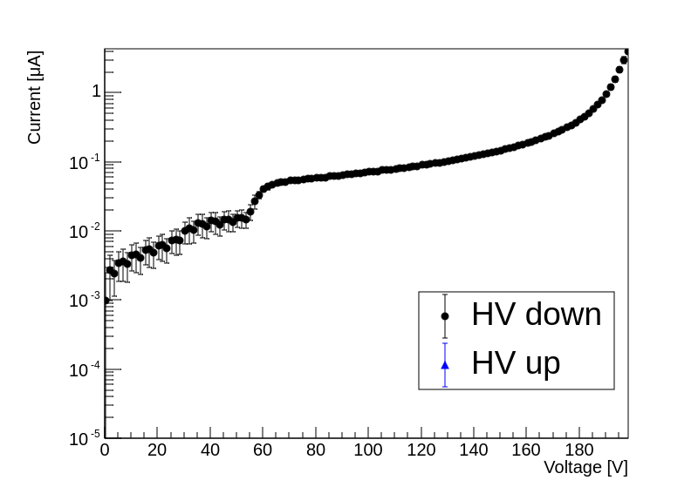
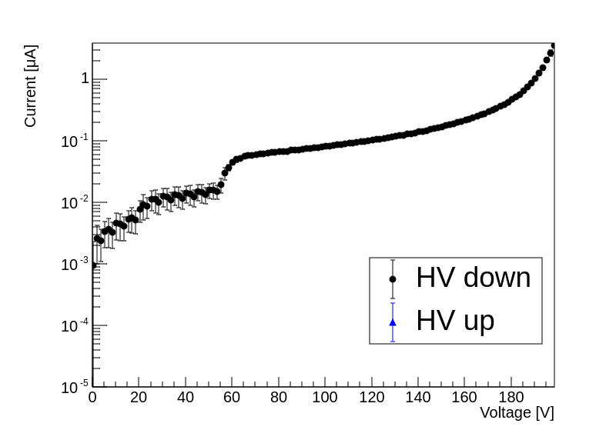
Baseline Strip Sensors
Five sensors have been bonded
Classified by voltage value at which leak current reaches 1μA
4 Class-S (1μA @ BV>=190V)
1 Class-C (1μA @ 160<BV<170V)
Class-C
Class-S
Class-S
Class-S
Class-S

Slide 21
Statistics of Test-Beam @ DESY 2025
Statistics for Strip (Triggered Event)
Nominal HV Run
5.6 GeV
3 Class-S Sensors: 10ch/10ch/10ch (Pattern-2)
All 185V: ~2x10⁶
HV Scan Run
5.6 GeV
3 Class-S Sensors: 10ch/10ch/10ch (Pattern-2)
Side 185V + Middle 175V/160V/150V: ~2x10⁶ each
Positioning Measurement Run
5.6 GeV
2 Class-S Sensors: 15ch/15ch (Pattern-3)
185V: ~2x10⁶
Class-C Sensor Run
5.6 GeV
3 Class-S Sensors: 10ch/10ch/10ch (Pattern-2)
160V: ~2x10⁶
Low Energy Run
3.6 GeV
3 Class-S Sensors: 10ch/10ch/10ch (Pattern-2)
All 185V: ~12 x10⁶
Low Energy HV 200V Run
3.6 GeV
3 Class-S Sensors: 10ch/10ch/10ch (Pattern-2)
All 200V: ~12 x10⁶
Statistics for Pixel (Triggered Event)
Small Pixel Nominal HV-1 Run
5.6 GeV
Small-Pixel: 20um/30um
HV: 110V/150V ~6x10⁶
Small Pixel Nominal HV-2 Run
5.6 GeV
Small-Pixel: 20um/30um
HV: 100V/130V ~6x10⁶
Big Pixel Nominal HV-1 Run
5.6 GeV
Small-Pixel: 20um/30um
HV: 100V/160V ~6x10⁶
Big Pixel Nominal HV-2 Run
5.6 GeV
Small-Pixel: 20um/30um
HV: 80V/140V ~6x10⁶
+ADC Calibration Run
Inject Pulse: 10/20/30/40/50/60/70/80/90/100/150/200/250/300mV
Into all channels

