Slide 1
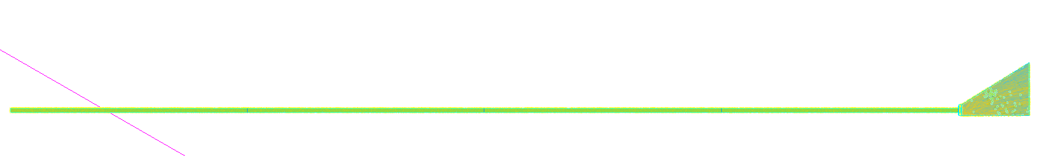
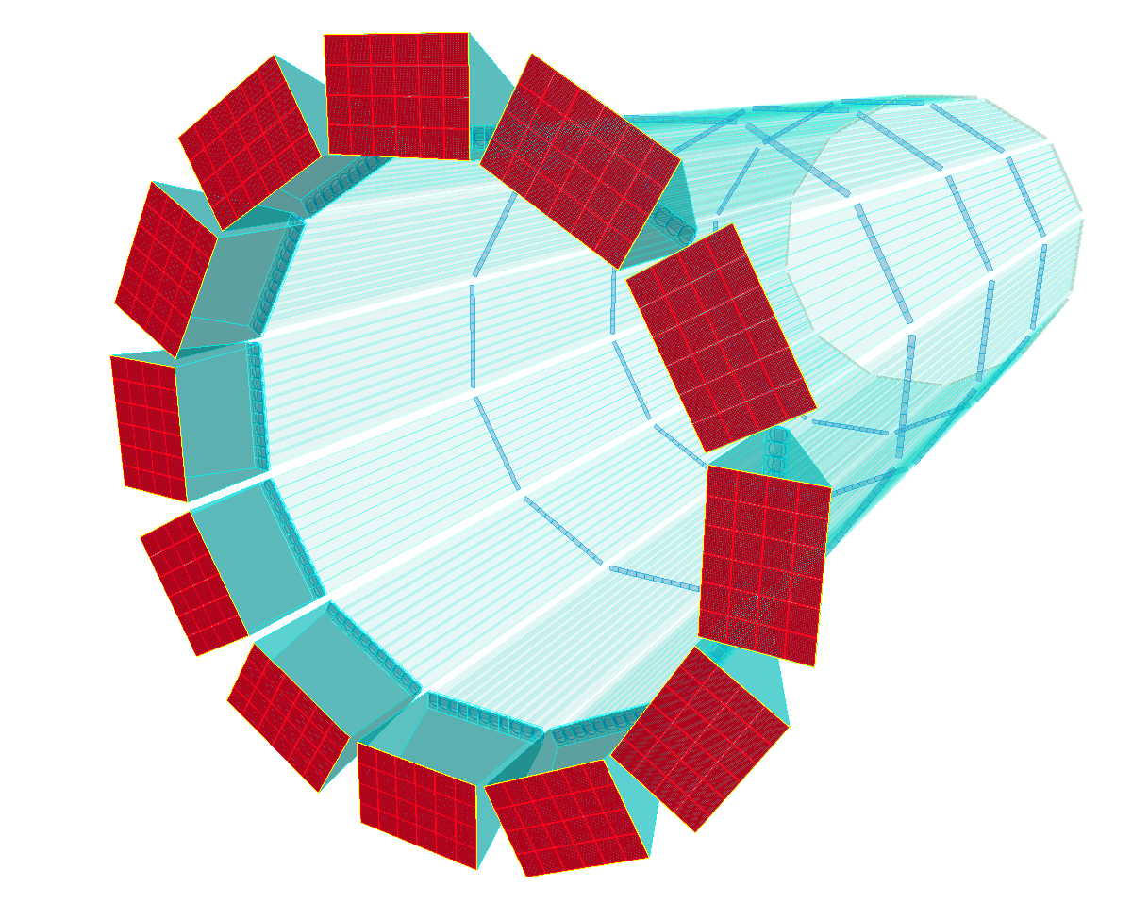






Simulations for ePIC hpDIRC Detector
Shubham Dutta
ePIC Collaboration Meeting
January 23rd, 2026

Slide 2
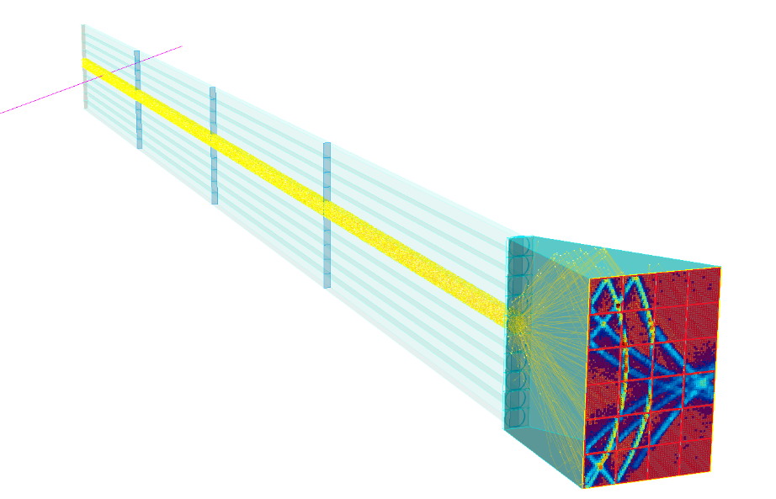
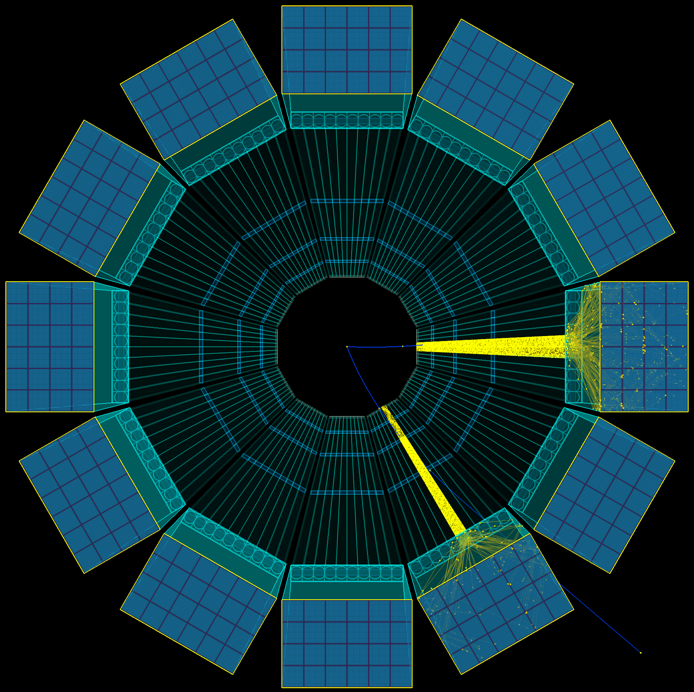
hpDIRC Near-term Software Goals
Standalone:
Optimization of hpDIRC based on geometry changes
Misalignment mitigation
Sensor performance (PDE, arrangement)
Simulation of CRT and Lens characterization
Development of xpDIRC (studies potentially relevant for ePIC)
Single particle gun events to map hpDIRC performance
Stand-alone hpDIRC simulation

Slide 3
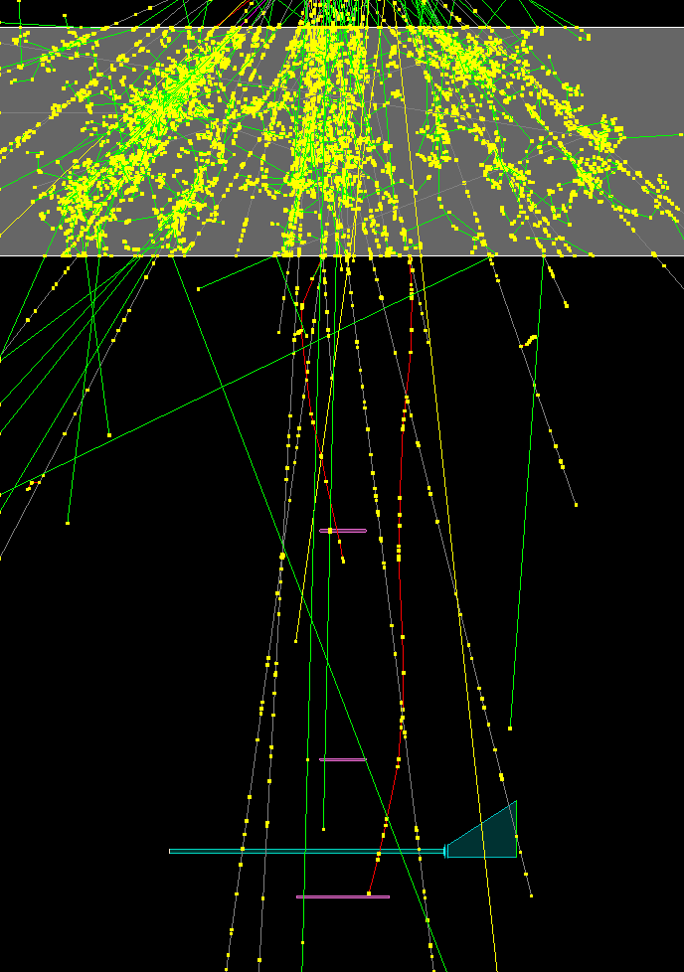
hpDIRC Near-term Software Goals
Standalone:
Optimization of hpDIRC based on geometry changes
Misalignment mitigation
Sensor performance (PDE, arrangement)
Simulation of CRT and Lens characterization
Development of xpDIRC (studies potentially relevant for ePIC)
Geant4 simulation of CRT setup

Slide 4
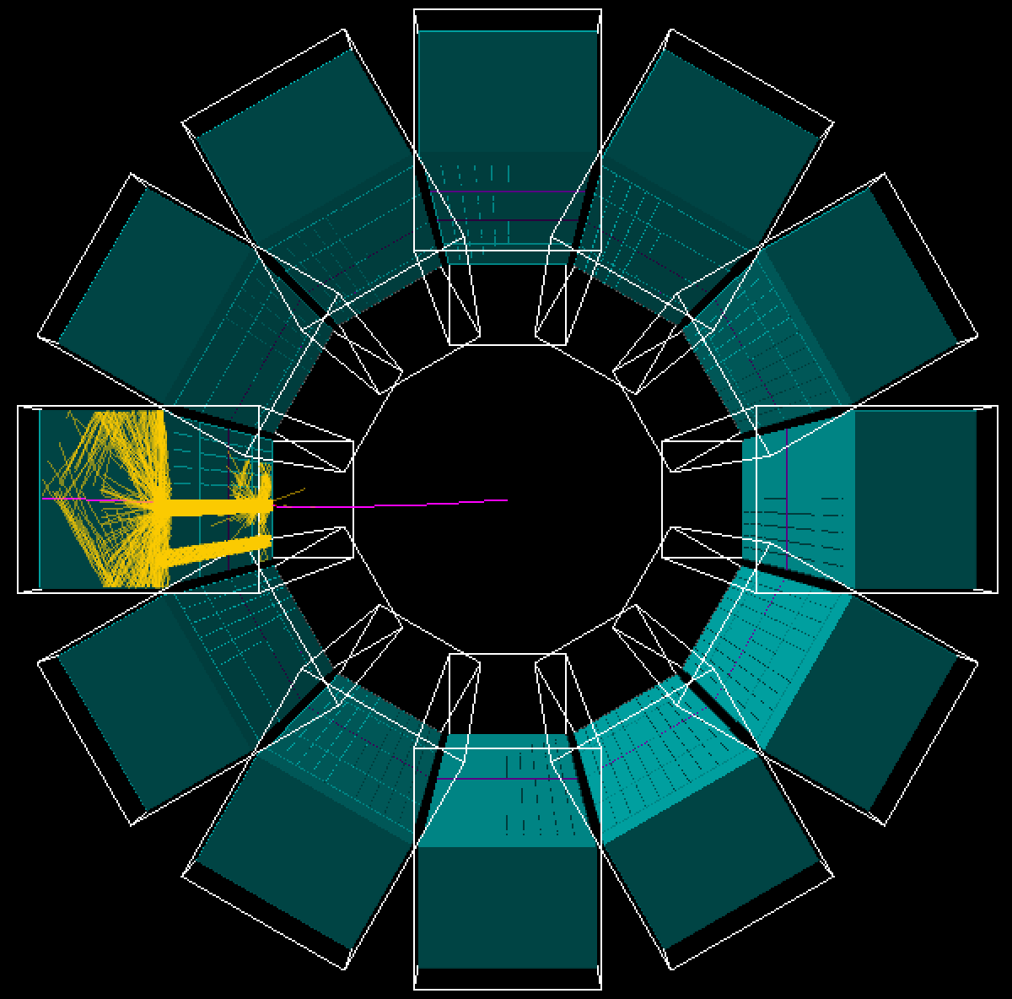
hpDIRC Near-term Software Goals
Standalone:
Optimization of hpDIRC based on geometry changes
Misalignment mitigation
Sensor performance (PDE, arrangement)
Simulation of CRT and Lens characterization
Development of xpDIRC (studies potentially relevant for ePIC)
ePIC stack (focus of further slides):
Finish implementation of geometric and time-imaging reconstruction in eicrecon
Debug any potential discrepancies in performance between eicrecon and standalone
Repeat PID performance with backgrounds (multiple hits/bar) with full stack & all detectors
hpDIRC in ePIC simulation
Stand-alone hpDIRC simulation

Slide 5
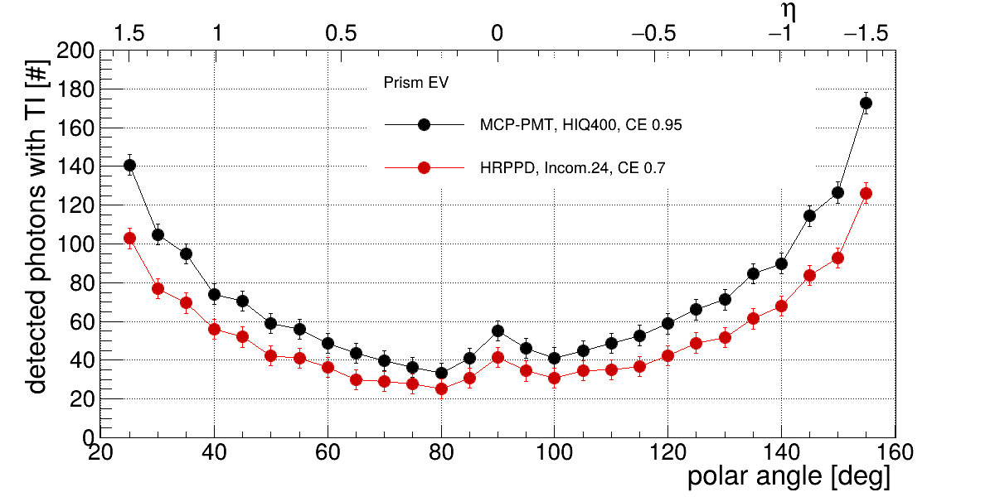
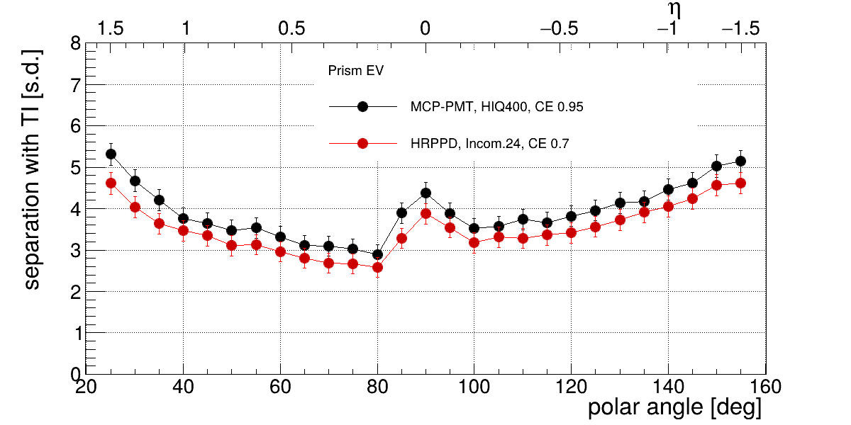
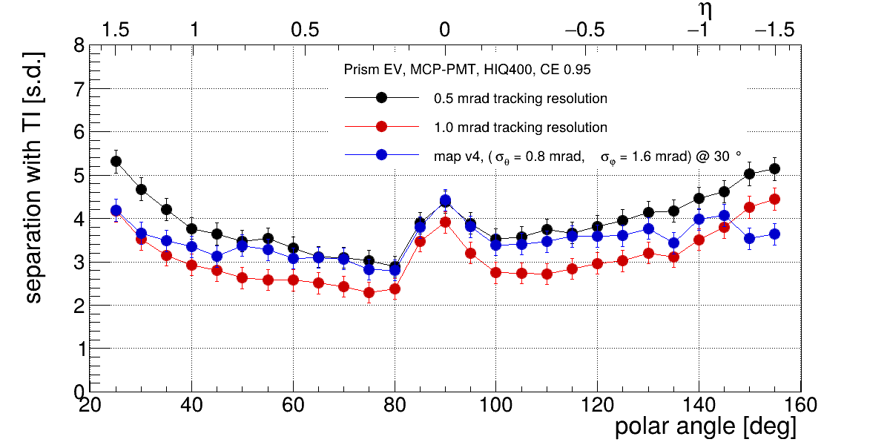
hpDIRC Performance Studies For TDR
Performance evaluation may come from ePIC stack (time-permitting)
Sensor choice (Greg's talk on Wednesday)
Measured most up-to-date sensor characteristic (e.g. PDE) impact on hpDIRC performance
Tracking resolution
We still hope that 0.5 mrad is reached, eager to test new resolution maps
Number of detected photons per particle
π/K separation power at 6 GeV/c
π/K separation power at 6 GeV/c

Slide 6
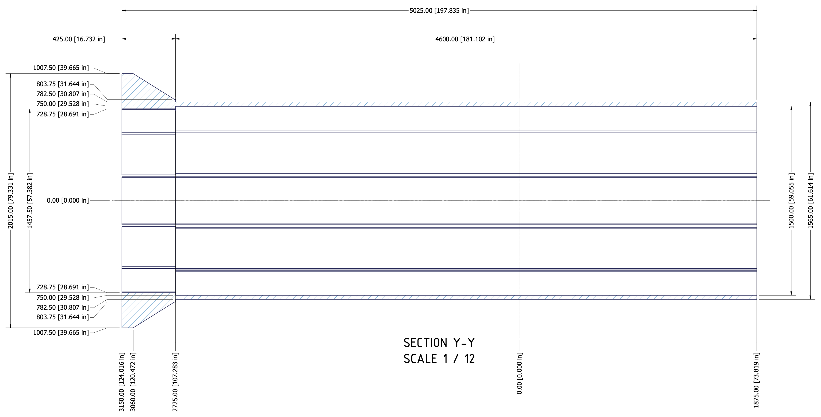
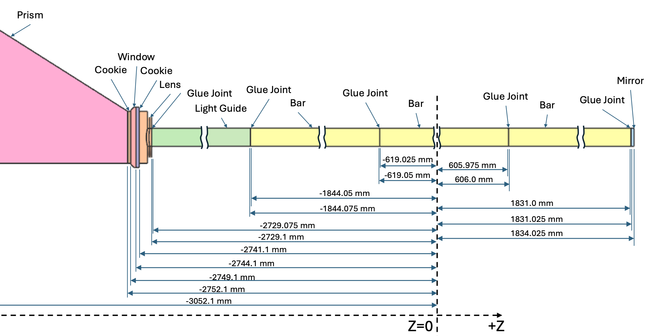
hpDIRC Ongoing Software Tasks
Done:
Rationalizing dimensions/positioning between npsim/eicrecon design and dirc.xml
Rebuilding simulation/analysis framework in npsim/eicrecon (to the functional level)
ePIC baseline geometry 09/12/2025
indico.bnl.gov/event/29963/
extracted from mechanical design 11/20/2025
(Kris Cleveland)

Slide 7
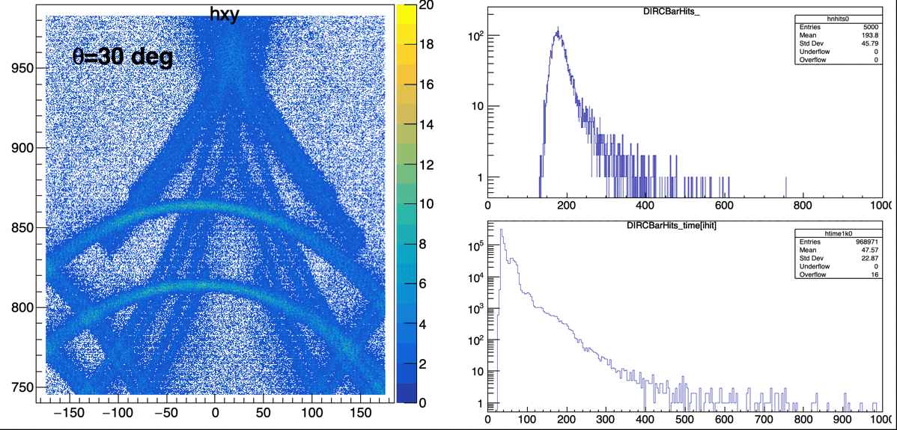
hpDIRC Ongoing Software Tasks
Currently
First look at optical photons on the senson plane obtained using npsim (from ePIC stack). The plots look reasonable.
hits per track
True hit positions on detector plane
photons propagation time
Goal: Comparing performance between eicrecon and the standalone framework

Slide 8
hpDIRC Ongoing Software Tasks
Currently
Comparing performance between eicrecon and the standalone framework
Digitization based on either the standalone or dRICH approach (DIRCRawHit / RawTrackerHit → cell ID → position → PMT ID & pixel ID → DIRC tree)
Reimplementation of geometric and time-imaging PID reconstruction within eicrecon
Near term
Repeat multiple-hits-per-bar studies using the full ePIC geometry
Quantify performance with Pythia using the latest ePIC geometry, including realistic sensor background rates
Far term
Implementation of alternative ML-based reconstruction method
hpDIRC in ePIC simulation
Stand-alone hpDIRC simulation

Slide 9
Thank you!
Questions?

