Slide 1


EIC Computing and Software Joint Institute Status Report
Alexei Klimentov
aak@bnl.gov
Amber Boehnlein
amber@jlab.org

Slide 2
Outline
EIC Computing and Software Joint Institute
Motivation and the primary technical responsibilities of host labs
EIC computing in DOE and International context
EIC International Computing Organization
Preliminary estimate of BNL and JLab requirements for the ePIC/EIC computing in 2027-2032
Motivation
Basic assumptions
Risks
EIC Computing and Software Joint Institute status and priorities

Slide 3
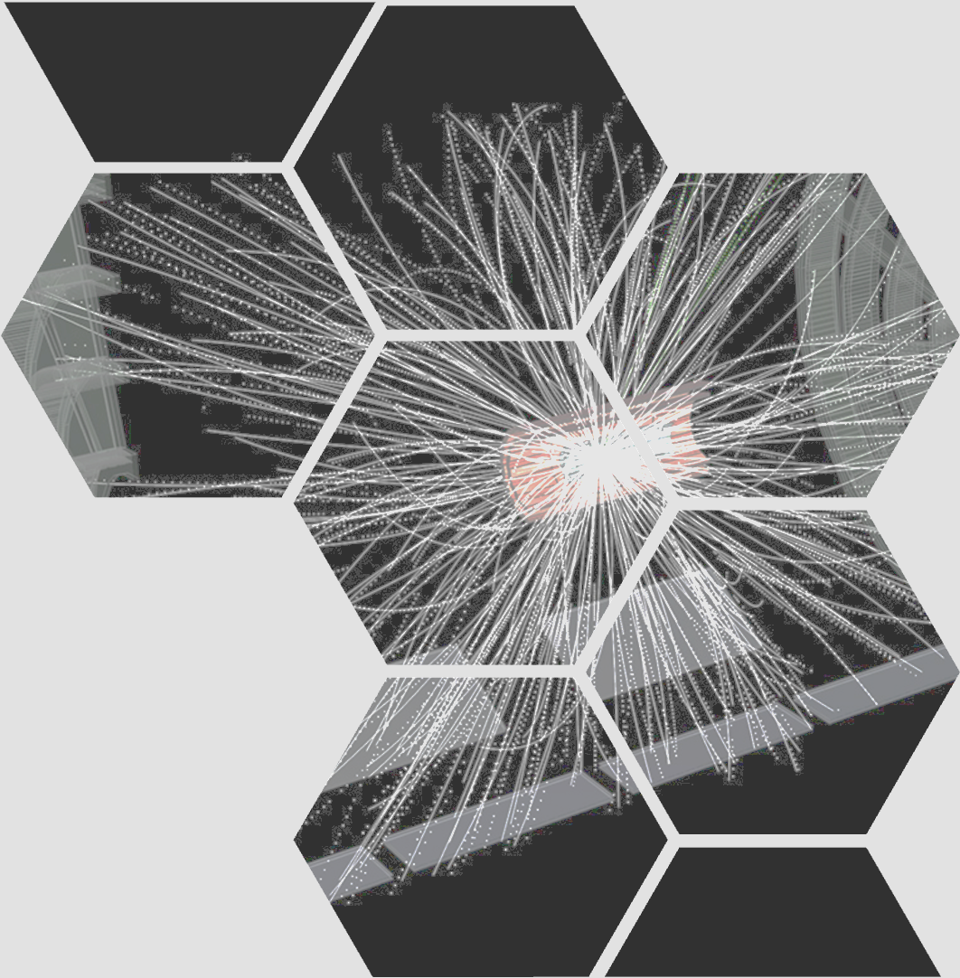
EIC Computing and Software Joint Institute

Slide 4
EIC Computing and Software Joint Institute.
Brookhaven National Laboratory and Thomas Jefferson National Accelerator Facility, as Electron-Ion Collider host labs, have established a collaborative entity, the EIC Computing and Software Joint Institute (ECSJI¹). The Institute reports to the host Labs and the host Labs delegate functions to ECSJI (for instance, organize SW&C review)
This joint institute is designed to support the computing and software needs and activities of the EIC.
The Institute was created about two years ago (fall 2023)
ECSJI leverages complementary expertise at the two labs and provides needed visibility to the respective lab management and stakeholders.
BNL and JLab's expertise in computing and software stems from our long-standing involvement in HEP and NP experiments, as well as supporting other scientific domains such as NSLS, materials science, and astroparticle physics, both domestically and internationally.
The advantages of such a structure also include increased reliability and availability of resources for the ePIC collaboration and other future collaborations.
¹List of abbreviations and glossary

Slide 5
EIC Computing and Software Joint Institute. Cont’d
EIC Computing and Software Joint Institute provides for EIC computing and software matters:
1) A single entity to interface with the EIC programme and the ePIC collaboration,
2) Maintains Service Level Agreements and statements of work outlining the host labs’ contribution to the ePIC collaboration concerning computing resources, services, and personnel assigned to work on ePIC computing and software deliverables,
3) A coordinating body for interacting with international partners providing computing resources as in-kind contributions. This includes assessing resources, managing the agreements of cooperation with the sites delivering resources (including service levels agreements), and facilitating and assessing the delivery against the agreements,
4) Execution of host laboratories responsibilities
Assessing resources.
Managing the agreements with the sites delivering resources (including service levels).
Facilitating and assessing the delivery against the agreements.
The ECSJI scope may evolve over time and the organization of the institute as well

Slide 6
The Primary Computing Technical Responsibilities of Host Labs
Oversight for ePIC distributed software and computing designs and execution to provide assurance functions for the host labs and DOE.
Provisioning and operating standard infrastructure solutions consistent with supported lab infrastructures and community best practices.
Support for the EIC International Computing Organization.
Interface for local resources and policies at the respective labs.
On-going computing operations in support of the accelerator and detector design and construction.
Operational support functions for:
Experimental data curation.
First-pass processing.
Data analysis.
Support of collaboration(s) and users.
Accelerator and detector simulations .
ECSJI charter, Nov 2023

Slide 7
EIC Computing, DOE Context
Communication
DOE OFFICE OF NUCLEAR PHYSICS
Reporting
EIC Project
EIC Computing
ePIC Collaboration
EIC Project
[& EIC Committees]
EIC Computing Council [ECC]
ePIC Spokesperson
BNL NPP ALD, JLab DDST
[David Dean & Abhay Deshpande]
EIC Computing & Software
Joint Institute [ECSJI]
EIC Computing & Software Advisory Committee
[ECSAC]
Two ECSJI co-directors [nominated by ECC]
[Amber Boehnlein & Alexei Klimentov]
ePIC SW & Computing
Coordination
v0.25 May 27, 2025
ECC and ECSAC roles

Slide 8
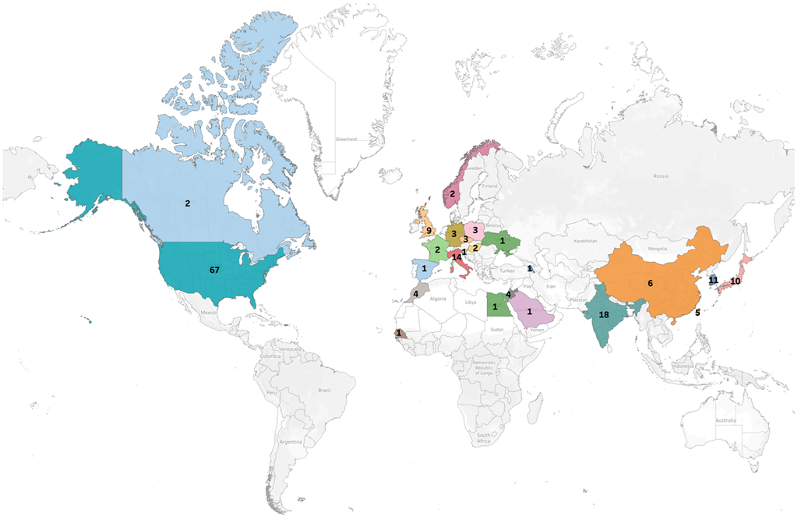
>1100 collaborators
181 institutions, 25 countries
ePIC is a CERN recognized experiment
EIC International Computing Organization
J.Lajoie & S. Dalla Torre talk

Slide 9







EIC International Computing Organization
The RRB 2024 meetings discussed international contributions for the EIC's extraordinary computing needs
The proposed mechanism for managing the contributions at a technical level is the EIC International Computing Organization (EICO) to include representatives of the funding agencies contributing computing resources
EICO kick-off meeting in October 2024. Regular EICO/ECSJI meetings in 2024/26. These meetings are held every two weeks. EICO WG : Representatives of CA, FR, JP, IT, TW, UK, and ECSJI/ePIC.
The following points have been discussed in 2025/26:
Organization of funding for Nuclear Physics computing at the national level.
Structure of computing for the EIC and for ePIC within each respective country.
Existing support and commitment for EIC computing.
ePIC Streaming Computing Model
EIC Computing in global context (WLCG, OSG, DUNE, Vera C.Rubin, SKA,…)
EICO boards and forums
EICO Overview Board composition
EICO and RRB communication
Intellectual property
A.Boehnlein
F.Bossu
A.Bressan
W.Deconinck
M.Diefenthaler
D.Elia
T.Gunji
P.Jones
R.W.L.Jones
A.Klimentov
C.Munoz Camacho
F.Noferini
B.Sawatzky
D.Sokhan
E.Yen

Slide 10
EIC International Computing Organization. Cont’d
In-person meeting in April 2-4 at BNL to complete first charter draft
Addressed comments from IT and CA FA at EICO working group – 2nd draft out of comments
Addressed comments from EIC and ePIC stakeholders – 3rd draft out for comments; Addressed comments from Elke and Rolf
Addressed comments from DOE NP – 4th draft out of comment
Presented at ePIC/EIC RRB meeting in June 2025
Addressed ePIC/EIC RRB comments – 5th draft out of comments
Updated EICO charter was presented at EIC Computing and Software Advisory Committee (October 2025)
Final version of EICO charter was presented at ePIC/EIC RRB meeting in November 2025 and approved
November 2025 – January 2026
Discuss and define priorities and next steps
Drafting committee (April 2025):
A.Boehnlein (JLab), M.Diefenthaler (JLab), A.Klimentov, (BNL)
A.Bressan(University and INFN Trieste)
R.W.L.Jones (Lancaster University)
T.Gunji (Tokyo University)
C. Munoz Camacho (University Paris Saclay)
E. Yen (ASGC)
ECSAC October 2025
ECSAC Comments : We believe that the EICO is a reasonable construct to structure the international distributed computing framework for the EIC experiment(s). It maps well with existing structures such as WLCG and many of the involved parties are familiar with these structures as they have been in place for many years.
ECSAC Recommendation : We recommend implementing the EICO as described during the review. We suggest a staged approach focusing initially on the aspects more related to the collaboration (Collaboration/Overview boards) and the links with WLCG
EICO 2026 priorities :
Networking (LHCONE & ESnet)
Echelon2 requirements
EICO Overview Board composition
Review ECSJI charter

Slide 11
EIC Computing, International Context
Communication
EIC Resources Review Board
v0.25 May 27, 2025
Reporting
[US National and International Funding Agencies]
EIC Project
EIC Computing
Computing Scrutiny Group
ePIC Collaboration
EIC Project
[& EIC Committees]
DOE OFFICE OF NUCLEAR PHYSICS
ePIC Spokesperson
EIC Computing Council [ECC]
BNL NPP ALD, JLab DDST
ePIC SW & Computing
Coordination
EIC Computing & Software
Joint Institute [ECSJI]
Computing & Software Advisory Committee
[ECSAC]
Two ECSJI co-directors [nominated by ECC]
EIC International Computing Organization
[EICO]

Slide 12
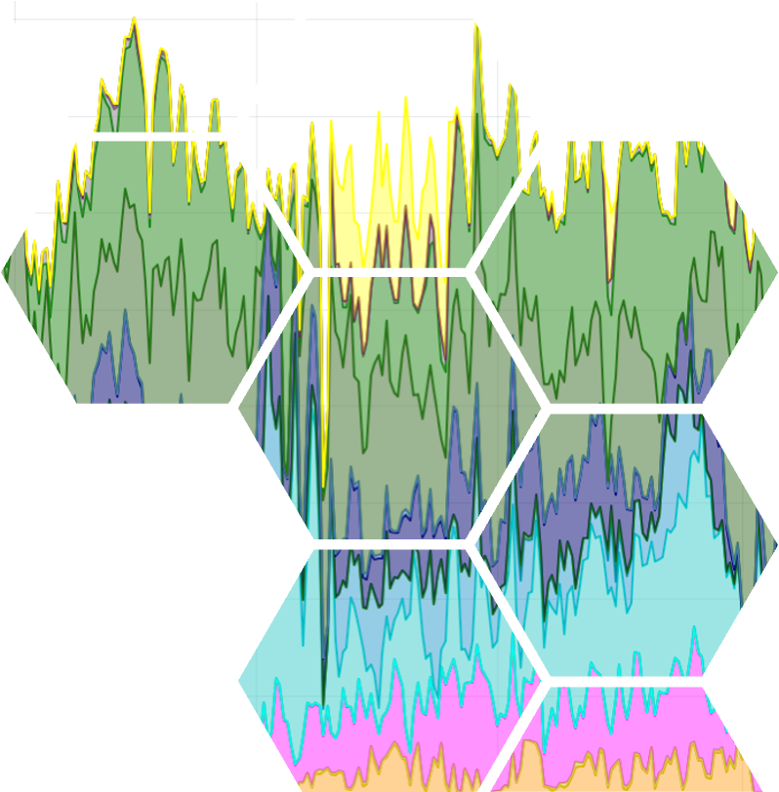
Estimate of BNL and JLab requirements for
the ePIC/EIC computing in 2027-2032.

Slide 13
Estimate of BNL and JLab requirements for the ePIC/EIC computing in 2027-2032. Motivation
The host laboratories for the EIC, BNL and JLab are primarily responsible for developing and implementing EIC computing services and infrastructure, from online delivery of data to its processing and archiving.
AI will play a central role in this development, positioning EIC computing as a leader in AI for the online system and computing in general. Several demos for Genesis (AmSC) mission are proposed
This development is being conducted in close collaboration with the EIC project and the ePIC collaboration. The ePIC collaboration is co-designing the detector and the computing of the primary experiment at the upcoming Electron-Ion Collider.
These systems are being developed in parallel and in close coordination to establish a distributed computing model that enables seamless data processing from the detector to the physics analysis, incorporating AI and streaming readout.
Current efforts focus on data transfer and processing from the detector to Echelon 1 sites at BNL and JLab, as well as collaboration with international partners on distributed computing.
We must be fully prepared for the early tests and data challenges planned with the ePIC collaboration.
Currently, ePIC/EIC computing opportunistically uses Labs and DOE/NSF resources, which are partly supported by the Labs' program development funds. Both Laboratories support the EIC computing in all three core categories: compute, software infrastructure, and storage.
We successfully completed the initial phase of the ECSJI and EICO in 2024/25, and we are ready to start developing the EIC computing infrastructure prototype. This prototype will be integrated with the ePIC international computing resources in CY 2027 and will be ready for the planned DAQ challenges in 2027/2028.

Slide 14
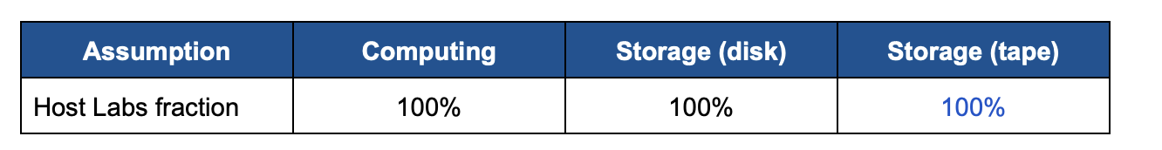
Estimate of BNL and JLab requirements for the ePIC/EIC computing in 2027-2032. Inputs and Assumptions
The estimates are based on the most recent version of the ePIC Streaming Computing Model Report, it is assumed that in 2034 the EIC will operate at 10% of its expected maximum luminosity of approximately 10³⁴ cm⁻²s⁻¹
To estimate host labs contributions, we assume their share is based on the following allocation fractions for the first year of running
It is further assumed that Echelon 1 computing facilities will be sufficient to perform prompt and full processing of ePIC data at the EIC startup. This aligns with the expectation that two data replicas will be archived at BNL and JLab and Echelon 2 sites will not be fully operational by 2034.
We assume a typical 99% of uptime for the Echelon1 computing resources.
A common 5-year replacement cycle is assumed for computing and storage servers. Equipment can be purchased with longer warranty (at a cost) and can also be operated out-of-warrant (at a risk).
Final assumption: The final assumption concerns the EIC schedule. The execution of the current request will cover the period between 01/01/2027 until 12/31/2032. Computing procurement and deployment are aligned with the overall EIC Project schedule and the associated timelines for the development and deployment of the ePIC DAQ, computing, and AI components.

Slide 15
Estimate of BNL and JLab requirements for the ePIC/EIC computing in 2027-2032. Risks
Risk 1: Given the large increase in computing and storage needs just prior to the start of the
EIC Operations, additional schedule delays may modify the amount of funds needed in this 6-year
request.
Risk 2: We assume a 10% and 5% reduction per year in the computing cost per kHS and in the disk storage per PB. External factors like supply-chain interruptions, exchange rates, and additional costs due to importing tariffs (or high demand on storage and compute) may have a large impact on the assumption of cost reduction per year. Changes in architecture (eg, GPU and FPGA computing, or NVMe storage) can also have an impact on the cost.

Slide 16


ECSJI Progress and Priorities in 2025 - 2026
EIC International Computing Organization (EICO) Charter
It was done together with EICO Working Group
The charter was presented and approved by RRB in November 2025
Estimating BNL and JLab Requirements for ePIC/EIC Computing in 2027–2032 (aka “white paper for DOE ONP” primary authors : Amber, Markus and Alexei)
Draft was sent to the BNL and JLab management and DOE ONP
Implementation details and funding profile are under discussion
Purchase cost model and labor profile
Timeline and milestones
Working closely with the BNL and JLab Management, EIC project and ePIC collaboration on computer-related and DAQ topics.
Regular meetings with EIC Management (Elke and Rolf), regular meetings with ePIC Management
Technical topics under discussion/evaluation/prototyping/pre-production/…
Testbed at BNL and JLab (moving to prototyping)
Data transfer modeling (the 1st prototype was presented at Echelon0-Echelon1 workshop in October at JLab)
Collaborative tools : active development (an integrated ecosystem for collaboration management)
Synergy with Genesis mission and AmSC
Networking requirements
Host labs and with international partners

Slide 17
ECSJI Progress and Priorities in 2025 – 2026. Important Dates
Event 2025
Echelon0-Echelon 1 workshop #1 (BNL) | Apr 2
EIC International Computing Organization Meeting (BNL) Finalize EICO charter version for RRB meeting | Apr 3-4
ePIC/ESCJI/EIC Computing and SW Advisory Committee Technical Interchange Meeting ePIC streaming model and data orchestration | May 12
ePIC/EIC Resource Review Board (Prague) The first version of EICO charter was presented for comments | Jun 5-6
JLab and BNL EJFAT demo (Secretary Wright visit to JLab) | Aug 19
DOE Review of Injector Operations and RHIC R&R/Injector Operations Review (BNL) | Sep 8-10
ePIC Software and Computing Review by ECSAC (JLab) ePIC Computing Model EIC Computing international community | Oct 6-7
Event 2025 -2026
Echelon0 - Echelon1 workshop #2 (JLab) Data transfer between BNL and Jlab Streaming Orchestration Modeling and prototyping Echelon0 and Echelon1 computing needs | Oct 8
ePIC/EIC Resource Review Board (BNL) EICO charter was approved The first ideas of Echelon 1 computing needs – presented | Nov 4-5
Submit white paper to DOE NP “Estimation of ePIC Echelon1 computing needs in 2027 – 2032” | Nov 12
BNL and JLab joint effort for AmSC and Genesis mission demonstrators | Work in progress
Host Labs meeting with ESnet and LHCONE | Feb, 2026
EICO F2F meeting (probably co-located with ePIC collaboration meeting) to write EICO charter addendums | May, 2026

Slide 18
Glossary and Abbreviations
AHM – All Hands Meeting
ALD – Associated Laboratory Director
CM – Computing Model
DDST – Deputy Director for Science and Technology
E0, E1, E2 – Echelon0, 1, 2 sites according to ePIC computing model
ECC - EIC Computing Council
ECSAC – EIC Computing and Software Advisory Committee
EICO – EIC International Computing Organization
ECSJI – EIC Software and Computing Joint Institute
HTC – High Throughput Computing
IKC – in-kind contribution
MB – Management Board
NPP – Nuclear and Particle Physics
OB – Overview Board
ONP – DOE Office of Nuclear Physics
OSG - Open Science Grid (NSF supported computing consortium)
RHIC R&R/injector Review - DOE Review of Injector Operations and RHIC Removals and Repurposing at BNL
RRB – Resource Review Board
SLA – Service Level Agreement
SW&C – Software and Computing
TF – Technical Forum
WLCG – World LHC Computing Grid

Slide 19
Acknowledgements
This talk drew on presentations, discussions, comments, input from many
Thanks to all, including those we’ve missed…
E.Aschenauer, T.Chou, D.Dean, A.Deshpande, J.Dunlop, D.Lawrence, J.Liu, P.Mantica, T.Wenaus and EICO team (Andrea, Carlos, Daria, Domenico, Eric, Francesco, Peter, Roger, Taku, Wouter, …)
Special thanks to Markus and Rolf, with whom we collaborated on the EICO charter and DOE ONP white paper. They made significant contributions to improving them.

Slide 20
Back up slides

Slide 21
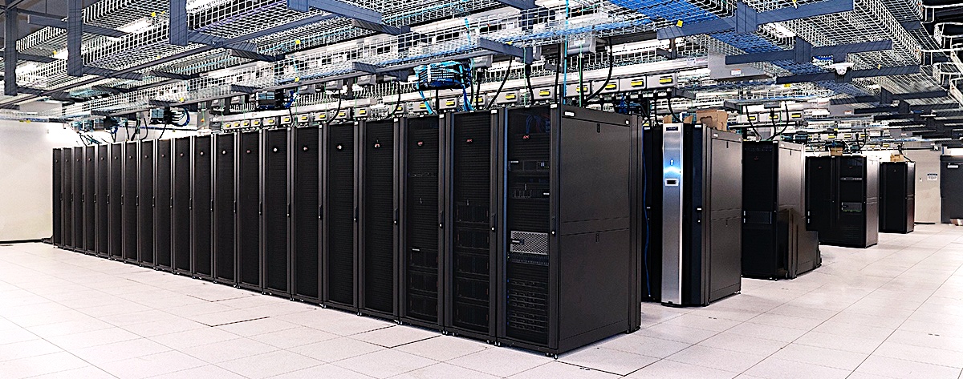
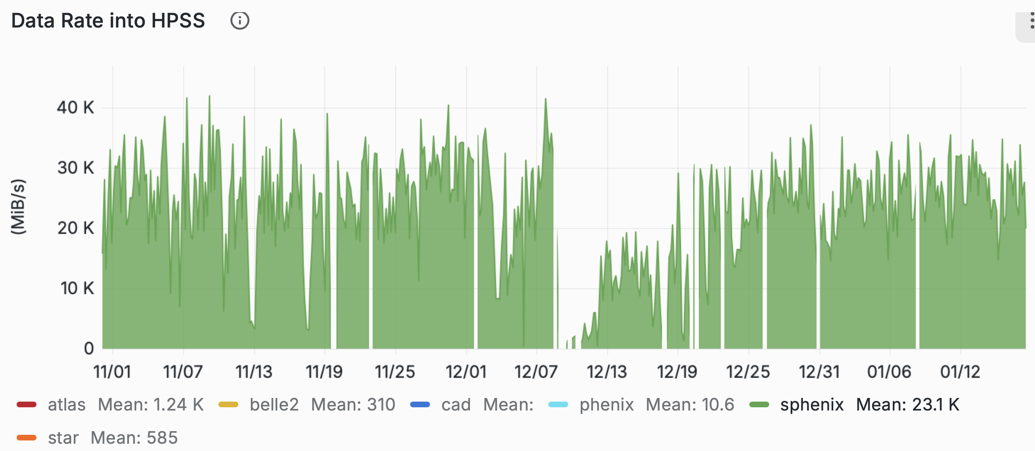
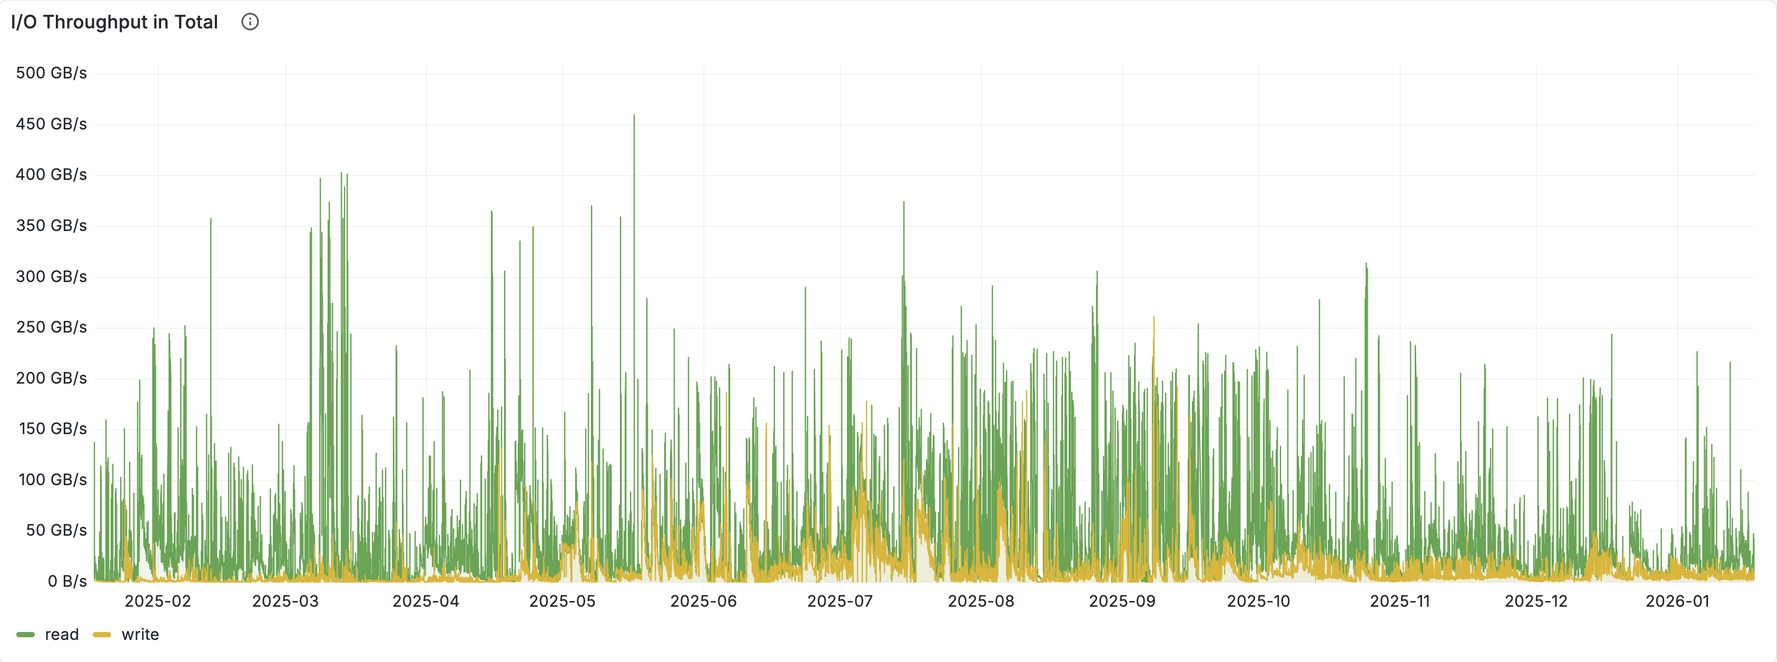
Resources and Expertise: BNL Scientific Computing and Data Facilities
Leading computing center for high-throughput computing and scientific data
supports high energy and nuclear physics experiments, as well as BNL-based and international projects, including EIC, LQCD, NSLS-II, CFN, BES, WLCG and OSG
~2200 nodes (~220k CPU cores and 400 GPUs)
externally connected to global network at 1.6 Tbps: ~1 PB/day transferred in & out of BNL
infrastructure: 59,000 ft² with power 4.8 MW anticipated to grow to 9.6 MW
Energy-efficient data center with 1.3 current PUE, aiming for 1.2 PUE with full IT payload deployment
One of top-10 scientific data centers in world
largest HEP/NP data archive in United States
0.6+ EB of data archived (exabytes by 2030), the largest NP
and HEP data archive in US
170+ PB on disks
Mass storage HPSS system used in Data Carousel mode when data actively migrated between disk and tape
Seamless integration with LCF and HTC
Commercial clouds integration with on-prem resources
Advanced Computing Laboratory : Emerging technology testbed in collaboration with industry
Running experiments in NPP for 25 years and new experiments with new ideas and new approaches
One of three largest WLCG centers and the only one with 100% availability and reliability in Jul’24 – Dec’25
Unprecedented Data Taking Rate to Tape (HPSS) for sPHENIX in 2025
40 GiB/s
Unprecedented Data Taking Rate from Disk (Lustre) for sPHENIX in 2025
400 GB/s
read
write

Slide 22

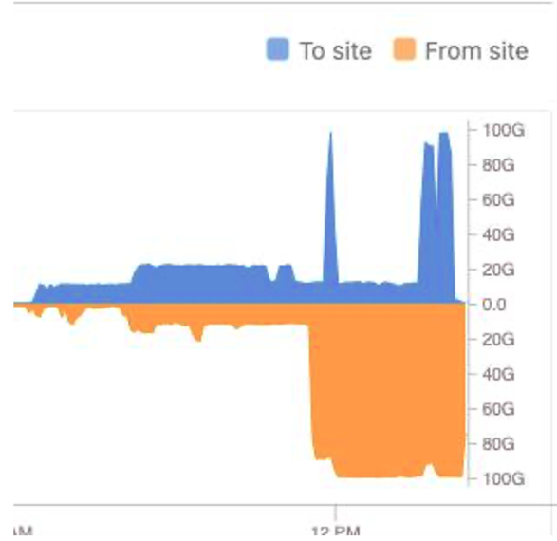


Resources and Expertise: Jefferson Lab Scientific Computing and Data Facilities
D.Lawrence
High-throughput computing for experiments & analysis
Supports CEBAF experimental halls (A/B/C/D), accelerator operations, and lab-wide data analysis
Critical computing partner for EIC/ePIC simulation campaign through OSG
JLab “Farm” provides ~30,000 compute cores for batch throughput (Slurm)
Dedicated GPU resources (A100, A800, Gaudi2, Titan) for batch and interactive use
Interactive access via ifarm nodes and JupyterHub interfaces for development/testing
High-performance distributed storage for workflows: ~11 PB Lustre and ~5 PB NFS/XRootD
Scientific data services & archival storage
Tape archive of 100+ PB, integrated with disk caches via the JASMine mass storage system
Data movement and collaboration tooling (e.g., Globus, Rucio) for large experiment datasets
Future growth: DOE High Performance Data Facility (HPDF) lead and future site of HPDF Hub facility.
Networking highlight
Sustained real-time experimental data streaming at 100 Gb/s over ESnet (EJFAT) to NERSC, enabling near real-time processing/feedback with remote HPC resources.
Notes:
[Sources] - JLab Software & Computing Workshop (Sep 2024) slide deck (“The JLab Farm”): ~30,000 compute cores; ~11 PB Lustre; ~5 PB NFS/XRootD; 100+ PB tape; ~400 kW. https://indico.jlab.org/event/879/sessions/2954/attachments/11663/18089/Computing_tools-tricks-Sep2024.pdf - JLab ServiceNow KB (ifarm node specs): https://jlab.servicenowservices.com/kb/?id=kb_article&sysparm_article=KB0014687 - Jefferson Lab news release (100 Gb/s connection and demonstration): https://www.jlab.org/news/releases/california-streamin-jefferson-lab-esnet-achieve-coast-coast-feed-real-time-physics - ESnet EJFAT project page (100 Gb/s streaming context): https://www.es.net/network-r-and-d/ejfat/ - Jefferson Lab Mass Storage and File Replication Services (JASMine): https://www.jlab.org/div_dept/admin/publications/papers/01/PHY01-17.pdf - DOE Categorical Exclusion Determination for Jefferson Lab Data Center (JLDC) / HPDF: https://science.osti.gov/ssp/NEPA-Documents/Categorical-Exclusion-Determinations/-/media/ssp/pdf/nepa-documents/categorical-exclusion-determinations/tjso/2025/Jefferson-Lab-Data-Center-as-part-of-the-HPDF-Project--TJSO-SC-25-01-NEPA-CX-Determination.pdf - Jefferson Lab news release on HPDF Hub selection: https://www.jlab.org/news/releases/jefferson-lab-lead-300-million-high-performance-data-facility-hub - Data center photo (Jefferson Lab): https://www.jlab.org/sites/default/files/221206_DateCenter2.jpg - Jefferson Lab logo (Comms resources): https://www.jlab.org/sites/default/files/images/logos/JLab_Logo_RGB_Red_Black_Horizontal.png [/Sources]

Slide 23
EIC Computing Organization & Governance.
Computing Council (ECC)
Review the ECSJI strategic direction and support leadership in managing effective interfaces of the ECSJI to the EIC project and ePIC collaboration.
Authority: Approve the ECSJI strategic direction, leadership changes, annual budgets, resource allocations, and performance milestones.
The Institute Management [two co-directors, each nominated by one lab]
ECSJI co-directors have regular meetings with host labs management
To discuss how Computing and Software activities (personpower and resources) are supported by Labs
ECSJI co-directors have regular meetings with ePIC (spokesperson and deputy, SW&C coordinator) and EIC Management (Co-Associate Directors for the EIC Experimental Program)
Typically, bi-weekly – address host Labs < == > ePIC and host Labs < == > EIC project issues
Duties and accountability:
The management is responsible for organizing the Institute to deliver defined responsibilities.
The management will maintain a multi-year operation plan for the host labs, providing matrixed staff members to support activities.
Institute management will provide a yearly report to the host labs’ management.

Slide 24
EIC Computing Organization. Computing and Software Advisory Committee
Computing and Software Advisory Committee (ECSAC)
The ECSAC’s role is to provide advice, guidance, and counsel on the strategy and
objectives of the Institute and of the EIC International Computing Organization.
Strong connection to International Computing and Software community
ECSAC has members from US Laboratories, US Universities and International
Laboratories (CERN, GSI)
The first review by ECSAC was held in October 2023, followed by reviews in 2024 and 2025
Technical Interchange Meeting was organized in May 2025 to discuss ePIC Streaming Model
M.Al-Turany (FAIR, GSI)
I.Baldin (JLab)
M.Cromaz (LBNL)
S.Campana (CERN) - Chair
P.Mato (CERN/PIC)
W.Yang (SLAC)
Former ECSAC members :
D.Brown (LBNL)
C.Paus (MIT)
H.Schellman (U Oregon)
F.Wuerthwein (OSG, UCSD)
LHC

Slide 25
Major Elements from the EICO Charter
EIC International Computing Organization is led by the Institute's co-directors and administered by the ECSJI. This organization exists to provide computing resources, infrastructure, and services related to the EIC. The current focus is on the ePIC experiment. This will be extended to other foci as endorsed by the EIC RRB. Funding agencies will indicate the activities and services they will provide, and this will be approved by RRB. The EICO structure is formally documented in this charter.
EICO Overview Board. The Overview Board (OB) oversees the functioning of the EICO. It is composed of a representative of each Institution that is a member of the EICO, the ECSJI directors and the Spokesperson(s) of each EIC Experiment with voting rights. The OB is co-chaired by EIC Computing Council Members (or one of ECSJI directors), which include a member of the OB appointed as a co-chair.
OB approves the report that details the accomplishments of the EICO, and the individual site metrics outlined in the cooperation agreement.
The OB has the responsibility to manage external relationships with partner organizations, such as WLCG
The OB also provides a resolution path for institutional issues relative to the cooperation agreement .

Slide 26
Major Elements from the EICO Charter. EICO Management Board
EICO Management Board : The Management Board (MB) organises the work of the EIC Computing as a set of formal activities. It maintains the overall programme of work and all other planning data necessary to ensure the smooth execution of the work of the EIC Computing. It provides half-year progress and status reports to the OB. The MB membership includes the ECSJI directors, the Technical Heads of the Echelon 0, Echelon 1 and Echelon 2 Centres, the leaders of the major activities and projects managed by the Board, the Computing Coordinator of each EIC experiment, the Chair of the Technical Forum, a Scientific Secretary and other members as decided from time to time by the Board. MB meetings are held on a regular basis (usually monthly). MB has several roles, including :
To broker and manage agreements between the resource centres and the experiment(s). In practice, this will require background agreements with other organisations that run various parts of the infrastructure, such as fabrics and storage operations, certificate authorities, network providers, etc.;
to broker and manage agreements between resource centres, and between resource centres and EIC host labs;
to review schedules, service performance, resource utilisation, etc. and decide about tools to be used to assess centers reliability and availability;
to oversee publications, communications, conference submissions, and speakers, where it concerns software and computing activities that are not completely within EIC experiment(s).

Slide 27
Major Elements from the EICO Charter. EICO Technical Forum
EICO Technical Forum : The Technical Forum (TF) is part of the EICO and represents in particular the computing centers (including Echelon 1 centers). The TF has several roles, including:
to exchange information;
to act as a forum for technical discussions and planning, including schedules, resources utilization and technical solutions, challenges and requirements;
to organize technical discussions related to production system and middleware, etc and make proposals to the MB;
discuss technical roadmap for the evolution of EIC facilities and services;
The TF meetings are open to all interested members of the EIC computing.
Other parties may be invited for topical discussions.
The TF chairperson is appointed by MB for a two-year period.
Extension is possible with full concurrence of OB. The TF reports to the MB.
The chair of the TF is an ex officio member of the EICO Management Board.
The TF may start and stop working groups when needed to address technical issues.
TF shall provide regular (bi-monthly) updates on its activity to MB.

