Slide 1
Urgent ePIC Simulation Feedback needed by the EIC
Andrii Natochii (BNL)
E.C. Aschenauer (BNL)
and the EIC Accelerator Team
ePIC Collaboration Meeting
January 2026

Slide 2
What Backgrounds do we have
and where do we stand

Slide 3
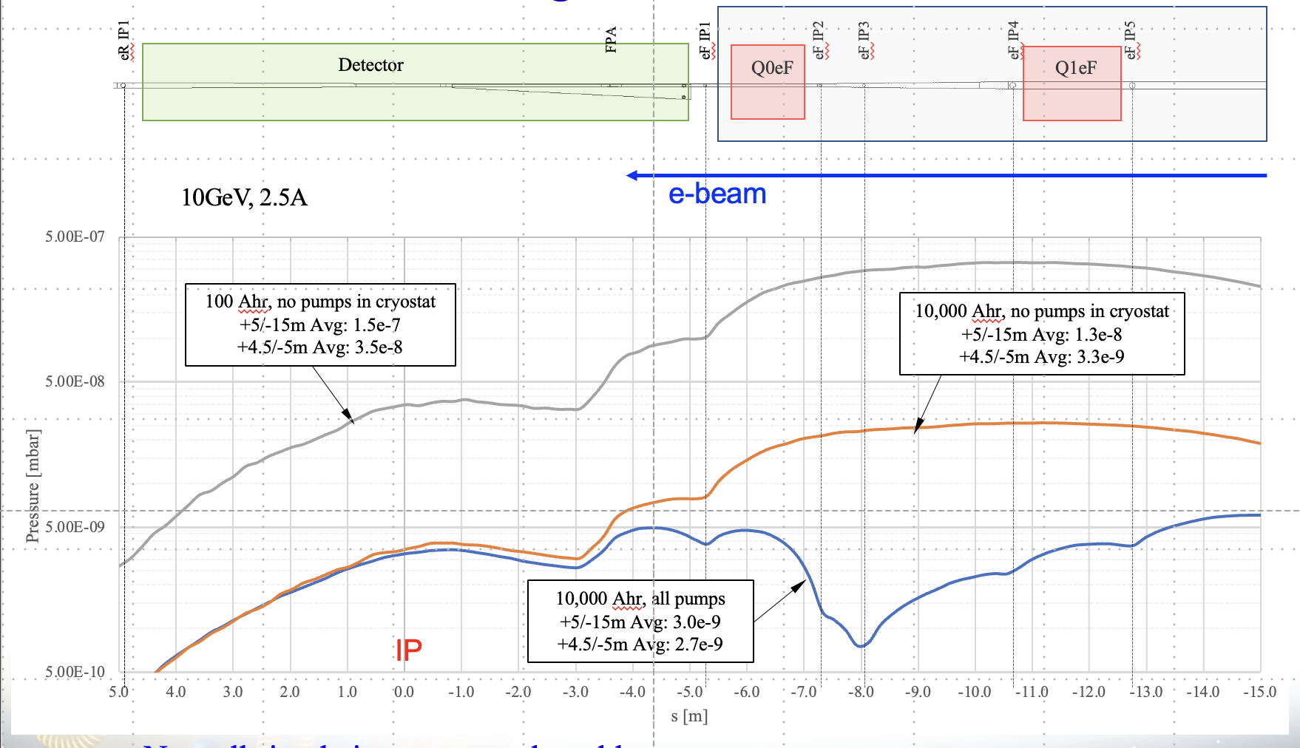
Beam Background Sources
Background/radiation sources : Different to hadron-hadron colliders beam related background cross-sections are larger than signal cross-section
Note:
a good vacuum is critical for all beam gas related backgrounds → need to limit how often we
break vacuum
collimation systems will minimize backgrounds, but not if the background is generated in IP-6
Hadron Beam
Low beam lifetime during injection and ramping
→ can be mitigated by collimation system → no impact on data taking
Beam-gas scattering through Coulomb process.
→ can be mitigated by collimation system
Inelastic beam-gas interaction (producing showers of secondaries in the IR).
We just finished particle tracking for protons
→ actively working on heavy ions
especially difficult – LHC recently finished full particle tracking for ions
Pressure reduces with integrated current
during running

Slide 4
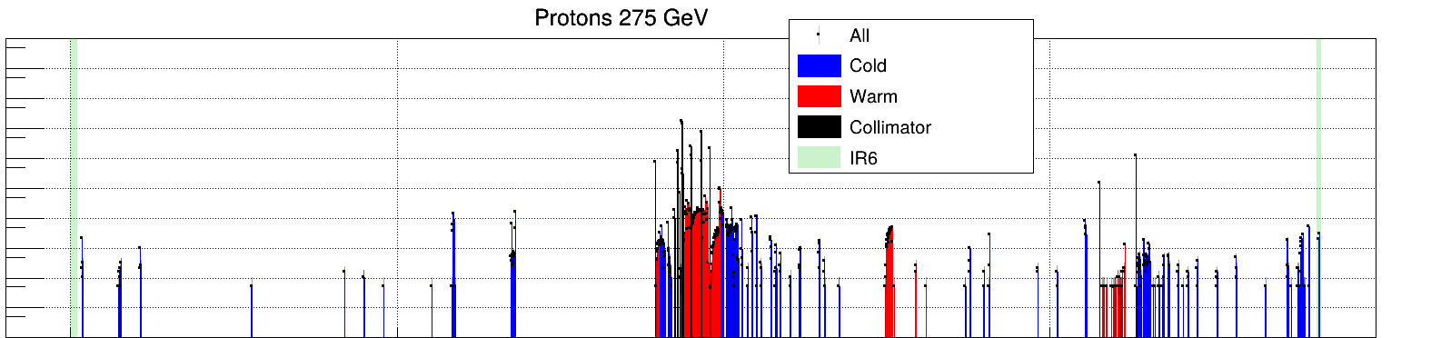
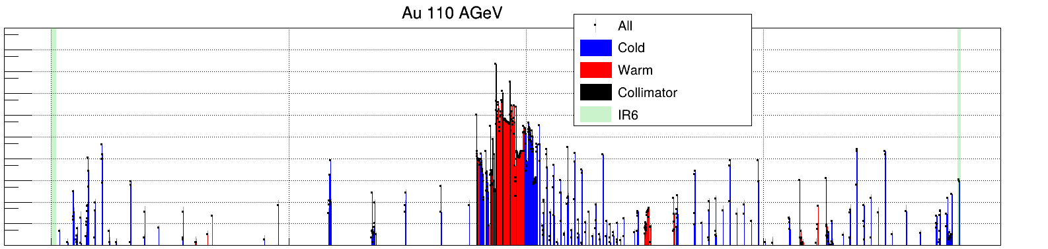
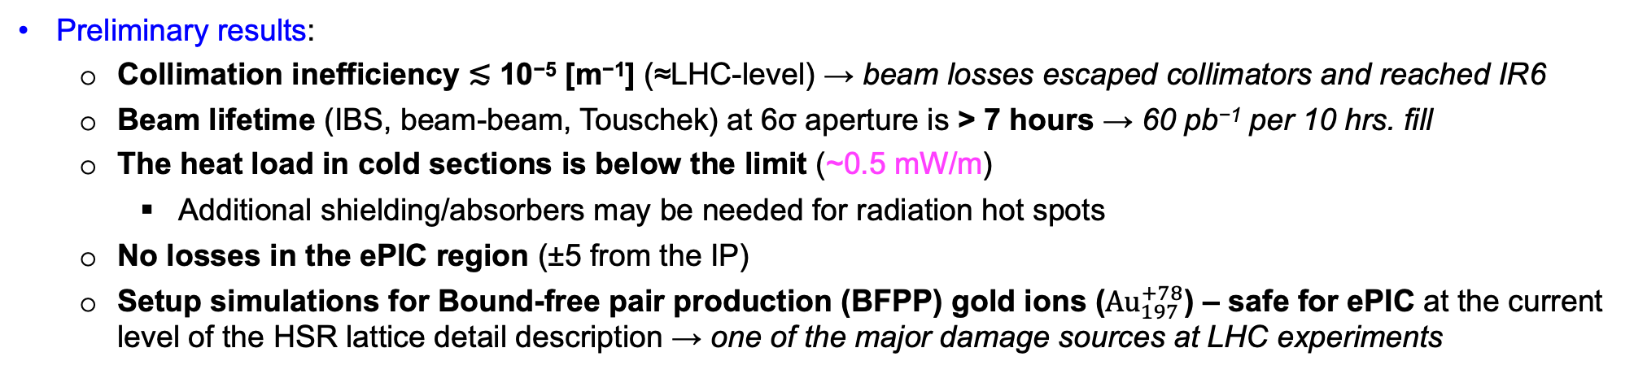
HSR Collimation
IR6-FWD
IR4
IR2
IR12
IR10
IR8
IR6-BWD
Tool: Xsuite (CERN) with accurate beam-matter interaction for collimators
Method: Annular halo for betatron and RF sweep for momentum collimation (CERN-like)
Setup: One primary with two secondary betatron per plane + one primary with two secondary momentum
→ 9 collimators in IR12
+ 2 vertical tertiary collimators in IR8
10⁴
10²
Proton 275 GeV
1
Power [W/m]
10⁻²
10⁻⁴
10⁻⁶
HSR
10⁴
10²
Au ions 110 AGeV
1
Power [W/m]
10⁻²
10⁻⁴
10⁻⁶
Preliminary results:
Collimation inefficiency ≲ 10⁻⁵ [m⁻¹] (≈LHC-level) → beam losses escaped collimators and reached IR6
Beam lifetime (IBS, beam-beam, Touschek) at 6σ aperture is > 7 hours → 60 pb⁻¹ per 10 hrs. fill
The heat load in cold sections is below the limit (~0.5 mW/m)
Additional shielding/absorbers may be needed for radiation hot spots
No losses in the ePIC region (±5 from the IP)
Setup simulations for Bound-free pair production (BFPP) gold ions (${Au}_{197}^{+78}$) – safe for ePIC at the current level of the HSR lattice detail description → one of the major damage sources at LHC experiments
0
1000
2000
3000
S [m]
4000

Slide 5
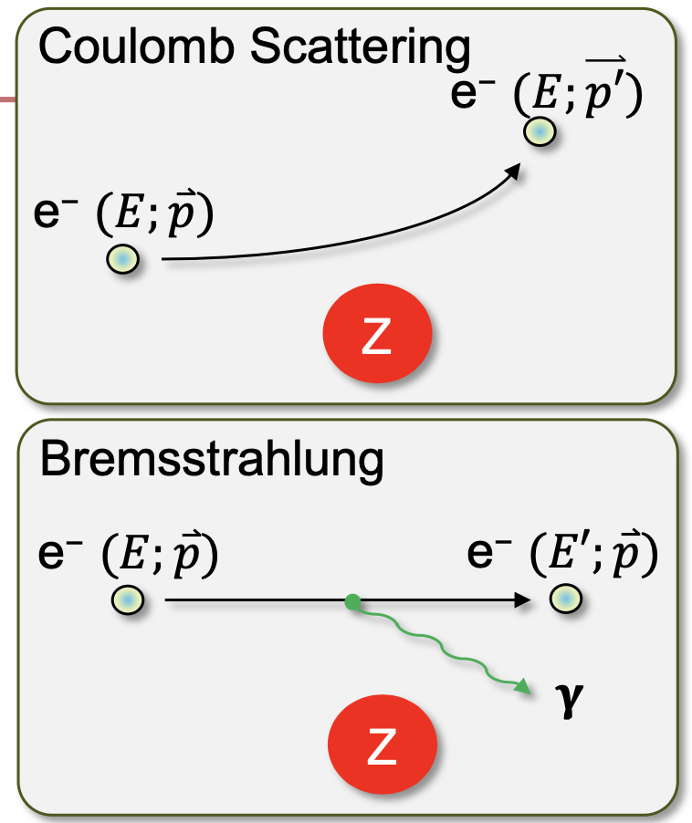
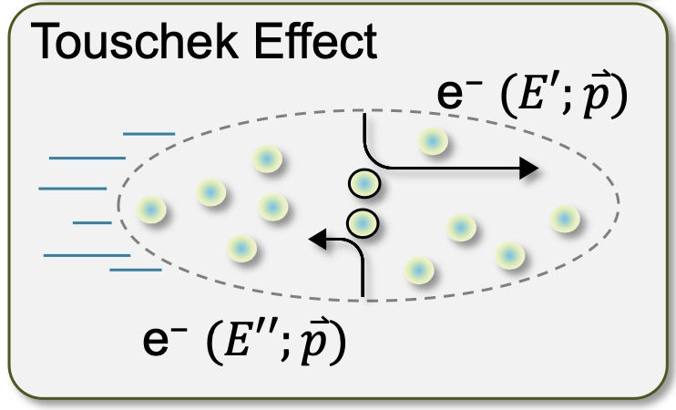
Beam Background Sources
Background/radiation sources : Different to hadron-hadron colliders beam related background cross-sections are larger than signal cross-section
Electron Beam
background due to de-excitation of beam if bunches are replaced (replace bunches with 1Hz)
→ can be mitigated by collimation system
Beam-gas scattering through Coulomb and Bremsstrahlung (Bethe-Heitler) processes:
→ Elastic and inelastic beam particle scatterings on residual gas molecules and a hadron beam.
Touschek effect:
→ Incoherent scattering of the particles in the same beam bunch.

Slide 6
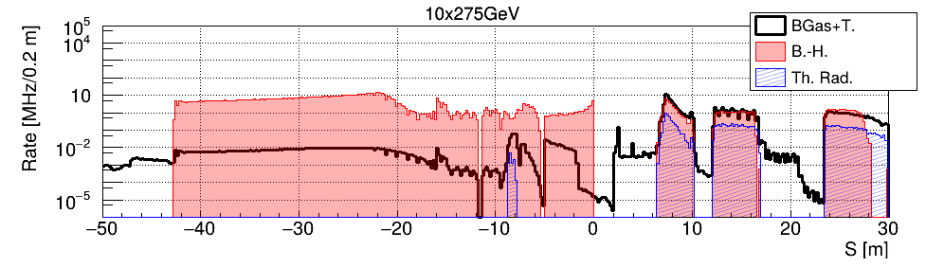
ESR Collimation
Tool: Xsuite + SuperKEKB beam loss physics model for beam-gas and Touschek scatterings
Method: Scattered particle tracking
Setup: One primary betatron collimator per plane per energy → 6 collimators in IR4
ESR
IP6
Simulation results of the IR6 ESR beam losses at 10 GeV due to beam-gas (BGas), Touschek (T.), Bethe-Heitler (B.-H.), and thermal radiation (Th. Rad.) scatterings with collimators in place.
Preliminary results:
Single-turn nature of losses → collimators are placed upstream of IR6 as close as possible to ePIC, but far enough to avoid tip-scatterings
Beam lifetime is about 3, 9, and 14 hrs. for 5GeV@2.5A, 10GeV@2.5A, and 18GeV@0.2A, respectively, assuming a realistic IR6 gas pressure profile corresponding to 10 kAh of the beam dose
Not critical for luminosity (swap-out at ~1 Hz)
Crucial for beam losses → detector backgrounds
Prepared Monte Carlo samples of beam losses in IR6 → used for ePIC performance and damage studies
Momentum collimators are not necessary
However additional collimators might be needed for better ePIC background control and in failure modes → Where can we place them? (see the next slide)

Slide 7
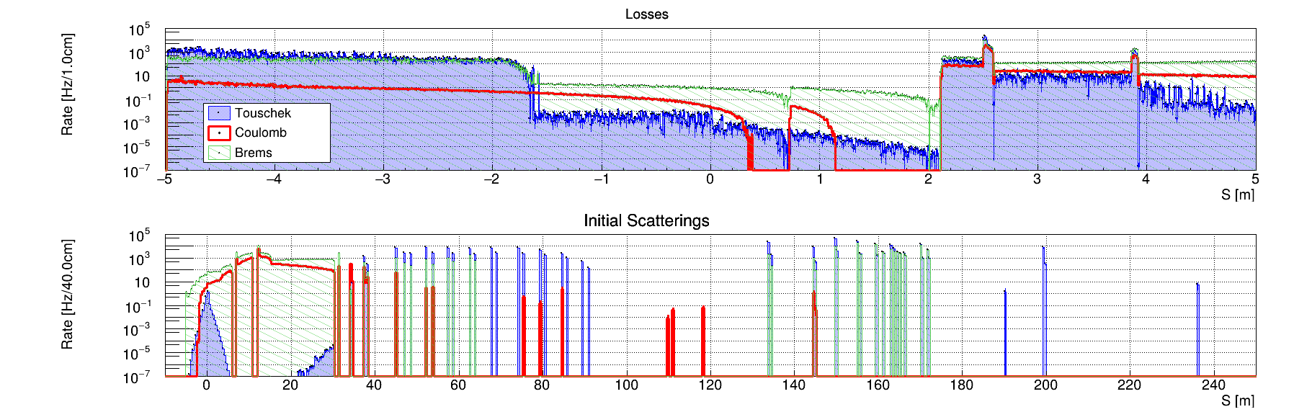
ePIC Background Reduction – ESR Collimation
We have installed pairs of primary collimators (vertical and horizontal) in IR4 at 5, 10, and 18 GeV in phase with final focusing quads → minimal impact on beam lifetime; maximum loss rate reduction; minimal impedance contribution
The collimators can reduce local losses at the quads by a few orders of magnitude keeping the integrated cryostat heat load on the cold mass below the limit
Unfortunately, the collimators cannot mitigate detector background rates → wide variation of the betatron phase around IP6
ePIC losses originate mainly from the regions downstream the IR4 primary collimators (between IR6 and Sector-5)
IF the ePIC beam-induced background (Beam-gas and Touschek multi-turn losses) is unacceptable we must install an additional collimator(s) upstream of IR6 (30m < S < 100m) to mitigate the beam losses in the detector region
10 GeV
IR6 ESR beam losses
ESR
IR6
SECTOR-5
Initial scattering locations

Slide 8
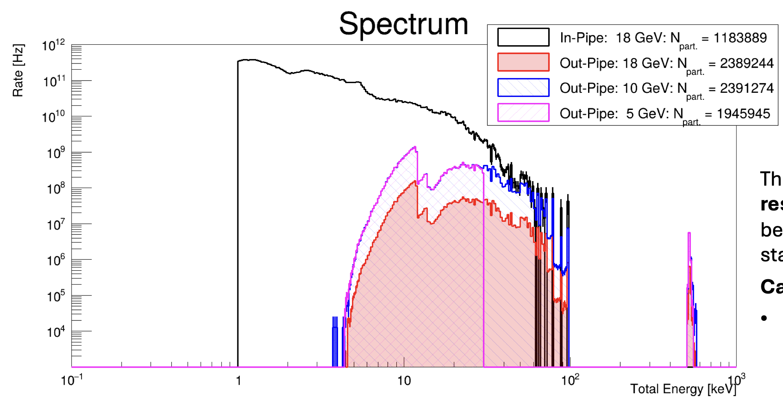
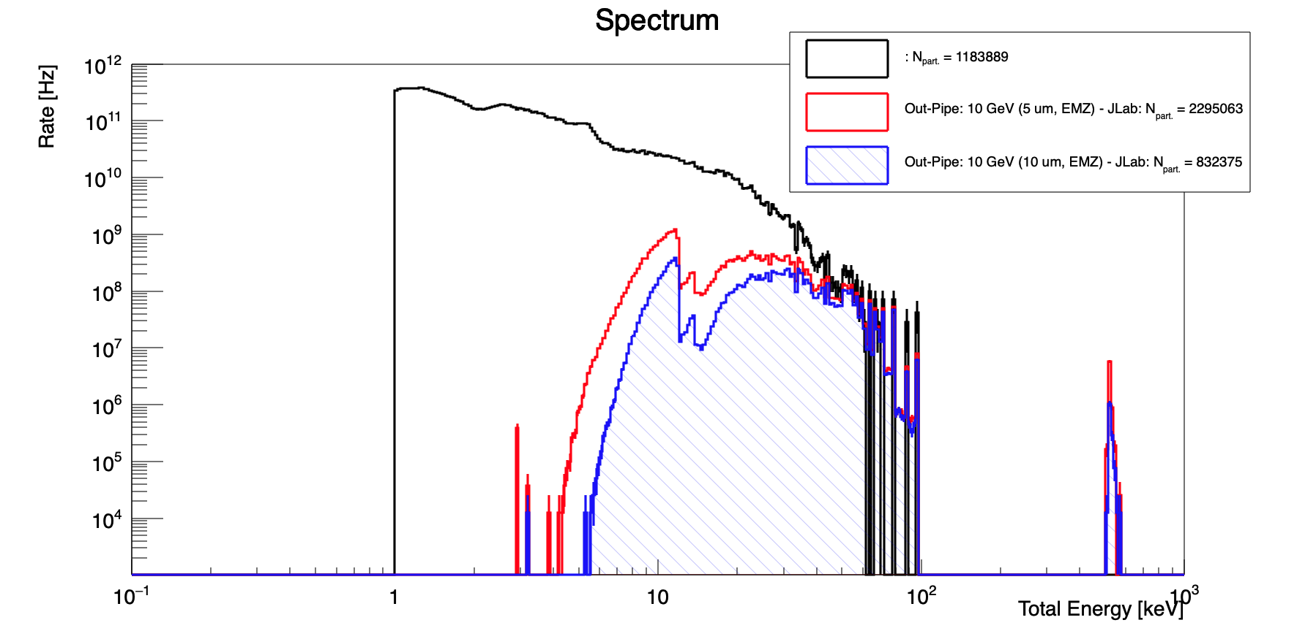
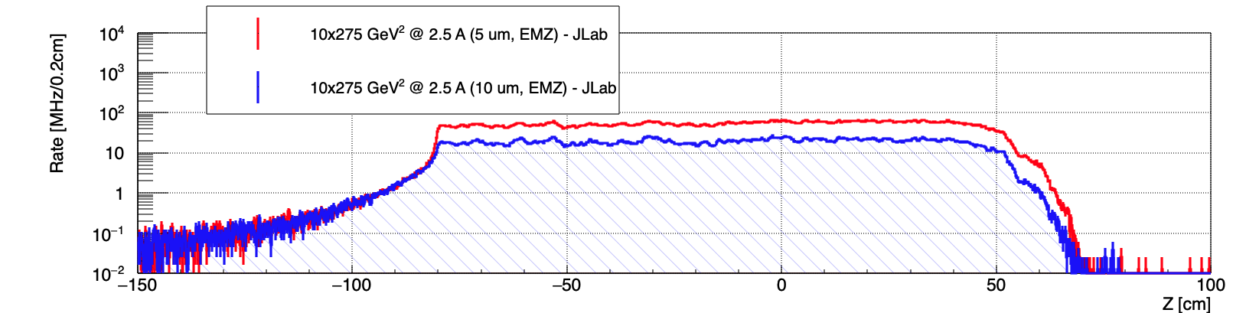
Beam Background Sources
Electron Beam
Synchrotron Radiation
→ It is critical to keep the dipole strength closes to the IP low
→ SR photon energy largest at highest beam energy
→ Photon intensity directly proportional to electron beam current
5, 10 GeV – 2.5 A, 18 GeV 0.2 A
Mitigation: Photon – masks integrated in beam pipe
gold coating of Be-beam pipe section 5 μm vs. 10 μm

Slide 9
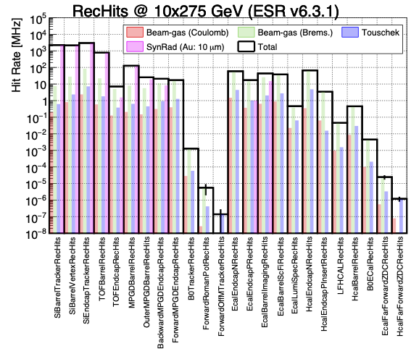

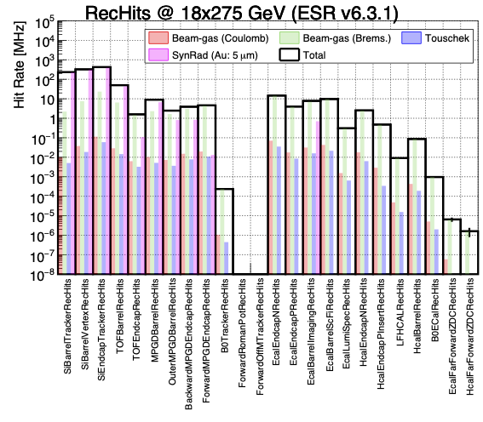
Current Results
Process | 5 GeV x 41 GeV | 5 GeV x 100 GeV | 10 GeV x 100 GeV | 10 GeV x 275 GeV | 18 GeV x 275 GeV
Total ep | 12.5 kHz | 129 kHz | 184 kHz | 500 kHz | 83 kHz
Hadron beam gas | 12. 2 kHz | 22.0 kHz | 31.9 kHz | 32.6 kHz | 22.5 kHz
Electron beam gas Bremsstrahlung | 2182 kHz | 2826 kHz | 3177 kHz | 3177 kHz | 317 kHz
Electron beam gas Coulomb |  | 117 kHz |  | 30 kHz | 0.86 kHz
Electron beam gas Touschek |  | 1112 kHz |  | 233 kHz | 0.55 kHz
Electron SR |  | 36608 MHz |  | 36608 MHz | 3324 MHz

Slide 10
Examples for Impact on ePIC

Slide 11
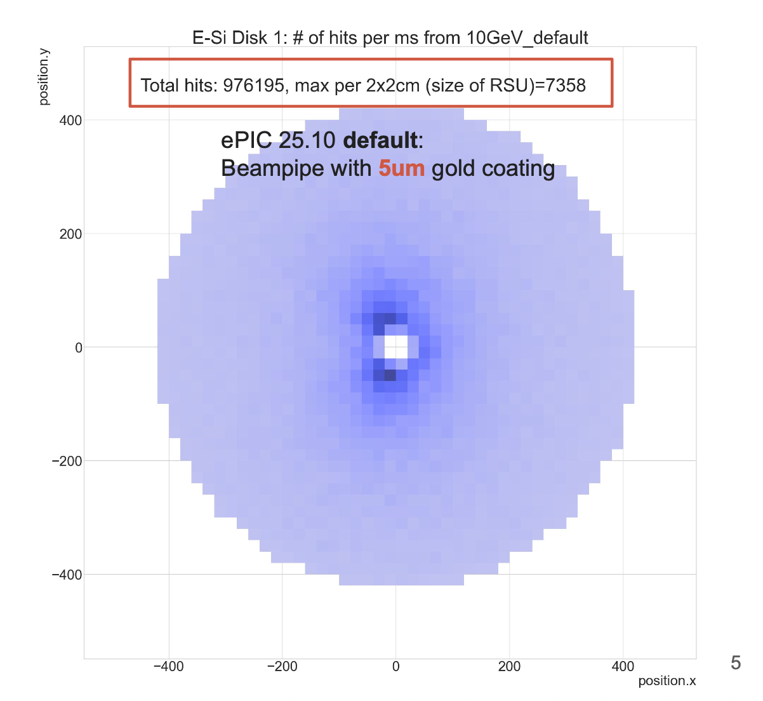
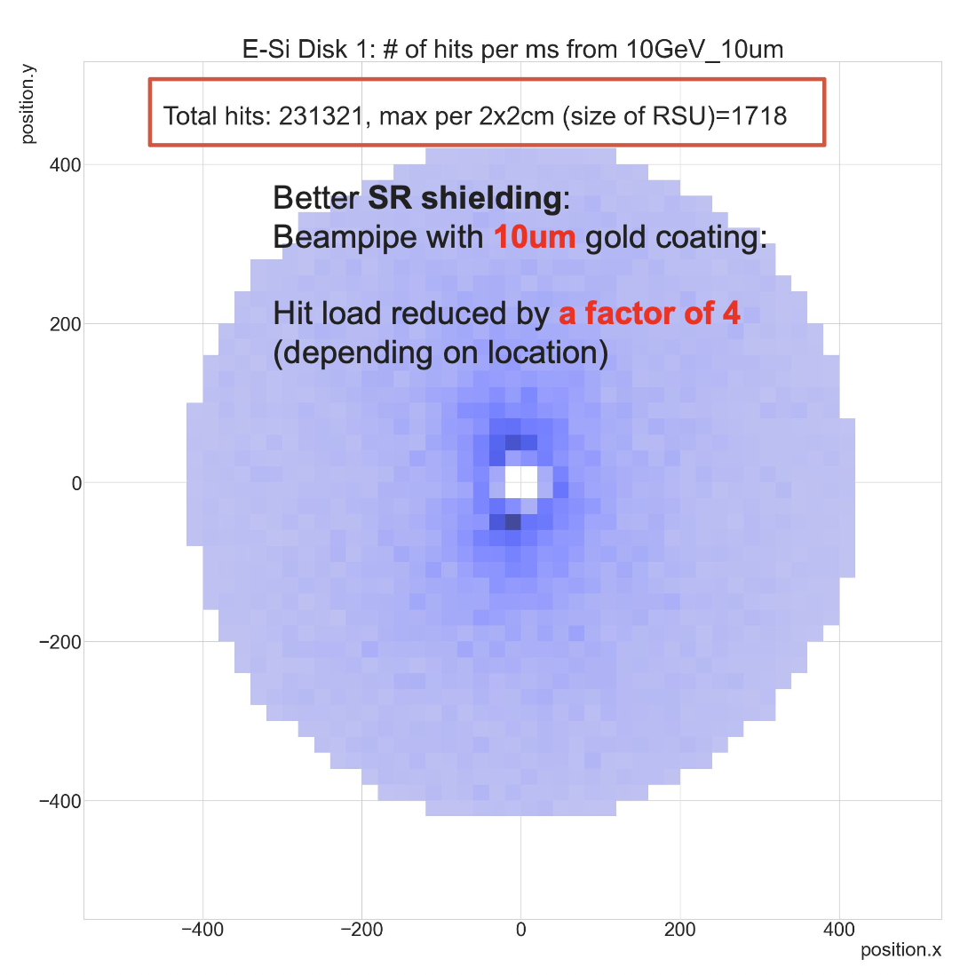
Hit Rate Example: SVT
Shujie Li, Ernst Sichtermann
→ plot digitized hits (edep > 0.54 keV) on each SVT surface
Rphi v.s. Z on barrels
x v.s. y on disks
→ accumulate number of hits per
2x2cm square (roughly size of one RSU = 12 tiles),
or 9.8x3.5mm (tile)
→ Show accumulated/averaged counts per
ms (500 x 2us slices → kHz)

Slide 12
Data Sizes
Jeff Landgraf
ASIC | Charge Share | Times Readout | Formula | Bits / Hit FEB | Old HitSize | Bits / Noise FEB | Bits / DAQ Output | Max Rate
ITS-3 | 4 | 1 | 16 x (C+3) | 112 | 128 | 64 | 128 | Not simple
Discrete (FECAL) | 4 | 5 | 12 x C x (5 x T + 7) | 576 | 144 | 144 | 128 | 50 kHz / ch
CALOROC | 4 | 5 | 32 x T x (4 + C) | 1280 | 480 | 800 | 128 | 50 kHz / ch
EcalBarrelScFi | 4 | 5 | 2 x ( 32 x T x (4 x C) ) | 2560 | 960 | 800 | 128 | 50 kHz / ch
EICROC1 | 128 | 8 | (T x 24 + 8) x C | 25600 | 576 |  |  | 12 hz / ch
EICROC2 | 9 | 5 | (60 + T x 8) x C | 900 | 576 | 900 | 128 | 350 hz / ch
FCFD | 4 | 5 | 32 x T x (4 + C) | 1280 | 192 | 800 | 128 | 50 kHz / ch
ALCOR | 1 | 1 |  | 64 | 64 | 64 | 64 | 300 kHz / ch
SALSA | 4 | 5 | C * (T + 4) * 32 | 1152 | 320 | 288 | 128 | 25 kHz / ch
Actual ASIC sizes are typically 2-4 times larger than previous assumption
Maximum supported rates are also lower
The rates are bandwidth limited

Slide 13
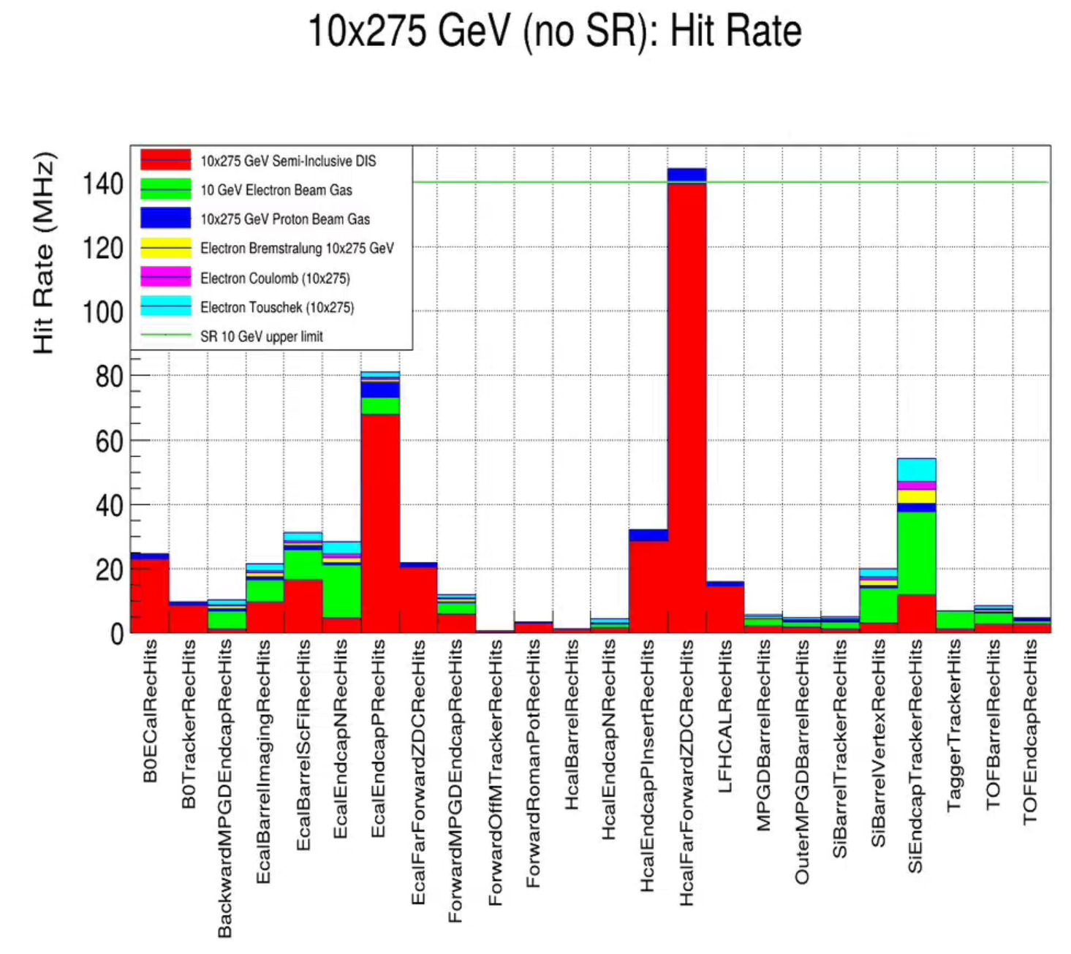
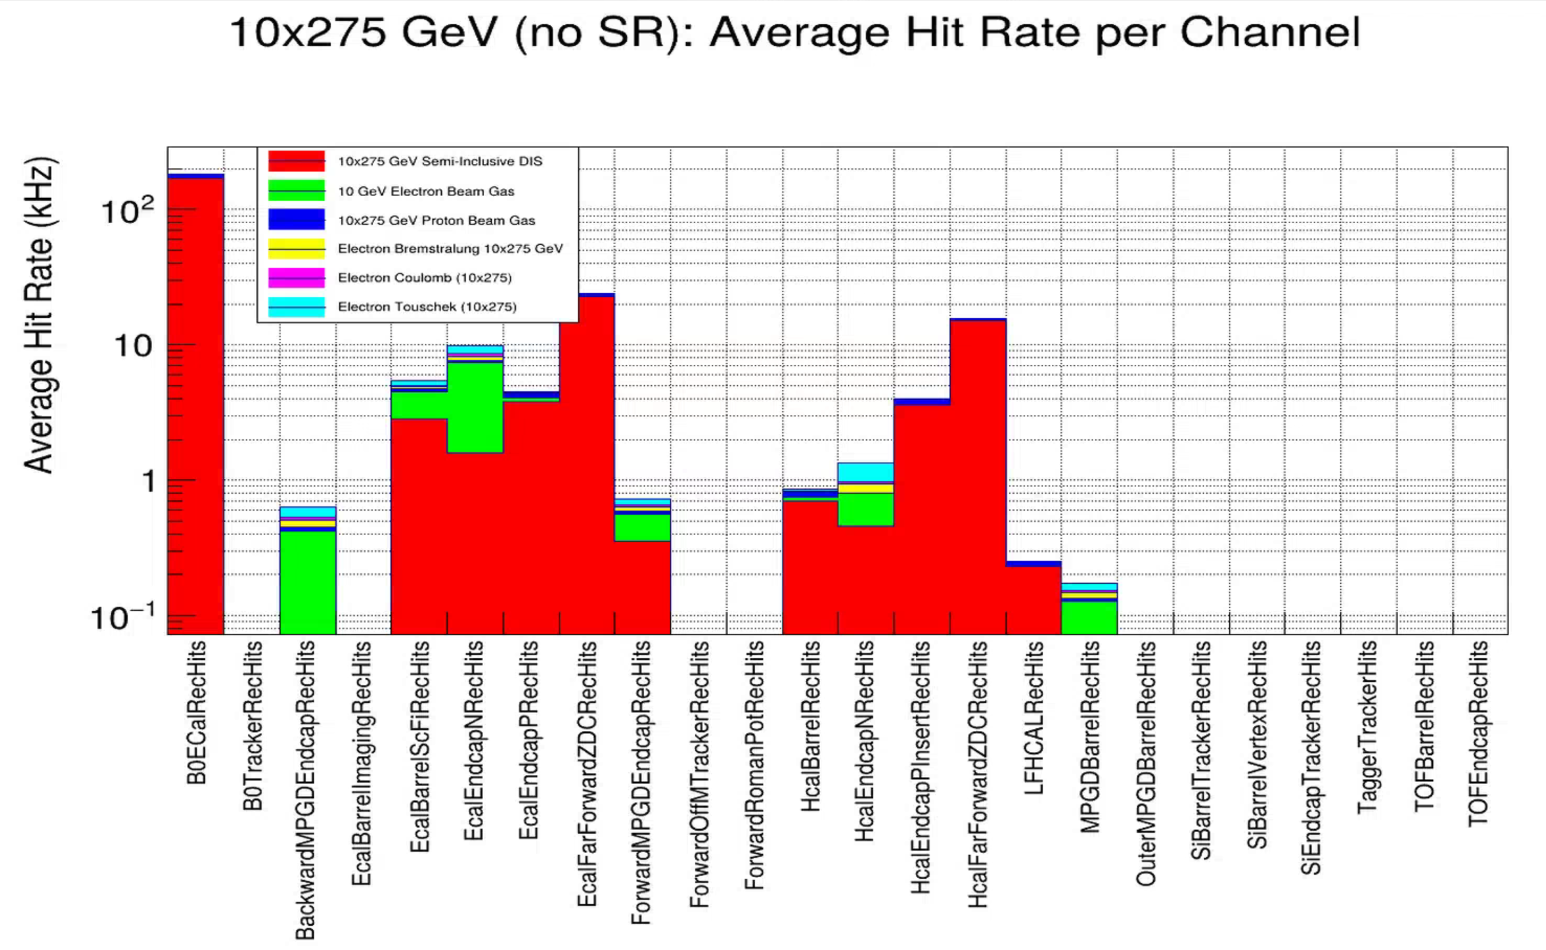
Hit Rates
Jeff Landgraf
CALOROC (50 kHz)
SALSA (25 kHz)
EICROC (350 Hz)

Slide 14
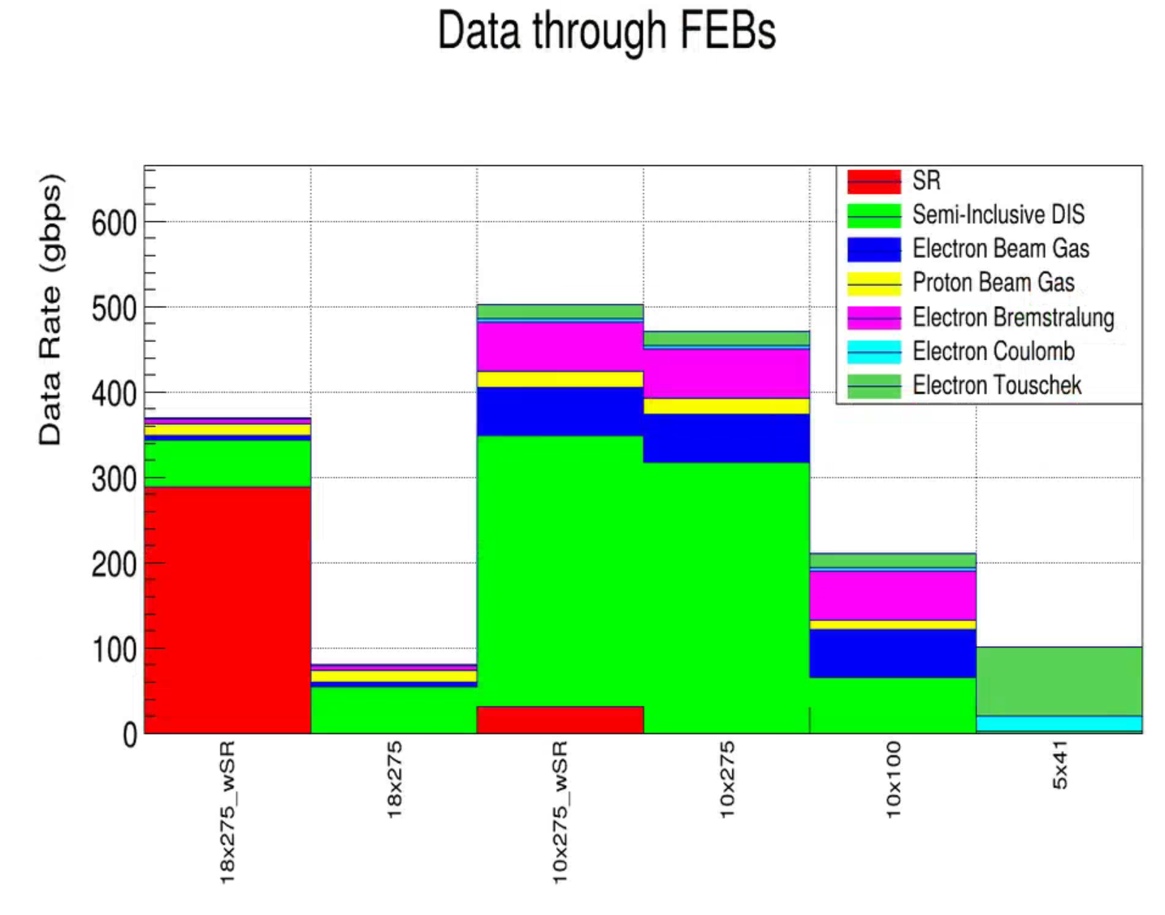
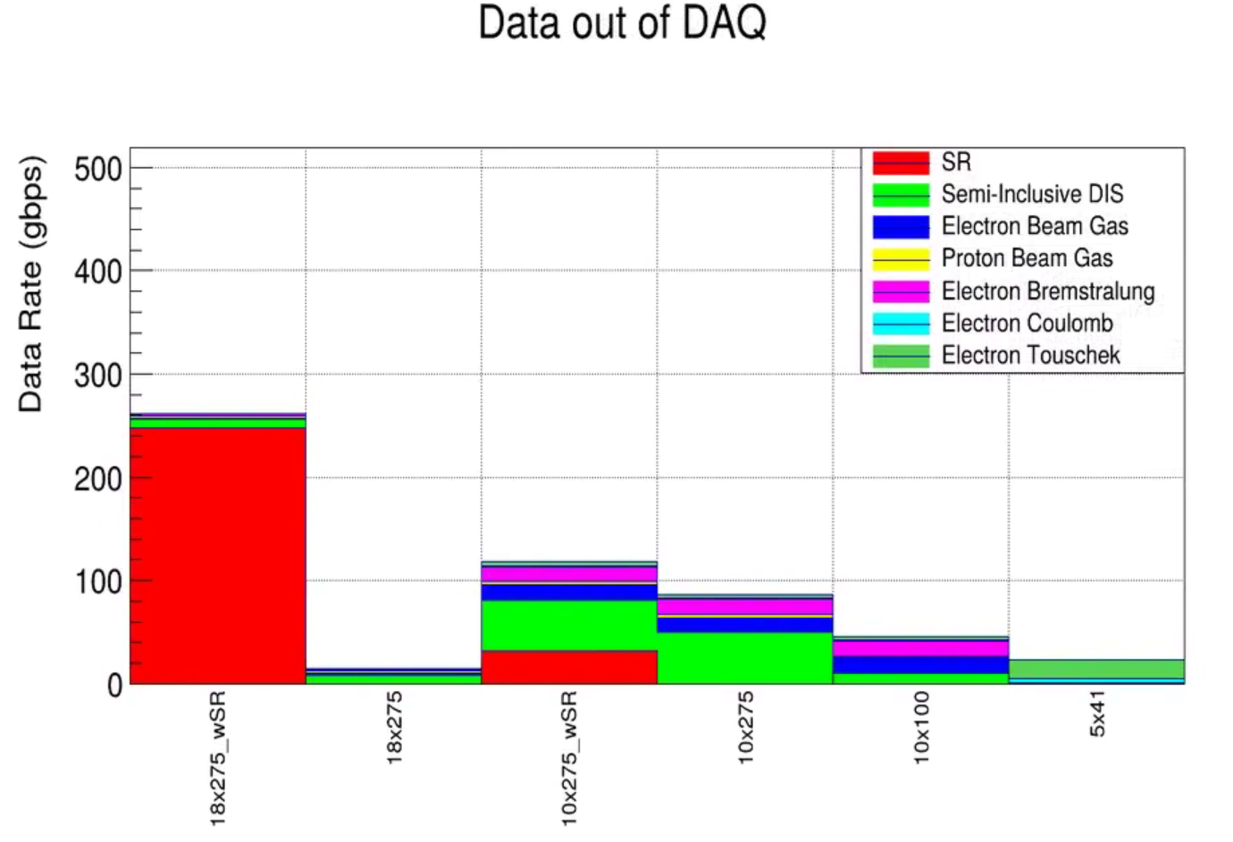
Data Rates for Different Energies (eP)
Jeff Landgraf
Needs update with the newest backgrounds
These are well within our capabilities (ignoring for now the SR)
The goal of not touching the data at all in DAQ is not likely to be possible at moderate luminosities, however the ASIC formats are not very compressed, we can likely get to 100 gbps target via lossless repacking and/or simple analysis such as clustering
We need to evaluate the maximum rate regions of each detector to ensure the ASICs can keep up with the data volume.
The most recent numbers for the Synchrotron Radiation in the SVT (with 10mm Gold coating) are:
254 Gbps for 10x275
76 Gbps for 18x275
The 76 Gbps fits (approximately) into projected maximum data rates.
254 Gbps doesn't fit the ePIC projected rates - we'd need more resources for analysis, but is technically feasible for DAQ as designed without much headroom.

Slide 15
Recent Review Recommendations
MPGD PDR:
Recommendation 2: Comprehensive simulations, including realistic background conditions and beam-energy dependence, are needed prior to baselining to validate the technical approach. Completing this work at an early stage reflects systems-engineering practice and effective risk management, as it helps reduce the likelihood of post-baseline design changes that could introduce complications across mechanical, electrical, and integration interfaces.
DAC Technical Baseline Review:
Charge Question #2: Are the remaining work and technical, cost and schedule risks adequately understood? Are there opportunities?
For the PID there was a recent 60% design review with a positive outcome and all systems remain at an appropriate design stage and are progressing well. Nevertheless, it will be reassuring if the test results on the second box of quartz bars from SLAC are comparable to those from the first box. Additionally, simulations using the ePIC framework should be carried out for PID that includes all sources of backgrounds – from the machine and materials.

Slide 16
Possible Mitigations

Slide 17
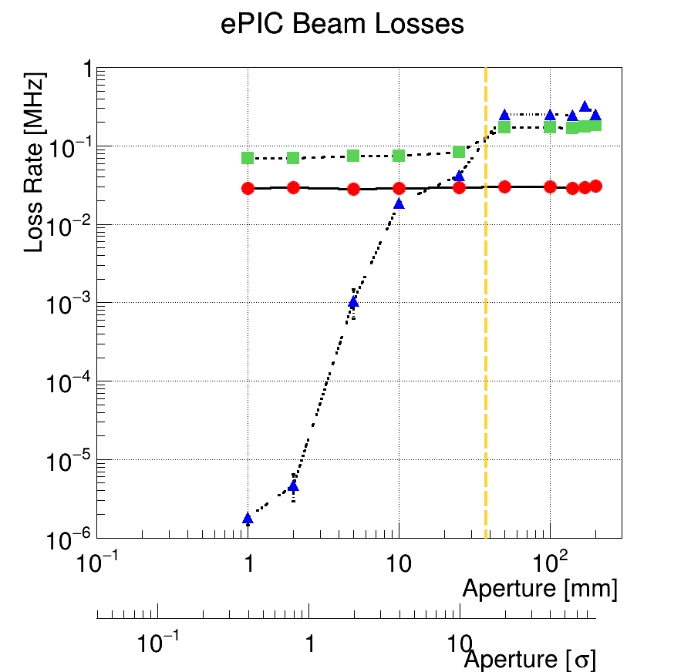
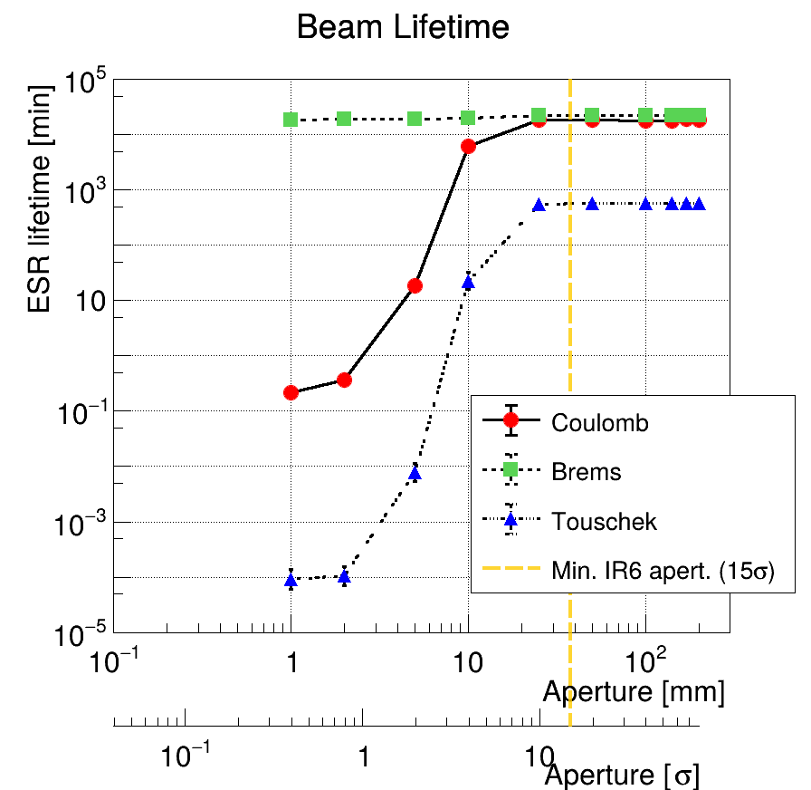
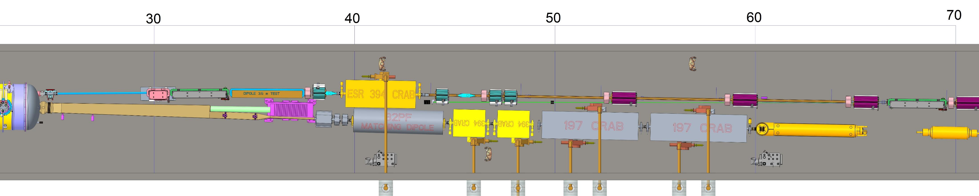
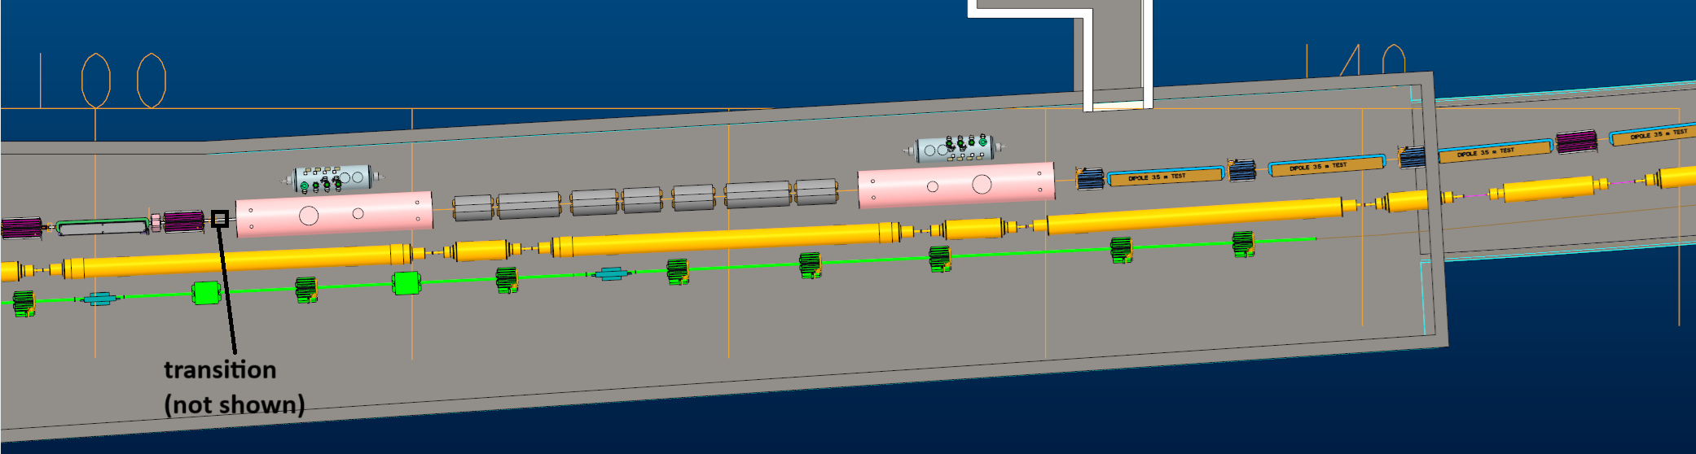
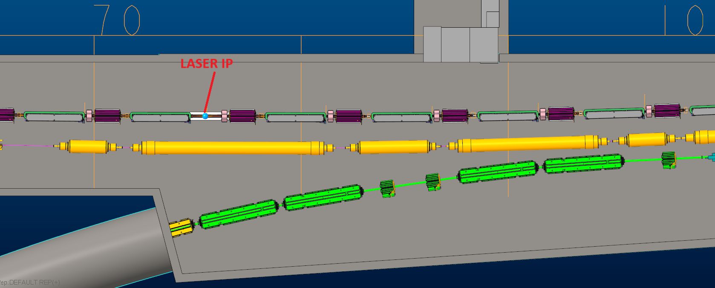
Sector-5 Collimator
The arc and Sector-5 are fully occupied by magnets, crab cavities, and detectors (polarimeter) → no space for the collimator
A collimator installed in front of the cryostat can potentially reduce ePIC region beam losses by a factor of a few without affecting the beam lifetime (> 10σ) → close to detectors; extra shielding might be needed
Promising location
cons: high SR, close to IP6 - tip-scattering
pros: in phase with the FWD cryostat & ePIC, upstream of the cryostat and downstream of Sector-5
FWD IR6 CRYO

Slide 18
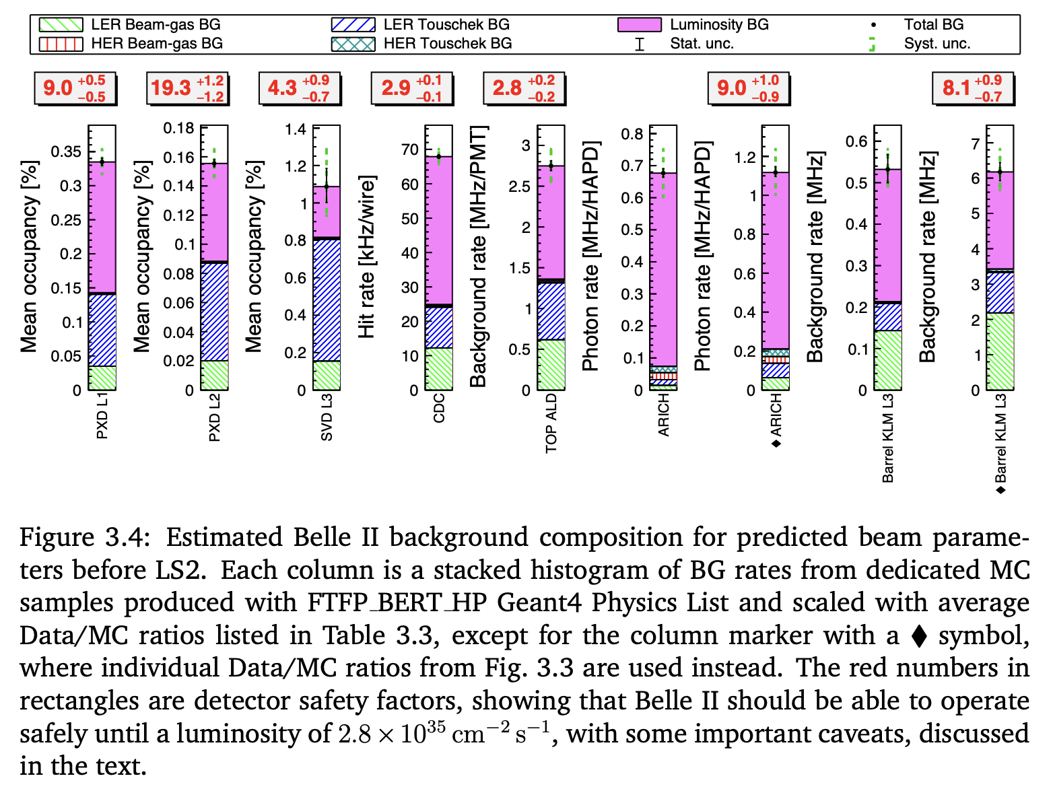
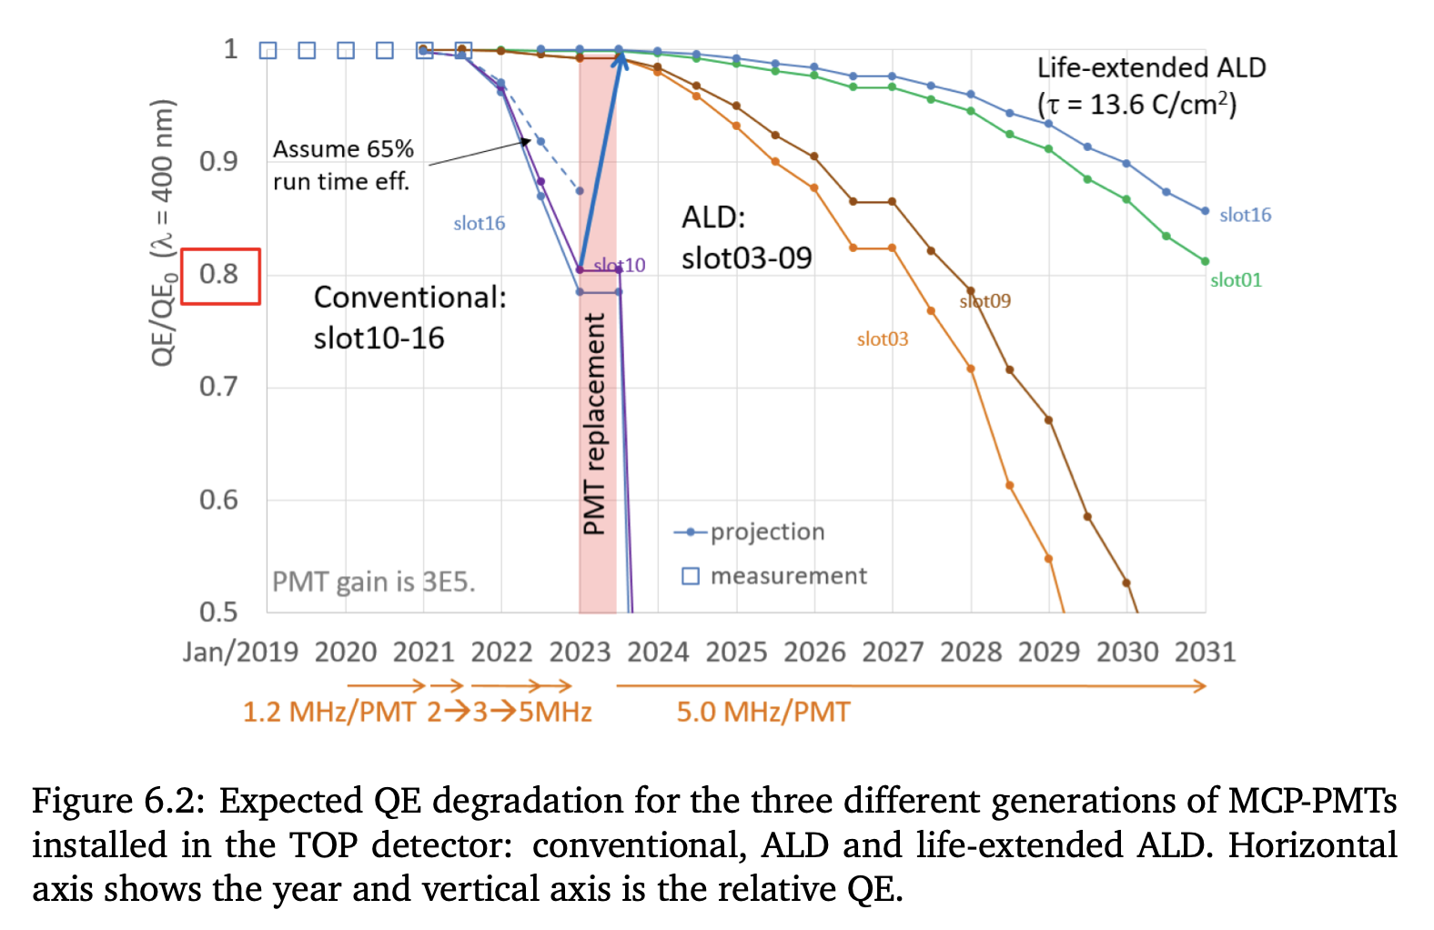
Required Info from ePIC
Before finalizing the ESR collimation system and radiation shielding designs, we need answers to the following questions:
What is the level of detector performance (e.g., tracking reconstruction, dE/dx) degradation due to beam-induced backgrounds?
What is the associated detector limit of background hit rates at each energy? → This will allow us to define safety limits and optimize background countermeasures (see the top fig.)
What is the radiation damage limit for sensitive equipment?
How long we can operate at the current level of radiation before the damage element replacement (e.g., QE degradation on PMTs; see bottom fig.)?
At what radiation limit we can avoid frequent replacement?
Are there any thermal heat limits (especially for the inner tracker)?
Belle II [link]
Belle II
[link]

Slide 19
Summary
Further Synchrotron Radiation Mitigation:
adopt 10 μm Au layer
further optimize the beam pipe → Andrii and Vacuum group are already working on it
We are freezing the lattice of the ASR for the CD2/3 review need feedback please asap, because integration of a collimator in sector 5 is extremely tricky
Need the information to resolve review recommendations and pass upcoming reviews
If baseline is established can start to develop a commissioning scenario for the ESR
Beam Background Mantra design with safety factors as it always comes worth then predicted

Slide 20

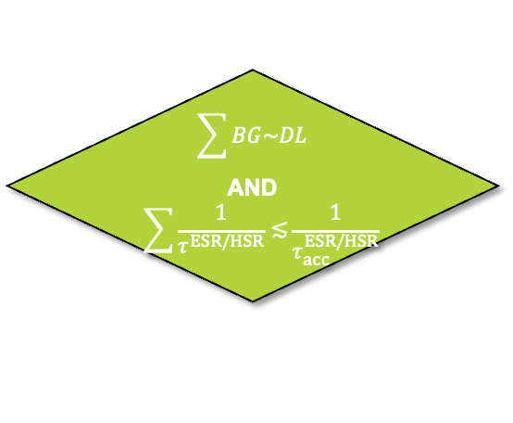

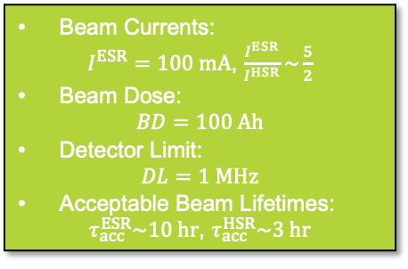


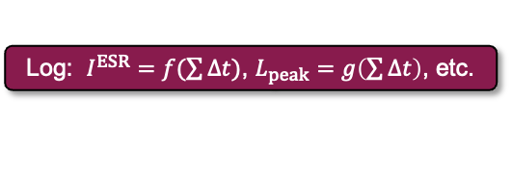
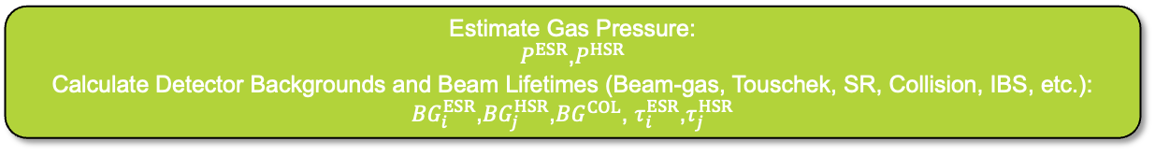

Finding Correlation between Vacuum and Beam Current
Beam Currents:
$I^{ESR}=100 mA$, $\frac{I^{ESR}}{I^{HSR}}\sim \frac{5}{2}$
Beam Dose:
$$BD=100 Ah$$
Detector Limit:
$$DL=1 MHz$$
Acceptable Beam Lifetimes:
$τ_{acc}^{ESR}\sim 10 hr$, $τ_{acc}^{HSR}\sim 3 hr$
Loop Until: $I^{ESR}<I_{nominal}^{ESR}(2.5 A)$
Initial Parameters @ 10x275 GeV
Estimate Gas Pressure:
$P^{ESR}$,$P^{HSR}$
Calculate Detector Backgrounds and Beam Lifetimes (Beam-gas, Touschek, SR, Collision, IBS, etc.):
${BG}_{i}^{ESR}$,${BG}_{j}^{HSR}$,${BG}^{COL}$, $τ_{i}^{ESR}$,$τ_{j}^{HSR}$
$$\sum{BG\sim DL}$$
AND
$$\sum{\frac{1}{τ^{ESR/HSR}}≲}\frac{1}{τ_{acc}^{ESR/HSR}}$$
NO
YES
Increase Beam Dose:
$$BD+=I^{ESR}∙∆t(1 day or 1 week)$$
$$\sum{BG>DL}$$
OR
$$\sum{\frac{1}{τ^{ESR/HSR}}>}\frac{1}{τ_{acc}^{ESR/HSR}}$$
Log: $I^{ESR}=f(\sum{∆t})$, $L_{peak}=g\left(\sum{∆t}\right)$, etc.
NO
YES
Reduce Beam Current:
$$I^{ESR}−=∆I(10 mA)$$
Increase Beam Current:
$$I^{ESR}+=∆I(10 mA)$$

Slide 21


Slide 22


Slide 23
What Studies with Background are needed
Three “core” combinations to study:
Separating DIS events from background when both are present in the detector simultaneously.
→ study impact of background on subsystem performance, tracking, track – cluster matching, energy
reconstruction in calorimeters, ….
→ study as function of Q² of DIS event
→ determine rates for DAQ (low Q² (~ 10⁻⁹) DIS + background
→ what does the background do to to ePIC detection efficiency for rare events, e.g. DVCS, TCS, …
Mix: DIS events with full Q² range with all hadron and electron beam backgrounds
Identifying events where a “real” low-Q2 event is present (electron misses ePIC), but electron beam+gas background ”tricks” you into thinking you have a higer-Q2 event (beam+gas scattered electron hits ePIC in region where your electron finder ”thinks” a moderate Q2 electron would be)
Mix: DIS events with Q² <1 with all hadron and electron beam backgrounds
How often do we mistake “pure” background for a DIS event, when NO DIS event is present?
Mix: all hadron and electron beam backgrounds no DIS events needed

Slide 24
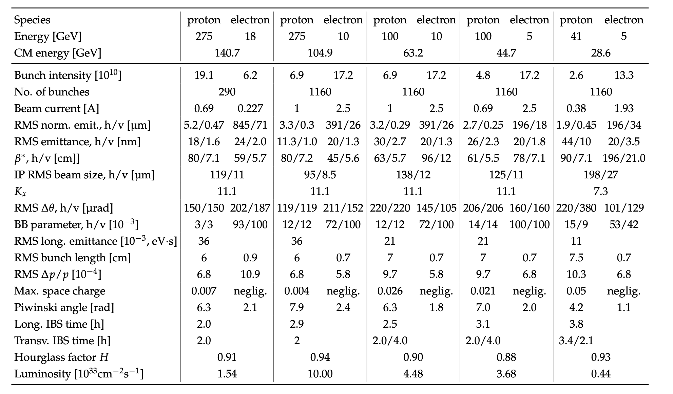
EIC Beam Parameters
electron beam current and energy impact electron beam gas background and synchrotron radiation
→ Radiated SR power: P(kW)=88.46 E_{B}(GeV)⁴ / r(m)² I (A)
hadron beam current impacts hadron beam gas
beam energies and luminosity impact the radiation and neutron fluence

Slide 25
Lessons from HERA II upgrade
HERA performed an upgrade to increase luminosity by a factor of 5
Mainly by squeezing the beam more at the IP by redesign of the IR
The upgrade increased backgrounds dramatically → Several month shutdown to implement improvements
Electron beam polarization never reached HERA-I levels, H1 and Zeus solenoids (~1T) not well compensated
Main culprits:
no careful simulations prior to the upgrade
Proton beam-gas interactions most severe background
Needed an extremely good vacuum to mitigate this
Synchrotron radiation background
Background to detectors
Excess heating of beam pipe
Can damage flanges, etc.
Can heat beam pipe, decreasing vacuum
Electron beam-gas

Slide 26
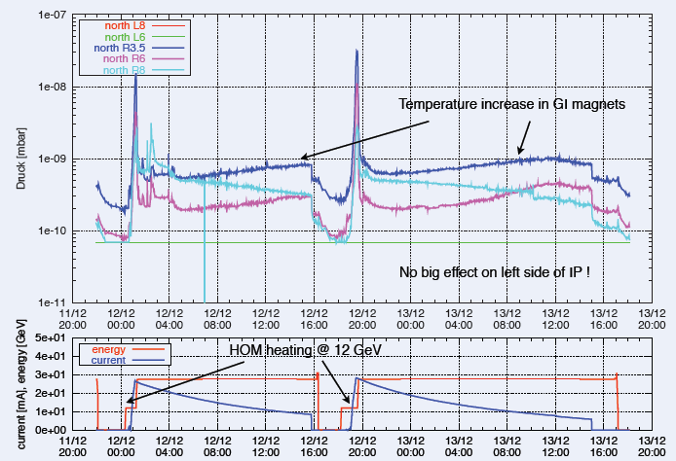
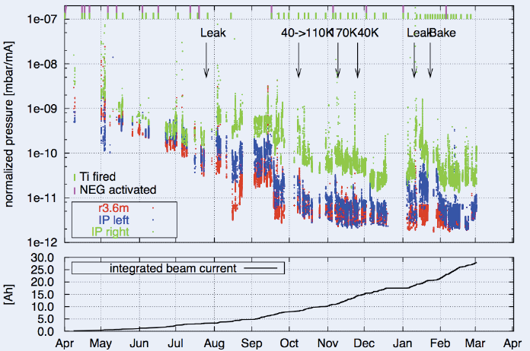
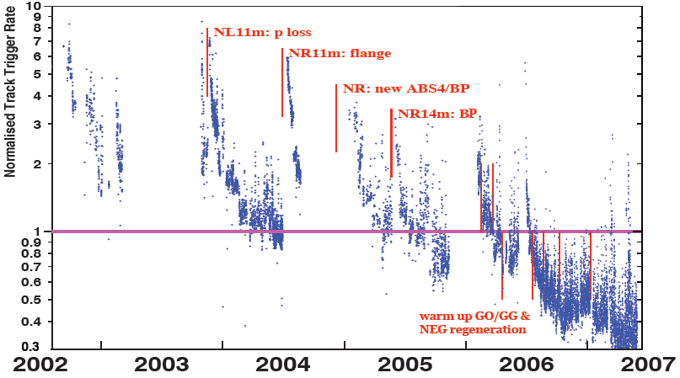
Lessons from HERA II upgrade
Dynamic pressure increase due
to thermal and photo desorption
Pressure vs. integrated electron
current 2002 - 03
Proton Beam Gas Background
Two time constants for vacuum
conditioning
Short term after leaks 20 – 30 days
Long term 600 days

