Slide 1

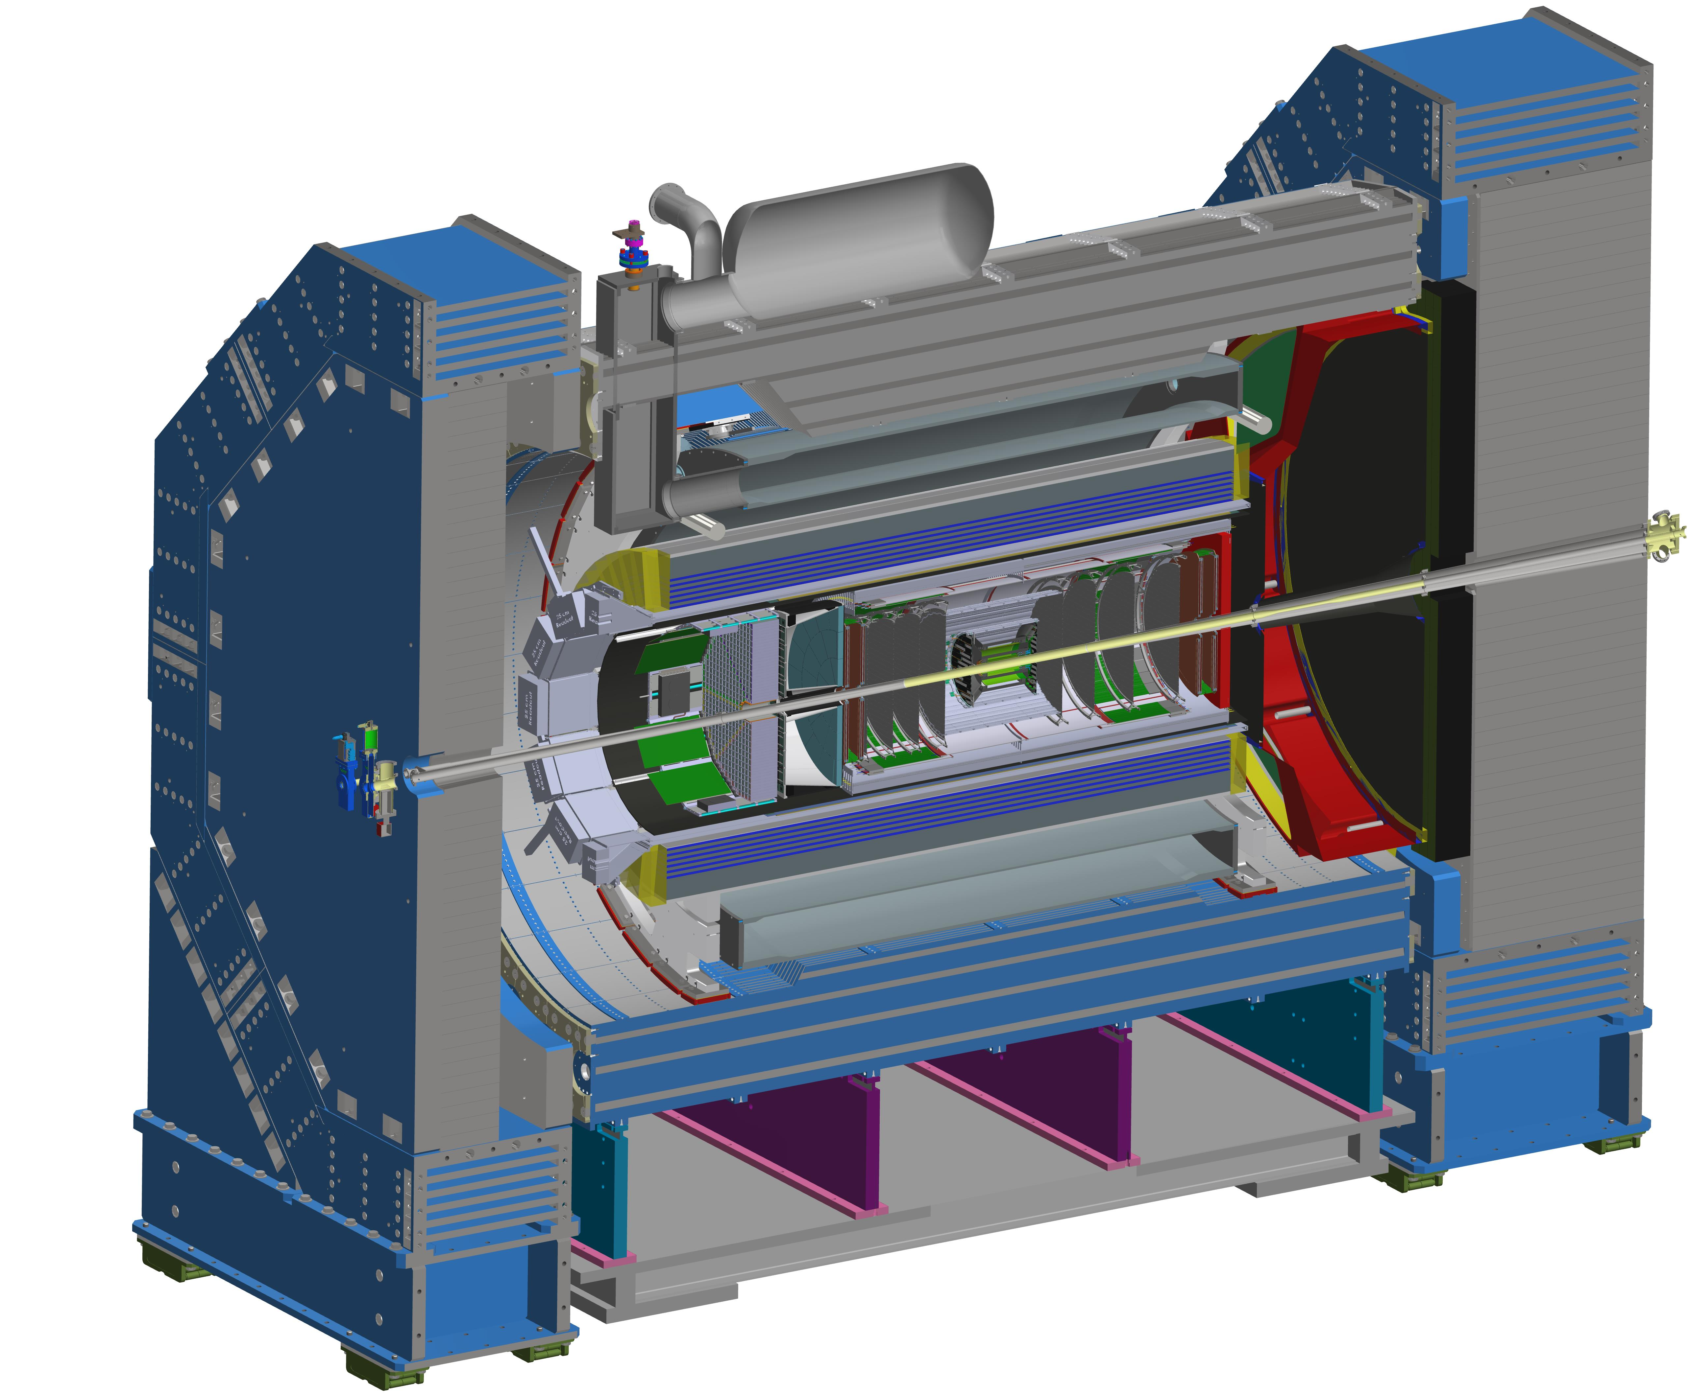
2026 Goals
John Lajoie
Silvia Dalla Torre
January 23, 2026

Slide 2
Recap of 2025, Looking forward to 2026
For 2025 see additional material posted for this talk
Summary of priorities arising from Frascati collaboration meeting
Our previous effort at priorities had a lot of information:
Not always clear what the main effort of the collaboration was or how it was supported by the efforts in the coordination offices.
Coordinators discussed their 2026 priorities in Tuesday presentations
In this talk I want to connect these to what I see as the broader goals of the collaboration
Things are moving quickly – focus on goals to accomplish between now and the next collaboration meeting in July

Slide 3
Proposed Goals for the first half of 2026
Support the EIC project and ePIC Technical Design:
Close the design loop with ePIC simulations
Advance the pTDR in preparation for CD-2
Respond to review recommendations
Complete the Early Science whitepaper
Progress in developing a multi-year plan for ePIC Software and Computing
Begin submissions to the NIMA Special Issue

Slide 4
Close the Design Loop with ePIC Simulations
Review changes to the ePIC baseline
Both design and scope
Synchronize simulation geometry with mechanical design
Regular incorporation of full backgrounds in simulation samples
Almost there with recent advances arising from the October campaign
New methods for incorporating backgrounds in simulations
Realistic detector response
Several ongoing activities to incorporate noise, realistic digitization
All levels – detector level through physics analysis
Establish a feedback loop with project
See following talk by Elke

Slide 5
Complete the pTDR for CD-2
See Silvia/John Hagerty’s talk at the start of this session
The pTDR has advanced a great deal, but there is still work to do
Continue to develop the connection between requirements and performance
Incorporate advances from test beams, integration, backgrounds, PED, etc.
Editorial and review process to polish the document
Reduced focus on deadlines, increased focus on documenting ePIC performance and how it addresses the detector requirements.

Slide 6
Close the Design Loop with ePIC Simulations
Complete the pTDR for CD-2
Technical Coordination
Software and Computing
Physics Analysis
Validate ePIC simulation geometry
Design optimization studies
Reconstruction (PID/PF) and Analysis tools and workflows
Holistic reconstruction (electron finder)
Review baseline changes
pTDR editorial process
Verify subsystem performance by simulation
Simulation campaigns with backgrounds
Rucio (data) and PanDA (workflow)
AI at scale
Apply to physics performance the electron finder, particle flow, PID reconstruction, muon reconstruction
Targeted simulation studies at all levels: detector -> reco -> physics

Slide 7
Complete the Early Science Whitepaper
The Early Science whitepaper is critically important to communicate to stakeholders in the EIC community as well as the broader NP community the exciting start of EIC science.
Document must be accessible to multiple audiences
“Benchmark” simulation campaign in March
Need to define “must have” simulation and reconstruction changes
Define required event samples
Important to be efficient with workforce
Timescale is short, and we need workforce on other priorities

Slide 8
Complete the Early Science whitepaper
Technical Coordination
Software and Computing
Physics Analysis
Reconstruction and Analysis tools and workflows
Verify subsystem performance by simulation
March benchmark simulation campaign
Performance for targeted Early Science physics measurements
Author the Early Science document
Review Early Science document, collaboration review.

Slide 9
Software and Computing Multi-Year Plan
ECSAC Recommendations:
We recommend the ePIC collaboration to establish a multi-year plan for SW&C, focusing on the deliverables for the next three years. Such a plan should be presented at the next ECSAC meeting in Fall 2026.
We recommend the ePIC collaboration and the host labs to start developing a data management and lifecycle plan, agreed with the Funding Agencies.
We recommend the ePIC collaboration to continue with the ongoing demonstrators and testbeds the commissioning plan, which should include assessing the E0-E1 interfaces and workflows
A well-developed plan is key to the long-term effort to communicate the compute resources and workforce that will be required to implement the ePIC Streaming Computing Model.
This is a long-term effort that the collaboration needs to start now

Slide 10
Software and Computing Multi-Year Plan
Technical Coordination
Software and Computing
Physics Analysis
Multi-year plan for S&C
Data management and lifecycle plan
Streaming orchestration
Demonstrators and testbed commissioning plan

Slide 11
NIMA Special Issue
This Special Issue will be an important tool to communicate to the NP community the depth, breadth and excitement for EIC science.
NIMA Special will open March 2026
Open through October 2026
Coordinators to act as Guest Editors
Goal of the issue is a comprehensive overview of ePIC
Contributions will undergo peer review
Plan to publish a super-set of the material prepared for the pTDR
Subsystem technical papers derived from pTDR
Physics performance paper spin-off from pTDR*
Early Science whitepaper*
Exclusive, Diffraction and Tagging paper(s)
Streaming Computing Model*
Planning for publications to be Open Access
* Full collaboration author list

Slide 12
NIMA Special Issue
Technical Coordination
Software and Computing
Physics Analysis
Validate ePIC simulation geometry
Design optimization studies
Reconstruction (PID/PF) and Analysis tools and workflows
Holistic reconstruction (electron finder)
Organize contributions from DSC’s based on pTDR
Organize the Streaming Computing Model contribution
Additional contributions?
Organize the ePIC Performance contribution
Organize the Early Science contribution
Organize the PWG contributions

Slide 13
Other Aspects of the Collaboration
There is always a need to improve communication
We need to continue to work on early-career engagement
Need to foster an environment where early career individuals can easily contribute to ePIC and get recognized as a part-time activity
Research support for groups working on EIC science
Communicate the importance of EIC science to the broader scientific community
Make use of and improve the collaboration statements of service

Slide 14


Slide 15
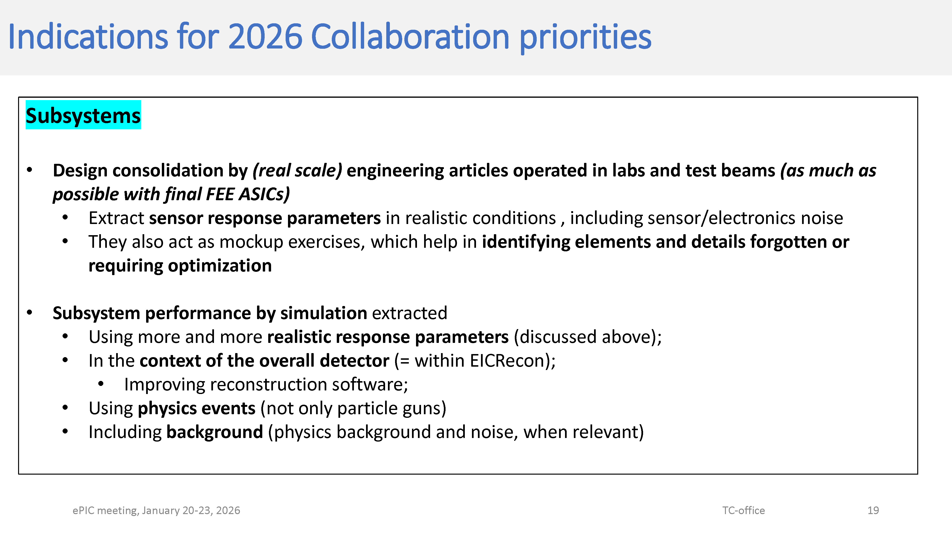

Slide 16
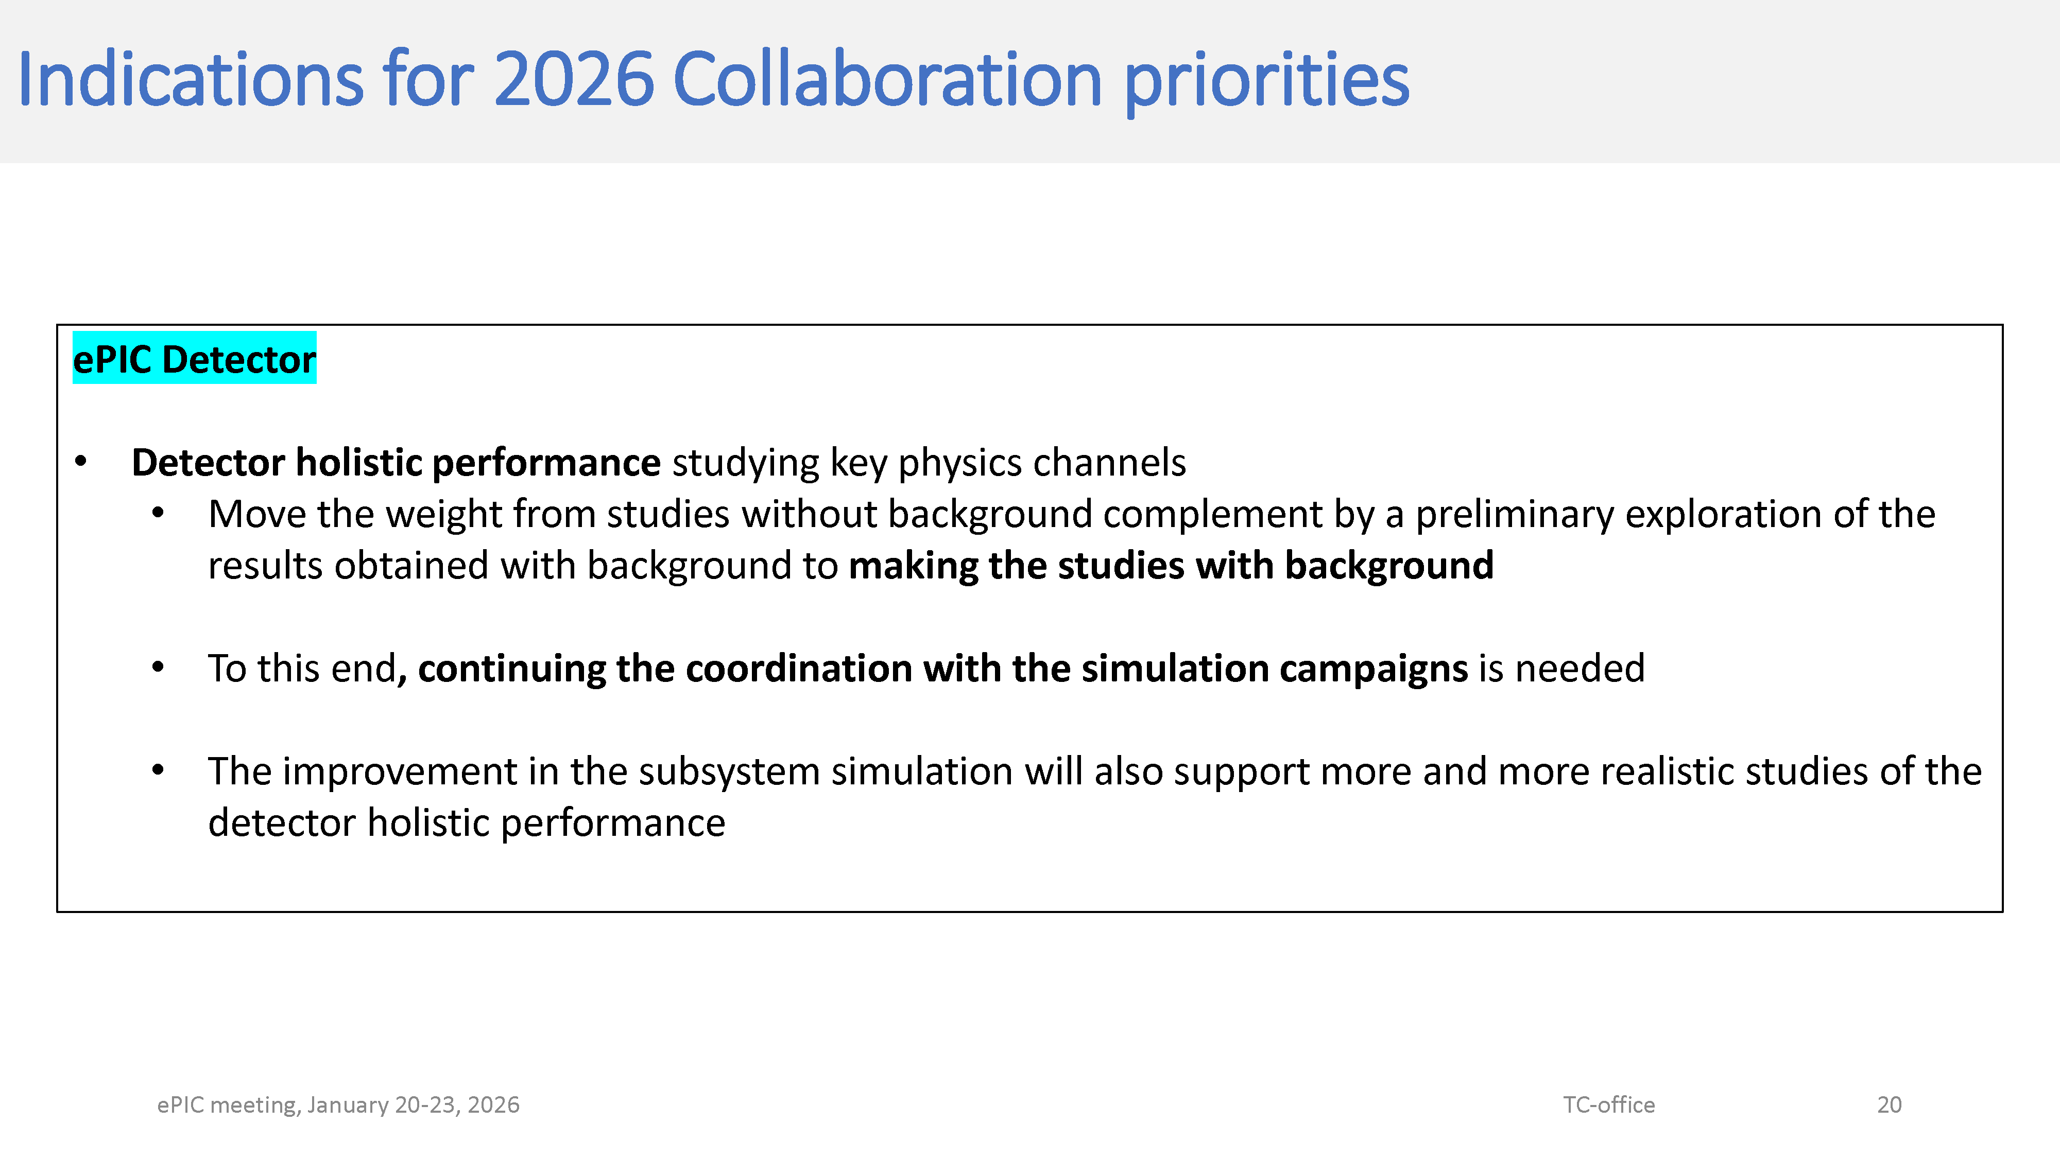

Slide 17
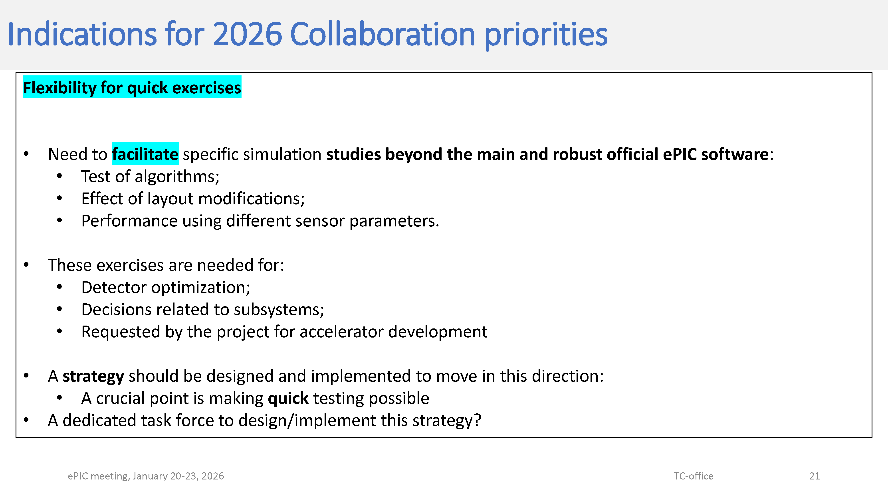

Slide 18
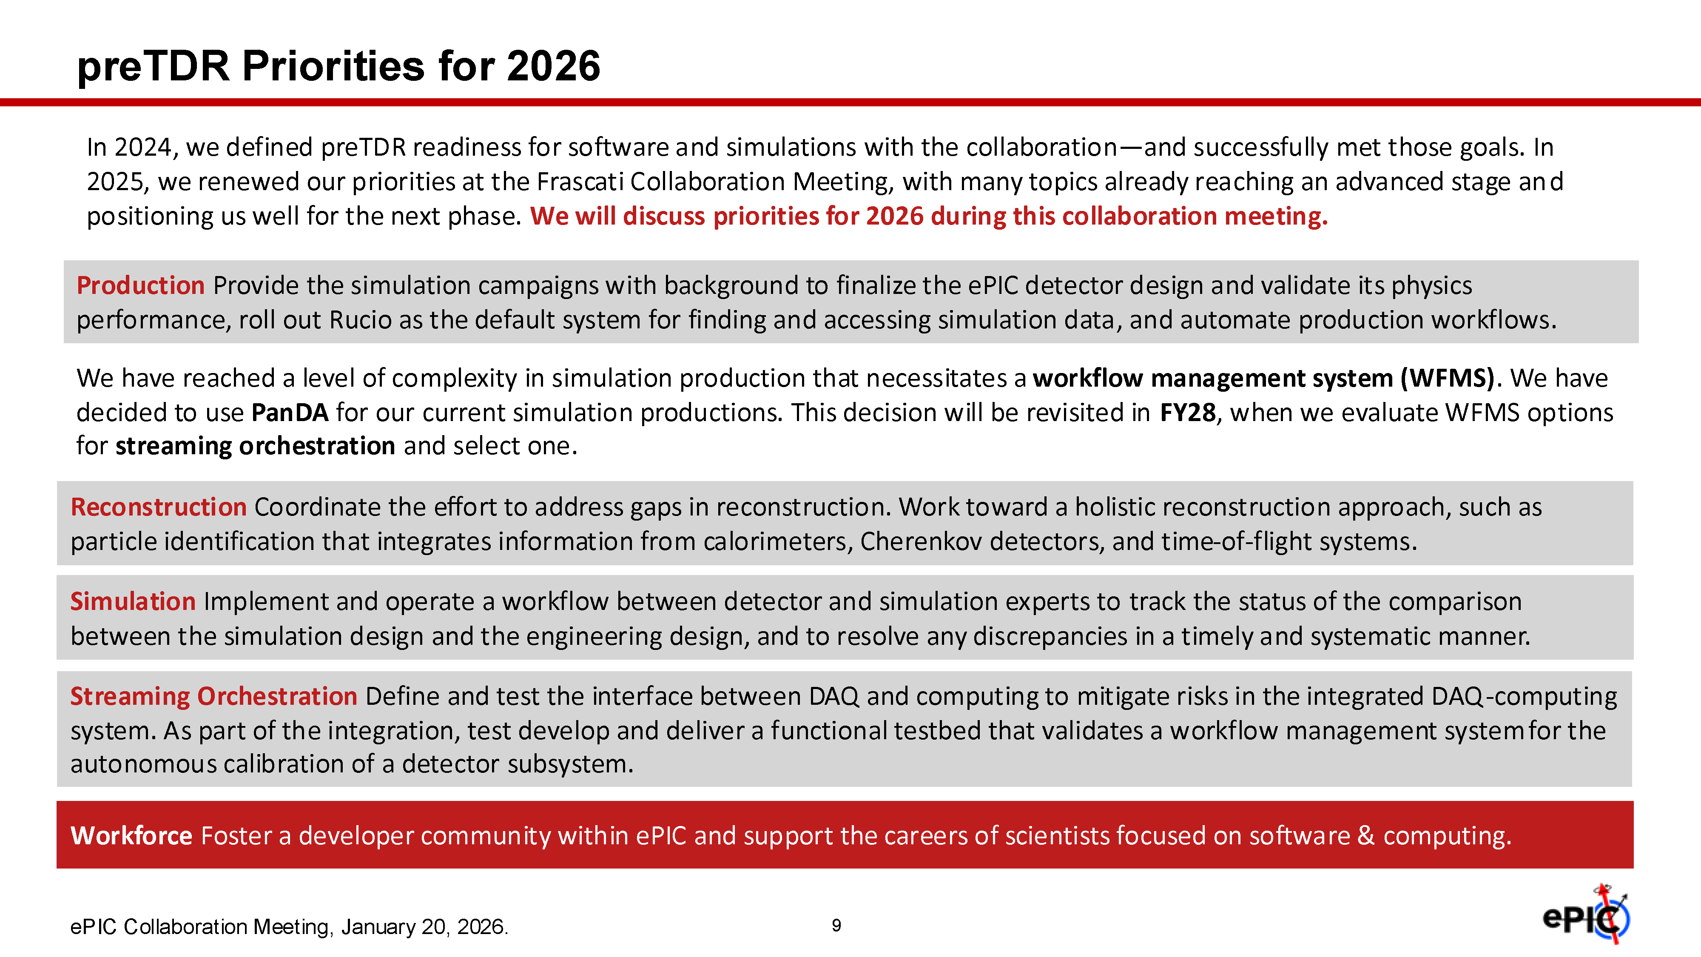

Slide 19
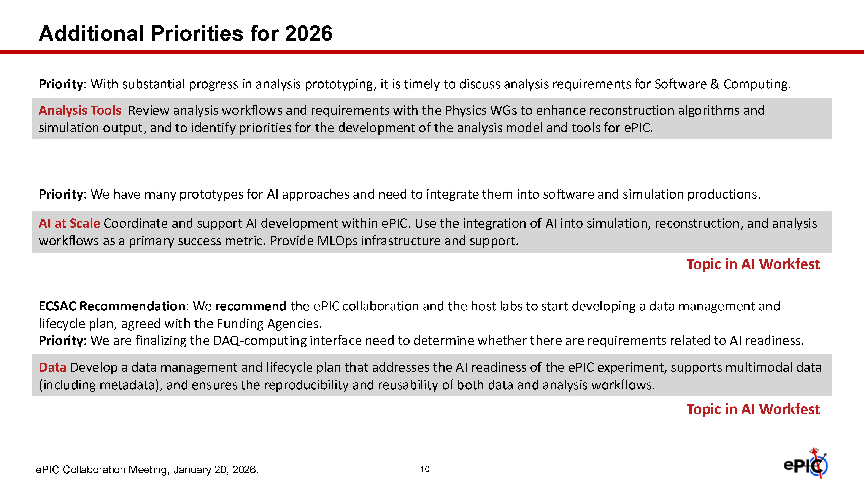

Slide 20

2026 Reconstruction Priorities
Will keep pursuing 2025 priorities for 2026 as well!
Holistic reconstruction
There has been a tremendous progress with our reconstruction software, which has enabled many physics performance studies over the past year!
Nevertheless, further development of a more realistic holistic treatment of information from different components is crucial
Starting with 2026: working together with S&C, we prioritize:
Development of our electron finder into a more complex tool, capable of identifying all electrons candidates and assigning to them a probability, via combining informations from calorimeters, trackers and PID systems
Complete the development of a particle flow algorithm
Development of a true PID reconstruction, using the information from all PID subsystems (we are currently using look-up tables)
Development of a muon finder, using tracker and veto from HCAL

Slide 21
ePIC Resources
Public Website - https://www.bnl.gov/eic/epic.php
Mailing Lists – https://lists.bnl.gov/mailman/listinfo
Indico Agenda - https://indico.bnl.gov/category/402/
ePIC Software and Computing: https://indico.bnl.gov/category/435/
Wiki - https://wiki.bnl.gov/EPIC
ePIC Software Training:
Landing Page: https://eic.github.io/documentation/landingpage.html
Tutorials: https://eic.github.io/documentation/tutorials.html
Mattermost: https://chat.epic-eic.org
ePIC Zenodo Community: https://zenodo.org/communities/epic

Slide 22


EICUG Membership
The EICUG is a vital organization to promote the interests of the EIC community!
Without the EICUG we would never have gotten far enough to form ePIC!
Please register your institution!
Check with your EICUG IB representative to get registered as a member
https://www.eicug.org/content/join.html

Slide 23
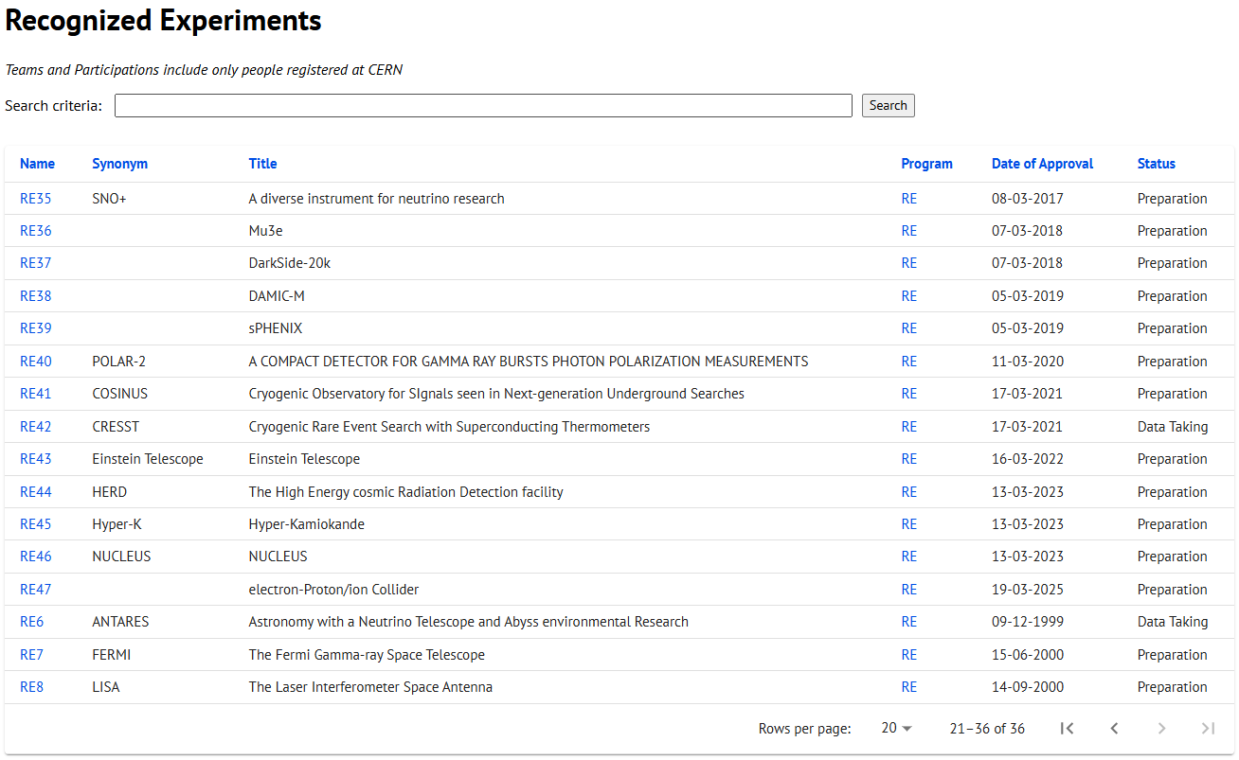
CERN Recognized Experiment Status: RE47
ePIC now appears in the CERN Grey Book database as RE47: https://greybook.cern.ch/experiment/recognized
Two steps to get ePIC Collaborators registered at CERN:
CC Representative needs to register as team leader with CERN Users Office:
https://usersoffice.web.cern.ch/
https://usersoffice.web.cern.ch/team-leaders-corner
Users.Office@cern.ch
CC member can then certify registrations of team members
Contact us if you run into problems!

