Slide 1
ePIC 2025 Priorities
Collected from presentations at the Jan. 2025
ePIC Collaboration Meeting in Frascati, Italy
2/17/2025

Slide 2
Common Themes from Priority Discussion I
There is a need for better communication within the
collaboration, across multiple different entities
  Not a single problem with a single solution - something
  that we need to continually work on. Tailor the
  communication to collaboration needs
  (newsletter, minutes of meetings, etc.)
  Accelerate development of and transition to the website
Evolve technical coordination into less of a reporting body, with a proactive coordinating effort supporting the DSC’s
  Organize and coordinate preTDR effort
  Increase the direct engagement of the TC-Office with DSCs and CC WGs,
  TC Office presence in DSC meetings
  Set standards/requirements for DSC internal reviews, assist with organization
  Facilitate communication with CAMs and EIC Project
  Organize common solutions – cooling, grounding, database,…
This list is a synthesis of the Tuesday group exercise by the SP Office the Coordinators.
Sub-bullets are examples that support the priority but are not exhaustive.

Slide 3
Common Themes from Priority Discussion II
Need a better way to grow/onboard analysis efforts
  Not just software! Onboard analysis as well
  Common reconstruction tools facilitate higher-level
  analysis efforts
  Use Early Science studies as a focus for efforts in analysis
  and engagement with theory
Need to define a set of 2025 milestones for progress in simulations
  This includes simulation framework, fidelity to the mechanical design, inclusion of backgrounds, and reconstruction and common tools
  Work with DSC’s to set software goals, SCC to support
  Define how we work towards simulation reconstruction in timeframes
Workforce and Engagement
  Need to increase workforce and support engagement across all three coordination offices
This list is a synthesis of the Tuesday group exercise by the SP Office the Coordinators.
Sub-bullets are examples that support this priority but are not exhaustive.

Slide 4
Spokesperson’s Office

Slide 5
Spokesperson Office Focus Items for Next Term
Continue to develop the infrastructure of the collaboration to support communication:
  An effective and well-maintained website
Restructure technical coordination to better support the DSC’s
  Continue to explore paths that lead to a full-time ePIC TC stationed at BNL
Work with the project to evolve the project plan
  A pre-TDR and a project review in 2026 is essential to maintaining momentum in ePIC
Substantially improve engagement in Physics Analysis
Communicate the need for explicit support for EIC research within DOE NP and international funding agencies
Pursue dedicated funding for ePIC Software and Computing
Updates to the ePIC Charter now that policies are in place (working with CC)
Put ePIC Common Funds on a path to starting with ePIC construction
Pursue increased engagement from the JLab community
Actively develop the next generation of ePIC Leadership
Notes:
Of course the primary role of the spokesperson’s office is to support the execution of collaboration priorities. These are the things we think we need to do to best position the collaboration to be successful in executing its priorities.
(Is these all too honest? It’s pretty direct….especially the Jlab comment?)

Slide 6
Technical Coordination

Slide 7
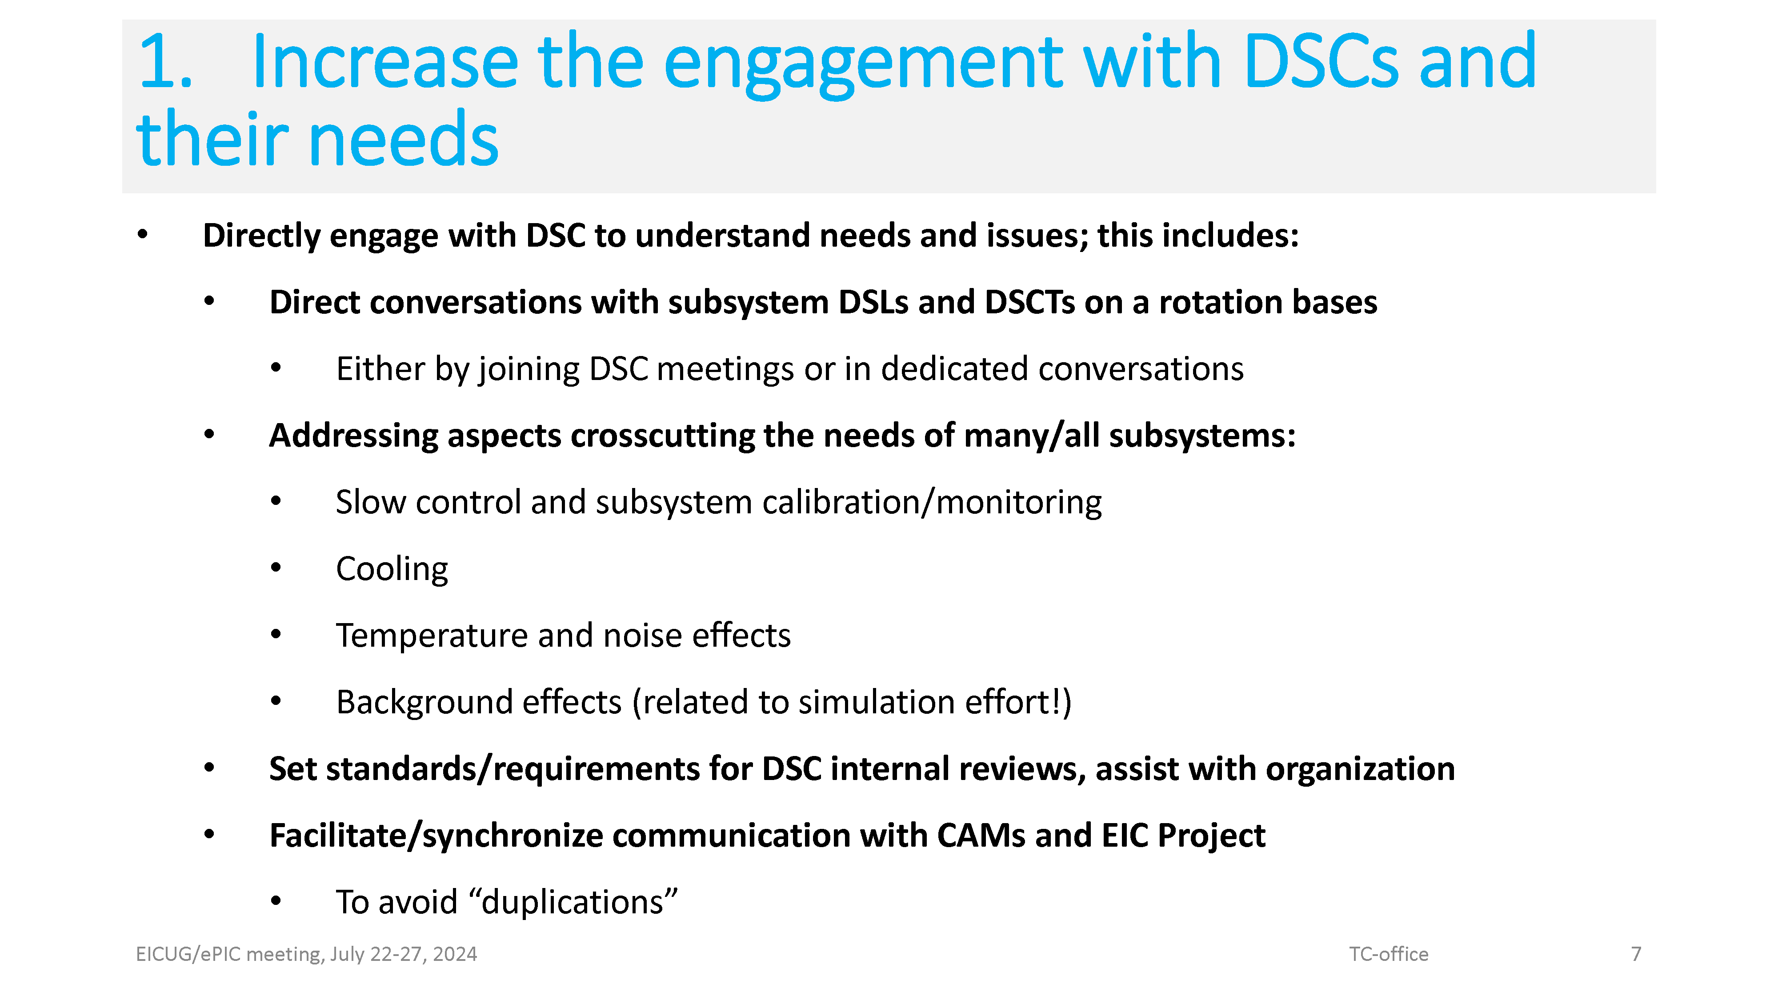

Slide 8
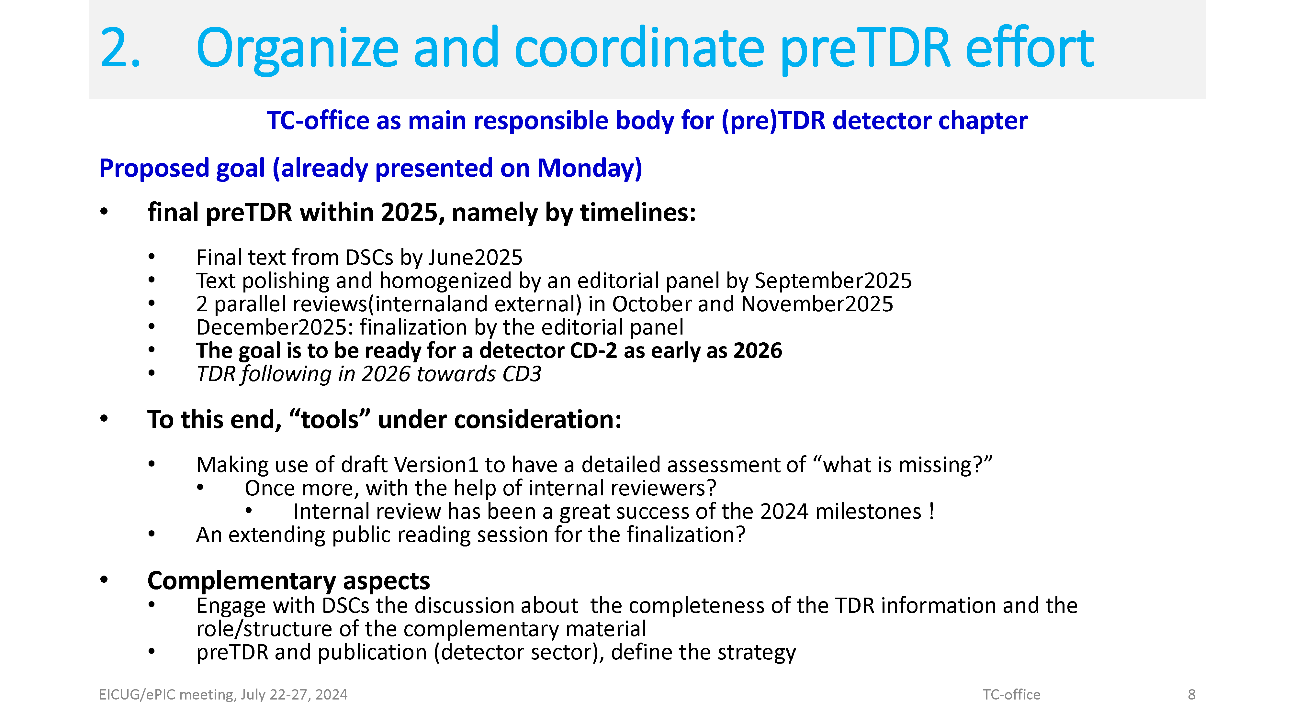

Slide 9
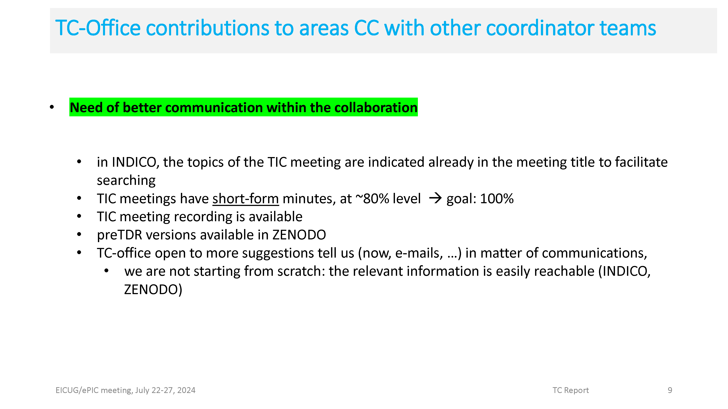

Slide 10
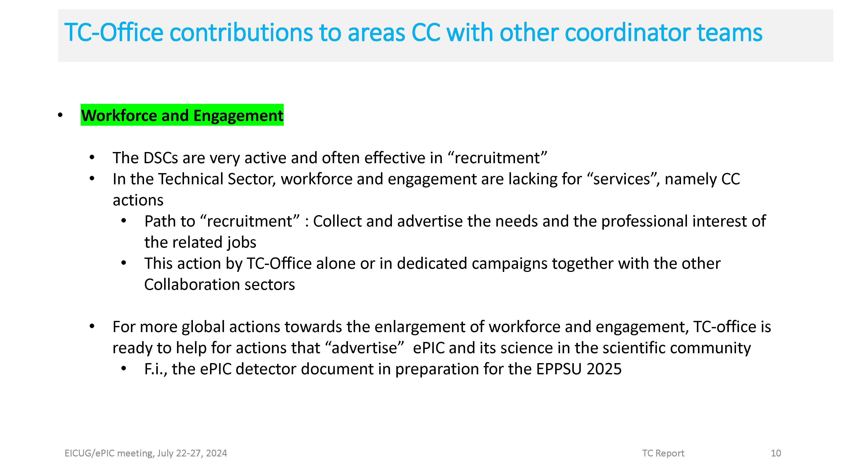

Slide 11
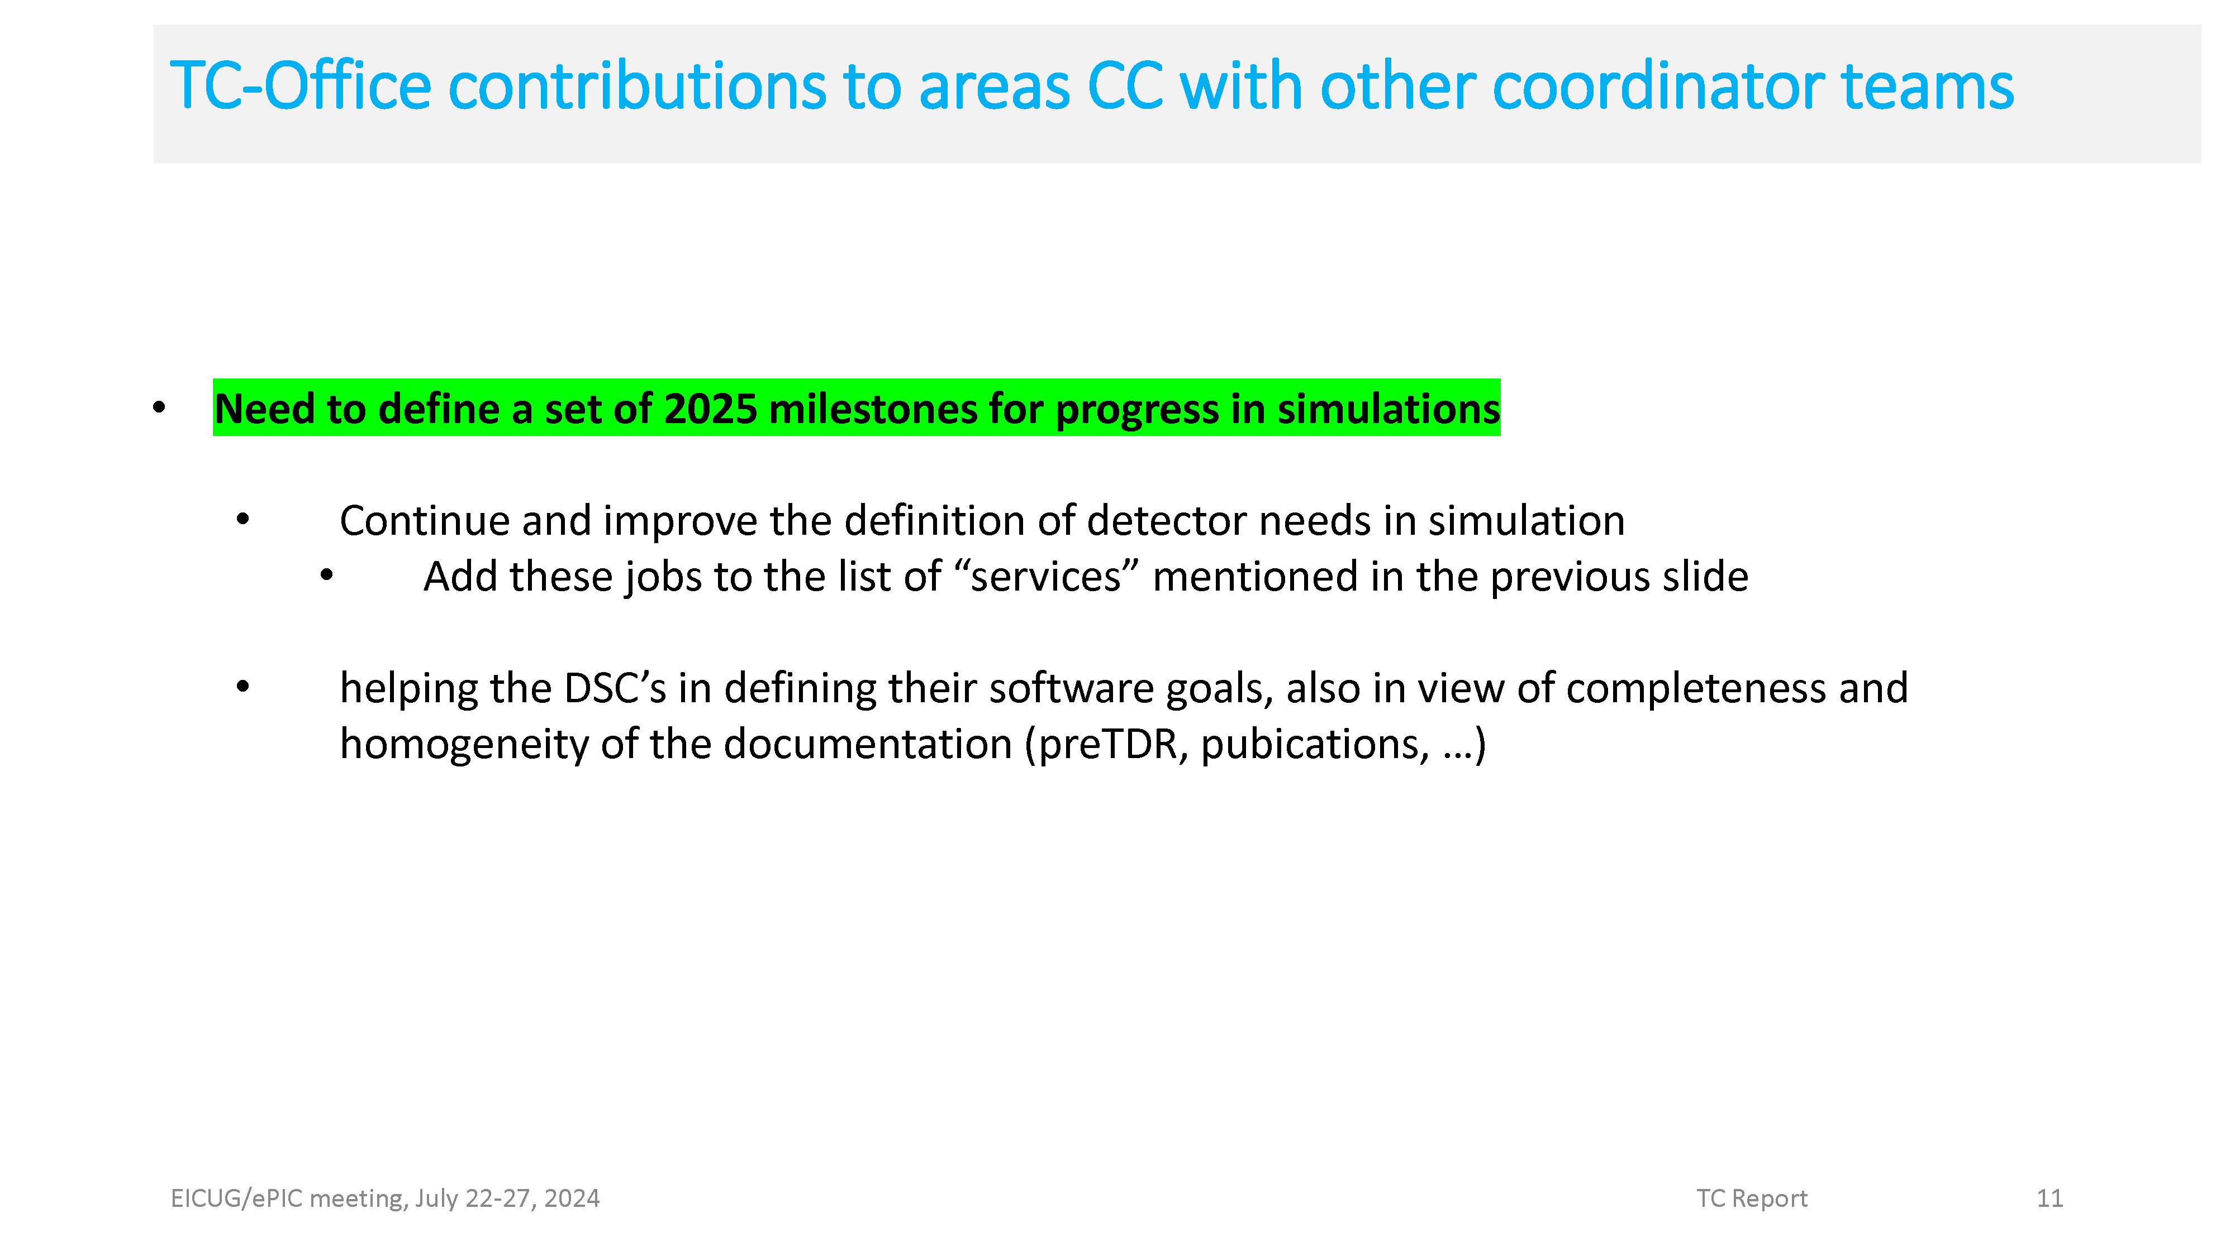

Slide 12
Software and Computing Coordination

Slide 13
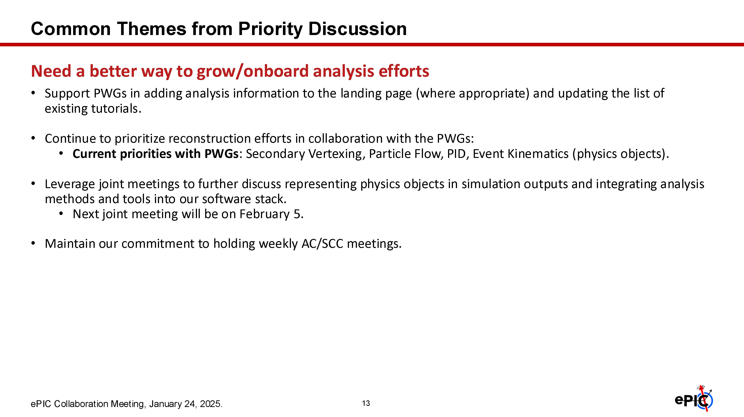

Slide 14
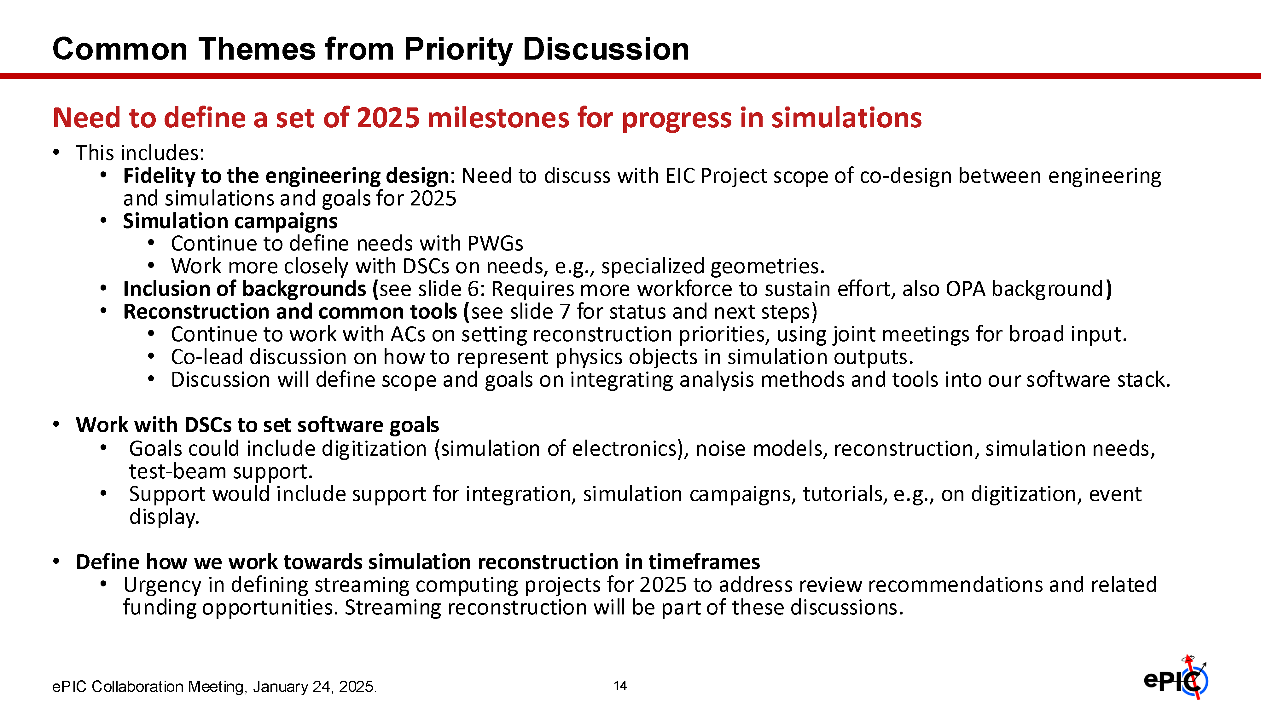

Slide 15
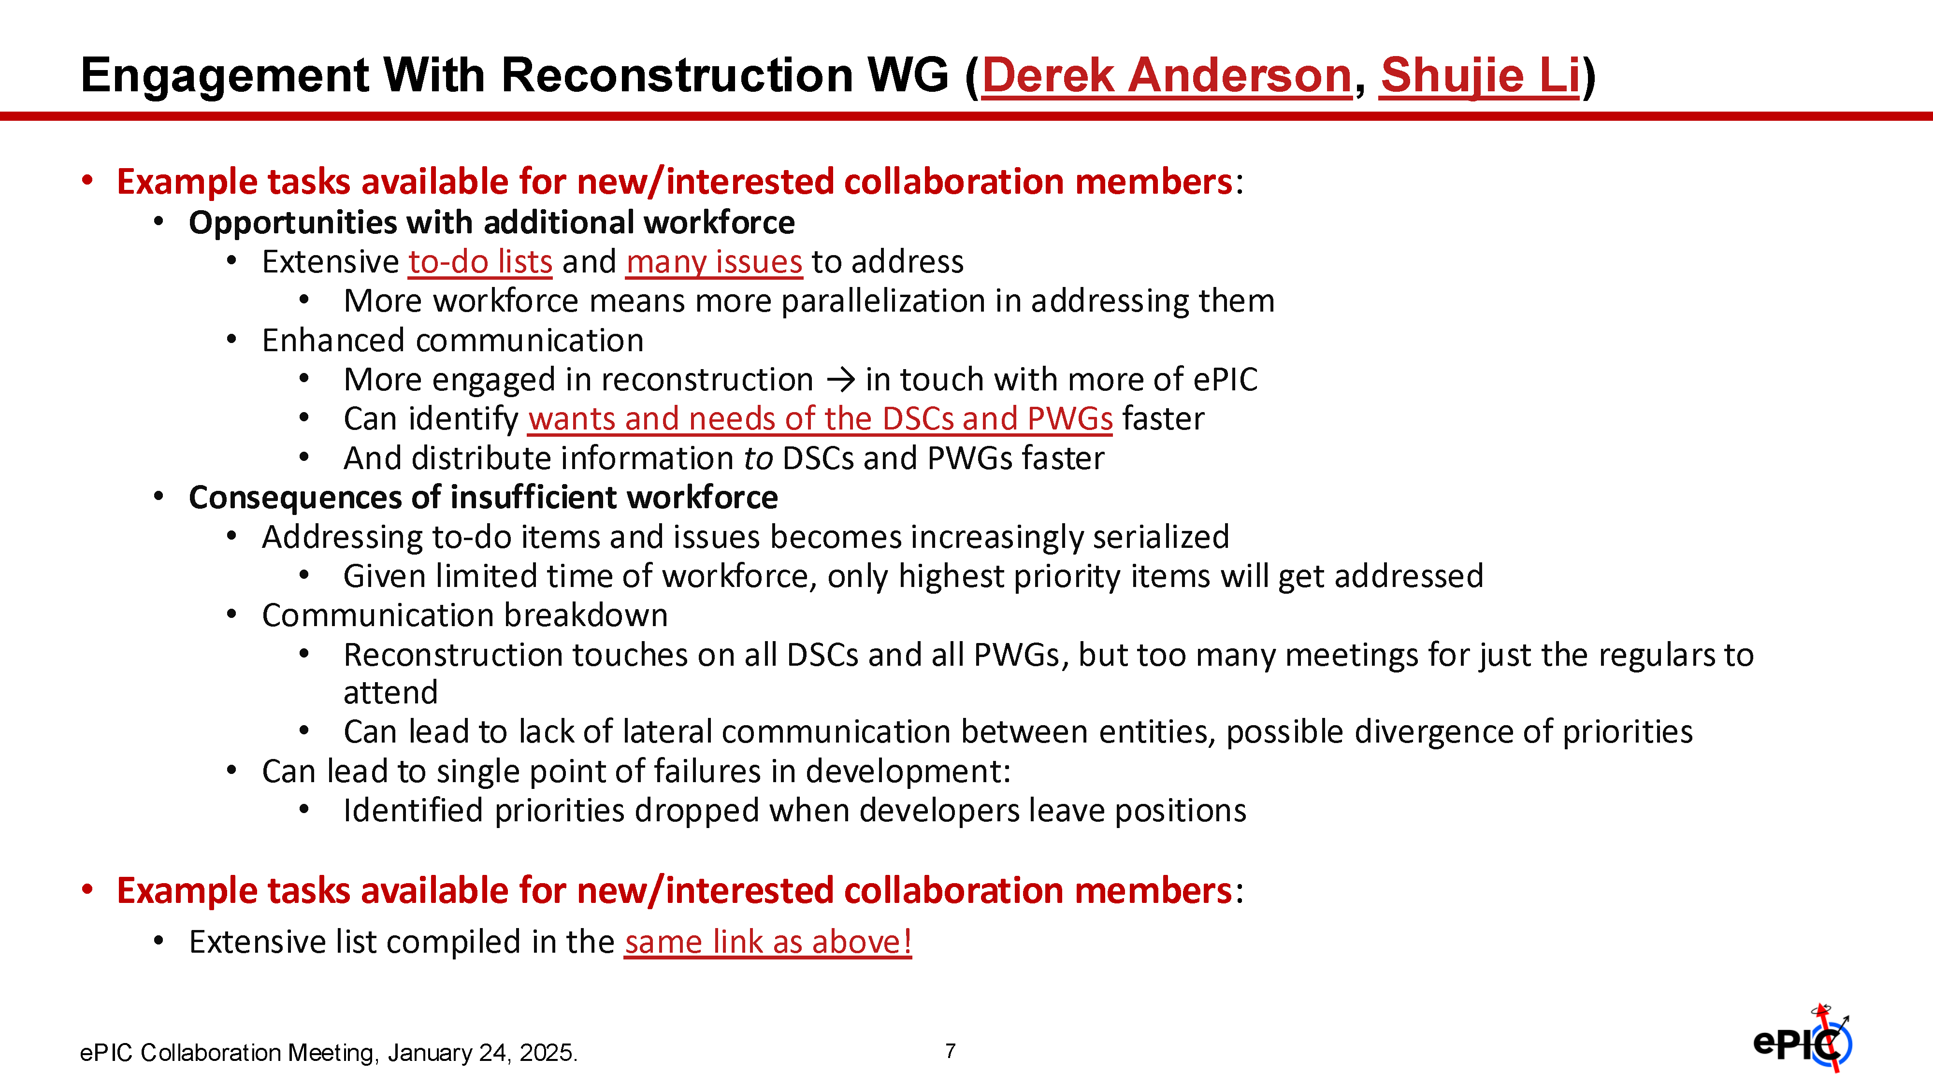

Slide 16
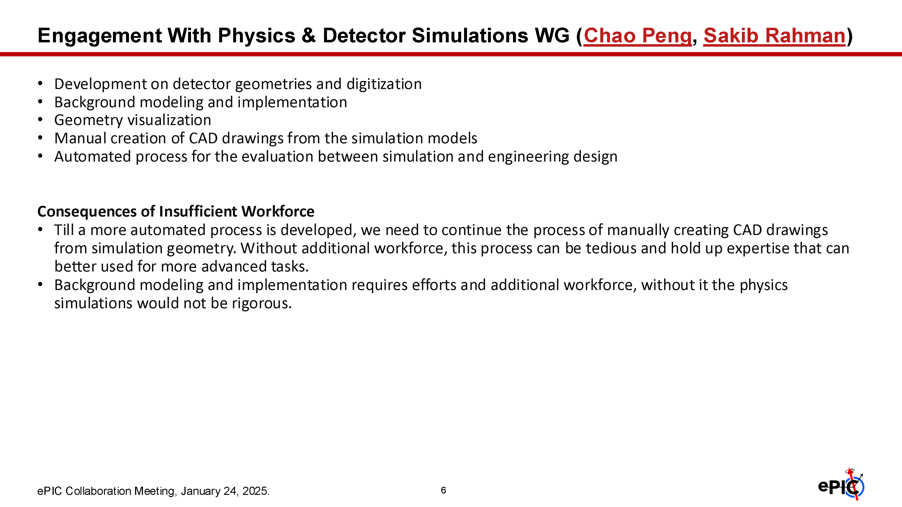

Slide 17
Analysis Coordination

Slide 18
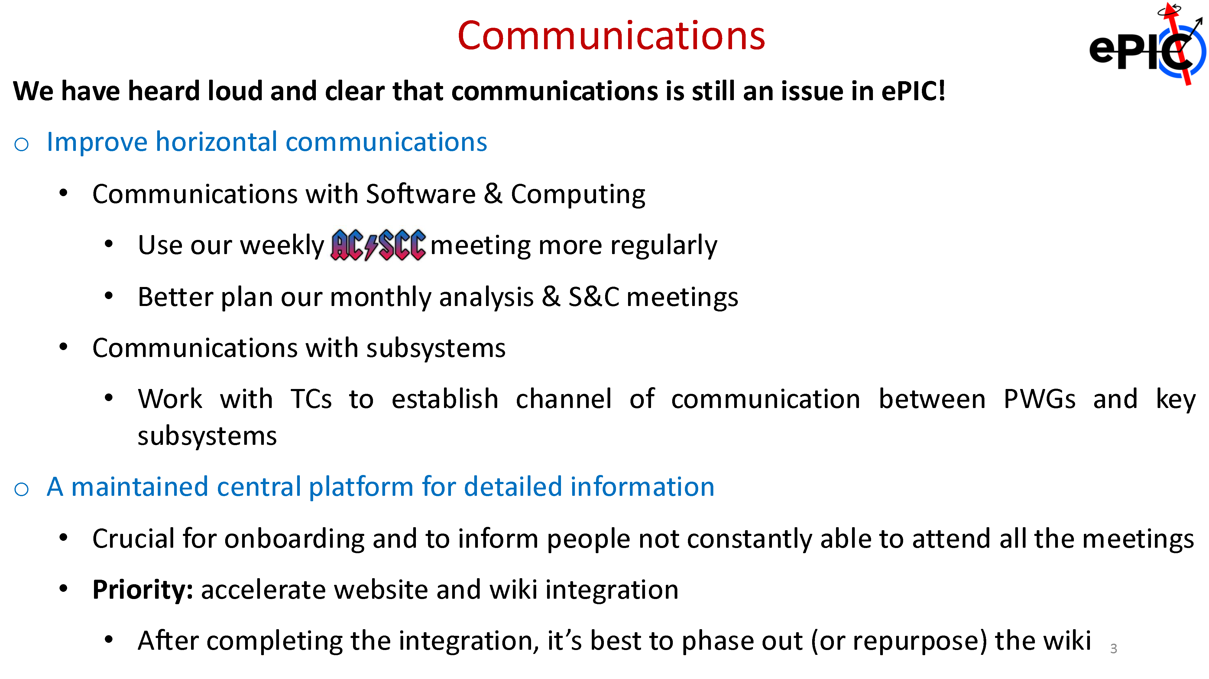

Slide 19
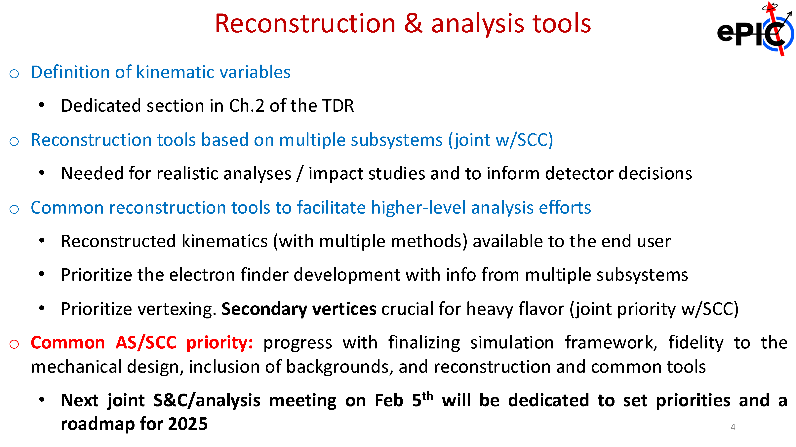

Slide 20
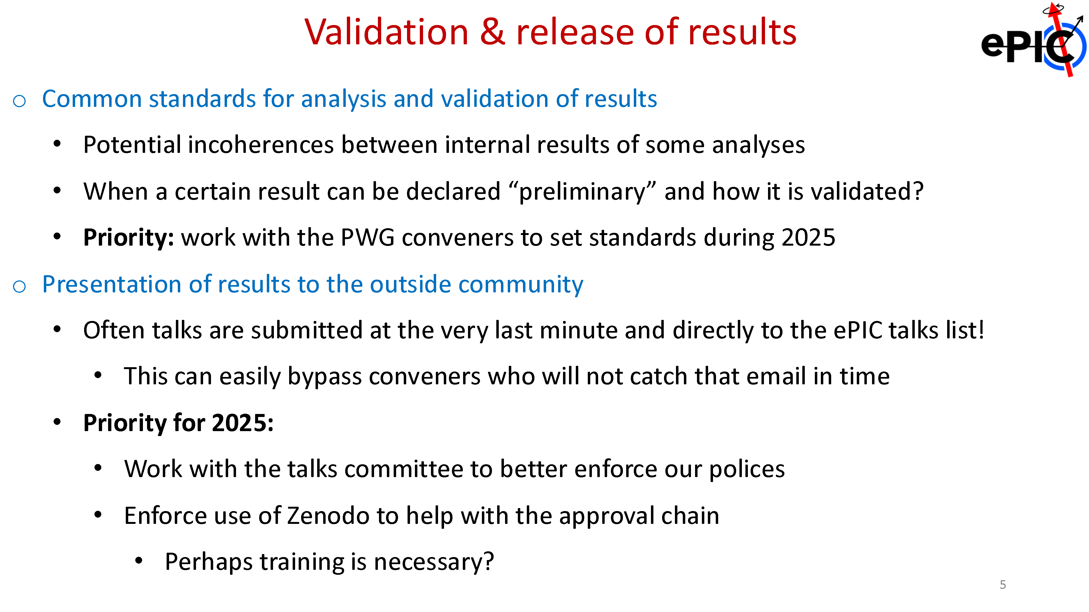

Slide 21
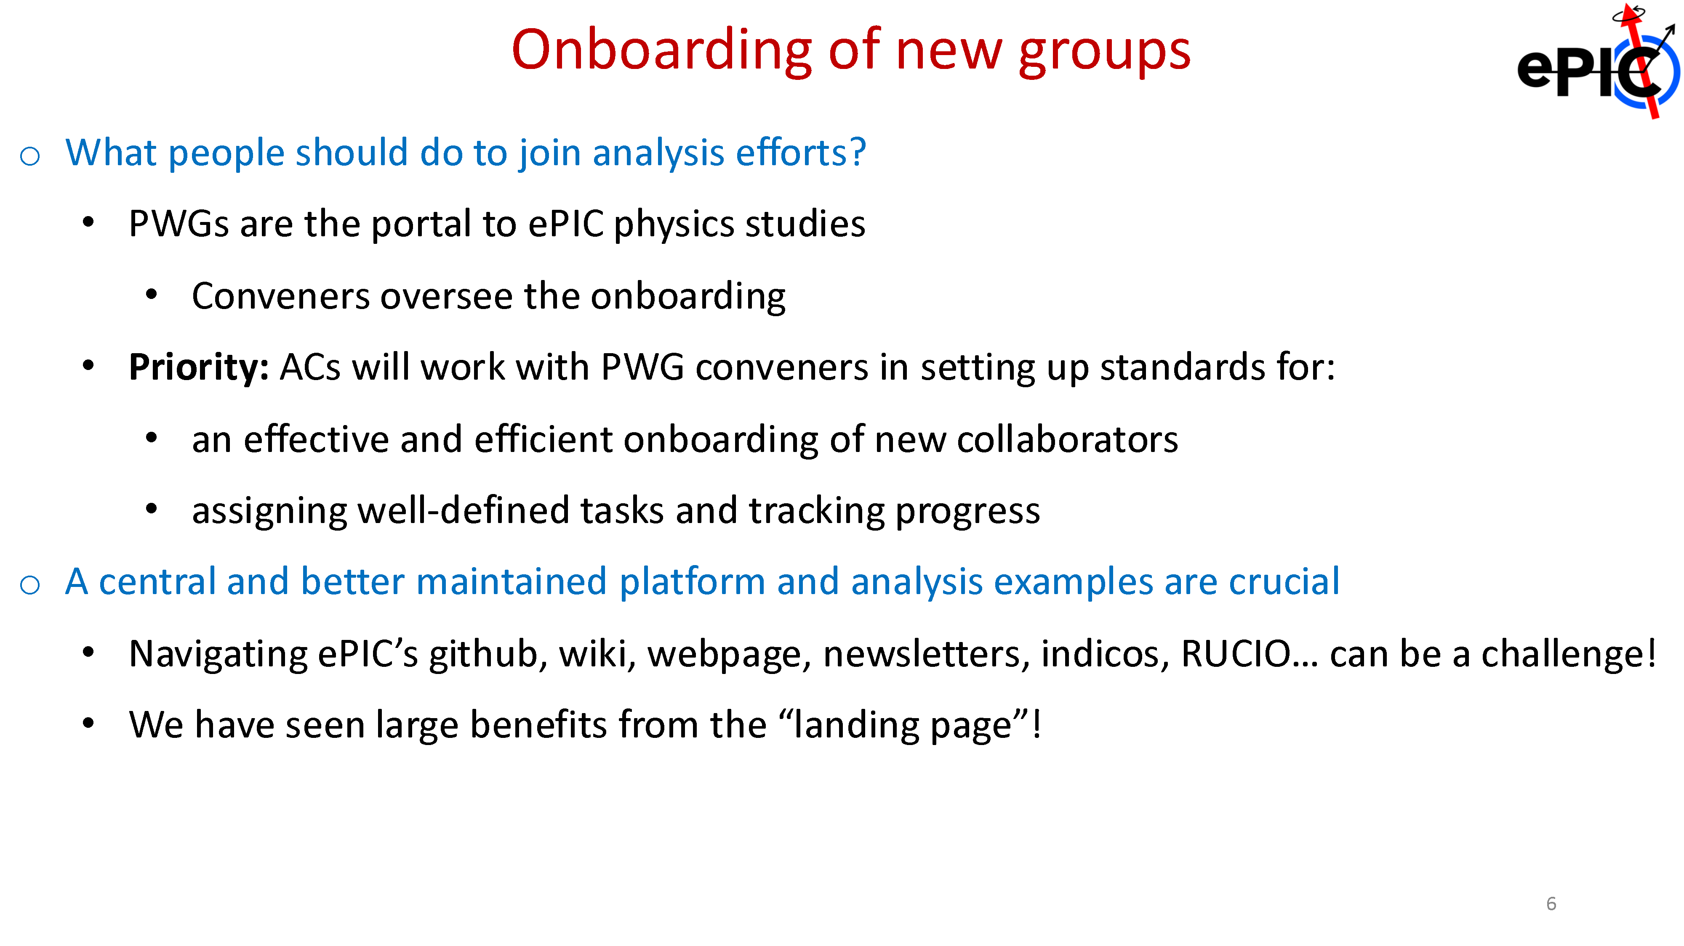

Slide 22
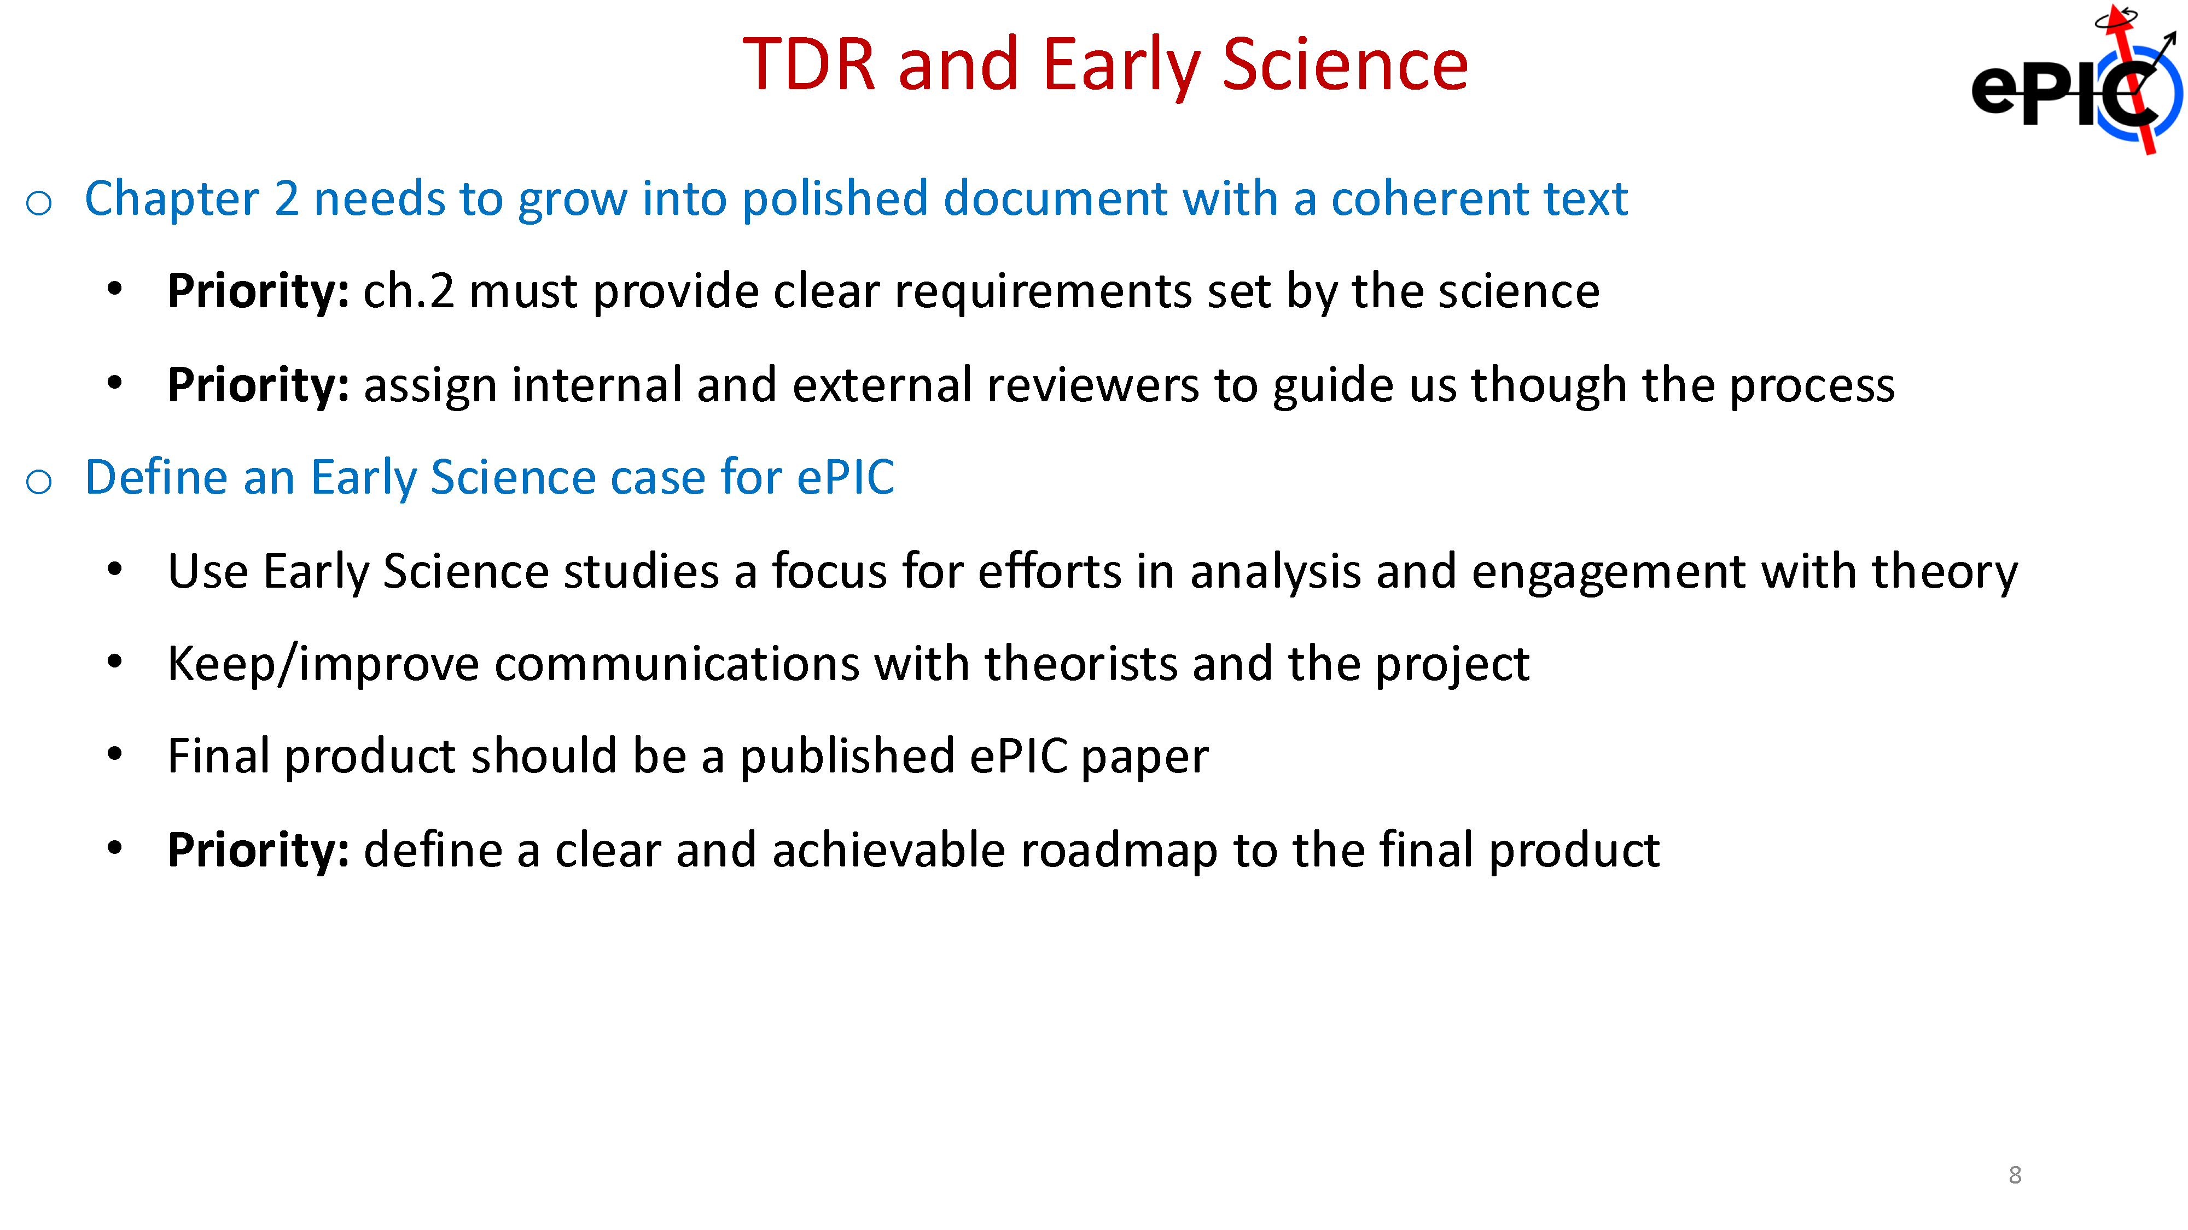

Slide 23
