Slide 1
Introduction to Calo WG Calibration Workfest.
O.Tsai (UCLA)
ePIC Collboration Meeting, BNL. Jan. 23, 2026

Slide 2
Initial Discussion 03/12/2025
Within Calo WG we did not yet touch calibrations.
There will be on-going discussion during next few months on this topic.
Goals:
Understand calibration requirements and procedures for each subsystem.
Fulfill request made by Computing/software WG, deadline end of Feb.
How we’ll do this?
Similar to discussion we had for SiPM degradations, i.e. folders for each sub-systems with common questions which has to be answered. (List of questions TBD – part of our discussion, let’s plan to define it during next calo meeting on Dec. 17’th)
As a start please look at TIC meeting 01/12/2025 “The ePIC Computing Model and Calibrations”
https://indico.bnl.gov/event/30589/contributions/116726/attachments/66484/114079/gunji_TIC_SRO_Calibration_20251201_v2.pdf
Here you will find what Computing group wants to hear from us.
ePIC Collboration Meeting, BNL. Jan. 23, 2026

Slide 3
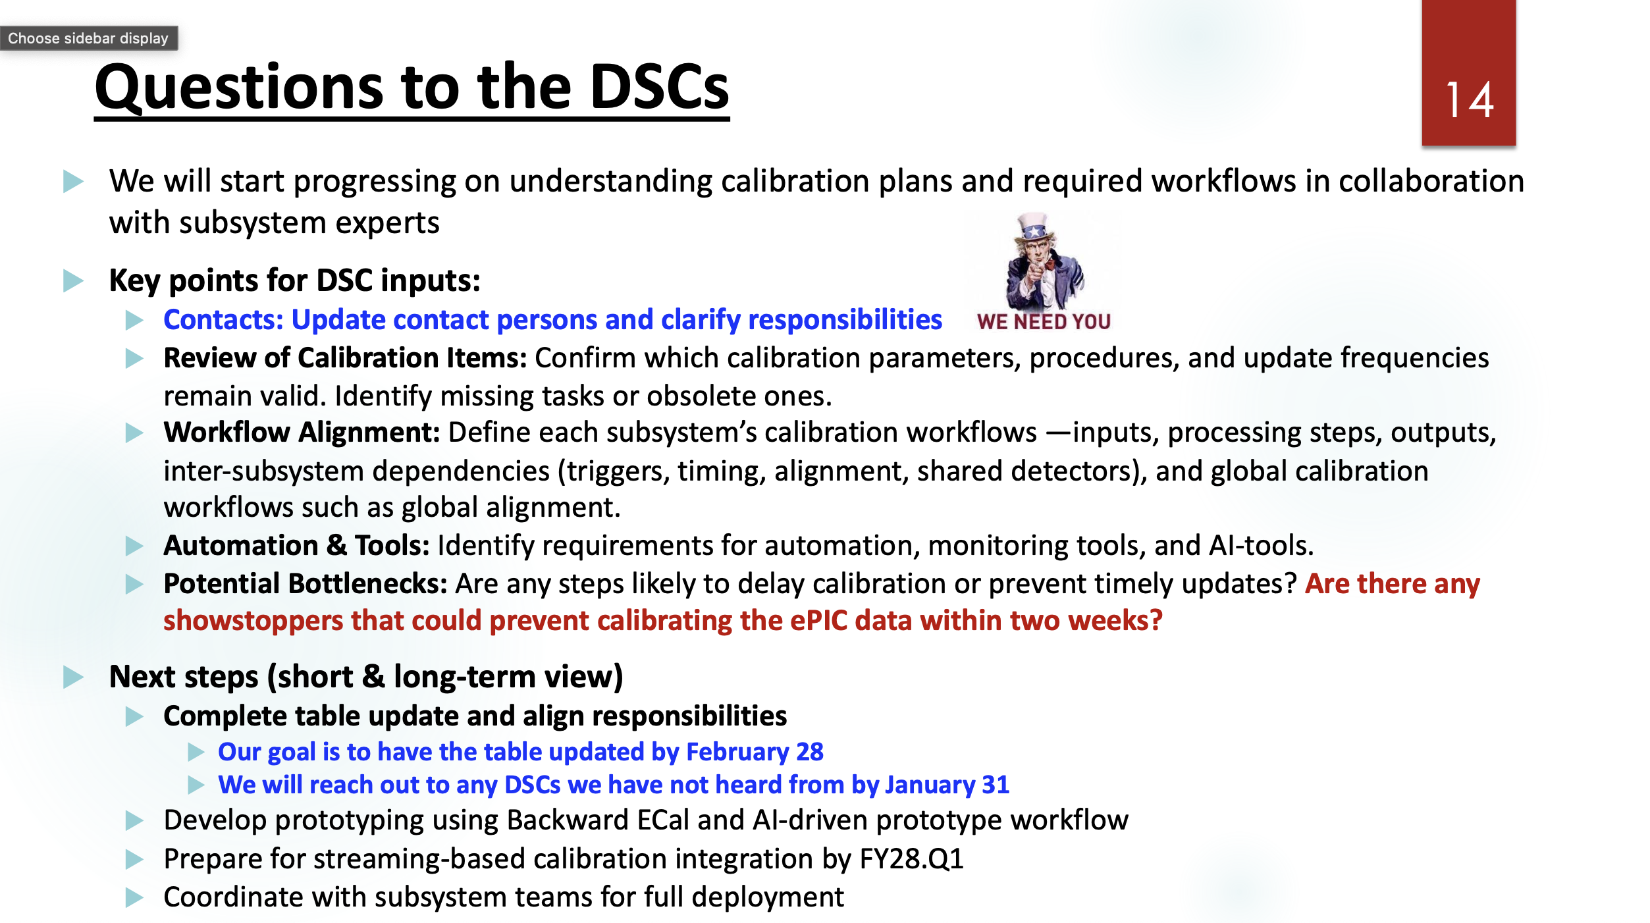
ePIC Collboration Meeting, BNL. Jan. 23, 2026

Slide 4
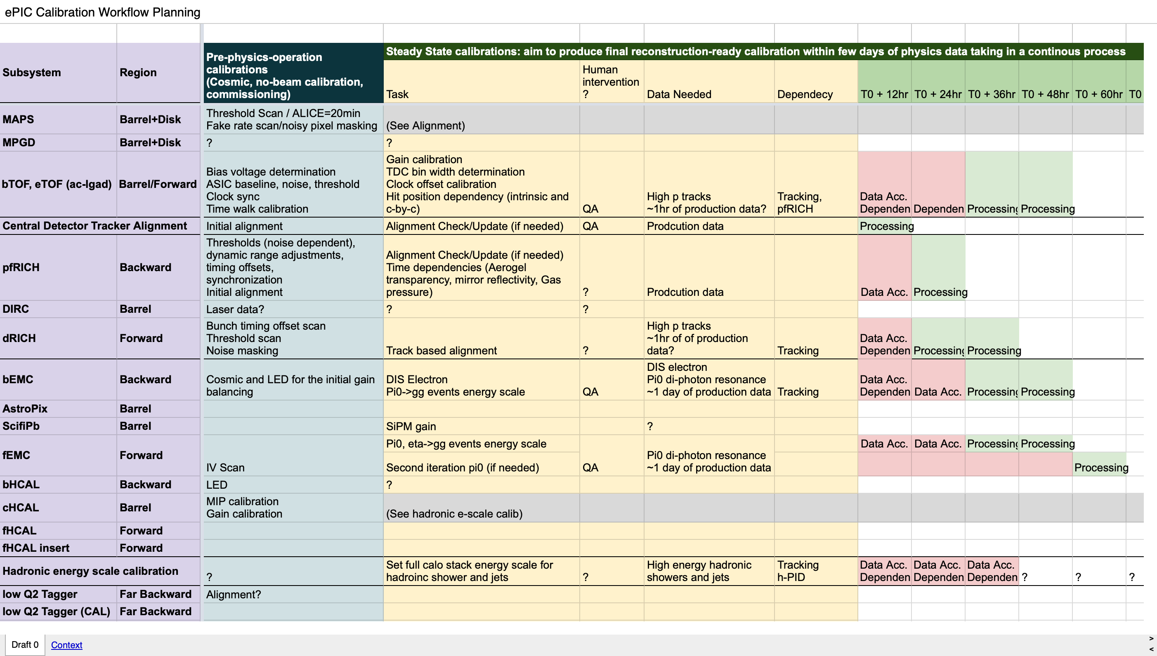
How Realistic is this?
ePIC Collboration Meeting, BNL. Jan. 23, 2026

Slide 5
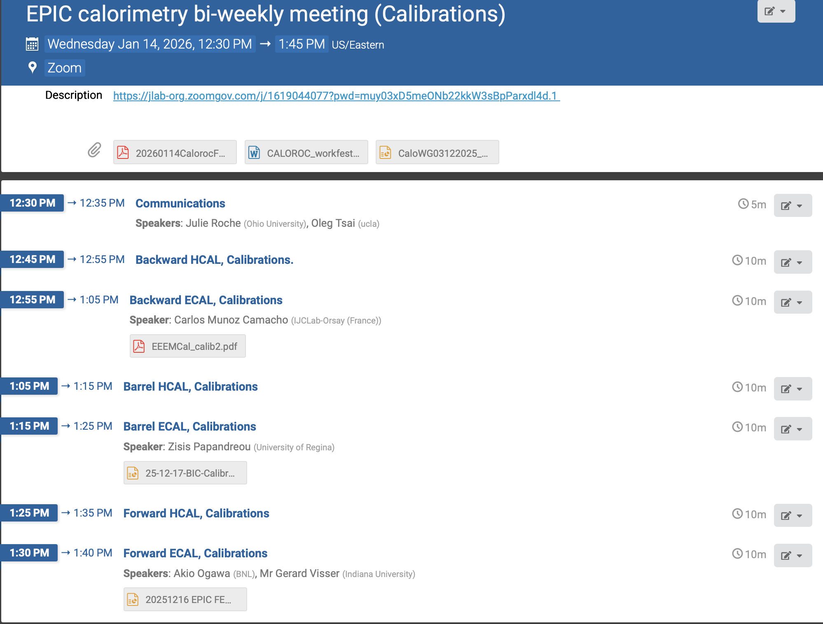
Where are we with the survey ?
https://indico.bnl.gov/event/31122/
After two dedicated calo WG meetings we got some information regarding ECals.
And very little for HCals.
Reminder: this is a survey, we do not expect to see a solid numbers from sub-systems.
But we need you to be engaged!
ePIC Collboration Meeting, BNL. Jan. 23, 2026

Slide 6
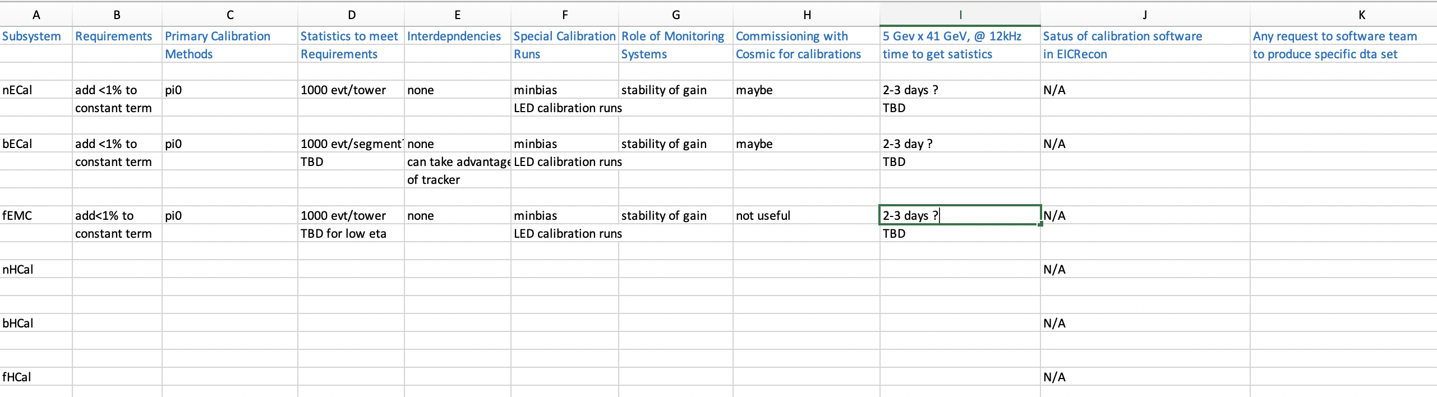
What we want to achieve?
Fill the spreadsheet as much as we can.
Formulate right questions/requests relevant to calibration procedures to solidify numbers (statistics etc.)
Comments and Questions?
ePIC Collboration Meeting, BNL. Jan. 23, 2026

