Slide 1
FEMC, Calibrations Initial Assessments.
O.Tsai (UCLA), A.Ogawa (BNL)
ePIC Collboration Meeting, BNL. Jan. 23, 2026

Slide 2
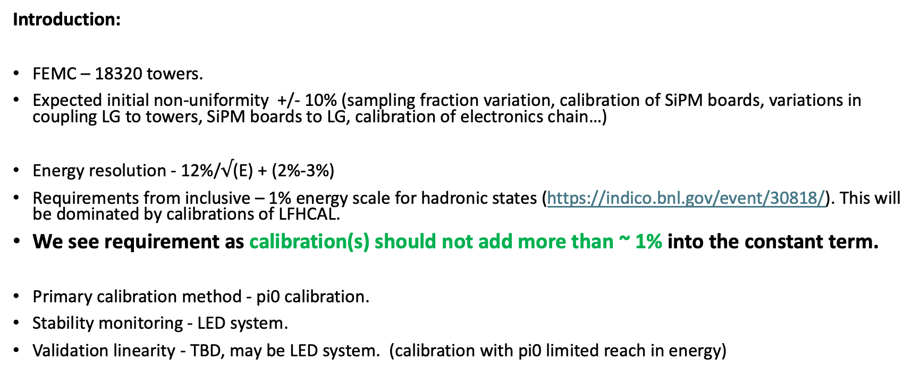
Introduction:
FEMC – 18320 towers.
Expected initial non-uniformity +/- 10% (sampling fraction variation, calibration of SiPM boards, variations in coupling LG to towers, SiPM boards to LG, calibration of electronics chain…)
Energy resolution - 12%/$√$(E) + (2%-3%)
Requirements from inclusive – 1% energy scale for hadronic states (https://indico.bnl.gov/event/30818/). This will be dominated by calibrations of LFHCAL.
We see requirement as calibration(s) should not add more than ~ 1% into the constant term.
Primary calibration method - pi0 calibration.
Stability monitoring - LED system.
Validation linearity - TBD, may be LED system. (calibration with pi0 limited reach in energy)
ePIC Collboration Meeting, BNL. Jan. 23, 2026

Slide 3
As and example.
STAR FCS calibration with pi0, Run 22, pp 500 GeV.
Successfully calibrated within few days at the start of the Run22.
Typical for forward calorimeters:
Rates drops fast moving away from the beam pipe.
Energy of particles drops fast away from the beam pipe.
Background changes.
Peripheral towers may need more statistics.
Usual calibration methods work well for small(ish) impact angles (STAR FMS, FCS).

Slide 4
Forward ECAL pi0 calibration
PYTHIA6 Q²=0~1GeV DIS events
No decay, no detector MC, just counting PYTHIA pi0 towards FEMC
Assume 20kHz. (12.5kHz ?) DIS events in 1st year of EIC (5 GeV x 41 GeV)
Assume 60% uptime
→ 1B DIS events / day
Radius [cm] | # of towers | # of >5GeV pi0 / day / tower | # of >2GeV pi0 / day / tower
20<R<100 | ~4800 | 37k | 108k
100<R<150 | ~6200 | 43 | 2.6k
150<R<190 | ~6800 | 4 | 390
At this low energy, opening angle between 2 decay photons are large
May need to combine with photons in BEMC for outer radius
Working on study with decay, detector MC, clustering and pi0 reconstruction including background
Akio Ogawa 2025 Dec 17 EPIC Calorimeter meeting

Slide 5
Summary:
Central part of the detector can be calibrated within day or two at 5 GeV x 41 GeV, lumi numbers had to be understood, especially at startup.
Peripheral part of the FEMC (R>150cm) is TBD.
No special running conditions required.
Interdependency – probably none (BEMC+FEMC for peripheral part may be too complicated).
Cosmic for calibration is not useful.
How well calibrations algorithms work for peripheral part of the FEMC is TBD.
All calibration software for FEMC had to be implemented in EICrecon, right now we have nothing in place.
Need a minbias sample for 5 GeV x 41 GeV to verify calibration procedures.

