Slide 1
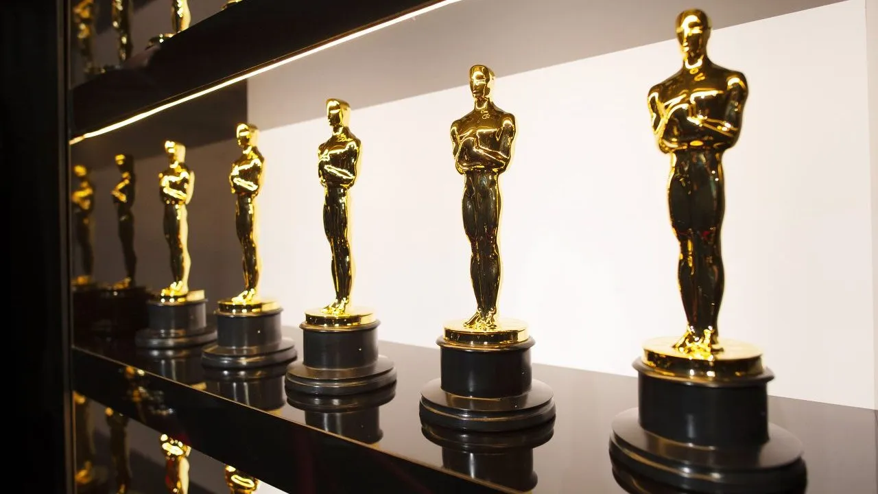
Thank you everybody for voting
We had 136 votes for the photo contest
And the Winners are

Slide 2
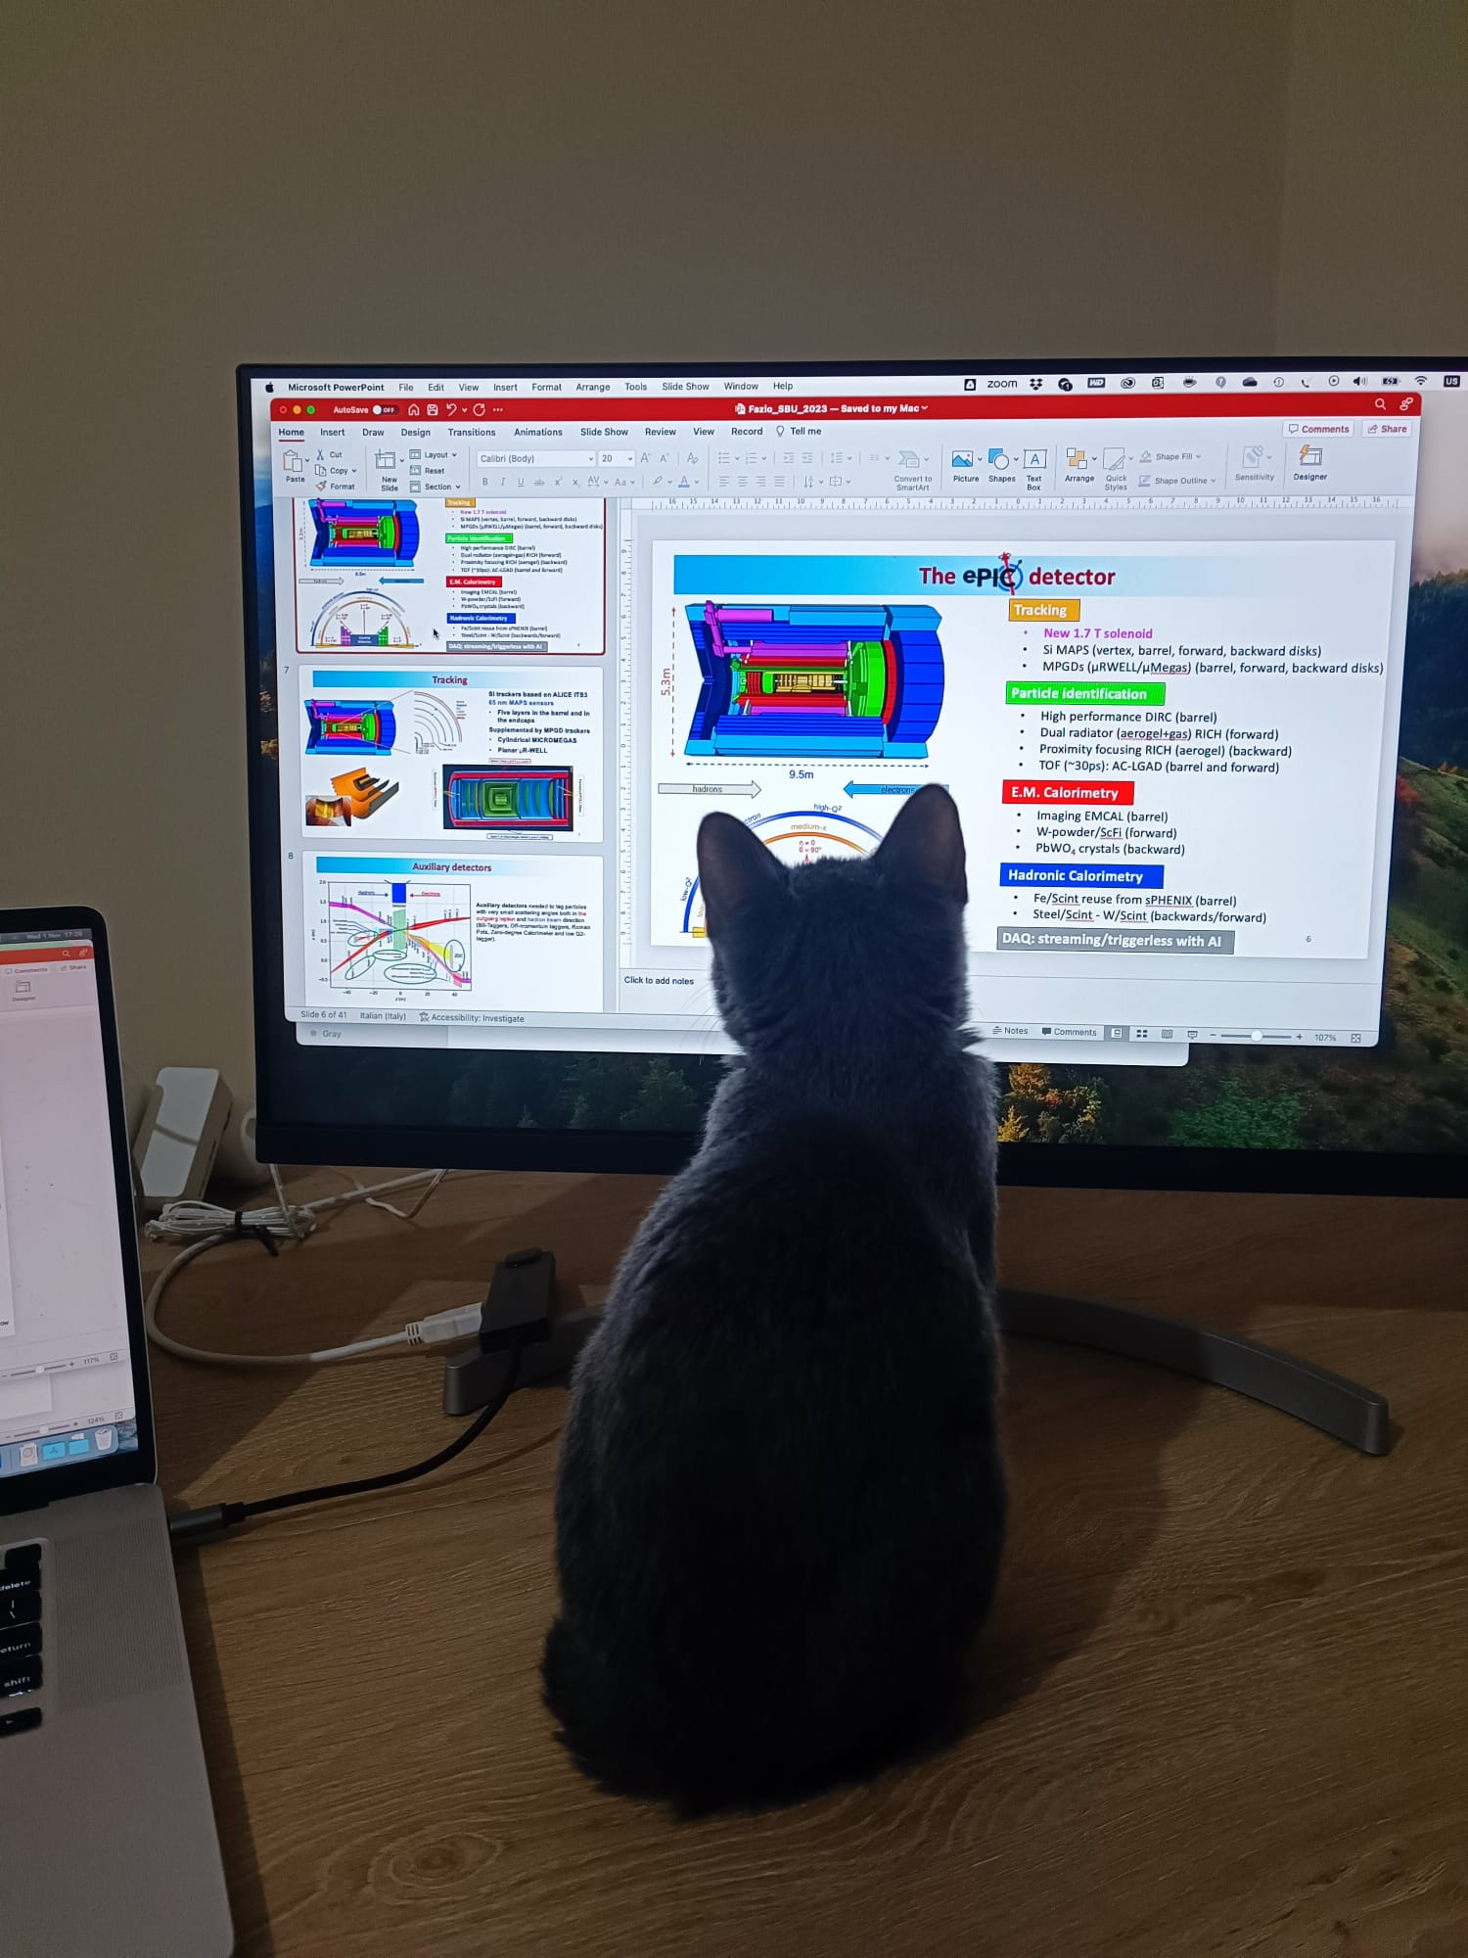
Pawsome ePIC

Slide 3
3rd ePIC Photo Contest
1st Place
Salvatore Fazio
January 20 - 23, 2025

Slide 4
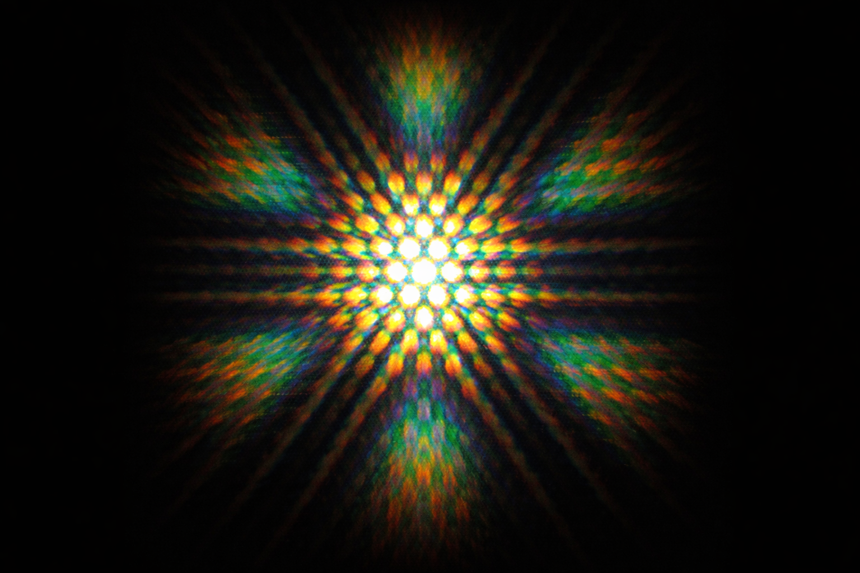
When Lights meets Structure

Slide 5
3rd ePIC Photo Contest
2nd Place
Arshak Asaturyan
January 20 - 23, 2025

Slide 6
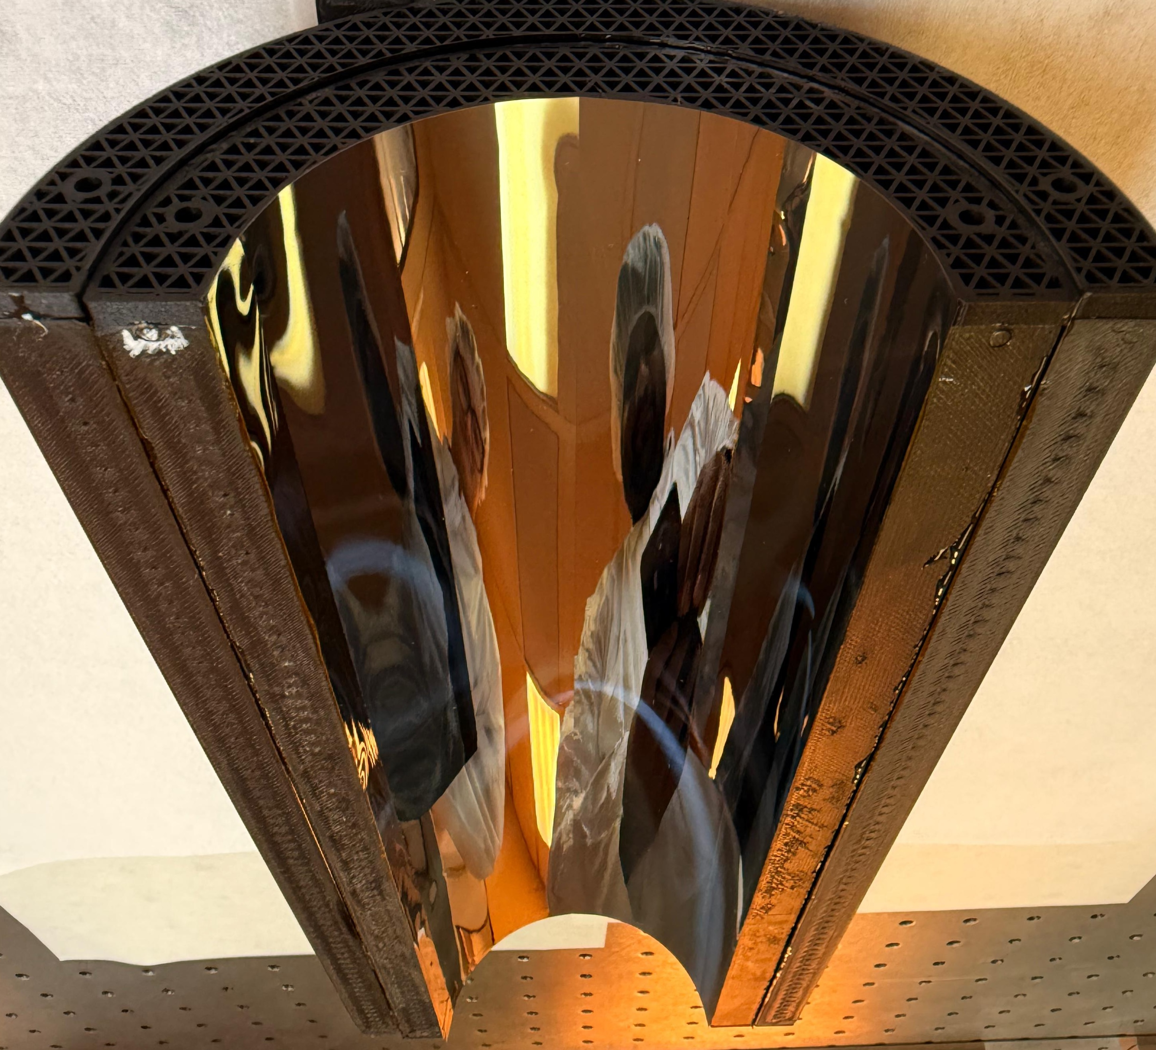
Through the bent magic (SVT) mirror

Slide 7
3rd ePIC Photo Contest
3rd Place
Domenico Colella
January 20 - 23, 2025

Slide 8
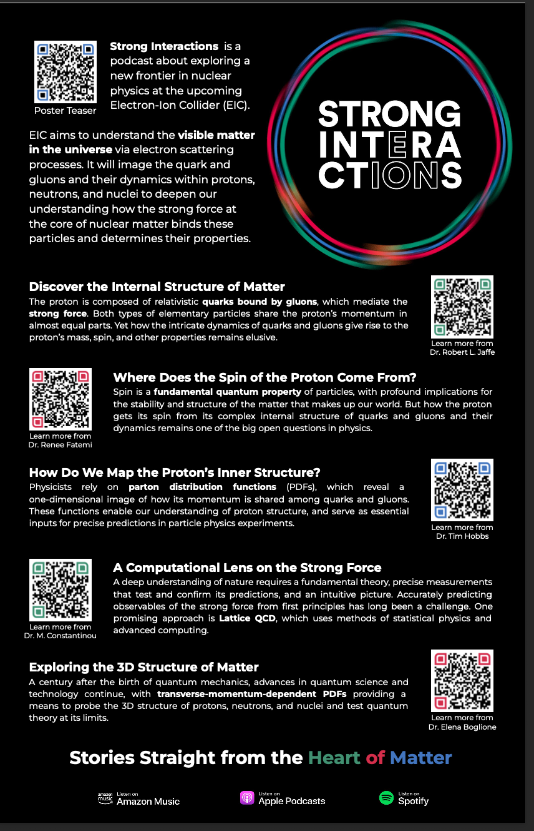
Thank you to
Azizah Mahmood
preparing this nice and
interesting poster
Video Teaser:
https://drive.google.com/file/d/1dcP3w5y1hC_EBCOFWQFjS9MYqynNZpex/view?usp=sharing

Slide 9

A big Thank You to Gabriel Garcia
and Peter Steinberg
for all the help

