Slide 1

ePIC Collaboration News
J. Lajoie, S. Dalla Torre
December 5th, 2025

Slide 2
Hey John, start the recording….

Slide 3
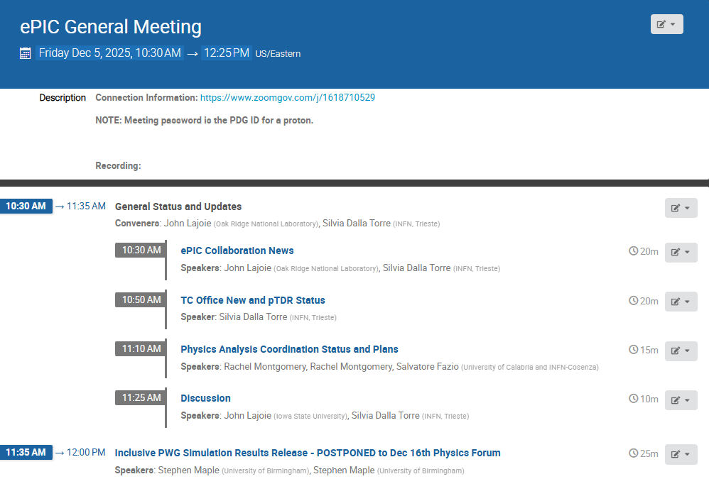
Agenda
Some news from the collaboration, TC Office, and PA coordinators

Slide 4
Project Delivery Strategy
Deliver the full EIC facility scope using subprojects and the phased implementation of the EIC project scope. The strategy enables the start of the EIC construction when the first subproject is ready and the start of the EIC science program during collider commissioning, concurrent with the final subproject equipment installation. Line-Item Construction Project includes the full scope required to meet EIC facility performance requirements.
Integrated Project Office & Beam Commissioning (IPO) (L. Lari, Project Manager)
 | Long Lead Procurements & NYS Funded Scope (C. Folz)
First SP |  | Accelerator Storage Rings (ASR) – Infrastructure, HSR, ESR, Install (C. Folz, SPM)
 |  |  | Detector (DET) – Integration, Install (R. Ent and E. Aschenauer, POCs)
 |  |  |  | Interaction Region (IR) - Civil Construction, SC Magnets, Crab Cavities, Machine Protection, Installation (S. Nagaitsev, POC)
 |  |  |  | Electron Injector (EIN) – Infras., LINAC, RCS, Install (Q. Wu, POC)
Last SP |  |  |  |  |  |  | Energy and Luminosity Ramp-up (ELR) (K. Wilson, POC)

Slide 5
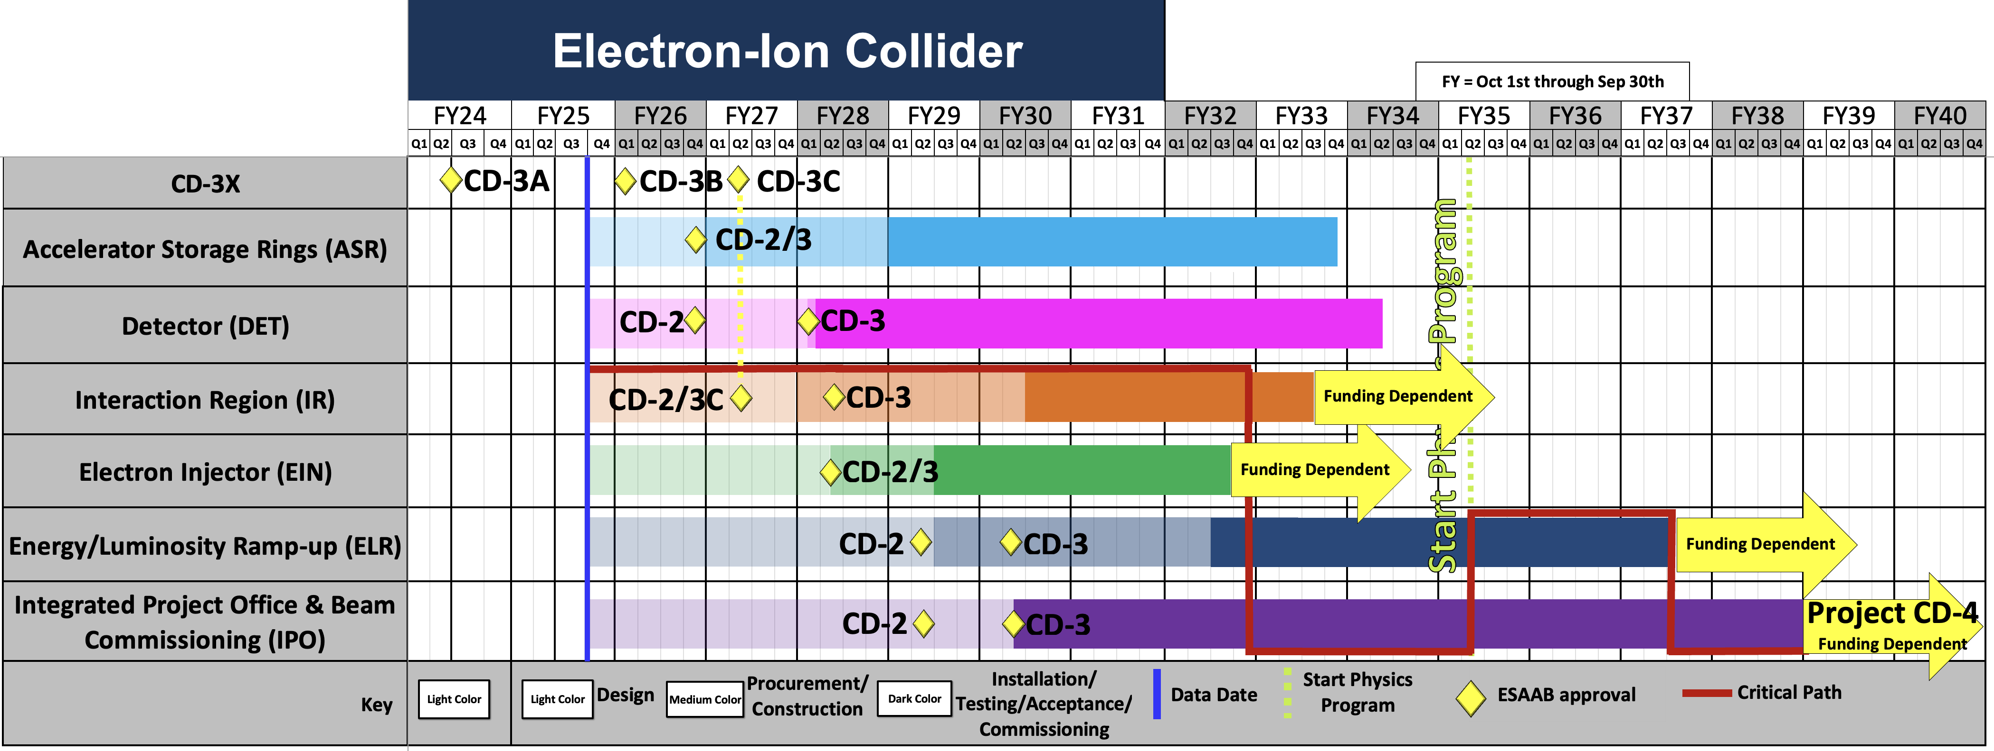
High Level Schedule
Plans for CD-2/CD-3 for ASR and CD-2 for DET remain aligned with conclusion of RHIC operations January 2026
Effect of the $300M/y peak funding profile on the schedule

Slide 6
Detector Reviews & Meetings planned for 2025/2026
Preliminary Design Reviews (60% design maturity equivalent, called PDR, PDR2 or PDR3, pending the subsystem)
PDR2: Cherenkov-based Particle Identification Detectors (6.10.04; pfRICH, hpDIRC, dRICH) – April 1-2, 2025
PDR3: Electronics/DAQ-computing (6.10.08. 6.10.09.01) – September 3-4, 2025 (this does not include slow controls)
PDR3: Barrel EM Cal (6.10.05.02) – September 17-18, 2025
PDR (60%) Barrel & Forward & Backward HCAL (6.10.05.01; 6.10.06.02; 6.10.06.03) and forward ECAL – October 30-31, 2025
PDR: Magnet Cryogenics and infrastructure (6.10.07) – November 4-5, 2025 (integrated in overall EIC Project Cryogenics PDR)
PeerReview: AC-LGAD-based Particle Identification Detectors (focus on sensors) – December 3rd 2025
PDR: Integration, Infrastructure and Installation (6.10.10) – everything inside & outside GST, includes cradle, HCAL, etc. – Dec. 8-9
PDR: MPGD Tracking Detectors (6.10.03.02) – Dec. 15
PDR2: Silicon Tracking Detectors (6.10.03.01) – week of Jan. 26, 2026
PDR2: Polarimetry (6.10.14) – aim for February 18-19, 2026
PDR: DAQ-Slow Controls (6.10.09.02) – Spring 2026 – Separated from electronics/DAQ to ensure integration in the collider common platform
PDR3: IR Integration and Auxiliary Detectors (6.10.11) – March/April 2026 – includes 6.10.14 lumi detector
PDR2: AC-LGAD-based Particle Identification Detectors (6.10.04; BTOF, FTOF, common systems) – April 2026
Final Design Reviews (FDR):
FDR: Final Design Review of the BABAR DIRC Bar Refurbishment for the High Performance DIRC Particle Identification Detector – April 1, 2025
FDR: Backward EM Calorimetry – Mid February 2026
Project Reviews:
DOE OPA CD-3B Review – January 7-9, 2025
“Red Team” Review (acts as Director’s Review for DOE OPA Focused Status Review) – May 20-21, 2025
Comprehensive ePIC/EIC Detector Review by Detector Advisory Committee – June 11-13, 2025
DOE OPA Focused Status Review – August 5-7, 2025
Detector Baseline Readiness Review November 12-14, 2025 → postponed to Feb 3 – 5, 2026
DOE Status Review March 9-12, 2026
CD2 IPR & ICR June 2026?
Other Meetings:
EIC International Computing Organization (EICO) – April 2–4, 2025 @BNL
Detector R&D Day hosted by ePIC and EIC Project – April 16-17, 2025
Technical interchange meeting with EIC Computing and Software Advisory Committee (ECSAC) – May 12, 2025
5th RRB Meeting: June 5-6, 2025 – Prague, Czech
10th DAC Meeting – Comprehensive look to design status and readiness for CD-2. June 11-13, 2025.
EIC Software & Computing annual review – October 6-7 @ JLab (and Echelon 0–1 mini-workshop on October 8)
6th RRB Meeting: November 4-5, 2025 - BNL

Slide 7
Subsystem Reviews
Subsystem | PDR Completed | PDR Scheduled | FDR Completed
Tracking | 40% Si & MPGD | 60% Si week of Jan. 26, 2026 & MPGD Dec. 15, 2025
PID | 40% & 60% hpDIRC, pfRICH, dRICH ToF 40% | ToF Peer review Dec. 3rd, 2025, 60% PDR April 2026 | DIRC Bar refurbishment
ECals | 60% bECal, BECal, fECal |  | SiPM & SciFi fECal, BEcal SiPM & PbW04 bECal
HCals | 40% & 60% BHCal & fHCal 40% & 50% bHCal |  | SiPM bHcal & fHcal Lead blocks fHCal
Solenoid | 60% PDR Cryogenics |  | Magnet, Conductor and Power Supply
Electronics | 40%, 50% & 60% |  | VTRX+ & lpGBT
DAQ | 40%, 50% & 60%
Integration- Installation - infrastructure |  | 60% Inner and outer Barrel support-structures on Dec. 8-9, 2025 | electron and hadron endcap support structures
Auxiliary Detectors | 30% & 40% RP, B0, ZDC, Low Q2-Tagger, Lumi. | 60% RP, B0, ZDC, Low Q2-Tagger, Lumi: Late March/early April 2026
Polarimetry | 40% RCS & ESR Compton Polarimeter & HSR Polarimeters | 60% RCS & ESR Compton Polarimeter & HSR Polarimeters aim for February 18-19, 2026.
June 11-13, 2025: Comprehensive Design Review by DAC
Feb 3-5, 2026: Baseline Readiness Assessment review scheduled

Slide 8
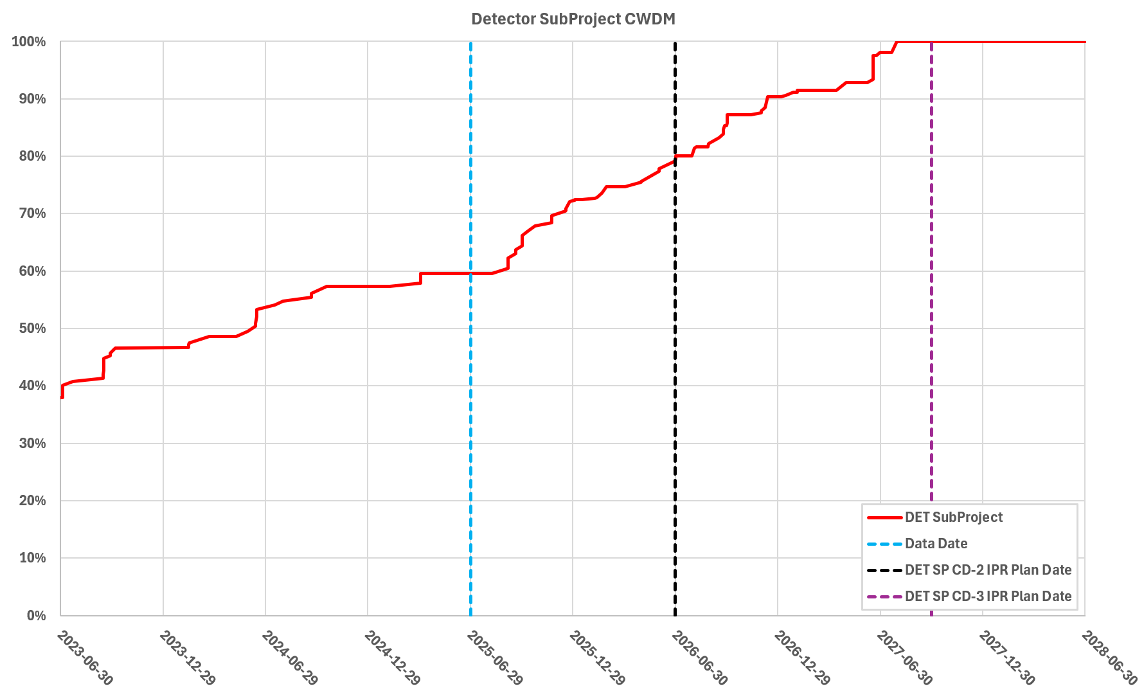

Path to Baseline – Design Maturity
Cost-weighted design maturity:
Present design maturity >60%
Jun. 11-13: Comprehensive Design Review by DAC
Projected ~80% in June 2026
Nov. 12-14: Baseline Readiness Assessment review planned. (postponed to Feb. due to impacts of government shutdown)
All 26 subsystems have already received at least one PDR
Until Late 2025/Early 2026: 6 subsystems need a final PDR
Until CD-3 (Q1FY28): 17 FDR

Slide 9
Project Strategy Workshop (Dec 4, 2025)
Goal: Engage stakeholders in the development of plans for delivering the EIC facility and efforts to align with DOE funding guidance and the mission need.
Assess progress on revising plans based on new funding guidance
Discuss plans and results of the Assessments of Baseline Readiness
Discuss plans for establishing subproject baselines and starting construction in 2026
Participants: EIC primary points of contact and DOE observers
Chairs of Advisory Committees, Steering Group, and EIC Governance Boards
EIC Users Group and ePIC Collaboration Leadership
EIC Project Advisory Committee Chair and/or members
Format: Similar to Aug 2024 Project Strategy Workshop (Focused on Subprojects)
August 2024 Indico Site: https://indico.bnl.gov/e/PSW

Slide 10

Software and Simulation Readiness for the preTDR
Process design phase
Writing
(TDR/notes)
Prepare papers for
publication
Structuring the
effort
preTDR v2.0
Review v2.0 (internal/external)
preTDR v1.0
Dec. 24
December 2025 next pTDR draft
Mid Jan.24
Mid Mar.24
In 2024, we defined preTDR readiness for software and simulations with the collaboration—and successfully met those goals. In 2025, we renewed our priorities at the Frascati Collaboration Meeting, with many topics under our charge already reaching an advanced stage and positioning us well for the next phase.
Our advanced software and large-scale simulations serve as the backbone of both the pre-TDR efforts and the development of the Early Science Program
Strong emphasis is placed on coordination with Physics WGs on simulation targets, reconstruction
Surveys of DSCs provided insight into both ongoing activities and future plans.
Plan to use the October simulation campaign (25.10) for the detector and physics studies in next pTDR version.

Slide 11
Software Release 25.10
Tagged ePIC 25.10.0 geometry (TODO), select notable changes:
Updated refraction index for dRICH (Chandra)
New Inner Barrel SVT geometry (Shujie)
New Outer Barrel SVT geometry (Aditya and Sam)
New SVT supports (Shujie)
Reduced overlap check tolerances (Wouter)
Tagged EICrecon 1.30.0, select notable changes:
Clustering for TOF/LGAD implemented - not yet used in tracking (Tommy)
Updated dRICH PID LUT (Ramandeep)
Resolved bug with overflow bin being populated for pfRICH PID LUT (Simon)
Low Q-2 ONNX workflow used by default, old TMVA implementation removed (Simon)
Reconfigured island clustering in ScFi to not use longitudinal hit position (Wouter)
Resolved issue with embedded background events missing calorimeter hits due to arbitrary timing cut (Wouter)
Enabled digitization for FTOF (Honey)
New reference positions for light attenuation in ScFi (Minho)
Updated SiPM and light yield parameters for EEEMCal (Dmitry)
Planned vs. Released Features
Geometry and Materials: ✅ Updated silicon outer barrel geometry, ✅ revisions to MPGD geometry, ✅ and material map update for FTOF.
Reconstruction: 🚧 ACTS patches to undo regressions with new material map generation, ✅ reworked low-Q² tagger momentum reconstruction, ✅ and clustering in TOF.
Ongoing Discussions: ✅ EEEMCal performance to be addressed, ❌ forward ECal geometry, ❌ random noise injection, ❌ and secondary vertexing under discussion.
We met all goals set for the 25.10 software release.

Slide 12
Software Release 25.10: Patches
Release Version | Release Date | Description
25.10.0 | 10/17 | Initial Release
25.10.1 | 10/30 | EICrecon was updated at Alex Jentsch’s request to enable polynomial interpolation in far-forward reconstruction, with the agreement of the Exclusive PWG and PACs.
25.10.2 | 11/03 | Correction to 25.10.1.
25.10.3 | 11/06 | Fixed a memory issue related to backgrounds.
25.10.4 | 11/11 | Correction to 25.10.3.

Slide 13
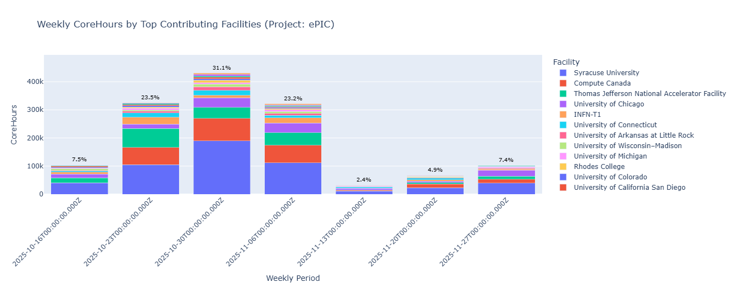
Simulation Campaign 25.10: Simulation Requests
The 25.10 simulation campaign included many new requests from the PWGs, including, for the first time, productions for the 10×100 beam energy configuration with embedded background.
Agreed with the PACs to complete all simulation production requests marked with priorities 1 and 2,
These requests are outlined in our simulation request overview.
This copy is color coded to show priority 1 (red) and priority 2 (yellow) items that are yet to complete.
Most of the priority 1 productions were available by November 18, and many productions are now available.
102M core hrs (Aug) -> 140M core hrs (Oct)
The productions with the 10×100 beam energy configuration and embedded background are delayed due to another memory issue that remains to be resolved. This issue is related to the high occupancy, with O(1000) hits within the time window of the MAPS.

Slide 14
Simulation Campaign 25.10: Future Plans
The December campaign will also cover all requests with priority levels 1, 2, and 3.
The memory issue affecting simulation production with 10 GeV electrons is not yet resolved. Therefore, in the December campaign, we will process all productions except those involving the 10×100 beam energy configuration.
Will include smaller productions with the 10×100 beam energy configuration and the 10×275 beam energy configurations for tracking and vertexing studies.
Once the memory issue is resolved, we will revisit this plan.
The October simulation campaign was overall a big success:
First campaign to try to systematically integrate background in simulations
Processed a much larger set of simulation requests than in the past
We continue to owe a huge debt to the Production WG conveners
Plan to build on this success in the December campaign, set 2026 simulation roadmap at the January collaboration meeting.

Slide 15
ePIC pTDR and Publication Plan
process design phase
writing
(TDR/notes)
Prepare papers for
publication
structuring the
effort
preTDR v2.0
Review v2.0 (internal/external)
December 2025 pTDR next draft
NIM Special Issue
mid-2026
Mid Jan.24
Mid Mar.24
pTDR v1.0
Dec. 24
July 2025
Formation of Editorial Board
Will open a NIM Special Issue in early 2026, open for ~6 mos
Goal of the issue is a comprehensive overview of ePIC
Paperwork in preparation
Potential solution to open access costs identified but not yet secured
Plan to publish a super-set of the material prepared for the pre-TDR
Subsystem technical papers derived from pTDR
Physics performance paper spin-off from pTDR (full collab author list)
Early Science whitepaper (full collab. author list)
Exclusive, Diffraction and Tagging paper
Streaming Computing Model publication also in preparation
Full collab. author list
Confirmed with NIM editors that S&C papers are welcome

Slide 16
Upcoming Small-Author Paper
Physics Analysis Coordination has discussed the intention to provide ePIC simulation data for a small-author list paper:
Inclusive electron-proton measurement prospects in early Electron-Ion Collider running
Javier Jiménez-López, Stephen Maple, Paul R. Newman, and Katarzyna Wichmann
ePIC simulations are used to obtain statistical precision from an event generator sample.
This falls under “Technical and simulation papers with limited authorship”
Section 5.2 of the publication policy
ePIC Public Result (Performance) under our results release policy
Requires an approved analysis note, all results and plots documented and in Zenodo
Planning a presentation to the collaboration in Dec. 16th Physics Forum

Slide 17
Additional Simulation Results for Approval
Exclusive, Diffractive and Tagging PWG:
DVMP (π⁰), diffractive phi in eA results
A1 projections from eHe³ collisions and double tagging
SIDIS Early Science Results (TBC)
In collaboration with Marco Radici for projections
Approval of performance requested to make plots available for use in presentations at conferences, etc.
It’s time to start showing ePIC results…
These are also “ePIC Public Result (Performance)” under our results release policy
Requires an approved analysis note, all results and plots documented and in Zenodo
Planning presentations to the collaboration in Dec. 16th Physics Forum
More on the upcoming “Physics Forum” in the talk from Rachel and Sal.

Slide 18
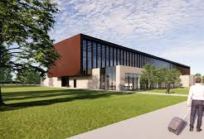
January 2026 Collaboration Meeting
Jan 20-23rd, 2026 at Brookhaven National Laboratory
In new Science and User Support Center (SUSC)
Registration is OPEN! https://www.bnl.gov/epic-meeting/ Due Jan 7th!
Guest registration for non-US citizens: https://www.bnl.gov/guv/gis.php
Early-career travel support available https://www.epic-eic.org/collaboration/travel_support.html
Registration for online participation required (no fee)
Workfest proposals (were) due Nov. 28th
A huge thanks to Thomas and the BNL LOC for organizing the meeting on short notice.

Slide 19
DRAFT Block Agenda – Jan 2026
Tues 1/20
Wed 1/21
Thurs 1/22
Fri 1/23
Intro Plenary
Workfest 1
CC Mtg
Plenary
8/9 AM-Noon
Plenary
Workfest 2
Plenary
Workfest 4
Excursion
1PM-5PM
S&C Plenary
Conf Dinner
Workfest 5 (if needed)
6PM-8PM

Slide 20
DRAFT Workfest Schedule
PENDING: Calorimetry Calibrations workfest
Wed 1/21
Fri 1/23
TDR+ESR 1 Rachel/Sal
CALOROC Norbert/ Carlos
Streaming WG Marco++
Integration Prakhar
8/9 AM-Noon
TDR+ESR 2 Rachel/Sal
FFWD DSC (pixel AC-LGADS) Alex/Yulia/ Dominique
Electronics/DAQ Jeff/ Fernando
PIC CC WG Brian/ Sourav
AI in ePIC
S&C
Joint SW-CCWG PID Derek++
Jets/HF
RongRong/Shyam
ExDF
Stephen/ Kong
1PM-5PM
6PM-8PM (2 hrs)
Discoverable Software Stephen/ Holly
The workfest schedule will be very full and run through the end of the day Friday. Plan your travel accordingly!
Thurs 1/22

Slide 21
What’s Ahead in 2026
It is imperative that the EIC project transition to a construction project in 2026.
Must develop a project plan that fits budgetary, and mission need constraints
Continue to make technical progress that justifies the CD-2/3 milestones
This transition will not be easy.
The collaboration has been successful by continuing to push on the technical readiness of the ePIC design and developing the Early Science physics program.
This puts us in the best position to advocate for EIC science!

Slide 22
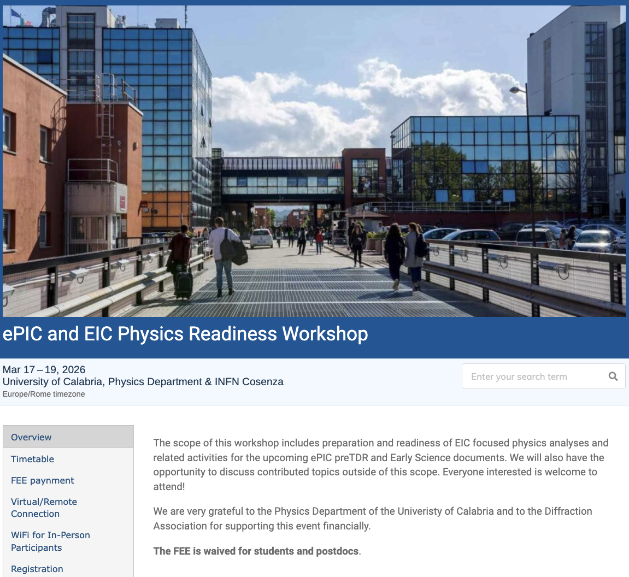
The discussion on performance continues!
Next Physics Readiness Workshop scheduled for March 17-19
Hosted by the University of Calabria & INFN Cosenza
Indico: https://indico.bnl.gov/event/30283/
Hybrid format - Please register even if attending online (select proper option)
€150 FEE waived for students/postdocs
Possibility (limited) for ECRs support
The workshop will focus on the finalization of studies and text for the TDR and early science documents

Slide 23
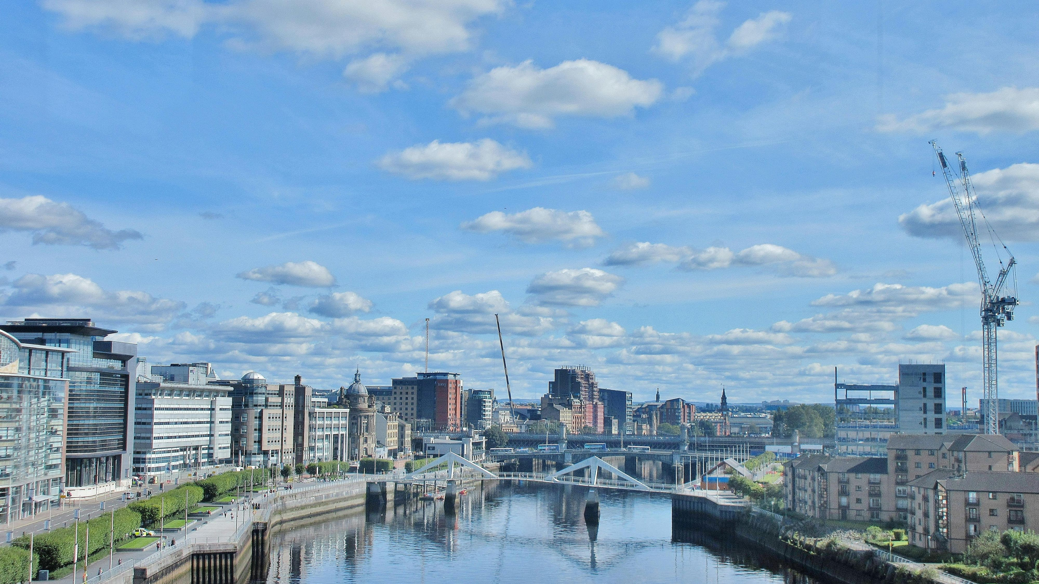
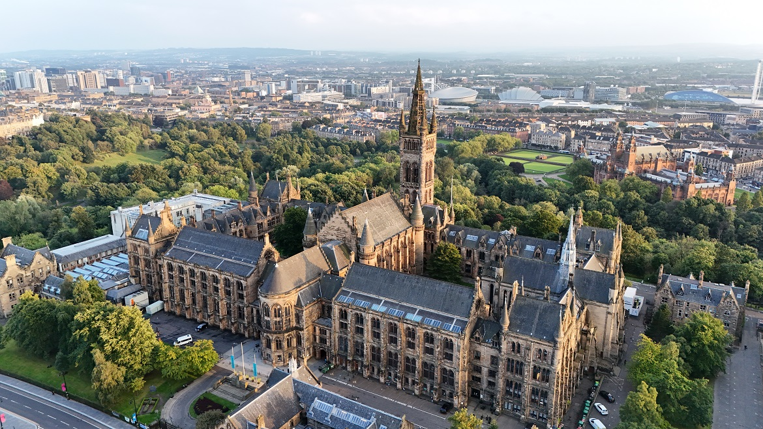
Summer 2026 Joint EICUG/ePIC Meeting
After discussions with the EICUG SC, the ePIC CC Chair/Vice-Chair, and the ePIC Spokespersons and coordinators, we have accepted a bid by the UK to host the Summer 2026 joint EICUG/ePIC meeting at the University of Glasgow July 13-17th , 2026.
More information coming soon!

Slide 24
Conclusion
There is an enormous amount of activity in ePIC, and that activity is increasing rapidly!
Supporting the EIC project IPR/PDR and DET review process
Completing the next draft of the pTDR
This is a whole of the collaboration effort! (TC, S&C, PAC)
Development of the ePIC Streaming Computing Model
Physics WG’s developing analysis for pTDR and Early Science WP
Carry this momentum forward into 2026!
ePIC Collaboration Meeting – Jan. 20-23rd @ BNL

Slide 25


Slide 26

ePIC Resources
Public Website - https://www.bnl.gov/eic/epic.php
Mailing Lists – https://lists.bnl.gov/mailman/listinfo
Indico Agenda - https://indico.bnl.gov/category/402/
ePIC Software and Computing: https://indico.bnl.gov/category/435/
Wiki - https://wiki.bnl.gov/EPIC
ePIC Software Training:
Landing Page: https://eic.github.io/documentation/landingpage.html
Tutorials: https://eic.github.io/documentation/tutorials.html
Mattermost: https://chat.epic-eic.org
ePIC Zenodo Community: https://zenodo.org/communities/epic

Slide 27


EICUG Membership
The EICUG is a vital organization to promote the interests of the EIC community!
Without the EICUG we would never have gotten far enough to form ePIC!
Please register your institution!
Check with your EICUG IB representative to get registered as a member
https://www.eicug.org/content/join.html

Slide 28
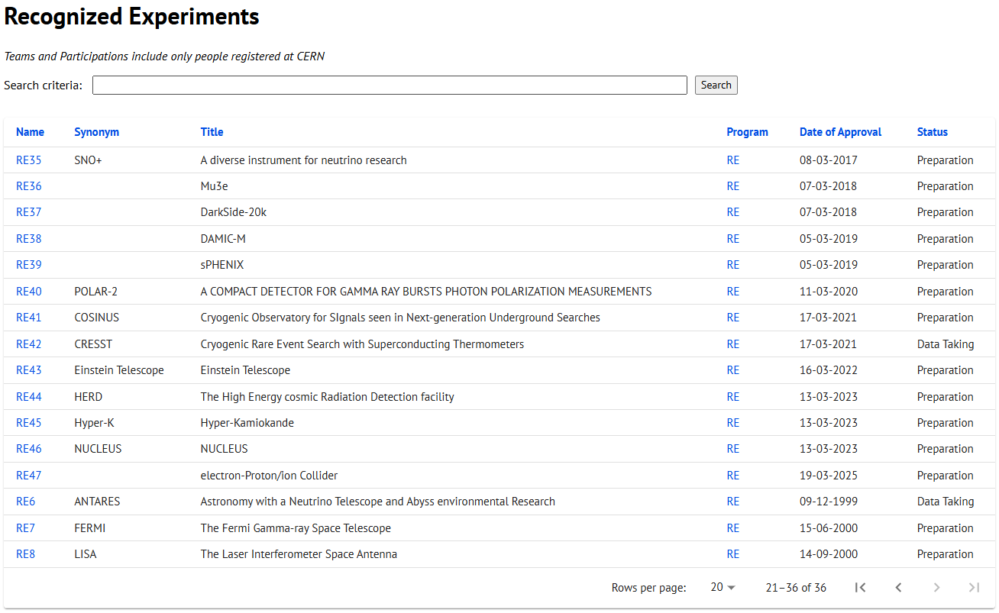
CERN Recognized Experiment Status: RE47
ePIC now appears in the CERN Grey Book database as RE47: https://greybook.cern.ch/experiment/recognized
Two steps to get ePIC Collaborators registered at CERN:
CC Representative needs to register as team leader with CERN Users Office:
https://usersoffice.web.cern.ch/
https://usersoffice.web.cern.ch/team-leaders-corner
Users.Office@cern.ch
CC member can then certify registrations of team members
Contact us if you run into problems!

Slide 29



2025 -2026
PDR: DAQ - Slow Controls
Spring 2026
PDR2: Polarimetry
Week of Feb 18-19, 2026
DOE OPA Status 5-7th August, 2025
PDR3: IR Integ. & Aux. Det
March/April 2026
PDR2: Si Tracking Detectors
Week of Jan 26, 2026
10th Detector Advisory Committee June 11-13th 2025
ePIC Physics Readiness Workshop Sept. 17-18th, 2025
PDR: HCals/fwd ECal
Oct. 30-31, 2025
PDR2: Cerenkov PID
April 1-2, 2025
FDR: BABAR DIRC Bar Refurbishment
ePIC Early Physics Workshop April 24-25, 2025
PDR2: MPGD Detectors
Dec 2025
PDR2: AC-LGAD Detectors
Dec. 2025
ePIC Software and Computing Review Oct 6-7, 2025
ePIC Software and Computing Technical Interchange – May 12th
PDR: Magnet/Cryo Infrastructure
Nov. 4-5th 2025
FDR: Backward EM Calorimetry
Feb 2026
BIC In-Person Workshop April 9-11, 2025
SVT Summer Workfest June 9-11, 2025
PDR3: Elec./DAQ
Sept. 3-4th, 2025
Frascati
Jan 20-24,2025
ePIC pre-TDR
Next Draft (Dec 2025)
DOE IPR and ICR, 9-13th March. 2026
Jefferson Lab. July 14-18
BNL Jan. 20-23
PDR: Integ. + Installation (inside and outside GST)
Week of Dec. 8th, 2026
Calorimetry Workshop June 5-9th, 2025
PDR3: Barrel EMCal
Sept. 17-18th 2025
Detector Baseline Readiness Review February 3-5,2026 (tentative)
EICO 2-4th April 2025
FDR: Backward & Forward EM Calorimetry, Barrel & Forward HCAL
July 2025
HSF-India/ePIC Workshop May 13-17th, 2025
6th EIC RRB Meeting Nov. 4-5th 2025
5th EIC RRB Meeting
June 5-6th 2025
SVT Workfest Dec 15-19, 2025
CD-2 Review Late 2026
Detector R&D Day (ePIC/Project) 16-17th April 2025

