Slide 1


Physics Forum
Salvatore Fazio, Rachel Montgomery, Rosi Reed
4th December ePIC General Meeting 2025

Slide 2
Motivation for Physics Forums
Lots of activities and progress in PWGs - many analyses soon looking to release ePIC Public (Performance) Results based on simulation studies
Released Performance Results can be used for publications, conference talks and showcasing our physics to wider community
Release procedure in accordance with ePIC Results Release Policy
Policy: https://zenodo.org/records/15390156
In addition, we want to establish a custom of holding a Physics Forum linked to each release of Performance Results
Physics Forums aim to …
Encourage dialogue between analysers, PWGs, and ePIC Collaboration
Generate awareness on the physics linked to the results and collect feedback from the Collaboration on Performance Results being released
Highlight work and efforts of analysers

Slide 3
Summary of Foreseen Steps
This is a summary only - please see the Results Release Policy for full details
Principle Analysers (PA) present analysis in PWG meetings and write Analysis Note (AN)
For Performance Results - AN can be brief and should include descriptions of e.g.:
Production campaign; how analysis was performed; cuts, how plots were made
Link to code for reproducing plots and metadata for collaboration
PWG Convenors approve the AN and release the results
PACs review and confirm approval of the AN and results release, and assign an official AN tag
AN and plots uploaded to Zenedo and circulated
PA gives presentation at a Physics Forum open to ePIC Collaboration for discussion and feedback
Performance Results released for Collaboration use (talks, papers, documents … etc)
Released Performance Results can be shared with phenomenologists for impact studies

Slide 4
First Physics Forum Planned for Dec 16th
First Performance Results related to physics analysis ready to be released!
For Physics Forums we currently plan to stick with regular PAC meeting slots, but we will ensure the Collaboration is made aware in advance that a Physics Forum is taking place
Upcoming agenda plans to include analyses from Exclusive, Diffractive and Tagging, and Inclusive Physics Working Groups:
Inclusive proton structure functions in ep collisions (Stephen Maple, University of Birmingham)
Diffractive phi production in eAu collisions (Maci Kesler, Kent State University)
Exclusive pi0 production in ep collisions (Jihee Kim, BNL)
A1 projections from eHe3 collisions and double tagging (Win Lin, Stony Brook University)
The releases of these results are linked to forthcoming papers (see John’s talk)

Slide 5
Everyone in the Collaboration is invited to join us at the first Physics Forum on December 16th!
We encourage you to come and hear about the interesting ePIC Public (Performance) Results being generated by the PWGs and join the discussions surrounding the physics
Date: 16th December 2025
Time: 11:00 am ET
Indico with zoom link: https://indico.bnl.gov/event/30818/
This is the first of many Physics Forums to come - there are more analyses in the PWGs which are very close to being ready for release of ePIC Public (Performance) Results

Slide 6
Other On-going Activities - Workfest Planning
We are working on our agendas for the physics workfests at the January Collaboration Meeting
Currently in planning for:
2x half-day sessions for “Physics Readiness for TDR and Early Science Report”
Combined amongst all PWGs
Agenda will also include synergistic topics amongst PWGs (e.g. backgrounds, systematics, electron finding).
Exclusive, Diffractive and Tagging PWG will have 1x half-day workfest
Topics will include new analysis opportunities and new activities in the PWG
Still collecting inputs for workfest topics (reach out if you have ideas or suggestions)

Slide 7
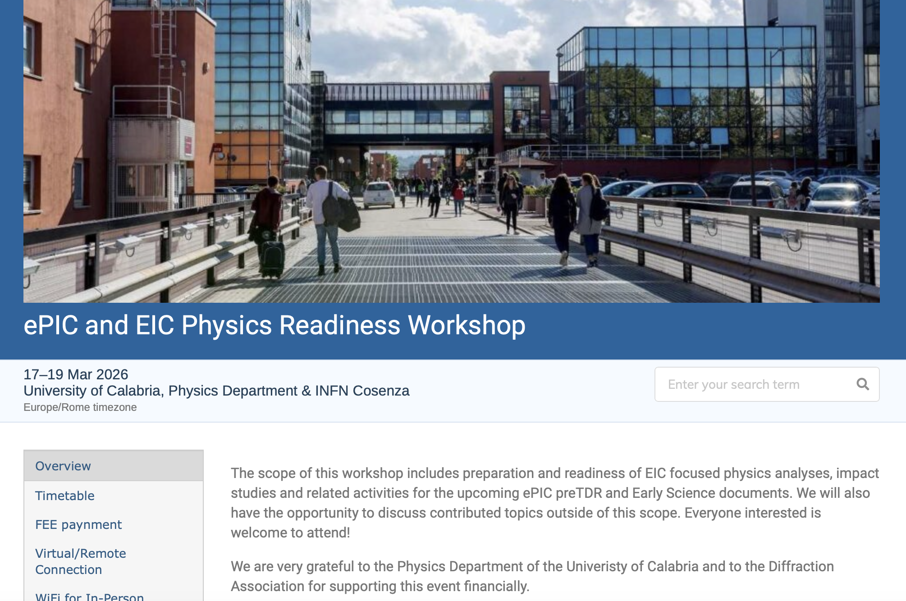
Other On-going Activities - Early Science+TDR Workshop
In addition to on-going preTDR efforts, we are busy preparing for
Early Science Report (due May 1st)
Physics Readiness Workshop in Calabria March 17-19 2026
Please register for the workshop if you are keen to join. All welcome!
Registration: https://indico.bnl.gov/event/30283/overview
Fee waived for ECRs

Slide 8
Thank you and hope to see you at the first Physics Forum…🙂

