Slide 1
Update on Stave Design and Prototyping
19/11/2025

Slide 2
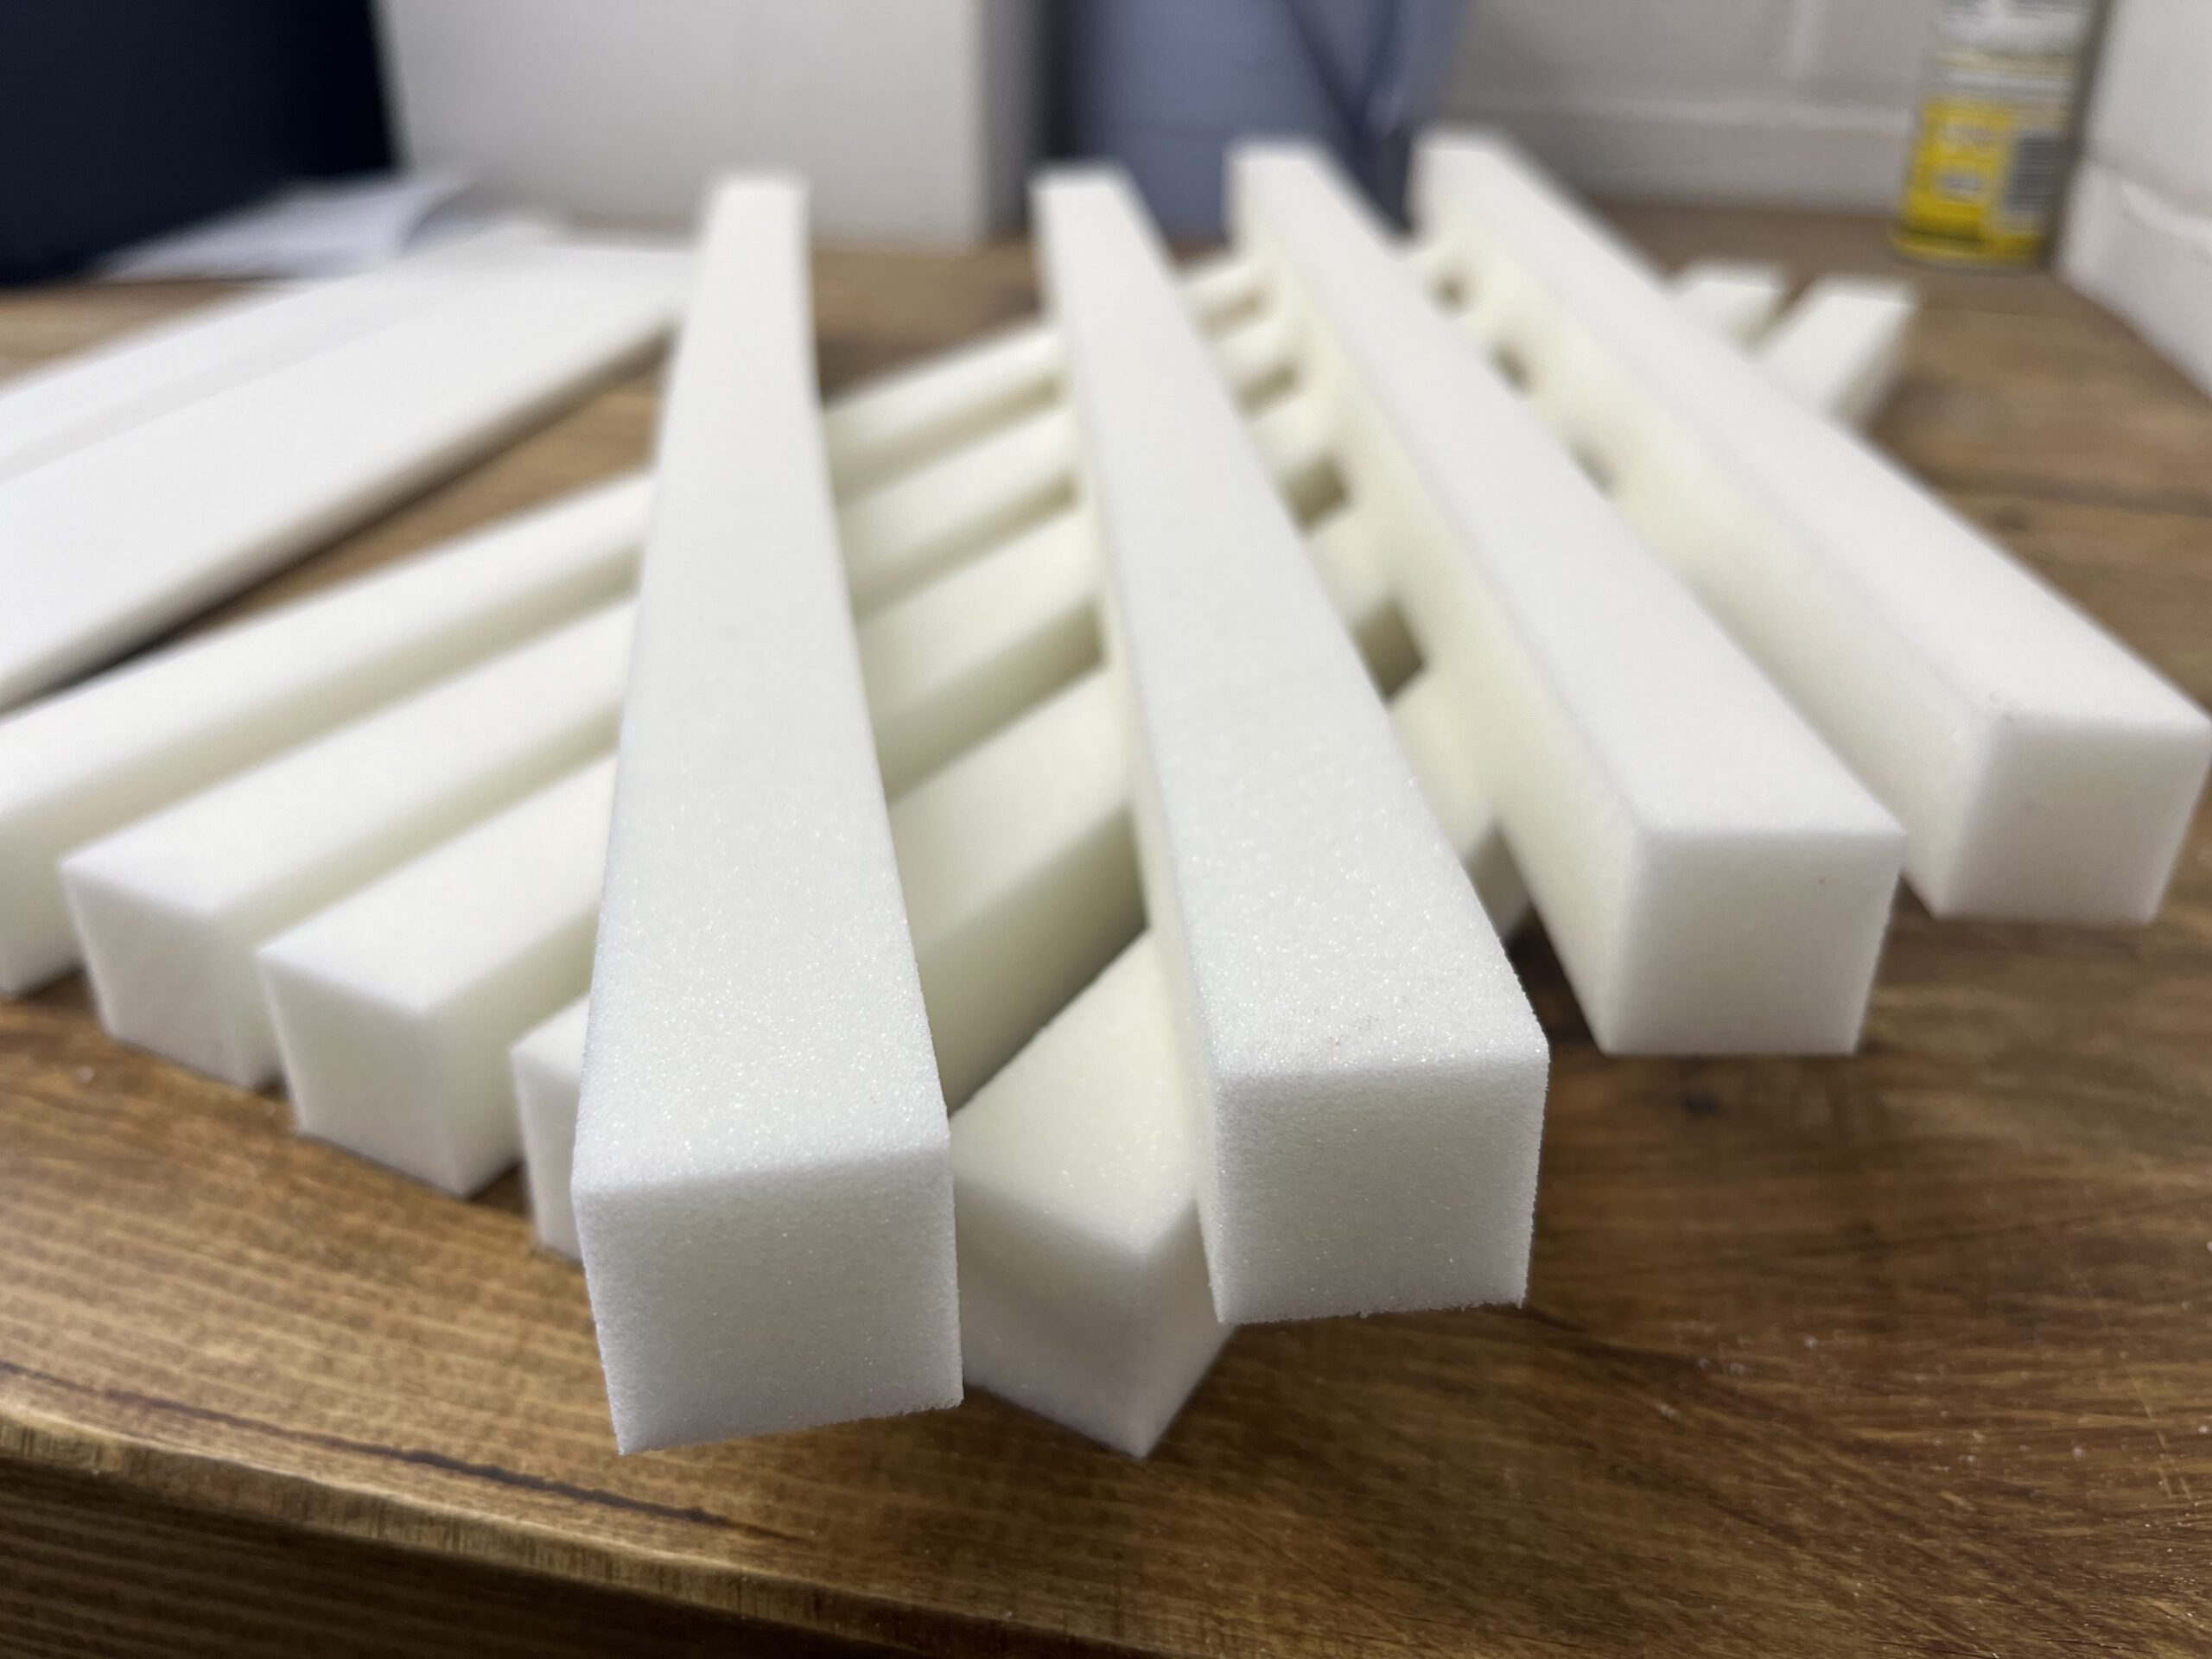
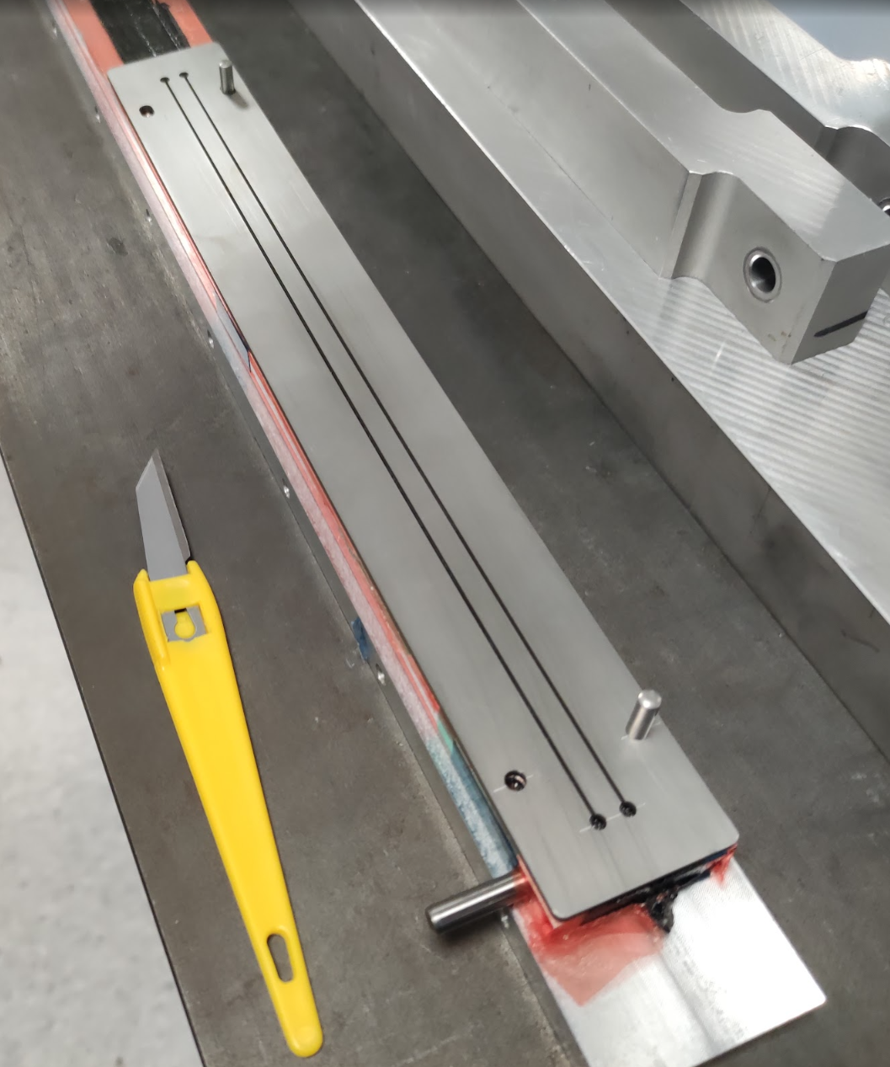
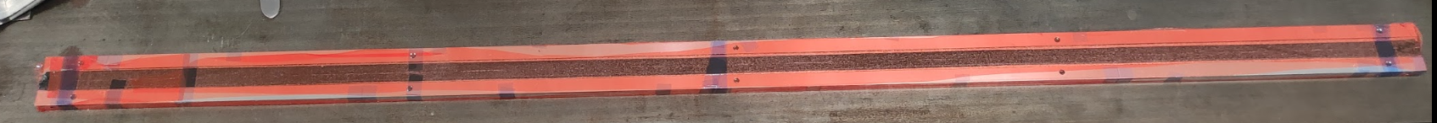
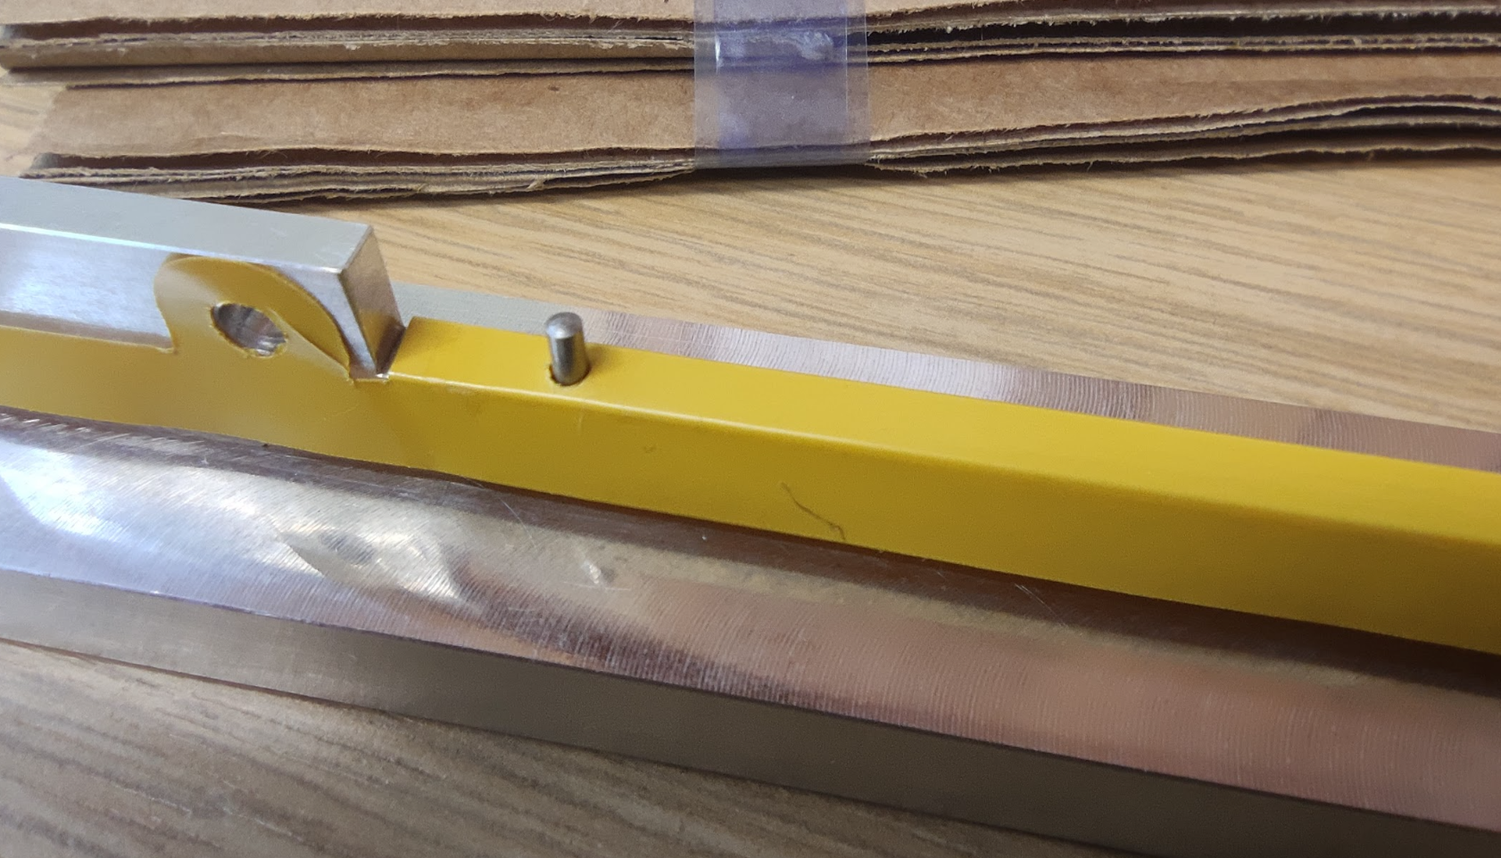
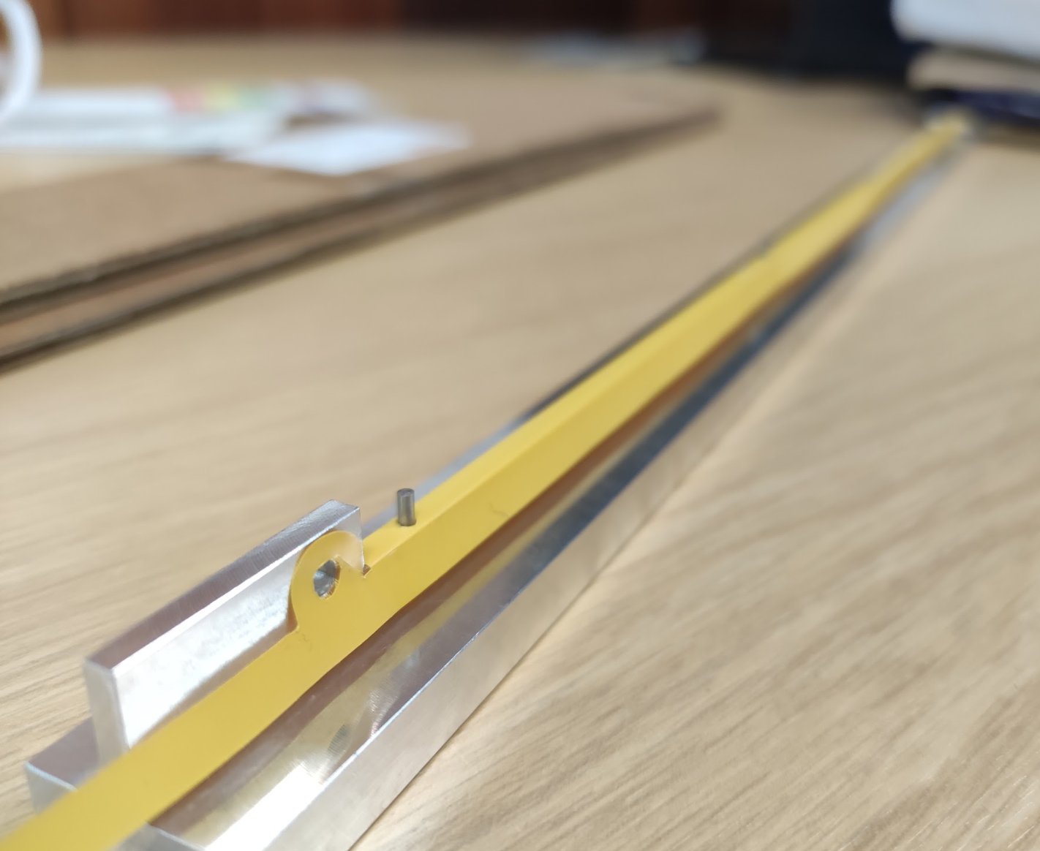
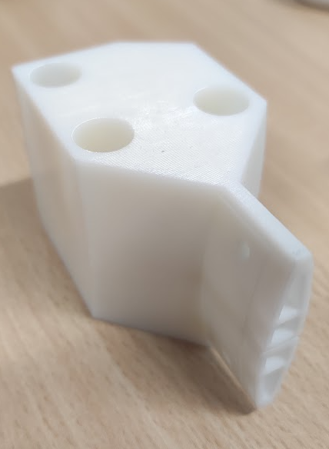
First Full Length L4 Prototype
Based on old geometry with minimum overlap between modules
  Up to date L4 stave would be shorter (by approx. 50 mm)
New tooling for FPC & I-beam manufacture tested
  Kapton thermal forming tooling works well, alignment holes are very effective
  I-beam tooling may need refinement, very difficult to remove
6 of 18 K9 foam blocks replaced with Rohacell 110
  Low thermal conductivity, closed cell foam, holes added to allow airflow
Redesigned stave ends for vibration & flow testing
CF Trimming Tool
Kapton FPC Forming Tooling
Stave End Supports

Slide 3
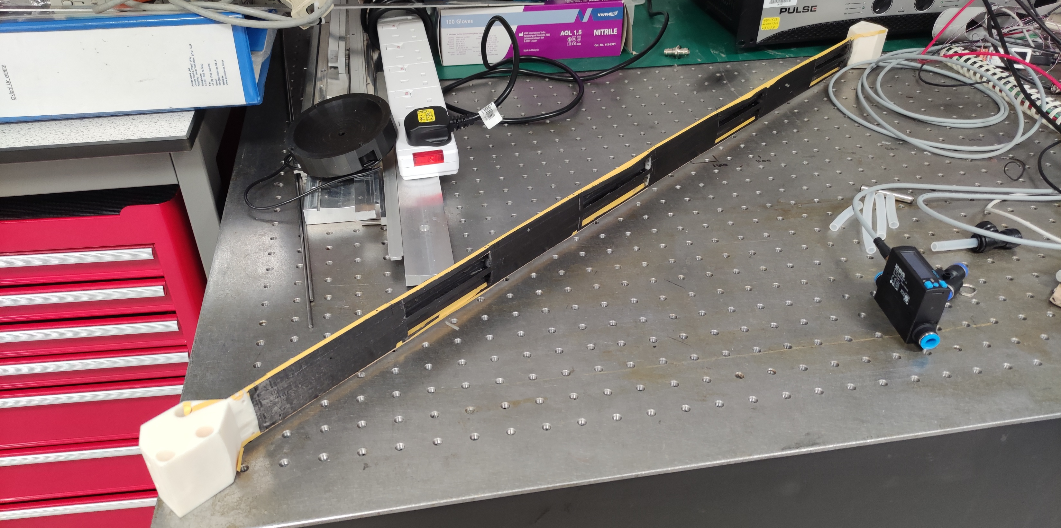
First Full Length L4 Prototype

Slide 4
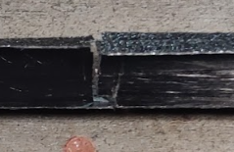
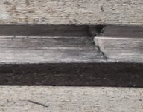
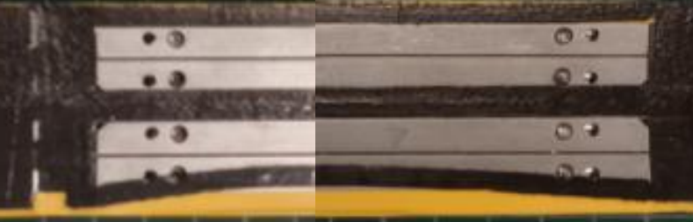
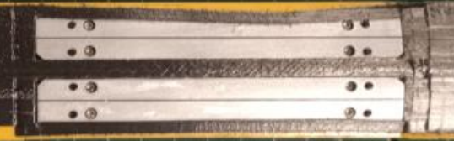
First Full Length L4 Prototype
Imperfections:
  I-beam fractured in 2 places during mould removal
    Joints luckily lined up with foam cross braces, impact on stiffness expect to me minimal (couple of % level)
  I-beam top T joint has split in sections, this may have occurred during internal tooling removal (discussed in next slide)
  Some of the thin carbon fibre section which run along the Kapton moved/split
    K13 C2U is not very tacky
    Movement most likely occurred during release film wrapping
    Silicone intensifier layer again may help
  High amount of epoxy seepage between mould parts
    CF consolidation is still very good
    Tooling was difficult to remove!
    Glue created a rim around the tooling parts
    CF face sheets pierced a couple of times during tooling removal

Slide 5
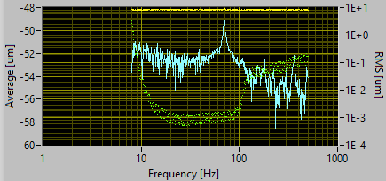
L4 Stave Prototype Vibration Response
Stave suffered some damage during mould removal
  Some holes in CF facesheet (expect only cosmetic effect)
  More seriously: gaps underneath CF bridges on top of I-beams (5 out of 8)
    Not clear whether this is facesheet bridge not bonded to I-beam, or split at the top of the vertical section I-beam
    Applied Araldite to gap, and cured with tape holding down
Frequency scan of the stave response (fixed-fixed constraint):
  1st mode at ~71 Hz (was 57 Hz before repair)
  Will instrument setup with more sensors so that we can study mode-shapes in more detail (longitudinal and torsional)

Slide 6
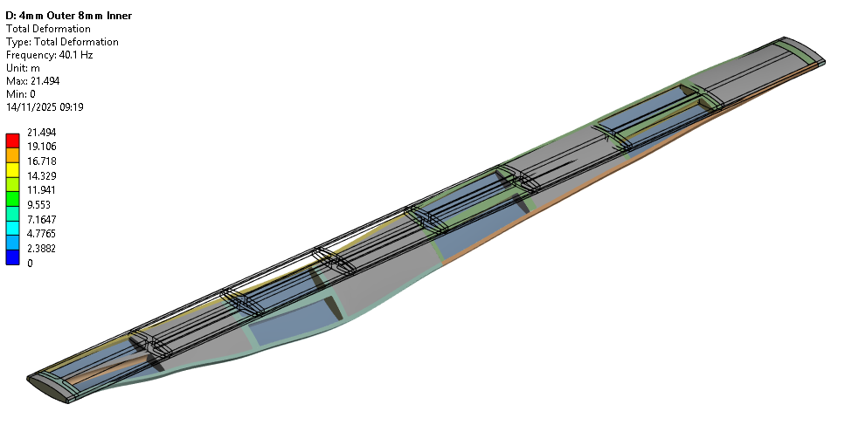
FEA Modal Analysis – No Modules

Slide 7
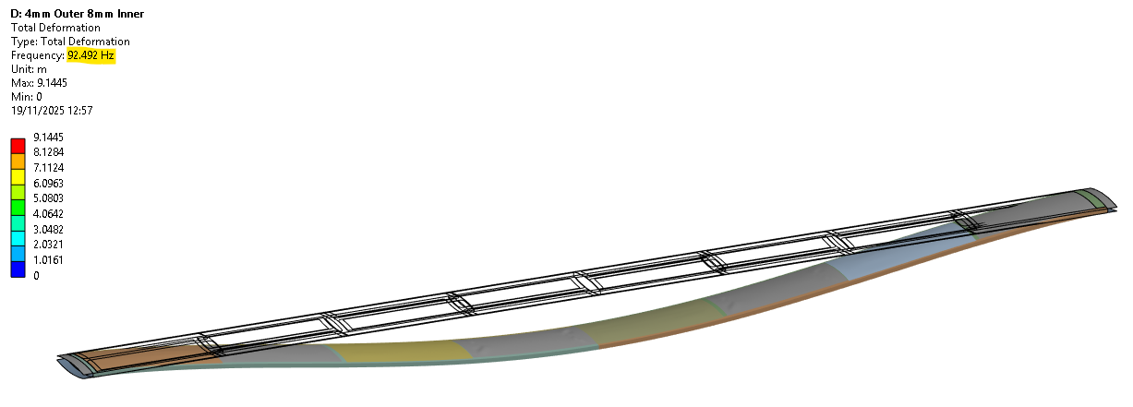
FEA Modal Analysis – 50-micron Steel Shim

Slide 8
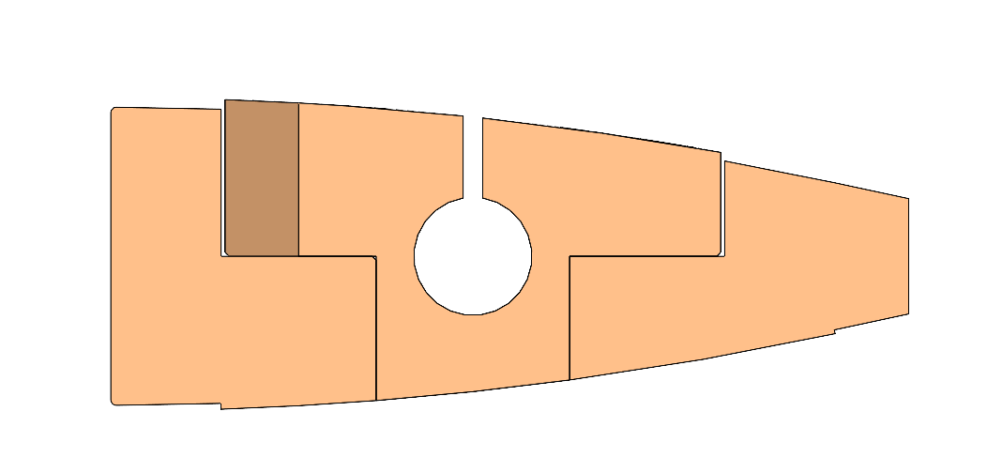
Improvement Plan
Further QSPs will be used to test tooling/assembly improvements
  Step 1
    Flashbreaker tape to cover module tooling part joints
      Stops epoxy leaking into tooling, should be easier to remove
  Step 2
    FPC alignment with pin holes in FPC & cross braces
      FPC position will be the driver of module position
        Positional tolerance sub-mm
      ~10 µm positional accuracy requirement for bridge FPC to FPC alignment
  Step 3
    Curing I-beam in-situ
      Reduces risk of damage
Seepage Area
Flashbreaker

Slide 9
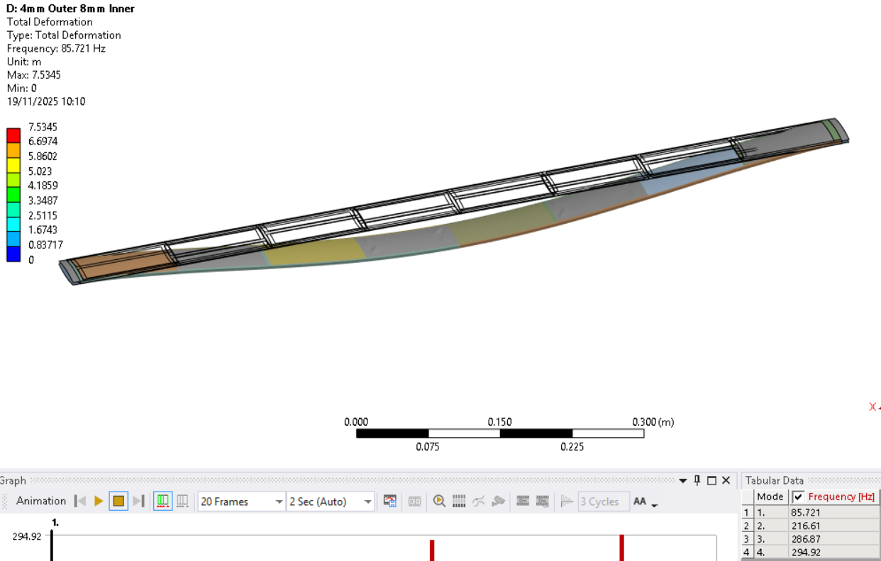
100-micron Steel Shim

