Slide 1
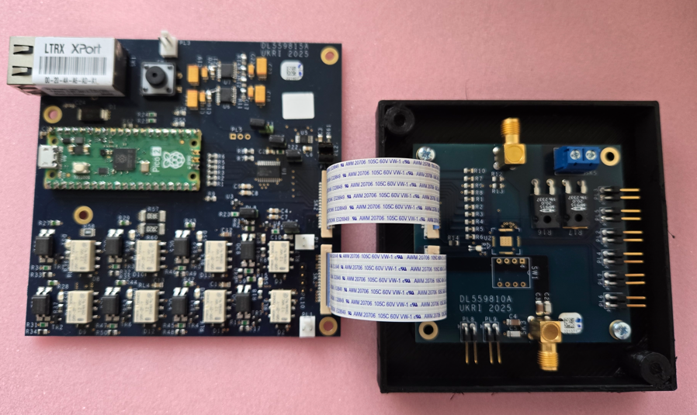
SLDO ASIC Test System
Presentation Outline
User Manual Preparation.
Test and Commissioning of the test system.
Conclusion & Initial Chip Tests.
Andrew Hill
STFC Daresbury Laboratory
Keckwick Lane
Daresbury
Warrington
Cheshire
WA4 4AD

Slide 2
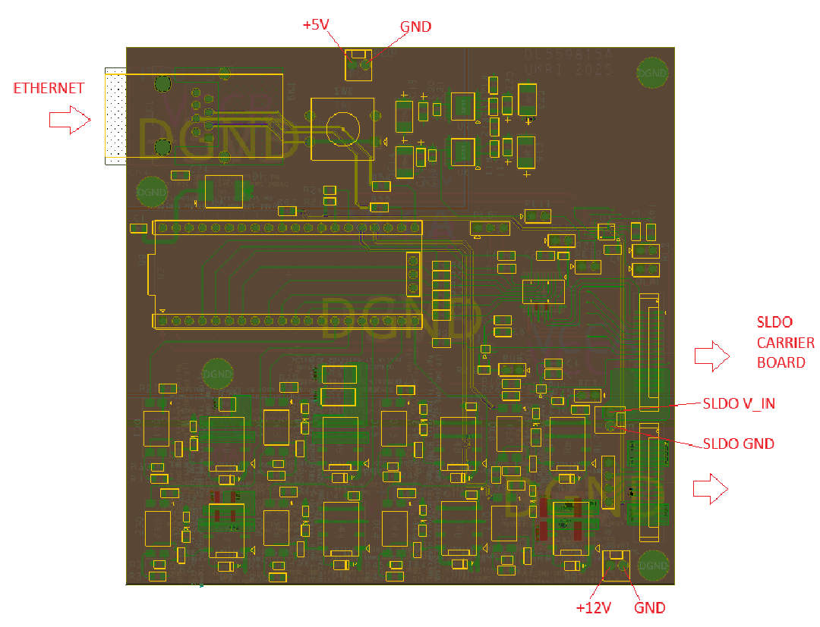
SLDO Test System Operating Instructions
Andrew Hill
STFC Daresbury Laboratory
Keckwick Lane
Daresbury
Warrington
Cheshire
WA4 4AD

Slide 3
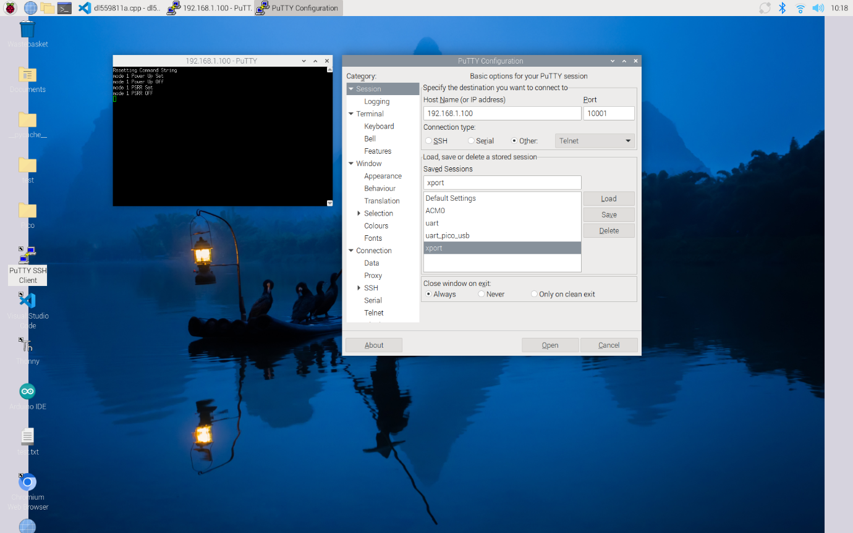
Communication
Andrew Hill
STFC Daresbury Laboratory
Keckwick Lane
Daresbury
Warrington
Cheshire
WA4 4AD

Slide 4
Commands
Command | Function
0x01 1 | Relay 1 ON 40mA Load
0x01 2 | Relay 1 OFF
0x02 1 | Relay 2 ON 500mA Load
0x02 2 | Relay 2 OFF
0x03 1 | Relay 3 ON 900mA Load
0x03 2 | Relay 3 OFF
0x04 1 | Relay 4 ON 100nF CAP
0x04 2 | Relay 4 OFF
0x05 1 | Relay 5 ON 1uF CAP
0x05 2 | Relay 5 OFF
0x06 1 | Relay 6 ON 10uF CAP
0x06 2 | Relay 6 OFF
0x23 1 | Relay 7 ON 10nF CAP
0x23 2 | Relay 7 OFF
Over Current Load. 0x24 1 | Relay 8 ON 1.6A Load
0x24 2 | Relay 8 OFF
Command | Function
0x07 1 | DIS_LATCH_Q_N ON
0x07 2 | DIS_LATCH_Q_N OFF
0x08 1 | SEL_EXT_DISABLE ON
0x08 2 | SEL_EXT_DISABLE OFF
0x09 1 | EXT_DISABLE ON
0x09 2 | EXT_DISABLE OFF
0x10 1 | ACTIVATE_OCP_N ON
0x10 2 | ACTIVATE_OCP_N OFF
0x11 1 | RESET_OCP_N ON
0x11 2 | RESET_OCP_N OFF
Command | Function
0x12 1 | CONTROL_4 ON
0x12 2 | CONTROL_4 OFF
0x13 1 | CONTROL_3 ON
0x13 2 | CONTROL_3 OFF
0x14 1 | CONTROL_2 ON
0x14 2 | CONTROL_2 OFF
0x15 1 | CONTROL_1 ON
0x15 2 | CONTROL_1 OFF
0x16 1 | CONTROL_0 ON
0x16 2 | CONTROL_0 OFF
Andrew Hill
STFC Daresbury Laboratory
Keckwick Lane
Daresbury
Warrington
Cheshire
WA4 4AD

Slide 5
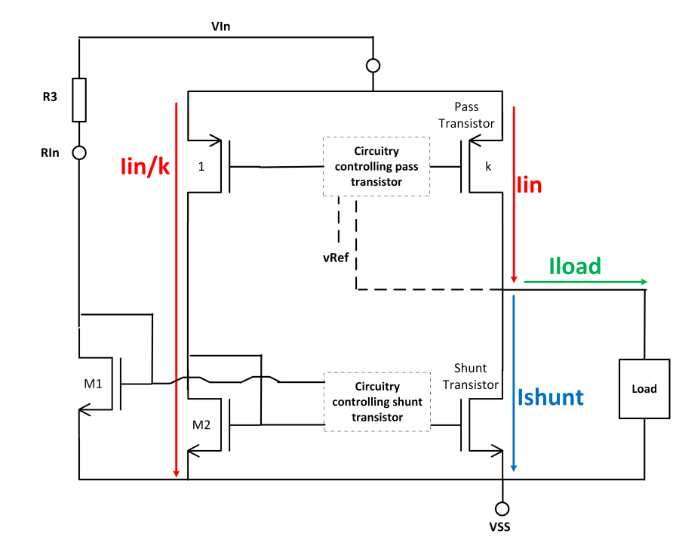
R_IN Value
Load on ASIC Output | Board | Value to send To Rheostat | Resistance Required
500mA | 1 | 1285 | 5.213K
900mA | 1 | 1167 | 2.906K
40mA | 1 | 1594+ (Fit 47K to PL2) | 58K
500mA | 2 | 1285 | 5.22K
900mA | 2 | 1167 | 2.911K
40mA | 2 | 1594 +(Fit 47K to PL2) | 58.02K
500mA | 3 | 1285 | 5.22K
900mA | 3 | 1167 | 2.909K
40mA | 3 | 1594 | 58K
500mA | 4 | 1285 | 5.219K
900mA | 4 | 1167 | 2.911K
40mA | 4 | 1594 + (fit 47K to PL2) | 58K
500mA | 5 | 1285 | 5.218K
900mA | 5 | 1167 | 2.916K
40mA | 5 | 1594 + (fit 47K to PL2) | 58K
Andrew Hill
STFC Daresbury Laboratory
Keckwick Lane
Daresbury
Warrington
Cheshire
WA4 4AD

Slide 6
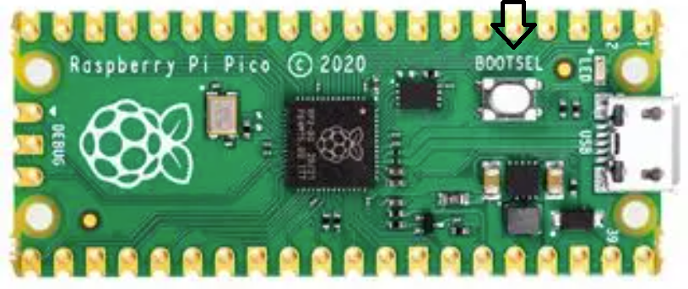
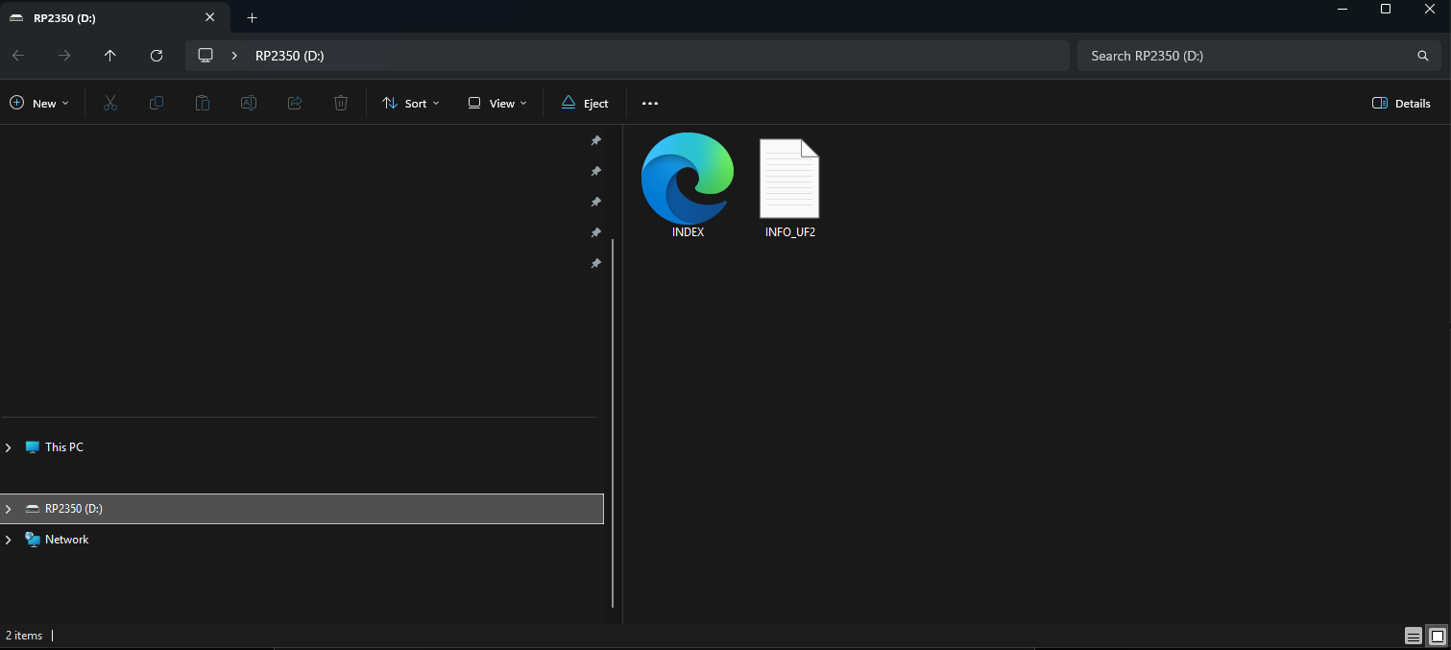
Program Update
Andrew Hill
STFC Daresbury Laboratory
Keckwick Lane
Daresbury
Warrington
Cheshire
WA4 4AD

Slide 7
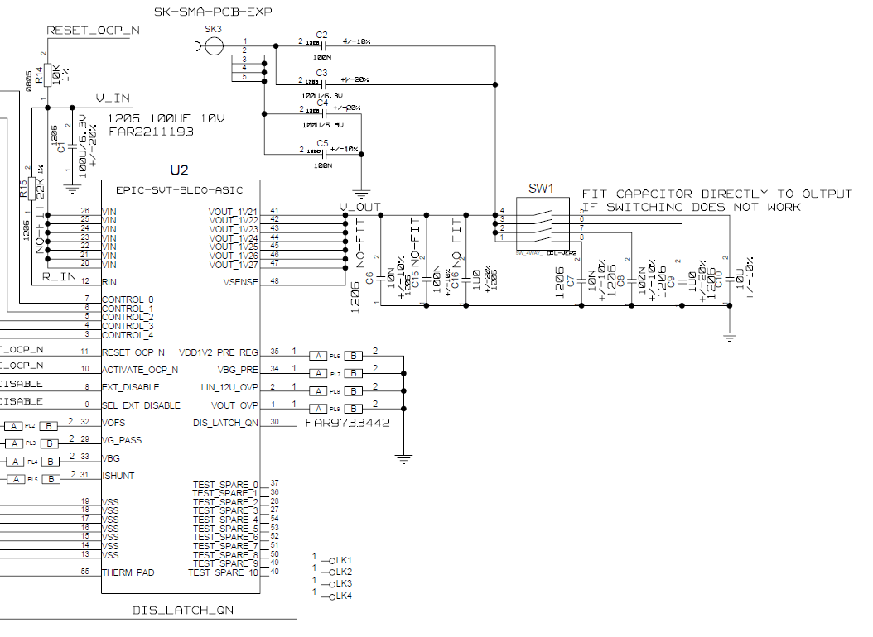
Just In Case
Andrew Hill
STFC Daresbury Laboratory
Keckwick Lane
Daresbury
Warrington
Cheshire
WA4 4AD

Slide 8
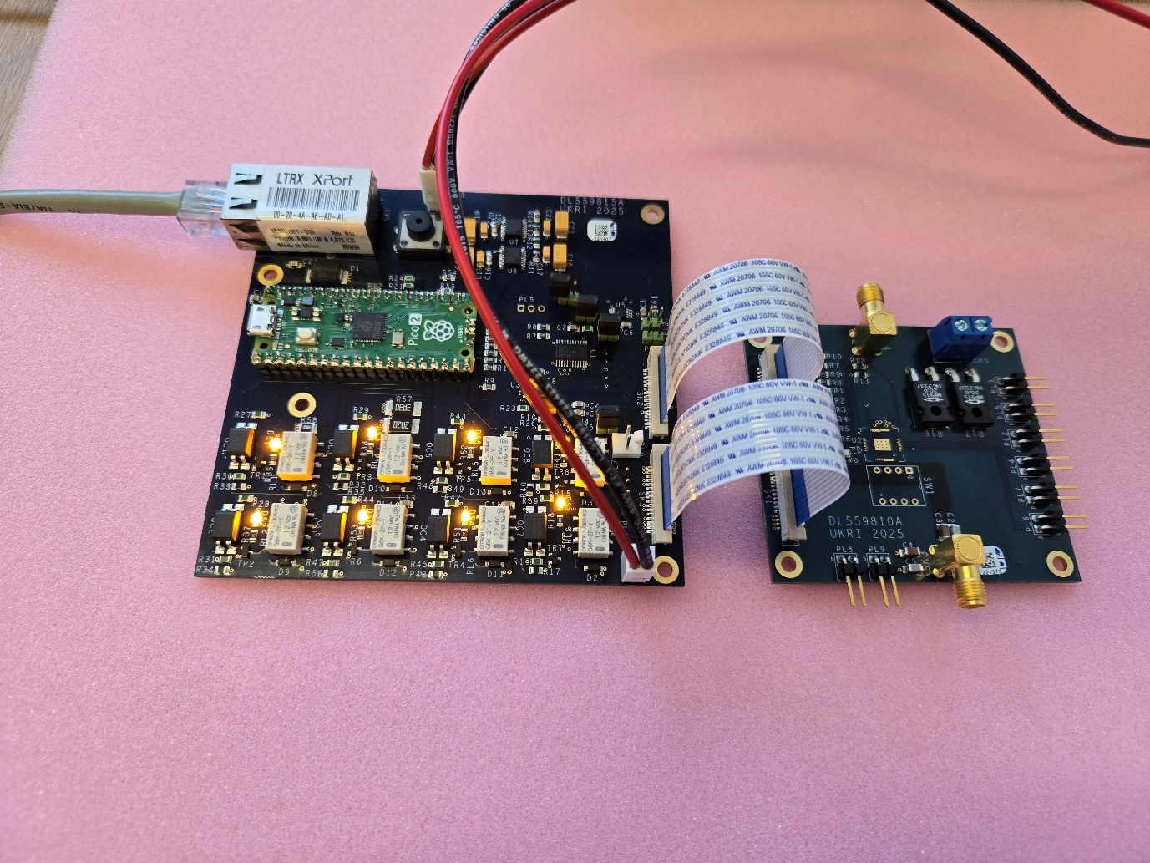
Test and Commissioning
Andrew Hill
STFC Daresbury Laboratory
Keckwick Lane
Daresbury
Warrington
Cheshire
WA4 4AD

Slide 9
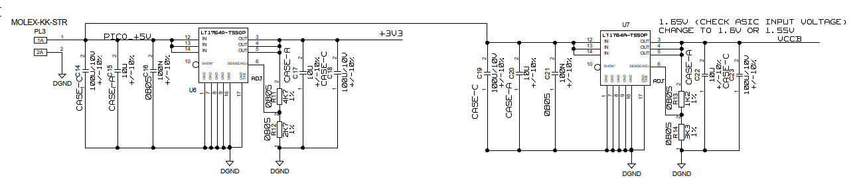
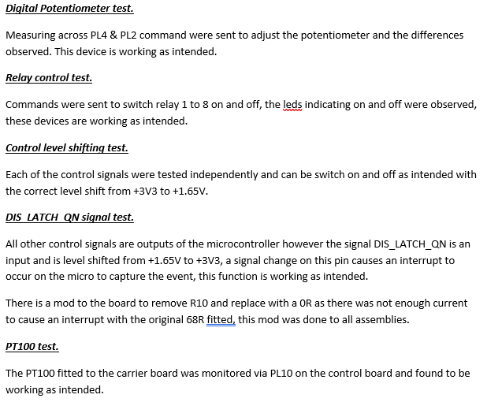
Configuration and Initial Tests
DL559815A Initial configuration: -
Board 1 IP address set to 192.168.1.100
Board 2 IP address set to 192.168.1.102
Board 3 IP address set to 192.168.1.101
Board 4 IP address set to 192.168.1.104
Board 5 IP address set to 192.168.1.105
Andrew Hill
STFC Daresbury Laboratory
Keckwick Lane
Daresbury
Warrington
Cheshire
WA4 4AD

Slide 10
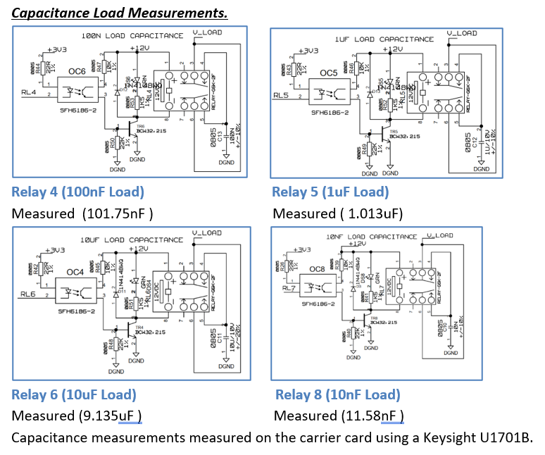
Capacitance Load Test
Andrew Hill
STFC Daresbury Laboratory
Keckwick Lane
Daresbury
Warrington
Cheshire
WA4 4AD

Slide 11
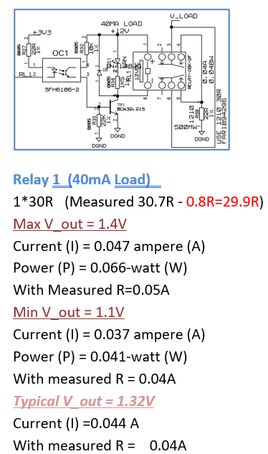
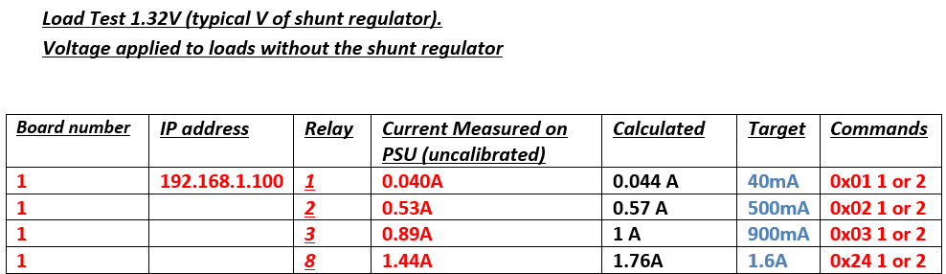
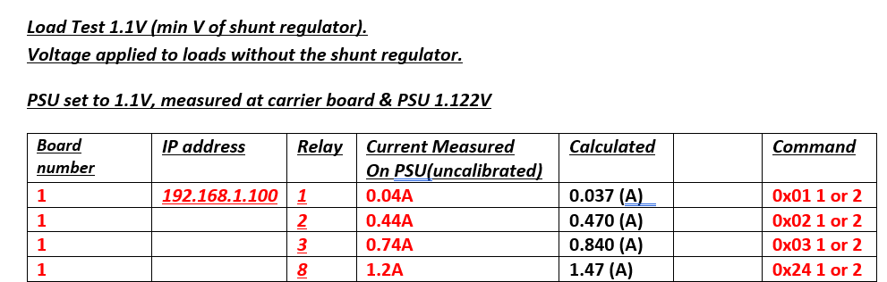
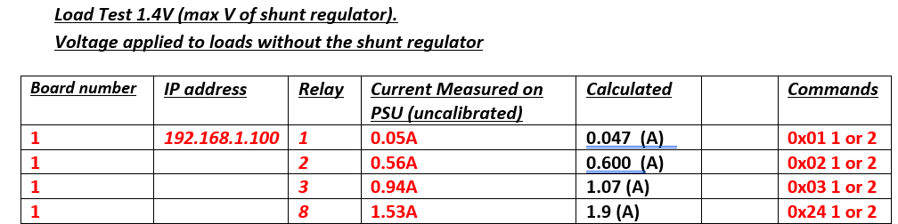
Resistive Load Tests

Slide 12
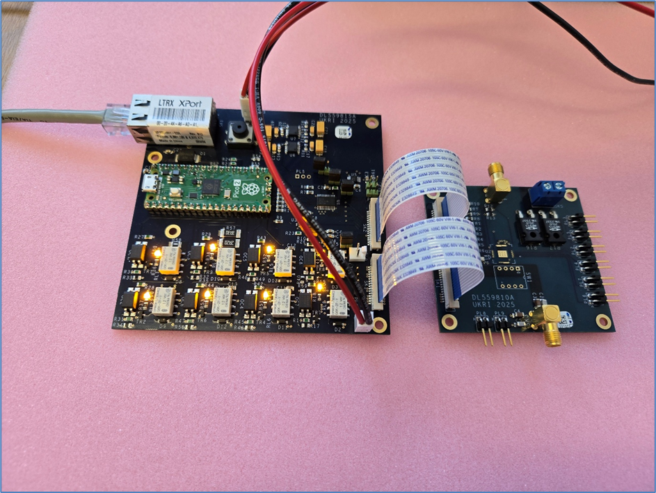
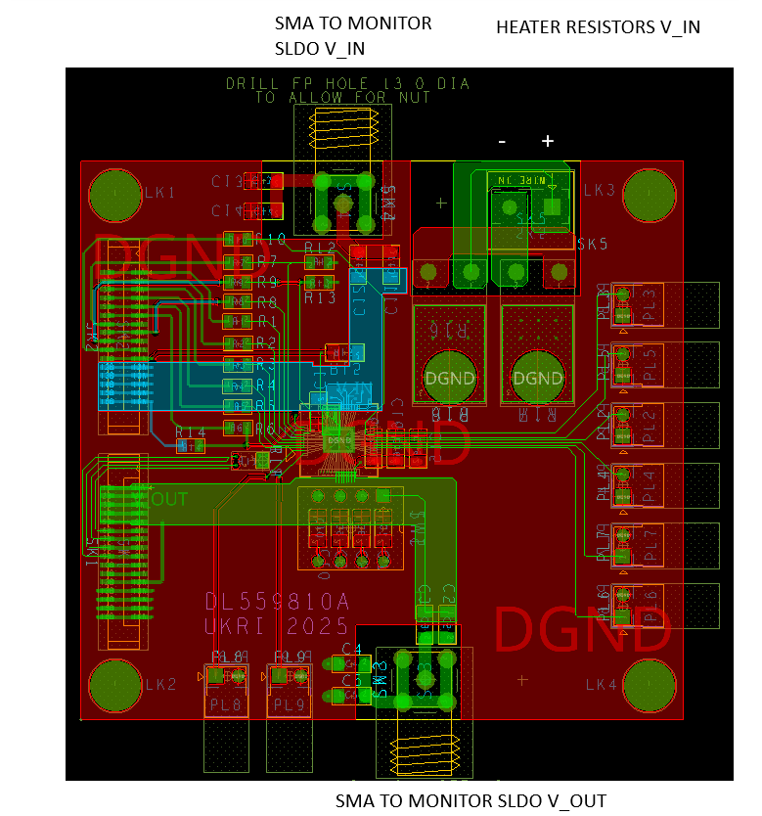
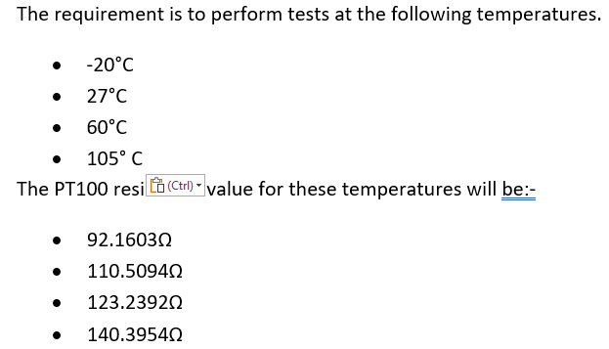
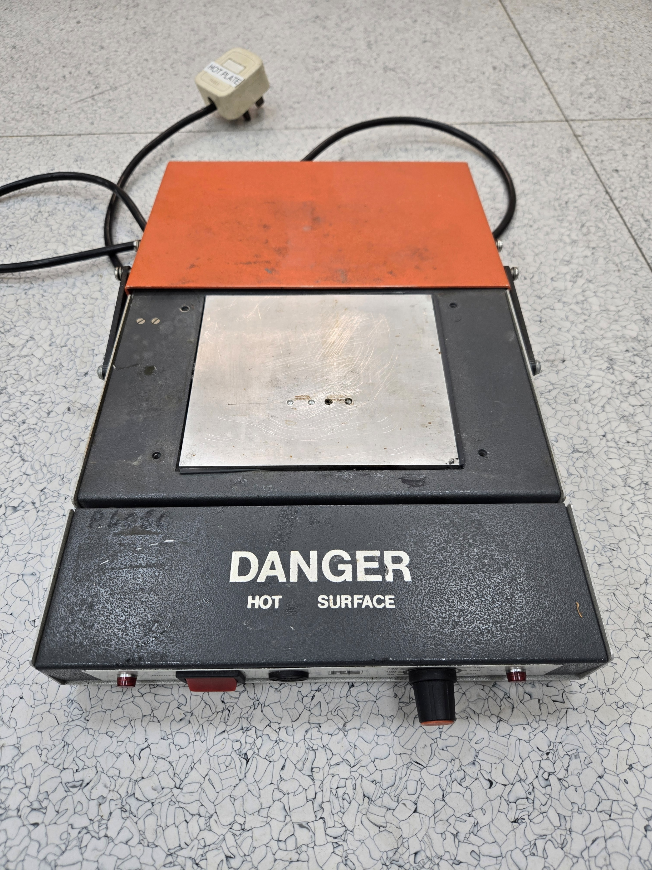
Temperature Tests
A voltage of 18.5V was applied to the Carrier Board Connector SK5.
The current was limited to 0.45A.
As the temperature rose:-
110.6 Ω was measured.
123.4 Ω was measured.
To achieve 105º C we will need to use a hot plate in conjunction with the heater resistors.

Slide 13
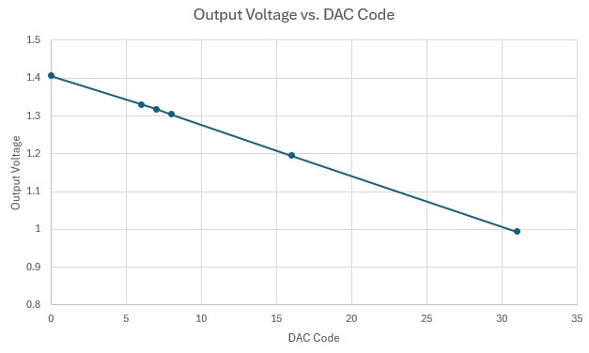
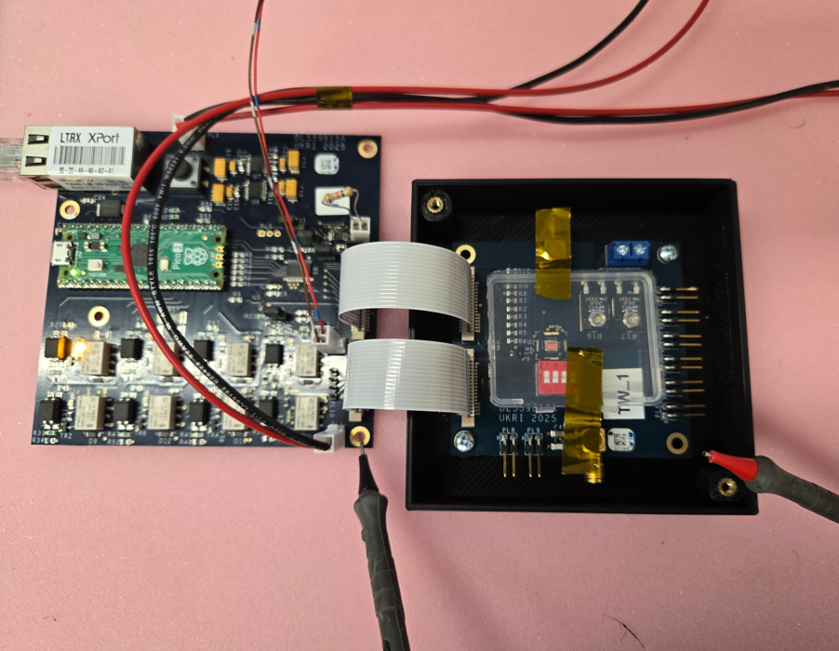
Conclusion

