Slide 1
Modular RICH Detector (mRICH) Wall in sPHENIX simulation Framework
Cheuk-Ping Wong
Georgia State University
04-24-2018

Slide 2
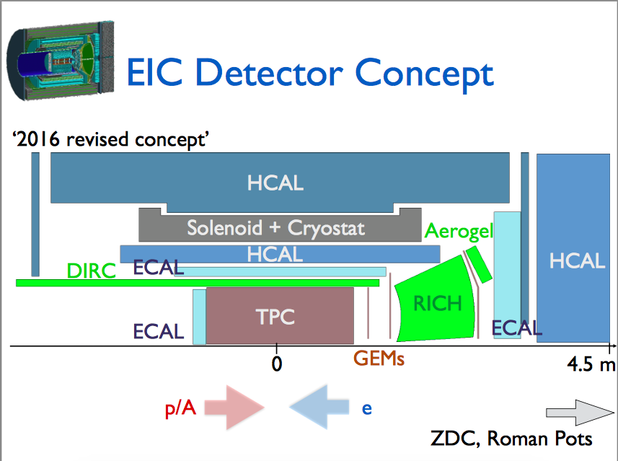
fsPHENIX Design
Rapidity coverage : 1.1 – 1.9
~3m
Christine Aidala and Nils Feege,
sPHENIX Cold QCD Topical Group Meeting, BNL, Nov 15 2016

Slide 3
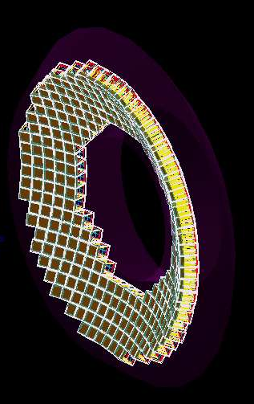
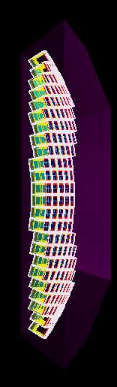
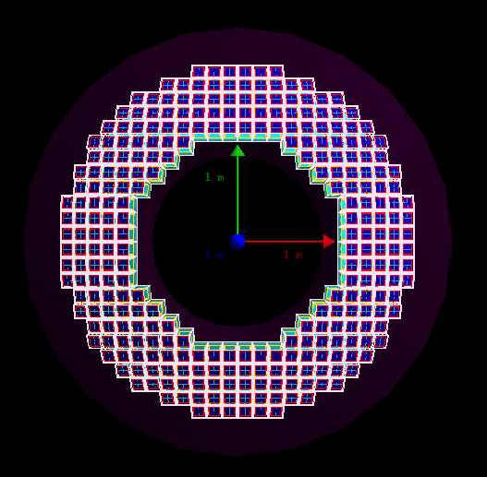
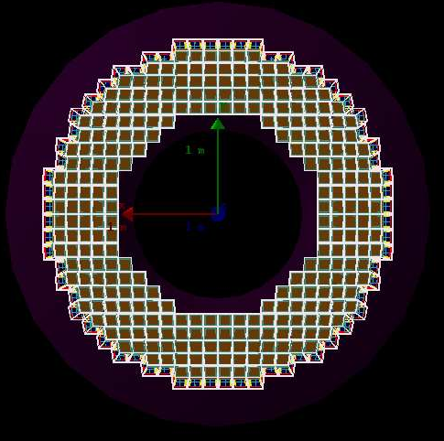
mRICH Wall
Aerogels in brown
Sensor planes in blue
Mother volume (air)
y
Downstream
x
3m (+3cm offset)
z
Beam pipe direction
284 modules
Side view
Upstream

Slide 4
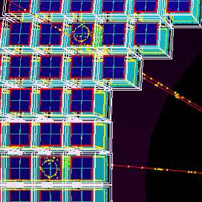
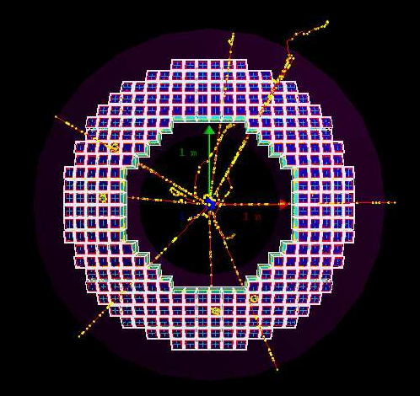
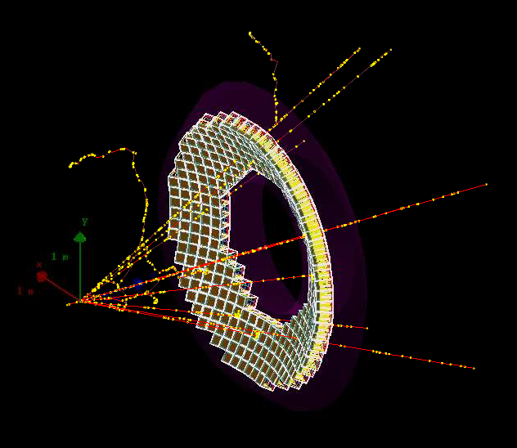
10 Muons at 10 GeV
Aerogels in brown
Sensor planes in blue
Down stream

Slide 5
Next
pull request to master branch on github
Check rapidity coverage and effective area of the subsystem
Technical Problems
Specific dimension of mRICH subsystem
Output and Analyze dst readout

Slide 6
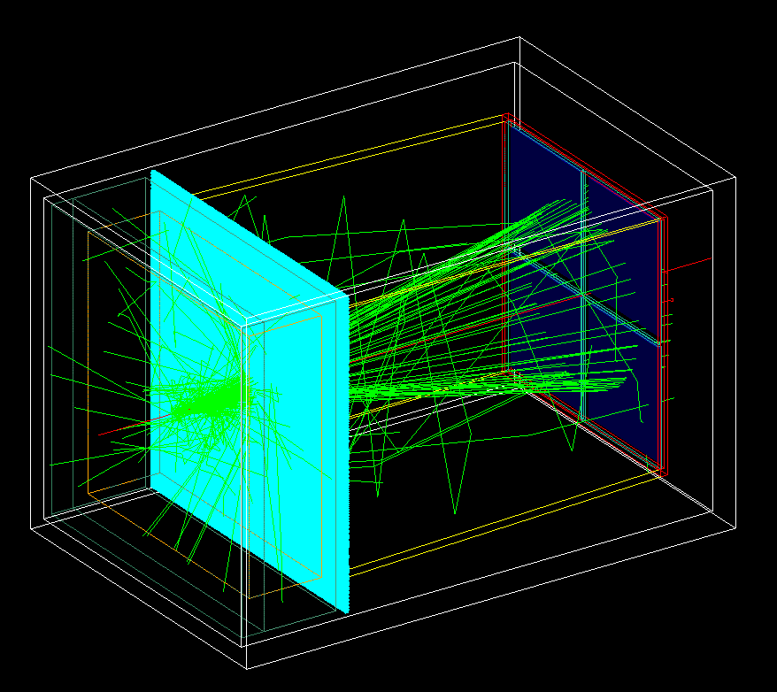
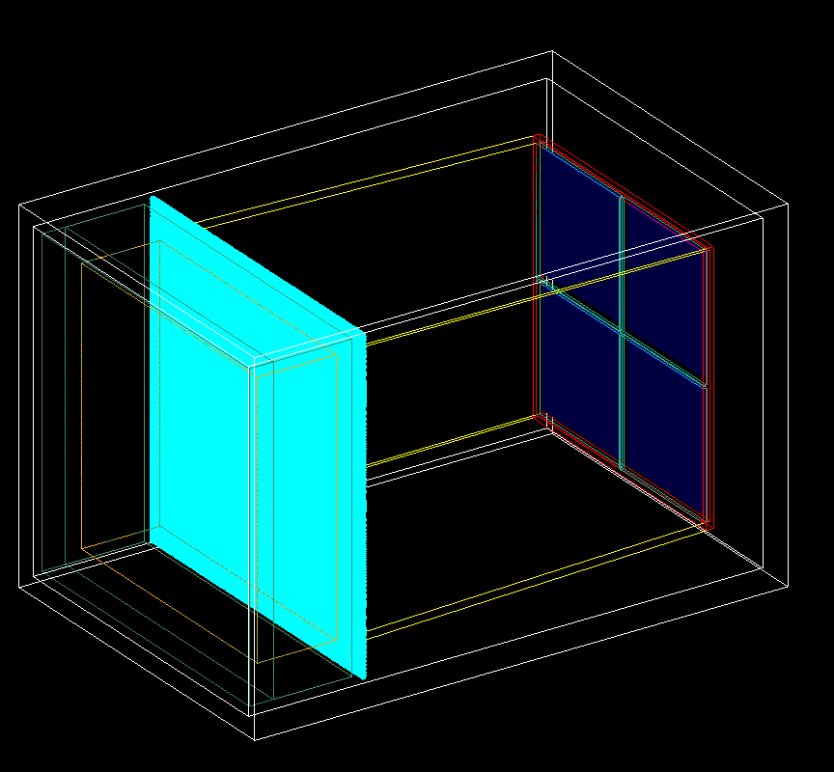
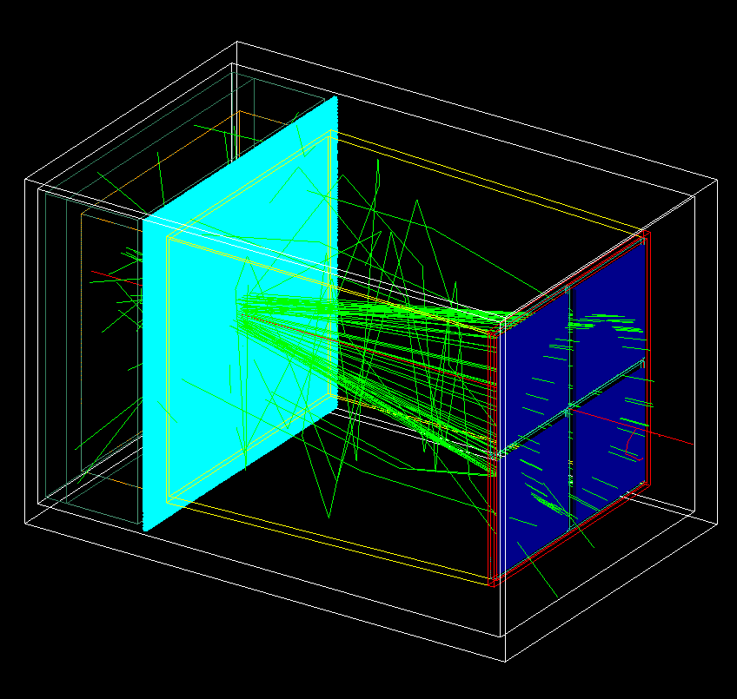
Back Up: mRICH 2nd Prototype Detector
6” focal length Fresnel lens
Single pion at 9GeV/c
Mirror set
Glass windows
And sensors
14.8 cm
Readout electronics
-- pion- -- Optical photons
Fresnel lens
Mirror set
Aerogel
Foam holder
Holder box
14.8 cm
22.3 cm

