Slide 1
mRICH Wall at MEIC Electron Endcap
Cheuk-Ping Wong
Georgia State University
04-24-2017

Slide 2
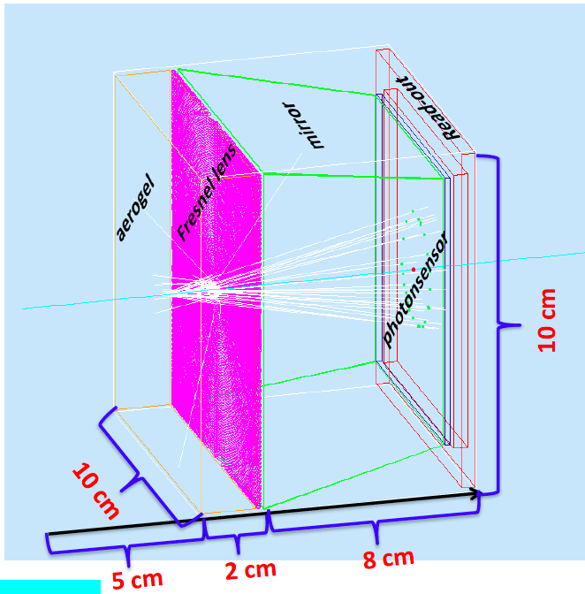
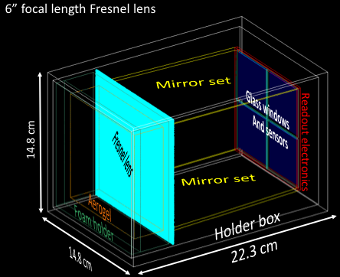
Update
Replace the obsolete mRICH design in MEIC framework
Obsolete mRICH design
mRICH 2nd prototype design

Slide 3
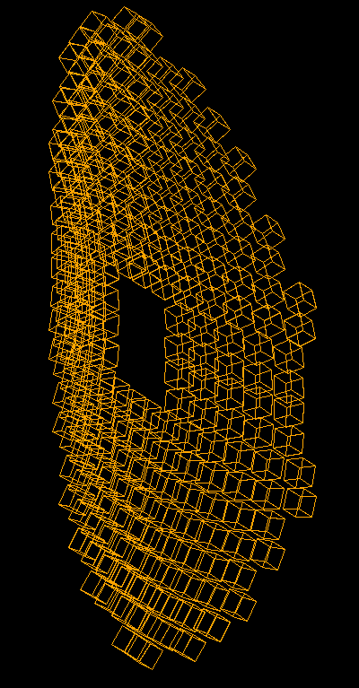
Update
Fix alignment of each module
origin
origin
Before update, wrong alignment
Correct alignment should look like

Slide 4
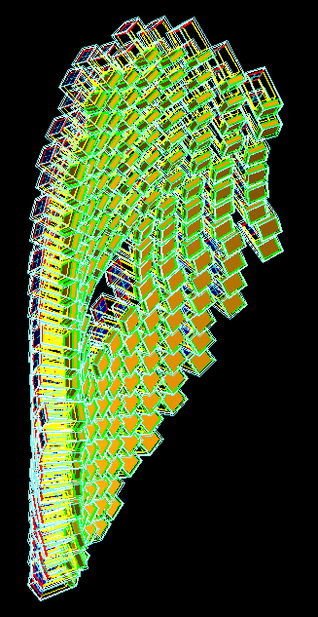
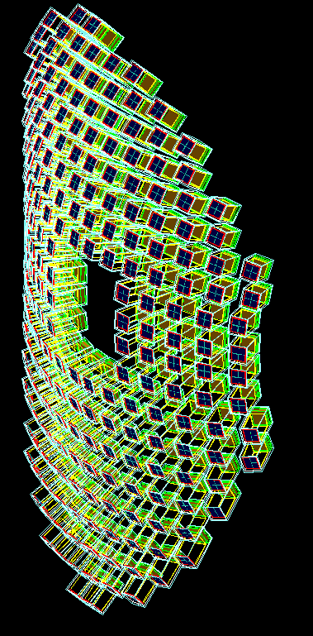
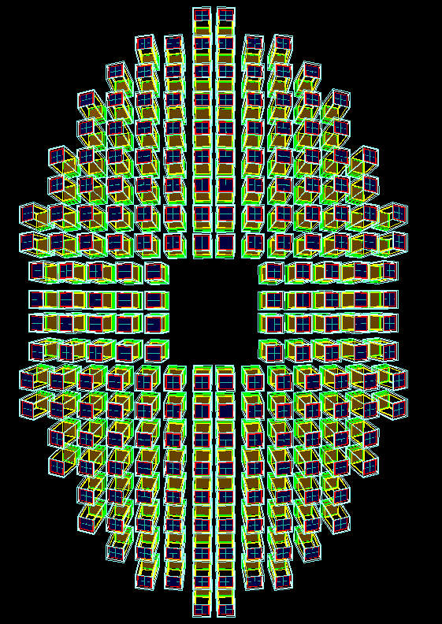
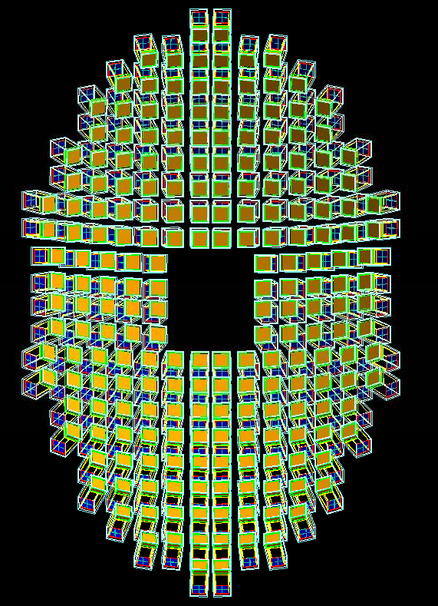
mRICH wall with 2nd Prototype Design
Aerogel in orange
Sensor plane in blue
Fresnel lenses are not drawn for quick test
Beam pipe
side
side
front
back

Slide 5
Next
Commit to Jlab repository

