Slide 1
EIC Computing Infrastructure Modeling
Kuan-Chieh Hsu, Lingda Li, Marc Lukasczyk, Shijeki Misawa, Adolfy Hoisie
12/05/2025

Slide 2
Current Status of Modeling
Developed a high-level E0/1 computing infrastructure simulator
Based on current networking/buffer estimations/requirements
Configurable/parameterized timing simulation
Tunable system configurations
Tunable incoming data pattern from DAQ
Models resource utilization (quantitative characterization, bottleneck detection, optimization)
Design Space Exploration for the EIC computing infrastructure.
Quantitative, holistic, potentially multi-resolution approach

Slide 3
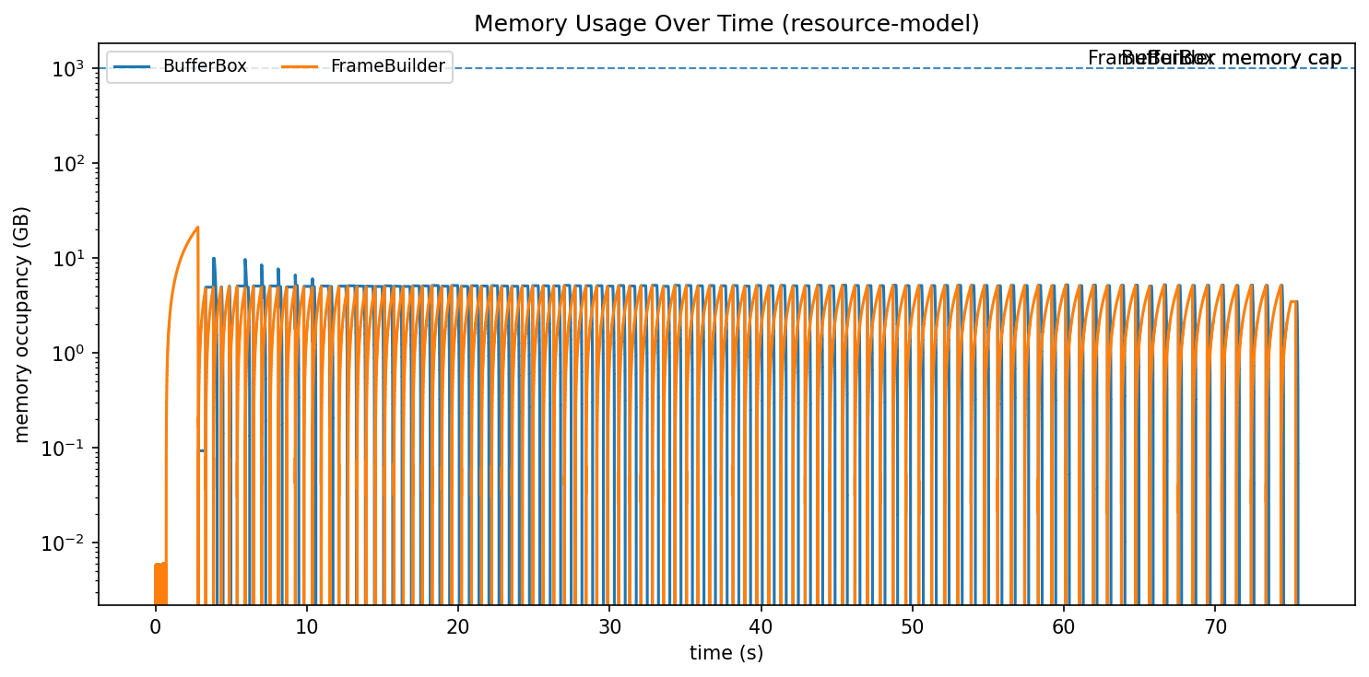
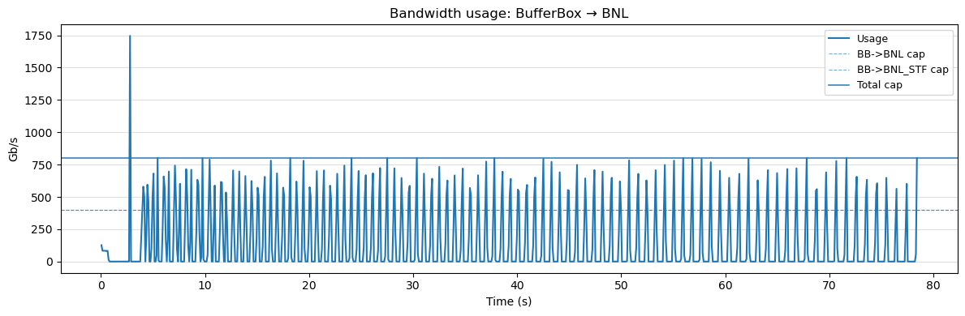
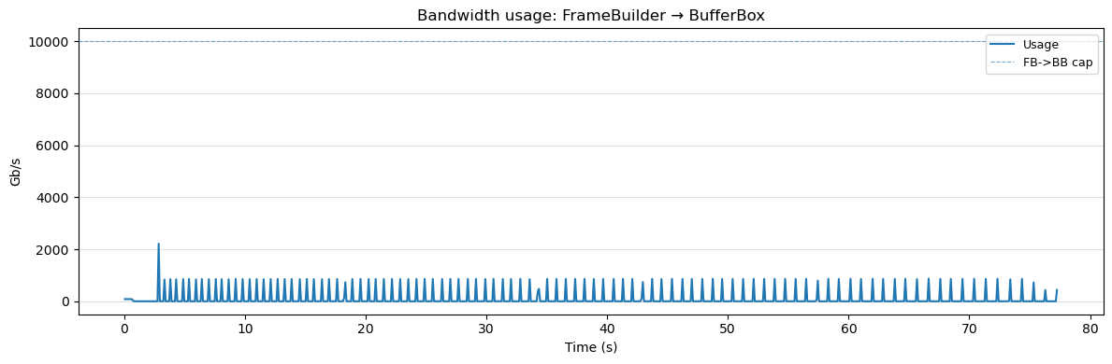
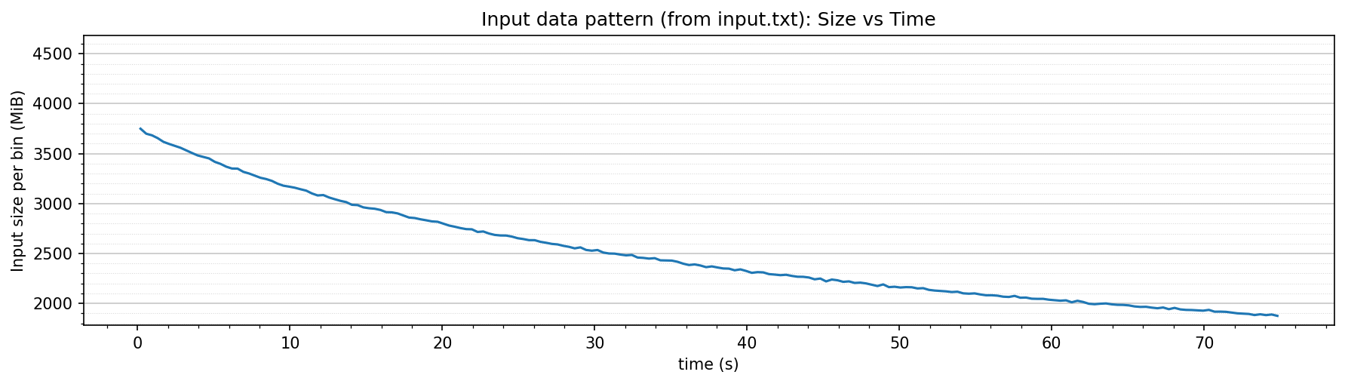
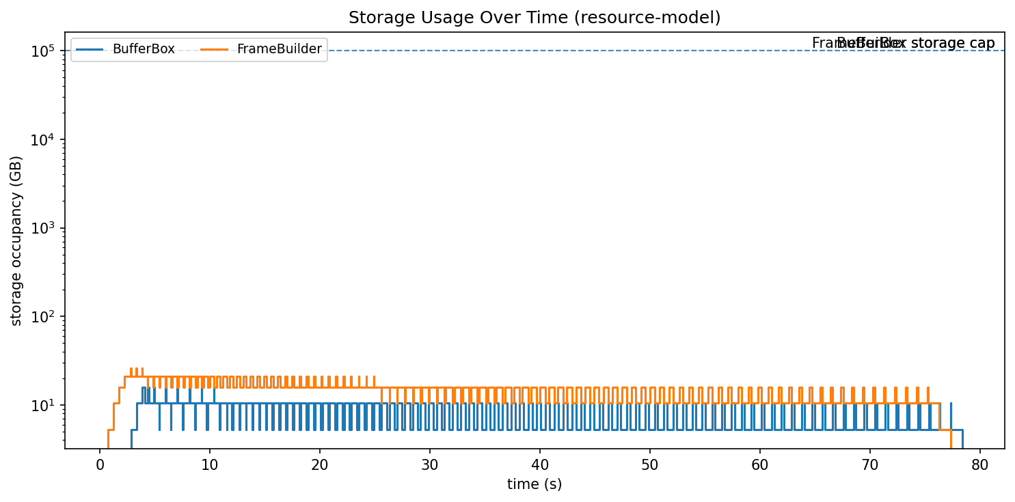
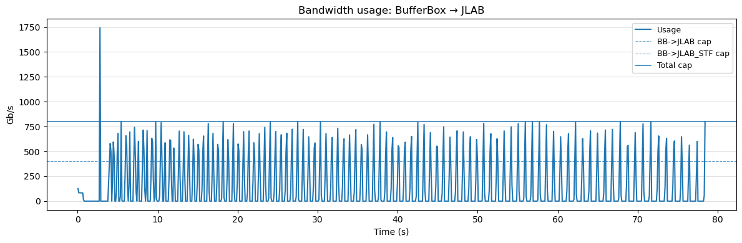
Overview of the Current Simulator
Network module 2
Frame
Builder
Buffer Box
E1
BNL
Memory
model
Network module 1
Memory
model
Network module 3
Storage
model
Storage
model
Input TFs stream
E1
JLAB
Echelon 0 computing/networking (SCDF enclave)
Memory model: TFs are memory objects only.
Storage model: STFs will reside in storage as files.
Network modules: We give different parameters for different network modules.

Slide 4
Modeling Toolbox Overview
 | High level | Medium level | Low level
Computation | # operations, # memory accesses Peak compute/memory throughput | Algorithm, profiling info (# cache accesses, # FP multiplications, …) | Program source code and execution trace Detailed hardware configuration (cache size, # function units, …)
Communication (network) | Data size End-to-end bandwidth | Stream size, arrival time Topology, link bandwidth | Packet trace Detailed switch/link configuration, congestion protocol
Detail level selection depends on:
modeling purpose
specification/ parameters availability
desired fidelity level
Accuracy
Li, Lingda, Thomas Flynn, and Adolfy Hoisie. "Learning Generalizable Program and Architecture Representations for Performance Modeling." SC24: International Conference for High Performance Computing, Networking, Storage and Analysis. IEEE, 2024.
Li, Lingda, et al. "Simnet: Accurate and high-performance computer architecture simulation using deep learning." Proceedings of the ACM on Measurement and Analysis of Computing Systems 6.2 (2022): 1-24.
K. J. Barker, J. Sancho, D. J. Kerbyson, K. Davis, S. Pakin, A. Hoisie, and M. Lang, “Using performance modeling to design large-scale systems,” Computer, vol. 42, no. 11, pp. 42–49, nov 2009.
Notes:
Put modeling examples for other works (papers, wprks, scatch)

Slide 5
2026 Plan: Streaming modeling
Towards streaming modeling
Extend the modeling capabilities to include both streaming and file transfers.
Streaming modeling objectives
Feedback loop optimization
System configuration design to with set performance ranges
Streaming/file transfer ratio modeling
E 1/2 resource placement and scheduling impact for important use case scenarios that involve streaming.
Validation plan
Using surrogate data on available testbeds

Slide 6
2016 Plan: E1/E2 Use Case Scenarios
Inclusion of computing workload modeling
Tunable workload characterization based on type (e.g. reconstruction/simulation) and complexity of algorithms, analysis goals
Include Echelon 2 and inter-site network into the model
Understand potential computing characteristics, and provide guidance for the requirements discussion for E1/2
Workload distribution modeling among E1/2 sites: study and optimization
Validation plan
Use data from WLCG (ATLAS infra.) (or OSG) as surrogate
Validate on surrogate, predict for EIC

