Slide 1

Test-Beam @ DESY
Satoshi YANO

Slide 2
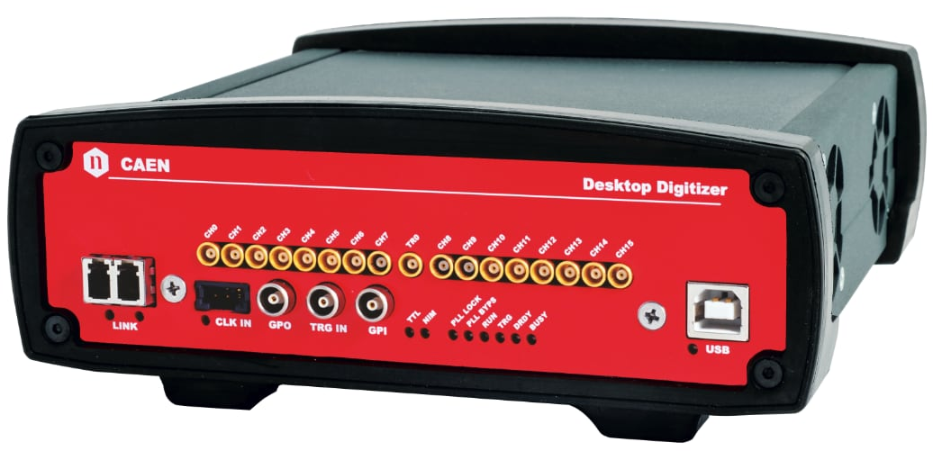
Beam-Test @ DESY
Schedule: Dec. 15 ~ 21
  6GeV electron @ TB21
Two digitizers, CAEN DT7542 (16+1ch, 5GS/s, 500MHz), will be used for AC-LGAD readout
  2-layer AC-LGAD + 2 scintillators for trigger
  Time difference between 2 sensors are used for timing resolution
    DC-LGAD is the backup solution for the timing reference
  2-layer scintillators (10x10 mm²) are used for event trigger
EUDET-Type Telescope for tracking
  6-layer MIMOSA26: 21.2x10.6 mm, 1152x576 px, 18um pitch
  Trigger by Trigger Logic Unit (LTU)
  EUDAQ for data acquisition
    Dead time: ~115us = 8.5 kHz

Slide 3
Measurement Subject
Baseline strip-type sensor
  64x2ch, 10x0.05 mm, 500 um pitch, 50um thickness
  Wire-bond on middle 8x2=16 channels
  Timing & Positioning resolution @ Best Bias-Voltage
  Timing resolution v.s. hit position along strip direction
  Timing & Positioning resolution @ Several Bias-Voltage (HV-Scan)
Prototype pixel-type sensor (eRD112 FY24)
  4 different pad geometries
  2x2 pads x 4 pad-size & pitch = 16 channels
  Timing & Positioning resolution @ Best Bias-Voltage
Anything else?

Slide 4
Test-Beam Setup
EUDRBs
Telescope DAQ PC
DUT DAQ PC
DIGITIZER
DIGITIZER
20 mm
32 mm
10 mm
Sci.1
DUT
~11 mm
~4 mm
10 mm
Sci.1&2
Scintillator
AC-LGAD
AC-LGAD
Scintillator
10 mm
Sci.2
Telescops1
Telescope2
Wire-Bonded Area
COINCIDENCE
MIMOSA Area
TLU
TRIGGER
TRIGGER

Slide 5
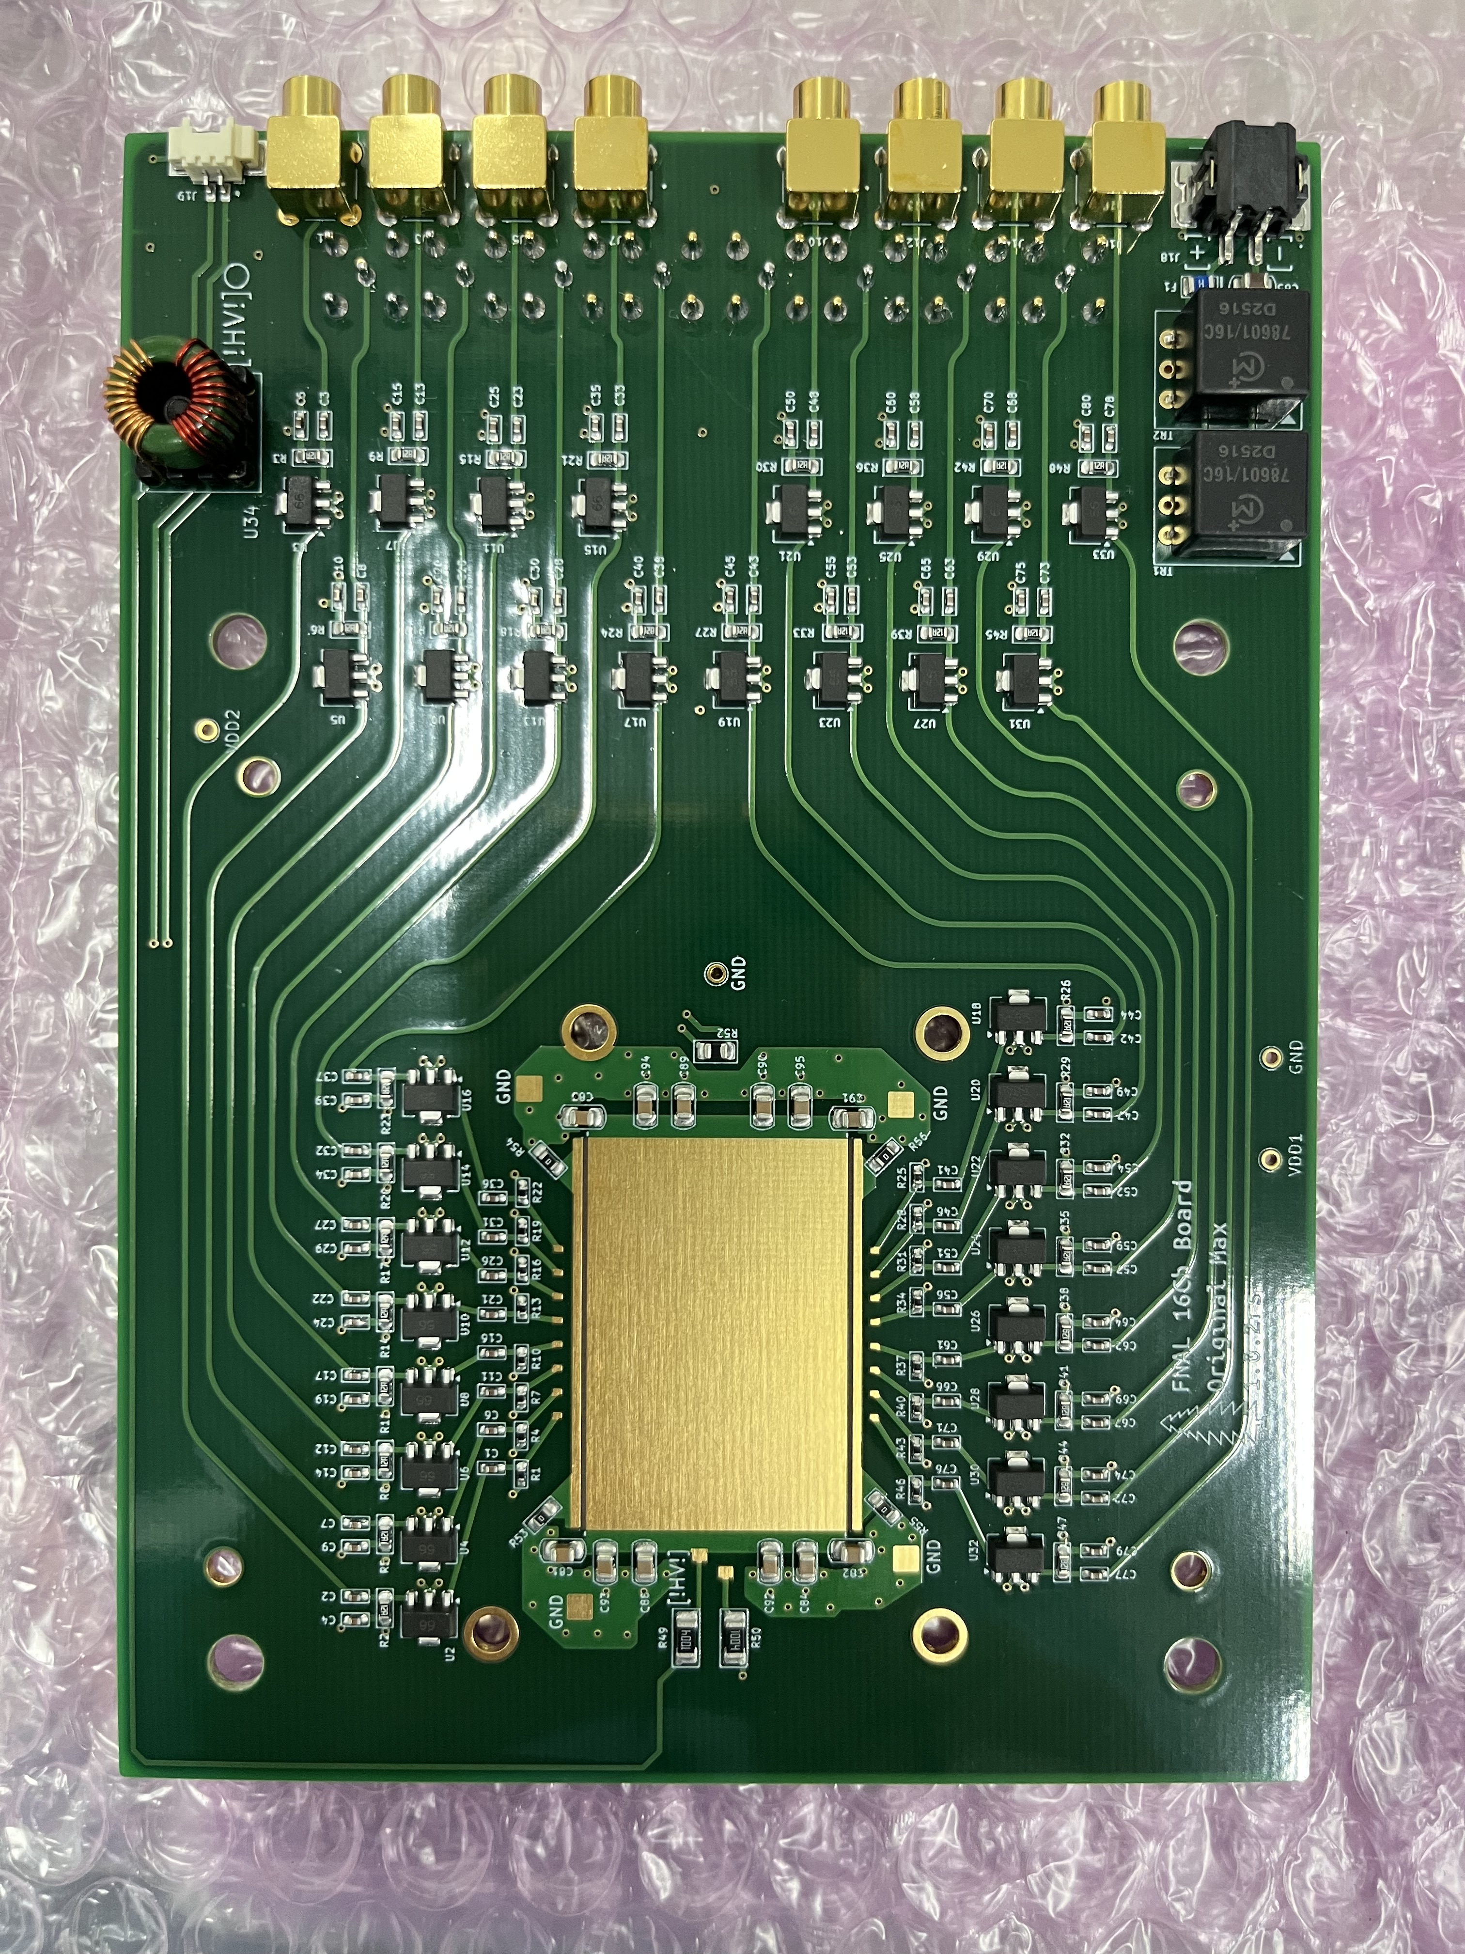
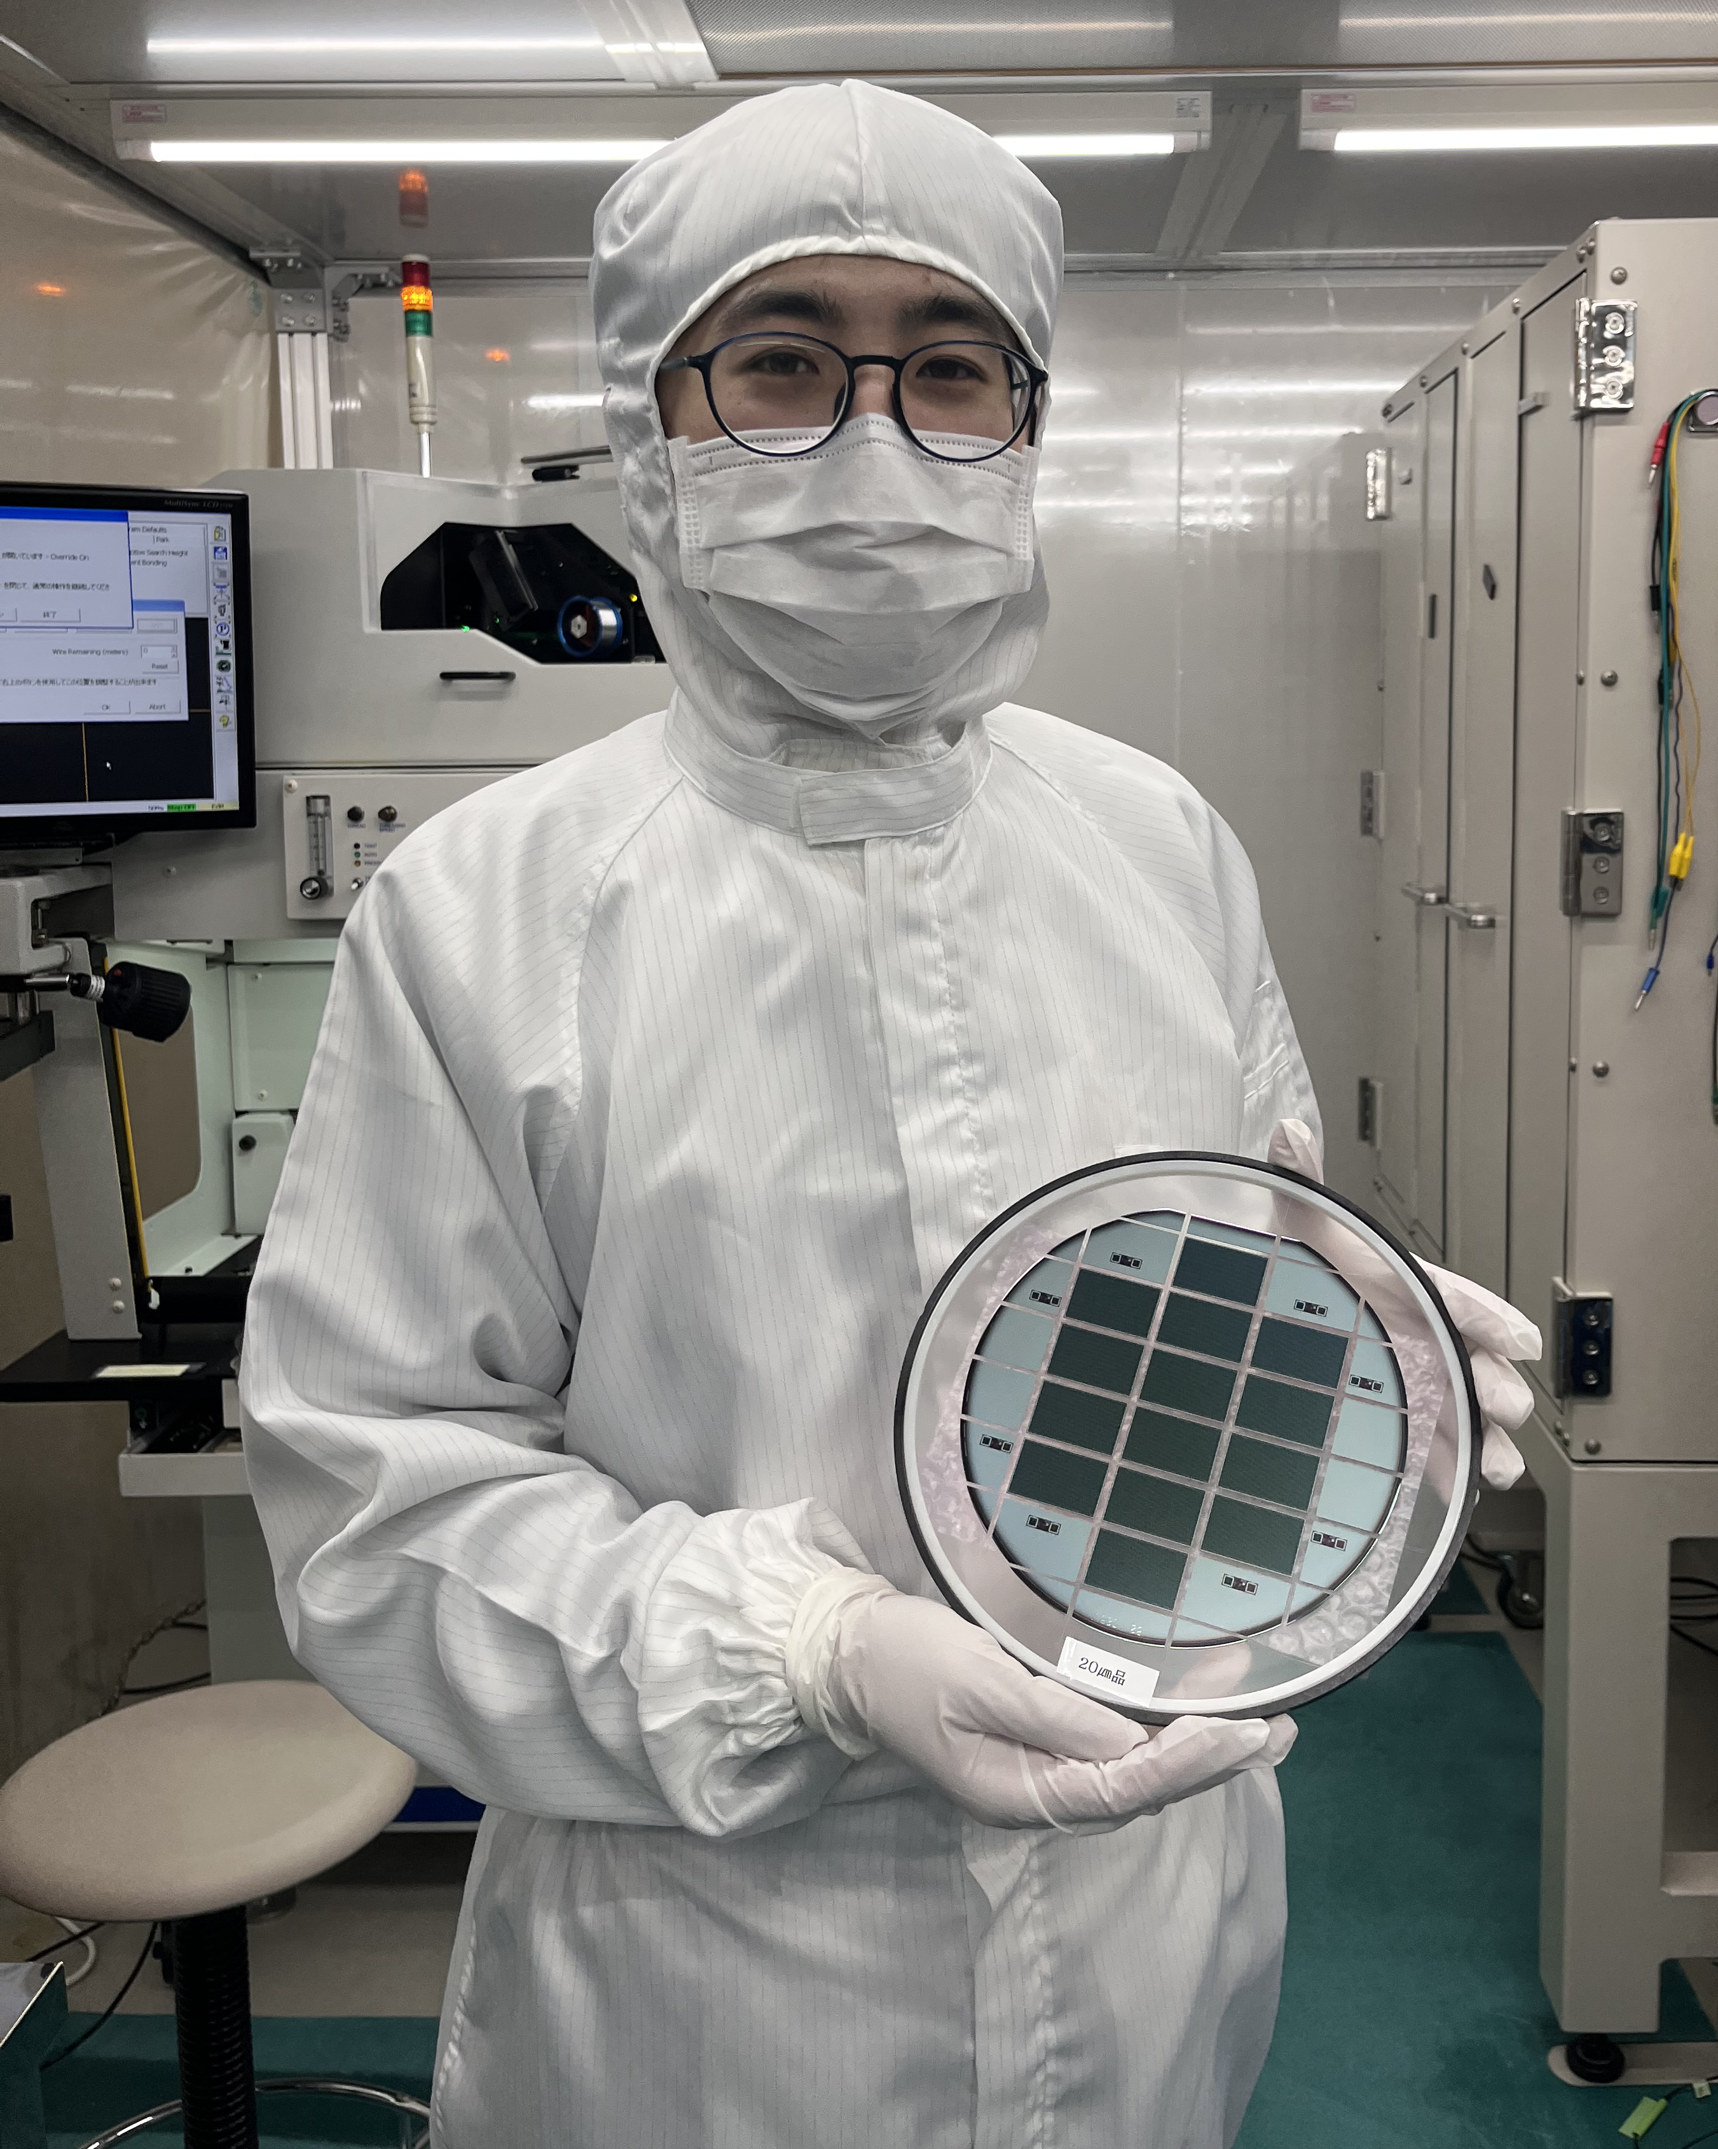
Preparation Status: Sensor
Sensor has been shipped to RIKEN this summer
  Baseline Sensor: 20um, 30um, 50um
    12 working sensors and 2 mechanical sensors each
  FNAL/UCSC boards are fabricated in Japan
Wire-bonding @ Kyushu University
  Bonding parameters has been tuned last week
    The wire-bonding parametrization study will be reported
  Hiroshima and Nara Women’s University students are conducting the bonding for the test just now!!!
  5 x 50um sensors will be mounted on the boards today
FNAL/UCSC Board made in Japan
Wire-Bonding @ KU Clean Room

Slide 6
Preparation Status: Digitizer
Simone has prepared the digitizer in Europe
  Preparation to ship to DESY is ongoing
Due to export restrictions, shipping to Europe from Japan has become difficult...
We were able to secure the digitizer thanks to the support of Italian team especially Manuel Colocci (Bologna), who connected us to the right person, and Gianpiero Vignola (DESY), who actively located and arranged the device at DESY!
Now, Hiroshima Team is working on the digitizer setup @ HU

Slide 7
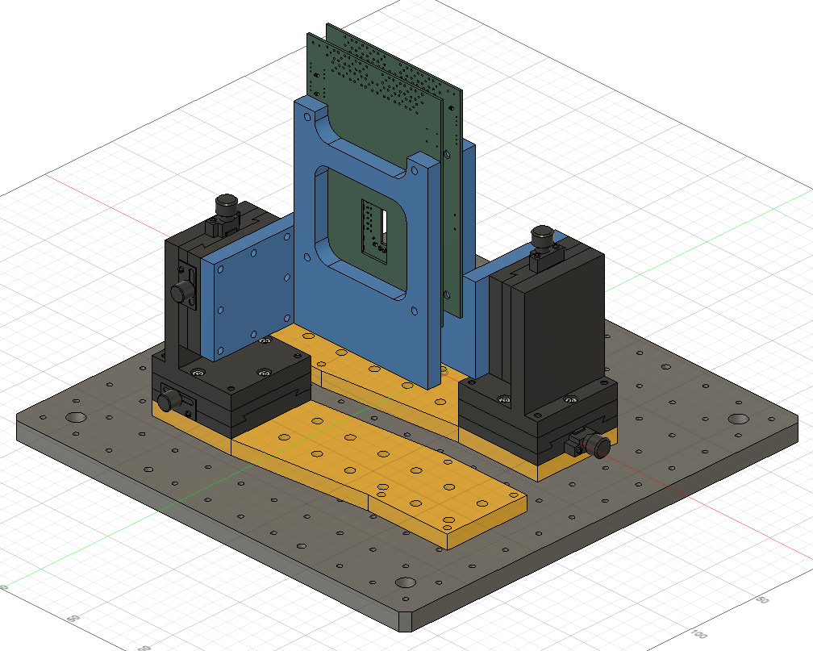
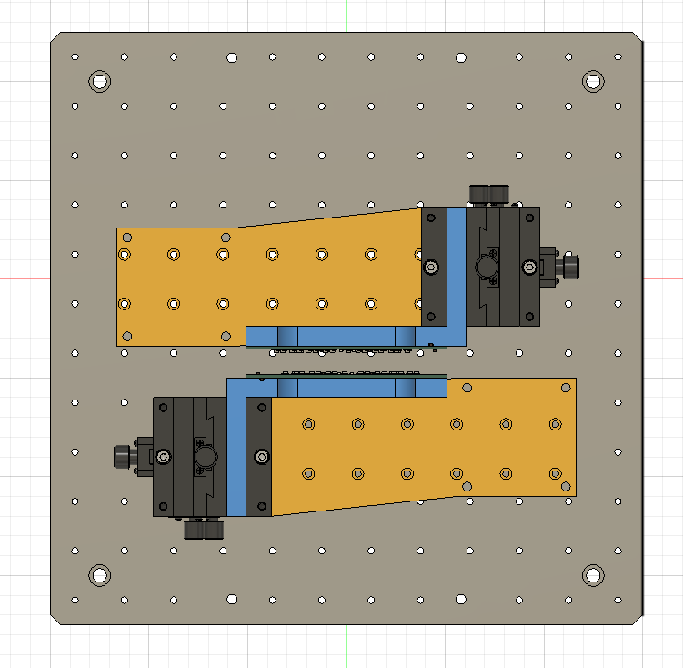
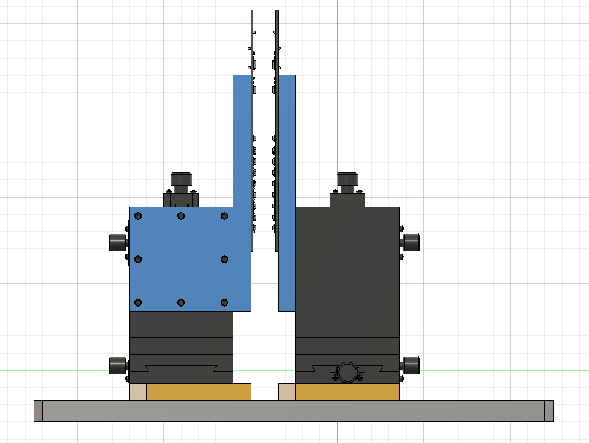
Preparation Status: Jig (2 sensors)
Top View
Side View
1.3 mm
XY-stage (Δx = Δy ~ 10mm ) is mounted on bread-board
The other parts are made by 3D-printer (high rigid configuration)

Slide 8
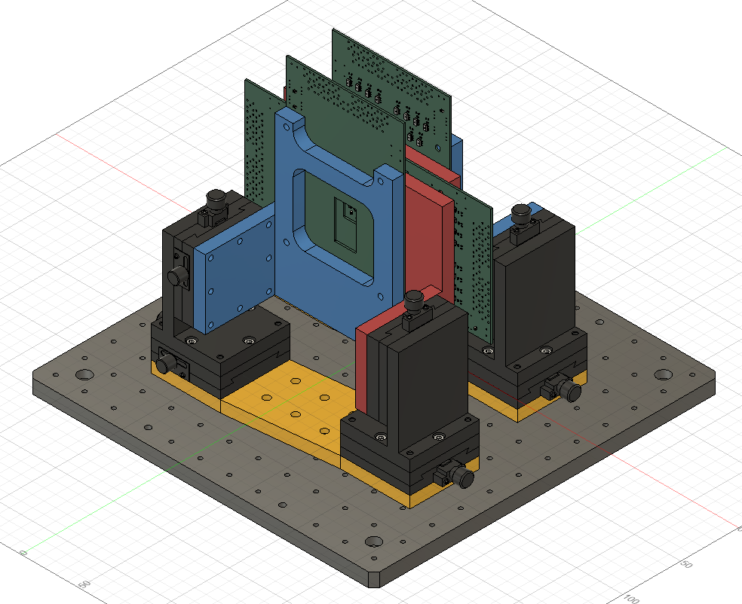
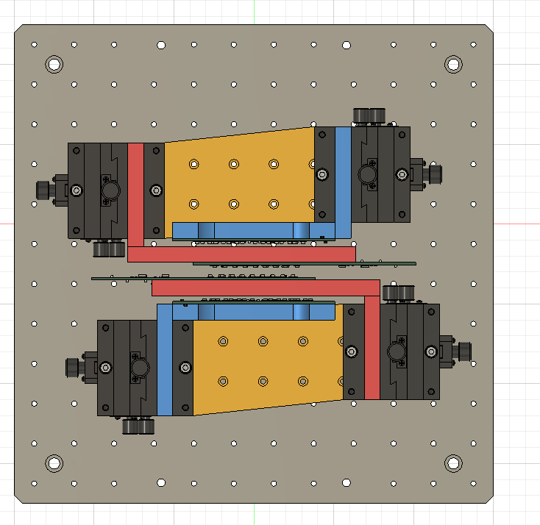
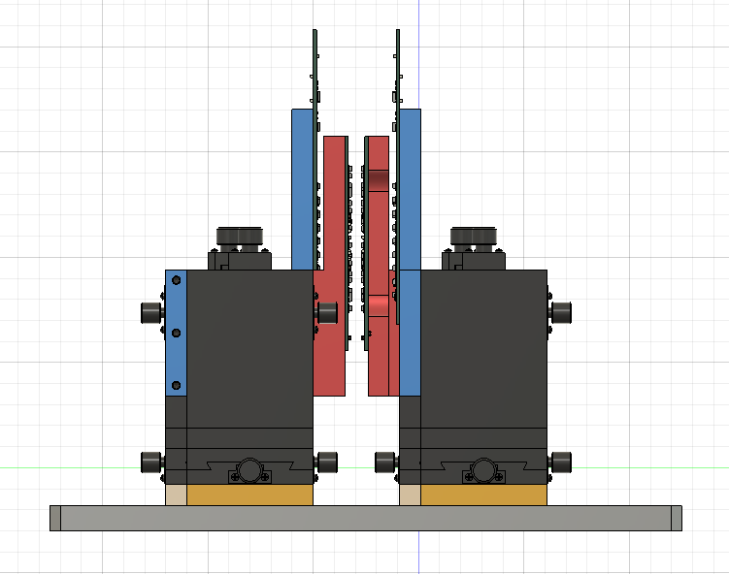
Preparation Status: Jig (4 sensors)
Top View
Side View
XY-stage (Δx = Δy ~ 10mm ) is mounted on bread-board
The other parts are made by 3D-printer (high rigid configuration)

Slide 9
Schedule
12/1~12/7
  University of Tokyo and Nara Women’s University teams will setup the LTU and EUDAQ with the telescope @ DESY
12/7 ~ 12/14
  Hiroshima University and Nara Women’s University teams will make the logic circuit by NIM modules and integrate AC-LGADs into the system
12/15 ~ 12/21
  Hiroshima University, Nara Women’s University, University of Tokyo, and Shinshu University teams will take data

Slide 10
Remaining Issues
NIM modules, HV and LV power supply will be needed to the setup
  We want to get these devices somehow near DESY

Slide 11
Backup

Slide 12
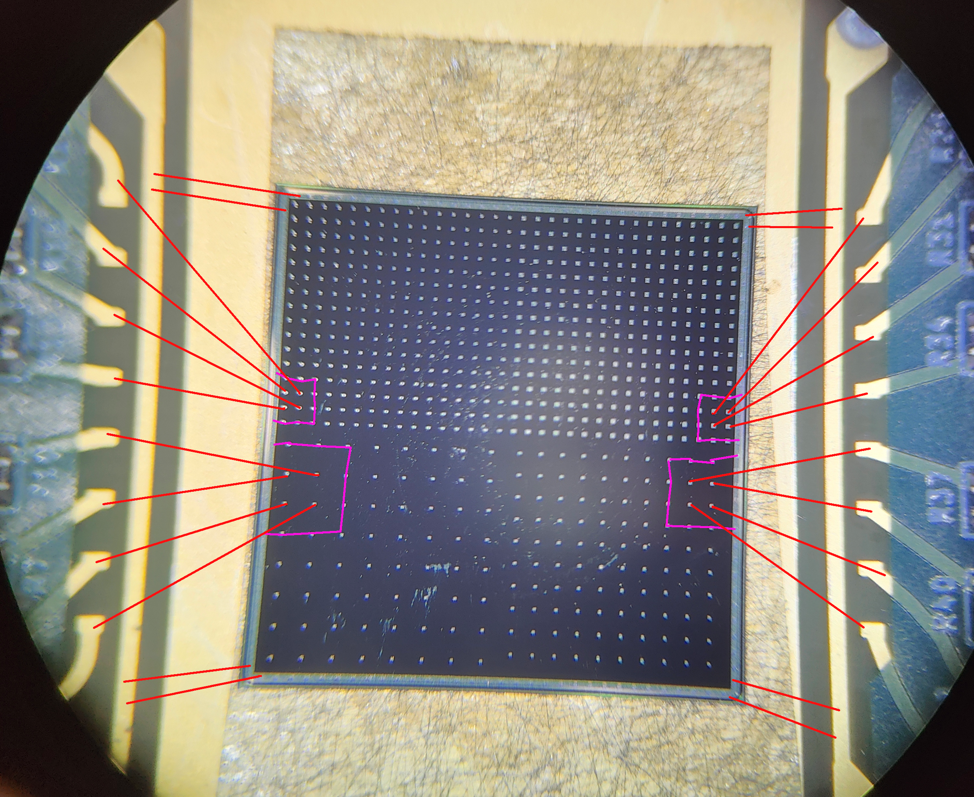
2 cm
25 strip
Bonding on GND Pad
3 strip
3.2 cm
Bonding on RDO Pad
8 strip
Bonding on GND Pad
3 strip
25 strip

Slide 13
DESY DAQ Logic Circuit
DUT-Board-1
MCX
14
SIGNAL
CLK
DUT-Board-2
MCX
16
SIGNAL
TRIG
MCX
3 pin
LEMO
LEMO
DT5742-1
LEMO
BUSY
LEMO
DUT-PMT-1
LEMO
LEMO
Discriminator
LEMO
LEMO
Coincidence
(AND)
LEMO
FIFO
(OR)
LEMO
LEMO
DUT-PMT-2
LEMO
LEMO
Discriminator
LEMO
LEMO
TRIG
DT5742-2
BUSY
LEMO
LEMO
LEMO
LEMO
LEMO
LEMO
VETO
MCX
3 pin
CLK
LEMO
Dummy BUSY Telescope Busy (>110 us)
Gate Generator
LEMO
TRIG
TRIG
HDMI
LEMO
CLK
DESY Telescope
AIDA-2020
TLU
BB-1
LEMO
LEMO
Level Translator
LEMO→LVDS
LVDS
HDMI
HDMI
CLK
LVDS
CLK
BB-2
LEMO
LEMO
HDMI
HDMI
HDMI→LEMO
Breakout Board

Slide 14
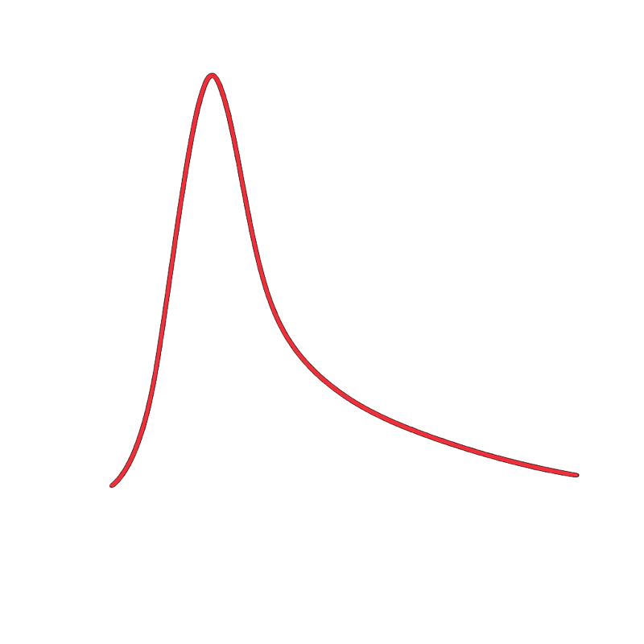
CAEN DT5742: 5GHz + TRIG-IN
Event
T=t0
Sampling Hold
T=t0+L
Sampling Hold
T=t1+L+tD
Event
T=t1
Sampling Hold
T=t1+L
Sampling Hold
T=t1+L+tD
Trigger Latency
Trigger Latency
Pre-sample
Dead Time
Pre-sample
Dead Time
ADC
ADC
WF~10 ns
WF~10 ns
Sampling
（5GHz）
90 ns
115 ns
tD=110 us
90 ns
115 ns
tD=110 us
~205 ns
~205 ns
Dead Time終了直後の1024サンプル（~205ns）以内に次のイベントが生じる確率は0.01%@1kHz event rate

