Slide 1
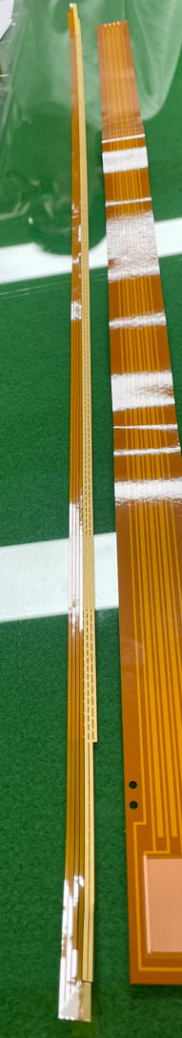
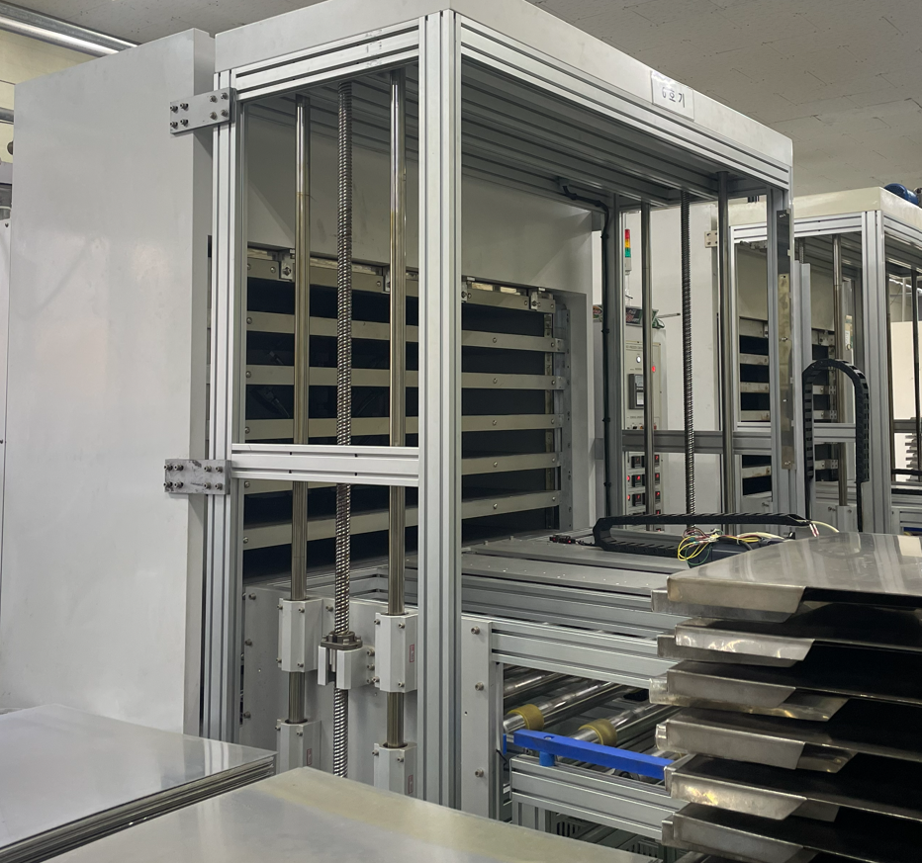
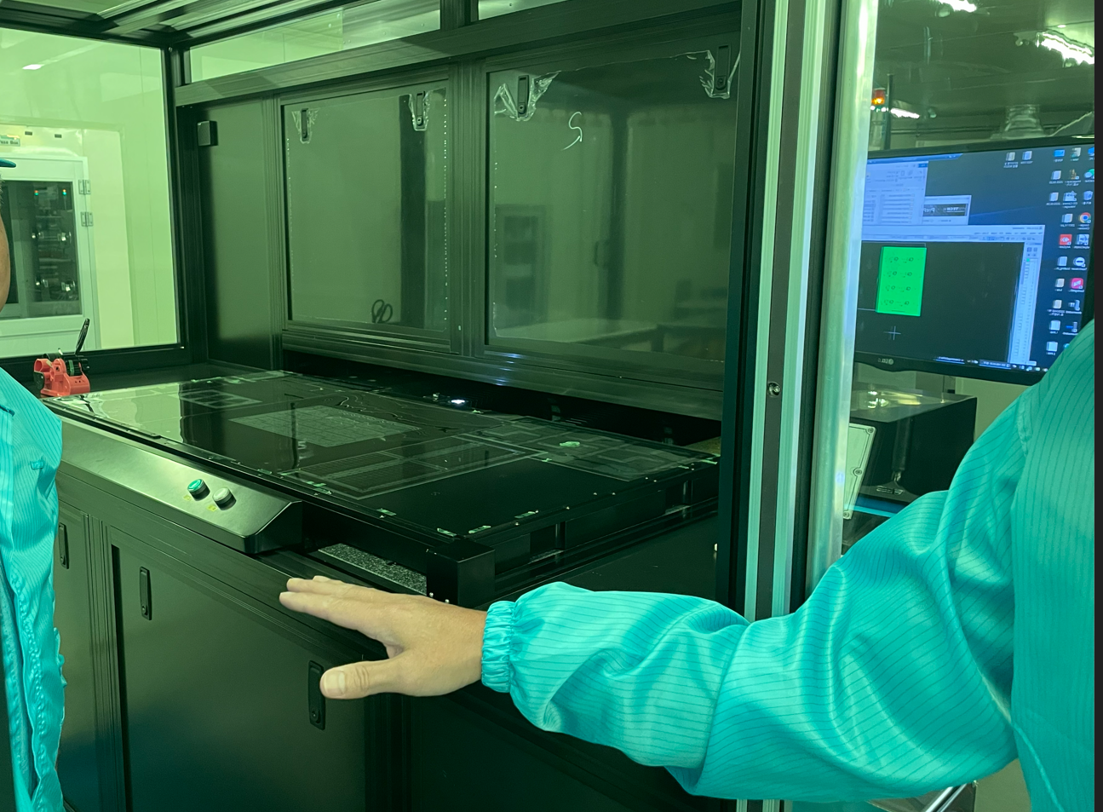
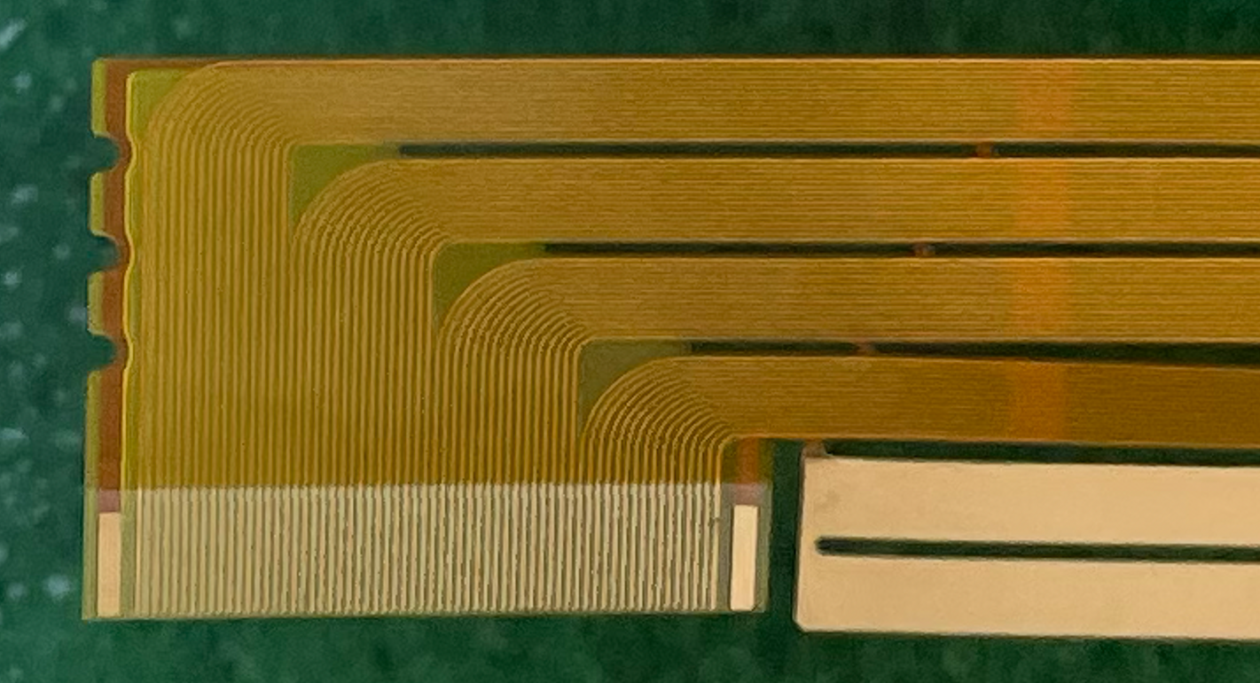
Visit to the FPC company in Korea (Nov. 12)
Big laminator to stack multi-layers
They made big GEM for CMS detector before.
They can make long FPC (>1m) with very narrow signal lines
  40um width of signal lines experienced
1.1m
40um width
Laser lithography machine

Slide 2
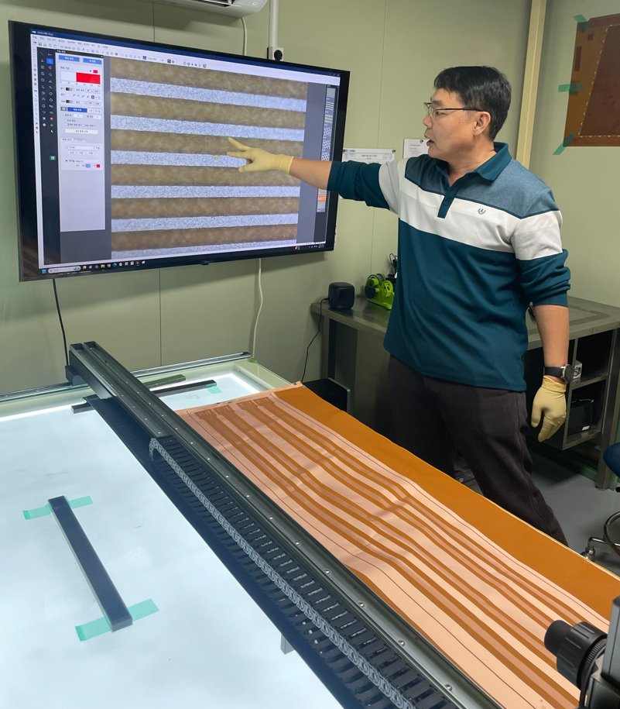
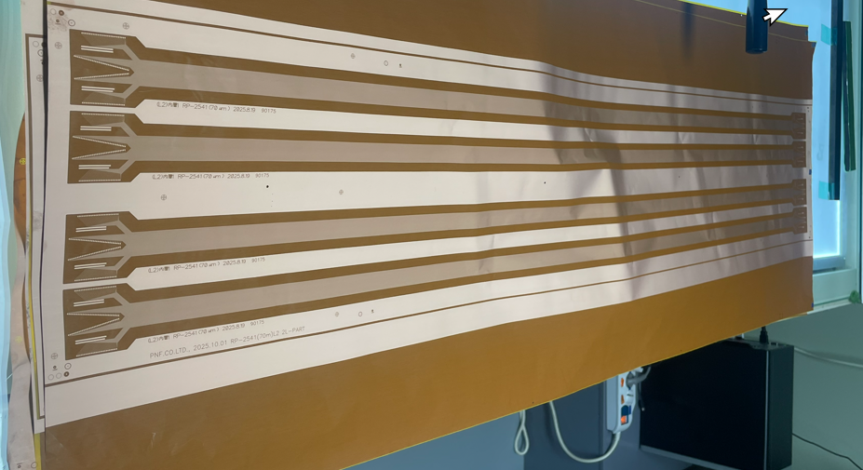
Testing Line width uniformity
We plan to check the uniformity of line width for 1.4m FPC
  Testing 3 different widths : 50, 70, 100um
  100 um is confident,
  70 um needs mild care,
  50um needs special care, the company said.
Signal layer FPCs were made as 1st test
  FPC design is same as sPHENIX long FPC (BTOF FPC design is under discussion)
  Paperwork for the contract is on going
Next step :
  Make multi-layer FPC with 70um (and other line width if necessary)

