Slide 1
Roman pots/OMD updates
Alex Jentsch (BNL)
FF Meeting
December 2nd, 2025

Slide 2
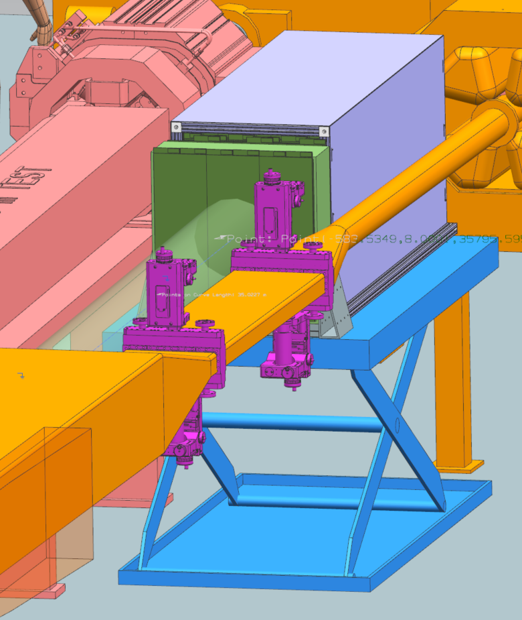
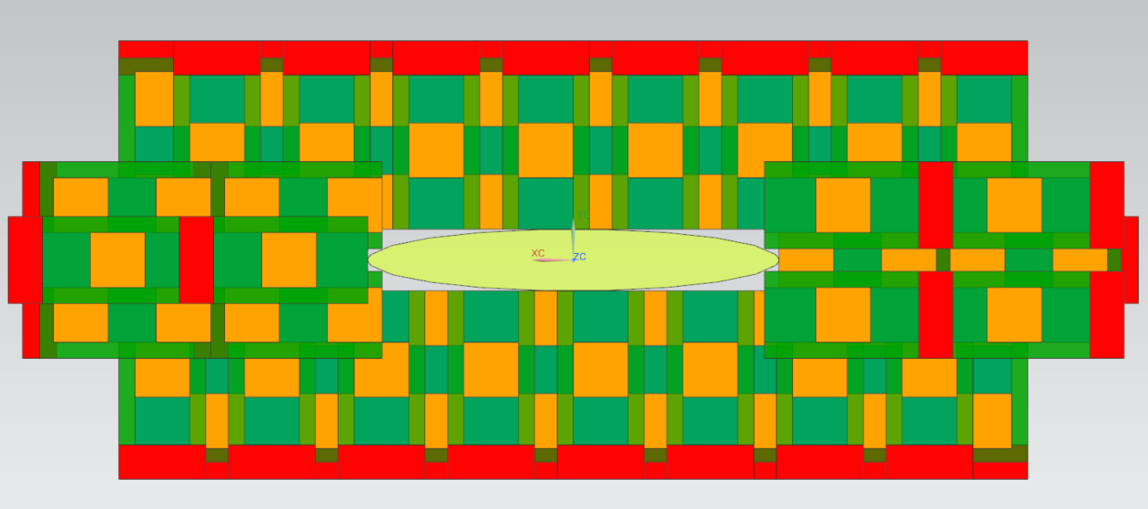
Roman pots/Off-Momentum Detectors
Tracking planes inserted directly into machine vacuum.
Used to tag protons with very small (< 5mrad) scattering angle from IP.
OMD used to tag protons from nuclear breakup.
One plane of Roman pots subsystem arranged around beam “stay clear”.
132 sensors + EICROCs per layer (40% less for OMD per layer)
Alex Jentsch (BNL)

Slide 3
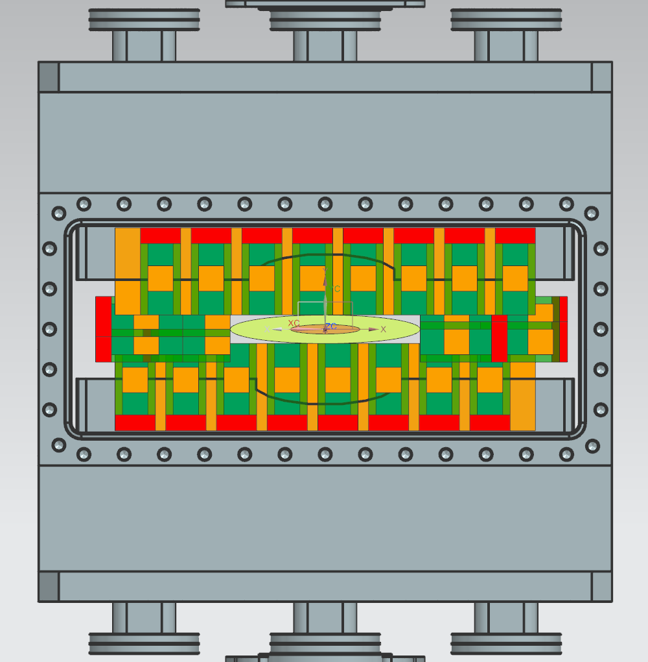
Mechanical Considerations
Scattering chamber updated to meet needs for beam envelope (was originally about 40% too narrow, vertically).
Working on layout to reduce number of motion stages (currently assume 4 – two on top, two on bottom of chamber) → issue is the actual ”arms” reaching into the scattering chamber.
The layout also has to allow necessary control of detector aperture (10 sigma) and detector alignment (e.g. beam orbit misalignment).
Feed-throughs for signal/power cables from vacuum to FEB outside.
Integration of passive cooling elements.

Slide 4
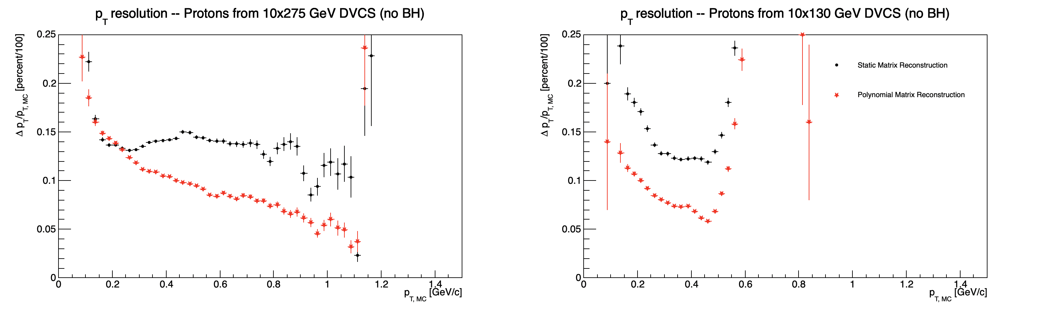
Updated RP reconstruction → Impact on DVCS (as an example)
With afterburner effects, RECO compared to MCParticles (to only show effect of matrix reconstruction).
As expected, significant improvement with polynomial method.

Slide 5
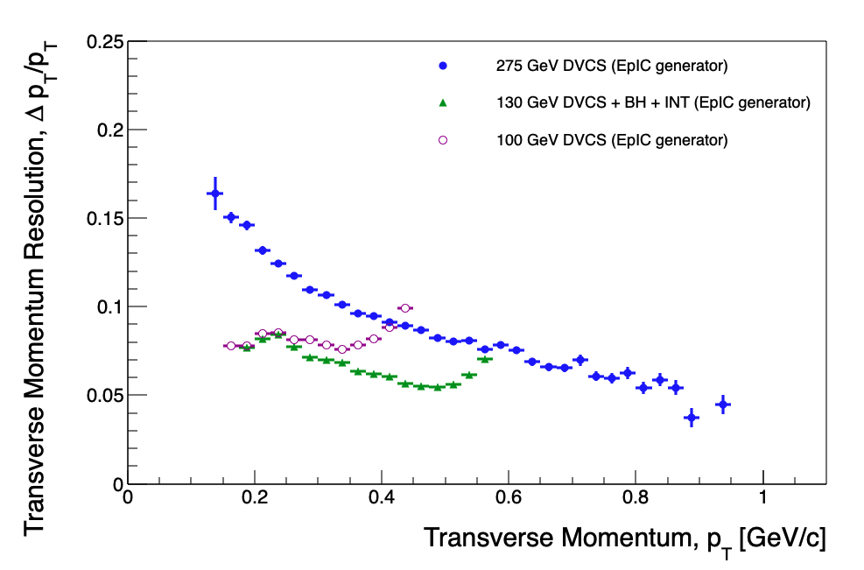
Roman pots/Off-Momentum Detectors
ePIC Performance
Overall performance is similar to that of B0, but only when not assuming charge sharing for the RP/OMD.
Performance improves with charge sharing (only minimal charge sharing assumed here).
Alex Jentsch (BNL)

Slide 6
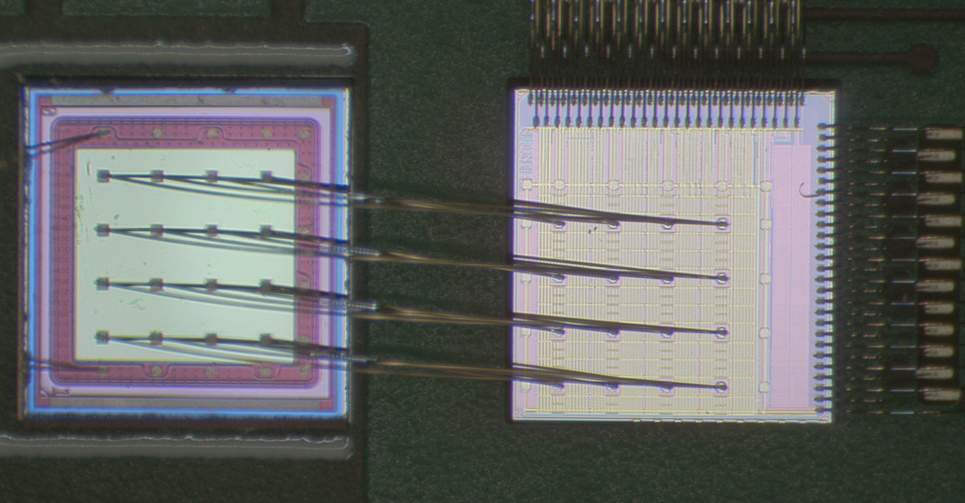
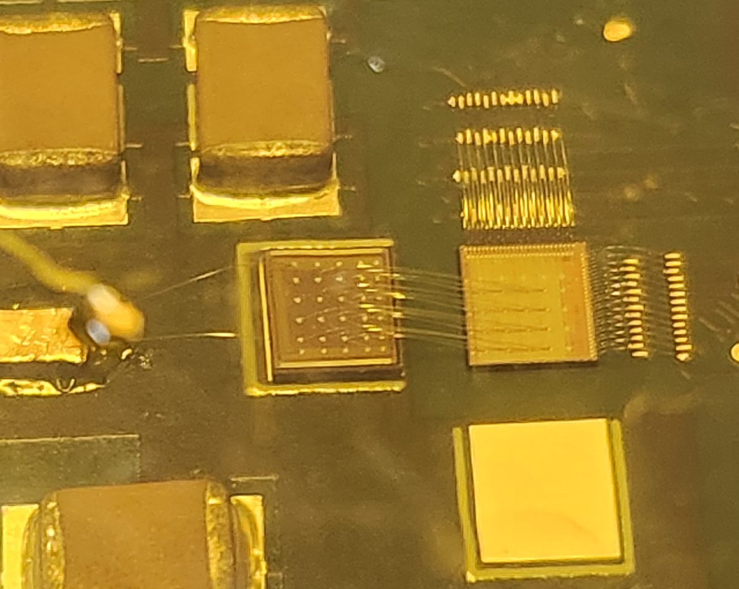
Implementation of AC-LGADs for FF Tracking
AC-LGAD
EICROC0
BNL AC-LGAD:
500x500 um² pixel pitch
100x100 um² metal electrode
30um active thickness
EICROC ASIC proposed for pixilated AC-LGADs.
Uses infrastructure from ALTIROC (used for DC-LGADs in ATLAS) and HGCROC (I2C)
Currently only 4x4 channel version exists, 32x32 (full channel count) in production (to arrive in Feb./March 2026).
Also used in FTOF (or any pixilated AC-LGAD detector).

Slide 7
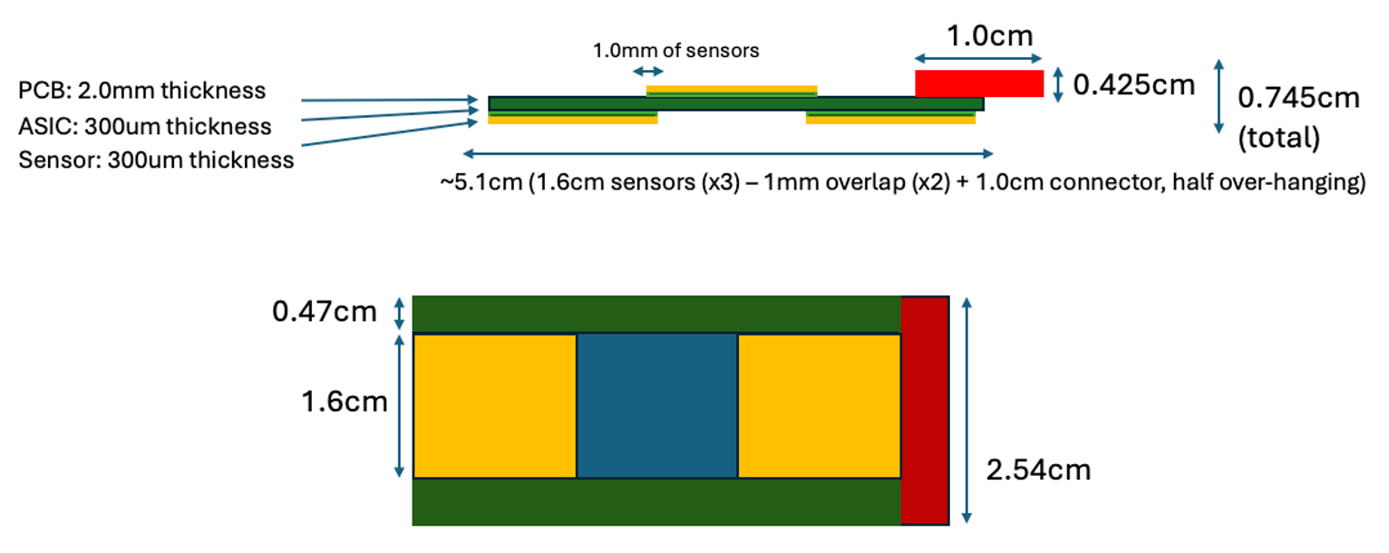
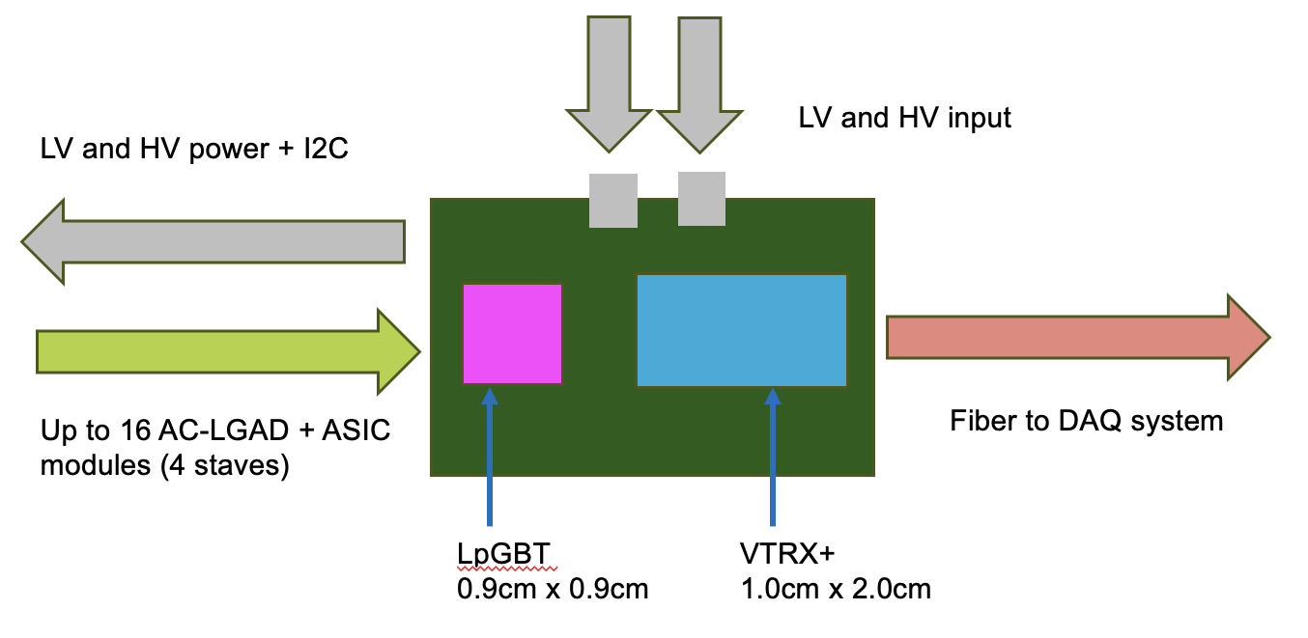
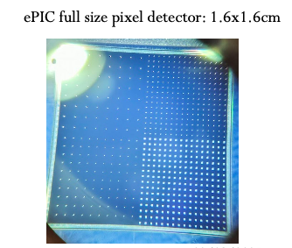
Implementation of AC-LGADs for FF Tracking
Readout needs to be separated from sensor/ASIC board to obey physical constraints for far-forward subsystems.
*Stave dimensions will be updated once EICROC1 schematic is in-hand.
Far-forward sensor “staves”
(3) 1.6cm x 1.6cm AC-LGADs with 500um pixel pitch
bump-bonded to EICROC1/2 ASICs
staggered on a two-sided PCB to provide full active-area coverage.
These sensors have 32x32 channels, matching the EICROC1/2.
Currently have 32x32 channel sensors from HPK which are under test.

Slide 8
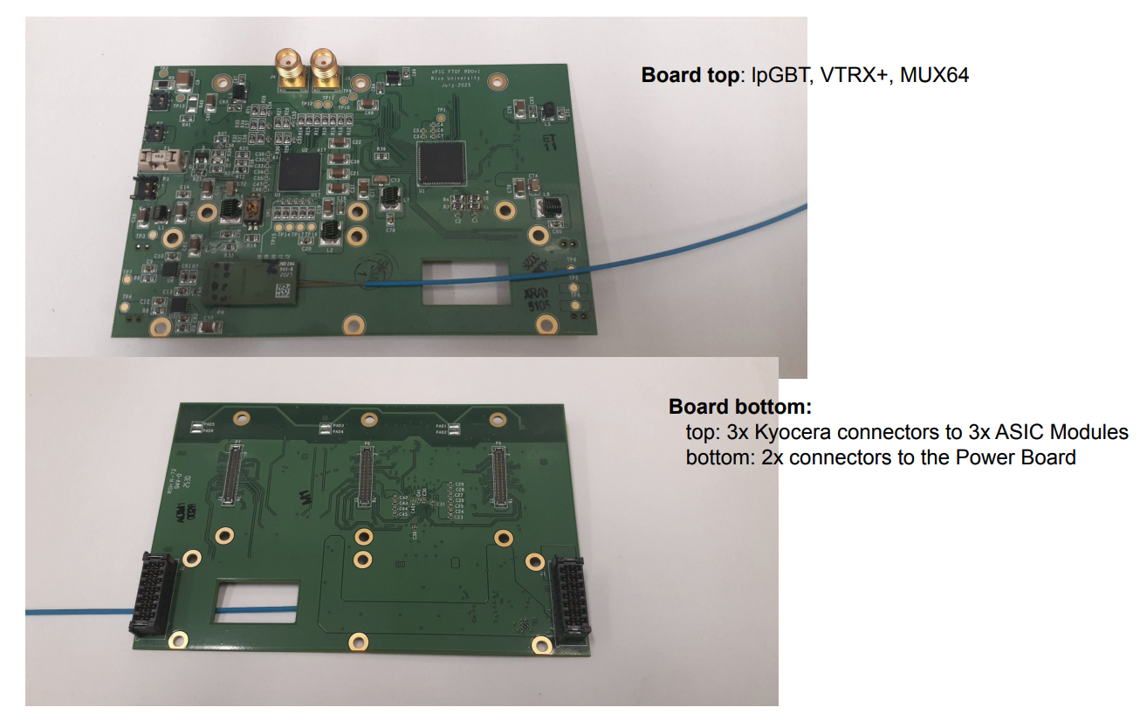
Implementation of AC-LGADs for FF Tracking
Tonko Ljubicic (Rice Univ.)
*Stave dimensions will be updated once EICROC1 schematic is in-hand.
Far-forward sensor “staves”
(3) 1.6cm x 1.6cm AC-LGADs with 500um pixel pitch
bump-bonded to EICROC1/2 ASICs
staggered on a two-sided PCB to provide full active-area coverage.
These sensors have 32x32 channels, matching the EICROC1/2.
Currently have 32x32 channel sensors from HPK which are under test.
Strong synergy with TOF: front-end + power board will be the same as FTOF.
Only difference is sensor stave/module, and the separation of the FEB for flexibility for FF detector needs.
Presently optimizing choice of readout board “flavor” which works best for auxiliary detector needs.

Slide 9
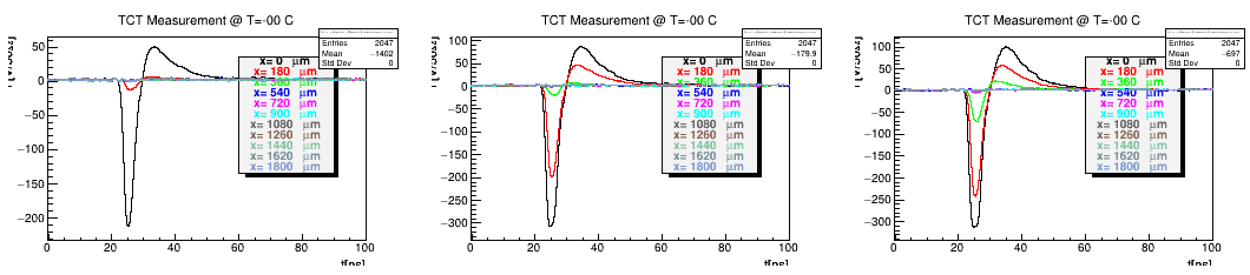
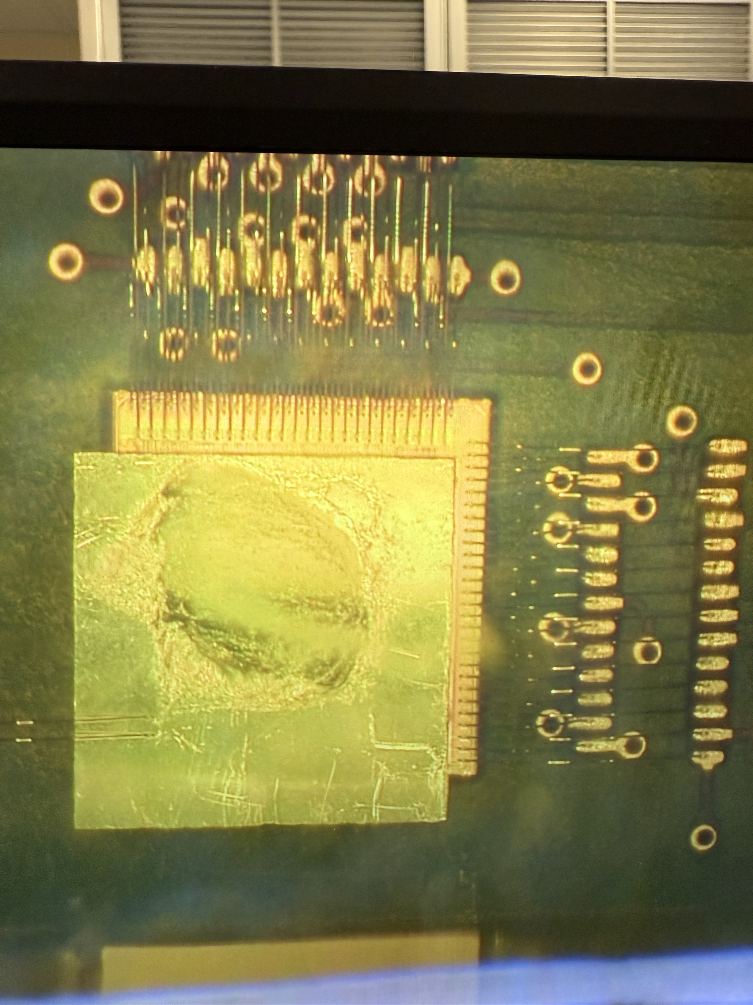
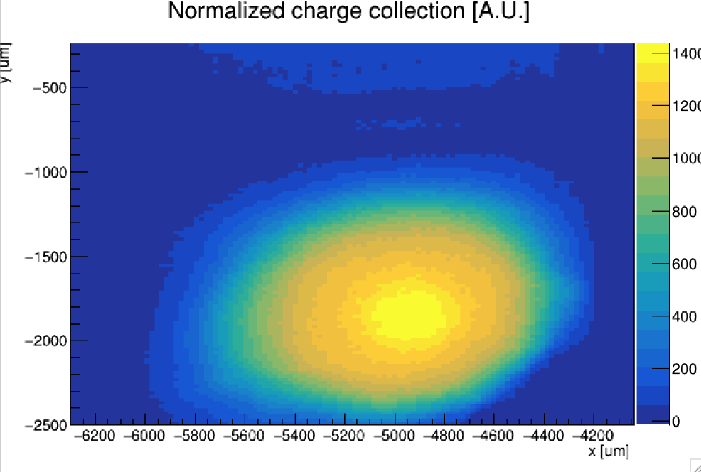
AC-LGAD Testing → AC-LGAD + EICROC0
V [mV]
V [mV]
V [mV]
t[ns]
t[ns]
t[ns]
AC-LGAD (HPK) “etched” to remove portions of the backplane which normally block incident TCT IR light from the laser in a bump-bonded assembly.
Etching by Simone Mazza from UCSC.
TCT is useful for doing position dependent measurements (e.g for spatial resolution), and for probing uniformity of charge collection and gain.
Etched, bump-bonded assembly.

Slide 10
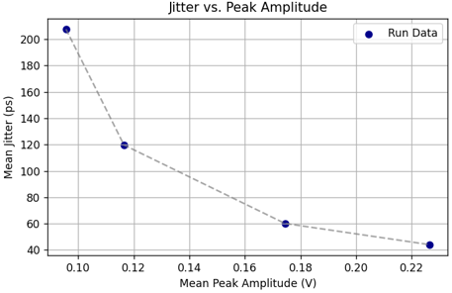
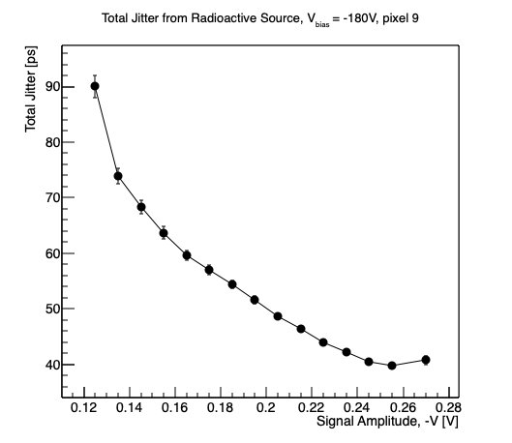
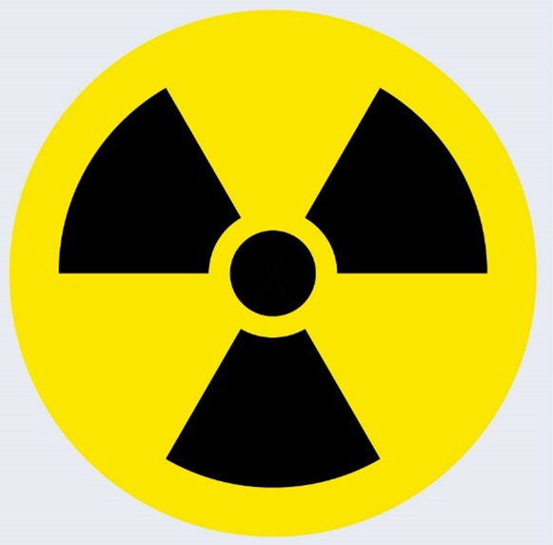
AC-LGAD Testing → AC-LGAD + EICROC0
Laser measurements (variable laser power)
Sr-90 radioactive source
Jitter measured using full bump-bonded sensor + ASIC (readout with commercial Xilinx FPGA board).
Jitter of sensor ~ 10ps; EICROC (TDC) via charge injection ~ 10-15ps.
Total jitter (via analog output of EICROC test board) ~ 40ps – why?
Likely from hybridization and/or non-optimal analog readout → under study.

Slide 11
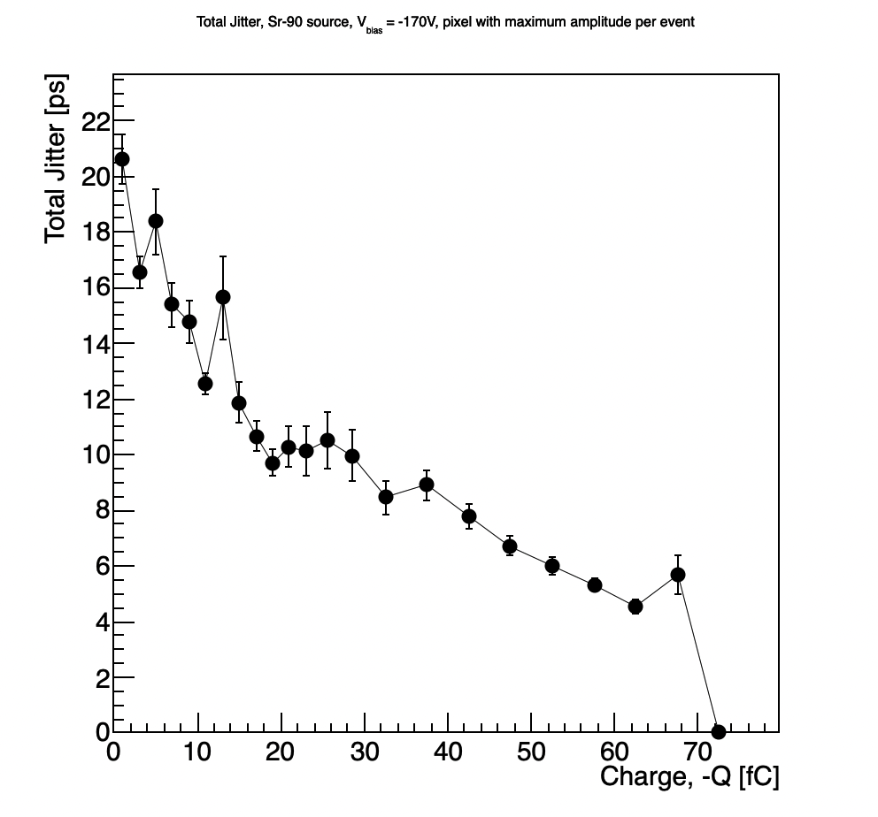
AC-LGAD Testing → AC-LGAD + Fermilab Board
Sr-90 radioactive source
Jitter measured here using a 30um HPK sensor (same as the other tests) wire-bonded to a Fermilab test board with fast, low-noise preamps.
Much lower jitter observed.
Jitter measured here by reading out 4 pixels, with one serving as a trigger with a very low threshold, and taking the pixel with the maximum amplitude in each event – those were then used to calculate jitter as a function of charge.
Waveform time-integrated, and then divided by preamp gain (100) and impedance (50 Ohms)

Slide 12
Overall testing plans for AC-LGADs
Sensor and ASIC testing between TOF/auxiliary subsystems leverages workforce from all groups.
Example (currently happening):
HPK sensors characterized (IV curves) at UCSC,
shipped to BNL for testing with EICROC + laser/sources,
RBv1 developed by Rice, then sent to BNL (arriving in Dec. 2025),
sensor/ASIC integration tested at BNL with FPGA; Rbv1 setup tested in parallel,
when EICROC1 received (Feb./March 2026), integration with RBv1 tested,
all groups use results for e.g. test beam planning at SPS.
QA needs for sensors/modules for pixilated systems understood (for common items).
Sensors, ASICs, readout, hybridization, etc.

Slide 13
Broad timeline of AC-LGAD activities (non-exhaustive)
Action Item | Current Status | Dates (expected completion) | Notes
4x4 BNL and HPK sensors tested at Fermilab | Complete | 2020 to Summer 2022 | Established timing resolution ~ 20ps and spatial resolution ~ 20um (7x better than normal for pixel pitch due to charge sharing)
EICROC0 testing with charge injection | Mostly complete (jitter still under study) | Summer 2023 to now (Feb. 2026) | Tested analog and digital output, measured jitter, tested linearity of ADC Firmware does not support external trigger; will be updated to enable this with EICROC1
4x4 sensor testing with EICROC0 | Mostly complete (jitter still under study) | Summer 2023 to now (Feb. 2026) | Testing has been done with AC-LGADs wirebonded to EICROC0 – noise unacceptably high. Now using bump-bonded assemblies. Tested with TCT and Sr-90 source. Jitter from individual components small (10-15ps) – total jitter from analog output of EICROC0 testboard with AC-LGADs bump-bonded high – under study now.
Testing of full-size 32x32 channel HPK sensors | In-progress | Summer 2025 to now (Summer 2026) | IV curves measured and breakdown voltages identified; production yield > 90%; first test beam @ DESY in December 2025; hope for test beam @ SPS in Summer 2026; Lab testing underway (laser, source)
RBv1 setup and initial tests | In-progress | Summer 2025 to now (Spring 2026) | Work done to validate setup at Rice; setup being established at BNL to test EICROC1 with two different readouts after receipt of ASIC
Testing of EICROC1 | Not started | March 2026 to Fall 2026 | Will test with FPGA setup as done with EICROC0; aim is to test with RBv1 (lpGBT-based readout) as soon as EICROC1 is received.
Full-chain tests (32x32 sensor with EICROC1 and RBv1) | Not started | Late Spring 2026 – TBD (end of 2026) | Goal is to have initial full chain testing done by Summer if EICROC1 testing + RBv1 setup is successful.

