Slide 1




Measuraments of inclusive differential diffractive cross sections in DIS at ePIC
GRUPPO COLLEGATO COSENZA

Slide 2
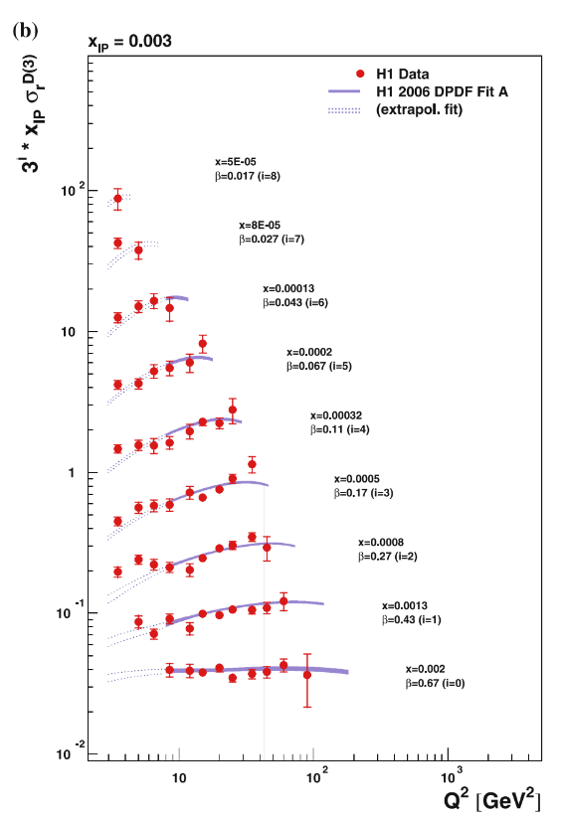
Motivation
Status of work:
Hadi Hashamipour left in May.
Inclusive diffraction e+p:
Never studied in detail at ePIC detector.
Cross Section -> DPDF
DPDF -> Sensitive to gluon densities
Saturation
GRUPPO COLLEGATO COSENZA

Slide 3
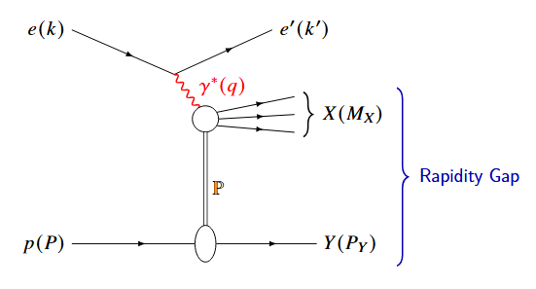
DIS Variables
INCLUSIVE
Q² = - q² = - (k - k’) ² = s y x
x_{Bj} = Q² / 2 (P · q)
y = P · q / P · k
W² = (q + P) ²
GRUPPO COLLEGATO COSENZA

Slide 4

DIS Variables
DIFFRACTIVE
t = (P − P’) ²
$β$ = Q² / (Q ² + M_{X}² − t) = x_{Bj}/x_{pom}
M_{X} ² = (q + P − P’) ² = E_{X}² - |P_{X}|²
x_{L} = P_{z}’/P_{z} = 1 - x_{pom}
x_{pom} = (Q² + M_{X} ² − t)/(Q² + W² − m²_{p})
GRUPPO COLLEGATO COSENZA

Slide 5

Diffractive DIS
$$\frac{dσ^{ep→ eXY}}{dt}={\left.\frac{dσ^{ep→ eXY}}{dt}\right|}_{t=0}e^{−Bt}$$
$$Y_{+}=1+{\left(1−y\right)}^{2}$$
$$\frac{d^{3}σ^{ep→ eXY}}{dx_{pom}dβdQ^{2}}=\frac{2πα^{2}}{βQ^{4}}Y_{+} σ_{r}^{D\left(3\right)}\left(x_{pom},β,Q^{2}\right)$$
$$σ_{r}^{D\left(3\right)}\left(x_{pom},β,Q^{2}\right)=F_{2}^{D\left(3\right)}\left(x_{pom},β,Q^{2}\right) −\frac{y^{2}}{Y_{+}}F_{L}^{D\left(3\right)}(x_{pom},β,Q^{2})$$
GRUPPO COLLEGATO COSENZA

Slide 6
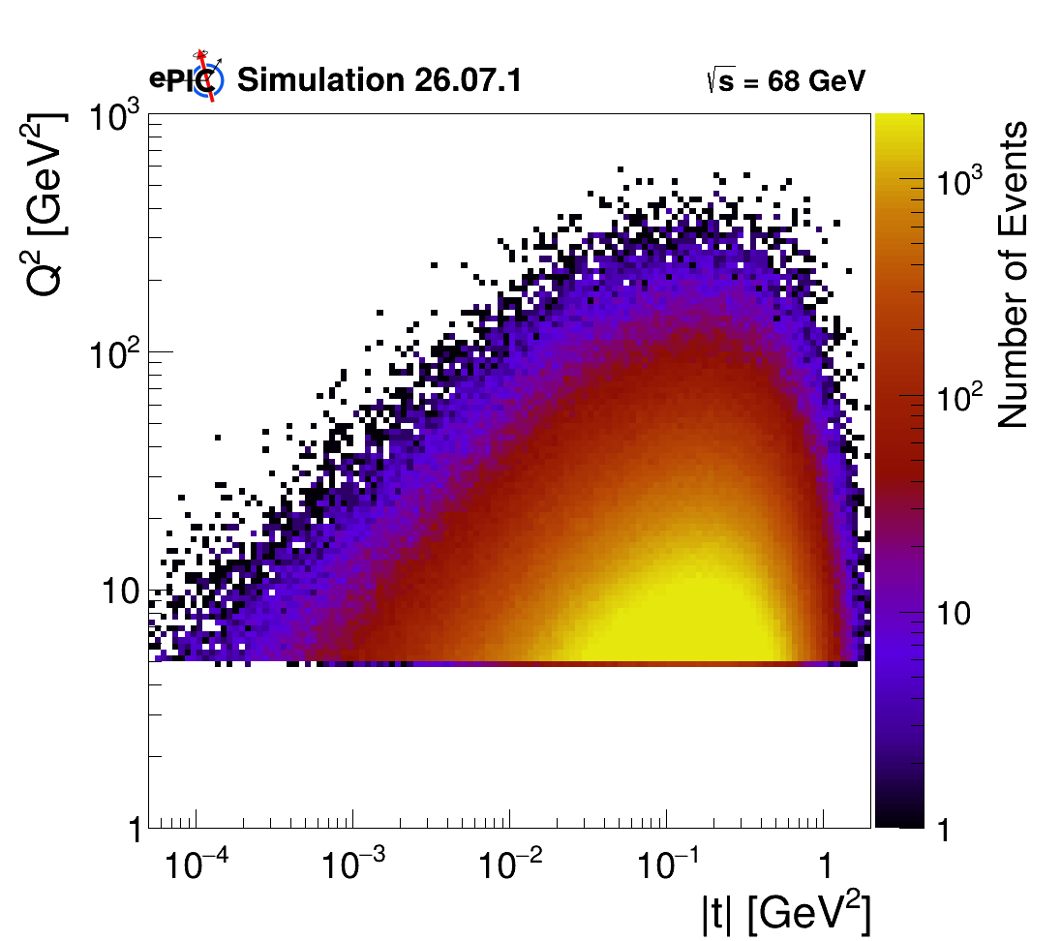
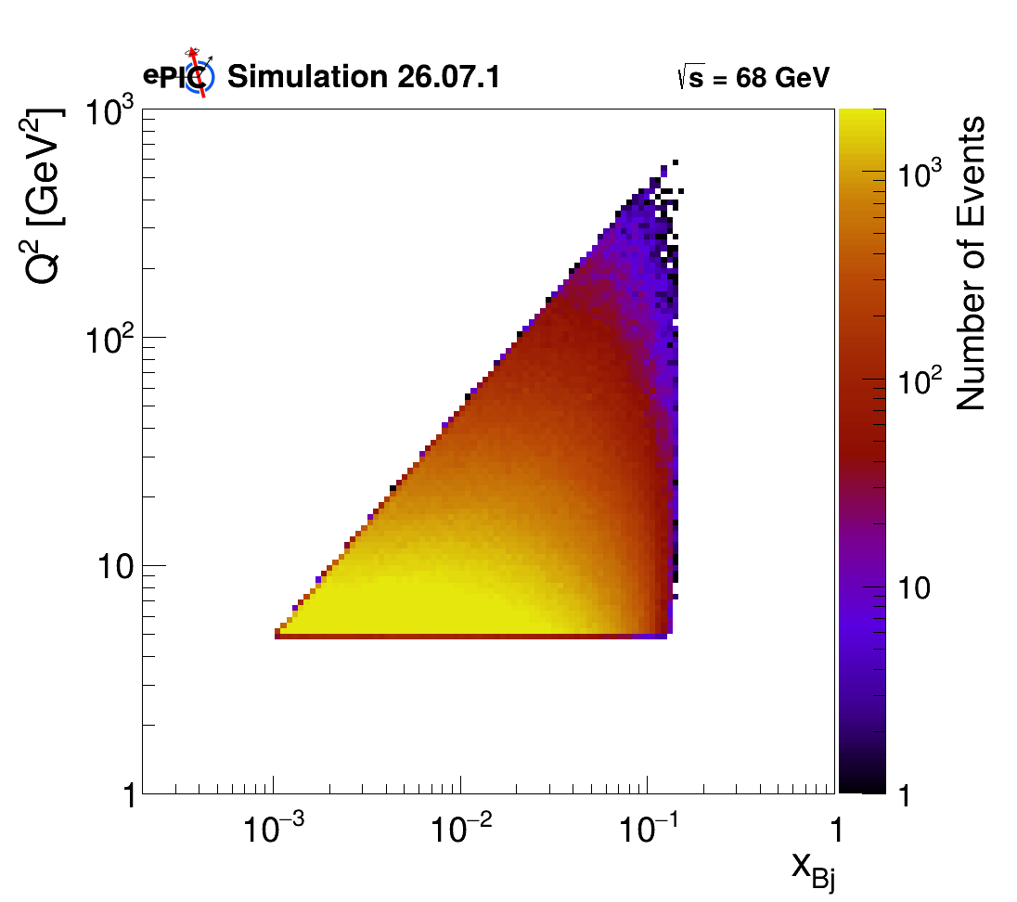
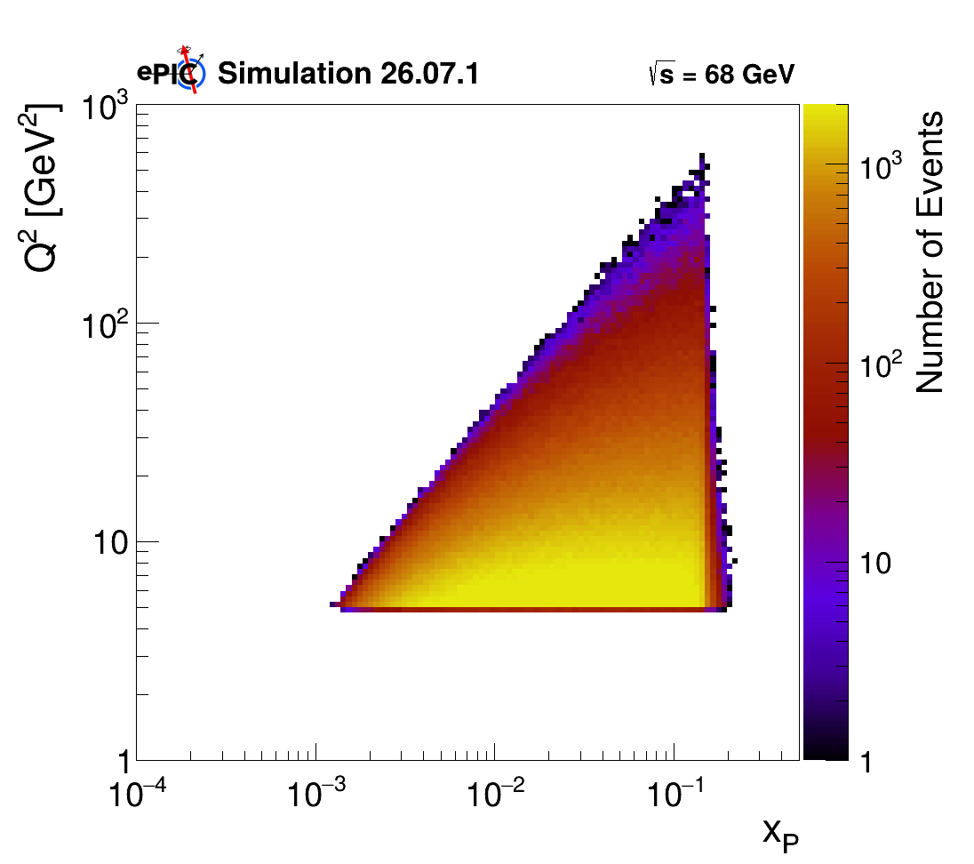
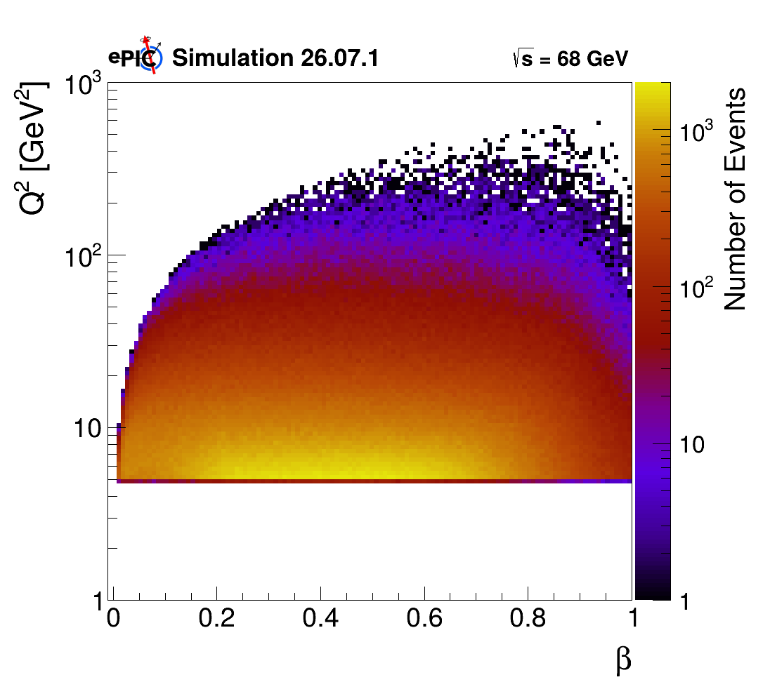

Simulation Campaign 26.07.1
Number of event: 2M
MC: Rapgap 3.10
Afterburner 0.1.3
NO ISR, 9 x 130
Q² > 5 GeV²
10⁻³ < y < 1
10⁻³ < x_{Bj} < 0.15
7 x 10⁻⁶ < t < 2 GeV²
10⁻³ < x_{pom} < 0.2
8 x 10⁻³ < $β$ < 1
GENERATOR LEVEL PHACE SPACE:
GRUPPO COLLEGATO COSENZA

Slide 7
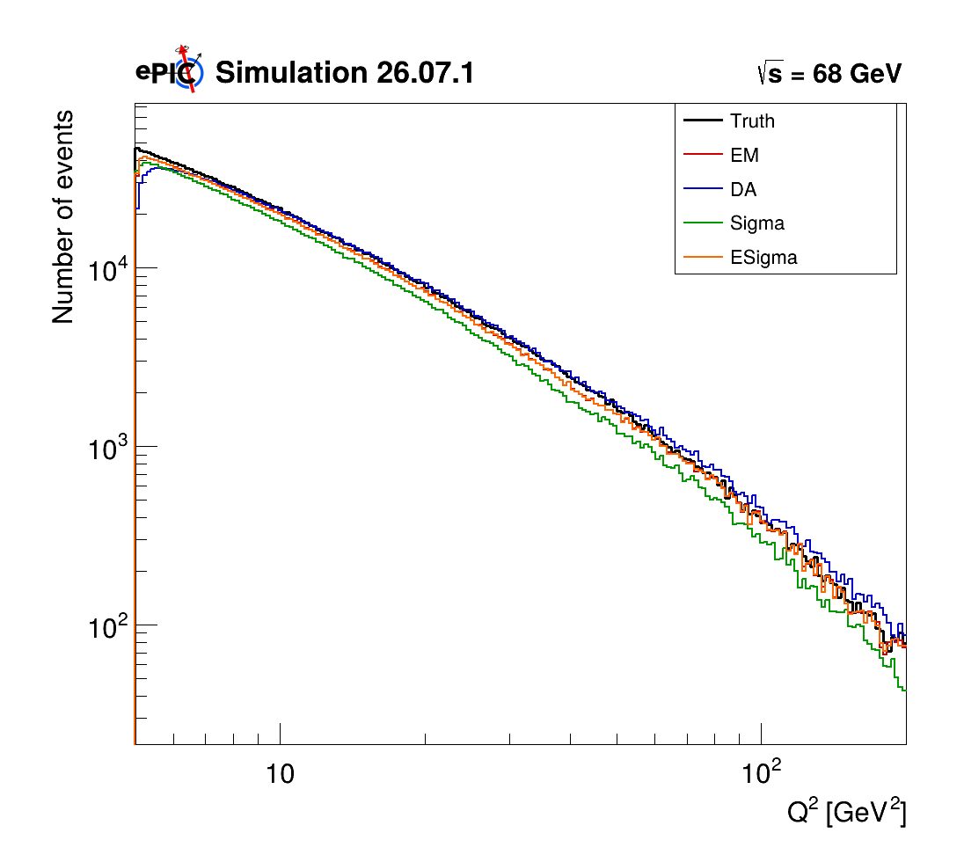
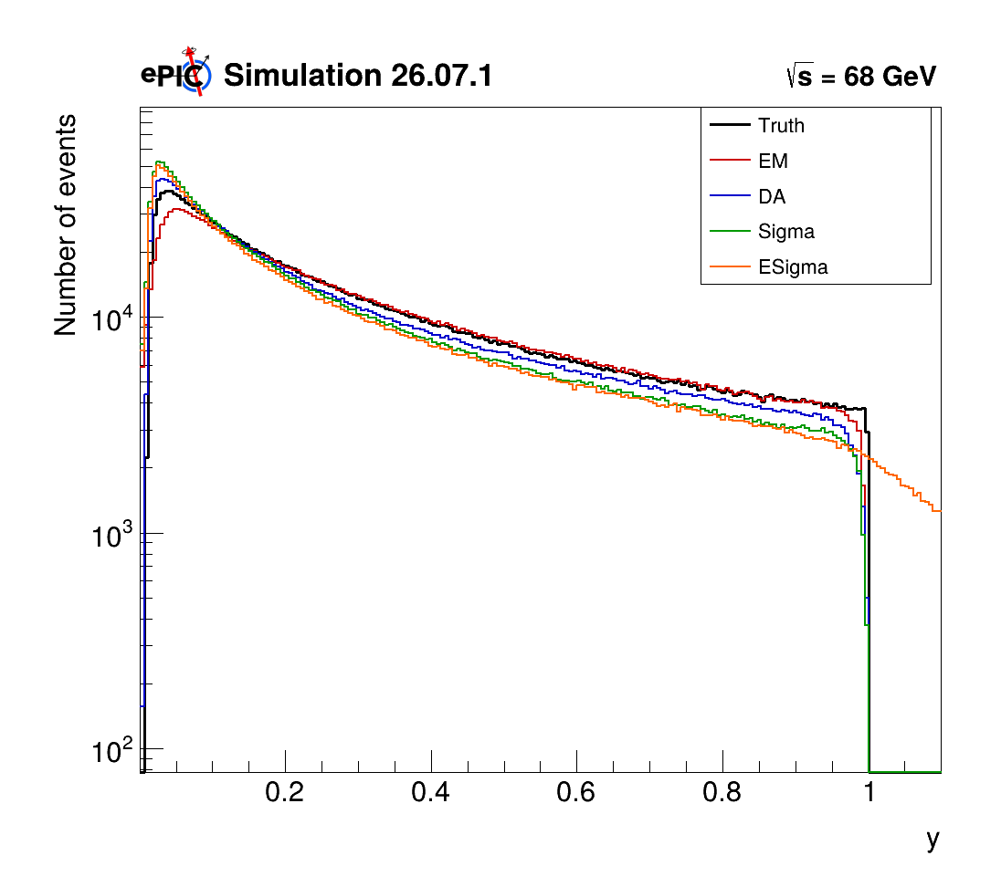
Q² and y distributions
GRUPPO COLLEGATO COSENZA

Slide 8
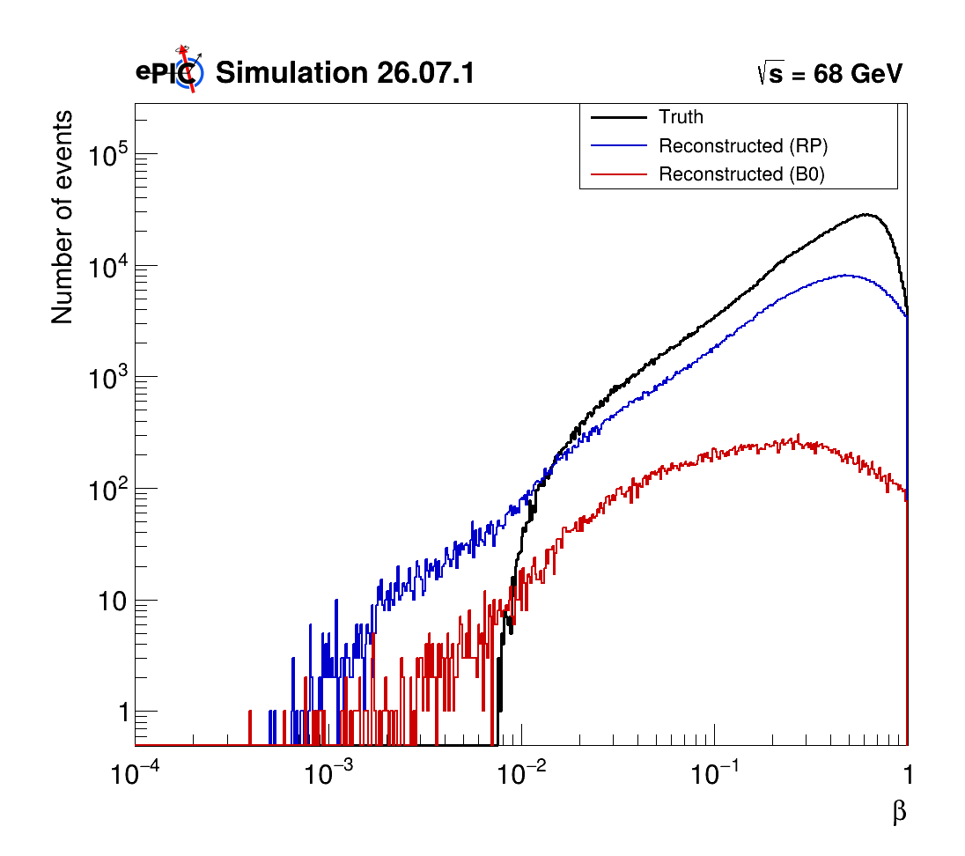
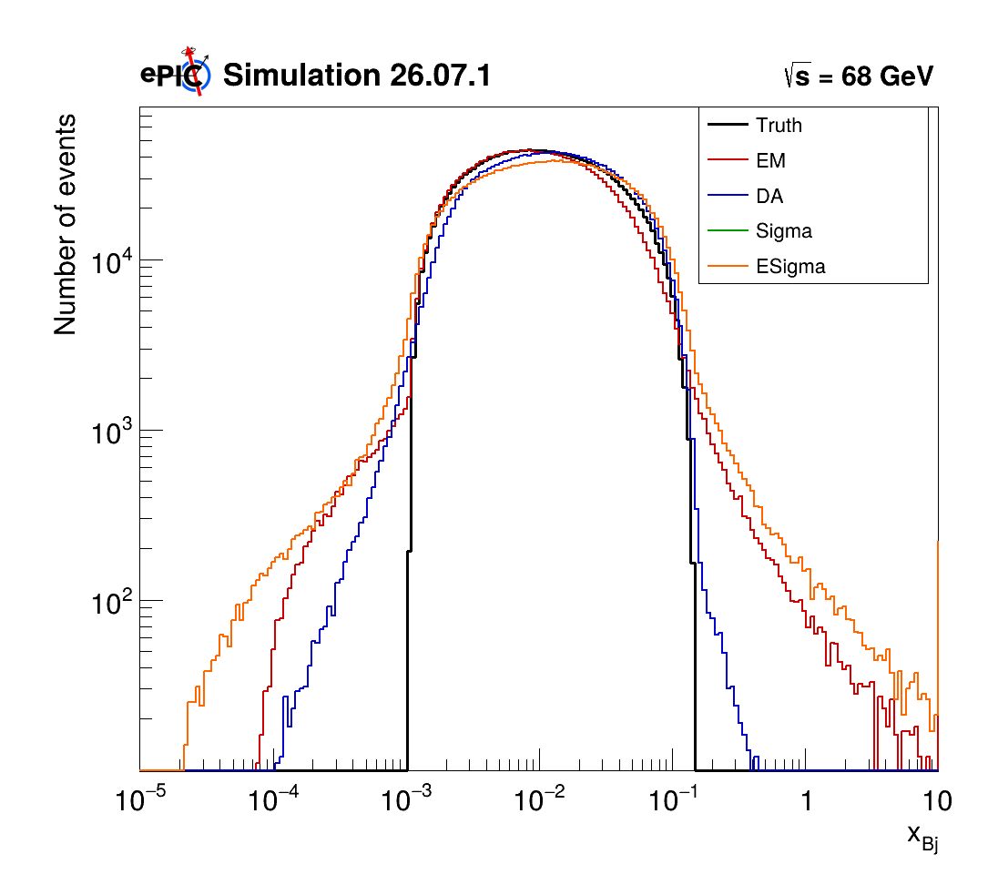

$β$ and x_{Bj} distributions
GRUPPO COLLEGATO COSENZA

Slide 9
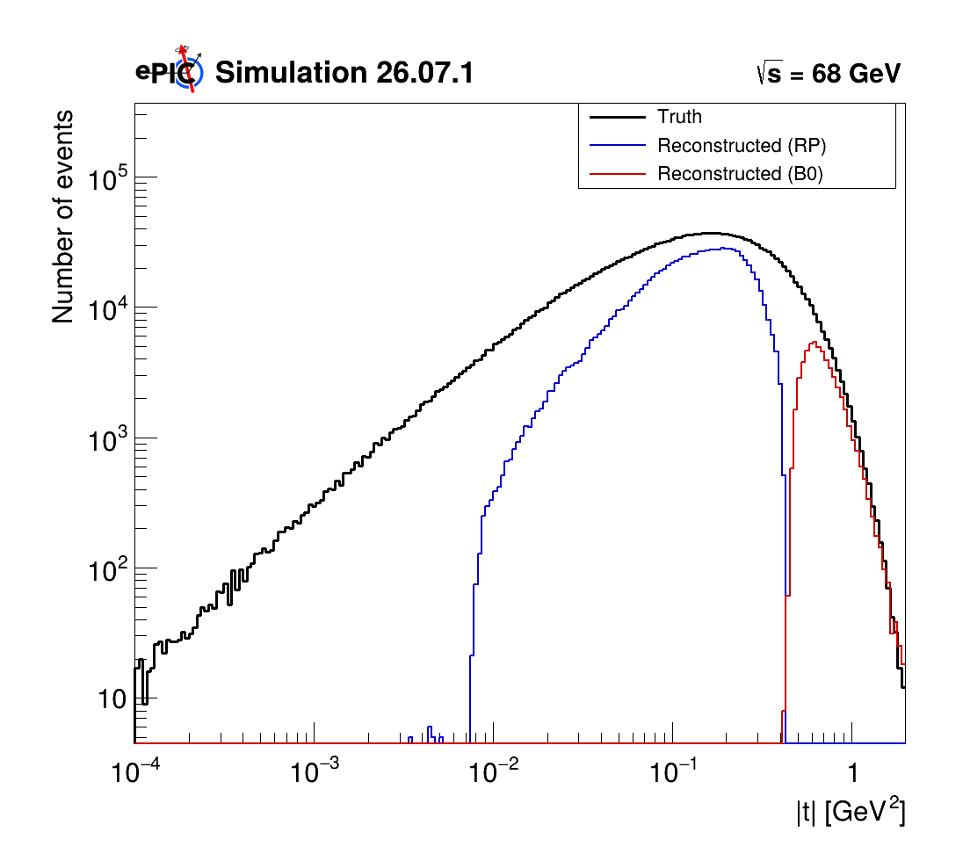
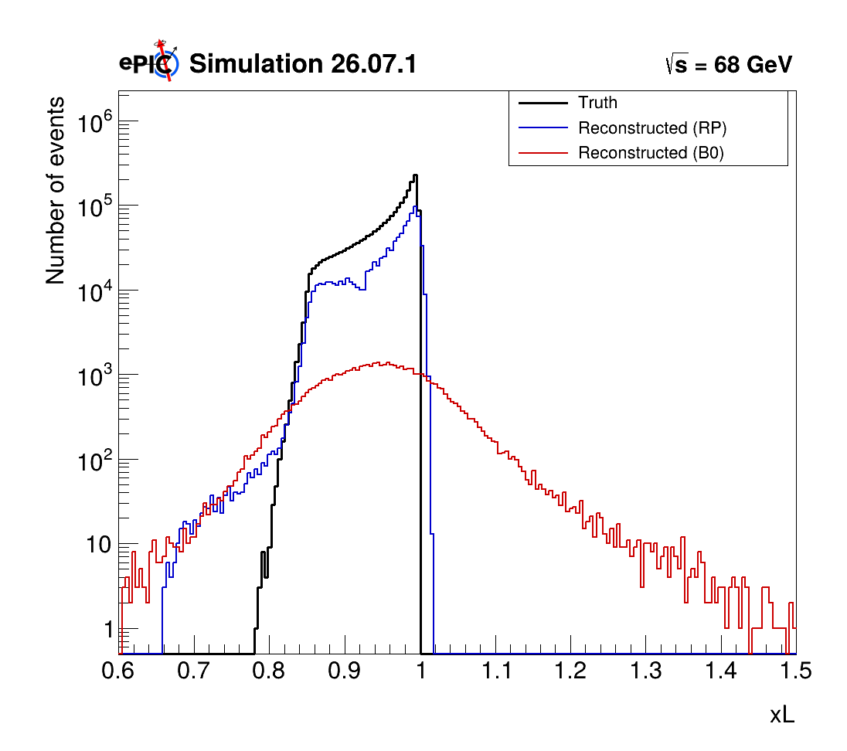
t and x_{L} distributions
GRUPPO COLLEGATO COSENZA

Slide 10
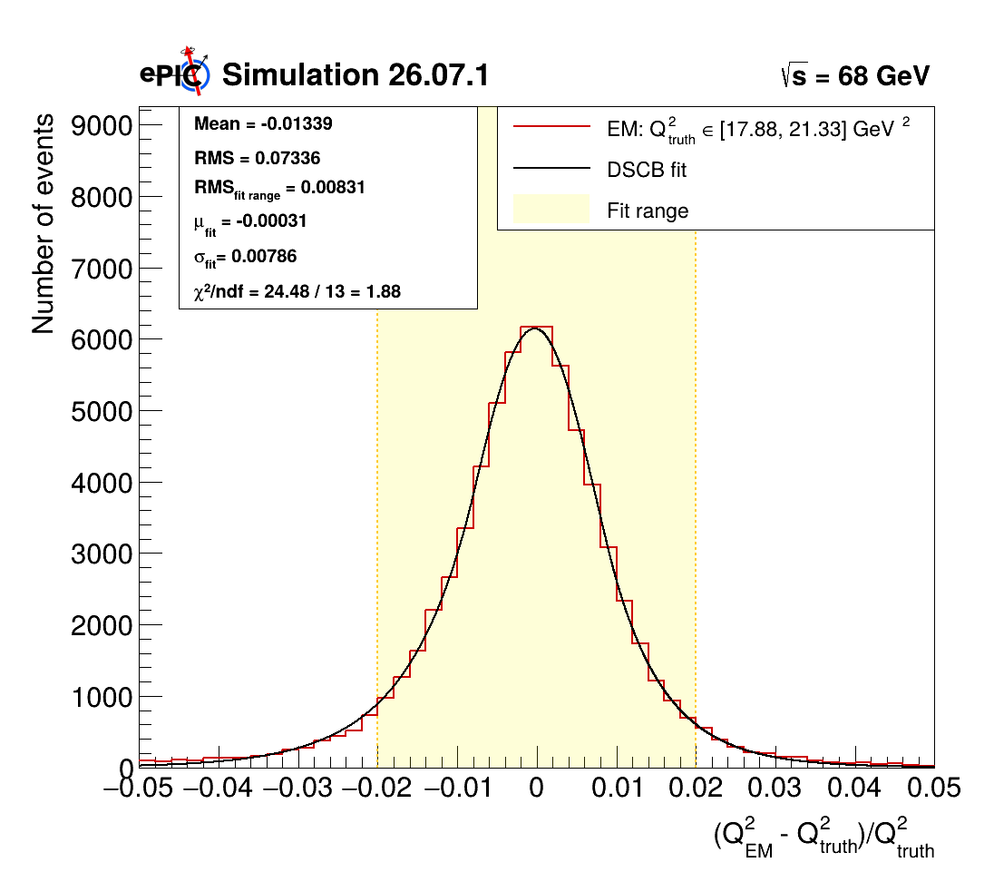
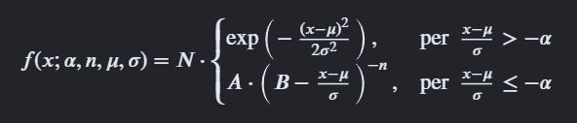

Resolution
Fitted with Double-Side Crystall ball:
RMS or $σ$ → bin total dispersion
Mean or $μ$ → bin systematic bias
All plots HERE
GRUPPO COLLEGATO COSENZA

Slide 11
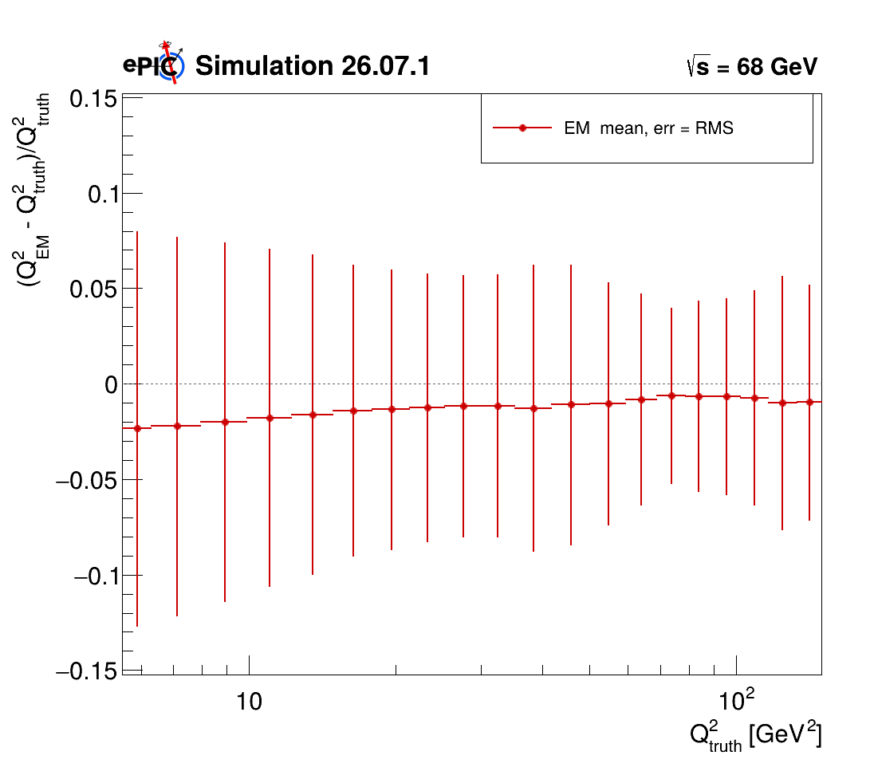
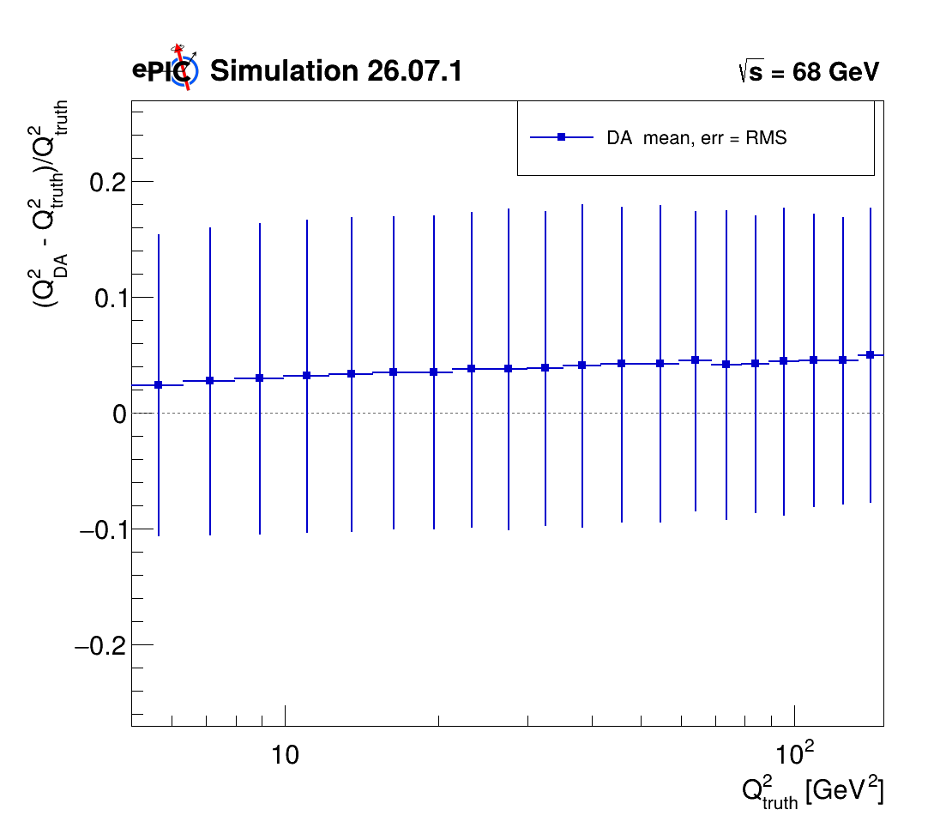
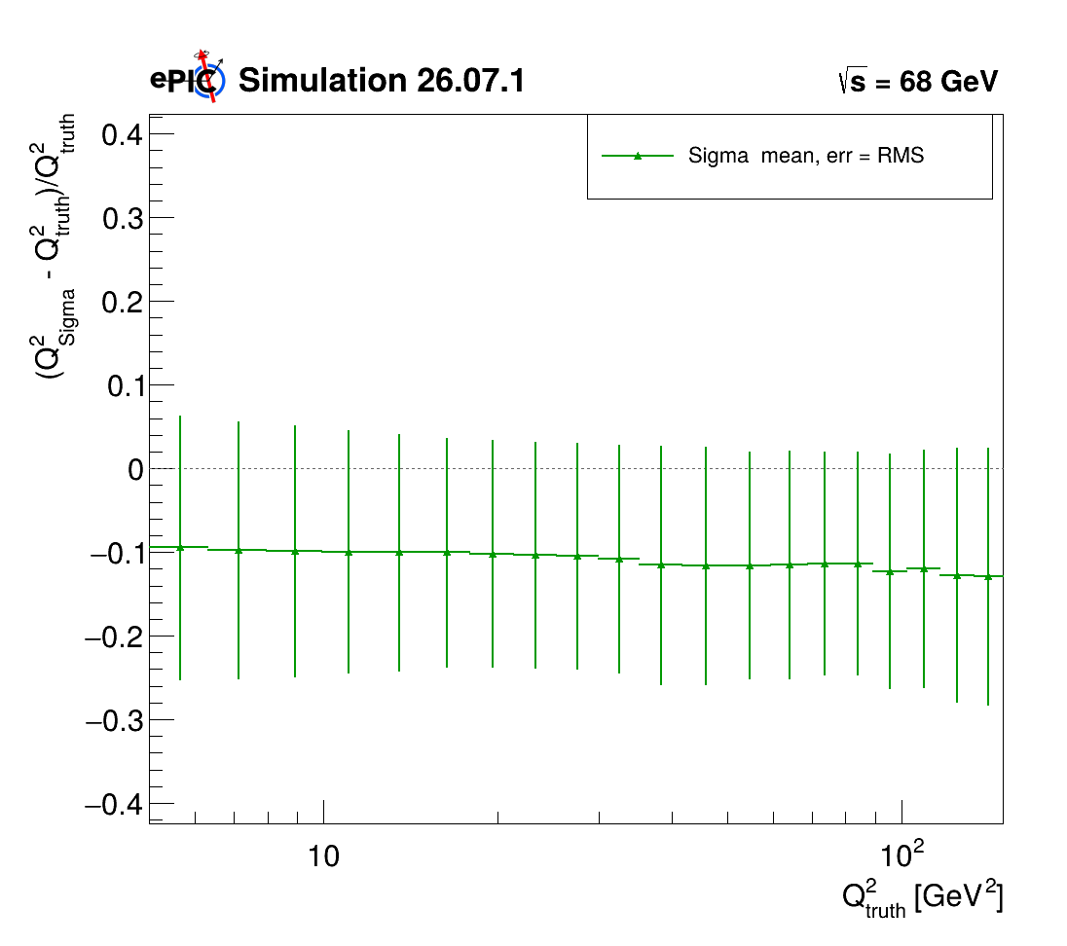
Q² Bin Resolution
ALL THE RESOLUTIONS PLOTS HERE
GRUPPO COLLEGATO COSENZA

Slide 12
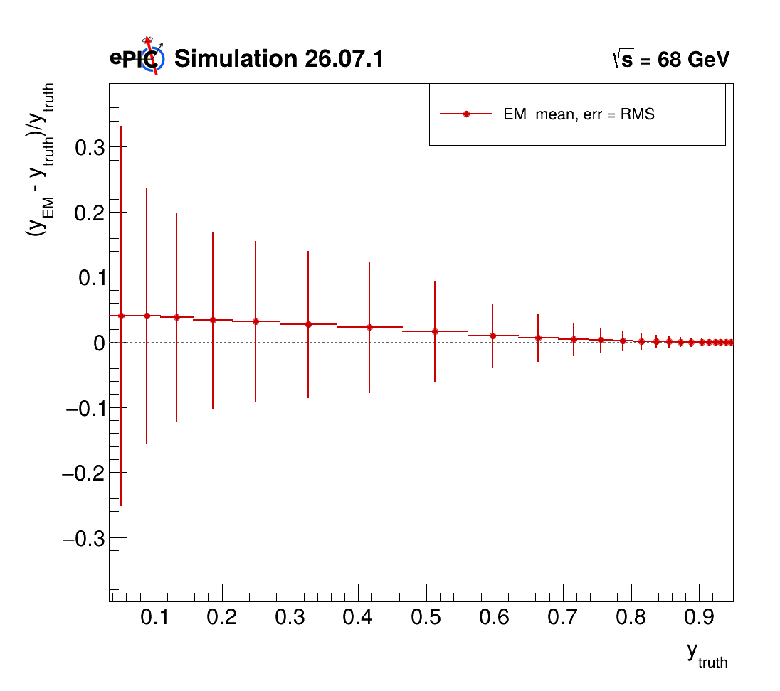
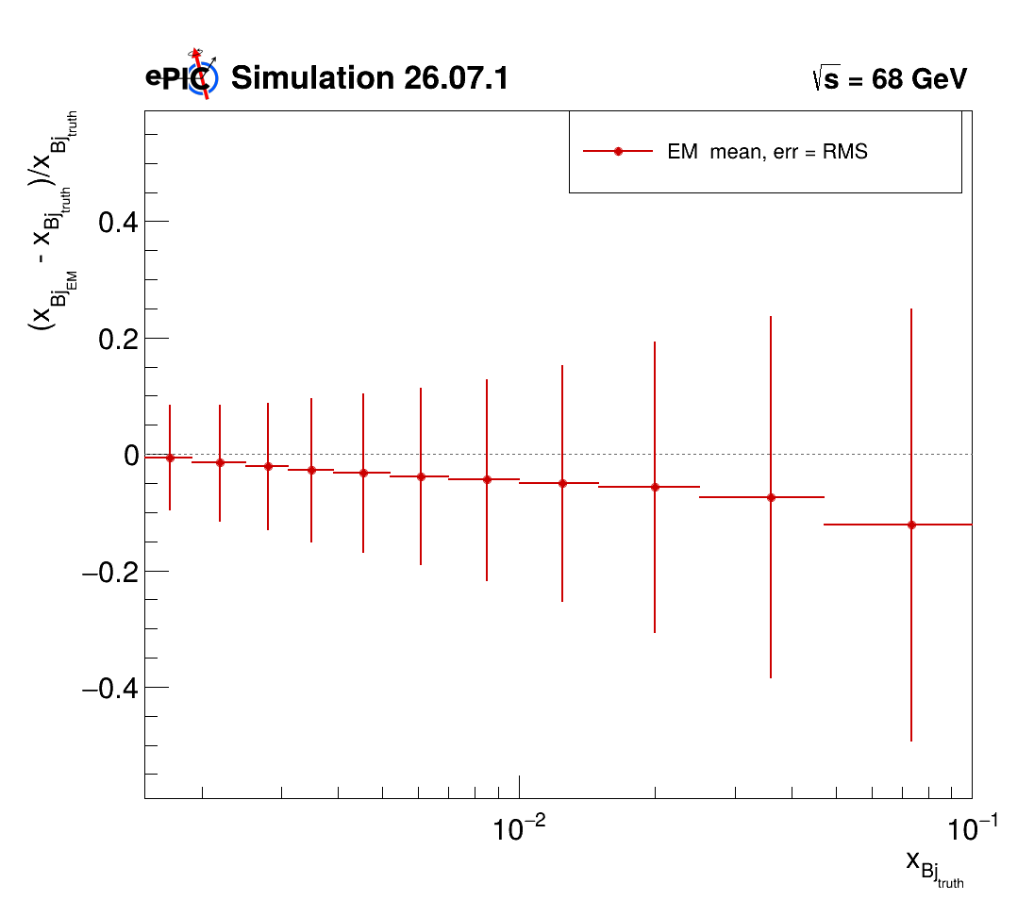
Q² , y, x_{Bj} : Bin Resolution e-Method
Q² Resolution plots
y Resolution plots
xbj Resolution plots
GRUPPO COLLEGATO COSENZA

Slide 13
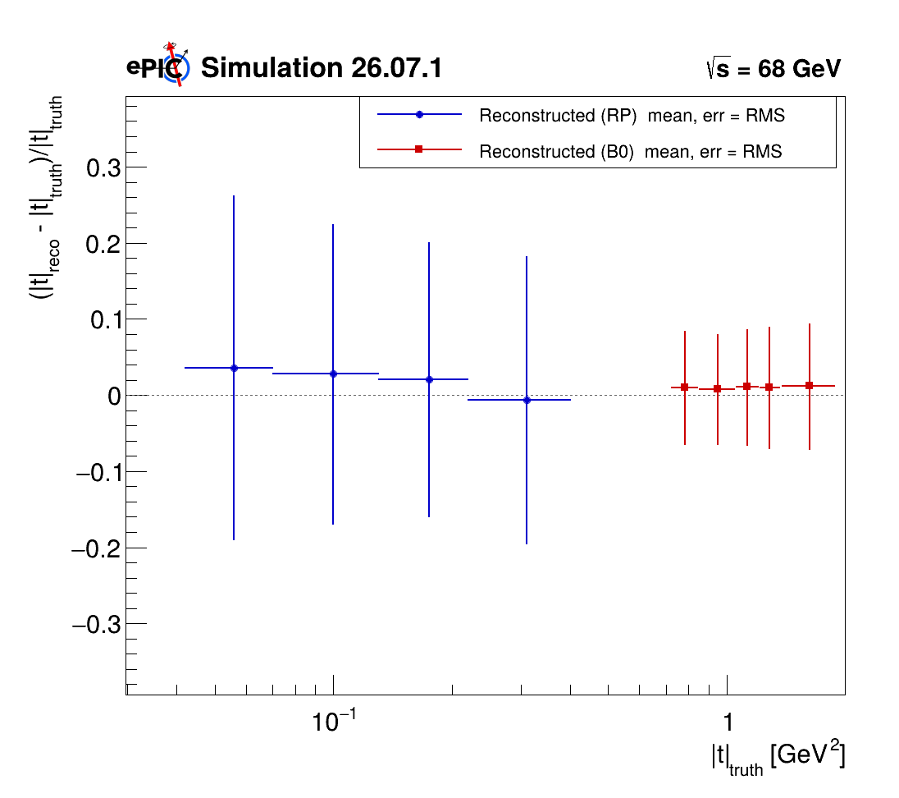
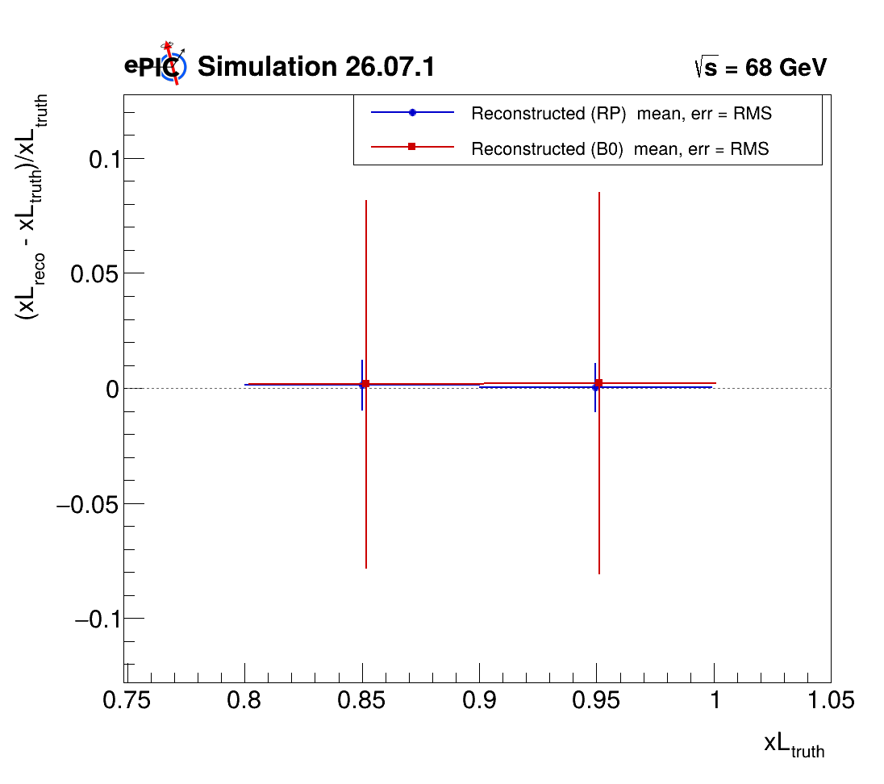
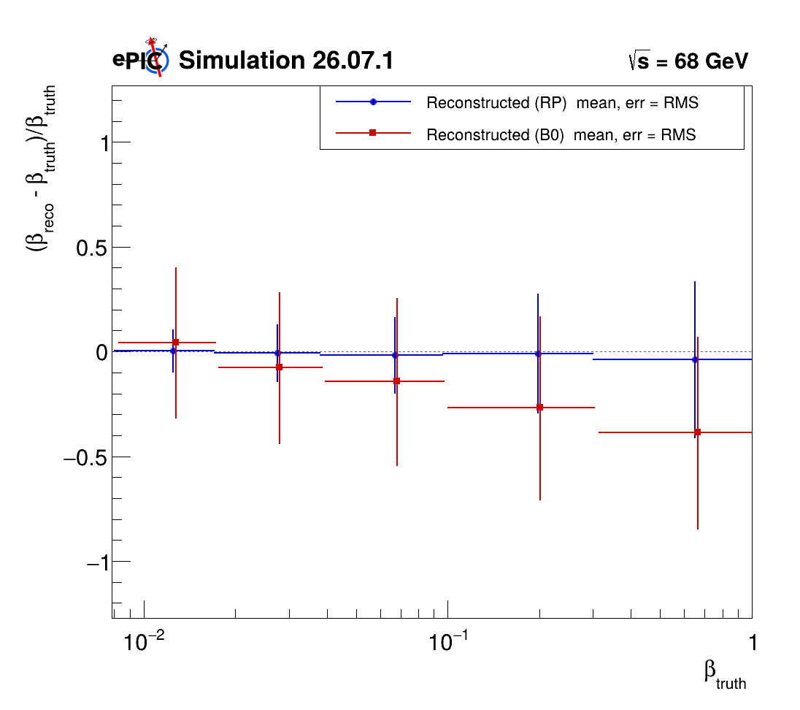

t, x_{L}, $β$ : Bin Resolution
t Resolution plots
xL Resolution plots
beta Resolution plots
GRUPPO COLLEGATO COSENZA

Slide 14
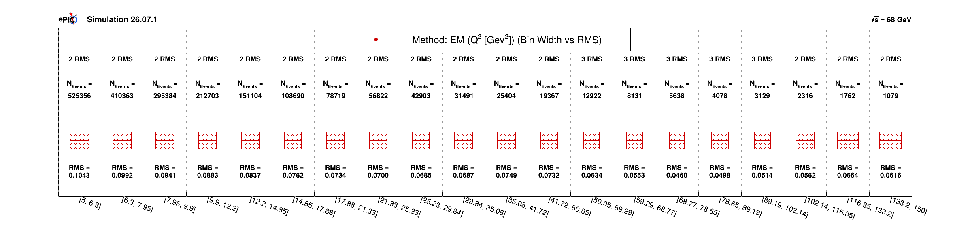
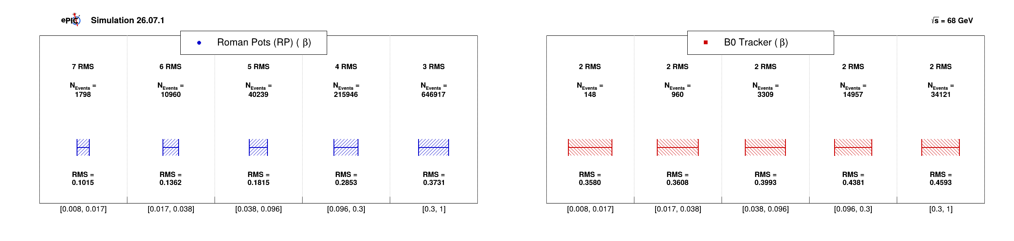

Bin Resolution-Q2 and $β$
GRUPPO COLLEGATO COSENZA

Slide 15
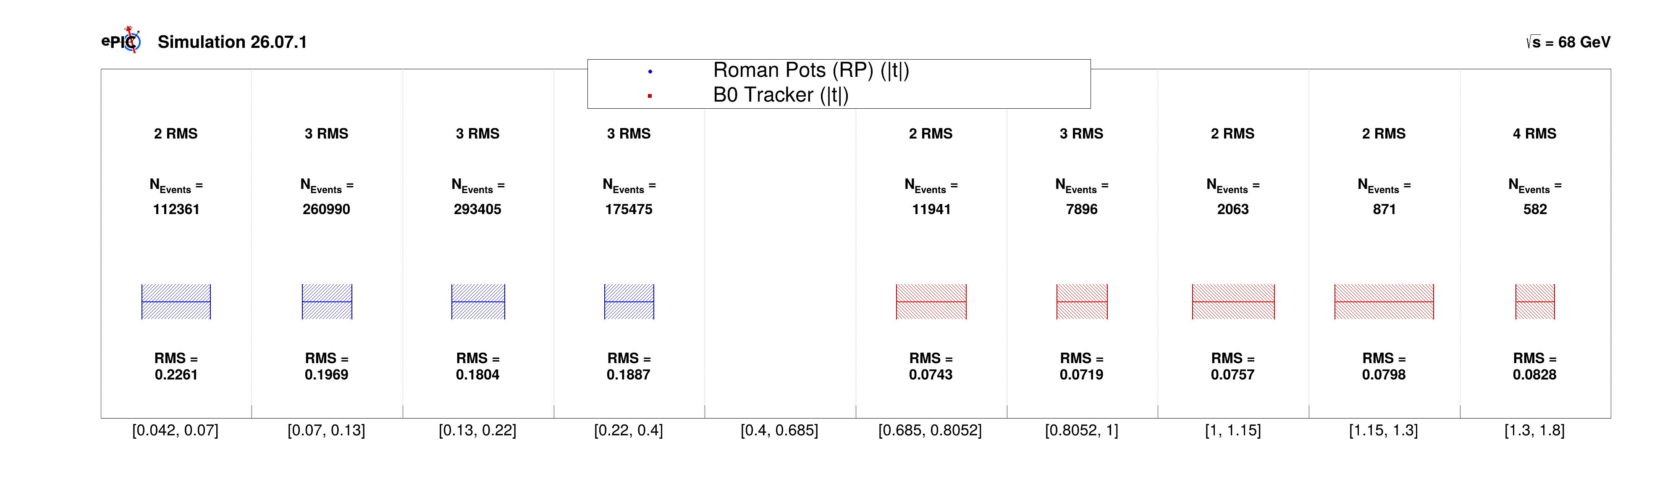
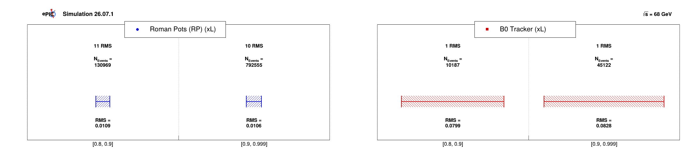
Bin Resolution-t and x_{L}
2D
3D
GRUPPO COLLEGATO COSENZA

Slide 16
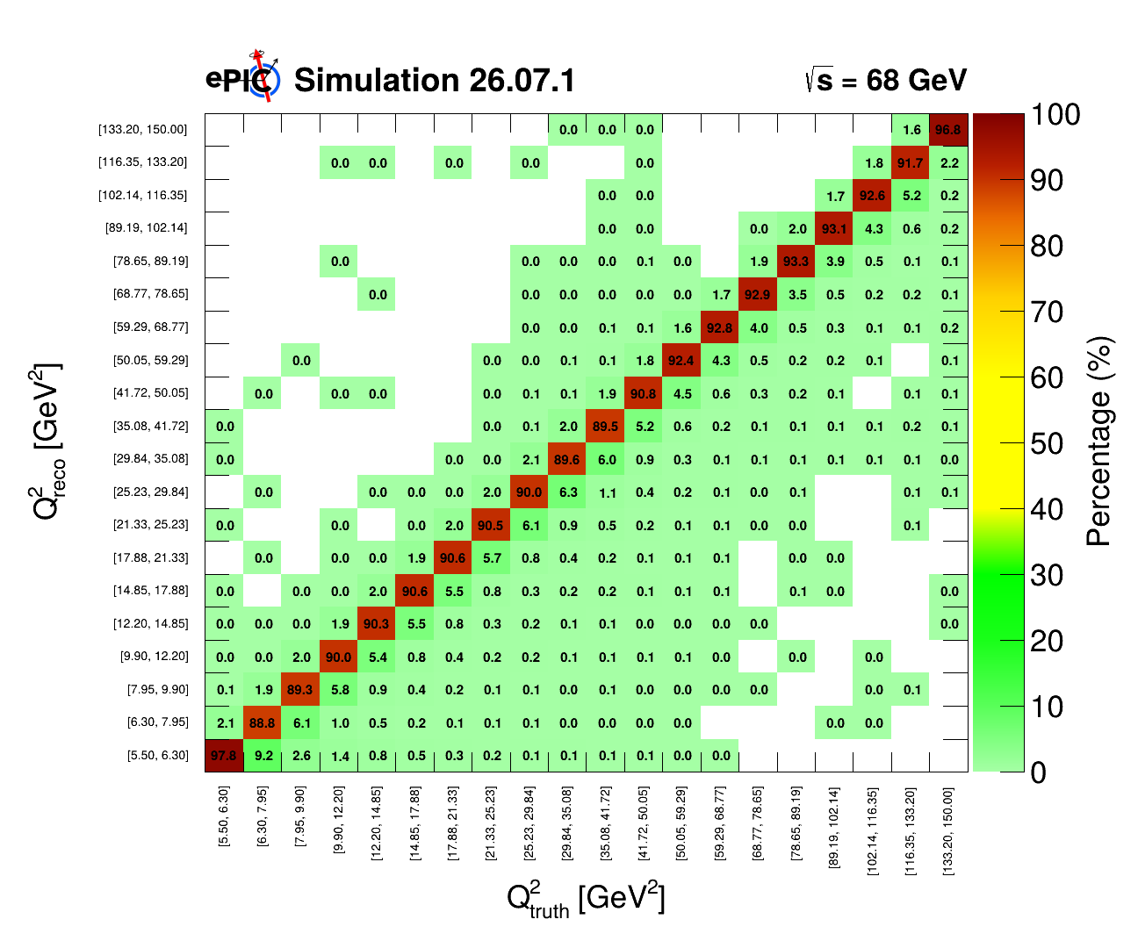
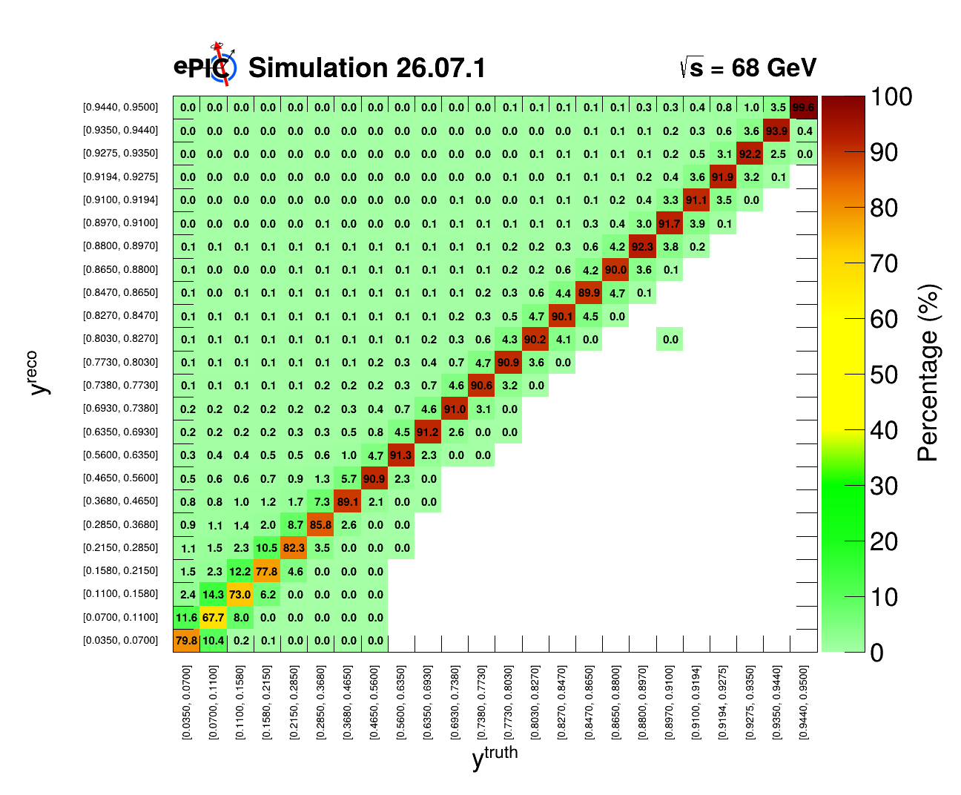
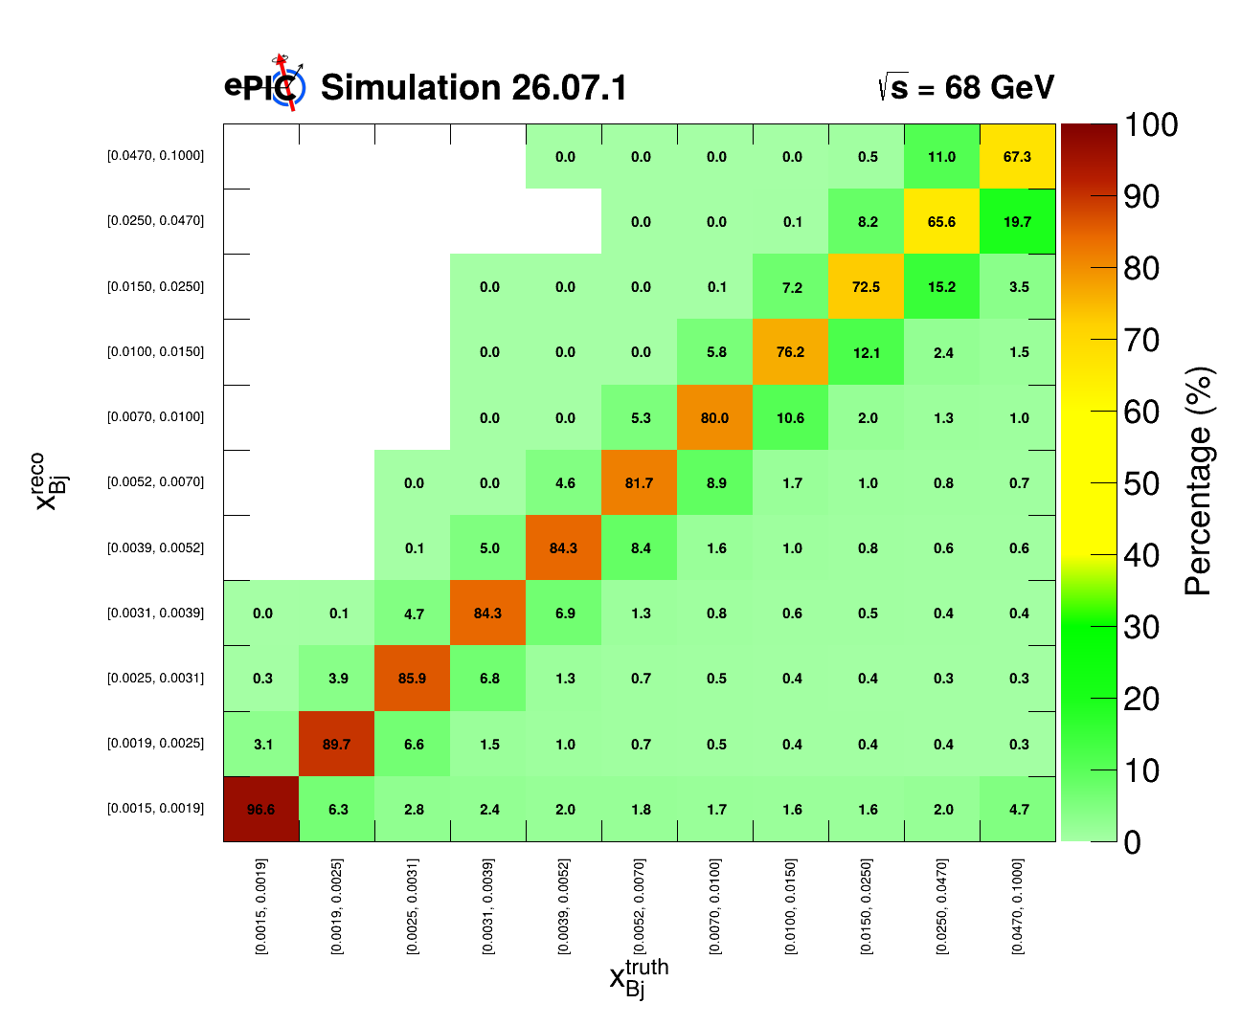
Q² , y, x_{Bj} : Migration Matrices
GRUPPO COLLEGATO COSENZA

Slide 17
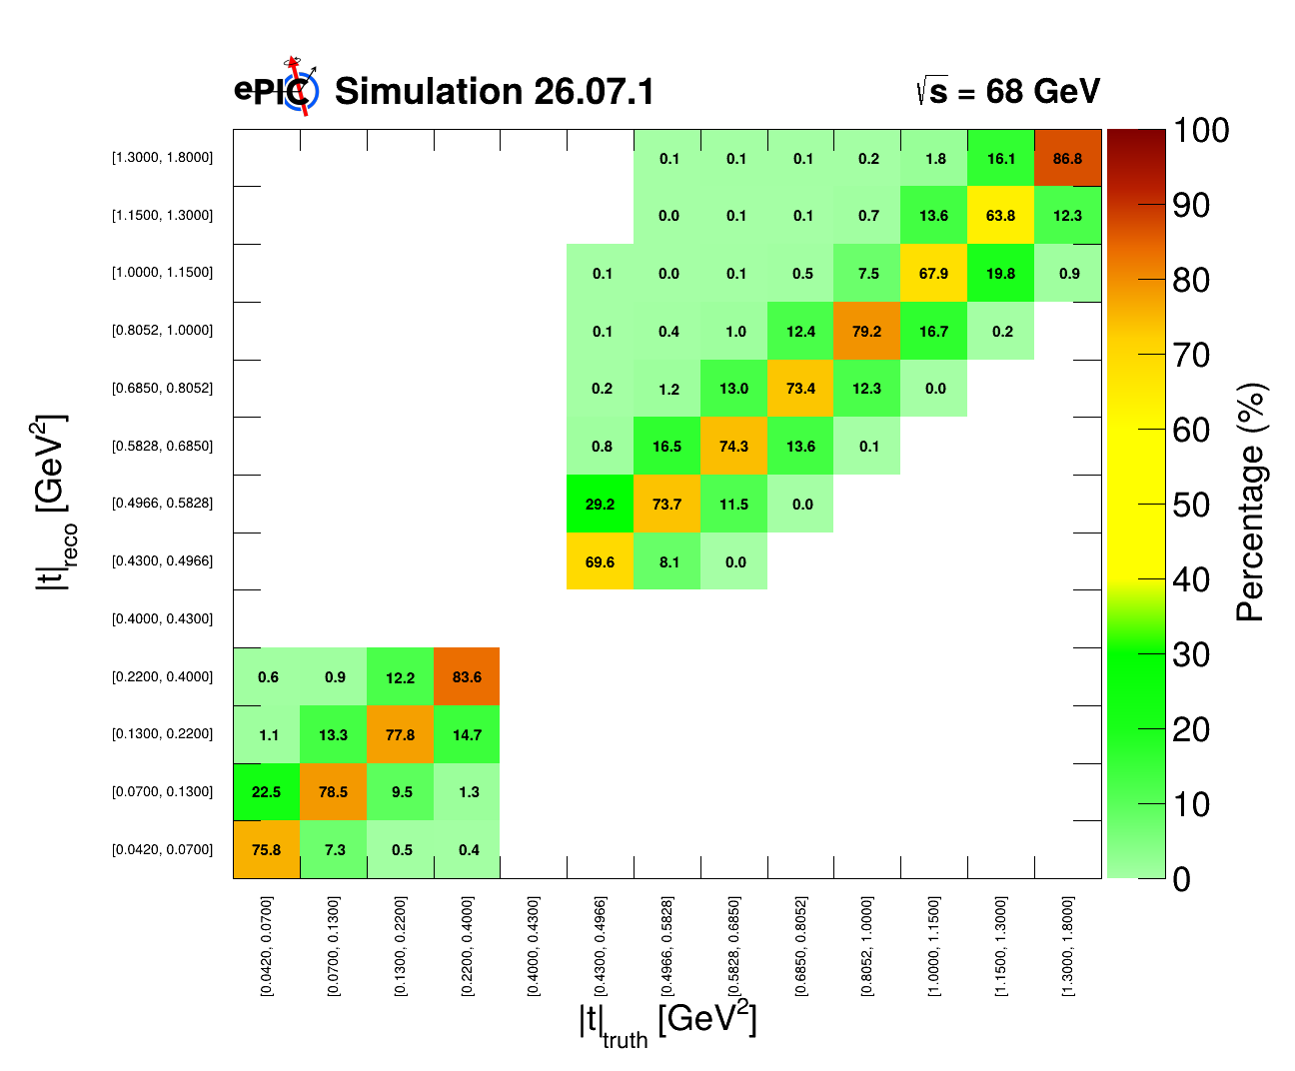
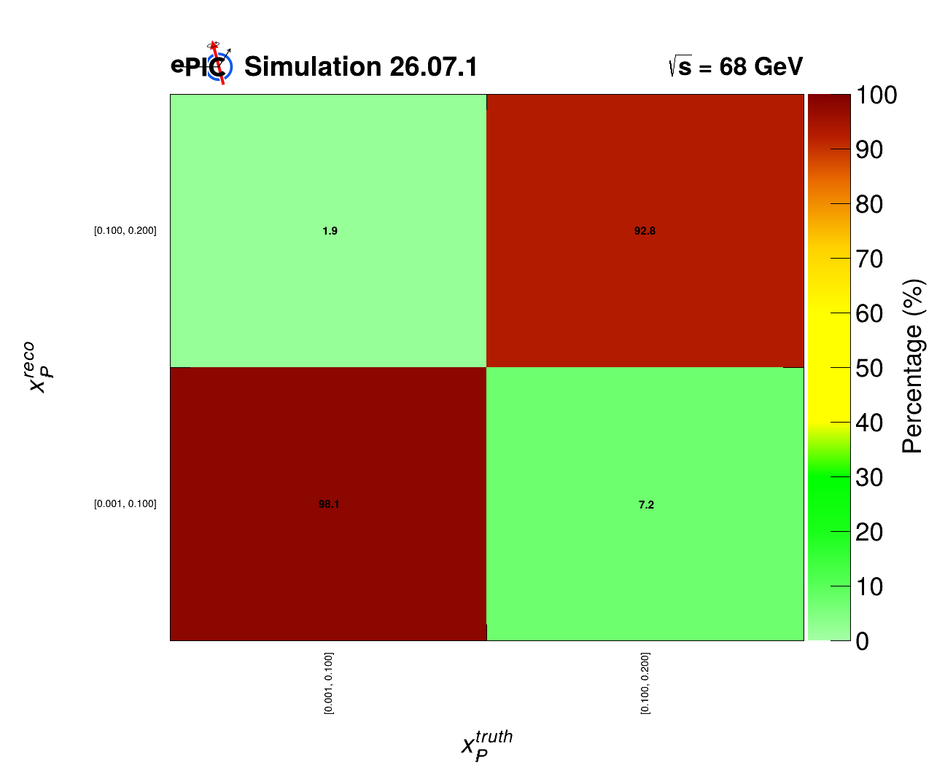
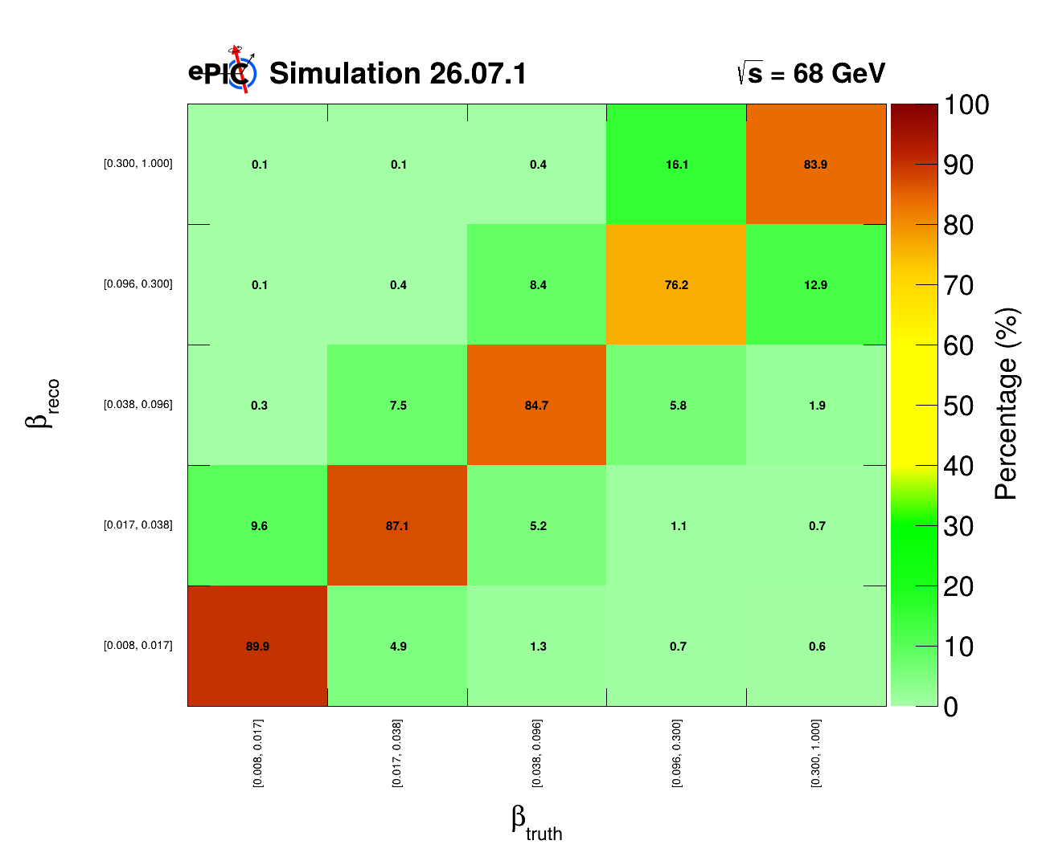

t, x_{pom}, $β$ : Migration Matrices
Also, with luminosity scaled to 1 fb⁻¹ HERE
GRUPPO COLLEGATO COSENZA

Slide 18
GRUPPO COLLEGATO COSENZA

Slide 19
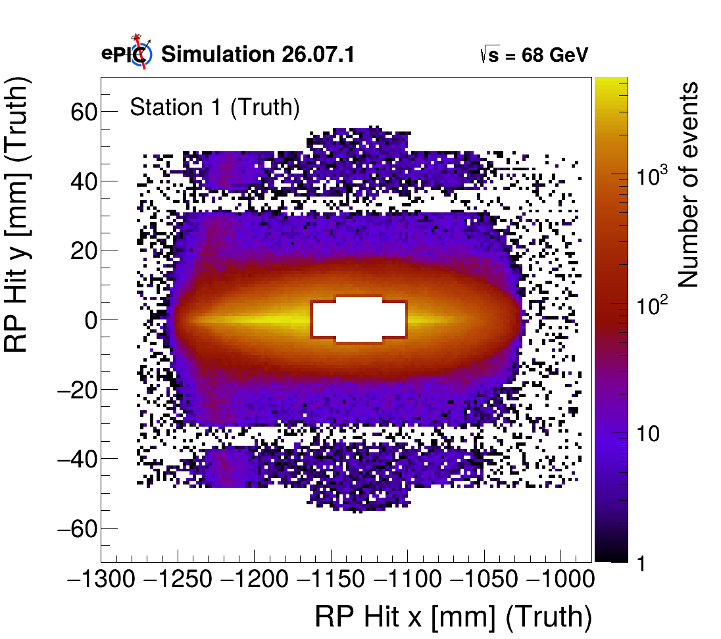

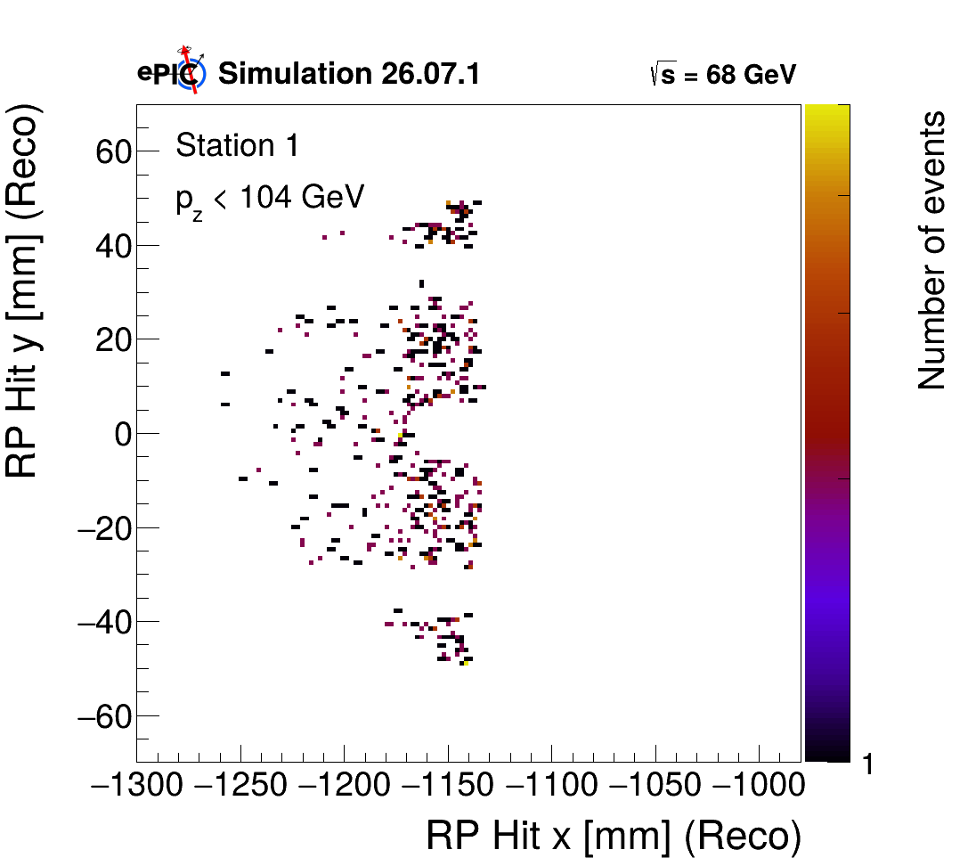
Hit and proton P_{z}
Correlations
GRUPPO COLLEGATO COSENZA

Slide 20

Event selection
Proton Tagged Cuts
Event Selection | Condition | Surviving Events (Single cut) | Surviving Events (Cutflow) | Single cut efficiency [%] | Cutflow efficiency [%]
No Selection | - | 1,999,998 | 1,999,998 | 100.00 | 100.00
Tagged Events | Tag RP or Tag B0 | 1,152,760 | 1,152,760 | 57.64 | 57.64
x_{L} Cut | $$0.75<x_{L}<1.0$$ | 911,623 | 911,149 | 45.58 | 45.56
$θ$ Cut | $$0<θ<5$$ $5.5<θ<20$mrad | 974,508 | 910,911 | 48.73 | 45.55
t Cut | $0.04<t_{RP}<0.22$/ $0.35<t_{B0}<1.0$ | 903,208 | 840,384 | 45.16 | 42.02
GRUPPO COLLEGATO COSENZA

Slide 21

Event selection
DIS Kinematics Cuts / Scattered Electron
Event Selection | Condition | Surviving Events (Single cut) | Surviving Events (Cutflow) | Single cut efficiency [%] | Cutflow efficiency [%]
Q² Cut | Q² > 5.5 GeV² | 1,659,799 | 697,884 | 82.99 | 34.894
y Cut | 0.01 < y < 0.95 | 1,886,048 | 681,532 | 94.30 | 34.077
E_{e} Cut | E_{e}' > 0.5 GeV | 1,520,210 | 538,493 | 76.01 | 26.925
$η_{e′}$Cut | -2.4 < $η_{e′}$ < 2.4 | 1,526,996 | 536,171 | 76.35 | 26.809
$Σ\left(E−P_{z}\right)$Cut | 15 < $Σ\left(E−P_{z}\right)$ < 22 GeV | 1,677,146 | 467,097 | 83.86 | 23.355
All DIS Cuts | Q² + y + E_{e’} + $η_{e′}$ + $Σ\left(E−P_{z}\right)$ | 1,117,553 | 467,097 | 55.88 | 23.355
GRUPPO COLLEGATO COSENZA

Slide 22
Event selection
Event Selection | Description | Surviving Events | Total Eff [%]
Total Generated Events | Initial simulation sample | 1,999,998 | 100.00
Proton tag (RP || B0) Roman Pots (RP Tag) B0 Tagger (B0 Tag) | Events tagged in RP or B0 Events tagged in RP Events tagged in B0 | 1,152,760 1,051,585 101,175 | 57.64 52.58 5.06
Roman Pots (RP Tag) Station 1 RP Station 2 RP | Events with hit in RP | 1,051,585 1,099,047 1,078,204 | 52.58 54.95 53.91
Station 1 & 2 Coincidence | Hits in both RP stations | 1,051,585 | 52.58
GRUPPO COLLEGATO COSENZA

Slide 23
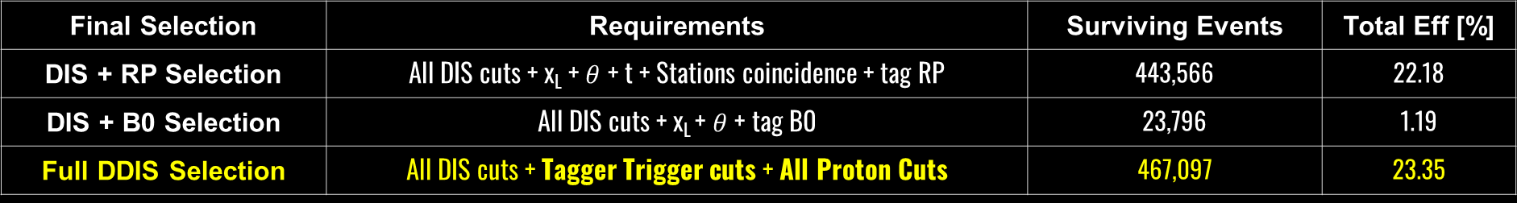
Event selection summary
Final Selection | Requirements | Surviving Events | Total Eff [%]
DIS + RP Selection | All DIS cuts + x_{L} + $θ$ + t + Stations coincidence + tag RP | 443,566 | 22.18
DIS + B0 Selection | All DIS cuts + x_{L} + $θ$ + tag B0 | 23,796 | 1.19
Full DDIS Selection | All DIS cuts + Tagger Trigger cuts + All Proton Cuts | 467,097 | 23.35
GRUPPO COLLEGATO COSENZA

Slide 24
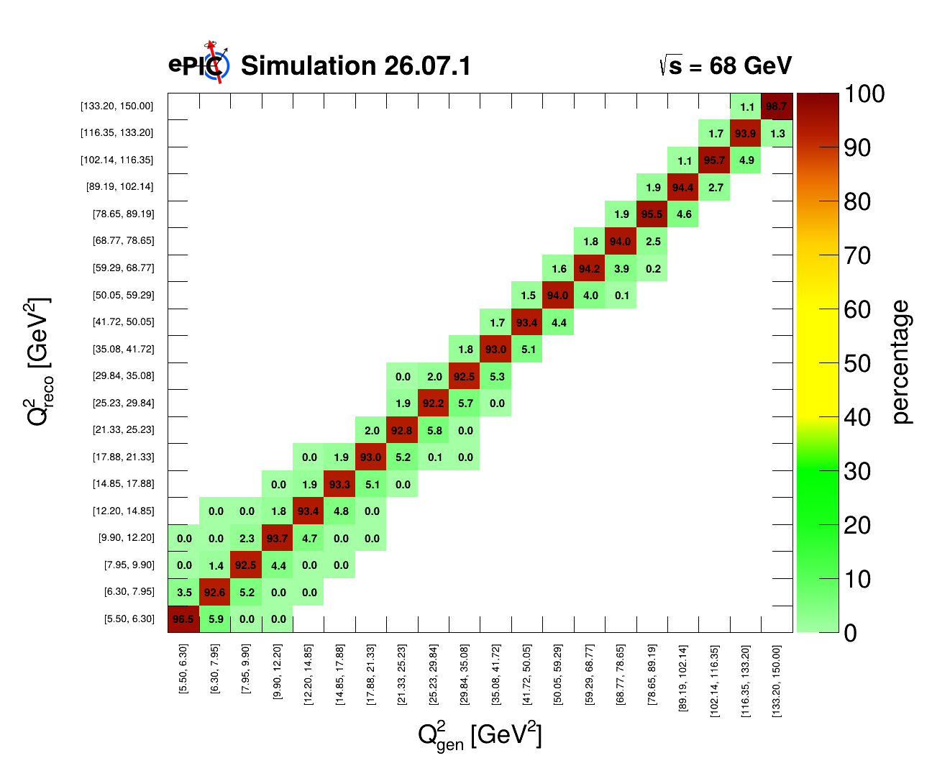
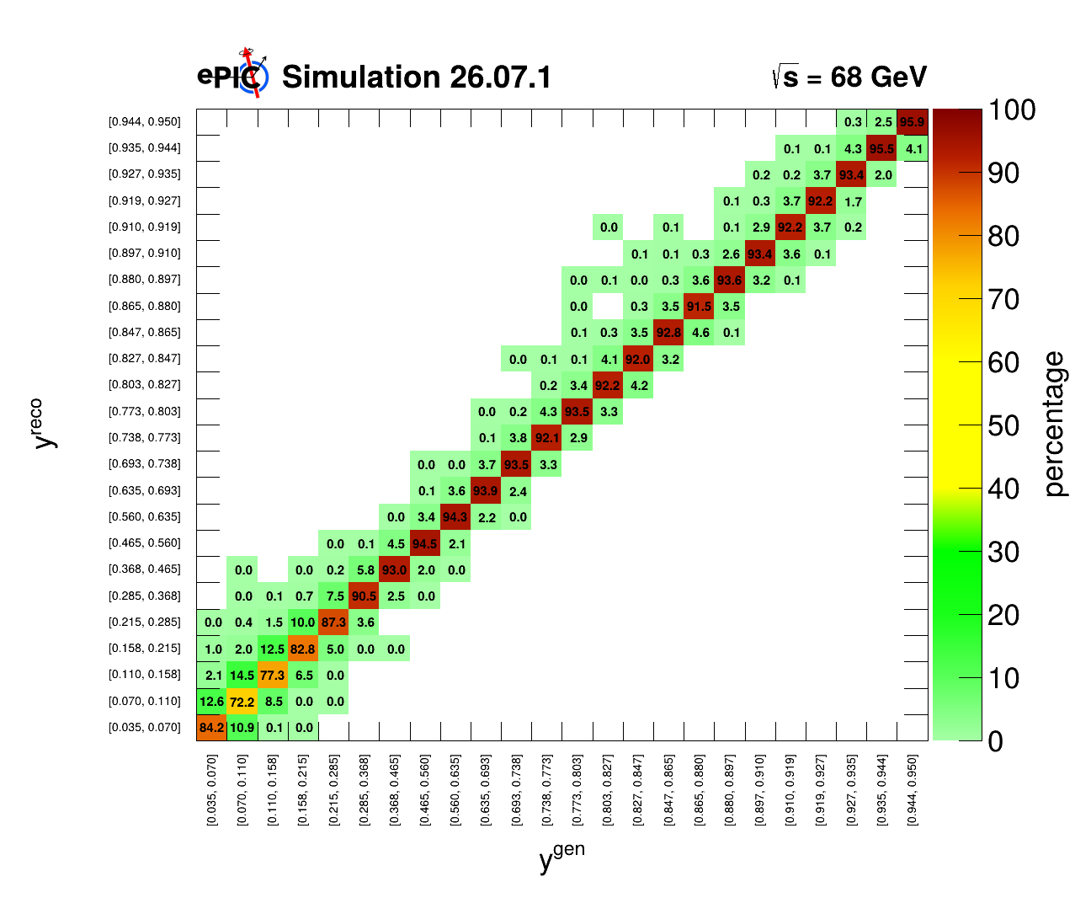
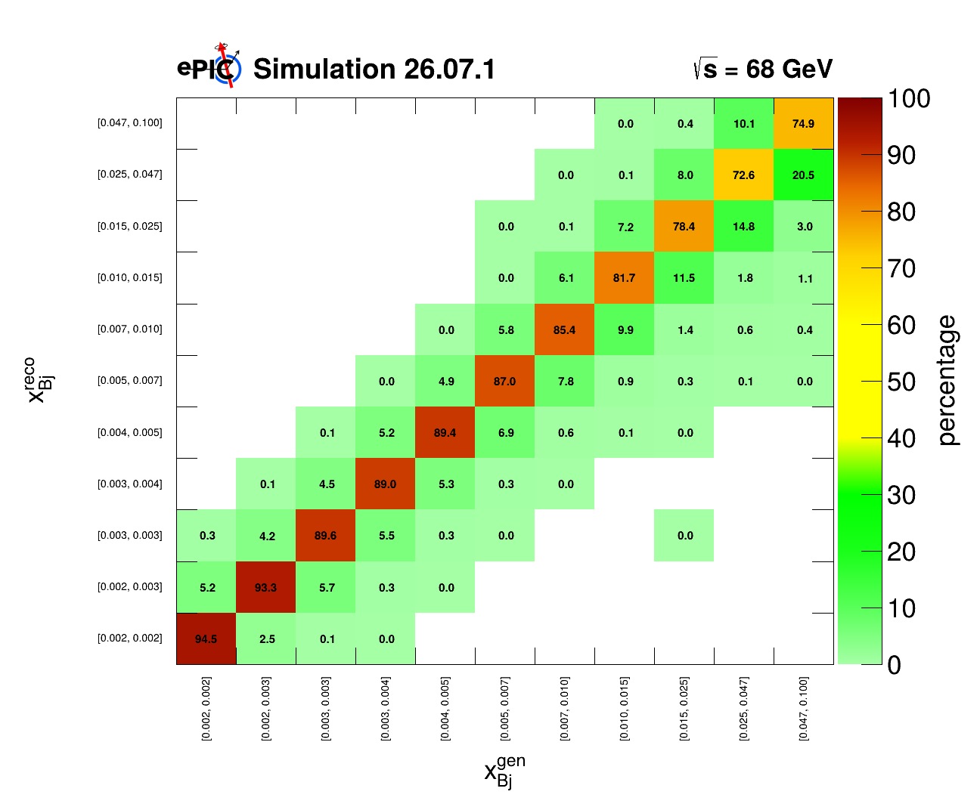
Migration Matrices with Cuts
GRUPPO COLLEGATO COSENZA

Slide 25
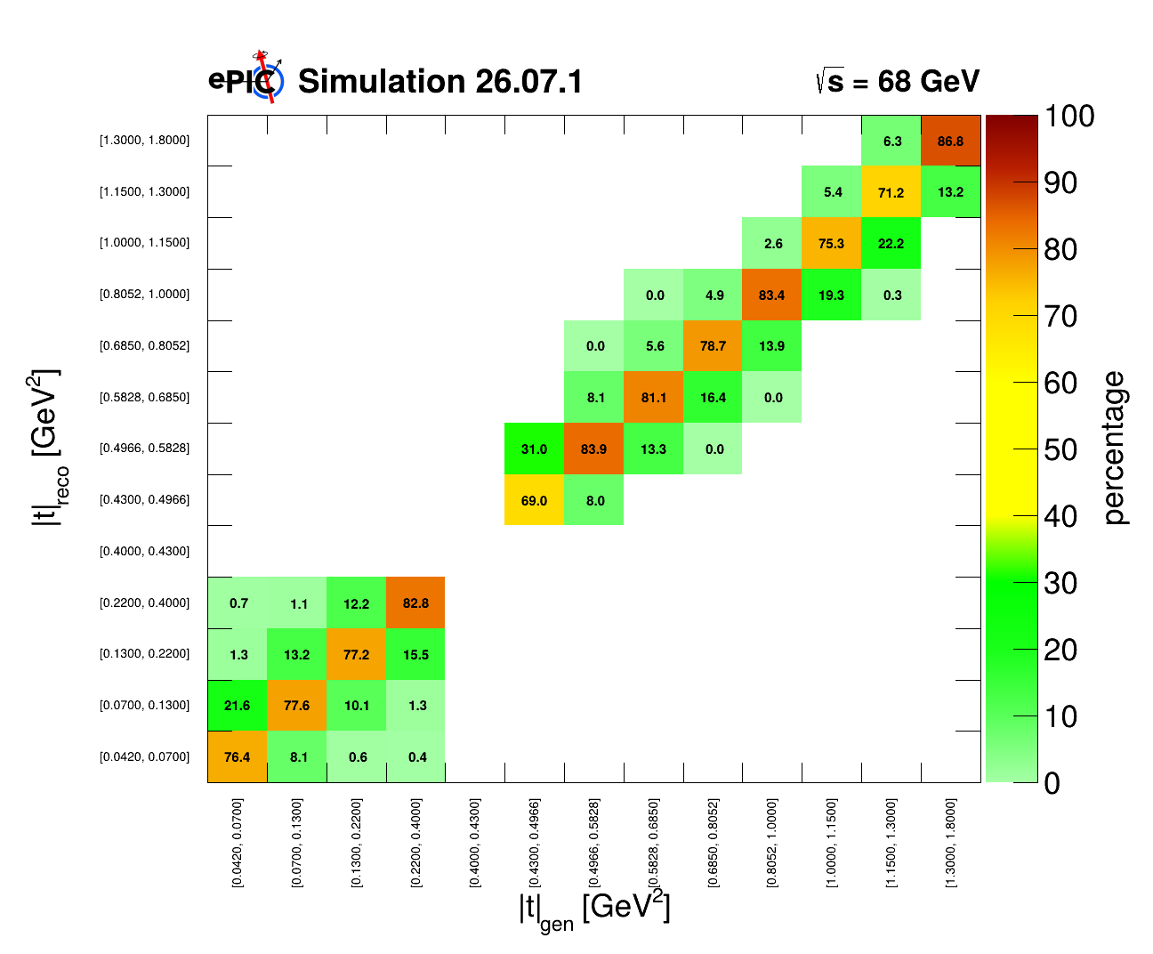

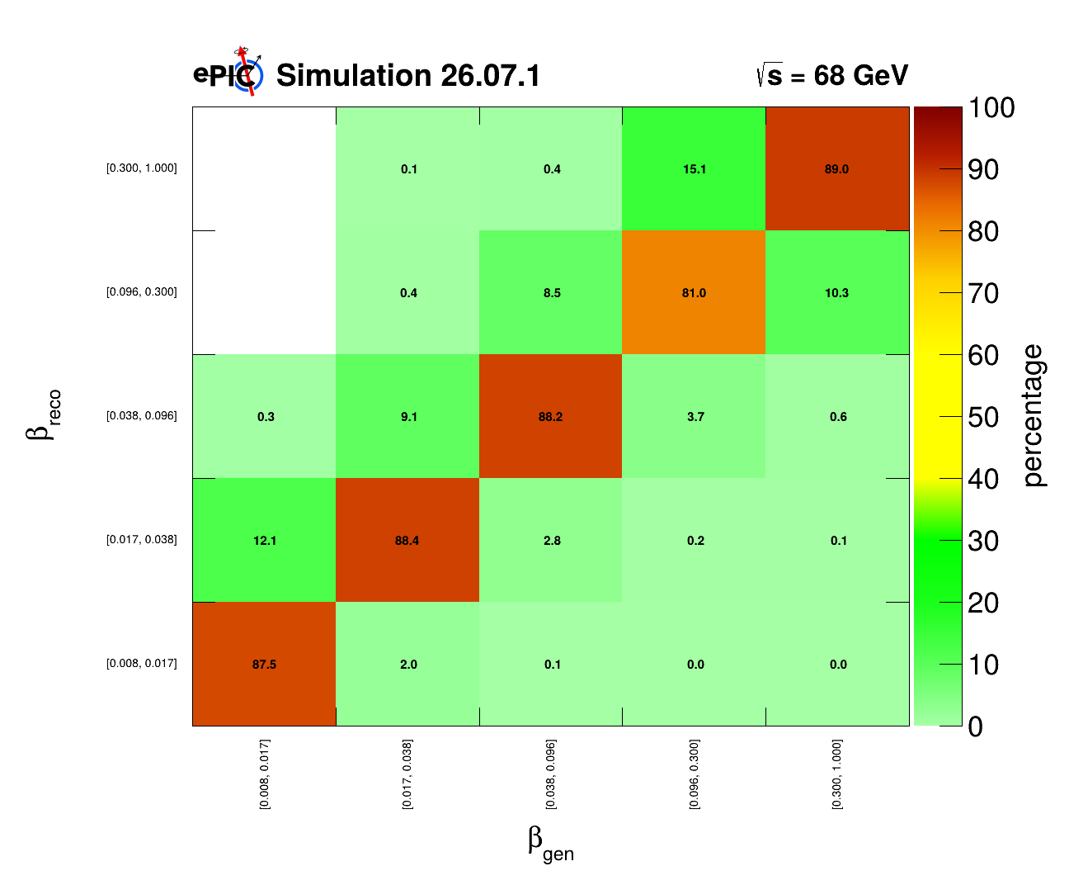
Migration Matrices after Cuts
Also, with luminosity scaled to 1 fb⁻¹ HERE
GRUPPO COLLEGATO COSENZA

Slide 26
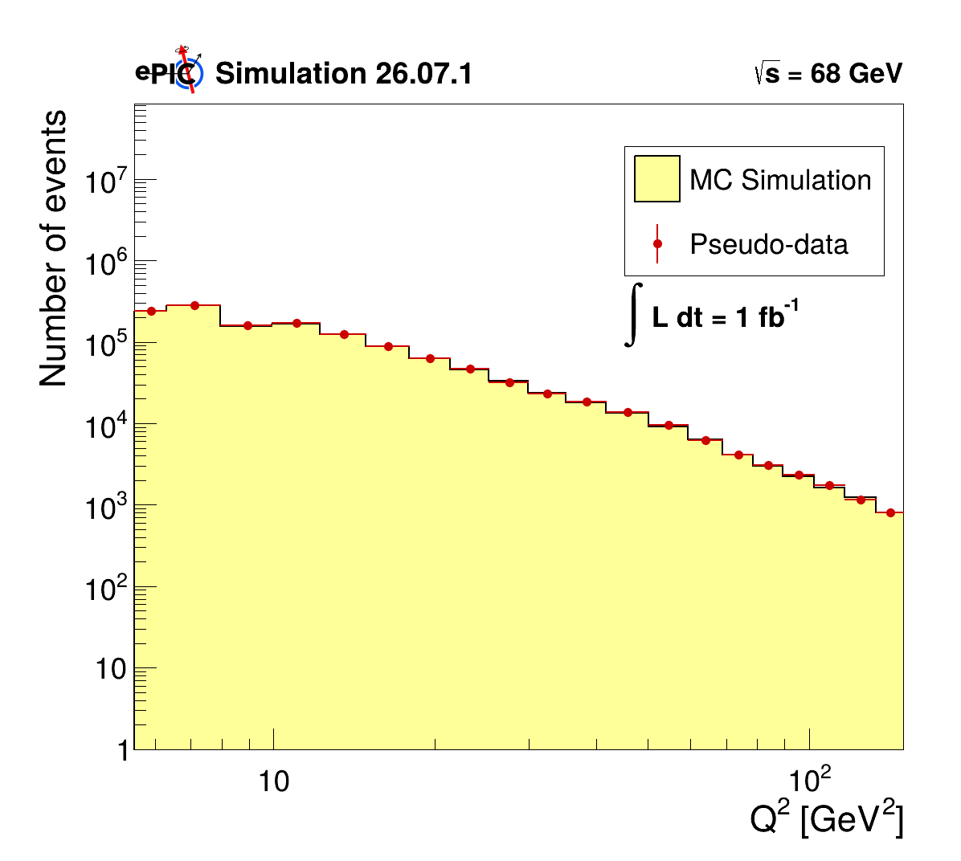
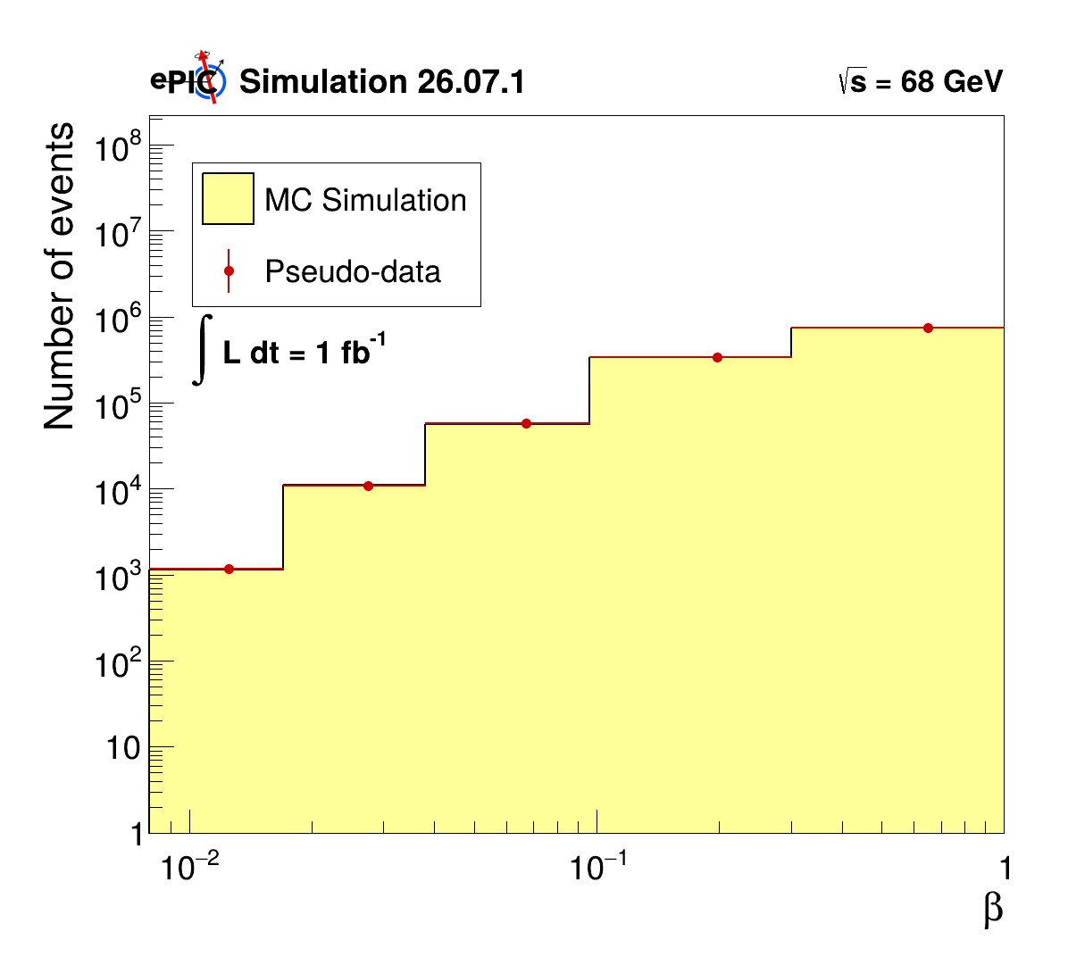
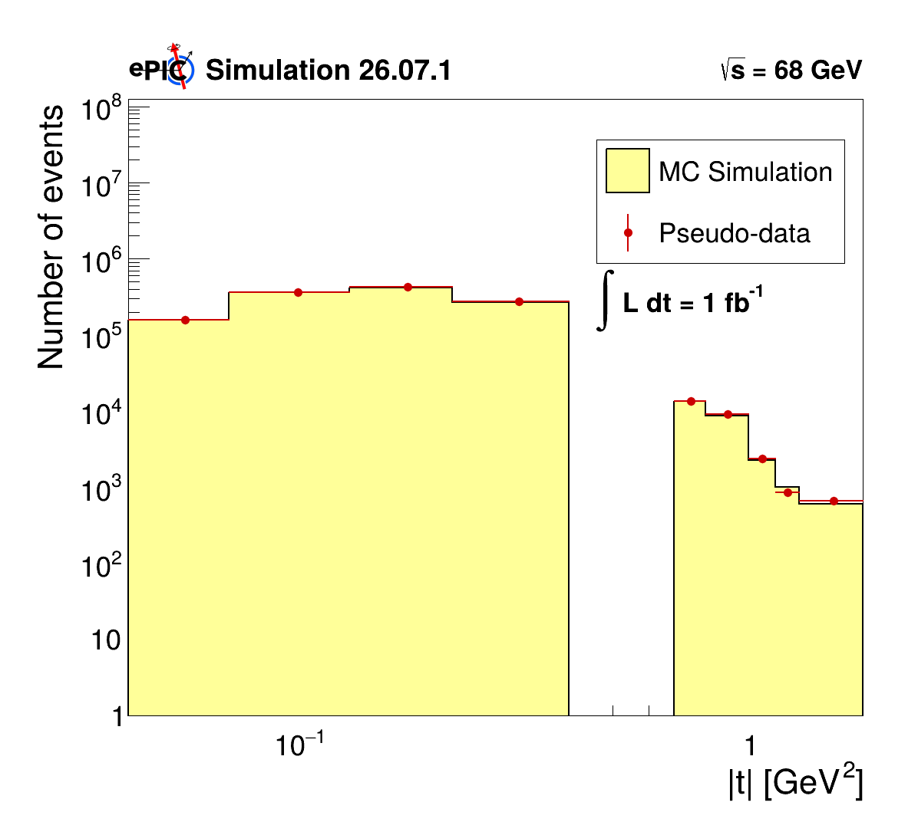
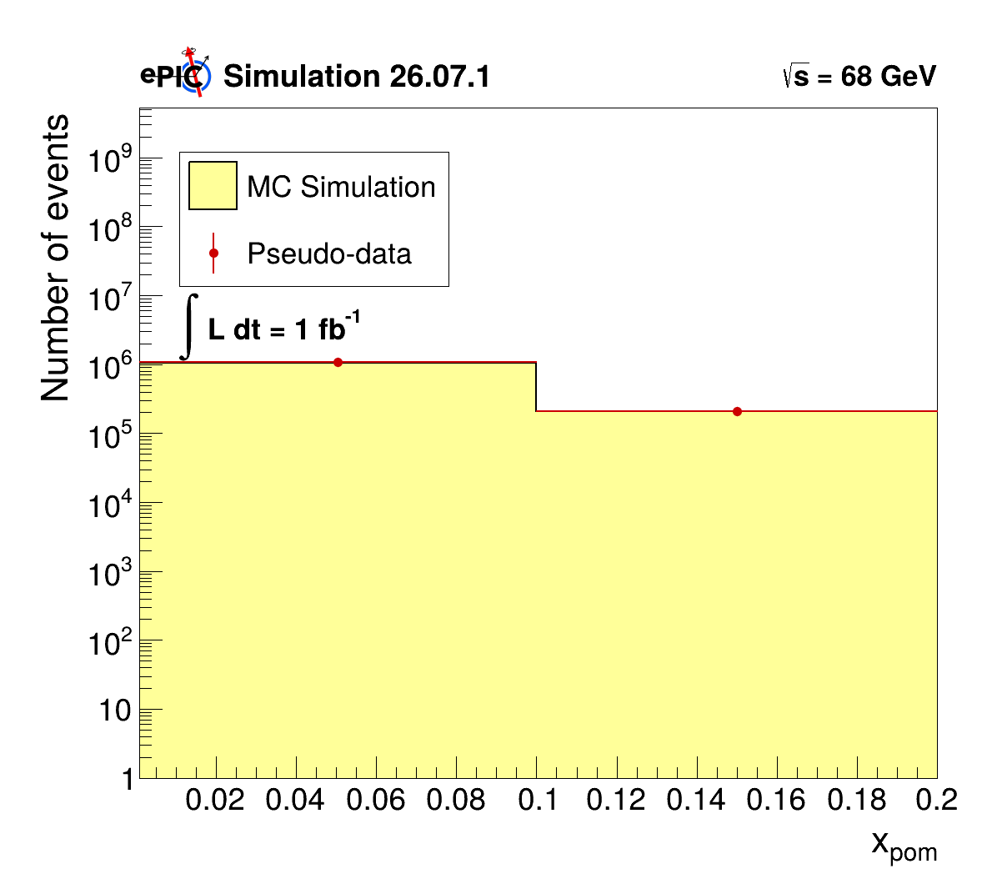
Control Plots
MC 2/3 dataset
Pseudodata 1/3 dataset
L_{MC} = 2.24 fb⁻¹
L_{data} = 1.12 fb⁻¹
All HERE
GRUPPO COLLEGATO COSENZA

Slide 27
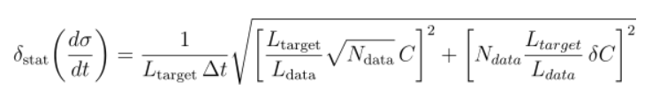



Differential Cross-Section in t
For each events in bin $i$:.
$N_{i}^{gen}$: truth-level generated events in the acceptance.
$N_{B0,i}^{reco,MC}$: reconstructed MC events in B0.
$N_{RP,i}^{reco,MC}$: reconstructed MC events in RP.
$N_{B0,i}^{reco,data}$: reconstructed data events in B0.
$N_{RP,i}^{reco,data}$: reconstructed data events in RP.
$L_{MC}=\frac{N_{MC}^{tot}}{σ_{tot}}$. $L_{target}=1 fb^{−1}$
$L_{data}=\frac{N_{data}^{tot}}{σ_{tot}}$.
$${\left(\frac{dσ}{dt}\right)}_{i} =\frac{(N_{B0,i}^{reco,data}+N_{RP,i}^{reco,data})}{L_{data} Δt_{i}}\frac{N_{i}^{gen}}{\left(N_{B0,i}^{reco,MC}+N_{RP,i}^{reco,MC}\right)}$$
$$C_{i}=\frac{N_{i}^{gen}}{\left(N_{B0,i}^{reco,MC}+N_{RP,i}^{reco,MC}\right)}$$
GRUPPO COLLEGATO COSENZA

Slide 28
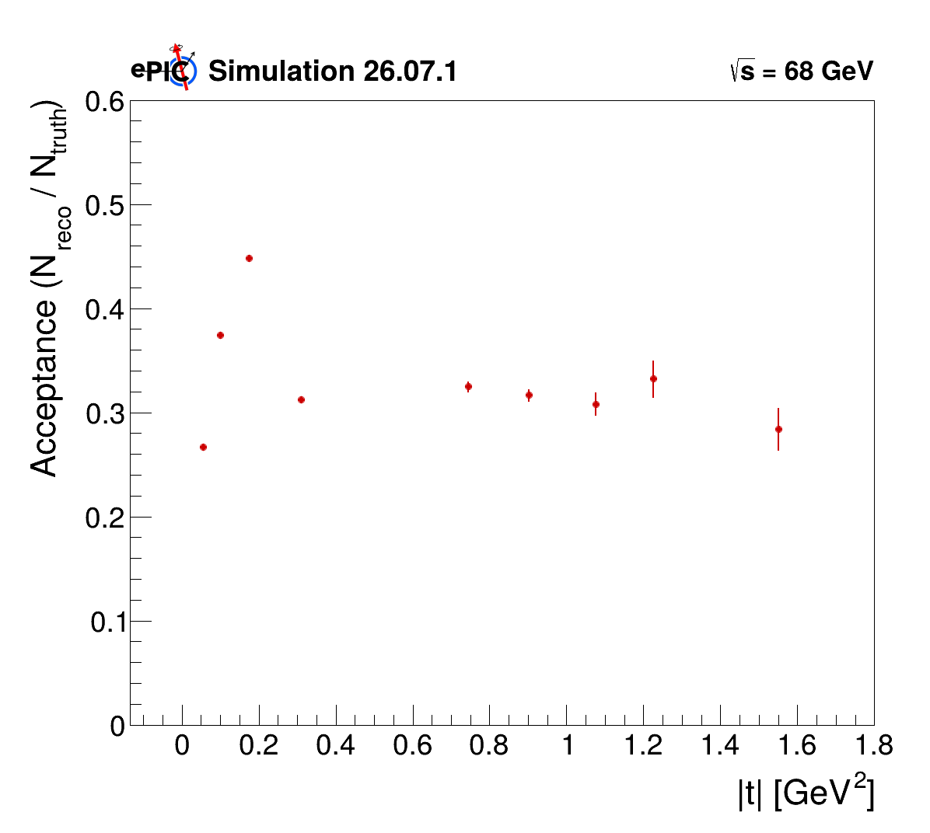
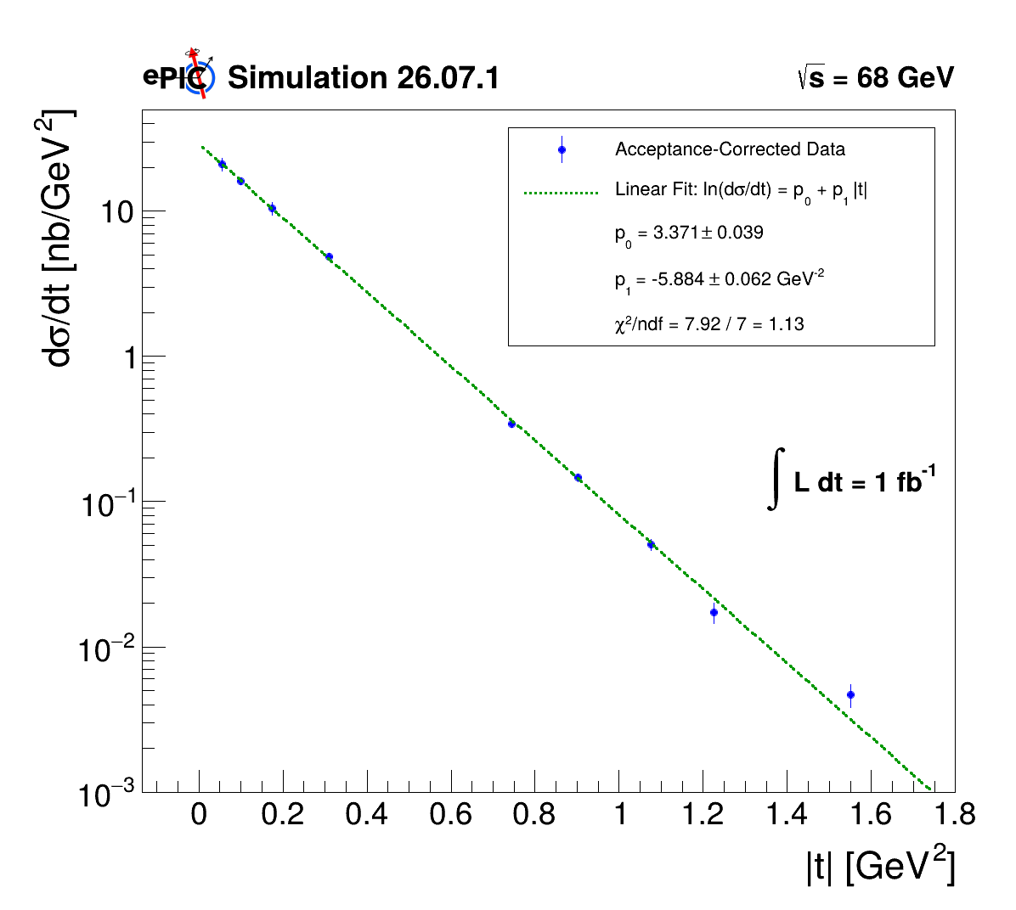
Differential Cross-Section in t
GRUPPO COLLEGATO COSENZA

Slide 29

Inclusive Differential Cross-Section
GRUPPO COLLEGATO COSENZA

Slide 30













First look at Triple Differential Cross-Section
${\left(\frac{dσ}{dQ^{2}dβ dx_{pom}}\right)}_{ijk} =$
$$\frac{(N_{B0,ijk}^{reco,data}+N_{RP,ijk}^{reco,data})}{L_{data} ΔQ_{i}^{2} Δβ_{j}Δx_{pom,k}}\frac{N_{ijk}^{gen}}{\left(N_{B0,ijk}^{reco,MC}+N_{RP,ijk}^{reco,MC}\right)}$$
$$β∈\left[0.008, 0.017\right]$$
$$(i=4)$$
$$β∈\left[0.008, 0.017\right]$$
$$(i=4)$$
$$β∈\left[0.017, 0.038\right]$$
$$(i=3)$$
$$β∈\left[0.017, 0.038\right]$$
$$(i=3)$$
$$β∈\left[0.038, 0.096\right]$$
$$(i=2)$$
$$β∈\left[0.038, 0.096\right]$$
$$(i=2)$$
$$β∈\left[0.096, 0.3\right]$$
$$(i=1)$$
$$β∈\left[0.096, 0.3\right]$$
$$(i=1)$$
$$β∈\left[0.3, 1.0\right]$$
$$(i=0)$$
$$β∈\left[0.3, 1.0\right]$$
$$(i=0)$$
GRUPPO COLLEGATO COSENZA

Slide 31

First look at Triple Differential Cross-Section
GRUPPO COLLEGATO COSENZA

Slide 32
Summary and outlook
Detail studies of reconstruction of proton tagged diffractive events;
Measuraments of single and triple diffractive differential cross section (to be fully cross checked);
Plan to include systematic uncertanties;
Well on track for NIM-A publication.
GRUPPO COLLEGATO COSENZA

Slide 33
Thanks for the attention
GRUPPO COLLEGATO COSENZA

Slide 34
Backup
GRUPPO COLLEGATO COSENZA

Slide 35



Backup: Global resolution
GRUPPO COLLEGATO COSENZA

Slide 36



Backup: Global resolution
GRUPPO COLLEGATO COSENZA

Slide 37



Backup: Global resolutions
GRUPPO COLLEGATO COSENZA

Slide 38


Backup: $\frac{dN}{d\left|t\right|}$
GRUPPO COLLEGATO COSENZA

Slide 39



Backup: Distributions after cuts
Cutted Q2 Resolution
Cutted y Resolution
Cutted xbj Resolution
GRUPPO COLLEGATO COSENZA

Slide 40



Backup: Distributions after cuts
Cutted t Resolution
Cutted xL Resolution
Cutted beta Resolution
GRUPPO COLLEGATO COSENZA

Slide 41


Backup: Distributions
GRUPPO COLLEGATO COSENZA

Slide 42


Backup: Distribution
GRUPPO COLLEGATO COSENZA

Slide 43


Backup: Distributions
GRUPPO COLLEGATO COSENZA

Slide 44

Q² binned
GRUPPO COLLEGATO COSENZA

Slide 45


x_{Bj} and |t| binned
GRUPPO COLLEGATO COSENZA

Slide 46



$β$ and x_{L} binned
GRUPPO COLLEGATO COSENZA

