Slide 1
EIC-UK WP1 Mechanics meeting
07/01/26

Slide 2
Mechanical Prototyping
Full L4 - 1
First L4 stave needs modules (steel shim with Kapton heaters) mounting
Vibration testing with modules
Thermal flow testing
Full L4 – 2
Full K9 foam blocks (modified geometry)
Flow resistance will be more representative
Test improvements to build procedure
I-beam cure in-situ
Tooling leakage protection
Curved modules installation
Use dummy silicon and curved module tooling for module installation trials (we have a couple of quarter stave prototypes which could be used for this)

Slide 3
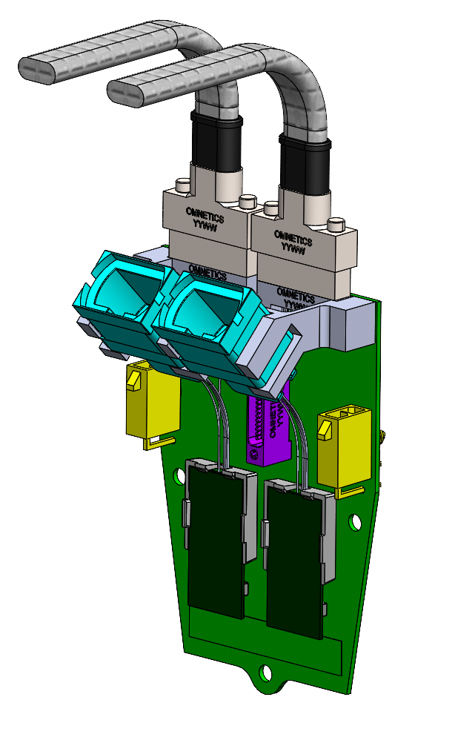
L4 FIB Design Options
Angled MTP connector by 45 degrees to improve optical cable routing (less tight radius of curvature required on cable)
MTP now obstructs nano-D installation or at least makes nano-D installation riskier unless we add an optical cable guard
Moved to a 90-degree connector, cable radius shown only just clears the support tube.
Alternatively, if the FIB was longer and use straight connector located along the top edge of the board, cable would not need to be curved by 90 degrees

Slide 4
L4 FIB Design Options
Angled MTP connector by 45 degrees to improve optical cable routing (less tight radius of curvature required on cable)
MTP now obstructs nano-D installation or at least makes nano-D installation riskier unless we add an optical cable guard
Moved to a 90-degree connector, cable radius shown only just clears the support tube.
Alternatively, if the FIB was longer and use straight connector located along the top edge of the board, cable would not need to be curved by 90 degrees

Slide 5
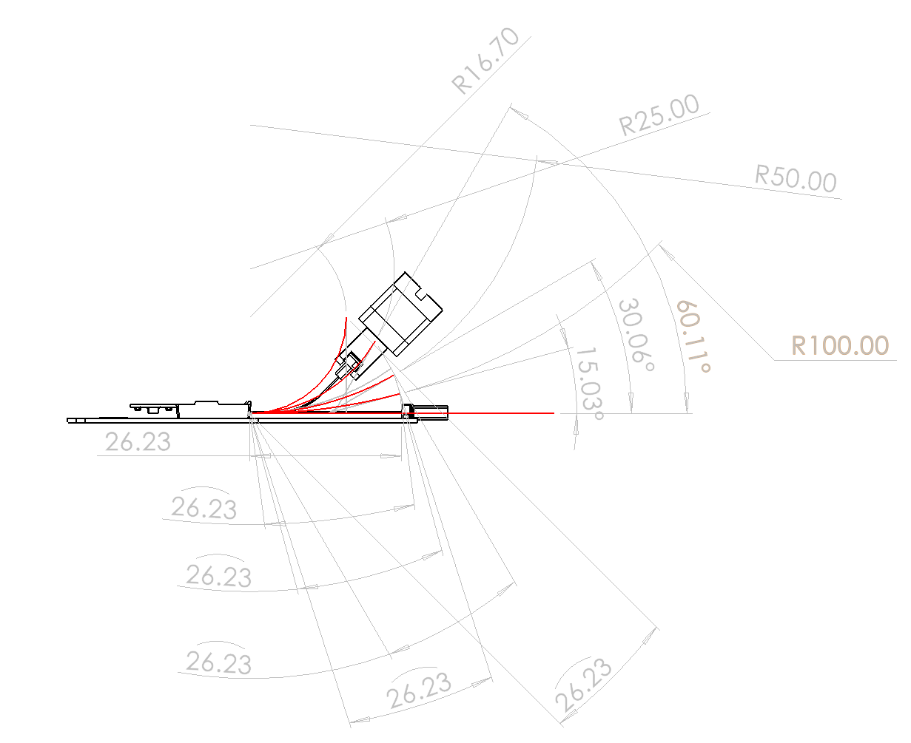
Feasibility of the angled MTP connector (what angles might be achieved with the length of the fibres).

Slide 6
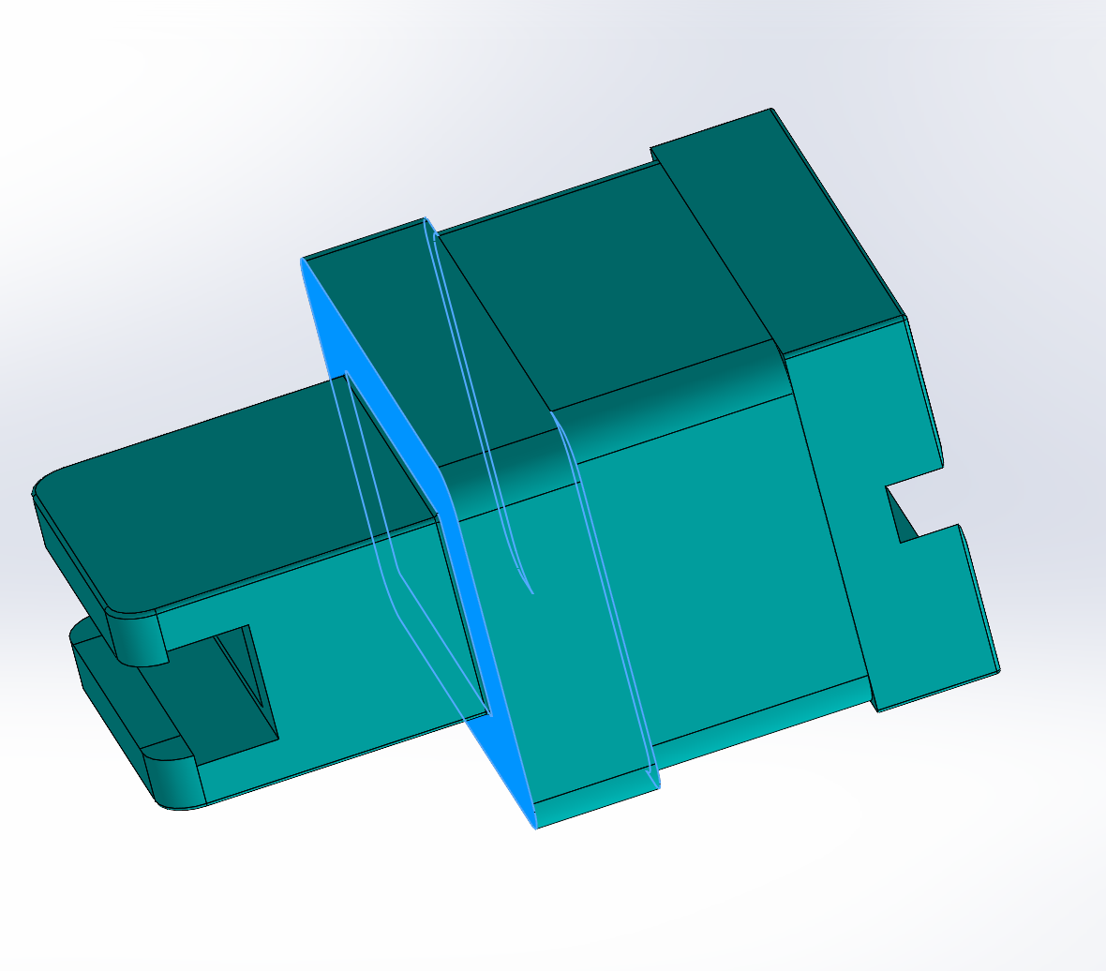
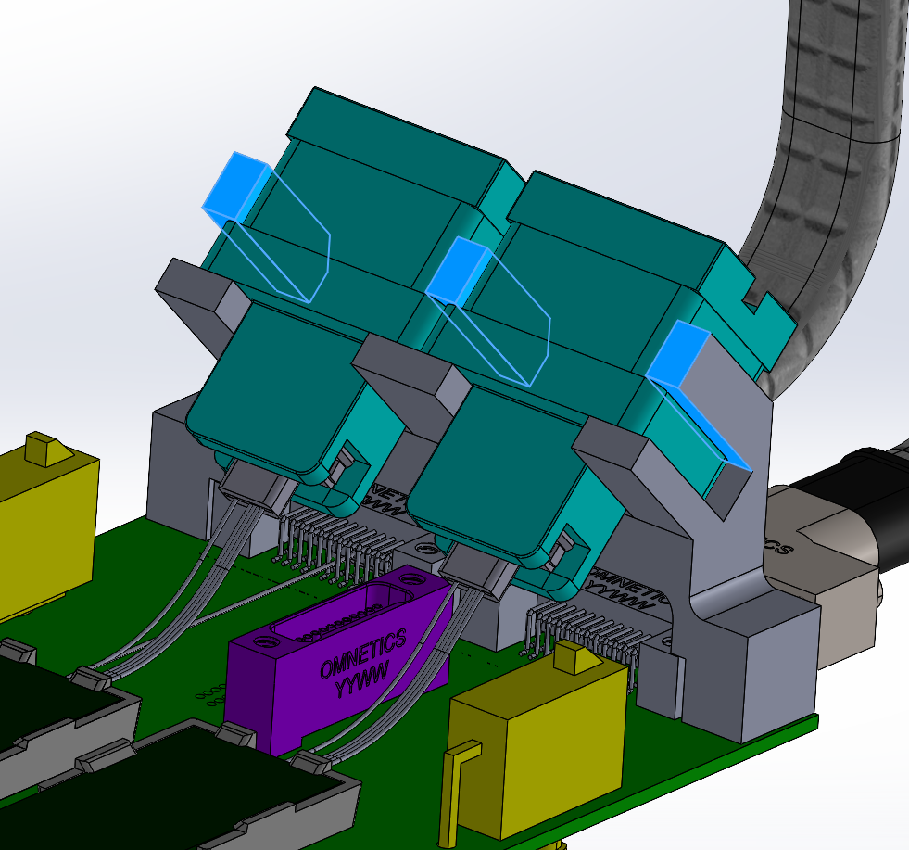
Mounting strength and options of the MTP connector clamp.
Highlighted faces (image right) give most area in connector installation direction
Fingers constrain the horizontal location and angle of connectors
Top cap would be needed to secure connector in last degree of freedom (or integrate clip into the fingers

Slide 7
Design options that can be transferred to the L3 and disk (if Ernst joins) variants.
L3 – keeping FIB at 45 degrees seems more logical
JG design looks to be the best form factor
Currently L3 FIB overlap with IB SCB
SCB on top of L3 FIB?

